Slide 1
Automated Test System for Powerbrick
Nader Afshar, Simin Chen
19/10/2022
Notes:
Today I want to introduce our newly developed field automatic test system for the motion controller named powerbrick

Slide 2
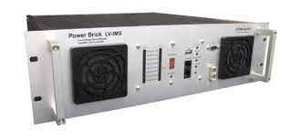
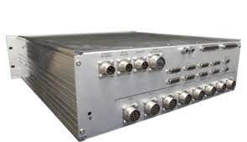
Overview
Powerbrick is the generic motion controller built by Faraday Motion UK, which embeds the "Powerbrick LV" of the off-shelf product from Delta-Tau.
Powerbrick has been selected as the preferred motion controller for the BRIGHT projects (new beamlines) and the Refurbishment project (existing beamlines).
However several quality issues have been reported.
Notes:
The Powerbrick is an integrated Motion Controller combining the brain of powerful delta-tau PMAC processor and high performance 8-axis motor drivers. Additional axes are available via EtherCat up to 64 EtherCat axes.
Powerbrick has been selected as Australian synchrotron preferred motion controller for both the new beamline projects and old beamline refurbishment project. The total number of required powerbrick is over 100, but several quality issues have been found during our visual inspection.

Slide 3
Challenges
No FAT test report is provide for each unit
  Do Site Acceptance Test (SAT) -> Tester
D-Sub connectors stand-off
  Vision inspection and SAT -> Tester
Wires and connectors are below required current rating
  No power margin.
Wrong screw type.
. . .
Notes:
A major issue relates to this topic is the missing of factory acceptance test report for each unit. We have requested that all units have to pass agreed FAT test and arrive with a completed quality inspection checklist but it has not been supplied yet. Due to this situation a site acceptance test is compulsory.
During our visual inspection the other issue we have found is the D-sub connector stand-off issue, which may result in signal contact issues. These problems can be easily detected by a site acceptance test.
The calling for a powerbrick test system is urgent. At first we do these work manually and the whole process takes several hours. Later we have developed an automatic test system to reduce the time to minutes.

Slide 4
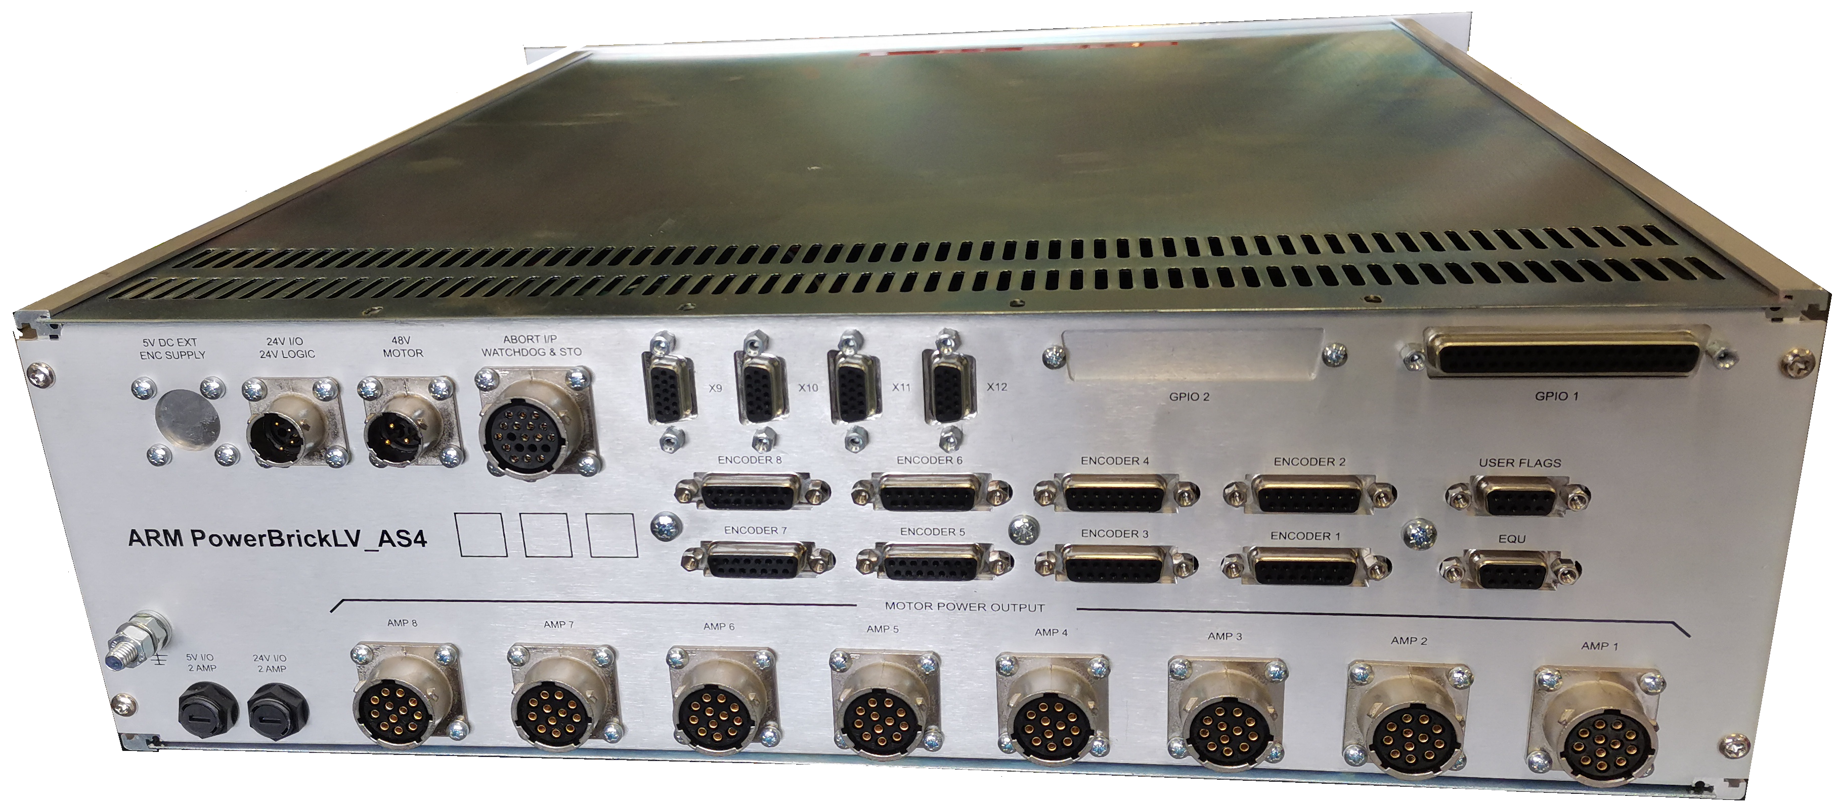
Scope
STO Analog I/O x 4 GPIO
Power
User Flags
EQU
Encoders x 8
Motors x 8
Implemented: STO, Analog I/O, GPIO, User Flags and EQU
Plan to do: Encoders and Motors
Notes:
This image shows the rear panel of powerbrick. The connectors inside the green area are within the phase 1 scope of the automatic test system. They are all the analog and digital input and output connectors and a powerbrick control connector, including Safe torque off, short as STO, 4 analog input and output connectors, 1 general purpose input and output connector, 1 user flags input connector and 1 compare equal output connector.
The 8 motor connectors and 8 encoder connectors testing is planned to be covered in the future.

Slide 5


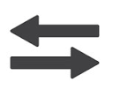

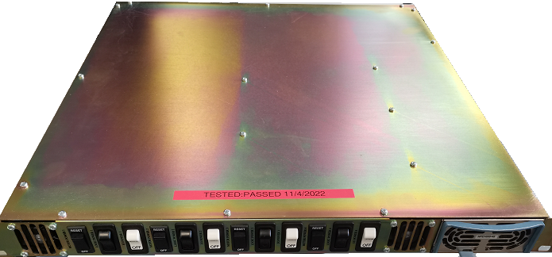
Architecture
Test Virtual Machine
Test
Script
Test operator
PVs
Test
IOC
Power
Network
Operational VM
I/O In
I/O Out
Op.
IOC
Automatic Test Box
Power
Notes:
The automatic test system consists of 2 parts: a test virtual machine and a test box. Inside the virtual machine there is a test script written in Python and a test IOC to drive the powerbrick under test. For the convenience of field usage, the box is power by the same power supply of the powerbrick.
To use the automatic test system, the first step is disconnect the connectors to be tested and connect them to the test box. This is the only required hardware configuration change. After that the test operator creates a ssh connection to the operational virtual machine via wifi or wired Ethernet and stop the running of operational IOC that drives the powerbrick, then the operator starts the test IOC and runs the test script. The script exchanges data with the test IOC via the process variable channel access, and the IOC converts the requests from the script to formatted Ethernet data packages and sends to the powerbrick under test. The powerbrick drives the output signals to high voltage under request, then the signal loopback to the corresponding input pins through the test box circuits. The voltage change on the input pins is then feedback to the test script to compare with the expected value.

Slide 6
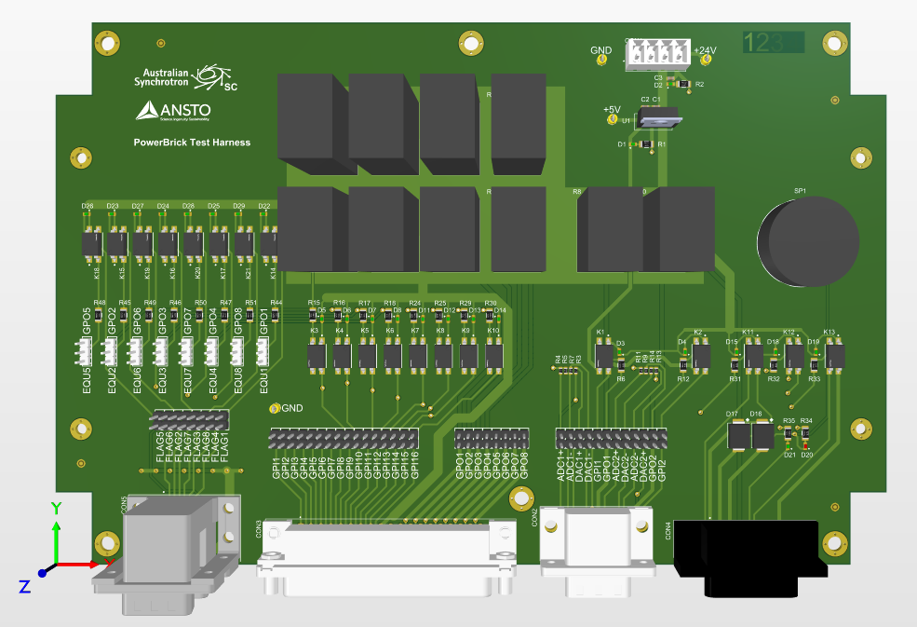
Hardware
Power
Power by PB PSU
  Ideal for field testing
All SSR
  Compact design
Test at limit condition
  Cover all application
High power Resistors with heat sink
  Burn prevention
User Flags & EQU
GPIO
AIO
STO
Notes:
This is the 3D model of the test box PCB assembly. The PCB area can be divided into 5 parts. From left to right they are the test circuits for user flags connector and equ connector, GPIO connector, analog IO connector, safe torque off connector, and finally the power supply circuits. The feature of this design includes it is powered by the same power supply unit of the powerbrick under test, which means it is ideal to test the deployed powerbrick. And all the relays used in this design are solid state, which makes the box in a compact size. The third item is that the test condition is pushed to the design limit, which means all of the application conditions have been covered. Because of this design, the power consumption of the output payload resistor is up to 12 watt, high power resistors with a heat sink is provide to avoid burning.

Slide 7
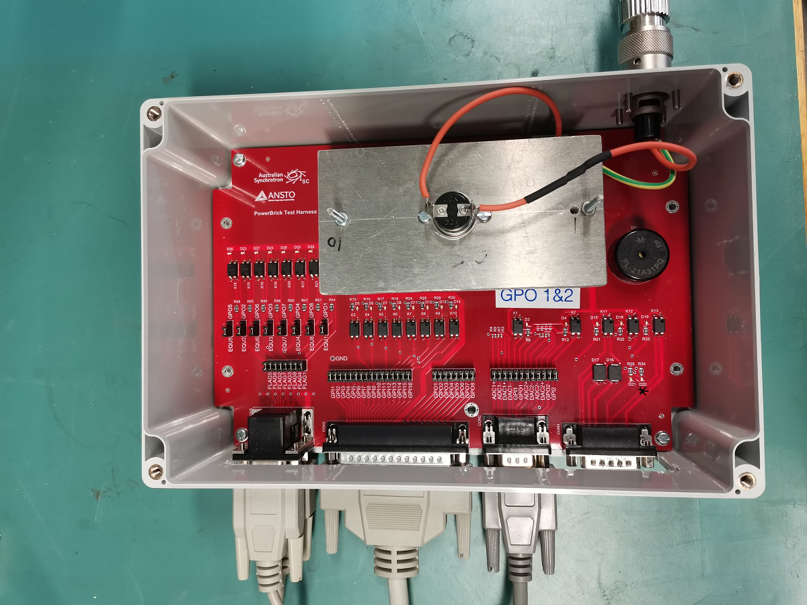
Hardware (Cont.)
Notes:
This is the prototype of a fully assembled the test box, an extra thermal switch is mounted on top of the heat sink to cut off the power supply once the heat sink temperature raises over 80 degree Celsius.

Slide 8
Software (Test IOC)
Generic EPICS IOC
Create a connection through TCP/IP to the Powerbrick under test
  Powerbrick EPICS driver component included in the IOC
Convert PV request to Powerbrick commands and vice versa
  Bridging the test script and the Powerbrick under test
Notes:
On the software side, the test IOC is just a generic EPICS IOC, including the Powerbrick EPICS driver to create a TCP/IP connection to the test device and EPICS database to provide the process variables for the test script. It performs as a bridge to transfer data between the test script and the powerbrick under test.

Slide 9
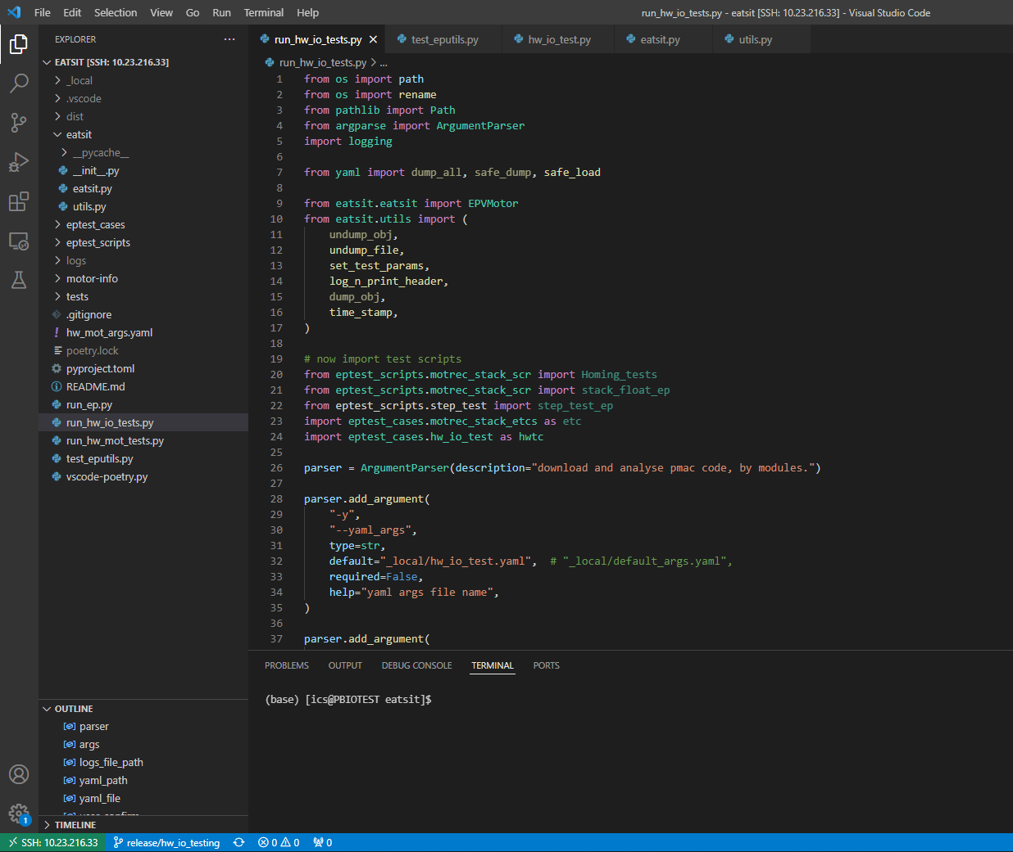
Software (Test Script)
Developed in Python 3
  Multiple platform
Layered architecture
  Test case layer
  Utility layer (eatsit)
Individual test report for each run
  Report name contains test date, time and result
Notes:
The test script is coded in Python 3, which means it can be run on either Linux or Windows, depends on the test operator’s preference. Layered architecture scheme has been applied to the project development. Test case layer includes the test cases, each one covers one rear panel connector. The test operator can simply add or delete a specific connector test by enable or disable a test case module.
After each running of the test script, a test report will generated to store the test data of each test item, and the report file name contains the test date, time and test result. It would be great if the test report file name contains the powerbrick unit serial number but this data is still not available from the powerbrick memory.

Slide 10
?
Notes:
The test script is coded in Python 3, which means it can be run on either Linux or Windows, depends on the test operator’s preference. Layered architecture scheme has been applied to the project development. Test case layer includes the test cases, each one covers one rear panel connector. The test operator can simply add or delete a specific connector test by enable or disable a test case module.
After each running of the test script, a test report will generated to store the test data of each test item, and the report file name contains the test date, time and test result. It would be great if the test report file name contains the powerbrick unit serial number but this data is still not available from the powerbrick memory.

