Slide 1
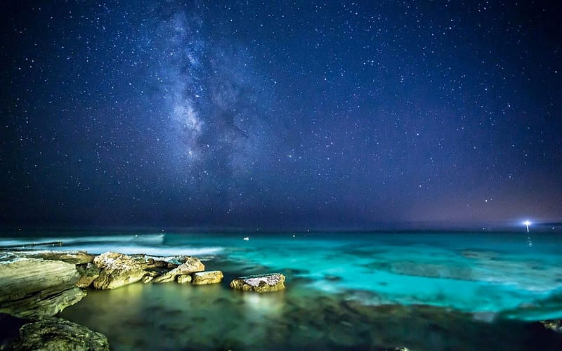
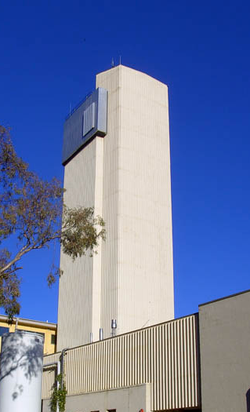
CUTTING THROUGH TIME
  Ferromanganese Crust
  Preparation for AMS studies

Slide 2
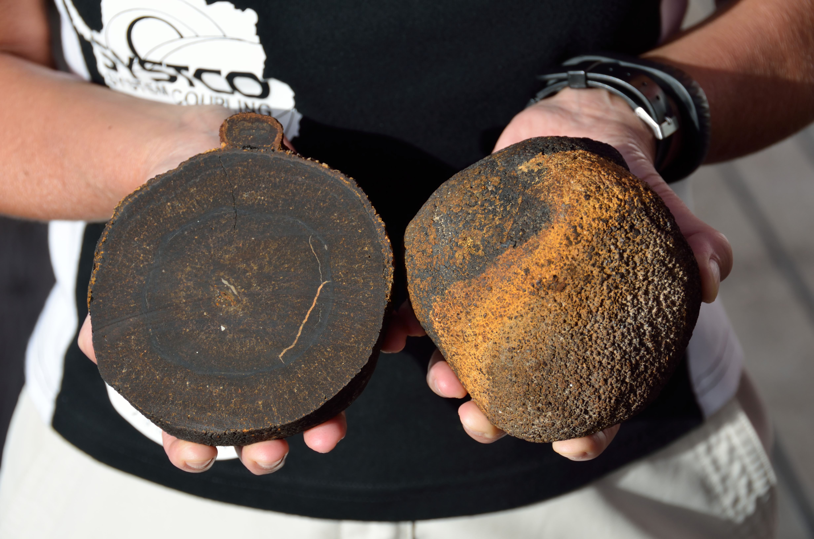
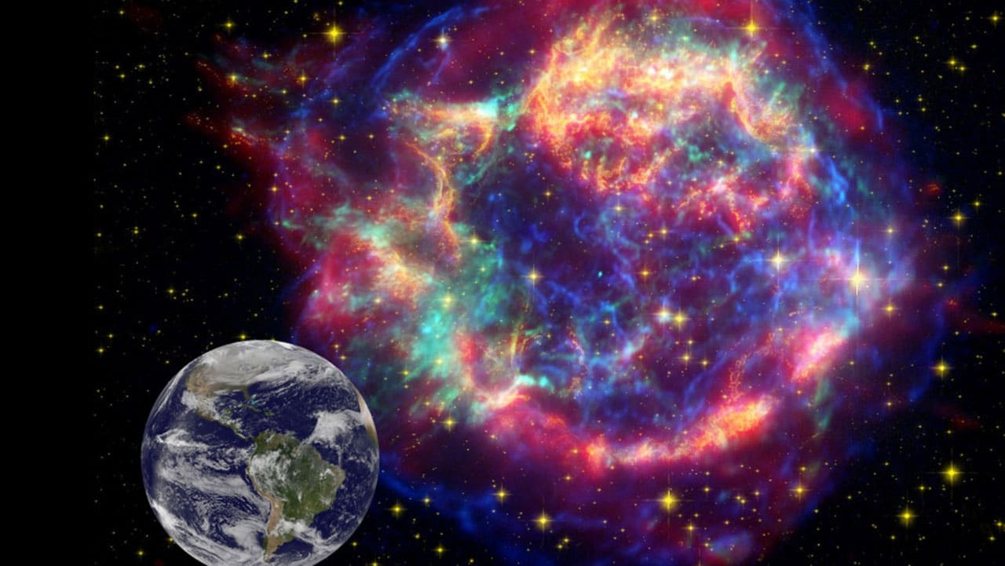
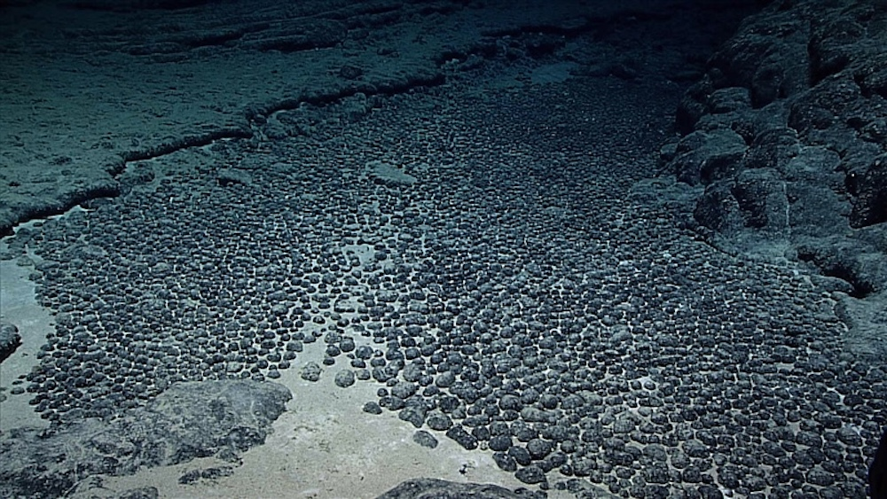
What is a Ferromanganese Crust?
Ferromanganese Crusts & Polymetallic Nodules
  Discovered 1868, subsequently found to be widespread
  Formed by a slow precipitation of metallic components from seawater onto a basaltic substrate (rocks)
  Similar nodules form around a core such as a shell or tooth
  Perhaps the slowest-forming natural material, 500,000yr/mm
  Earth passes through ‘clouds’ of interstellar dust, which settle on the seafloor and into the crust
  Scientific interest – to study the presence of various elements on earth over many millions of years

Slide 3
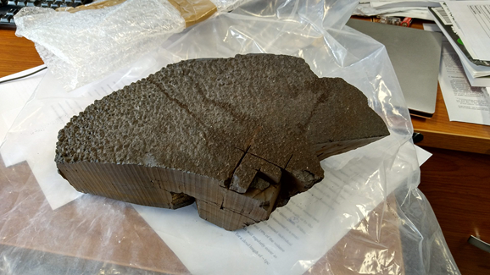
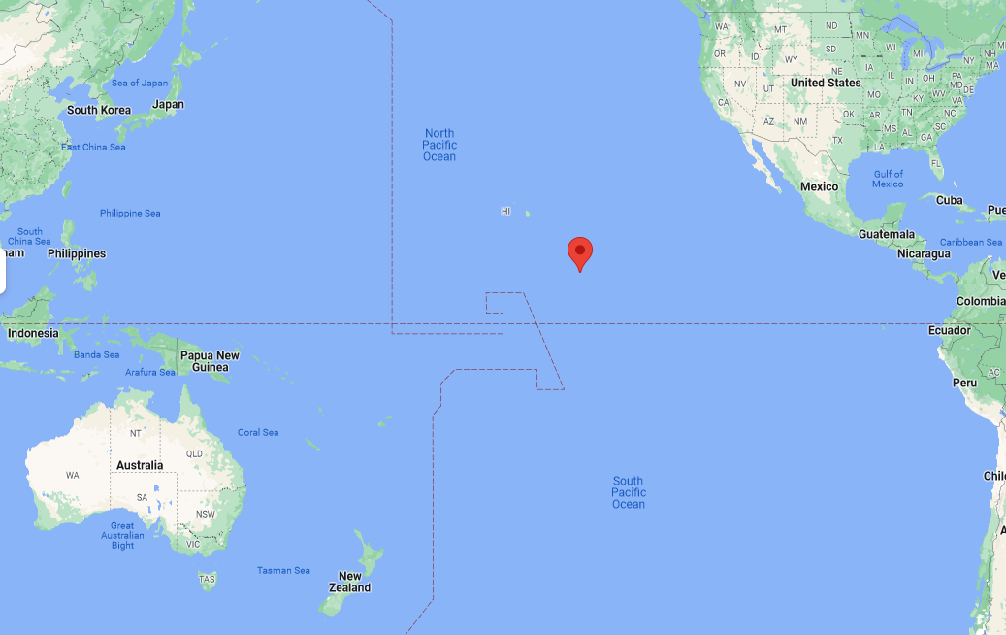
The Project
Objectives
  The search for extra-terrestrial radionuclides, initially;
  Supernova-produced ⁶⁰Fe
  R-process nuclide ²⁴⁴Pu
  Others including ⁵³Mn, ¹⁸²Hf, ²⁴⁷Cm
  Dating purposes ¹⁰Be, ²⁶Al, ¹²⁹I
  The Sample
  Ferromanganese crust VA13/2-237KD, 3.7kg piece of crust obtained from BGR (Federal Institute for Geosciences and Natural Resources) Hannover, Germany
  Collected in 1976 at depth 4830m, 09N 146W

Slide 4
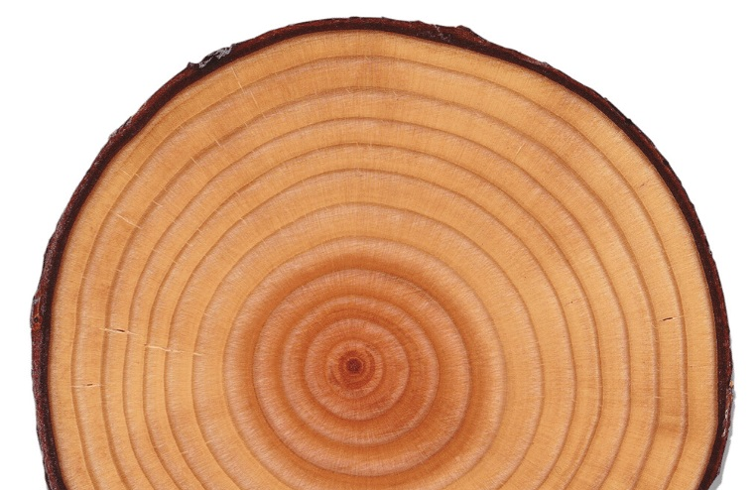
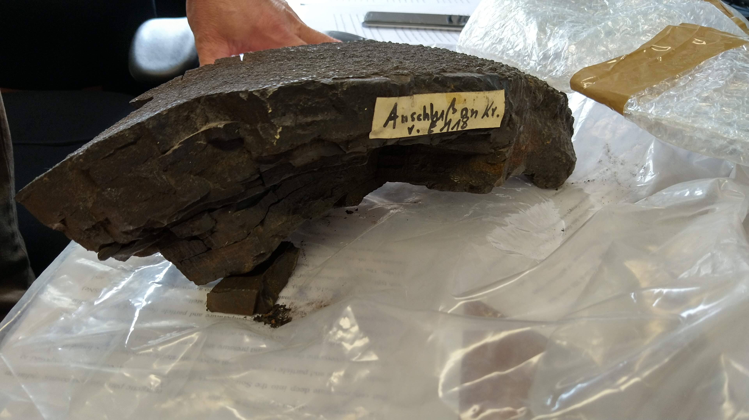
The Challenge
  Previous AMS studies have been undertaken on core samples
  But looking for rarer isotopes like ²⁴⁴Pu requires a larger volume of sample
  Requires removal of accurate time-resolved ‘layers’
  Non-uniform, organic shape
  Fragile
  Process – CNC Milling > Holding > Geometry > 3D Model

Slide 5
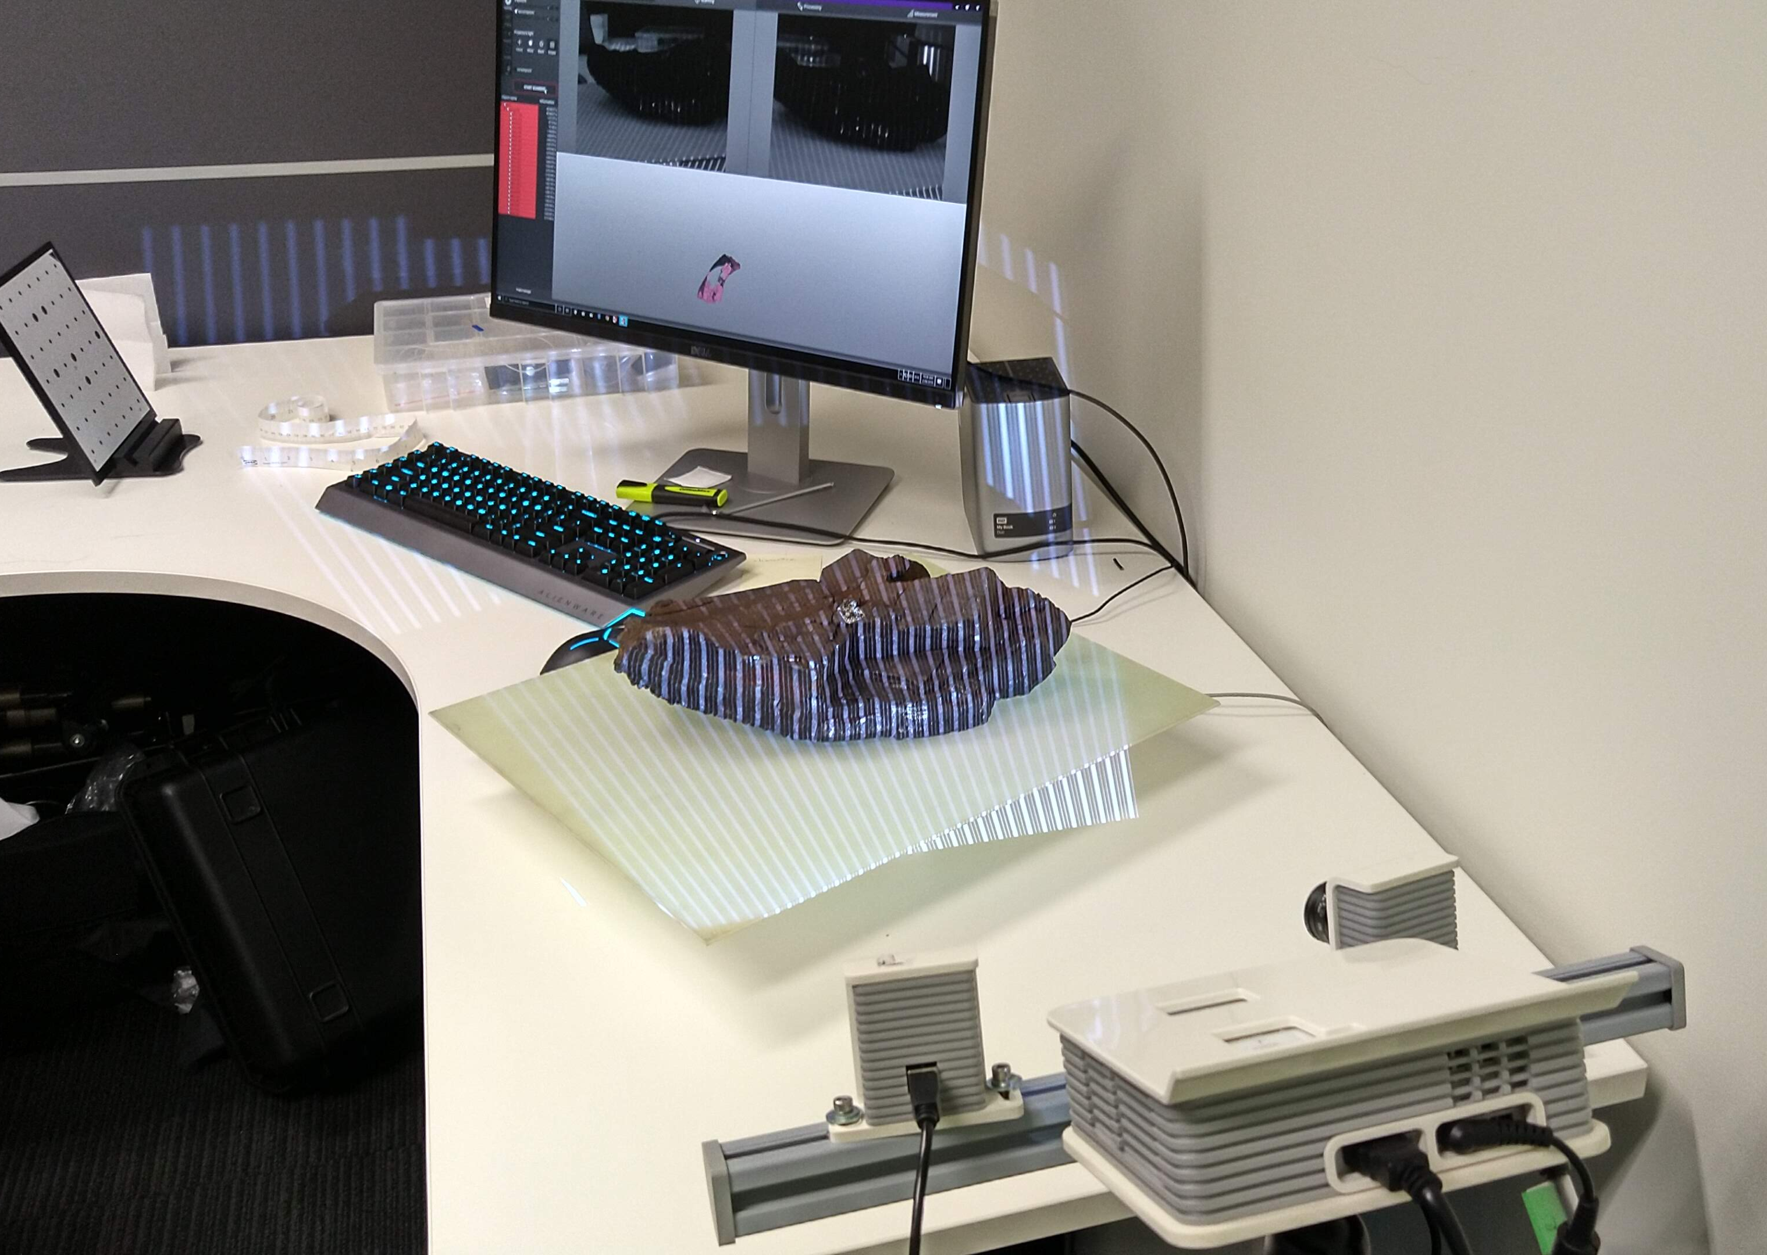
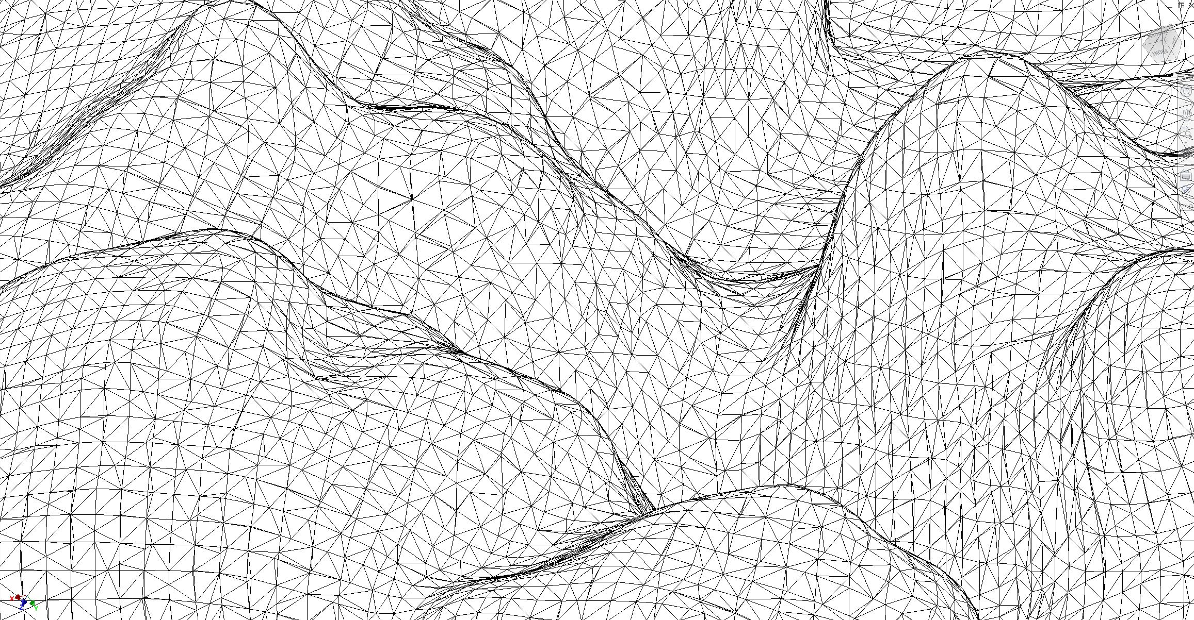
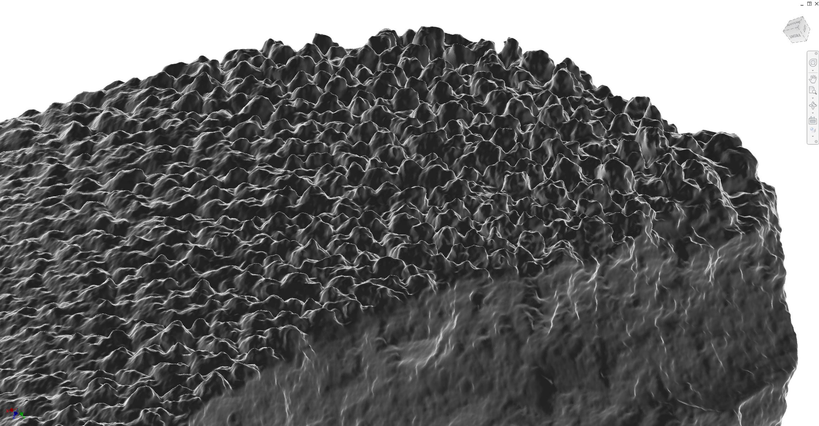
3D Scanning
  Centre for Digital Humanities, ANU College of Arts & Social Sciences
  Rangevision Spectrum 3D Scanner
  Initial point cloud model of 11M vertices, reduced to 800k for practicality
  Confirmed dimensionally accurate

Slide 6
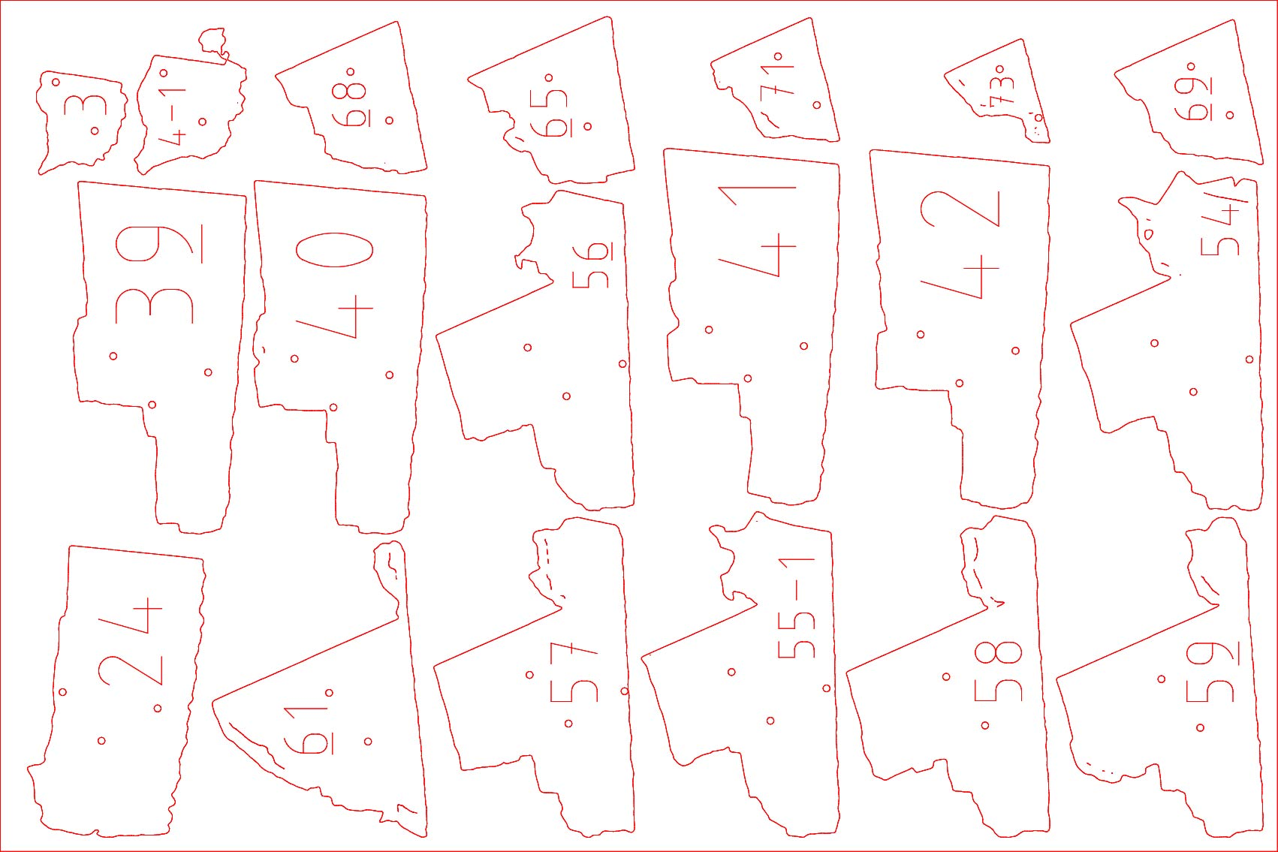
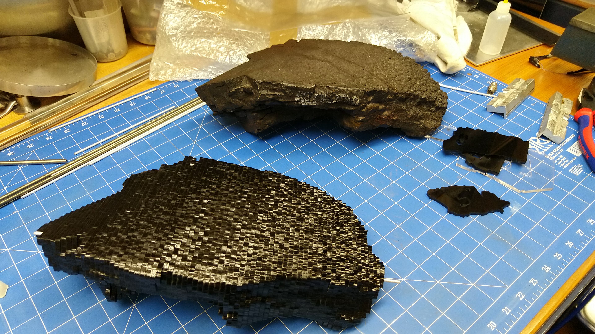
Test Model
  Test piece for proving of all setups – no 2nd chances
  3D-printing not practical
  Slicer software > Laser Cutter
  Researched, programmed, cut & assembled in 2 days

Slide 7
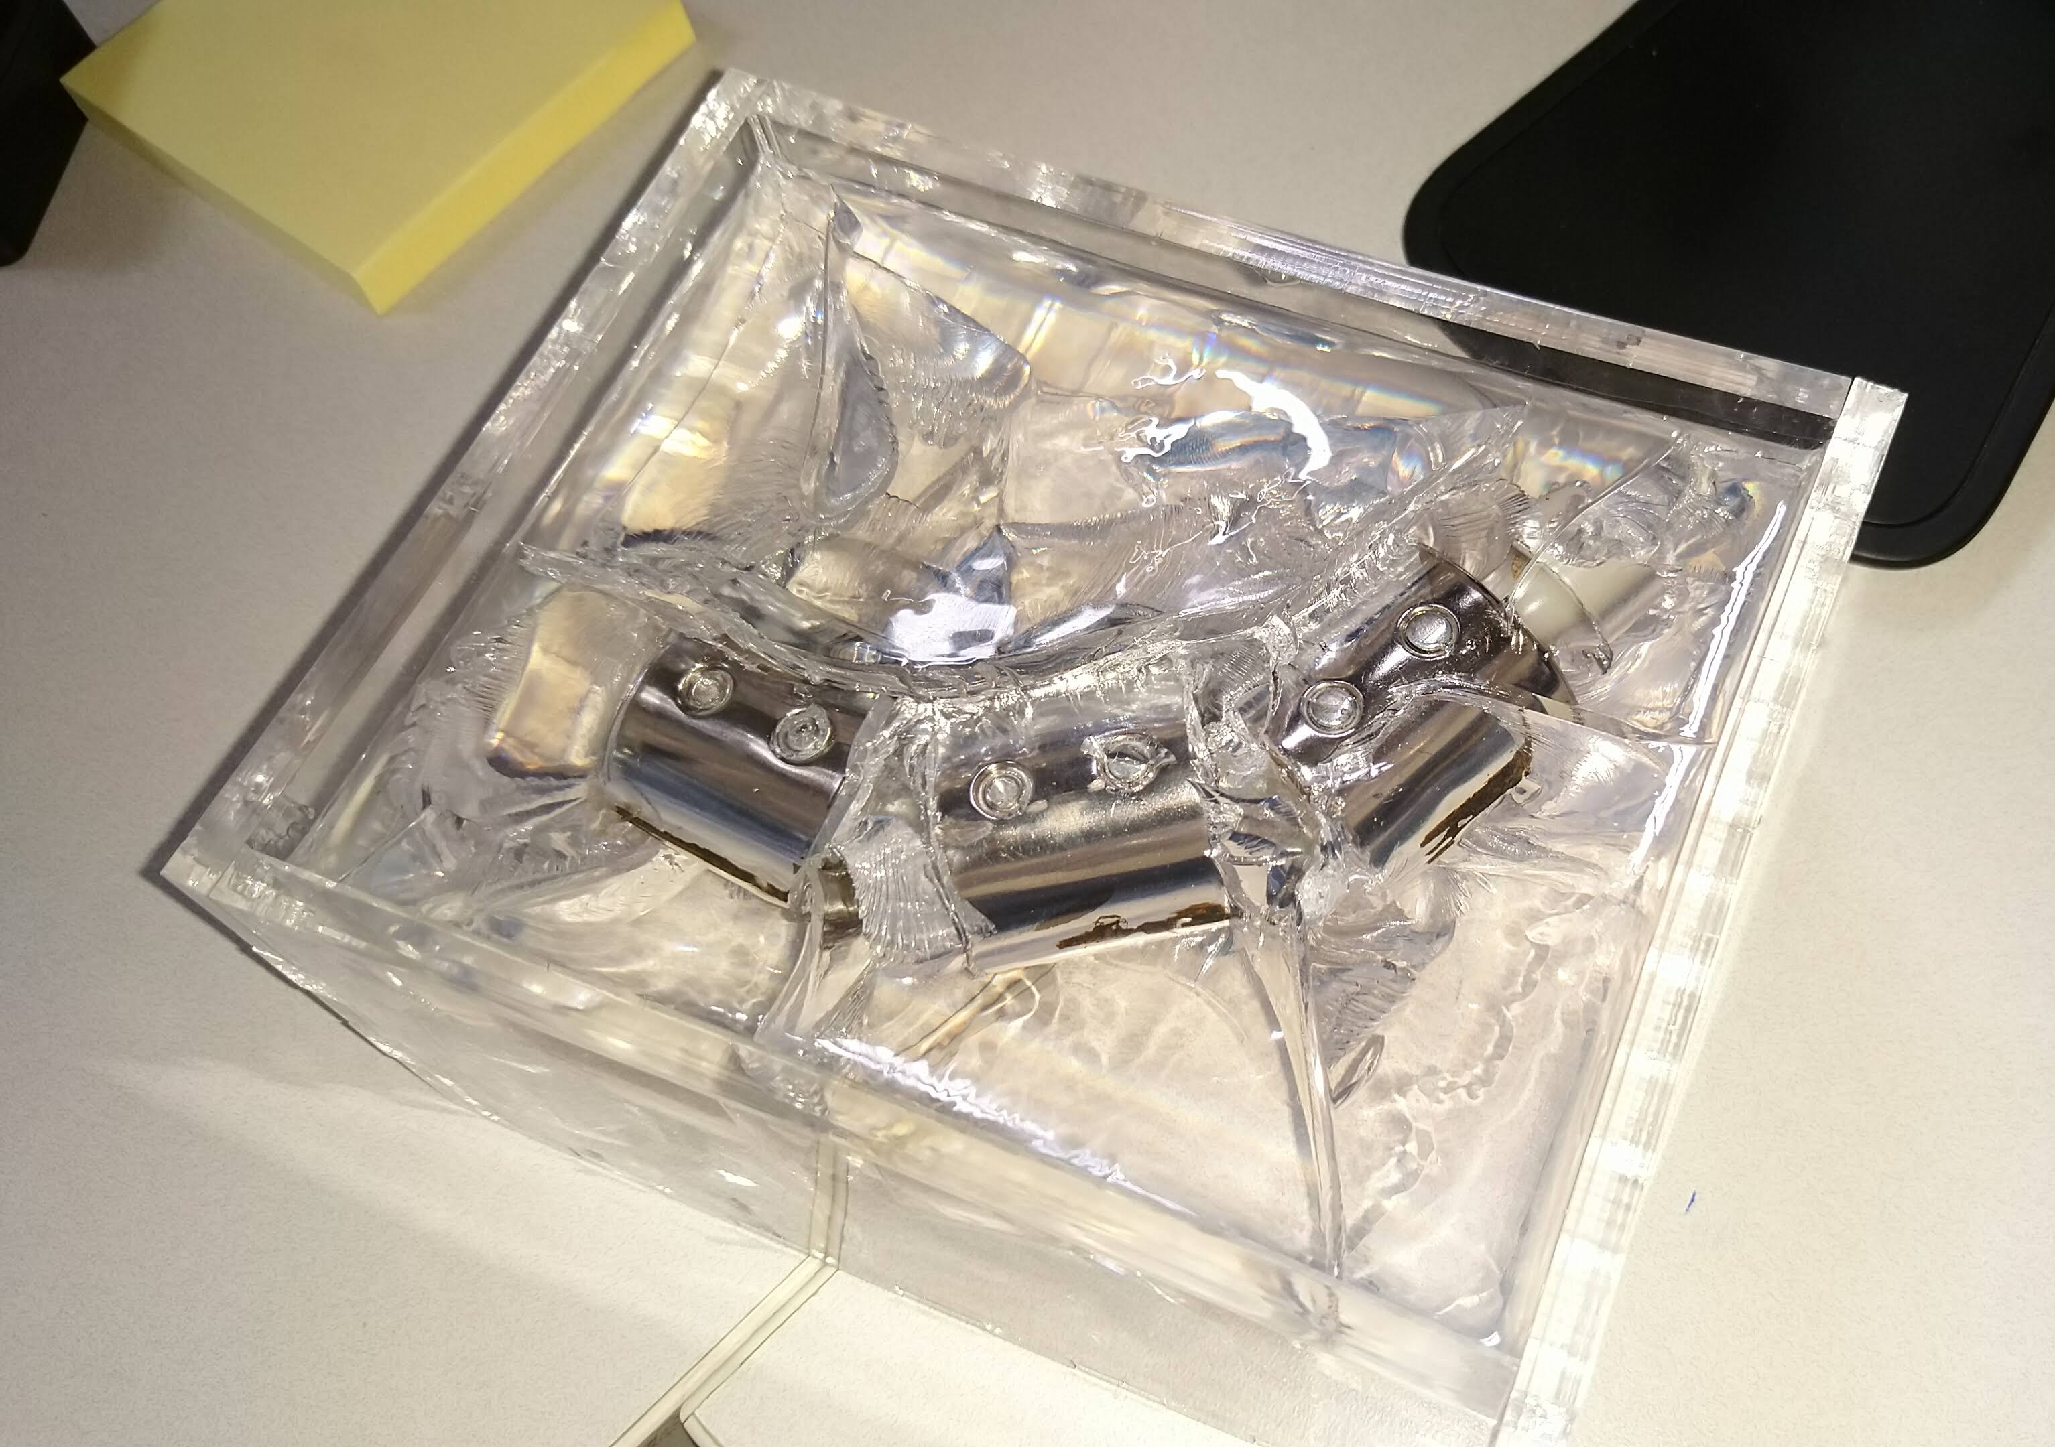
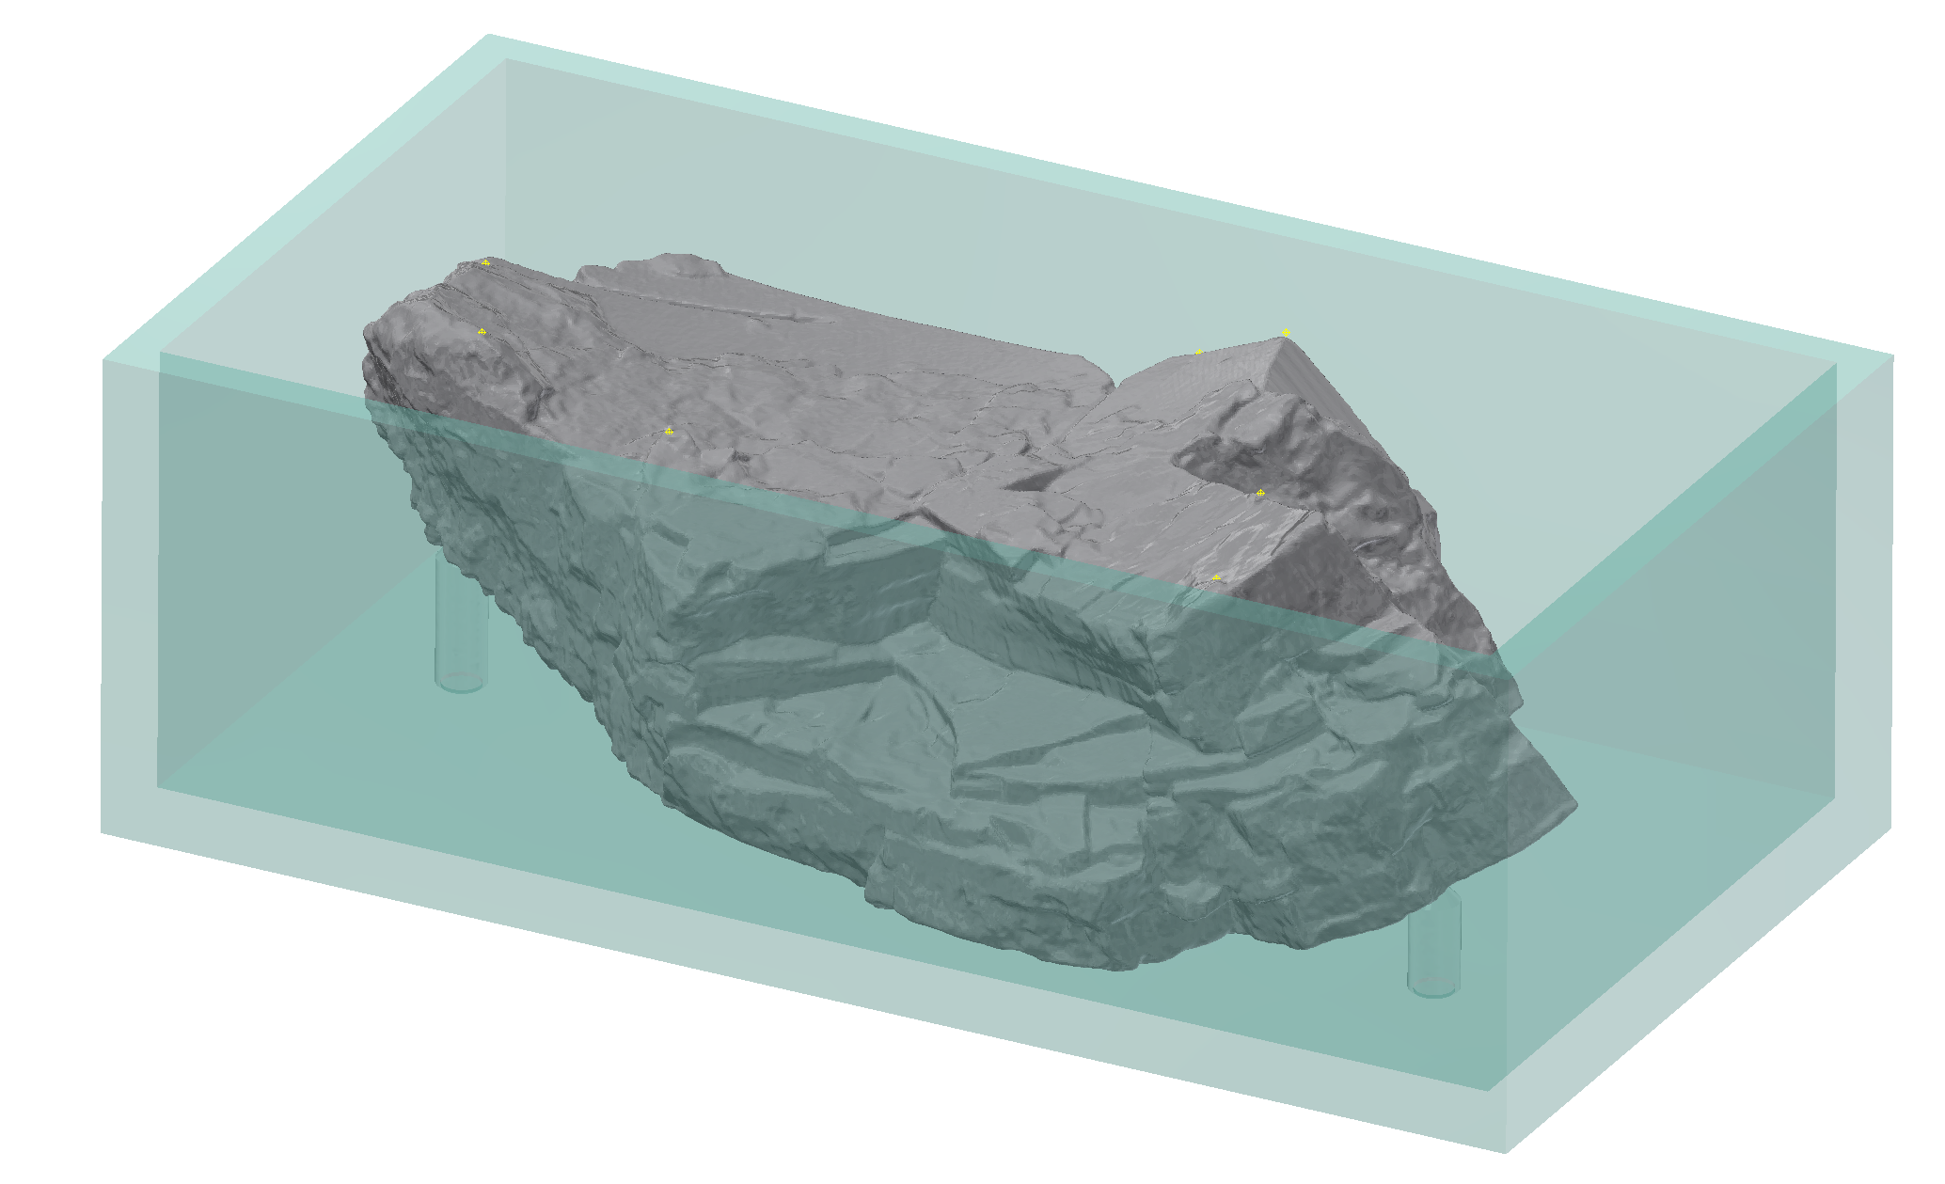
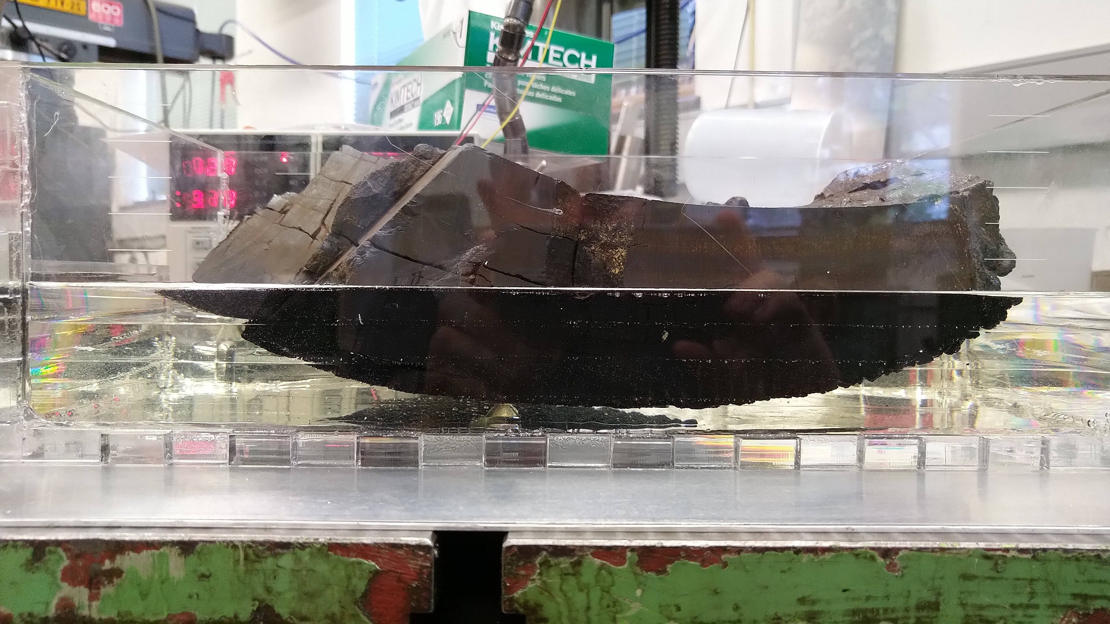
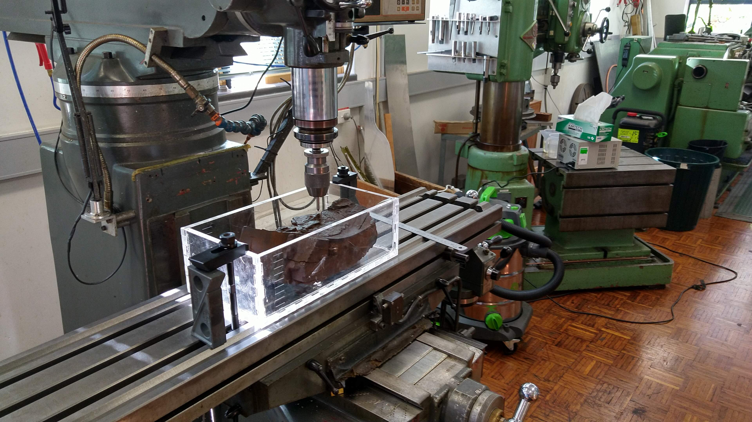
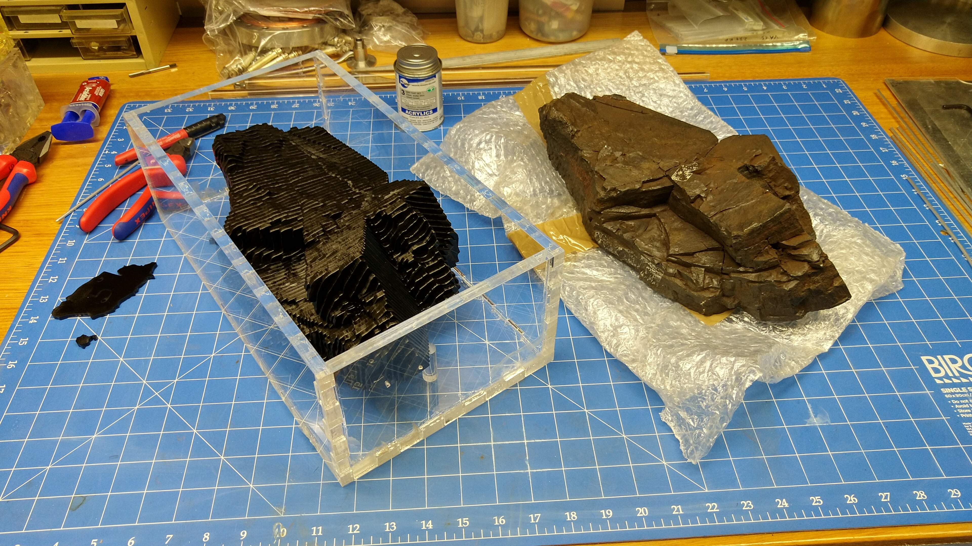
Encapsulation
  Support & Location
  Initial test difficulties – heat buildup and cracking
  Positioning – resting on 3 points in box then glued in place
  CAD model aligned to measured points
  Cast into box
    Test Model first to confirm no heat issues
    27hr process, three ‘shifts’

Slide 8
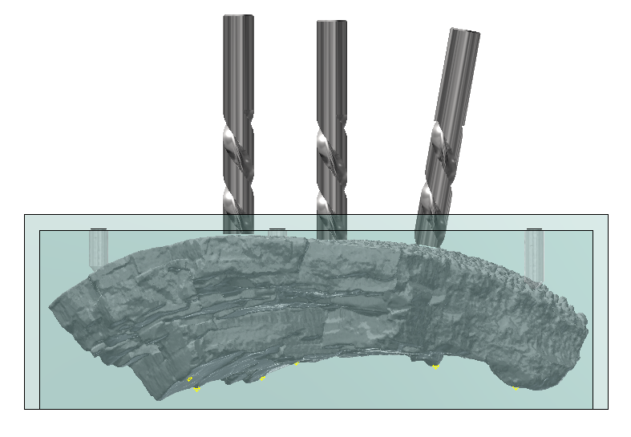
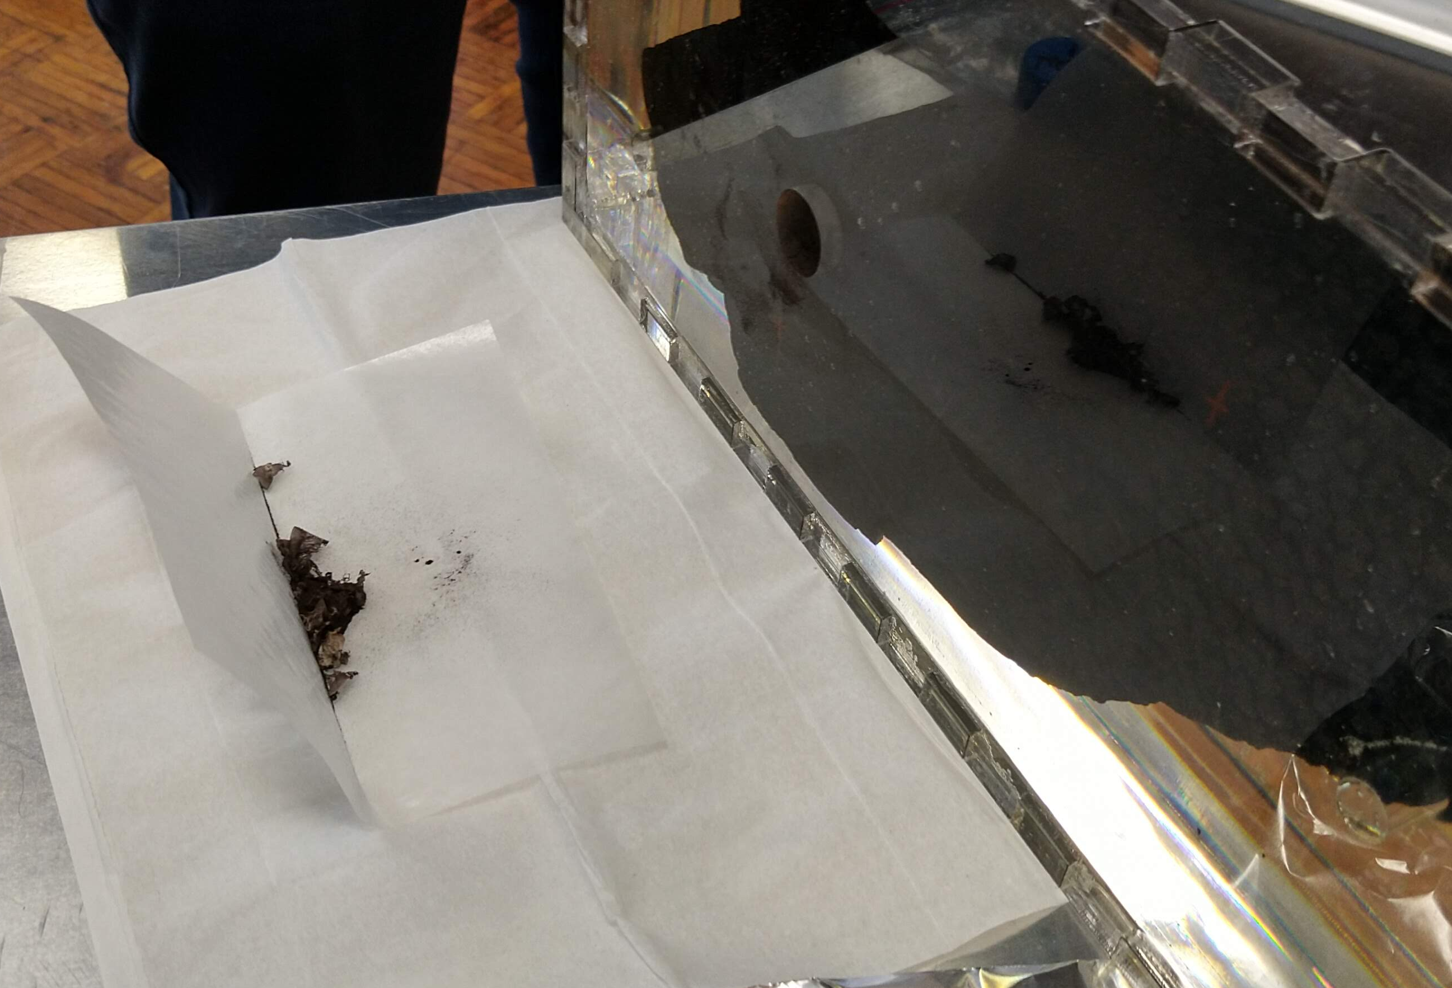
Core Samples
  Three 20mm cores taken to study ⁶⁰Fe for research and ¹⁰Be to characterise the age profile
  Cuts of 1 & 2mm depth, samples collected
  Each sample chemically processed to extract and isolate each element (Ion chromatography)
  ⁶⁰Fe measured at HIAF (ANU)
  ¹⁰Be measured at DREAMS (Dresden)
  ⁹Be carrier measured at SIRIUS (ANSTO)
  Geometry confirmed with model

Slide 9
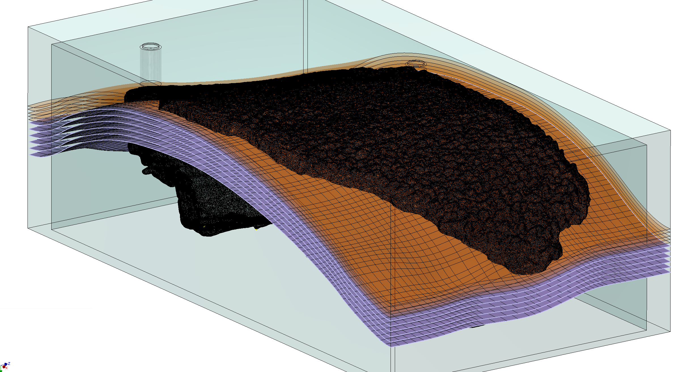
Layering
  The layers were taken for study of ²⁴⁴Pu and other rare isotopes
  Freeform surfaces generated to match as closely as possible the time profile of the sample
  First cut 2.5mm to get through irregularities and past the ‘bomb pulse’
  Three cuts @ 2.0mm
  Five tapered cuts based on time profile

Slide 10
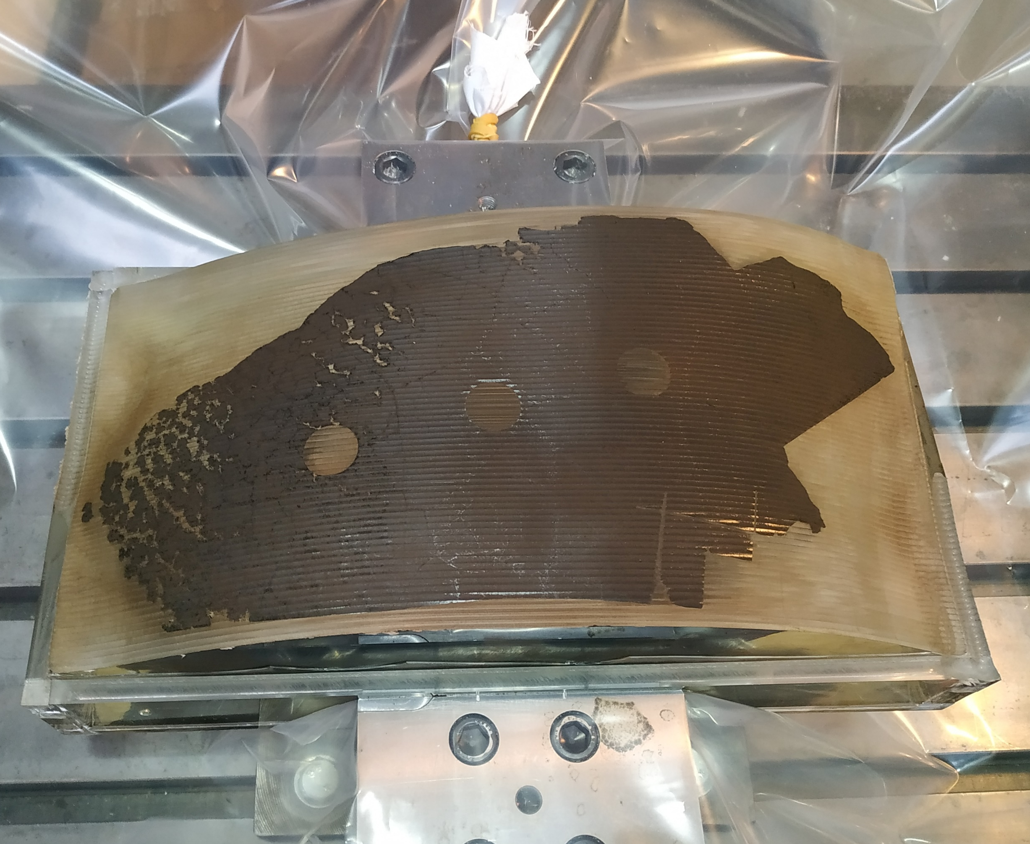
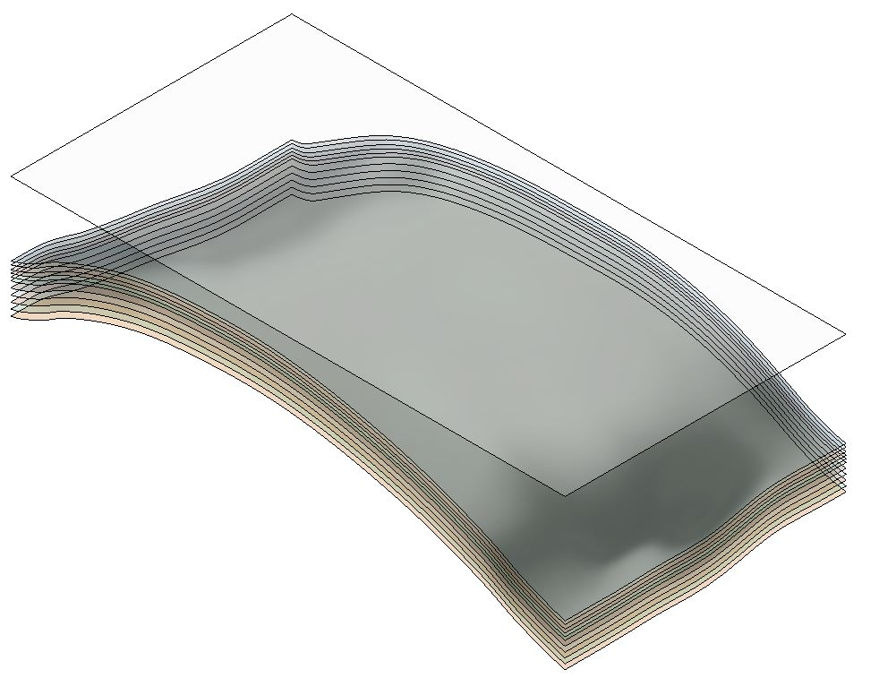
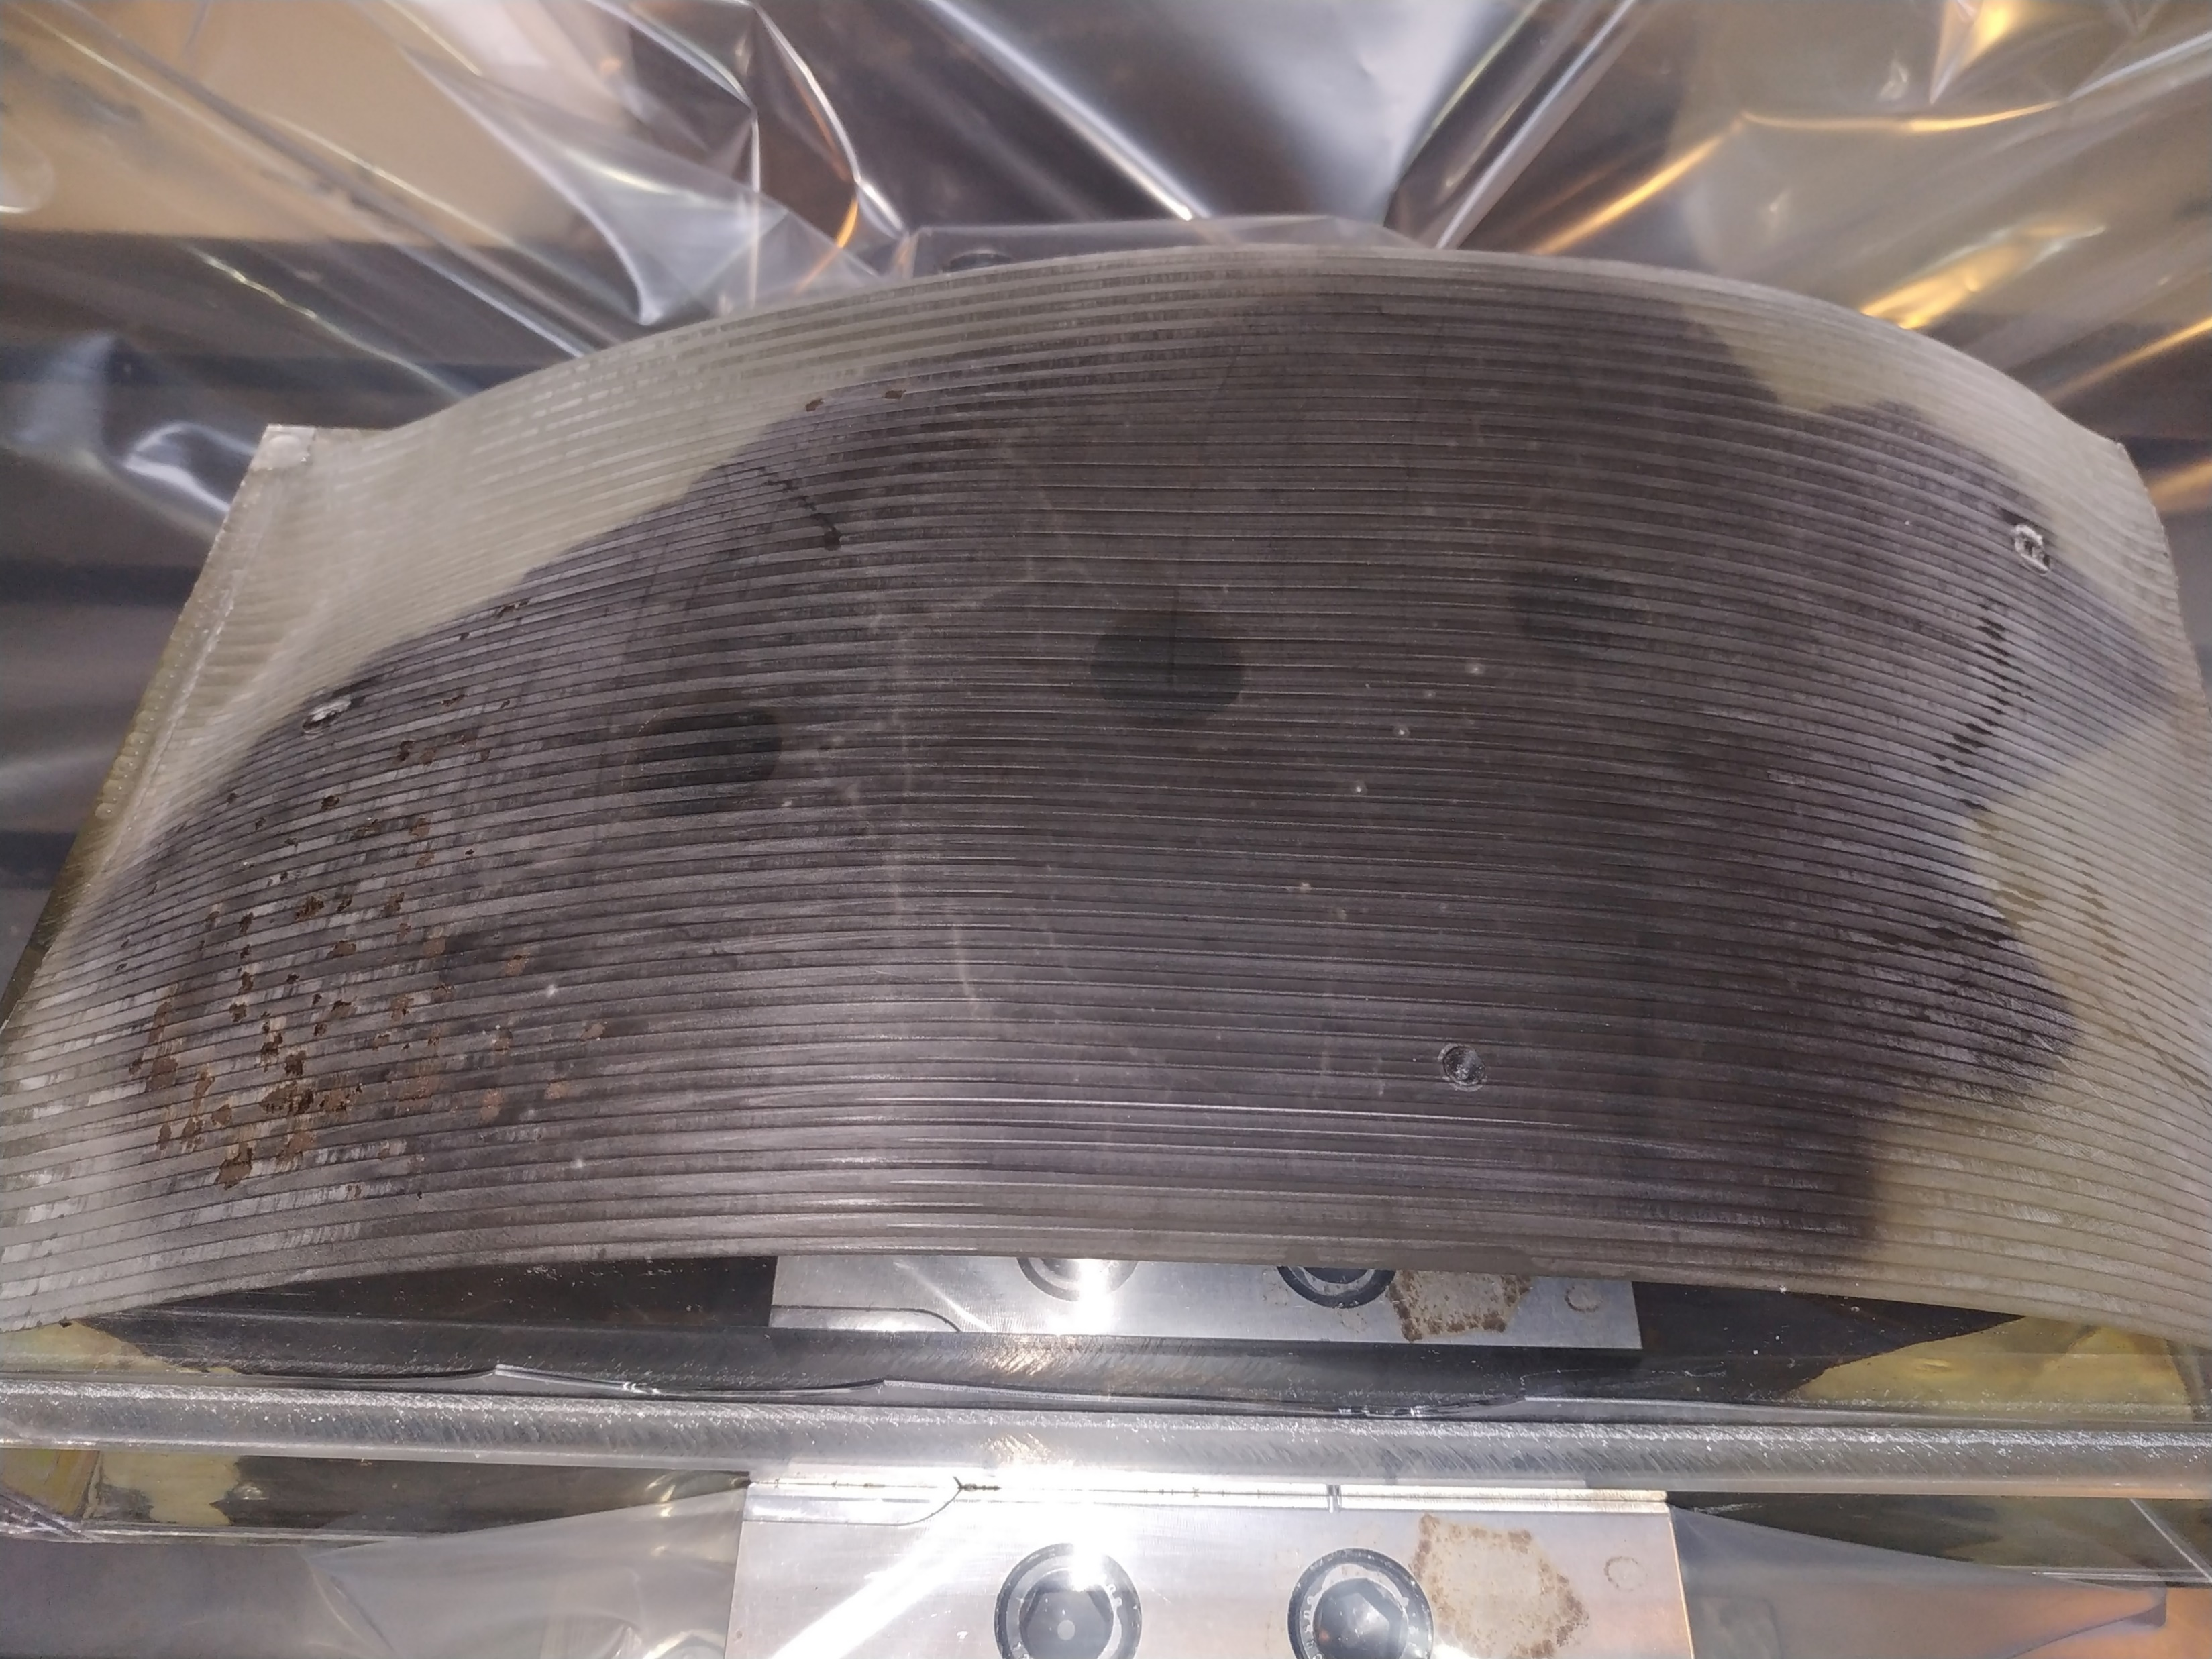
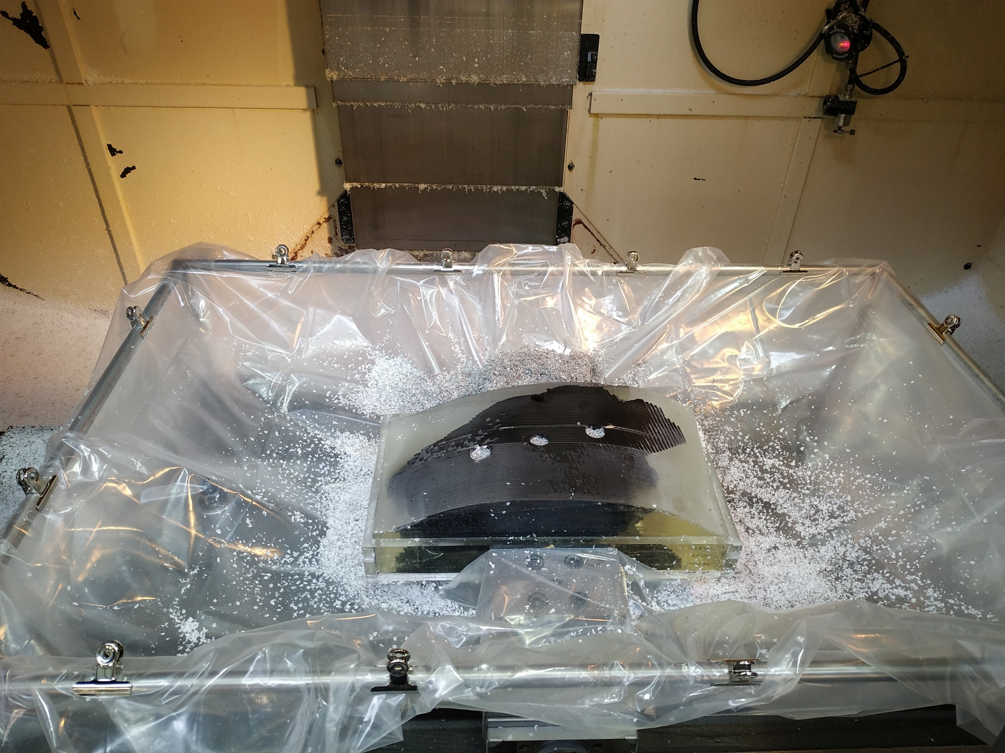
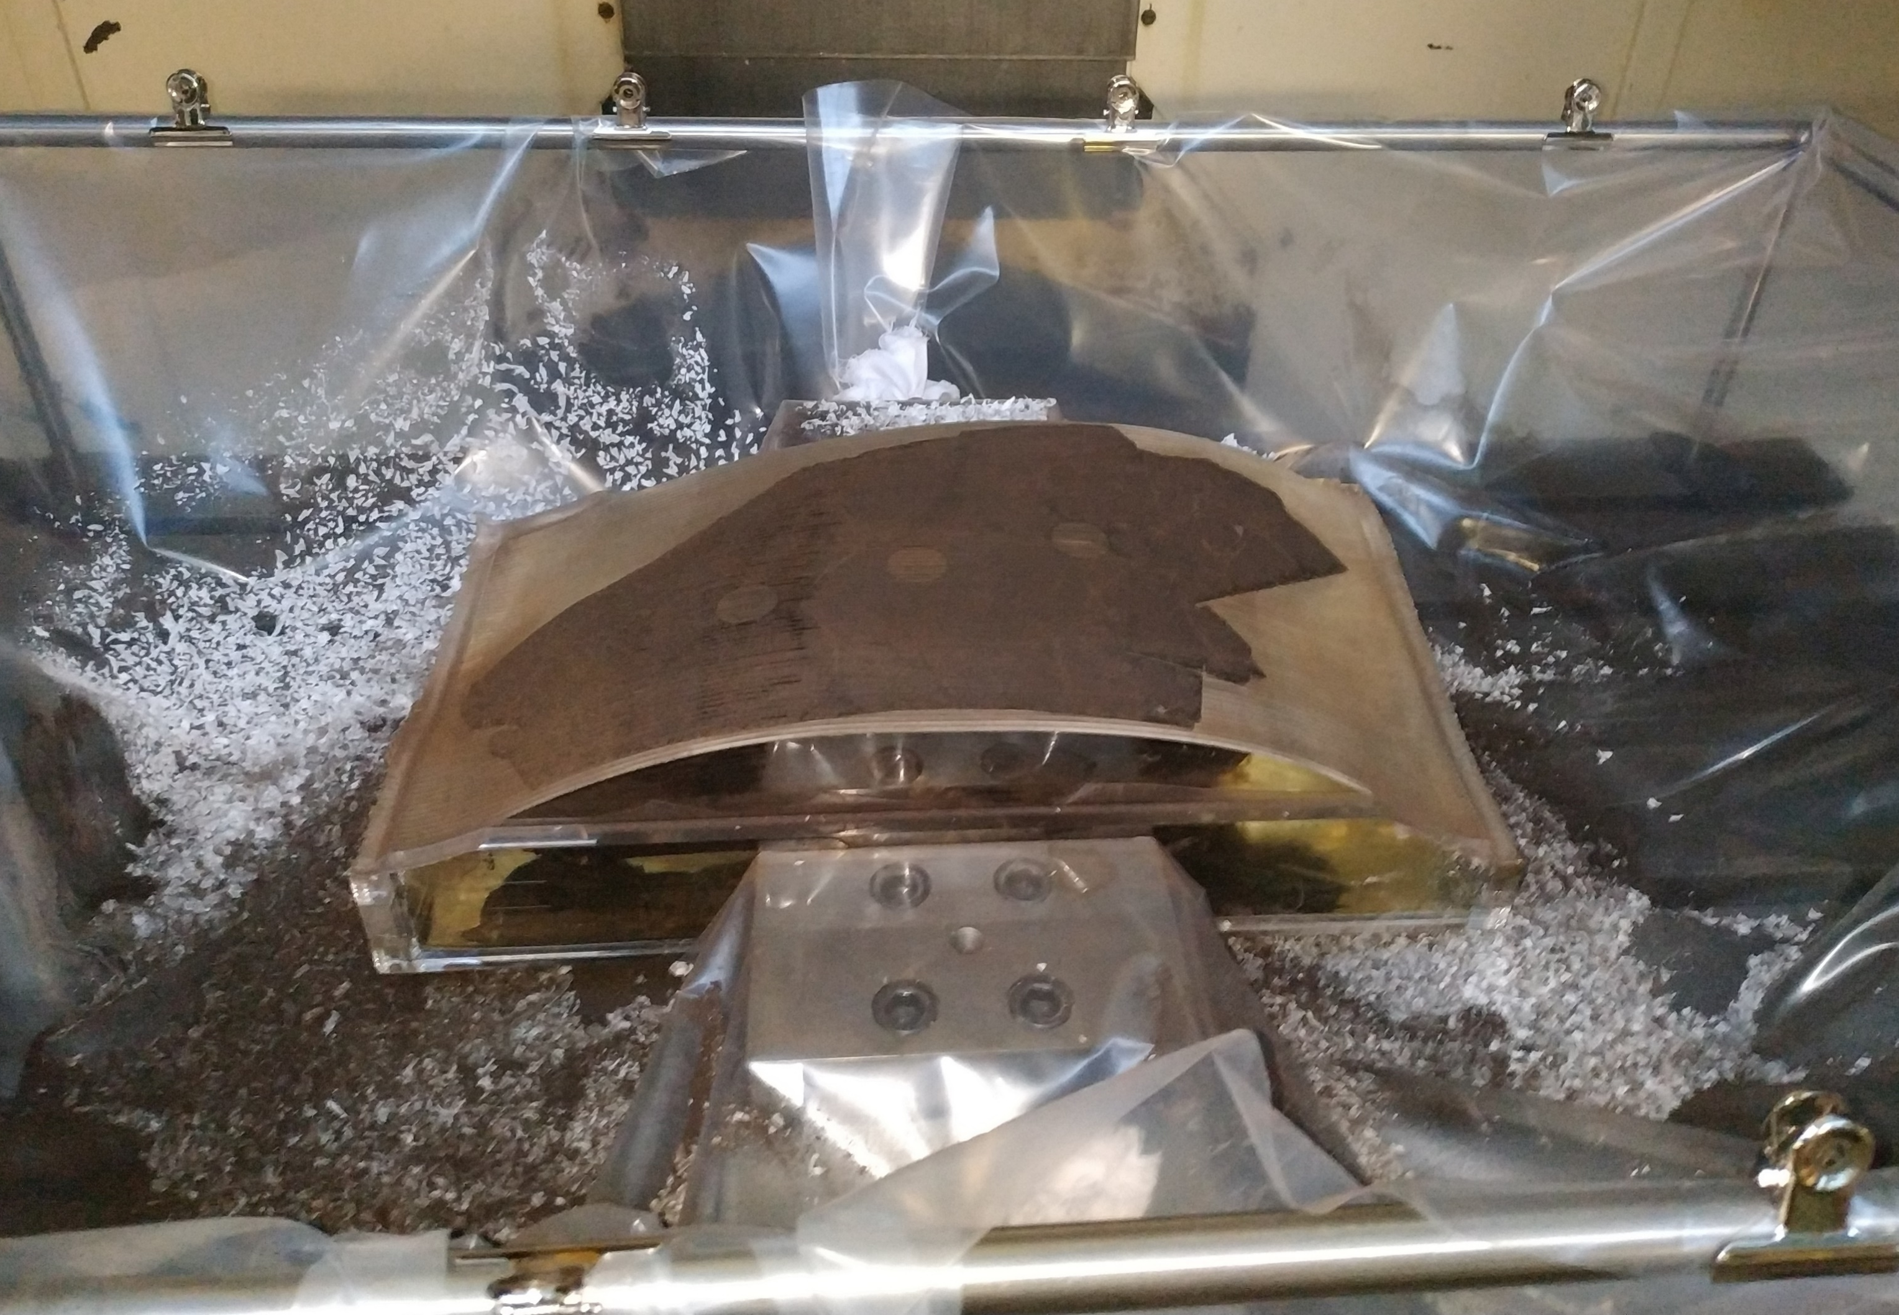
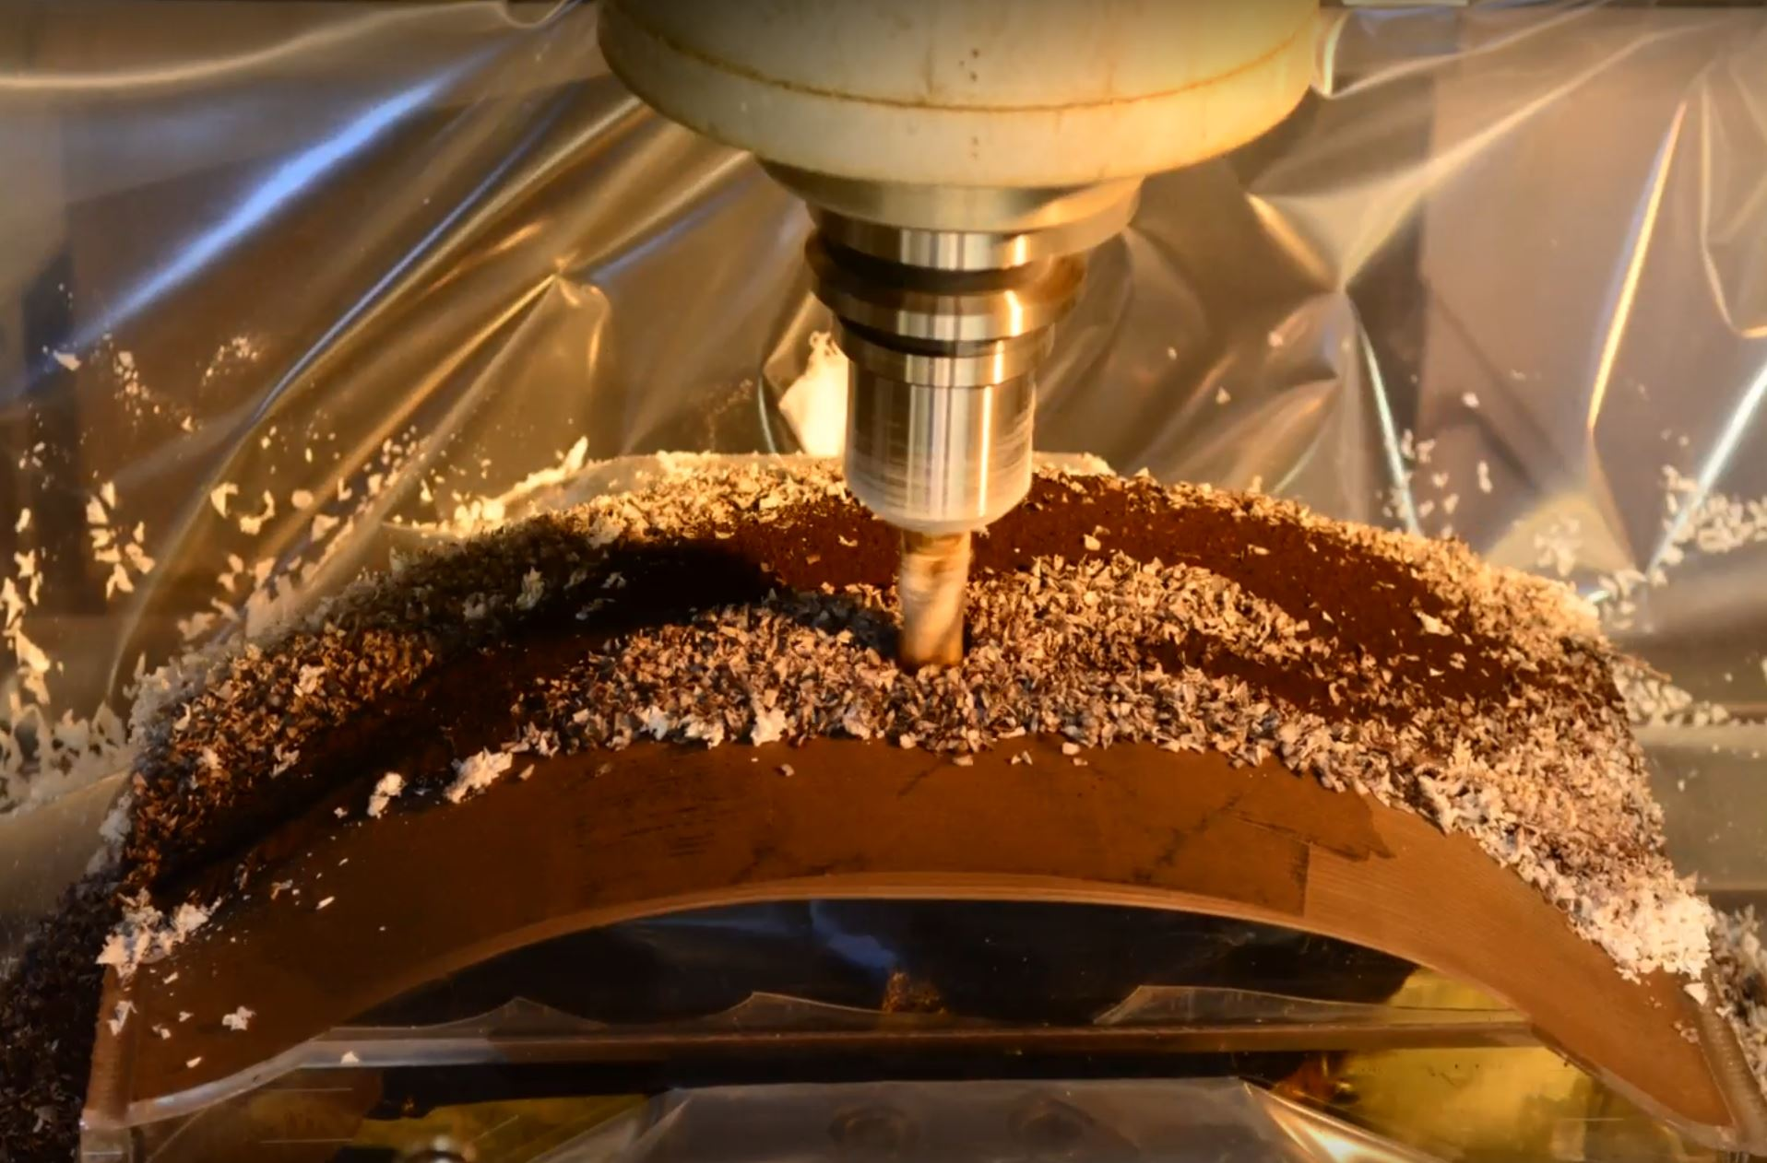
3D Machining
  Layer geometry provided to workshop
  Frame and plastic sheet was constructed to catch the cuttings
  Test Model was used to confirm all operations
  6-8hrs machining time per layer
  Core samples were filled with resin to support the material and prevent mixing of any material
  Breakthrough across the surface was as expected
  Seven layers were cut

Slide 11
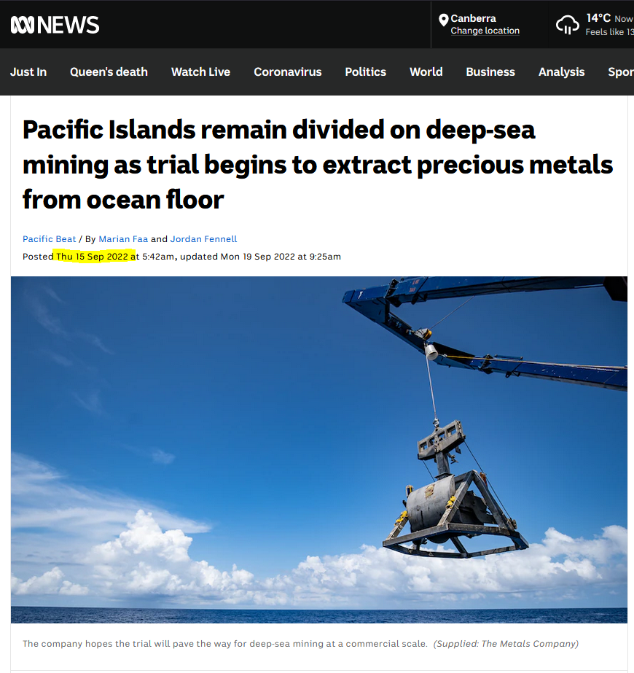
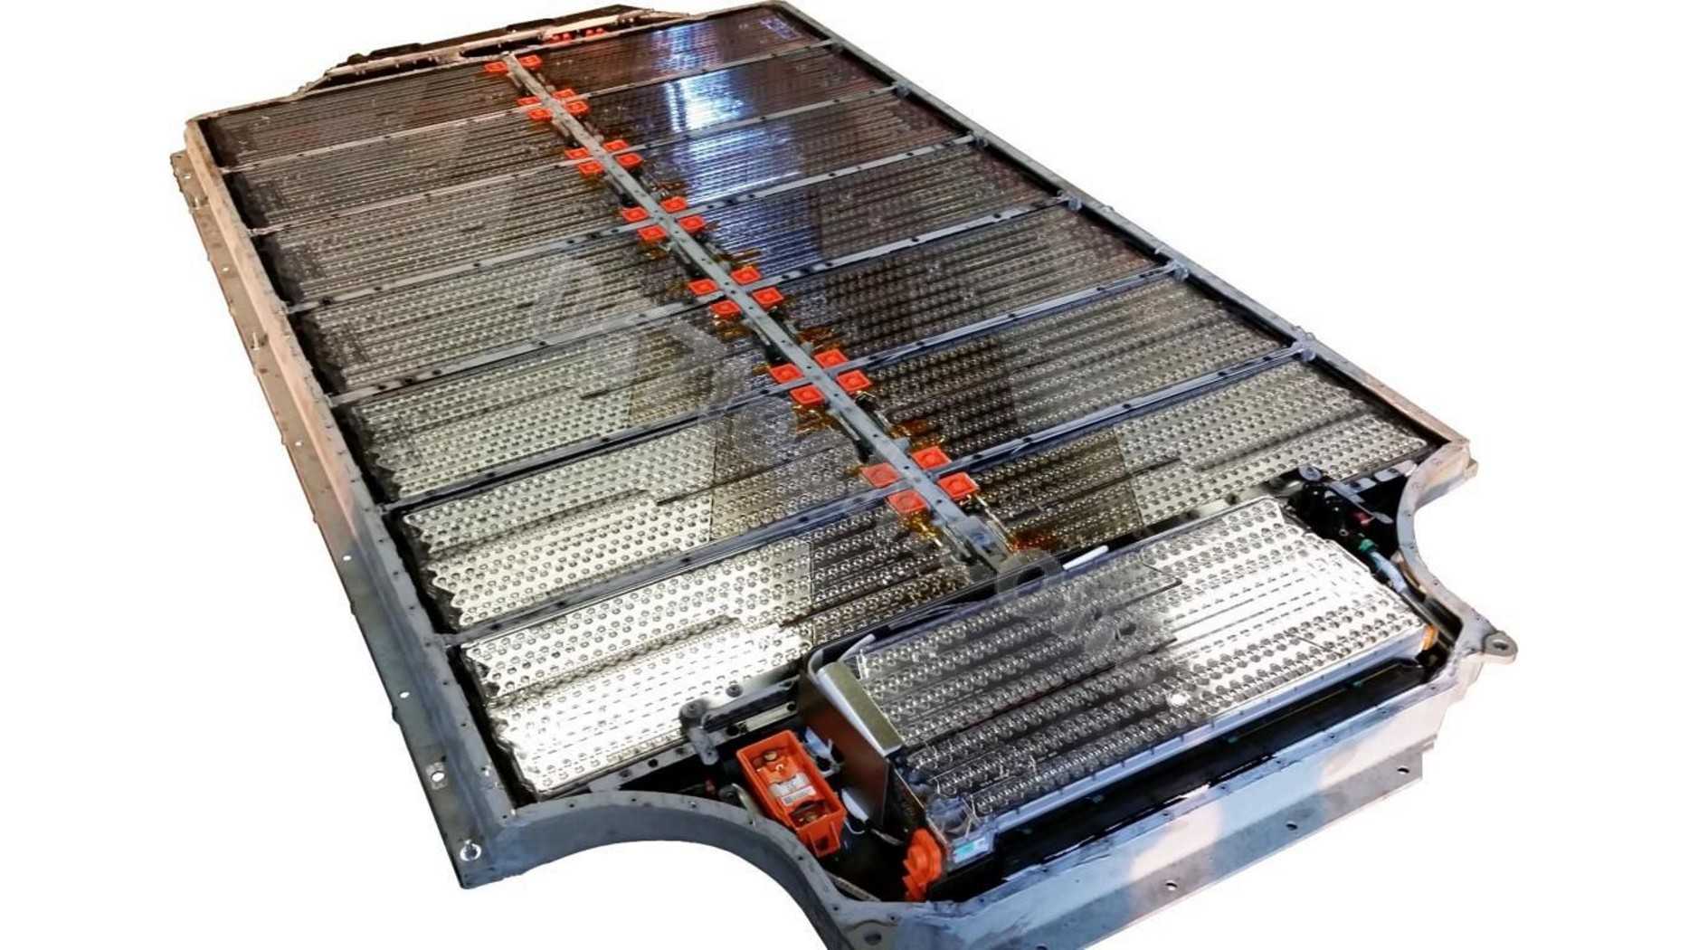
Epilogue
  Crusts and Nodules are rich in manganese, cobalt, copper & nickel
  Batteries!
  Mining trials are starting in 2022…

Slide 12
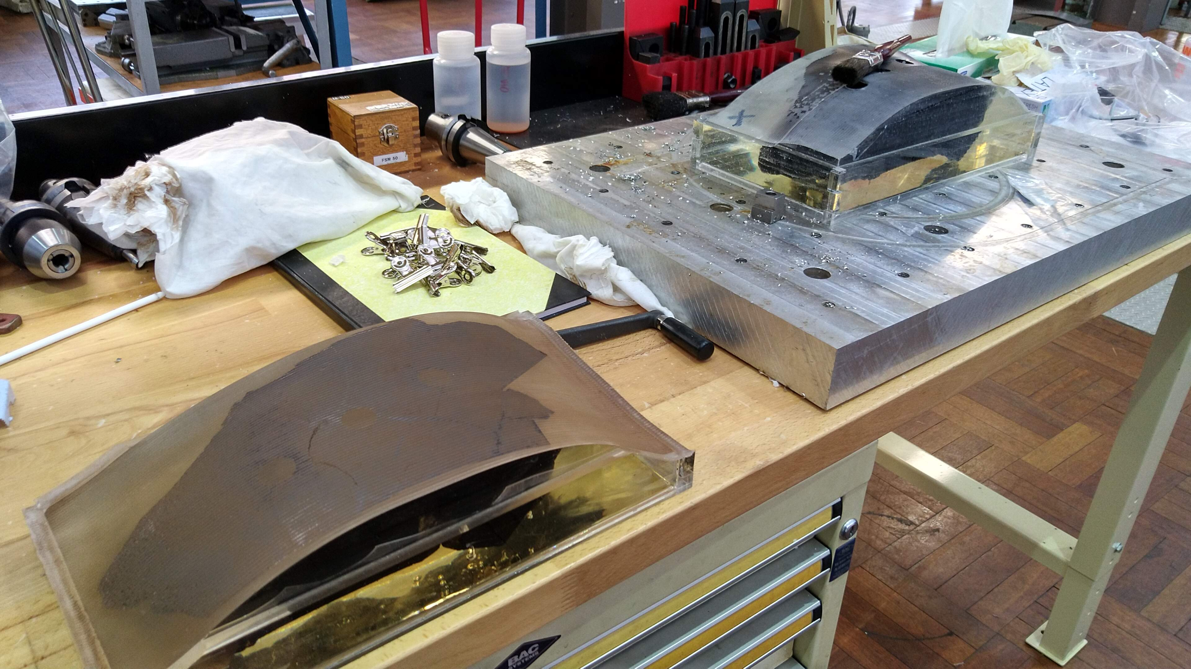
Acknowledgements
  HIAF ANU Tech Team
  AMS Groups (ANU/ANSTO/HZDR Dresden)
  Renee Dixson (ANU) – 3D Scanning
  Alex Shanahan (ANU) – CNC Machining
  Klaus Wilcken (ANSTO) – SIRIUS ⁹Be carrier measurements
  Mike Hotchkis & David Child (ANSTO) – VEGA
  ARC Discovery Programme
  EU Research and Innovation Programme HORIZON 2020

