Slide 1

Research Advances in Key Technologies of Ultra-Large Cryo-plants at TIPC of CAS
Prof. Liqiang Liu
Technical Institute of Physics and Chemistry, CAS
April 2023, Melbourne

Slide 2
Contents
1. Background
2. Advances in Key Parts/Tech.
3. Advances in Systems
4. Conclusions & Prospects
Contents

Slide 3
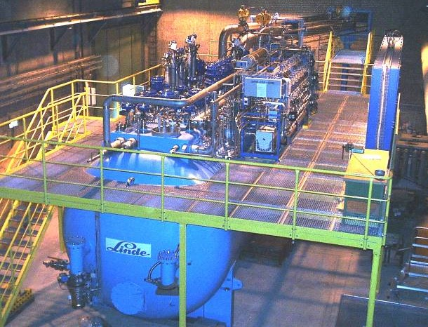
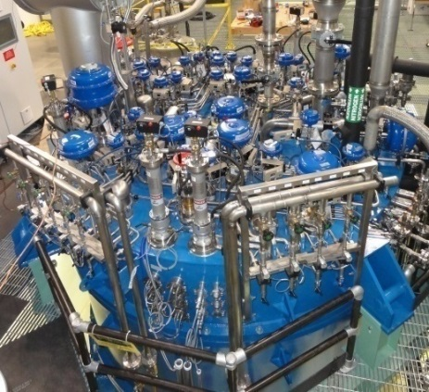
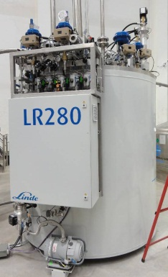

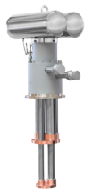
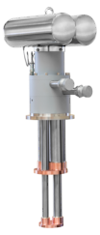

1. Background：Scale & Type of Cryo-plant (CP)
Scale Classification
UL-CP（Q_{eq}>10kW）
L-CP（Q_{eq}>1kW）
M-CP
（Q_{eq}>100W）
Ultra-Large 2K Cryo Refrigerator
Ultra-Large Hydrogen Liquefier
Ultra-Large Helium Liquefier
S-CL
（Q_{eq}∼W）
Typical Type
Q_{eq}: Equivalent cooling capacity @ 4.5K

Slide 4
1. Background：Development journey of CP at TIPC
Start to develop Helium CP System
Start to develop
ULCP
>10kW@4.5K
Piston helium expander
40L/h Helium Liquefier A
40L/h Helium Liquefier B
200W@4.5K
Helium CR
1959
1976
2009
2012
2014
2015
2016
2017
2018
2020
2021
Turbo helium expander
2kW@20K
Helium CR
10kW@20K
Helium CR
250W@4.5K
Helium CR
2.5kW@4.5K/500W@2K
Helium CR

Slide 5
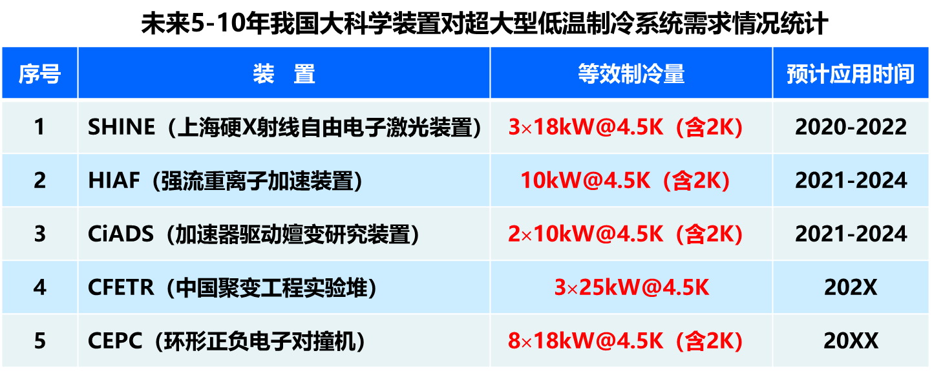
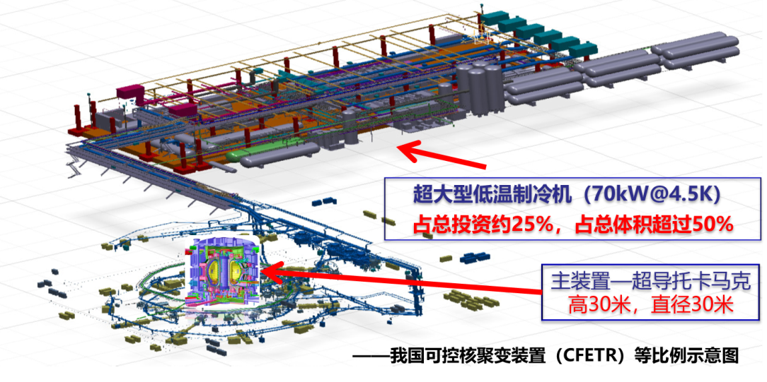
1. Background：Demands – LS-Facilities
ULCPs are the indispensable core equipment for LS-Facilities
ULCPs and their related systems usually account for 1/4 of the investment and 1/2 of the space
More and more LSF need ULCP ⎯ LHC，ITER，E-XFEL , ESS，LCLS-II，KSTAR

Slide 6
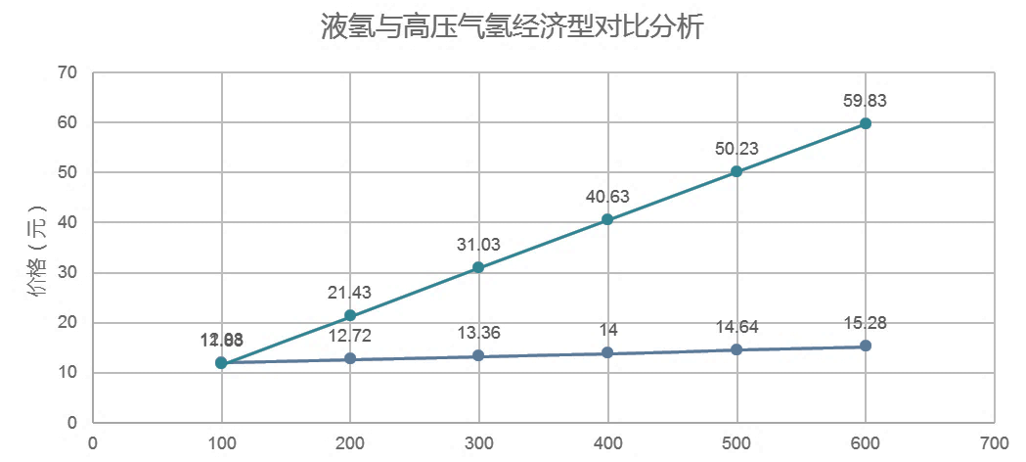
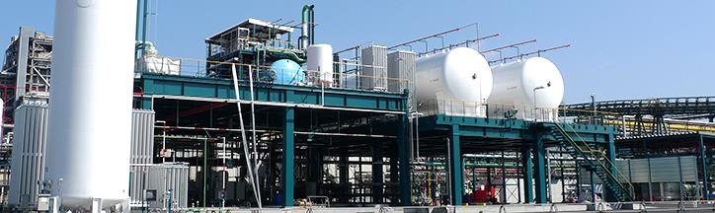
1. Background：Demands – H₂ Energy Utilization
The bottleneck of H₂ energy utilization: transportation cost is too high
LH₂: Best means for L-distance, L-scale, L-cost and Uh-purity Storage & Transportation
Industrial threshold level: 5 tons/day H₂ Liquefier
Economic analysis of H₂ transportation
High pressure GH₂
Price [CNY]
LH₂
Transportation distance [km]

Slide 7
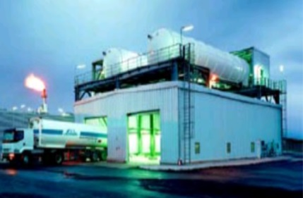
1. Background：Demands – Helium Exploitation
NG containing Helium or BOG
Pretreatment
(deacidification and dehydration)
Concentration
(60-90%)
Purification and liquefaction (99.999% -- >99.9999%)
    ULCP is the key equipment for helium exploitation from NG
External transportation

Slide 8
1. Background：Core Technologies
M.C.
CL & ORS
4K CB
Val
Int Pur
C.C.
Val
ULCP System composition
Control
T.E.
HX
VLP-HX
2K CB
Core Technologies
Equipment/system | Function | Core Technologies
T.E.（heavy load） | The only moving and cooling part of 4K system (4K heart) | Stability technology of heavy duty, low-T and high speed turbine machinery
C.C.（Large flow） | The only moving and cooling part of 2K system (2K heart)
Internal Purifier | Purification of contaminated helium (Liver detoxification) | High-η low-T internal purification technology
System design and Integration | Overall system construction and control (brain command) | High-η and high-reliability system design and integration technology

Slide 9
Contents
1. Background
2. Advances in Key Parts/Tech.
3. Advances in Systems
4. Conclusions & Prospects
Contents

Slide 10
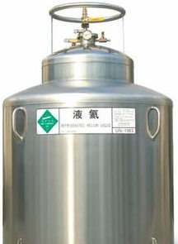
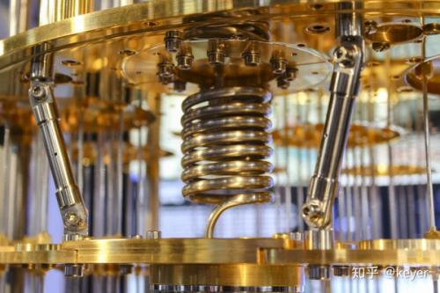
2. Typical Working Process of ULCP
M.C.
CL & ORS
T.E.
HX
Val
4KCB
Concentration Device
（60%∼90% helium）
Int. Purifier
Process Design
Source
（∼3% helium）
C.C.
Val
VLP-HX
2K CB
LHe user
SFHe user

Slide 11
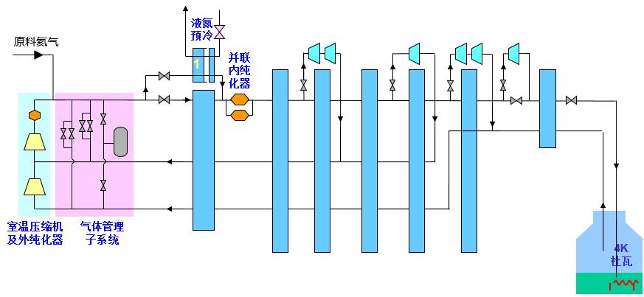
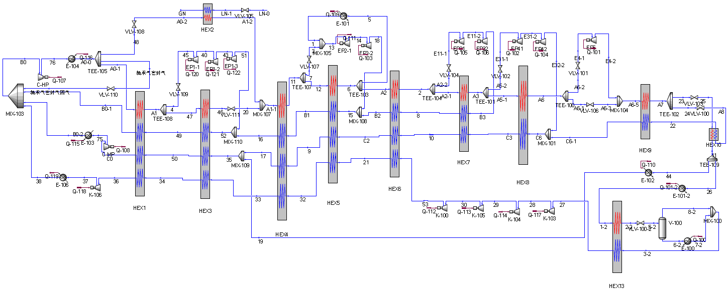
2. Process Design: Main Work
According to the requirements of CiADS for TS, supercritical He and superfluid He, 4kW@2K CP design and optimization has been completed.
H₂ liquefaction process with liquefaction rate of 3800L/h and specific power consumption of 11.67kWh/kgLH has been completed.
Based on the demand for helium transportation, the process design and optimization of 3000 L/h helium liquefier was completed with the goal of liquefaction rate and specific power consumption.
3000L/h He Liquefier flow scheme
4kW@2K Superfluid He CP flow scheme
3000L/h H₂ Liquefier flow scheme

Slide 12
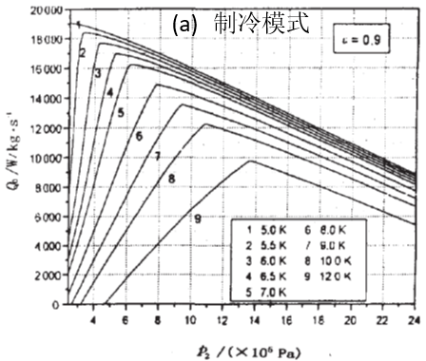
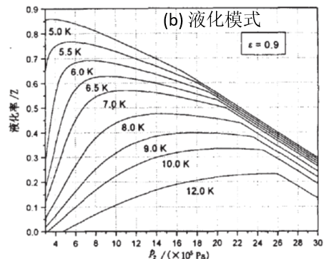
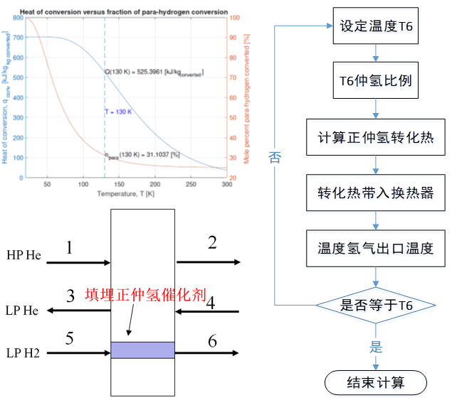
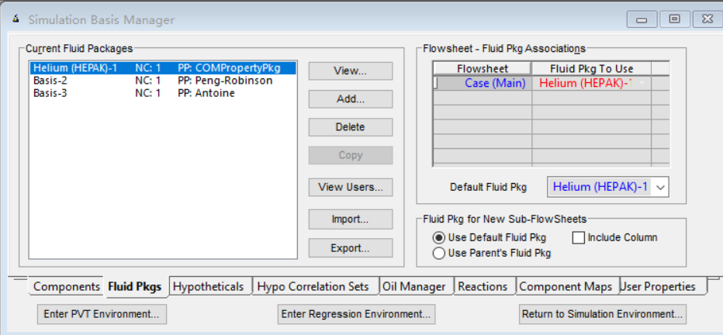
2. Process Design: Technological Breakthroughs
The optimal working point model of the throttle is established, and the optimal design method of the UL-CP is proposed
The He property library (especially the data at superfluid He temperature zone) invoking problem has been solved
OP integrated calculation model of hydrogen conversion and heat exchange have been established and implanted
Optimization method (relationship between T/P and Q/L at the high voltage side of the final HX)
Directly calling Hepak
Integrated calculation model of OP conversion heat transfer

Slide 13
2. HL Expansion Turbines: Main Work
Development process
Theoretical Research
Construction of test bench
Heavy load dynamic balancing machine
Bearing design calculation
Test rig for bearing-rotor system dynamic balance
Main parameters of rotor system
Preliminary design of bearing -rotor system
Bearing-rotor systems with different parameters
Test rig for rotor orbit
Rotor-bearing system stability test
Rotor dynamics analysis
Input from process design result
Air compressor
Bearing performance prediction model
Optimizing design parameters
Feedback
Experimental Research
Input parameters
Detailed Design
Engineering design
Processing & manufacturing
experimental condition
Assembling & Testing

Slide 14
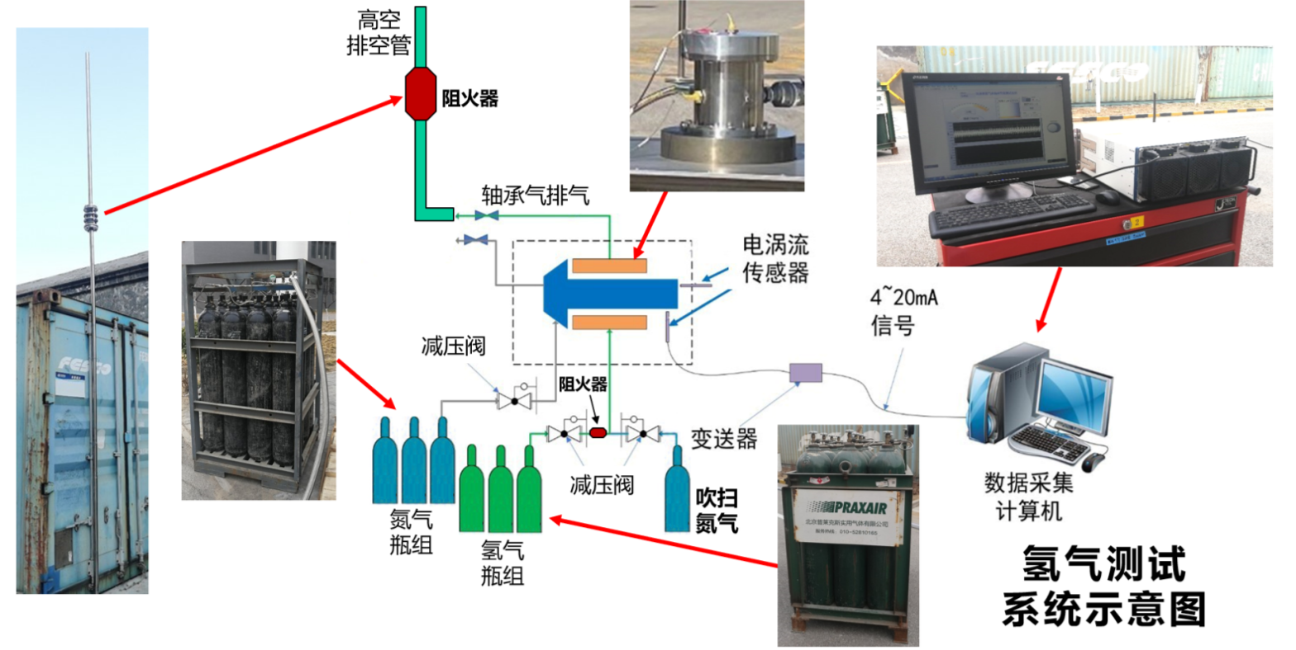
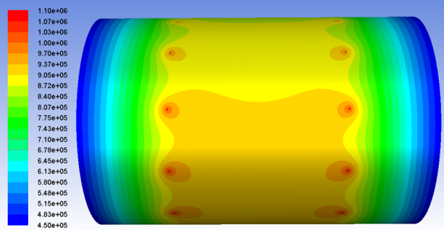
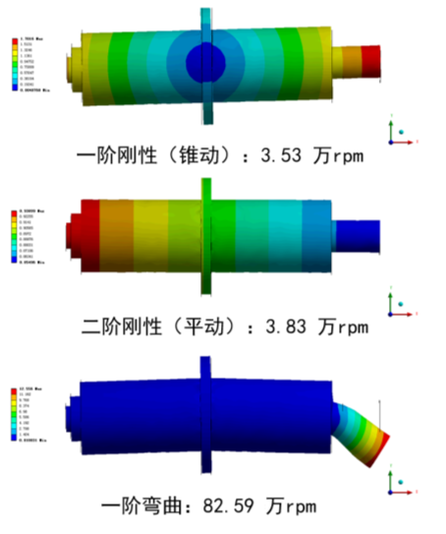
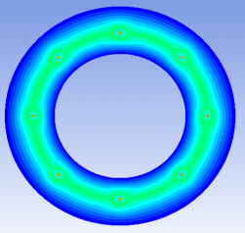
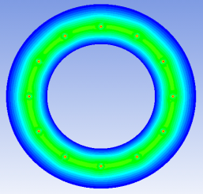
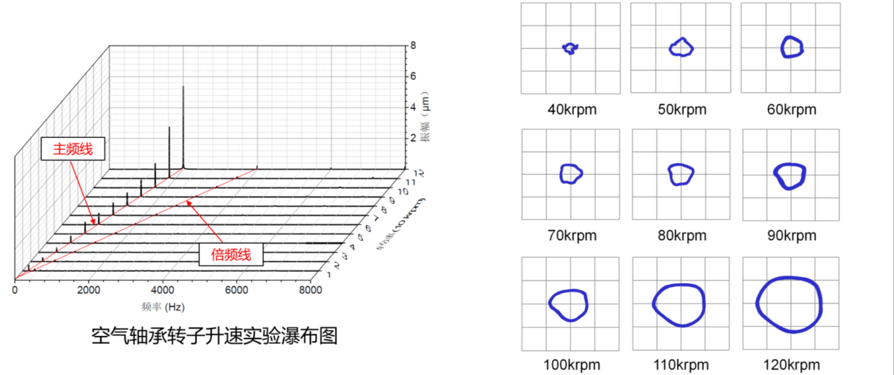
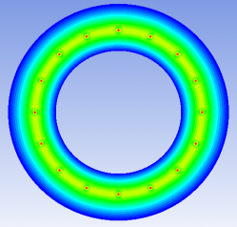
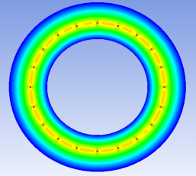
2. HL Expansion Turbines: Main Work
Design, Rig and Test
D=45mm，P=11bar
P distribution of journal bearing
Test Rig for H₂ bearing
8孔
12孔
16孔
20孔
P distribution of thrust bearing
Rotor dynamics analysis
Waterfall diagram of gas bearing rotor speed increase test

Slide 15
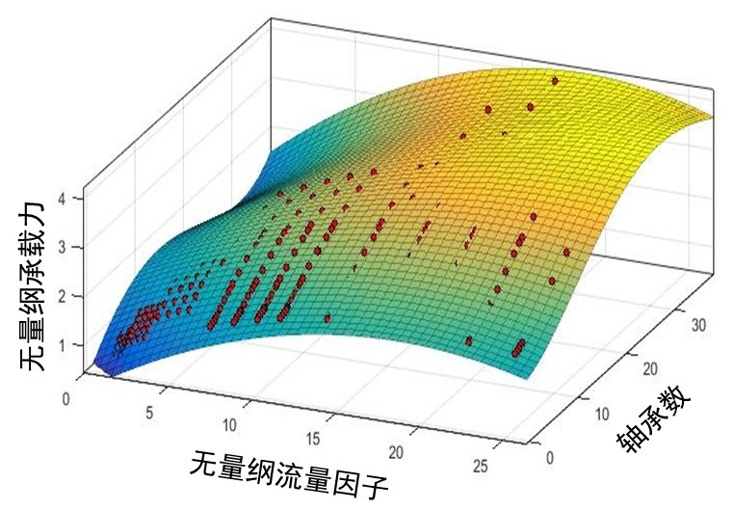
2. HL ETs: Technological Breakthroughs
The universal prediction method of static and dynamic load capacity of gas bearing is established and verified (Dimensionless Flow Factor and Number of Bearing)
Significance of this prediction method
Spreading the experience of air bearing to that of He and H₂: improving economy and safety
The static P effect of H₂ is between or higher than that of He and Air
Dimensionless FF：
NOB：
Dimensionless Load Capacity
Relative Parameter | Air | H₂ | He
Relative dimensionless flow factor (FF) | 1.0 | 1.8 | 2.9
Relative number of bearings (NOB) | 1.0 | 0.5 | 1.1
NOB
Dimensionless FF
Dimensionless Bearing Capacity Curved Surface

Slide 16
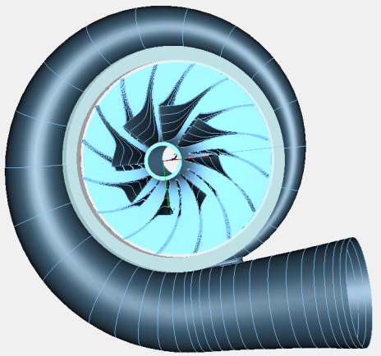
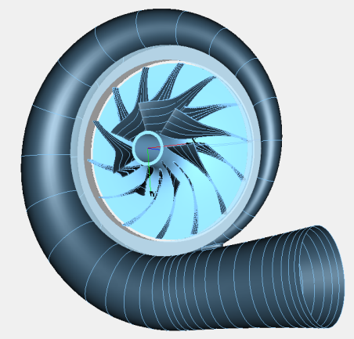
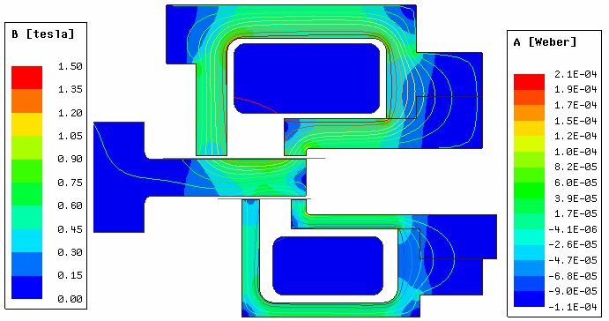
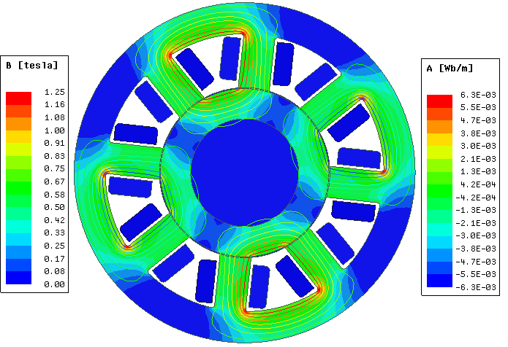
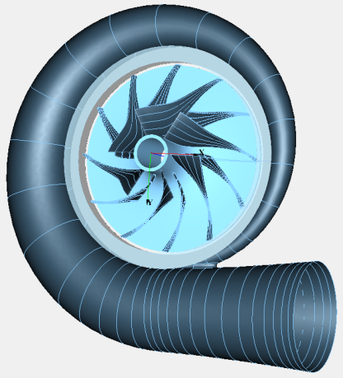
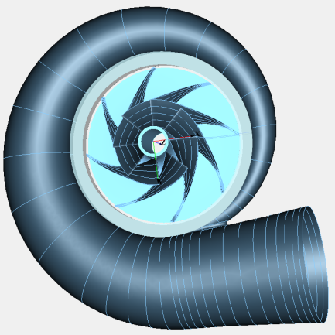
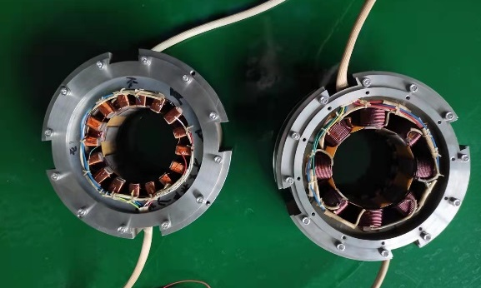
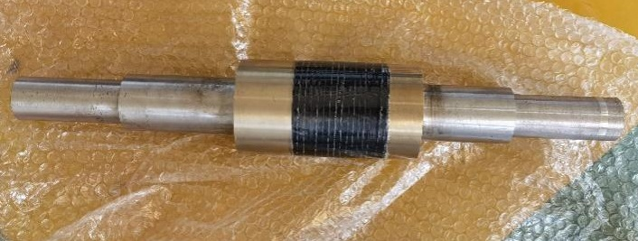
2. LF Cold Compressors: Main Work
Scheme：higher work（7kW）→ 4 stages
Parameters：Compression Ratio，Rotary Velocity
Prototype of the 4th stage CC is developed（Vmax）
 | CC1 | CC2 | CC3 | CC4
Ratio | 2.9 | 2.1 | 1.8 | 1.5
V/(rpm) | 12000 | 16000 | 21000 | 30000
Axial magnetic bearing
Radial magnetic bearing
Flow passage of each stage of CC
Key parts of the prototype

Slide 17
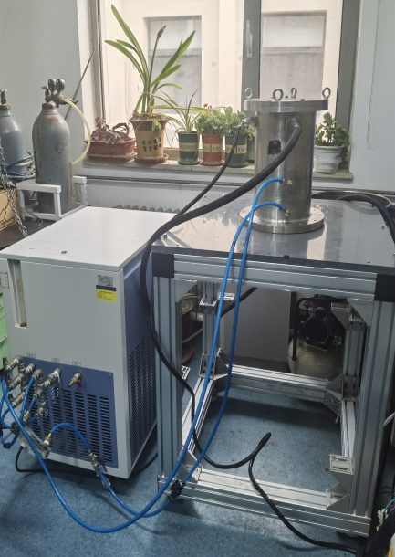
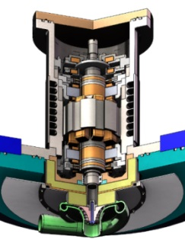
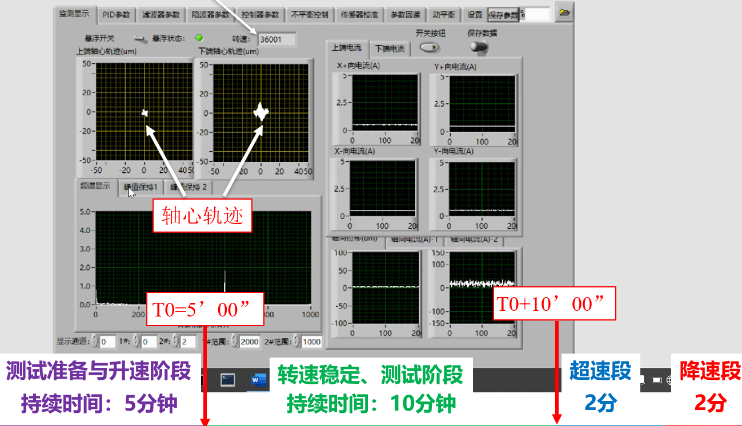
2. LF Cold Compressors: Main Work
Test Rig, Process and Results
Maximum Speed：42010 rpm（120% design speed）
Rotary accuracy：14 μm
Orbit
Loading
5 min
Stable & test
10 min
Ovrspd
2 min
Unload
2 min
Test rig at RT

Slide 18
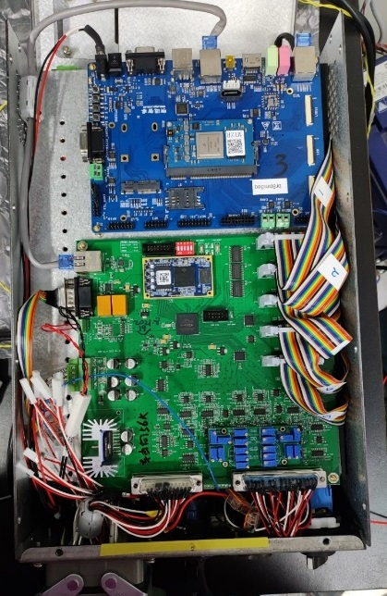
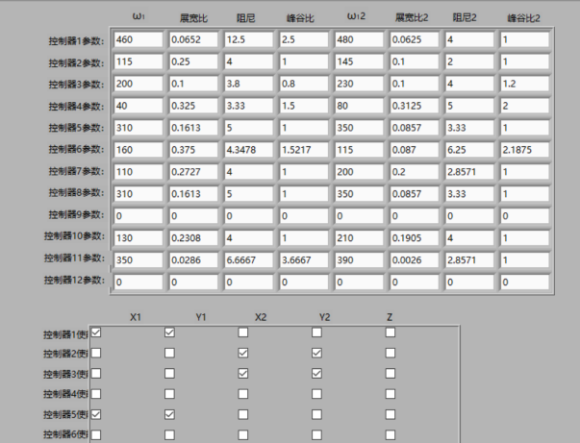
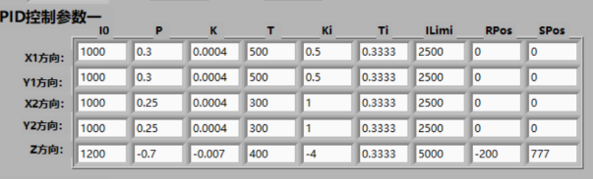
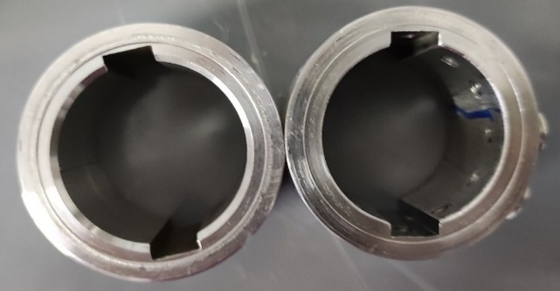
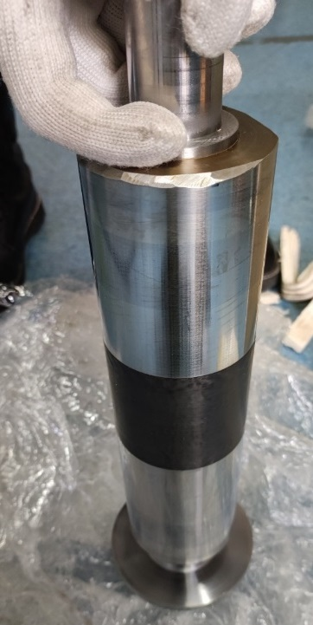
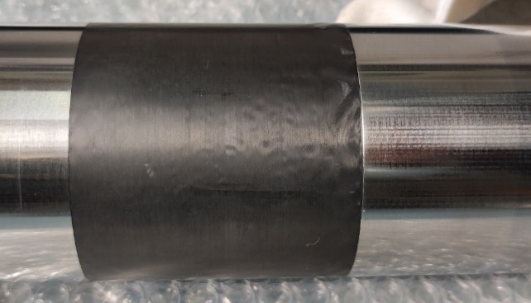
2. LF CCs: Technological Breakthroughs
The control system of MB is simplified and improved
The online adjustment and optimization of the control parameters of MB is realized
The problem of anti-strong current interference of bearings and sensors has been solved
Balance disc is set and rotor mass is decreased to reduce unbalance of the rotor
The winding mode of rotor sleeve is optimized to prevent deformation of the rotor at high speed (50mm→80mm)
Magnetic bearing circuit board and control parameter setting
Structural optimization of main shaft

Slide 19
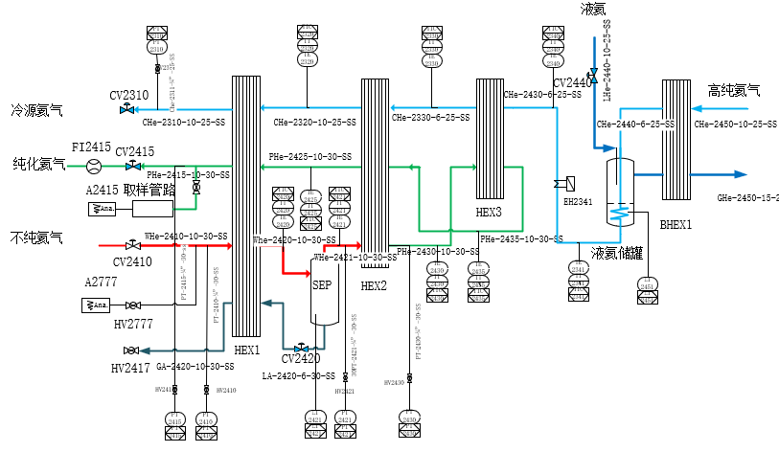
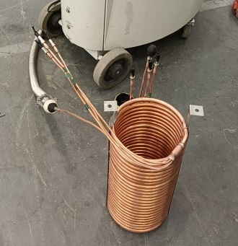
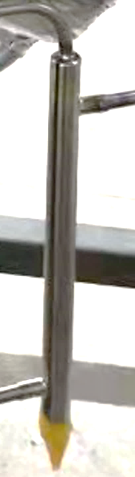
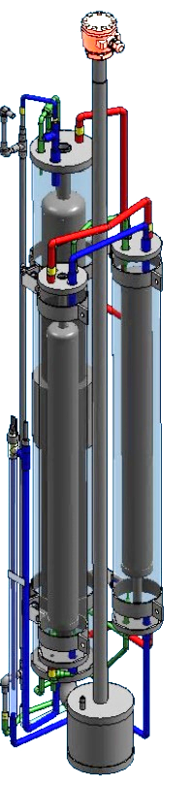
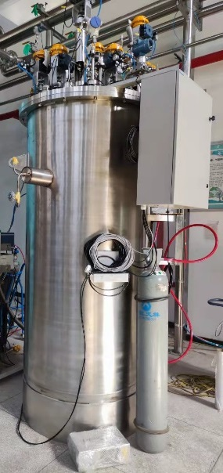
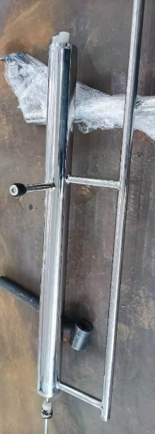

2. Internal Purifier: Main Work
System Scheme：
  Cold source：LHe → Flexible and efficient
  Flow process：3HX+Lair tank → Cold recovery
Key parts：
  HX: HT + Condensing & freezing separator
  Lair Tank：Setting a 5μm filter for G-L separation
Sleeve type (HX3)
Test CB
Lair tank with gas-liquid separation and liquid level measurement
Multi-channel sleeve type (HX1)
Frost-containing finned tube type (HX2)

Slide 20


2. Internal Purifier: Technological Breakthroughs
The utilization process of Lair cooling capacity to make the refrigeration capacity stable has been proposed
Sequence control method for internal purifier has been mastered
High-η internal purifier process (utilization of Lair cooling capacity)
Liquefaction rate / cold helium flow vs. feed gas purity
Liquefaction Rate [L/h]
Sequence control process
Purity of feed gas

Slide 21
Contents
1. Background
2. Advances in Key Parts/Tech.
3. Advances in Systems
4. Conclusions & Prospects
Contents

Slide 22


3. System advances: 300L/h He Liquefier - Prototype
Liquefaction Rate（L/h） | 309.6
Specific power consumption（kWh/L） | 1.36
The 1st set of 300L/h domestic industrial He liquefier
& 2000L domestic LHe Dewar

Slide 23

3. System advances: 300L/h He Liquefier - Formal
Liquefaction Rate（L/h） | 372.1
Specific power consumption（kWh/L） | 1.13
LHe Volume in Dewar [L]
Time [h]
300L/h industrial helium liquefier – formal type
Performance curve

Slide 24


3. System advances: 5t/d H₂ Liquefier
The CB of 5t/d H₂ Liquefier has been integrated and will be tested soon
Vacuum degree | 10⁻⁸ | Pa⋅m³/s
3D Design of the CB
Length | 14.7 | m
Width | 6.0 | m
Height | 5.4 | m

Slide 25

3. System advances: 3000L/h LHe / 4kW@2K CR
3000L/h / 4kW@2K / 18kW@4.5K CB mechanical design
Skid-mounted distribution structure
>80K：Connected by axial movable flange with the main part (fixed)
80K-20K：Main part
<20K：Connected by upper flange with the outside
T>80K Region 80K<T<20K Region T<20K Region

Slide 26
Contents
1. Background
2. Advances in Key Parts/Tech.
3. Advances in Systems
4. Conclusions & Prospects
Contents

Slide 27
4. Conclusions and Prospects：Conclusions
The core technologies of the series of 10kW CP represented by “HL-TE, LF-CC, Internal Purifier, and process design" have been conquered for the first time at TIPC of CAS and in China.
With the support of relevant government departments and enterprises, the R&D of the complete systems of the 10kW CP are being in progress
  3000 L/h Helium Liquefier → LS-Facilities, Helium resource extraction
  5 t/d H₂ Liquefier × 2 → H₂ Energy Utilization
  4 kW@2K Superfluid Helium Cryo-plant → LS Facilities

Slide 28




4. Conclusions and Prospects: Prospects
  With the joint support of TIPC and Zhongshan City, Zhongshan Institute of Advanced Cryogenics (ZIAC) was established to build a large cryo-plants development platform and carry out research on the high efficiency, long life and application of ULCP
System Bld
Key Tech Bld
H₂ Bld
Complex Bld

Slide 29
Thank you for attending!

