Slide 1


High brightness photoinjector driven high-resolution high-energy X-ray CT
Zheng Zhou
Institute of Applied Electronics, China Academy of Engineering Physics

Slide 2
Content
Background
Research Status
High-brightness photoinjector method
Proof-of-principle experiments
Upgraded apparatus
Conclusion
Notes:
I will give my talk from the following aspect,

Slide 3
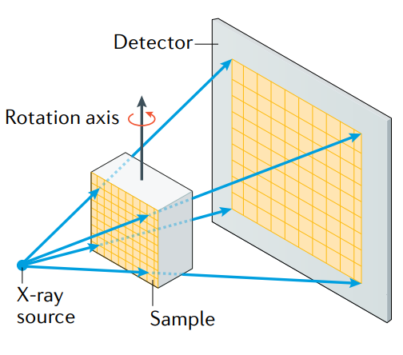
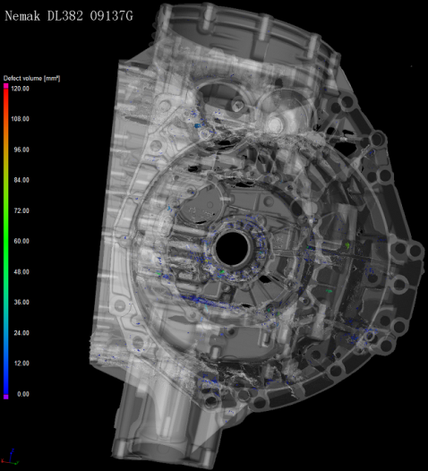
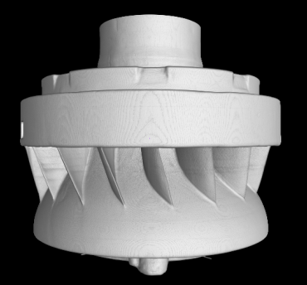
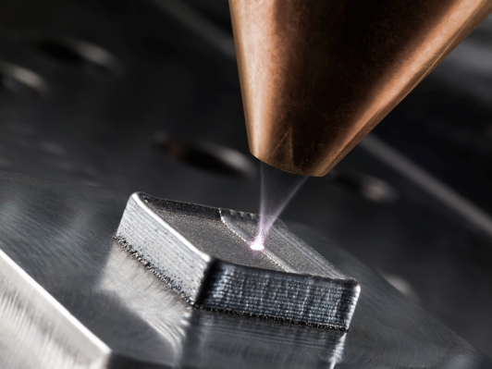
Background
As one of the most powerful tools in non-destructive testing, high energy, high resolution industrial X-ray computed tomography (CT) has attracted growing interest in numerous areas:
auto industry
Important Parameters：
Beam energy
- Penetration depth
Dose rate
Signal-to-noise ratio
Scanning time
aerospace
additive manufacturing
Resolution
How fine features can be distinguished ?
Stability
Reliability

Slide 4
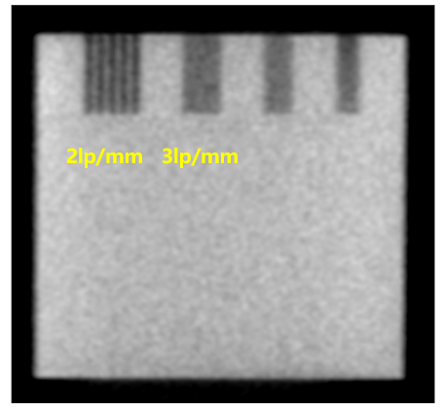
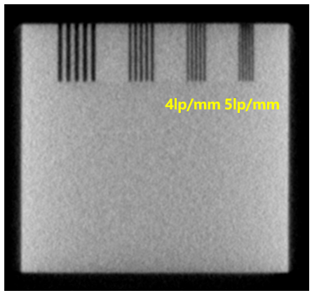
Conventional high-energy X-ray CT
Linac accelerator driven high-energy X-ray CT
Thermal gun
Electron linear accelerator
2/4/6/9/12/15 MeV
Conversion
target
X-ray
In conventional CT, electron beam size has determined X-ray focal size to 1~2mm, limiting resolution to 2 Lp/mm (250 μm)
Conventional X-ray CT
performance
High resolution X-ray CT
performance
can see
can resolve
What can we do ？

Slide 5
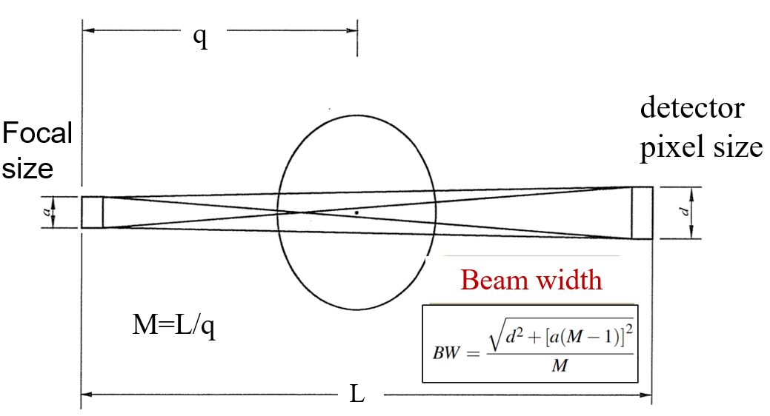


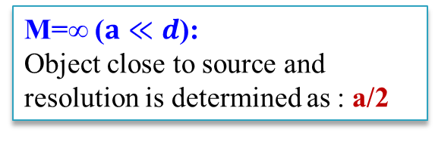
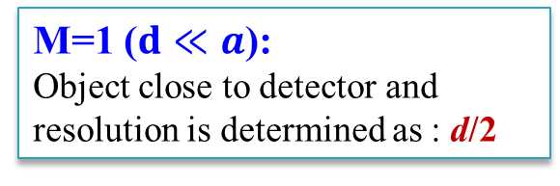
Way to get higher resolution
An useful formula: equivalent beam width (BW)
M=1 ($d≪a$):
Object close to detector and resolution is determined as : d/2
Ideal situations
M=∞ ($a≪d$):
Object close to source and resolution is determined as : a/2
Strategies to improve resolution:
Lowering detector pixel size d
Lowering X-ray focal size a

Slide 6
Status- optimizing detector
CoLOSSIS high energy industrial CT in Lawrence Livermore National Lab:
Conventional 9MeV electron linac with a: 1~2mm
Specially designed detector with d: 50μm
Magnification factor: ~1
100 μm
CoLOSSIS high resolution X-ray CT
Practical restrictions:
Expensive detection system (Scintillator, CCD camera etc);
Dose rate drops as object far away from X-ray source, causing long scanning time (10 hours)

Slide 7
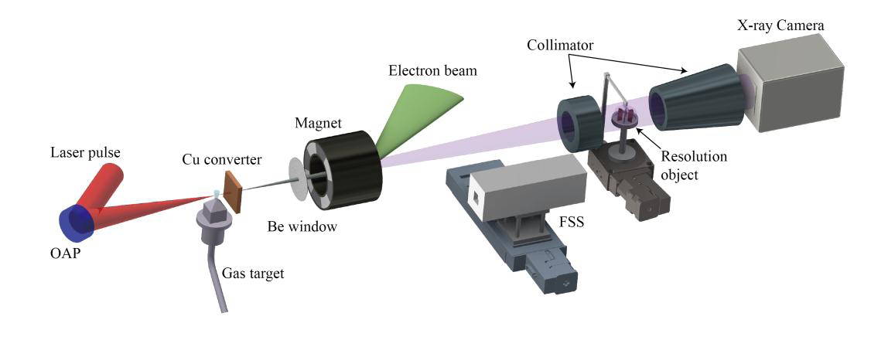
Status- optimizing X-ray source
Attempts to achieve sub-mm focal size :
Micro Target
Novel e- accelerator
Collimation
Japan, eXTRACT ^{[1]}：
100μm X-ray target:
100μm resolution
Low dose rate:
0.1 Gy/min
China, Tsinghua Uni^{[2]}：
Compact laser plasma accelerator, ~40μm beam size
100 μm resolution
low dose rate: 10 Rad/min
China, Chongqing Uni^{[3]}：
Specially designed bicylinder collimator
100 μm resolution
low dose rate
[1]Katsutoshi Sato, et al. Precision Engineering 2018 (54): 276-283
[2]Y.C.Wu et al, Scientific Reports. 2018(8) :15888
[3] Patent: CN103945633B

Slide 8
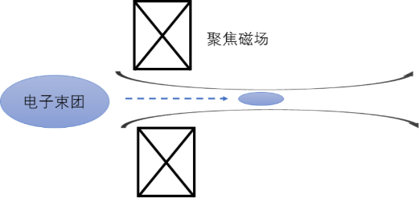
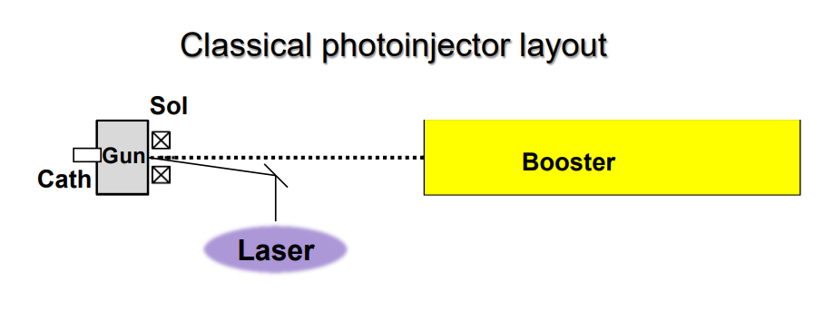
High-brightness photo-injector method
On-target electron beam size is crucial for X-ray focal size
Ultra-small electron beam need high quality electron beams!
Focusing
element
Requirements：
Small emittance
Small energy spread
Tight focusing
High –brightness electron source
E-beam
High-brightness photo-injector is state-of-the-art high-brightness electron source, should be suitable for high-resolution X-ray CT
Excellent beam quality
High peak/average beam current
Energy tunable

Slide 9
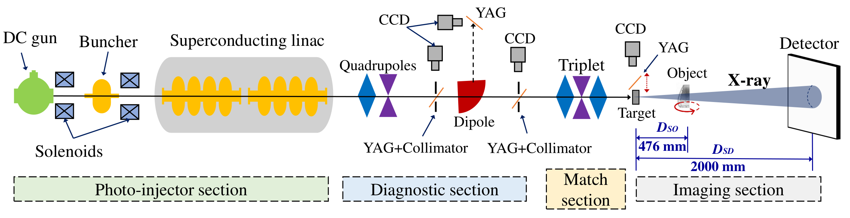
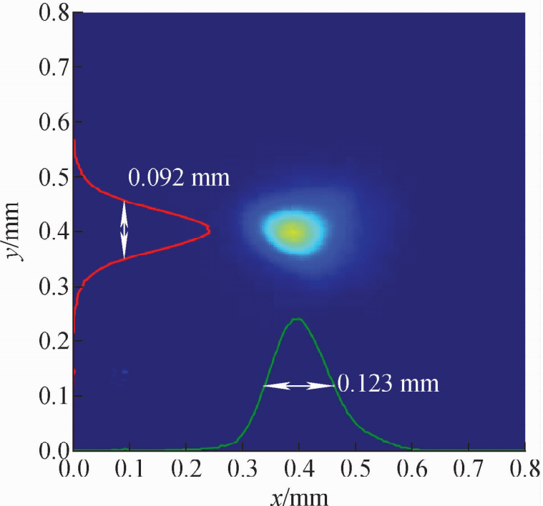
Proof-of-principle experiments
POP high energy X-ray CT on CAEP THz FEL photoinjector beamline
Beam parameters and obtained 100μm beam size:
Beam profile on target
Beam energy: 4-9 MeV
Beam average current: 1.5 mA
Normalized emittance : < 10 mm.mrad
Bunch length: 10 ps
Energy spread: 0.1%
High Power Laser and Particle Beams, 2020, 32: 000000

Slide 10
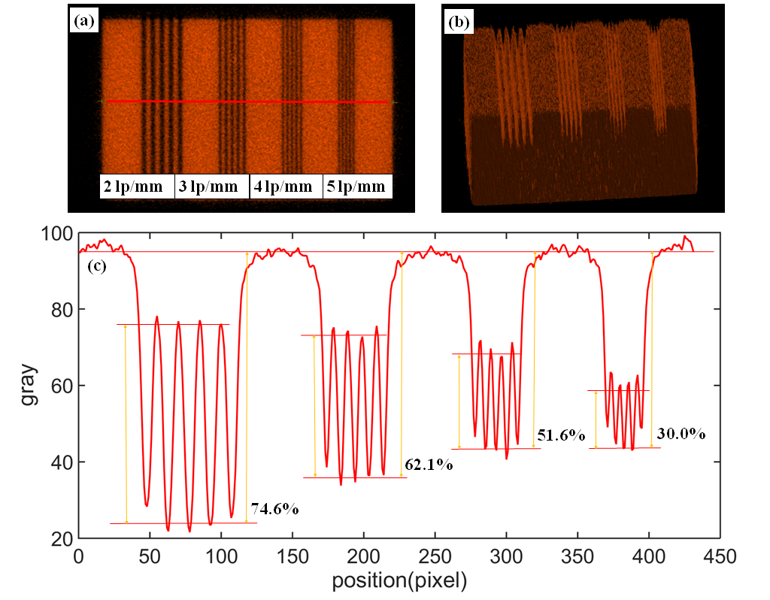
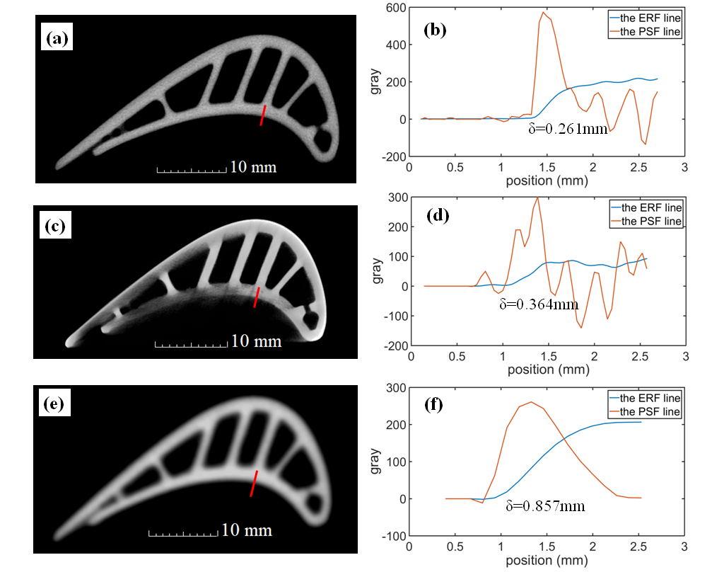
Proof-of-principle experiments
Imaging results using line-pair:
Comparison of turbine blade using different CT
This CT
450 kV MF CT
Low energy,
cannot penetrate
9 MeV CT
Not clear,
low resolution
Benefits:
Penetration: deep
Resolution: < 100 μm
Dose rate: 3000 Rad/min
Hu D, Zhou Z, Wang J, et al. J Xray Sci Technol. 2022;30(1):1-12.

Slide 11
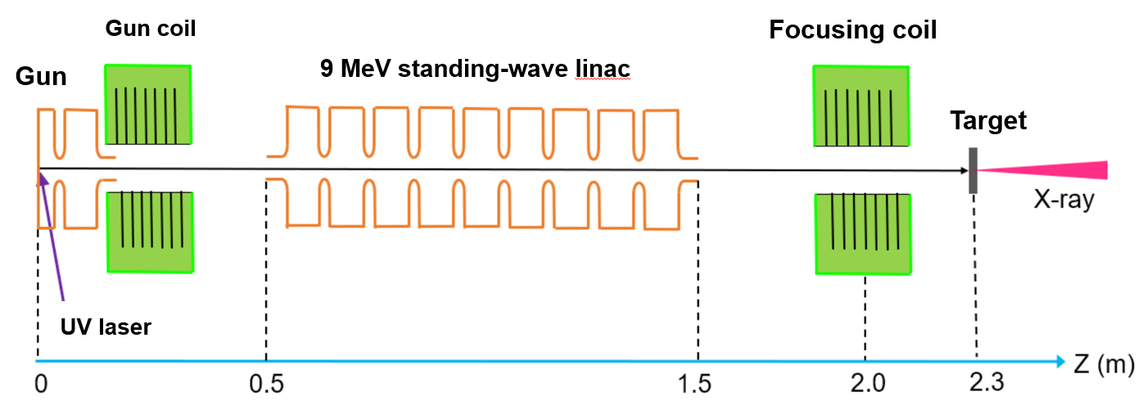
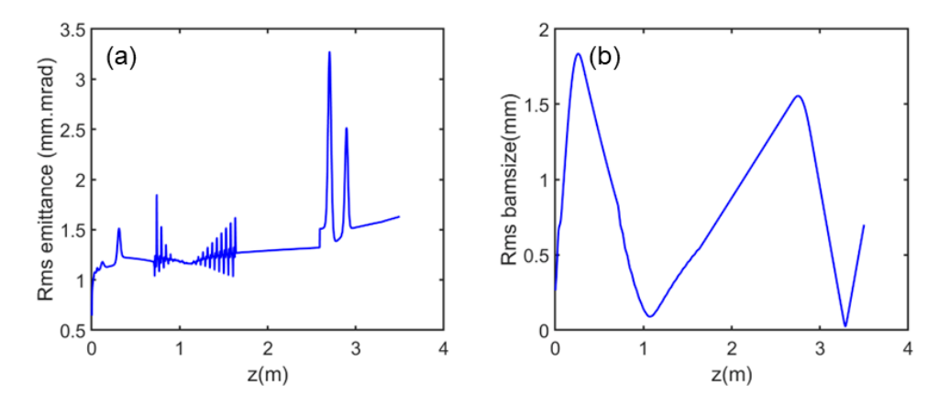
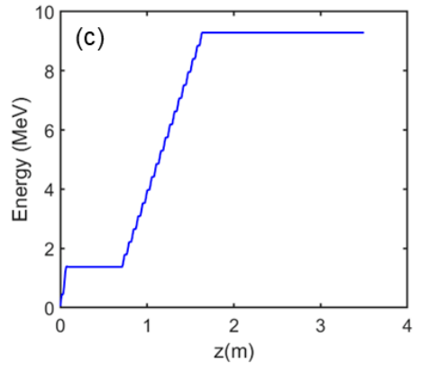
Upgraded apparatus
Based on high-brightness photoinjector roadmap, an upgraded apparatus using normal-conducting S-band linac is built:
Compact
High duty factor to ~1%
Dose rate up to 1500 Rad/min
Small beam size to < 50 μm
Beam simulations:

Slide 12
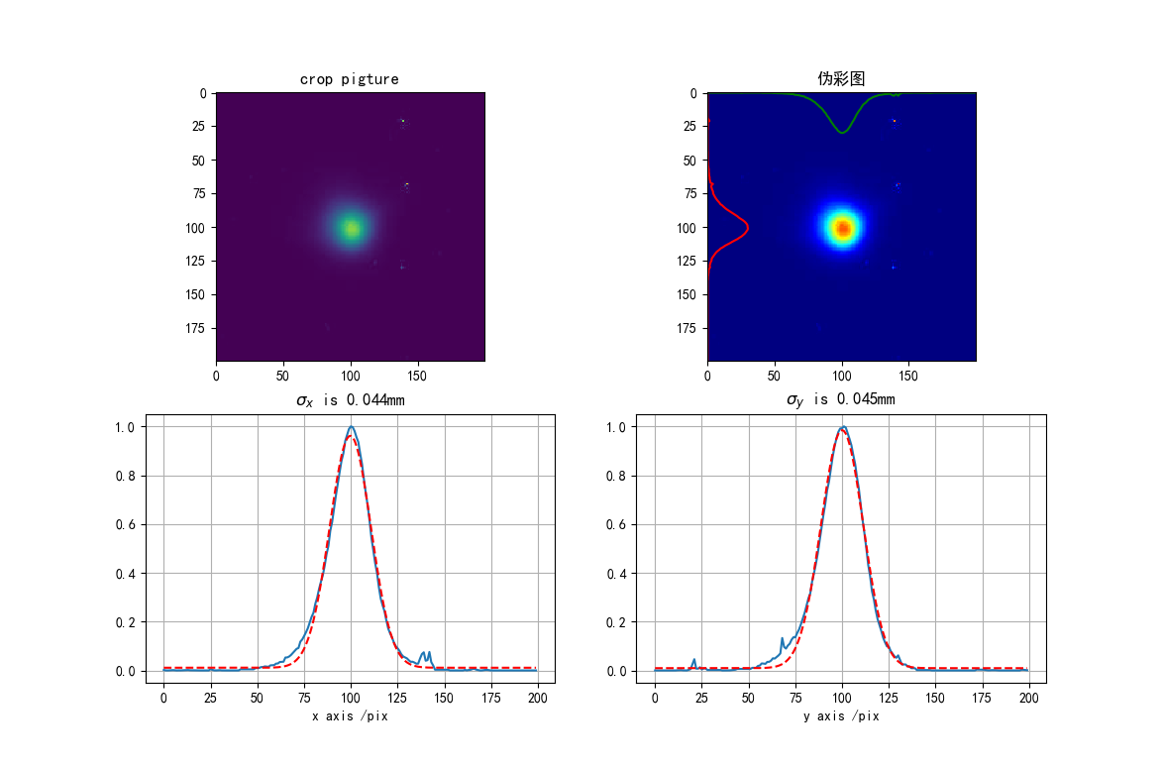
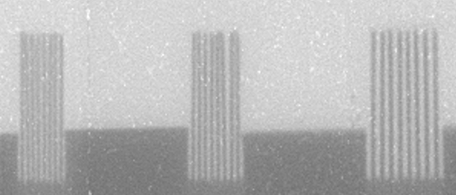
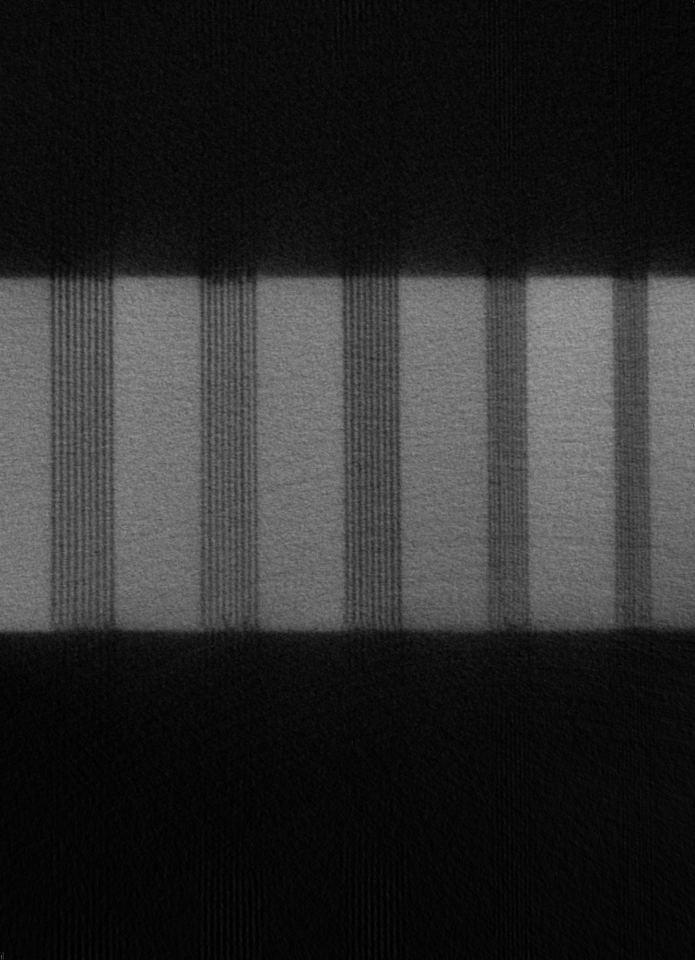
Upgraded apparatus: testing results
Ultra-small beam size measurement:
Line-pair imaging :
DR image
50 μm
60 μm
75 μm
10 Lp/mm
CT image
5 Lp/mm
σ：44/45 μm
50 μm
60 μm
75 μm
85 μm
100 μm
Liu Qinghua, Li Jing, Shan Lijun, et al. High Power Laser and Particle Beams, 2022, 34: 124001.
Best ever resolution of high-energy X-ray CT !

Slide 13
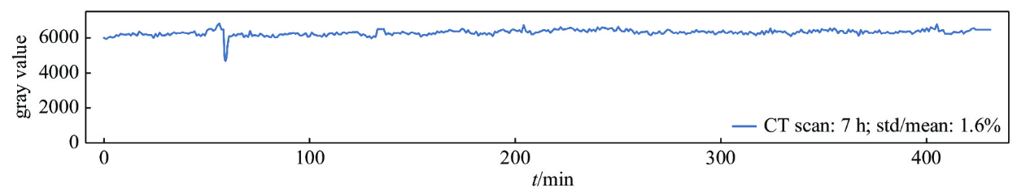
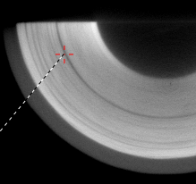
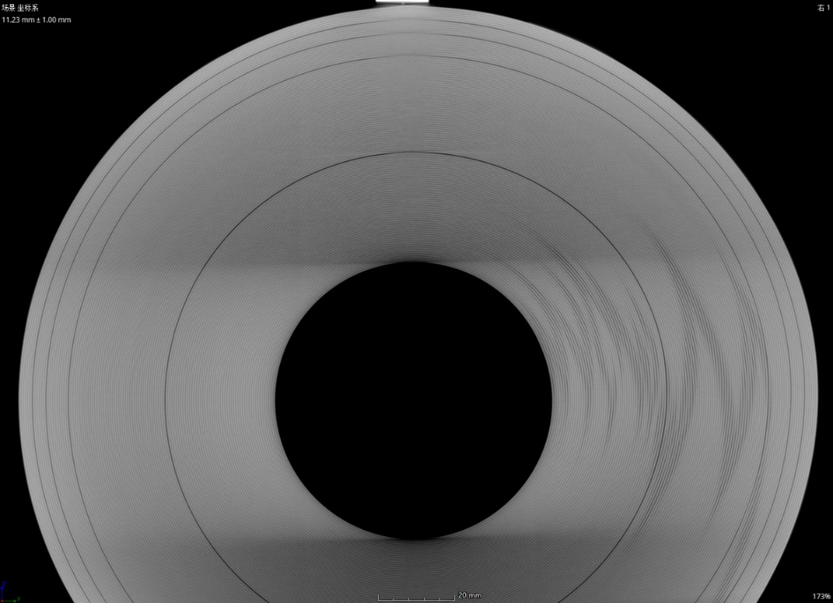
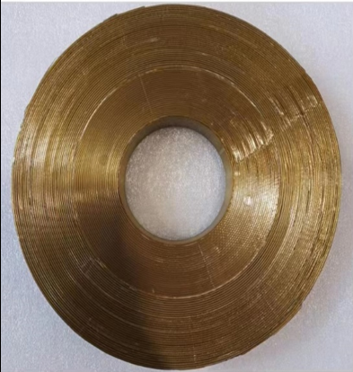
Upgraded apparatus: testing results
Long-term dose-rate stability test
Typical application: overwhelming superiority over the conventional CT
superconducting coil in Tokamak
Conventional 9 MeV CT
Our high-resolution CT
See defects
Distinguish defects
wire diameter: 0.7mm
Gap error in coil winding

Slide 14
Conclusion
High-brightness photo-injector based high-resolution high-energy X-ray CT is feasible;
We have built a normal-conducting 9 MeV photo-injector driven high-resolution X-ray CT and unprecedented resolution of 50 μm has been readily obtained.

Slide 15
Thank you for listening！

