Slide 1
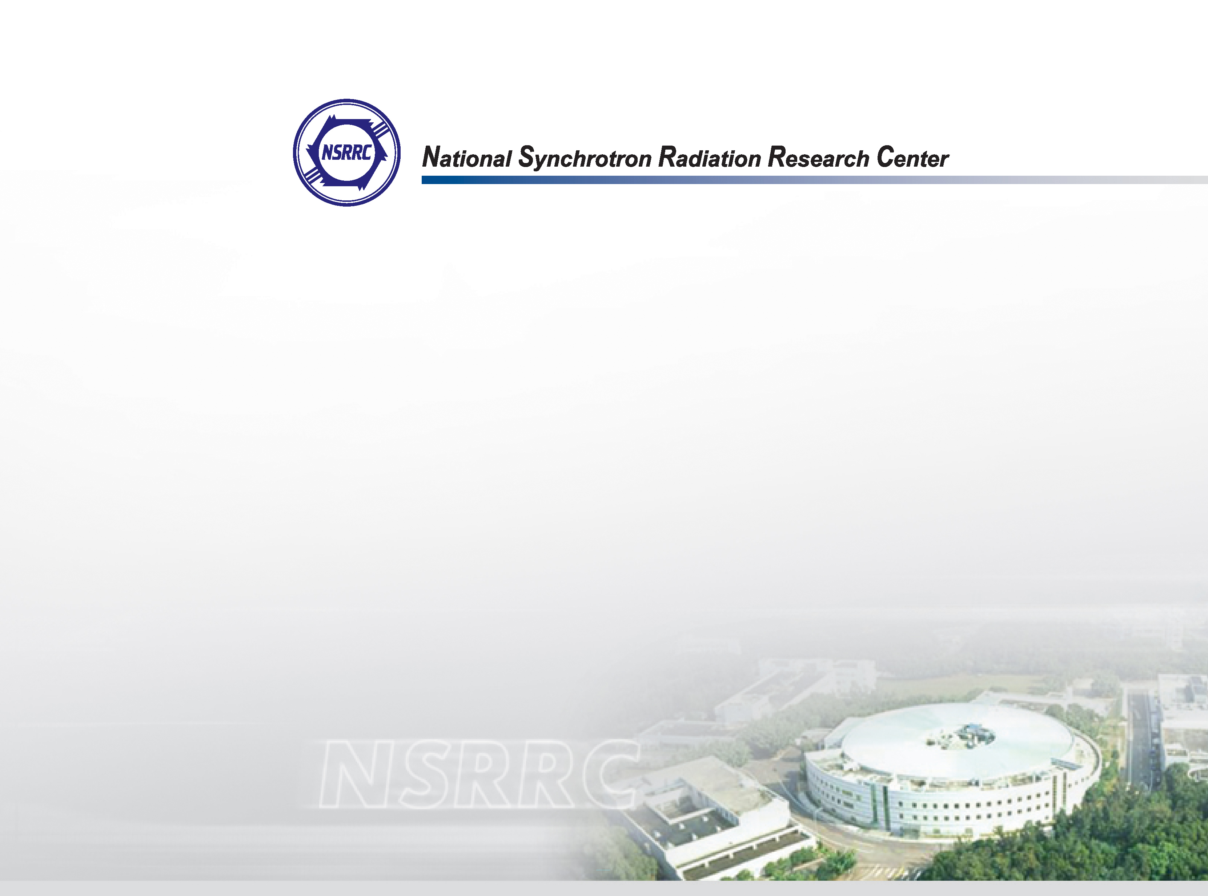
Operation status and future plans of the SRF module at NSRRC
Asian Forum for Accelerators and Detectors 2023
Melbourne, Australia, April 12-14 2023
National Synchrotron Radiation Research Center
RF Group
Zong-Kai Liu
2023/04/12

Slide 2
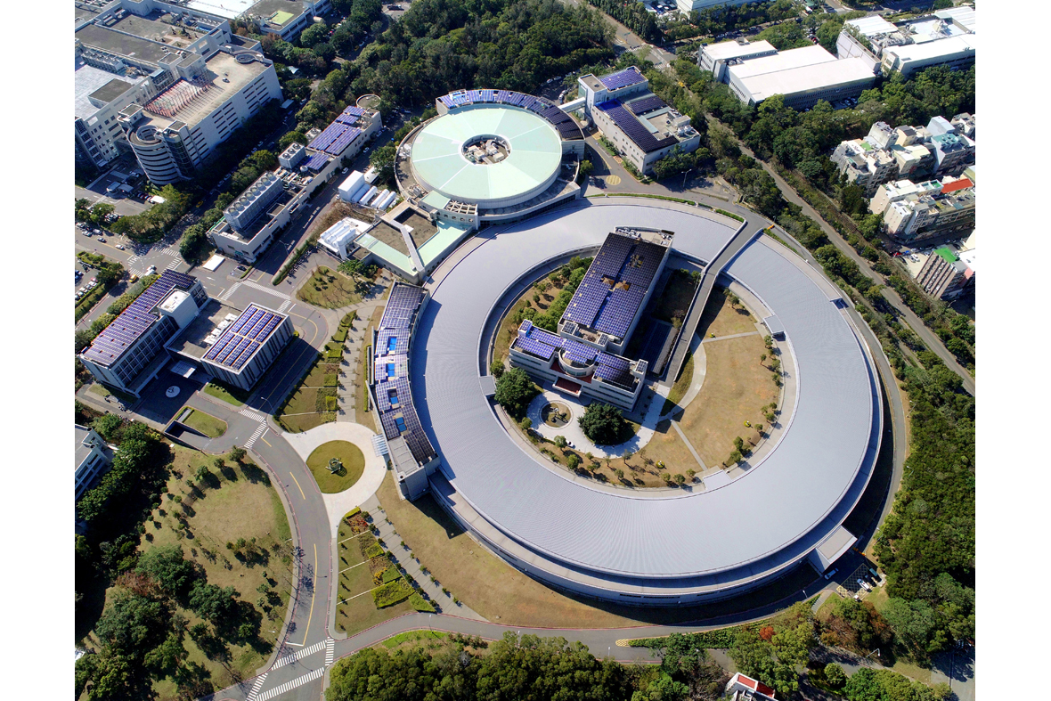
Two Light Sources in NSRRC
TLS Storage Ring
(1.5 GeV)
25 beam lines
Office & Lab
Administration Building
TPS Storage Ring
(3.0 GeV)
Phase I + Phase II: 16 beam lines
Phase III: 9 beam lines (~2026)

Slide 3
Machine Parameters
Main parameters | TLS | TPS
Circumference [m] | 120 | 518.4
Beam energy E [GeV] | 1.5 | 3.0
LINAC [MeV] | 50 | 150
Beam current [mA] | 360 | 500
Natural emittance ε_{x} [nm-rad] | 22 | 1.6
RF frequency [MHz] | 499.654 | 499.654
Harmonic number | 200 | 864
Momentum compaction | 6.78 x 10⁻³ | 2.4 x 10⁻⁴
Energy spread σ_{E}/E | 7.56 x 10⁻⁴ | 8.86 x 10⁻⁴
Energy loss/turn (dipole) [keV] | 128 | 852.7
RF voltage [MV] | 1.3 | 3.0 (1.5x2)
RF Plant | CESR-type SRF module | KEKB-type SRF module
Straight sections [m] | 6m X6 | 12m X6 & 7m X18

Slide 4
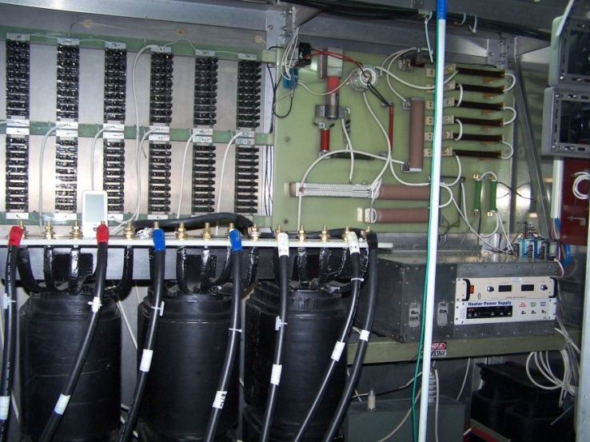
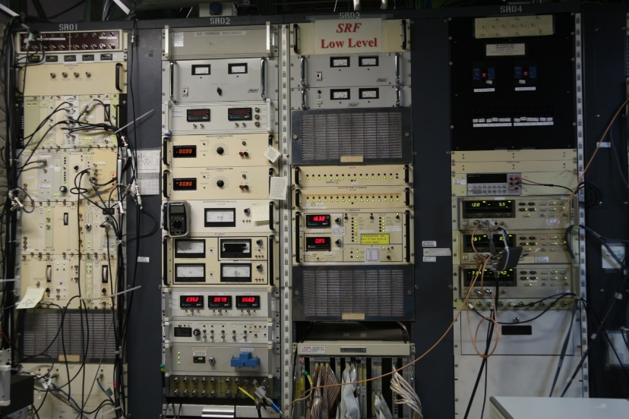
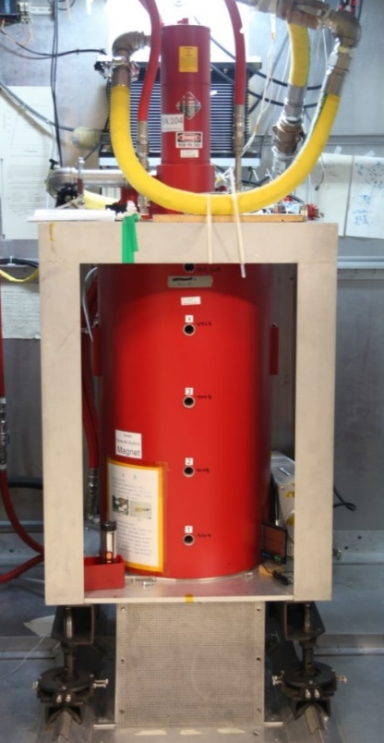
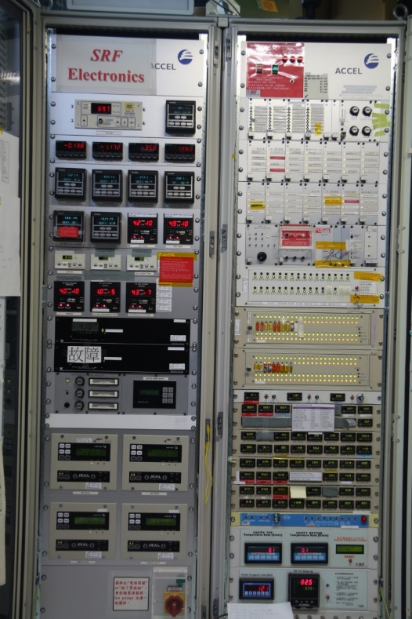
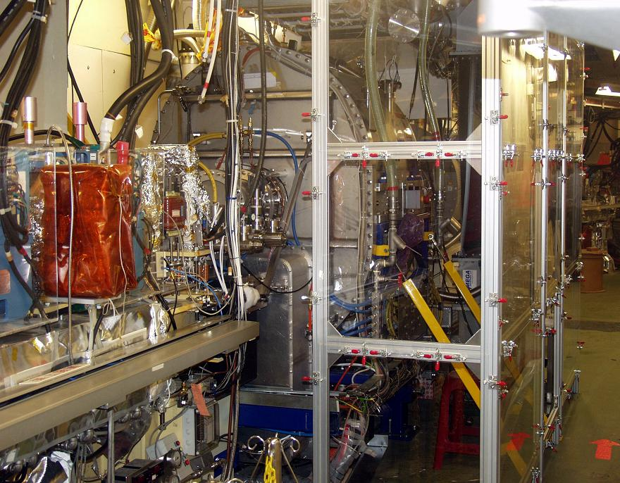
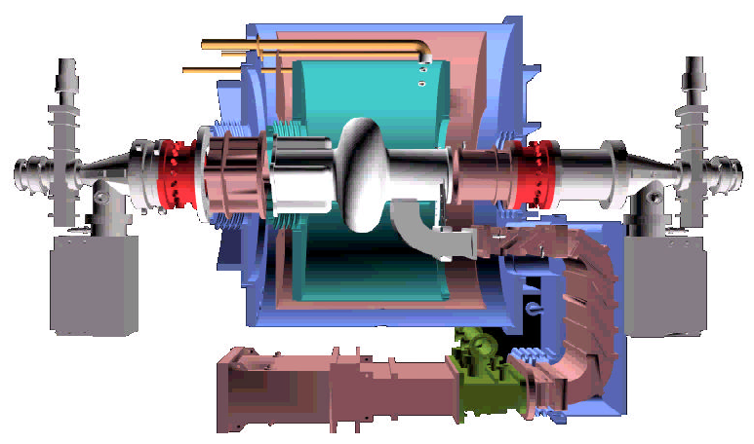
TLS RF System (Storage Ring)
CESR type SRF Module
100 kW klystron transmitter
Analog LLRF

Slide 5
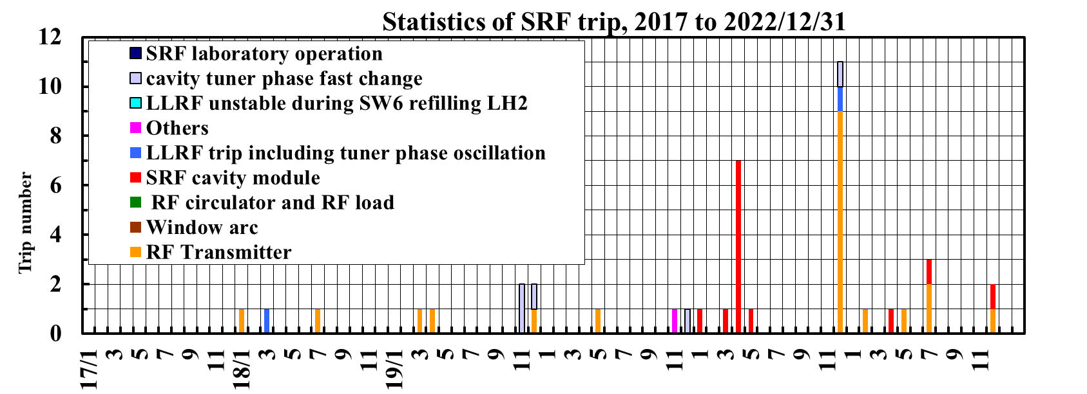
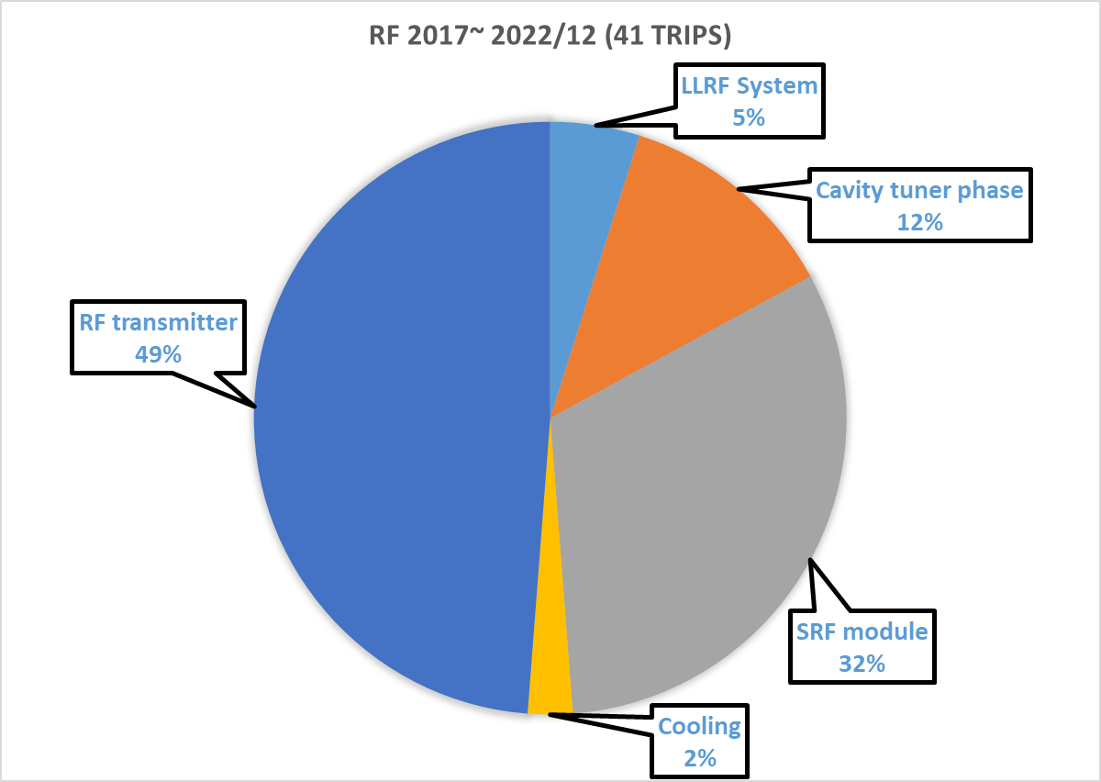
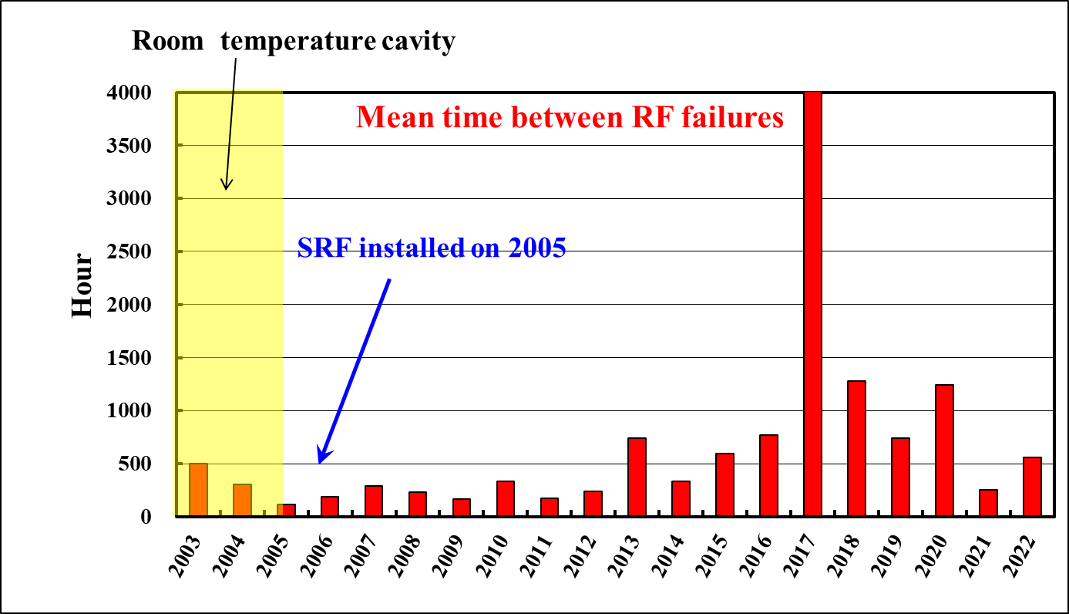
Operation Status of TLS SRF System

Slide 6
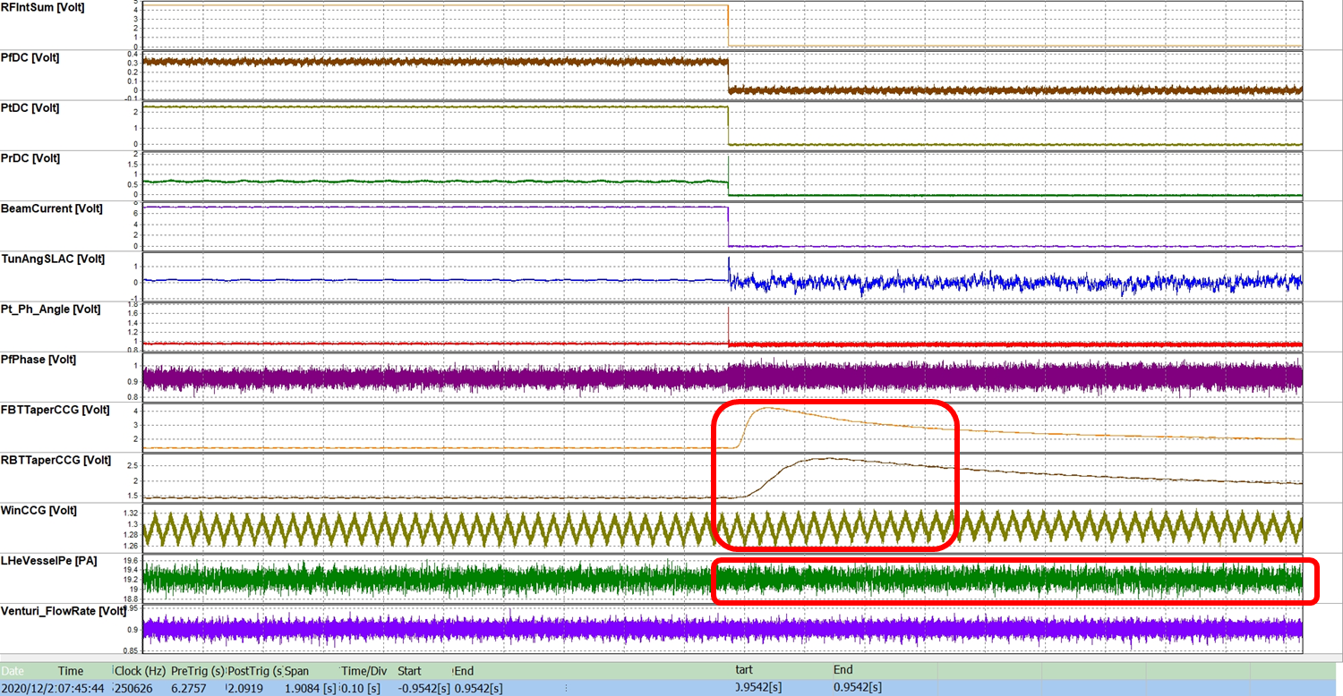
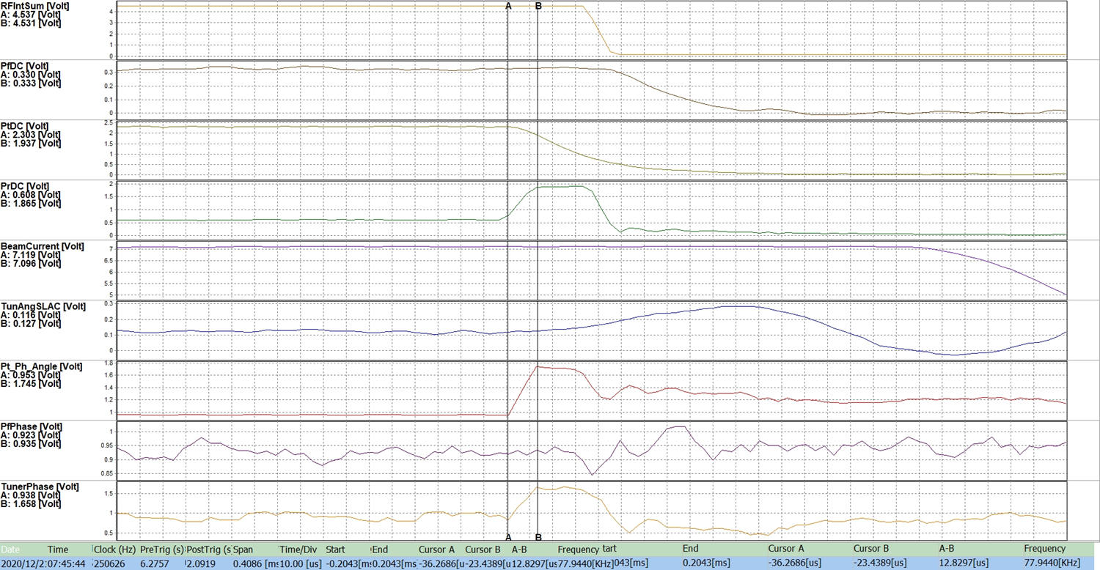
Operation Status of TLS SRF System
Recent major SRF trip events－unknown quench：
  Vacuum activity in RBT/FBT，but there is no vacuum event in the window.
  LHe pressure does not change.
  Pt falls rapidly、Pt/Tuner phase changes rapidly、Pr rises rapidly within ~ 12 us.
It may be the arc/MP/other activity in the cavity, which may be related to the heavy gas loading.
Vacuum
Pt
Pr
Partial warm up (to 60 K) and run with lower RF voltage (from 1.6 MV to 1.3 MV).
Pt/Pf phase

Slide 7
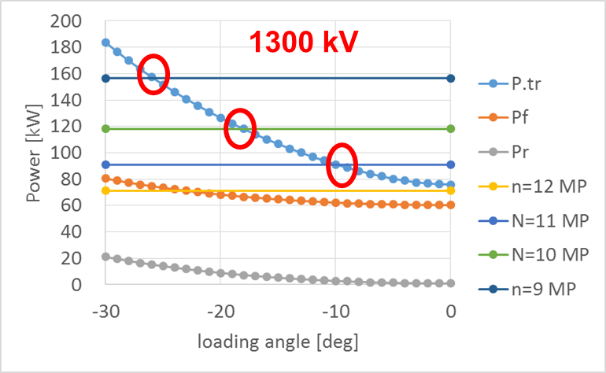
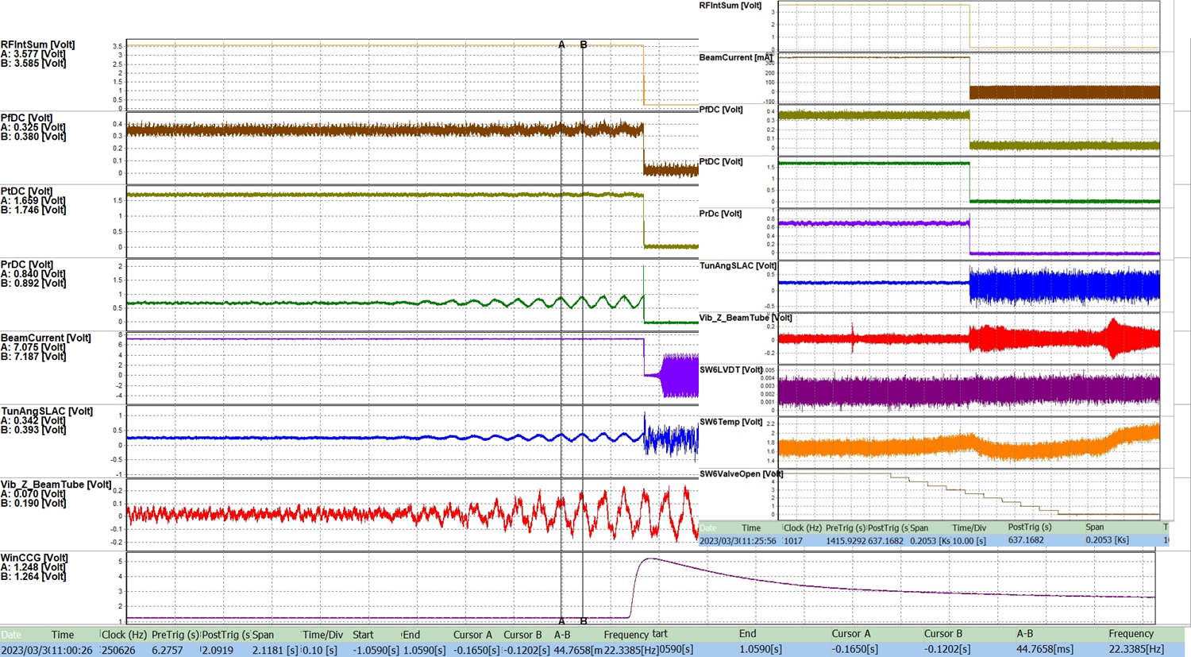
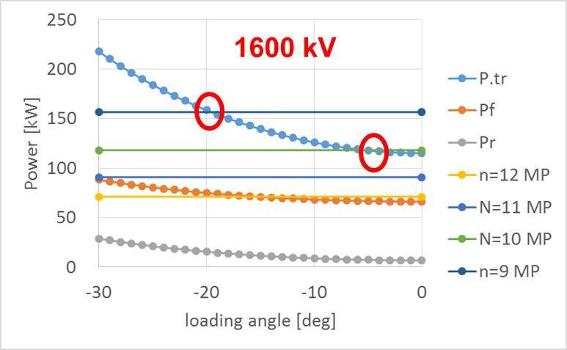
Operation Status of TLS SRF System
Recent major SRF trip events－Vacuum burst with tuning angle change：
  During the LHe refilling of a SC wiggler (SW) at the down stream of SRF module.
  There is always a 22 Hz beam tube vibration in Z direction, and resulting in a oscillation of tuning angle.
  Occurred frequently during 2011~2013 with 1.6 MV operation (solved by optimizing the LHe filling process of SW and applying beam processing/aging).
  Repeated several times in 2022~2023 with 1.3 MV operation, no vacuum activity during aging/processing. (the original filling process is changed to reduce heat load of SW)
Tuning angle
Beam Tube Vibration
Window CCG

Slide 8
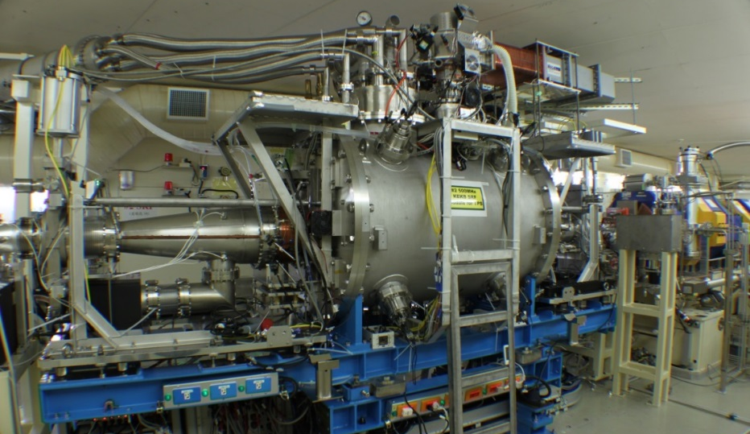
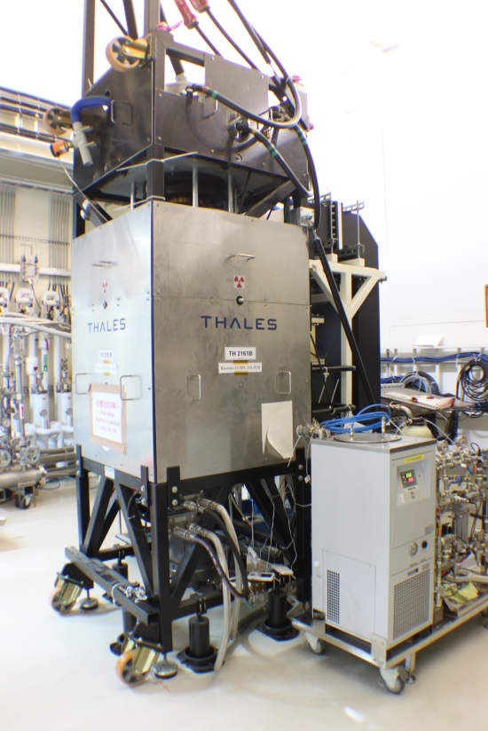
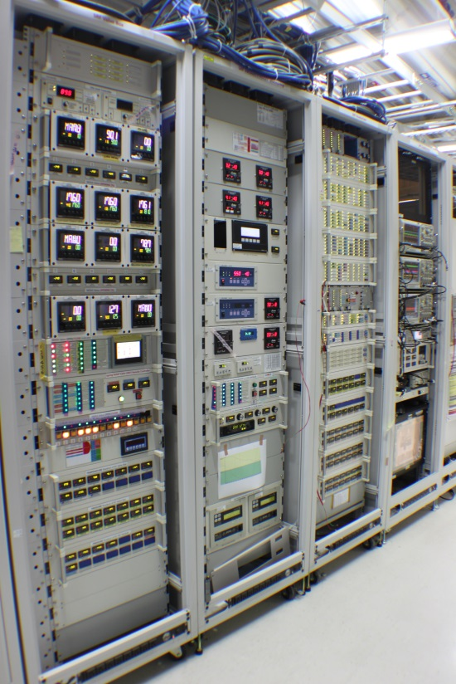
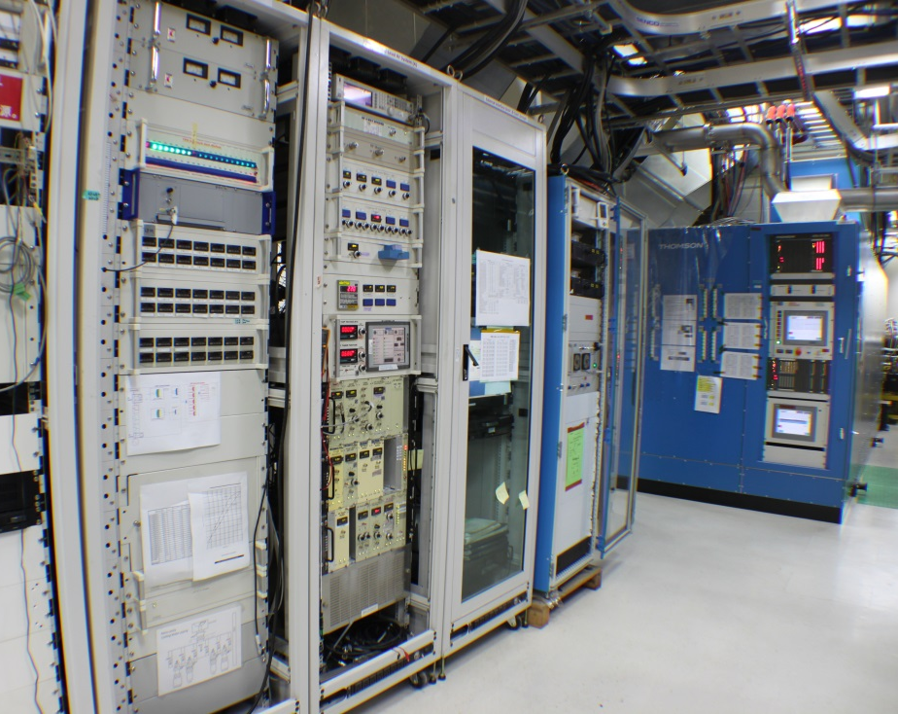
TPS RF System
Two RF plant in operation
KEKB type SRF module
300 kW klystron transmitter for 1 station
Analog LLRF
300 kW klystron
SRF electronics
KEKB type SRF module
300 kW transmitter & LLRF

Slide 9
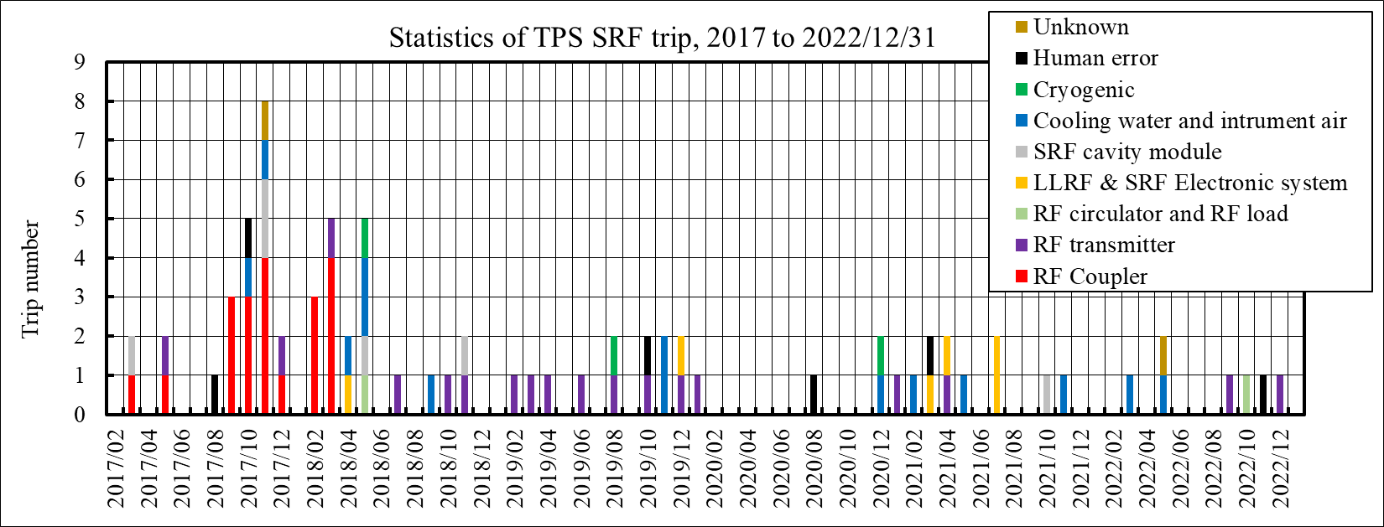
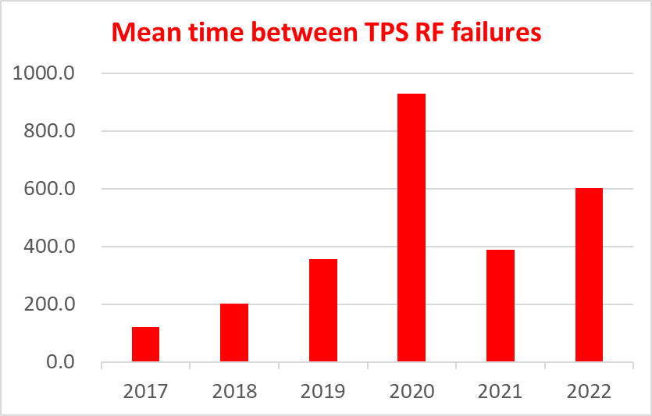
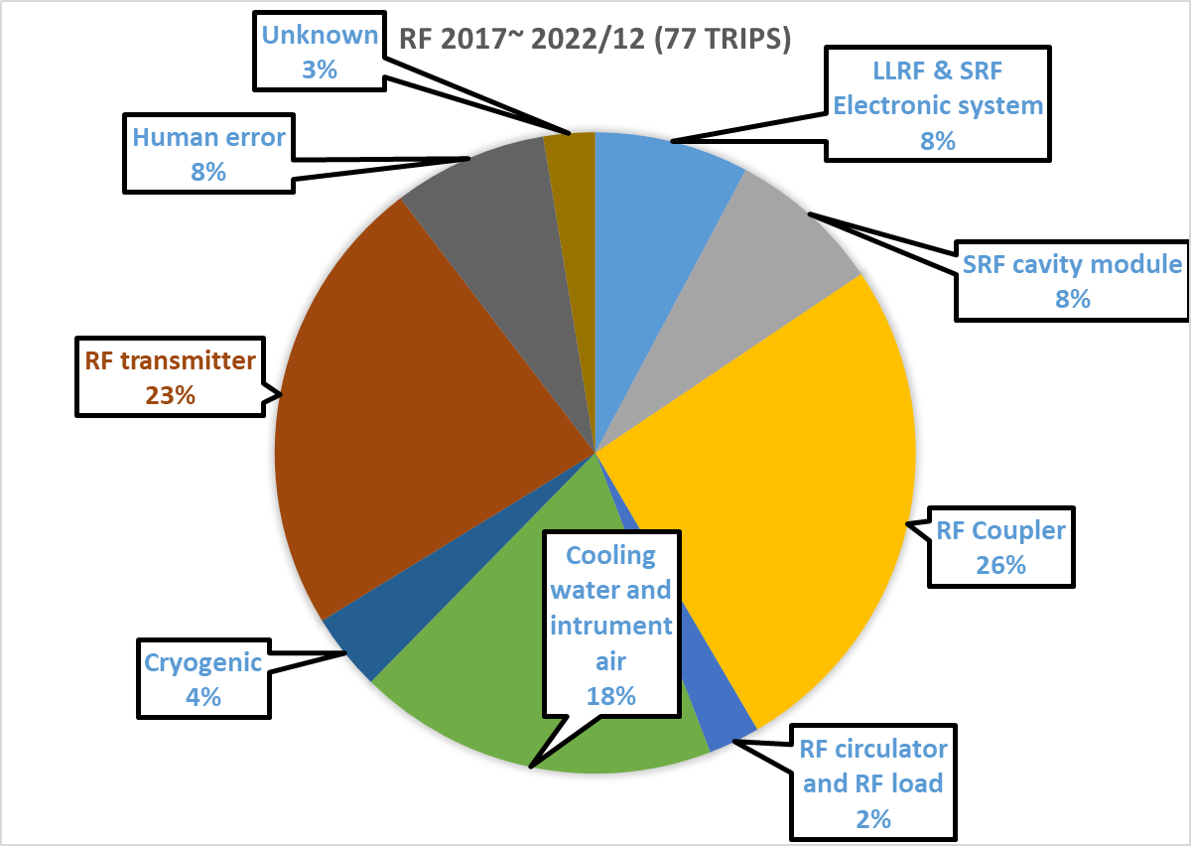
Operation Status of TPS SRF System

Slide 10
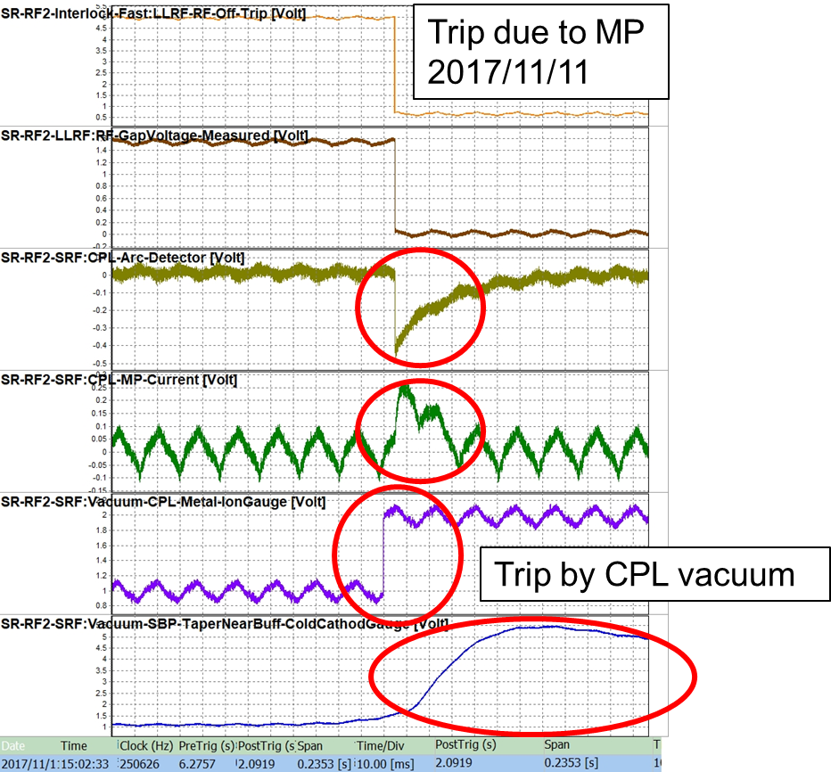
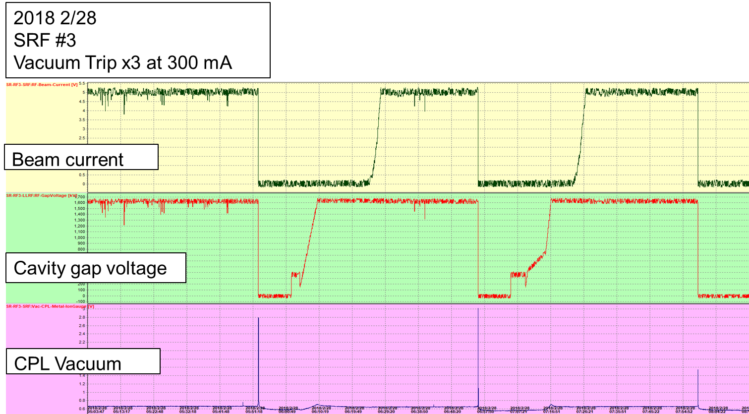
Operation Status of TPS SRF System
Trip during early stage of operation：
  Due to Multipacting (MP) in the coupler
  It may continuously cause trip
  Apply bias voltage (+1000 ~ +1200) to avoid MP

Slide 11
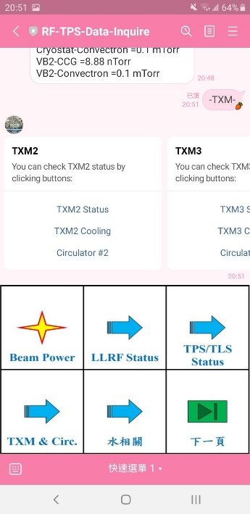
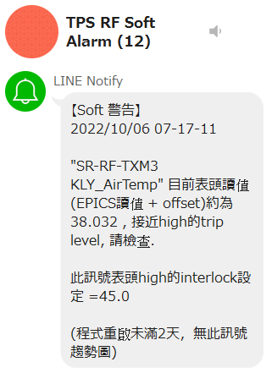
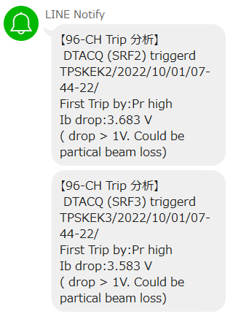
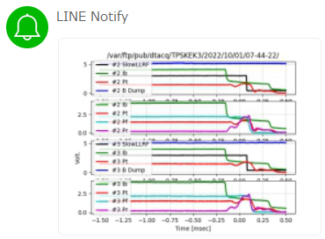
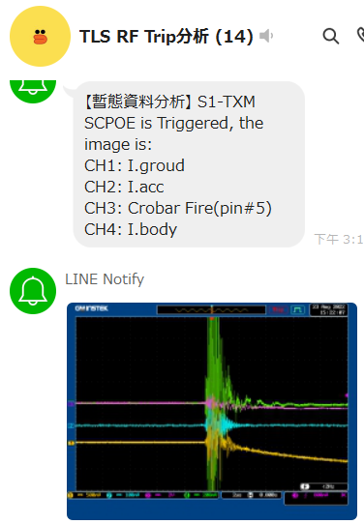

LINE-based RF Soft alarm System
Soft alarm system is developed to shorten the downtime and diagnosis time、as well as to improve the reliability (avoid trip due to slow changed signals).
All messages and figures are sent to user’s smart phone and PC via LINE (an instant messaging app.)
Real time signal inquiry (check message machine status)
LINE Message
API
RF soft alarm
Accelerator operation alarm
SRF trip indicator
RF Trip analysis
Oscilloscope display
LINE
Notify
Display on cell phone/PC

Slide 12
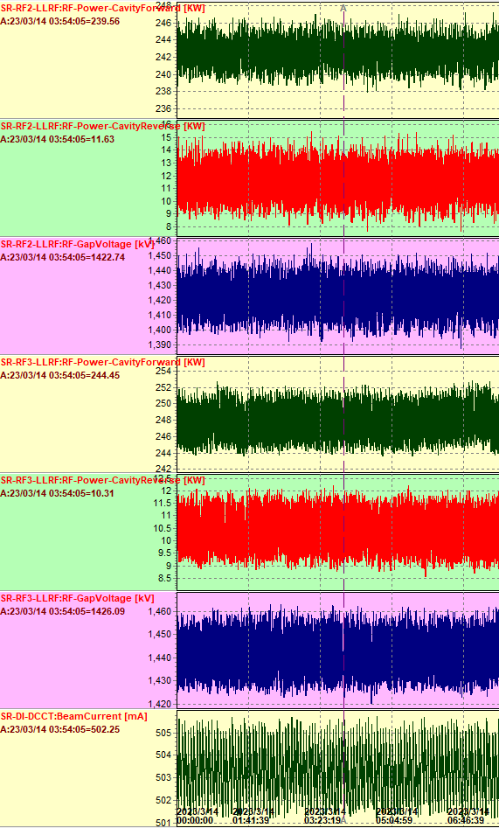
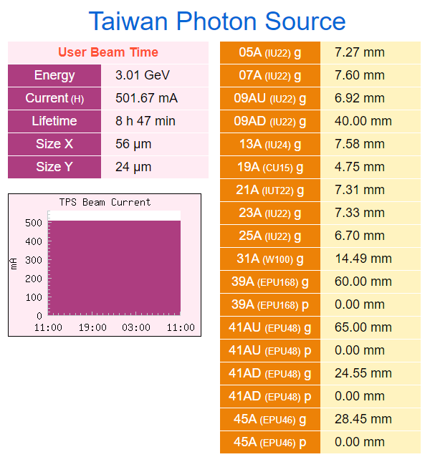
Future Plan (1)－Power Combine
Stored current reached 500 mA at the end of 2020.
Several insertion devices will be installed into the storage ring.
RF power of 2 stations with 300 kW klystron may reach the limit in 3 years.
Pf#2 243 kW
Pr#2 12 kW
500 mA | Total Pb | 2 x RF
w/o ID | 427 kW | 213 kW
Phase I | 476 kW | 238 kW
Phase I+II | 526 kW | 263 kW
Phase I+II+III | 576 kW | 288 kW
Vc#2 1.42 MV
Pf#3 245 kW
Beam power only and with all ID gap close to the minimum.
Pr#3 10 kW
One solution is: Combination of an 80-kW SSPA to a 300-kW klystron in TPS.
Vc#3 1.42 MV
Ib 500 mA

Slide 13
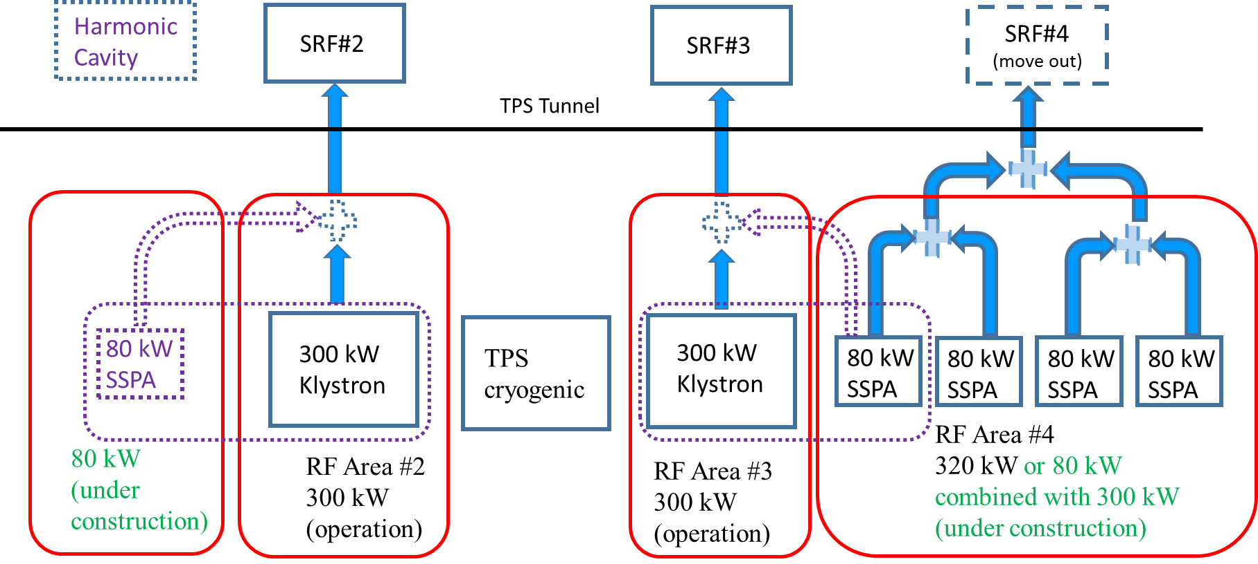
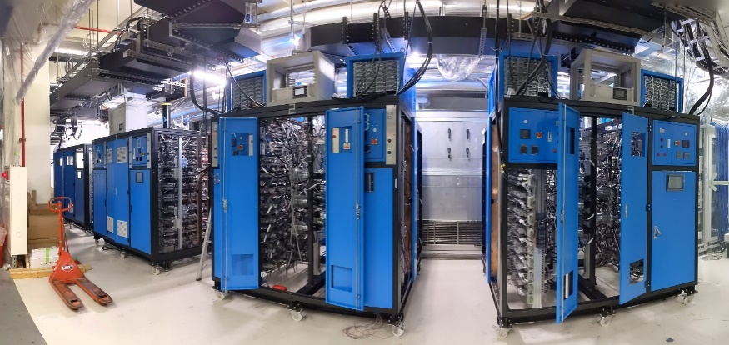
Future Plan (1)－Power Combine
Combine method was tested in the RF Lab.

Slide 14
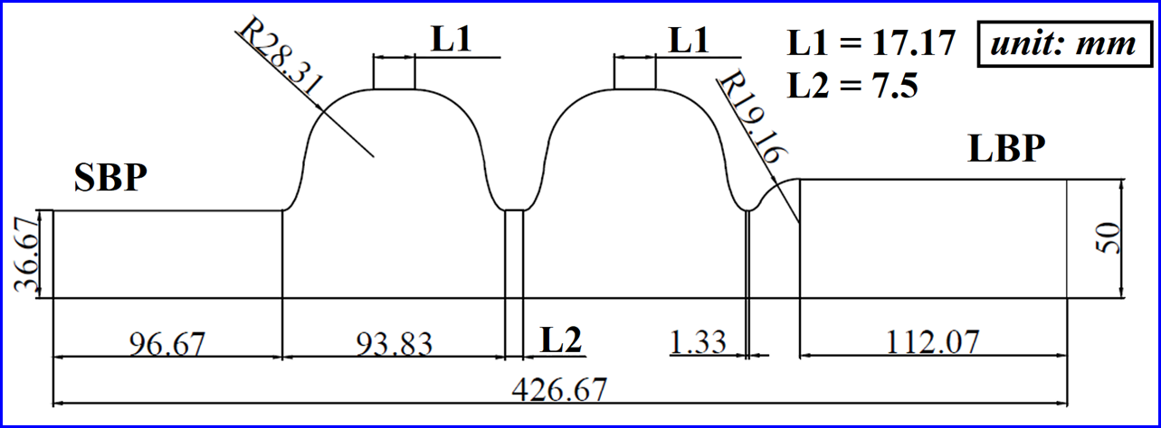
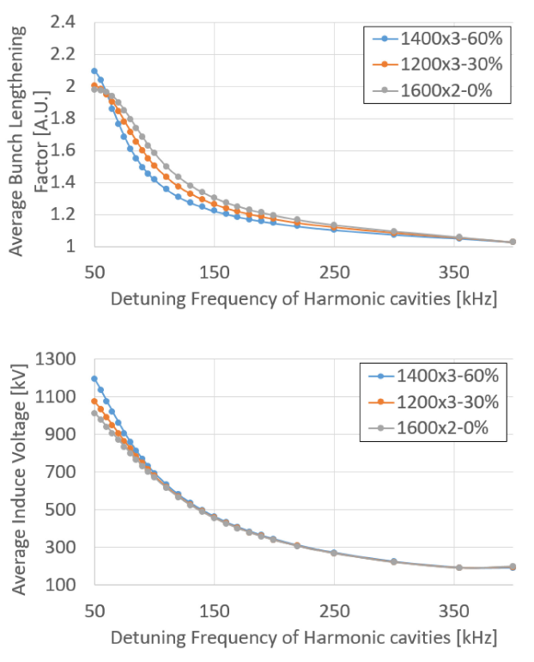
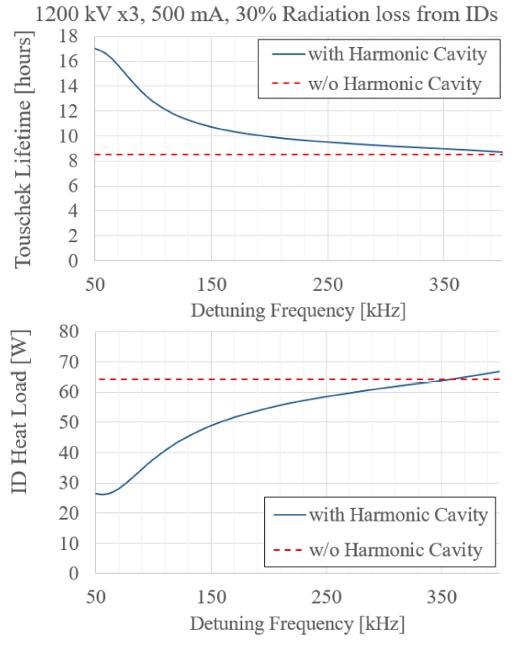
Future Plan (2)－SC Harmonic Cavity
Bunch lengthening by the passive 3rd harmonic cavities: to reduce the beam-induced heat on magnet arrays of IDs and to improve the beam lifetime.
1.5 GHz, Two-cell SRF cavity designed by NSRRC. (2016-2018)
Niobium cavity contracted to MHI MS, Japan. (2020-2021)
EPs and annealing to be done at KEK. (2023)
Cryostat to be designed and assembled by NSRRC. (2022-2023)
HOM absorbers contracted to RI, Germany. (2022-2024)
Assembly and integration at NSRRC. (2024-2025)

Slide 15
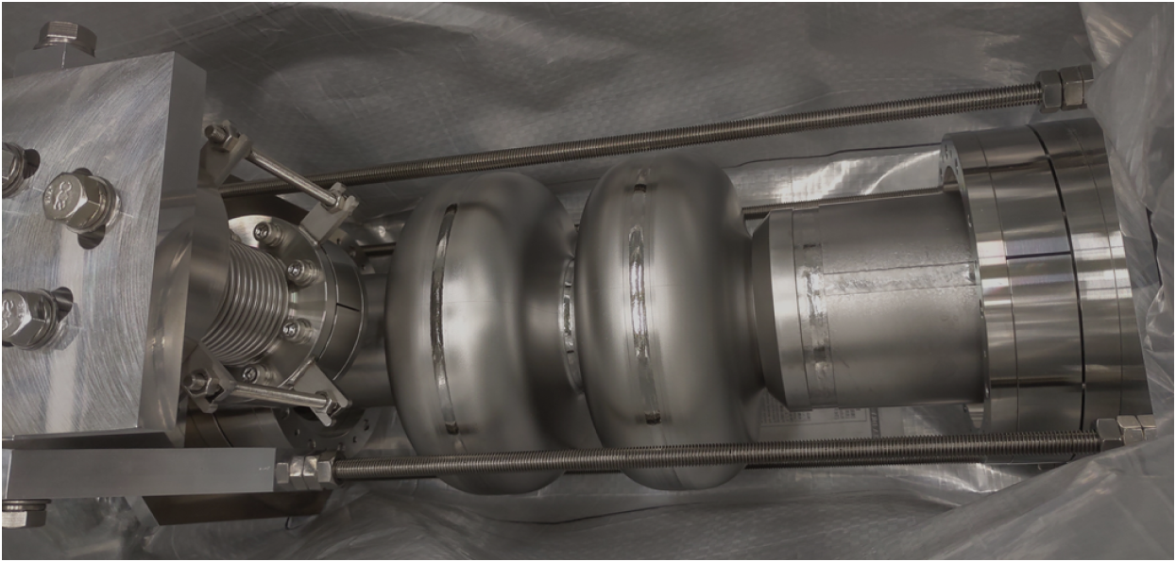
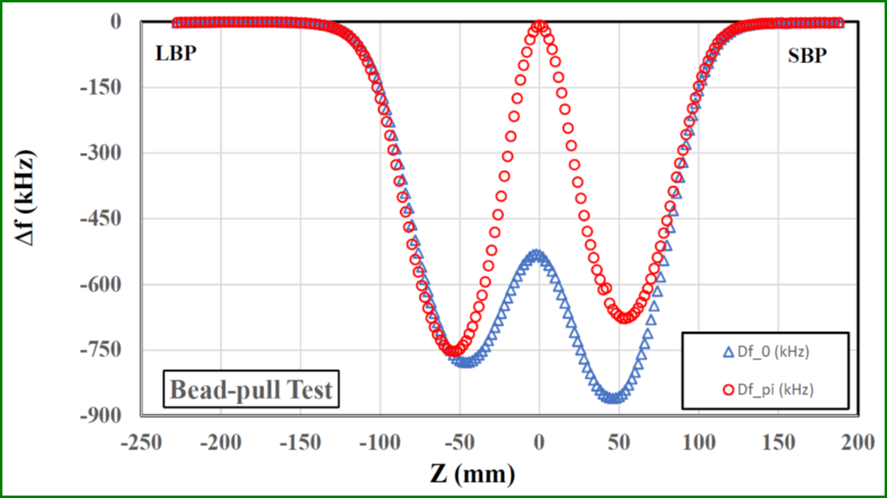
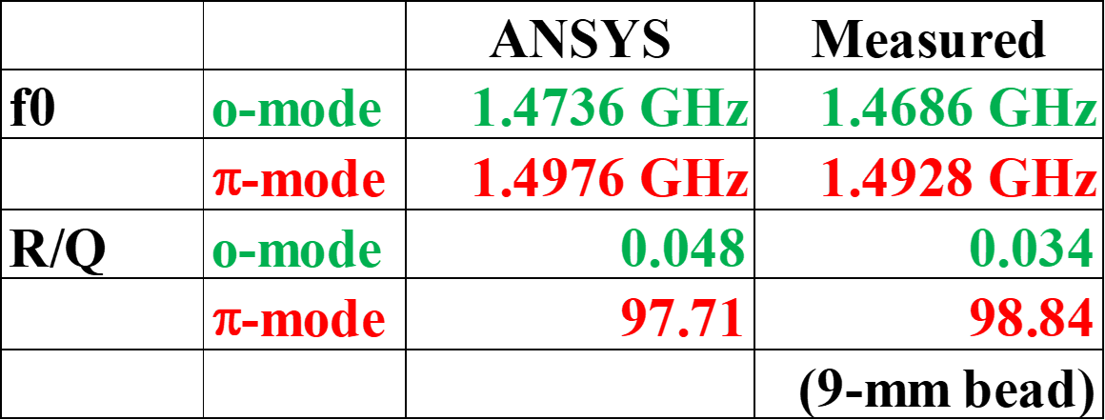
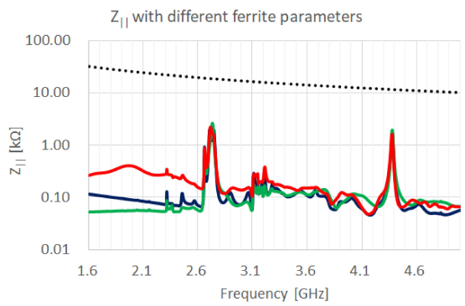
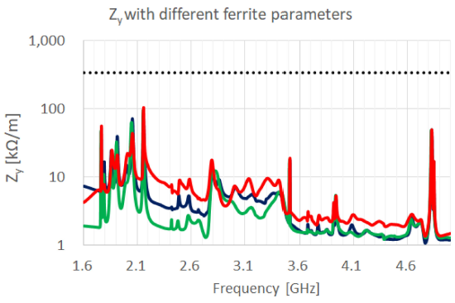
Future Plan (2)－SC Harmonic Cavity
HOM absorbers of panel type:
Courtesy of Chih-Hung Lo (lo.ch@nsrrc.org.tw)
Courtesy of Ming-Chyuan Lin (chyuan@nsrrc.org.tw)

Slide 16
Summary
Two light sources (TLS & TPS) use 500 MHz SRF modules as their accelerating cavity, MTBF of both RF systems are all > 500 hours in 2022.
Major trip types and improvements in recent years:
  CESR type for 1.5 GeV TLS
    Unknown quench events: Partial warm up and lower operating RF voltage.
  KEKB type for 3.0 GeV TPS
    Multipacting in coaxial coupler: applying positive bias voltage.
    Develop soft alarm system to shorten the downtime and improve the reliability.
Future plans for TPS SRF activity:
  Power combination for each SRF module.
  SC 3rd harmonic cavity to lengthen the electron bunch.

Slide 17
Thank you

