Slide 1
FLASH radiotherapy using high energy X-rays: Metrological challenge and solution in dose measurement
Yiwei Yang, Dai Wu, Tangzhi Dai, Zhen Liu
Institute of Applied Electronics, China Academy of Engineering Physics
Mianyang Central Hospital
West China Hospital of Sichuan University
AFAD2023

Slide 2
Outline
Introduction: X-FLASH and PARTER
Metrological challenge in FLASH&PARTER
Dose monitor for X-FLASH
Dosimeter for X-FLASH
Preclinical experiments
Conclusion

Slide 3
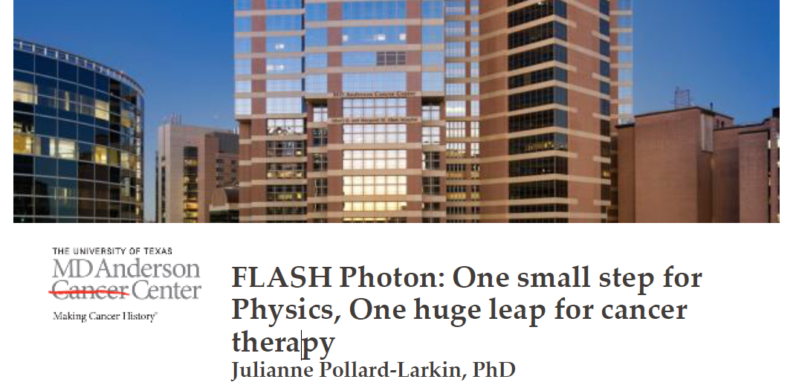
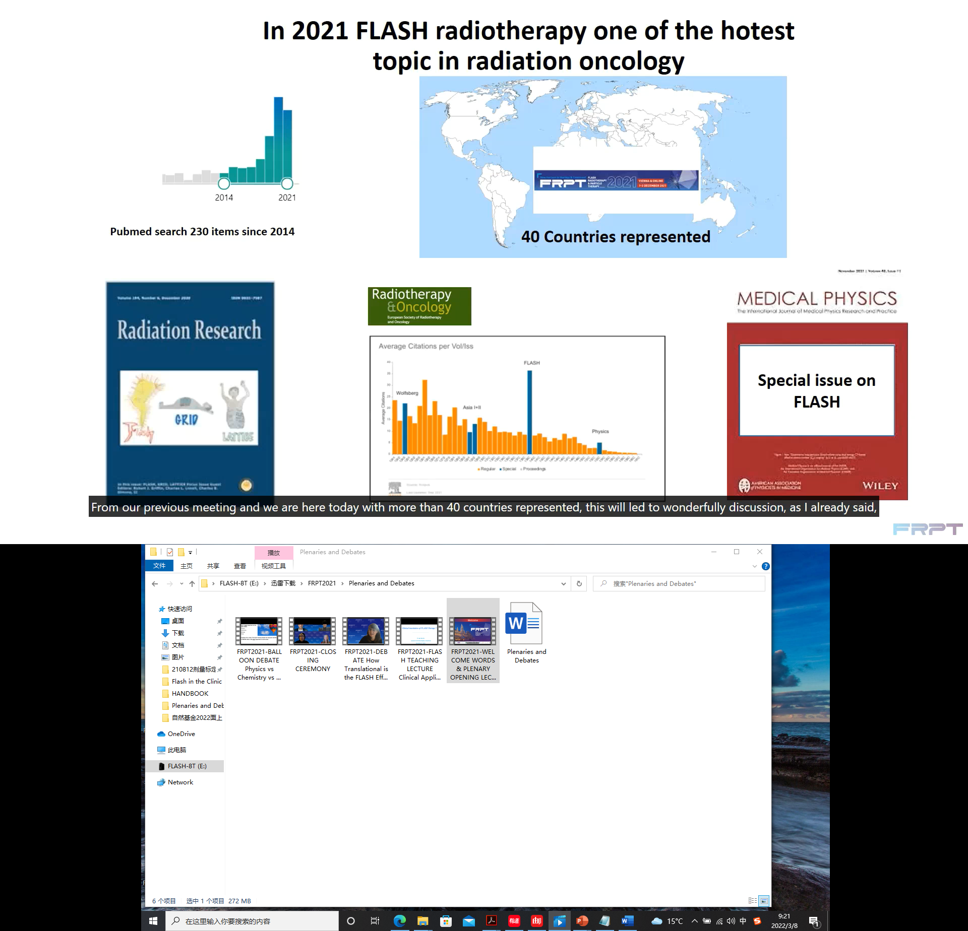
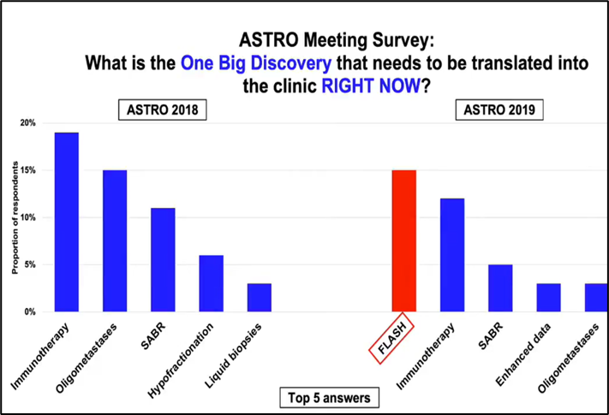
Introduction: FLASH-RT
FLASH radiotherapy: ultrahigh dose-rate radiation (>40 Gy/s) enables tumor control to be maintained while reducing toxicity to surrounding non-malignant tissues.
Hottest spot in radiotherapy research.
2014
FLASH first reported
V. Favaudon
2019
First patient treatment
Switzerland
2021
first clinical trial
Varian FAST-01
2023
FAST-02 clinical trial
FLASH speed up

Slide 4
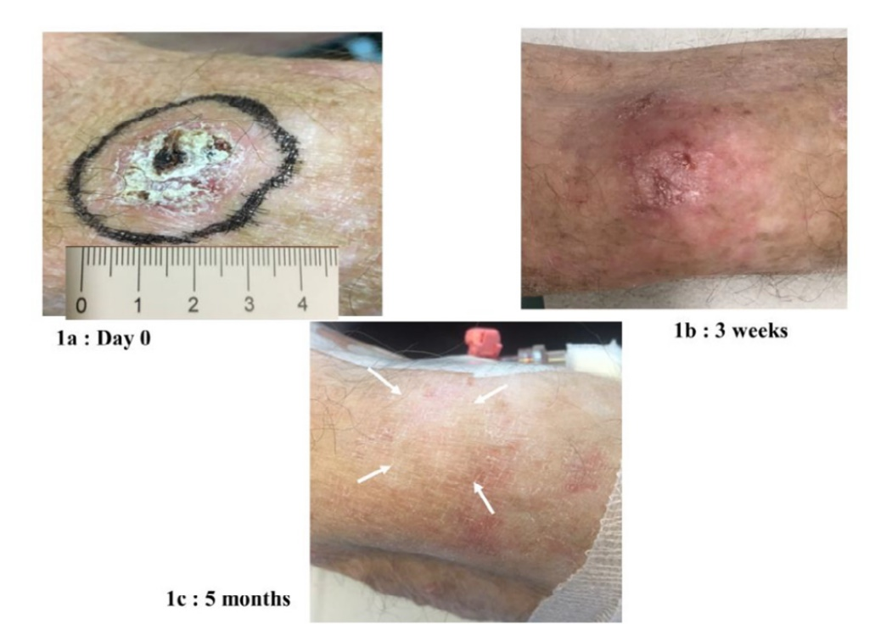
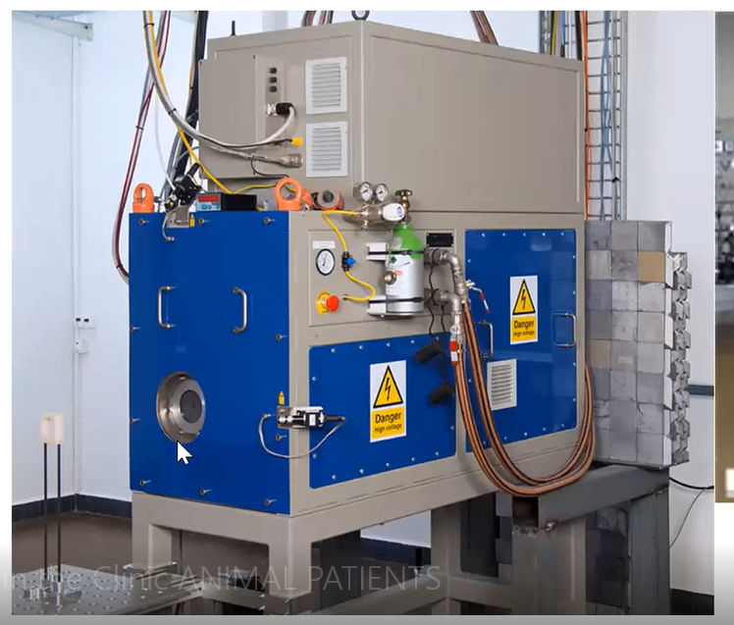
FLASH radiation: electron
Electron:
Currently main FLASH radiation
High dose deposition efficiency
Easy to achieve FLASH condition
Shallow penetration depth and big scattering
Rarely in clinical practice
Institut-curie: Kinetron 4.5 MeV
*FLASH RADIATION THERAPY: ACCELERATOR ASPECTS，IPAC2020
Oriatron eRT6—5.6MeV
J. Bourhis, W. J. Sozzi, P. G. Jorge et al., Treatment of a first patient with FLASH-radiotherapy, Radiotherapy and Oncology
VozeninMC et al. ClinCancer Res 2018

Slide 5
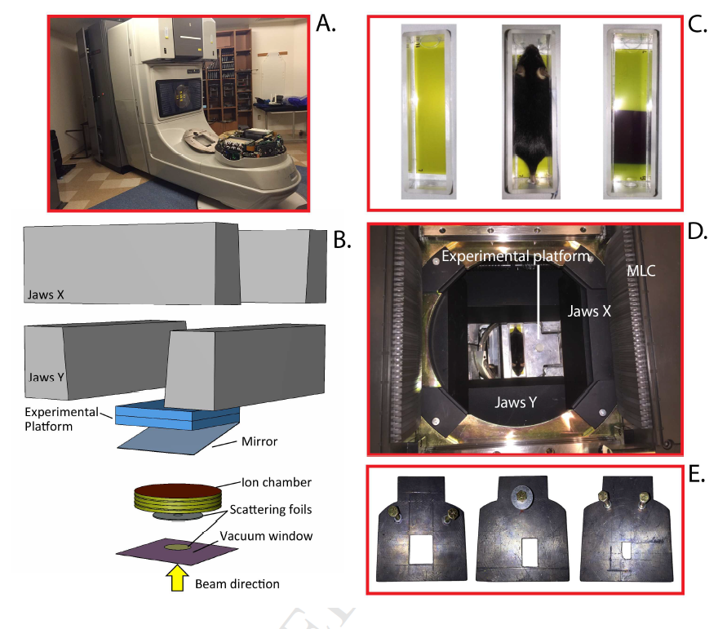
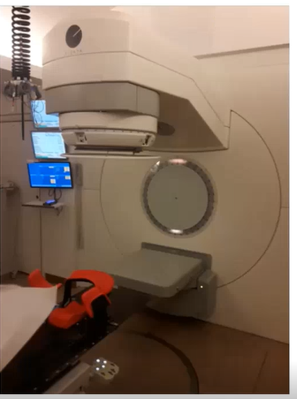
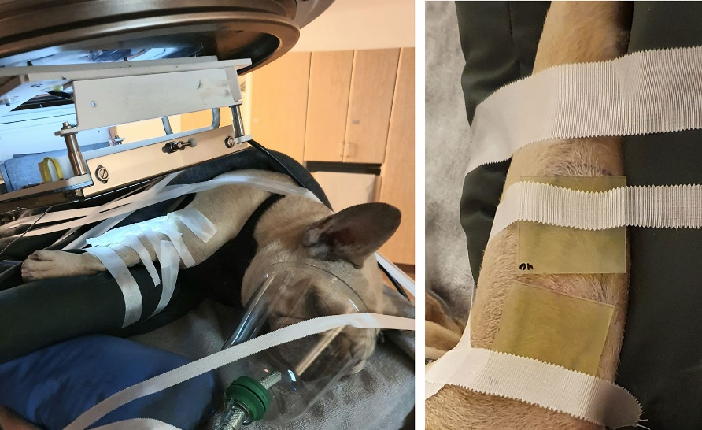
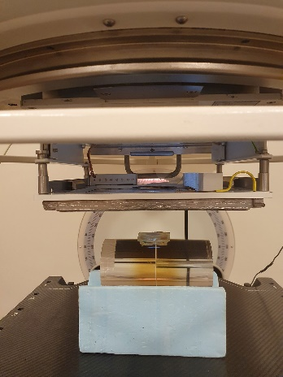
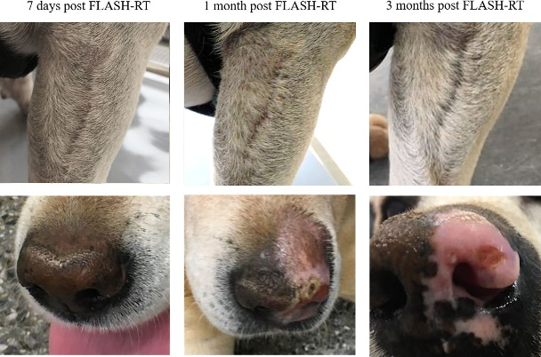
FLASH radiation: electron
Konradsson . Front Oncol. 2021
Stanford way，modify Varian LINAC：74 Gy/s (8E4 Gy/s), field size 1cm，bad uniformity。
Swidden Lund，modify Elekta LINAC，mean dose-rate 1000Gy/s（instantaneous＞1E5 Gy/s ）。
Dog FLASH treatment
E Schüler, et al. International Journal of Radiation Oncology, Biology, Physics 97.1(2016):195-203.

Slide 6
FLASH radiation: electron
VHEE: Very High Energy Electron
55-200 MeV: Deep penetration with ultrahigh dose-rate
CERN: TeraHertz (THz) test stand at the CERN Linear Electron
Accelerator for Research (CLEAR)
Pencil beam scanning so good resolution
High cost and big
No preclinical result published
Poppinga, D., et al. (2020). "VHEE beam dosimetry at CERN Linear Electron Accelerator for Research under ultra-high dose rate conditions."

Slide 7
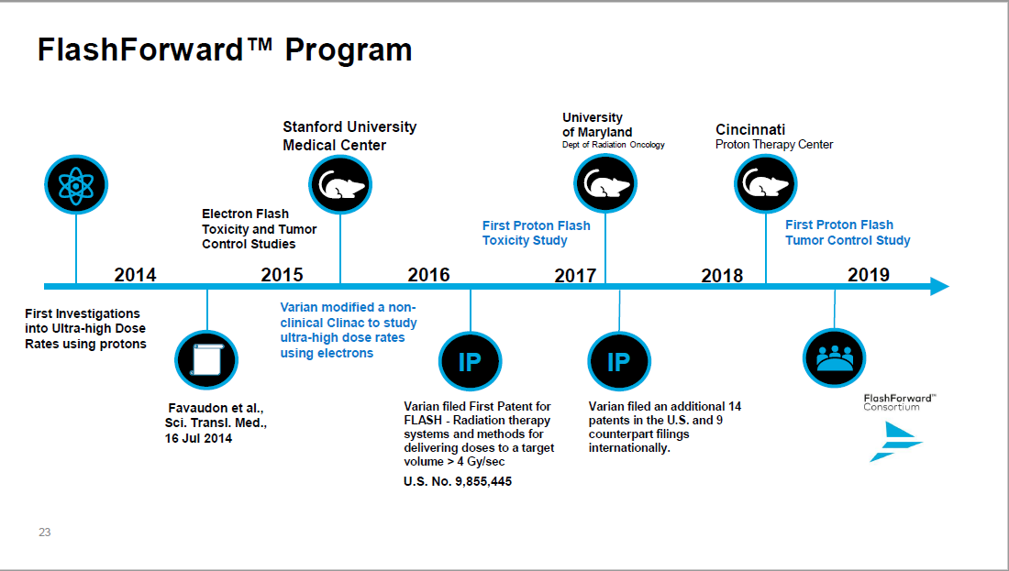
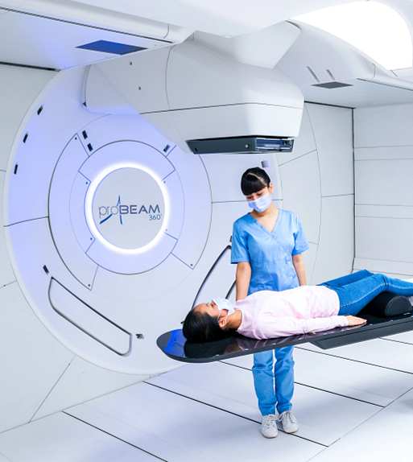
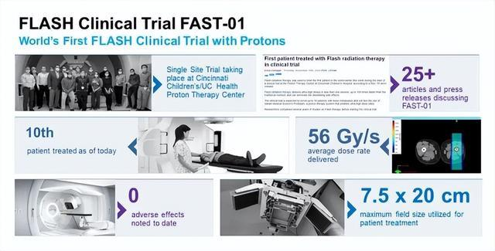
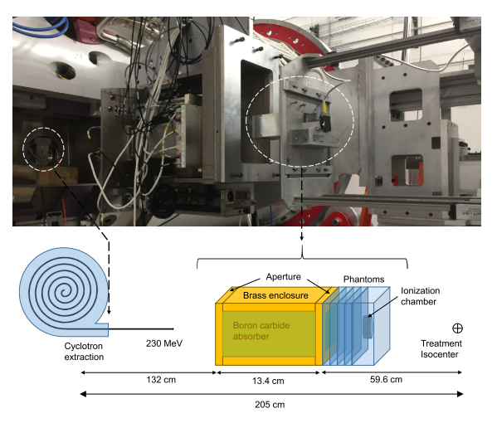
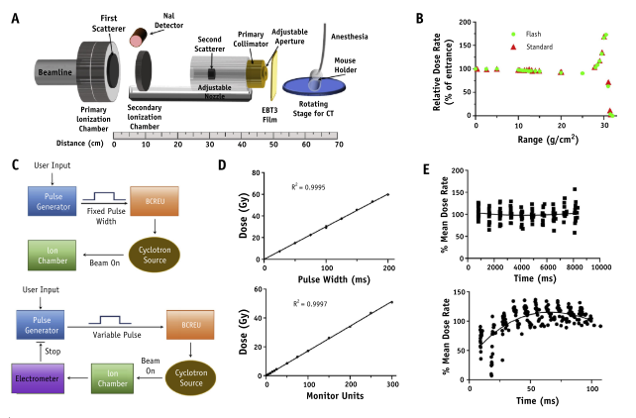
FLASH radiation: proton
FLASH proton: high energy and high cost, fastest in clinical trial
Institut-curie: proton cyclotrons
*FLASH RADIATION THERAPY: ACCELERATOR ASPECTS，IPAC2020
Mevion cyclotron,
Medical Physics, doi:10.1002/MP.14253
IBA Proteus Plus
Int J Radiation Oncol Biol Phys, Vol. 106, No. 2, pp. 440e448, 2020
Varian proBEAM360, FAST-01, FASH-02

Slide 8
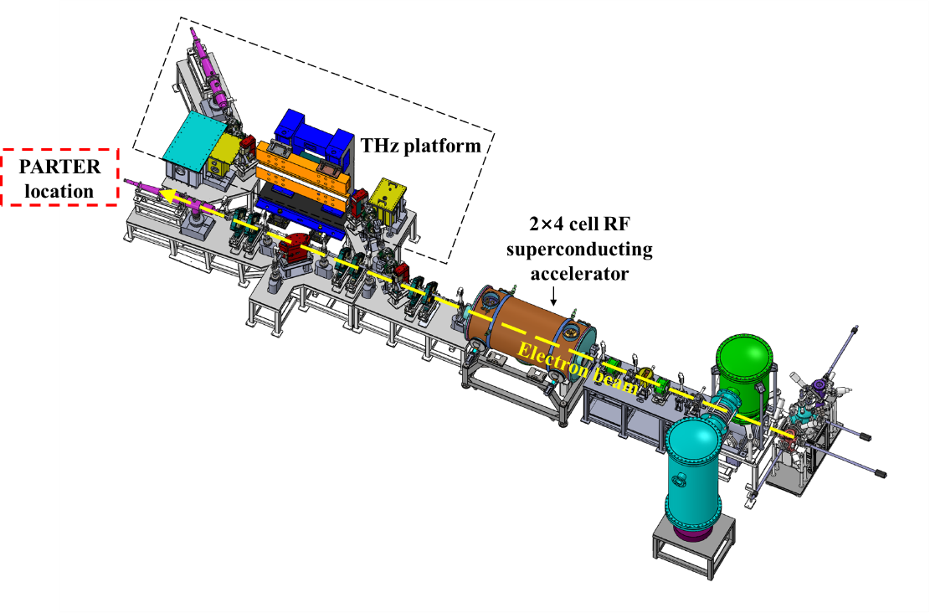
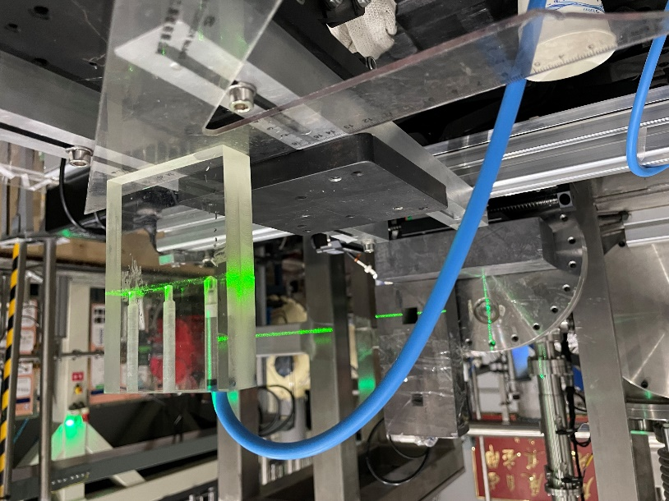
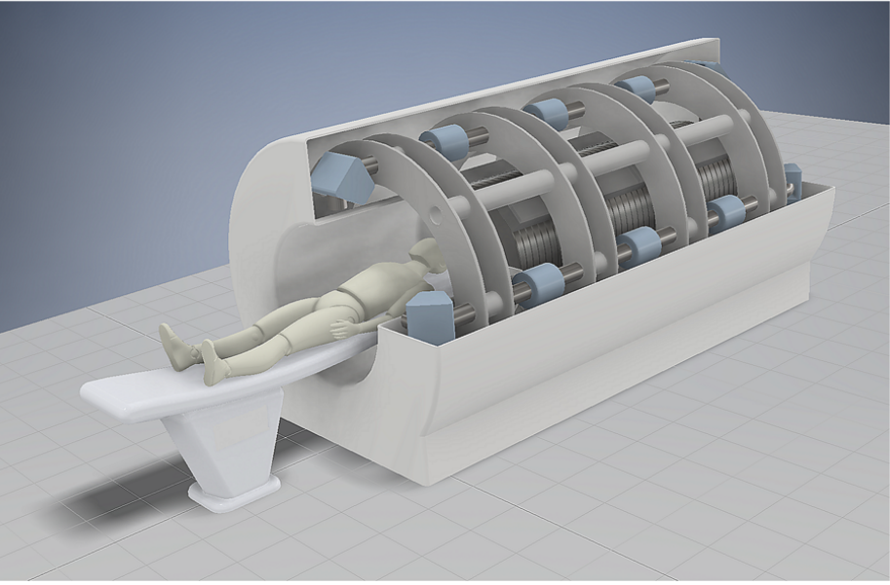
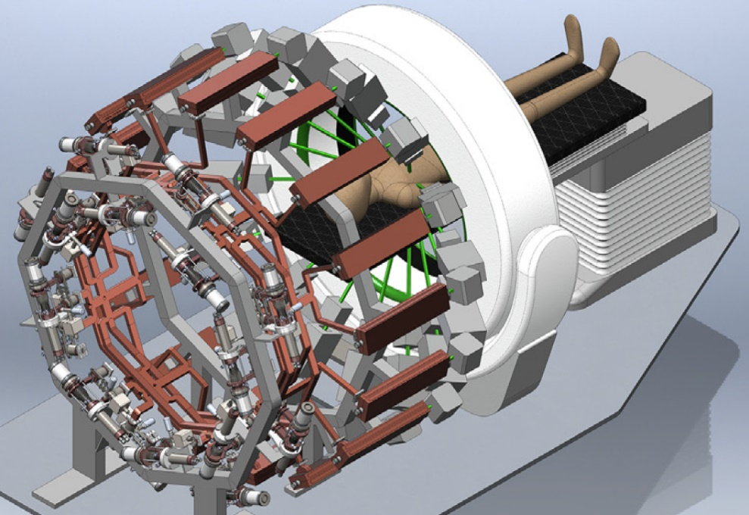
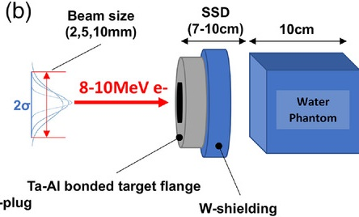
FLASH radiation: photon
The majority of radiation treatments using MVs X-ray
MVs FLASH X-rays need ultrahigh current LINAC
Many equipment are under developing, aiming at clinic.
A
B
C
Compact MVs FLASH X-rays equipment in Tsinghua
PARTER @CTFEL
D
E
F
FLASH X-rays @LLNL
PHASER@SLAC
Target
@TRIUMF
Notes:
Limited by its low dose deposition efficiency,

Slide 9

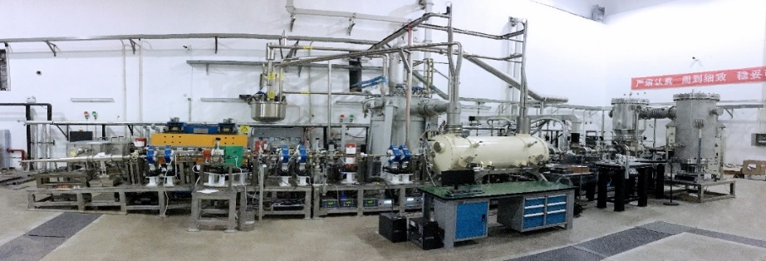
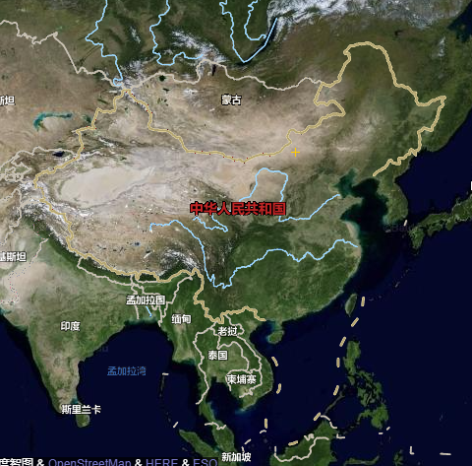
PARTER: First MVs FLASH X-rays platform
A Platform for Advanced Radiotherapy Research (PARTER) was set up at the Chengdu THz Free Electron Laser (CTFEL) facility to produce MV FLASH X-rays
Superconducting LINAC, FLASH radiation system and FLASH dosimetry.
Over 20 biological experiments have been carried out

Slide 10
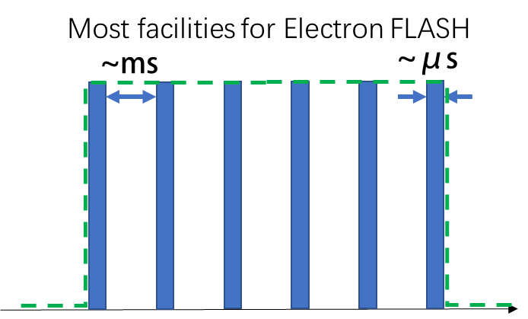
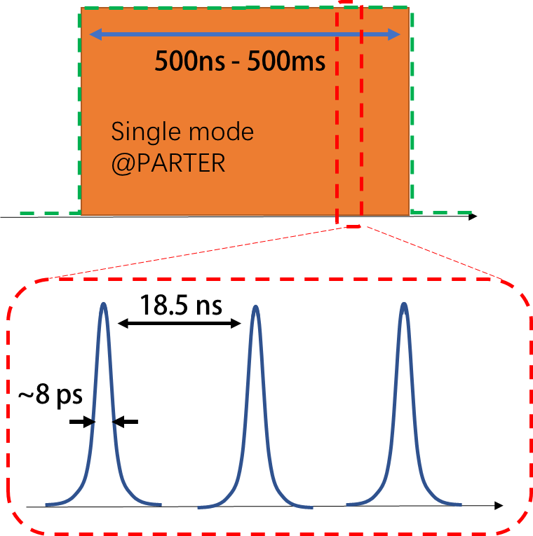
PARTER: Pulse structure
 | PARTER X-rays | Kinetron electrons ^{b}
Pulse repetition frequency (Hz) | 54.17 M | 1-250
Pulse width | ~8 ps | 0.05-2.2 μs
Maximum average dose-rate | ~400 Gy/s ª | ~400 Gy/s
Maximum dose in 1 μs | 0.4 mGy | 1.7 Gy
ª The maximum average dose-rate on PARTER can achieve over 1 kGy/s at short SSD and around 400 Gy/s at most used SSD (~20 cm).
^{b} V. Favaudon, et. al. Nuclear Inst. and Methods in Physics Research, A 944(2019)

Slide 11
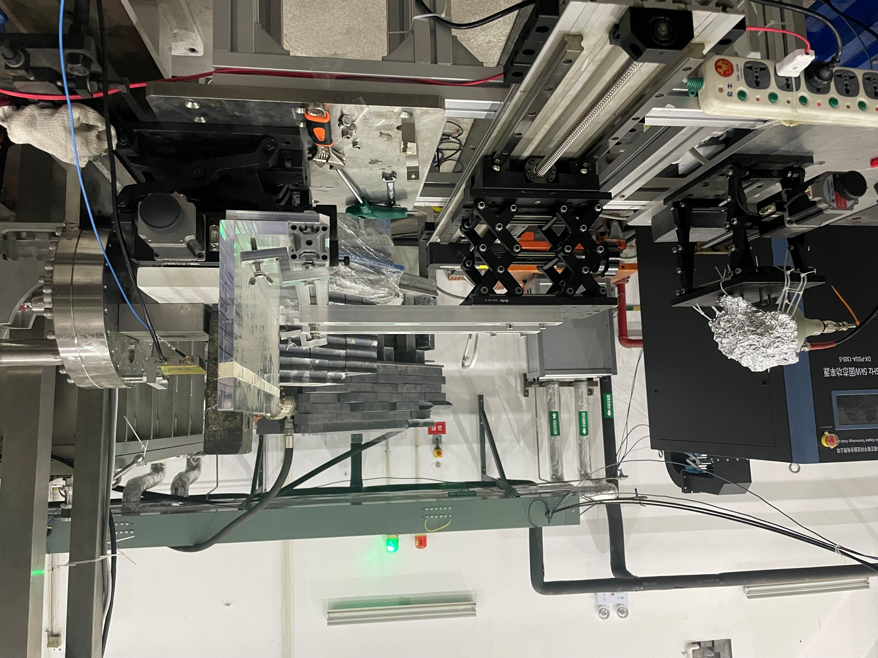
PARTER: Treatment area
Target
Collimator
Flattening filter
Beam monitor
Sample holder
MV X-rays

Slide 12
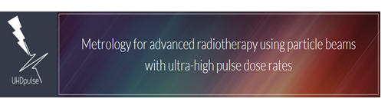
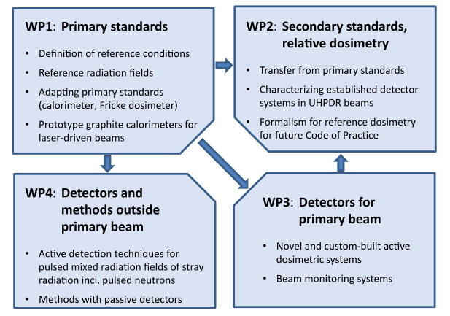
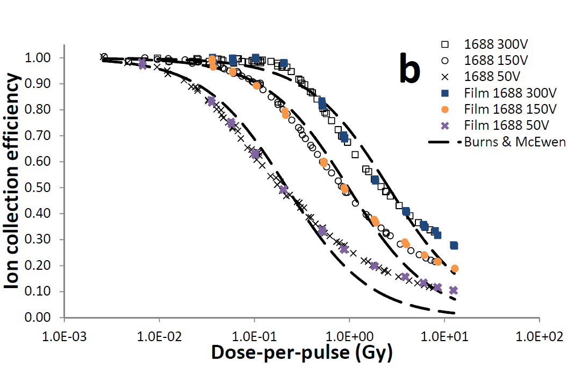
Metrological challenge
Precise radiation dose measurement is essential in FLASH-RT;
Biggest metrological challenge: failure of active detectors in FLASH
Ionization chamber: saturation
UHDpulse in EU
Physica Medica 80 (2020) 134–150

Slide 13
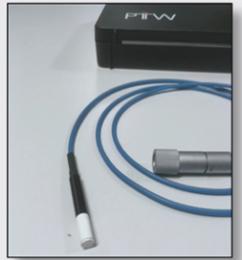

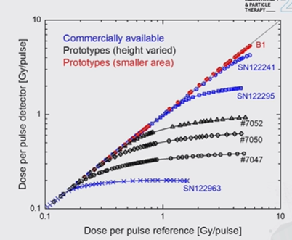
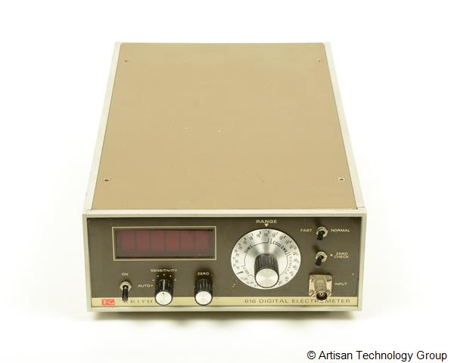
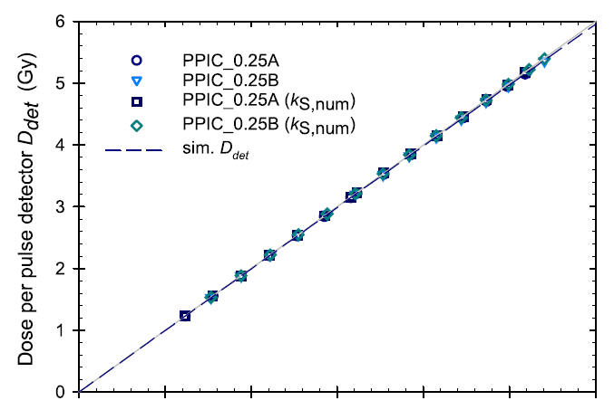
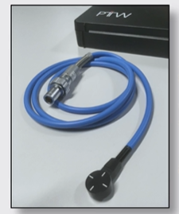
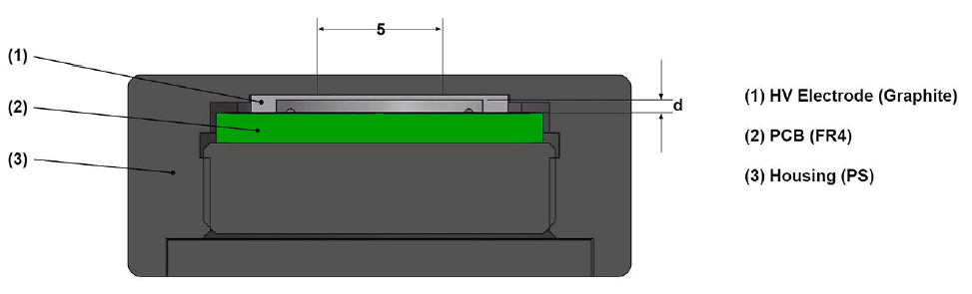
UHDpulse: FLASH measurement frame
Develop a measurement framework at ultra-high pulse dose rates:
  reference standards traceable to SI units
  Validated reference methods for dose measurements
Mainly for electron FLASH (rare proton and no X-ray FLASH machine)
Some hopeful solutions:
Micro diamond
By PTW
@FRPT22
Small gap IC
By PTW
@FRPT22

Slide 14
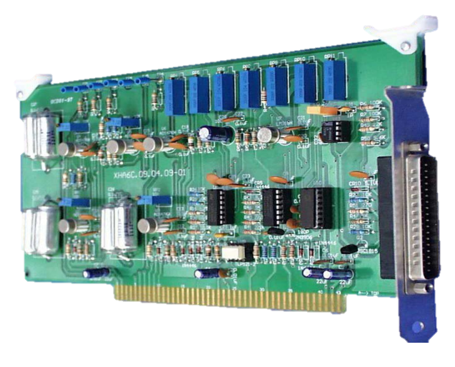
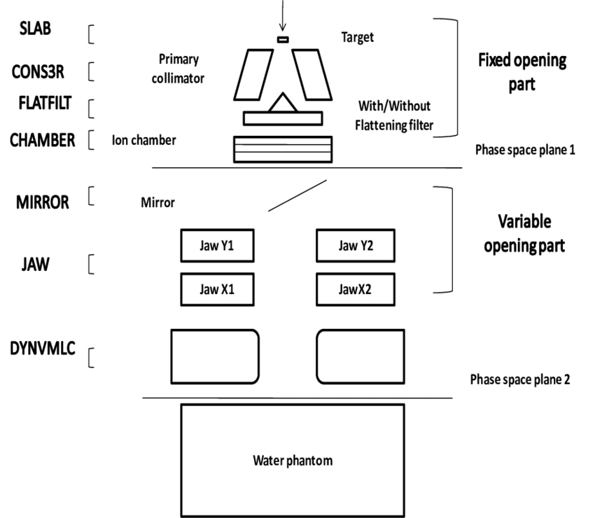
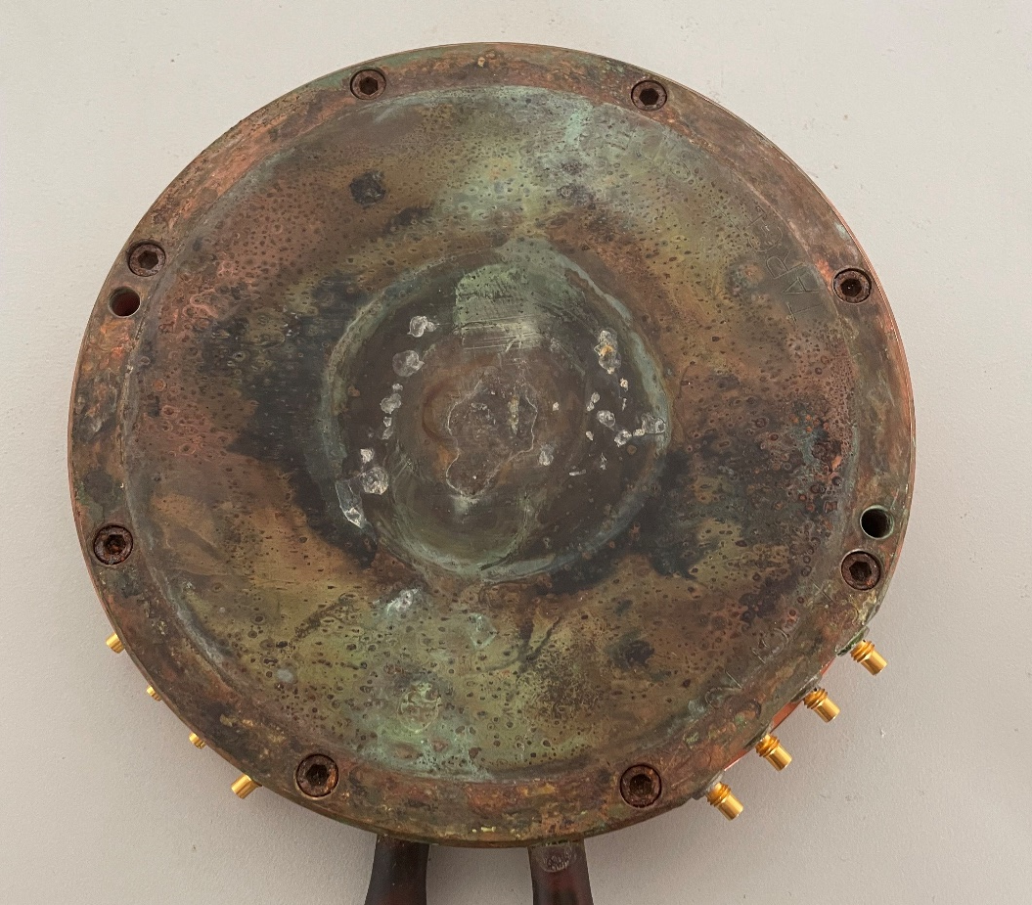
Dose monitor: PPIC
PPIC (Parallel Plate Ionization Chamber): standard detector in clinical radiotherapy
signal

Slide 15
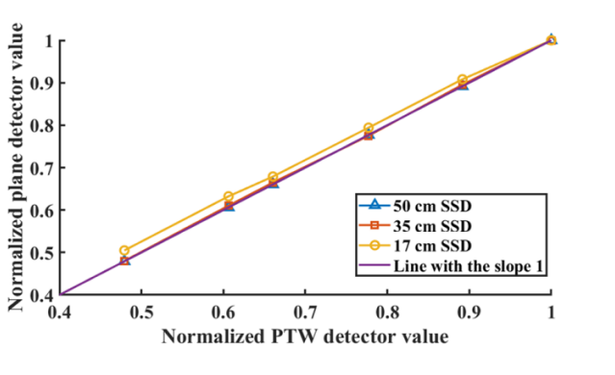
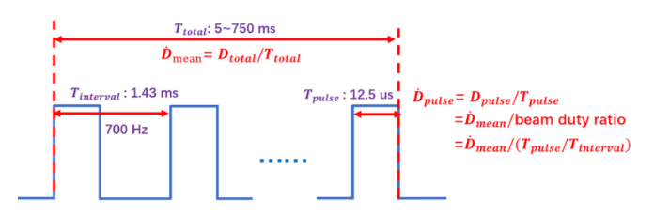
Dose monitor: PPIC
Saturation: depend on pulse mode and dose-rate
New PPIC: small gap for kGy/s?
PPIC for CONV-RT tested in Tsinghua Univ.
160 Gy/s maximum for 700 Hz , 500 V.
(~35 Gy/s saturation >1% in our calculation. 200 V?)
CW mode at CTFEL
saturation < 0.5% in 1000 Gy/s
Focheng Liu et al. doi: 10.1002/mp.16199.

Slide 16
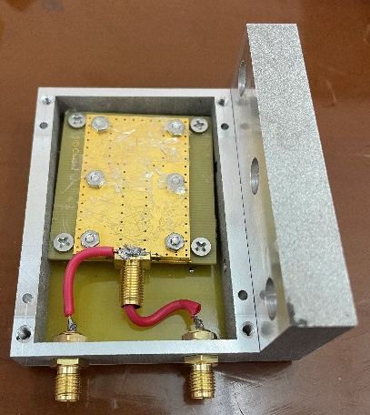
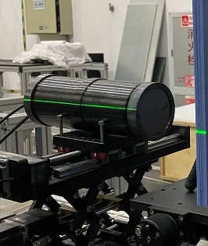
Dose monitor: PARTER
Three monitors adopted on PARTER
A: Fast Current Transformer (FCT) monitoring electron beam
B: Diamond monitoring X-rays upstream
C: Scintillator monitoring X-rays downstream
C
A
B3, CIVIDEC
B
A
B
C
ST401,
CeBr₃
scintillator

Slide 17
Dose monitor: PARTER
Good current linearity between monitors
Significant radiation damage for CeBr3 (~5% for ST401)
unpublished data
diamond vs. FCT
scintillator vs. FCT
unpublished data
Notes:
Cerium Bromide

Slide 18
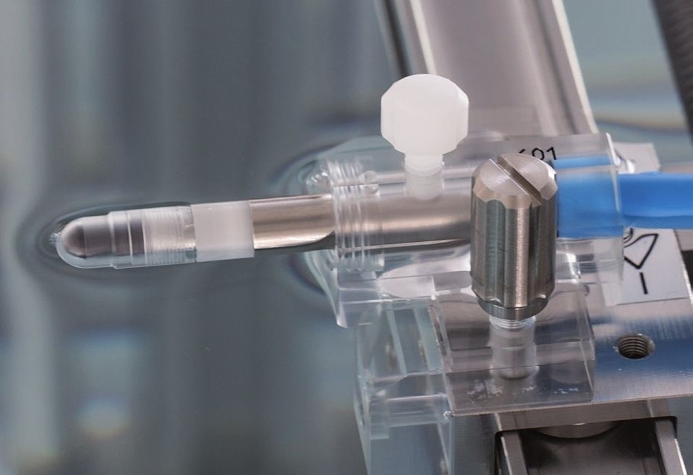
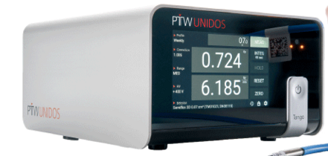
Dosimeter: Farmer type IC
Reference class relative dosimeter in clinical radiotherapy
Similar FLASH saturation with PPIC: smaller gap better
Depend on pulse mode: CW @ CTFEL means less ion density in ion collection time so higher collection efficiency
PTW 31022 1.15mm gap
CW mode at CTFEL
saturation < 0.5% in 1000 Gy/s

Slide 19
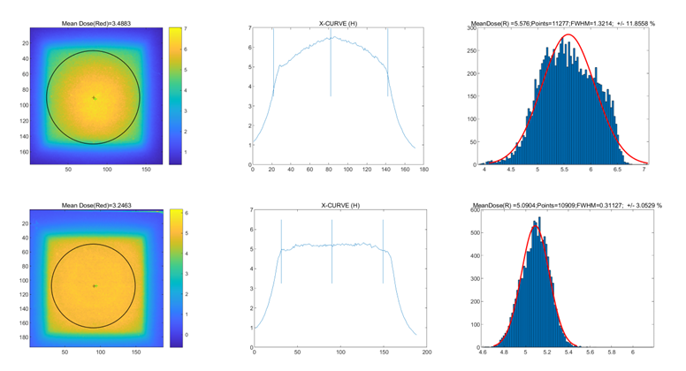
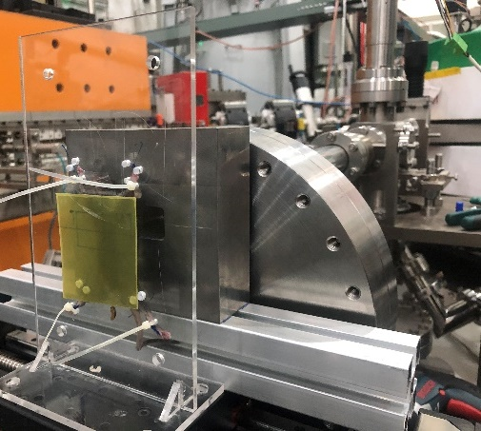
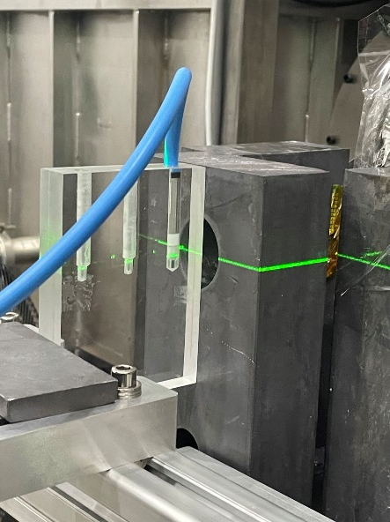
Dosimeter: PARTER
Passive: EBT3 film, dose distribution measurement
Active: PTW 31022 IC & UNIDOS electrometer, precisely point dose measurement.

Slide 20
Dosimeter: PARTER
PTW IC-diamond at different dose-rates
PTW IC vs EBT3
Agreement
with different pulse width @
160 Gy/s
unpublished data
unpublished data
PTW diamond 60019 shows agreement with IC in 100-200 Gy/s FLASH @ CTFEL

Slide 21
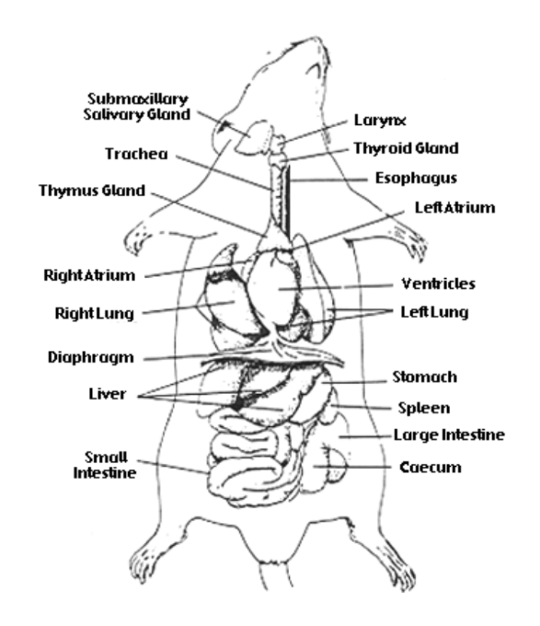
Preclinical experiments:
FLASH effect: Whole-lung
F. Gao et al. Radiother Oncol,2022
Tumor, tumor cells, oxygen depletion hypothesis dose fractionation tumor volume xenografted lung tumor
Y. Dai, et al. International Journal of Radiation Biology, DOI: 10.1080/09553002.2023.2194403
Tumor, CD8 + T cell, immune responses and reduce radiation-induced damage in the spleen and intestine;
H. Zhu, Clinical and Translational Radiation Oncology 38 (2023) 138–146
intestinal damage, the inflammatory blood cell counts and pro-inflammatory cytokine concentrations, inflammatory blood cells and diminished pro-inflammatory cytokine at the late stage. reactive oxygen species (ROS) signal,
H. Zhu, Med Phys. 2022;1–11.
H. Zhu, et al. International Journal of Radiation Oncology*Biology*Physics, 2022
H. Zhu, et al. International Journal of Radiation Oncology*Biology*Physics, 2021
FLASH effect: radiation enteritis and immunological effect
X. Shi et al. PNAS, 2022

Slide 22
Conclusion
A 3rd technical revolution of radiotherapy being promoted by FLASH effect;
MVs X-rays can trigger FLASH effect, has hopeful clinical advantages;
Metrological method in CONV-RT fails in FLASH-RT, to be rebuilt;
Some preliminary methods for FLASH electron appear in UHDpulse ;
Dose measuring method for FLASH X-rays is been studied on PARTER;
Diamond/FCT (Scintillator/PPIC) provide reliable beam monitoring;
PTW small gap IC (diamond) and EBT3 provide traceable dosimetry;
Detector performances are highly depend on pulse structures and dose-rates;
The monitor & dosimeter will be updated as accelerator improving;

Slide 23
THANK YOU !

