Slide 1
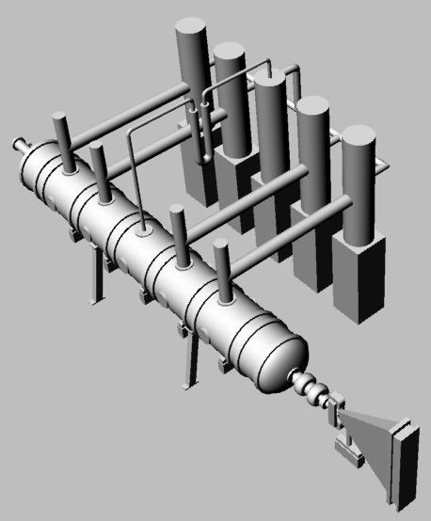
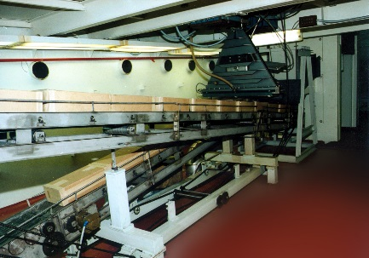
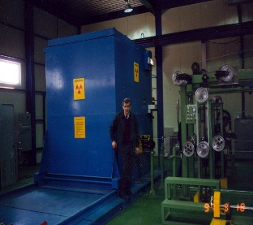
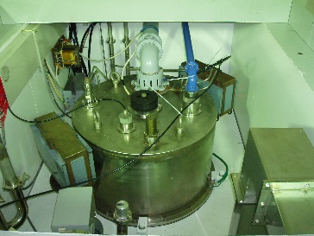

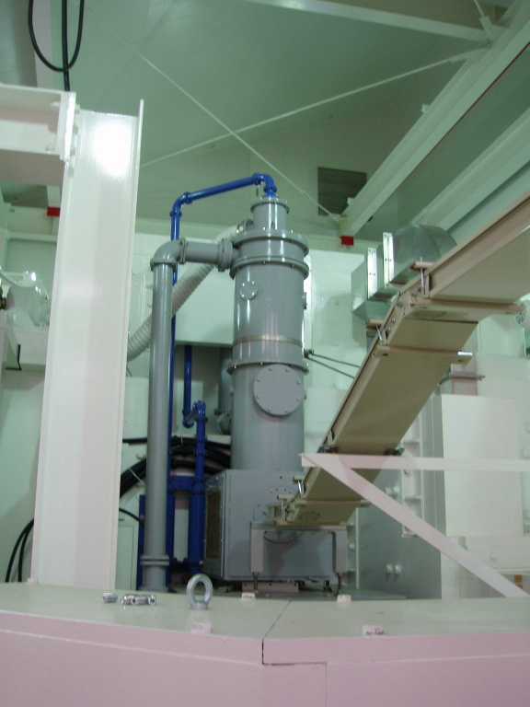
ILU RF electron accelerators for e-beam and X-ray applications.
Aleksandr Bryazgin
Budker Institute of Nuclear Physics
Novosibirsk, Russia

Slide 2
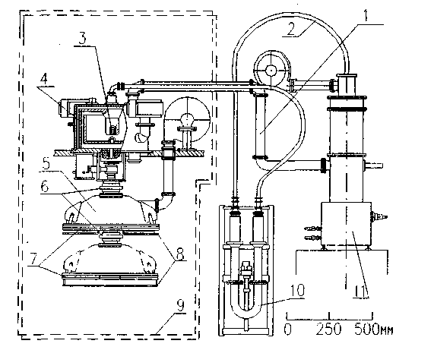
ILU-8 in Local Shield
Main features of ILU accelerators
Compact
Self-excitation
No insulation and gas systems
Pulse
GI-50
Energy 0.8-1 MeV
Av. Current 0-20 mA
Pulse current 0-500 mA
Pulse duration 800 mks
Pulse repetition 1-50 Hz
RF frequency 175 MHz
Dim D800x800 mm

Slide 3
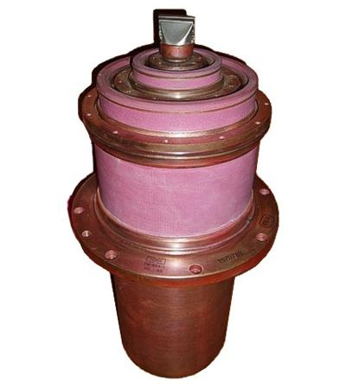
Features of ILU accelerators
Not expensive RF tube GI-50 with lifetime>7000 hour (~10000 USD) and pulse power 2 MW.
Soft requirements for temperature stabilization cooling water ~5-10 degrees of Celsius.
Fast start: not necessary warming of cavity, just fast warming of filaments.
Master-generator
Master-generator
Amplifier
Amplifier
Positive feedback
Cavity
Cavity
Usual linac
ILU accelerator
Tube GI-50A

Slide 4
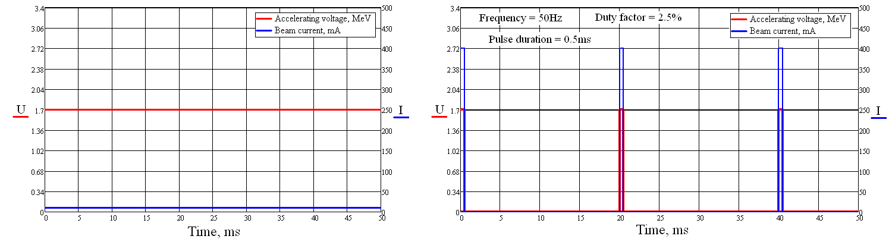
Cavity voltage and beam current for one cavity.
CW
Pulse
Energy looses in cavity always
No energy looses
here
No energy looses
here
Ibeam=10 mA
Ibeam (average)=10 mA
Efficiency lower
Efficiency higher
Pulse Linear Accelerator PLA=ИЛУ (ILU) in Russian

Slide 5
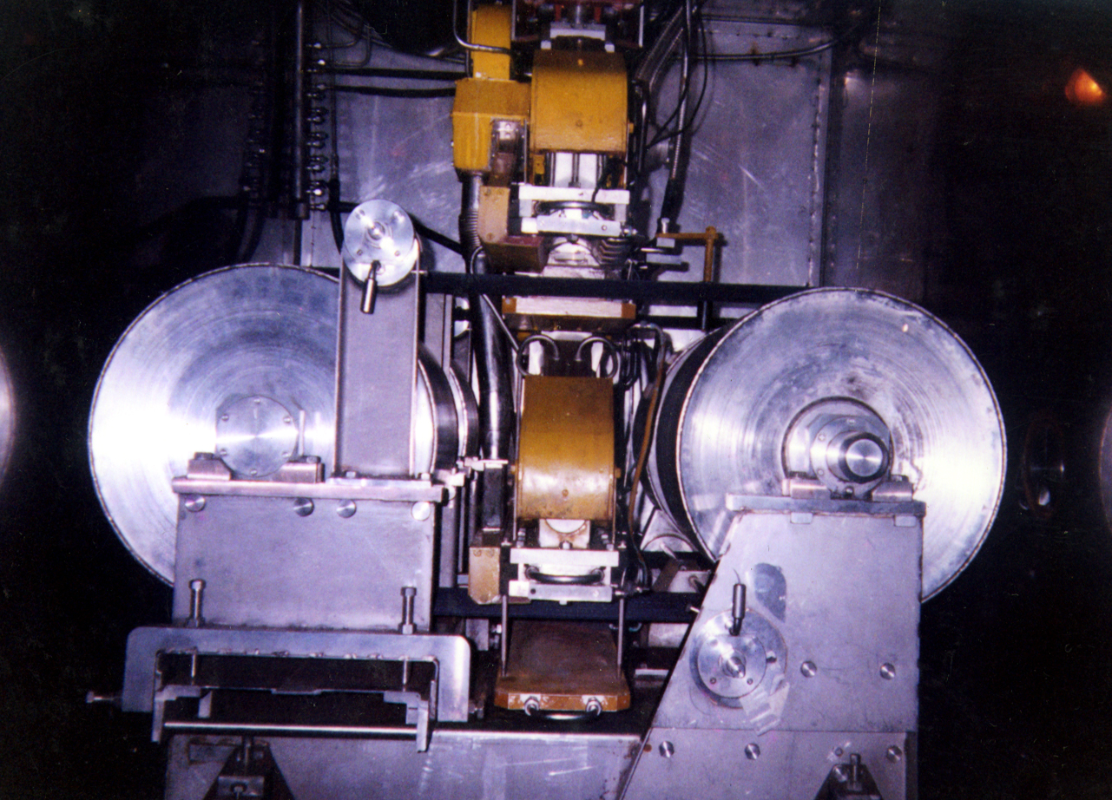
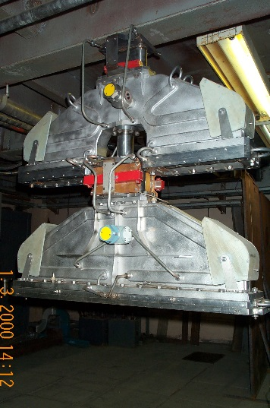
4-sided cable irradiation
Beam extraction device for 4-sided irradiation
allows to increase
beam usage efficiency
comparing with
2 sided irradiation
No cable twist

Slide 6
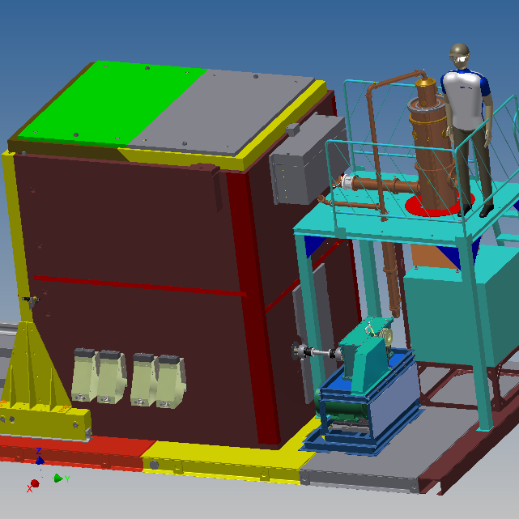
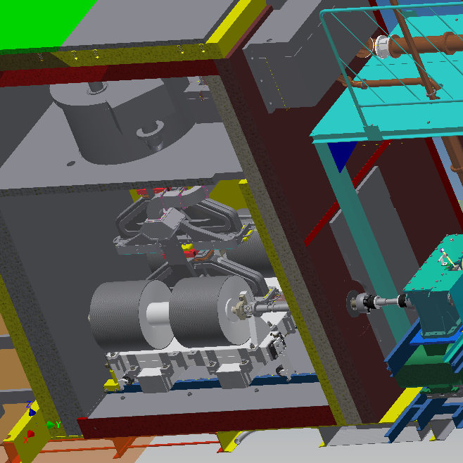
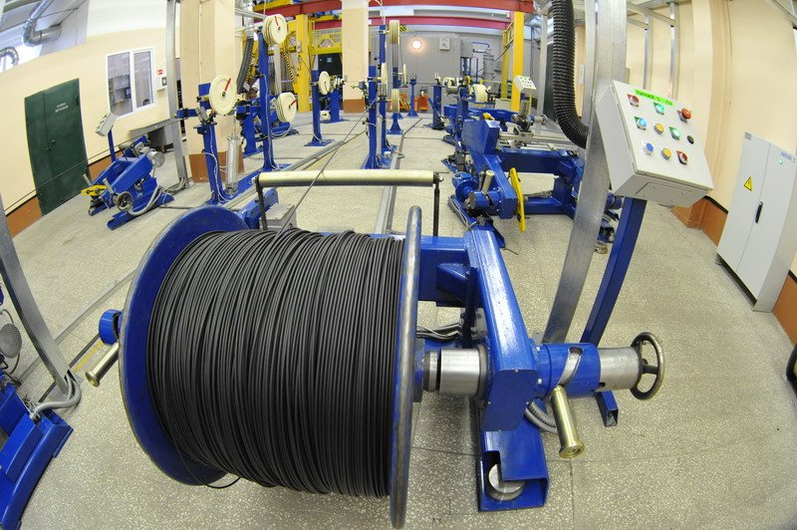
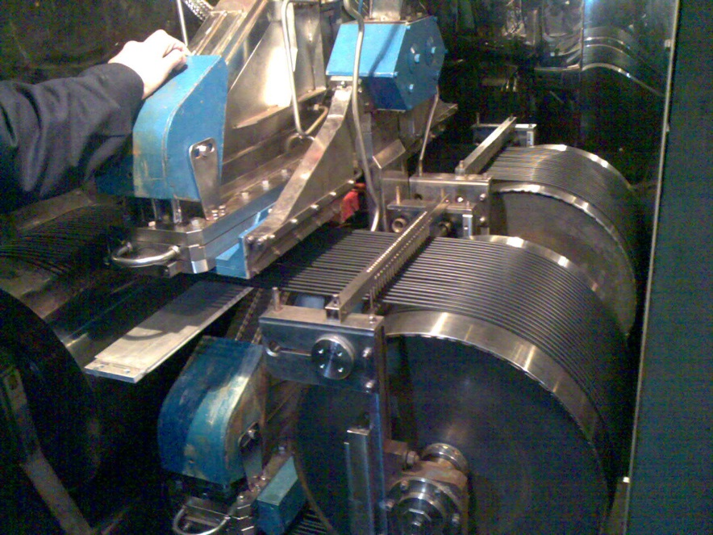
Accelerator ILU-8 in local shielding

Slide 7
ILU-10
Energy 4-5 MeV
Av. Current 0-10 mA
Pulse current 0-400 mA
Pulse duration 500 mks
Pulse repetition 1-50 Hz
RF frequency 115 MHz
Dim. D1280x1480 mm

Slide 8
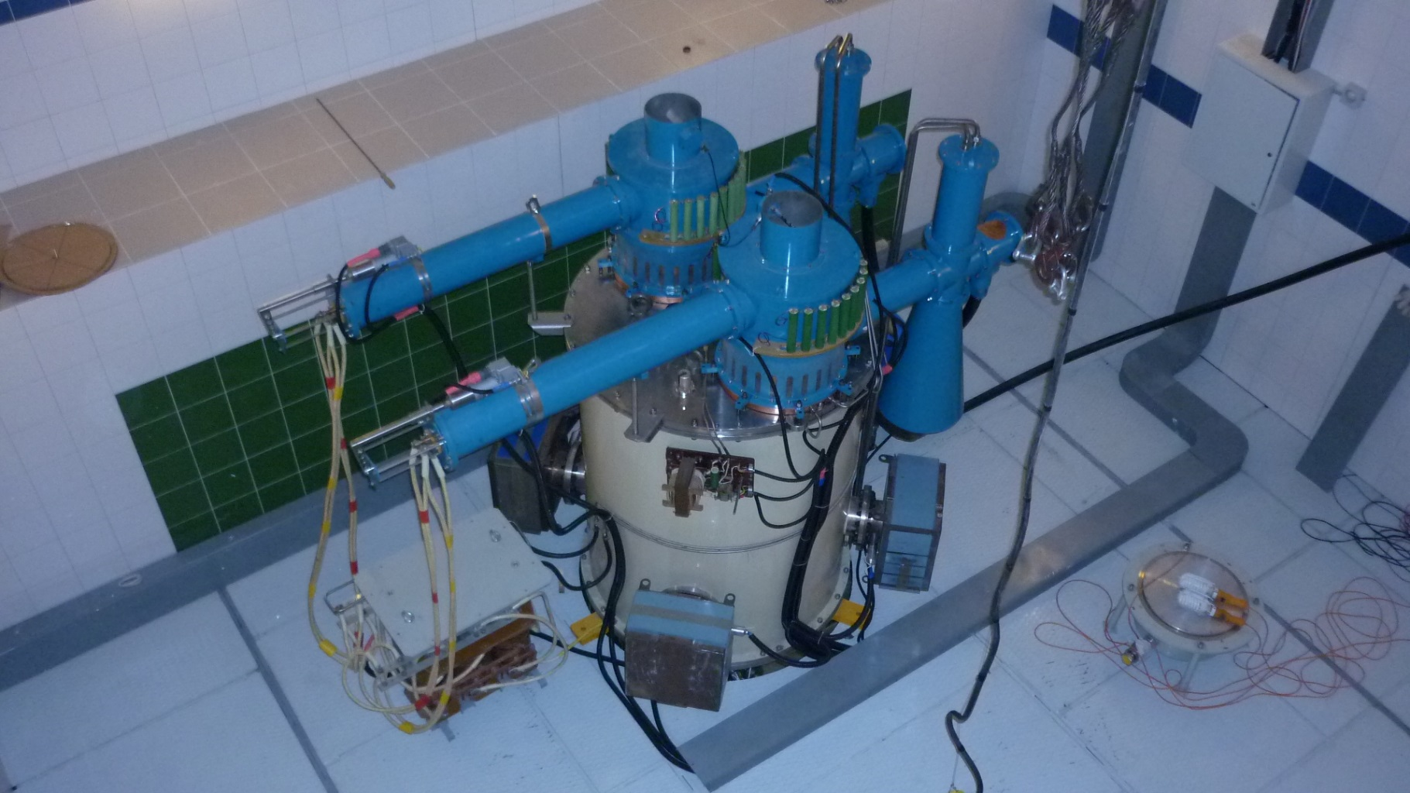
ILU-10 in Novosibirsk pharmaceutical plant 2013

Slide 9
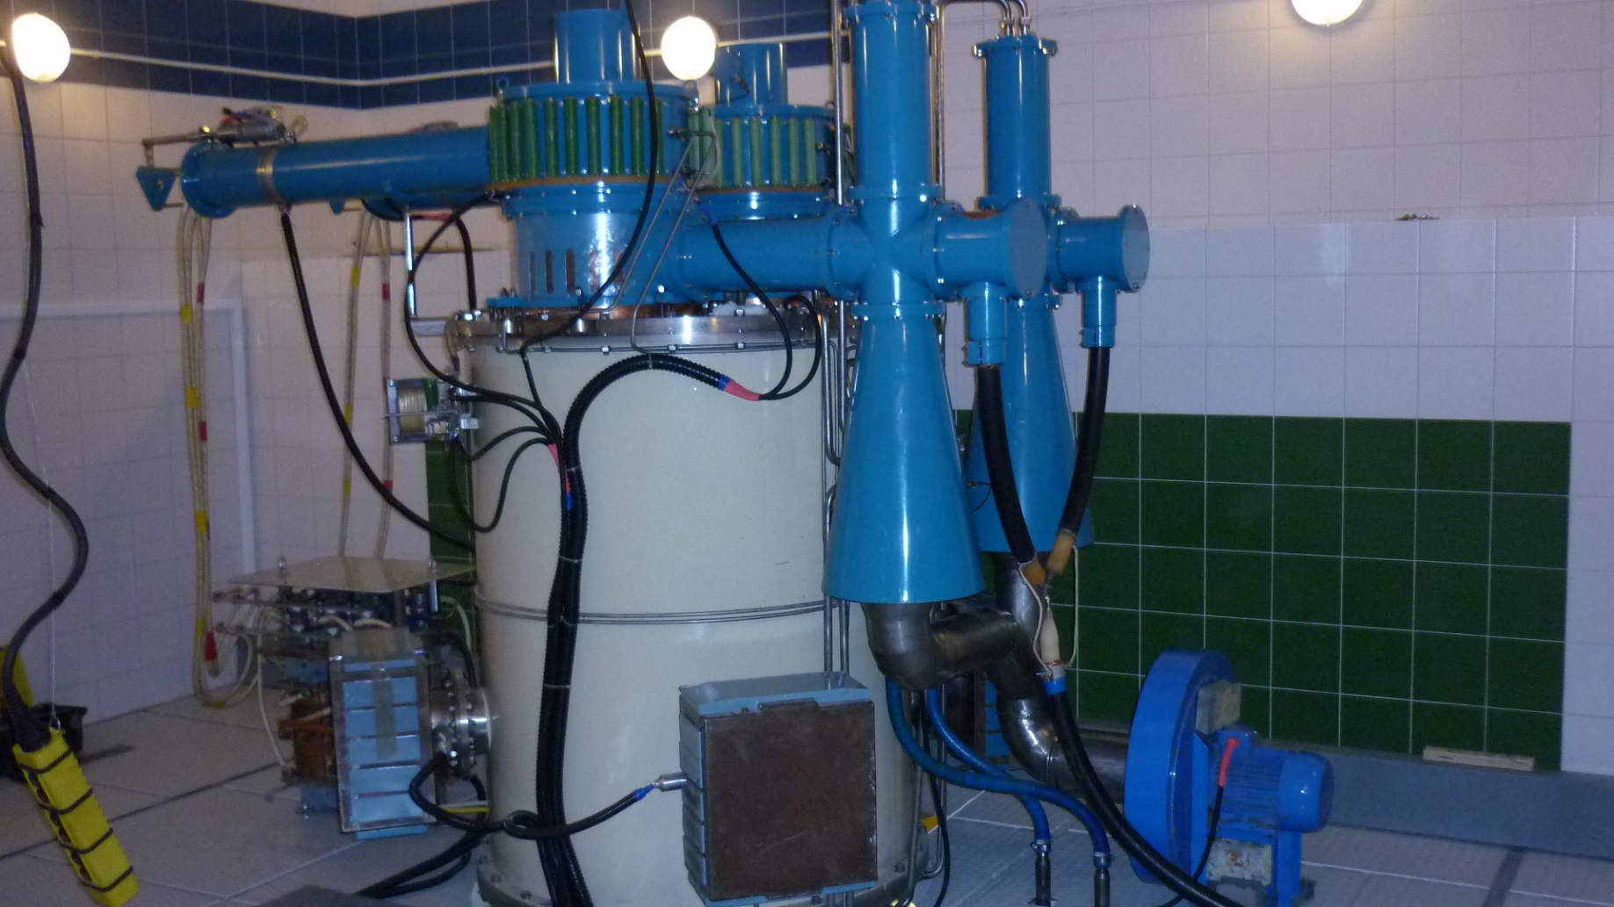
ILU-10 in Novosibirsk pharmaceutical plant 2013

Slide 10
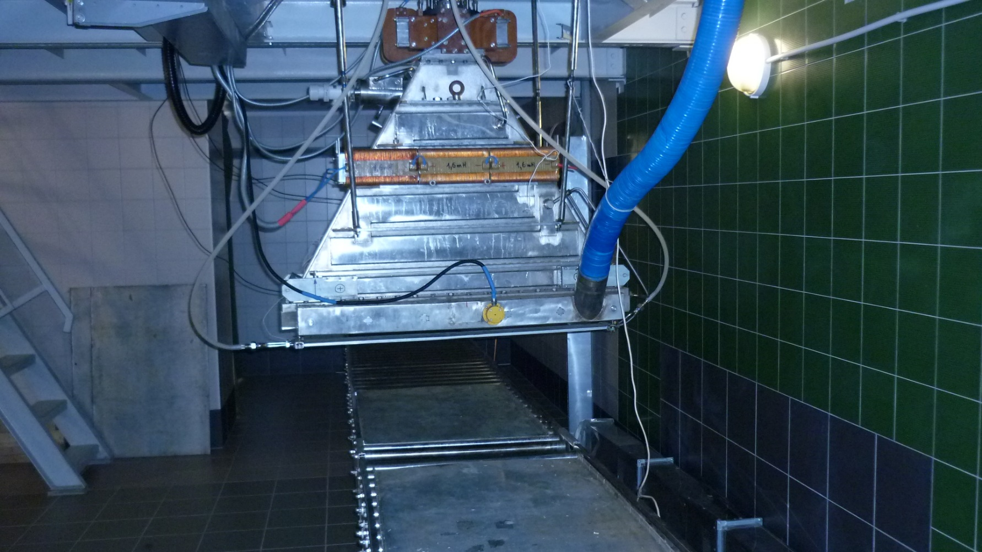
ILU-10 in Novosibirsk pharmaceutical plant 2013

Slide 11
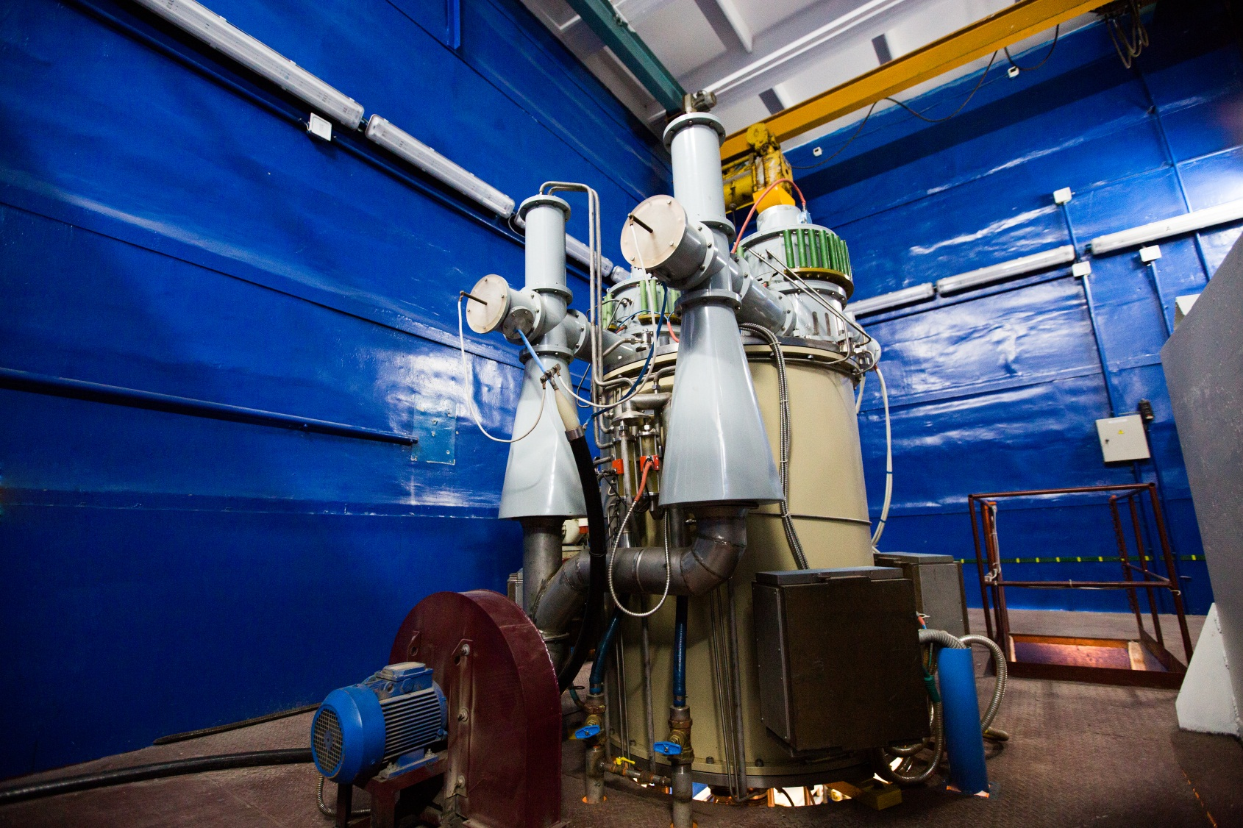
Centre of radiation technologies in Budker Institute (started 2014)

Slide 12
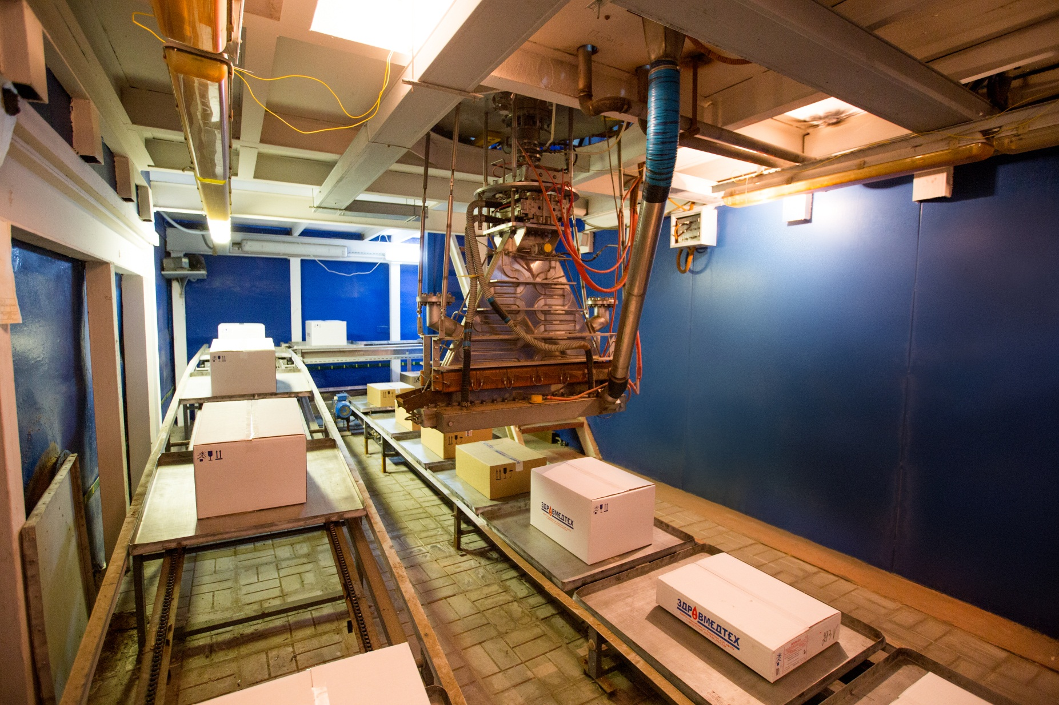
Centre of radiation technologies in Budker Institute (started 2014)

Slide 13
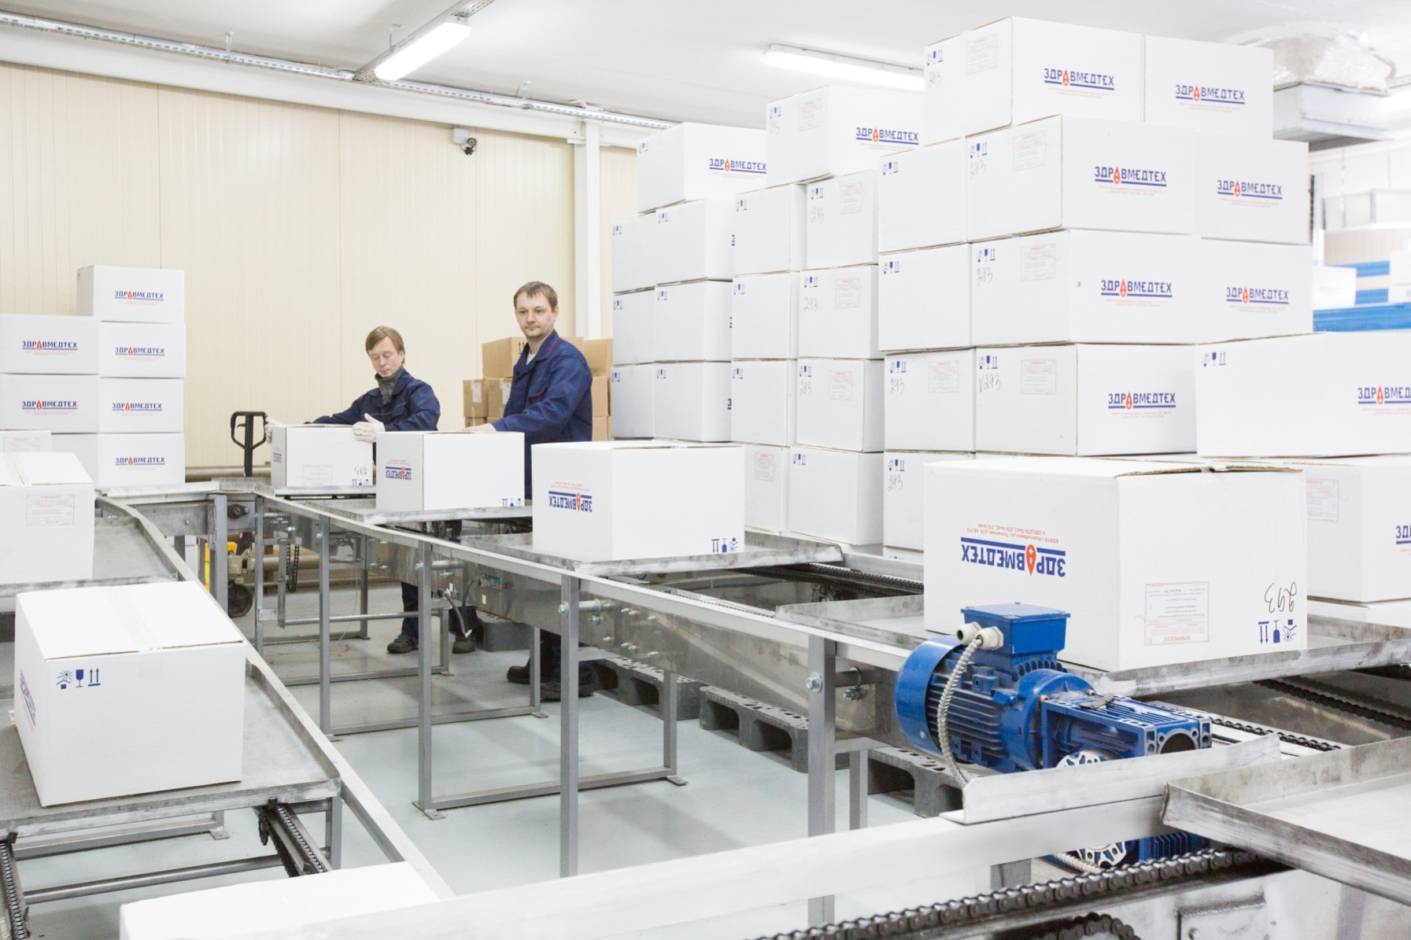
Centre of radiation technologies.
Conveyor load zone.

Slide 14
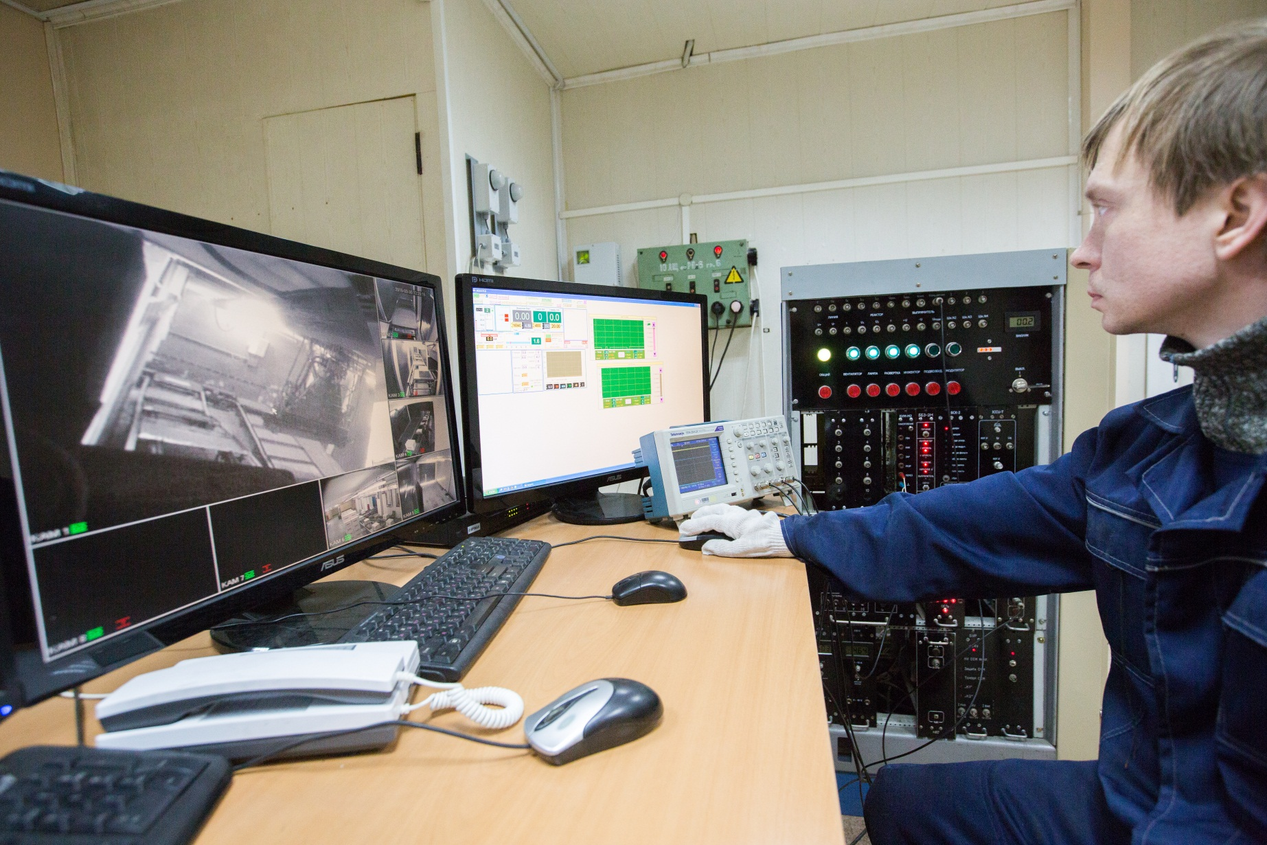
Centre of radiation technologies.
Control cabinet.

Slide 15
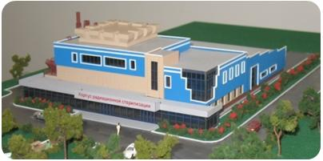
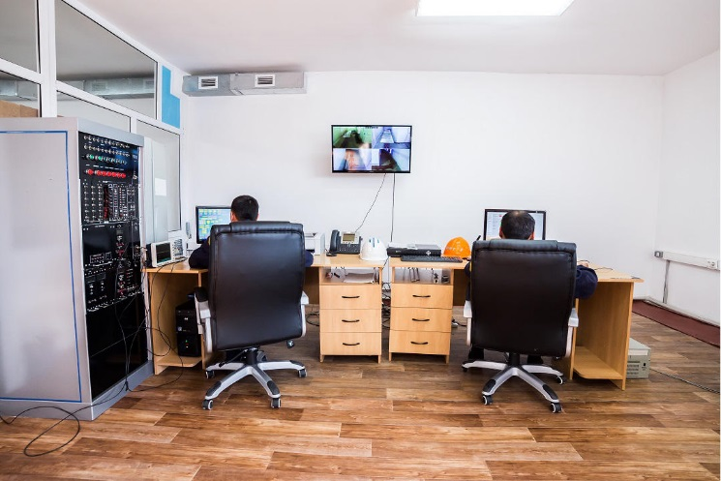

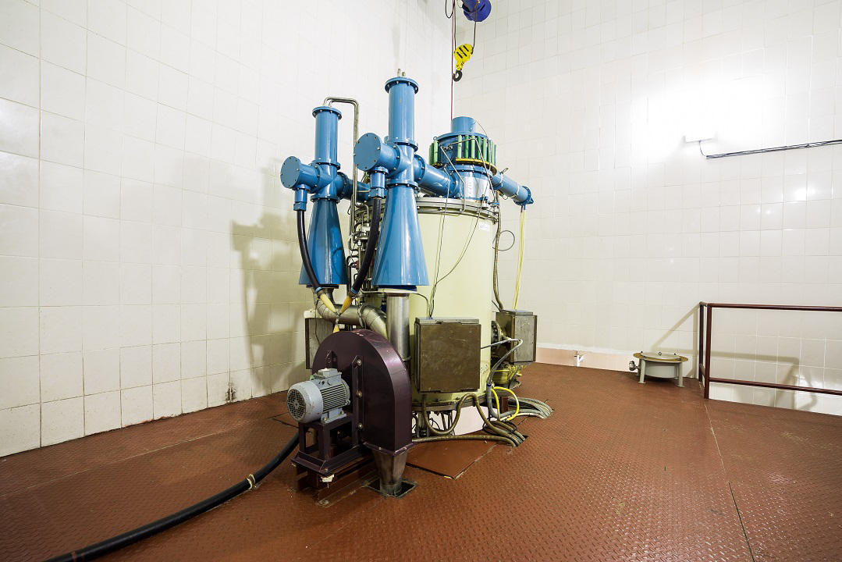
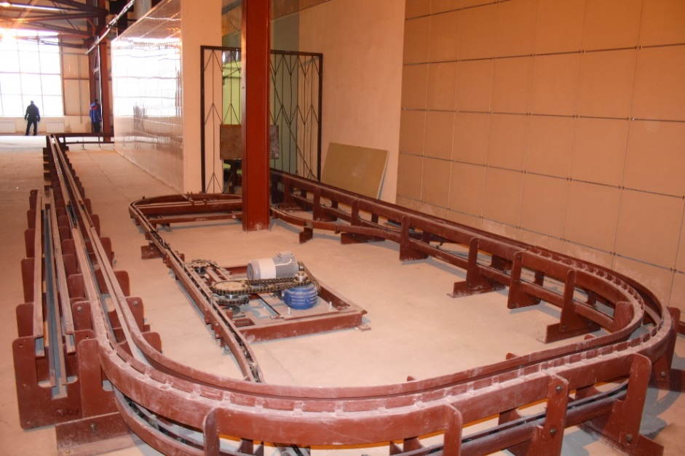
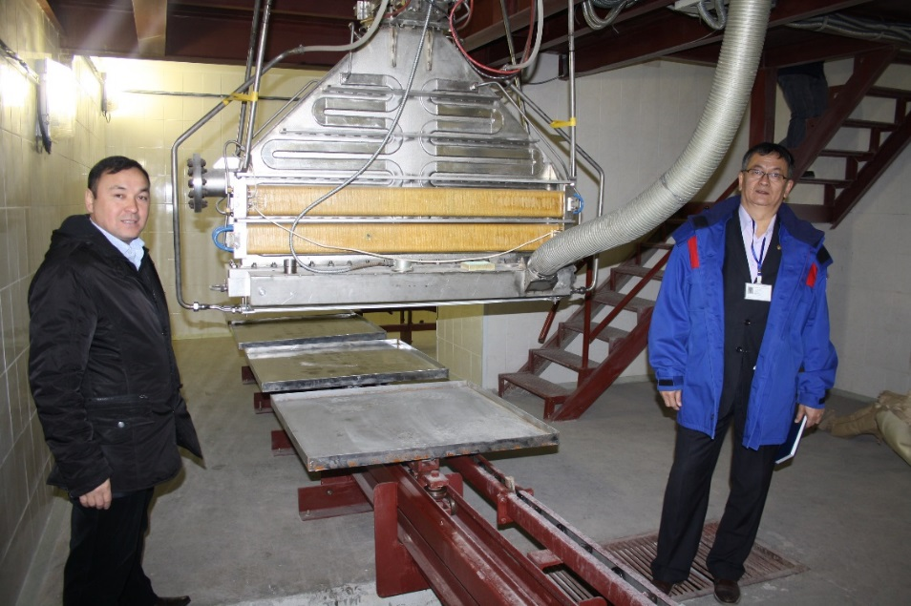
Sterilization center based on ILU-10 in Semipalatinsk
nuclear test site (STS) in Kazakhstan.

Slide 16
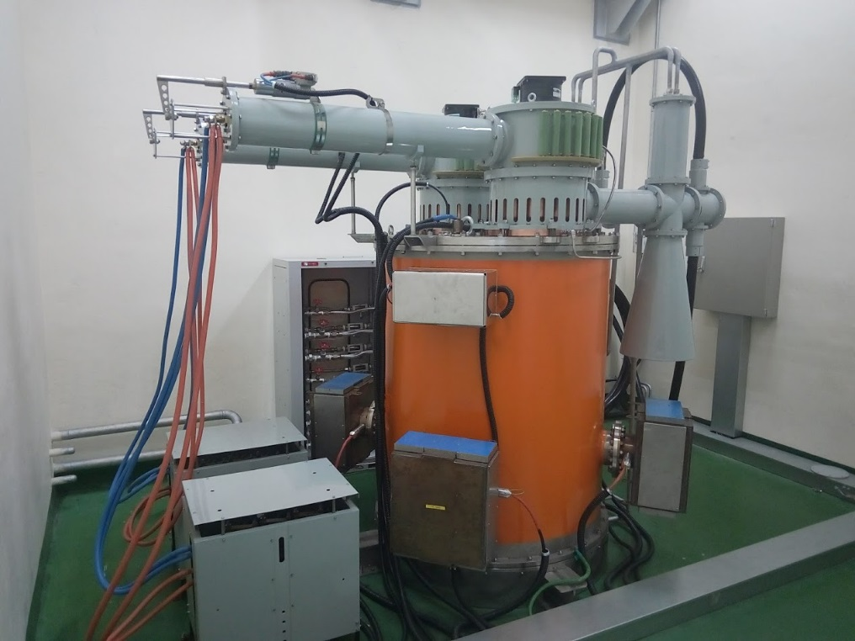
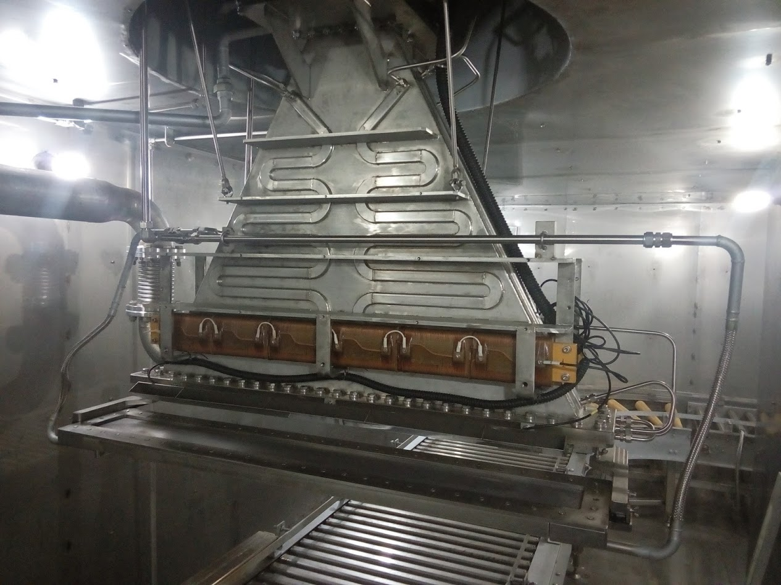


ILU-10 in Kaitech university, Korea
+
BINP

Slide 17
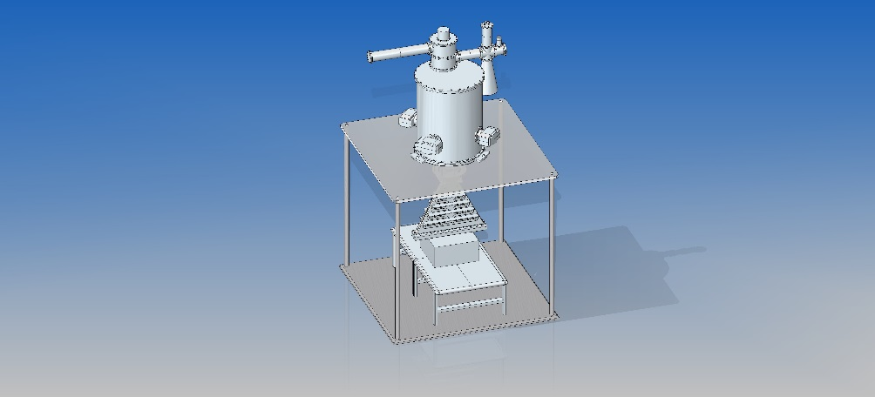
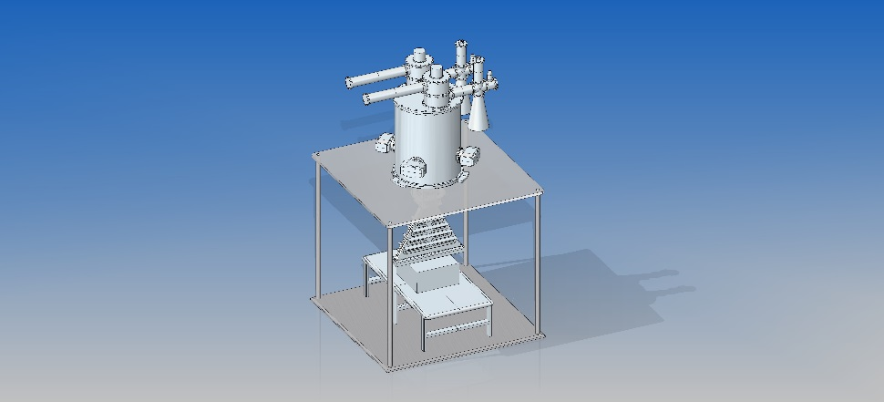
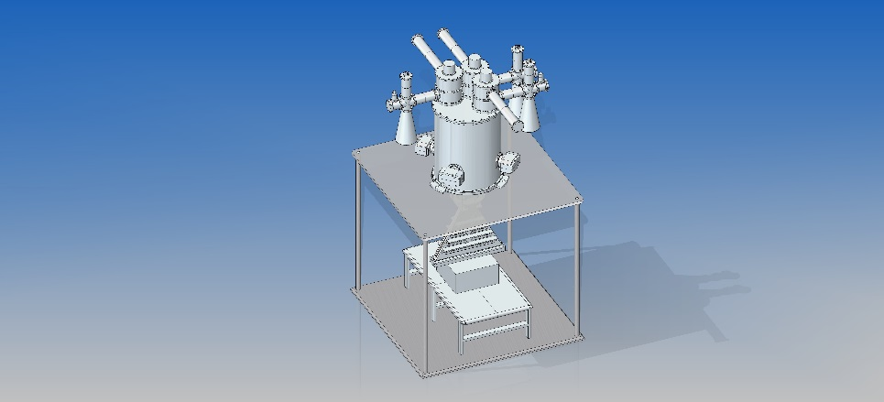
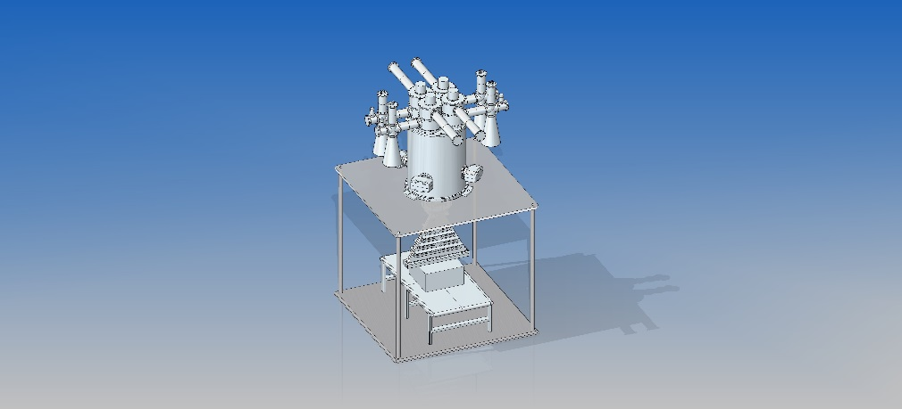

Increasing power of ILU-10
Number generators | Average beam power for 5 MeV (kW)
1 | 0
2 | 50
3 | 100
4 | 150
$P_{loss}=\frac{U^{2}}{2R_{Shunt}}$ = 1.77 MW
Rshunt=7 Mohm, U=5 MV
Ploss_av=1770*0.025=44.25 kW
RF power of 1 generator – 2 MW of pulse power or 50 kW of average power for duty cycle 0.025 (F=50 Hz, Tpulse= 500 mkS)

Slide 18
Medical sterilization and food irradiation markets required more energy and power.
Food irradiation requirements
10 MeV E-beam → small power
X-ray 5 MeV → huge power (conversion rate ~8%)
X-ray 7.5 MeV (USA, Indonesia, Canada, India, Korea) → high power (conversion rate~13%)

Slide 19
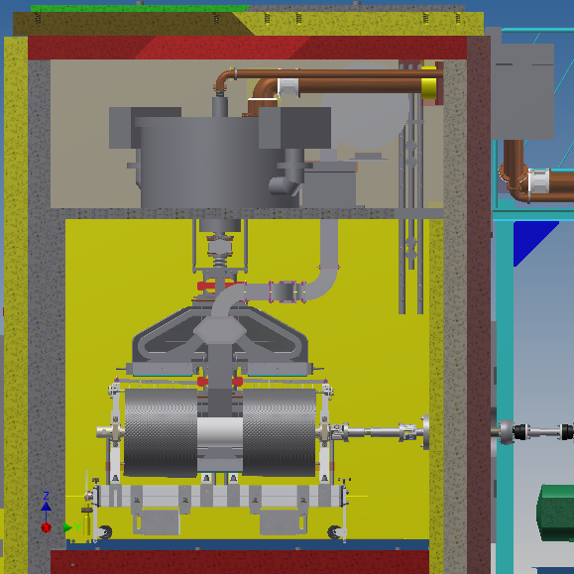
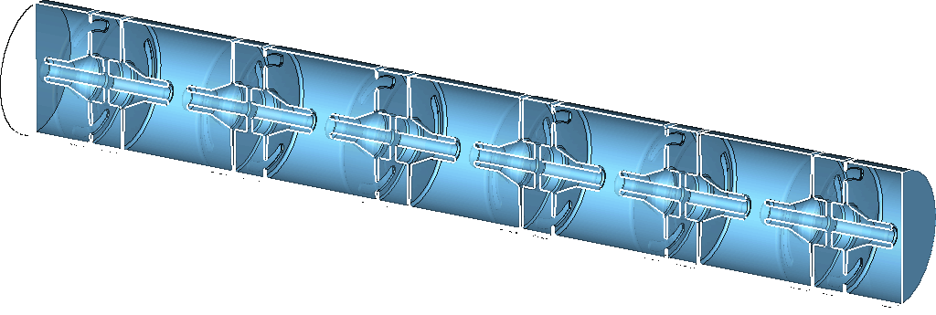
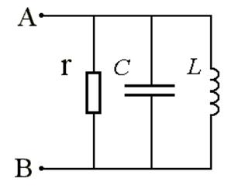
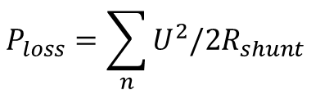

New multi-cavity ILU accelerator.
One cavity
Multi-cavity
$$P_{loss}=\sum_{n}{U^{2}/2R_{shunt}}$$
$$P_{loss}=U^{2}/2R_{shunt}$$

Slide 20
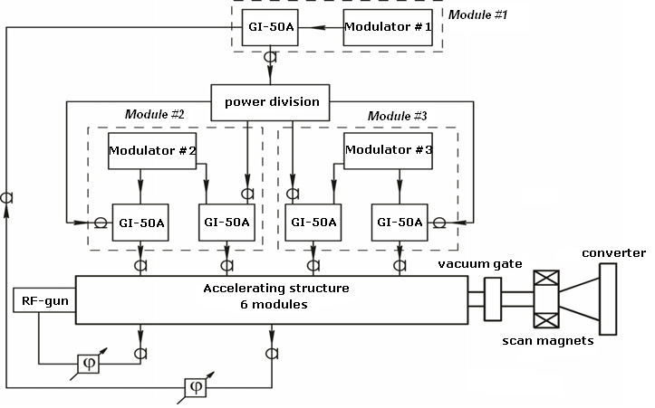
ILU-14 10 MeV 100 kW
Operating frequency, MHz | 176 | Full efficiency, % | 26
Electron energy, MeV | 7,5-10 | Modulator pulse duration, μs | 500
Average beam power, kW | 100 | Repetition rate, Hz | Up to 50

Slide 21
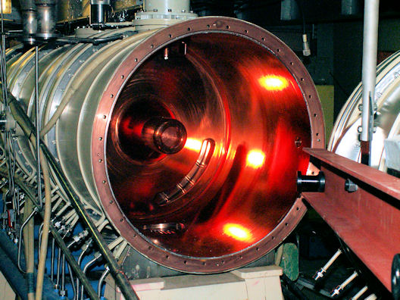
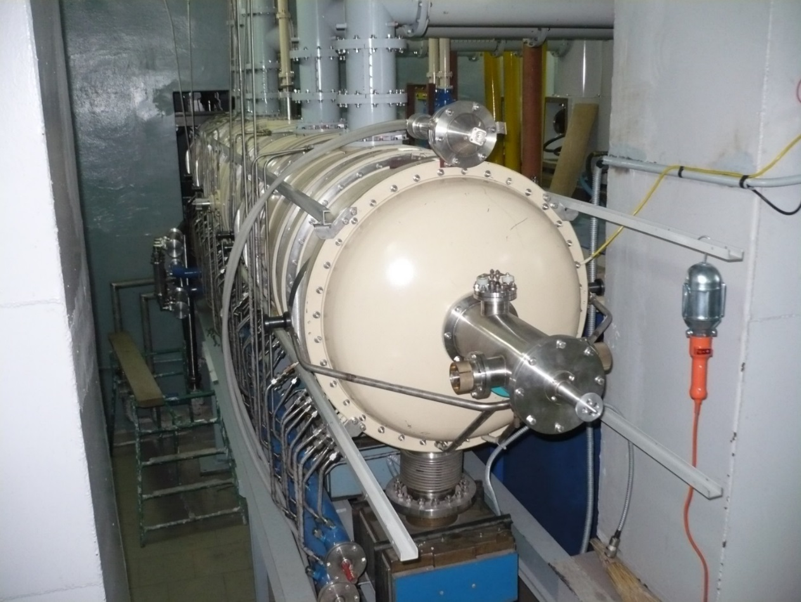
New multi-cavity ILU accelerator.
In operation from 2014 in Moscow

Slide 22
ILU-14 for food irradiation in Vietnam

Slide 23
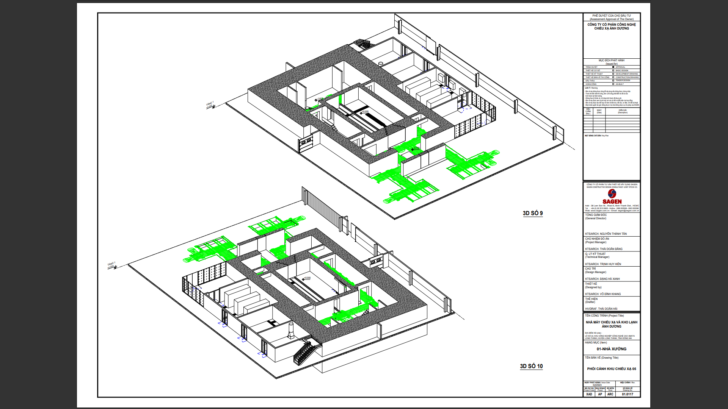
ILU-14 for food irradiation in Vietnam

Slide 24
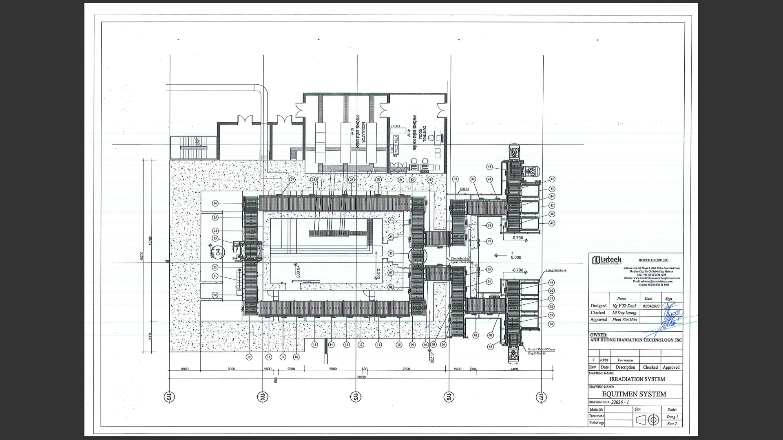
ILU-14 for food irradiation in Vietnam

Slide 25
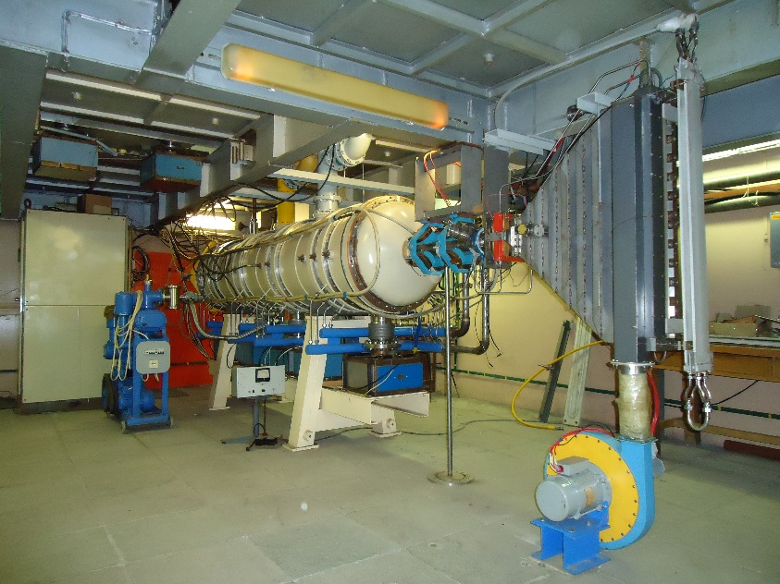
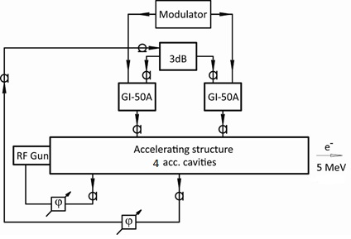
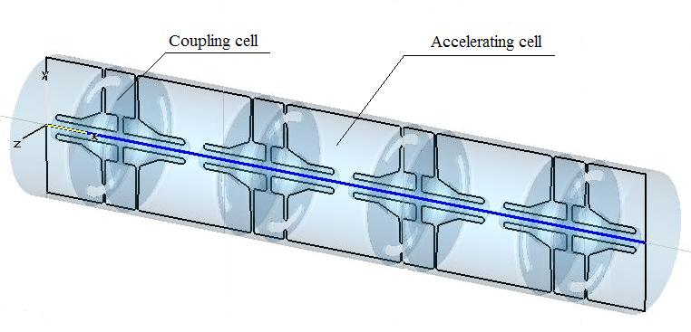
Shorter version – ILU-12
5 MeV 60 kW
7.5 MeV 40 kW
4 cavities
Possible upgrade to ILU-14

Slide 26
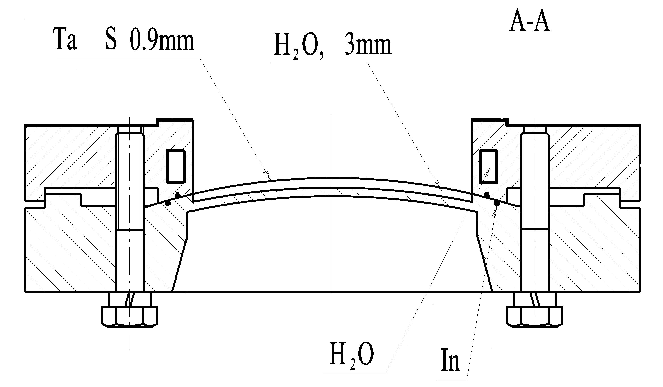
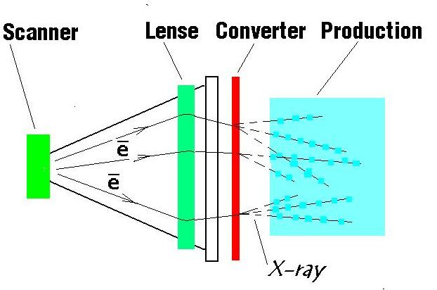
X-ray converter
Conversion rate X/ray/Ebeam power
E(MeV) | Ta thickness | 60 deg | 360 deg
7.5 | 0.9 | 13,2% | 16,9 %
5 | 0,7 | 8,3% | 12%

Slide 27
Thank you for your attention

