Slide 1

AFAD April 2023 Melbourne
Stand-alone Cryomodule for ANU HIAF upgrade
Nikolai Lobanov
on behalf of Accelerator Operation and Development Team

Slide 2
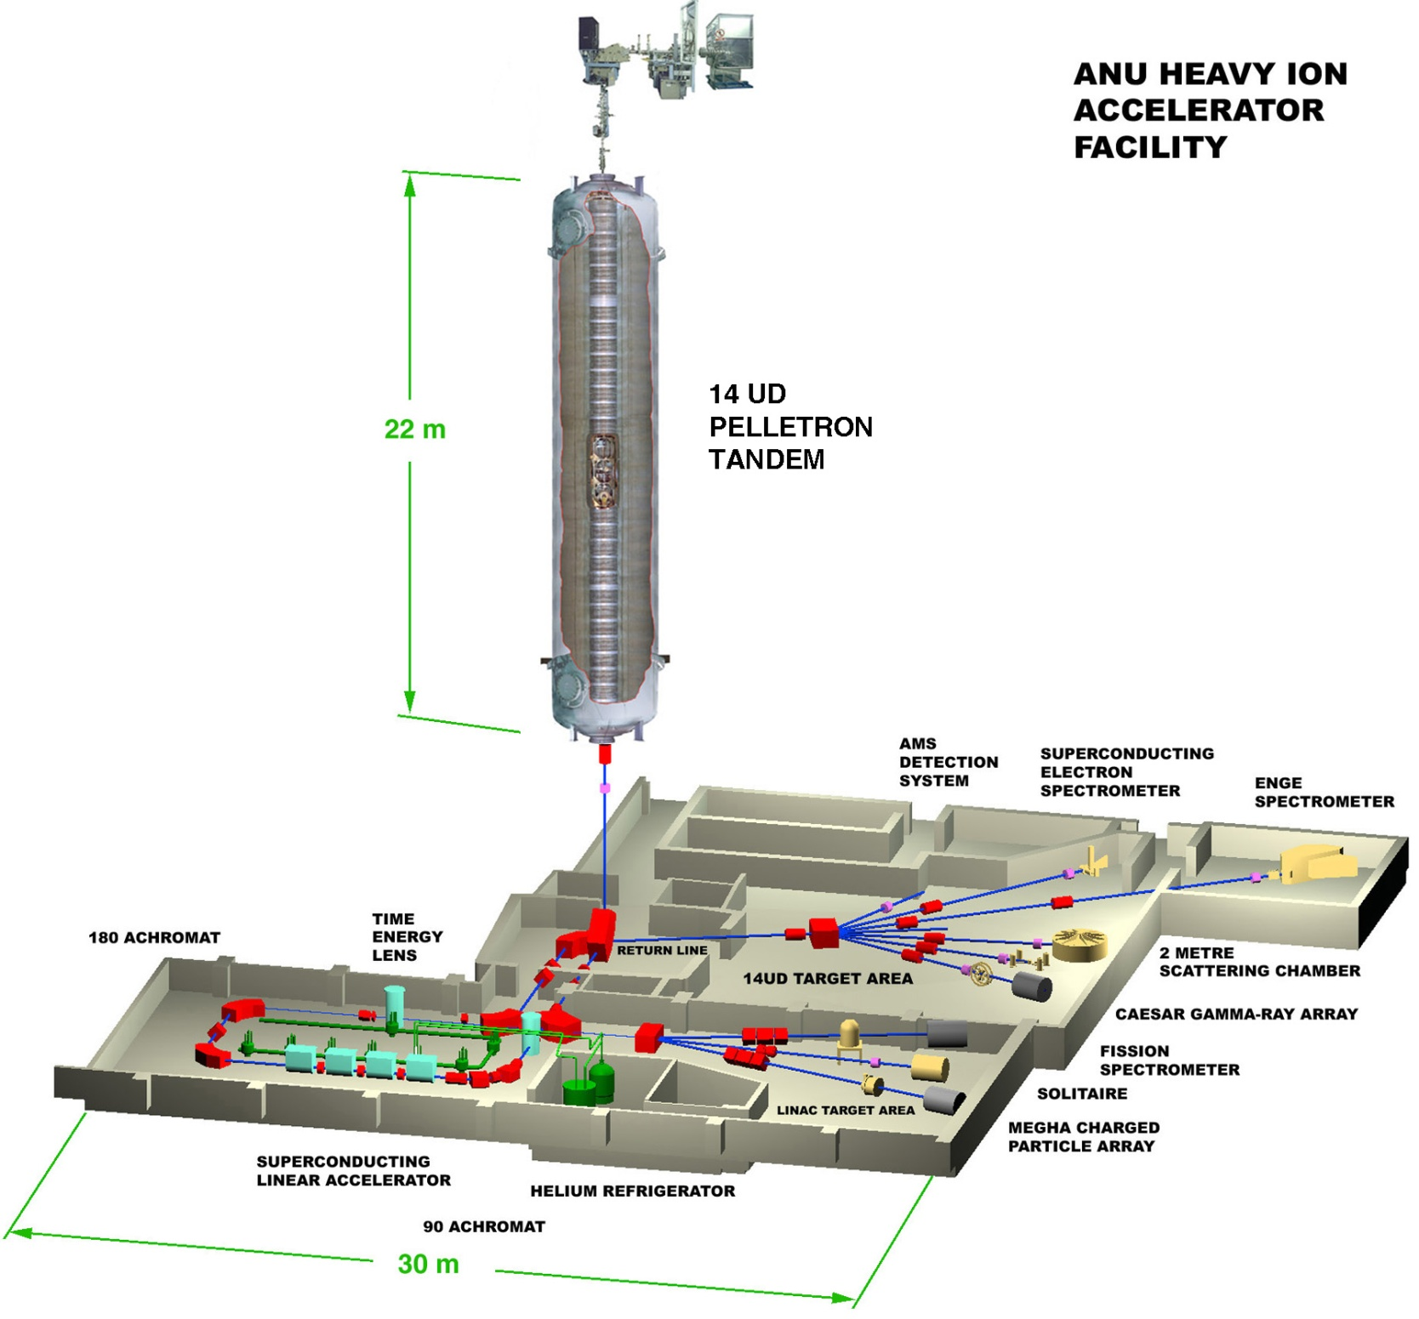
22 tonnes of SF6

Slide 3
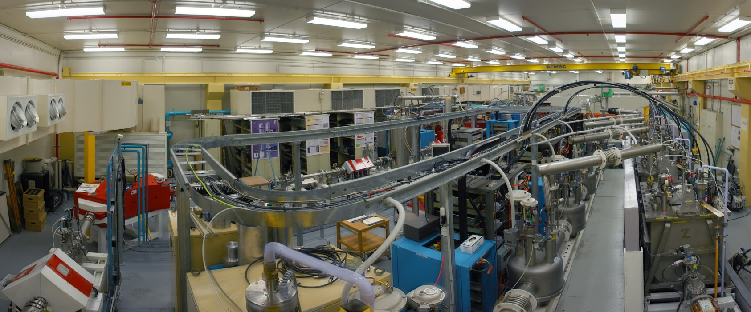
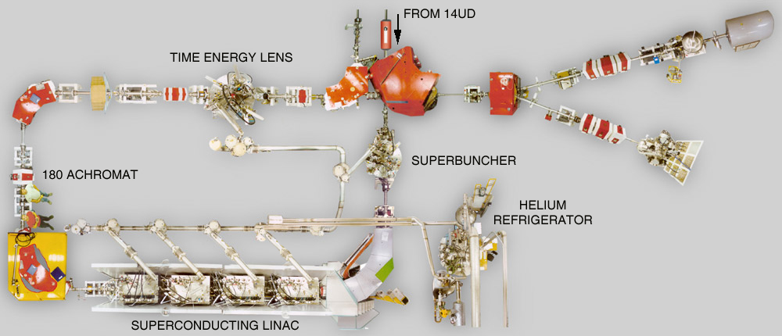
SRF linac booster 6.5 MV effective voltage

Slide 4
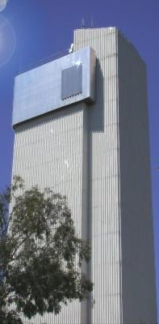
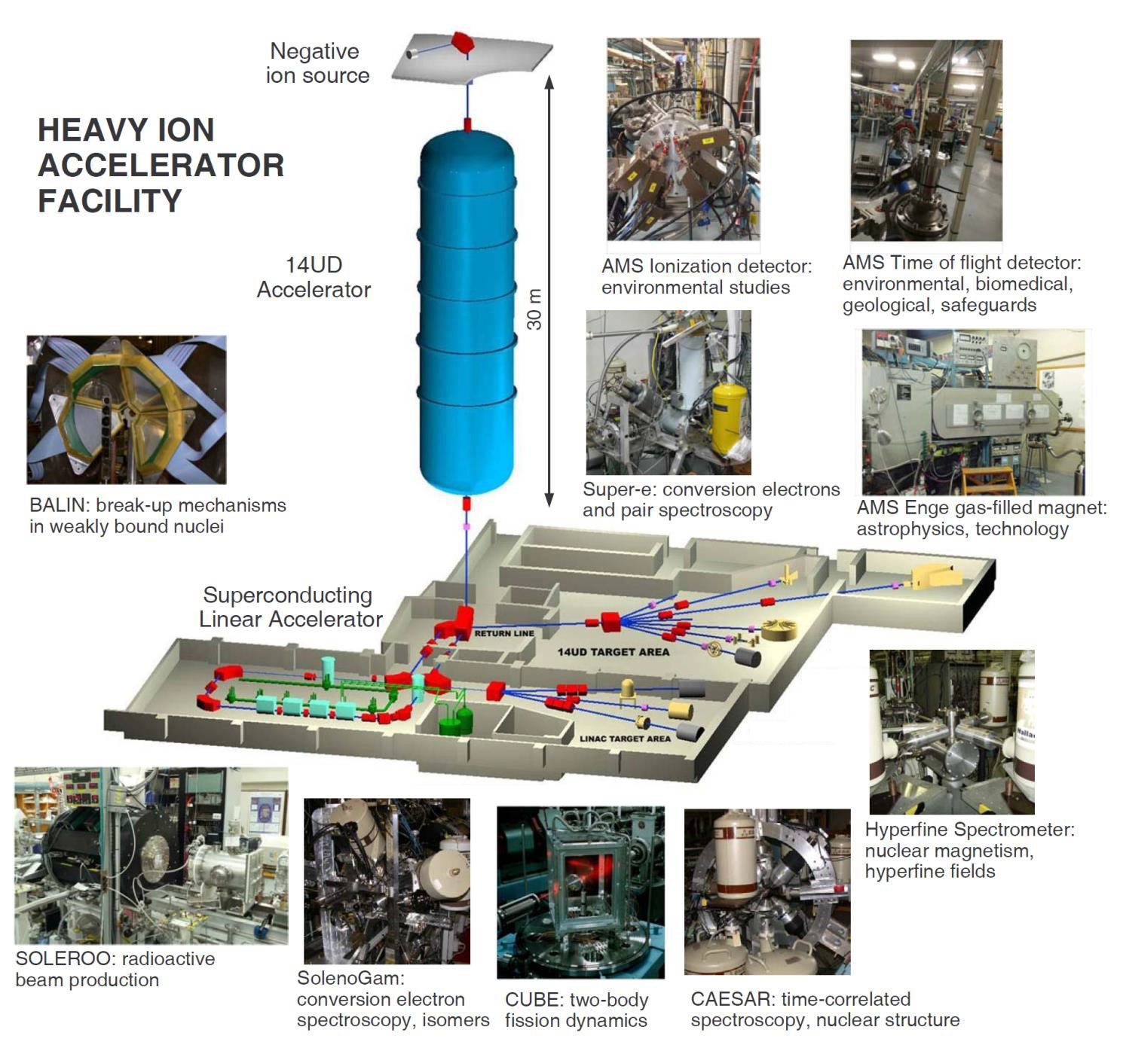
Ten Beam Lines

Slide 5
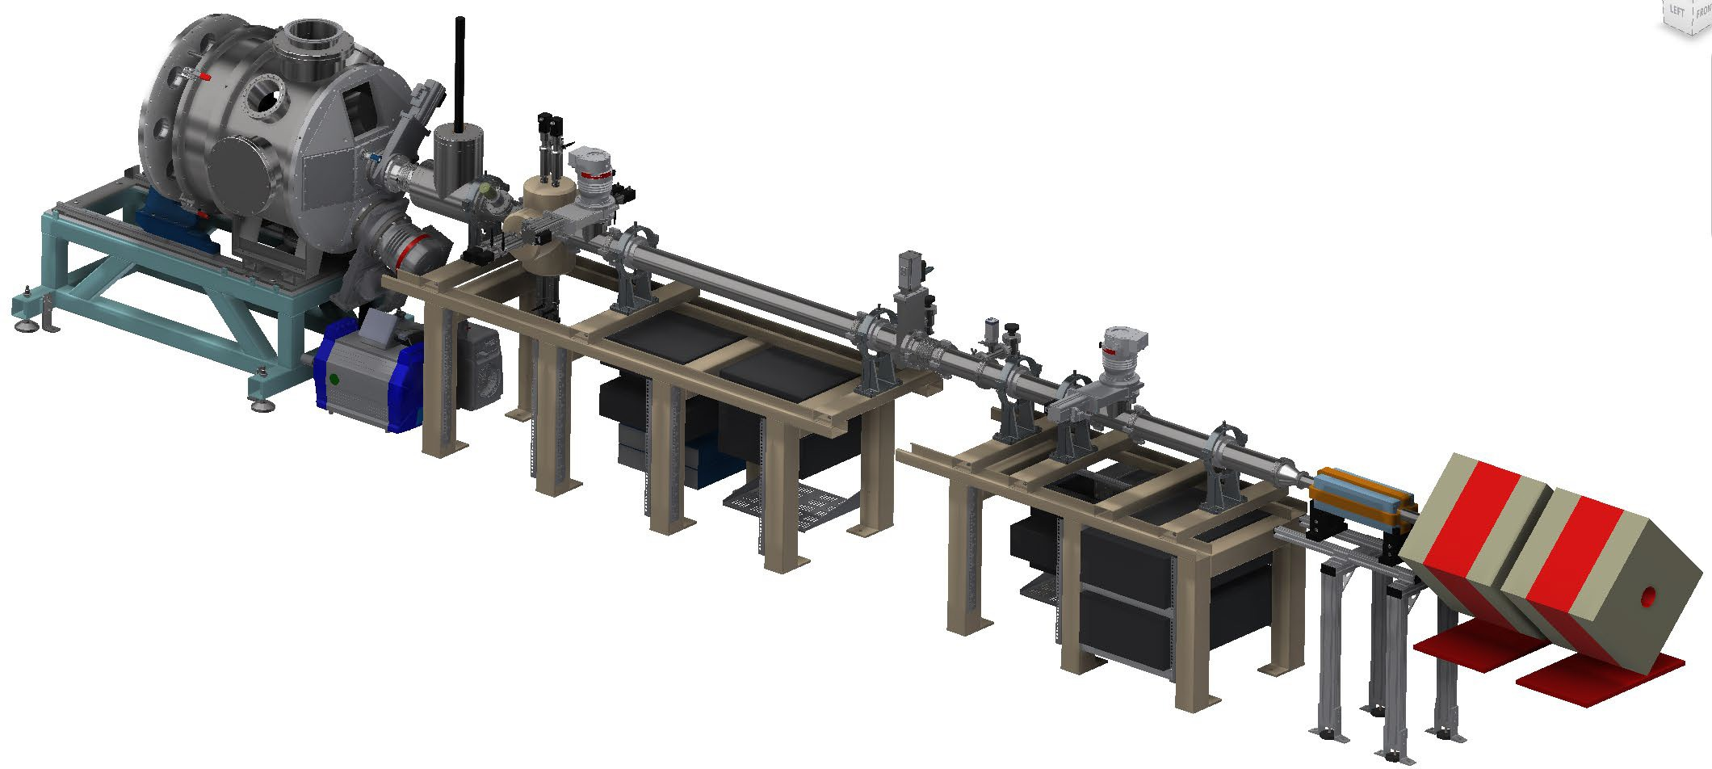
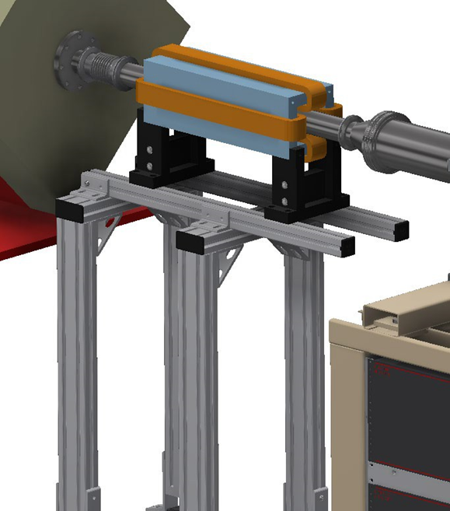
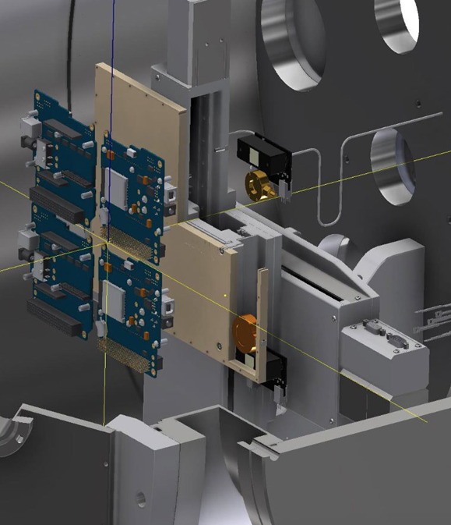
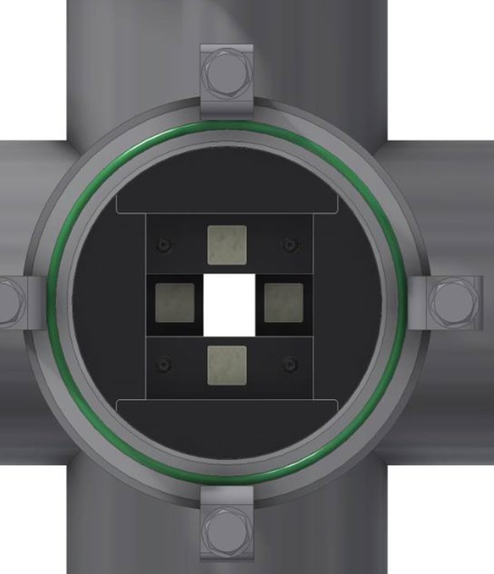
Space Radiation beam line
Ion beam scanning
Irradiation chamber Beam characterization

Slide 6
Past and present HIAF upgrades
14UD/linac and its instruments:
Tube entrance lens control NIMB 421 (2018) and NIMA 767 (2014)
L5 major upgrade and new He⁻ ion source
Entire inventory of posts and tubes ordered from NEC
(new e magnetic suppression- ondulator)
New target area, and beam lines under investigation
NP Department 3-6-9 years development plan has been updated
Upgraded SNICS and McSNIC for reliability NIM B 415 (2018)
Linac beam pulse width monitor, tunes with srf phase detector
PRAB 19 (2016), Cryogenics 85 (2017) and Physica C 519 (2015)
Linac resonators upgrade 2 x PRST AB 9 (2006), and PRST AB 10 (2007)

Slide 7
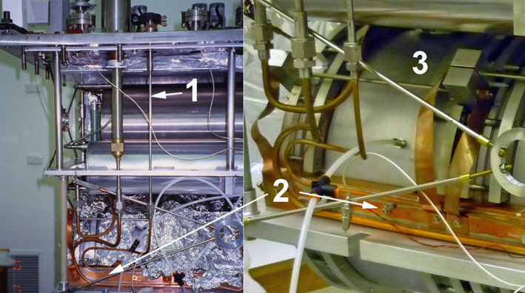
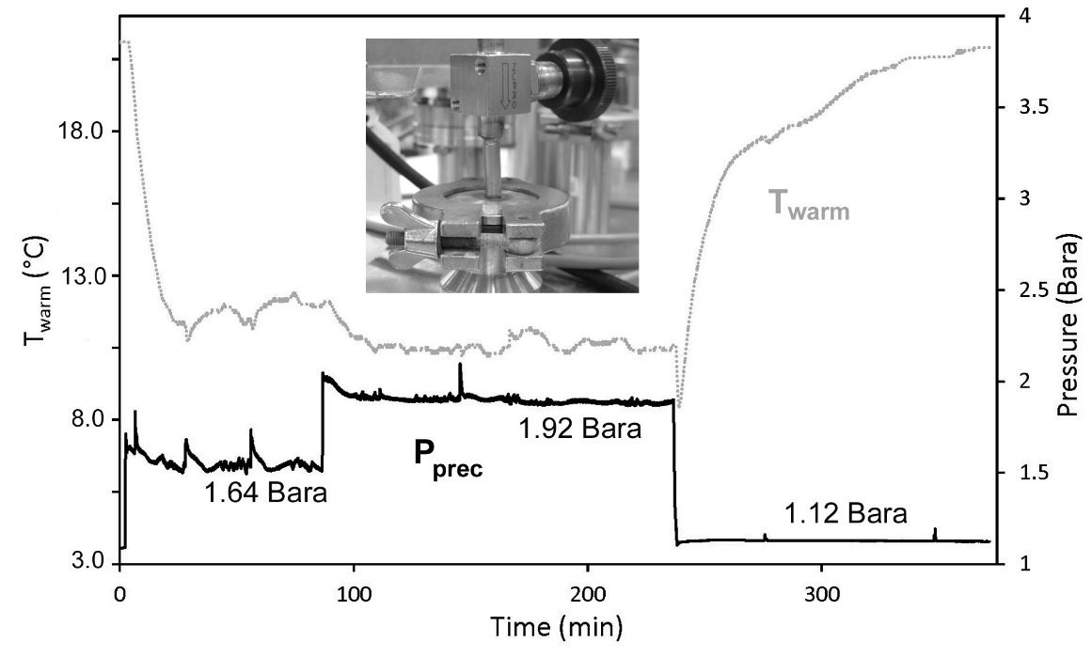
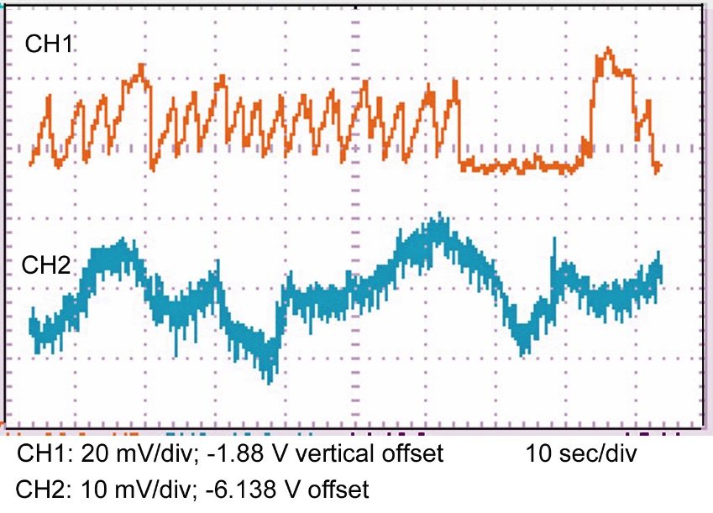
Precool TAO mitigation linac #29
N. Lobanov,
Cryogenics 85 (2017)

Slide 8
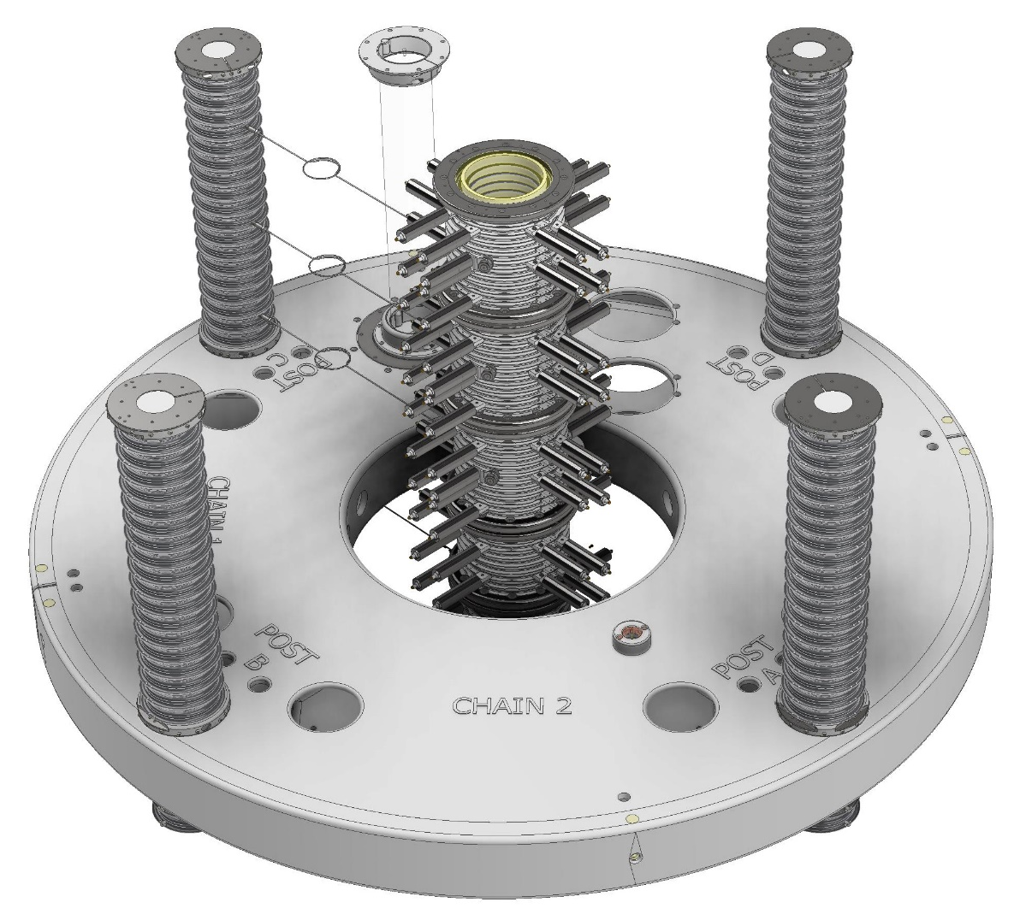
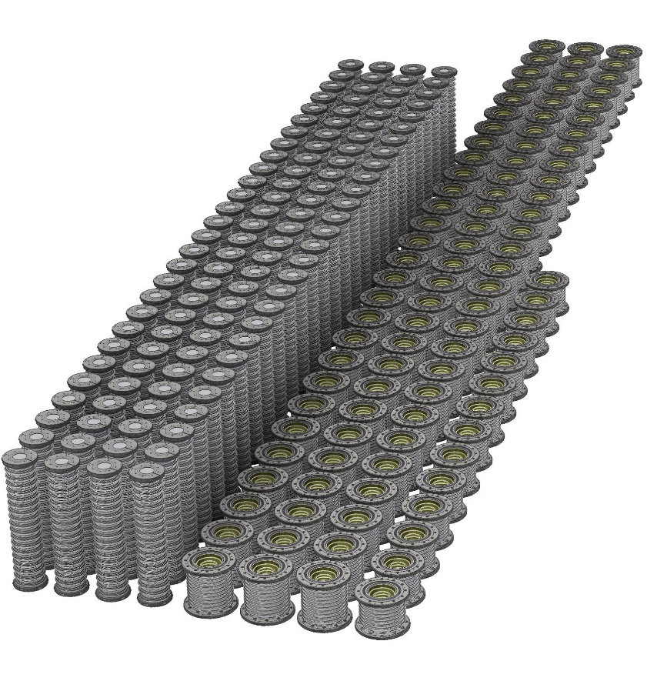
14UD acceleration unit
14UD = 112 ceramic posts
and 98 acceleration tubes
1 unit designed to 1 MV accelerating voltage per unit corresponding to ~1 MV/m accelerating field ; ~3 M$/1 MV hardware cost; ~0.6 kW/1 MV power cost

Slide 9
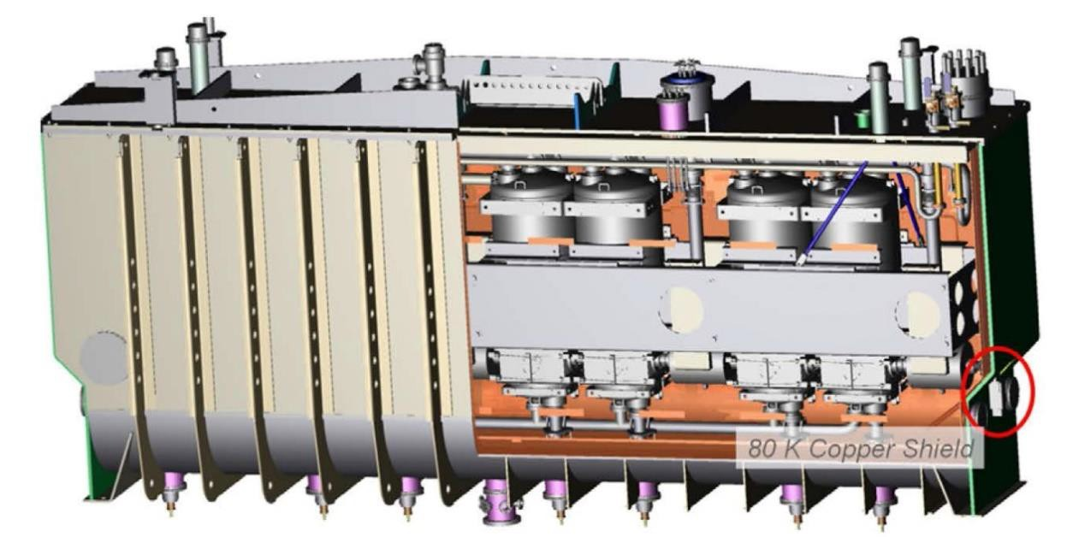
6-9 years and beyond
Accelerator development aspirations
Cost
Staged as funding available
New beam lines
New Linac 4× higher field gradient
New Linac injector
  Parallel operation of 14UD and Linac
Time
Prepared for new NCRIS infrastructure program
State of the art cryomodules
2 fit present Linac footprint
  Two give 35 MV boost
  5 times present Linac
  USD ?M$

Slide 10
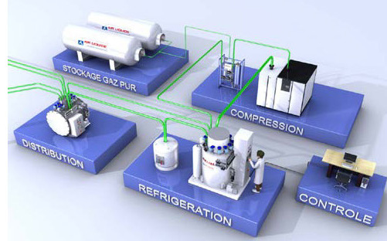
Commercial 4K refrigerator
Typical commercial 4K refrigerators or liquifiers require many systems: compressors, water cooling, electrical infrastructure, LN2 and LHe storage vessels, He gas storage and recovery systems, a He purification system, extensive piping, so maintenance, operation and reliability are always an issue.
R. Kephart et al Proceedings of SRF2015, Whistler, BC, Canada, Fermilab

Slide 11
Stand-alone cryomodule concept
SRF accelerators rely on central refrigeration systems and piping to distribute liquid helium and nitrogen coolants.
A stand-alone cryomodule would eliminate the need for cryoplants.
It can be placed in locations where extending the cryogenic distribution system is not feasible, or at facilities that never had cryogenics before and do not need the specialized staff/ infrastructure required for operation.
The cryomodules still need liquid helium for initial cooldown and filling the bath, which will be done once via dewar unless use conduction cooling
Stand-alone cryomodules require less frequent and simpler maintenance relative to cryoplants.
Cryocoolers are not economical for large-scale cooling demand due to lower efficiency: a large helium cryoplant requires ~0.4–0.8 kW(electrical)/W(cooling) while a cryocooler requires > 10 kW(electrical)/W(cooling).
Sergey V. Kutsaev et al IEEE Transactions on Applied Superconductivity ( Volume: 30, Issue: 8, December 2020)

Slide 12
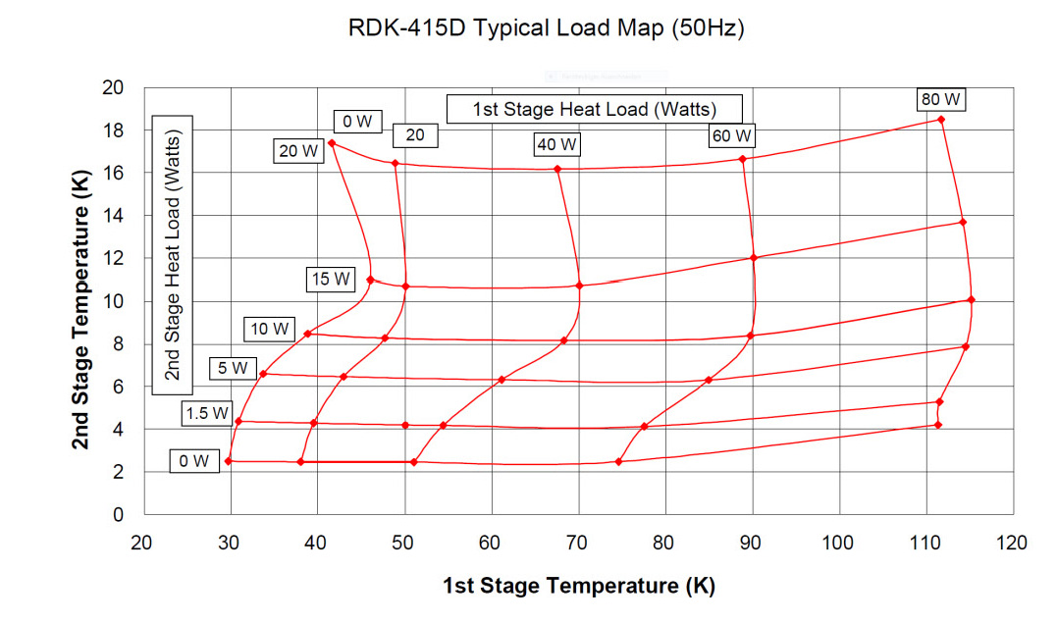
Typical cryocooler load map
The cooling capacity on the second stage of the cryocooler over the range of 8 K to 12 K is between 10 and 20 watts, and is almost independent of the first stage temperature over the range of 30 K to 70 K. The second-stage cooling capacity is up to 80 watts at 90 K and over 40 watts at 60 K.
A. Nassiri Proceedings of SRF 2013, (ANL)

Slide 13
New class of compact srf accelerators
When technological advances are integrated into a single design they enable an entire new class of high-power srf accelerators.These technologies are:
A new niobium surface processing technique “N-doping” dramatically reduces the cryogenic requirement at 1.8K and 4.4 K (Fermi Lab). Cavities prepared in this way and operated at 4.4 K achieve a Q₀ of ~6-7 x 10⁸ at 6 MV/m.
Single cell niobium cavities coated with Nb₃Sn (or MgB₂) can be operated with gradients of 10 MV/m with a quality factor (Q₀) of 2 x 10¹⁰ at a temperature of 4.2K (Cornell)
With reduced dynamic heating due to the advancements highlighted in 1) and 2), one can then envision conduction cooling of the SRF cavity resulting in a drastically simplified cryogenic system requiring no gas or liquid Helium inventory.
Recent technologies of RF control (Fermilab) and low heat leak fundamental RF power coupler with reduced static heat losses.
R. Kephart et al Proceedings of SRF2015, Whistler, BC, Canada, Fermilab

Slide 14
New class of rf superconductors
Heating in a SRF cavity is the result of non-zero resistance due to scattering of unpaired electrons excited by the radio frequency alternating fields. These “dynamic losses” can be reduced by:
improved cavity surface processing to decrease surface impedance.
lower the operating frequency since an electrons scale as the frequency squared;
lower the operating temperature, resulting in fewer unpaired electrons (e.g. 1.8 K for Nb), but with increasingly complex refrigeration requirements;
use a superconductor with a higher transition temperature (Tc) such as Nb₃Sn or MgB₂ (Tc ~39K). A. Nassiri Proceedings of SRF 2013, (ANL) Studies on the application of magnesium diboride (MgB2) high-Tc superconducting films.
R. Kephart et al Proceedings of SRF2015, Whistler, BC, Canada, Fermilab

Slide 15
Bulk Nb QWR ANL/RadiaBeam
RadiaBeam with ANL developed a stand-alone cryomodule, based on a commercially available cryocooler, for a ‘dressed’ 72.75 MHz QWR.
Several particular reasons not to use conduction cooling:
The existing cavity with known good performance already has an integral helium jacket
The two 5-Watt cryocoolers with a Joule-Thompson refrigerator coupled to a Gifford-McMahon cryocooler provide a natural way to maintain liquid and recilculate helium boil-off, unlike for the GM-only, which are typically sold as closed systems.
A successful demonstration in this case does not require expensive cavity R&D.
Static heat leaks are minimized to the level of 1.94 W
Efficient Nb QWRs can provide 2 MV accel voltage with 4.6 W dynamic losses;
Three stage Gifford-McMahon Joule-Thomson style cryocooler supplied by Sumitomo, a 5 W GM-JT. With a static heat load budget of <2 W, one of these cryocoolers should provide significant overhead for static losses. The second cryocooler should be fully available for the additional dynamic heat load
Sergey V. Kutsaev et al IEEE Transactions on Applied Superconductivity ( Vol: 30, Issue: 8, December 2020)

Slide 16
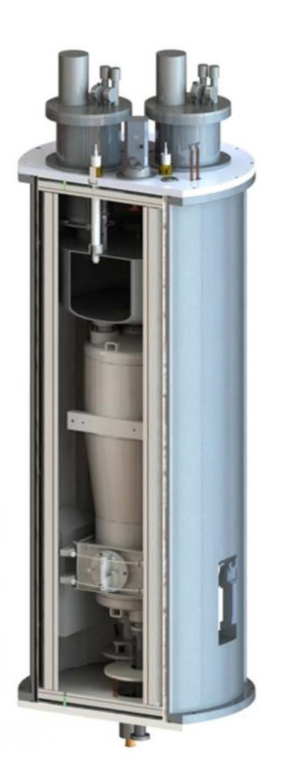
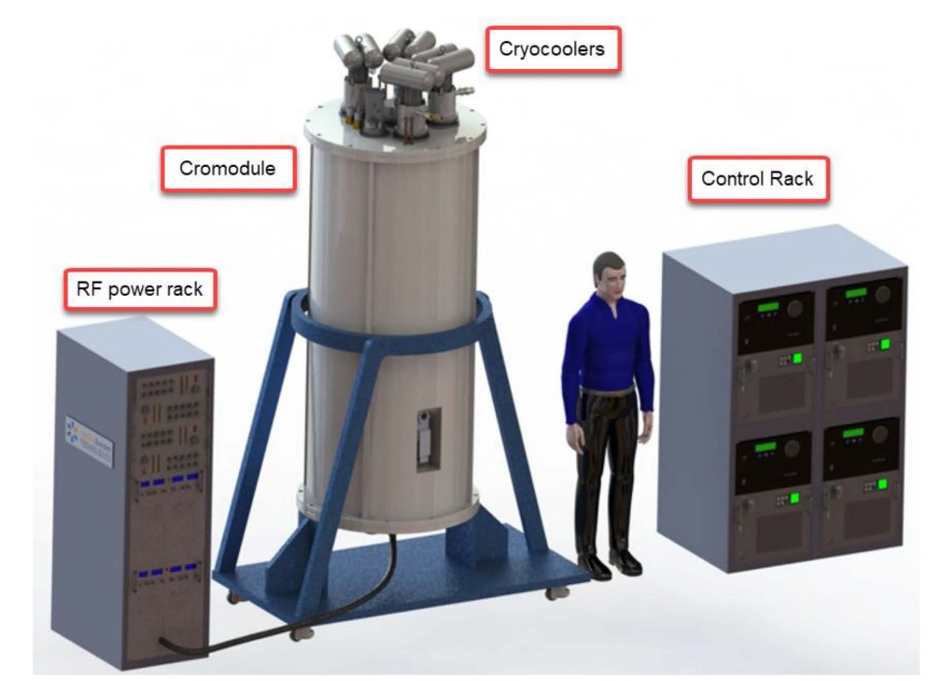
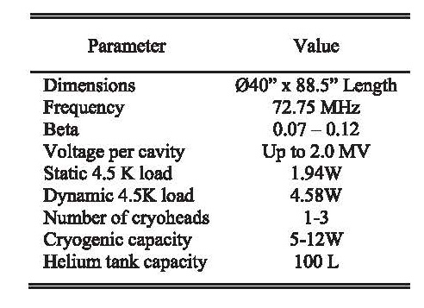
RadiaBeam cryomodule and QWR
State of the art stand-alone cryomodule based on
Nb QWR (RadiaBeam Systems and ANL)
2 fit present Linac footprint
  One gives 2 MV boost
  3 replace present Linac
  USD ? $
  Cryoplant and cryo crew are not required

Slide 17
Cryocooler with conductive cooling
Jefferson lab developed multi-metallic 1.495 GHz elliptical cavity conductively cooled by a cryocooler. (Cu- Nb- Nb₃Sn)
The cavity has a 2 μm thick layer of Nb₃Sn on the inner surface, exposed to the rf field, deposited on a 3 mm thick bulk Nb shell and a bulk Cu shell, of thickness > 5 mm deposited on the outer surface by electroplating.
A bolt-on Cu plate 1.27 cm thick was used to thermally connect the cavity equator to the second stage of a Gifford-McMahon cryocooler with a nominal capacity of 2 W at 4.2 K.
The cavity was tested initially in liquid helium at 4.3 K and reached a peak surface magnetic field of 36 mT with a quality factor of 2 x10⁹.
The cavity cooled by the crycooler achieved a peak surface magnetic field of 29 mT, equivalent to an accelerating gradient of 6.5 MV/m, and it was able to operate in continuous-wave with as high as 5 W dissipation.
G. Ciovati et al Superconductor Science and Technology, Volume 33, Number 7

Slide 18
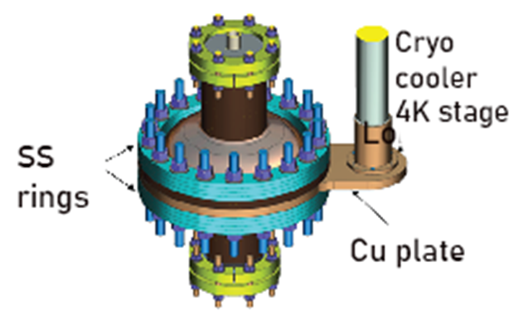
Jefferson single cell cavity
Nb₃Sn, Tc ~ 18 K as compare to 9K for pure Nb. Nb/Cu bi-metallic samples were produced by electro- plating Cu directly onto a Nb and thermal conductivity measurements showed that values of ~ 1 kW/(m x K) could be achieved at 4.3 K, compared to ~75 W/(m x K) obtained on Nb only. A copper layer ~76 μm thick was deposited on the cavity outer surface by cold-spray. Copper powder of 99.9 % purity and ~40 μm size was used along with He as gas carrier. Oxygen-free copper was then electroplated onto the cold-sprayed layer.
G. Ciovati et al Superconductor Science and Technology, Volume 33, Number 7

Slide 19
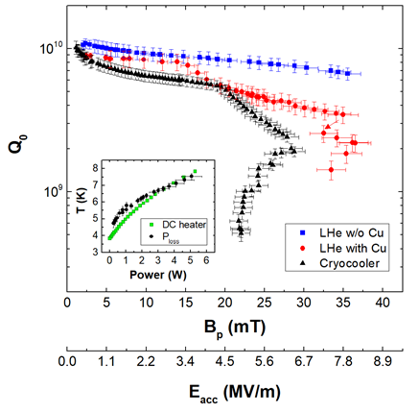
Q- test
Q drop may be caused by contamination of the Nb3Sn film by the plating solution. Another possibility is related to strain of the Nb₃Sn film given by the differential thermal expansion coefficient between the Cu layer and the Nb layer.
29 mT peak surface magnetic field at 5 W of power dissipation results in E_{acc}= 6.5 MV/m and ~2 MV accelerating voltage since L_{acc}= 0.318 m.
G. Ciovati et al Superconductor Science and Technology, Volume 33, Number 7

Slide 20
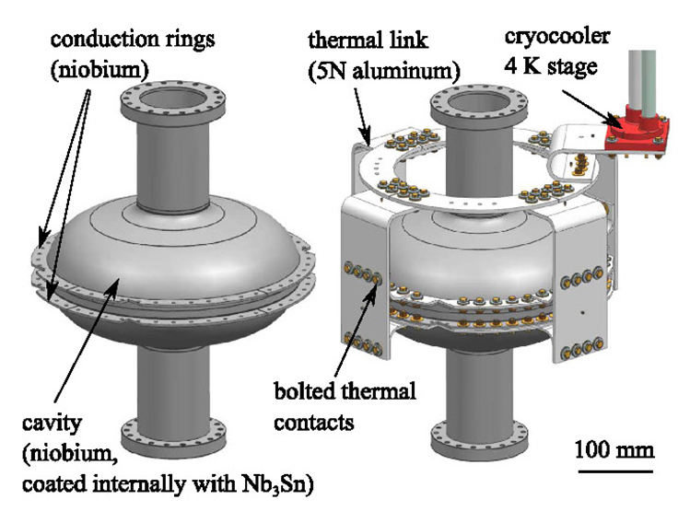
Conduction cooling at Fermilab
650 MHz Nb₃Sn cavity coupled using high purity aluminum thermal links to a 4 K pulse tube cryocooler generated accelerating gradients up to 6.6 MV/m at 100% duty cycle. Cryomech PT420 two-stage pulse tube cryocooler (rated to provide cooling of 2 W @ 4.2 K with 55 W @ 45 K).
R C Dhuley et al 2020 Supercond. Sci. Technol. 33 06LT01

Slide 21
Single cell cavity at Fermilab
650 MHz niobium cavity (RRR>300) for conduction-cooling: niobium rings electron-beam welded to the cavity near its equator (left) and a 5 N aluminum (purity >99.999%) thermal link connecting the cavity to the 4 K stage of a cryocooler (right).
The bolting procedure involves interposing a 4 mil thick foil of indium between the niobium and aluminum plates and pressing the contact with 2 kN force applied by a silicon bronze screw, a brass nut, and stainless steel Belleville disc springs.
The cavity was coated internally with a ~2 μm thick Nb₃Sn layer via vapour diffusion before cryogenic testing.
R C Dhuley et al 2020 Supercond. Sci. Technol. 33 06LT01

Slide 22
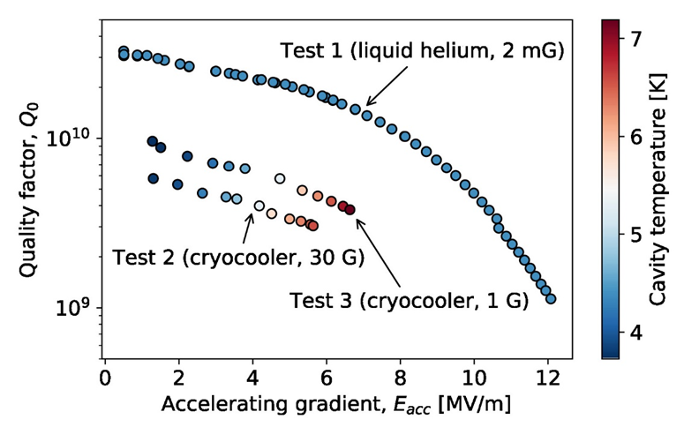
Q-test at Fermilab
Test 1 used a helium bath cooled cavity at 4.4 K. In Tests 2 and 3, the cavity was conduction-cooled with a 2 W @ 4.2 K pulse tube cryocooler. The improvement in Test 3 resulted from the reduction of magnetic field around the cavity when magnetic disc springs (residual ~30 G) were replaced with cleaner disc springs (residual < 1 G).
The colour gradient in the data for Test 2 and Test 3 reflects the cavity temperature vary from ~4 K to ~7 K depending on the E_{acc}.

Slide 23
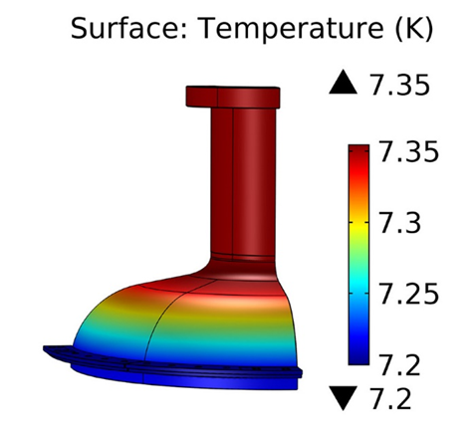
Cavity surface temperature
Simulated cavity surface temperature during operation at 6.6 MV/m E_{acc}. The conduction ring inner faces are held at the measured temperature of 7.2 K and 4 W of RF heat is applied on the inner surface of the cavity.
R C Dhuley et al 2020 Supercond. Sci. Technol. 33 06LT01

Slide 24
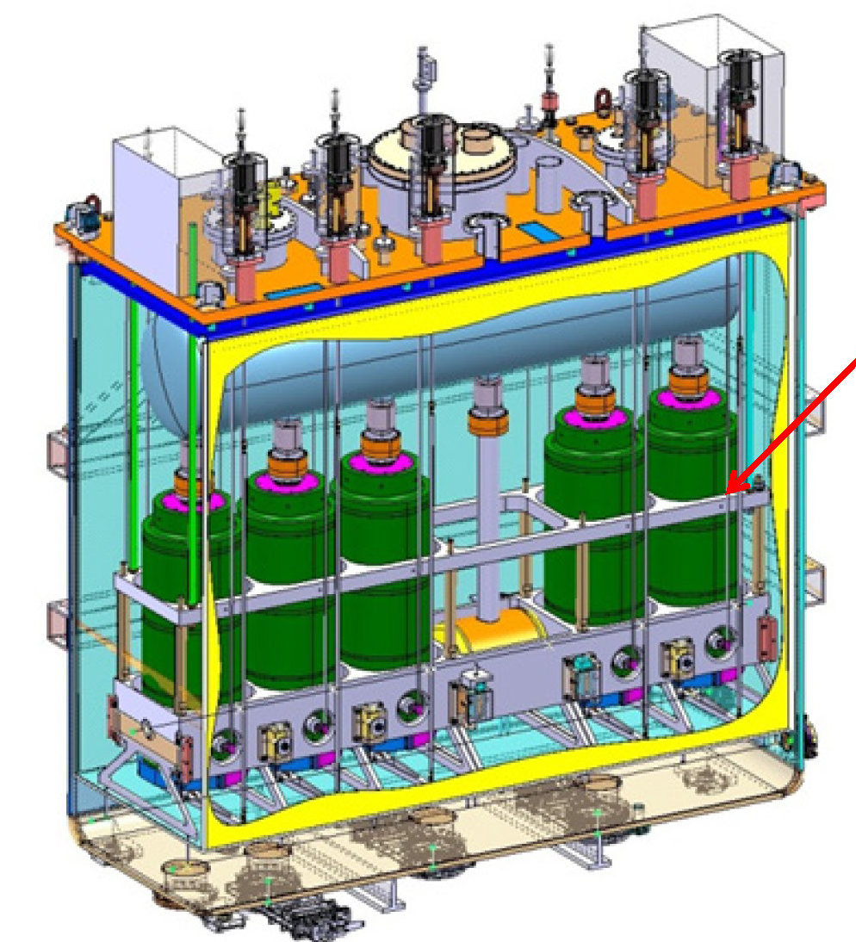
Alternative option: Nb sputtered on Copper
Nb sputtered on Cu
QWR
QWRs for HIE ISOLDE, CERN
Strong development program focused on bias diode sputtering method
W. Venturini et al SRF 2013 (CERN)

Slide 25
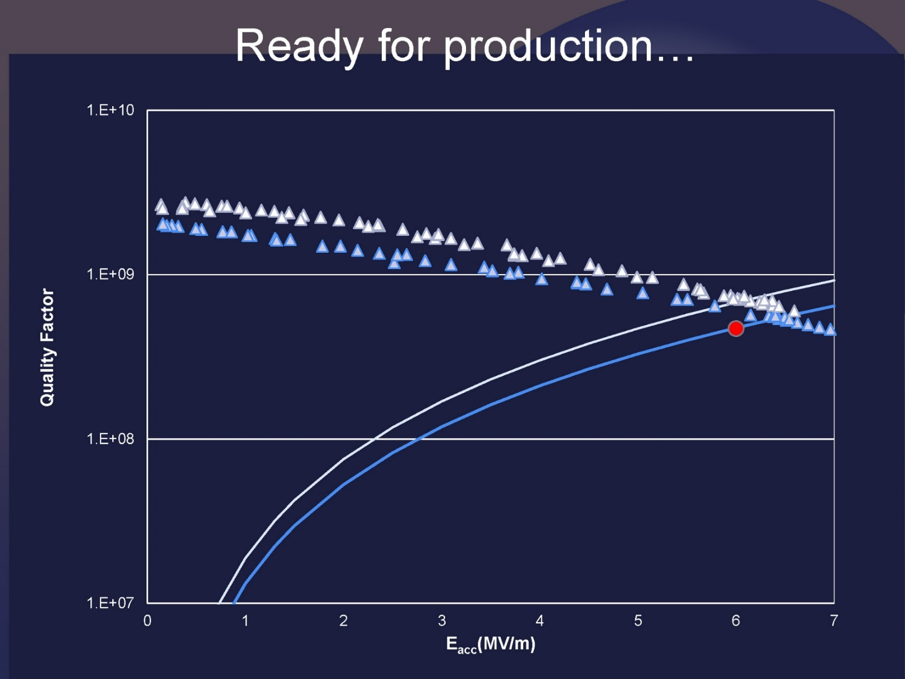
QWR performance
7 W
10 W
Extrapolated field at 5 W of power dissipation E_{acc}= 5.5 MV/m and ~1.2 MV accelerating voltage since L_{acc}= 0.22 m.

Slide 26
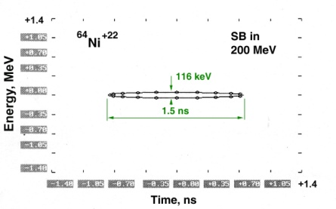
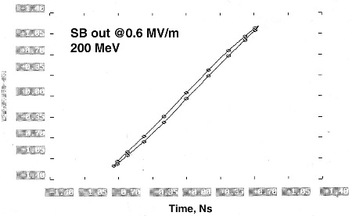
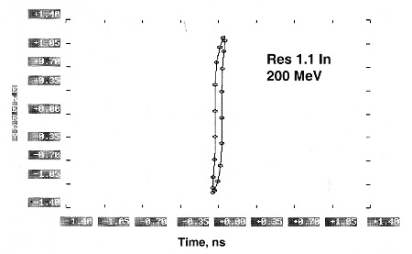
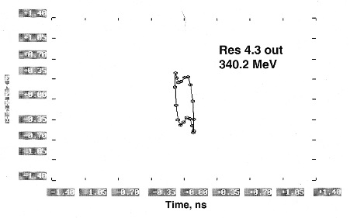
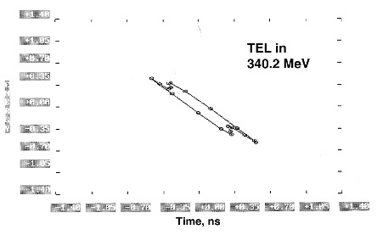
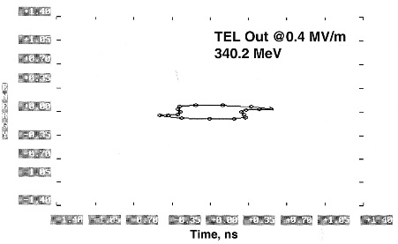
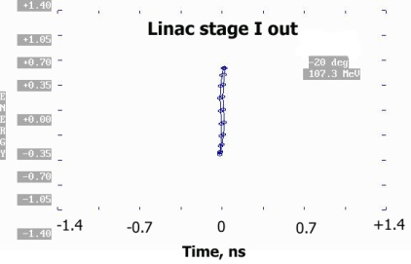
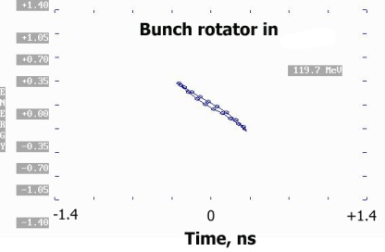
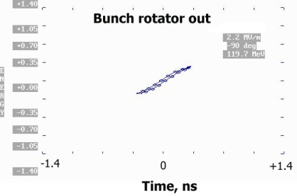
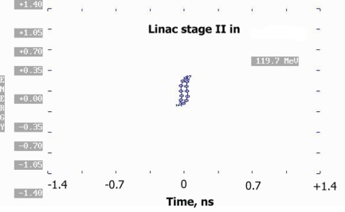
Operation modes of bunching system
(a) bunching
(b) de-bunching
(c) bunch rotation

Slide 27
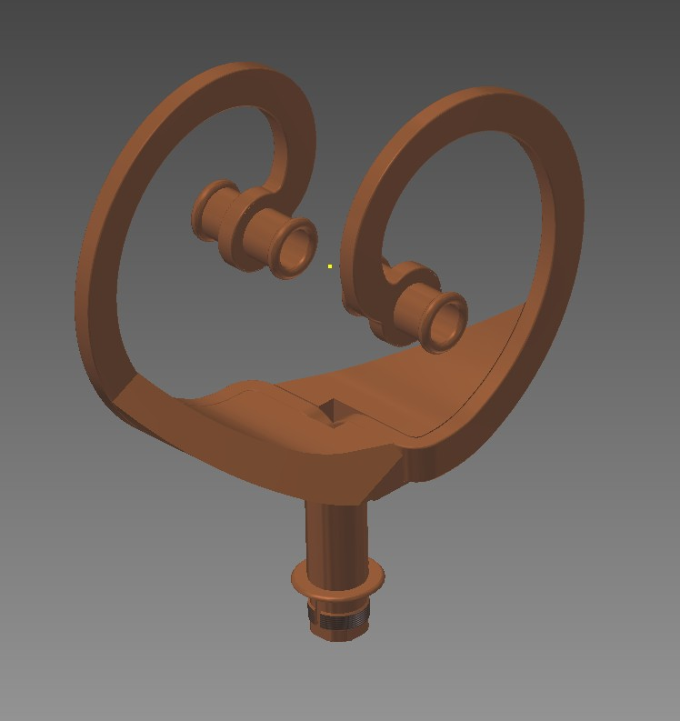
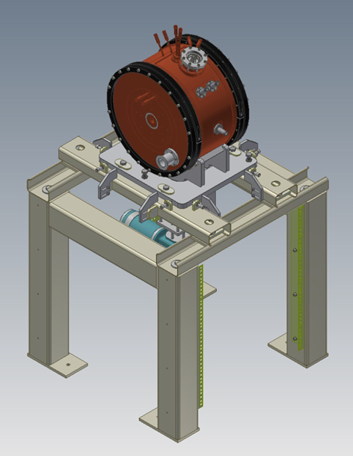
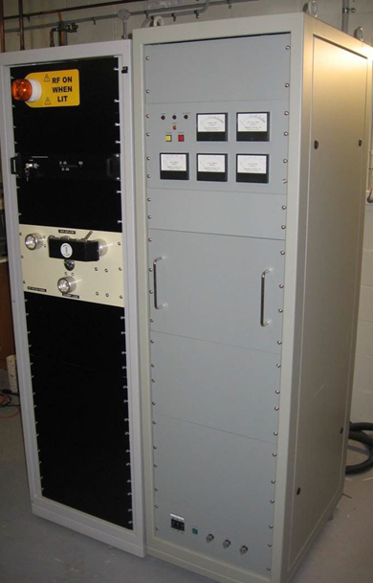
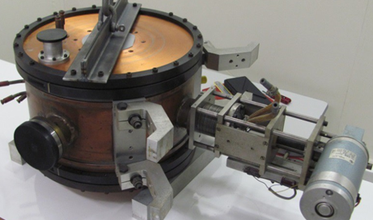
RT Super-buncher option
10 kW cw RF amplifier
Sourced unwanted resonators from decommissioned Heidelberg LINAC booster

Slide 28
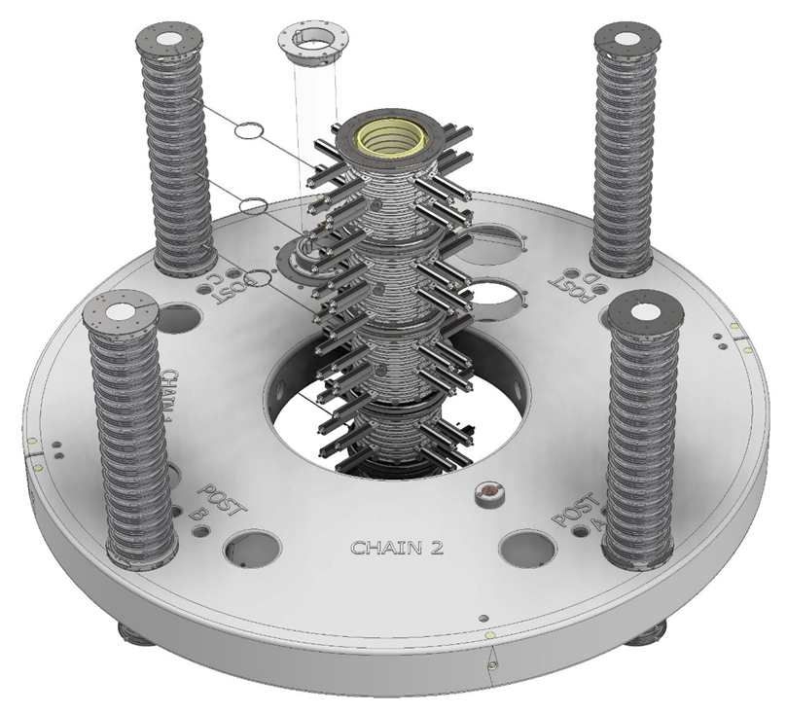

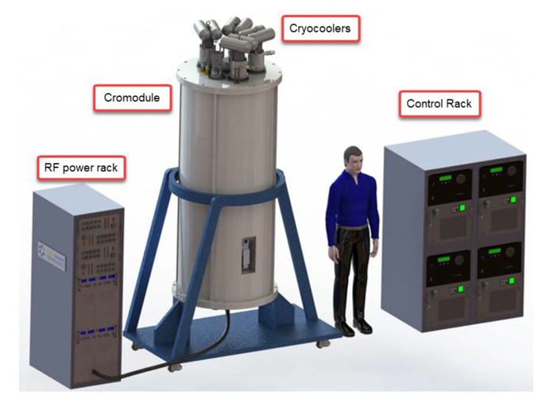
Conclusion
~ 3 M$/1 MV hardware cost;
~ 0.6 kW/1 MV power cost
14UD:
~ 2 M$/1 MV hardware cost;
~ 3 kW/1 MV power cost
Conventional linac:
~ 1 M$/1 MV hardware cost;
~ 3 kW/1 MV power cost
Stand alone linac:

Slide 29
Acknowledgement
NP Technical Staff:
T. B. Tunningley, S. T. Battisson, A.C. Cooper, J. Heighway, C. Kafer, T. Kitchen, P. Linardakis, C. Notthoff, D. Tempra, M. Gwynneth and R. Tranter

Slide 30
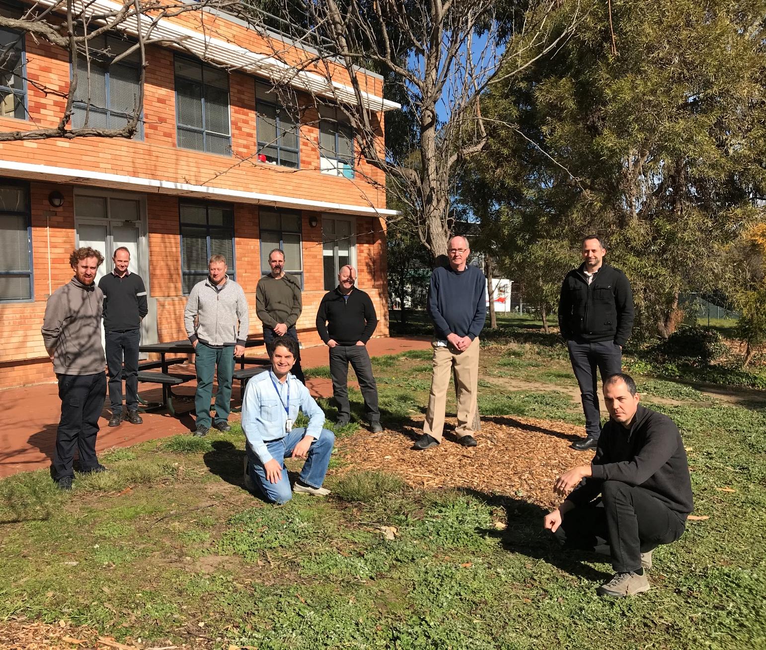
Q

