Slide 1

Development of high-energy irradiation accelerators in China
Jiaru Shi
Tsinghua University
On behalf of the linac team

Slide 2
Outline
Introduction to the irradiation accelerators
Backward traveling-wave (BTW) linac
Development of a 10-MeV, 24-kW BTW linac
Other activities on 10-MeV high-power irradiation

Slide 3
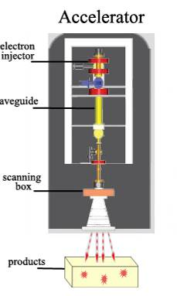
accelerator technology for irradiation & sterilization
Apply to irradiation processing of food, medical product, quarantine treatments and etc.
Damage to the molecular of the harmful organism. To control insects, parasites and pathogens, reduce spoilage.
Inhibit sprouting, delay ripening and extend self-life for certain farm produce.

Slide 4
Low Energy
  <300keV
  E-beam curing
Middle Energy
  0.3-5MeV
  Cross-linking of polymers, for cable / rubber …
High Energy
  5-10MeV
  Sterilization …Food irradiation

Slide 5
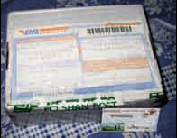
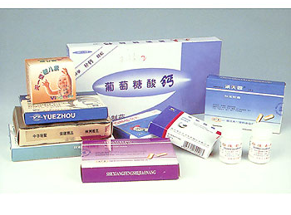
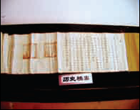
Application fields
Medical products, Medicine, Mails……Sterilization

Slide 6
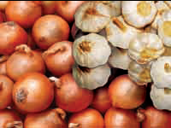


Application fields
Food irradiation

Slide 7
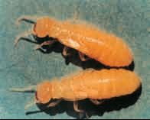
Application fields
Irradiation phytosanitary treatment

Slide 8
Excellence of E-Beam system
No environmental pollution.
Quick processing, high efficiency.
Do not open the packing case, so it can get across quickly and safely.
No toxicity or remains. Do not add any chemical reagent, so no original element and quality of products is influenced.

Slide 9
Linac
Irritation E-beam facility
  Dynamitron/Linac/Rhodotron/Ridgetron/Fantron
LINAC
  Standing wave/Traveling Wave/Backward Traveling Wave
Parameters
  10MeV （most common for e-beam）
  Beam power (higher is better: linac 20kW, rhodotron ~100kW)
[1] 陈怀璧等； 返波型行波电子直线加速结构的理论研究

Slide 10
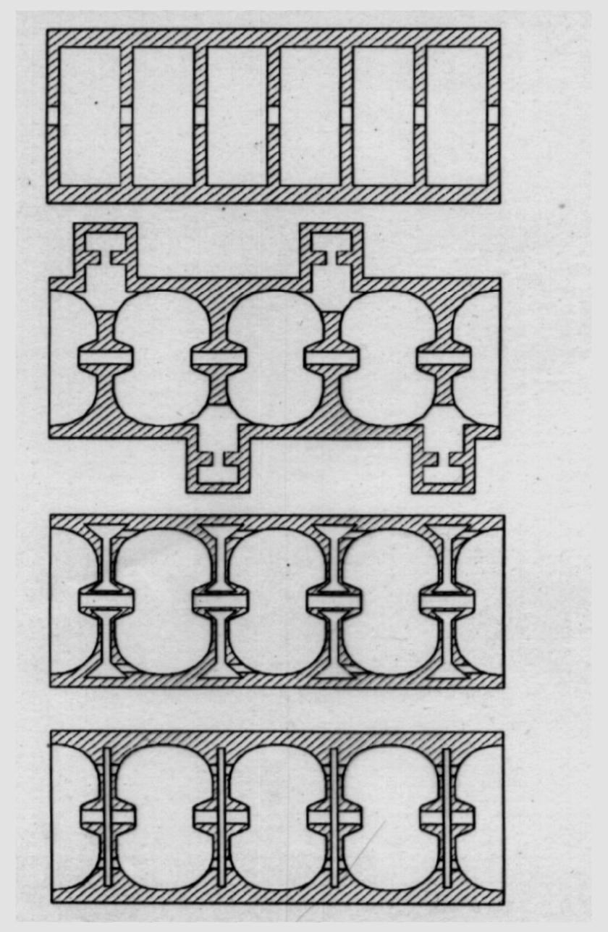
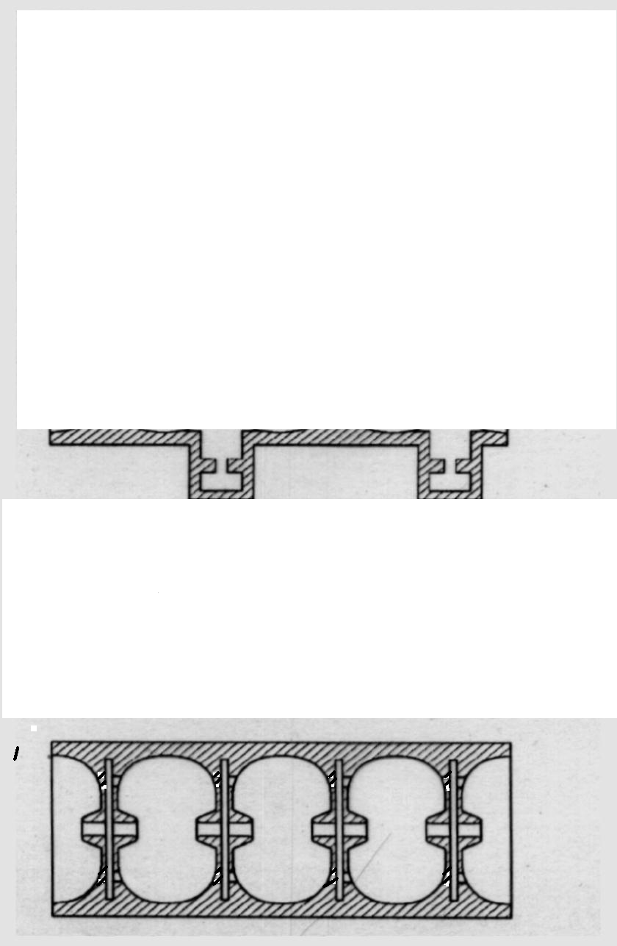
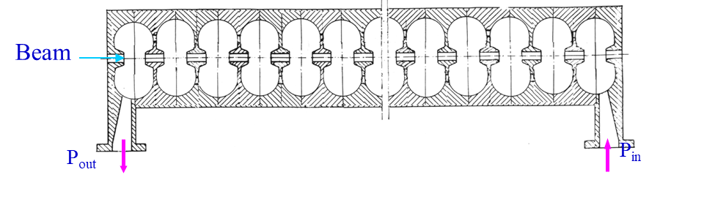
Introduction of BTW structure
BTW structure
  High-shunt impedance (~ Optimized shape)
  Short filling time (~Traveling wave)
 | Shunt impedance | Filling time | AFC | Reflection from input | Peak surface field
Disk-loaded TW | Low | Short | No | Low | Low
Bi-periodic SW | High | Long | Yes | High | High
BTW | High | Short | No | Low | High

Slide 11
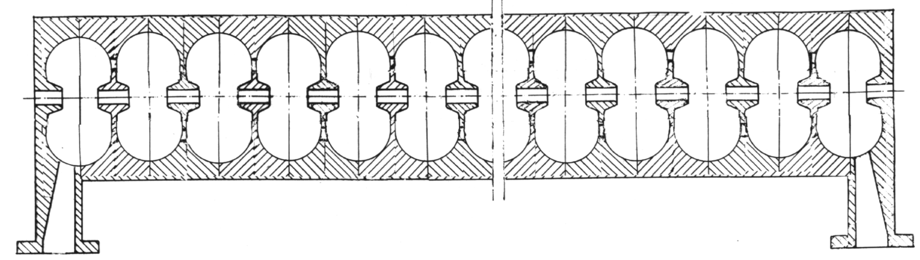
BTW structure
Beam
P_{out}
P_{in}
Cells coupled through coupling holes
  Beam-pipe cut off
  Easy for tuning a structure
  RF focusing
Power flow opposite direction to the beam
  High efficiency
  Easy for cooling the input coupler

Slide 12
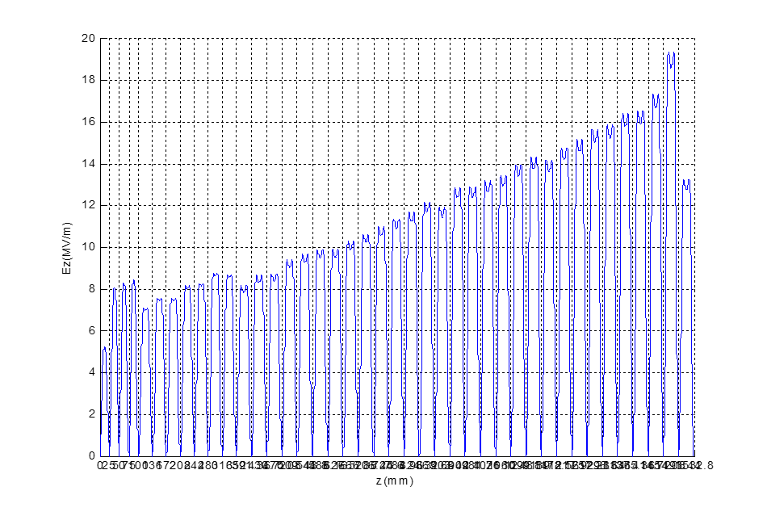
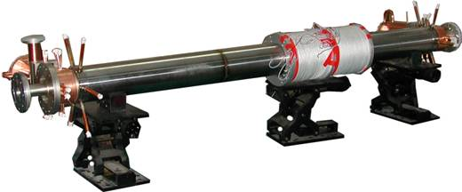
History of BTW 10MeV-20kW
Ebeam:
  Energy： 10MeV
  Peak current： 300mA
  Average power： 20kW
Accelerator tube:
  BTW type
  length：1.5meter
RF source:
  5MW/45kW klystron @ 2856MHz
Cooling jacket, Solenoid, Pumping port

Slide 13
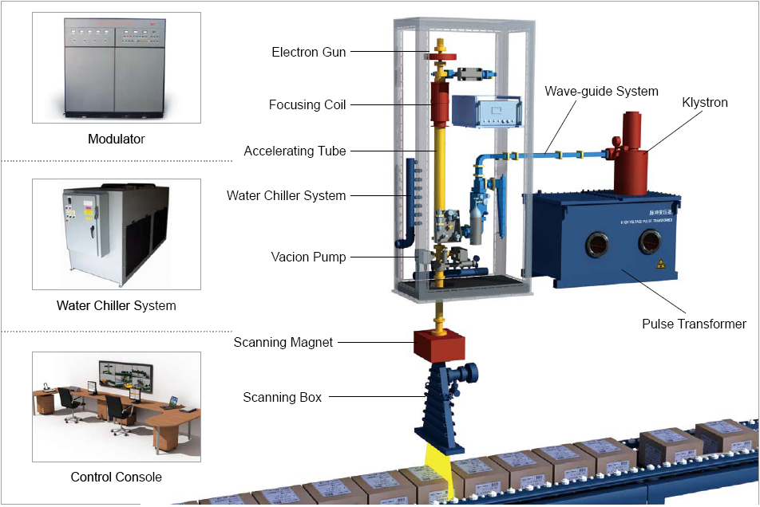
System integration (Nuctech)
Standing wave
Back wave

Slide 14
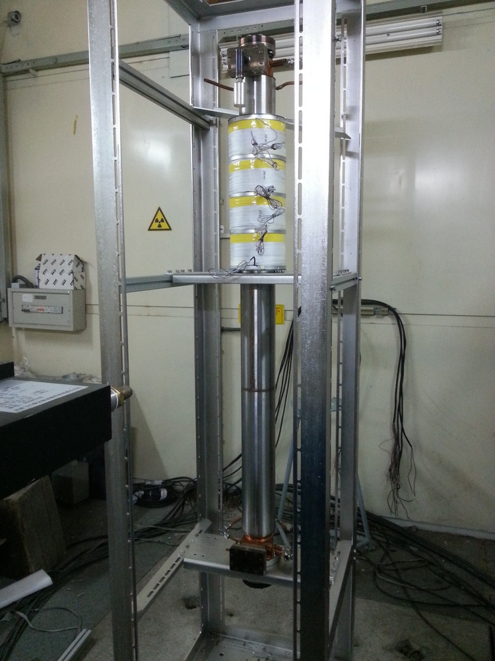
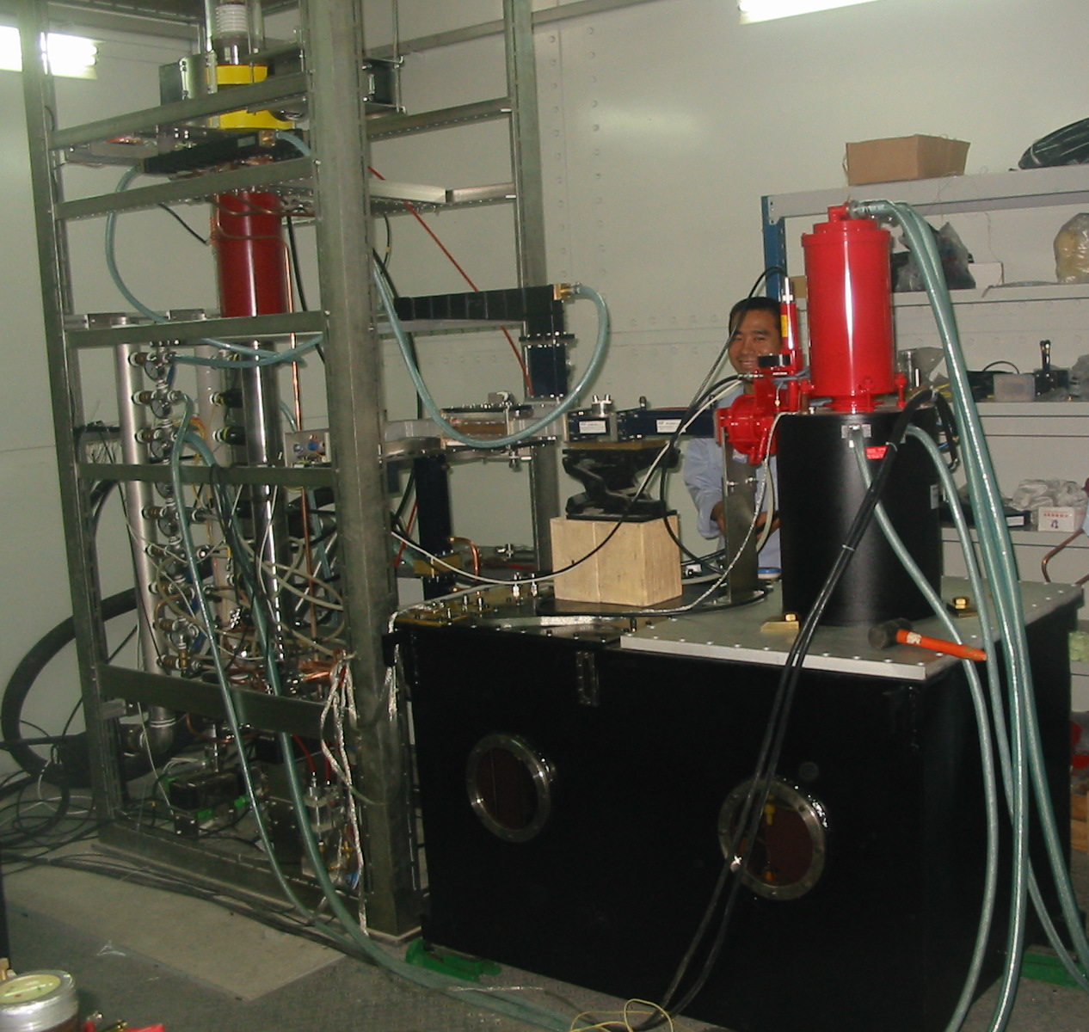
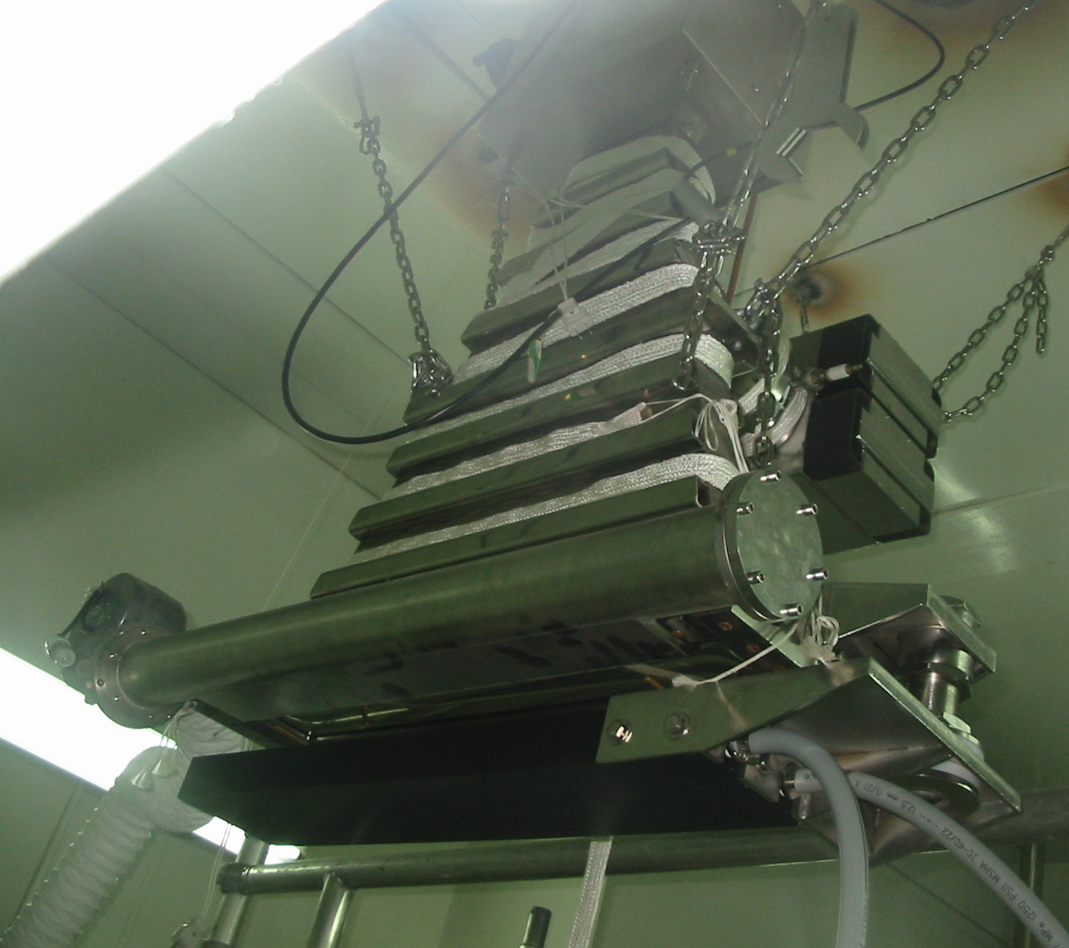
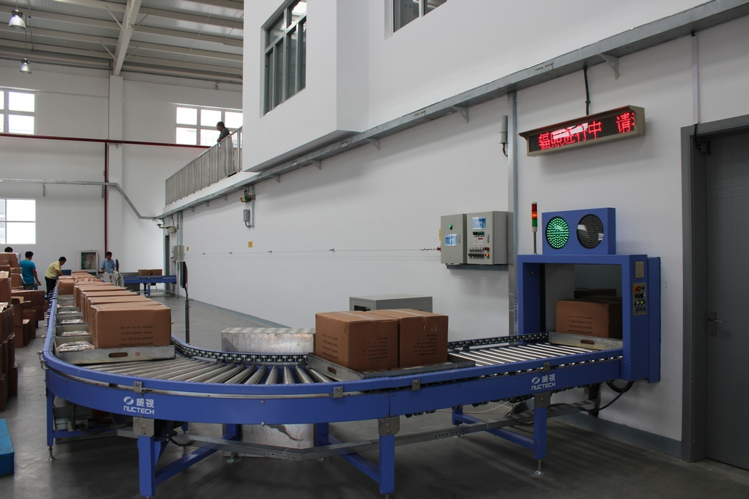
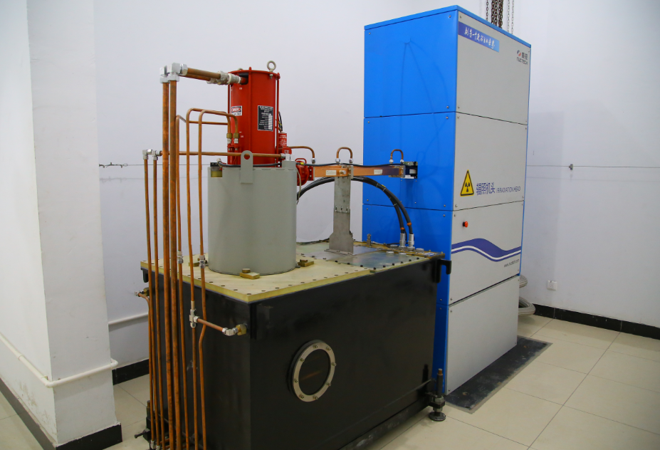

Slide 15
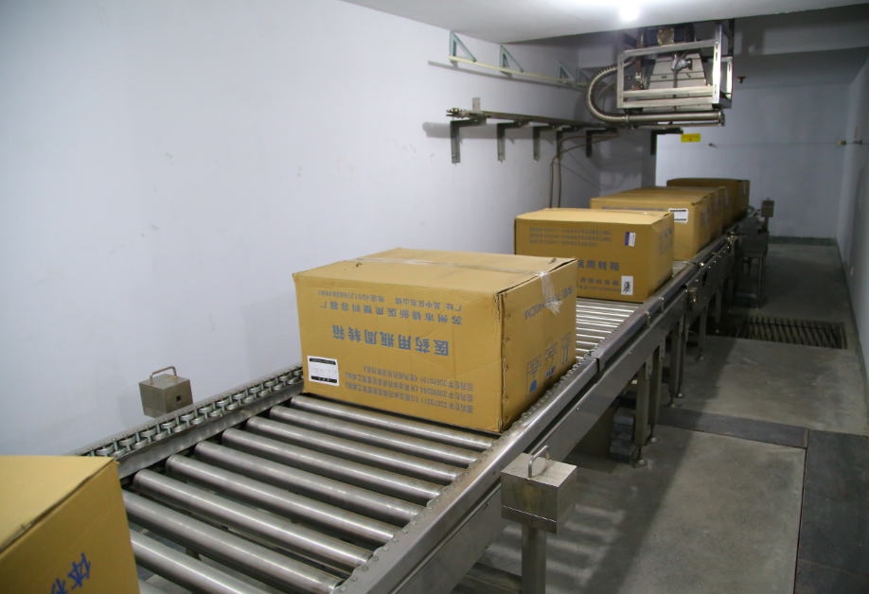
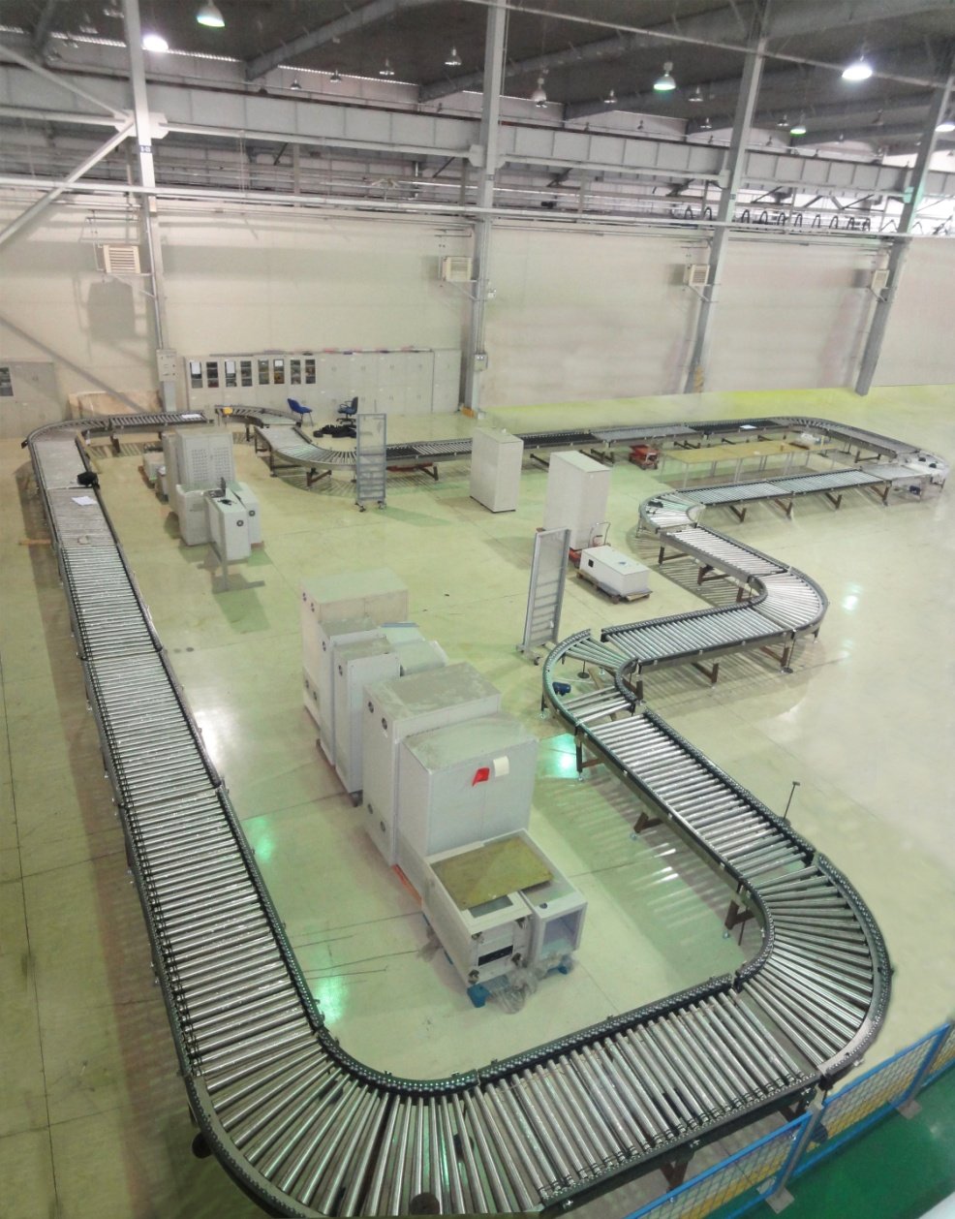
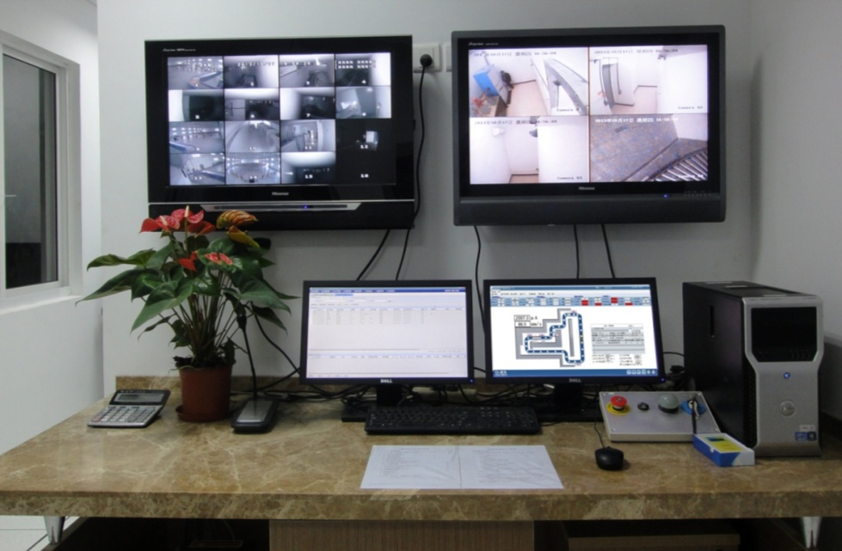
E-beam irradiation integrated processing center
Case 2 (Shanghai,2012)

Slide 16
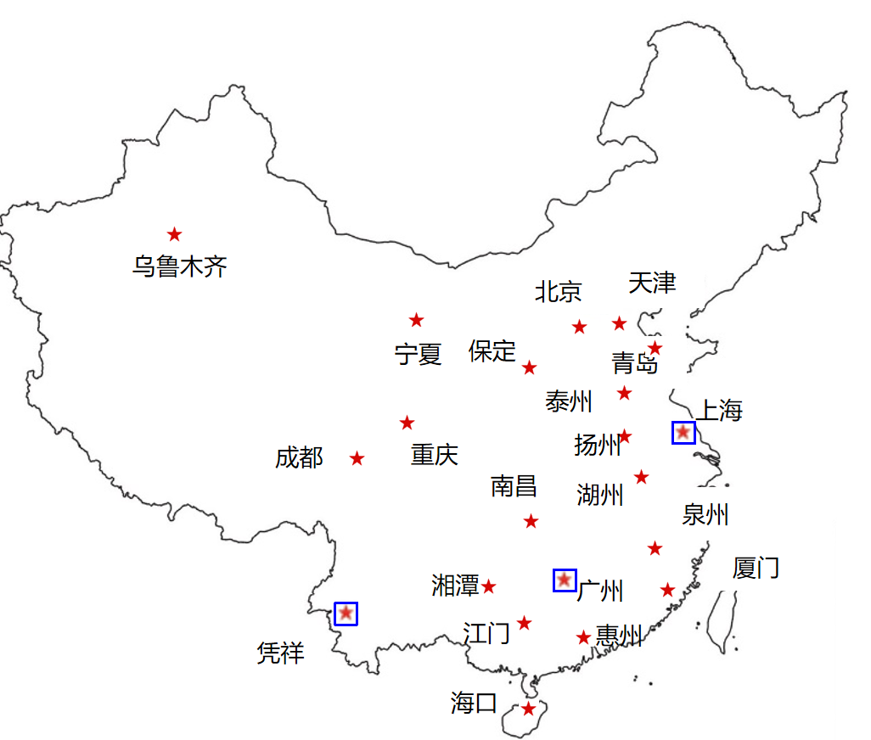
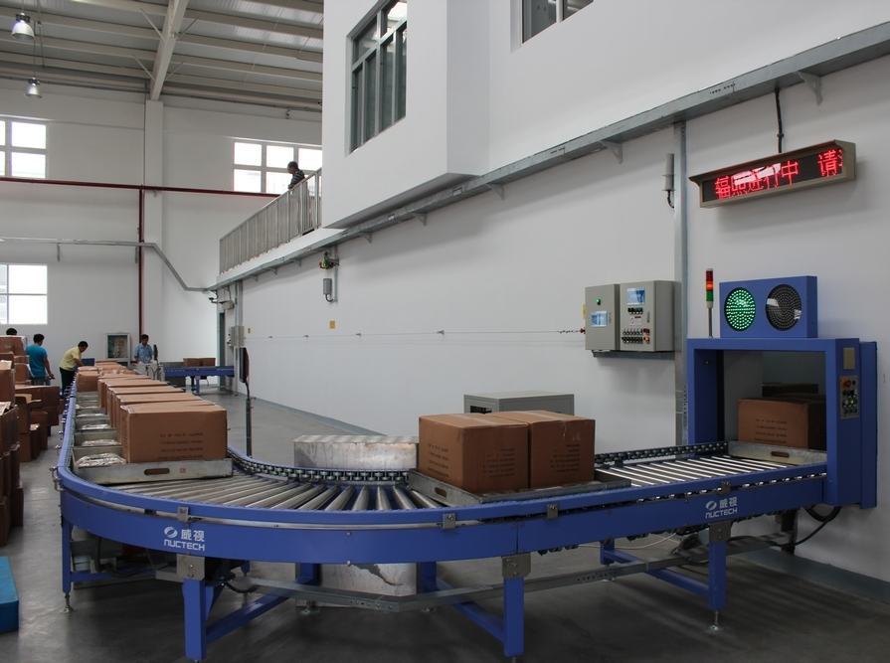
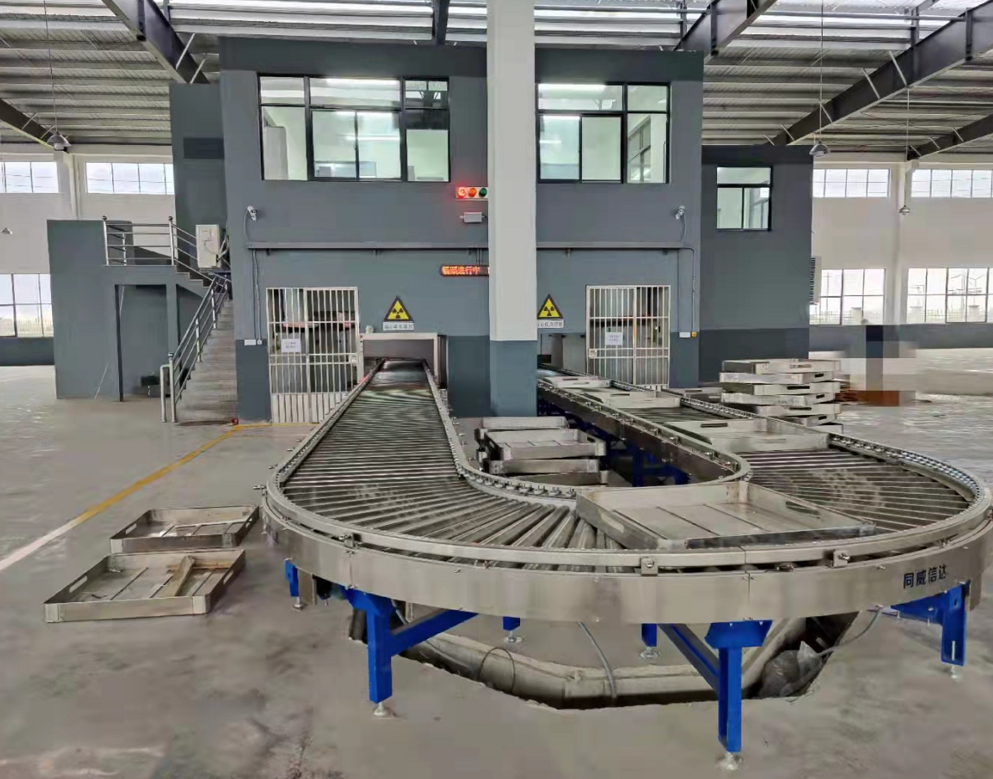
System operation
Mexico
Italy
Pakistan
2013 Sept, first set in Shanghai, operated for more than 50,000 hour until now;
2014~2021, in Shanghai, Guangzhou, Chongqing and etc., export to Mexico, Italy and Pakistan, with more than 20 set and all operating stably.

Slide 17
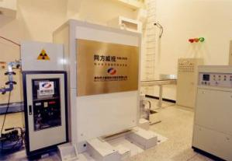
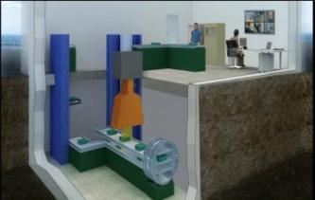
Products
Lower Power
5MeV/2kW mail sterilization
Mail sterilization System (2002)
Mail sterilization system (2008)
Mobile sterilization system (2005)
Notes:
17
17

Slide 18
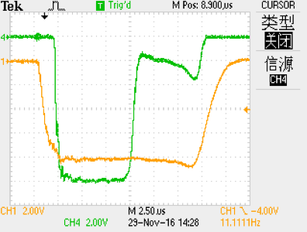
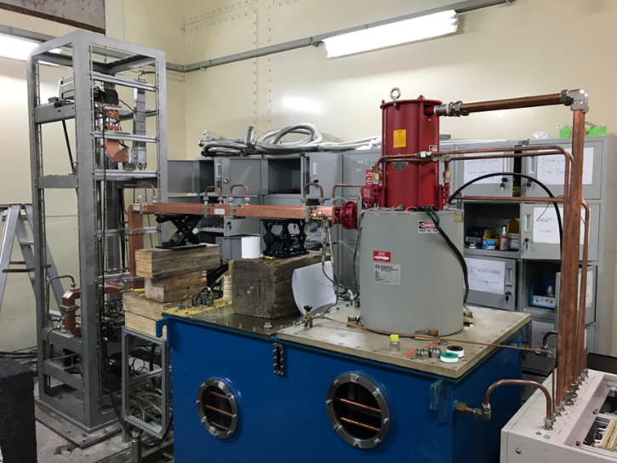
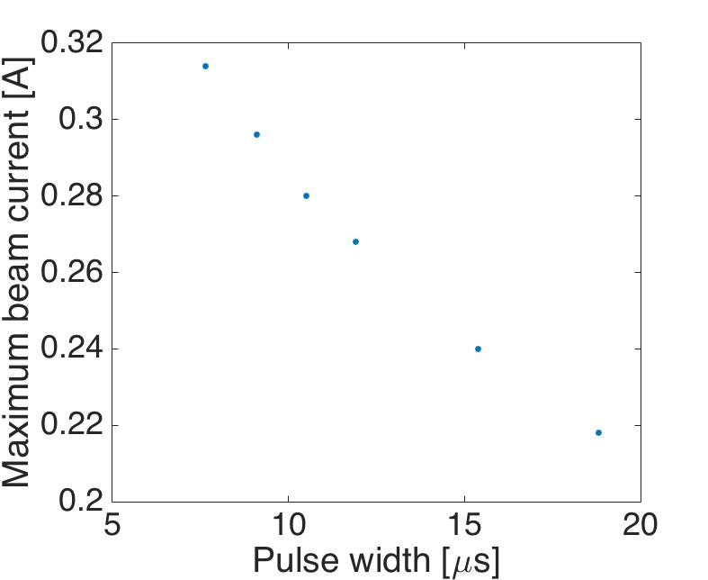
Problem of Beam breakup (BBU)
BTW linac system
Pulses of BBU (Orange gun emission，green Output of linac)
BBU experiment on 10MeV BTW linac
To observe BBU, sweeping the beam current and pulse width
Current larger than 260mA will result in BBU
Average Power Limited to 20kW
Pulse width vs beam current

Slide 19
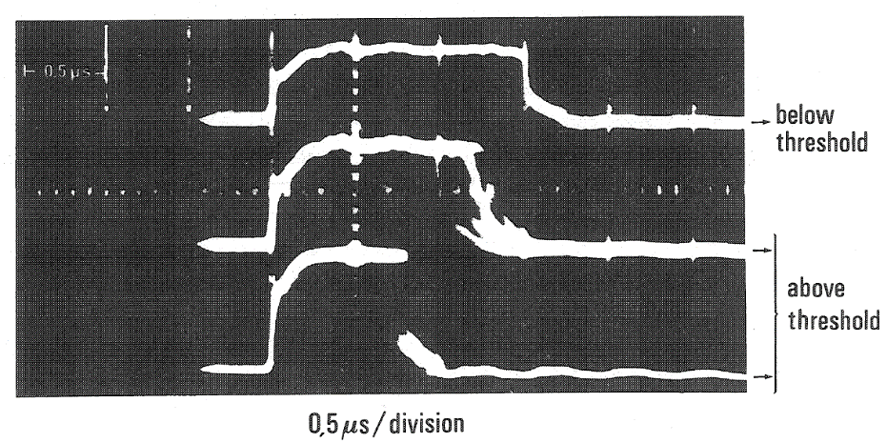
Beam breakup (BBU) study
Phenomenon
  The tail of pulse will be lost. The beam current is limited.
Physics mechanism
  The following electron will be deflected by the wake field generated by the previous beam.
  Collective beam instability.
  m=1 transverse wake field
  (HEM11 mode) can be amplified by the beam itself.
Loss
管壁
Normal
BBU
ebeam
Le Duff J. Beam break up[R]. Paris-11 Univ., 91-Orsay (France). Lab. de l'Accelerateur Lineaire, 1985.

Slide 20
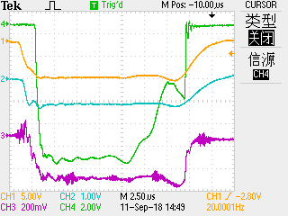
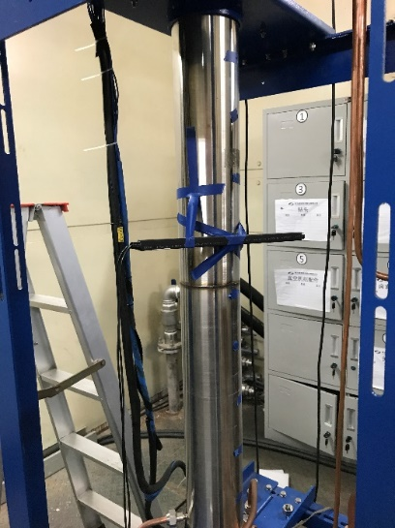
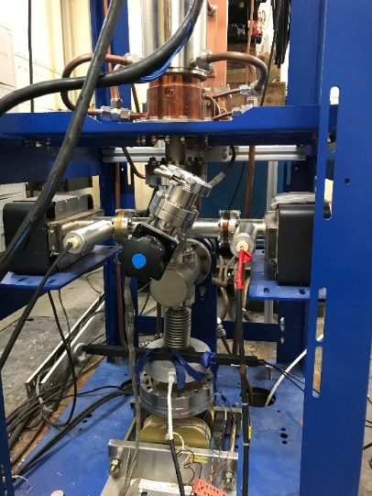
Physics study and new linac design
Beam breakup mechanism
Various beam experiments on 1020 linac to analyze causes of BBU
  Dose distribution after BBU
  Beam spot after BBU
  Microwave signal after BBU
  ……
New linac design
  Optimize bunching
  Optimize coupler
  …………

Slide 21
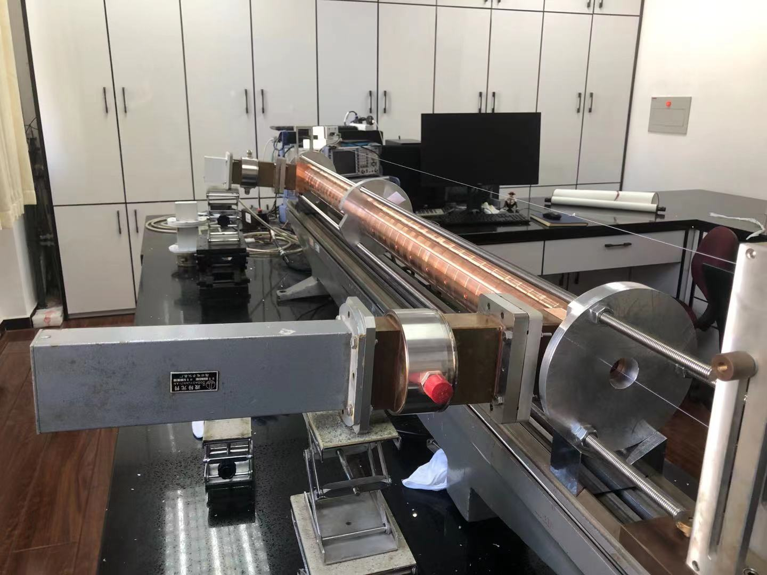
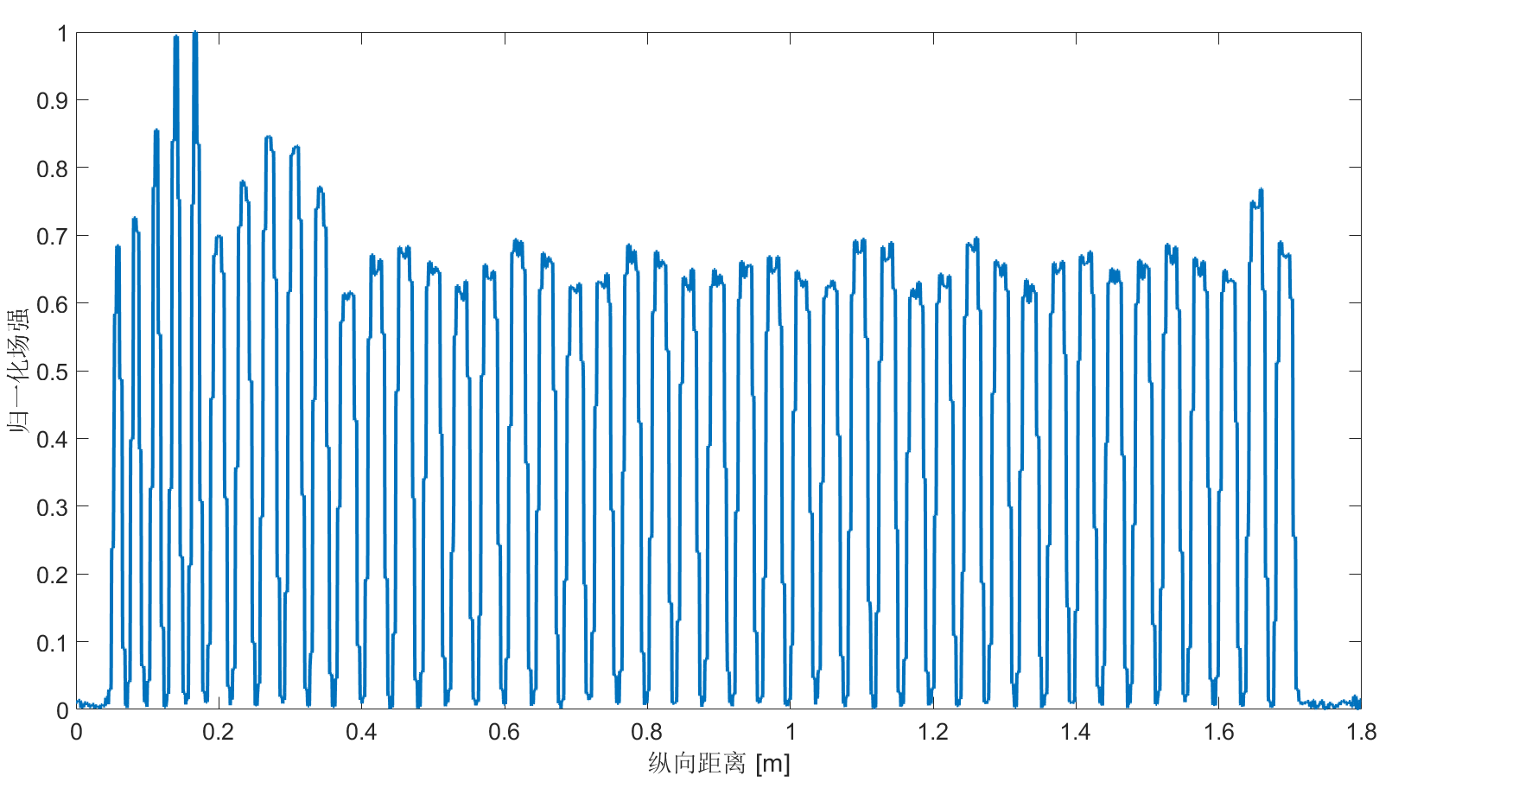
Timeline: low-power test
Development of new Tube in 2020
OLD design
NEW design
RF meas. in Tsinghua Acc Lab

Slide 22
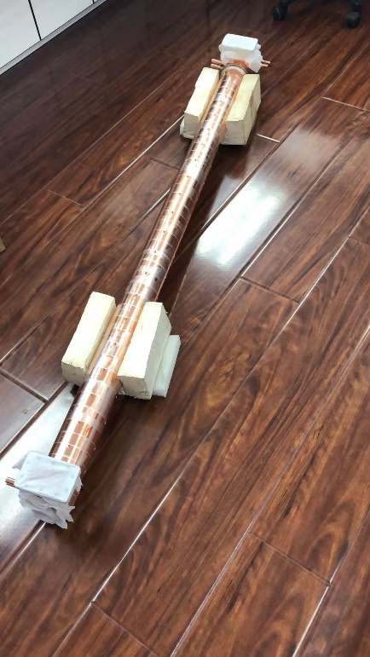
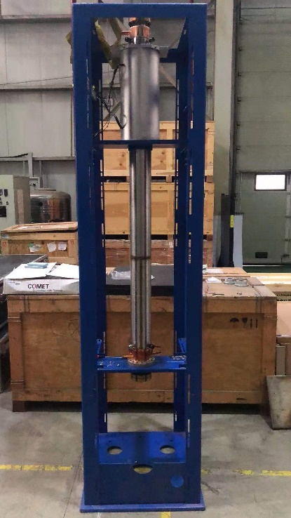
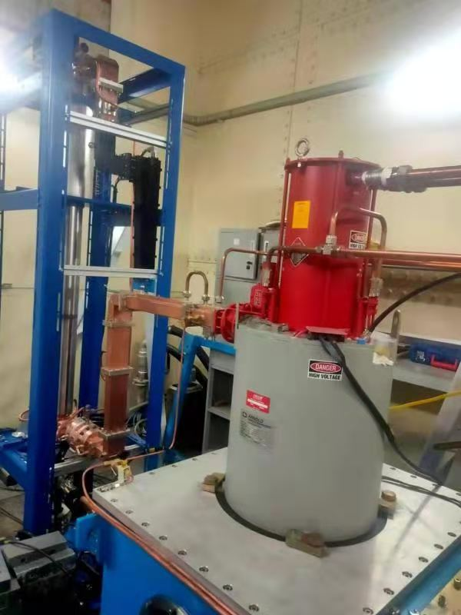
Timeline: high-power test
2020 September, fabrication complete
2020 Nov- 2021 Jan，High-power test at NUCTECH

Slide 23

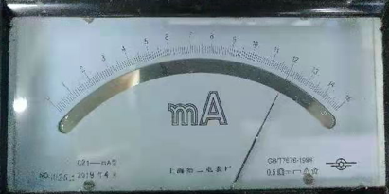
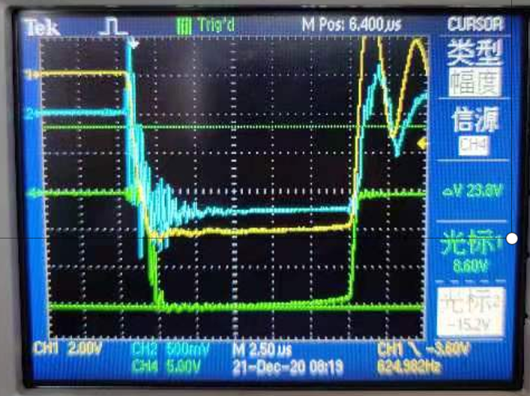
10MeV 24kW BTW
Full 24kW Beam Power Output！（2020.12.21）
>300mA without BBU
The new design solve the BBU problem!
Rep frequency: 625pps
Pulse current: 300mA
Pulse width： 12.5us
Energy: 10.5MeV
Ave current: 2.4mA
Beam power:
25.2kW

Slide 24
Parameters comparison
 | Old | New
Klystron | 5MW 45kW | 5MW 45kW
Pulse current | 260mA | 310mA
Beam energy | 10MeV | 10MeV
Rep. frequency | 650Hz | 625Hz | 650Hz
Current width | 12us | 12.5us | 12.5us
Average current | 2mA | 2.4mA | 2.4mA
Capture rate | 30% | 35% | 35%
Efficiency | 45% | 53% | 53%
Beam power | 20kW | 25.2kW | 26kW

Slide 25
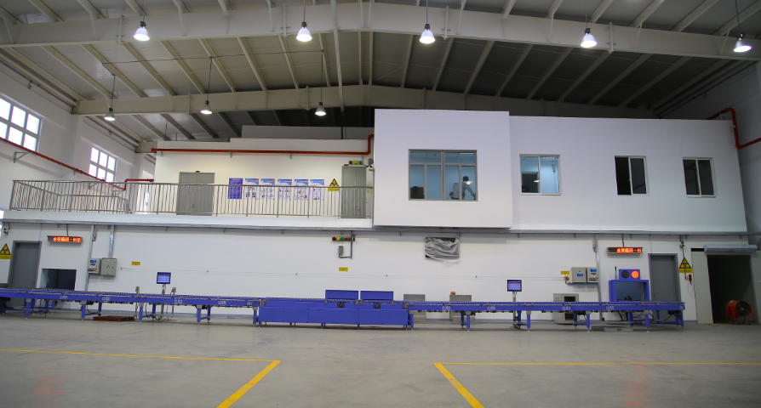
10MeV 24kW system upgrade
More than 10 sets of 24kW system in the pipeline
Two finished in 2022

Slide 26
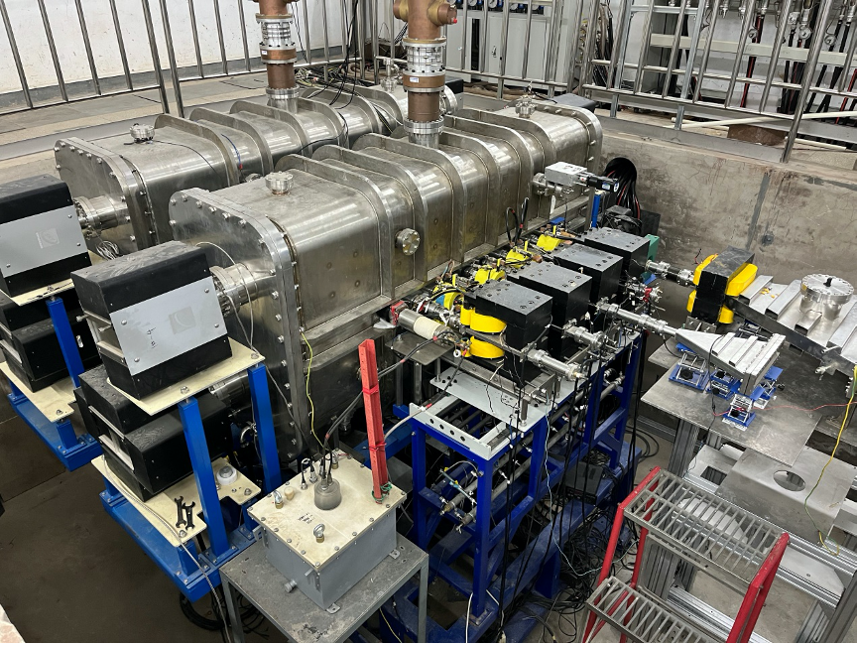
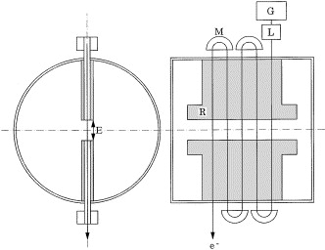
Ridgetron prototype @ CIAE
CIAE: China Institute of Atom Energy (in Beijing)
http://www.ciae.ac.cn/newsContent.jsp?RID=3627
Energy 9.8MeV
Power 56kW
Result of 2022.12
Picture from: N Hayashizaki, et al. NIMA Volume 427, Issues 1–2, 1999,

Slide 27
Summary
10MeV linac systems have been developed and widely installed in China
10MeV-24kW systems successfully developed in Tsinghua University. Been operating for ~1 year. Beam-power and Efficiency upgrade
Ridgetron (10MeV-50kW) prototype developed in CIAE in China

Slide 28
Thanks for listening！
E-mail：XXX XXX

