Slide 1


Advanced Quasistatic Approximation
Konstantin Lotov, Petr Tuev, Roman Spitsyn
Budker Institute of Nuclear Physics
Novosibirsk State University

Slide 2

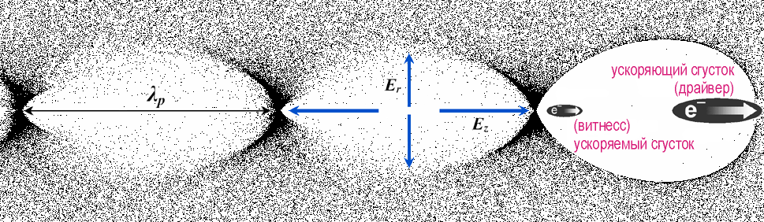

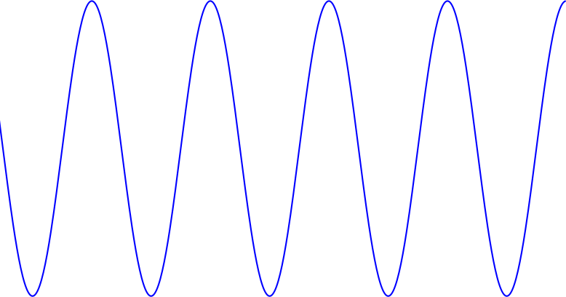
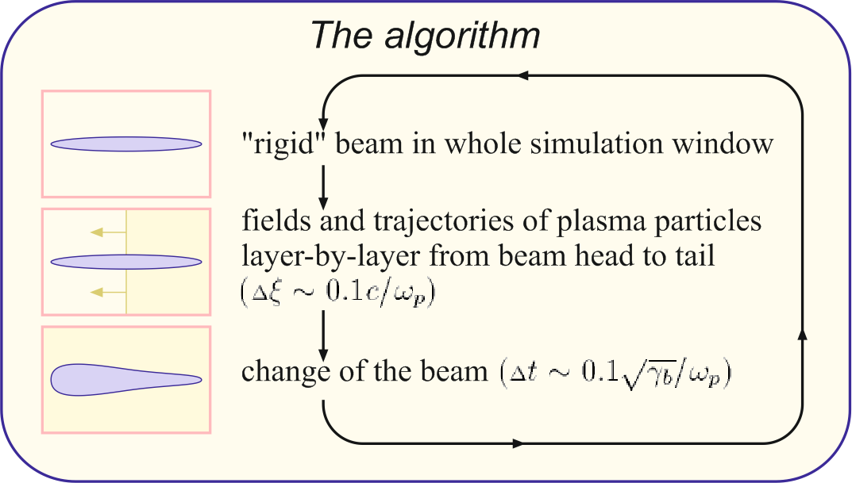
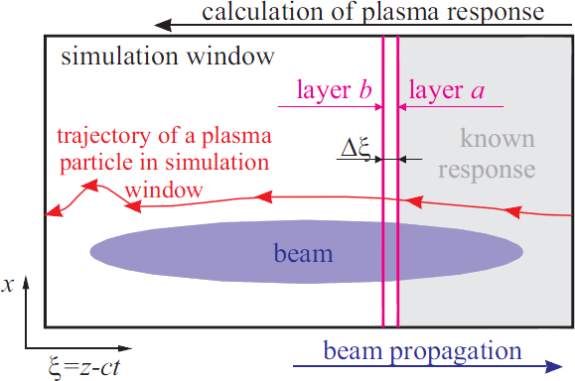

K. Lotov, AFAD-2023, 13.04.2023, p. 2 of 13
Plasma (or Laser) WakeField Acceleration: there are too different scales in the problem
(numerical example for n₀=10¹⁶см⁻³ and 500 GeV (γ=10⁶) final energy)
accelerating structure size c/ω_{p}≈50 μm
driver wavelength
λ≈0.8 μm
betatron period,
up to $\sqrt{\text{γ}}$ c/ω_{p}~5 cm
Acceleration length,
γc/ω_{p}~50 m
10⁻⁶
~10⁻⁸
Difficult to simulate.
Reduced or modified models are welcome:
fluid models
boosted frame
reduced geometry
envelope equation
quasistatic approximation:
moving window,
beam changes slowly,
all plasma particles started from r₀ with p₀ (almost) copy the motion of each other
Calculation of plasma response:
In PIC:
Particle parameters: x, y, z, p_{x}, p_{y}, p_{z}
Depend on: t
Simulation domain: x, y, z

Slide 3
K. Lotov, AFAD-2023, 13.04.2023, p. 3 of 13
Plasma (or Laser) WakeField Acceleration: there are too different scales in the problem
(numerical example for n₀=10¹⁶см⁻³ and 500 GeV (γ=10⁶) final energy)
accelerating structure size c/ω_{p}≈50 μm
driver wavelength
λ≈0.8 μm
betatron period,
up to $\sqrt{\text{γ}}$ c/ω_{p}~5 cm
Acceleration length,
γc/ω_{p}~50 m
10⁻⁶
~10⁻⁸
Difficult to simulate.
Reduced or modified models are welcome:
fluid models
boosted frame
reduced geometry
envelope equation
quasistatic approximation:
moving window,
beam changes slowly,
all plasma particles started from r₀ with p₀ (almost) copy the motion of each other
Calculation of plasma response:
Co-moving coordinate ξ =z-ct
Particle parameters: x, y, z, p_{x}, p_{y}, p_{z}
Depend on: t ξ
Simulation domain: x, y, z
Trajectory parameters: x, y, p_{x}, p_{y}, p_{z}
Depend on: ξ
Simulation domain: x, y

Slide 4
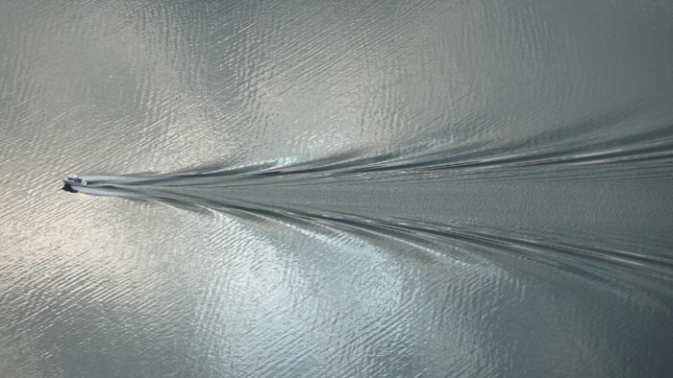
K. Lotov, AFAD-2023, 13.04.2023, p. 4 of 13
The essence of quasistatic approximation (illustrated with a speed boat on the sea)
Suppose we need to simulate the motion of the boat on the sea.
We do not have the resources to simulate the whole sea. We can simulate only a small area.
To know how a liquid element behaves over time, we need to know the state of the neighboring areas, so we simulate not only the area immediately near the boat, but also around it.
We move the simulation window together with the boat.
This is the classic PIC method.

Slide 5
K. Lotov, AFAD-2023, 13.04.2023, p. 5 of 13
The essence of quasistatic approximation (illustrated with a speed boat on the sea)
Suppose we need to simulate the motion of the boat on the sea.
We do not have the resources to simulate the whole sea. We can simulate only a small area.
To know how a liquid element behaves over time, we need to know the state of the neighboring areas, so we simulate not only the area immediately near the boat, but also around it.
We move the simulation window together with the boat.
This is the classic PIC method.
However, each "layer" of fluid encountered by the boat behaves the same way, although with different time delay. Let us trace its dynamics only once, on the example of layer at z₀.
We take the states of our layer at other moments of time as the states of neighboring layers.
z₀
z₀-Δz

Slide 6
K. Lotov, AFAD-2023, 13.04.2023, p. 6 of 13
The essence of quasistatic approximation (illustrated with a speed boat on the sea)
Suppose we need to simulate the motion of the boat on the sea.
We do not have the resources to simulate the whole sea. We can simulate only a small area.
To know how a liquid element behaves over time, we need to know the state of the neighboring areas, so we simulate not only the area immediately near the boat, but also around it.
We move the simulation window together with the boat.
This is the classic PIC method.
However, each "layer" of fluid encountered by the boat behaves the same way, although with different time delay. Let us trace its dynamics only once, on the example of layer at z₀.
We take the states of our layer at other moments of time as the states of neighboring layers.
When we find the state of fluid around the boat, calculate drag force and fuel consumption. Repeat the operation after 1 km.
This is quasistatic approximation.
z₀

Slide 7
K. Lotov, AFAD-2023, 13.04.2023, p. 7 of 13
The essence of quasistatic approximation (illustrated with a speed boat on the sea)
Suppose we need to simulate the motion of the boat on the sea.
We do not have the resources to simulate the whole sea. We can simulate only a small area.
To know how a liquid element behaves over time, we need to know the state of the neighboring areas, so we simulate not only the area immediately near the boat, but also around it.
We move the simulation window together with the boat.
This is the classic PIC method.
However, each "layer" of fluid encountered by the boat behaves the same way, although with different time delay. Let us trace its dynamics only once, on the example of layer at z₀.
We take the states of our layer at other moments of time as the states of neighboring layers.
When we find the state of fluid around the boat, calculate drag force and fuel consumption. Repeat the operation after 1 km.
This is quasistatic approximation.
z₀
The law of change of "our" fluid layer depends on its state in the future!
This is potentially unstable situation.
Because of this, making a stable difference scheme for quasistatics is an art.
Each quasistatic code (WAKE, LCODE, QuickPIC, HiPace, QV3D) has its own way around the problem of “taking information from the future”.

Slide 8
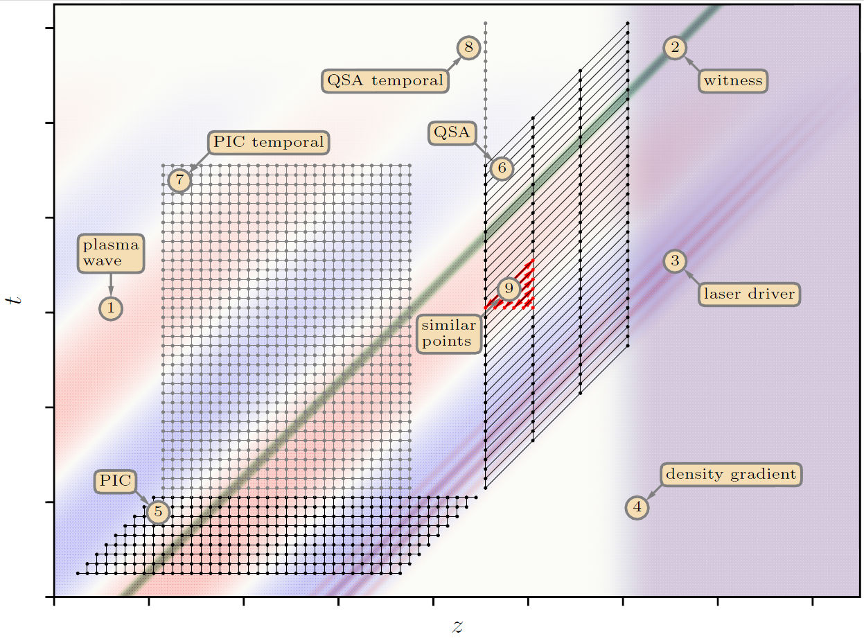
K. Lotov, AFAD-2023, 13.04.2023, p. 8 of 13
Advantages of quasistatic approximation (QSA)
c=1
Objects simulated and the simulation grids used in conventional PIC codes (5),(7) and in quasistatic codes (6),(8) for modelling beam dynamics (5),(6) and temporal evolution of the plasma wave (7),(8).
1. The gain in speed (ratio of grid steps):
ratio of beam evolution length to the plasma or laser wavelength (depending on the driver type and laser model).
2. Reduced dimensionality: χ(x, y, z)
3. Effectiveness in simulating long-term dynamics of the plasma wave: gain in speed is several times the ratio λ_{p}/Δz.
QSA is good, but …
… what if plasma particles do not copy the motion of each other because the beam changes its shape quickly or the plasma is not longitudinally uniform?

Slide 9
K. Lotov, AFAD-2023, 13.04.2023, p. 9 of 13
Need for advanced quasistatic approximation (AQSA)
QSA is good, but …
… what if plasma particles do not copy the motion of each other because the beam changes its shape quickly or the plasma is not longitudinally uniform?
QSA becomes imprecise.
When calculating the plasma response, we assume that plasma and beam are exactly the same at all z, but if they are not, inaccuracy ~ λ_{p}/(scale of beam or plasma change).
However, the change of variables
does not narrow the generality of plasma description.
Let us properly take into account the exchange of information between plasma layers.
= AQSA
no information exchange between layers in plasma solver (only through beams)

Slide 10
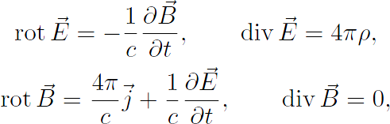








K. Lotov, AFAD-2023, 13.04.2023, p. 10 of 13
Advanced quasistatic approximation, equations
We start from Maxwell equations for fields:
Equations for particle parameters are
They have the form
combine them:
We change variables:
change variables:
and obtain
assume
conventional QSA without this term
conventional QSA without this term
Other equations (calculation of currents and densities, beam motion) are the same as in QSA
and similarly for the magnetic field:
The new terms were added into LCODE solvers

Slide 11
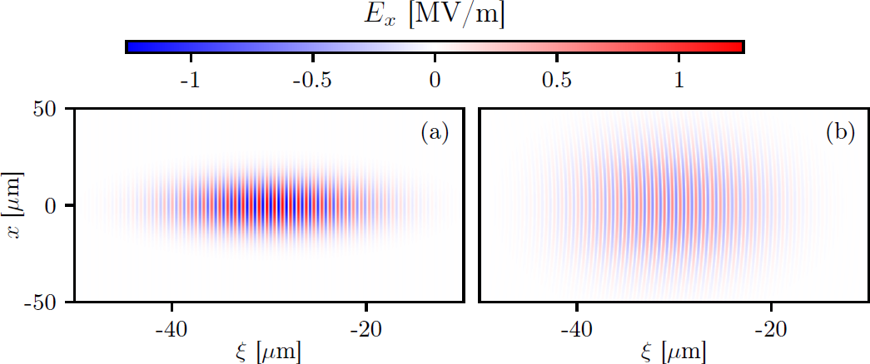

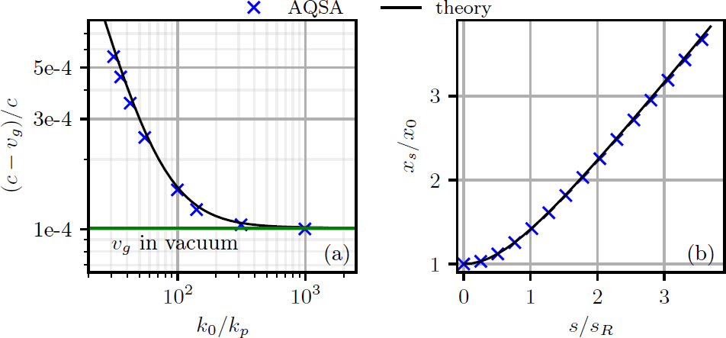
K. Lotov, AFAD-2023, 13.04.2023, p. 11 of 13
Benchmarking the new model: laser pulse in uniform plasma
Simulation results quantitatively reproduce the theoretically predicted velocity of the wave packet and its transverse dispersion.
Propagation of this pulse is provided by the plasma solver with
AQSA can simulate perturbations that propagate from one plasma layer to another,
and retains the main advantage of QSA, speed.

Slide 12
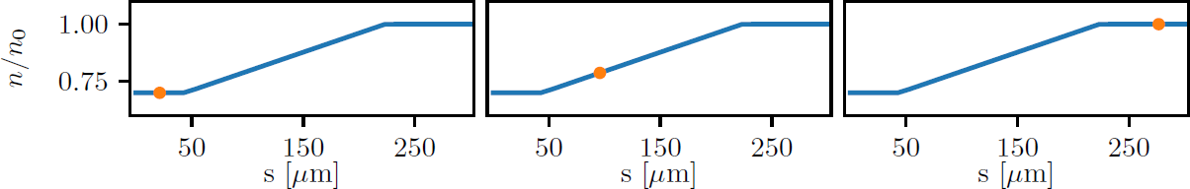
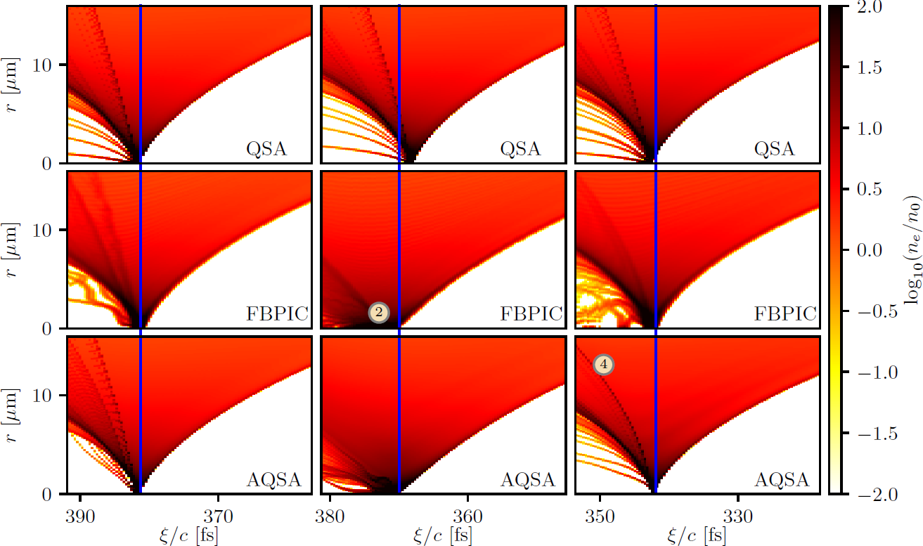
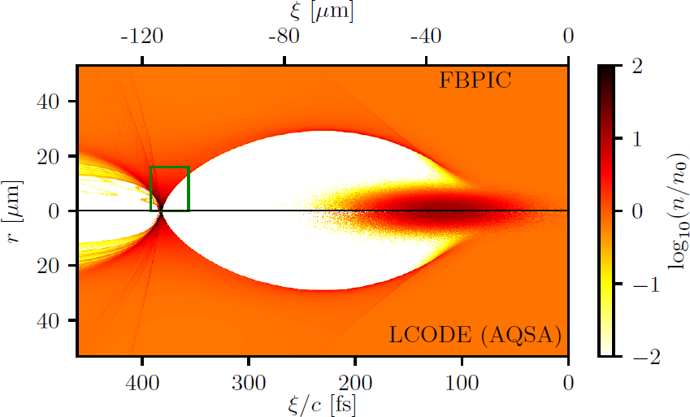
K. Lotov, AFAD-2023, 13.04.2023, p. 12 of 13
Benchmarking the new model: plasma with longitudinal density gradient
Short electron beam propagates through non-uniform plasma in bubble regime
Compare:
QSA (LCODE), PIC (FBPIC), AQSA (based on LCODE)
In regions of uniform plasma, the results perfectly agree:
In the gradient region, AQSA reproduces bubble features similarly to FBPIC, but 80 times faster
(close to the theoretical estimate ).

Slide 13
K. Lotov, AFAD-2023, 13.04.2023, p. 13 of 13
To conclude:
It is possible to switch to quasistatic variables
AND preserve the generality of the description of physical processes.
Some problems are more convenient to solve in ordinary variables,
and some in quasistatic variables (like PWFA or LWFA).
When describing plasma wakefield acceleration, the new approach retains the main advantages of
quasistatics: speed and reduced dimensionality.
We have only taken the first step toward creating a full physical model that will speed up calculations
by 2-3 orders of magnitude compared to PIC, there is still much work to be done.
More details: Plasma Physics Reports 49, 229 (2023).
Thank you

Slide 14
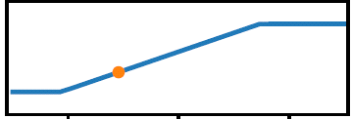
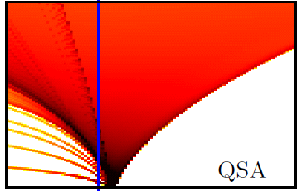
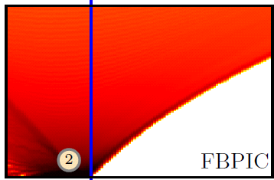
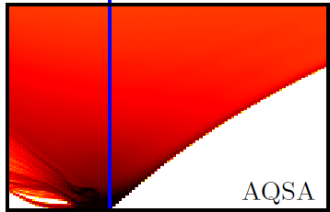
Advanced Quasistatic Approximation (Konstantin Lotov, Budker INP, Novosibirsk, Russia):
Quasistatic approximation offers advantages of speed and reduced dimensionality in simulations of plasma (laser) wakefield acceleration, but until now it was limited to very slowly changing beams in uniform plasmas.
More accurate change of variables
(retaining small terms in equations of plasma response) allows to extend the applicability area of quasistatic codes, and this was demonstrated with two examples.
Laser pulse propagation in uniform plasma: correct group velocity and transverse dispersion are provided by the plasma solver.
Short electron beam propagation through non-uniform plasma in bubble regime:

