Slide 1
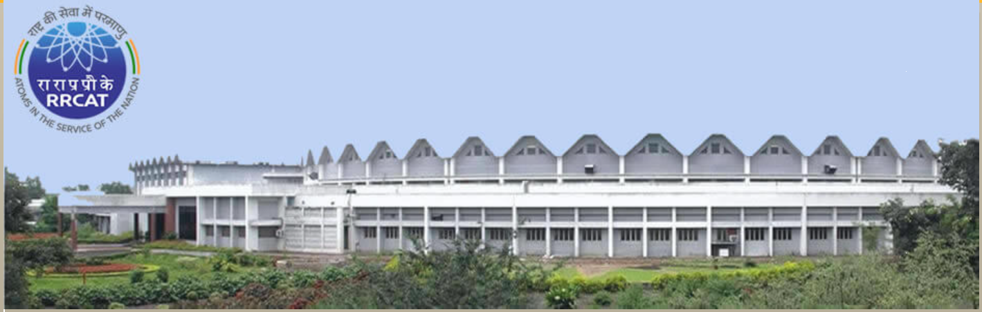
Materials science research at
Indus beamlines
Tapas Ganguli
Accelerator Physics and Synchrotrons Utilization Division
Raja Ramanna Centre for Advanced Technology
INDIA

Slide 2
Plan of the presentation:
Introduction to Indus Synchrotrons
Brief details of the beamlines at Indus
Some examples of interesting research carried out by users
Brief review of materials research at APSUD, RRCAT (Intermetallic alloys, large bandgap oxides)

Slide 3
Plan of the presentation:
Introduction to Indus Synchrotrons
Brief details of the beamlines at Indus
Some examples of interesting research carried out by users
Brief review of materials research at APSUD, RRCAT (Intermetallic alloys, large bandgap oxides)
ACKNOWLEDGEMENT
All the users who have used the beamlines for their research
The machine operation and maintenance team at Indus
All the beamline scientists
This presentation is on behalf of all them

Slide 4
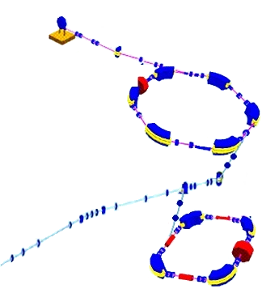
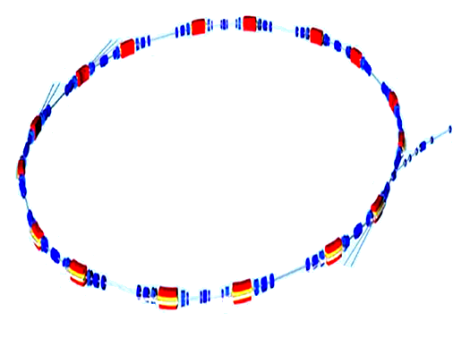
Indus Accelerator Complex: A schematic
Indus–1 and Indus-2 synchrotron radiation sources are in operation in round the clock mode, since Feb 2010
TL1
Microtron
20 MeV, 30 mA
Booster
550 MeV, 10 mA
Indus-2 details
Lattice Double bend achromat
No. of periods: 8
Provision for 5 insertion devices, with 3 operational devices
Current operating emittance: 135 nm rad (plans underway to reduce it to < 50 nm rad)
TL3
TL2
Indus-2
2.5 GeV
Indus-1
200 mA
450 MeV, 125 mA
Operational beamlines in Indus-1: 7
Operational beamlines in Indus-2: 18

Slide 5
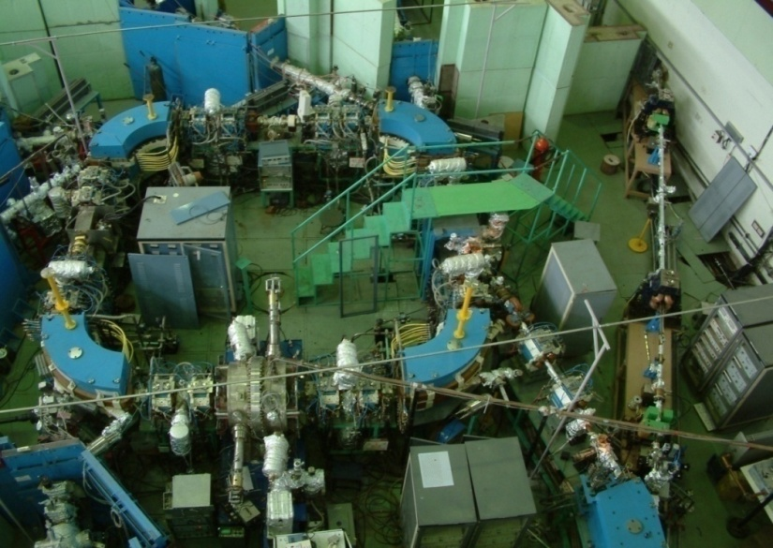
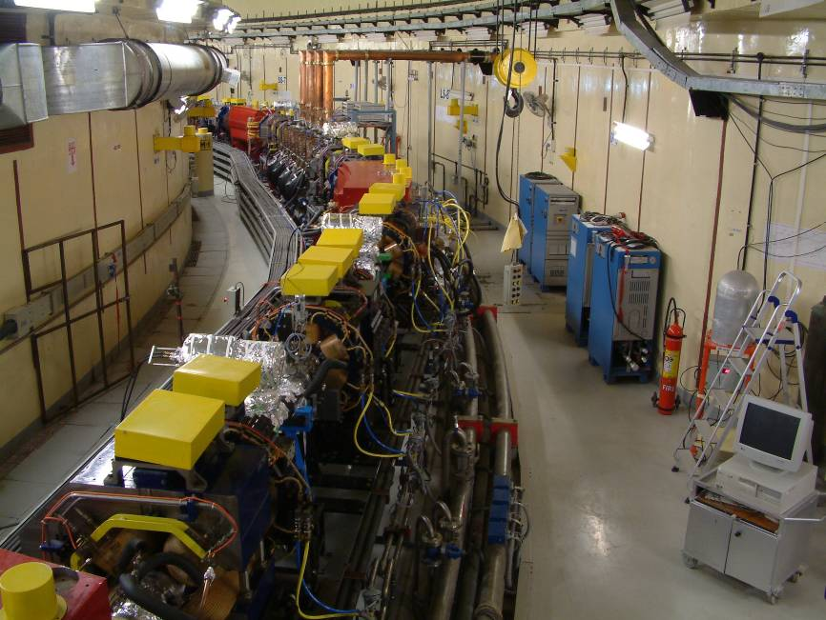
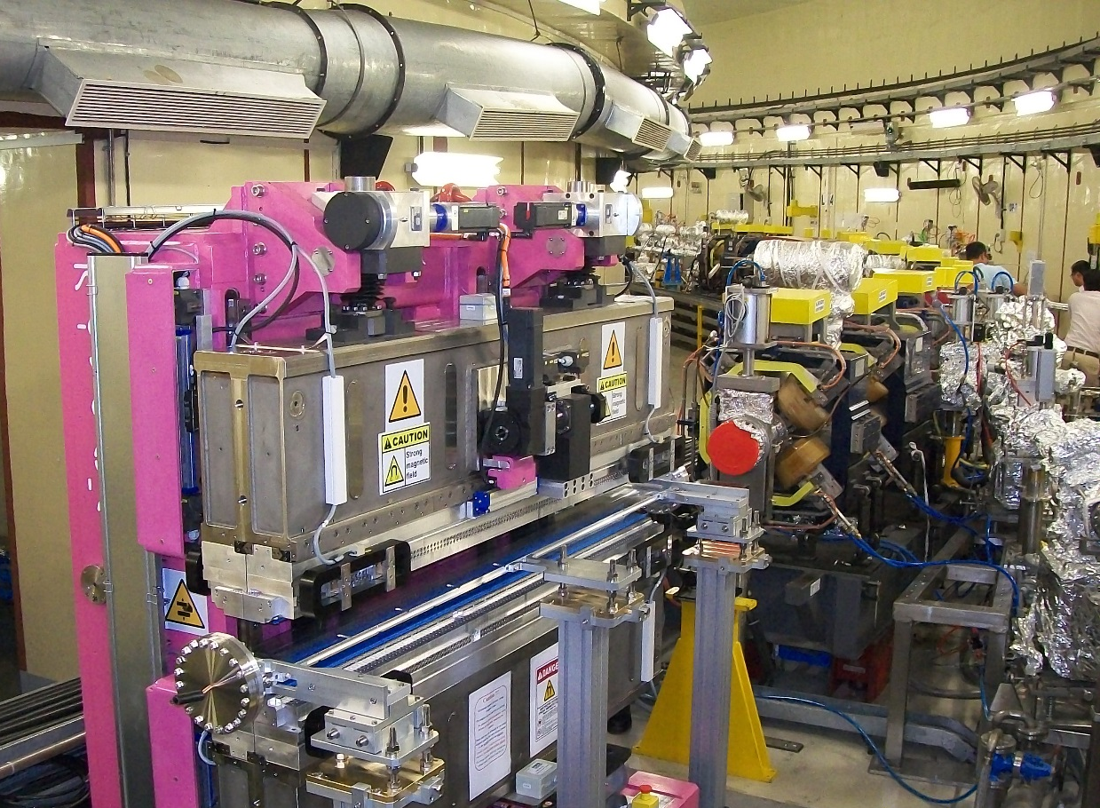
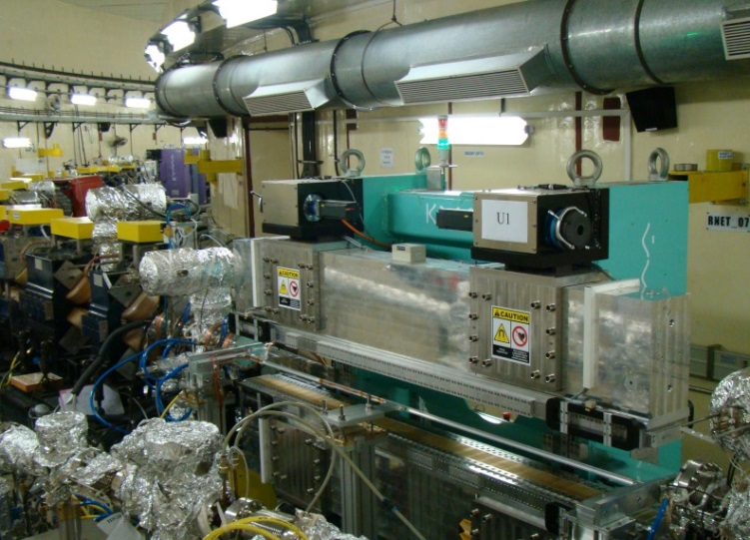
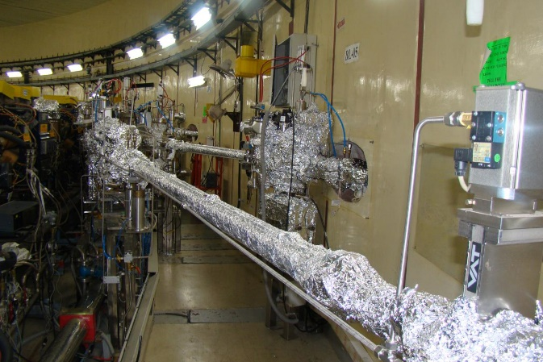
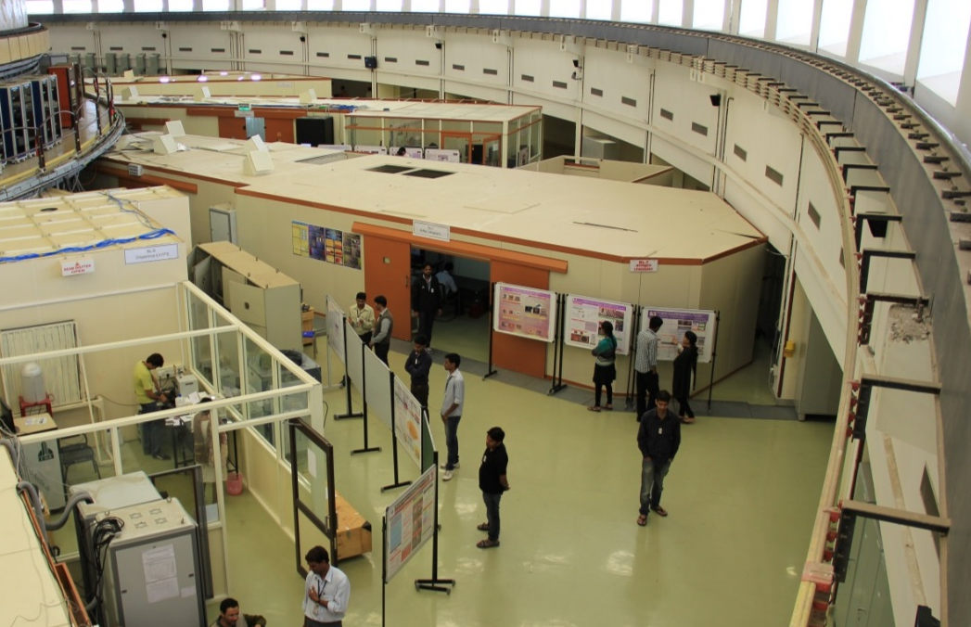
Indus at a glance:
Indus-1 storage ring
A section of Indus-2 storage ring
Planar permanent magnet undulator
APPLE-II undulator
Frontends for beamlnes (Indus-2)
Experimental area of Indus-2

Slide 6
Operational beamlines in Indus-2: 18
BL-1 Soft X-ray Absorption
BL-2 Engineering Applications
BL-3 Soft X-ray Reflectivity
BL-4 X-ray Imaging
BL-7 X-ray Lithography
BL-8 Dispersive EXAFS
BL-9 Scanning EXAFS
BL-10 Angle Resolved
Photoelectron Spectroscopy
BL-11 Extreme Conditions X-ray Diffraction
BL-12 Angle Dispersive X-ray
Diffraction
BL-13 Grazing Incidence X-ray
Scattering
BL-14 X-ray Photo Electron
Spectroscopy
BL-16 X-ray Fluorescence
Microprobe
BL-18 Small and Wide Angle X-ray
Scattering
BL-20 X-ray Magnetic Circular Dichroism
BL-21 Protein Crystallography
BL-23 Visible Diagnostics Beamline
BL-24 X-ray Diagnostic Beamline
Some beamlines are under development
Atomic molecular and optical Sciences
Extreme conditions XRD with a superconducting wavelength shifter
Protein crystallography with a superconducting wiggler
Spectroscopy and scattering in the tender x-ray range
Radiation safety studies
Photo emission electron microscopy
More details at: http://www.rrcat.gov.in

Slide 7
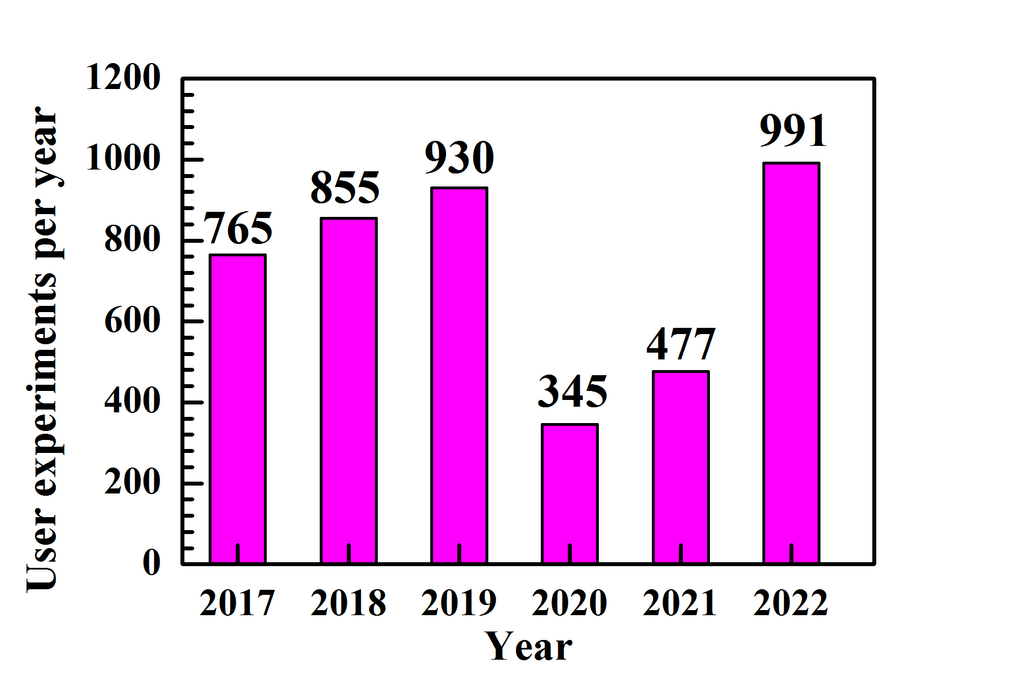
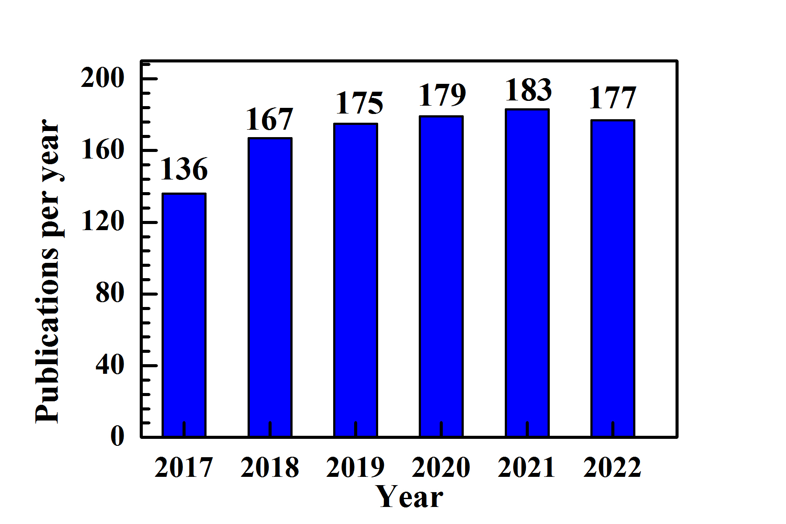
Some typical user data:
Number of user experiments
Number of publications
Scientists are researchers from nearly 150 institutes all over India have used the Indus beamlines
In the last few years, Indian industries (pharmaceutical industry) are also regularly using Indus beamlines
Facilities have contributed to several projects of national importance: Lunar missions of Indian Space Research Organisation (ISRO), Chandrayaan-I and Chandrayaan-II.
About 160+ structures deposited in the international protein data bank

Slide 8
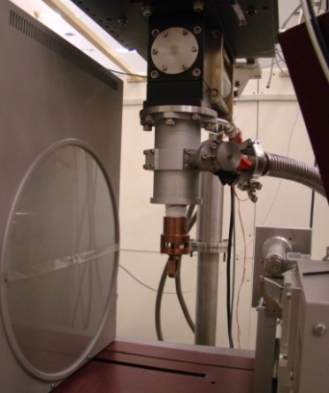
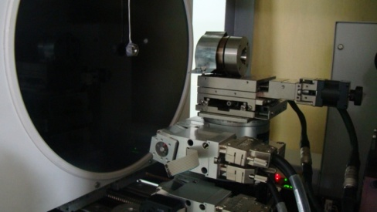
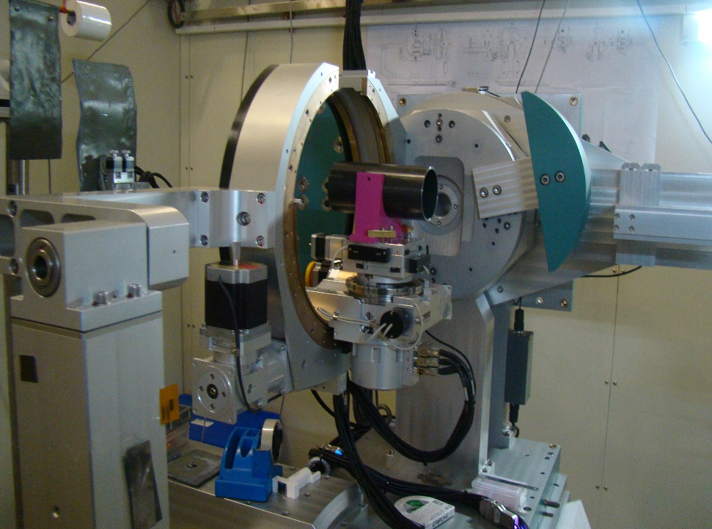
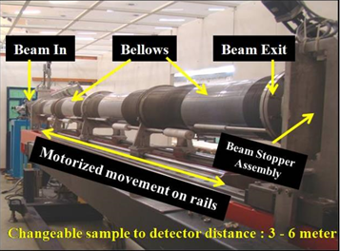
Facilities for X-ray diffraction and scattering
Angle dispersive XRD beamline, BL-12
Extreme conditions XRD Beamline BL-11
Energy range: 4 keV to 25 keV
Both Goniometer and image plate options available
Low temperature upto ~ 5 K
High temperature upto 550ºC
High pressure in Diamond cell
Crystal structure determination, phase identification etc.
Both energy dispersive and angle dispersive options available
Energy range: 4 keV to ~ 40 keV in the energy dispersive mode
High pressure and high temperature ~1200ºC
High pressure cell
Low temp. ~5 K
Engineering Appl. Beamline, BL-02
Small and wide Angle X-ray scattering, BL-18
Energy range: 5 keV – 20 keV
2-Dimension online image plate (SAXS); q-range: 0.05 – 3.5 nm⁻¹
Linear position sensitive gas detector (WAXS) q-range > 2.0 nm⁻¹
Structural correlation in ~1-100 nm length scale
Energy range: 4 keV - 25 keV
Measurements for stress, phase analysis etc.
Designed for Engg. Components weighing upto 15 Kgs
Elastic constant measurements
Experimental station
Experimental station

Slide 9
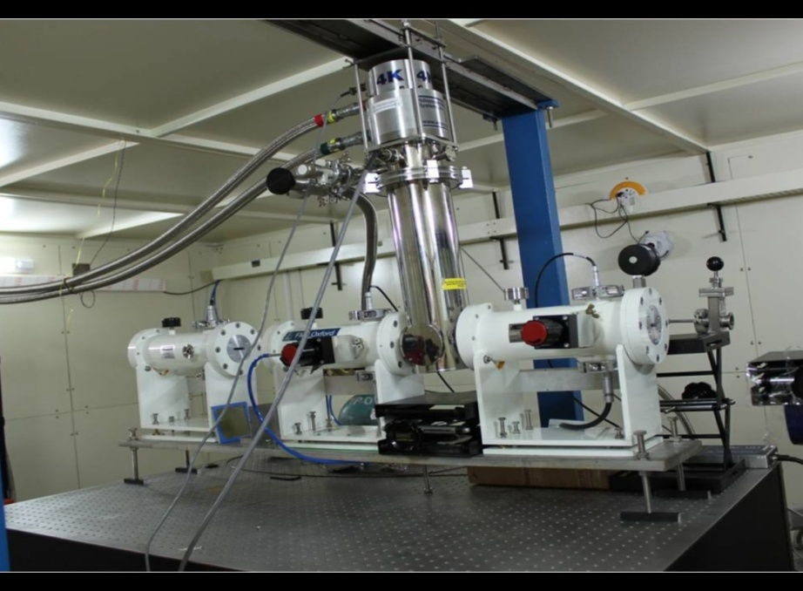
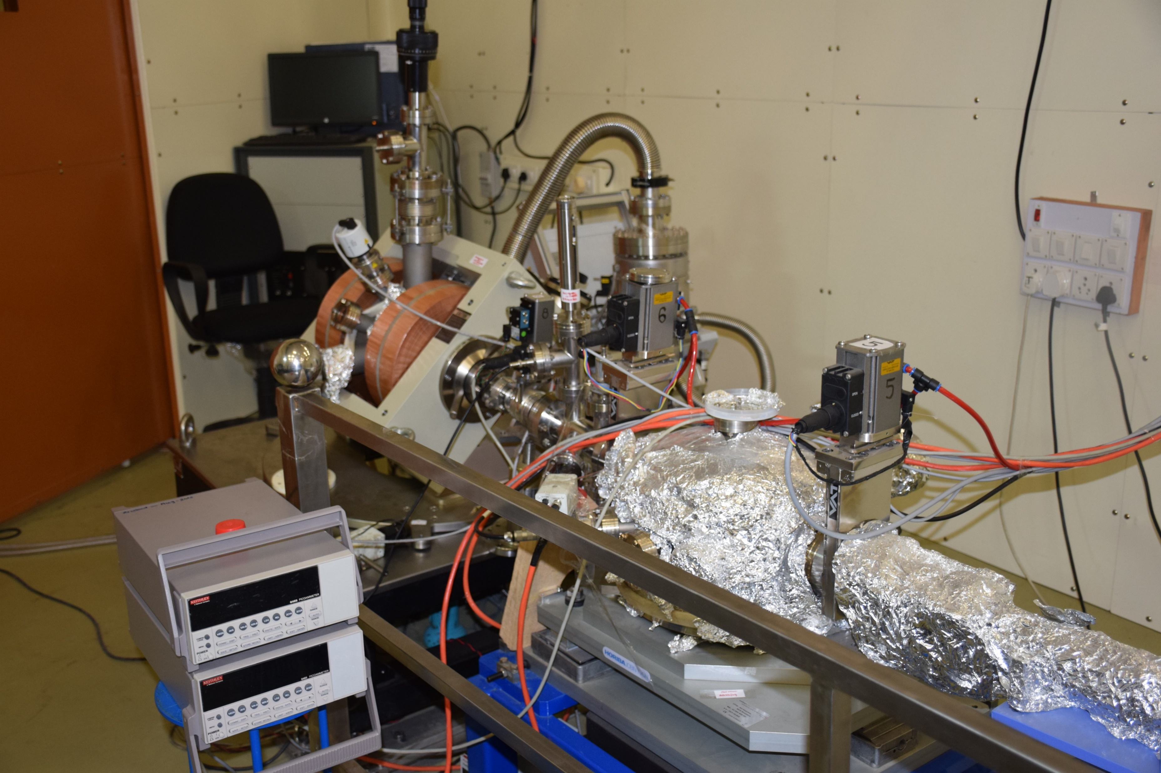
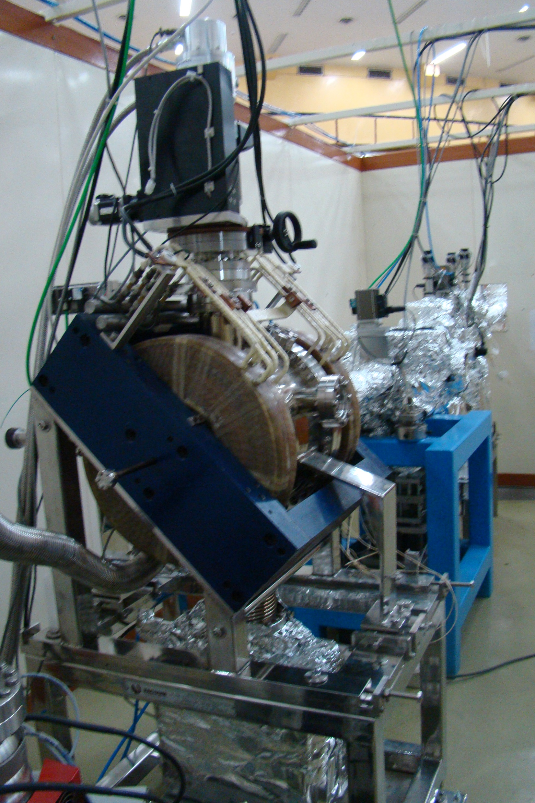
Facilities for X-ray absorption
EXAFS beamline,
BL-09
Polarized light Soft
X-ray beamline, BL-01
X-ray Magnetic Circular Dichroism beamline, BL-20
Energy range: 300 eV to 1000 eV (circular polarization)
Energy range: 300 eV to 2000 eV (linear polarization)
Low temperature upto ~ 20 K
Measurement in transmission and fluorescence mode
Magnetic field upto 1 Tesla
Element specific magnetic moment
Energy range: 4 keV to 25 keV
Low temperature upto ~ 10 K
Measurement in transmission and fluorescence mode
Facilities to perform in-situ/in-operando studies
Near neighbor configuration, chemical state
Energy range: 100 eV to 1200 eV
Low temperature upto ~ 10 K
Facility for absorption in fluorescence and TEY mode
Near neighbor configuration, chemical state

Slide 10
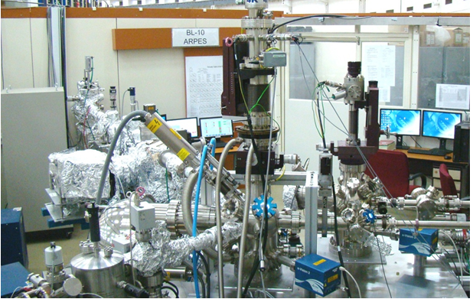
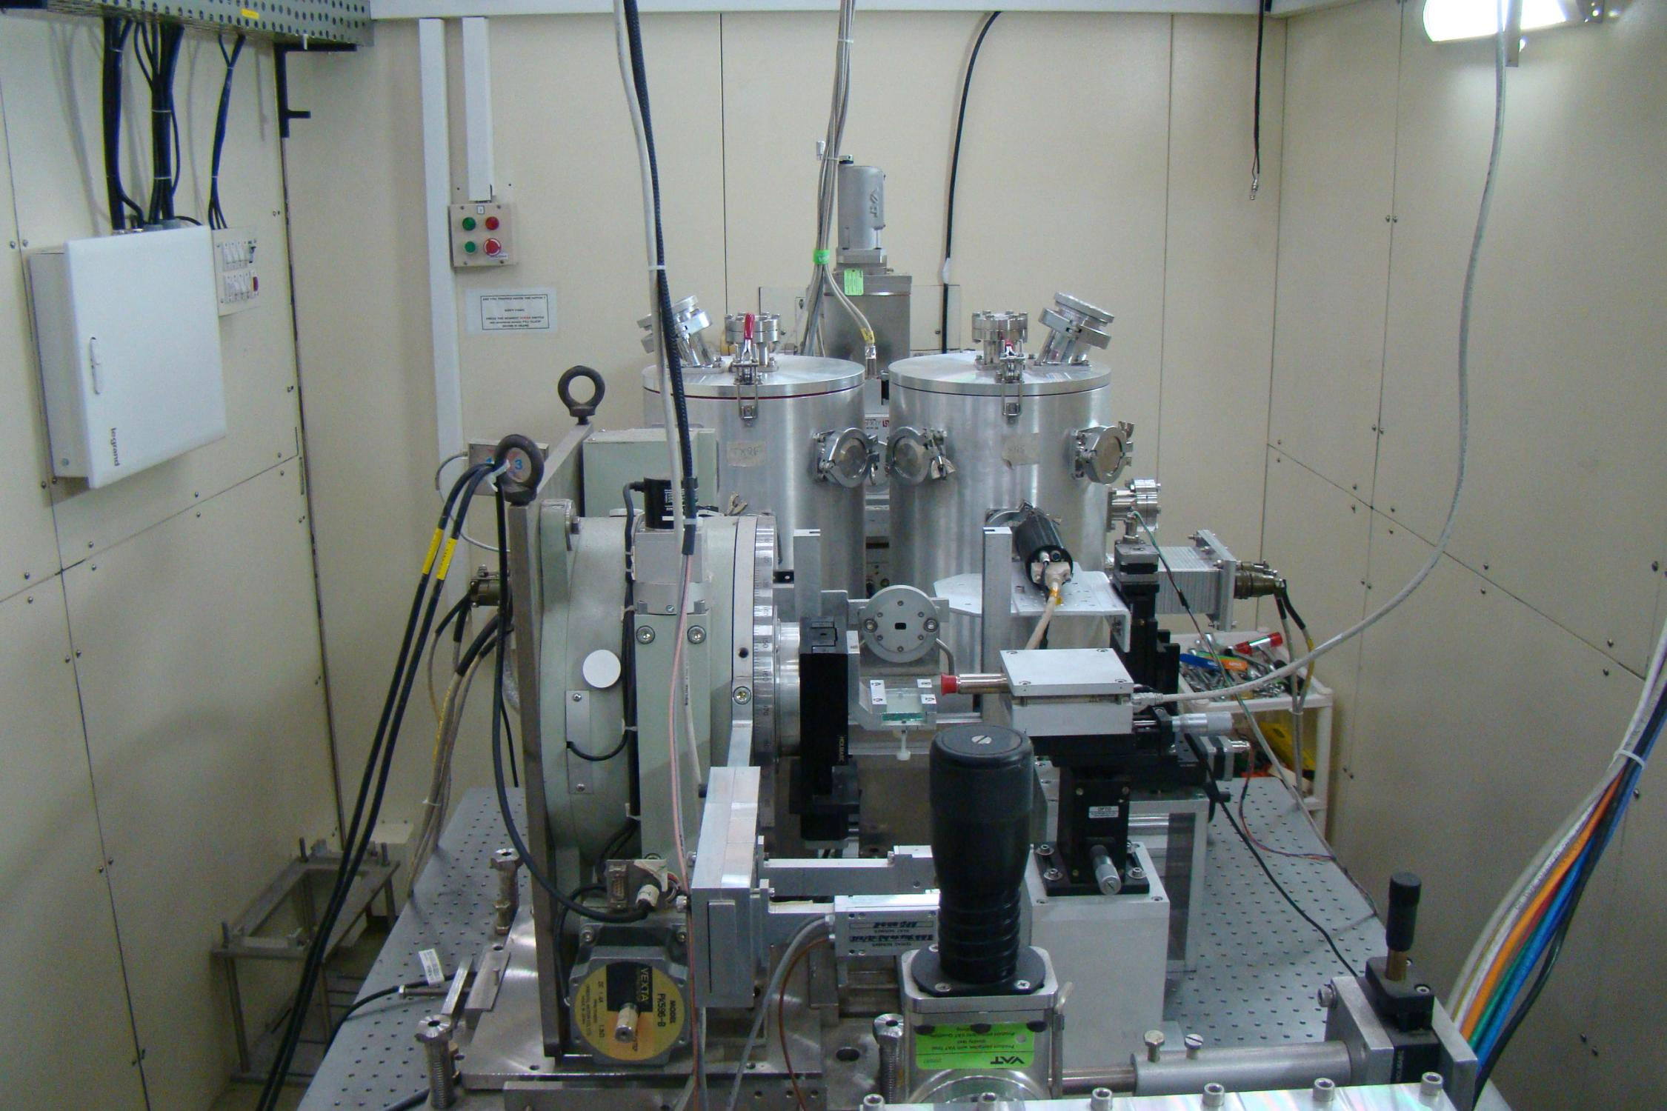
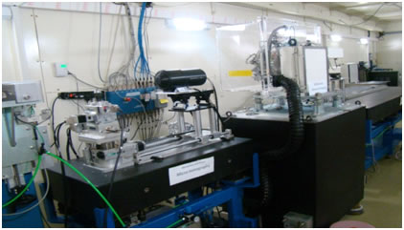
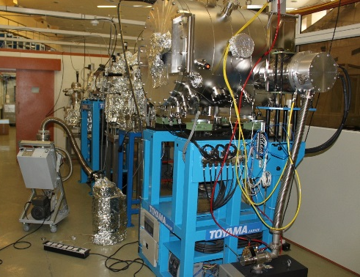
Some other beamlines
Angle Resolved Photoelectron Spec. BL-10
X-ray Fluorescence Microprobe BL-16
Energy range: 30 eV – 1 keV
20 meV resolution at 30 eV
Sample temperature ~ 20 K
Determine the electronic density of states and band structure
Energy range: 4 keV to 20 keV
Element detection down to Carbon
Microprobe 4.5 x 7.5 micron²
Total reflection XRF available for trace element detection, ppb level
X-ray imaging BL-04
Soft X-ray Reflectivity BL-03
Energy range: 100 eV - 1500 eV
Reflectivity measurements of thin films
To be upgraded with an wavelength dispersive emission spectrometer
Buried interface quality, intermixing
Energy range 8 to 35 keV
Absorption imaging
Phase contrast imaging
Micro tomography
Laminography

Slide 11
Some examples of interesting research carried out by users at Indus beamlines

Slide 12
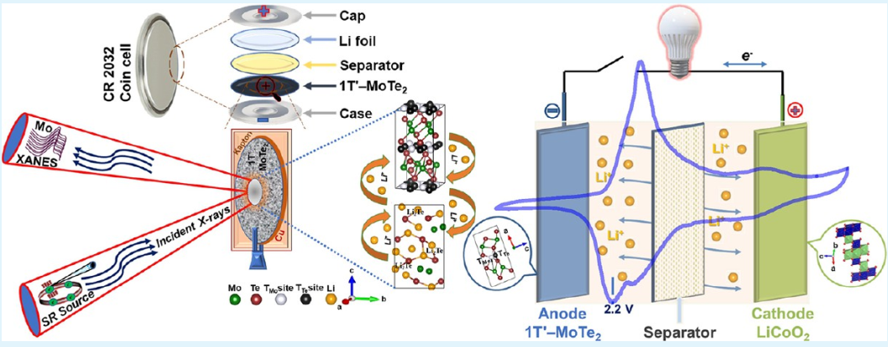
In-operando studies on Li ion batteries
Study 1: High Performance Lithium-Ion Batteries Using Layered 2H-MoTe₂ as Anode
Study 2: Fast Anodes for Lithium-Ion Batteries Based on the 1T′-MoTe₂ Phase Material
The X-ray absorption studies on battery anode materials with different extent of lithiation gives a picture of the changes that take place with charging and discharging.
Unique lithium reaction pathway and storage mechanism, which is supported by density functional theory based calculations.
In-operando studies on the chemical and structural changes taking place in the anode, with charging and discharging have also been reported.
Schematic of the Synchrotron based XANES measurement setup
Ref:
M.R.Panda et al. Small, Vol. 16, No. 2002669 (2020)
M.R.Panda et al. ACS Appl. Energy Mater., Vol. 5, pp 9625–9640 (2022)

Slide 13
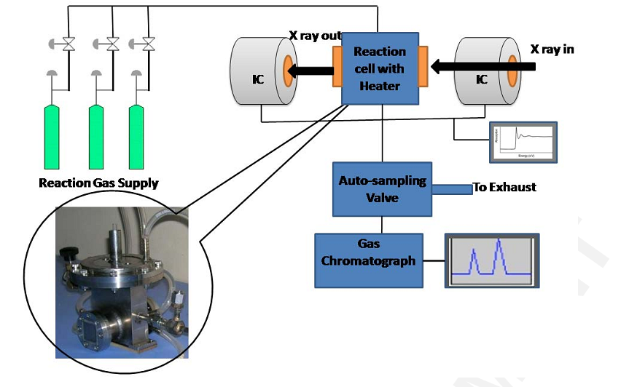
In-situ X ray Abs. Spect. study of Co catalysts
In-situ studies on structure-activity correlation during catalytic reaction
Co based catalyst during Fischer-Tropsch reaction for the generation of CH₄ from CO + H₂ reaction was studied
SBA-15 supported Co₃O₄ nanoparticle catalysts has been studied
It has been observed that with reaction temperature increasing from 280ºC-320ºC, activity of the catalyst increases significantly
Deactivation of the catalyst also observed with time.
XANES data rules out the formation of CoO as the cause of deactivation
Tentatively deactivation attributed to carbon deposition on the catalyst surface.
Schematic of the setup
established
Ref.: C.Nayak et al. J. Synchrotron Rad.
Vol. 26, p 137, 2019

Slide 14
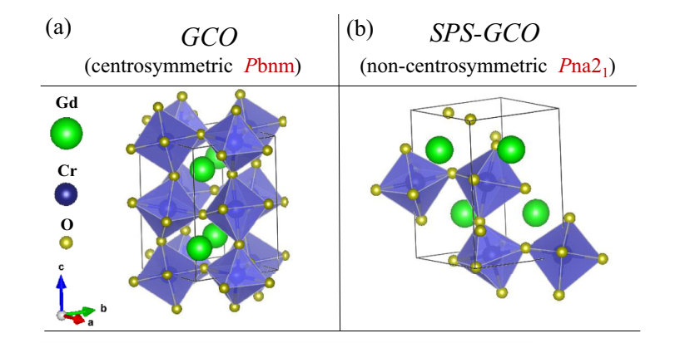
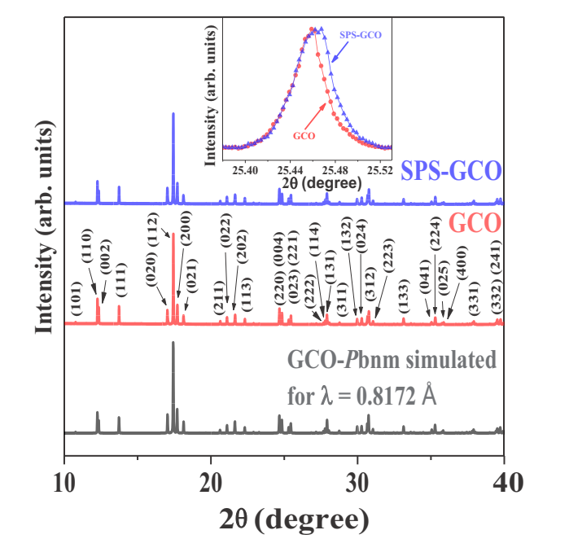
Observation of RT ferroelectricity in spark-plasma sintered GdCrO₃
GdCrO₃ prepared by solid state synthesis is paramagnetic at room temperature
Spark plasma sintered GdCrO₃ is ferromagnetic upto 450K
Structural refinement of high quality XRD data used to explain this observation
The previously known low temperature phase orthorhombic Pna2₁ was stabilized at room temperature by Spark plasma sintering method
High resolution, low noise XRD data helped in resolving the fine differences in the XRD pattern of the two phases.
XRD patterns of the two samples,
comparison of the peak profiles in the inset
Ref.: Suryakanta Mishra et al. Phys. Rev B 104, L 180101 (2021)

Slide 15
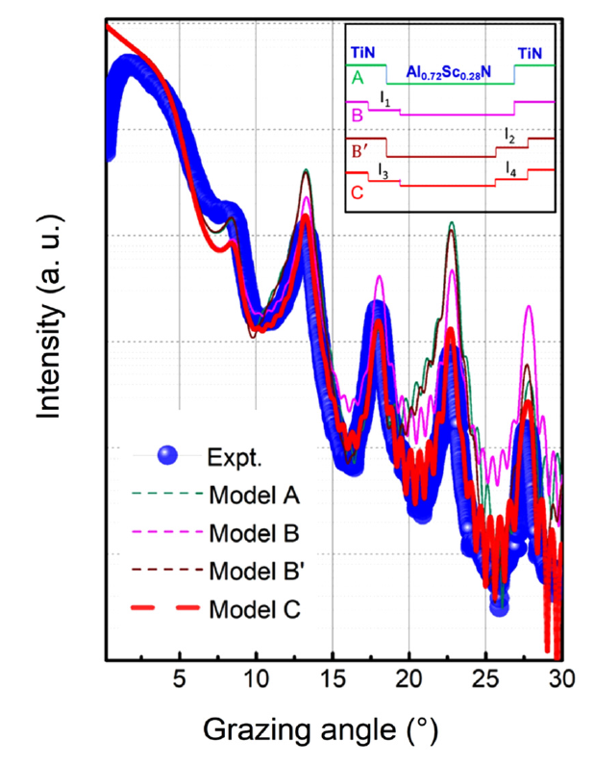
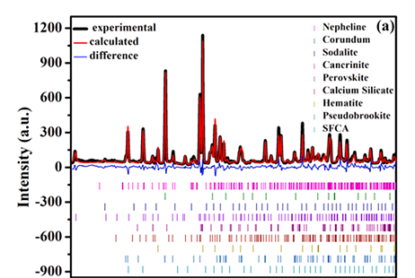

Some other user results ….
Green Conversion of Hazardous Red Mud into X-ray Shielding Tiles
Interfacial structure of epitaxial lattice-matched TiN/Al_{0.72}Sc_{0.28}N superlattices
Red mud is a solid hazardous alumina industrial waste, rich in iron, titanium, aluminum, silicon, calcium, etc.
The red mud contains 30–60% of hematite, thus suitable for shielding high energy X-rays and gamma rays.
Iron rich red mud was converted into diagnostic X-ray shielding tiles through ceramic route
Metal-semiconductor TiN/(Al,Sc)N superlattices have attracted significant interest in recent years for thermoelectric applications
Interface plays a key role in determining its properties
TiN/(Al,Sc)N interfaces are abrupt, with an asymmetric interface roughness ranging from two-to-three unit cells.
Secondary structure or phase formation at the interfaces.
Understanding transport properties of metal-semiconductor structures for devices
Diffraction data of red mud indicating the several components present in the sample
Experimental and simulated scattering profile
Ref.: Varsha Agrawal et al. J Hazardous Material, Vol. 424, p 127507 (2022)
Ref.: Bidesh Biswas et al. J. Vac. Sci. Technol. A Vol. 38, p 053201 (2020)

Slide 16
Study of interface reaction in a B₄C/Cr mirror at elevated temperature using soft X-ray reflectivity
Boron carbide coated x-ray mirrors are used in high brilliance synchrotron beamlines.
In-situ annealing of B₄C/Cr sample and soft x-ray characterizations are performed at Indus-1 reflectivity beamline.
Schematic of the structure
Reflectivity with sample temperature
At elevated temperature, reaction takes place at Cr/SiO₂ interface
Soft x-ray reflectivity and SIMS analyses reveal that Cr diffuses towards Si substrate after 500ºC temperature.
In this study the principal boron carbide layer was found intact upto 550ºC temperature
Ref.: M.H. Modi et al. J. Synchrotron Rad. (2022). 29; /doi.org/10.1107/S1600577522004738

Slide 17
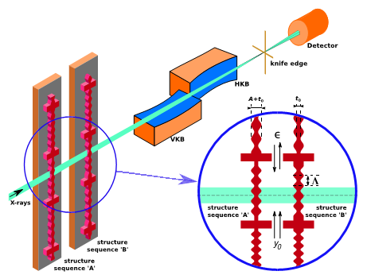
Development of adaptable refractive correctors for X-ray optics
Advances in x-ray sources put greater demands on x-ray optics.
Fabrication errors in optical elements lead to deformation of the radiation wavefront, which prevents diffraction-limited imaging of the source.
Adaptable x-ray phase compensator using refracting elements has been fabricated at the X-ray lithography beamline BL-07 at Indus-2 and tested/used at Diamond light source UK.
Ref:
David Laundy et al. Optica , Vol. 6, p 1484 (2019)
T. E.J. Moxham et al. Optics Express, Vol. 30, p 19185 (2022)

Slide 18
Brief review of materials research at APSUD, RRCAT
(Intermetallic alloys, large bandgap oxides)

Slide 19
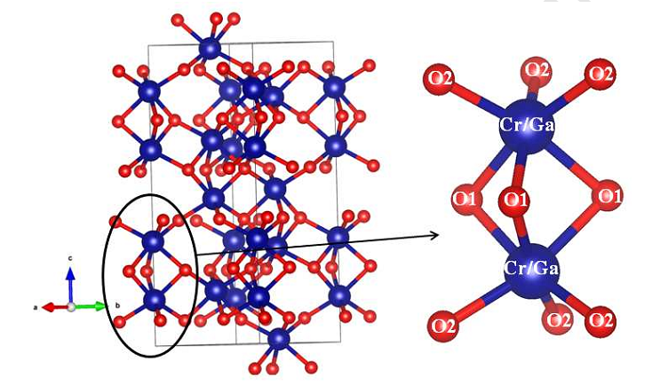
Ni:Ga_{0.9}Cr_{1.1}O₃: A new p-type large bandgap semiconductor
Cr₂O₃ although is a p-type conductor, has poor conductivity
Our approach: Substitute Ga with unfilled p-levels, that increase the O 2p and Cr 3d level hybridization
Can be grown epitaxially on available substrates like Sapphire
Ni substitution further increases p-type conductivity
O 2p
Ni doped Cr₂O₃
Ni doped GaCrO₃
Cr 3d
Photoelectron spectra
Resistance vs T
Single phase polycrystalline α-(Ni_{x}Ga_{0.9–x})Cr_{1.1}O₃ (0 ≤ x ≤ 0.02) synthesized by solid-state reaction method.
Ni doping improves delocalization of charge carriers, which results in reduction of resistance by around 10⁴ times wrt. undoped material
p-type α-(Ni_{0.01}Ga_{0.89})Cr_{1.1}O₃, with band gap of ~3.95 eV and work function of ~5.2±0.2 eV, is suitable as a hole transport layer in photovoltaic devices.
Atomic configuration
Band alignment from PES data
Ref.: R.Jangir et al. ACS Appl. Energy Mater. Vol. 5, p 8629 (2022); R. Jangir et al. J. of Alloys and Comp. Vol. 766, p 876 (2018)

Slide 20
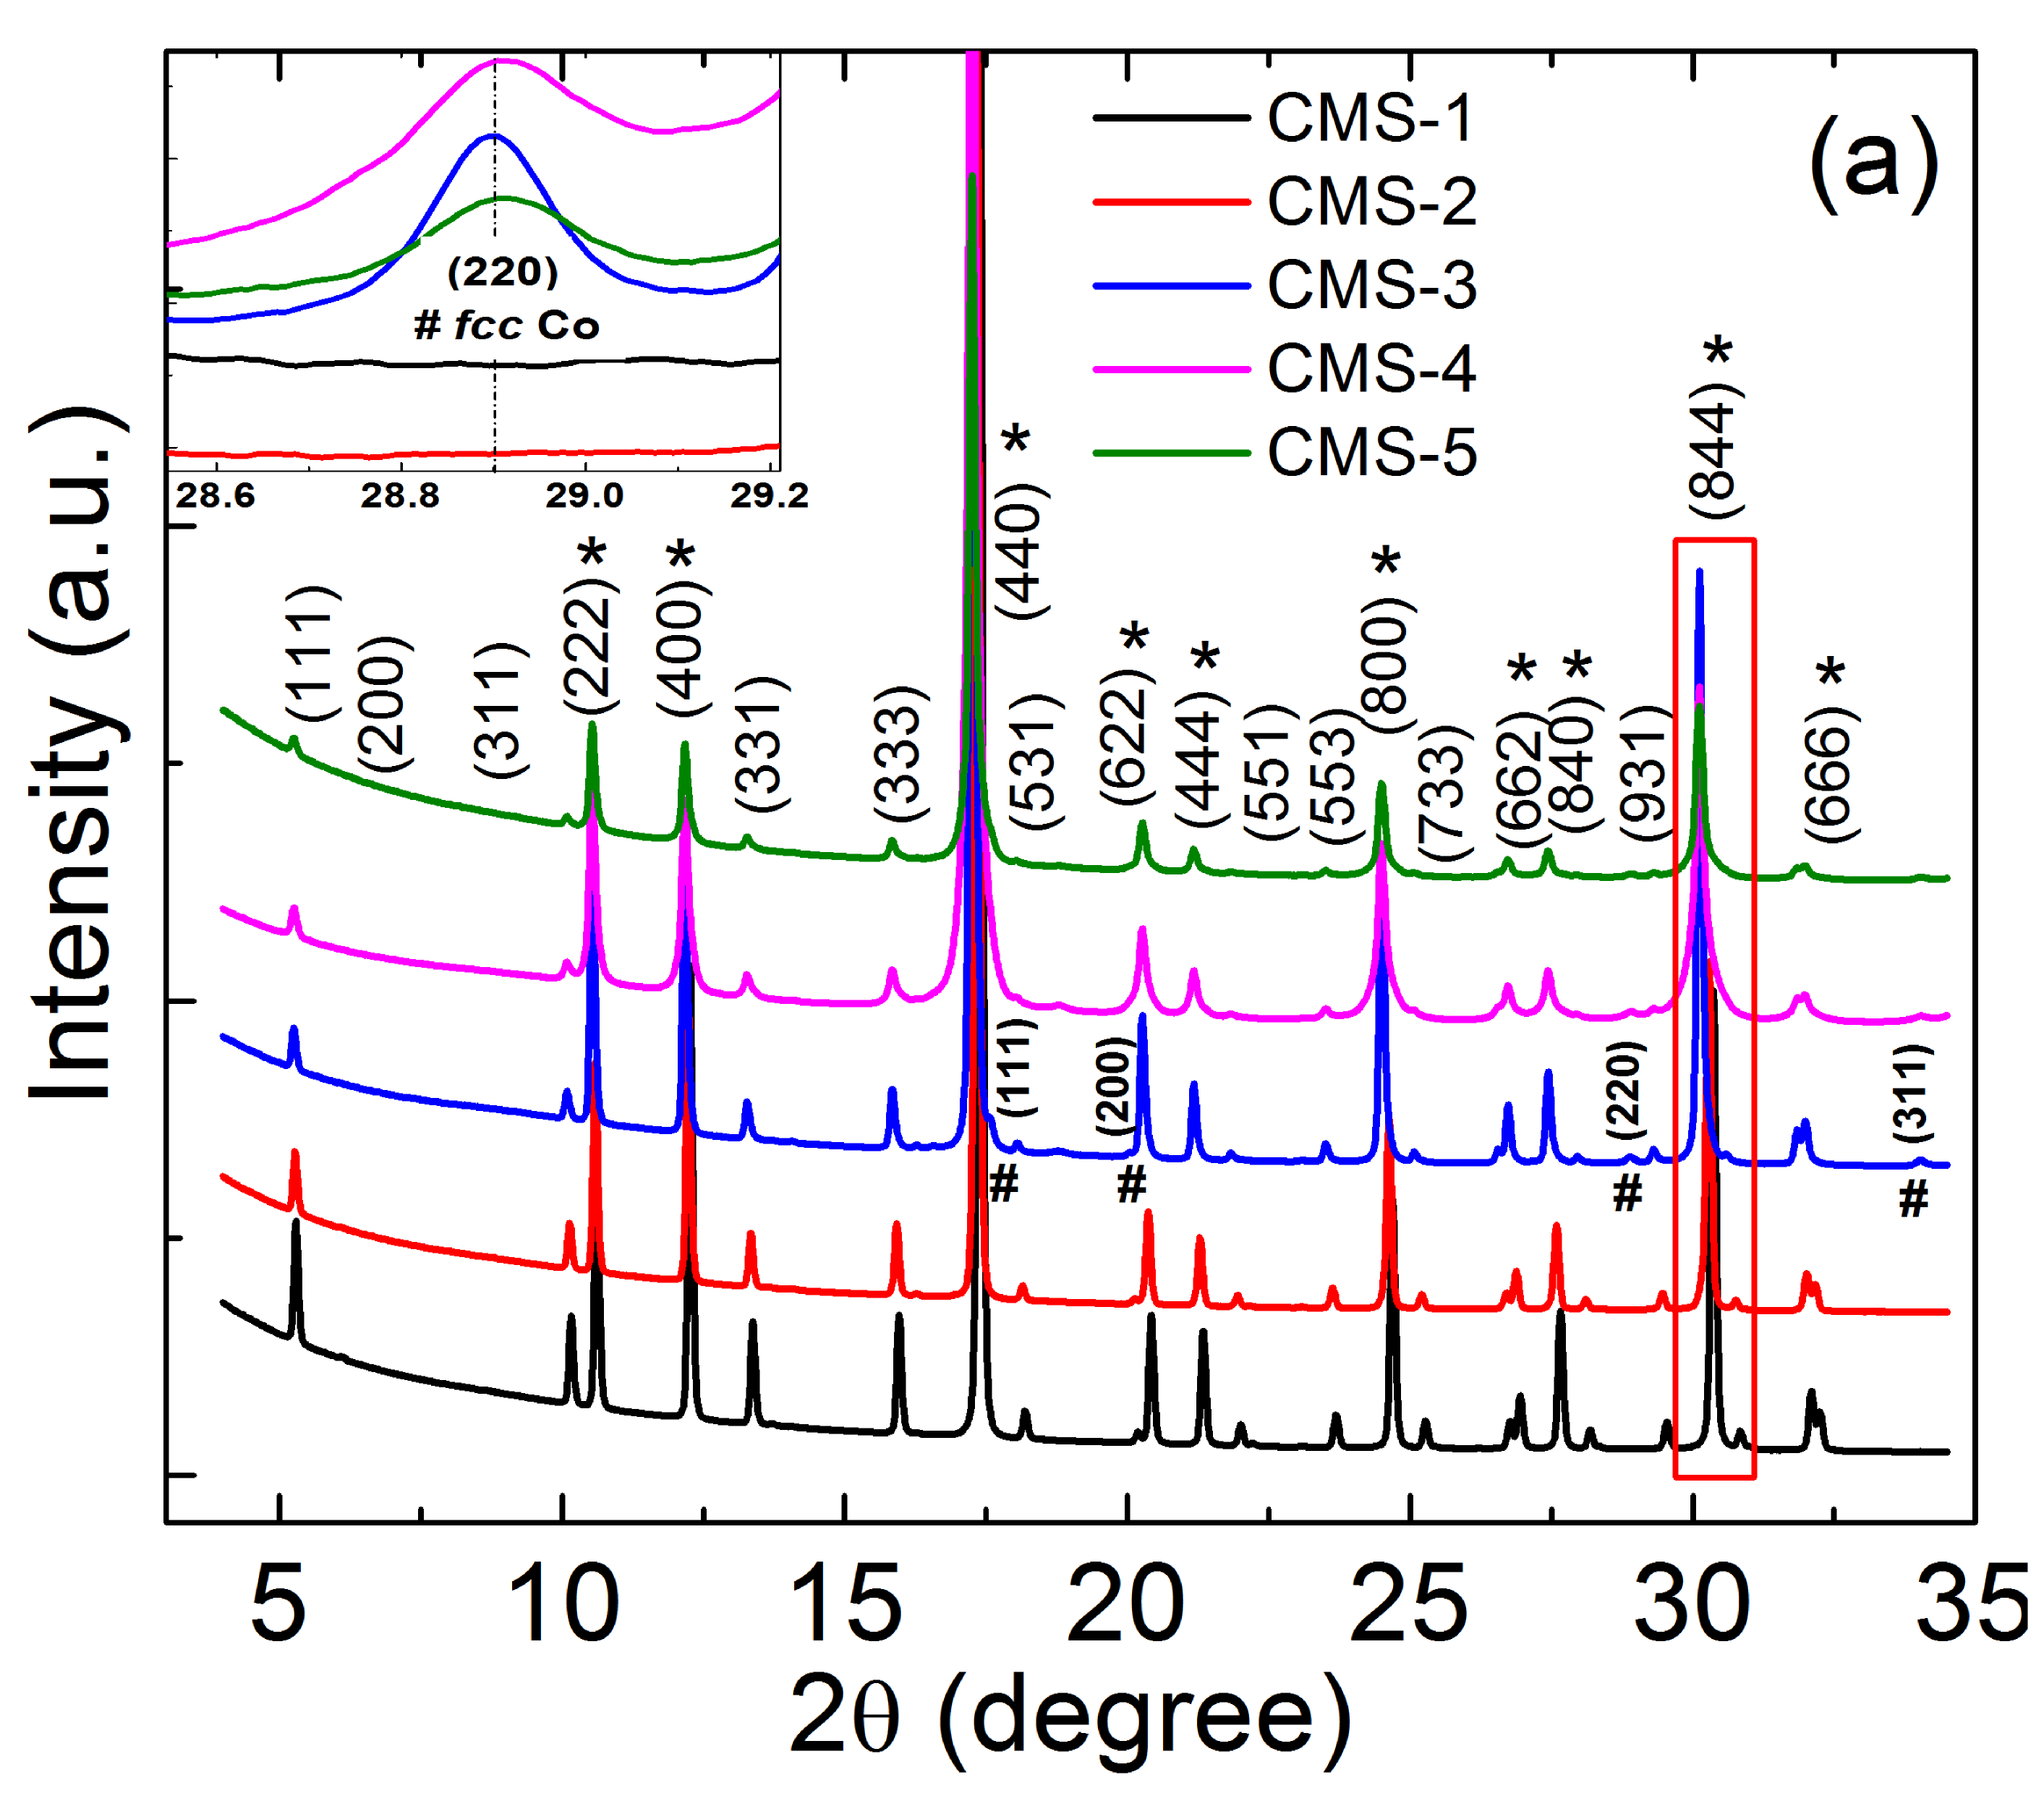
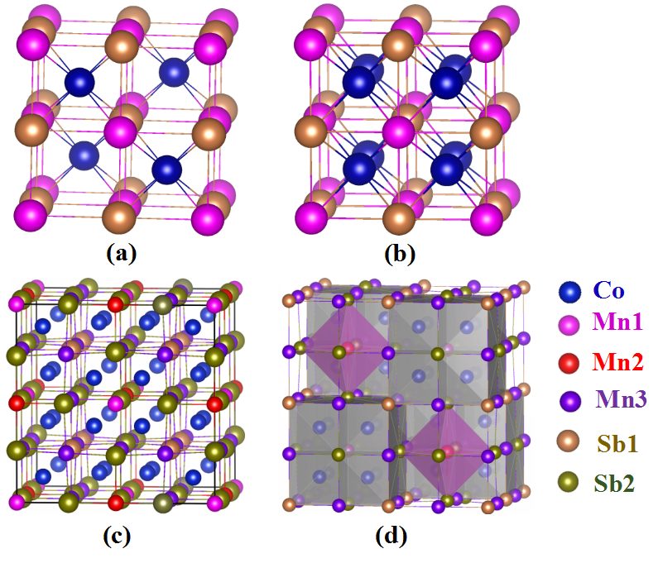
Revealing superstructure ordering in Co_{1+x}MnSb Heusler alloys and its effect on physical properties
Role of structure in enhancing the magnetic moment per formula unit of CoMnSb
Understand the progressive evolution of crystal structure and related physical properties in Co_{1+x}MnSb (0 ≤ x ≤ 1) through a combined experimental and theoretical study
Detailed powder XRD and Rietveld refinement results: All samples show superstructure ordering; Max. Co concentration accommodated is ~ 0.45.
Superstructure is the key to the increased magnetic moment per formula unit, from 3 μ_{b} to 4 μ_{b} per formula unit
C1_{b} structure
Superstructure
RT powder XRD patterns
Ref.: Madhusmita Baral et al. Phys. Rev B 105, 184106 (2022)

Slide 21
Thank you very much

