Slide 1




The recent results on linear accelerator of
Siberian Ring Synchrotron Light Source (SKIF)
Speaker: Xiaochao Ma
Budker Institute of Nuclear Physics

Slide 2
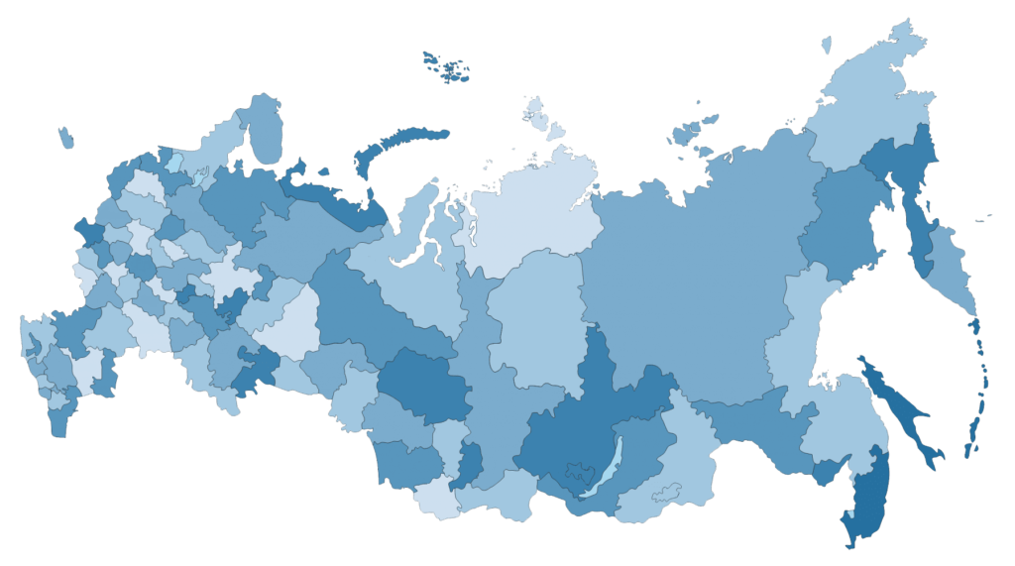


Siberian Circular Photon Source (SKIF)
SKIF layout
4th Generations synchrotron light sources
3 GeV Energy
Low-emittance
BINP, Novosibirsk, Russia
Novosibirsk

Slide 3
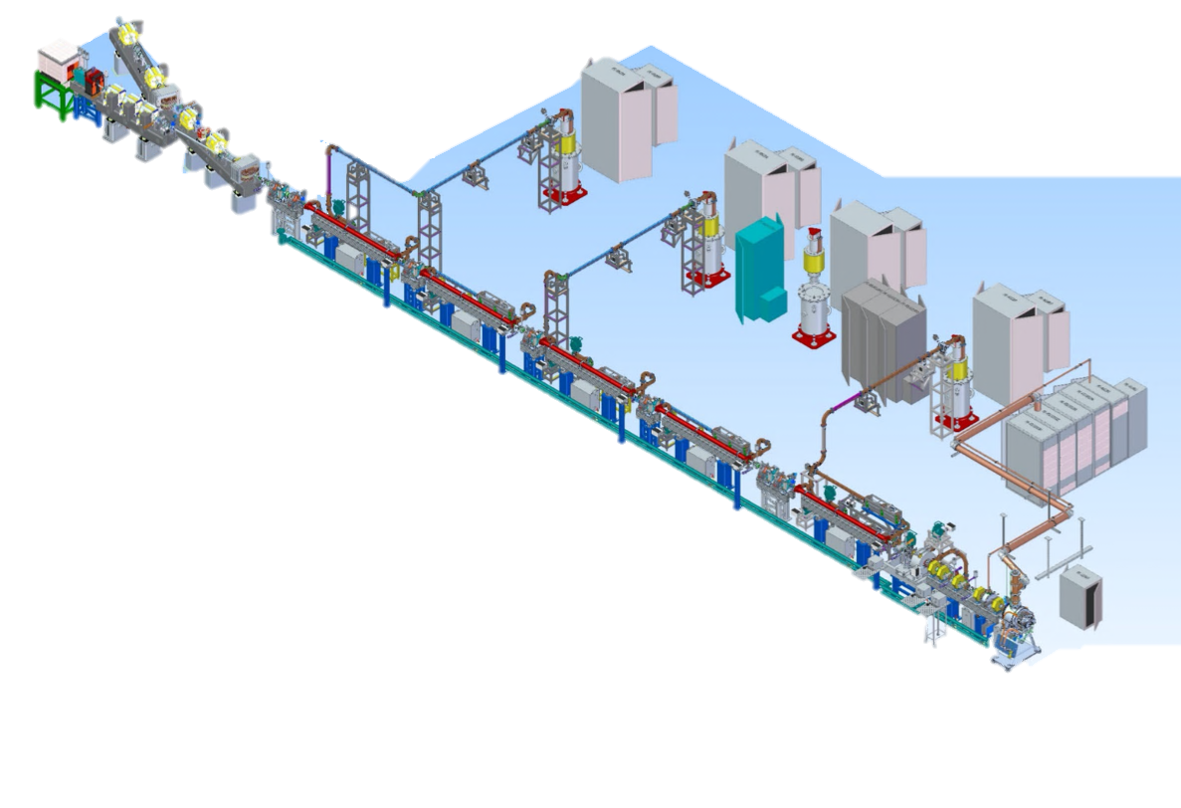
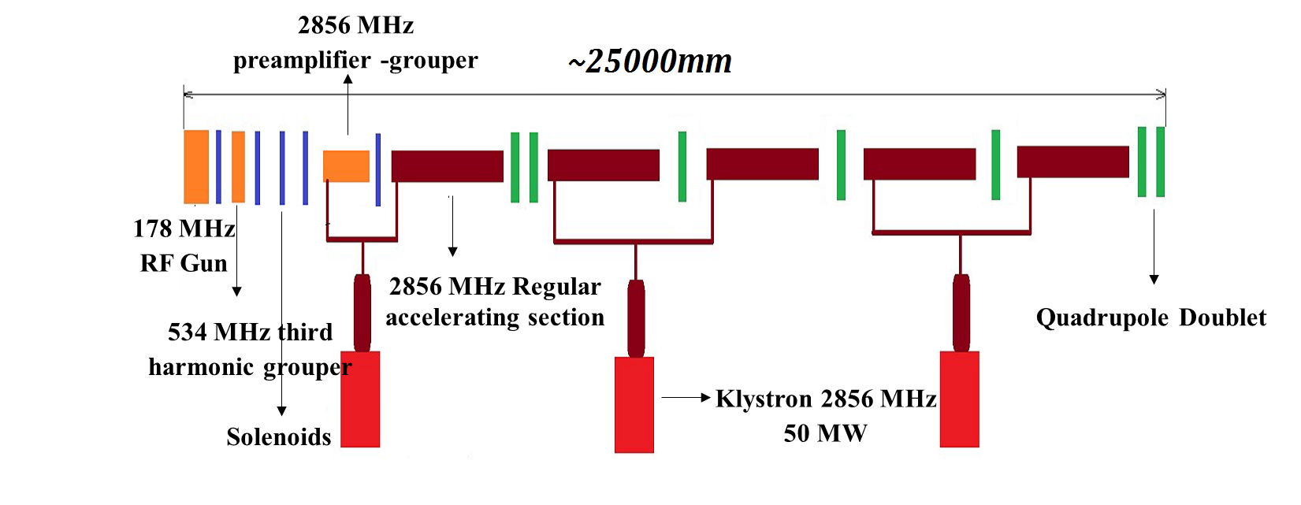
Linear accelerator of the SKIF injector
LINAC layout
Parameter | Value
Operating energy | 200 MeV
Energy spread (RMS) | 1%
Injection rate | 1 Hz
Bunch period | 5.6 ns
Number of bunches | 55
Single bunch charge | 0.3 nC
Horizontal emittance at 200 MeV | 150 nm
RF gun
Bunching system
Pre-accelerator
Five accelerating structures

Slide 4
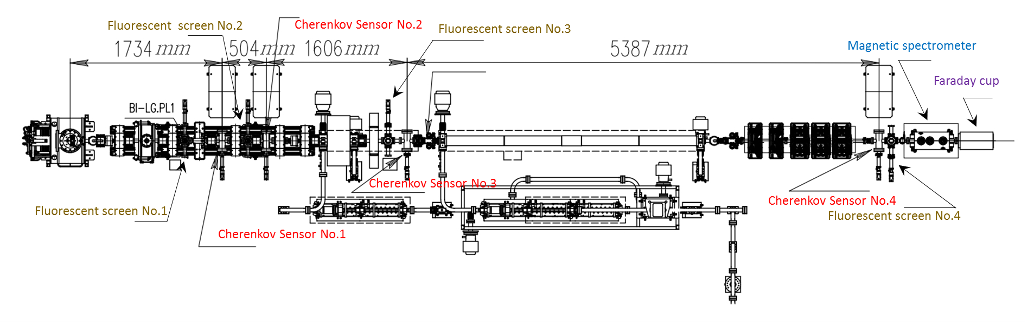
Test stand and diagnostics
Fluorescent screen | 4
Cherenkov Sensor | 4
Magnetic spectrometer | 1
Faraday cup | 1
BMP | 3
FCT | 3
The test stand of the SKIF linac is under testing now.
It consist of the RF gun, bunching system, pre-accelerator and the first accelerating structure.

Slide 5
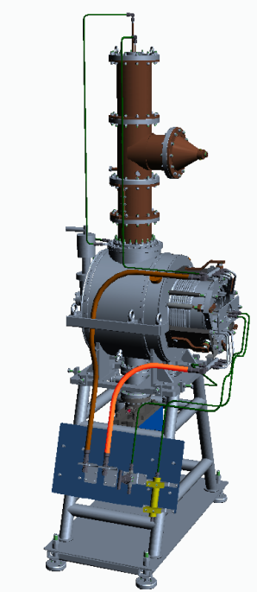
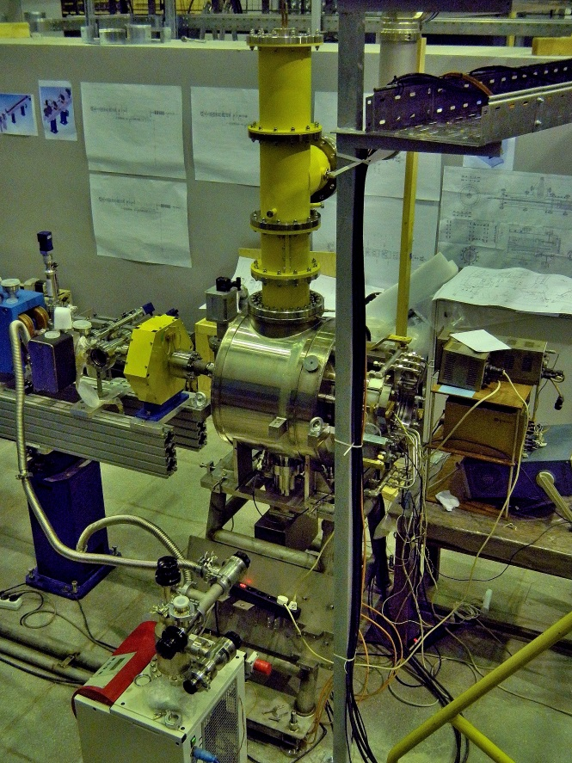
RF gun with gridded cathode
A cathode module is inserted and fixed in the RF gun cavity. The module consists of the grid cathode, heater, and modulator to control the extracted beams.
This device provides the required frequency and charge of the electron bunches.
Cathode from the triode GS-34 / EIMAC YU-171 triode
1 ns trigger pulses with a bias amplitude variable in the range of 0÷150 V are produced by the modulator.
Charge of up to about 1 nC.
Trigger pulses in the range from 0 Hz (no trigger pulses and no bunches) to 180 MHz.

Slide 6
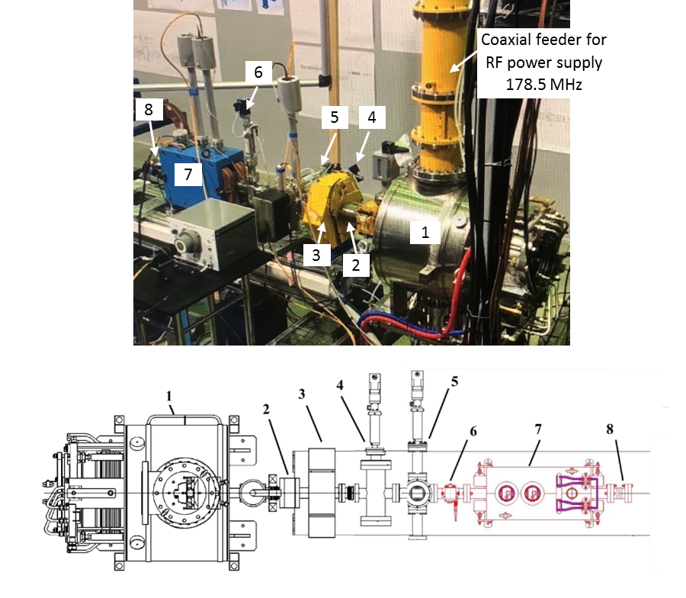
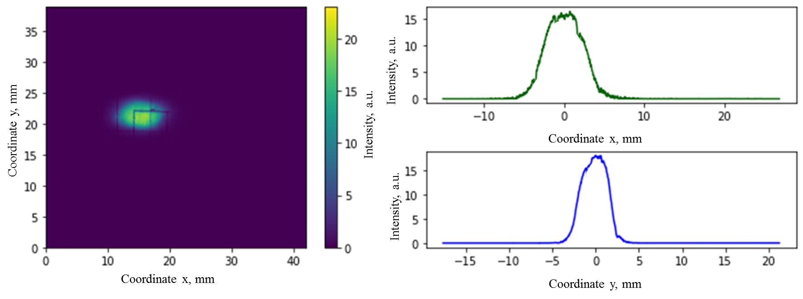
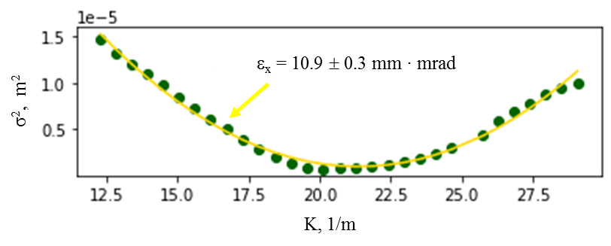
Diagnostics — after RF gun
σ_{x} = 2.32 mm
σ_{y} = 1.49 mm
Typical beam image recorded by the fluorescent screen behind the RF gun, E_{b} ≈ 0.5 MeV.
Appearance and scheme for measuring the beam parameters of an electron RF gun: 1 - RF gun, 2 - FCT, 3 - solenoid, 4 - Cherenkov sensor, 5 - fluorescent screen, 6 - collimator, 7 - spectrometer, 8 - Faraday cup
Determination of the emittance of an RF gun beam using solenoidal scanning.
The transverse dimensions and emittance of the beam are as expected!

Slide 7
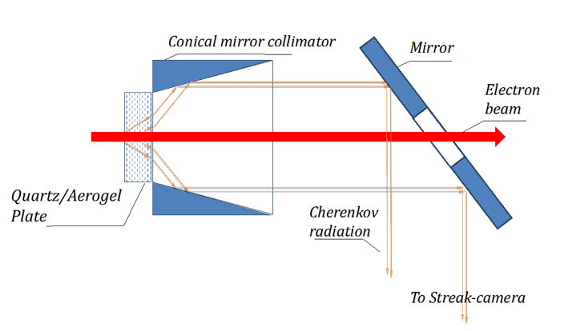
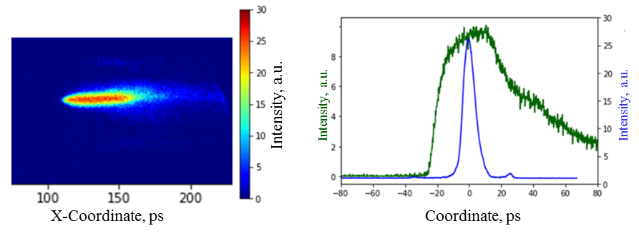
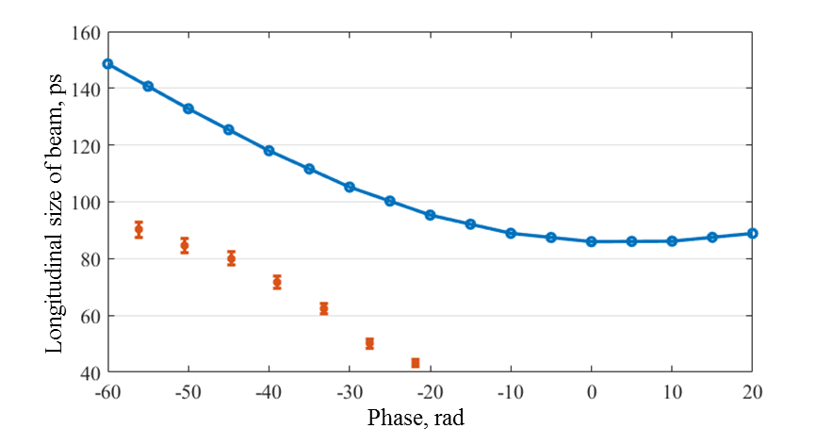
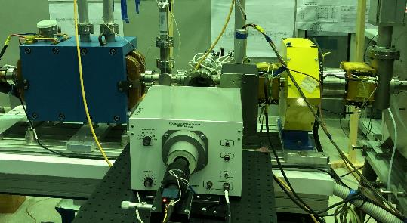
Diagnostics — after RF gun
The vertical central section of the image
The horizontal central section of the image
Beam duration FWHM = 65 ps.
Image and longitudinal distribution of the beam recorded at the phase of the RF gun resonator = -0.78 rad and modulator voltage U_{m} = 70 V.
Simulation results
Streak camera PS-1/S20
Measurement results
The device of the Cherenkov sensor and appearance
(Quartz plate as radiator)
Longitudinal beam dimensions (FWHM) recorded at different phases of the RF gun resonator by a Cherenkov sensor at modulator voltage Um = 70 V.

Slide 8
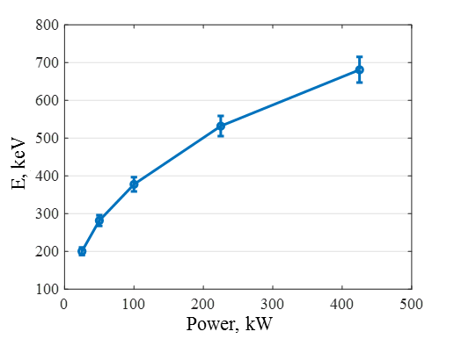
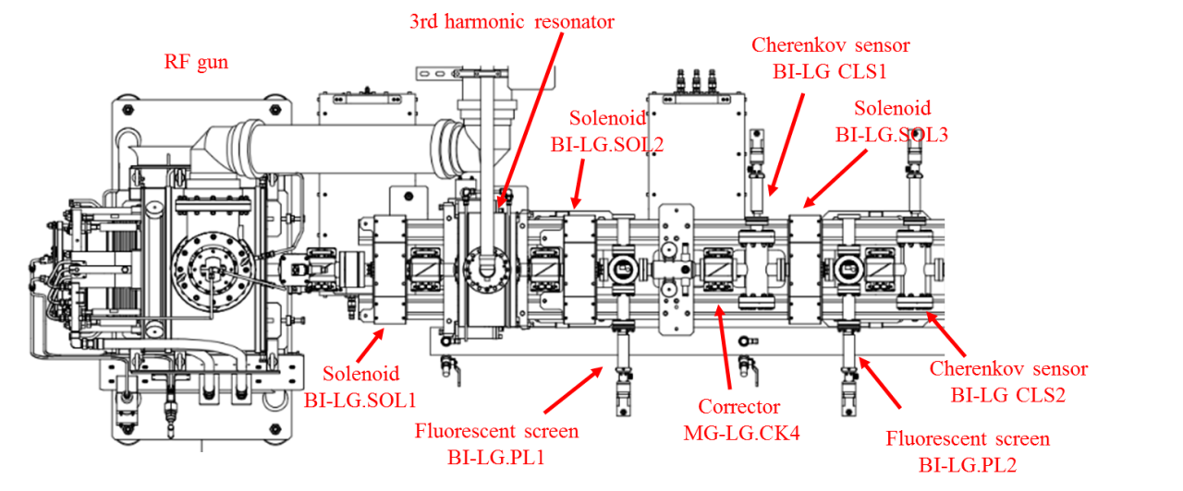
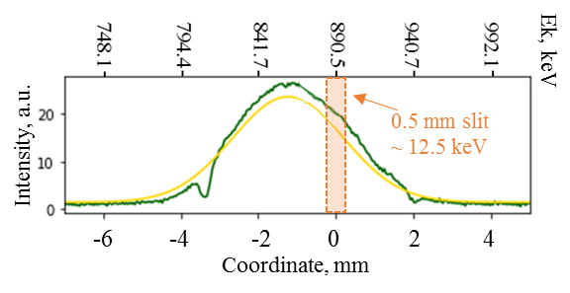
Diagnostics — after RF gun
Measured beam energies as a function of RF power applied to the gun resonator
The beam energy was determined using an corrector (MG-LG.CK4 ) and a fluorescent screen (BI-LG.PL2);
The energy spread was determined using a dipole magnetic spectrometer.
Determination of the energy spread of the beam using a magnetic spectrometer
The resulting energy spread is ∆E = 35 ±7 keV.

Slide 9
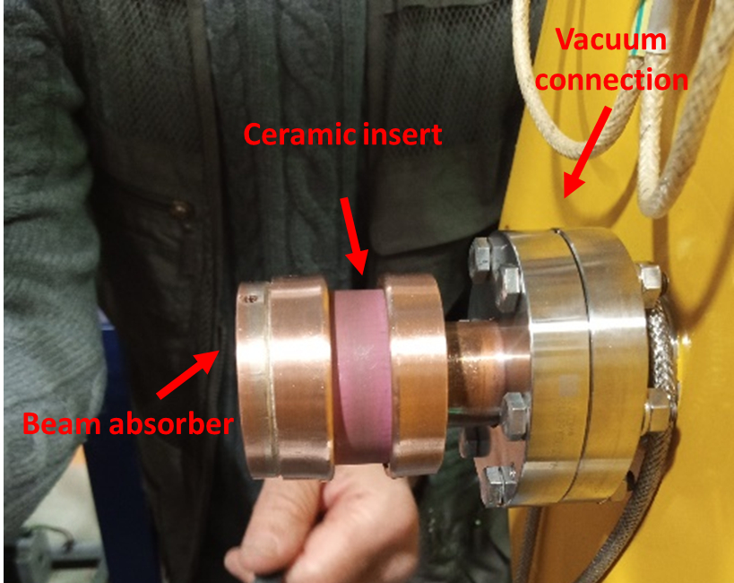
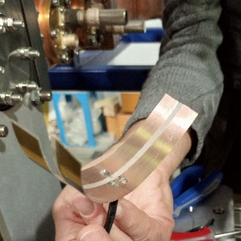
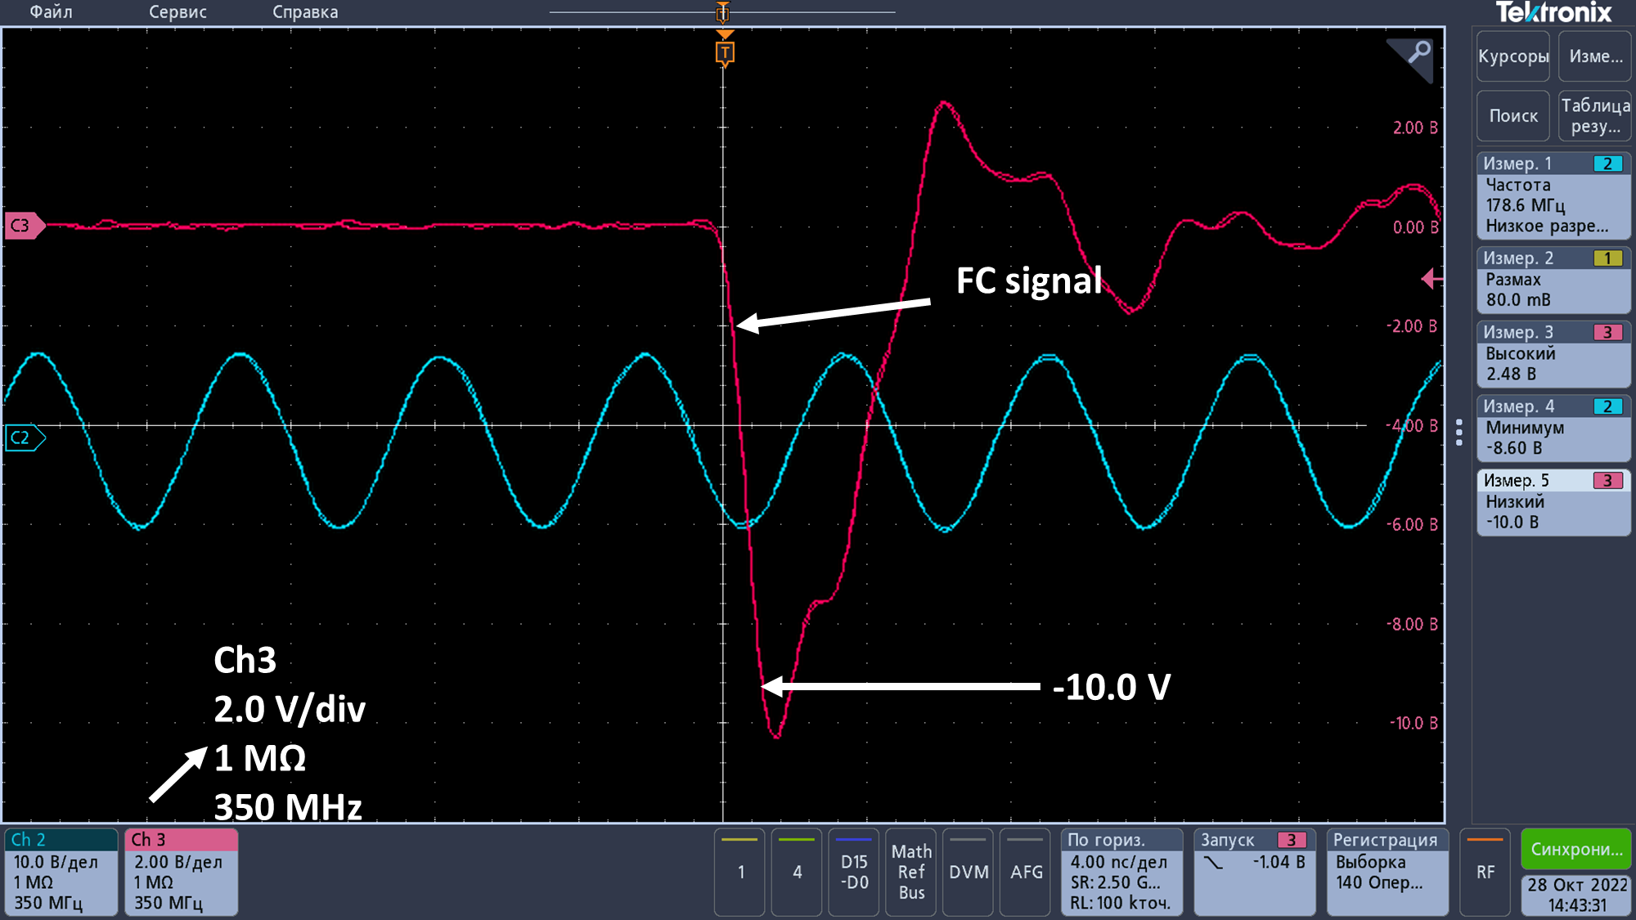
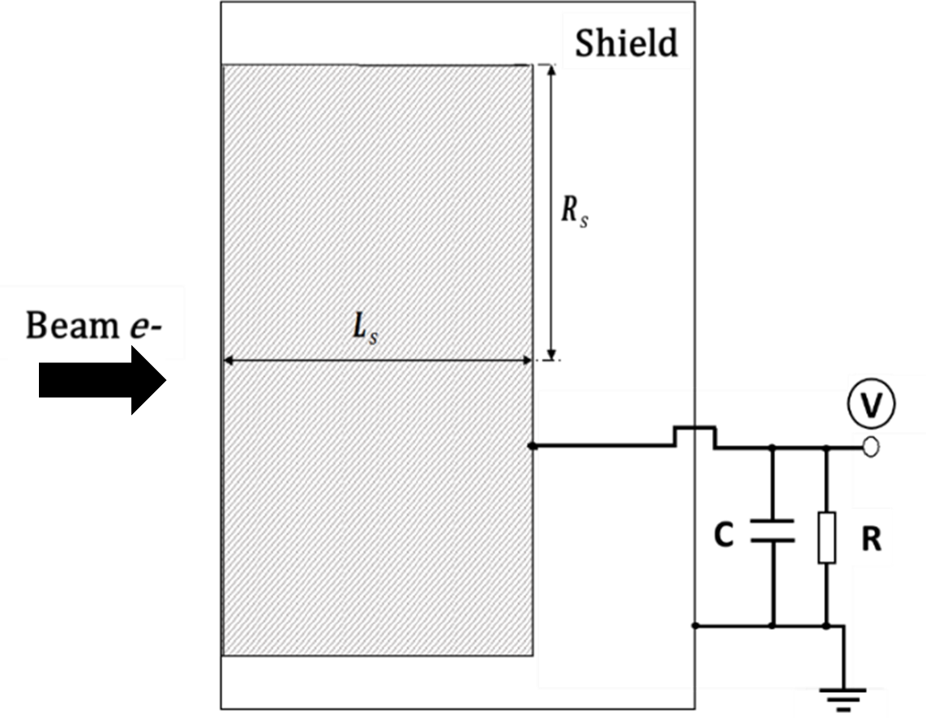
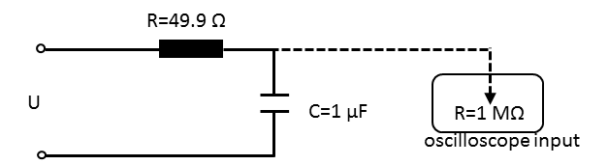
Diagnostics — after RF gun
Appearance of the Faraday cup
Contact pads for the FC signal cable, reducing parasitic inductance.
The digital filter signal when working on the high-resistance input of the oscilloscope (R = 1 MΩ).
Dependence of the RF gun beam charge on the voltage of the modulating pulse.
Scheme of the Faraday cup
Connection diagram of the digital filter for registering a broadband signal.

Slide 10
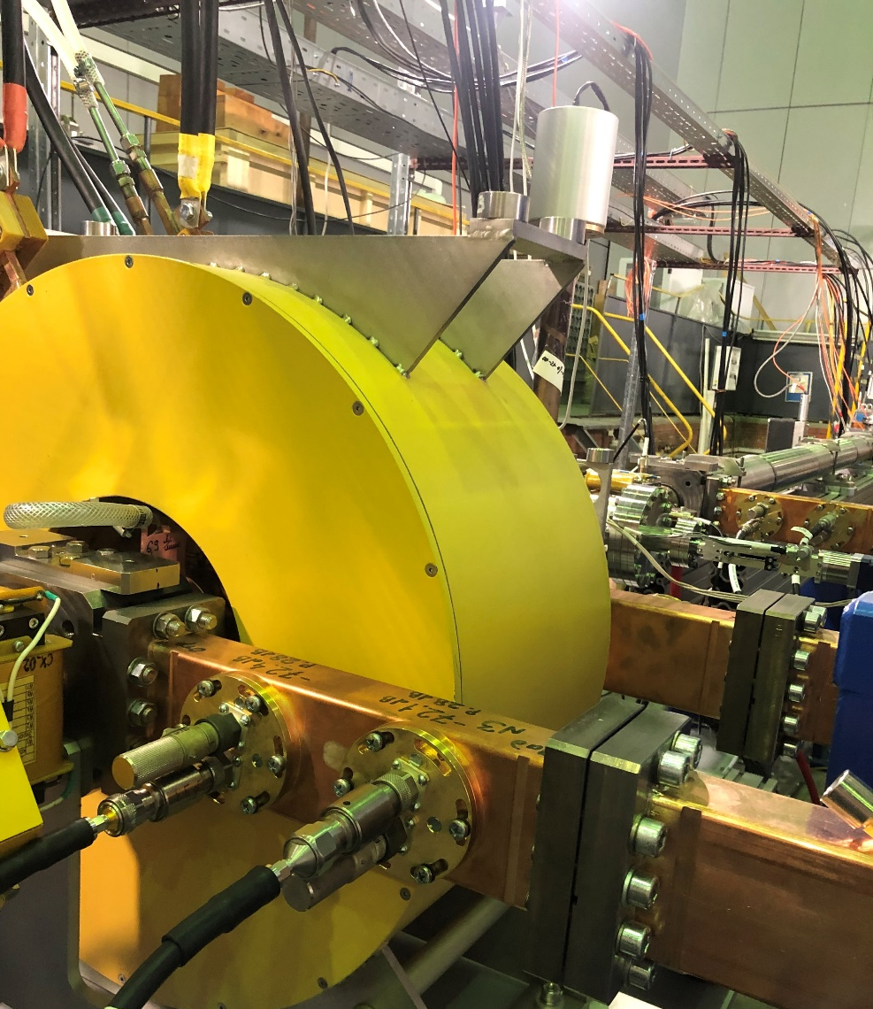
Buncher and pre-accelerator
Buncher pre-accelerator is short regular accelerating structure SLAC’s type.
The initial beam energy is enough to use the regular accelerating cells to bunch and pre-accelerate the beam.
The input power from the klystron is up to 10 MW and the energy of the beam should be about 3 MeV.
Measured parameters | Value
Frequency under the vacuum with temperature of Т=25 ºС | 2856.3 MHz
Operating mode | 2π/3
Total phase error | 2º
RMS phase deviation | ±3º
Q-factor | 1.2⋅10⁴
SWR | 1.5

Slide 11
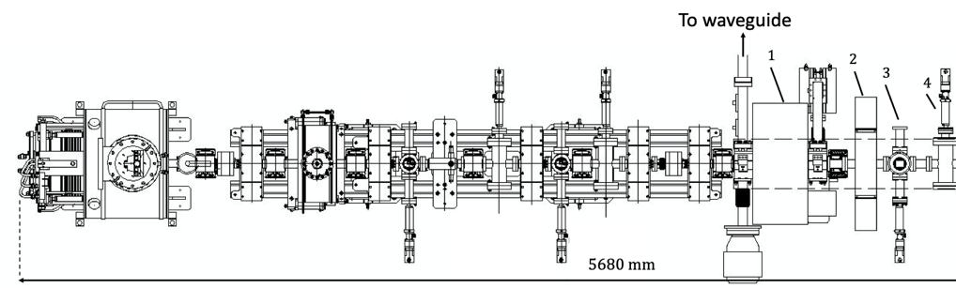
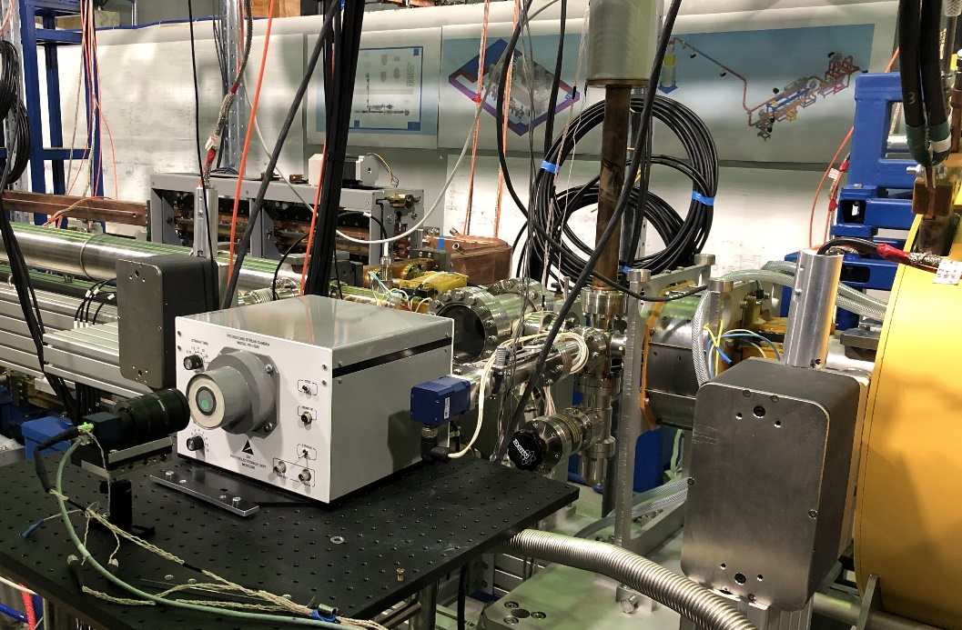
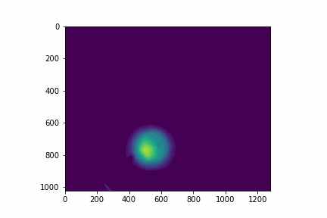
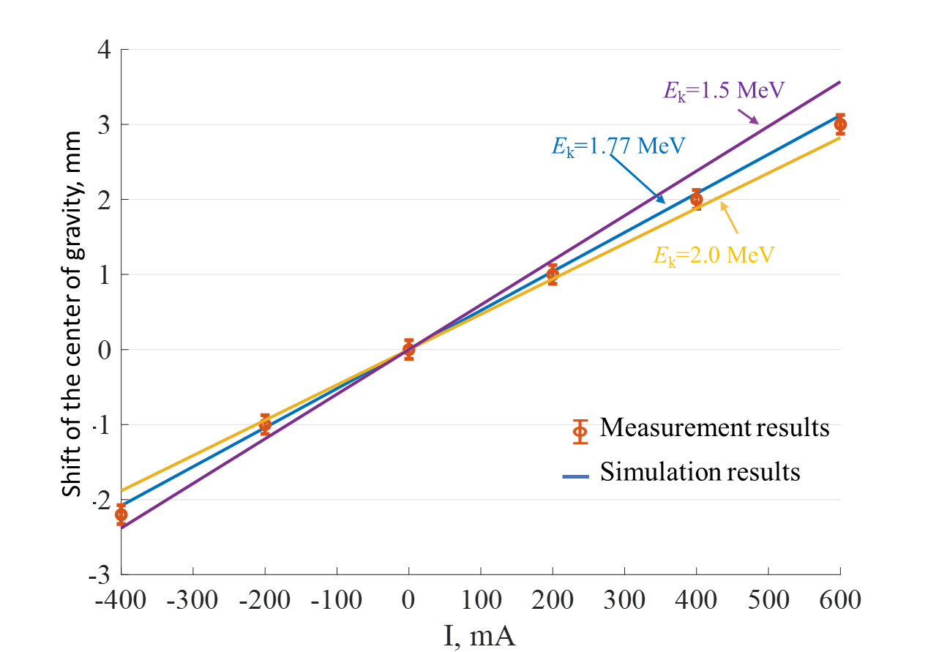
Diagnostics — after the preaccelerator-grouper
Energy beam up to 3 MeV
1 | Preaccelerator
2 | Solenoids
3 | Fluorescent screen
4 | Cherenkov sensor
4
3
pixels
pixels
Energy measurement: Scanning image with calibrator recorded on fluorescent screen. E_{k}=1.77 MeV

Slide 12
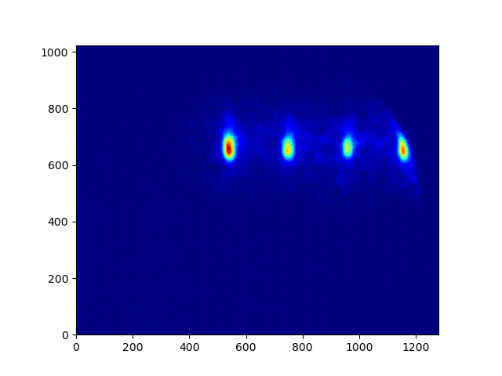
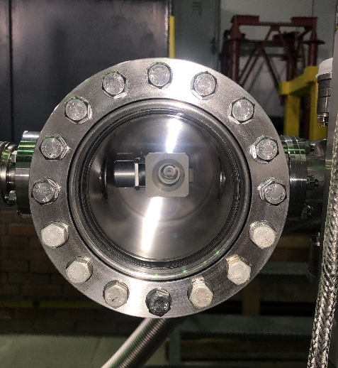
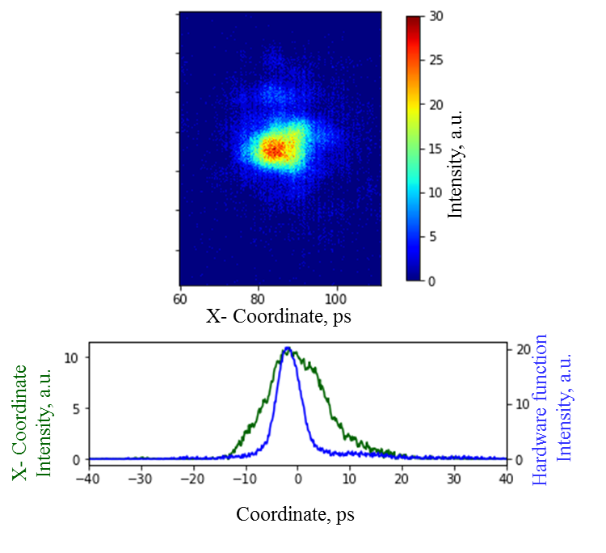
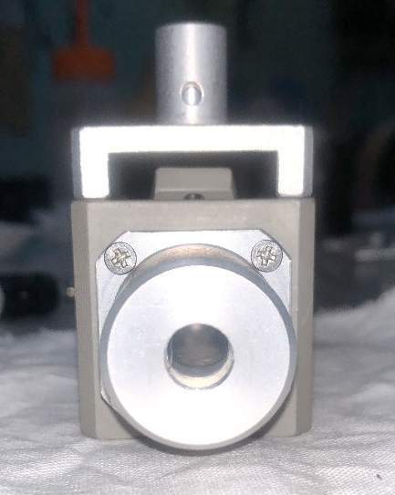
Diagnostics — after the preaccelerator-grouper
Time interval ~ 5 ps
The duration of one bunch turned out to be equal to τ_{beam} = 12 ± 3 ps.
Pixels
Pixels
Detail appearance of Cerenkov detector using aergel
Registration of the multi-bunch mode of accelerator operation with a streak camera sweep of 30 ns.
The achieved temporal resolution is several picoseconds for the duration of the beam.
Hardware function and expanded image of one bunch.

Slide 13
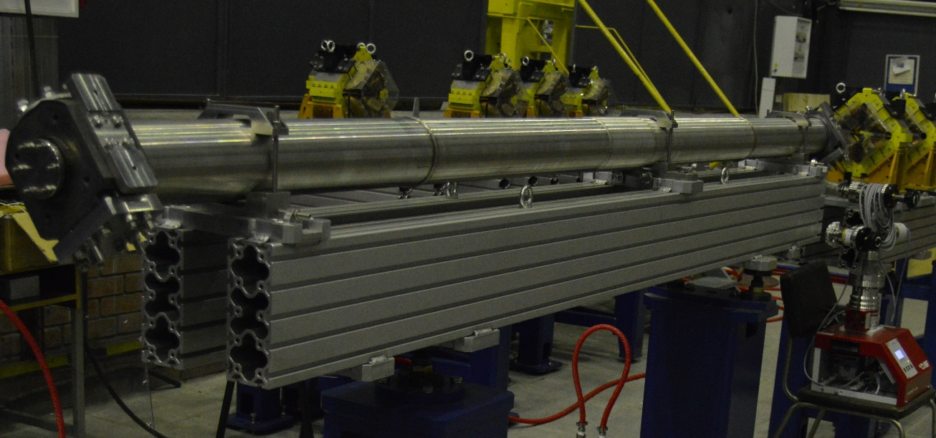
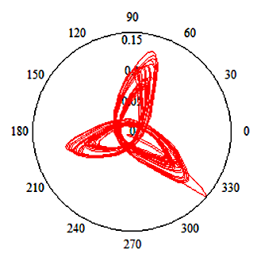
Regular accelerating structure
SLAC type accelerating structure with length of 3 m.
It consists of two coupling cavities and 83 accelerating cells.
Structure is produced and measured.
SLAC type accelerating structure with the constant impedance
Measured parameters | Value
Frequency under the vacuum with temperature of Т=25 С⁰ | 2856.6 MHz
Operating mode | 2π/3
Total phase error | 0.8⁰
RMS phase deviation | ±1.2⁰
Q-factor | 1.35⋅10⁴
SWR | 1.53
Phase diagram

Slide 14
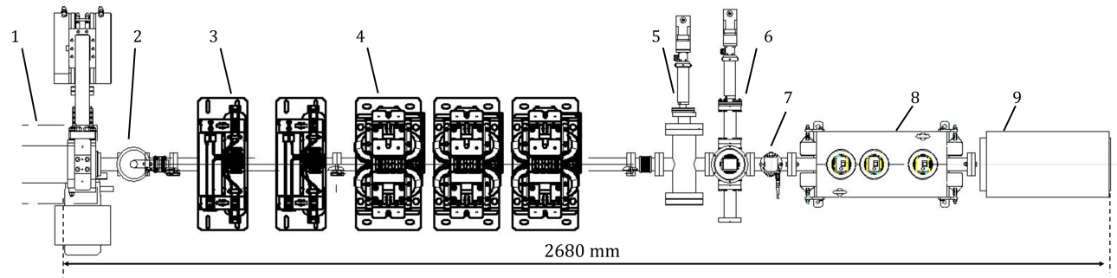
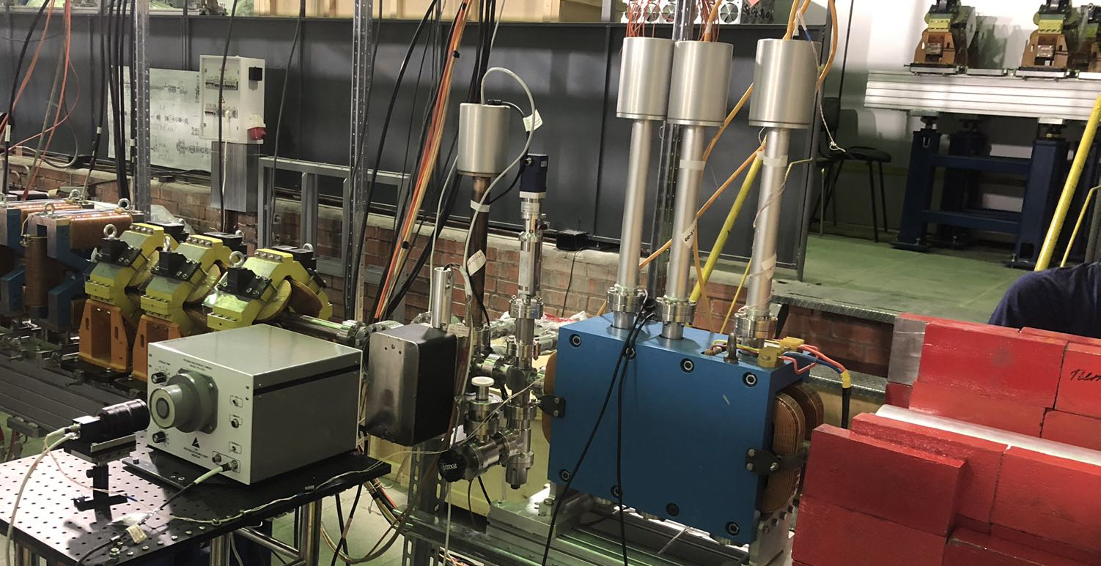
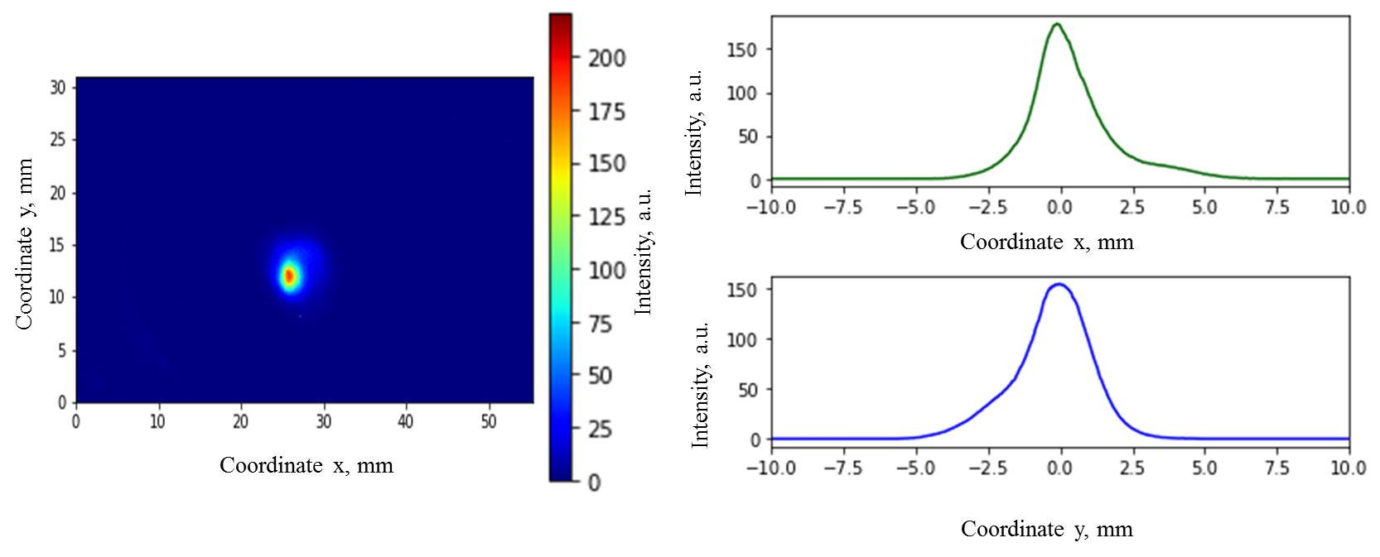
Diagnostics — after the first accelerating section
1 | Accelerating structure
2 | Gate valve
3 | Corrector
4 | Quadrupole
5 | Cherenkov sensor
6 | Fluorescent screen
7 | Collimator
8 | Spectrometer
9 | Faraday cup
6
7
σ_{x} = 0.8 mm
5
9
σ_{y} = 0.9 mm
8
Transverse beam size recorded by fluorescent screen

Slide 15
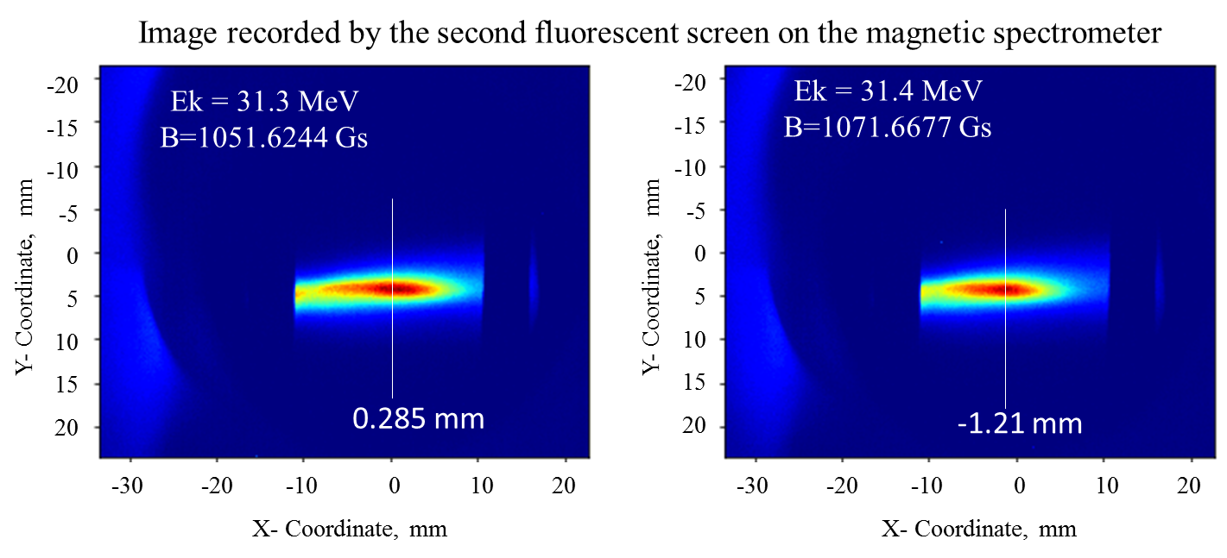
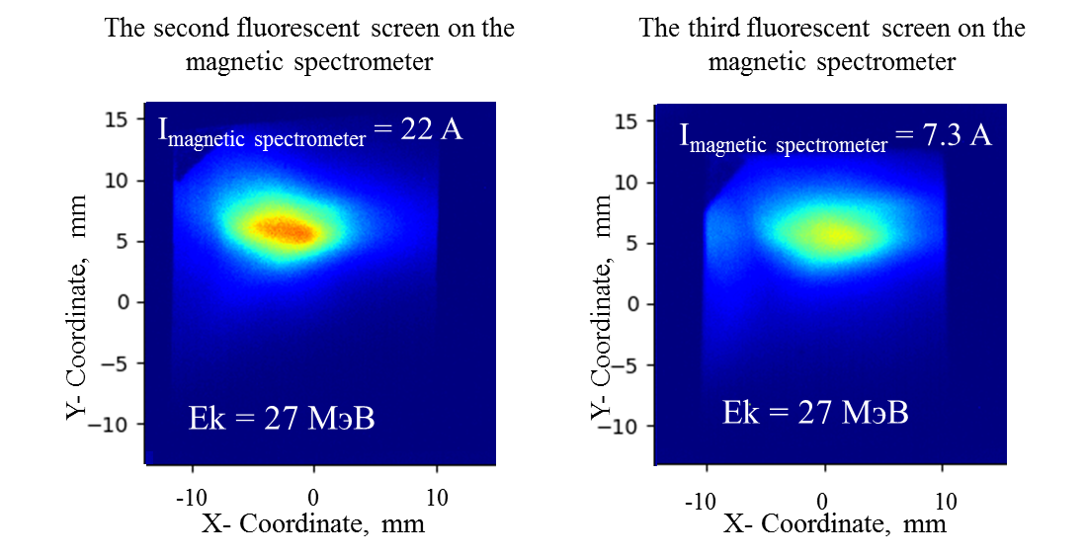
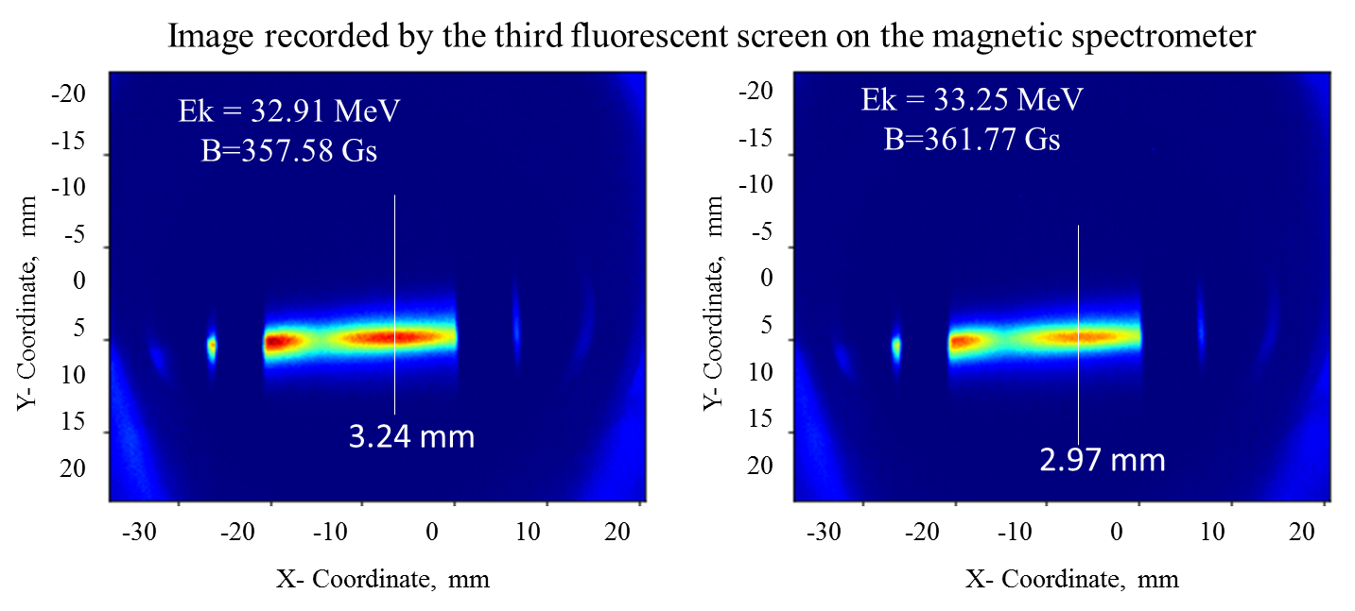
Diagnostics — after the first accelerating section
Energy is cross-checked in both screens.

Slide 16
Conclusion
Linear accelerator of the SKIF injector was developed. The main devices of the accelerator were produced and measured. Test stand with the RF gun, bunching system, the first accelerating structure and diagnostic system are operating in Budker Institute of Nuclear Physics. The first beam is accelerated in the accelerating structure. The achieved beam parameters are: an energy up to 30 MeV with RF power of about 15 MW, the bunch charge up to 1 nC, the bunch duration about 12 ps. It corresponds to our simulations. Measurements of beam parameters are in progress.
At present, all beam parameters are usable for the linear accelerator of the SKIF injector.

Slide 17
Linear accelerator team
In alphabetical order
Maria Arsentieva
Alexey Barnyakov
Alexander Batrakov
Evgeny Bekhtenev
Oleg Belikov
Evgeny Bykov
Dmitriy Chekmenyov
Viktor Dorokhov
Mikhail Fedotov
Gennady Karpov
Alexey Kondakov
Evgeny Kotov
Sergey Krutikhin
Grigory Kurkin
Alexey Levichev
Xiaochao Ma
Yulia Maltseva
Andrey Martynovskiy
Oleg Meshkov
Alexander Morsin
Sergey Motygin
Danila Nikiforov
Vladimir Ovchar
Anton Pavlenko
Oleg Pavlov
Ilya Pivovarov
Dmitry Pureskin
Vladimir Repkov
Evgeny Rotov
Sergey Samoilov
Dmitry Senkov
Nikita Shchegolkov
Dmitry Sukhanov
Vladimir Tcheskidov
Natalya Vasileva
Vladislav Borin
Vladimir Volkov
And others
Notes:
This is a list of contributors to the SKIF linear accelerator project, in no particular order.

Slide 18
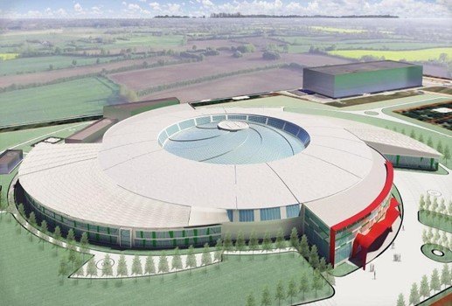
Thanks for attention!

