Slide 1

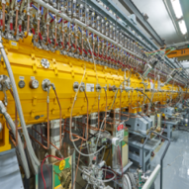
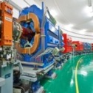
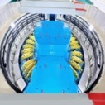
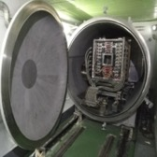


Design and Beam Commissioning of Dual Harmonic RF System in CSNS RCS
Speaker：Liu Hanyang
Authors：Prof. Wang Sheng
Dr. Xu Shouyan
Dr. Liu Hanyang

Slide 2
Main Content
    The dual harmonic RF system
    The beam loading effect
    Tomography in dual harmonic
    Beam measurement
    Next step

Slide 3
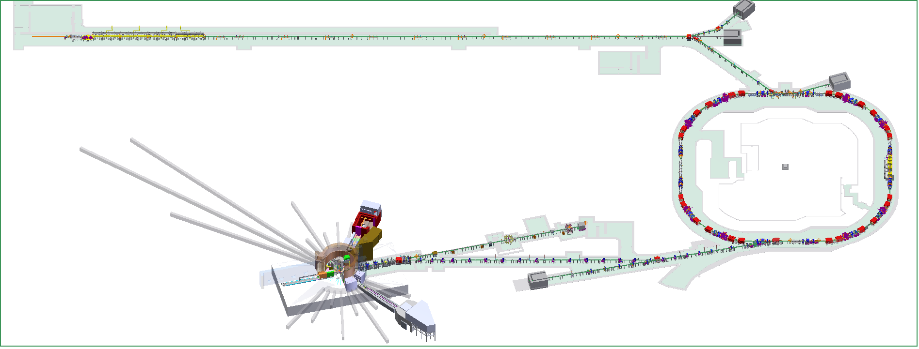
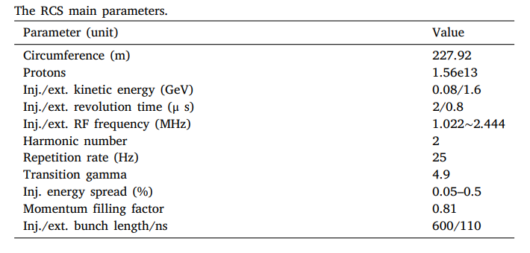
CSNS Layout
80MeV H⁻ linac
1.6GeV
RCS

Slide 4
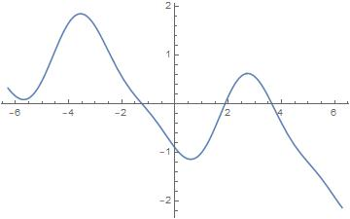
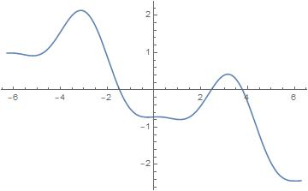
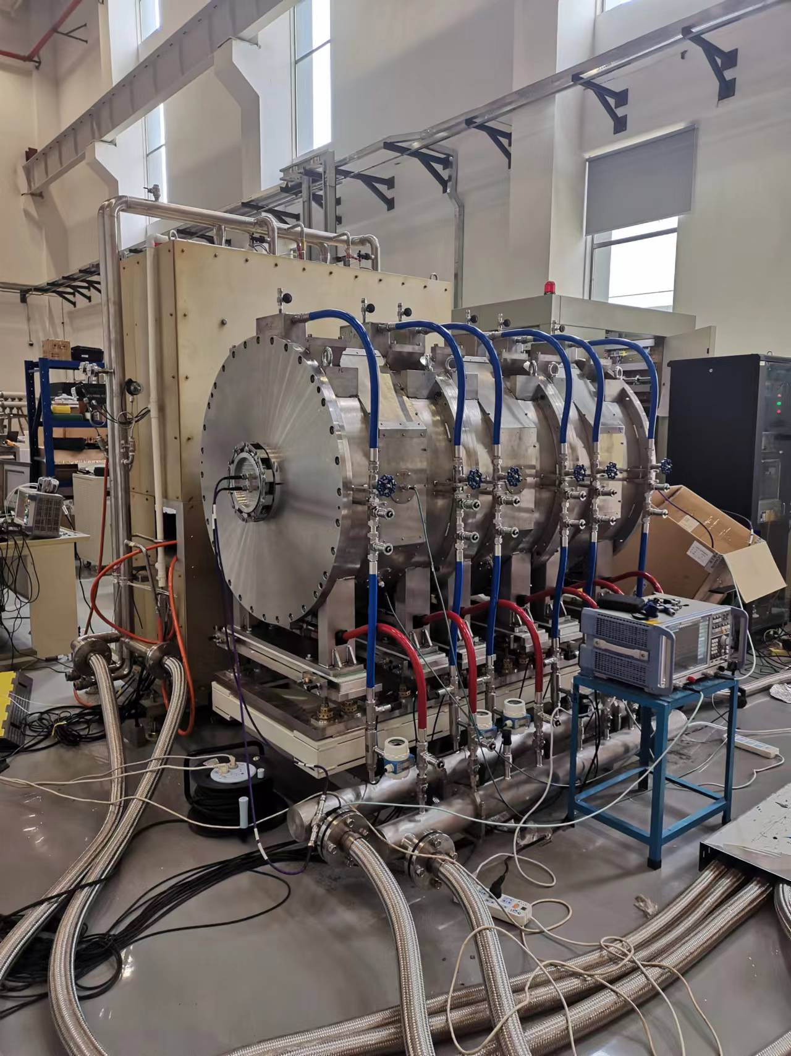

The Dual Harmonic RF System
Reduce the longitudinal peak current intensity, and thus reduce the beam loss caused by space charge effect.
Single harmonic(r=0)
Dual harmonic(r>0.5)
140kW has achieved
?
170kW
（One MA cavity added，60kV）
200kW
（Three MA cavities added ，100kV）
500kW
（300MeV Linac energy）

Slide 5
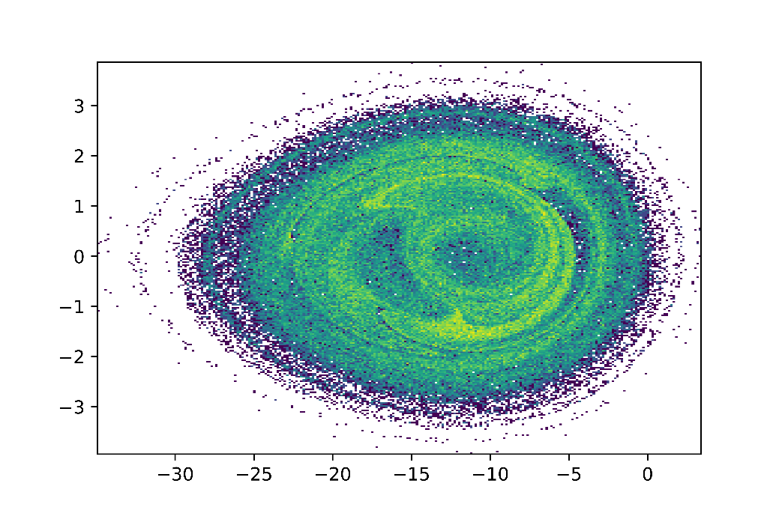
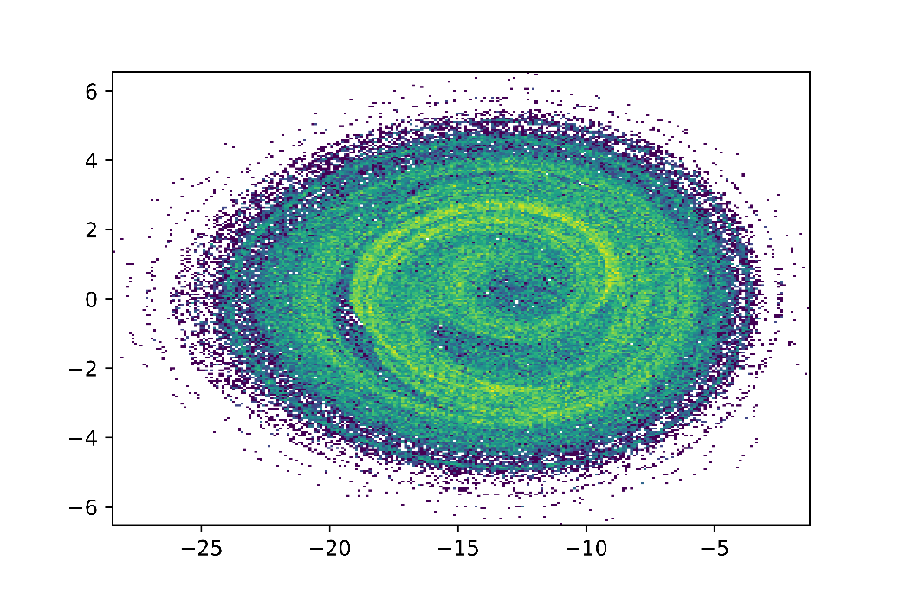
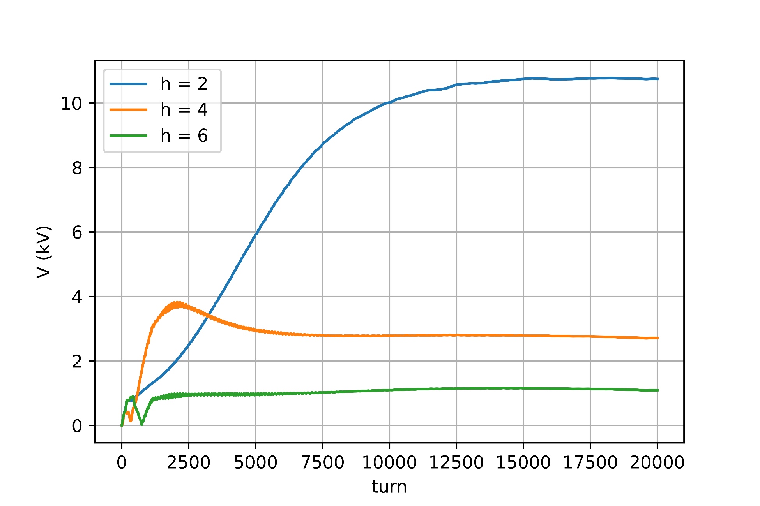
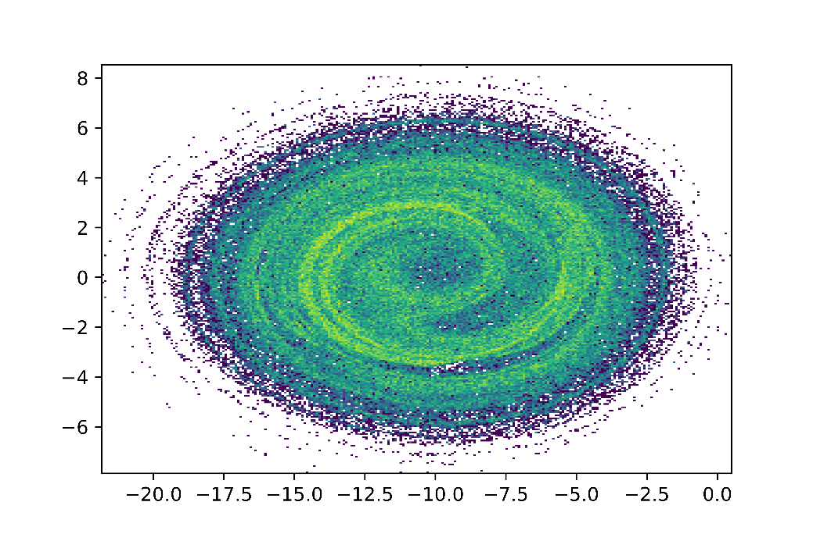
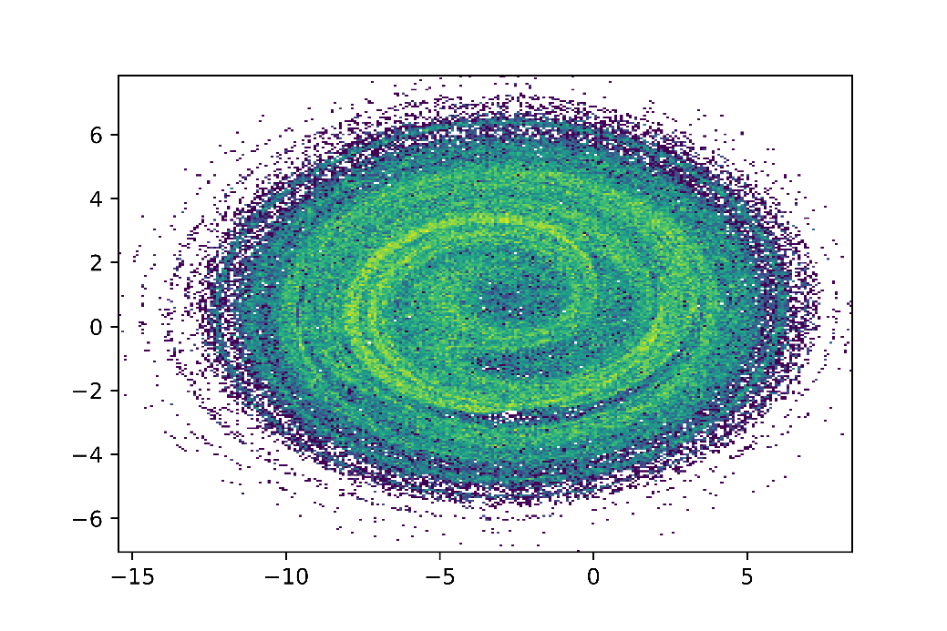
Beam Loading Effect
One MA cavity,
1.56×10¹³ Particle number per bunch
5000
10000
15000
Energy shift;
Bunch length increased
Q≈1.25
20000
Notes:
20000/20ms extraction

Slide 6
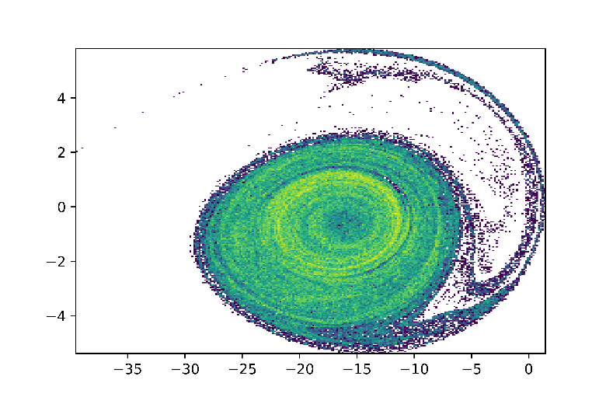
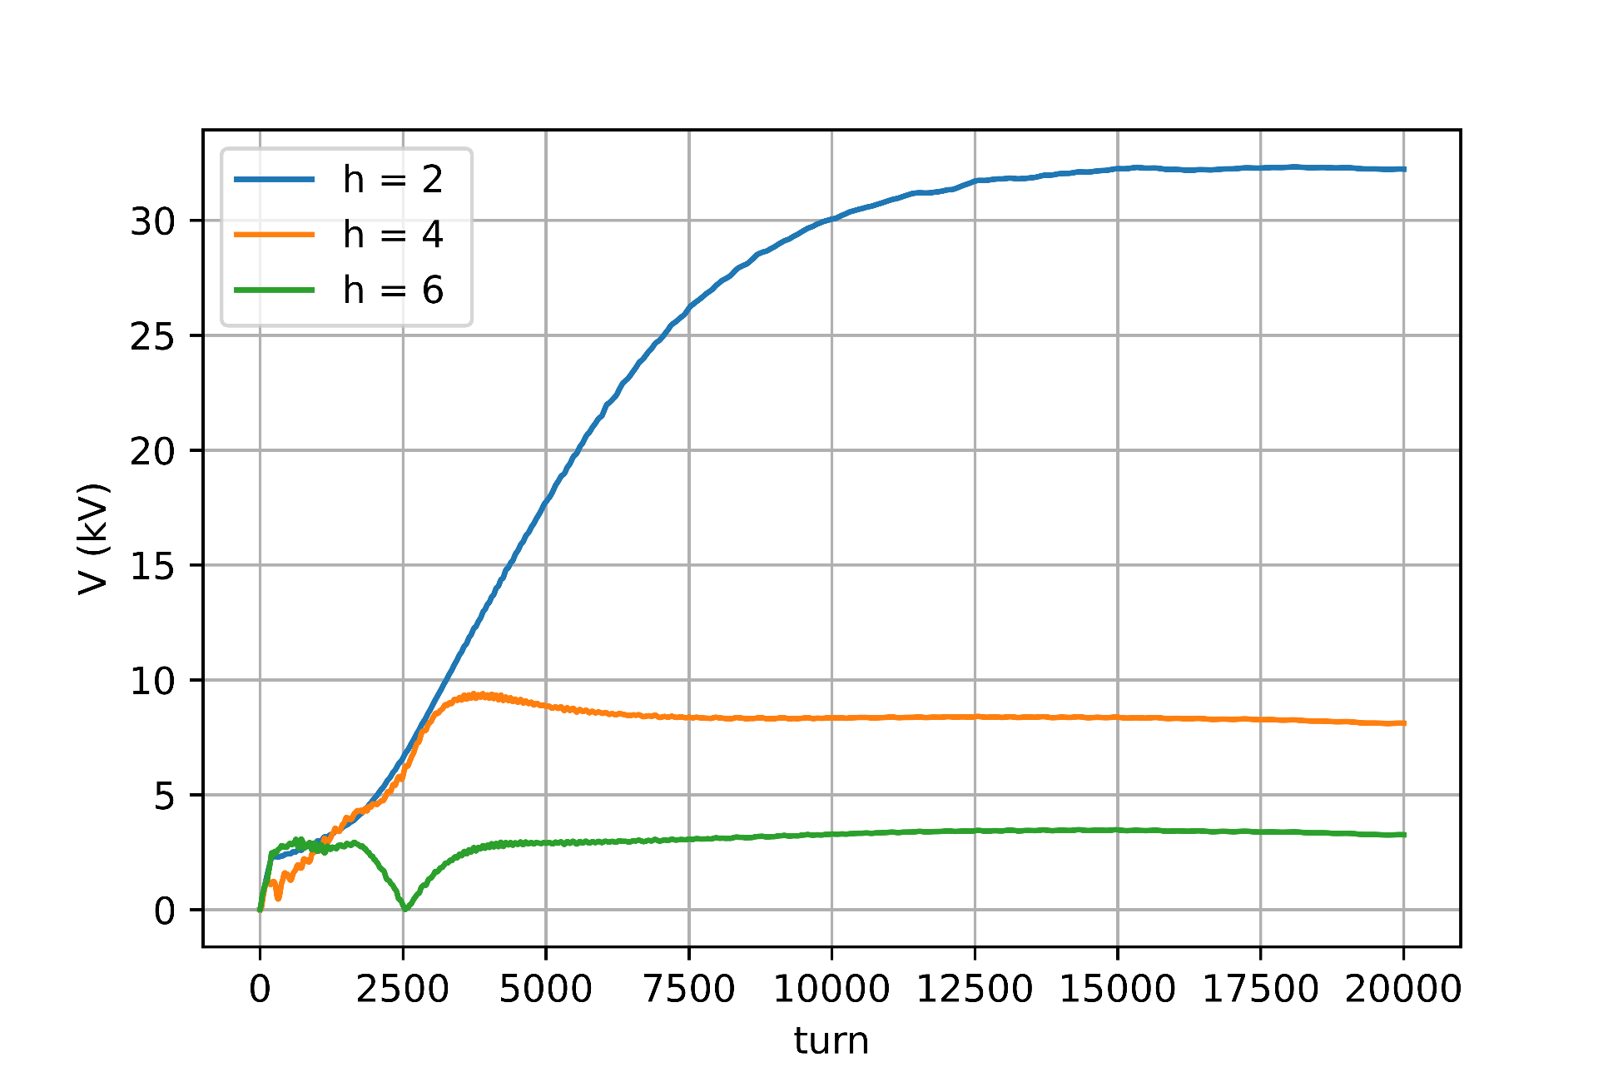
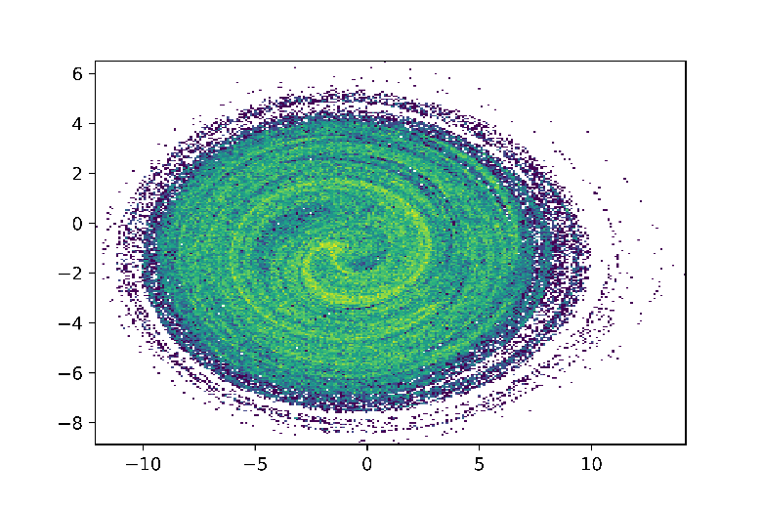
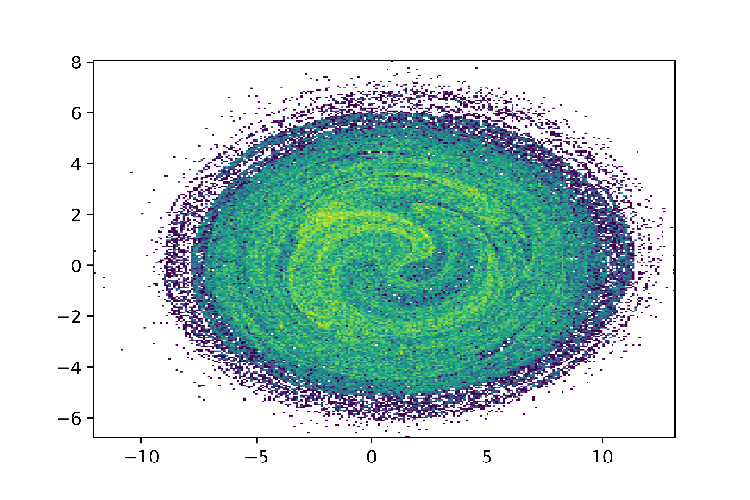
Beam Loading Effect
Three MA cavities,
1.56×10¹³ Particle number per bunch
H=2(7000)
Unacceptable phase space filamentation
H=4 (20000)
H=6 (20000)
Note: Each harmonic is considered separately

Slide 7
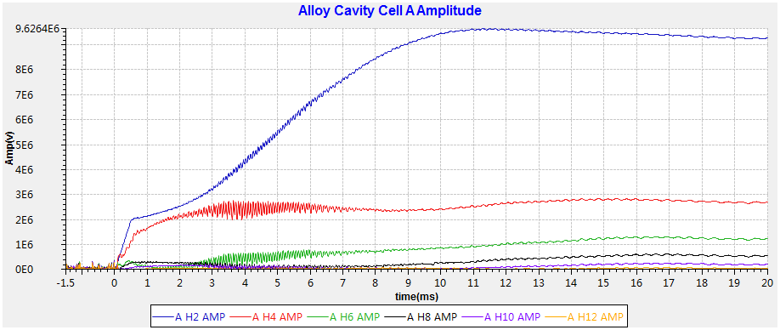
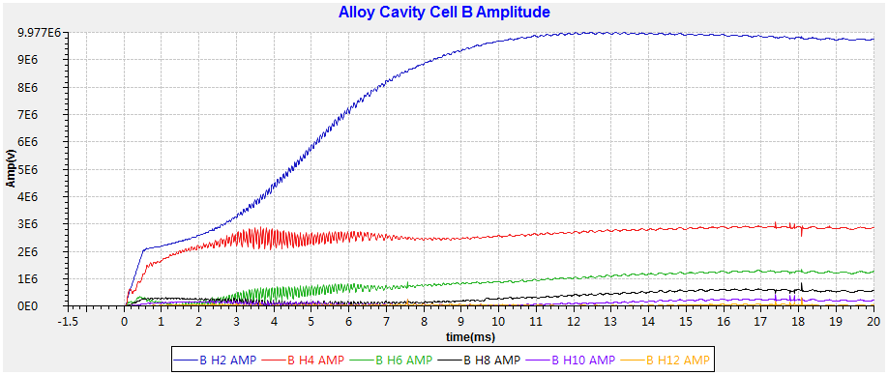
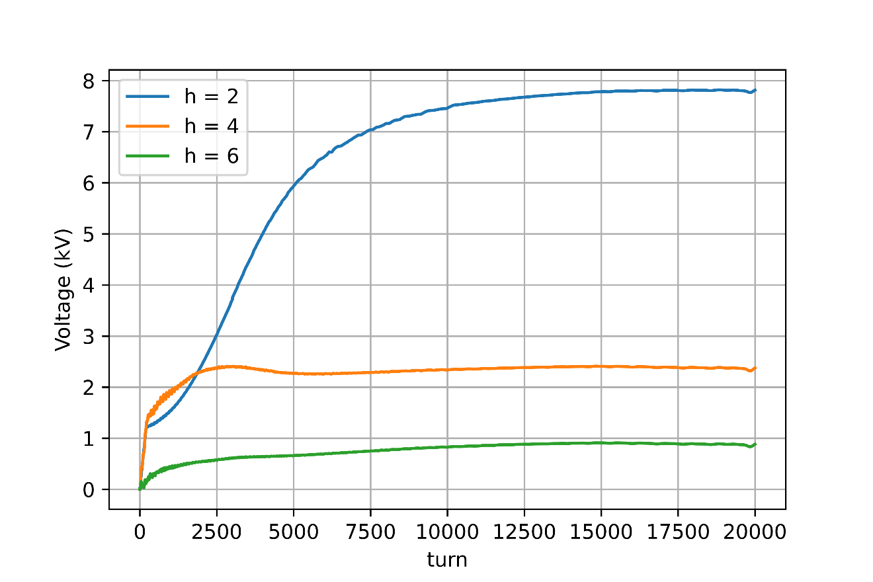
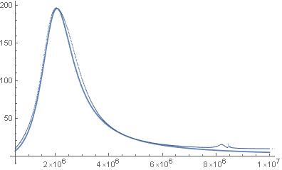
Beam Loading Effect- Measurement
Measuremtnt
H2 8kV
H4 2kV
H6 1kV
Simulation
2.06MHz

Slide 8
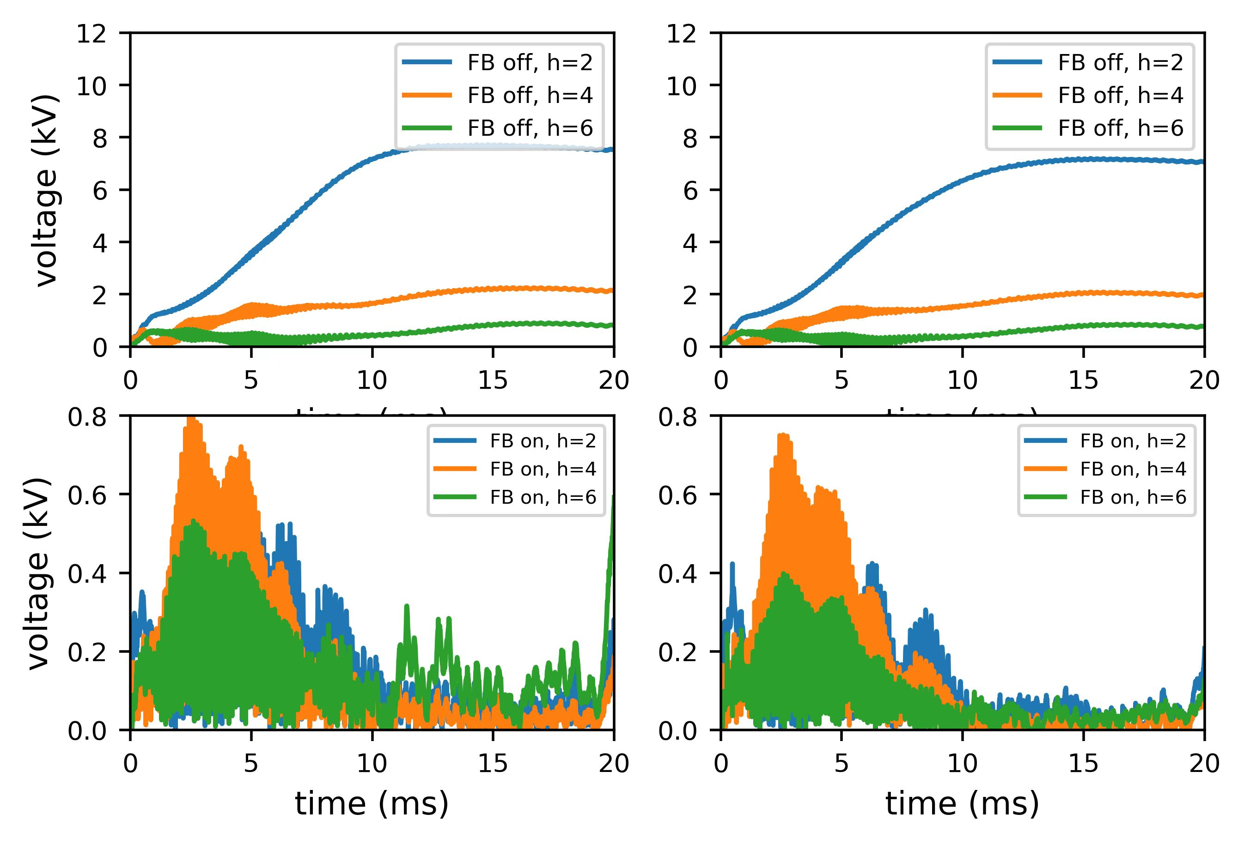
Beam Loading Effect-Compensation
Tank A
Tank B

Slide 9
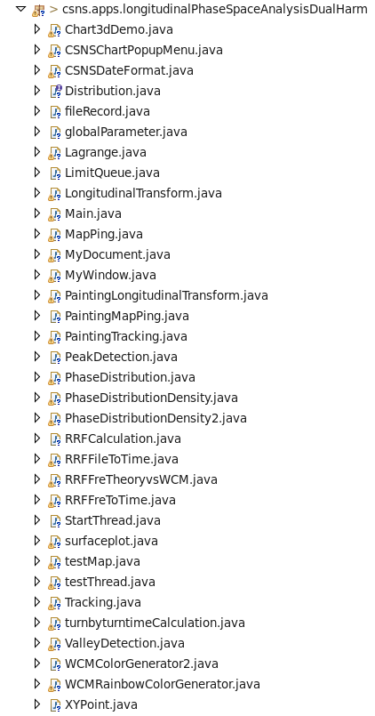
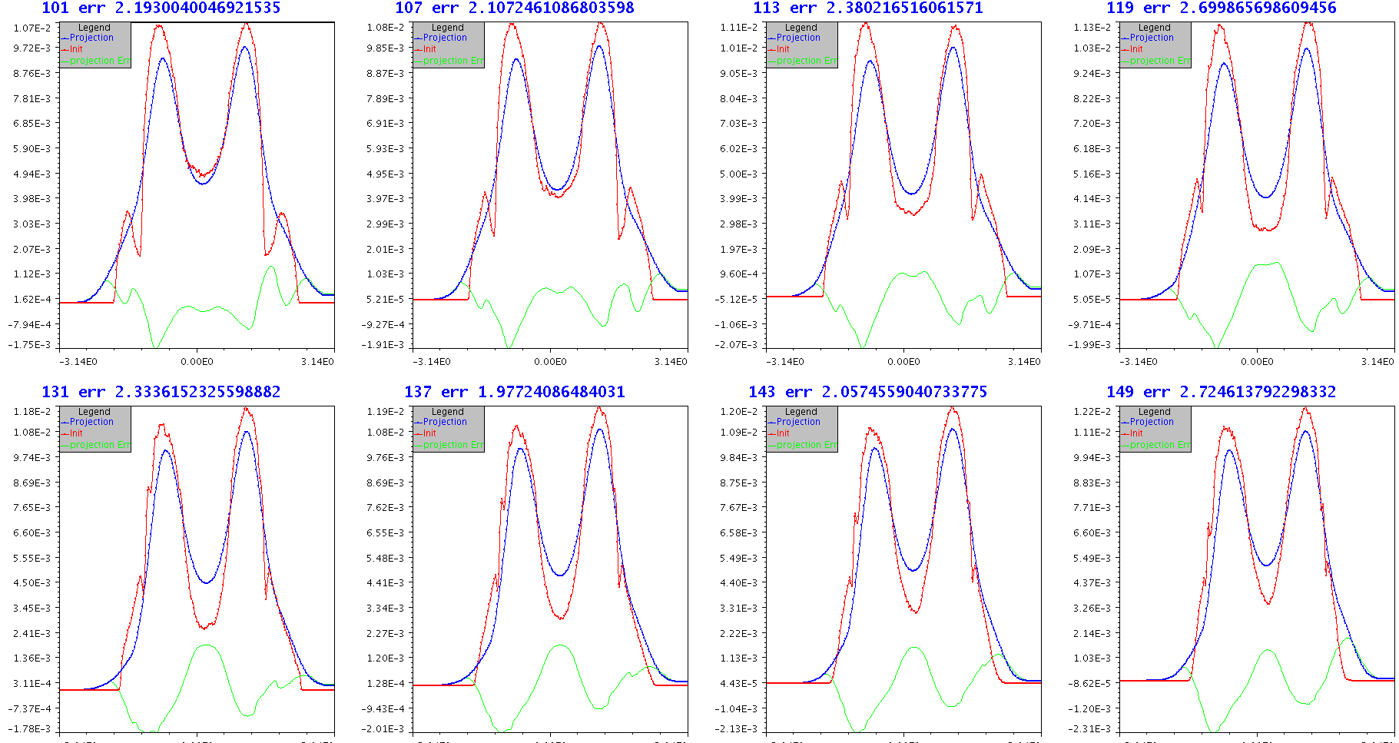
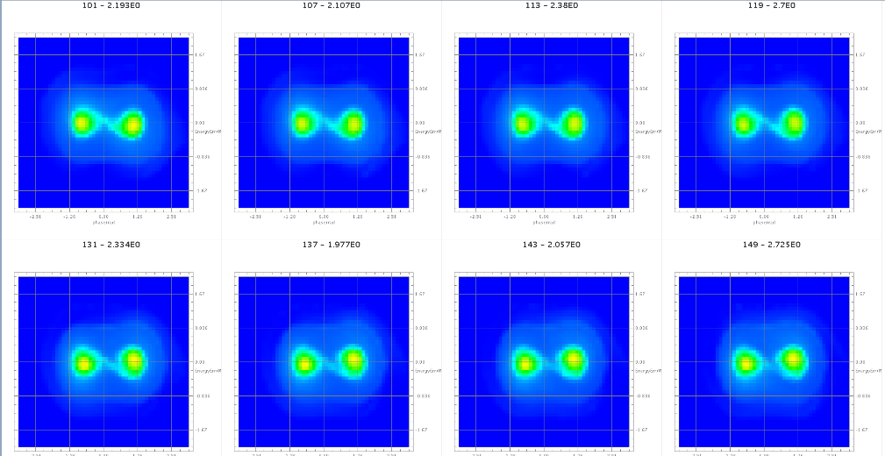
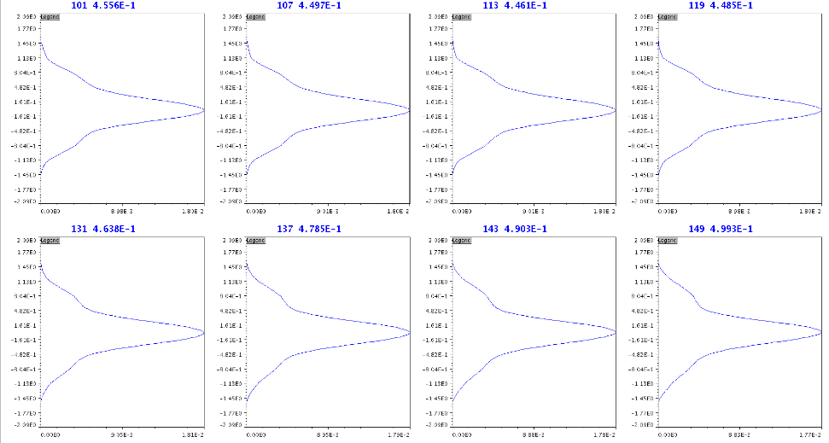
Tomography in dual harmonic
Base on th OpenXAL
The restored image
The information of phase space
https://doi.org/10.18429/JACoW-IPAC2019-MOPRB029

Slide 10
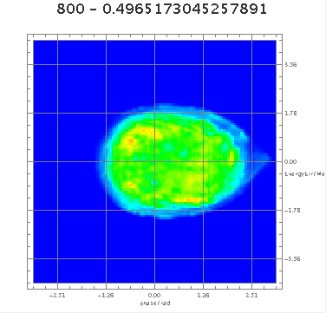
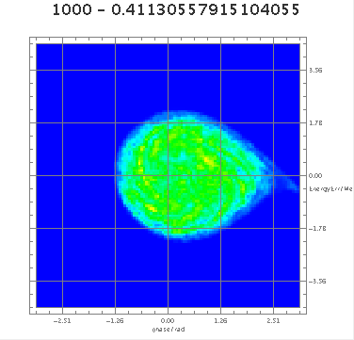
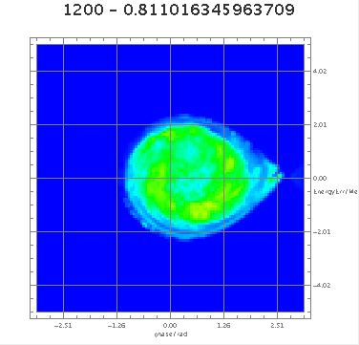
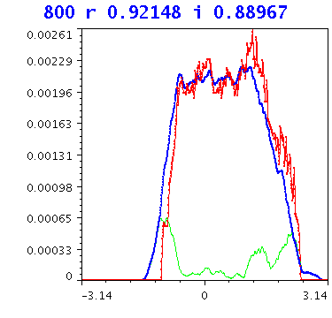
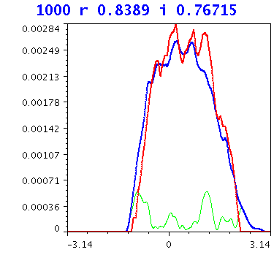
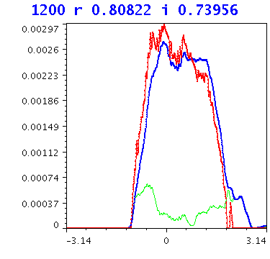
Tomography in dual harmonic
Beam measurement
WCM
Restored
Differ

Slide 11
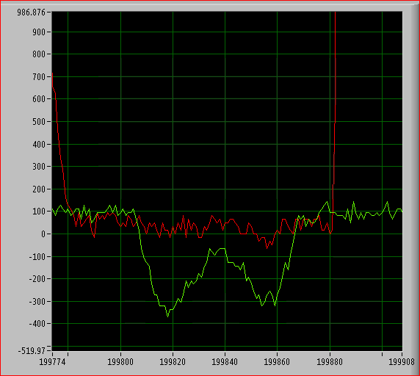
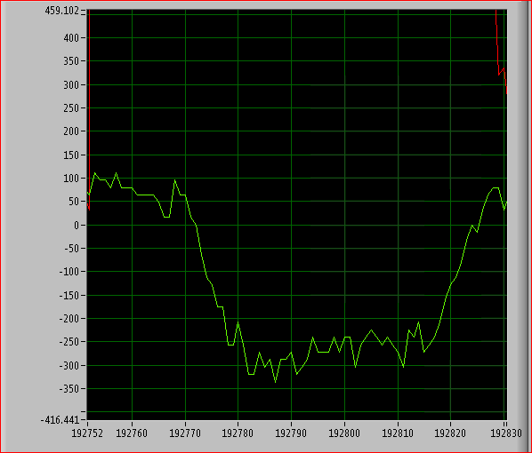
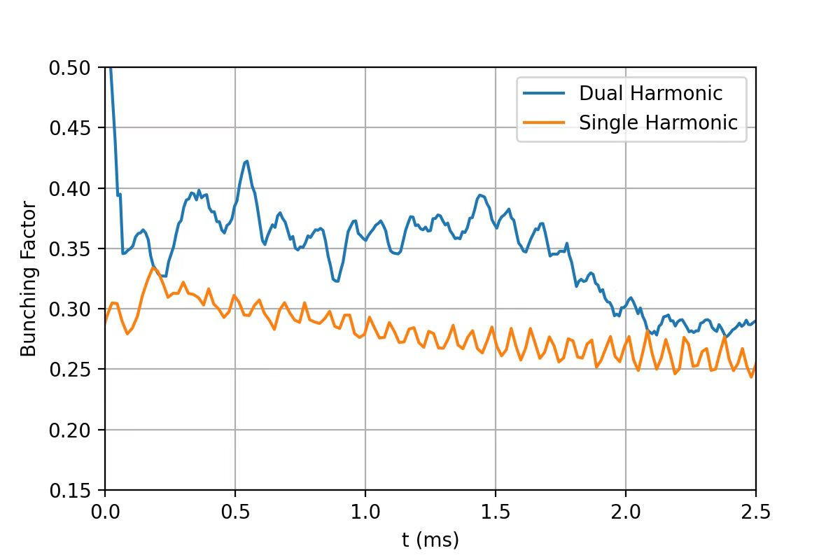
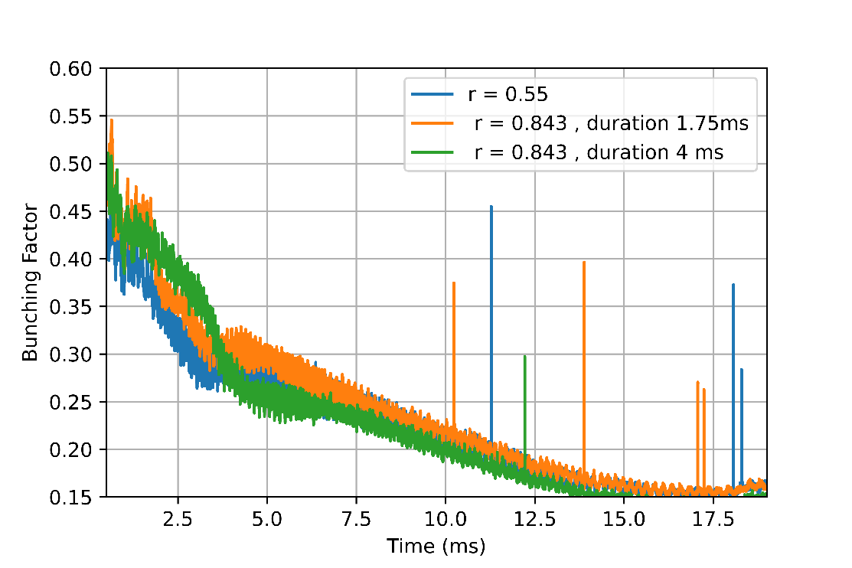
Beam measurement
Add magnetic alloy cavity, r=0.8, adjust the second harmonic phase, ensure the peak height of both sides same(phase calibration)
The nominal cavity RF is 16.6kV, the cavity pressure of ferrite is 32kV, r=0.5, which is consistent with the theoretical results (voltage calibration).

Slide 12
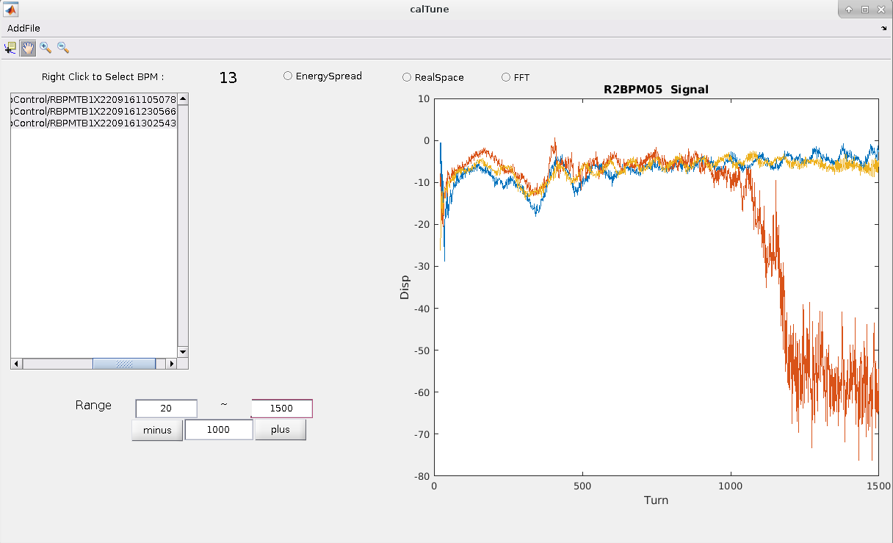
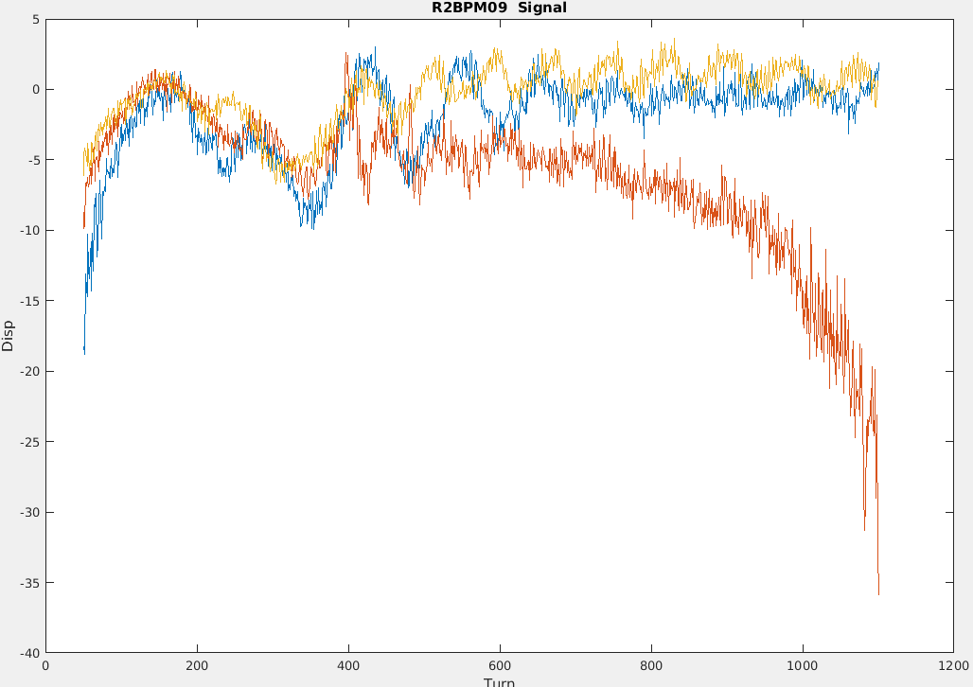
Beam measurement
MA cavity only
ferrite cavity only
both
MA cavity is insufficient for bunching
(Doesn’t matter)
The orbit in the arc section is consistent,
which ensures the timing and frequency are consistent to a certain extent

Slide 13
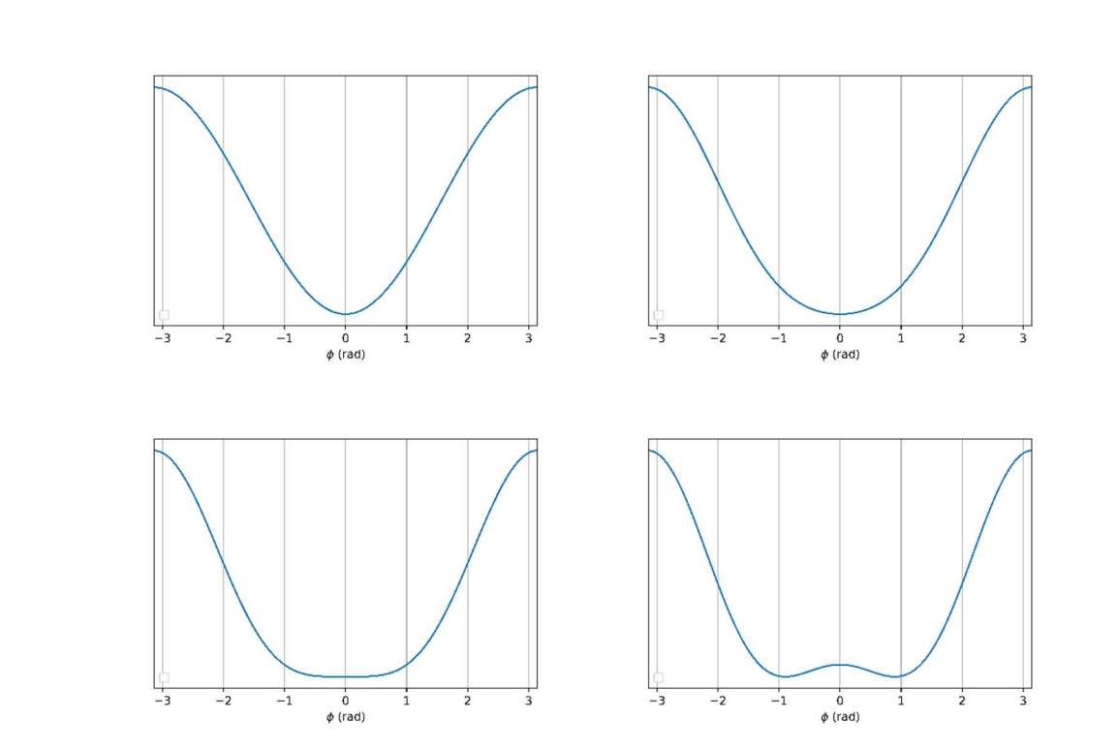
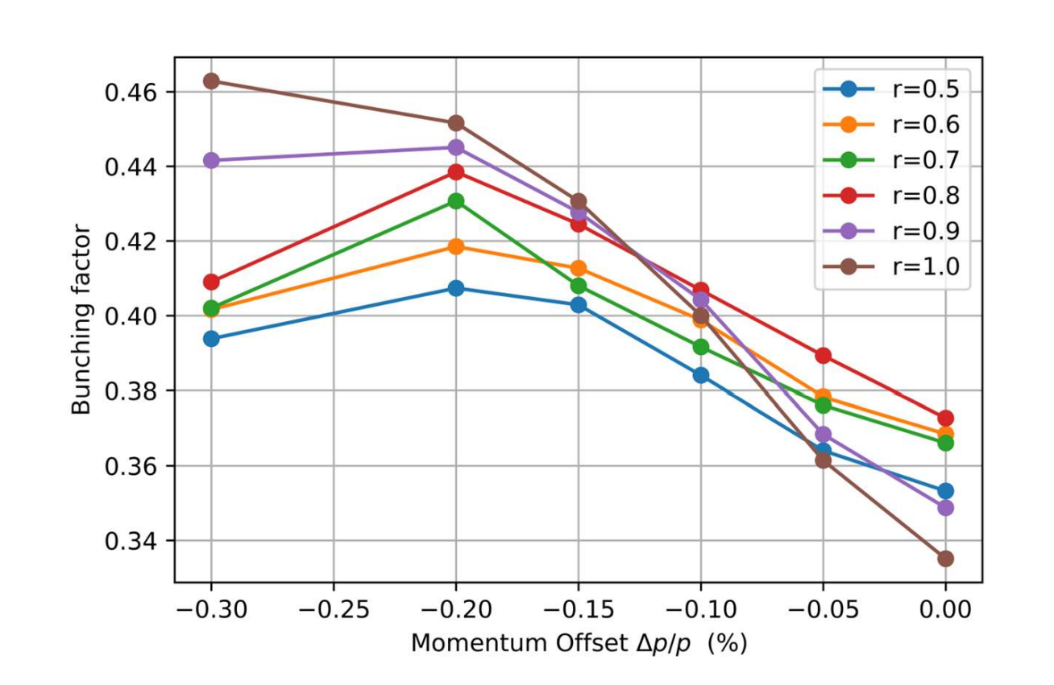
Beam measurement-Optimizations
Simulation results
Similar works have been done during the beam commissioning

Slide 14
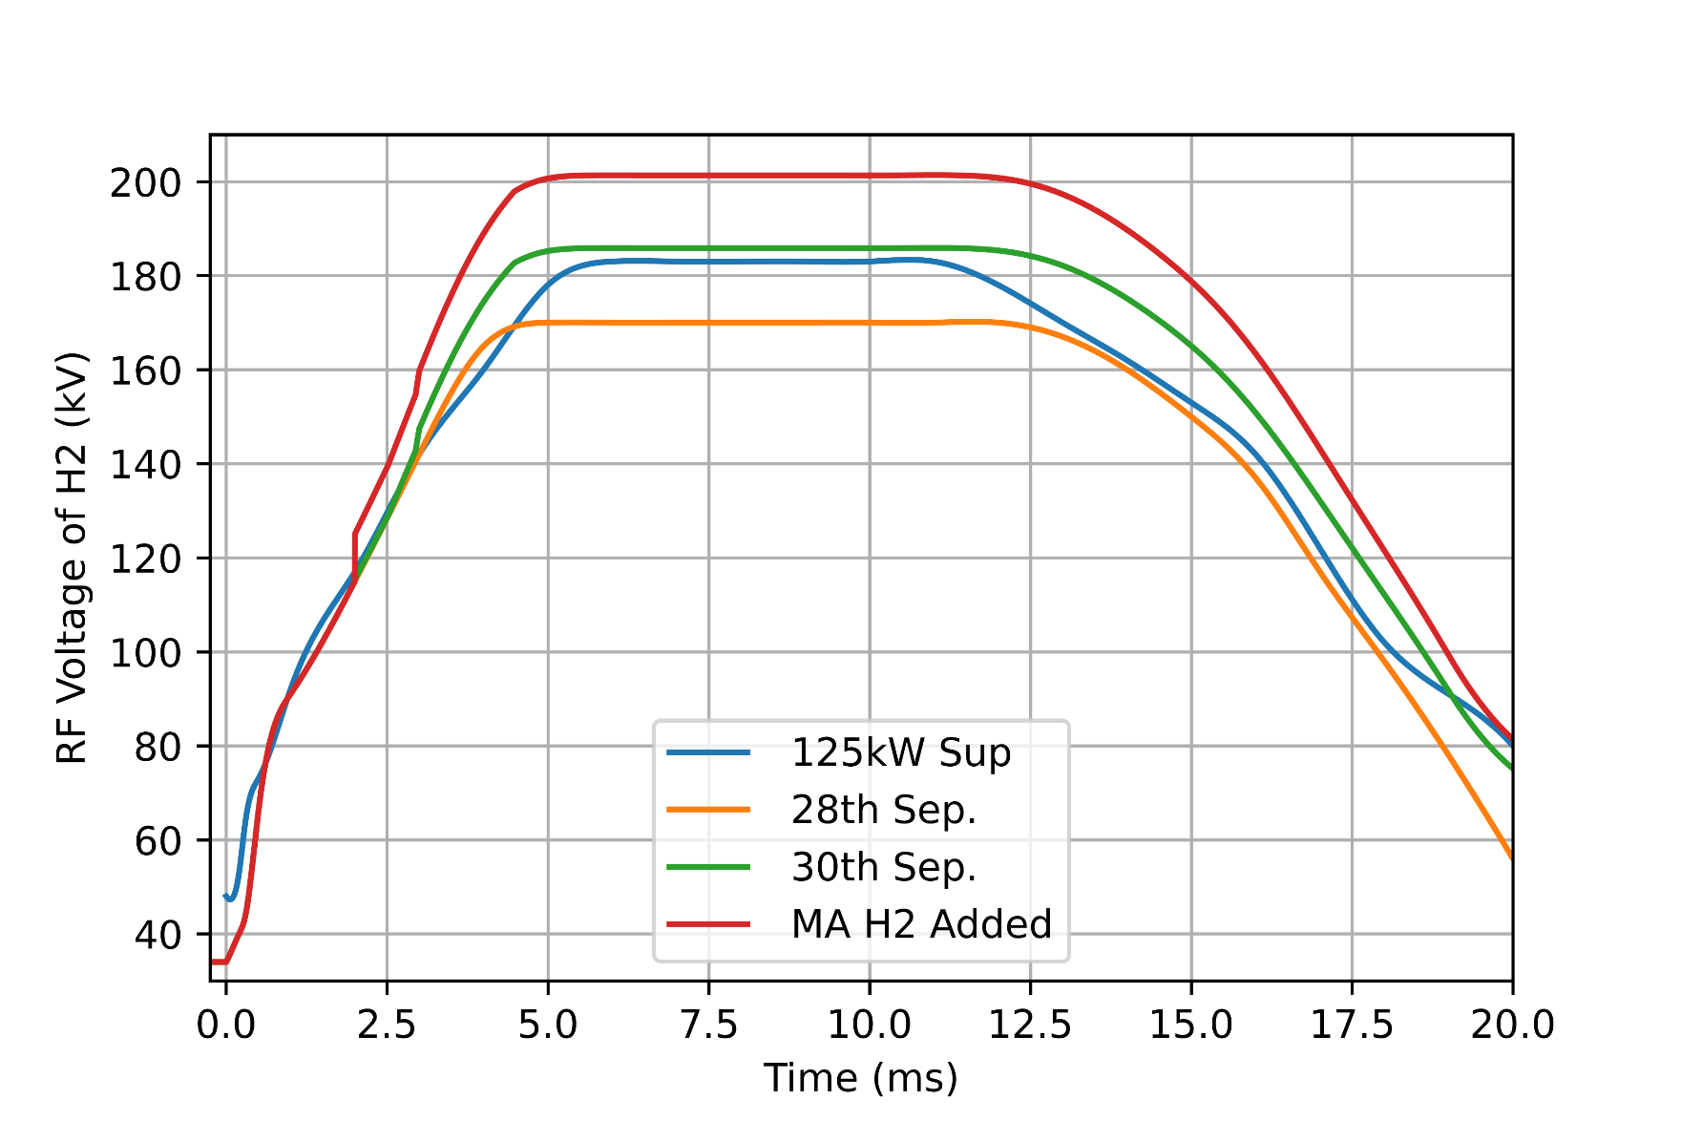
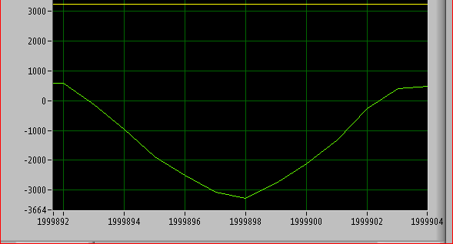
Beam measurement-Optimizations
Matching of synchronous oscillation period and injection turn
Extracted Bunch Length Compression (less than 120 ns)
Reduce the beam loss in the arc section and a certain degree of compression instability,

Slide 15
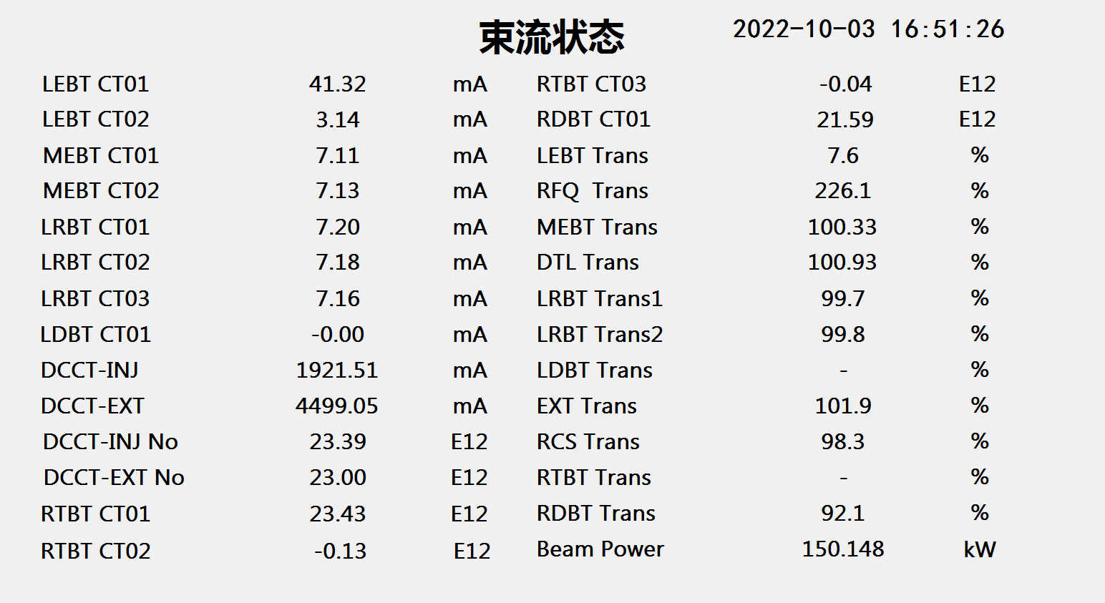
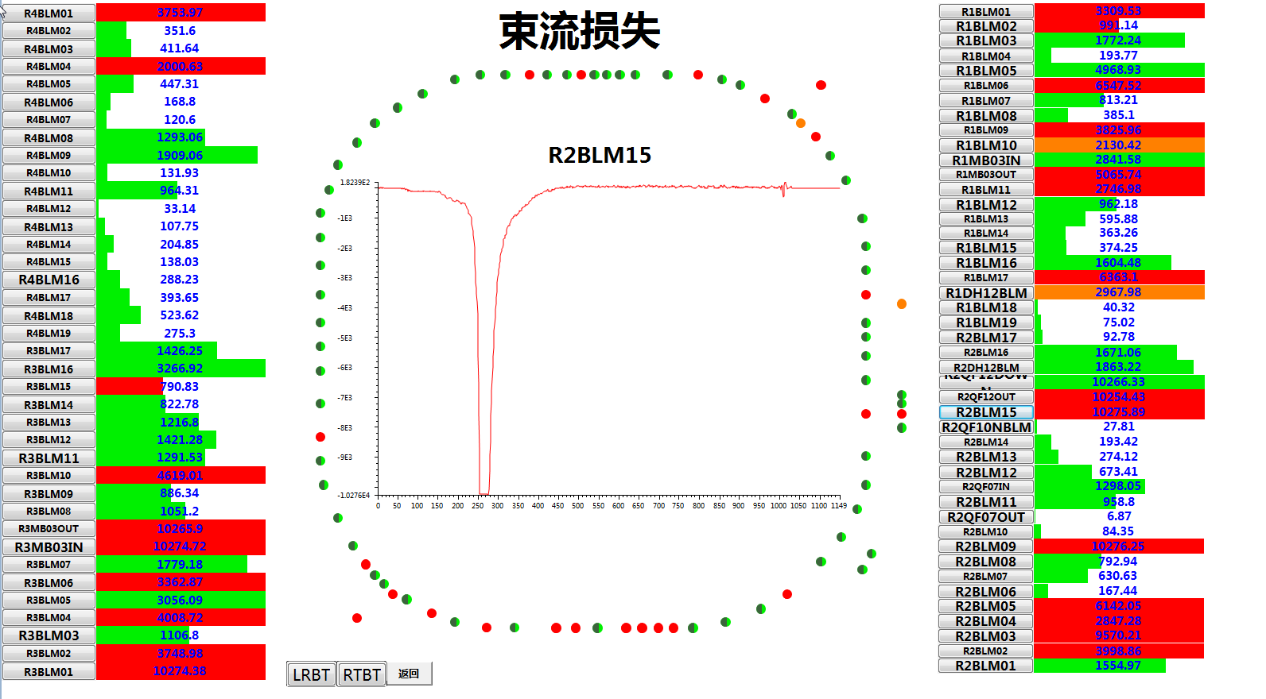
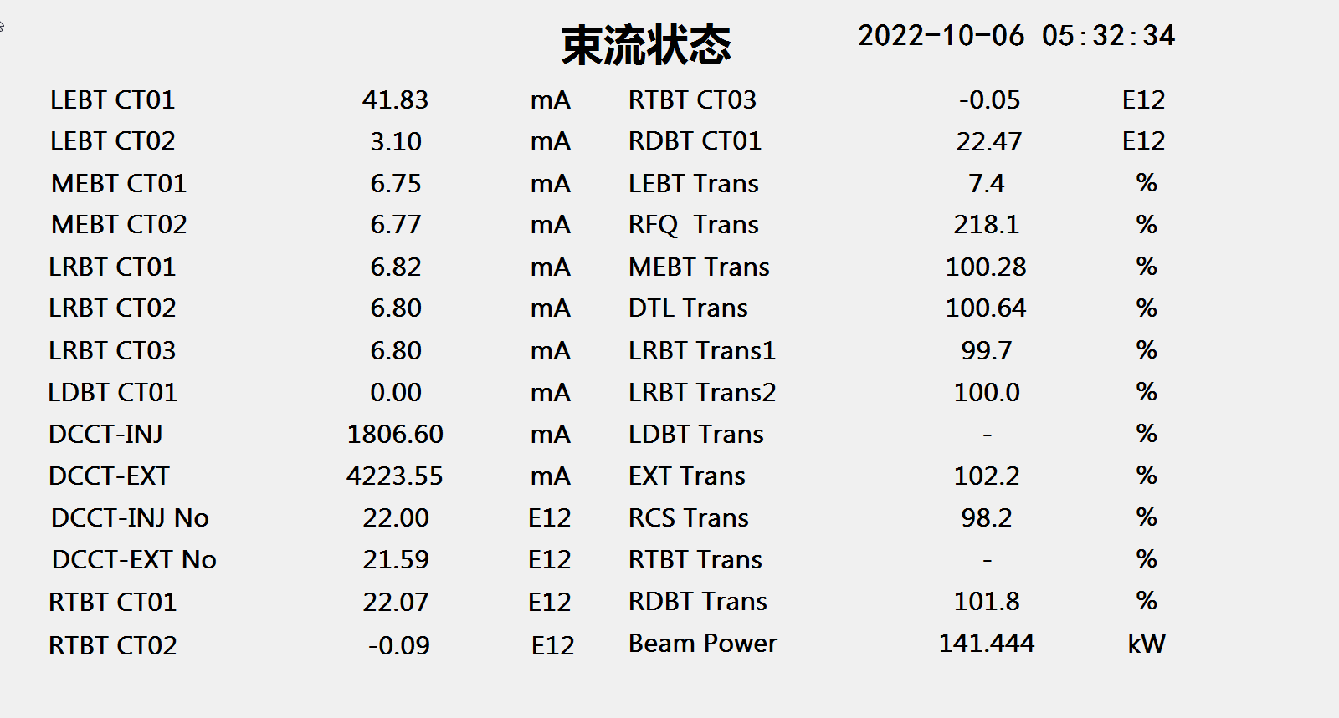
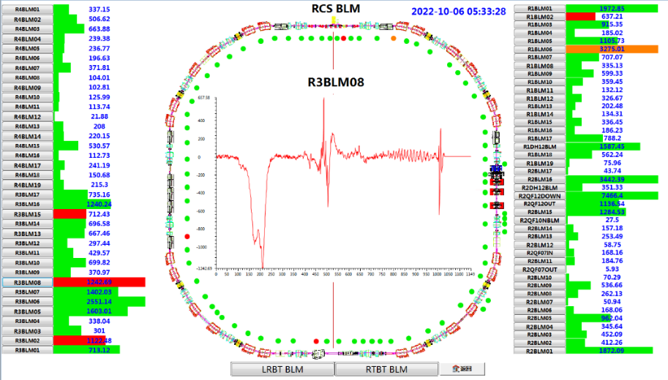
Beam measurement-Beam Status

Slide 16
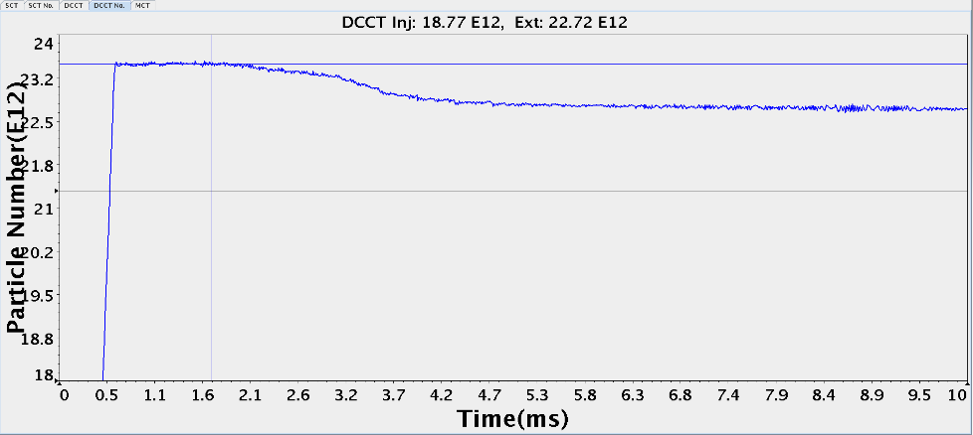
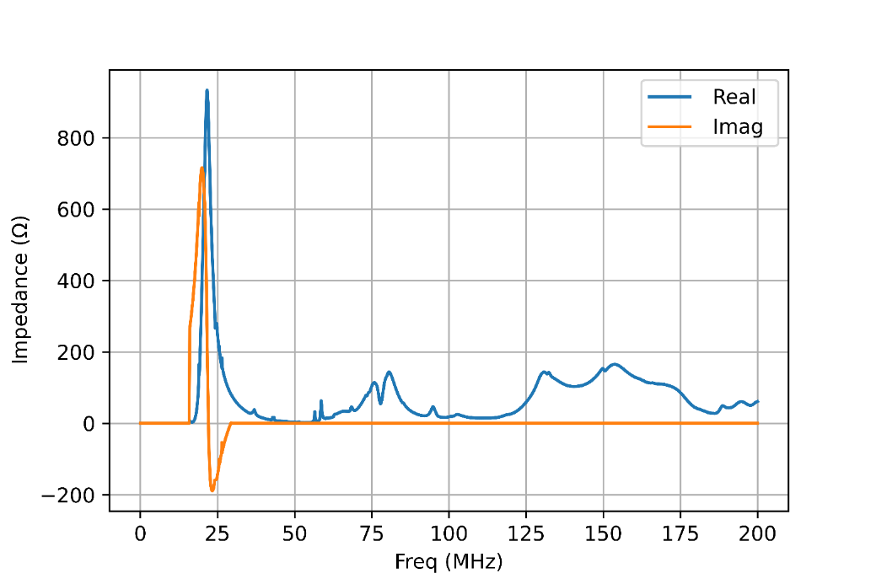
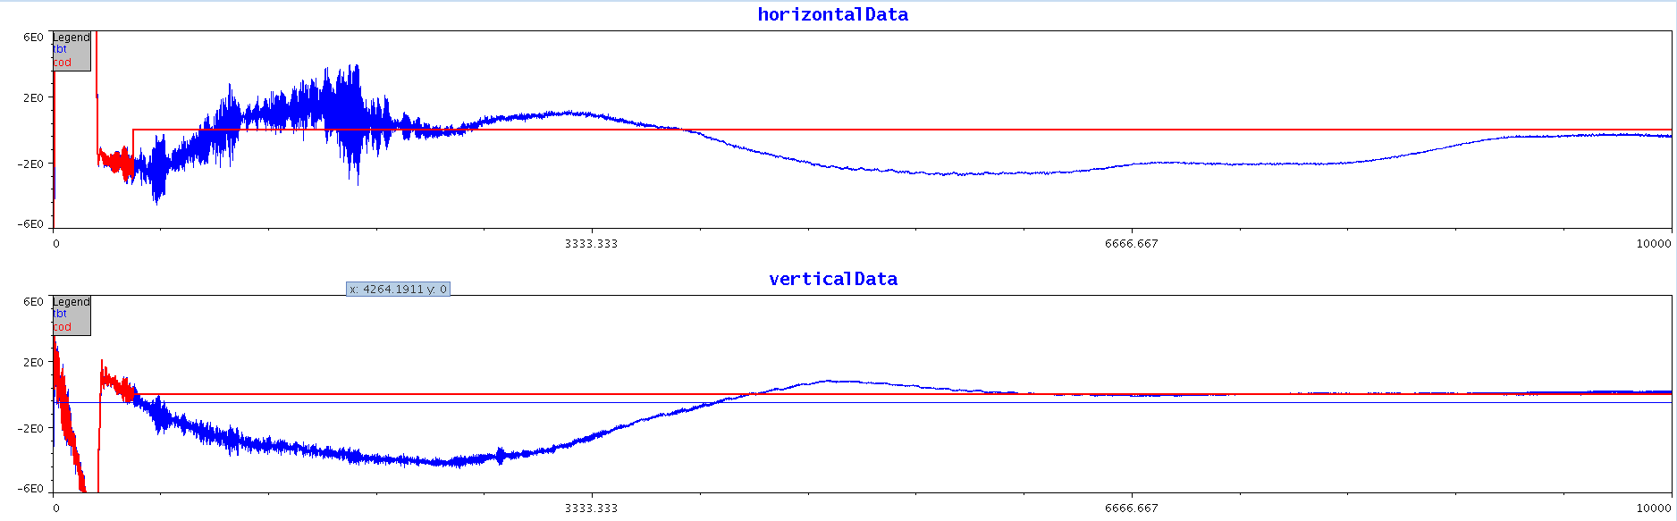
Next Step-Instability
longitudinal impedance of MA Cavity
(from power supply)
transverse instability

Slide 17
Summary & Outlook
The beam commissioning with the first MA cavity in CSNS RCS has been completed, and the beam power has achieved to 140 kW, which is 40% higher than the design.
One more MA cavity will be installed in the summer of 2023;
Momentum collimator has been designed;
Octupoles have been designed to increase Landau damping;
Increase the beam power to 200kW with the linac energy of 80MeV

Slide 18
Thanks for your attention !

