Slide 1


Particle and Nuclear Physics at the MeV scale in Australia
Martin Sevior¹⁾, Lindsey Bignell^{2,3)}, Catalina Curceanu⁴⁾, Jackson Dowie²⁾, David Jamieson¹⁾, Tibor Kibédi²⁾, Andrew Stuchbery²⁾, Andrea Tham¹⁾, Martin White⁵⁾
¹⁾ School of Physics, University of Melbourne
²⁾Department of Nuclear Physics and Accelerator Applications, Australian National University
³⁾ARC Centre of excellence for Dark Matter Particle Physics
⁴⁾ INFN- LNF (Frascati)
⁵⁾ University of Adelaide
Full Details: Sevior et al. https://arxiv.org/abs/2302.13281

Slide 2
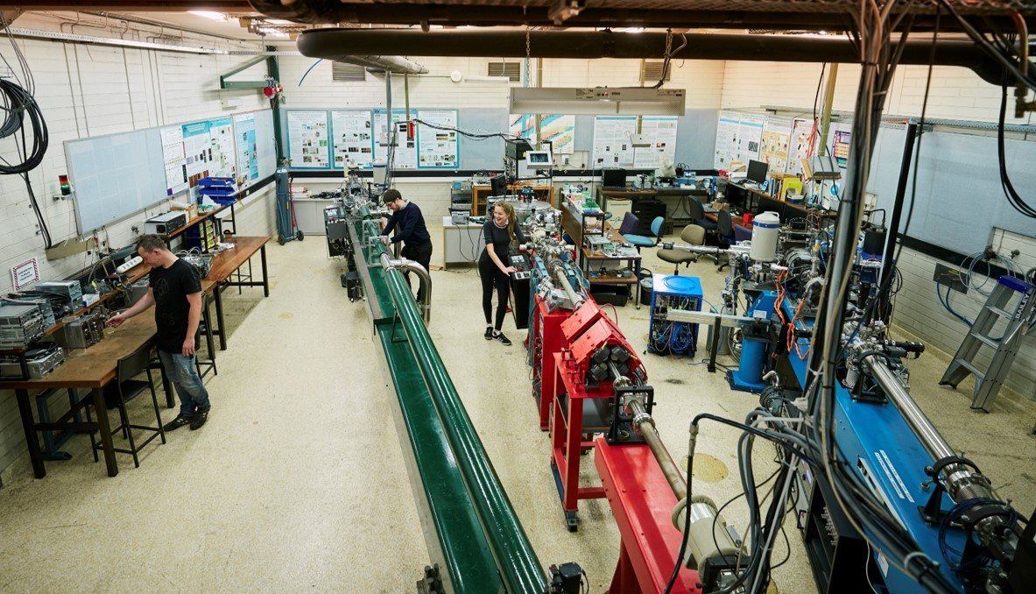
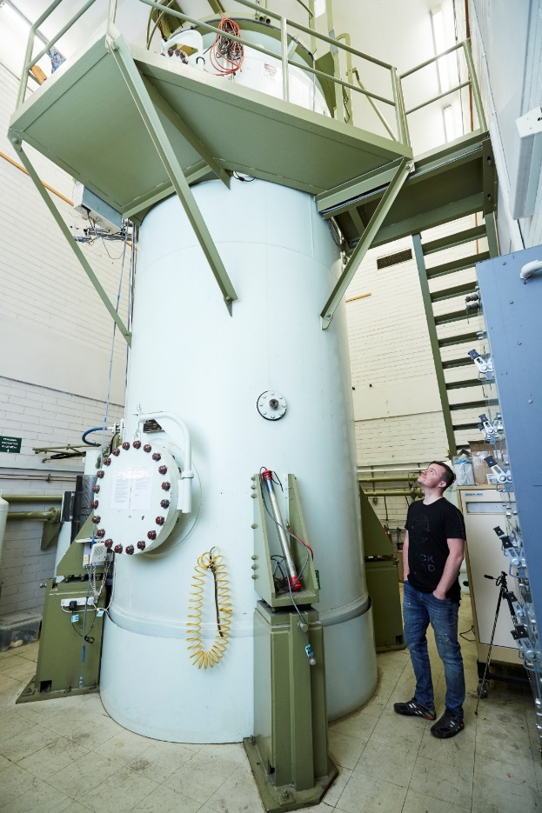
New Physics in the MeV regime?
Theoretical studies and experimental anomalies motivate a high-precision Time Projection Chamber for the Pelletron 5 MV accelerator at unimelb
Also enables qualitatively new Nuclear Physics experiments not previous possible
Employs advanced detector technology developed for HEP
The key: high resolution studies of electron-positron pairs from p + ^{Z}X →^{Z+1}Y + (e⁺e⁻) reactions:
To start: p + ⁷Li →⁸Be + (e⁺e⁻)
The Pelletron accelerator laboratory, University of Melbourne

Slide 3
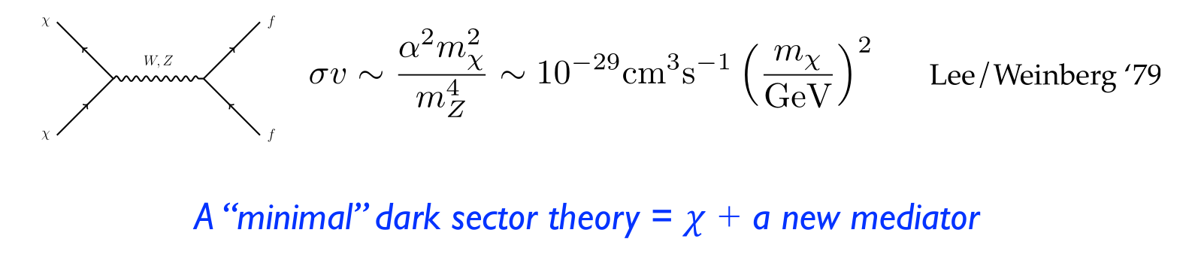



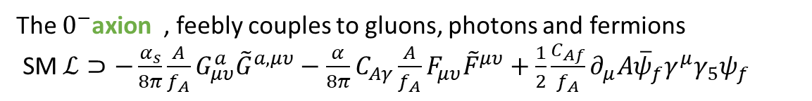


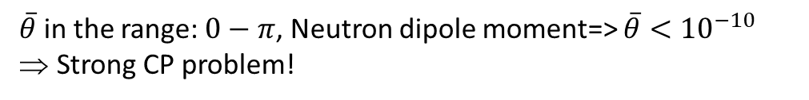
Dark Photons and Axion Like Particles
Dark Matter => New Physics
MeV-GeV thermal relic DM requires new, comparably light mediators to achieve required annihilation cross-section for Thermal freeze-out.
ε.q
$$∝ε^{2}$$
$${}_{}^{7}{Li}+p (\sim 1 MeV)$$
A’
e⁺
ε.e
A’
~18.5 MeV
e⁻
QCD $ℒ$ has a CP-violating angle similar to the CKM matrix
Can produce ~$2×{10}^{11}$ 5 - 22 MeV $γ$’s
$$ℒ⊂\overline{θ}\frac{α_{s}}{8π}G_{a}^{μυ}{\tilde{G}}_{a,μυ}$$
$\overline{θ}$ in the range: $0−π$, Neutron dipole moment=> $\overline{θ}<{10}^{−10}$
Strong CP problem!
$${}_{}^{8}{Be}$$
The $0^{−}$axion , feebly couples to gluons, photons and fermions
SM $ℒ⊃−\frac{α_{s}}{8π}\frac{A}{f_{A}}G_{μυ}^{a}{\tilde{G}}^{a,μυ}−$ $\frac{α}{8π}C_{Aγ}\frac{A}{f_{A}}F_{μυ}^{}{\tilde{F}}^{μυ}+\frac{1}{2}\frac{C_{Af}}{f_{A}}∂_{μ}A{\overline{ψ}}_{f}γ^{μ}γ_{5}ψ_{f}$
Axion Like Particles (ALPs) arise from additional global symmetries:
In principle ALPS have different coupling to gluons $(\frac{G_{ig}^{′}}{f_{a_{i}^{′}}})$, photons $(\frac{G_{iγ}^{′}}{f_{a_{i}^{′}}})$and fermions $(\frac{G_{if}^{′}}{f_{a_{i}^{′}}})$
Nuclear decays can explore viable ALP parameter-space and are sensitive to multi-TeV Physics!
(Tim Nelson, SLACMass, Feb 2020)

Slide 4
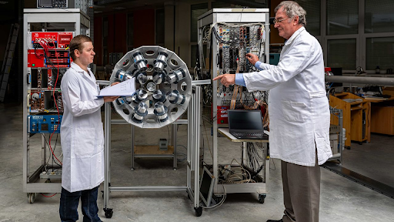
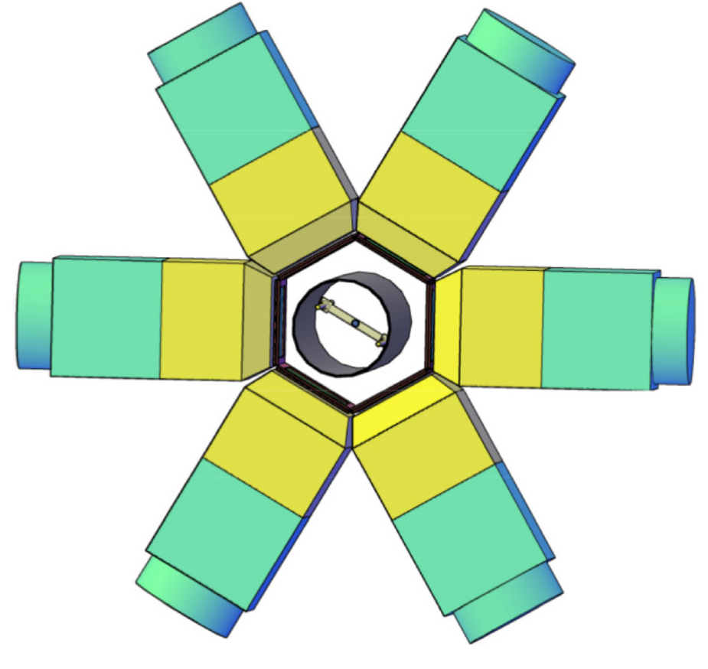
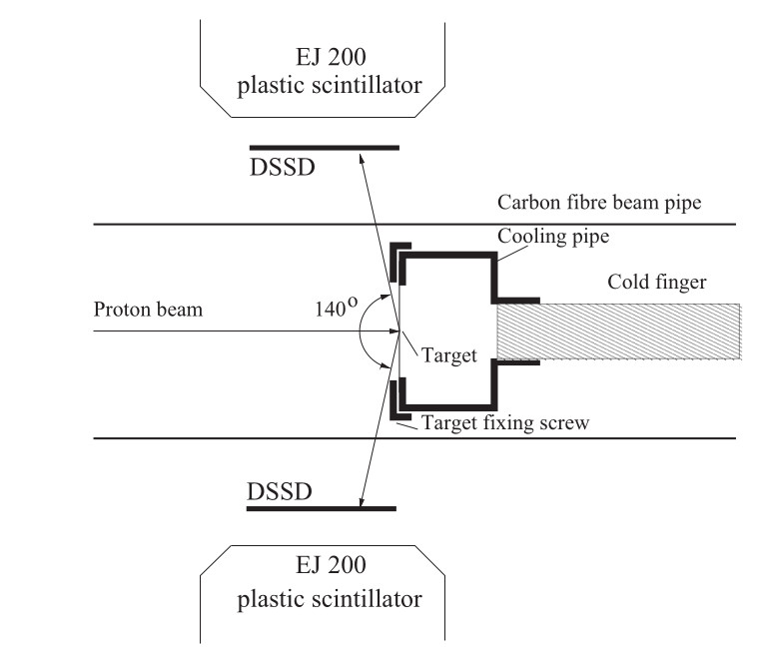
Particle Physics Motivation - Experiment
Well motivated theories for the existence of feebly interacting fundamental boson at the MeV scale.
ATOMKI group have found evidence for this at ~17 MeV invariant mass, the “X17”

Slide 5

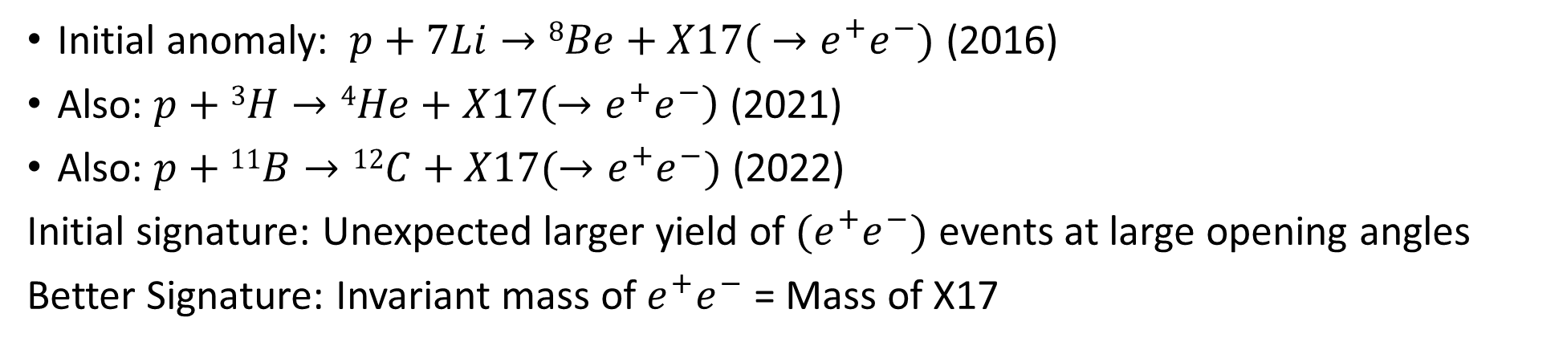

X17
Initial anomaly: $p+7Li→8Be+X17( →e^{+}e^{−})$ (2016)
Also: $p+$ $3H→4He+X17\left(→e^{+}e^{−}\right)$ (2021)
Also: $p+11B→12C+X17(→e^{+}e^{−})$ (2022)
Initial signature: Unexpected larger yield of $(e^{+}e^{−})$ events at large opening angles
Better Signature: Invariant mass of $e^{+}e^{−}$ = Mass of X17
An opportunity to do fundamental Physics research on the Pelletron
$${}_{}^{7}{Li}+p (\sim 1 MeV)$$
~18.5 MeV
17 MeV (X17)
$${}_{}^{8}{Be}$$

Slide 6

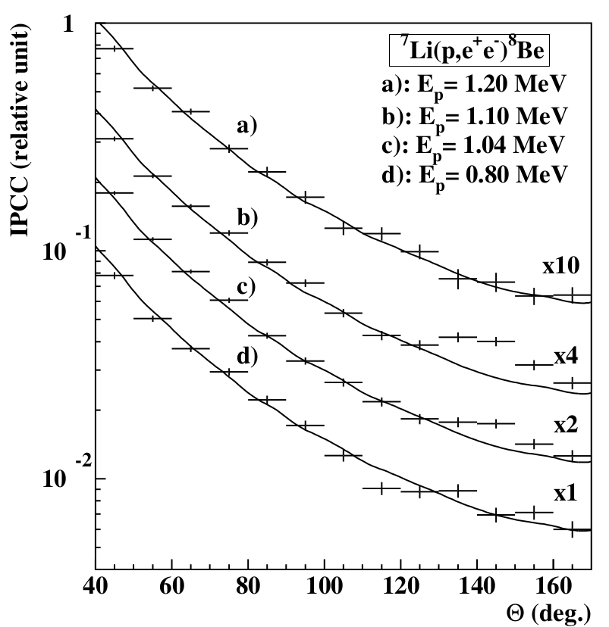
X17 particle
detectors
2016 observation¹
p + ⁷Li→⁸Be + e⁺e⁻
2021²: p + ³H→⁴He + e⁺e⁻
2022³: p + ¹¹B→¹²C + e⁺e⁻
e⁺e⁻ pairs
Θ
Nuclear
target
proton beam
1: arxiv 1504.01527,(PRL 116, 04215, (2016))

Slide 7
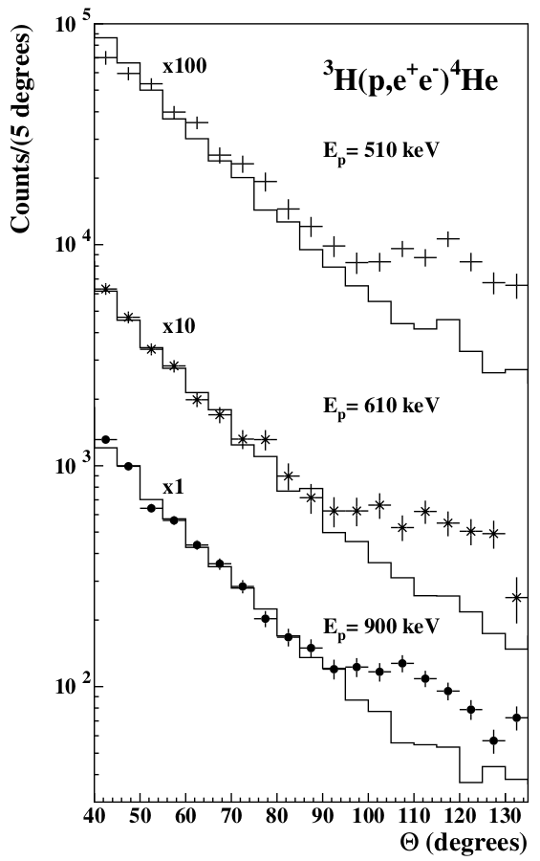
X17 particle
detectors
2016 observation¹
p + ⁷Li→⁸Be + e⁺e⁻
2021²: p + ³H→⁴He + e⁺e⁻
2022³: p + ¹¹B→¹²C + e⁺e⁻
e⁺e⁻ pairs
Θ
Nuclear
target
proton beam
1: arxiv 1504.01527, ,(PRL 116, 04215, (2016))
2: arxiv 2104.10075, (PRC 104,044003, (2021))

Slide 8
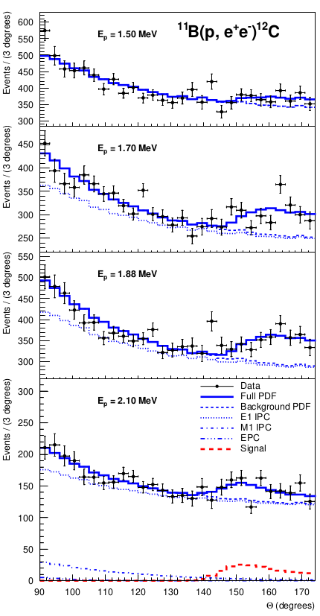
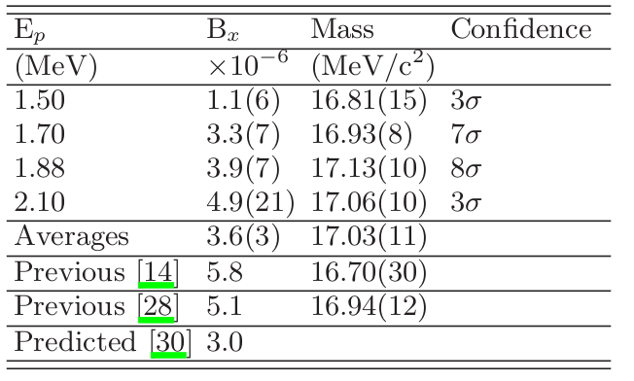
X17 particle
detectors
2016 observation¹
p + ⁷Li→⁸Be + e⁺e⁻
2021²: p + ³H→⁴He + e⁺e⁻
2022³: p + ¹¹B→¹²C + e⁺e⁻
e⁺e⁻ pairs
Θ
Nuclear
target
proton beam
1: arxiv 1504.01527, ,(PRL 116, 04215, (2016))
2: arxiv 2104.10075, (PRC 104,044003, (2021))
3: arxiv 2209.10795, (PRC In Press)

Slide 9
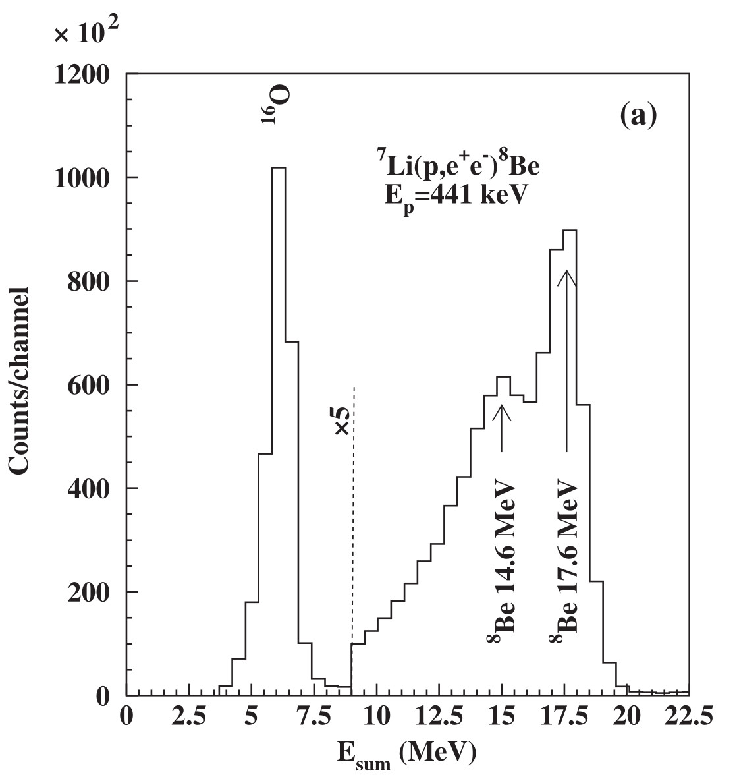
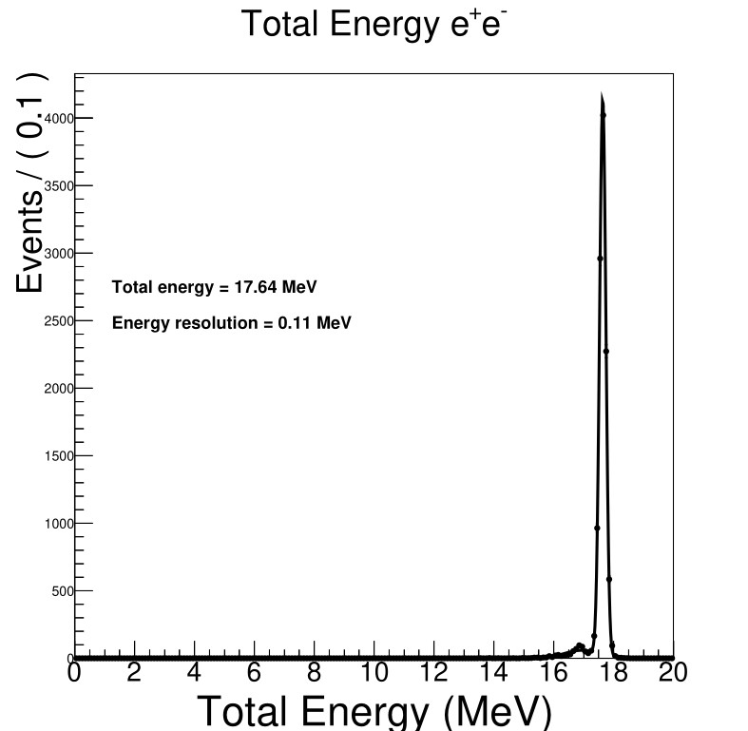



New Physics may exist at MeV- scale
Observable via “$X→e^{+}e^{−}$” using Melbourne Pelletron
We plan to build a Time Projection Chamber (TPC) and perform far higher precision experiments on the Pelletron
$e^{+}e^{−}$Invariant Mass
$e^{+}e^{−}$Invariant Mass
ATOMKI Energy Sum resolution ~1.5 MeV
TPC Energy Sum resolution 0.1 MeV
X17
Our expectation from TPC
If the X17 exists
ATOMKI X17 result
For p + ⁷Li→⁸Be + e⁺e⁻

Slide 10
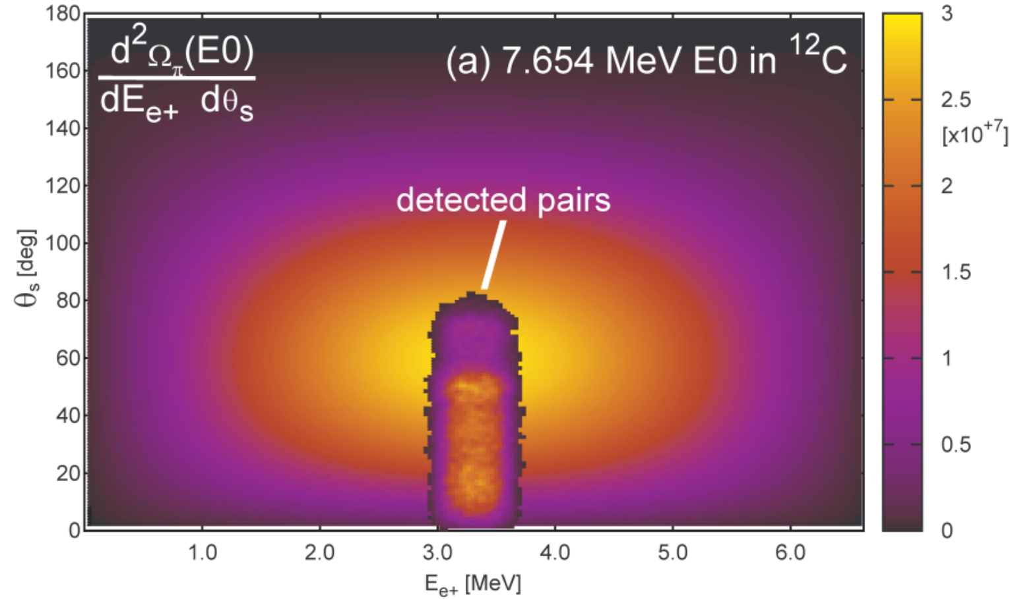
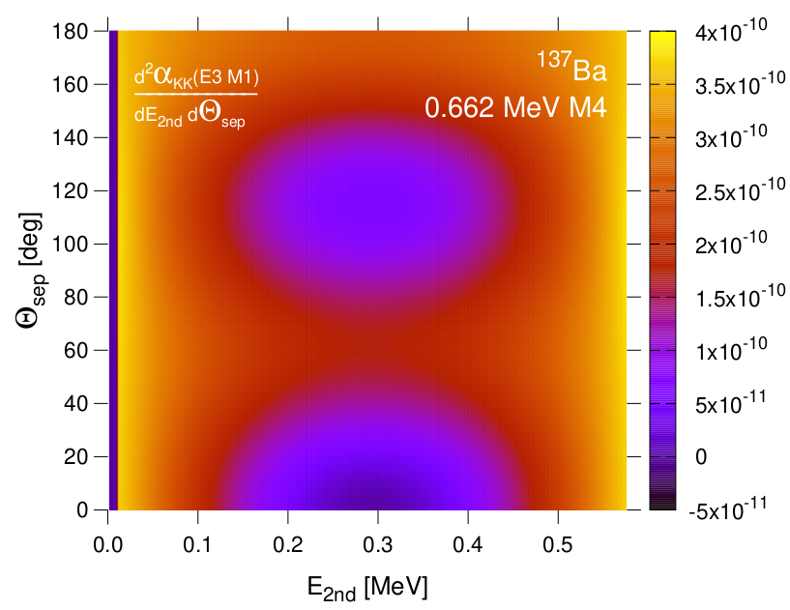
Applications in Nuclear Physics
World-first double-differential IPC cross-section measurements
e⁺e⁻ pairs
Nuclear target
proton beam
Also, large acceptance enables investigation of multi-particle final states
Unobserved 2-quantum nuclear processes¹:
double internal pair conversion
Both are qualitatively new Nuclear Physics investigations
¹Waltz et al. Nature,526:406 (2015)

Slide 11
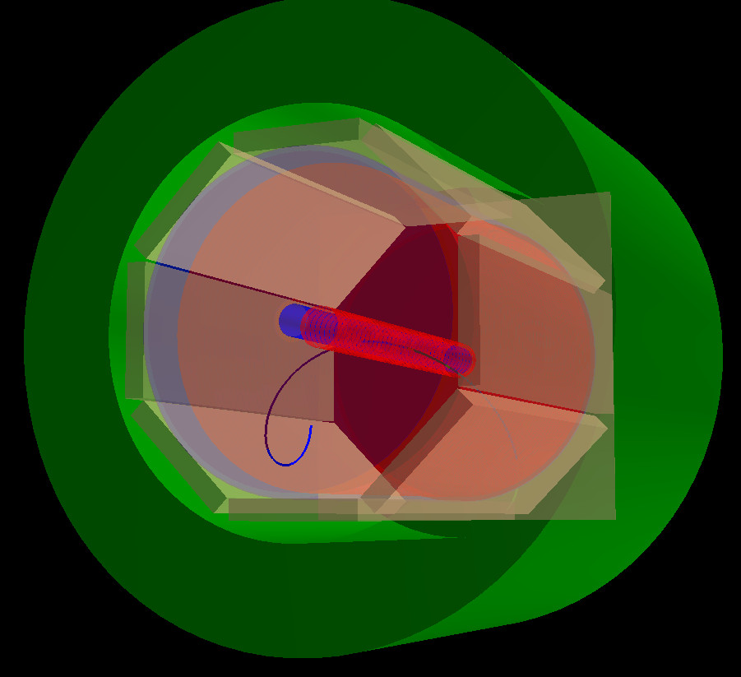
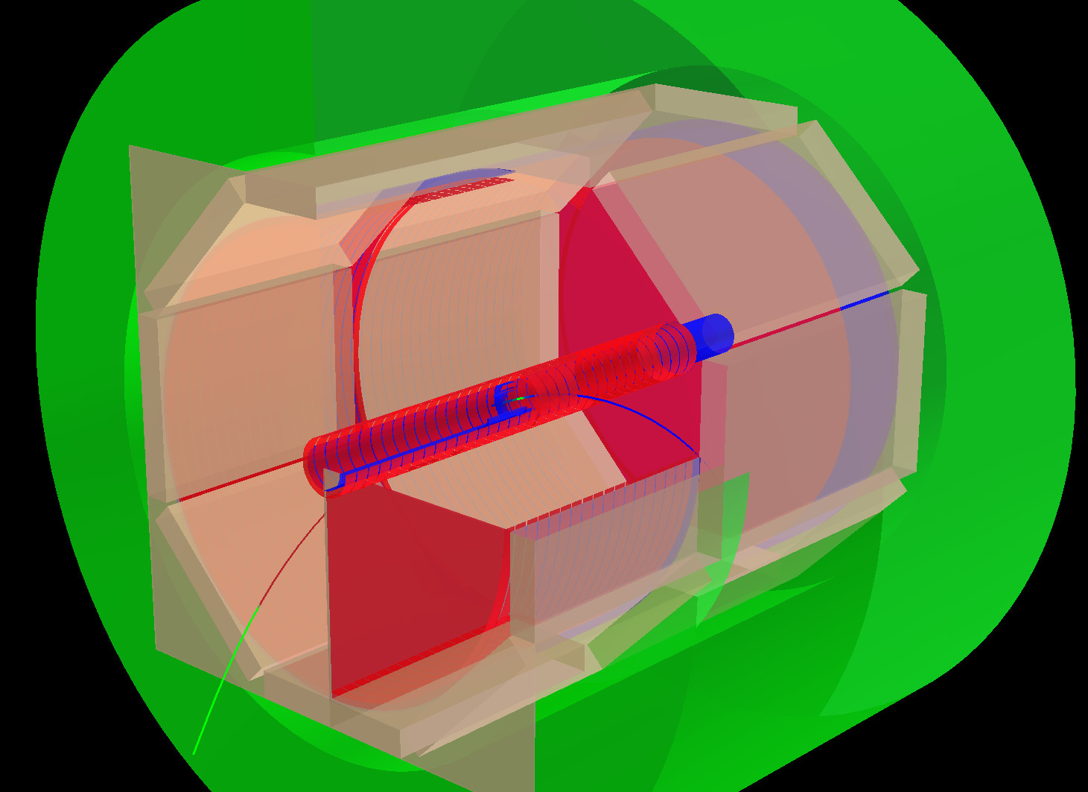
Time Projection Chamber to be installed on Pelletron
Iron Yoke (Electromagnet)
Trigger scintillators
Proton beam
Beam Pipe
Electric Field Cage

Slide 12
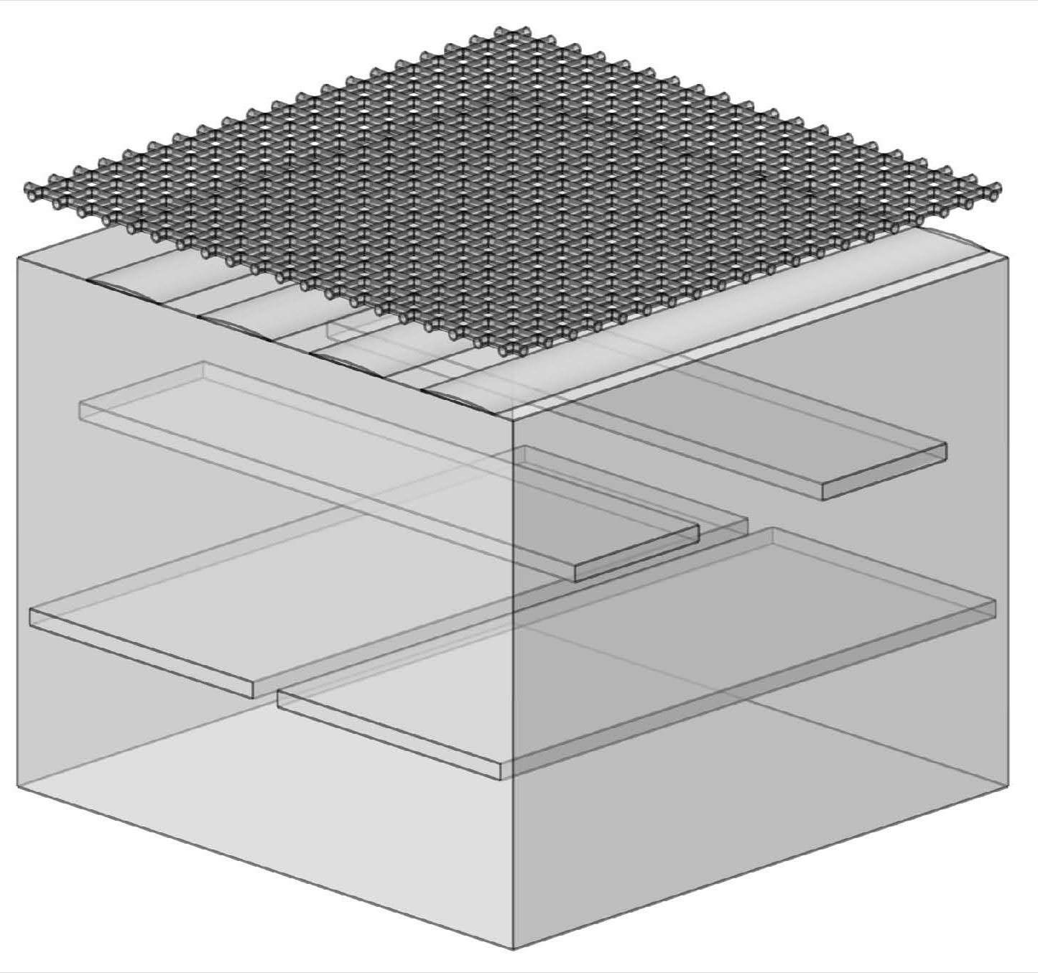
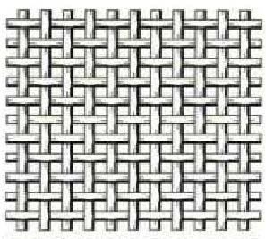
TPC side view
Ionization electrons
Drift with velocity v
Scintillators
z = v×t
15 KV
e⁺
0V
Ionization electron
Magnetic Field
0 V
Record (x,y,t)
120 μm
Electric Field
+800 V
Proton Beam
PCB
Readout strips on PCB
Electric Field
Magnetic Field
e⁻
+800 V
Micromegas wire mesh

Slide 13
Design of TPC
Conceptual design using EVE package in ROOT
Simulate electric fields inside the TPC and micromegas with COMSOL
Simulate Gas based detectors with HEP software GARFIELD
Simulate passage of primary electrons through TPC with Geant4
Record space-point hits with the expected resolution
Employ Genfit2 to reconstruct Particle trajectories
Employ RAVE to reconstruct interaction
Employ ROOT EVE for event display and visually validate reconstruction
Employ ROOT roofit to determine signal in the presence of background

Slide 14
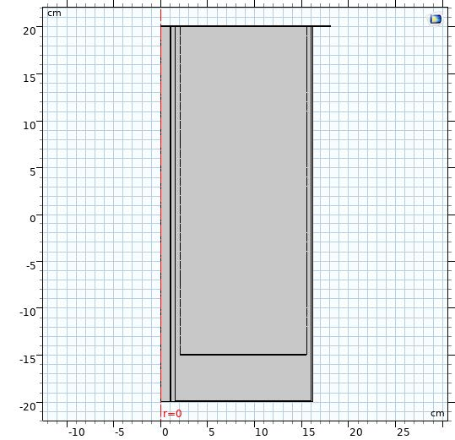
COMSOL electric field simulation of Field Cage
3D geometry
2D geometry with axial symmetry
Employed in COMSOL

Slide 15
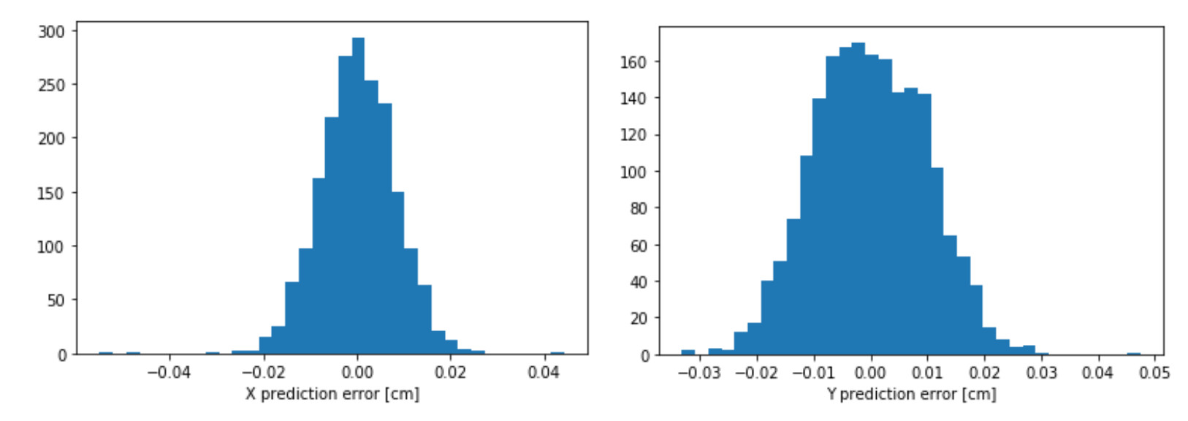
Projected x-y resolution ~ 100 microns
Design will work to provide 100 micron spatial resolution in (x,y)

Slide 16
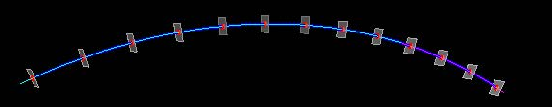
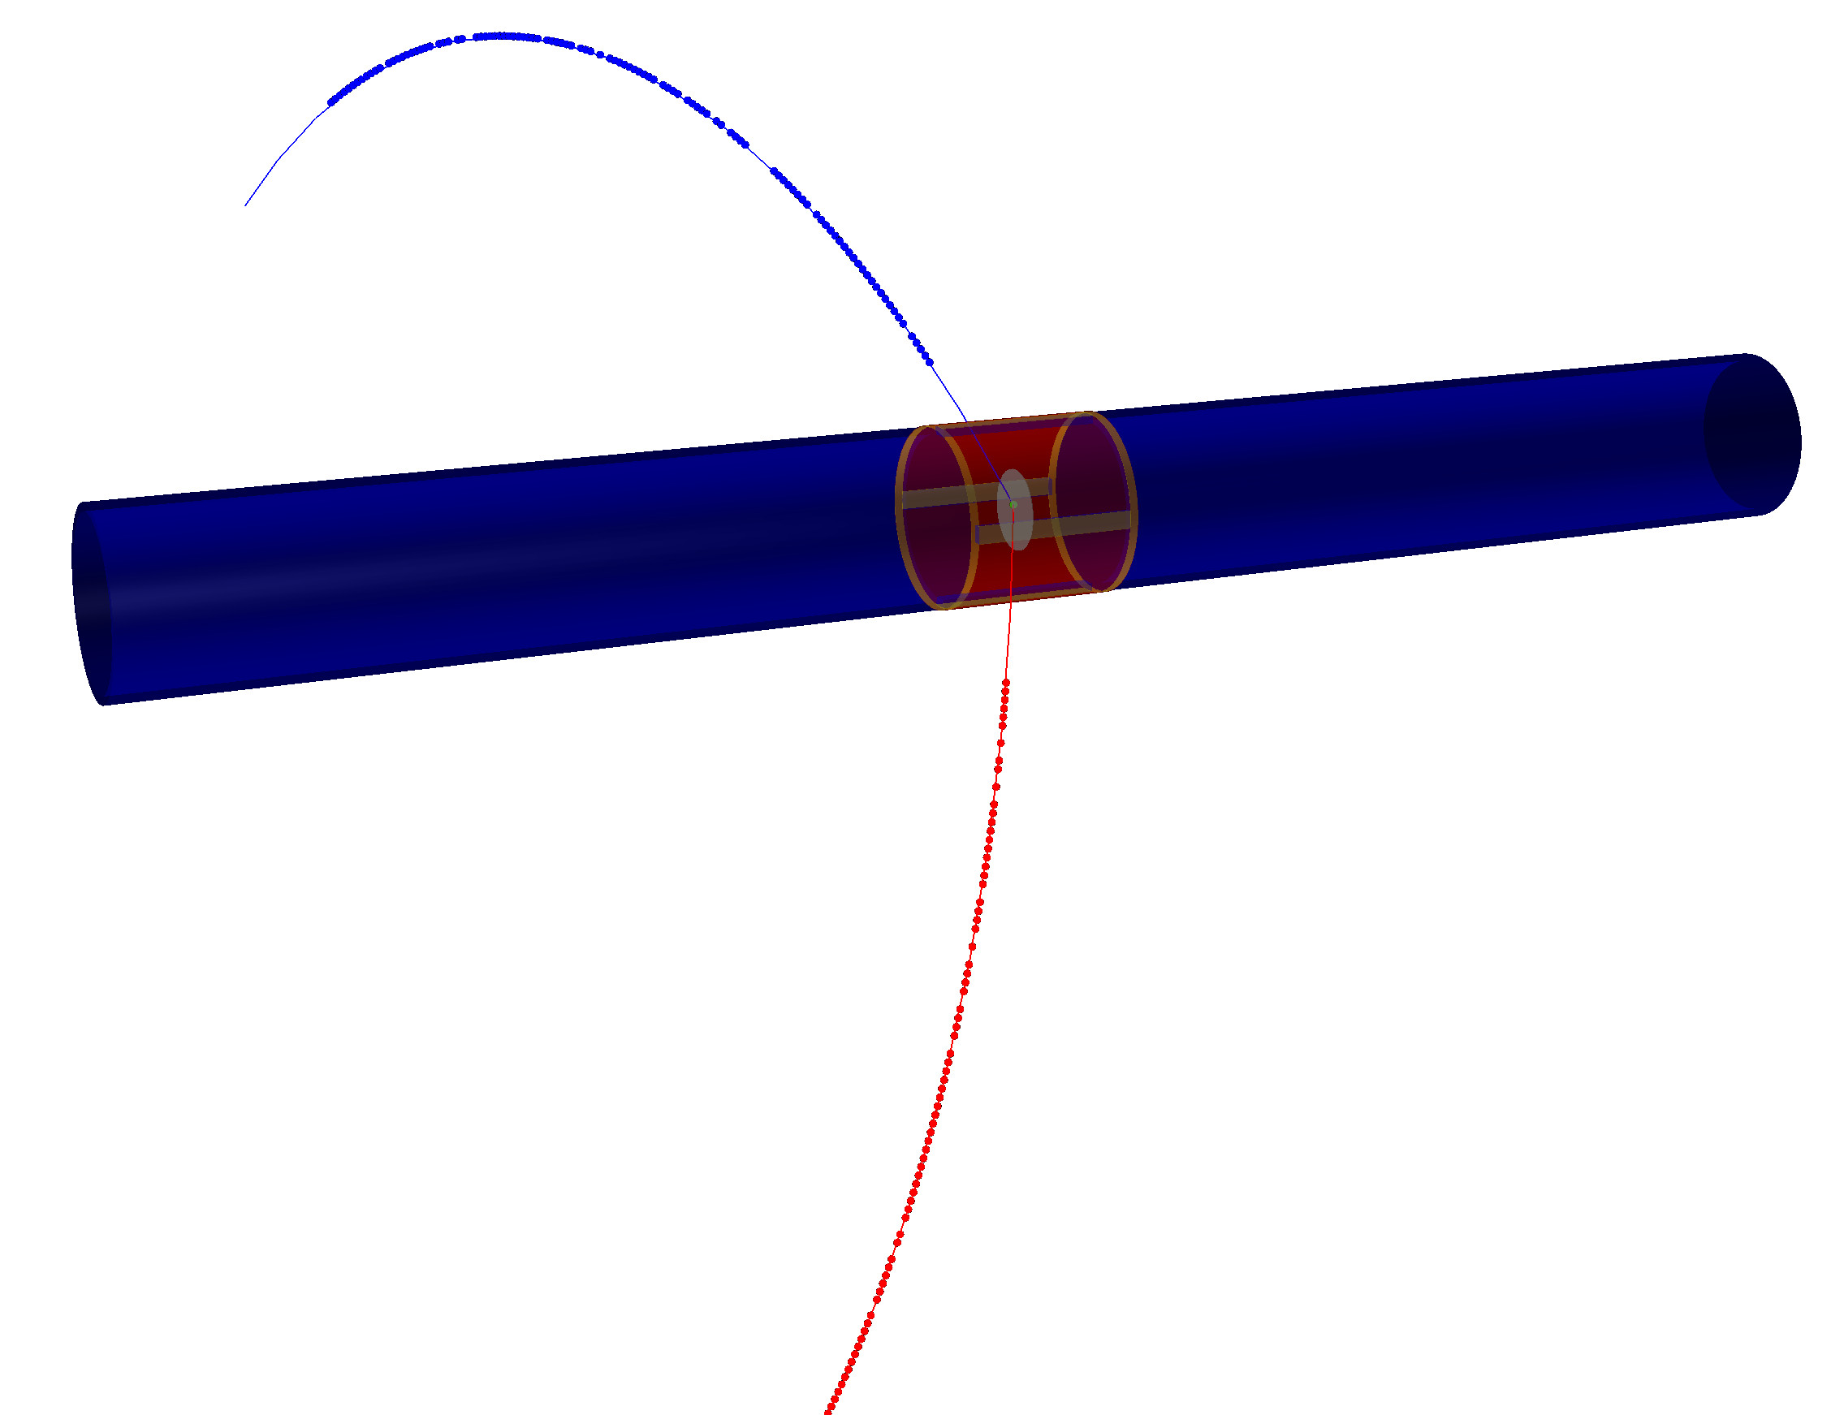
Geant 4 Simulations + Genfit2 + RAVE reconstruction
Full Geant 4 simulation of the TPC
Developed reconstruction software using “genfit2” HEP software library to reconstruct tracks
Developed vertex reconstruction software using “RAVE” HEP software library to project tracks to a common vertex

Slide 17
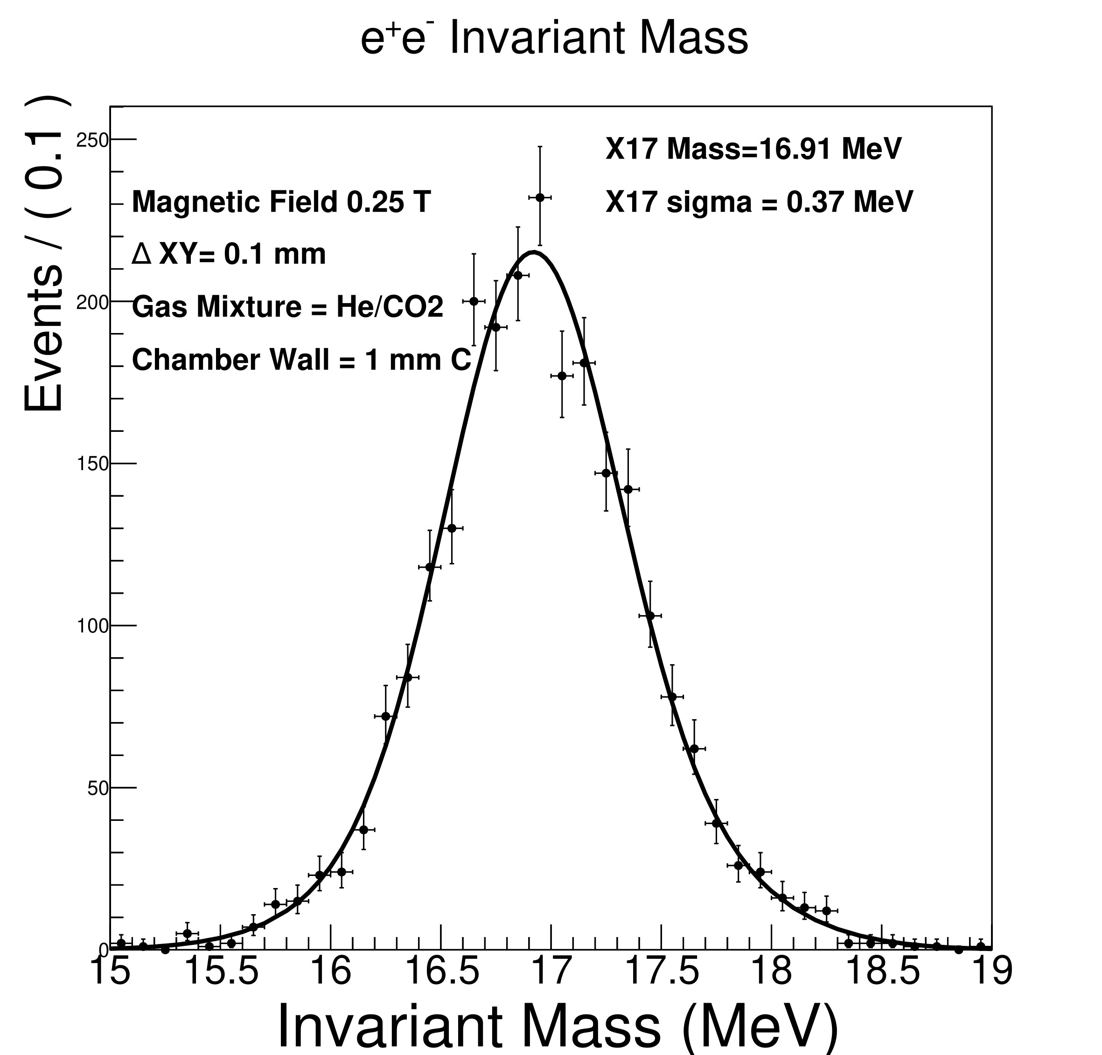
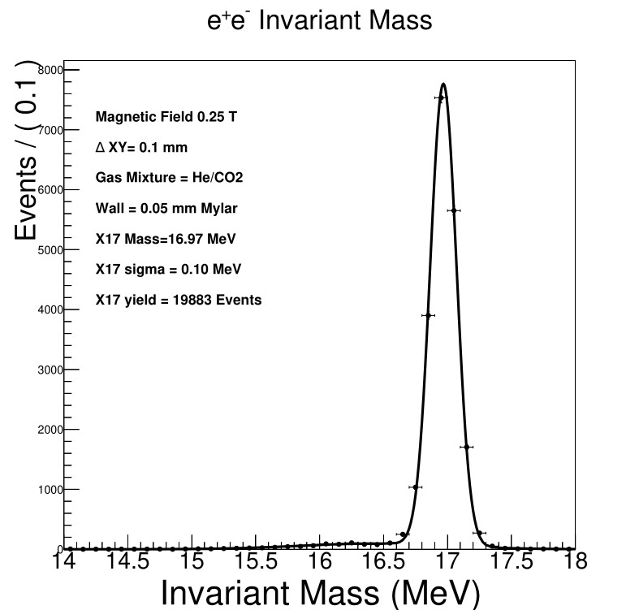
Geant4 + Genfit2 + RAVE
Made numerous simulations. Include 100 µm resolution in x-y, 1 mm in z
Found detector gas 90:10 He / CO₂ + thin Target chamber walls enable very good invariant mass resolution
σ = 0.37 MeV
Thin-walled Target Chamber is key
1 mm
Carbon
(ATOMKI)
50 µm
Mylar
σ = 0.1 MeV

Slide 18
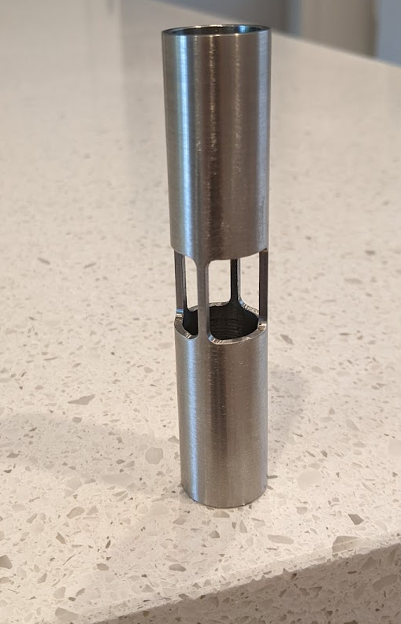
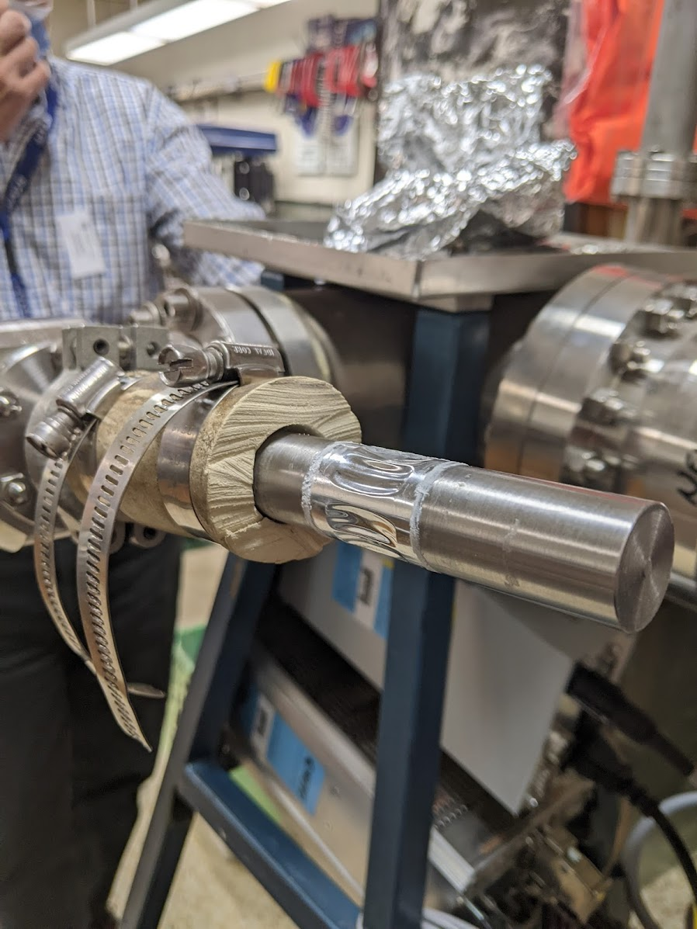
Prototype TPC Target Chamber
Best Invariant Mass Resolution requires very thin vacuum wall
Shear strength of Mylar foil (15 kg/mm²) implies 50 micron thick foil has a factor of 20 safety under vacuum

Slide 19
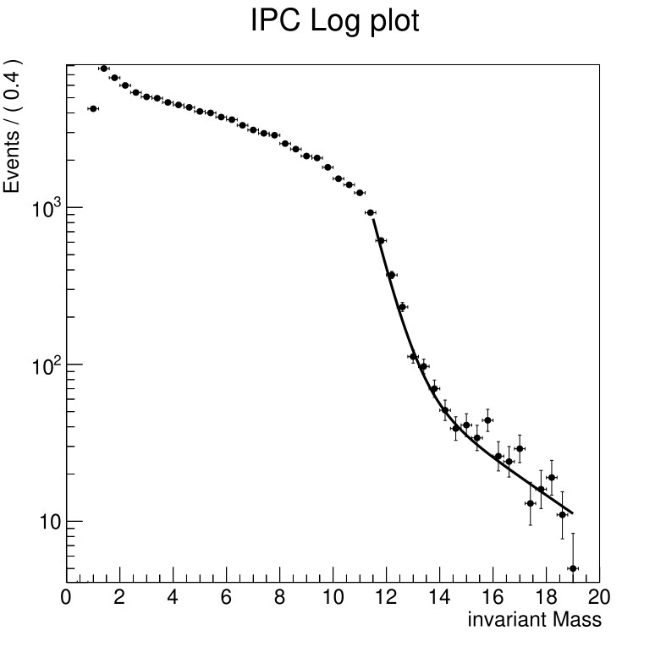
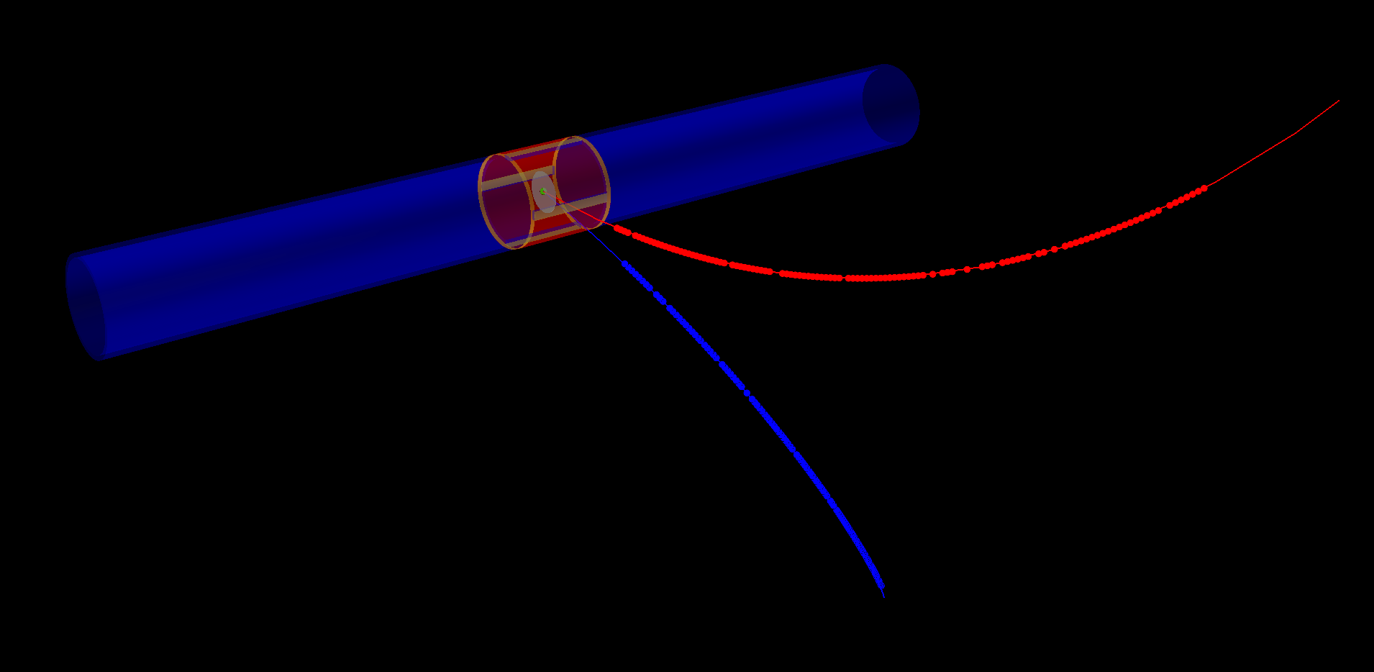
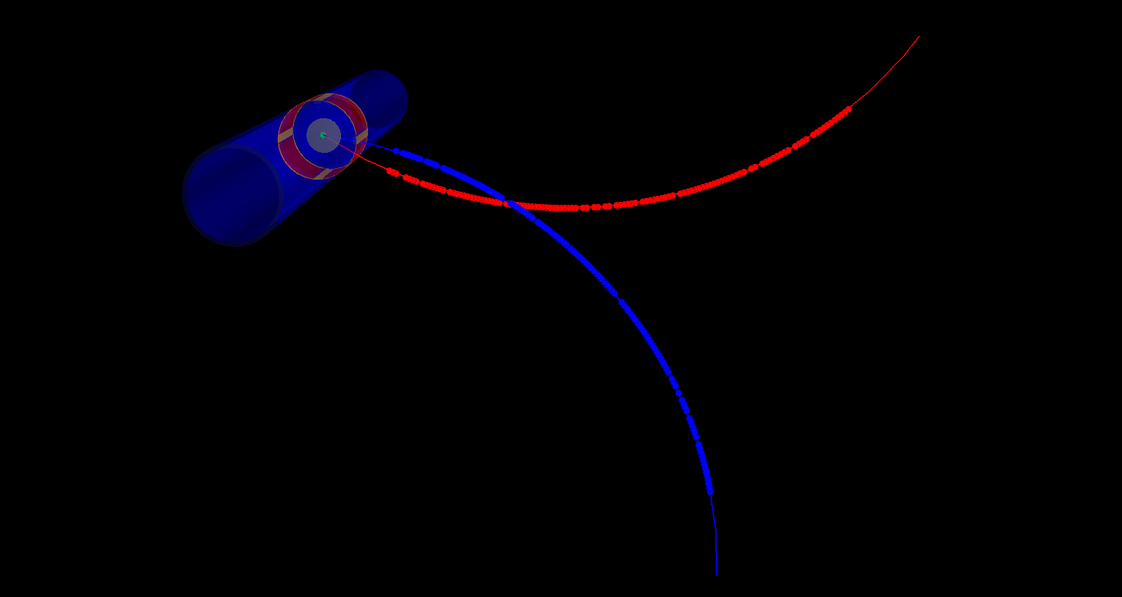
Internal Conversion Background (IPC)
Irreducible background comes from Nuclear Internal Conversion
$${}_{4}^{8}{{Be}^{∗}}→{{}_{4 }^{8}{Be}+γ}^{∗}→e^{+}e^{−}$$
Peaks at low invariant mass
Simulated with Born-approximation
Full GEANT4 Simulation + genfit2 + RAVE reconstruction with realistic TPC hits (~130 )
Black line is an ansatz fit

Slide 20
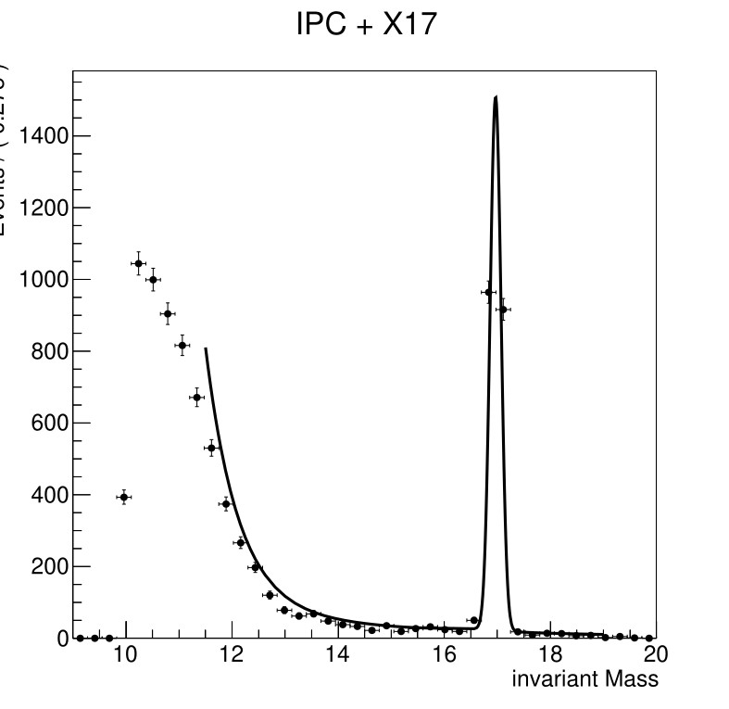
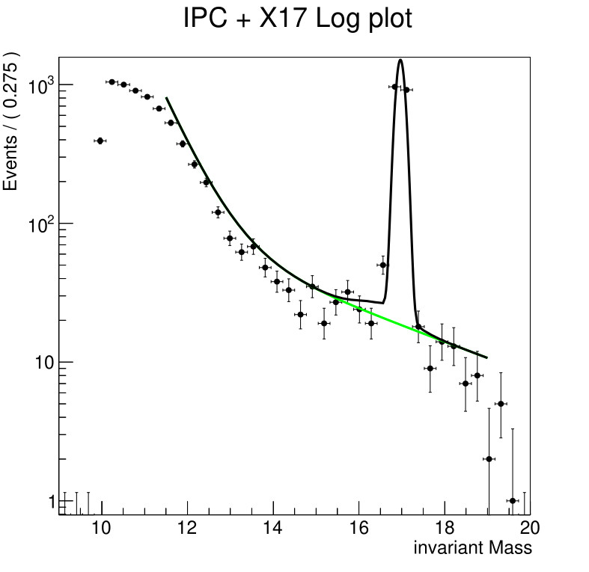
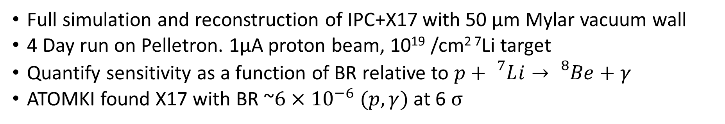
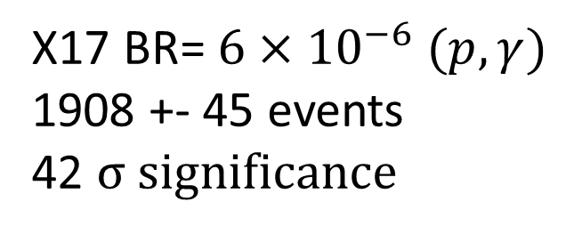
X17 + IPC background
Full simulation and reconstruction of IPC+X17 with 50 µm Mylar vacuum wall
4 Day run on Pelletron. 1µA proton beam, 10¹⁹ /cm² ⁷Li target
Quantify sensitivity as a function of BR relative to $p+{}_{}^{7}Li→{}_{}^{8}{Be}+γ$
ATOMKI found X17 with BR ~$6×{10}^{−6} (p,γ)$ at 6 σ
X17 BR= $6×{10}^{−6} (p,γ)$
1908 +- 45 events
42 σ significance

Slide 21
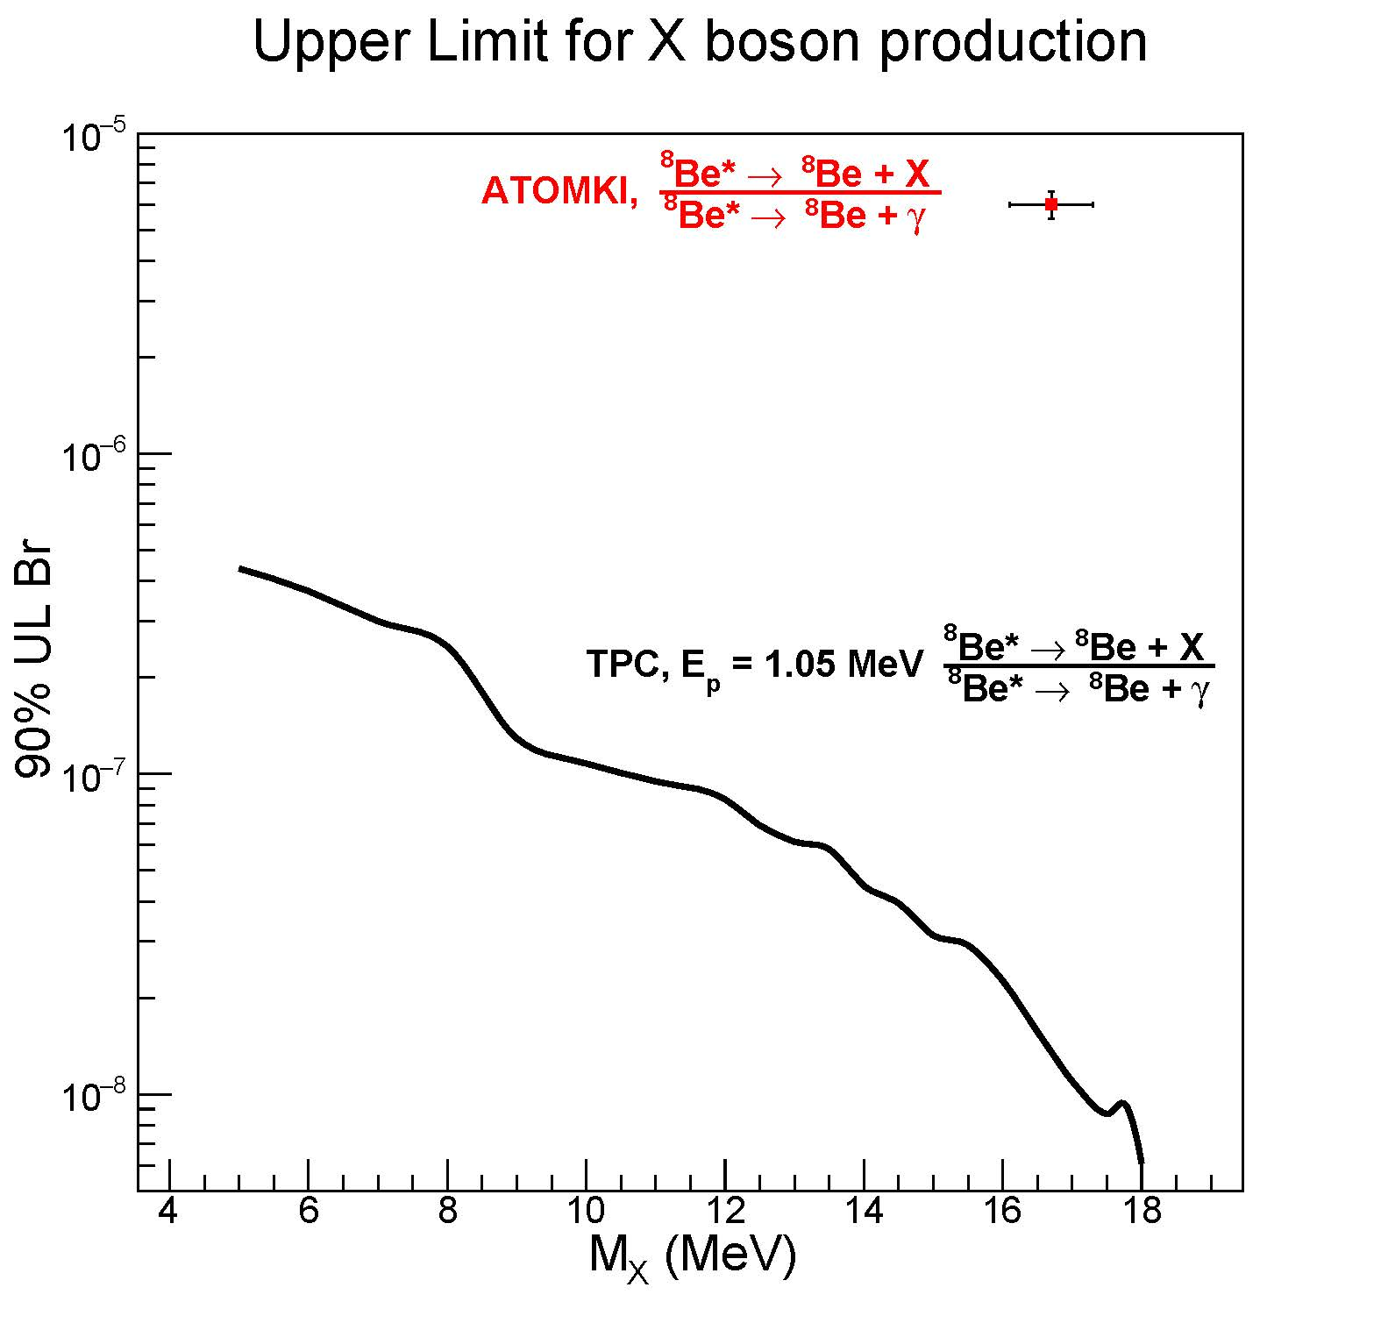
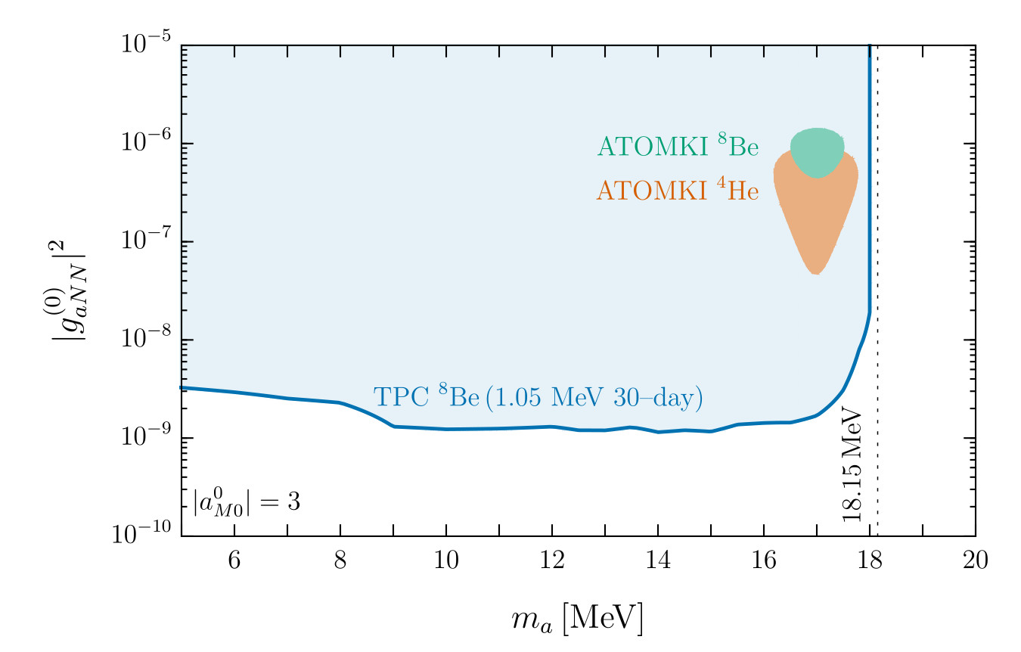
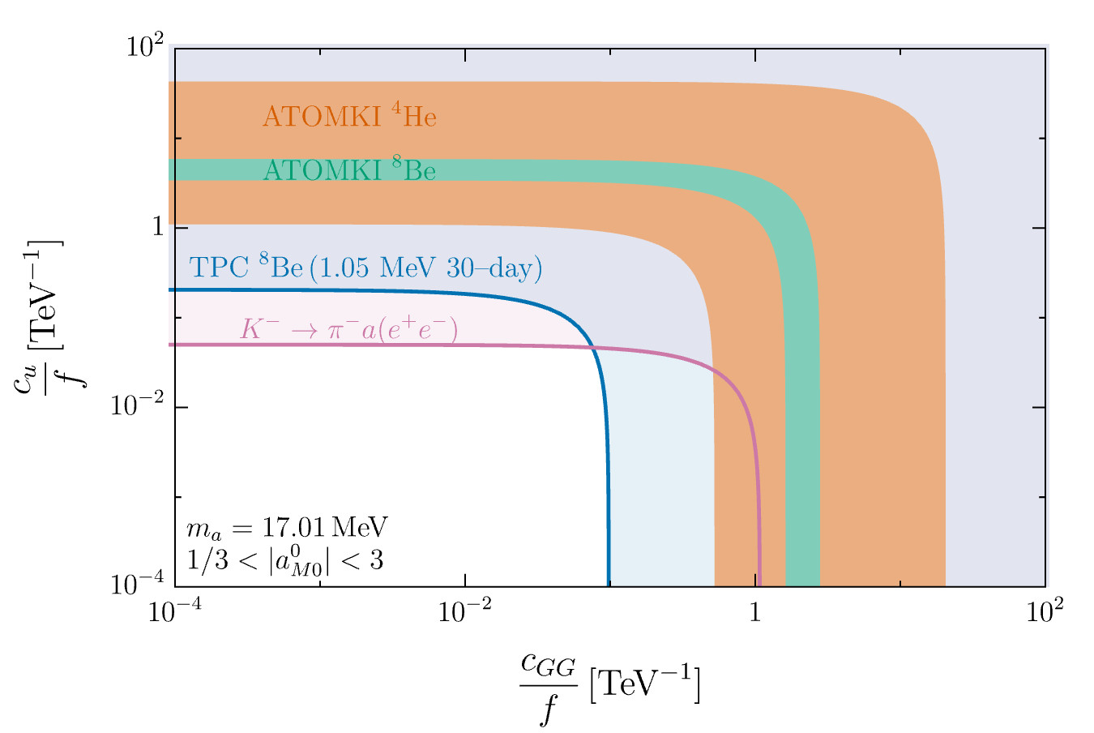
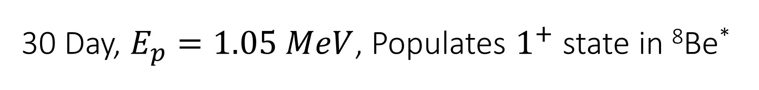

30 Day, $E_{p}=1.05 MeV$, Populates $1^{+}$ state in ⁸Be*
Limits on ALP
Coupling as a function of ALP mass
Limits on ALP
Parameter space for ALP mass =17 MeV
90% Upper limits on BR($\frac{{}_{}^{8}{{Be}^{∗}}→Be+X(e^{+}e^{−})}{{}_{}^{8}{{Be}^{∗}}→Be+ γ}$)

Slide 22
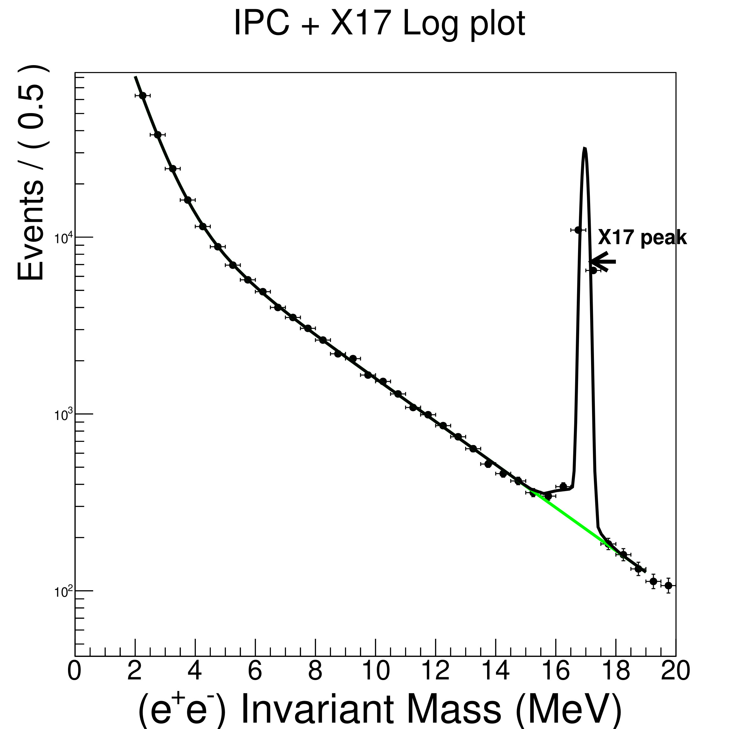
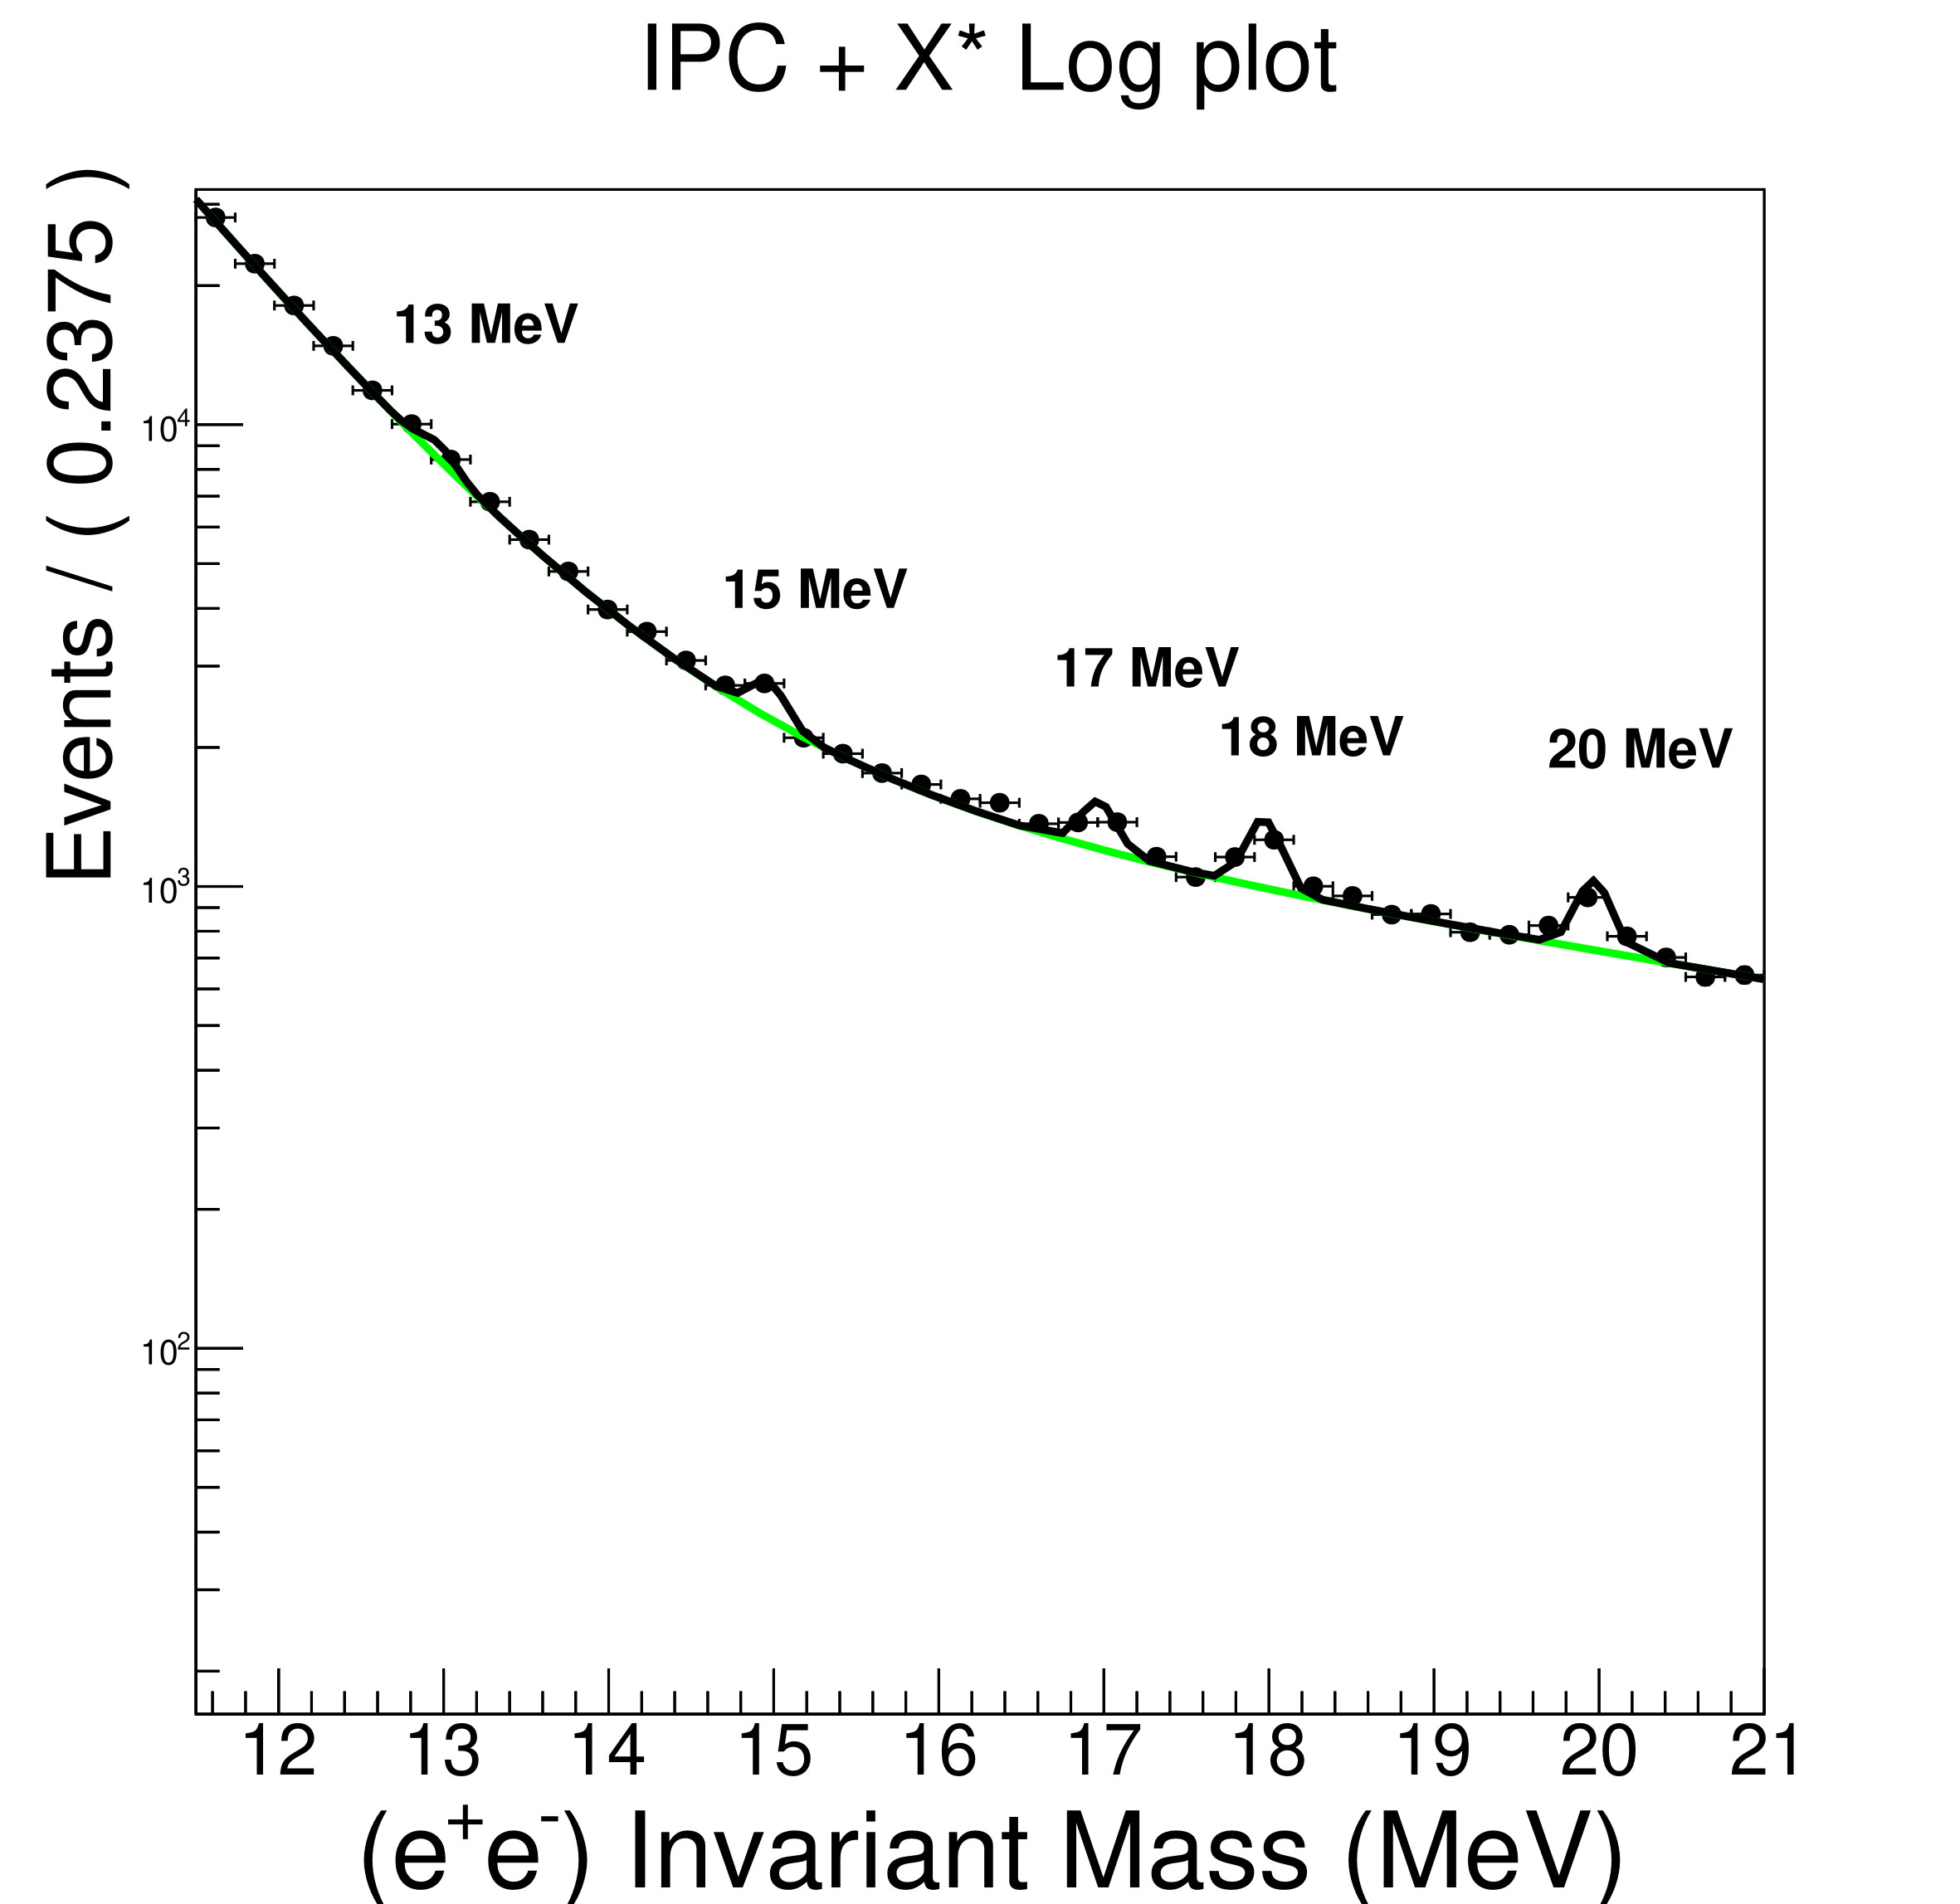
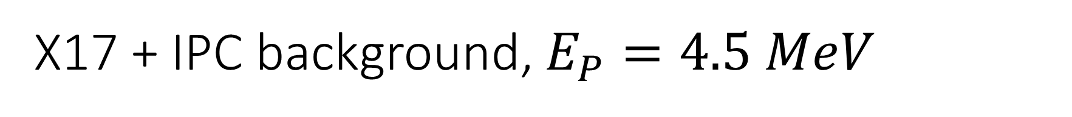
X17 + IPC background, $E_{P}=4.5 MeV$
$E_{p}=4.5 MeV ,$Target Thickness = $2×{10}^{20}$ Atoms/$cm^{2}$, $2 μA$proton beam, 30 Day Run
“X” boson produced at a rate 200 times less than X17

Slide 23
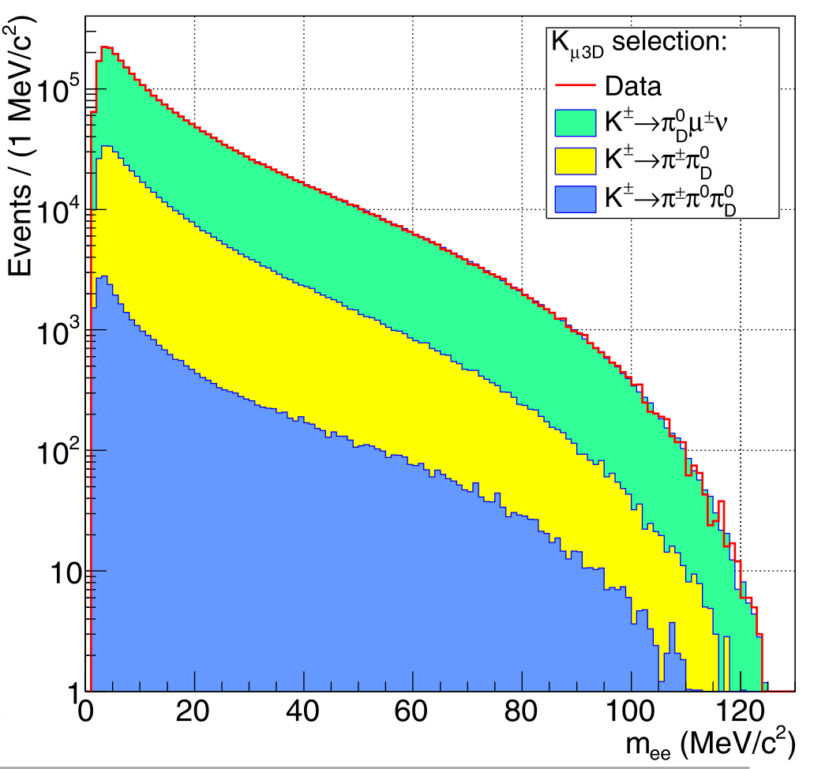
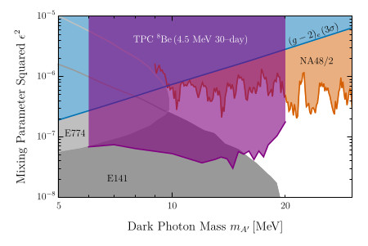
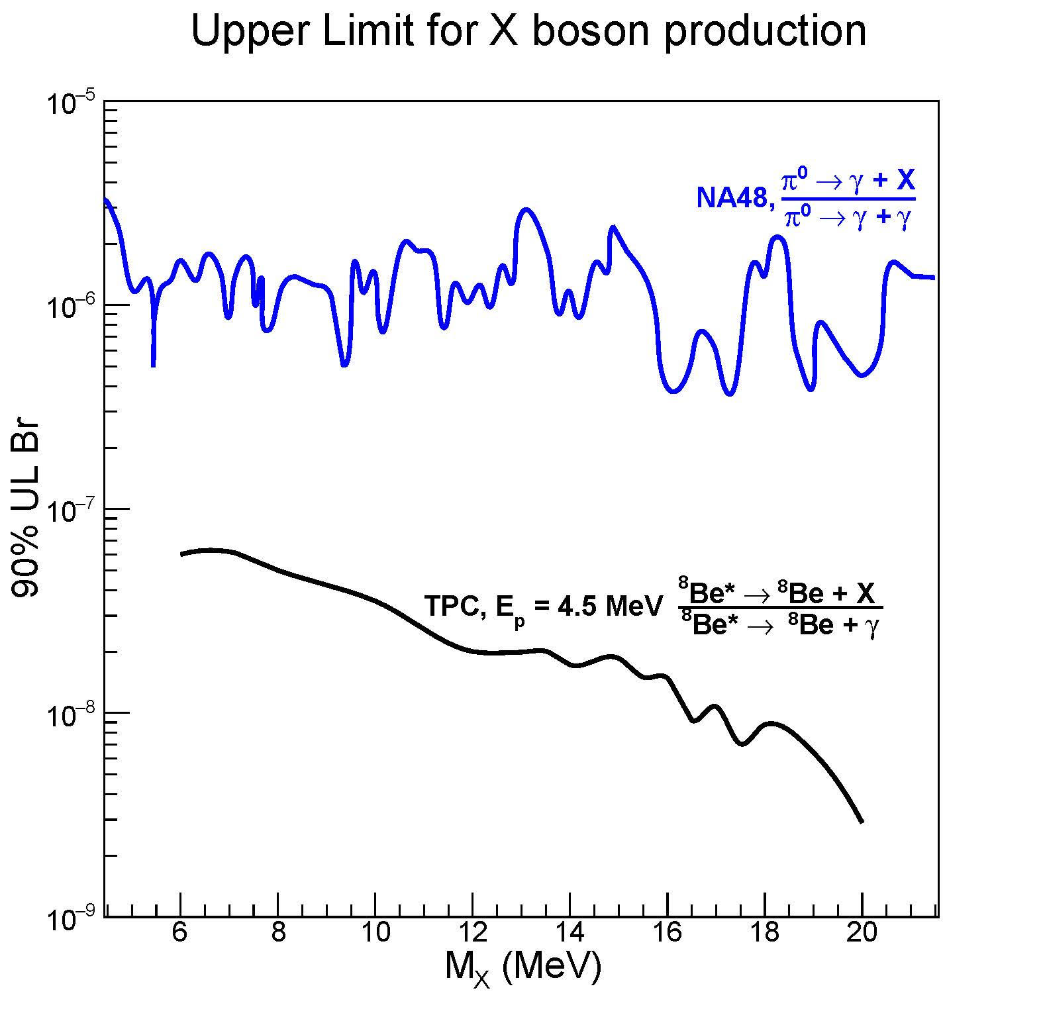
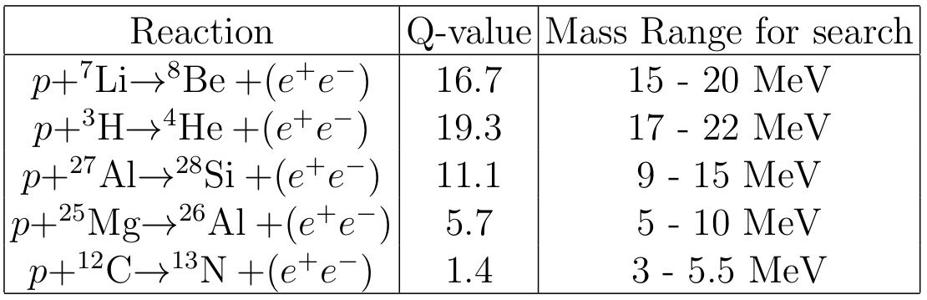
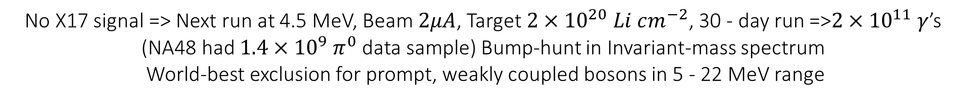

No X17 signal => Next run at 4.5 MeV, Beam $2μA$, Target $2×{10}^{20} Li cm^{−2}$, 30 - day run =>$2×{10}^{11} γ$’s
(NA48 had $1.4×{10}^{9} π^{0}$ data sample) Bump-hunt in Invariant-mass spectrum
World-best exclusion for prompt, weakly coupled bosons in 5 - 22 MeV range
IPC Background peaks at 1.1 MeV
Choose reaction for optimized X mass range
NA48 - Huge background at 5- 22 MeV
17.2
19.8
11.6
5.2
1.9
90% Upper limits on BR($\frac{{}_{}^{8}{{Be}^{∗}}→Be+X(e^{+}e^{−})}{{}_{}^{8}{{Be}^{∗}}→Be+ γ}$)

Slide 24
Conclusions
Proposed TPC facility can exclude the X17 with > 2 orders of magnitude in an identical nuclear system
Unique facility – world-leading probe of dark photon/ALP physics. Others?
Significant first measurements for fundamental Nuclear Physics

Slide 25
Backup

Slide 26
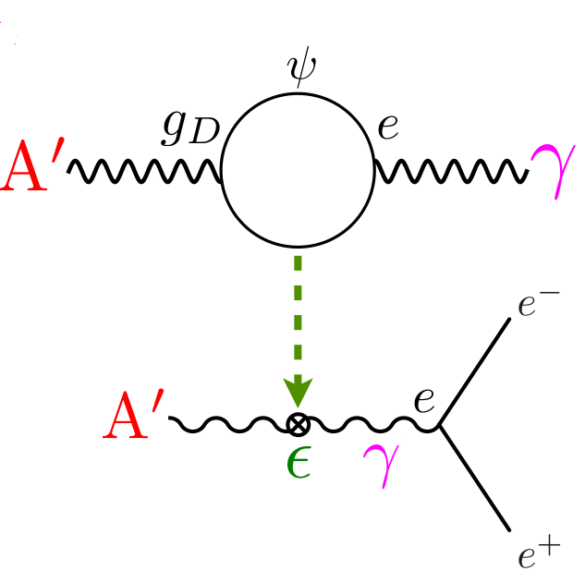
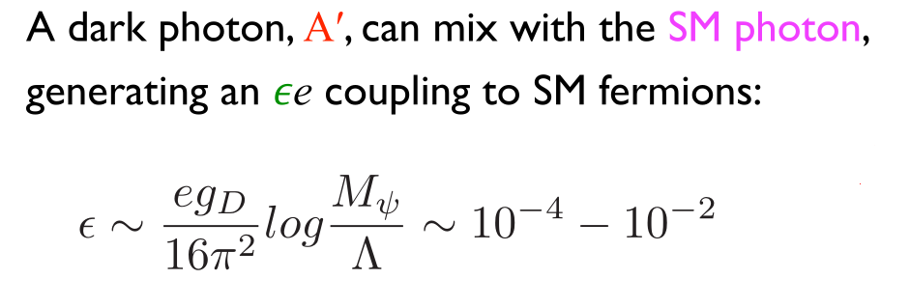



Particle Physics Motivation – “Dark Sector”
Dark Matter => New Physics
MeV-GeV thermal relic DM requires new, comparably light mediators to achieve required annihilation cross-section for Thermal freeze-out.
Lee & Weinberg 77
A’
ε.q
$$∝ε^{2}$$
$${}_{}^{7}{Li}+p (\sim 1 MeV)$$
A’
e⁺
ε.e
~18.5 MeV
e⁻
$${}_{}^{8}{Be}$$
(Tim Nelson, SLACMass, Feb 2020)
Can produce ~$2×{10}^{11}$ 5 - 22 MeV $γ$’s

Slide 27







Axion Like Particles (ALPs)
Axion Like Particles (ALPs) arise from additional global symmetries:
Global lepton number symmetry: Majoron
[Chikashige et al. 78; Gelmini &Roncadelli 81]
Global family symmetry: Familon
[Wiczek 82; Berezhiani & Kholpov 90]
Quantum Gravity
[Bauer, Neubert, Renner, Schnubel, Thamm 22]
QCD $ℒ$ has a CP-violating angle similar to the CKM matrix
$$ℒ⊂\overline{θ}\frac{α_{s}}{8π}G_{a}^{μυ}{\tilde{G}}_{a,μυ}$$
$\overline{θ}$ in the range: $0−π$
Neutron dipole moment=> $\overline{θ}<{10}^{−10}$
Strong CP problem!
Solved with the Peccei-Quinn ${U(1)}_{PQ}$ symmetry
Broken by the vev of a SM singlet scalar field:
$$σ\left(x\right)=\frac{1}{\sqrt{2}}\left(v_{PQ}+ρ\left(x\right)\right)e^{iA(x)/f}$$
Scale of this field >> 1 TeV (given by $f$)
The field $θ_{A}=A/f_{A}$acts as a space-time dependent field to cancel $\overline{θ}$
Gives rise to a pseudo Nambu-Goldstone boson: axion
The $0^{−}$axion , feebly couples to gluons, photons and fermions
SM $ℒ⊃−\frac{α_{s}}{8π}\frac{A}{f_{A}}G_{μυ}^{a}{\tilde{G}}^{a,μυ}−$ $\frac{α}{8π}C_{Aγ}\frac{A}{f_{A}}F_{μυ}^{}{\tilde{F}}^{μυ}+\frac{1}{2}\frac{C_{Af}}{f_{A}}∂_{μ}A{\overline{ψ}}_{f}γ^{μ}γ_{5}ψ_{f}$
$ℒ⊃−\frac{α_{s}}{8π}\frac{G_{ig}^{′}}{f_{a_{i}^{′}}}{a_{i}^{′}G}_{μυ}^{b}{\tilde{G}}^{b,μυ}−$ $\frac{α}{8π}\frac{G_{iγ}^{′}}{f_{a_{i}^{′}}}a_{i}^{′}F_{μυ}^{}{\tilde{F}}^{μυ}+\frac{1}{2}\frac{G_{if}^{′}}{f_{a_{i}^{′}}}∂_{μ}a_{i}^{′}{\overline{ψ}}_{f}γ^{μ}γ_{5}ψ_{f}$
Then the particle corresponding to the excitation:
$$\frac{A(x)}{f_{A}}≡\frac{C_{ig}^{′}}{f_{i}^{′}}a_{i}^{′}$$
Is the axion
Excitations of the field orthogonal to this are called
Axion-Like-Particles (ALPs)
In principle ALPS have different coupling to gluons $(\frac{G_{ig}^{′}}{f_{a_{i}^{′}}})$, photons $(\frac{G_{iγ}^{′}}{f_{a_{i}^{′}}})$and fermions $(\frac{G_{if}^{′}}{f_{a_{i}^{′}}})$
Nuclear decays can explore viable ALP parameter-space and hence are sensitive to multi-TeV Physics!
[Powell 16, Ringwald 16,Peccei&Quinn77;Weinberg 78; Wiczek 78]

Slide 28

ALP mass to gamma-coupling parameter-space

Slide 29

Garfield simulation of drift velocity
Dispersion of drift velocity is ~ 0.6%
Gives rise to a z-resolution of ~ 1mm

Slide 30



COMSOL electric field simulation of Field Cage
Default Electric field
radial Component
Optimized Electric field
radial Component
Default Electric field
Z Component
Default: 9 mm rings placed 1 mm apart
Optimized: 4.5 mm rings placed 0.5 mm apart
Initial upstream ring 1 mm downstream of cathode disk

Slide 31


COMSOL + Garfield simulation of micromegas
0 V
120 μm
+800 V
PCB
Electrons are directed through the mesh and enter the amplification region

Slide 32




Garfield simulation of Micromegas amplification
800 V over ~ 100 microns provides ~ 10⁴ gas gain
Induces pulses of around 5 pC on readout strips
mesh
Electron avalanche providing gas gain

Slide 33

LHC VMM ASICs + Scalable Readout System
Readout strips with VMM ASICs
Programmable gain
Test charge input
Records channel number, analogue charge, Time with 1 ns resolution and 64 µ-sec dynamic range
~pC pulses from strips in the right range for VMM linear response

Slide 34
Geant 4 Simulations
As charged particles propagate through matter interact causing:
  “Multiple” small angle scattering causing direction change
  Energy loss as they transfer energy to the medium
  Ionization liberating electrons
Have set up a Geant 4 simulation of the TPC
Final direction
Initial direction
Accurate determination of the Invariant mass of the e+ e- pair requires a precise measurement of the magnitude and direction of the charged particles
Accurate simulation of multiple scattering required.
Minimize the effect.
Low Density, Low Z material

Slide 35


Target Chamber
Prototype Target Chamber
Mylar foil on stainless steel pipe, nicely holds vacuum.
Reached 1.1×10⁻⁵ Torr (limited by outgassing in the connector)

Slide 36







Garfield Simulation of electron release and drift
Ionization electrons drift to detector at z=19 cm
Correlation in
Radial position
Uncorrected Resolution
100 μm resolution
Corrected Resolution
Primary MeV-scale $e^{+}(e^{−})$ at z=0
Corrected
Around 100 electrons per track released via ionization.
10 μm resolution

Slide 37



External Gamma conversion
Large flux of 18 MeV γ’s from $p{+ }^{7}Li→8Be+γ$
These can externally convert via $γ→e^{+}e^{−}$ in material
Simulated ${10}^{8}$ of these
Low mass near the target limits conversions to 0.01%
Vertex constraint removes > 99%
Background is negligible compared to IPC

Slide 38

Data rates
Comes from Thick-target bump hunt search + exclusion
Run at 4.5 MeV, Beam $2μA$, Target $2×{10}^{20} Li cm^{−2}$
Cross Section for $p+{}_{}^{7}Li→{}_{}^{8}{Be}+γ$ = 30 µb
N(γ)/sec = $3×{10}^{−29}×2×{10}^{20}×1.25×{10}^{13}=7.5×{10}^{4} s^{−1}$
Approx 0.01% gamma’s convert = 7.5 events/sec
IPC rate = $3.5×{10}^{−3}×7.5×{10}^{4}×0.5=131$events/sec
12 Kbytes/event $1.2×{10}^{4}×140=1.7$megabytes/sec
145 GB/day
4.5 TB for 30-day run
Well within the capacities of the unimelb Spartan HPC

Slide 39

Comparison to LHCb for generic dark photon
TPC

Slide 40



Search for the X17 at University of Montreal
Openning angle measurement of $e^{+}e^{−}$ pairs from $p+^{7}Li→^{8}Be+(e^{+}e^{−})$
arXiv:2211.11900v1

