Slide 1
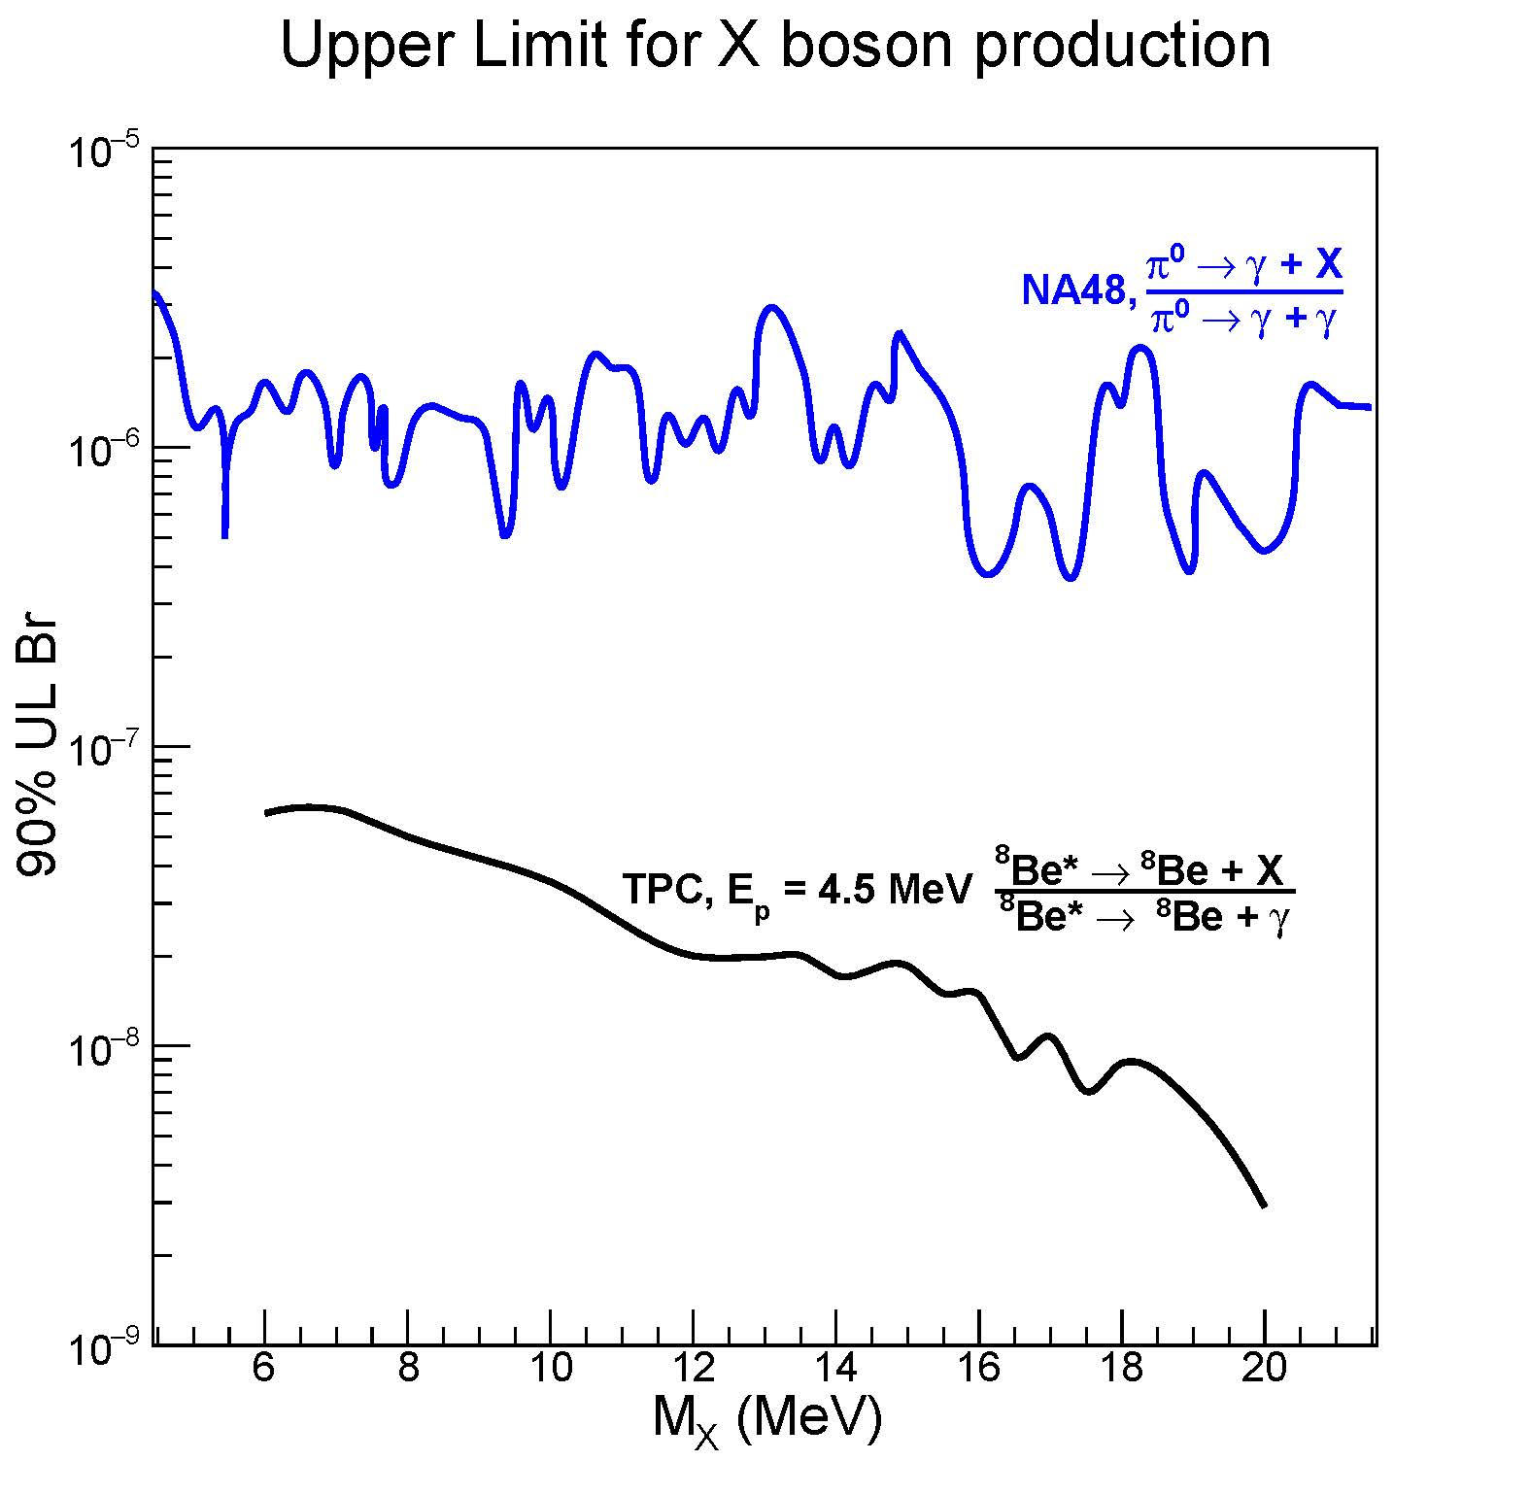
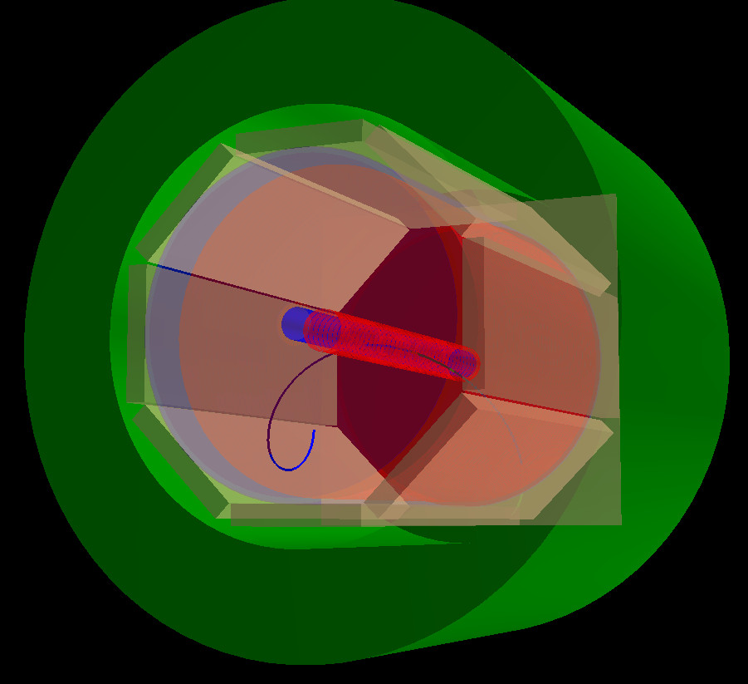
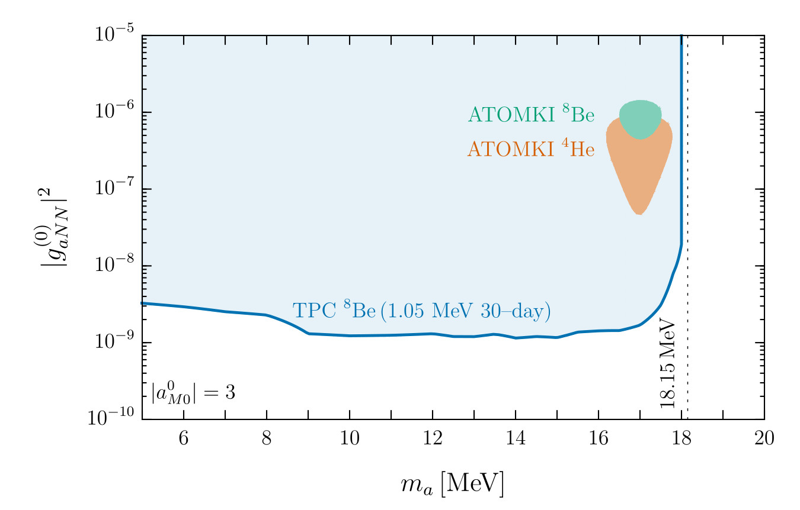
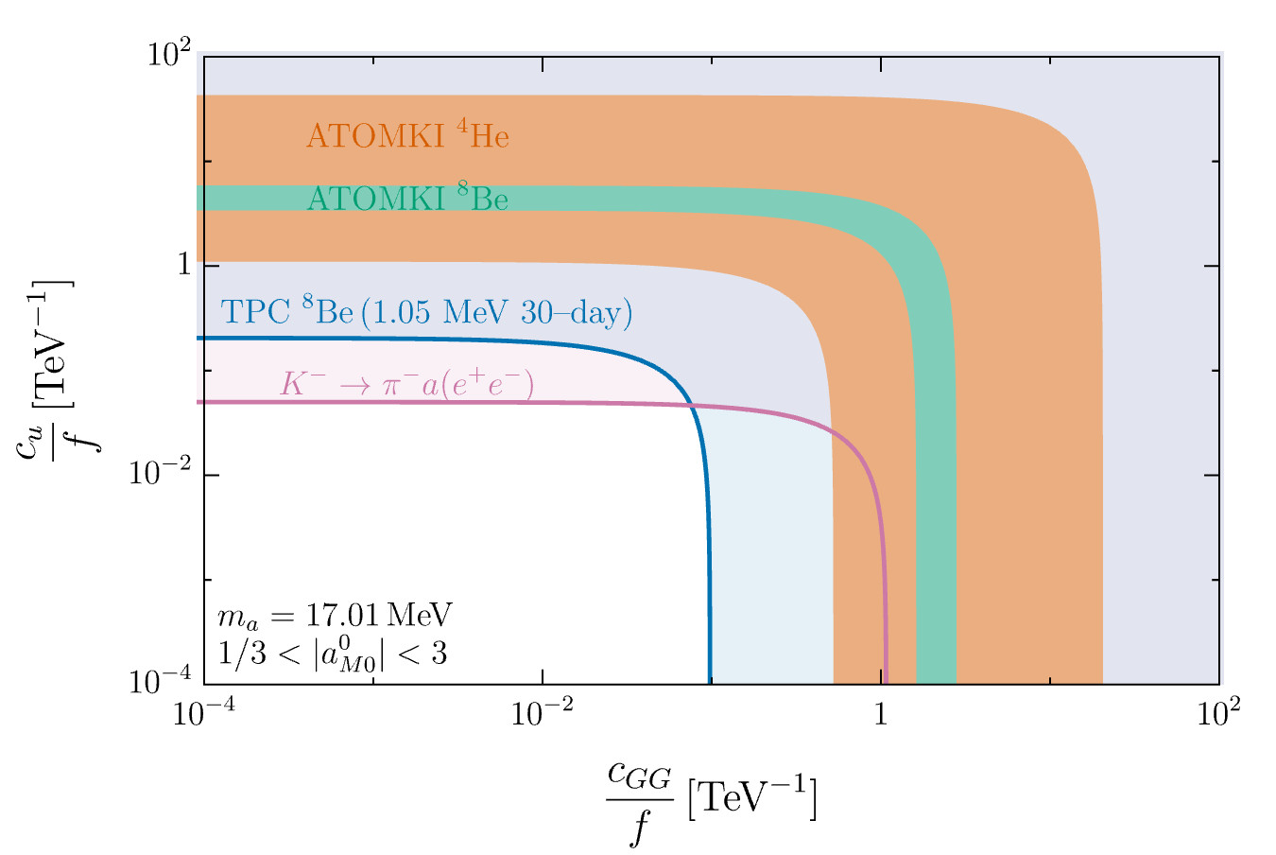
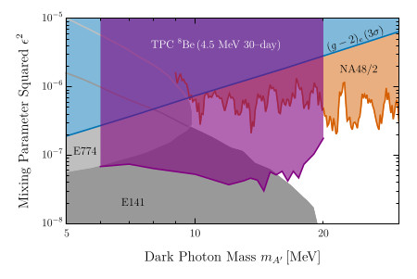

Particle and Nuclear Physics at the MeV scale in Australia, Martin Sevior University of Melbourne
Initial anomaly: $p+7Li→8Be+X17( →e^{+}e^{−})$
Time Projection Chamber
$e^{+}e^{−}$Invariant Mass
$e^{+}e^{−}$Invariant Mass
Iron Yoke (Electromagnet)
Trigger scintillators
Proton beam
Beam Pipe
X17
Our expectation from TPC
If the X17 exists
ATOMKI X17 result
For p + ⁷Li→⁸Be + e⁺e⁻
World-best limit for ALP Parameters
World-best limit on Dark Photon production
Full Details: Sevior et al. https://arxiv.org/abs/2302.13281

