Slide 1

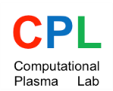



AFAD 2023
Apr. 12 – 14, 2023, Melbourne, Australia
Laser-Plasma Schemes of Narrowband THz Emission for THz Electron Acceleration
Min Sup Hur
CPL, Department of Physics, UNIST, Korea
Collaboration with
D. Jaroszynski at Univ. Strathclyde, UK,
K. Yu, BNL, US,
H. Suk, GIST, Korea
CHEA of UNIST, Korea

Slide 2

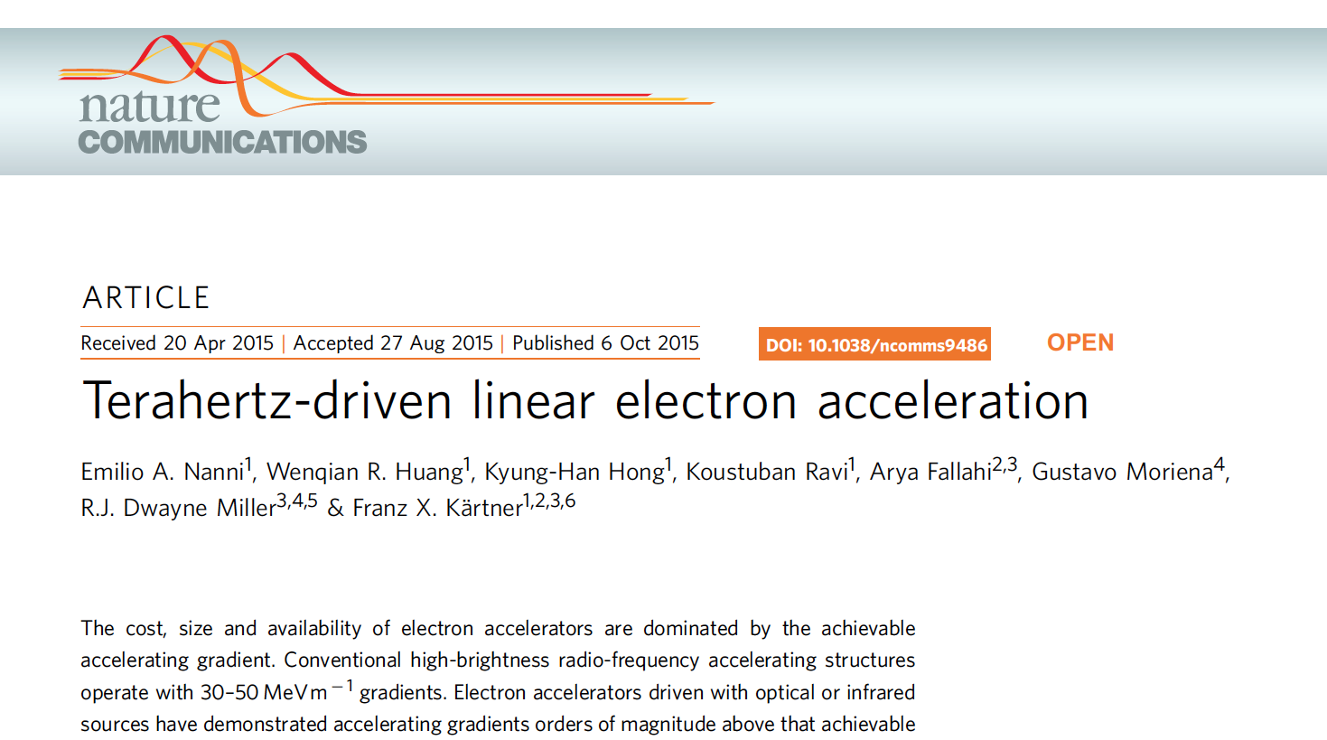
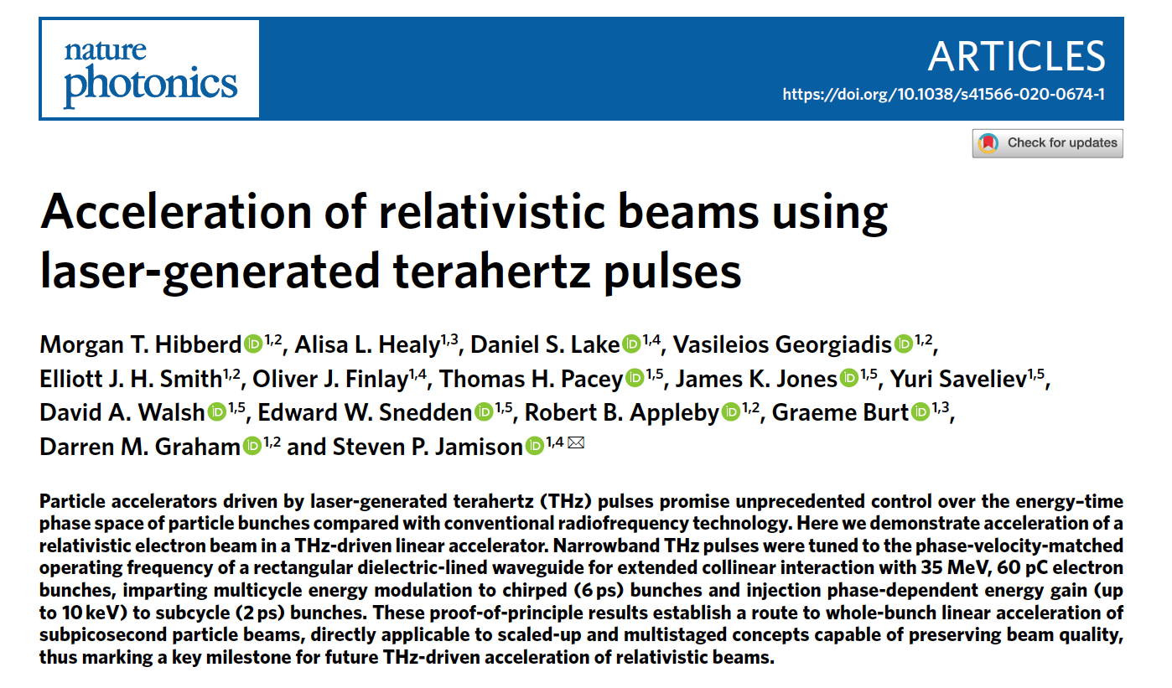
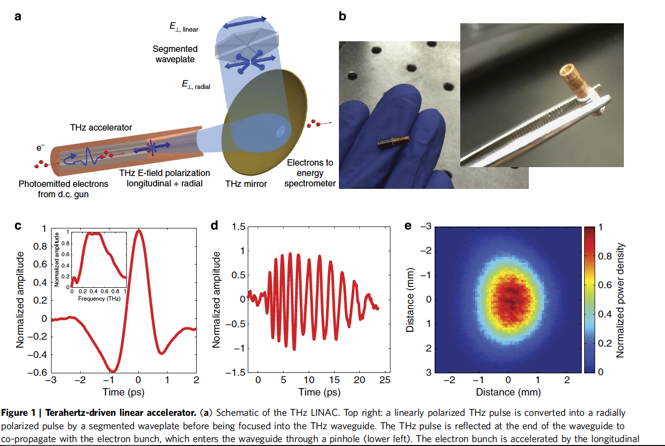
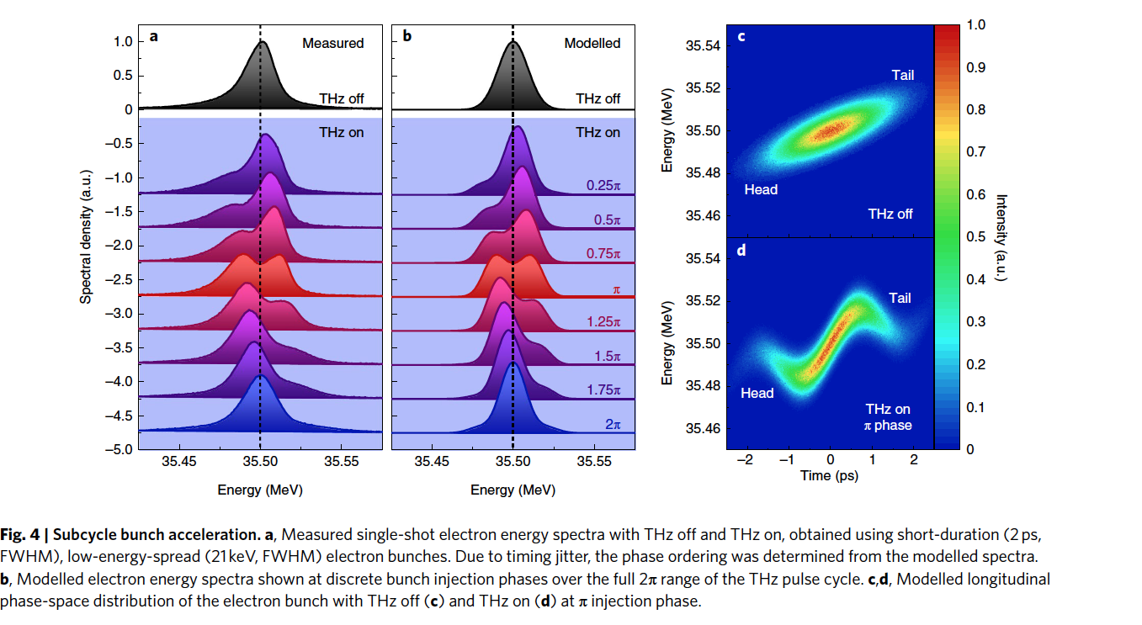
THz Electron Acceleration
AFAD 2023, Apr. 12 – 14, 2023, Melbourne, Australia

Slide 3
Plasma Oscillation as a Radiation Source
Oscillating Electrons Emit Radiation
Advantages as a Radiation Source
Readily tunable by changing the plasma density
Can cover an extremely broad spectral range from microwave to XUV
Monochromatic: high temporal coherence
ω
Difficulties
Electromagnetic
wave
Plasma oscillation usually exists as a plasma wave.
The plasma waves do not phase-match with the electromagnetic waves, making resonant energy conversion difficult.
Langmuir wave (plasma wave)
k
No crossing of dispersion curves except at k=0, where v_{g}=0.
AFAD 2023, Apr. 12 – 14, 2023, Melbourne, Australia

Slide 4
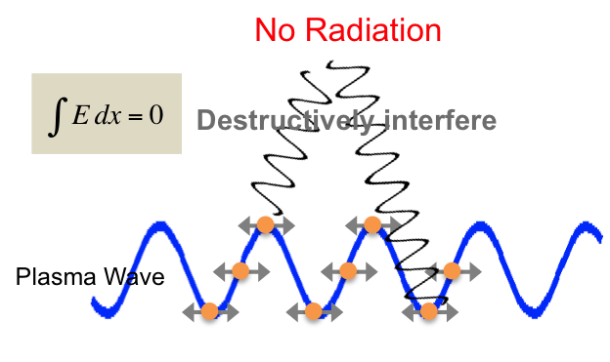
Plasma Oscillation
Harmonic oscillation of a solid-like electron block
Plasma
-
-
-
+
+
+
+
+
+
-
-
-
AFAD 2023, Apr. 12 – 14, 2023, Melbourne, Australia

Slide 5
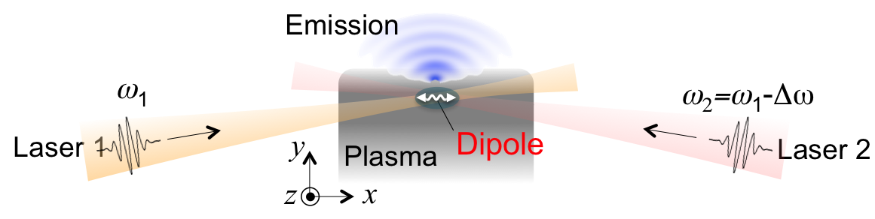
Generation of PDO
At the collision point of two detuned laser pulses,
a strong plasma dipole oscillation (PDO) is generated.
Mechanisms of PDO-generation
DC component of the nonlinear current (weak driver regime)
Cho et al., New J. Phys. 17, 043045 (2015).
2. Trapped particles on the moving potential train (strong driver regime)
Kwon et al., Sci. Rep. (2018).
AFAD 2023, Apr. 12 – 14, 2023, Melbourne, Australia

Slide 6
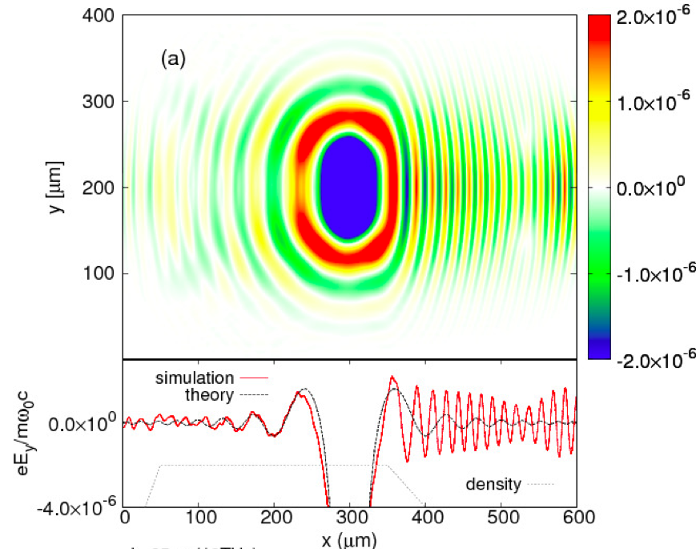
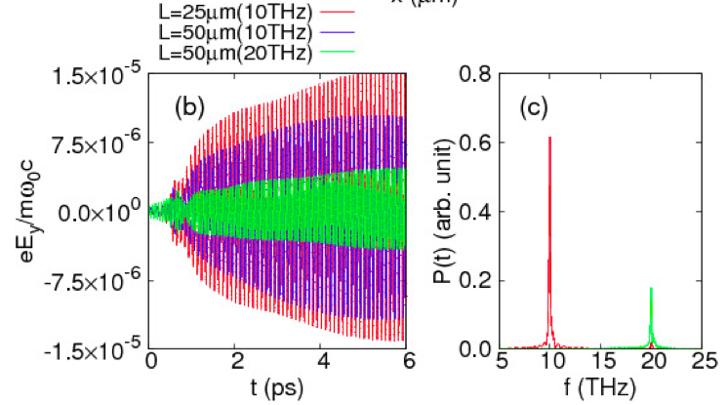
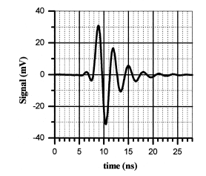
Spectrum Control by External B
The spectrum can be made very narrowband by external magnetic field
B_{ext}
bulk
gradient
vacuum
* A few cycles burst
E_{THz} ~ I_{L}²
AFAD 2023, Apr. 12 – 14, 2023, Melbourne, Australia

Slide 7
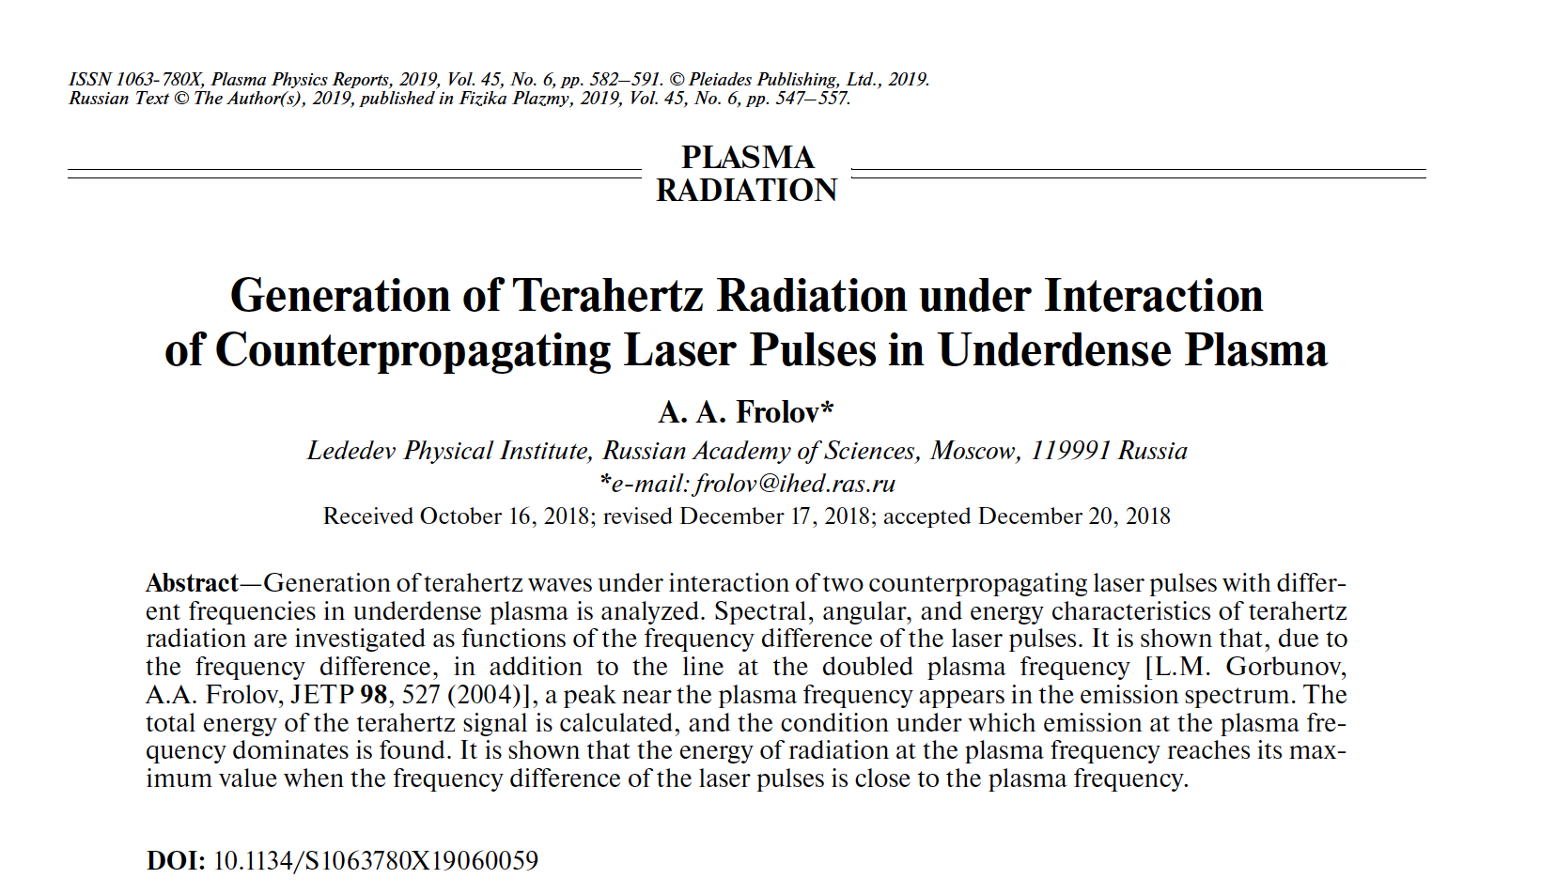
Similar Independent Work from Others
Similar to our weak-field regime
AFAD 2023, Apr. 12 – 14, 2023, Melbourne, Australia

Slide 8
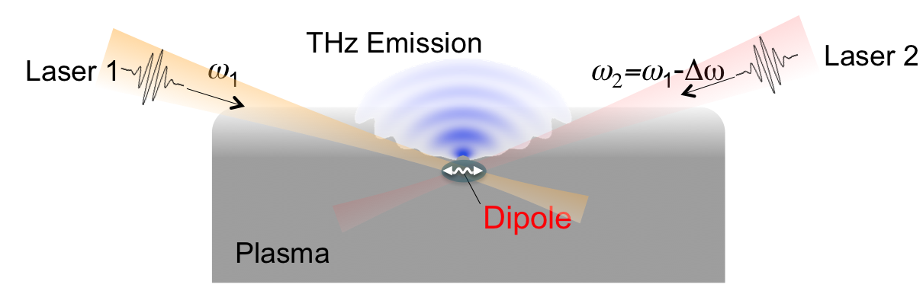
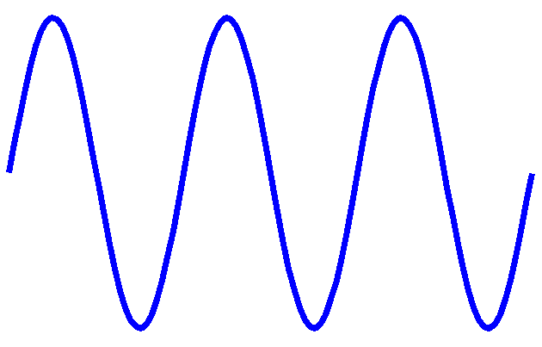
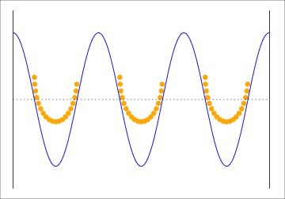
PDO by Trapped Particles
Moving Potential Train
∼ λ_{L}/2
Electrons riding on the potential train
are displaced in a block to the right
Velocity of the displacement is
determined by the laser detuning Δω
AFAD 2023, Apr. 12 – 14, 2023, Melbourne, Australia

Slide 9
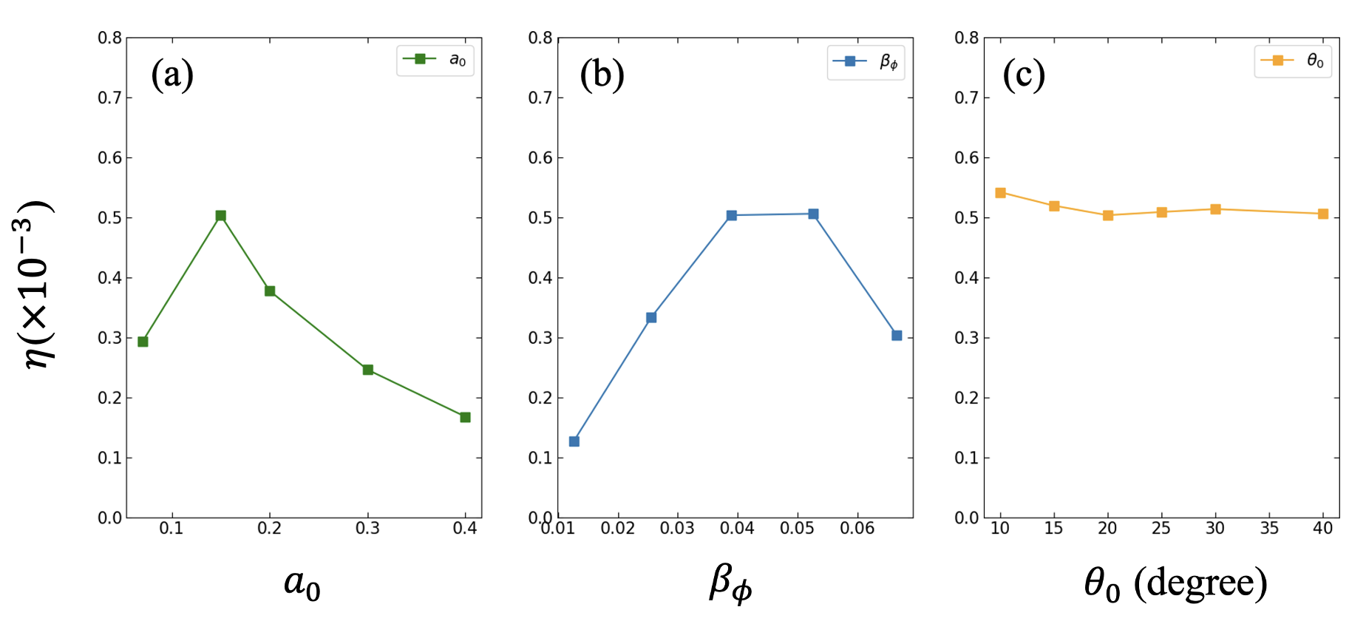
Radiation from PDO
Two-dimensional PIC simulation
Kwon et al., Sci. Rep. 2018
J. Lee et al., Phys. Plasmas (2023, in press)
AFAD 2023, Apr. 12 – 14, 2023, Melbourne, Australia

Slide 10
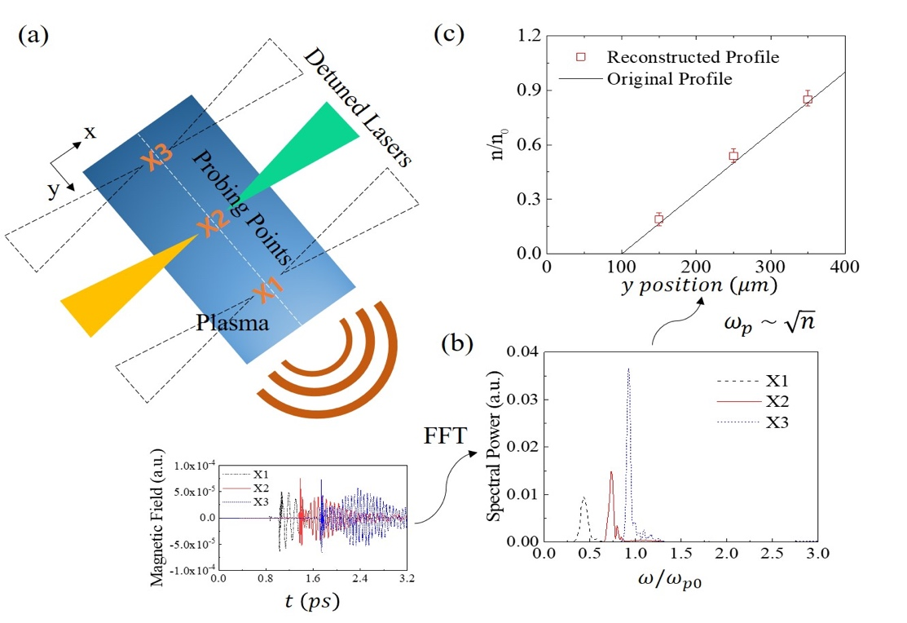
PDO on a Density Gradient
S. Kylychbekov et al., Plasma Sources Sci. Tech. 2020
AFAD 2023, Apr. 12 – 14, 2023, Melbourne, Australia

Slide 11
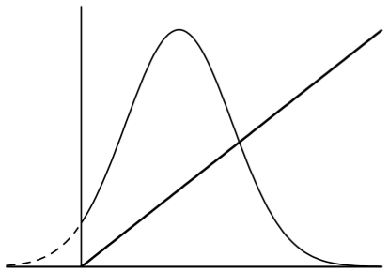
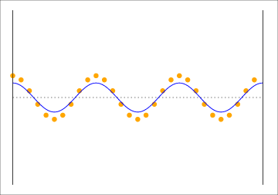
Drag-Release of a Plasma Block
Drag-Release Procedure,
leading to PDO
Trapping regime
F
Slow wave
regime
F_{di}
Wave-broken regime
R
F_{di}
T
Plasma
Slow plasma wave
0
t_{rel}
t
Plasma dipole oscillation
Plasma
AFAD 2023, Apr. 12 – 14, 2023, Melbourne, Australia

Slide 12
Maximization of Efficiency by Pulse Shaping
Efficiency can be enhanced by cutting out unnecessarily wasted pulse energy
F
Slow wave
regime
F_{di}
Wave-broken regime
R
T
0
t_{rel}
t
AFAD 2023, Apr. 12 – 14, 2023, Melbourne, Australia

Slide 13
Efficiency
Theoretical Upper Limit of the Conversion Efficiency
: velocity of the potential train
: laser pulse duration
: laser frequency
: plasma frequency
Efficiency is higher for higher frequency.
The maximum velocity of the potential train β_{φ} can hardly exceed 0.1
Long pulse duration τ leads to a high efficiency.
Presently, the ion motion seems to be the only limiting factor to increasing the pulse duration.
Assuming τ ~1 ps, we expect up to
η ~ 0.1
AFAD 2023, Apr. 12 – 14, 2023, Melbourne, Australia

Slide 14
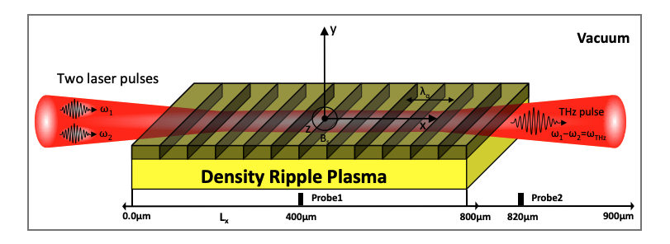
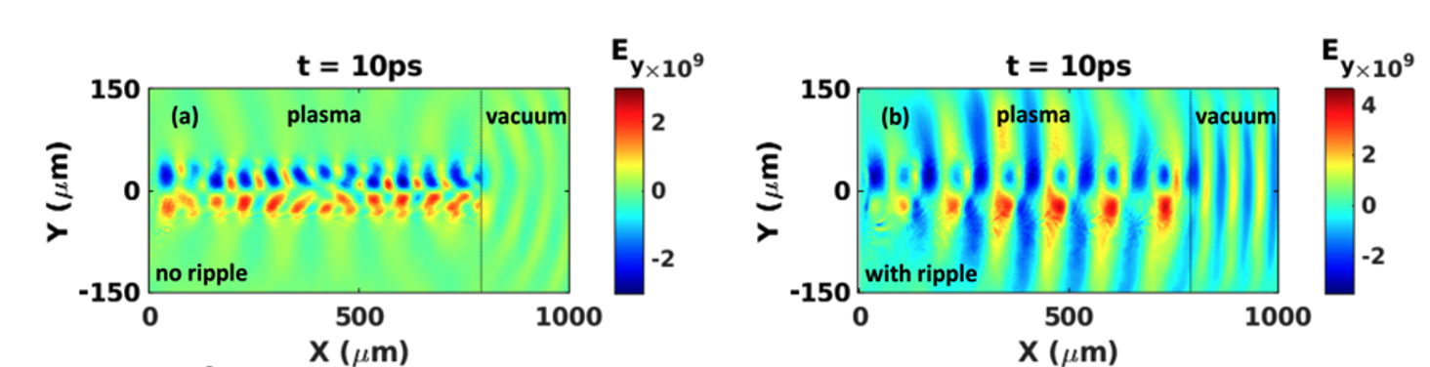
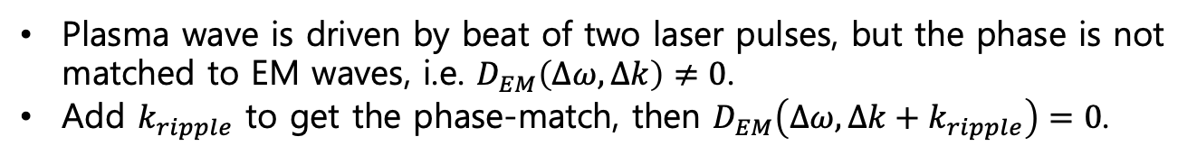
Density Ripple for Phase Matching
Add additional momentum for phase-match
Plasma wave is driven by beat of two laser pulses, but the phase is not matched to EM waves, i.e. $D_{EM}\left(Δω,Δk\right)≠0$.
Add $k_{ripple}$ to get the phase-match, then $D_{EM}\left(Δω,Δk+k_{ripple}\right)=0$.
M. Kumar, Phys. Plasmas 2021
AFAD 2023, Apr. 12 – 14, 2023, Melbourne, Australia

Slide 15
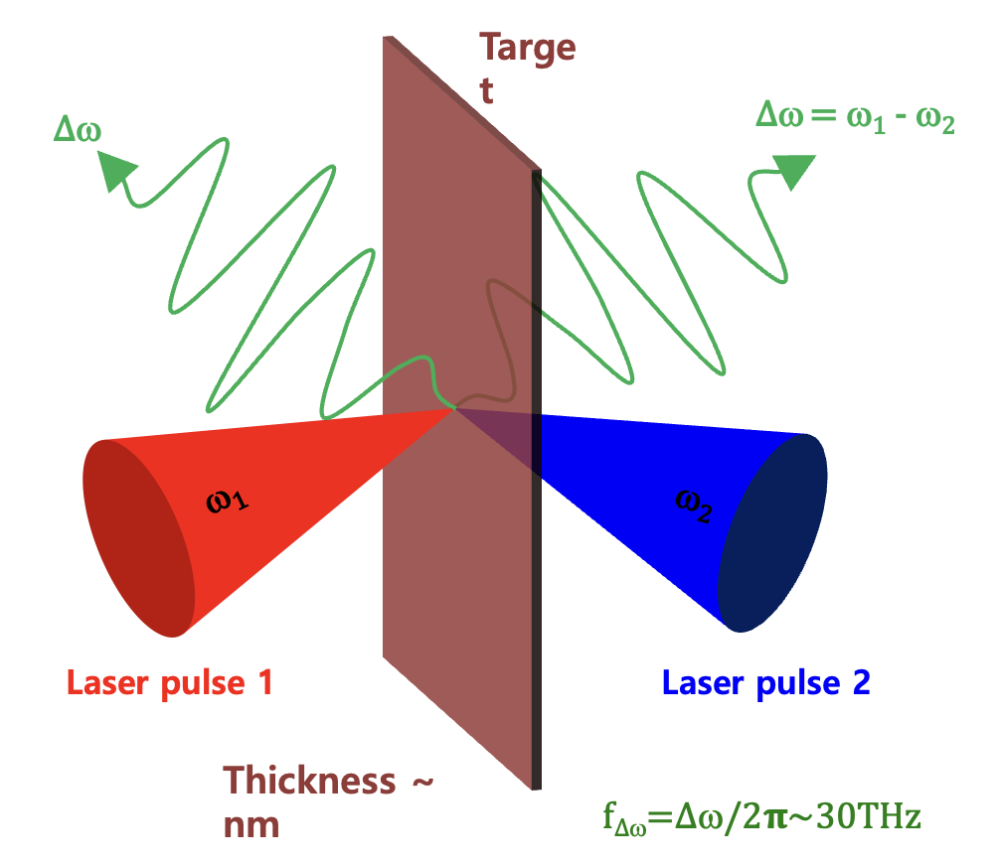
Thin-Film-Laser Interactions
M. Kumar et al., Sci. Rep. 2023
AFAD 2023, Apr. 12 – 14, 2023, Melbourne, Australia

Slide 16
Conclusion & Discussion
The hypothetical PDO could be brought to the real
world by a method of colliding laser pulses.
Practically the PDO can be a source of narrowband, highly-tunable, mJ THz pulses. Theoretically maximum of the efficiency reaches a few percent.
PDO concept has a well-organized path toward very high conversion efficiency (obtained up to 0.5 % from the simulation – manuscript under preparation) and strong THz field with a narrow spectrum.
Thank You
AFAD 2023, Apr. 12 – 14, 2023, Melbourne, Australia

