Slide 1
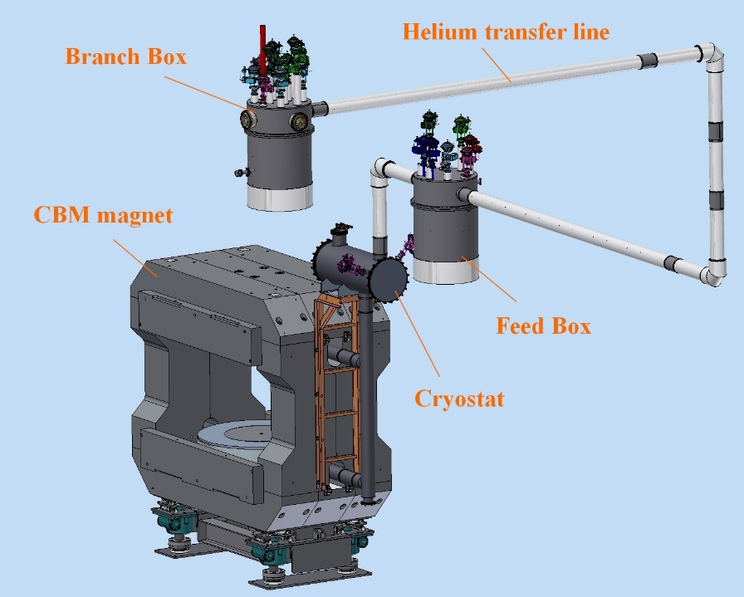
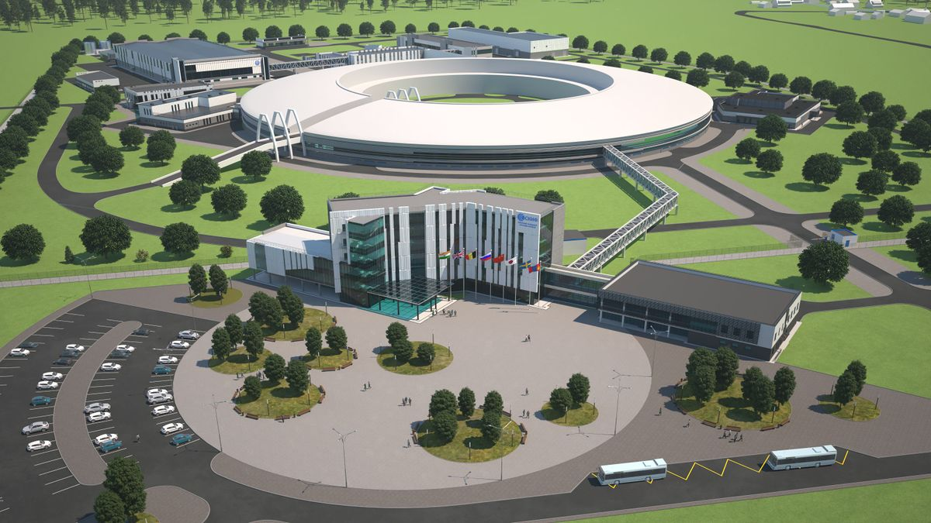
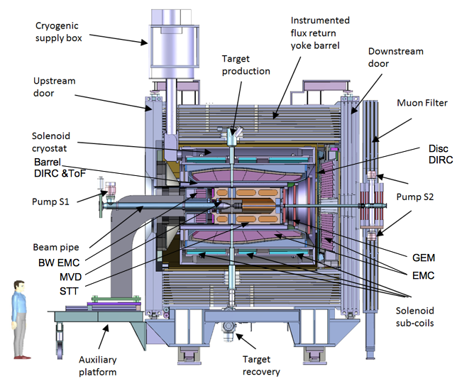
Overview of BINP works, Novosibirsk, Russia
SKIF light source is being built in Novosibirsk region
This is the 4+ generation type light source.
Energy 3 GeV, Accelerator length 476 m, Emittance 75 pm•rad
The operation should start in December 2024
It will be needed about 12 superconducting insertion devices.
Four SC insertion devices will be manufactured in 2023.
CBM magnet
Scope of BINP work
Superconducting magnets for CBM and PANDA detectors of FAIR facility are designed. The iron yokes are finished. The works are stopped.
The type of insertion device and the station number | Magnetic field, T | Period, mm | Number of poles | Radiation horizontal angle, mrad | Radiation power, kW
Undulator, 1-1 station | 1.25 | 15.6 | 128 | ± 0.32 | 7.66
Undulator, 1-2 station | 1.25 | 15.6 | 128 | ± 0.32 | 7.66
Undulator, 1-4 station | 1.6 | 18 | 111 | ± 0.46 | 11.75
PANDA solenoid

