Slide 1
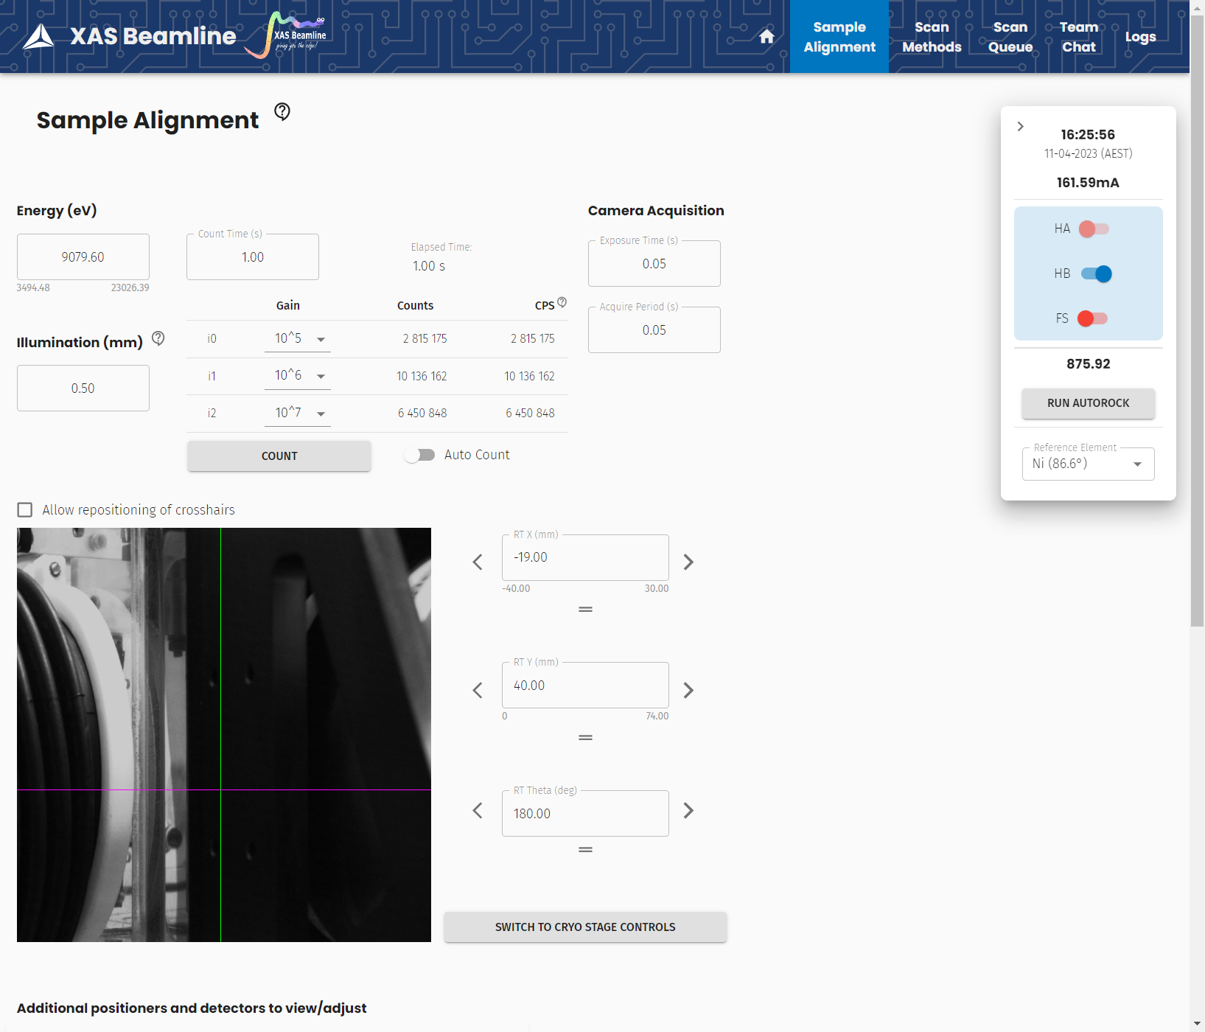
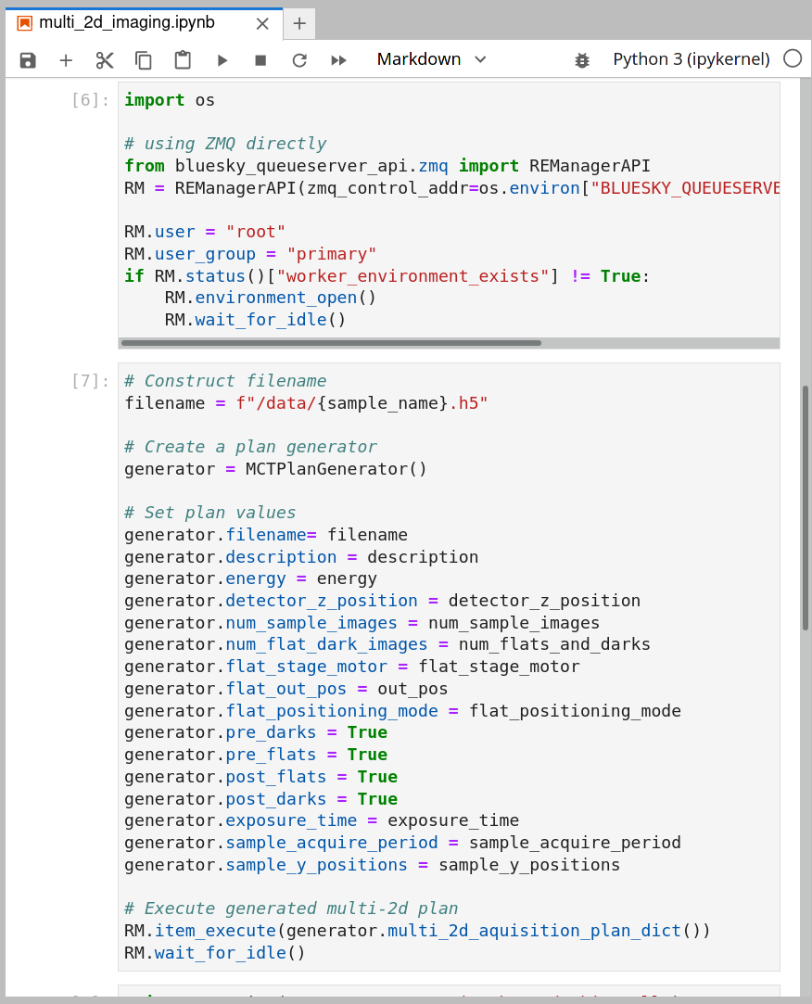
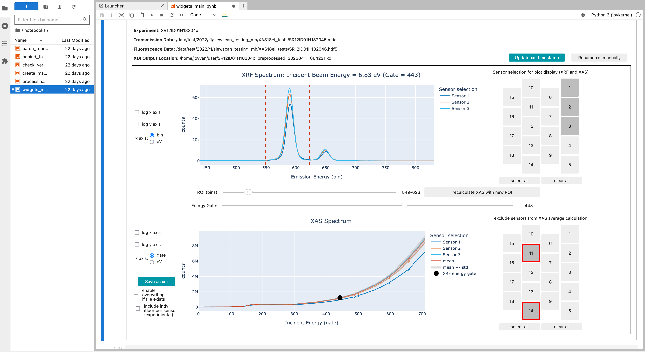
Scientific Computing at Australian Synchrotron
A new chapter of science
8 new beamlines
New, modern software stack
High throughput & automation
Focus on user experience
Reliable and fast
Industry standard tools where possible
Containerisation for reproducibility
IaC and Kubernetes for reliability
Established frameworks for data processing

