Slide 1
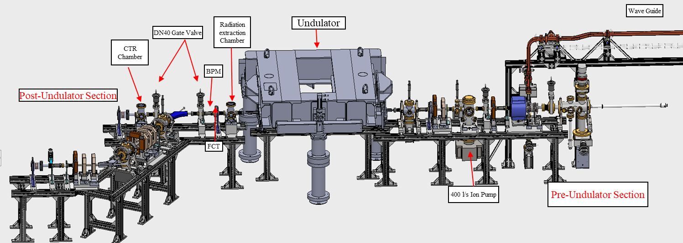
Commissioning status of Compact FEL-THz facility at IUAC and the first energy measurement of the electron beam
Subhendu Ghosh, Inter University Accelerator Centre, New Delhi. (The project is jointly supported by IUAC and DAE-BRNS)
Deliverables from FEL facility (Delhi Light Source) of IUAC
Results (10 March ’23)
THz Radiation
Input Power of RF gun (MW) | Acc. Field of RF gun (MV/m) | Mag. Field (BM#1) (Gauss) | Measured Energy of e-beam (MeV)
4 | 65 | 550 | 4.5
Frequency | Time width of the THz pulse train | Power of THz in one pulse train
(THz) | (ps) | (kW)
0.18 | 189.3 | 0.232
1 | 40 | 72
2 | 20 | 87.5
3 | 16 | 72
Electron beam
Time width | No. of electrons | Total electron current
~ 300 fs | 9.3 × 10⁷ | 75 A
1 sec. | 1.4 × 10¹² | 22.5 nA
12 | ~109 |  | 8
8 MeV is expected within a few months
Conclusion
DLS – Final stage of commissioning
Photocurrent e - beam: 4.5 MeV is measured
E-energy to be increased from 4.5 to 8.0 MeV
Beamline components, undulator are functional
Pilot experiment with e-beam will be performed
Demo of THz by undulator : by end of 2023

