Slide 1
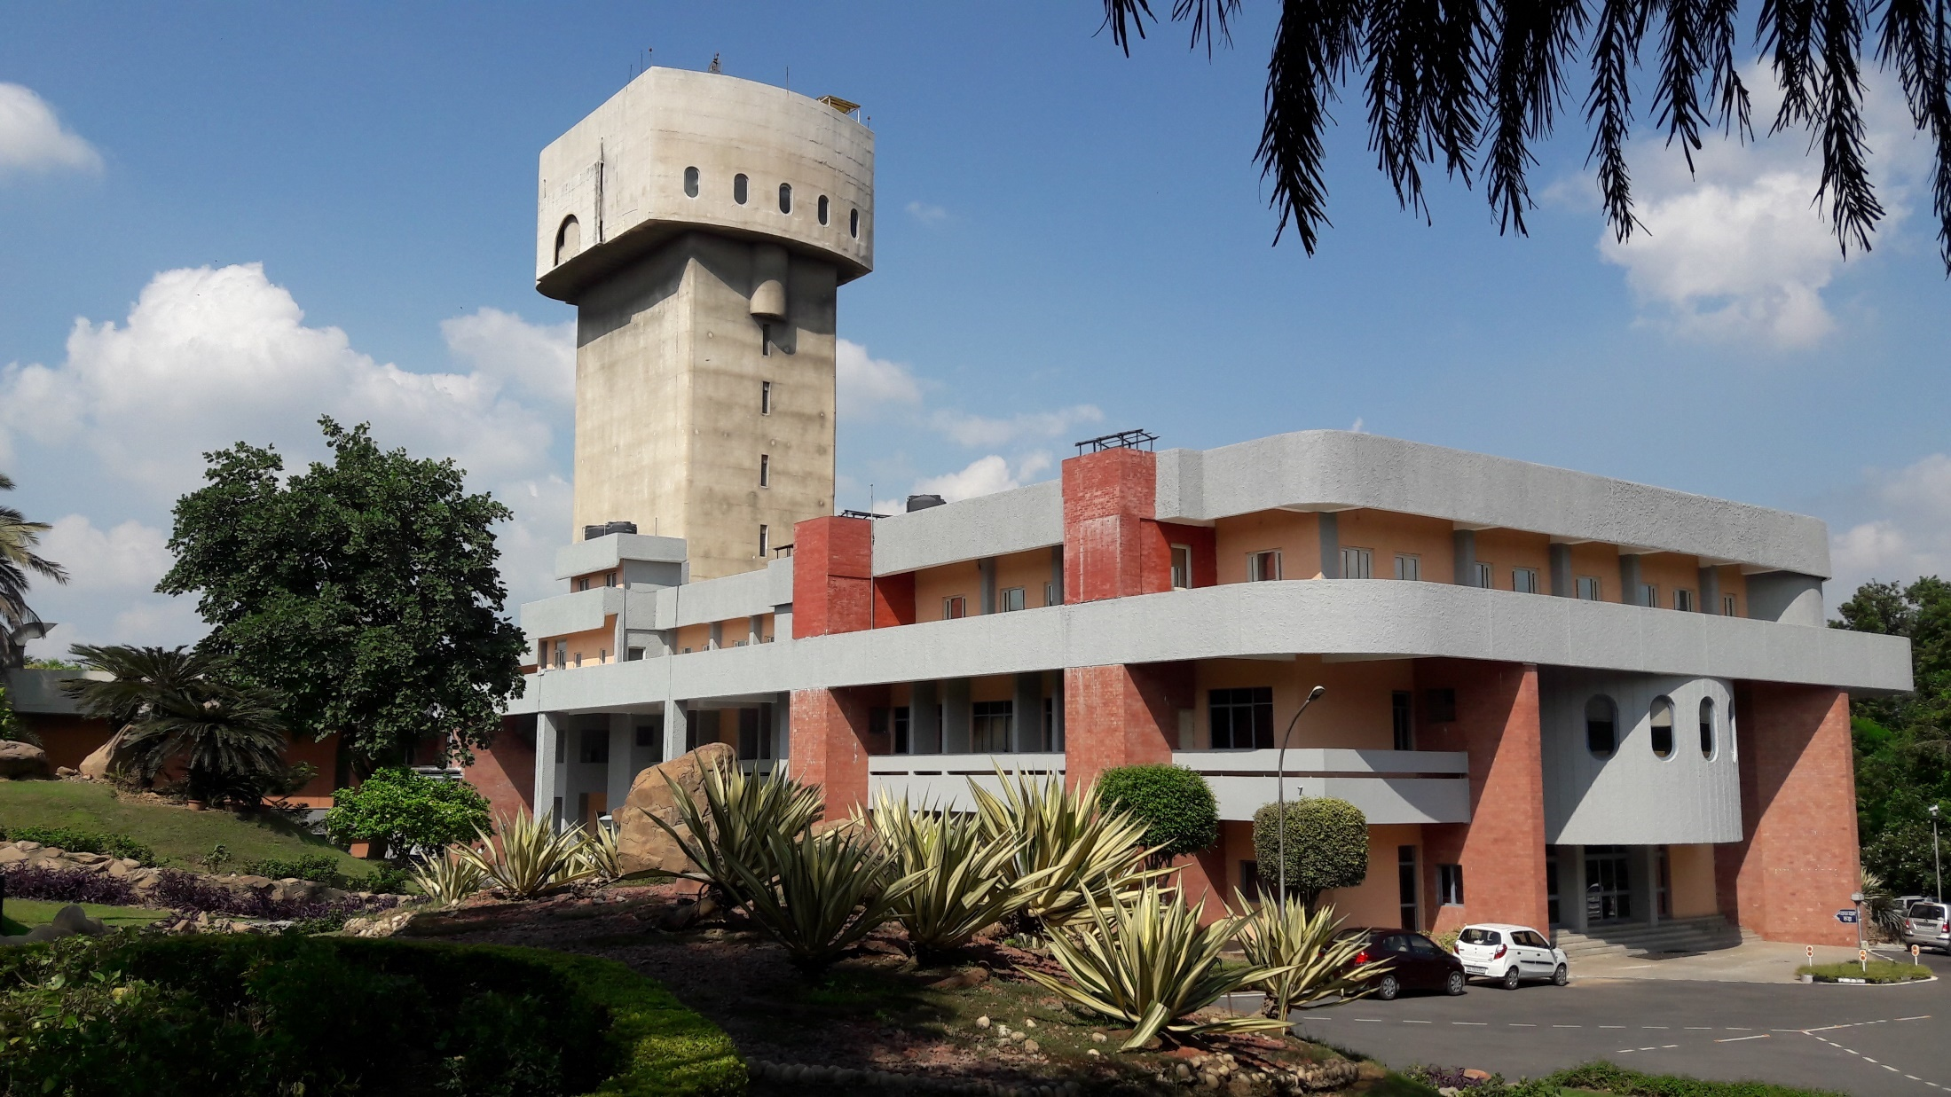
Commissioning status of Compact FEL-THz facility at IUAC and the first energy measurement of the electron beam
(The project is jointly supported by IUAC and DAE-BRNS)
Dr. Subhendu Ghosh
(on behalf of all the extended group members of FEL and all the national/international collaborators)
Inter University Accelerator Centre, New Delhi, India

Slide 2

Plan of Presentation
Outline of the Compact FEL facility at IUAC (Delhi Light Source)
First production of dark current and photocurrent electron beam
Ongoing commissioning status of the various sub-systems
Conclusion

Slide 3
Plan of Presentation
Outline of the Compact FEL facility at IUAC (Delhi Light Source)
First production of dark current and photocurrent electron beam
Ongoing commissioning status of the various sub-systems
Conclusion

Slide 4

Outline of the Compact FEL facility at IUAC
Compact FEL facility at IUAC – A Pre-bunched Free Electron Laser : How it is different from the conventional FEL?
Bunch length ~ 3 mm, E-energy = 7 MeV, Δt ∼ 10 ps onwards
t₀+Δt
t₀
t₀-Δt
7
6
5
S
3
2
1
Microbunching
in FEL
(Osc., Seeded and SASE)
Interaction of Photon and wiggling electron inside undulator magnet
7
6
CONVENTIONAL FREE ELECTRON LASER
5
7
6
5
S
3
2
1
3
2
λ_{U} – Undulator wavelength
B_{U} – Undulator mag field
1
Now all the electron disks emit radiation in synchronism, & the
light can amplify itself to form high-intensity laser radiation.
λ=wavelength of radiation

Slide 5
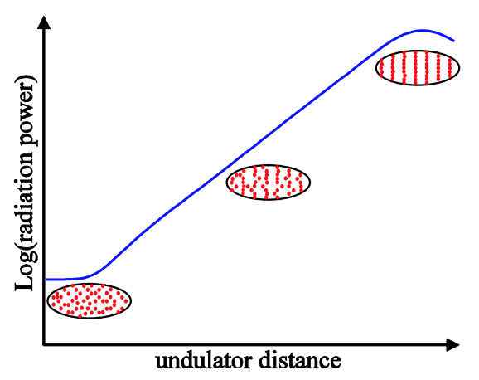
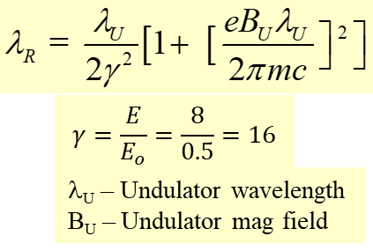
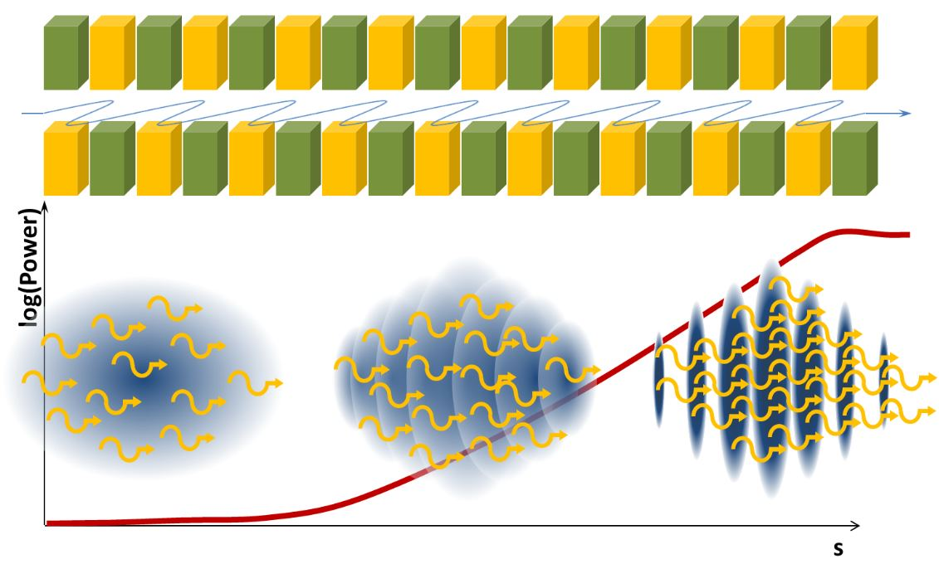
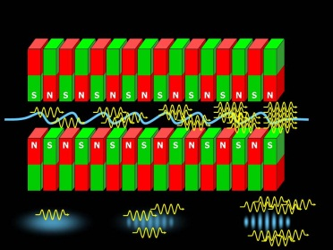
Outline of the Compact FEL facility at IUAC
Compact FEL facility at IUAC – A Pre-bunched Free Electron Laser : How it is different from the conventional FEL?
Starting point of Delhi Light Source
How can we produce
Micro-bunched
(‘Comb’) beam ?
Conventional FEL
Prebunched FEL (DLS)

Slide 6
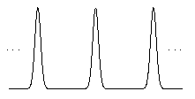
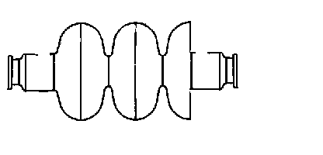
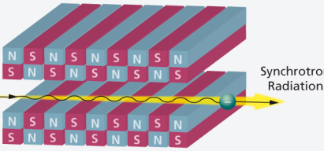

Outline of the Compact FEL facility at IUAC
Major components
10 Hz
Solenoid
Laser
Laser
beam
0.375 fs – 6.6 ps
Electron
beam
Undulator Magnet
Solenoid
An electron gun – laser operated PC & a resonator powered by klystron/modulator
A laser system – Ultra-short laser pulses – produces ultrashort electron bunches
– single ultrashort laser pulse is split into many (2,4,8,16)
3. Photocathode – Copper and Cs₂Te (Deposition system)
Solenoid, other electromagnets – focus/steer electron beam – Cavity to Undulator
5. Undulator – to produce THz radiation
6. Beam diagnostic and e.m. radiation detector systems
7. Electronics and Control system
$$γ=\frac{E}{E_{o}}=\frac{8}{0.5}=16$$
λ_{U} – Undulator wavelength
B_{U} – Undulator mag field

Slide 7
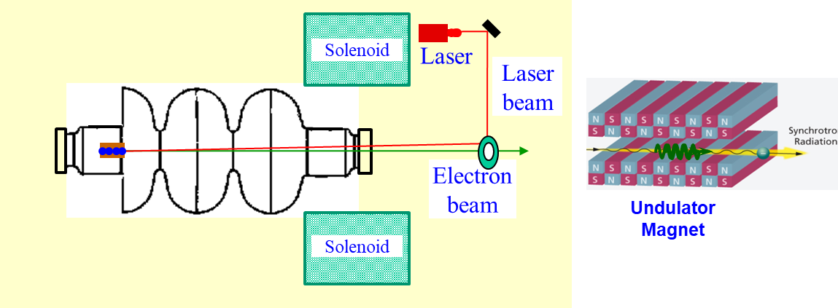
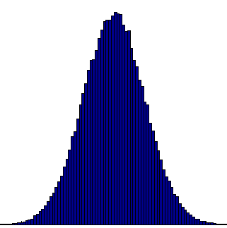

Outline of the Compact FEL facility at IUAC
Tuning of THz frequency
5 MHz
½ w plate rotates S-wave by 45º.
Polarizing beam splitter makes S-wave & P-wave by reflection & transmission.
16 micro bunched laser within 6-7 psec.
0.333-6.6 ps
f ~ 3 – 0.18 THz
T = 333 fs to 6.6 ps
λ = 100 μm to 2 mm
Laser pulses as well
Electron bunches
$$γ=\frac{E}{E_{o}}=\frac{8}{0.5}=16$$
λ_{U} – Undulator wavelength
B_{U} – Undulator mag field

Slide 8
Outline of the Compact FEL facility at IUAC
Scheme of Production of electron beam microbunches - Multi-bunch train of THz
~ 3 μs (RF width)
Total no. of laser
pulses (5 MHz)
are 15
1
15
200 ns
3 μs – nominal RF pulse width
6.25 Hz – Klystron/Mod freq.
Laser Osc. Frequency – 5 MHz
Laser splitting freq. – 3 / 0.18 THz
160ms (6.25 Hz)
~ 6 ps
1
16
333 fs (3 THz)
1
200 ns
2
15
3 μs
So total no. of laser micropulses/e-bunches/THz pulses 15 × 16 × 6.25 = 1500 pulses/sec

Slide 9

Outline of the Compact FEL facility at IUAC
Acceleration of multi-micro bunch train by proper phase of RF
3 μs
200 ns
349.65 ps
1
2
572
8580
6 ps
6 ps
6 ps
1
16
1
16
1
16
Resonator freq. = 2860 MHz, (T = 349.65ps), Laser freq. = 5 MHz, (T = 200 ns)
RF pulse duration = 3 μsec, Rep rate of RF = 3.125, 6.25 Hz up to 50 Hz

Slide 10
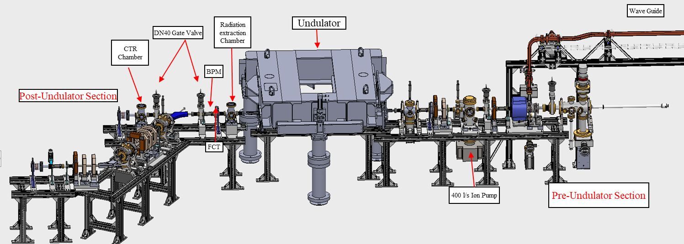
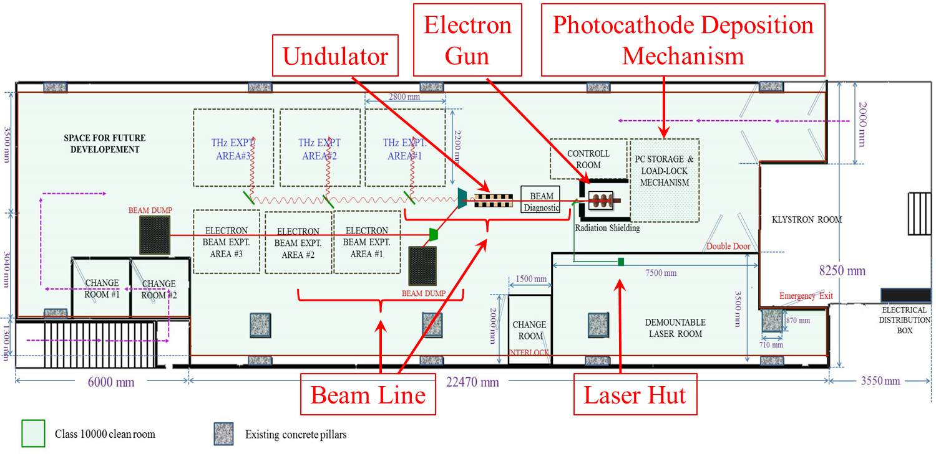
Outline of the Compact FEL facility at IUAC
FEL Beam Line
THz Expt. chambers
3
2
1
THz line
FEL Hall –
Class 10000
Clean room
Electron line

Slide 11
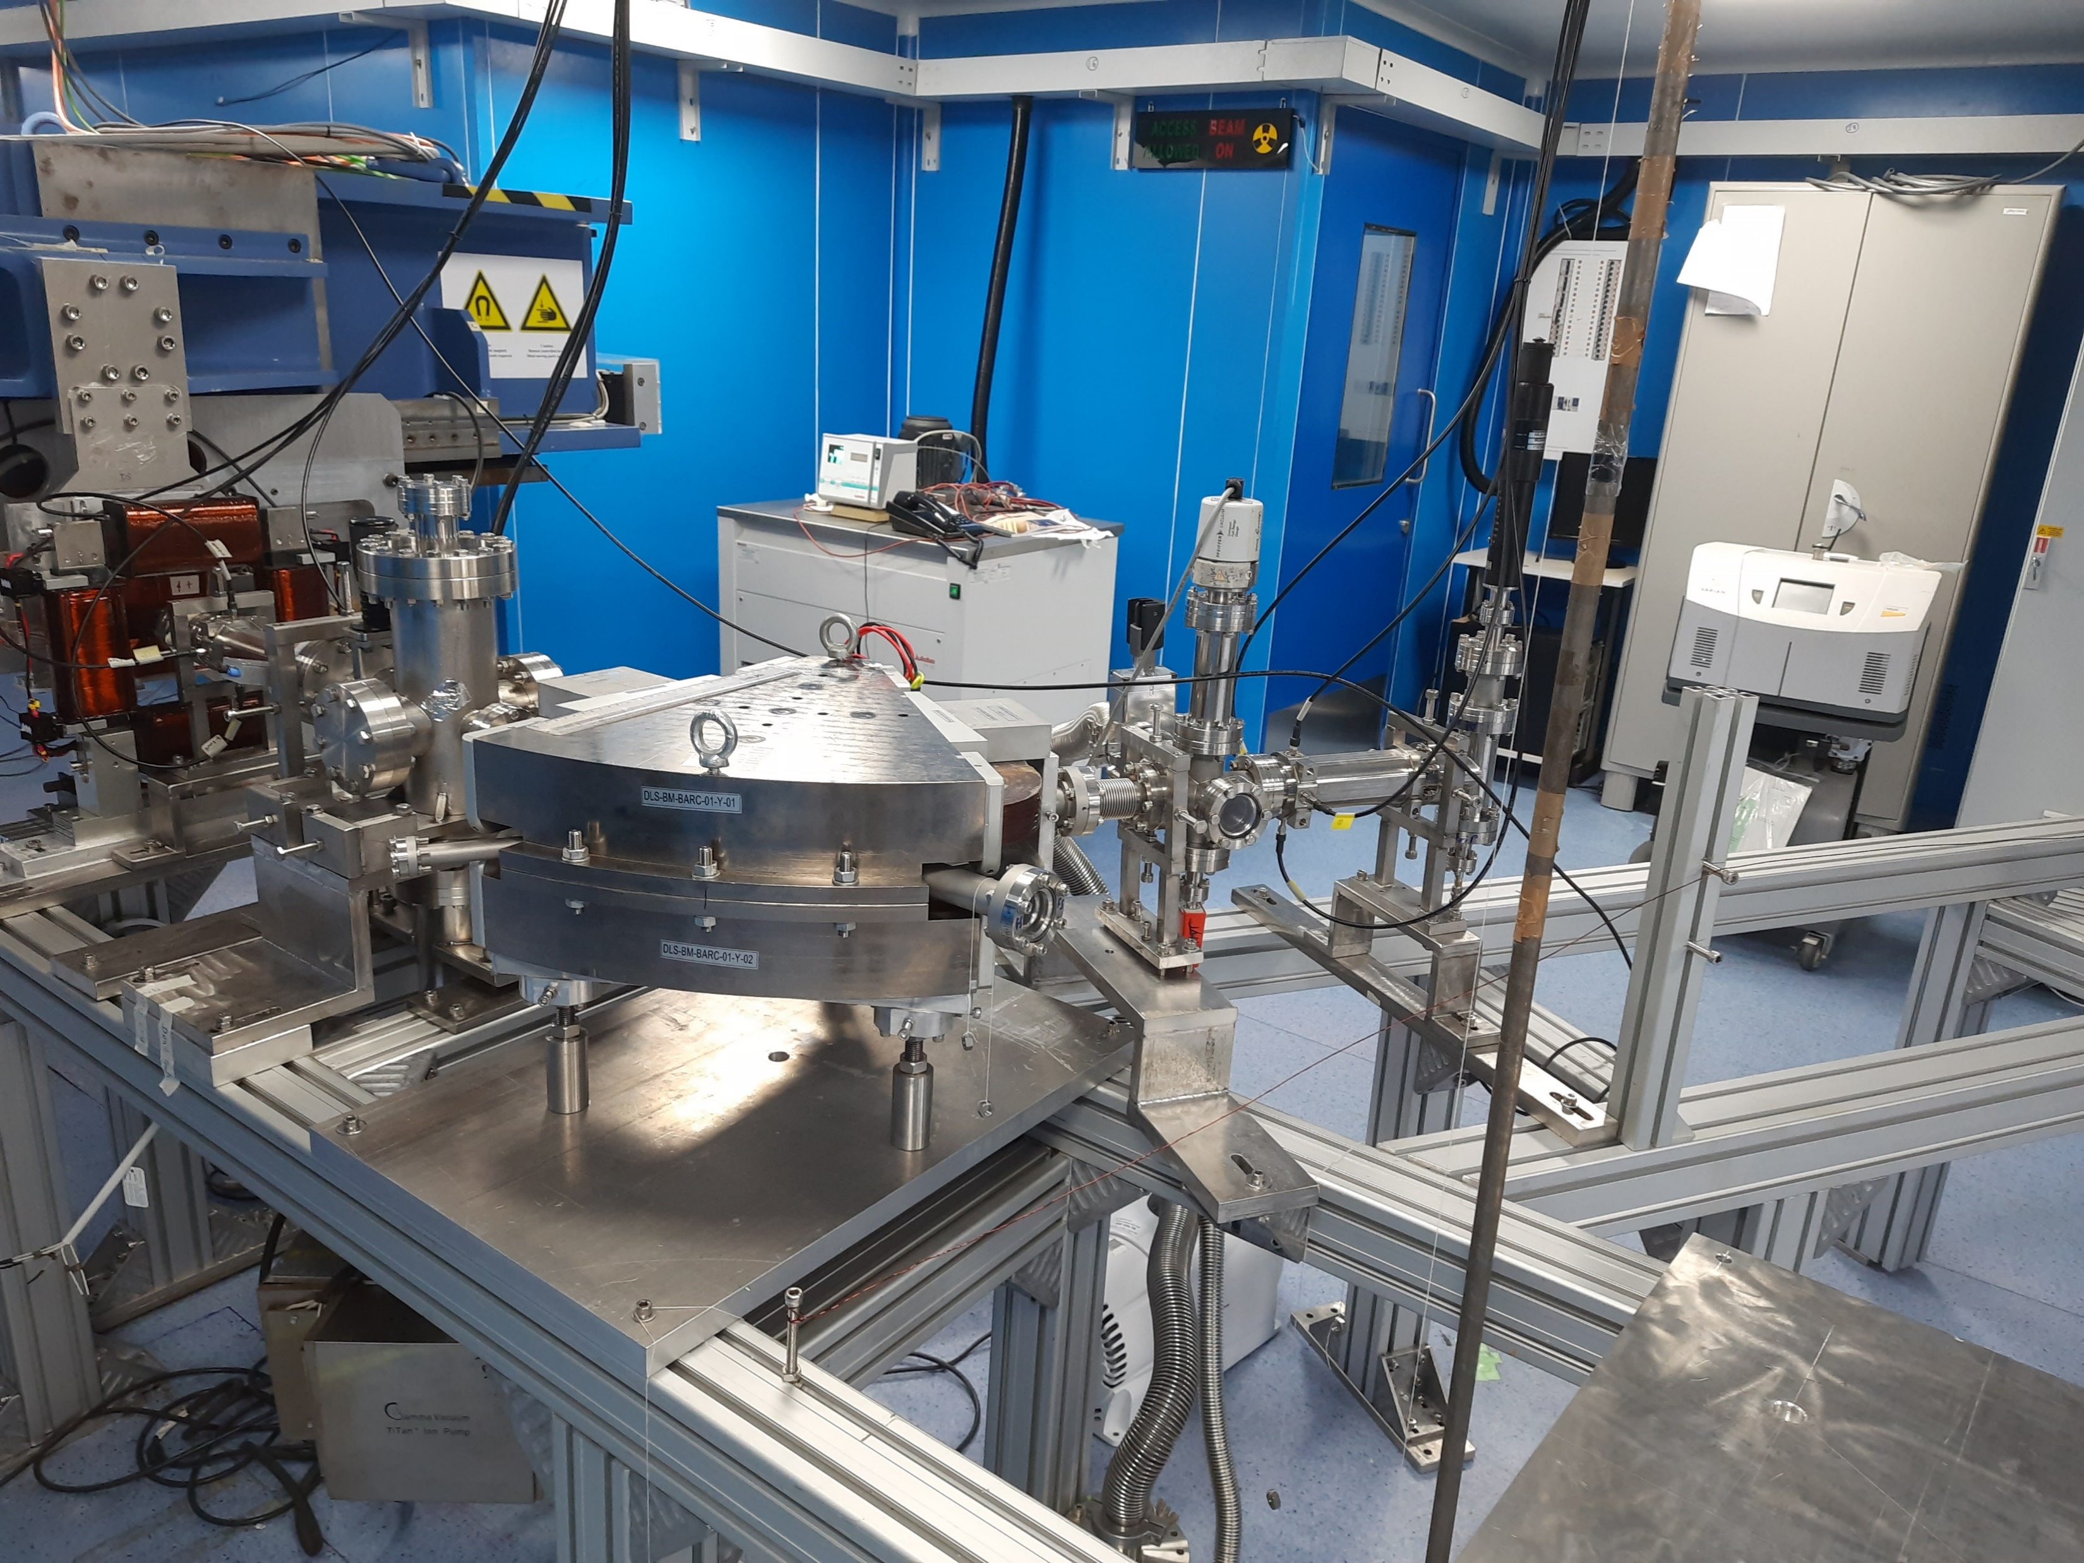
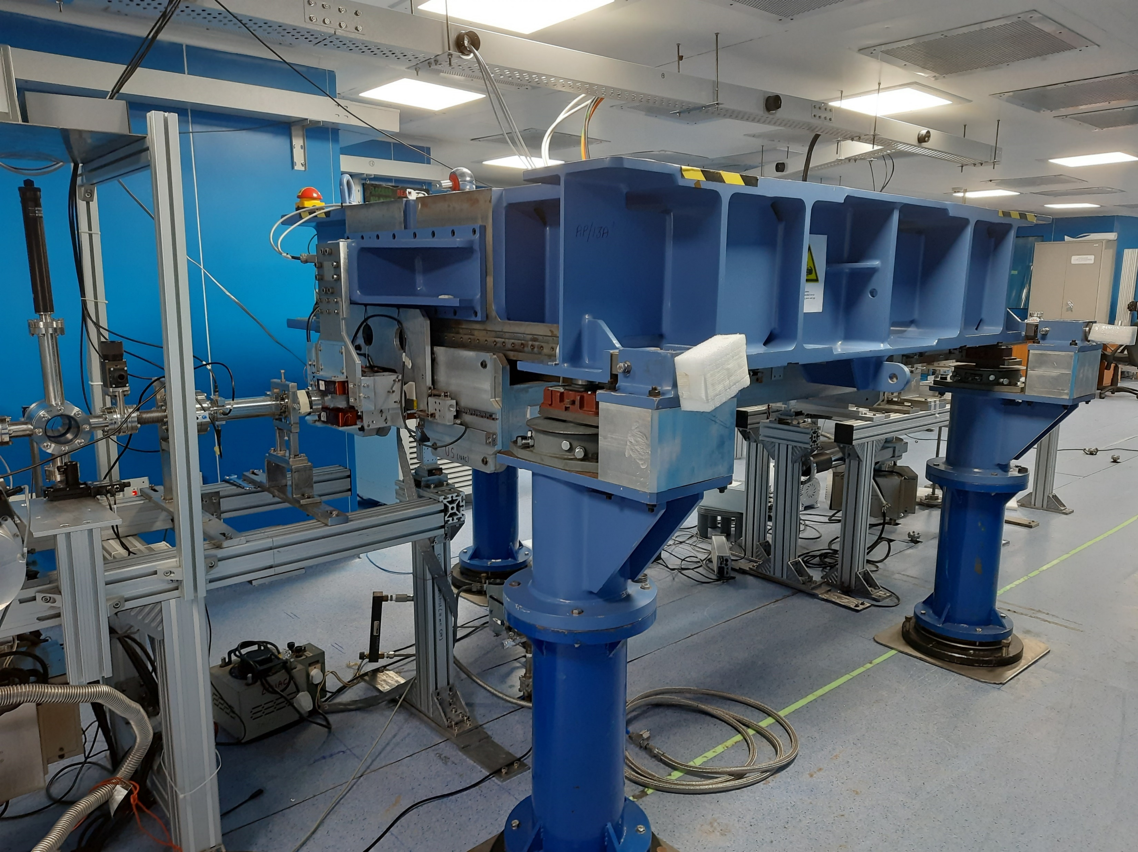
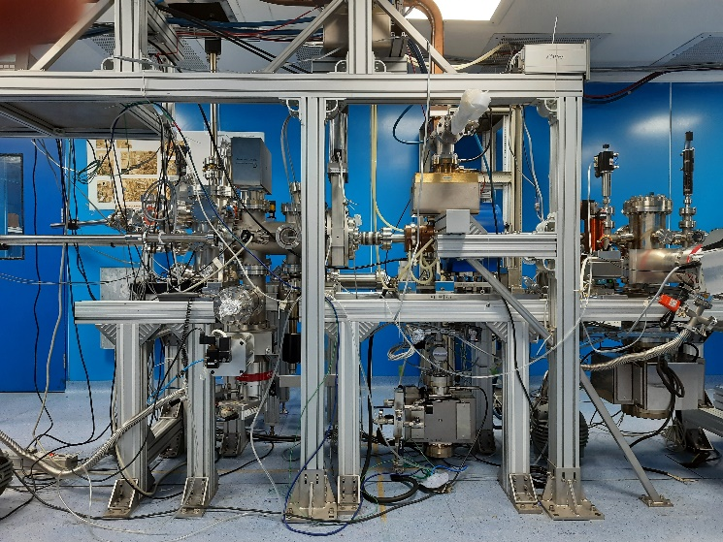
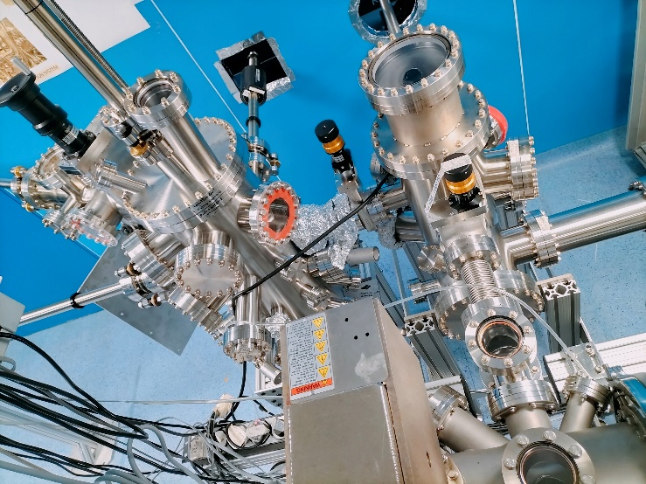
Outline of the Compact FEL facility at IUAC

Slide 12
Outline of the Compact FEL facility at IUAC
Expected Deliverables from FEL facility of IUAC
Time width | No. of electrons | Total electron current
~ 300 fs | 9.3 × 10⁷ | 75 A
~ 6 ps | 1.5 × 10⁹ | 40 A
~ 3 μs | 2.25 × 10¹⁰ | 1.2 mA
1 sec. | 1.4 × 10¹² | 22.5 nA
Electron beam
THz Radiation
Frequency | Wavelength | Energy of the THz pulse | Time width of the THz pulse train | Power of THz in one pulse train
(THz) | (mm) | (μJ) | (ps) | (kW)
0.18 | 1.66 | 0.044 | 189.3 | 0.232
0.6 | 0.5 | 0.7 | 60 | 11.6
1 | 0.3 | 2.88 | 40 | 72
1.5 | 0.2 | 1.88 | 26.6 | 71
2 | 0.15 | 1.75 | 20 | 87.5
3 | 0.1 | 1.15 | 16 | 72

Slide 13
Plan of Presentation
Outline of the Compact FEL facility at IUAC (Delhi Light Source)
First production of dark current and photocurrent electron beam
Ongoing commissioning of the various sub-systems
Conclusion

Slide 14
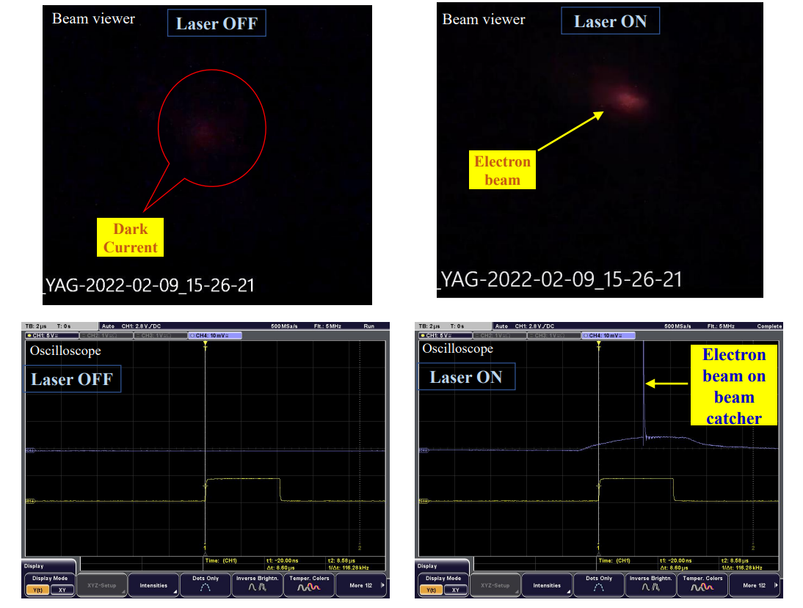
First production of dark current and photocurrent electron beam
First Photocathode electron beam on YAG screen
and beam Catcher (08 Feb 2022)
Solenoid
Laser
Laser
beam
Electron
beam
YAG
+
Beam
Catcher
Solenoid
The e-gun was only conditioned up to 1 MW
in absence of High Power Circulator

Slide 15
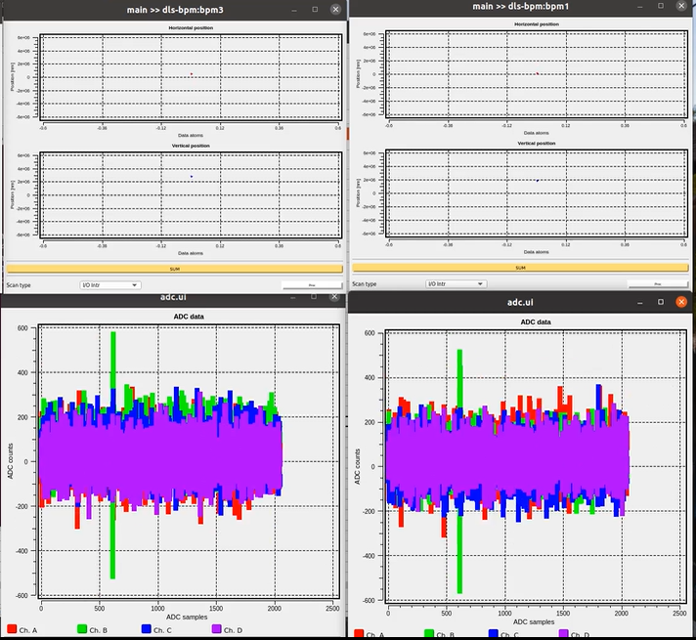
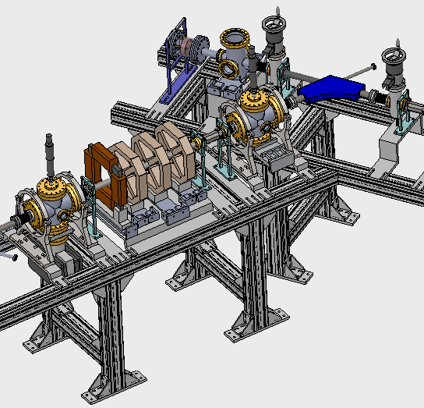
First energy (4.0 MeV) measurement of the electron beam from RF Photocathode gun of IUAC
e- beam direction
13 Feb. 2023
Bending Magnet #1
High Power Circulator
was installed in July 2022
BPM#3 (before BM)
BPM#4 (after BM)
BPM#4
BPM#3
Results (13 Feb. ’23)
Input Power of RF gun (MW) | Acc. Field of RF gun (MV/m) | Mag. Field (BM#1) (Gauss) | Measured Energy of e-beam (MeV)
3 | 56.5 | 500 | 4.0
Photoelectron

Slide 16
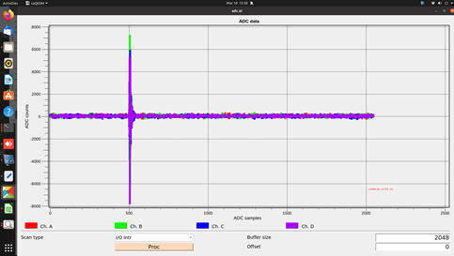
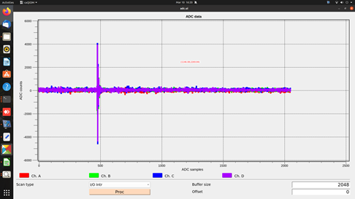
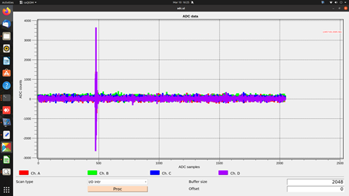
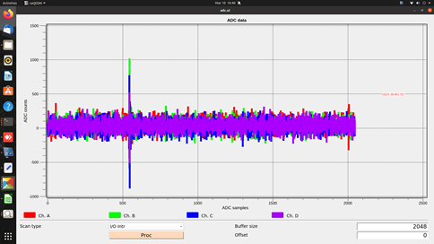
More energy (4.5 MeV) measurement of the electron beam
e- beam direction
10 March 2023
BPM#1
BPM#2
Bending Magnet #1
Results (10 March ’23)
Input Power of RF gun (MW) | Acc. Field of RF gun (MV/m) | Mag. Field (BM#1) (Gauss) | Measured Energy of e-beam (MeV)
4 | 65 | 550 | 4.5
BPM#3
BPM#4
12 | ~109 |  | 8
8 MeV is expected within a few months

Slide 17
First production of dark current and photocurrent electron beam
Achievements:
Photo-electron is produced and transported up to the Expt. Station after B.M.#1
Electron Energy is measured, already 56% of the designed value is achieved
A pilot experiment with the electron beam is being planned
Undulator is successfully characterized at IUAC and is fully operational
Demonstration of the first signature of THz is expected soon (by closing the jaws)

Slide 18
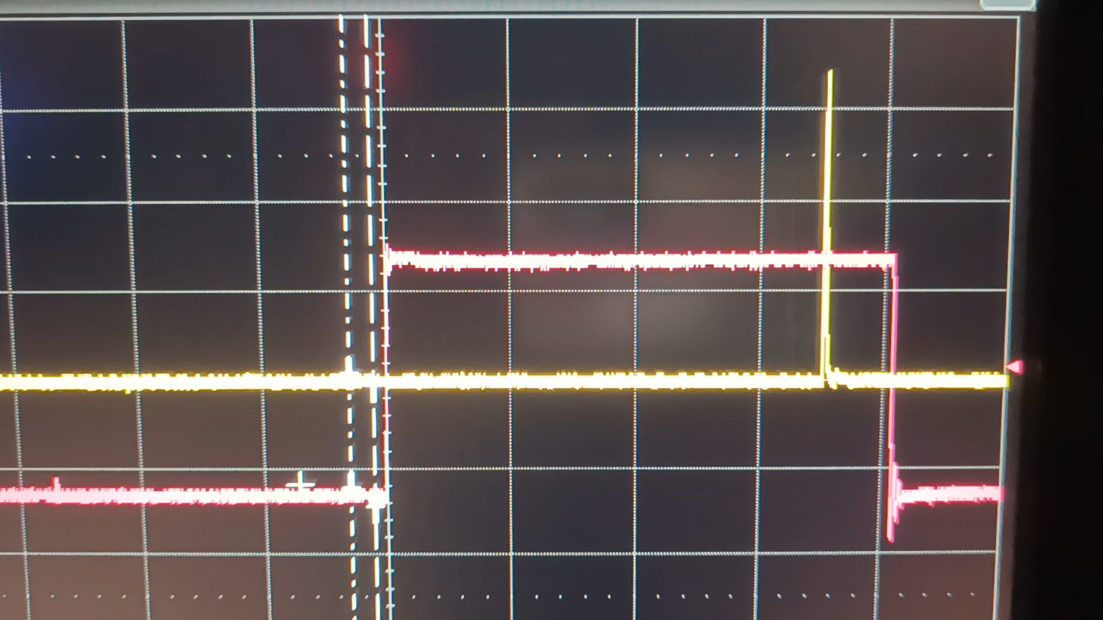
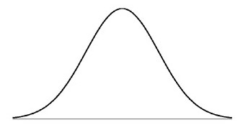
First production of dark current and photocurrent electron beam
Present limitations:
Presently nano-second laser pulse is producing the electron and occupies 3 RF period
No Phase synchronization between nano-second laser pulse with RF, Electron beam has long energy tail
The femto-second laser device will solve this
Installation of the femto-second laser system is expected during Oct-Dec. 2023
6 ps
30⁰
1
16

Slide 19
Plan of Presentation
Outline of the Compact FEL facility at IUAC (Delhi Light Source)
First production of dark current and photocurrent electron beam
Ongoing commissioning status of the various sub-systems
Conclusion

Slide 20
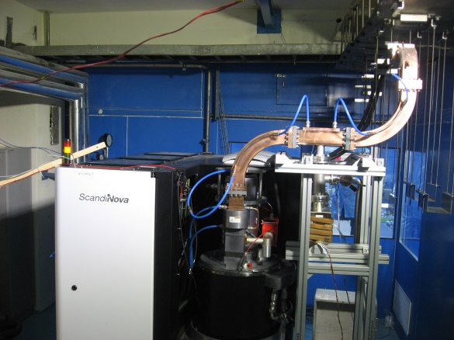
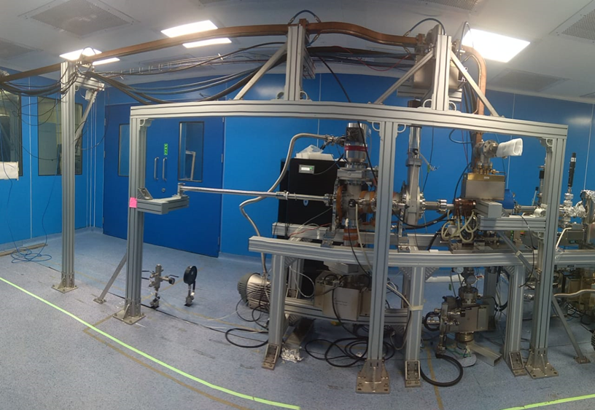
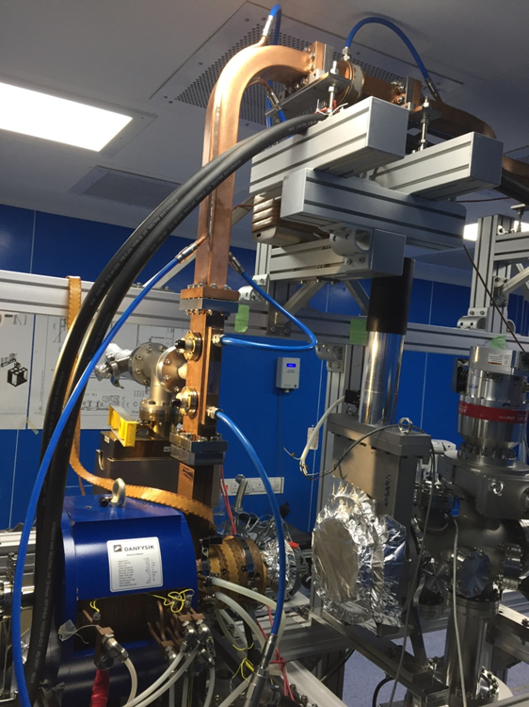
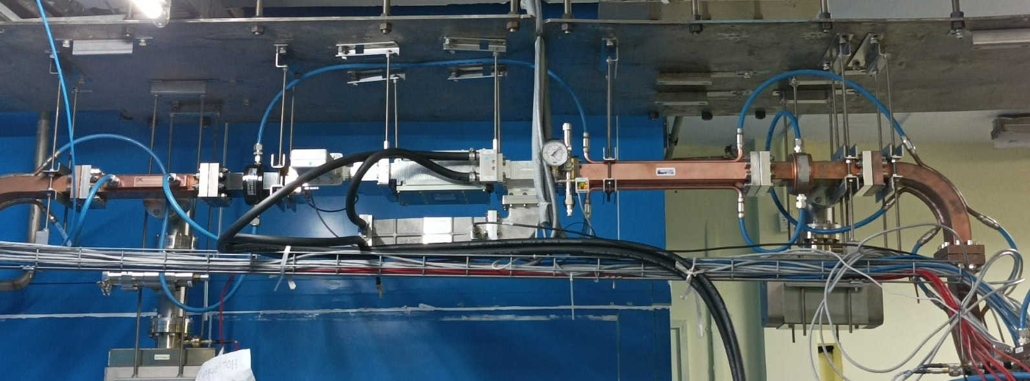
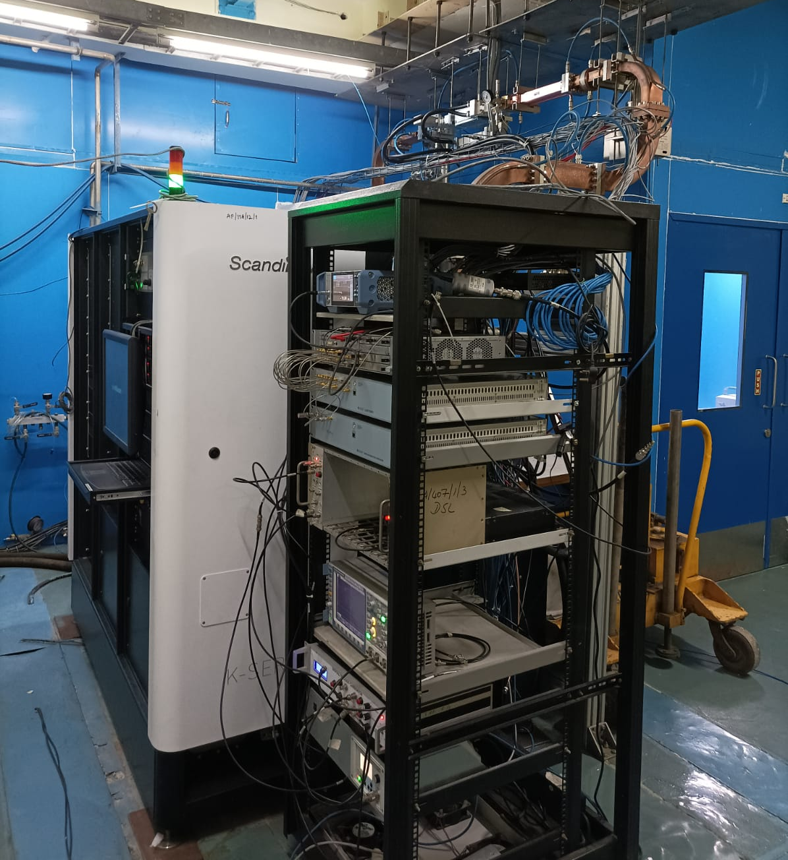
Ongoing commissioning status of the various sub-systems
High power RF System of DLS
Specifications:
Consists of solid state modulator based Klystron
Peak Power = 25 MW, 4µs pulse, 50Hz rep. rate
Vacuum based wave guide section
Klystron & Modulator
Waveguide connection
Inside the FEL hall
Status in 2019
A DUMMY WAVEGUIDE SECTION WAS CONNECTED
IN PLACE OF VACUUM CIRCULATOR
Waveguide & e-gun
connection
SF₆ based
Circulator
Chronological developments:
RF conditioning was accomplished w load at 25 MW, 4µs, 50 Hz (2019)
Vacuum Circulator could not be installed. Proposed SF₆ circulator.
SF₆ based Circulator could be installed only in July 2022.
Conditioning of e-gun could be started beyond 1 MW after July ‘22
Present power reached 5 MW (4 µs), 8.5 MW (1.2 µs)
Status in
July 2022

Slide 21
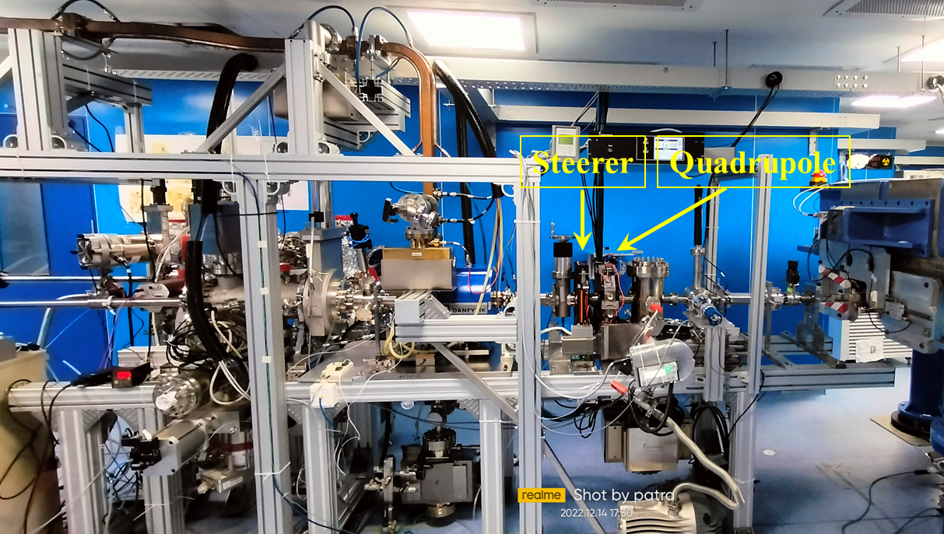

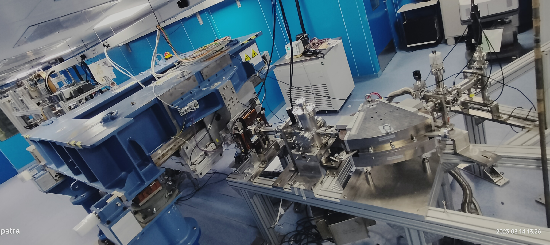
Ongoing commissioning status of the various sub-systems
Undulator
BPM#3
BPM#4
ICT#2
BM#1
ICT#1
Photocathode deposition
system
BPM#1
Electron Gun
BPM#2
Steerer

Slide 22
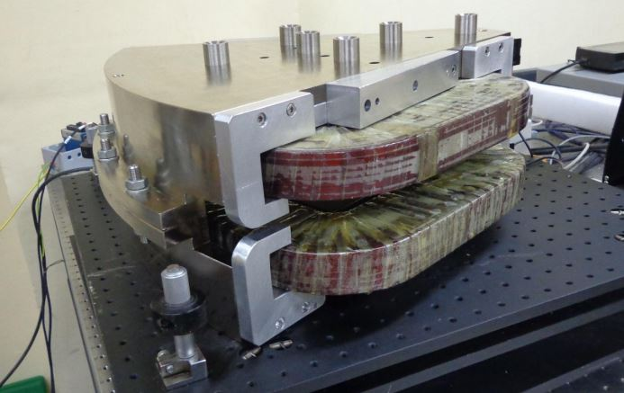
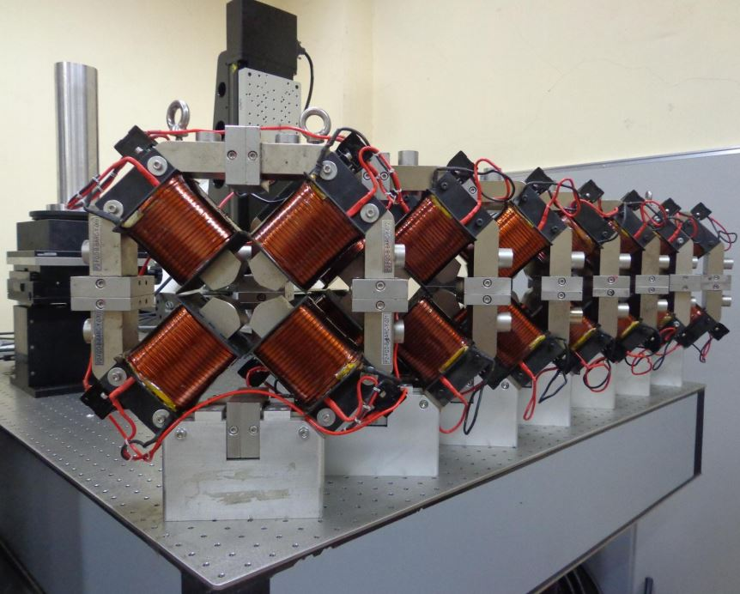
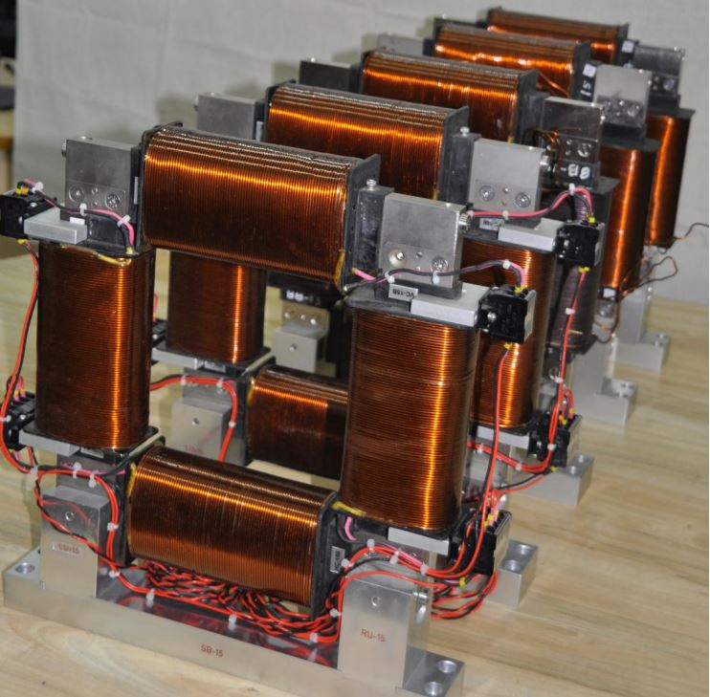

Ongoing commissioning status of the various sub-systems
Dipole, Quadrupole and Steering magnets
2 BMs, 7 Quads, 5 steering magnets
are designed and developed at
Electromagnetic Applications
and Instrumentation Division,
BARC in record time.
Magnets arrived at IUAC
on 24 Jan. 2020
Thanks to Shri Sanjay Malhotra & his team, BARC
P.S. of all the magnets - IUAC

Slide 23
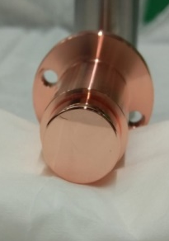
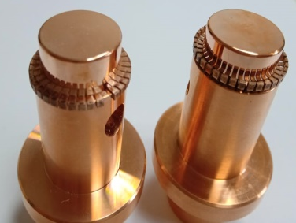
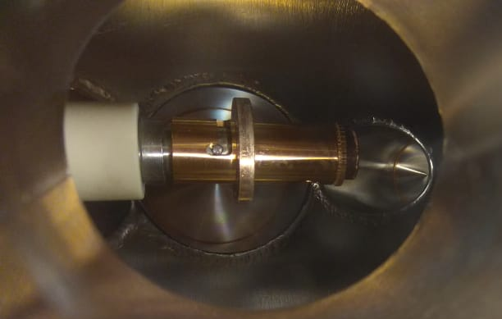
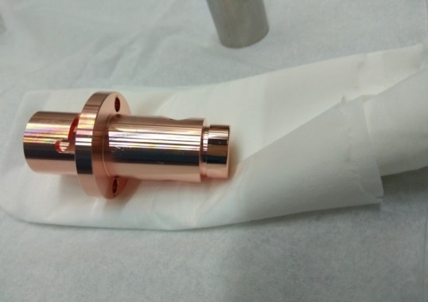
Ongoing commissioning status of the various sub-systems
DLS: Photocathode (Cu – Initial, Cs₂Te - final)
Initially metal (Cu) photocathode is being used for electron beam generation.
In later stage, semiconductor photocathode will be used for higher beam current.
Present status:
One Cu PC was inserted into the RF cavity and RF conditioning has been started.
First electron beam from Cu photocathode has been demonstrated.
Deposition system for Cs₂Te photocathode is commissioned, deposition will start soon
Polished surface
Cu-Be Spring for RF contact
Cathode plug during inserting into RF gun

Slide 24
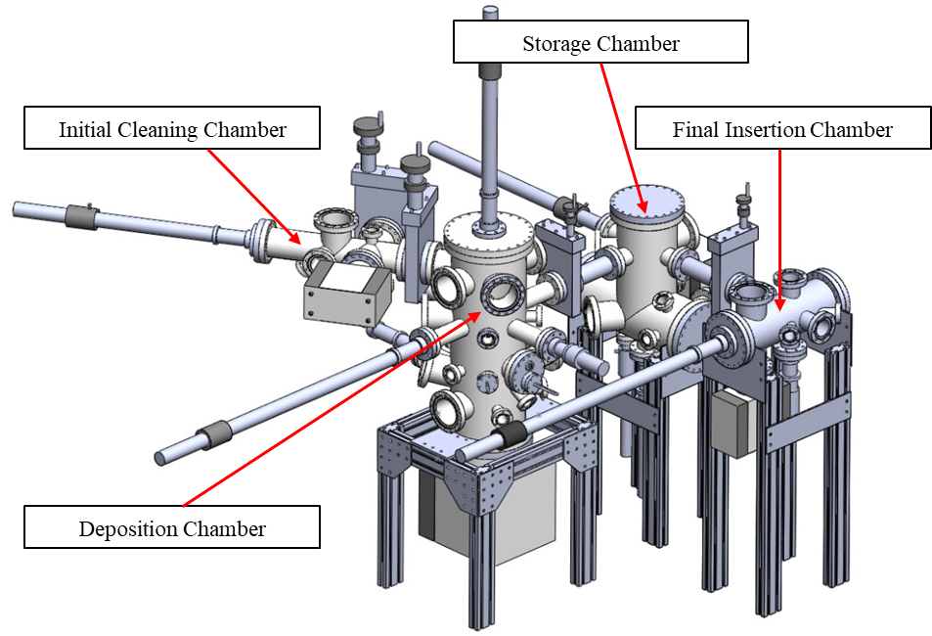
Ongoing commissioning status of the various sub-systems
Photocathode Deposition System designed by IUAC, fabricated at BNL, USA, with participation of IUAC.
The system was arrived at IUAC in July’21. It was commissioned and first deposition is expected – by 2023.
Salient features of PC deposition System:
System consists of 4 XHV chambers inter-connected to each other.
Operating vacuum ~ 10⁻¹¹ mbar.
Capable to develop mono and/or multi-alkali advanced photocathodes
by co-evaporation process.
Capable of (a) in-situ thickness monitoring,
(b) Q.E. measurement during the deposition process
(c) heating and cooling arrangements of the substrate etc.
Movement/transfer of the cathode plug from one chamber to another.
Temperature calibration on Mo plug is presently going on
CsTe deposition is expected to be started in next few months

Slide 25
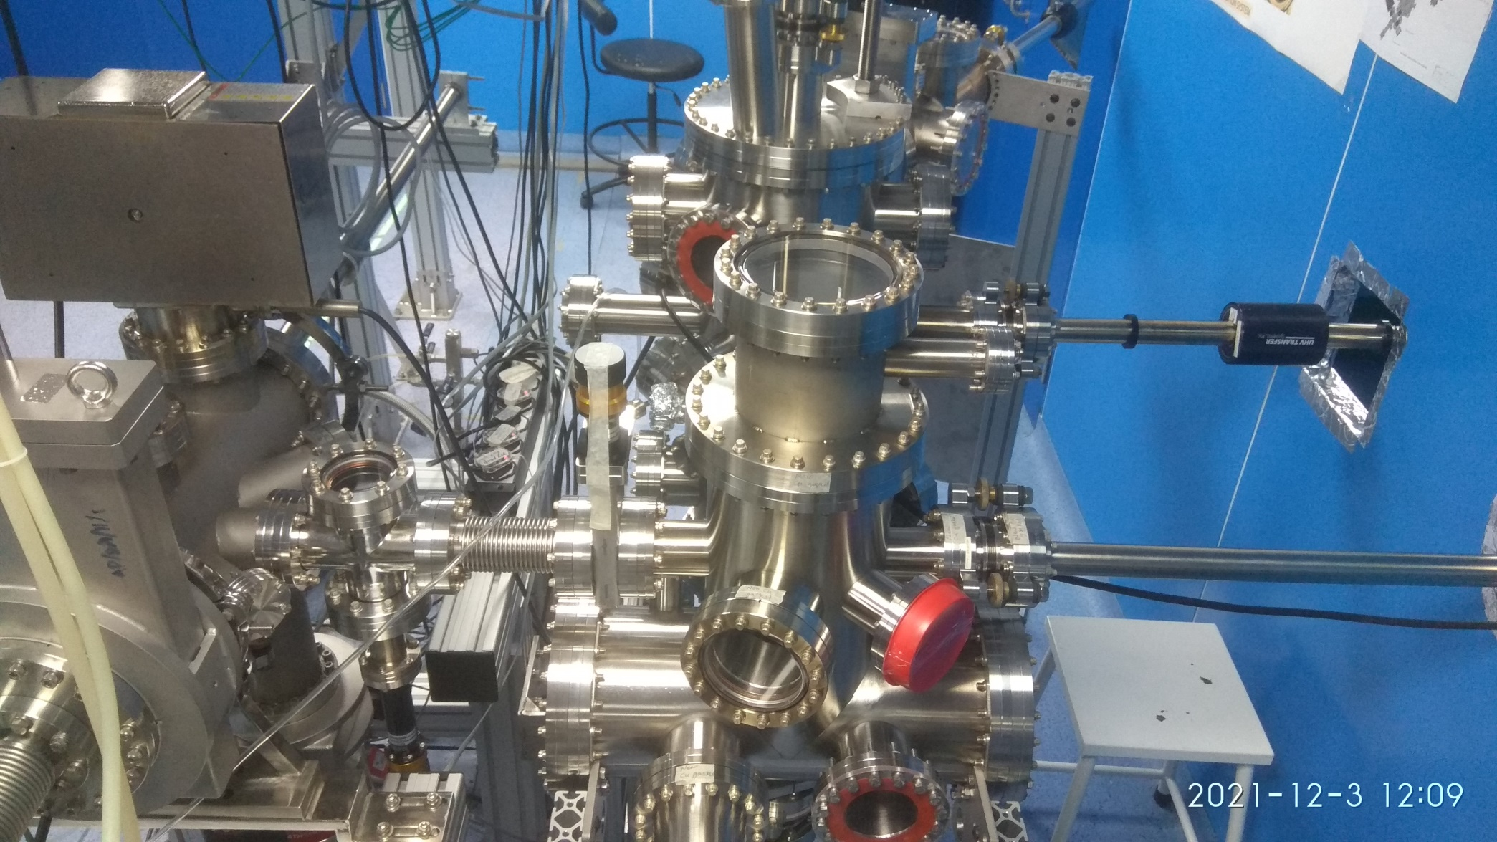
Ongoing commissioning status of the various sub-systems
Photocathode Deposition System
Deposition Chamber
Initial cleaning Chamber
Magnetic manipulators
PC Insertion Chamber
Storage Chamber

Slide 26

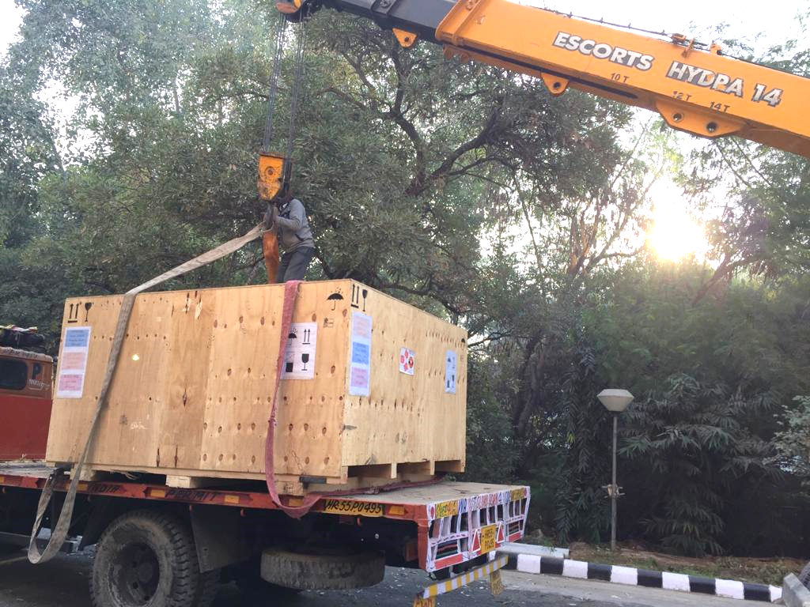
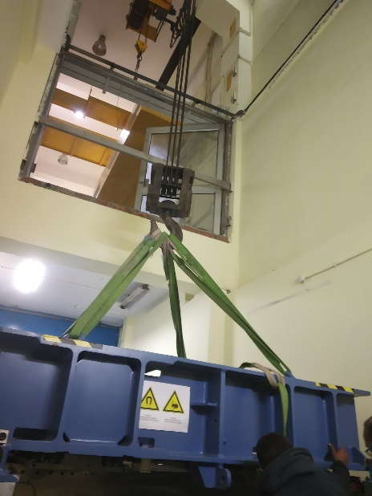
Ongoing commissioning status of the various sub-systems
Arrival and Commissioning of the Undulator (donated by HZB (BESSY), Refurbished at DESY) at IUAC
Undulator (U48) along with its other accessories reached IUAC on 25th December, 2020.
Current Status: Field measurement was done at IUAC (reported in InPAC2022),
Was commissioned and aligned in the beam line. It is ready to produce THz
Undulator

Slide 27
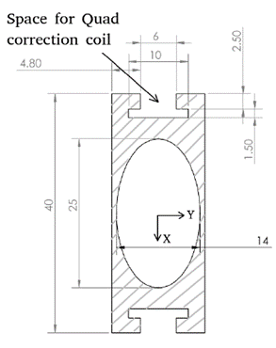
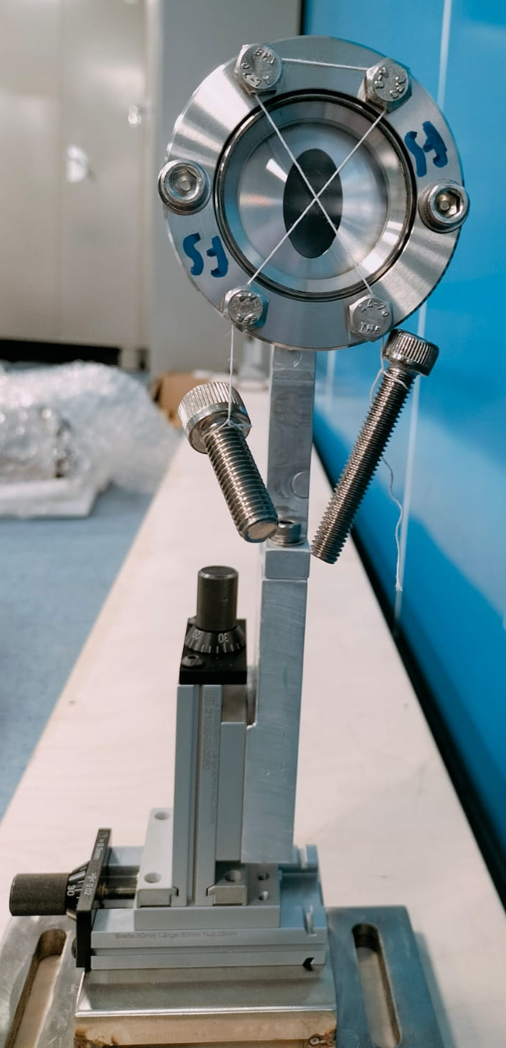
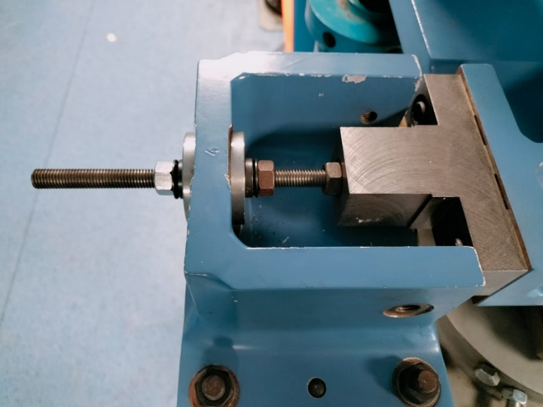
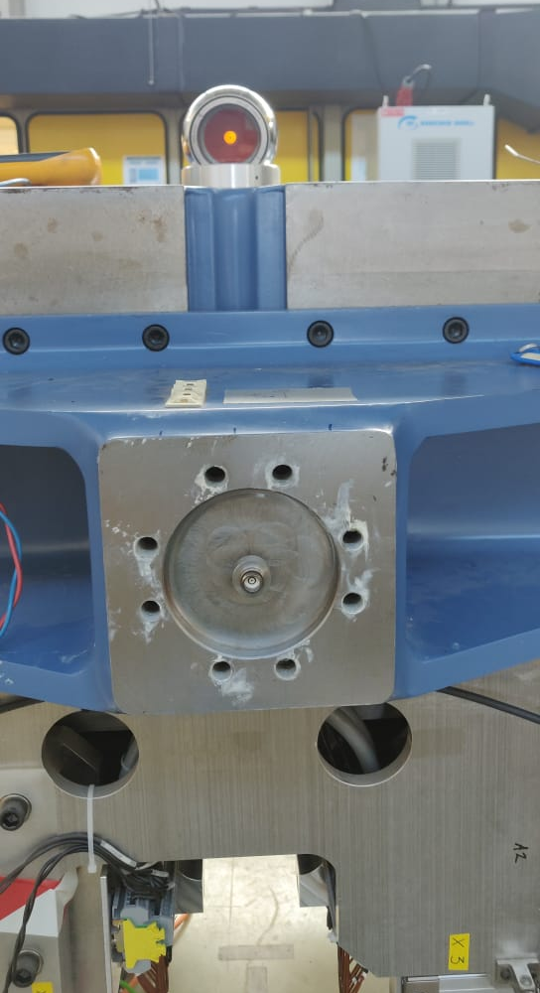
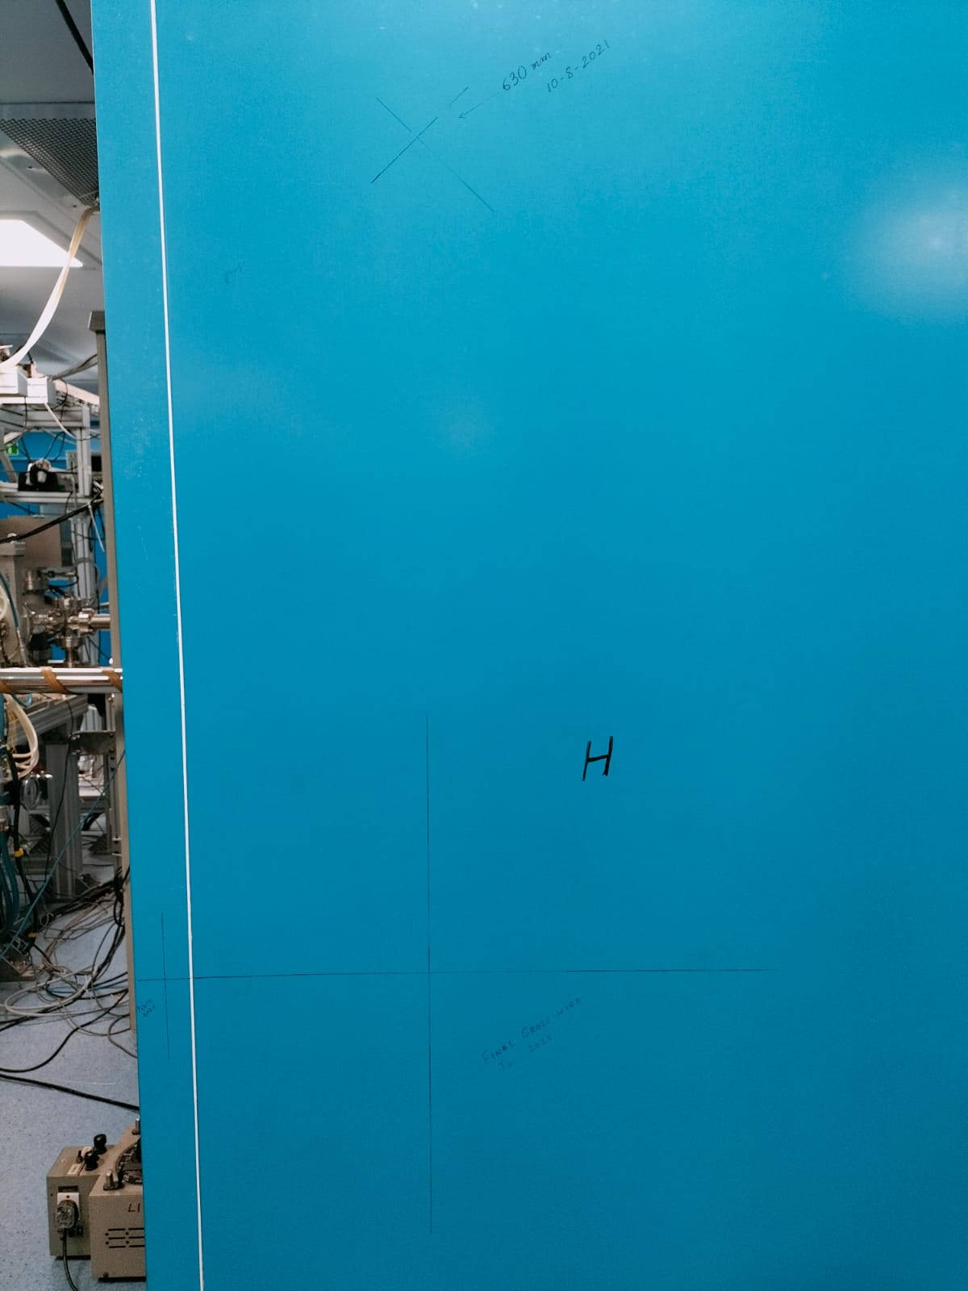
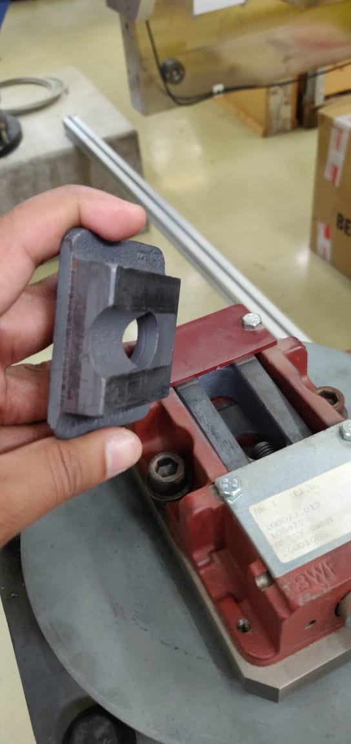
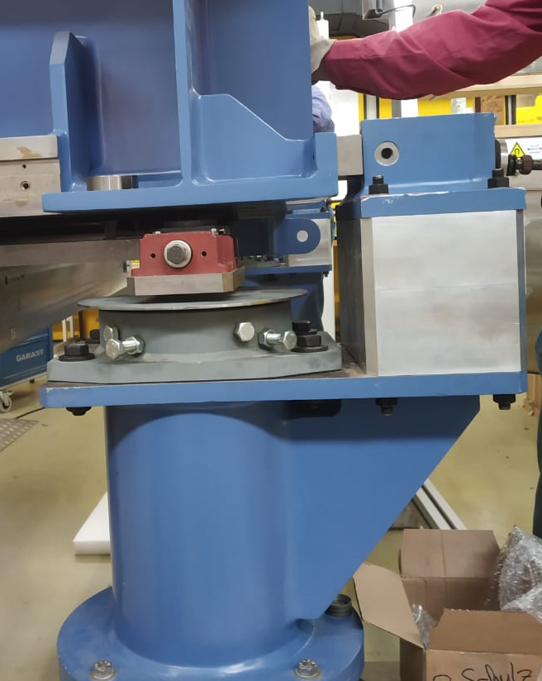
Ongoing commissioning status of the various sub-systems
Alignment of U48
Using Distance between Taylor-Hobson Fiducials and Magnet Centre (Beamline Height)
Vacuum chamber alignment
Horizontal Alignment bolt
Alignment Fixture
Linear Stages
Outer dimensions:
15.2 mm (Hor.) x 40 mm (vert.)
Inner dimensions:
14 mm (Hor.) x 25 mm (Vert.)
Length ~ 2500 mm
U48 in beam line
Wall reference
Final positioning of the magnet is done in 2023 after alignment/installation of vacuum chamber

Slide 28
Ongoing commissioning status of the various sub-systems
The Fiber laser system of DLS is currently being developed in collaboration with KEK, Japan with the active participation of three young personnel of IUAC under the supervision of RRCAT personnel
The major parameters
266nm laser pulse with time width ~ 200-300fs, Initial goal ~ 500 fs
Laser pulse energy at 266nm ~ 10 μJ, Initial goal is 1.5 μJ
Splitting the laser pulse into 2,4 and farther maximum upto 16 micropulses, Initial goal is 4 micropulses
Stable synchronization with the master clock which drive the electron gun
Electron gun is powered with 2860 MHz master clock with a 4 microsecond RF window. The laser pulses should be present inside this RF window with proper synchronization of master clock.
Case | Copper PC | Cs₂Te PC
Charge/μbunch (pC) | 3 | 15
No. electrons/μbunch | 9.38e+07 | 9.38e+07
Q.E. of PC | 1.0 e-05 | 1.0 e-03
No. photons required | 9.38 e+12 | 9.38 e+10
Photon energy required | 1.5 μJ | 72.6 nJ

Slide 29
Ongoing commissioning status of the various sub-systems
Pre-pre amplifier Yb doped fiber
Gain 30X
1030 nm wavelength
Bandwidth 25 nm
Pulse duration 2ps
Stretcher
(Gratings)
50% energy loss
bandwidth)15 nm
Feedback
(electronics) for Synchronization between laser and RFM or PCB
)Oscillator(Yb-doped fiber)
1030nm (wavelength)
~130 mW (ave. power)
~25 nm (bandwidth)
Pulse duration: 1.2 ps
SOA pulse picker
5-10 MHz from 130 MHz in 4 µs window
A
D
E
G
F
RF Sync.
With laser clock
Sync. Trigger (12.5Hz)
Sync. RF REF. (5 MHz and 130 MHz )
Phase locked loop
Pre amplifier
(Yb-doped PCF)
1030nm (wavelength)
CW pumping
Bandwidth 15 nm
pulse duration 30 ps (expected)
Pulse energy 25 nJ
Block diagram:
Fibre laser
C
B
J
I
Laser Master (2860MHz or 1300MHz)
For IUAC DLS
H
Burst Amp II
(Yb doped PCF rod)
1030nm (wavelength)
Gain 260X
3.13 Hz rep rate
Individual pulse energy 8.5 uJ
Burst Amp I
(Yb doped PCF rod)
1030nm (wavelength)
Gain 260X
3.13 Hz rep rate
M
N
K
L
4HG
(Telescope-BBO-BBO)
258 nm (wavelength)
3.13 Hz (rep.rate), 1-15pulses@5MHz,
1 - 16 pulses @ THz
Individual pulse energy is achieved so far 0.1 uJ
LTL+FF
(UV telescope)
258 nm (wavelength)
3.13 Hz (rep.rate)
~250 fs (pulse duration)
Laser Micro-Bencher
1030nm (wavelength)
3.13 (rep.rate)
1-15pulses@5MHz,
1 - 16 pulses @ THz
Compressor(Gratings)
1030nm (wavelength)
Energy loss maximum 30%

Slide 30

Ongoing commissioning status of the various sub-systems
Compressor and FHG
Pre-pre amplifier and stretcher
Burst amplifier I and II
Schematic of the
fiber laser system
Oscillator
Pulse picker
Pre amplifier

Slide 31




Present status
FHG 266nm
Lay out
Burst amplifier stage 1 and 2
Pre Amplifier
SOA pulse picker 130 MHz to 5/10 MHz
Oscillator 130 MHz
Pulse picker output
Oscillator.+Pulse Picker+Pre. Amplifier

Slide 32
Pre Amplifier
SOA pulse picker 130 MHz to 5/10 MHz
Oscillator 130 MHz

Slide 33
Ongoing commissioning status of the various sub-systems
Fiber Laser System
Present status:
FHG is demonstrated
Pulse width ~ few ps
Pulse Energy ~ tens of nJ
Hardware for splitting of a single laser in to 2,4, … is ready
Future Tasks:
Pulse width is to be reduced to a few hundred of femto seconds
Output energy per pulse to be enhanced ~ 1.5 μJ
Splitting of a single pulse in to 2,4,…. is to be demonstrated (proven technique)
Upgradation of a few existing components is needed.

Slide 34
Plan of Presentation
Outline of the Compact FEL facility at IUAC (Delhi Light Source)
First production of dark current and photocurrent electron beam
Ongoing commissioning status of the various sub-systems
Conclusion

Slide 35
Conclusion
Delhi Light Source - at the stage of final commissioning
Photocurrent electron beam is produced and 4.5 MeV is measured, Routine production ~ an hour
Need to condition e-gun up to 15 MW, then increase the electron energy from 4.5 to 8.0 MeV
Essential BL components and the undulator are installed and functional
Pilot experiment with electron beam will be performed soon
Commission/operate femto-second fiber laser at IUAC to produce monoenergetic, ultrashort e-bunches
Signature of THz by undulator should be demonstrated: by end of 2023 (after installation of fibre laser)

Slide 36
Acknowledgement
BRNS-DAE – partial funding for the project
Core members of FEL group at IUAC
Associated members of FEL group at IUAC
BARC (Shri Sanjay Malhotra),
RRCAT (Dr. P.K.Mukhopadhyay, Dr. K.K.Pant),
VECC (Dr. Vaishali Naik)
Dr. Triveni Rao, BNL, USA
Prof. Junji Urukawa, Dr. Alexander Aryshev, KEK, Japan
Dr. Markus Tischer, DESY, Germany
Dr. Peter Mitchel, HZDR, Germany
Dr. D.Kanjilal, Dr. Amit Roy, Former Director, IUAC
Dr. R.K.Bhandari, Honorary Visiting Scientist, IUAC
Prof. A.C.Pandey, Director, IUAC

Slide 37
Thank you for your kind attention

Slide 39



Deliverables: THz radiation
Frequency | Wavelength | K | Q_{total}, N_{m} | B_{avg} | E(real) | T-pulse | P(real) | P_avg @ 5MHz laser rep rate and @ 6 Hz RF of 3 μS
(THz) | (mm) |  | (pC, no.) |  | (μJ) | (ps) | (kW) | (μW)
0.18 | 1.666666667 | 3 | 30,2 | 0.45 | 0.044 | 189.3 | 0.232 | 3.96
0.6 | 0.5 | 2.43 | 60,4 | 0.77 | 0.7 | 60 | 11.6 | 63
1 | 0.3 | 1.2 | 120,8 | 0.72 | 2.88 | 40 | 72 | 259
1.5 | 0.2 | 1 | 120,8 | 0.52 | 1.88 | 26.6 | 71 | 169
2 | 0.15 | 0.99 | 120,8 | 0.43 | 1.75 | 20 | 87.5 | 157
3 | 0.1 | 0.6 | 240,16 | 0.2 | 1.15 | 16 | 72 | 103.5
𝑇_{𝑝𝑢𝑙𝑠𝑒} = 𝜆_{𝑟}(𝑁_{𝑢} + 𝑁_{𝑚} ∕𝛽) ∕𝑐

Slide 40


First production of dark current and photocurrent electron beam
E-gun – accelerated field was created during Feb-March 2021 (<1 MW)
First e-beam (dark current) was observed on 01 March 2021
Electron was pulled out from the surface, accelerated and
focused by solenoid and reached the YAG screen.
Solenoid
Laser
Laser
beam
Electron
beam
YAG
Solenoid
Electron beam (Dark Current)
on YAG Screen
Sometime, the dark current can be very intense

Slide 41


Installation of BARC made electromagnets in the beam line of DLS
Steerer
BM#1
Steerer
Quadrupole

