Slide 1
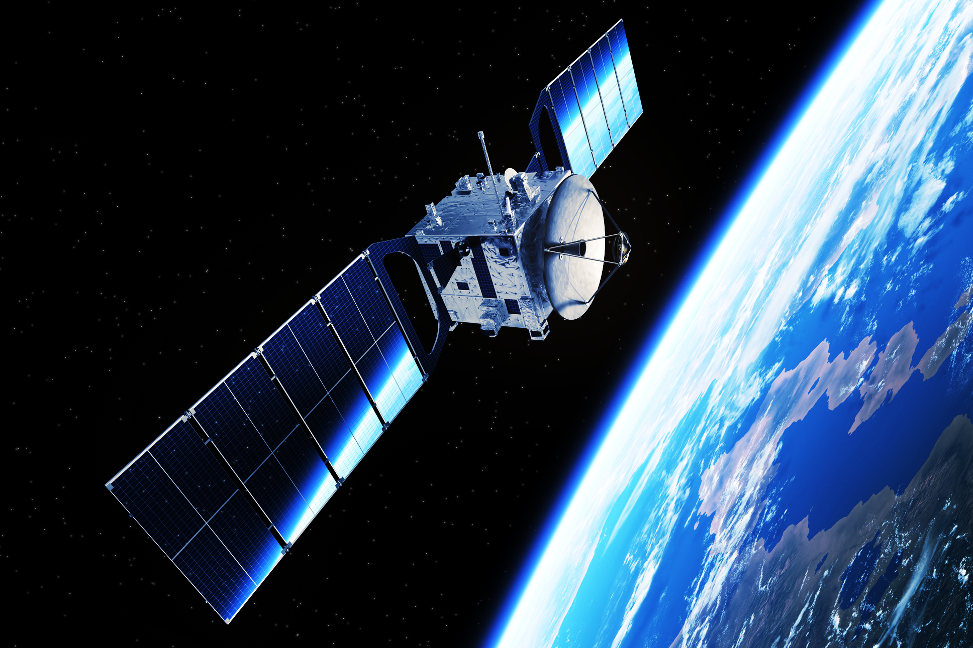
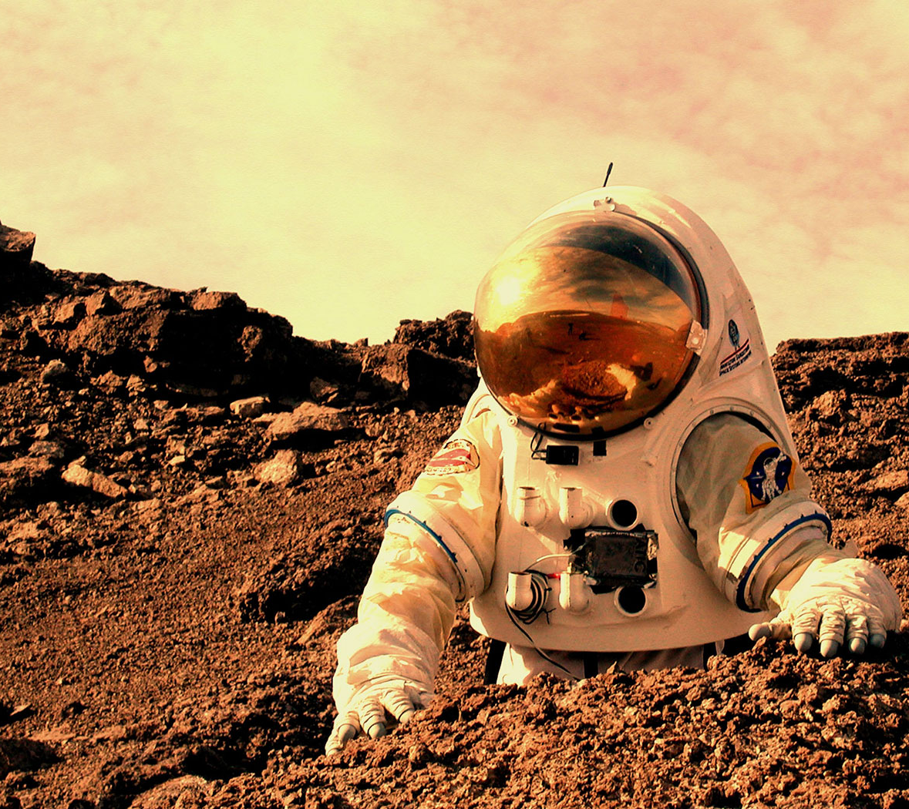
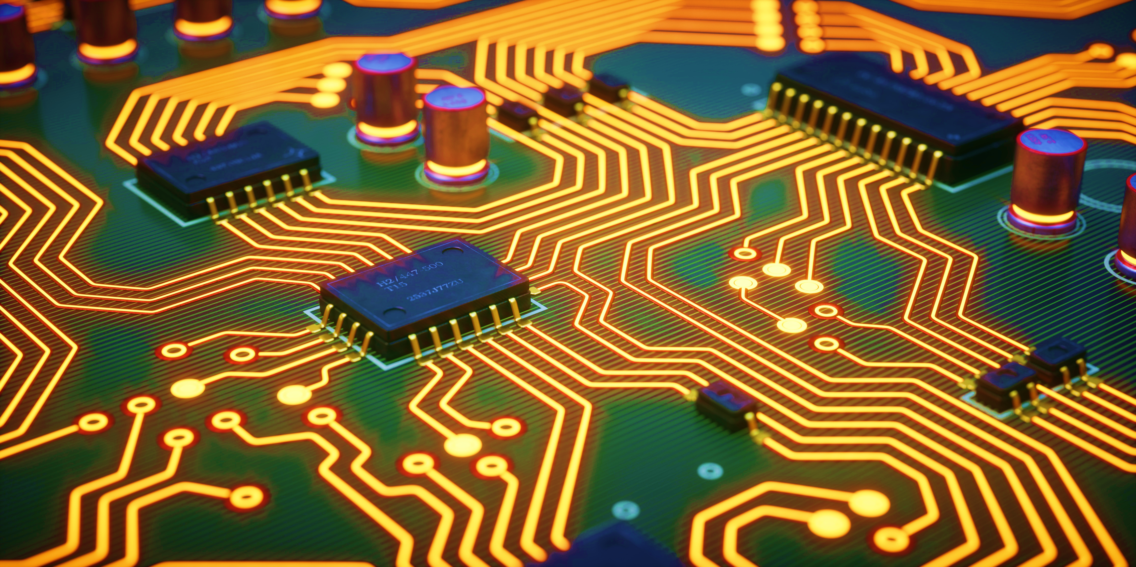
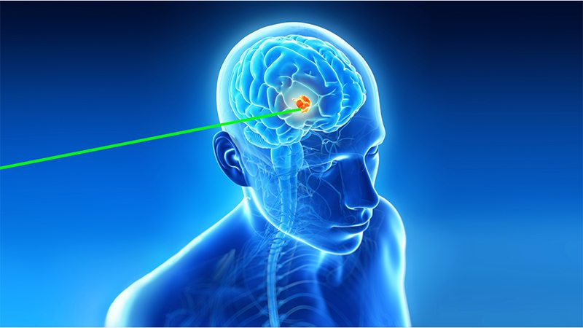
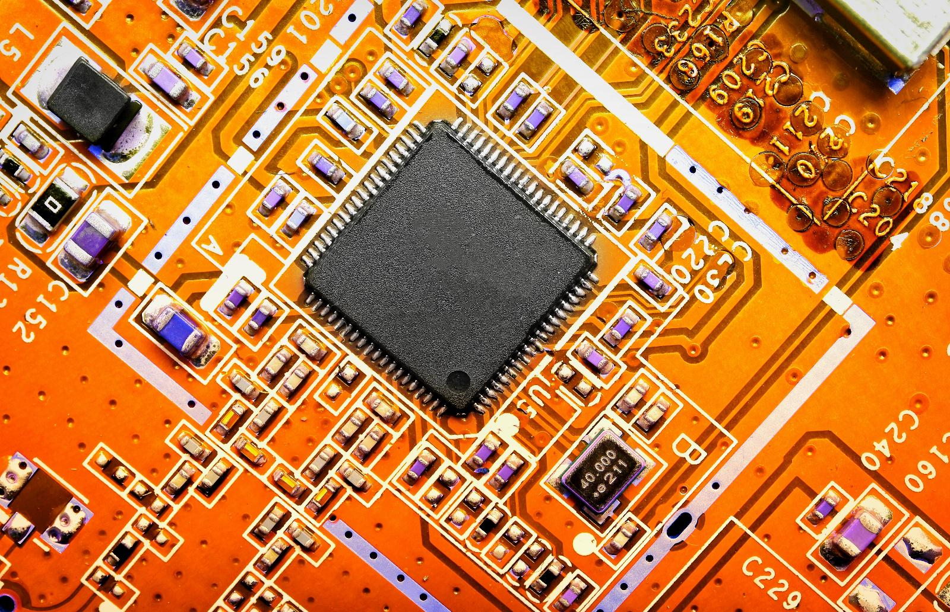
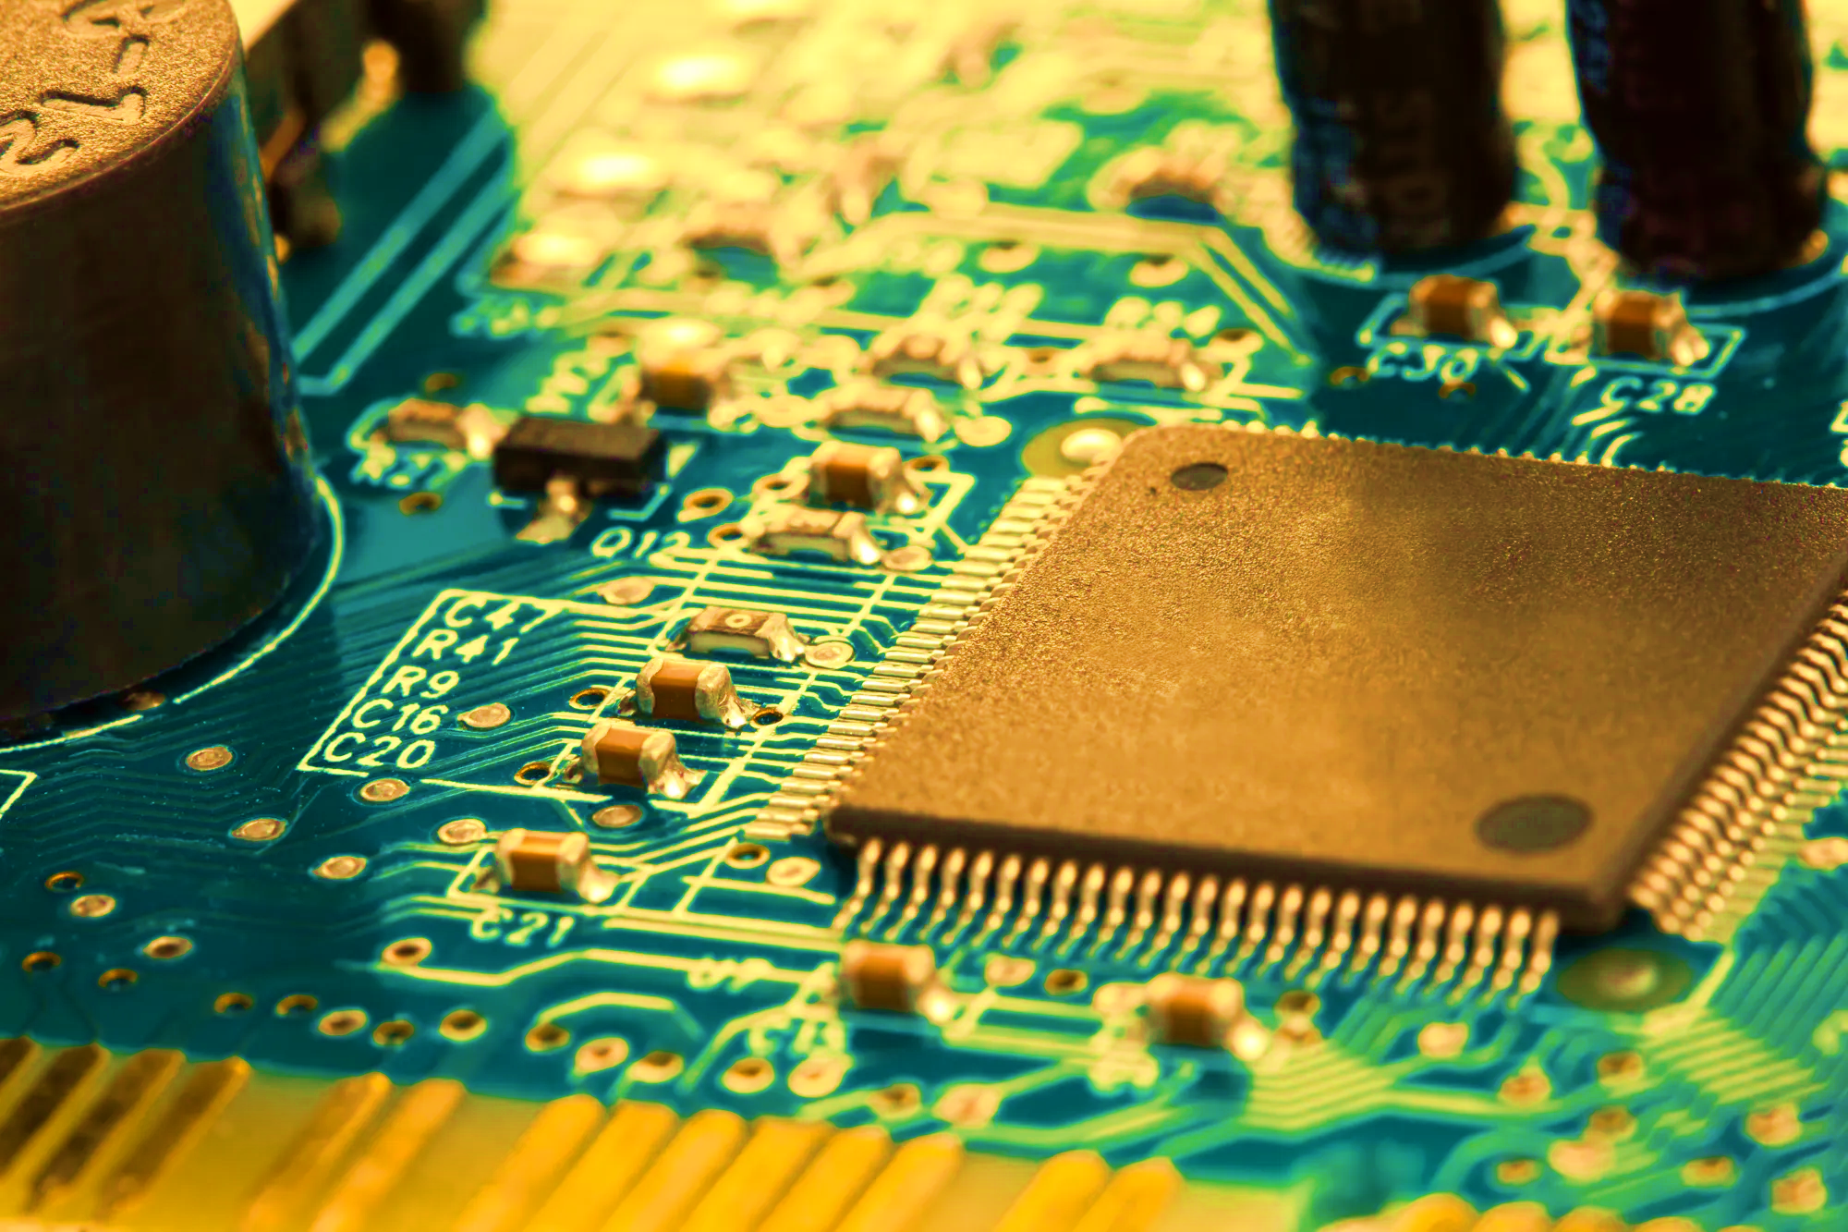

Australia’s Ion Microbeam Facility And Capability
For Space And Medical Applications
Dr Stefania Peracchi
Centre for Accelerator Science
Australian Nuclear Science &Technology Organisation
Lucas Heights, NSW Australia
Notes:
Exploring the past and the origin of the universe: measuring Plutonium 244 as signature product from supernova explosion.
Understanding the present: creating planetary materials to study their composition.
Solution for the future: designing technology radiation-resistance, and RADIOBIOLOGY, studying the effects on humans in space.

Slide 2
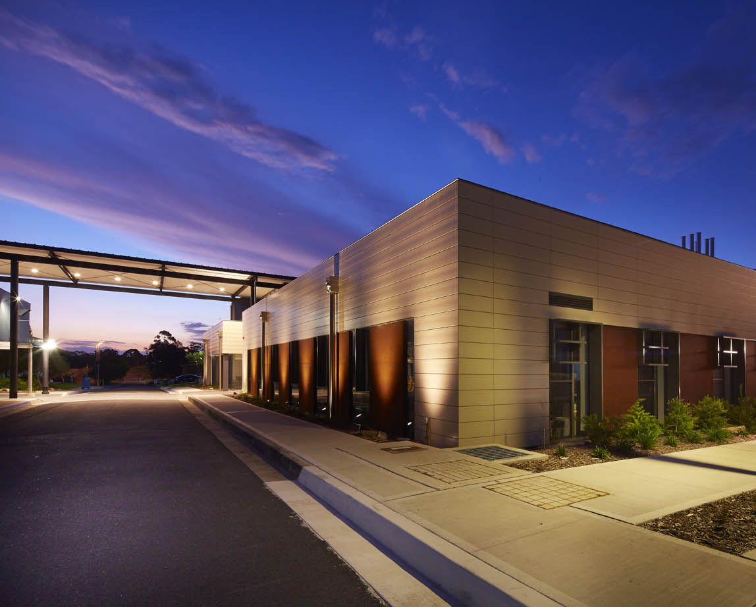


Centre for Accelerator Science
ANSTO’s LOCATIONS
A leader in Accelerator Mass Spectrometry
Unique IBA precision irradiation capabilities
A suite of 4 accelerators up to 10 MV, with more than 10 beamlines
Access available all year around to academia and industry
SYDNEY
Lucas Heights campus
Funded by National Collaborative Research Infrastructure strategy (NCRIS)
Partner of the National Space Qualification Network (NSQN)
MELBOURNE
Australian Synchrotron

Slide 3








National Space Qualification Network (NSQN)
$2M Australian Space Agency Space Infrastructure Fund awarded to 6 industry-academia-government partners. ANSTO to enhance its facility and capability for space radiation effects testing of electronics.
Notes:
And this is the accelerator collaboration in action
ANSTO is partnering to deliver 25% of a 12-month Space Infrastructure Fund project to establish the National Space Qualification Network, led by ANU’s In Space
We’re upgrading and validating to deliver industry standard testing with ions, synchrotron x-rays, gamma rays
CAS and HIAF ion beam radiation testing facilities will complement a network of thermal, vibration and vacuum testing alongside data analytics
Thus providing sovereign testing capabilities to boost the emerging Australian space sector.

Slide 4
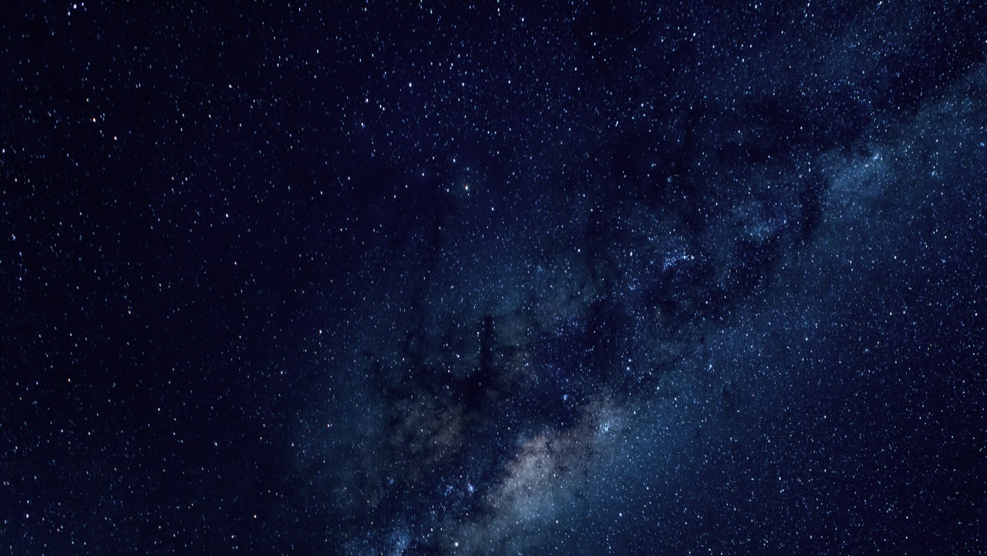
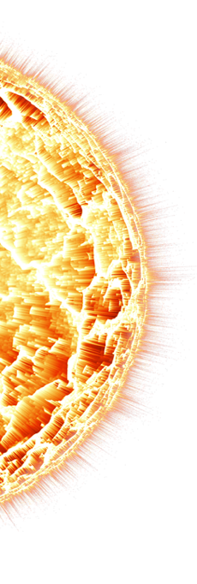
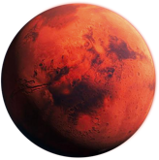

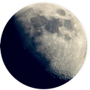


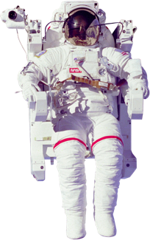

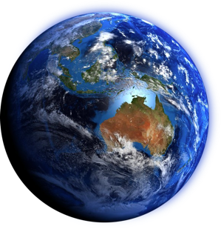


Space radiation and its challenges
300-400 mSv/yr
Large spectrum of radiation
Dose and energies
Upsets in electronics
Degradation of shielding
Damage of solar panel
DNA recognition and repair
Individual radiosensitivity
Countermeasures
GALACTIC
Protons | 85%
Alpha particles | 14%
Heavy nucleus | 1%
300-400 mSv/yr
150 mSv/yr
+ Secondary radiation
1000 - 1300 mSv/yr
+ Secondary radiation
for 2-3 year mission
SOLAR
Protons | 92%
Alpha particles | 6%
Heavy nucleus | 2%
4.5 mSv/yr
Max 70 mSv/yr
Notes:
Space is a great challenge for radiobiology, outside the protection on the van halen belt humans are exposed to doses and radiation types that are rarely or not even present on earth.
Background radiation on the international space station is about twice the one on earth and this background is up to 10 times higher on the moon or mars.
the radiation is a mix different doses, energies and type of radiation from solar and galactic origins. astronauts are already exposed to doses above what is authorised on earth for people working with radiation. countermeasures are needed especially for the longuer missions to come such as the Mars mission that is meant to last between for 2 or 3 years.
Another phenomenon happens in space and it the subject of our research here.
Equivalent dose melbourne london. London-Singapore-Melbourne. 42microSv 23 flights to reach a 1 milli Sv

Slide 5
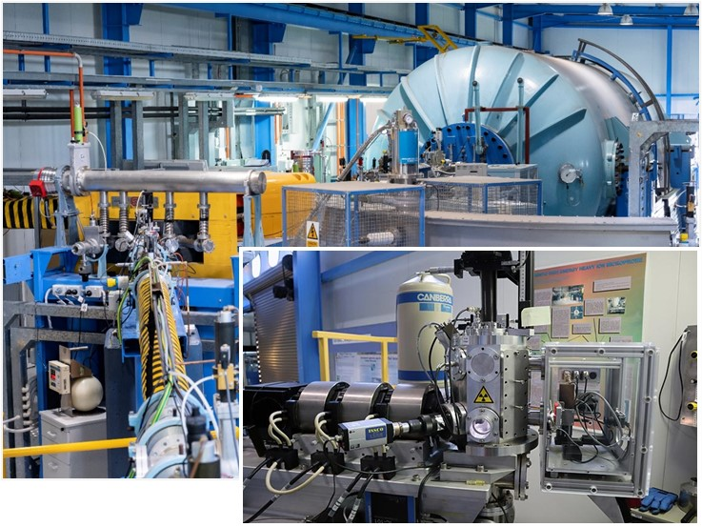
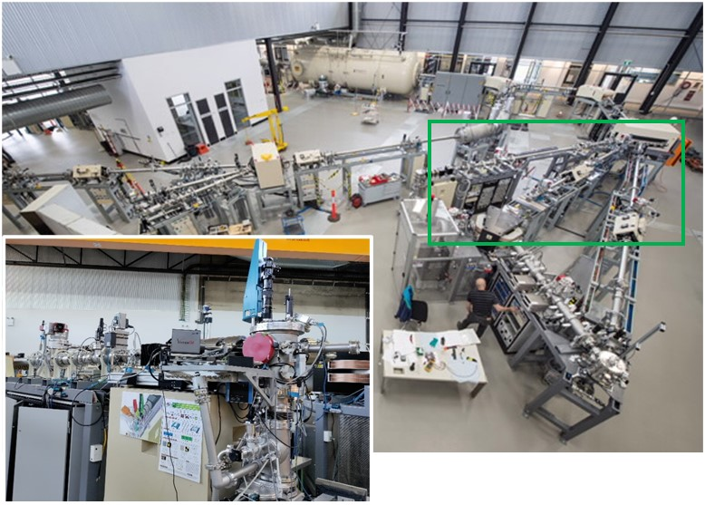

Accelerator Suite
  ANTARES – 10MV VAN DE GRAFF (1990)
  SIRIUS – 6 MV PELLETRON (2015)
R. Siegele et al. NIM B 158, 31 (1999)
Z. Pastuovic et al., NIM B 371, 142-147 (2016)
Both accelerators with Heavy Ion Beam Nuclear Microprobes

Slide 6
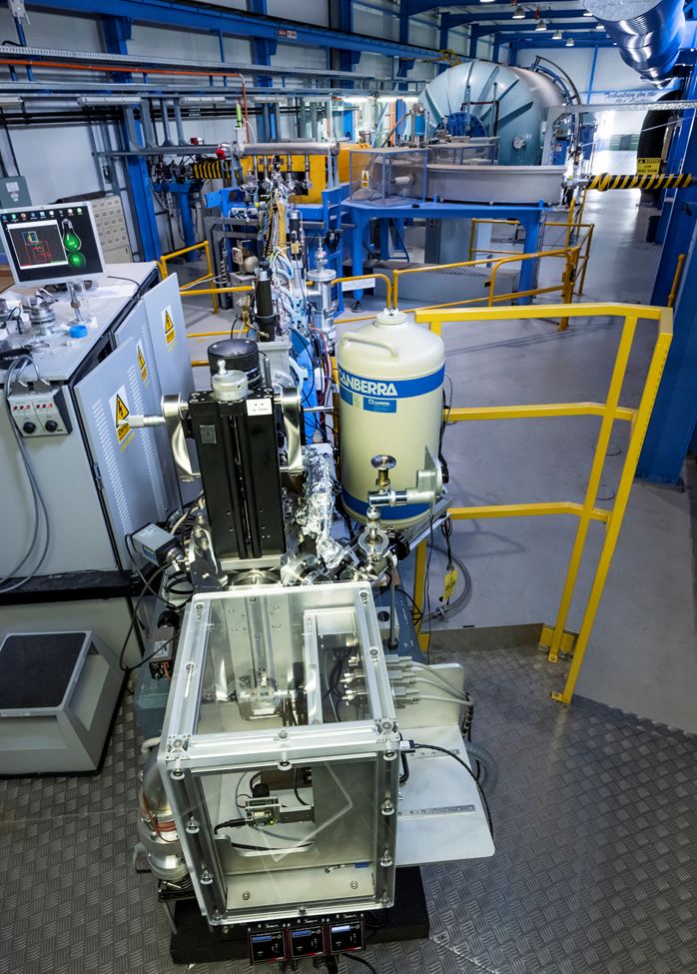
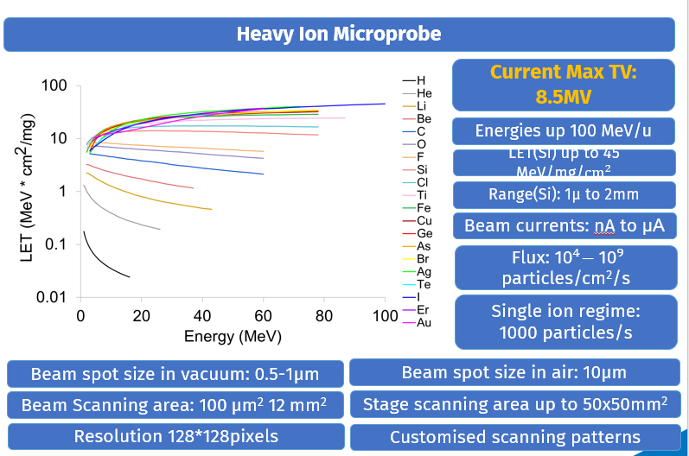
10 MV ANTARES accelerator
NOTE: energies are selected based on current max terminal voltage, max ion rigidity of 120, and beam yield above 10 %.

Slide 7
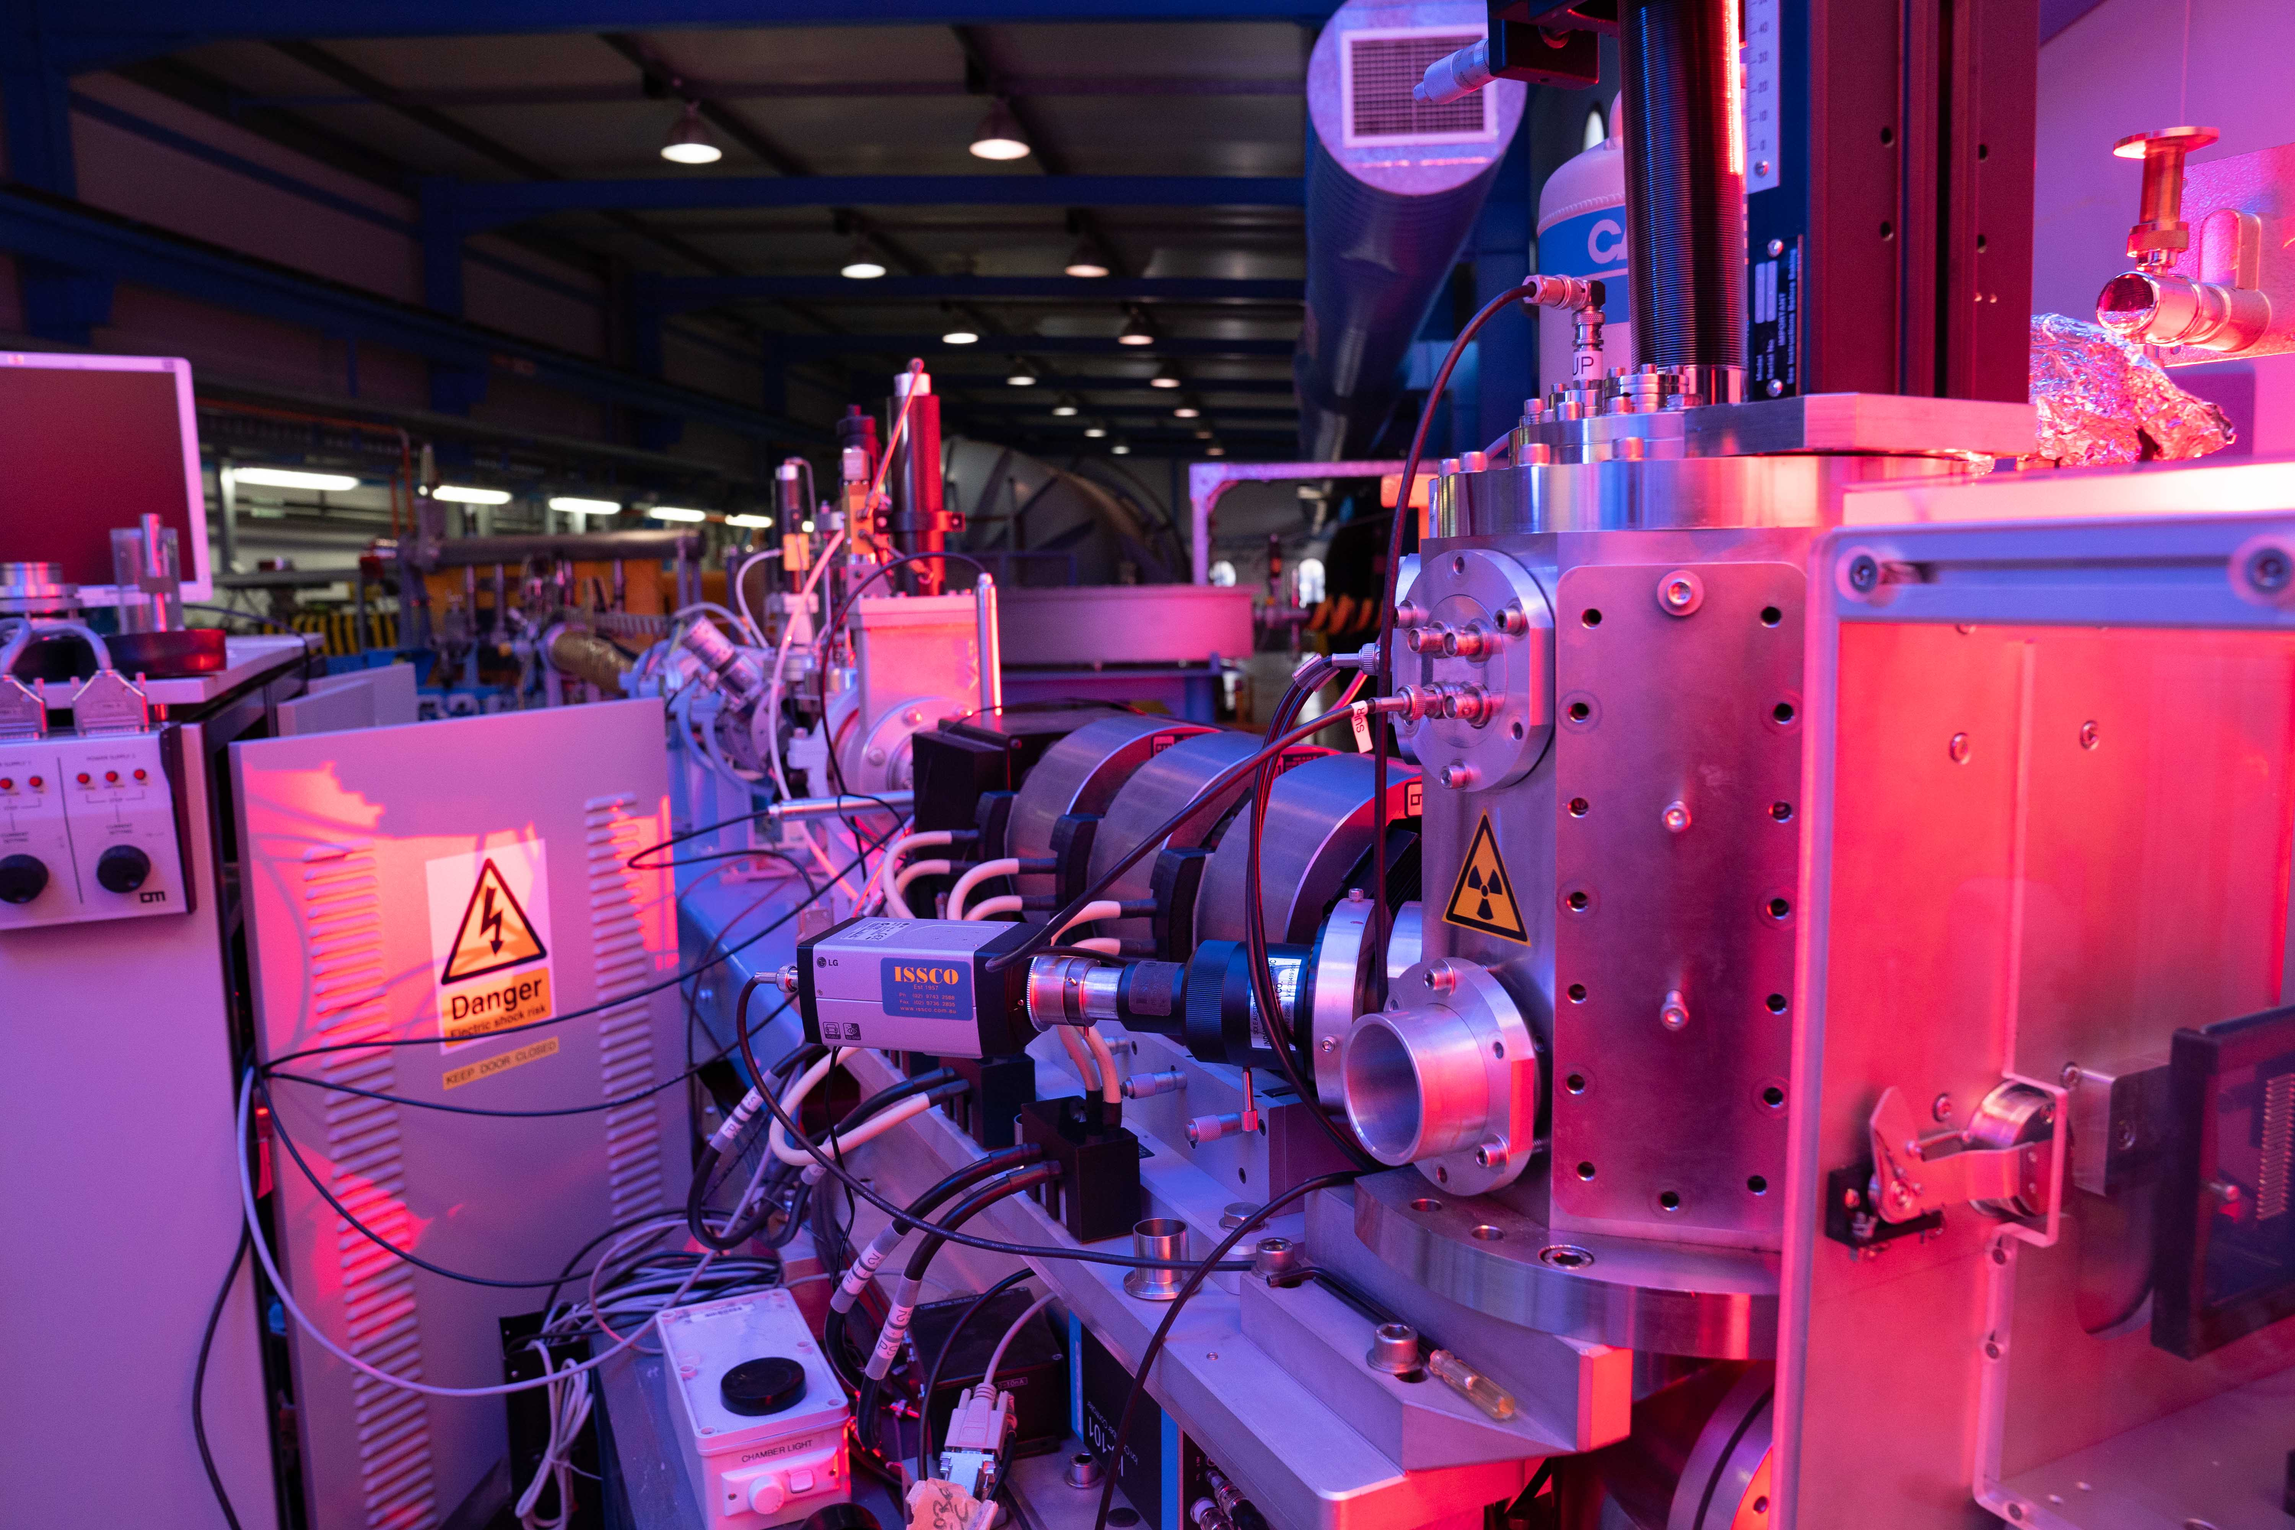
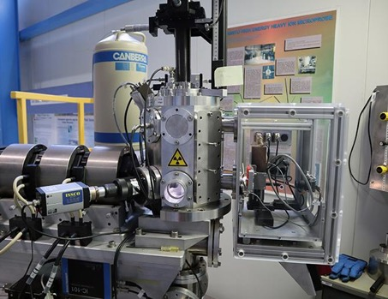
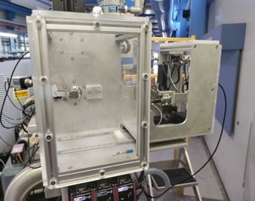
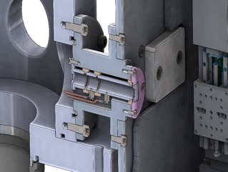
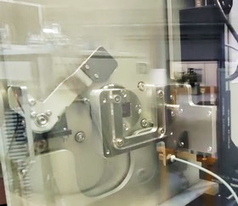

Australia’s First Ion Microbeam Facility in air
Vacuum chamber
SAFE SAMPLE HANDLING:
Drawer with a micromanipulator stage and attached sample holder.
Disabled direct access to the external beam and possible exposure.
Beam mechanic shutter when drawer out.
Micro-switch for sample positioning
Ambient chamber
Ions Beam
Sample holder up to 100mm x100mm
1µm Silicon Nitride
Window

Slide 8
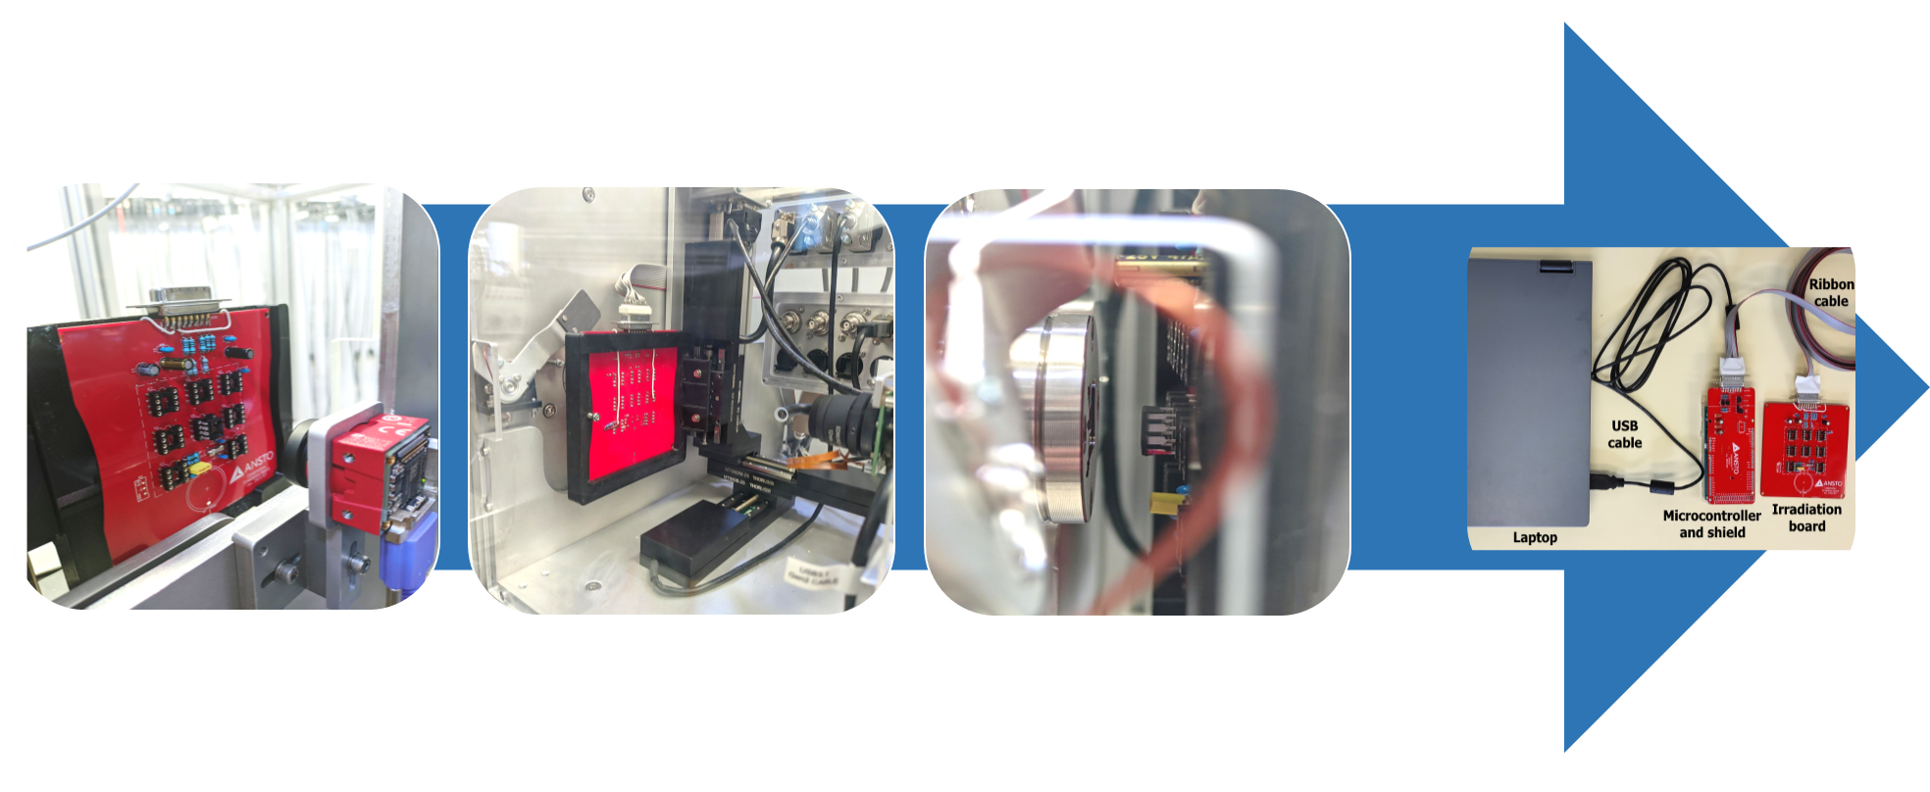
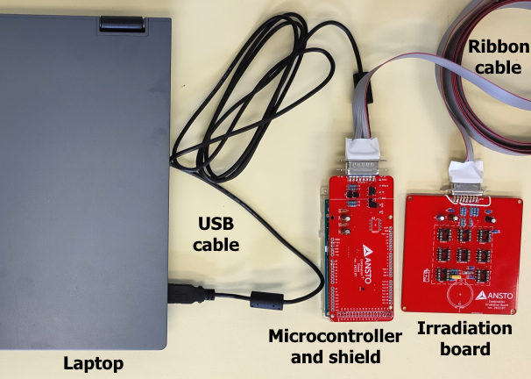
Space Radiation Effects Testing
  FEATURES
  Irradiation ANSTO PCB (in photo: 10 x 10 cm) that can house 8 different IC types
    Custom boards can fit a space of 15 x 25 x 20 cm (XYZ)
  Microcontroller and shield board to communicate with the chip during irradiation
  Computer program log results, interface with the DUT and the user
  Dual front-back camera for IC positioning of the beam axis
  XYZ linear stage for moving sample (range 0-50 mm, 0.8 µm step, 2.4 mm/s)

Slide 9
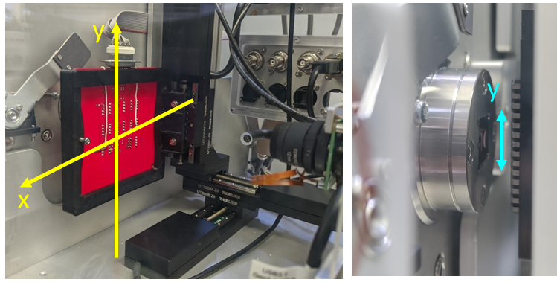
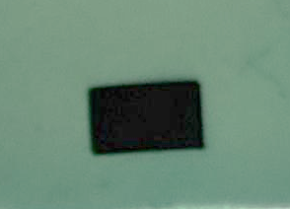
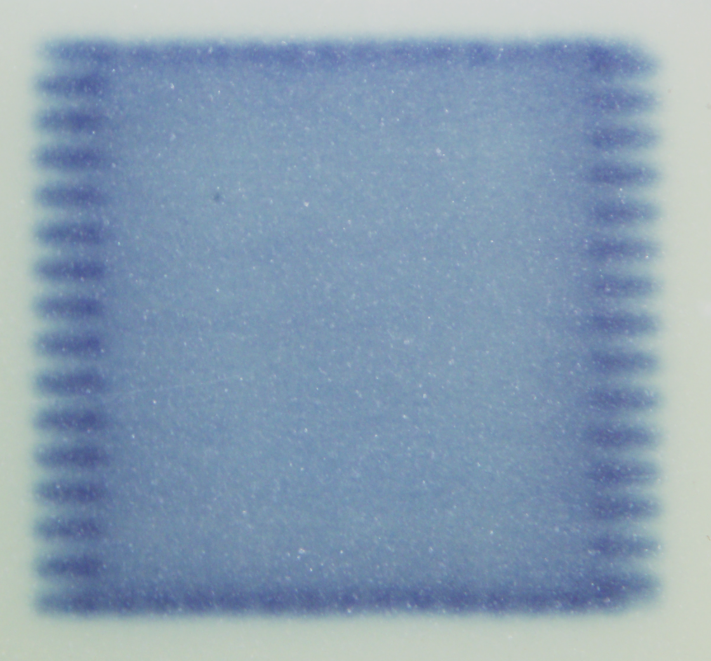
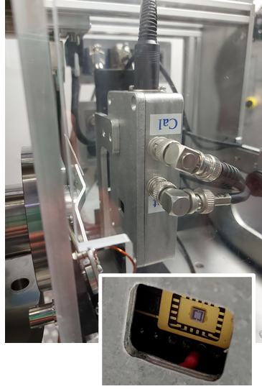

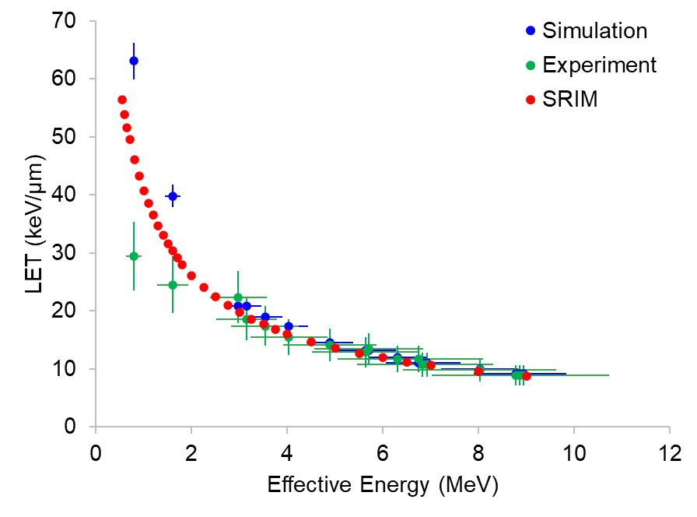

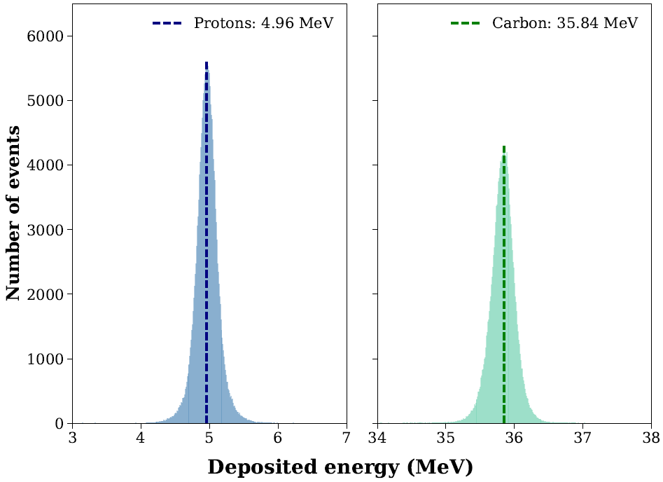
Calibration and characterisation
Beam uniformity:
Beam scanning up to 4x3mm²
Stage Scanning up to 50x50mm²
LET calibration:
SOI microdosimeter (collaboration with CMRP-UOW)
Direct measurement of LET spectrum in air
Energy calibration:
Silicon diode (collaboration with CERN)
Direct measurement of energy spectrum
Notes:
Inclusion of a micro-volt and micro-ampere measurement system to measure other SEEs i.e. latch up, burnout, gate rupture
Keysight DC power analyser
Front facing camera to allow the option of discrete irradiation of select regions of a die
Stage: Thorlabs MTS50-Z8

Slide 10
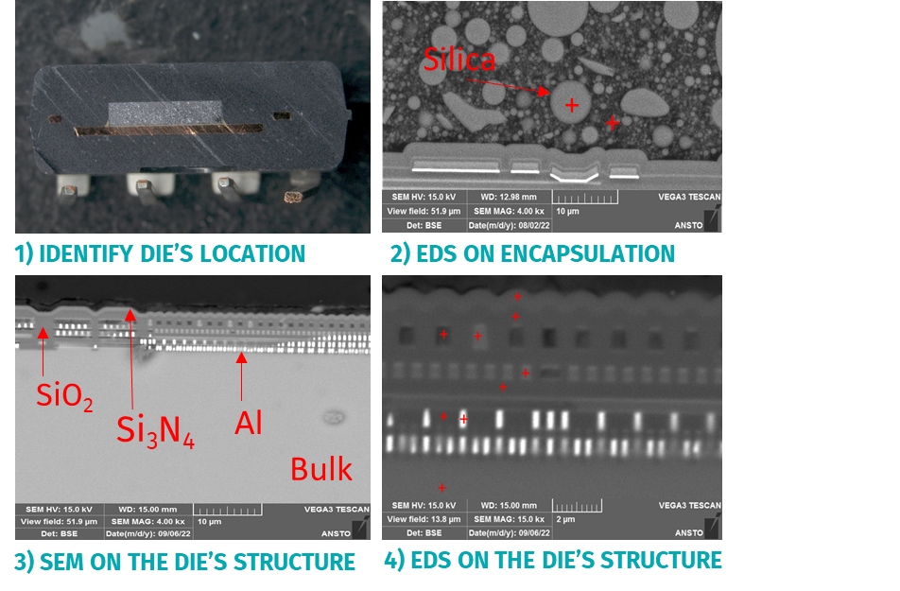
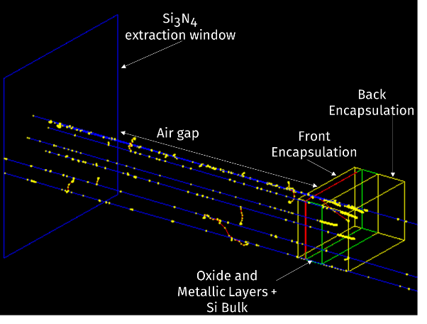
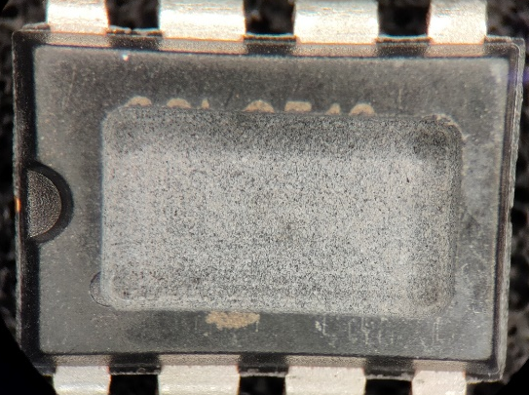
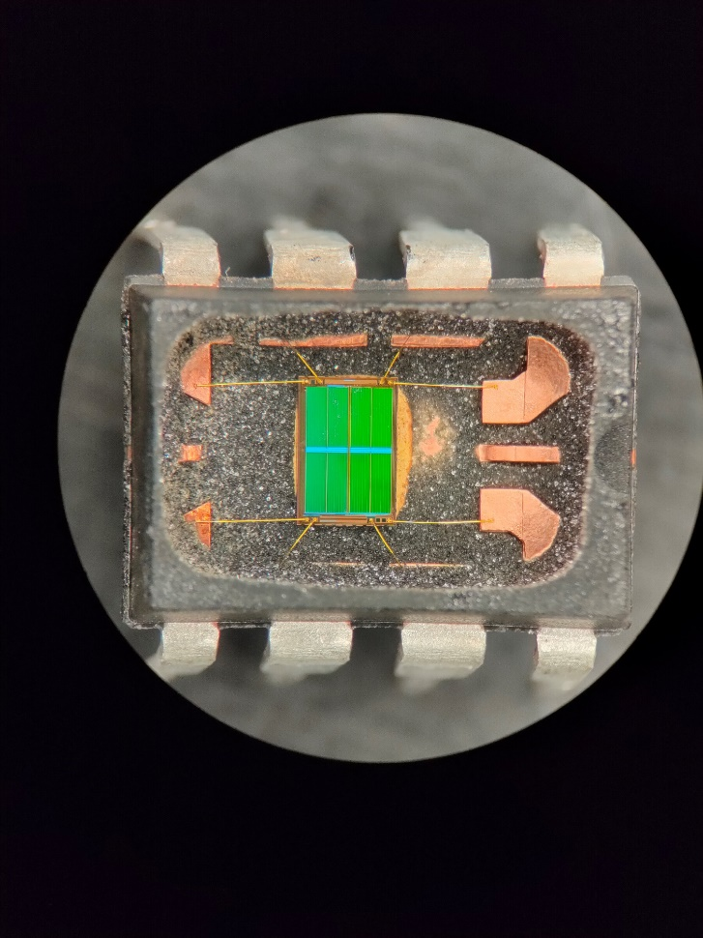
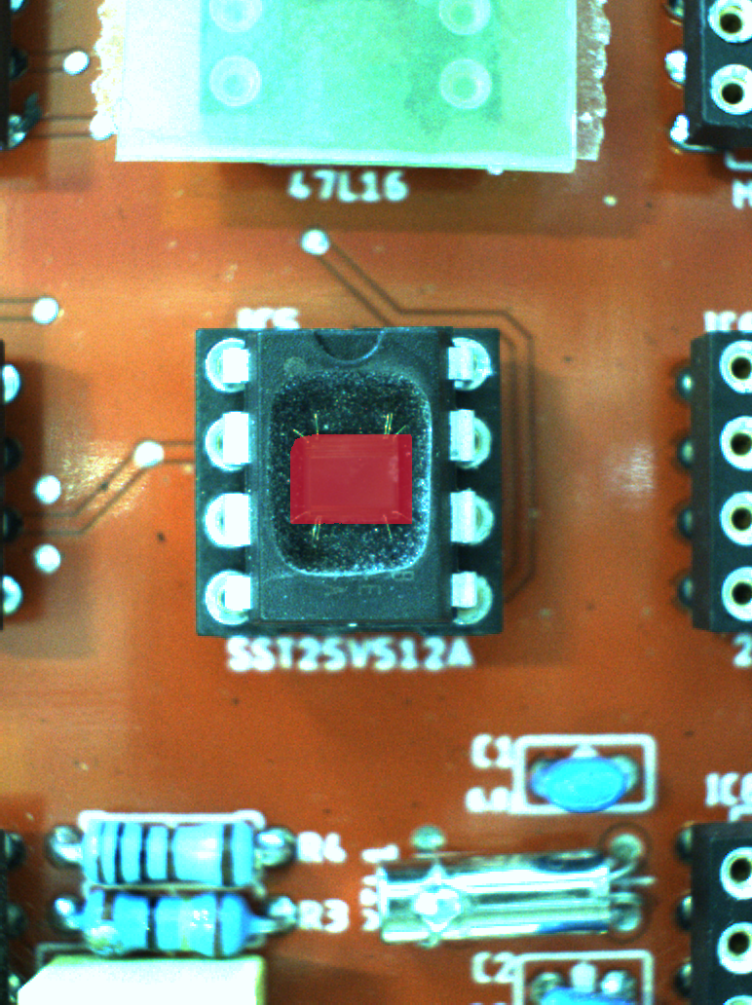
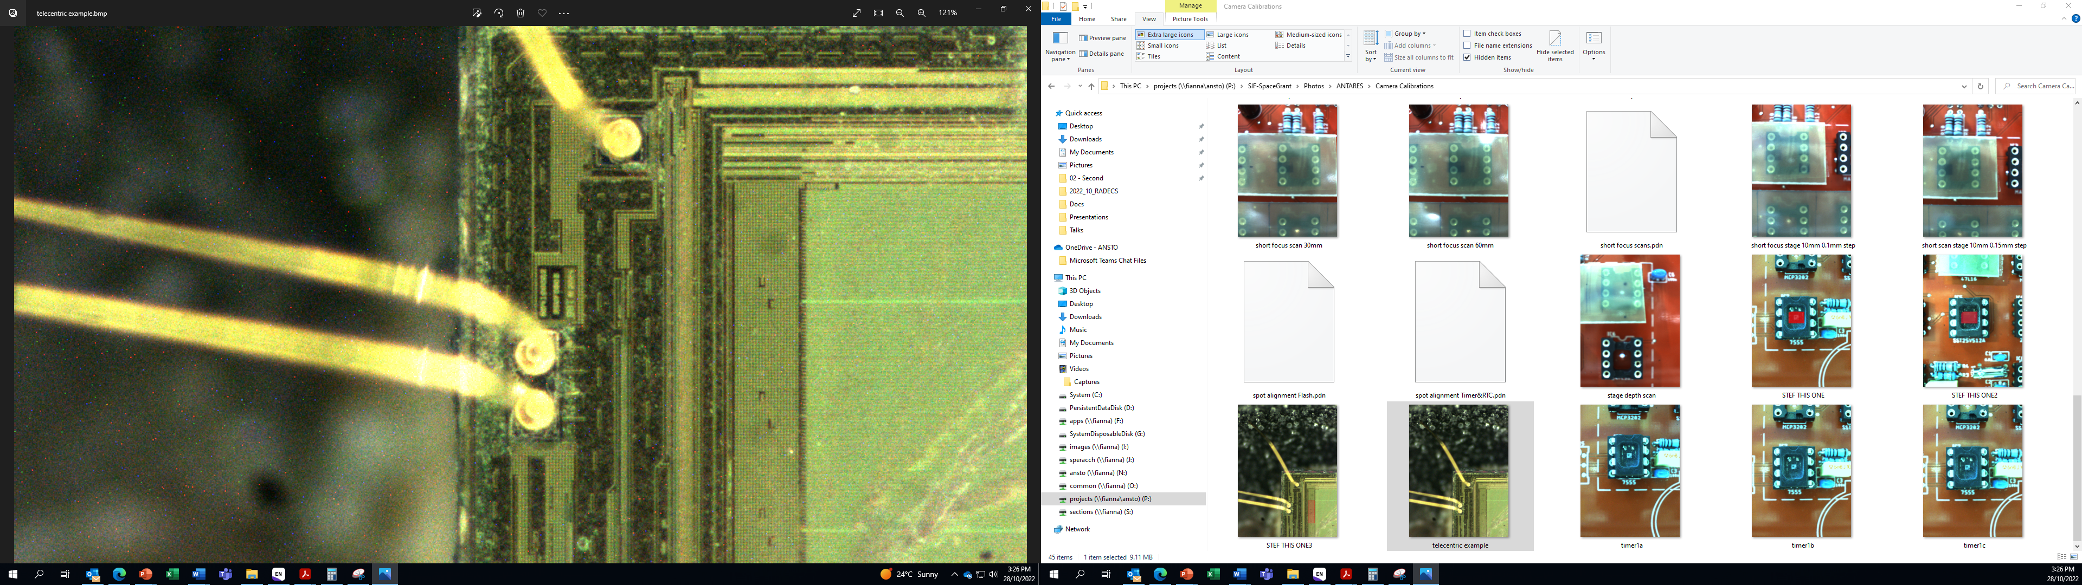
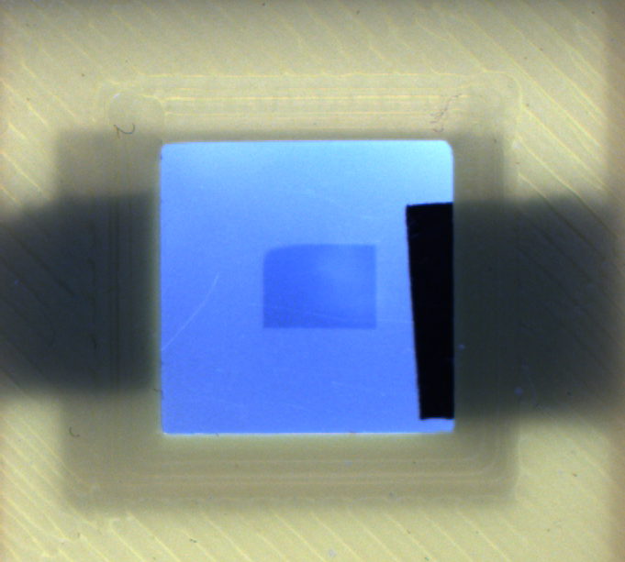

Sample preparation: reverse engineering and modelling
Scanning electron microscopy (SEM):
on a sectioned half to identify any structure
of interest (Si bulk, oxide and metallic layers, bond wires, encapsulation).
Energy dispersive spectroscopy (EDS):
to quantify the elemental composition of
those structures.
Decapsulation:
Mechanical CNC milling
acid etching to fully expose the die.
GEANT4 Monte Carlo Modelling
Beam transport in air and within the sample
LET and dose rate profile
Sample Alignment
Radiochromic film to record beam trace
Software to extrapolate beam trace and axis
Telecentric lenses to align the region of interest
Notes:
SEM: A 10 nm carbon film is deposited onto the samples to prevent charging, and imaging is performed on a TESCAN VEGA Compact SEM operated at an accelerating voltage of 15 keV.
ESD: with an attached Oxford Instruments X-Max 80 mm2 SDD X-ray microanalysis system,
Acid etching : Nitric and/or sulfuric acid jetting-Preservation of gold and copper bond wires, surface architecture
Milling: Z-accuracy ± 20 µm- Reduces chemical etching load

Slide 11
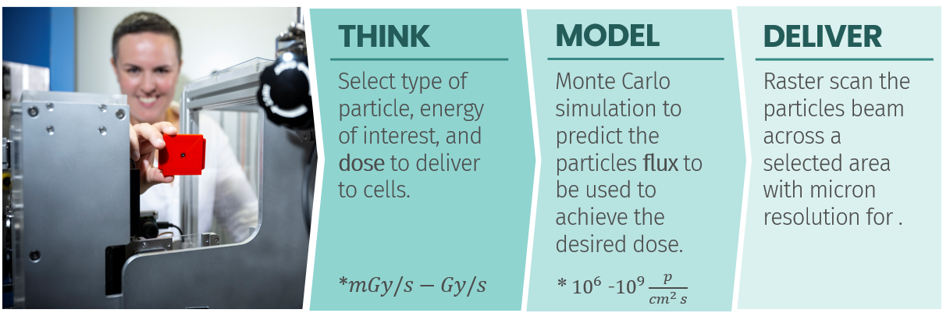
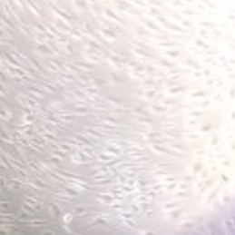
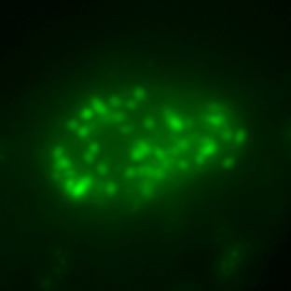
Radiobiology for Space (and not only)
Dr Melanie Ferlazzo,
Post-doc Radiobiologist
@ Department of Human Health, ANSTO
DNA break and repair mechanism study
Human fibroblast cells
Notes:
Other option to find with:
Customised capability
-Systematic setting
B…. Beam
Radiobiological R…..
M…. Method

Slide 12

Research directions
Drugs development
Space countermeasures
Cancer therapy enhancement
Particle therapy
Fundamental Radiobiology
Personalised treatment

Slide 13
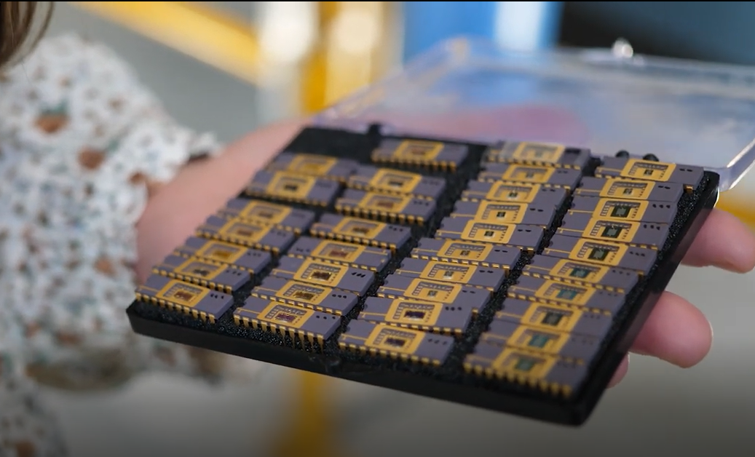
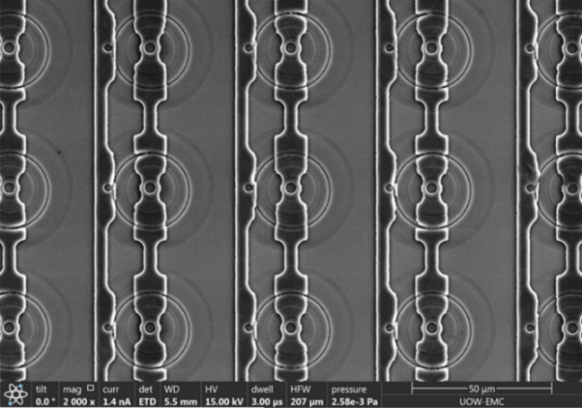
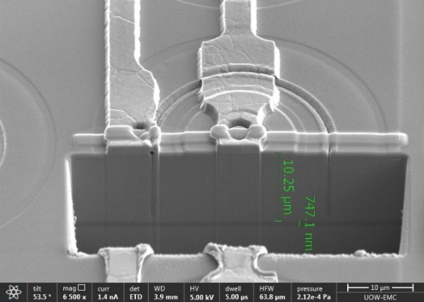
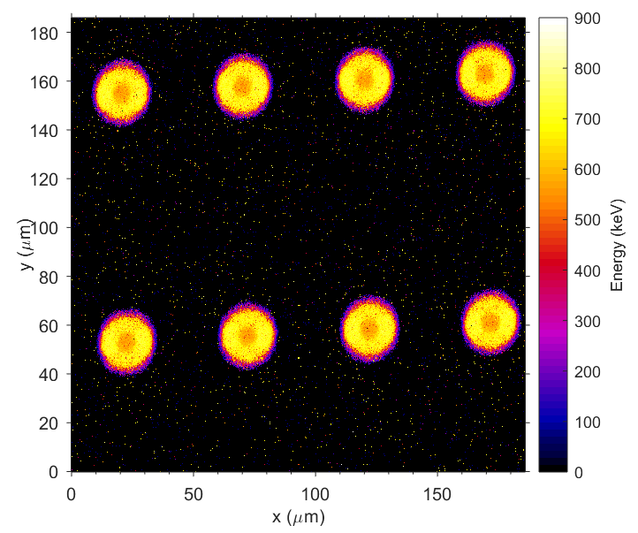
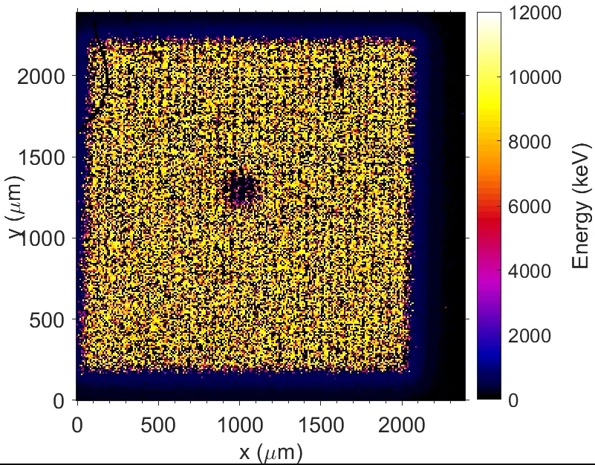
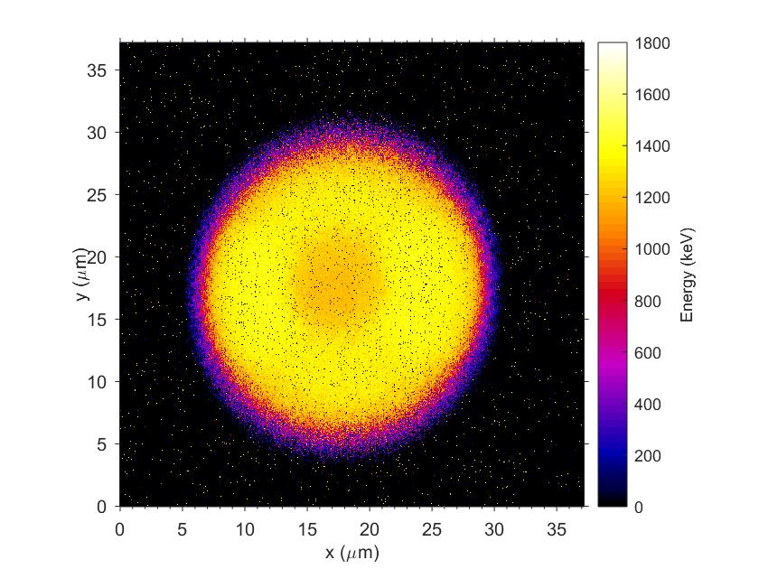




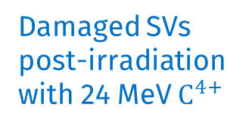
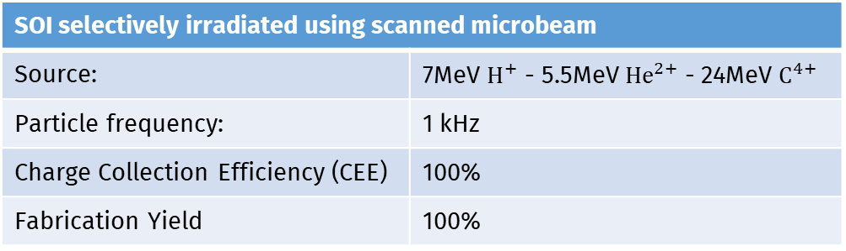
Microdosimetry for Quality Assurance in Particle therapy & Space
3D SOI MUSHROOM MICRODOSIMETER (developed by Centre for Medical Radiation Physics)
Every device is tested by Ion Beam Induced Charge microscopy at ANSTO
Every device prototype is optimised with findings of direct Charge Collection Efficiency
SOI selectively irradiated using scanned microbeam
Source: | 7MeV $H^{+}$ - 5.5MeV ${He}^{2+}$ - 24MeV $C^{4+}$
Particle frequency: | 1 kHz
Charge Collection Efficiency (CEE) | 100%
Fabrication Yield | 100%
Damaged SVs post-irradiation with 24 MeV $C^{4+}$

Slide 14
Conclusions
The new External micro-Beam Irradiation Facility at the Centre for Accelerator Science, ANSTO, demonstrated to be suitable for single event effects study on electronic chip for space application through:
Successful reverse engineering of electronic chips (decapsulation, sectioning, SEM, EDS)
High quality input information into the GEANT4 Monte Carlo modelling of LET and dose rates.
In-house developed readout system for online interrogation of chips’ performance.
Large dynamic range of particle current- dose rate and accumulated dose.
Different types of ionising radiation in ANSTO facilities.
Benefits to other interdisciplinary research application: life science, radiobiology, advance materials, energy, medical radiation physics, requiring precision irradiation.

Slide 15

















To conclude, Some Projects..
National Space Qualification Network (NSQN) (Partners: ANU, ANSTO, UOW, NOVA, Saber)
Radiation tolerance test of a custom SRAM memory for space applications (Swinburne Uni)
Radiobiology for space travellers (ANSTO Human Health)
Novel perovskite solar cells for satellite applications (USYD)
SOI microdosimeters for radiation therapy application (CMRP-UoW)
Characterisation and radiation damage of microdosimeters for aviation and space applications (CMRP-UoW)
Space radiation effects on additively manufactured polymers for space (RMIT)
Study of secondary alpha particles production in proton therapy (USYD)
Geant4 modelling of DNA breaks in humans in space (CMRP-UOW)
Single event effects on SiC MOSFET devices for space (ETH-Switzerland)
Radiation effects on new CMOs technologies for space (Uni of Saskatchewan-Canada)
If you are interested in beam time:
Submit a proposal for free access based on merit peer-review: https://portal.ansto.gov.au
Contact us for rapid commercial access: speracch@ansto.gov.au

Slide 16
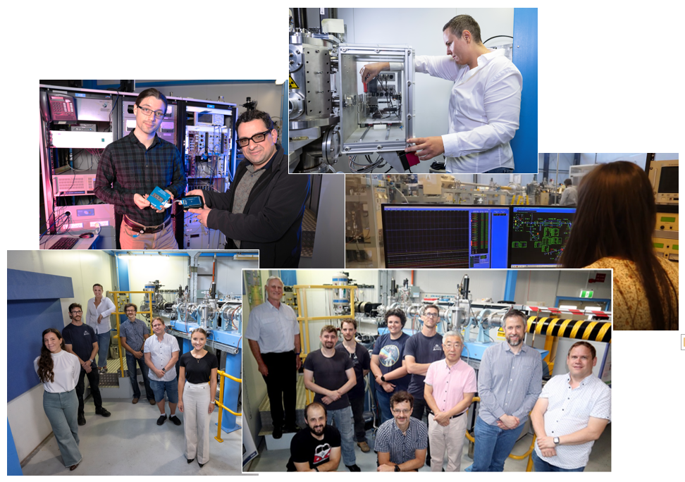
Team effort
ANSTO team
S. Peracchi
Z. Pastuovic
R. Drury
N. Paneras
M. Mann
D. Button
D. Cohen
C. Brenner
M. Ferlazzo
C. Basirun
R. Banati
GJ. Liu
N. Howell
R. Middleton
P. Holden
Notes:
For the beams experirement we’ve been collaboration with the Center for acceletor sciences to build the external in air enclosure, evething was design, build and 3d printed in house and it’s a great example of the knowldge and resources available at ANSTO.
behind all the beautiful people that are involved in this project you see the beam in the back,
let's now take a closer look to the installation.

Slide 17

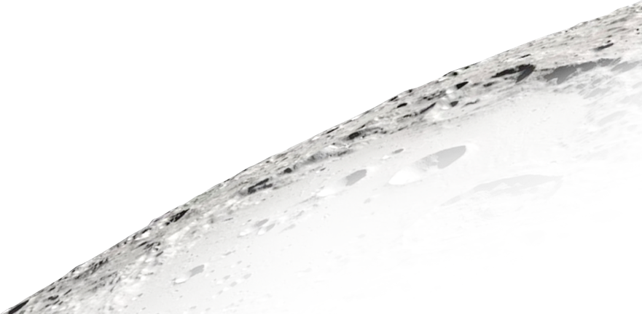

Thank you

