Slide 1




NEW TECHNIQUE OF ion IDENTIFICATION IN ACCELERATOR MASS SPECTROMETRY USING Low-pressure tpc WITH GEM READOUT
A. Bondar, A. Buzulutskov, V. Parkhomchuk,
A. Petroghitsky, T. Shakirova, A. Sokolov,
Budker Institute of Nuclear Physics,
Novosibirsk State University
December 2, 2022

Slide 2
Outline
Accelerator mass spectrometry
New concept of ion identification. Proof of Concept
Experimental setup
Measurements of energy spectra and track ranges
Recent results with AMS

Slide 3
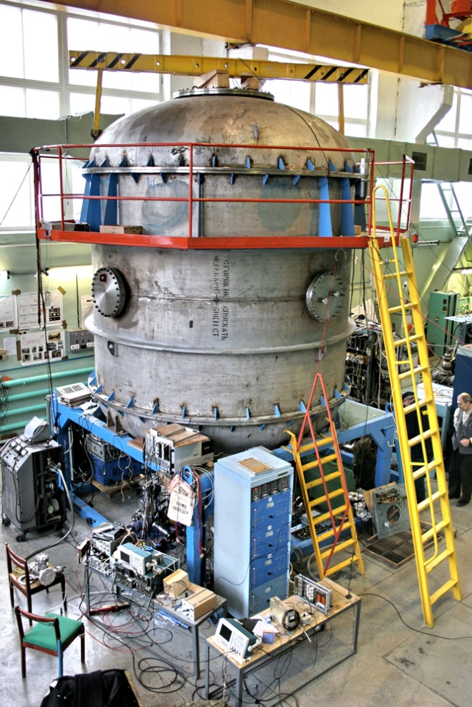
Accelerator mass spectrometry
Accelerator mass spectrometry (AMS) is an ultra-sensitive method of counting individual atoms. Usually it is the rare radioactive atoms with a long half-life. The archetypal example is ¹⁴C which has a half-life of 5730 years and an abundance in living organisms of 10⁻¹² relative to stable ¹²C isotope.
AMS facilities operate in more than 100 physical laboratories worldwide, one of which is located in Novosibirsk at Geochronology of the Cenozoic Era Center for Collective Use.

Slide 4
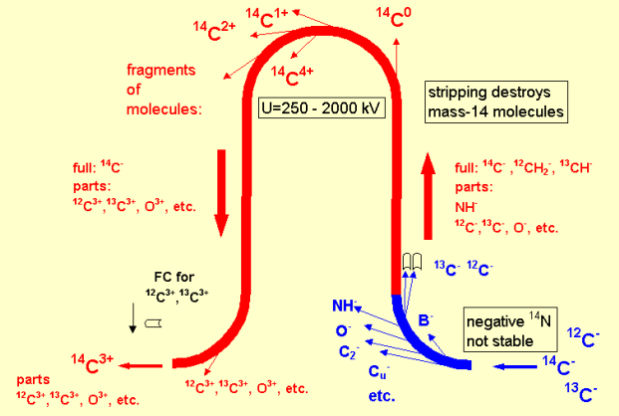
BINP AMS
1. Formation of an ion beam from atoms of the test sample
2. Ion selection at low energy
3. Ion acceleration
4. Recharging of atomic ions and destruction of molecular ions in magnesium target
5. Ion selection in a high voltage terminal
6. Ion acceleration
7. Ion selection at high energy
8. Identification and counting of ions
Mg stripper
BINP AMS provides reliable separation of a pure beam of radiocarbon ions from the accompanying ion background.

Slide 5
Isotopes used in AMS
Analyzed isotopes | Half life | Stable isotopes | Stable isobars
¹⁰Ве | 1,39 million years | ⁹Be | ¹⁰B
¹⁴C | 5730 years | ^{12,13}С | ¹⁴N*
²⁶Al | 717 thousand years | ²⁷Al | ²⁶Mg*
³⁶Cl | 301 thousand years | ^{35,37}Cl | ³⁶Ar*, ³⁶S
⁴¹Ca | 102 thousand years | ^{40,42,43,44}Ca | ⁴¹K
¹²⁹I | 15,7 million years | ¹²⁷I | ¹²⁹Xe*
* - isobars that do not form stable negative ions.
In the current AMS BINP setup the time-of-flight technique is used for the isotopes separation. But that technique there is a serious problem of separating the isobars - different chemical elements having the same atomic mass. The typical example are radioactive isotopes ¹⁰Be and ¹⁰B.

Slide 6
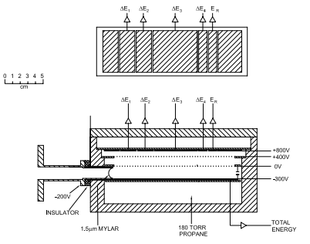
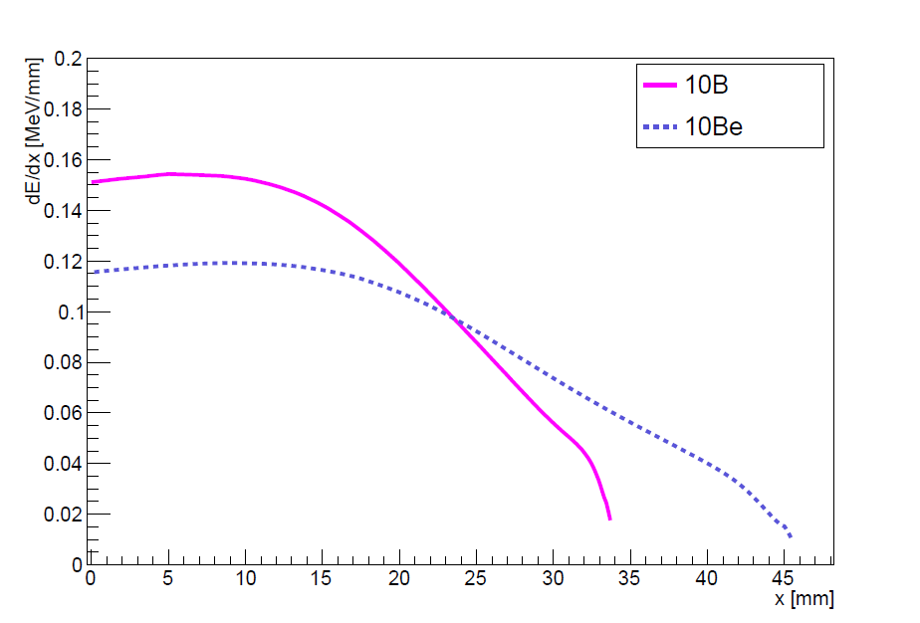
Traditional concept of ion identification at AMS
Detectors used to count the AMS isotope:
silicon detectors;
time-of-flight systems (BINP AMS);
ionization chambers.
∆Е-Е detectors
A cross section through the multi-element ionization chamber. The upper panel shows a plan view of the anode electrode.
Ions track lengths at 50 Torr of i-C₄H₁₀
<number>

Slide 7
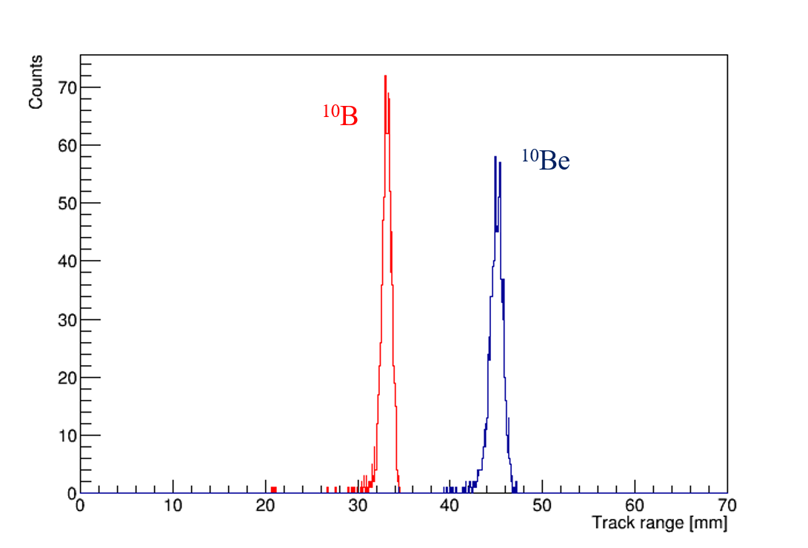
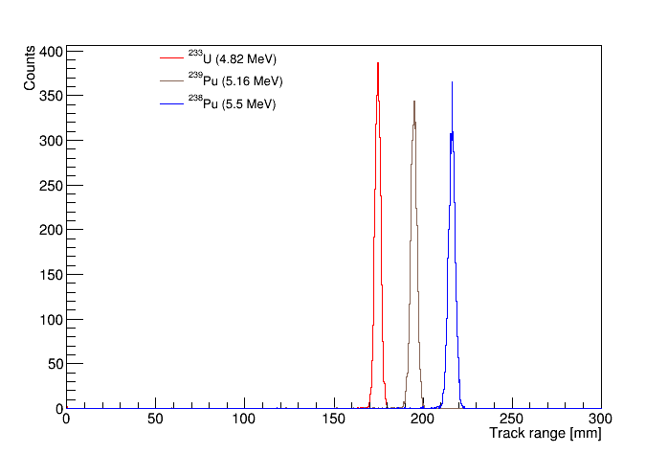
Proof of concept: measuring track ranges
SRIM (The Stopping and Range of Ions in Matter Software) –
is a collection of software packages which calculate many features of the transport of ions in matter.
Track ranges distributions in the low-pressure TPC for 4.025MeV ¹⁰B and ¹⁰Be ions for 200 nm silicon nitride window and 50 torr isobutane, obtained using SRIM simulation.
Ion ranges distributions in the low-pressure TPC for alpha particles with different energies for 200 nm silicon nitride window and 50 torr isobutane, obtained using SRIM simulation.

Slide 8
New concept of ion identification: low-pressure TPC
Schematic layout
Cathode
Shaping amplifiers
Naicam 226
Ion beam from AMS
or alpha particles
Ion track
24 mm
Ionization
$\vec{E}$
Isobutane
Charge-sensitive
Preamplifiers CAEN1523
Si₃N₄ window (200 nm)
GEM
Anode
Oscilloscope
LeCroy 4054AR

Slide 9
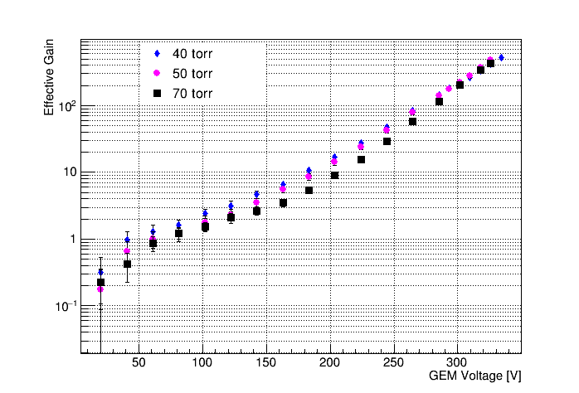
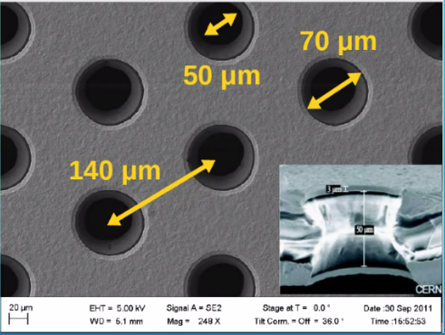
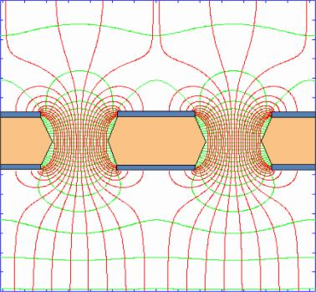
Effective gain of GEM
GEM effective gain as a function of the voltage in isobutane at pressures varying from 40 to 70 torr in the low-pressure TPC.
Electric field inside the holes.
50 µm
<number>

Slide 10
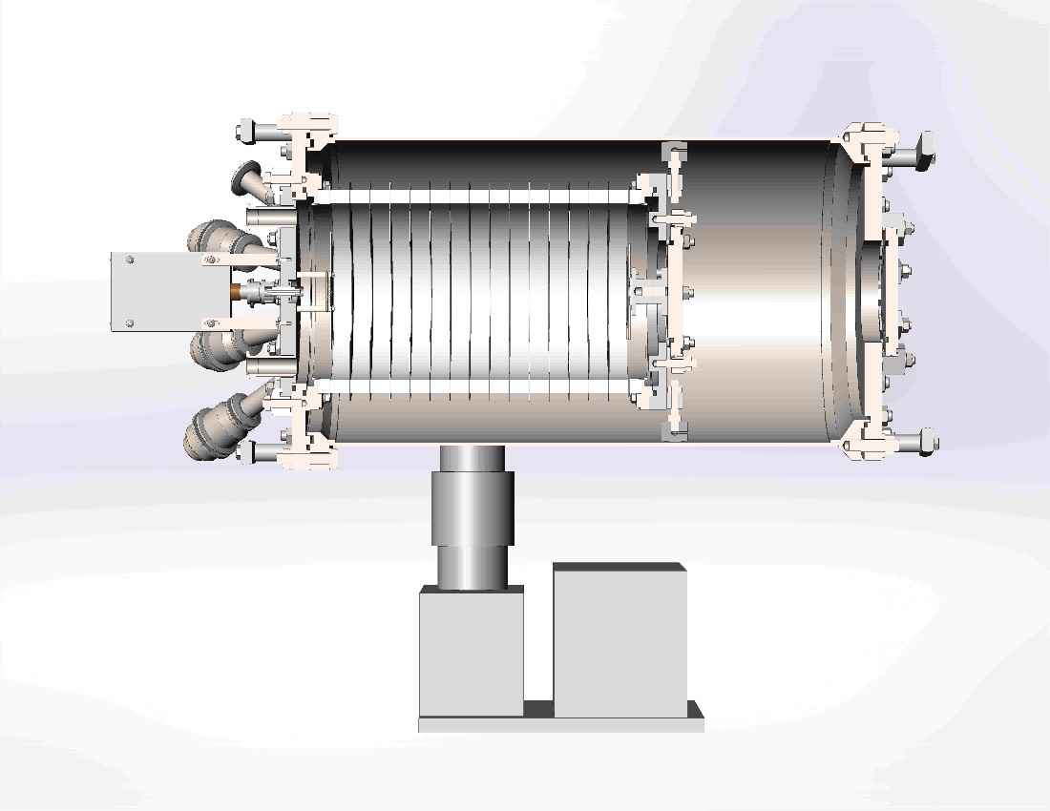
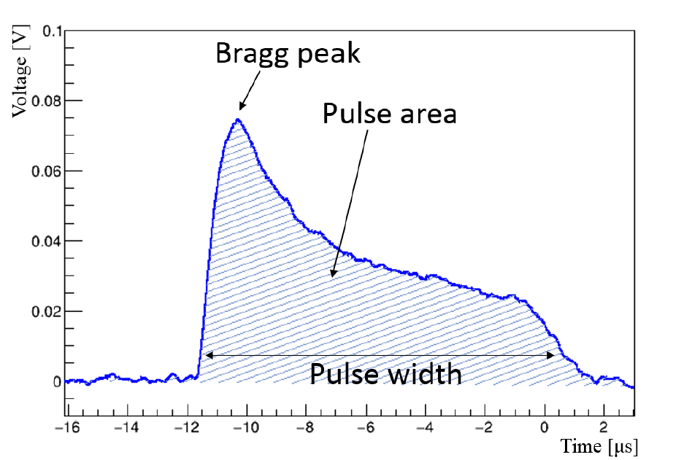
TPC Prototype: Principle of operation
Typical waveform shape of the signal from the alpha particle in low-pressure TPC
300
178
²³³U, ²³⁸Pu, ²³⁹Pu
source
Diameter – 178 mm
Length – 300 mm
pulse width -> track range
pulse area -> energy

Slide 11
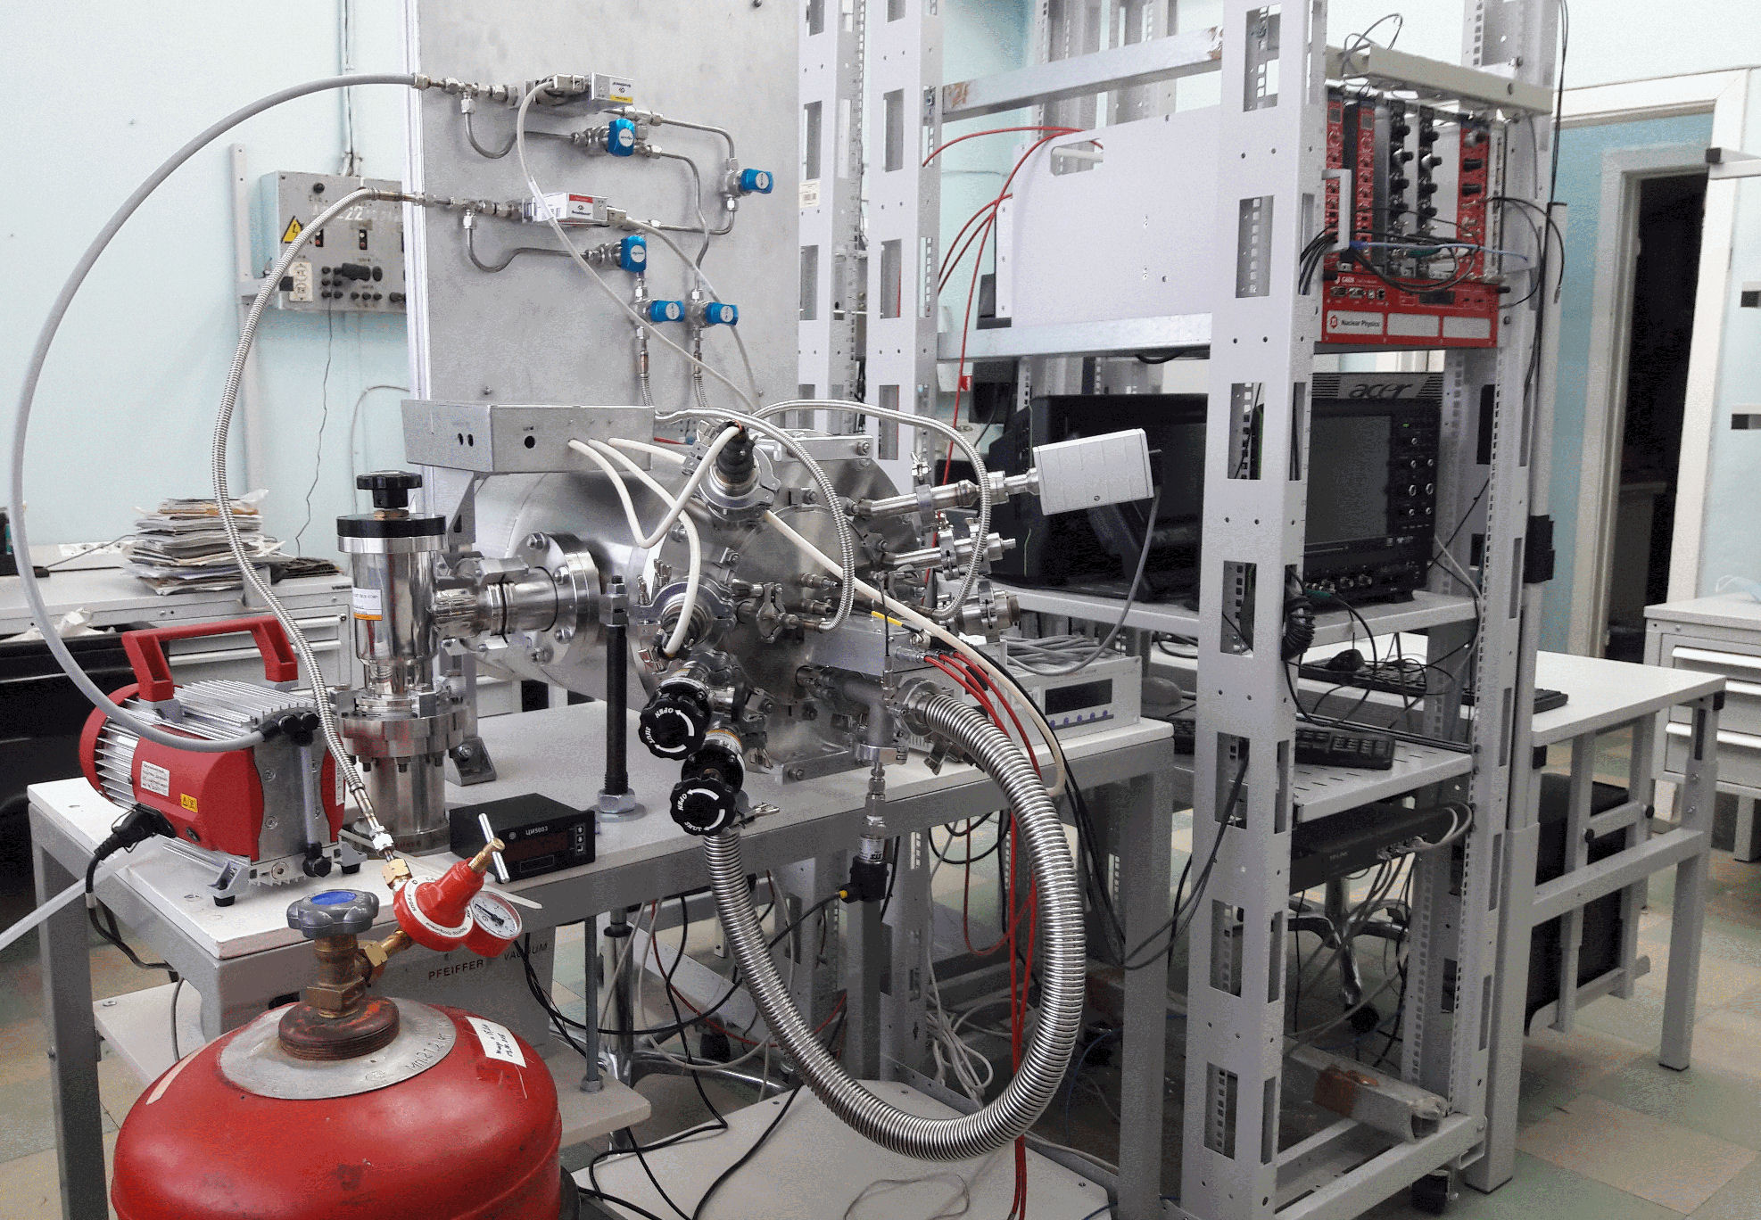
Test installation

Slide 12
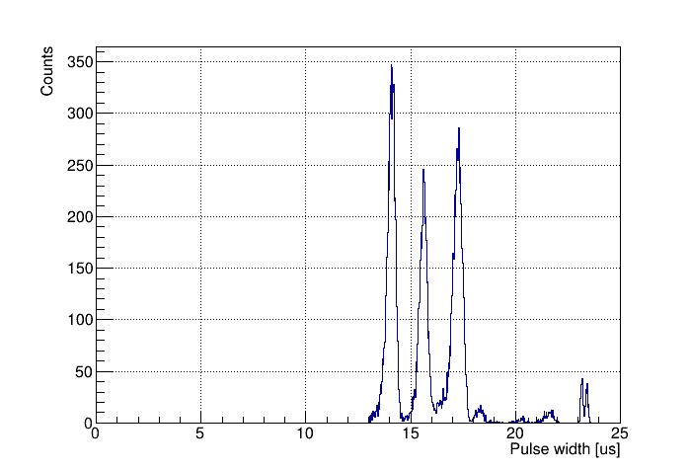
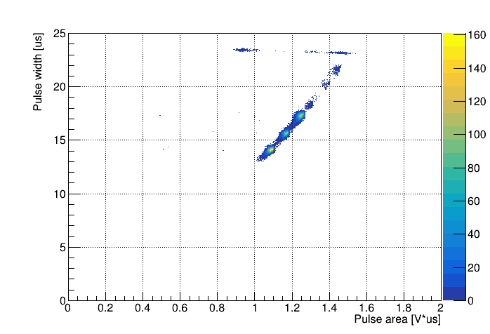
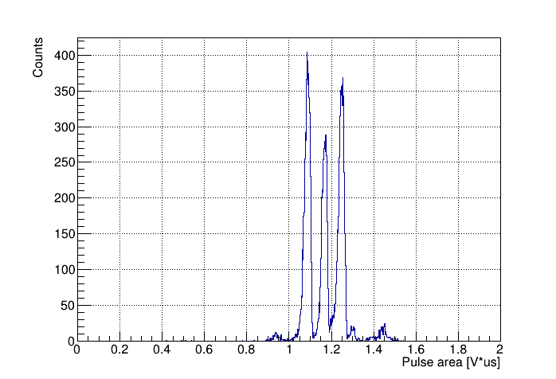
The measurement of track ranges
The alpha-particle source
²³³U, ²³⁹Pu, ²³⁸Pu
Pressure = 50 Torr
Gain = 225
Shaping time = 200 ns
2D plot of pulse width versus pulse area and their axis projection spectra for alpha particles from ²³³U (4.8 MeV), ²³⁹Pu (5.2 MeV) and ²³⁸Pu (5.5 MeV) source, measured in low-pressure TPC in Isobutane at 50 Torr and GEM gain of 225.
The pulse width and pulse area spectra reflect those of the track range and energy.
<number>

Slide 13
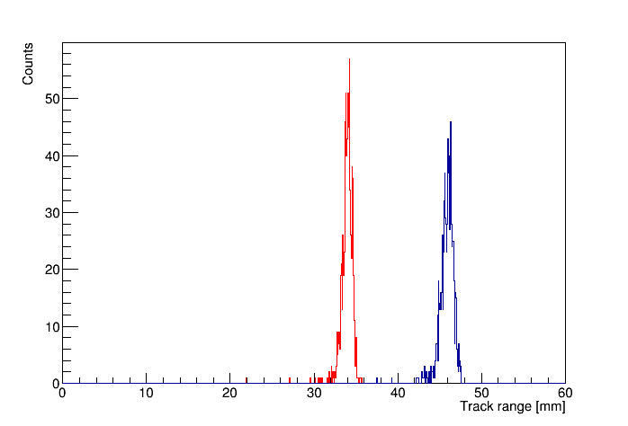
Results
Source | Shaping time | Gain | Pressure | Sigma/Range, % | Separation in sigma between two peaks
3 isotopes | 200 ns | 225 | 50 Torr | 1.24 | 8
¹⁰B
¹⁰Be
Using these results and SRIM code simulations, it is shown that isobaric boron and beryllium ions can be effectively separated at AMS, providing efficient dating at a 10 million years scale. This technique will be applied in the AMS facility in Novosibirsk.
Spectra of ion ranges for ¹⁰B and ¹⁰Be with energy 4.025 MeV in Isobutane at 50 Torr simulated with SRIM.
<number>

Slide 14
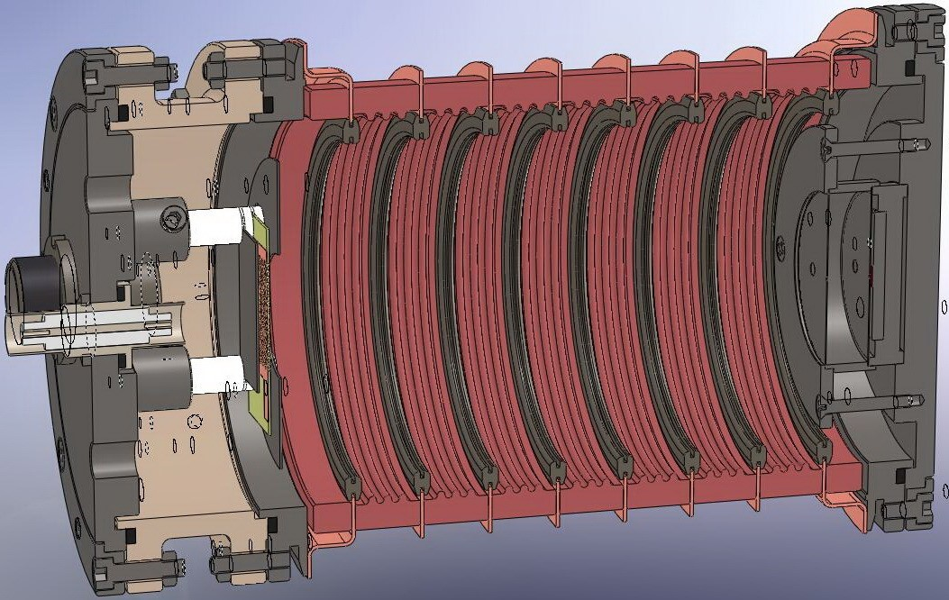
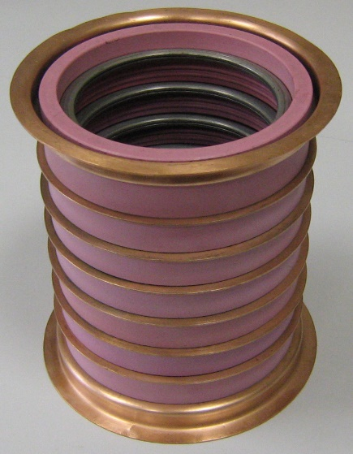
TPC for BINP AMS
70 mm
110 mm

Slide 15
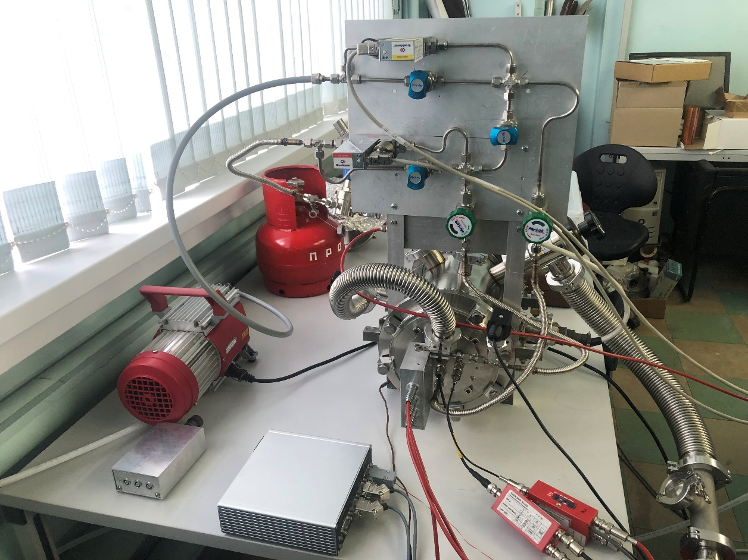
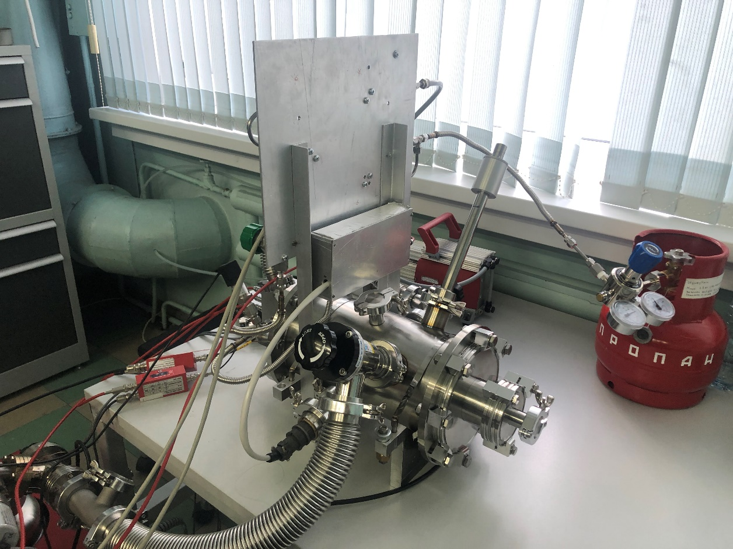
TPC for BINP AMS
Test of the low-pressure TPC in laboratory, before installation.

Slide 16
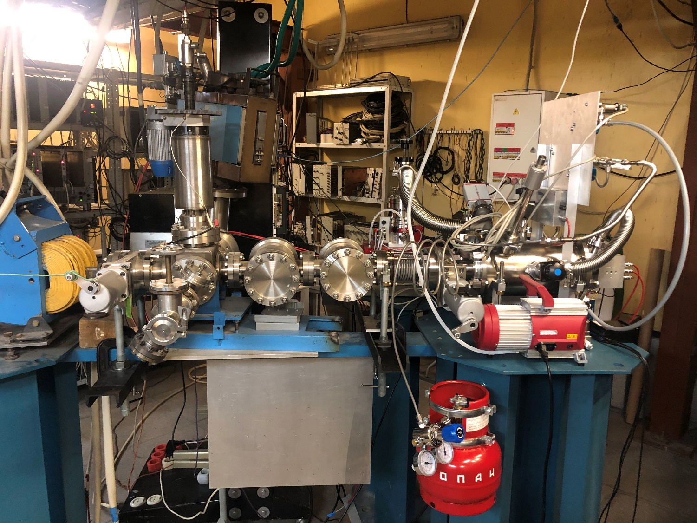
Installation of TPC on BINP AMS
TPC
TOF detectors

Slide 17
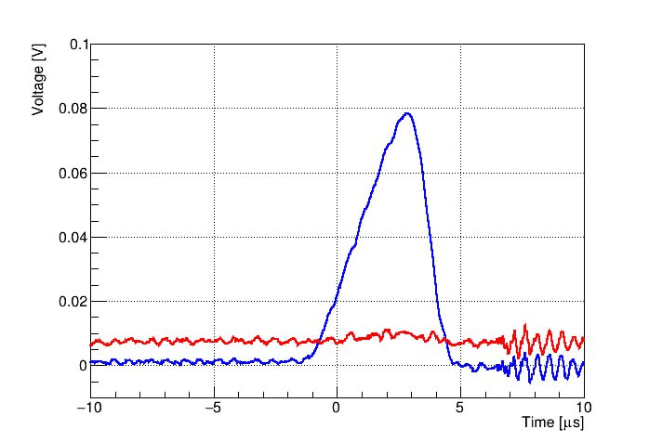
Signal from ¹⁴C and ⁴He
Signal from 4MeV ¹⁴C ion
Signal from 5.1 MeV alpha particle

Slide 18
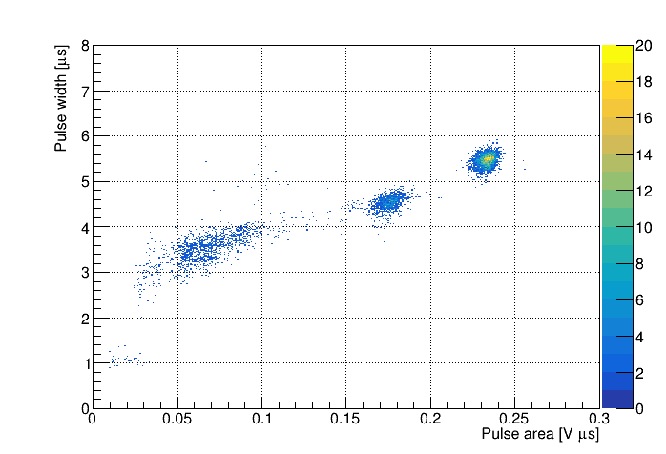
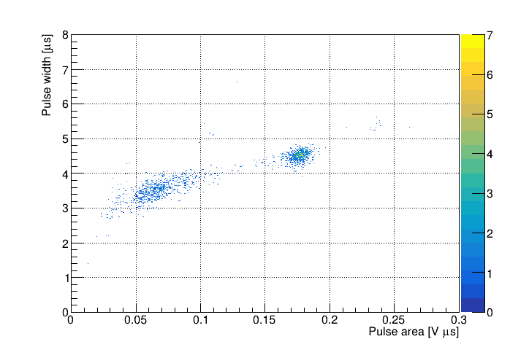
Results on carbon beam
PRELIMINARY
¹⁴C
Sample with “alive” carbon sample
Sample with “dead” carbon sample

Slide 19
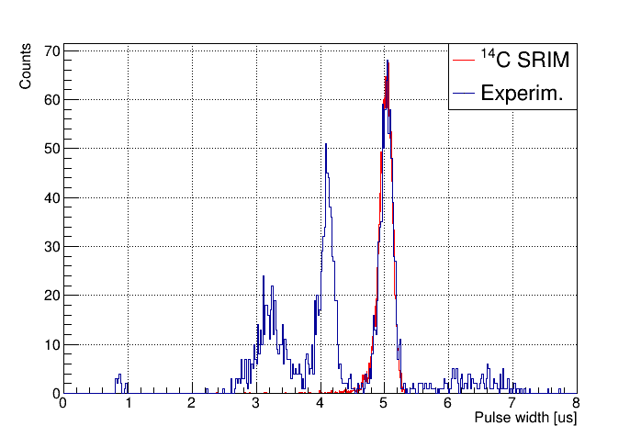
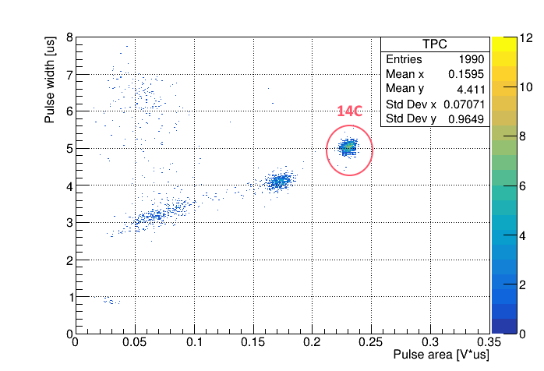
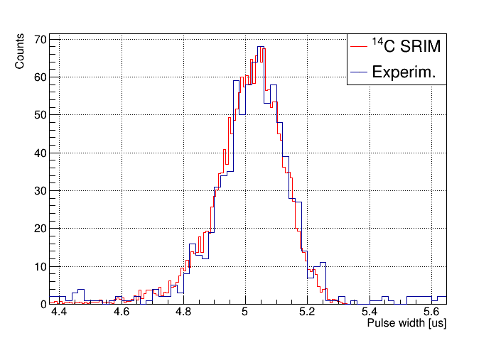
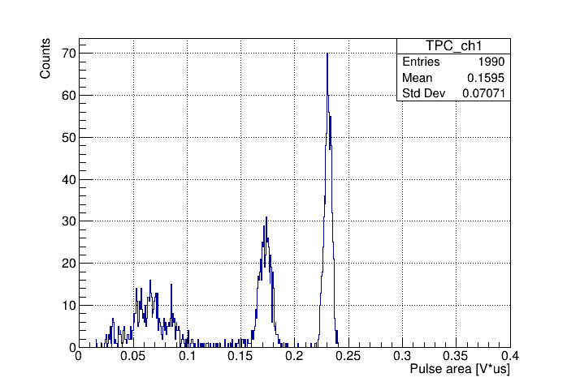
Results on carbon beam

Slide 20
Conclusion
A new concept of the detector for the accelerator-based mass spectrometer was proposed for identifying ions by their stopping range in gas;
A low-pressure TPC prototype, based on this concept, have been made and successfully tested;
The TPC have been installed on AMS;
First results on ¹⁴C beam are promising;
We are preparing to the tests with ¹⁰Be samples.

Slide 21
Thank you for your attention!
<number>

Slide 22
Backup slides
<number>

Slide 23
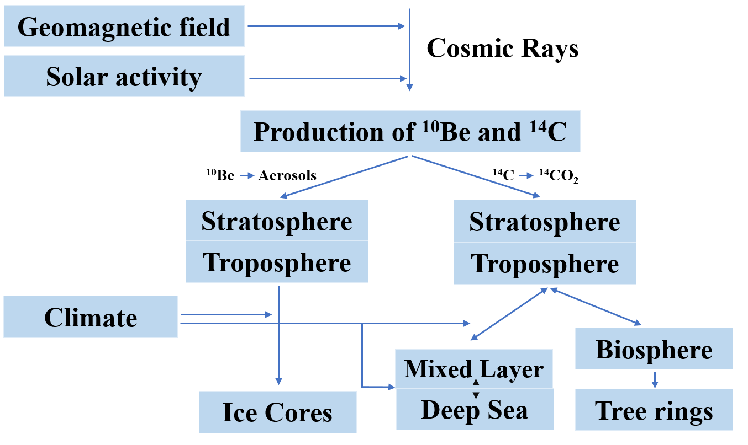
Formation and application ¹⁰Be
Application in-situ and
meteoric ¹⁰Be:
exposure dating to identified the growths and decays of the Antarctic ice sheet;
understanding ice shelf collapse history;
paleomagnetic excursions history reconstructions using ice cores;
understanding the erosion rates using depth profiles of mid latitudes outcrops;
identifying the timing of formation of the impact crater and so forth.
Time intervals of dating:
¹⁴C from 300 years to 40-60 thousand years
¹⁰Be from 1 thousand years to 10 million years

Slide 24
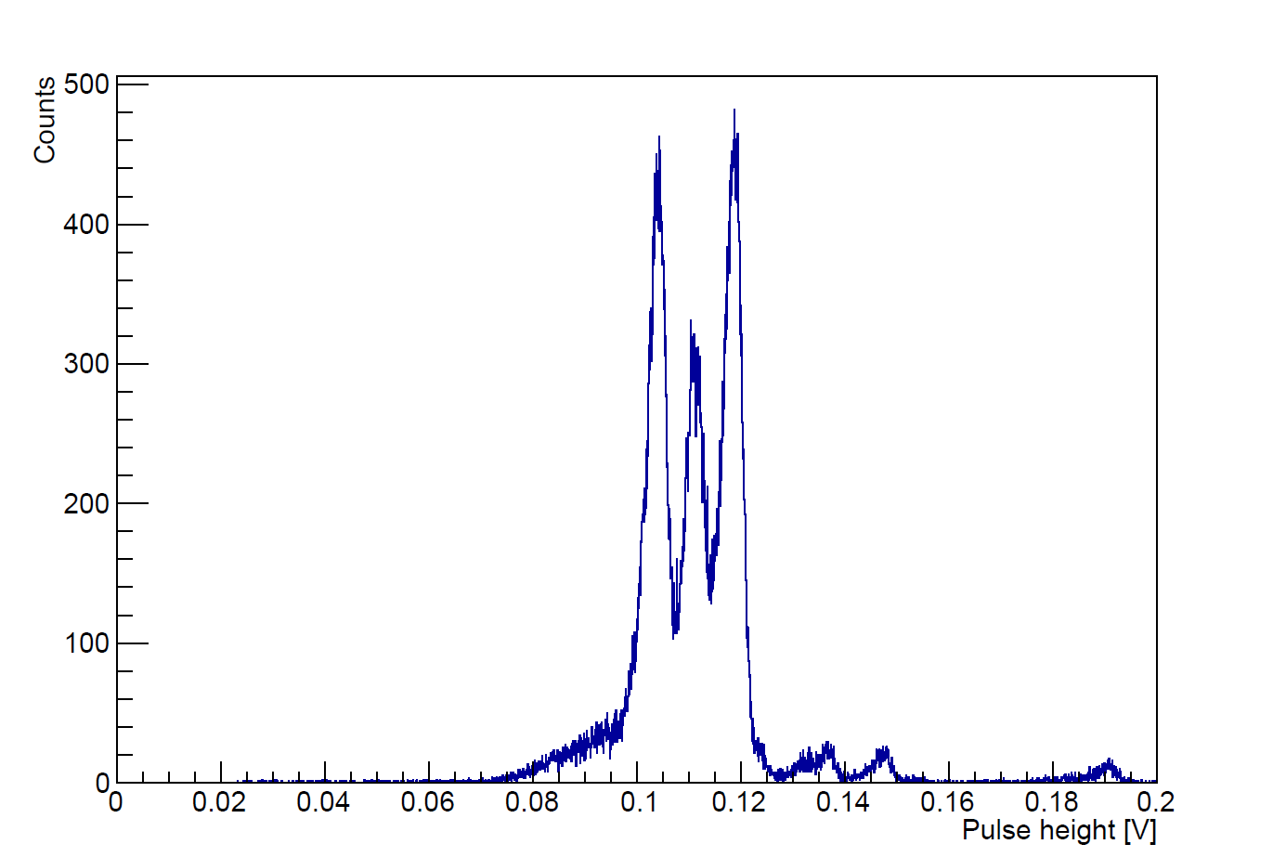
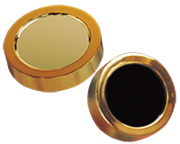
Measurements of energy spectra using semiconductor detector
Alpha particle source– ²³³U, ²³⁹Pu , ²³⁸Pu
Si Charged Particle Radiation Detectors for Alpha Spectroscopy
Energy spectrum of alpha particles from ²³³U (4.8 MeV), ²³⁹Pu (5.2 MeV) and ²³⁸Pu (5.5MeV) sources, measured using semiconductor detector
<number>

Slide 25
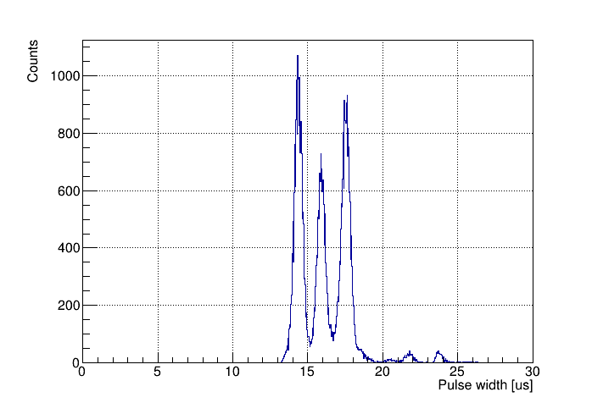
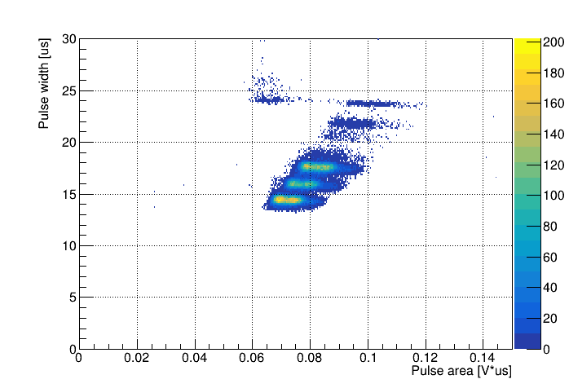
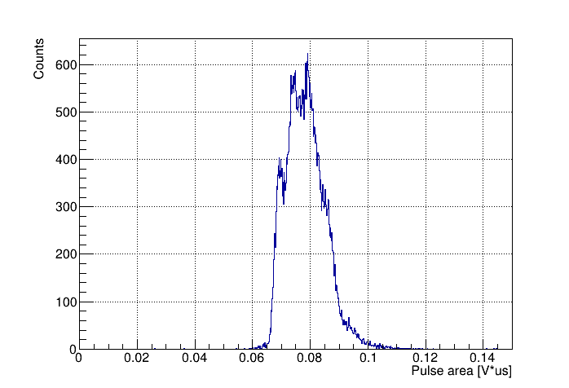
The measurement of track ranges
The alpha-particle source
²³³U, ²³⁹Pu, ²³⁸Pu
Pressure = 50 Torr
THGEM Gain = 67
Shaping time = 200 ns
2D plot of pulse width versus pulse area and their axis projection spectra for alpha particles from ²³³U (4.8 MeV), ²³⁹Pu (5.2 MeV) and ²³⁸Pu (5.5 MeV) source, measured in low-pressure TPC in Isobutane at 50 Torr and THGEM gain of 67.
The pulse width and pulse area spectra reflect those of the track range and energy.
<number>

Slide 26

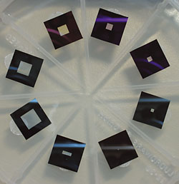
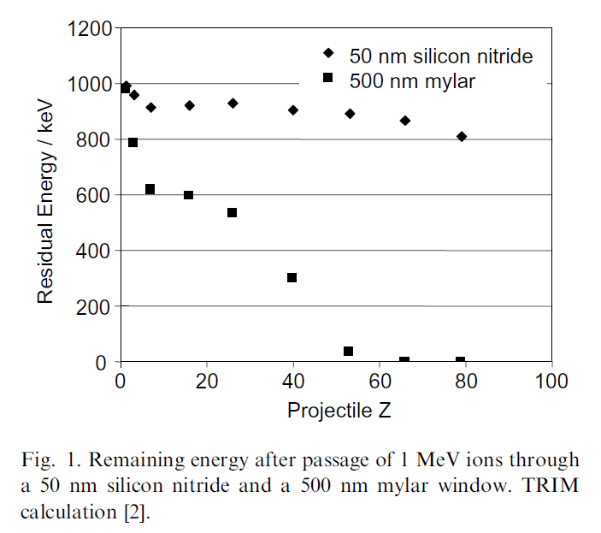
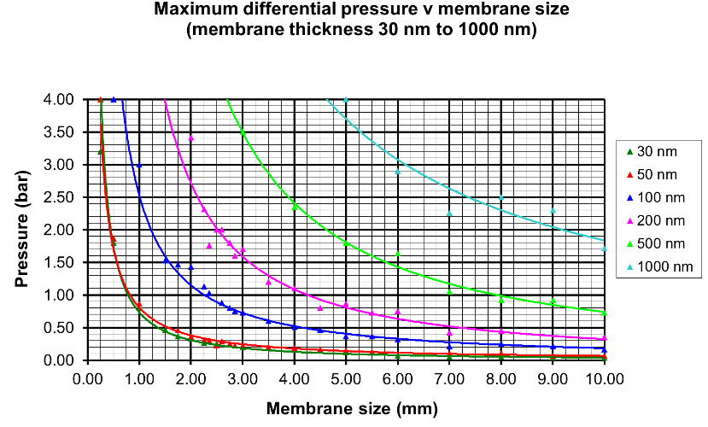
Silicon nitride membrane windows
Figure of silicon nitride membrane windows
M. Dobeli et al., Nucl. Instr. and Meth. B, 219-220 (2004) 415-419 doi:10.1016/j.nimb.2004.01.093
<number>

Slide 27
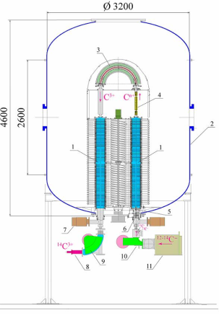
BINP AMS
BINP AMS characteristics:
magnesium vapor target for molecular destruction localized site of molecular breakdown;
sorting of ions by energy immediately after the destruction of molecular ions; effective screening of fragments of molecules; the energy of the pieces of the molecule is always less than the energy of the molecule;
time-of-flight detector for registering the moment of ions arrival.
BINP AMS scheme:
1 – accelerator tube, 2 – accelerator body, 3 – electrostatic turn on 180°, 4 – magnesium vapor target , 5 – corrector, 6 – electrostatic lens, 7 – vacuum pump, 8 – ion detector, 9 – high energy dipole magnetic spectrometer, 10 – low energy dipole magnetic spectrometer, 11 – ion source.
<number>

