Slide 1

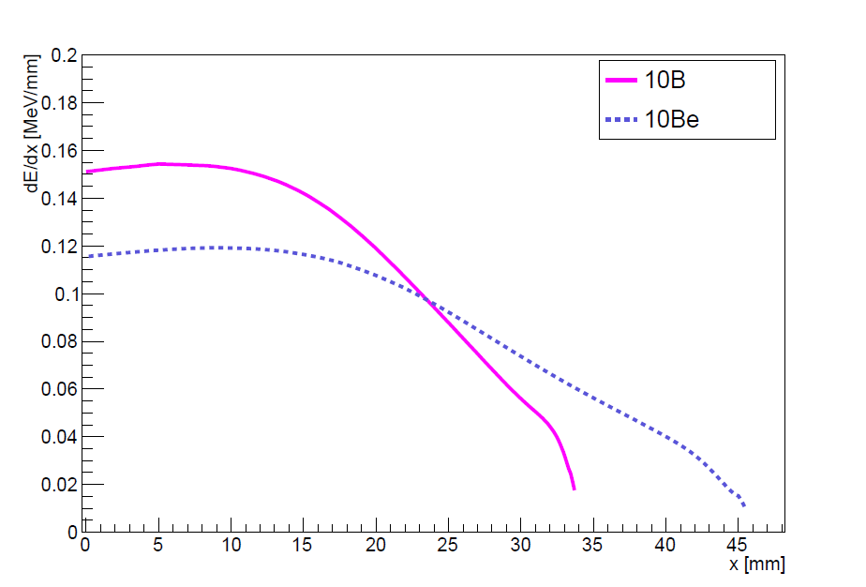
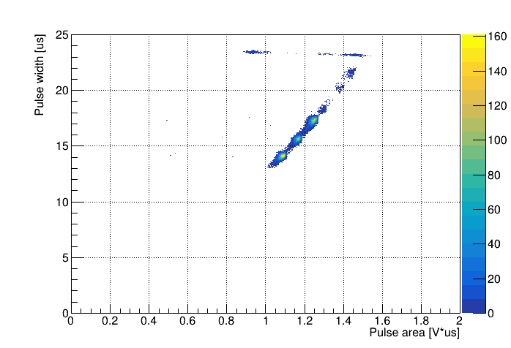
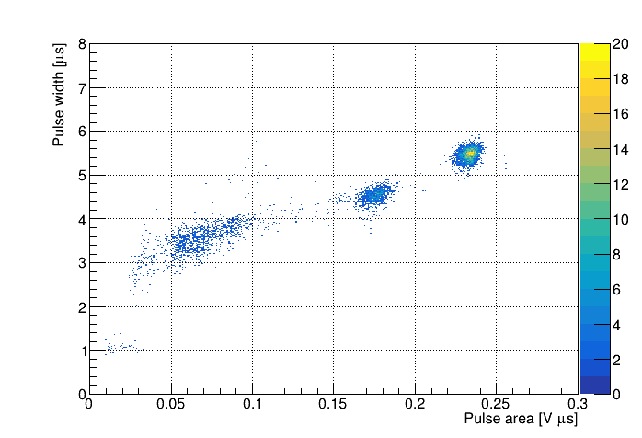
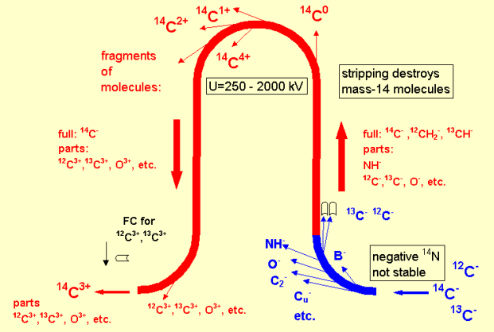
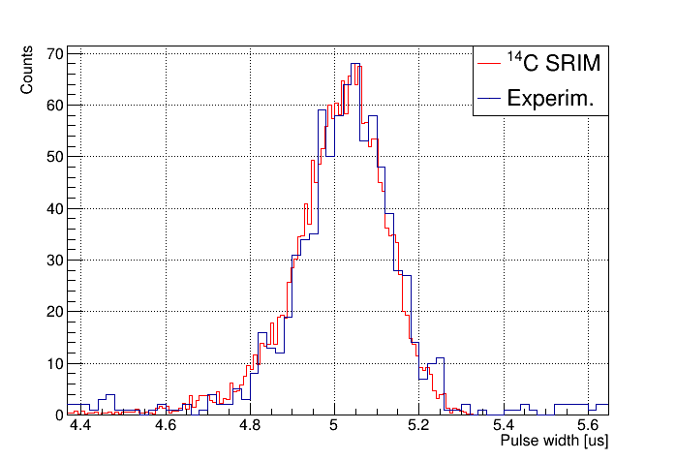
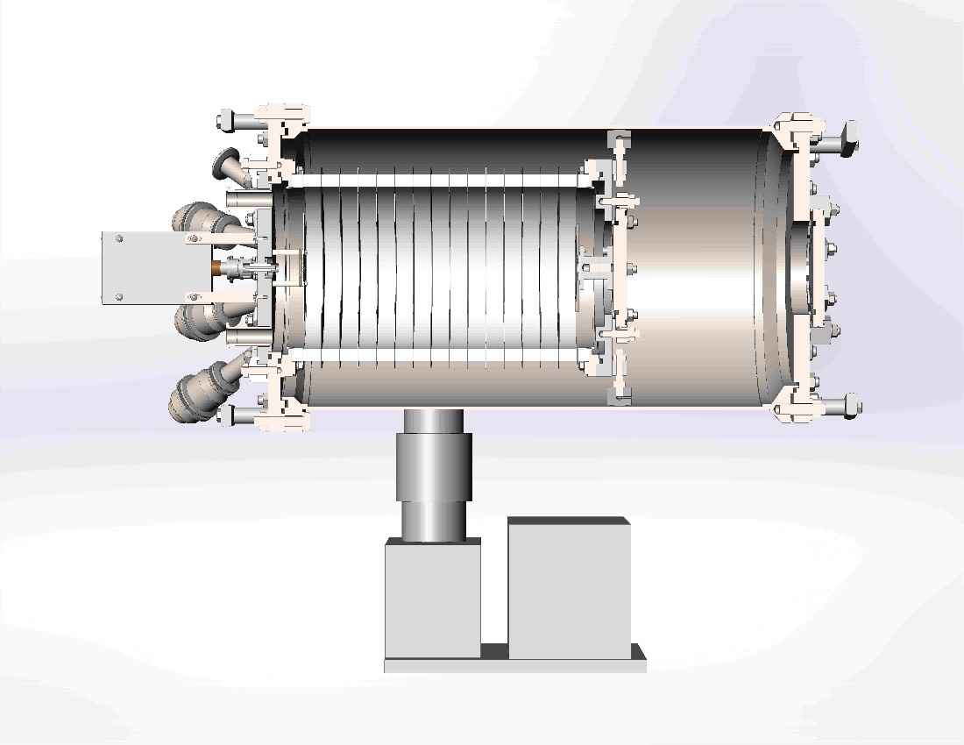
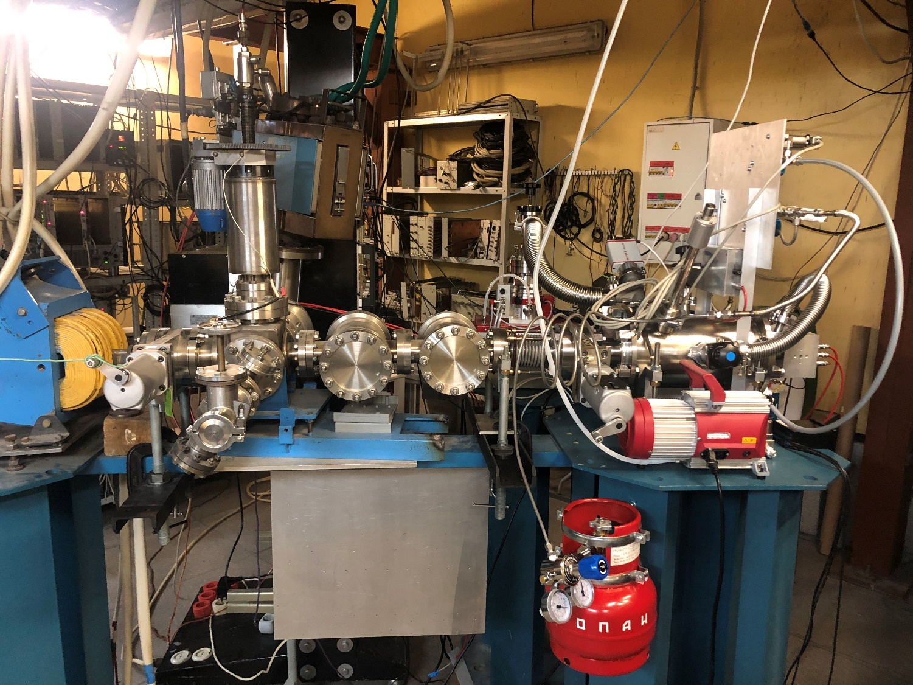
NEW TECHNIQUE OF ion IDENTIFICATION IN AMS USING Low-pressure tpc WITH GEM READOUT (A. Sokolov)
²³³U (4.8 MeV)
²³⁹Pu (5.2 MeV)
²³⁸Pu (5.5 MeV)
¹⁴C
BINP AMS provides reliable separation of a pure beam of radiocarbon ions from the accompanying ion background. But that technique can’t separate the isobars - different chemical elements having the same atomic mass. The typical example are radioactive isotopes ¹⁰Be and ¹⁰B.
The idea is to use the TPC with low pressure gas filling to measure track ranges from different ion species.
2D plot of pulse width versus pulse area and their axis projection spectra for alpha particles from ²³³U (4.8 MeV), ²³⁹Pu (5.2 MeV) and ²³⁸Pu (5.5 MeV) source. The pulse width and pulse area spectra reflect those of the track range and energy. The separation between peaks are more than 8 sigma.
A new concept of the detector for the AMS was proposed for identifying ions by their stopping range in gas;
A low-pressure TPC prototype, based on this concept, have been made and successfully tested;
The TPC have been installed on AMS;
First results on ¹⁴C beam are promising;
We are preparing to the tests with ¹⁰Be samples.
We built the prototype of the TPC and successfully tested it with the triple alpha-source. TPC was filled by the isobutan at 50 Torr pressure.
The TPC installation on BINP AMS

