Slide 1



Bayesian optimisation of a novel x-ray shaping device with no moving parts
Brendan Whelan, Stefania Trovati, Jinghui Wang, Rebecca Fahrig, Muhammad Shumail, Sami Tantawi, Julian Merrick, Joseph Perl, Paul Keall, Billy W Loo

Slide 2
COI
I consult for tibaray, a start up which is commercialising some of the technology for this work.
If my University ever gets its act together, I might even get money for this and have a proper conflict!
https://tibaray.com/index.php

Slide 3
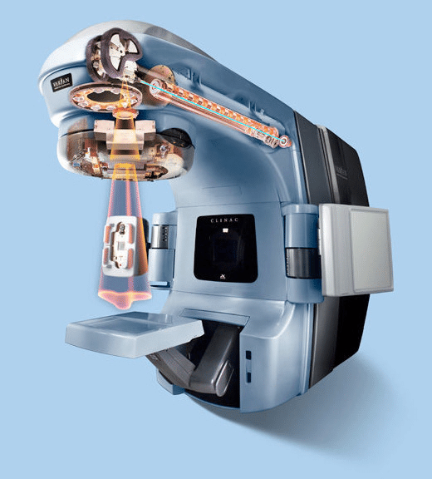
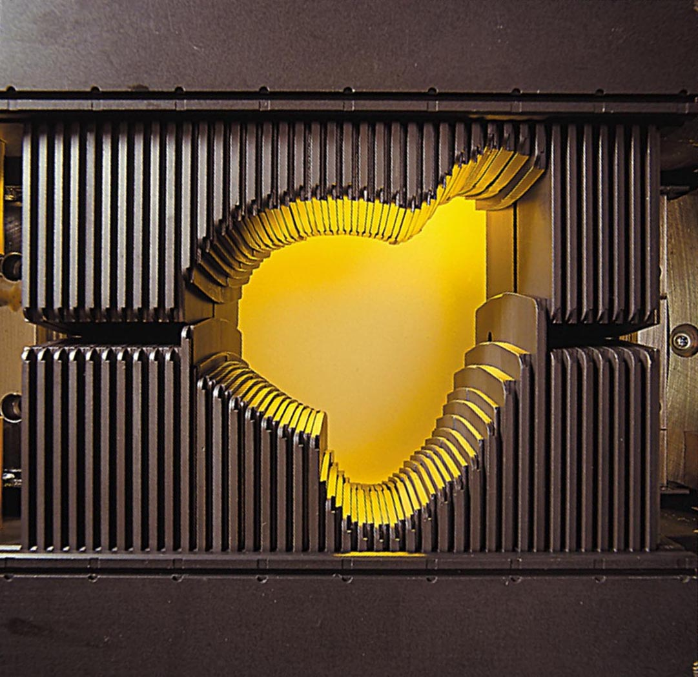
Standard Linear Accelerator for radiotherapy
Most treatments use MV X-rays generated via colliding an MeV electron beam with bremsstrahlung target
Beam shaping facilitated by Multi Leaf Collimator (MLC) – complex mechatronic component

Slide 4
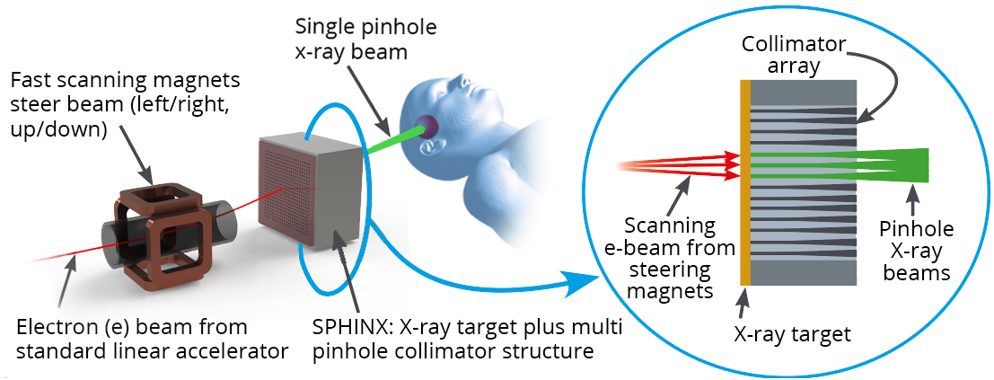
SPHINX: Scanning Pinhole Intensity Modulated X-ray Source
Why?
MLC is the machine components most likely to break down – especially true in developing countries Wroe 2020. "Comparative analysis of radiotherapy linear accelerator downtime and failure modes in the UK, Nigeria and Botswana."
Current approach cannot leverage order-of-magnitude advances in accelerator technology Tantawi 2020. "Design and demonstration of a distributed-coupling linear accelerator structure."

Slide 5
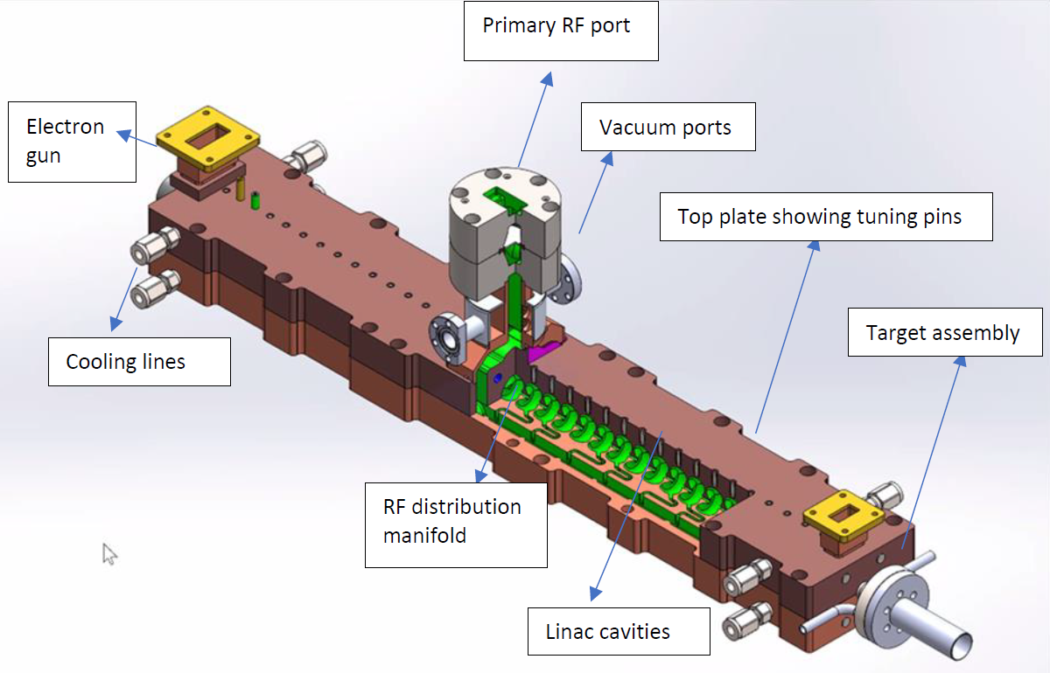
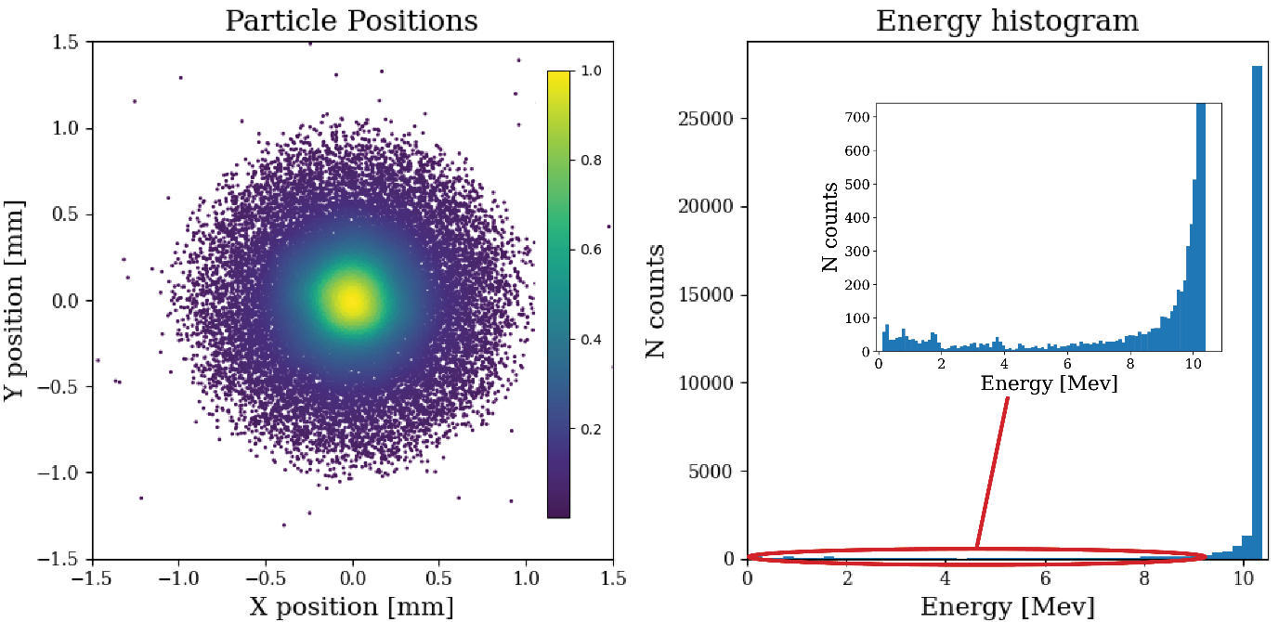
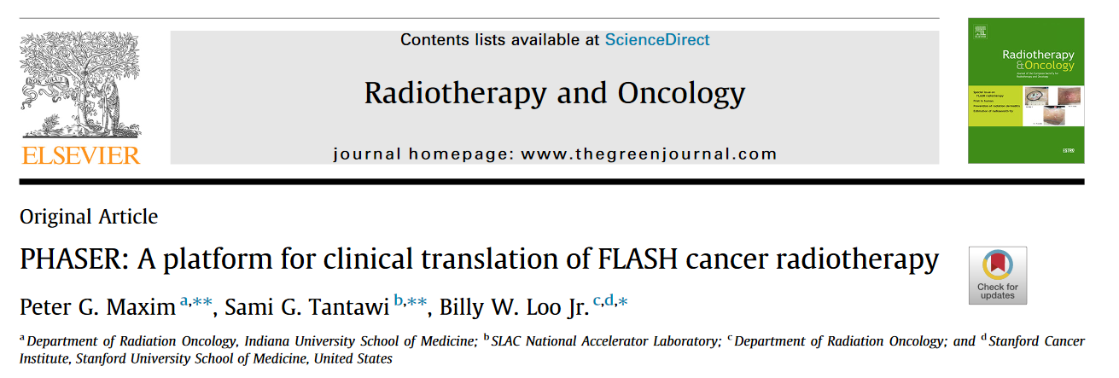
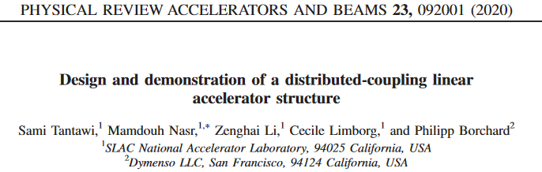
Electron source: The DRAGON Linac
Parameter | Conventionl Value | DRAGON Value
Duty cycle | 0.001 | 0.005 (x 5)
Current (during pulse) | ~ .1A | 0.3 A (x 3)
Energy | NA | 10.4 MeV

Slide 6
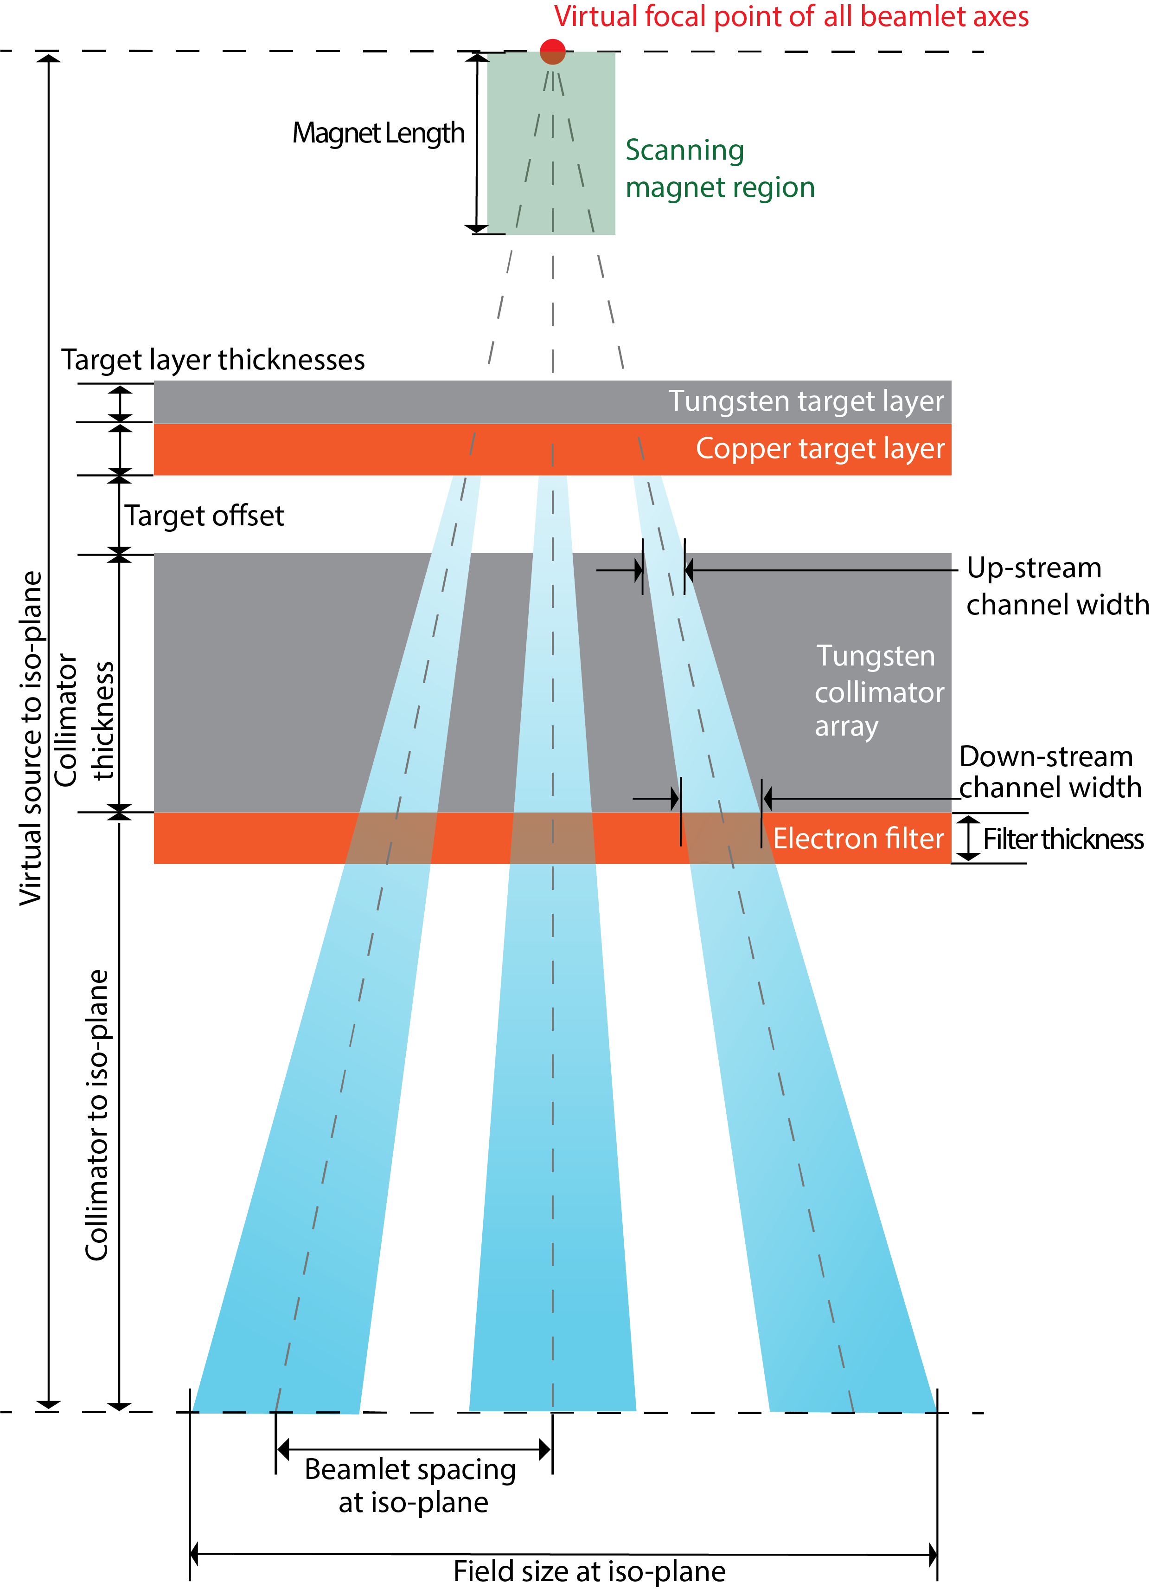

Slide 7
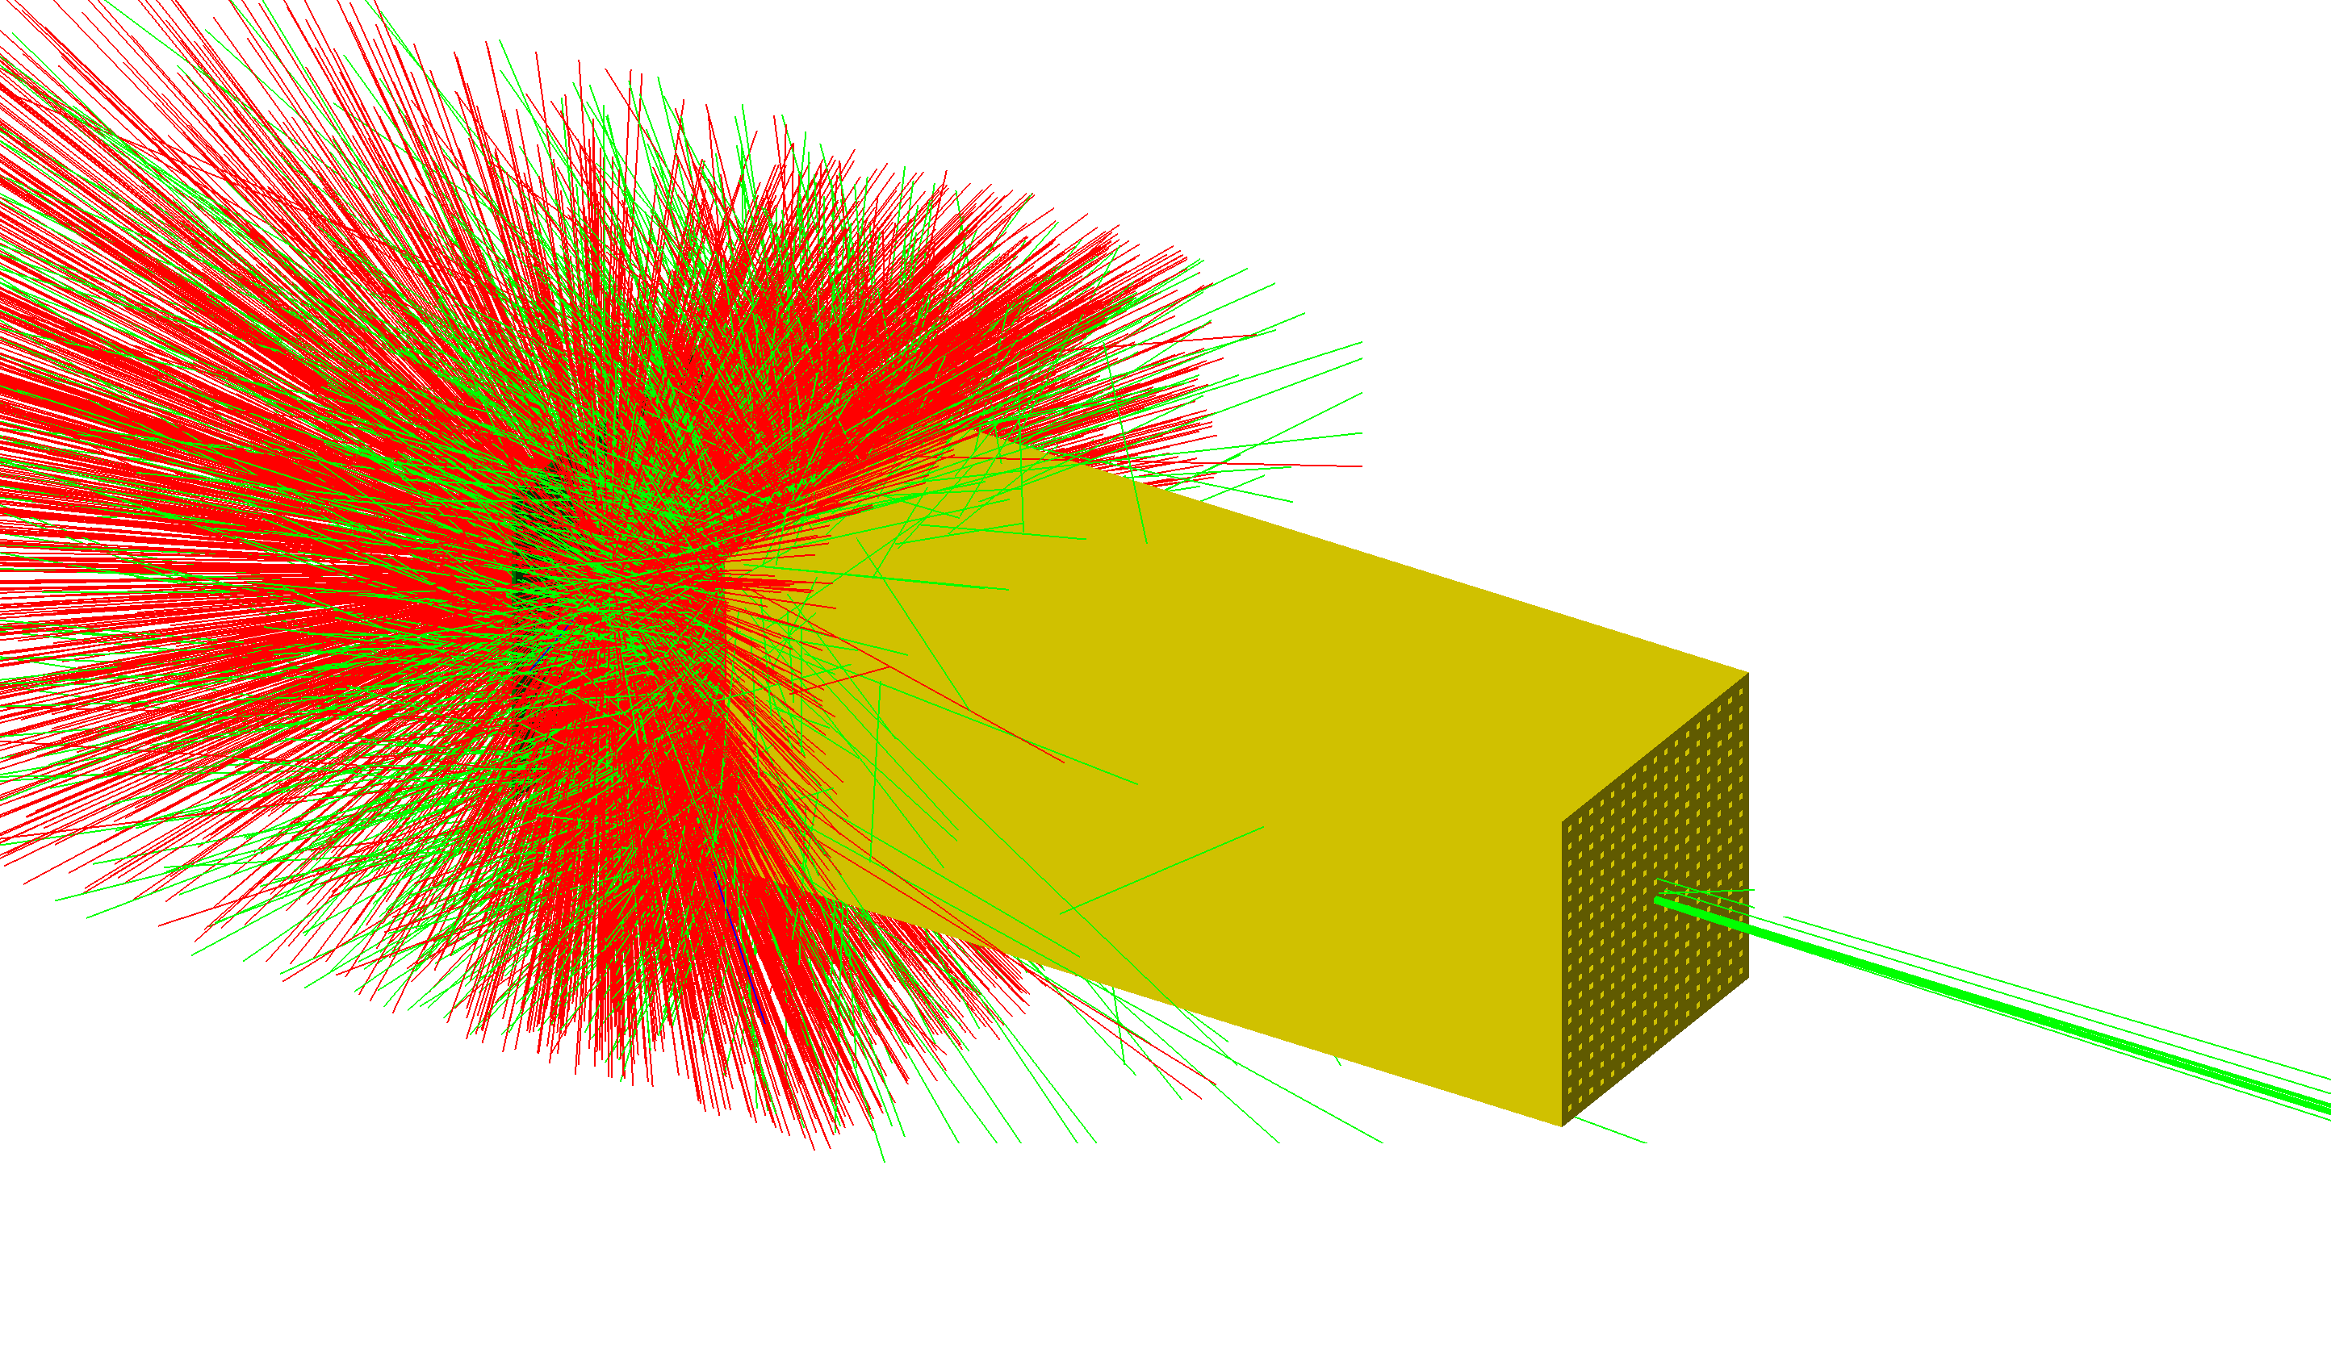
SPHINX: topas model
electrons
photons
Notes:
Choose which parameters to vary, and select some starting values and bounds
Simulate the design using those parameters. We use topas Monte Carlo to do this. This simulation incorporates the simulated electron phase space from a next generation linac being designed at SLAC, transport through the scanning magnets, X-ray production and transport through the collimator, and finally dose in a water tank.

Slide 8
TopasOpt: An open-source library for optimisation with Topas Monte Carlo
Brendan Whelan, Billy W Loo Jr, Paul Keall

Slide 9
Background: Monte Carlo modelling for radiation transport
Design of new accelerator components
Primary dose calculation
Secondary dose check
Research into novel therapeutic strategies
“It’s inevitable that your model will contain some parameters you don’t know the best value for.”
Brendan Whelan, AAPM, 2022
Notes:
If you’re designing a new component, you want to pick the parameters to optimise performance
If you’re doing dose calculations, you may have some experimental data but find that you don’t know either your geometric or beam parameters perfectly
Even when the geometry and particle definitions are locked in stone, there are many hyperparameters that determine the accuracy and speed of the overall calculation.

Slide 10
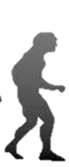
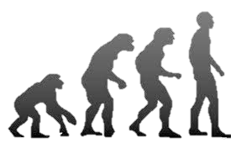

How to find the best value for unknown parameters?
Guesstimate
Random sampling
Structured grid search
Optimisation

Slide 11
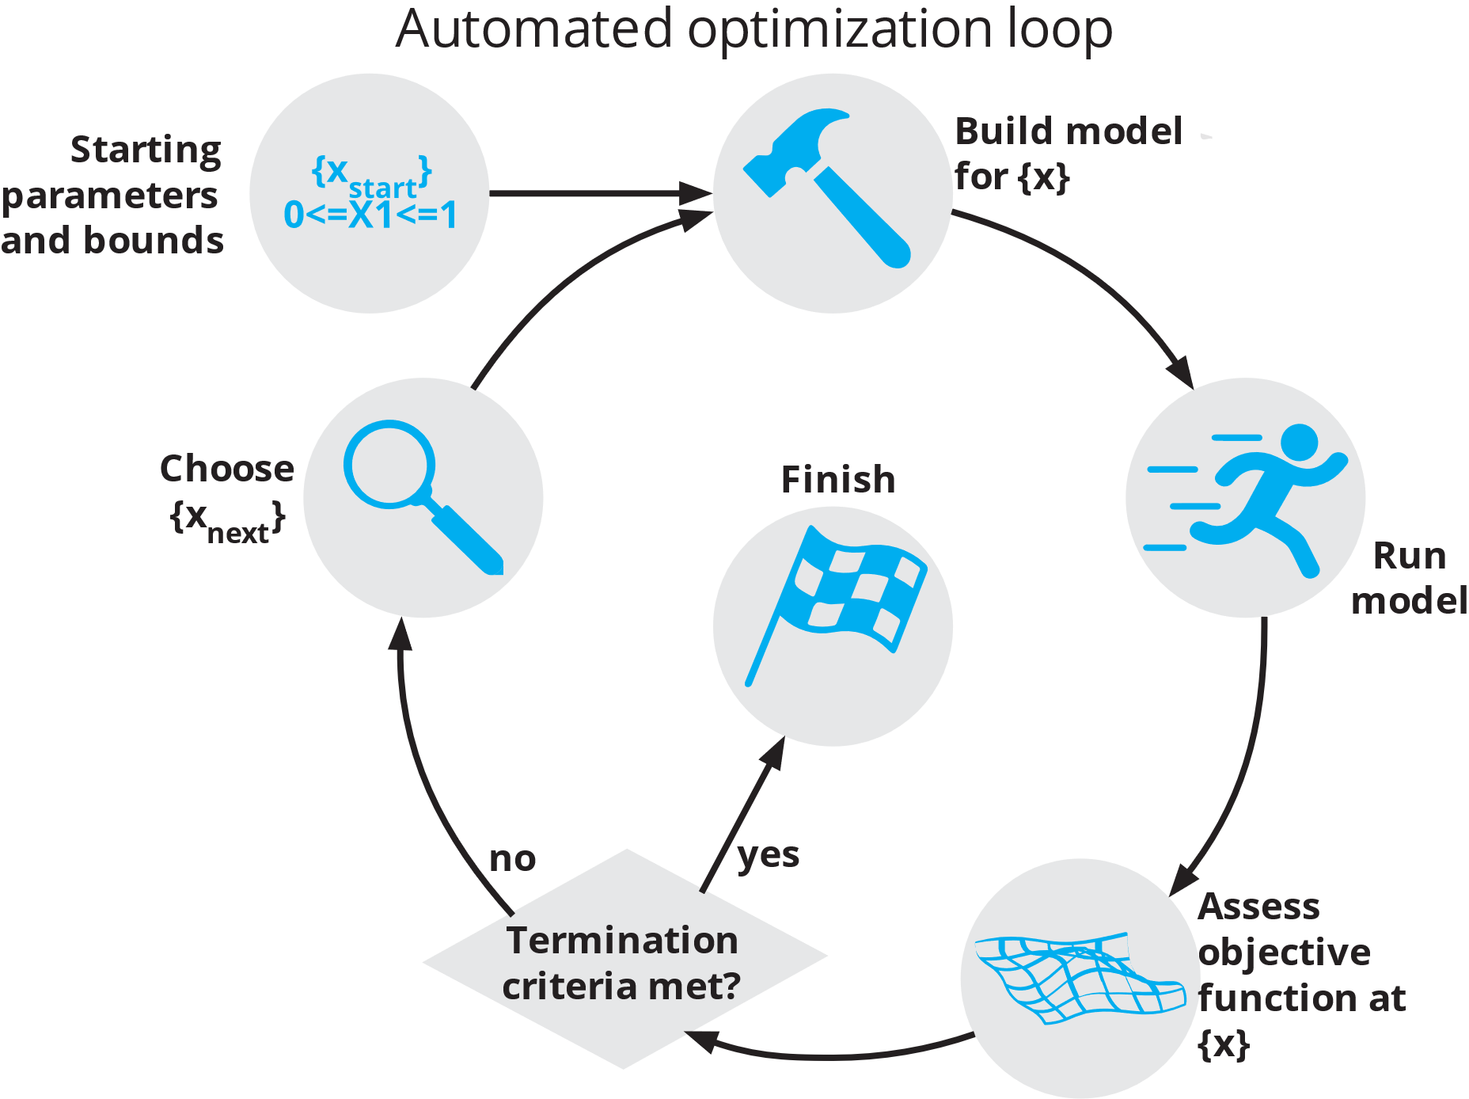
TopasOpt

Slide 12
TopasOpt

Slide 13
TopasOpt

Slide 14
TopasOpt

Slide 15
TopasOpt

Slide 16
TopasOpt

Slide 17
TopasOpt

Slide 18
TopasOpt
?

Slide 19
Algorithms

Slide 20
What type of objective function do we have?
Expensive (slow) to evaluate
X
We are here!
(very difficult)
Gradients available
Objective function of unknown form
Linear objective function
Cheap (quick) to evaluate

Slide 21
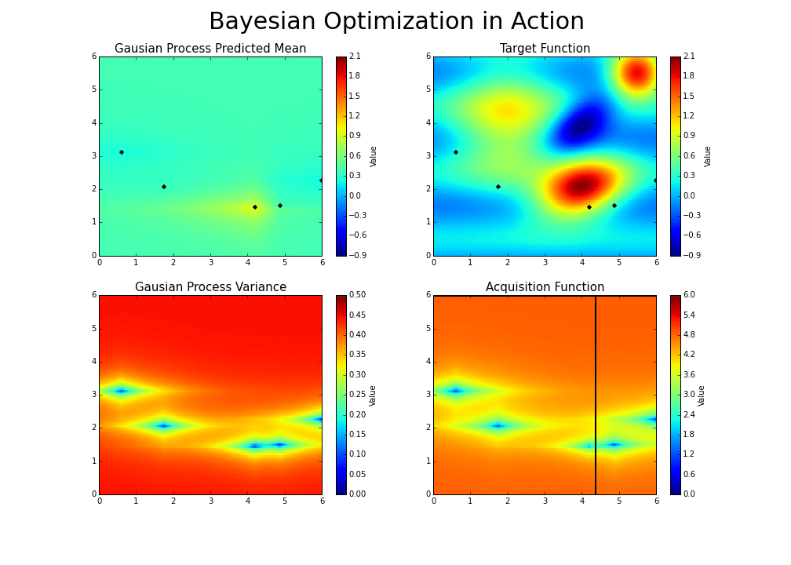
TopasOpt Algorithms: Bayesian Optimization
True objective (unknown)
https://github.com/fmfn/BayesianOptimization

Slide 22
TopasOpt Algorithms: Bayesian Optimization
True objective (unknown)
GP prediction
https://github.com/fmfn/BayesianOptimization

Slide 23
TopasOpt Algorithms: Bayesian Optimization
True objective (unknown)
GP prediction
GP variance
https://github.com/fmfn/BayesianOptimization

Slide 24
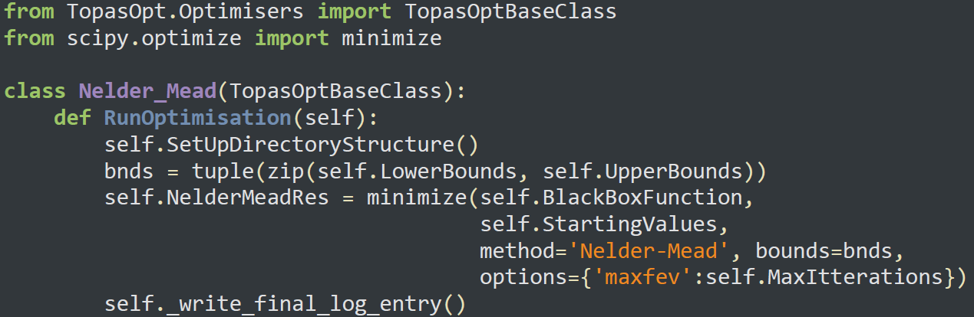
Implementing new algorithms

Slide 25

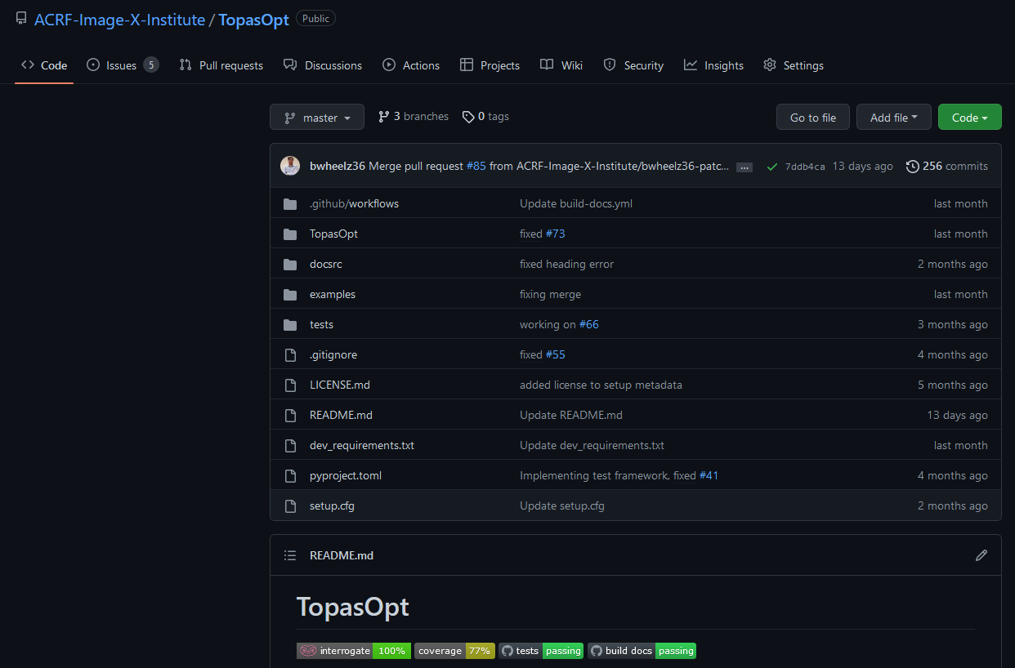
Free, Open Source, MIT licensed
We have worked examples of transforming existing topas models into optimisation problems
No more guestimates and grid searches!

Slide 26
So, back to SPHINX…
Maximize dose efficiency (Gy/C)
  While achieving a given beamlet width
  With minimal cross talk between channels
  With some minimum wall thickness
  And no electron contamination
Bayesian Optimization algorithm used to optimize 8 geometric parameters over 300 iterations, for beamlet widths of 5, 7, and 10 mm.

Slide 27
RESULTS

Slide 28
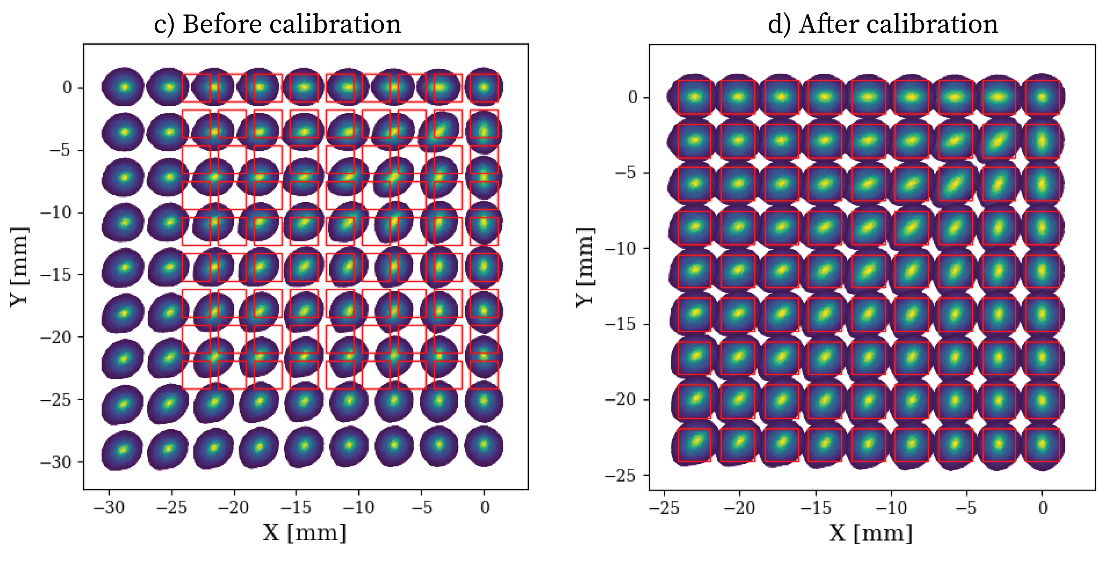
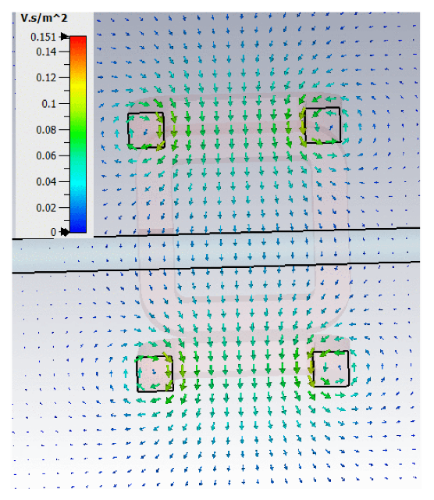
Scanning magnet calibration
Scanning magnet
Before calibration
After calibration
Y [mm]
Y [mm]
X [mm]
X [mm]

Slide 29
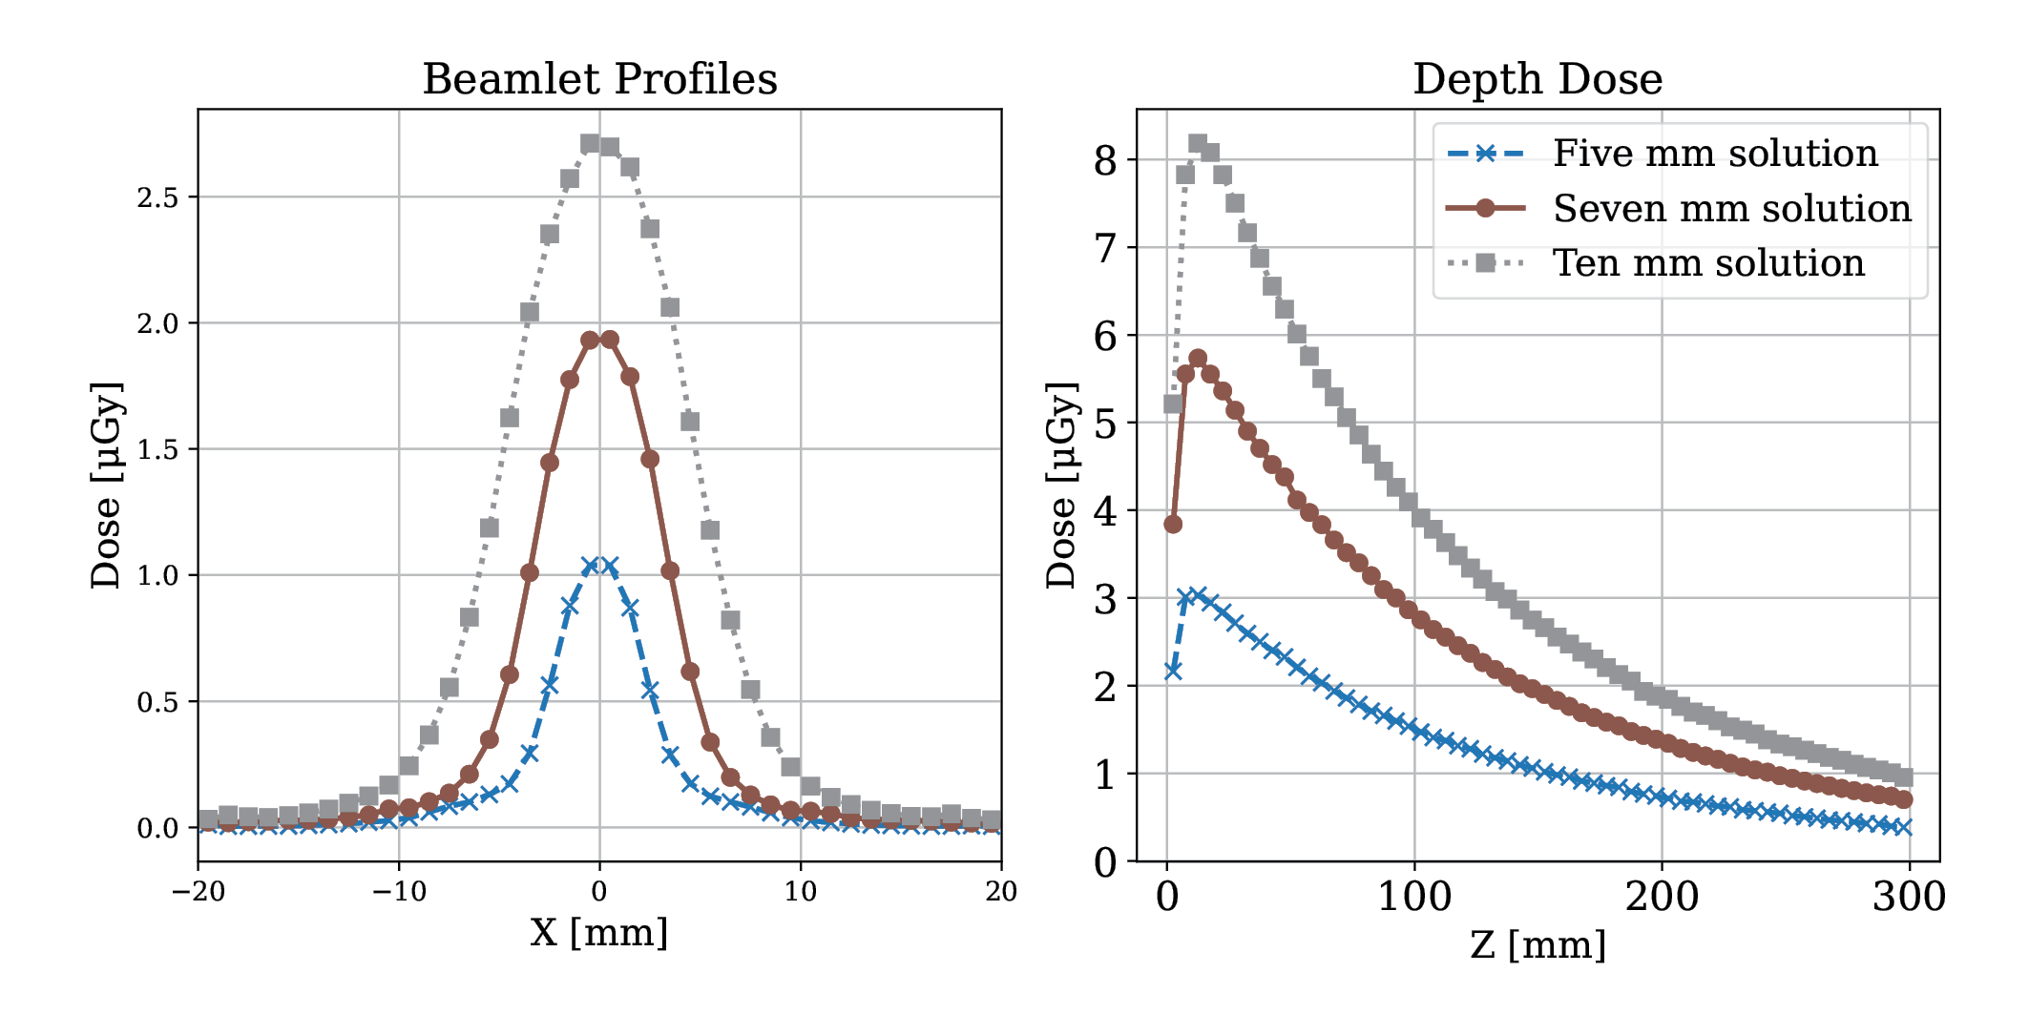
Designs
Beamlet Profiles
Depth Dose
Beamlet profiles
Dose [μGy]
Dose [μGy]
X [mm]
Z [mm]
All beamlet widths within 0.2 mm of goal
Notes:
- Smaller beamlets, reduced dose rate: 5 mm solution has approximately 1/3 of the dose rate of the 10 mm solution.
- Very normal looking: no cross talk and no electron contamination. This is not trivial for SPHINX!

Slide 30
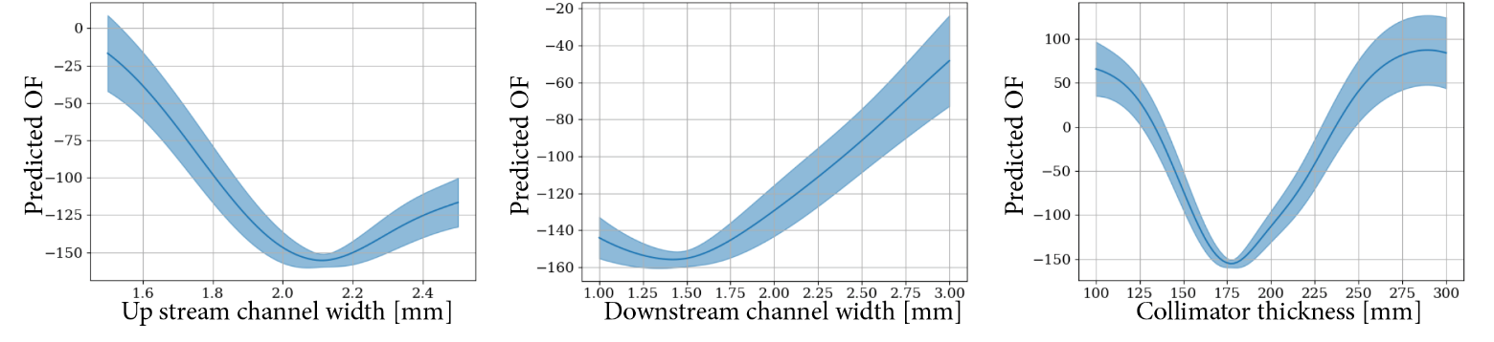
Gaussian process predicted objective values
Predicted OF
Predicted OF
Predicted OF
Upstream
channel width [mm]
Downstream
channel width [mm]
Collimator thickness [mm]

Slide 31
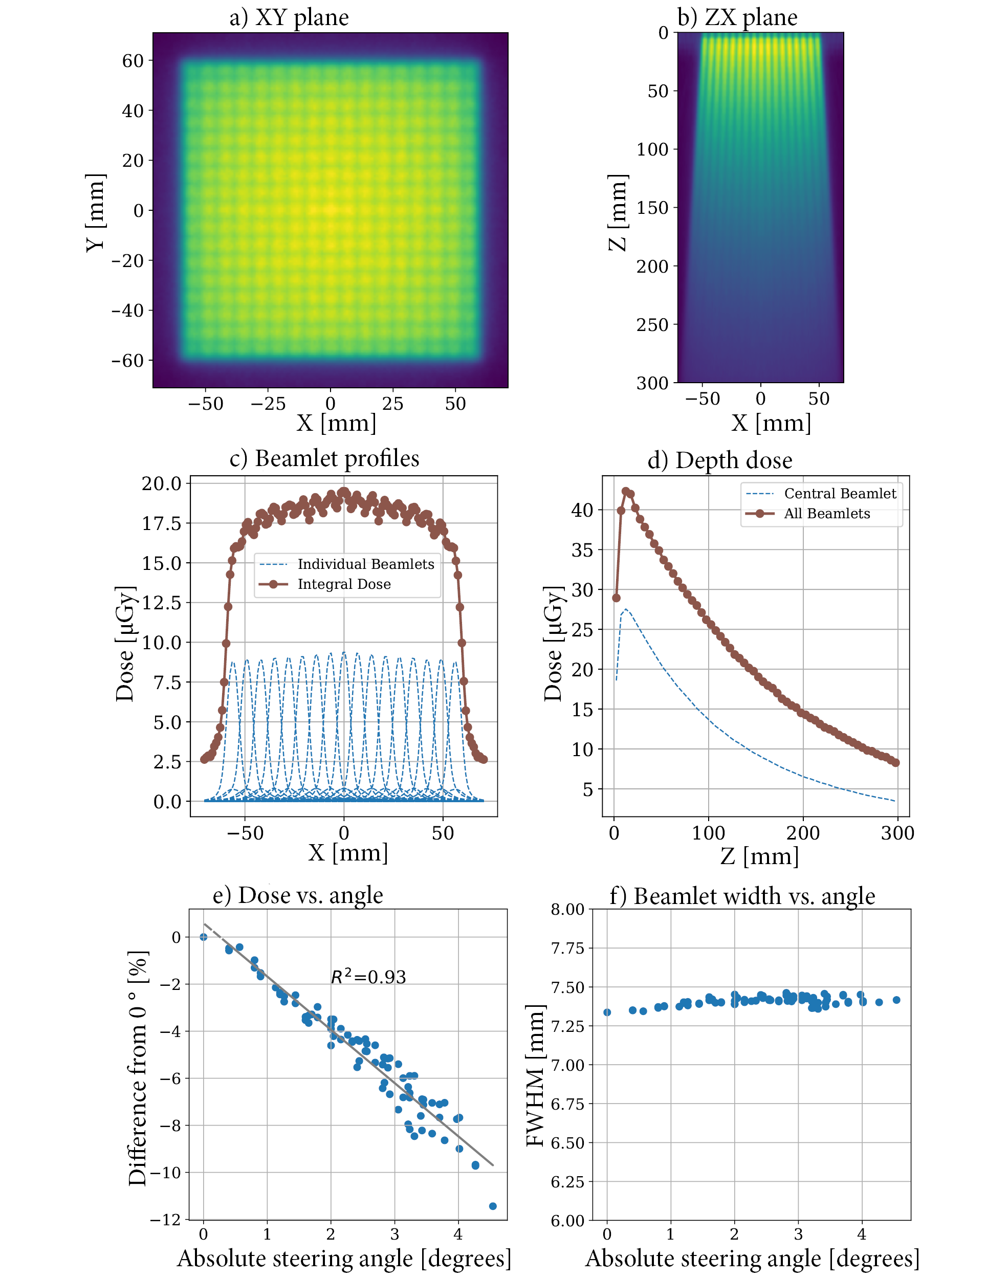
All beamlets in water
XY plane
ZX plane
Dose rate versus angle
Notes:
You can see some remnant grid structure in the dose distriubtions. Note that this is something that can be tuned; from a multi beam treatment we would expect that these effects are eliminated in the treatment volume
Also, this grid structure may even enable organ sparing

Slide 32
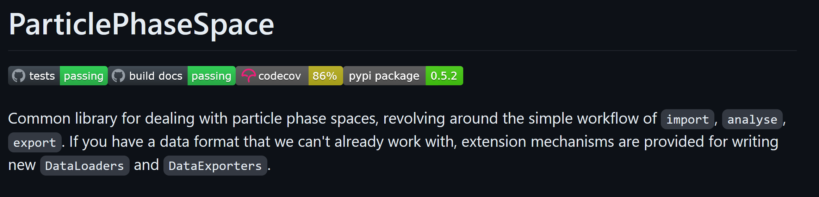
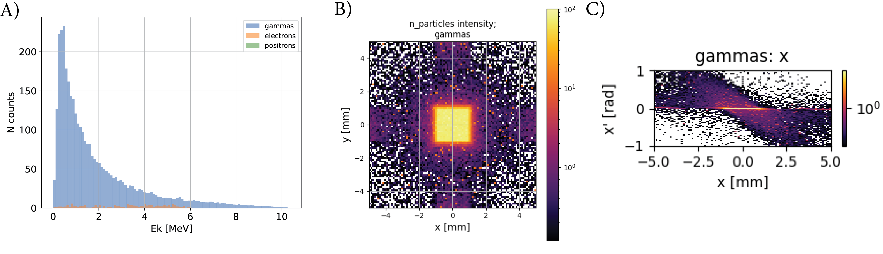

Slide 34

Bayesian optimisation of a novel x-ray shaping device with no moving parts
Thank you!

Slide 35
Electron source: The DRAGON Linac
Parameter | Conventionl Value | DRAGON Value
Duty cycle | 0.001 | 0.005 (x 5)
Current (during pulse) | ~ .1A | 0.3 A (x 3)
Energy | NA | 10.4 MeV

Slide 36
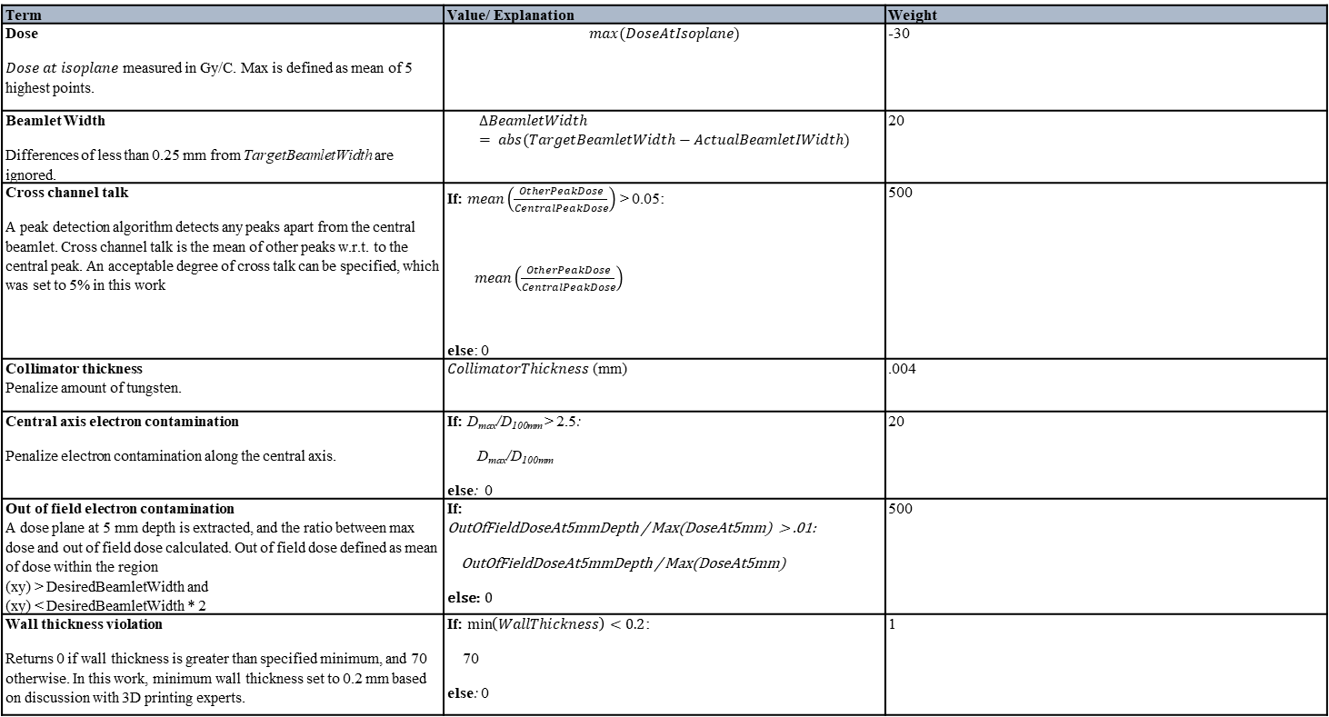
Term | Value/ Explanation | Weight
Dose $Dose at isoplane$ measured in Gy/C. Max is defined as mean of 5 highest points. | $$max(DoseAtIsoplane)$$ | -30
Beamlet Width Differences of less than 0.25 mm from TargetBeamletWidth are ignored. | $$∆BeamletWidth= abs(TargetBeamletWidth−ActualBeamletIWidth)$$ | 20
Cross channel talk A peak detection algorithm detects any peaks apart from the central beamlet. Cross channel talk is the mean of other peaks w.r.t. to the central peak. An acceptable degree of cross talk can be specified, which was set to 5% in this work | If: $mean\left(\frac{OtherPeakDose}{CentralPeakDose}\right)$ > 0.05: $mean\left(\frac{OtherPeakDose}{CentralPeakDose}\right)$ else: 0 | 500
Collimator thickness Penalize amount of tungsten. | $CollimatorThickness$ (mm) | .004
Central axis electron contamination Penalize electron contamination along the central axis. | If: D_{max}/D_{100mm} > 2.5: D_{max}/D_{100mm} else: 0 | 20
Out of field electron contamination A dose plane at 5 mm depth is extracted, and the ratio between max dose and out of field dose calculated. Out of field dose defined as mean of dose within the region (xy) > DesiredBeamletWidth and (xy) < DesiredBeamletWidth * 2 | If: OutOfFieldDoseAt5mmDepth / Max(DoseAt5mm) > .01: OutOfFieldDoseAt5mmDepth / Max(DoseAt5mm) else: 0 | 500
Wall thickness violation Returns 0 if wall thickness is greater than specified minimum, and 70 otherwise. In this work, minimum wall thickness set to 0.2 mm based on discussion with 3D printing experts. | If: $\min\left(WallThickness\right)<0.2$: 70 else: 0 | 1

