Slide 1
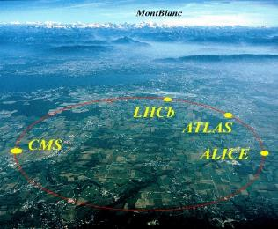
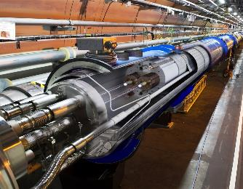
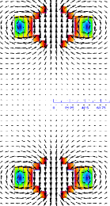
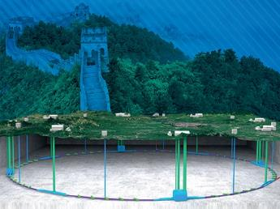
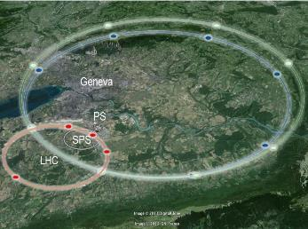


Progress of the High Field Magnet Technology
for the High-energy Particle Accelerators
Qingjin Xu
for the Superconducting Magnet Group at
the Accelerator Division, IHEP
Mar 30 2023
中国科学院高能物理研究所
Institute of High Energy Physics, CAS
AFAD2023, Melbourne, Apr. 12-14 2023
李政道研究所-粒子与核物理研究所联合报告

Slide 2

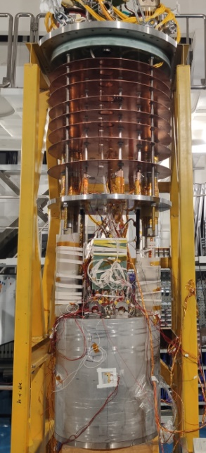
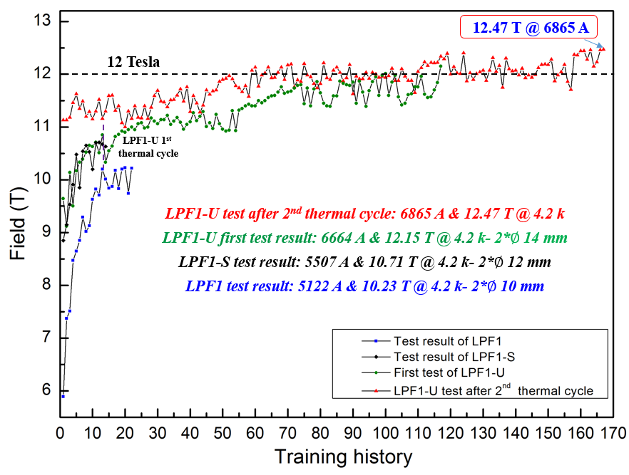
R&D of the High Field Model Dipoles
~90% SSL
2021
2019
2018
2

Slide 3
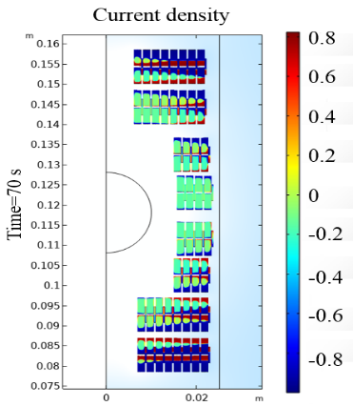
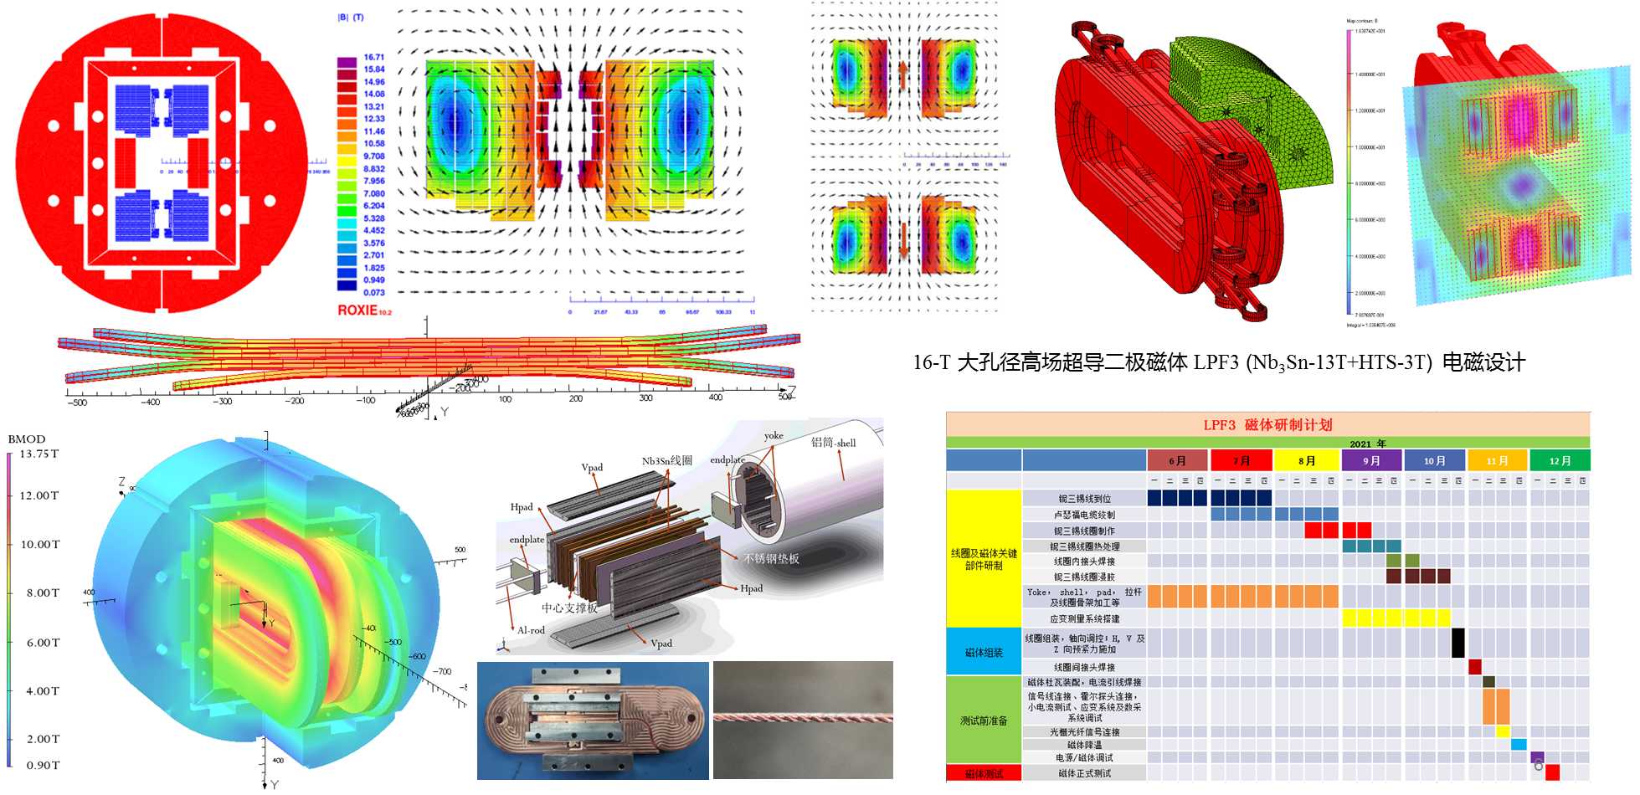
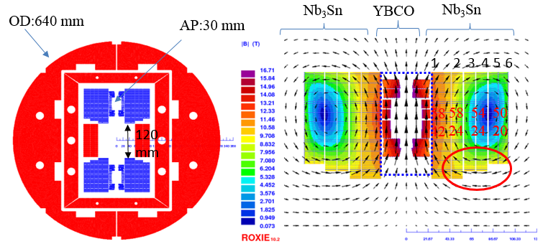
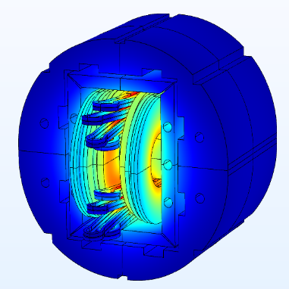
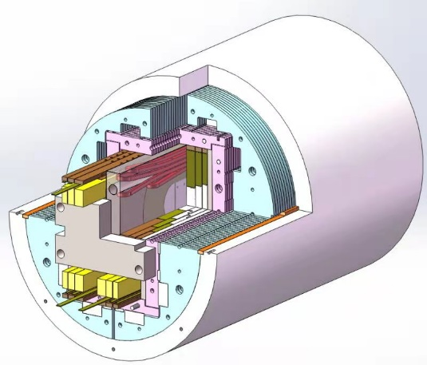
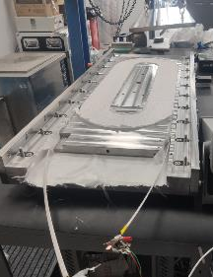
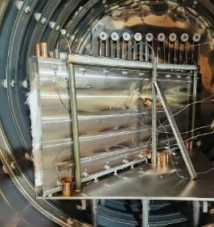
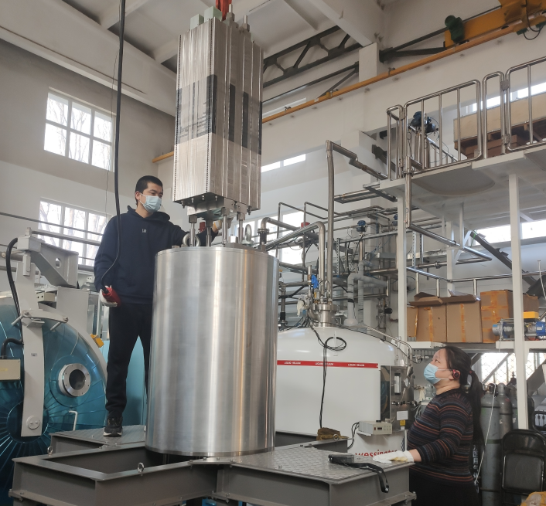
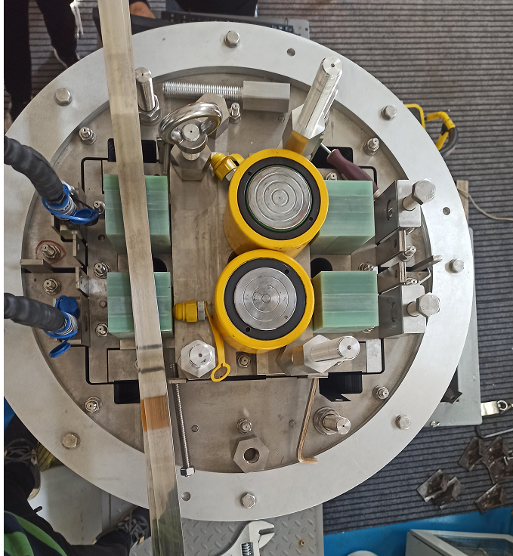
R&D of the High Field Model Dipoles
16 T Model Dipole: Nb₃Sn 12~13 T + HTS 3~4 T
3

Slide 4
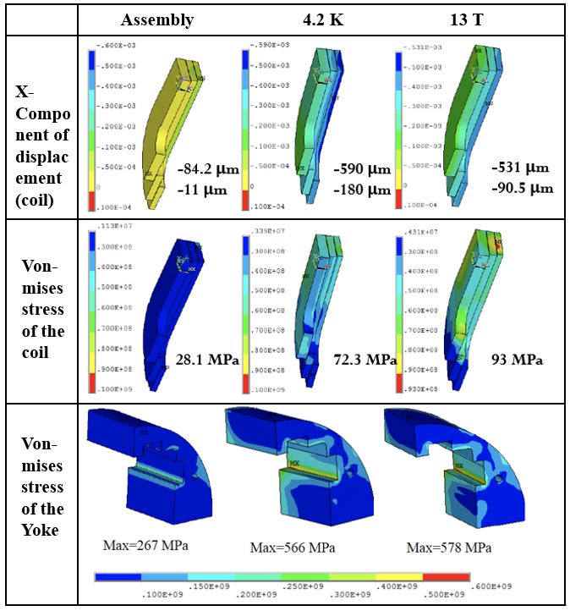
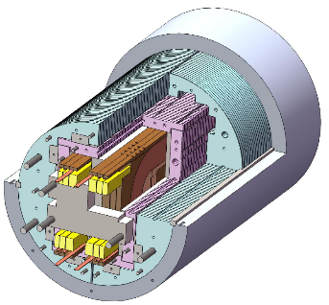
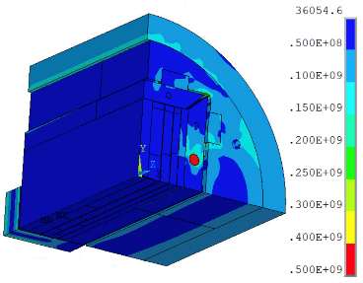
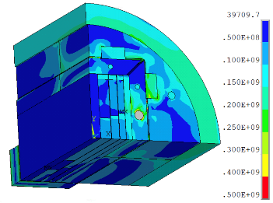
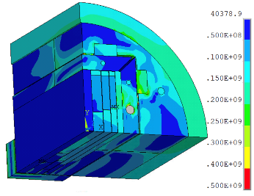
R&D of the High Field Model Dipoles
Stress distribution in different loading steps
Assembly
13 T
4.2 K
4

Slide 5
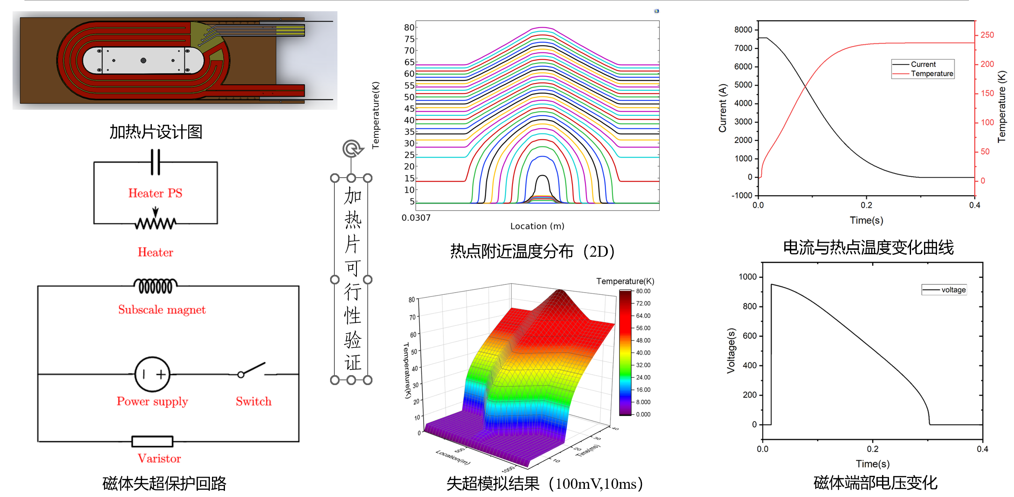
R&D of the High Field Model Dipoles
The calculation indicates that the temperature of hot spot is 237 K and the max voltage is 952 V. Safe.
5

Slide 6
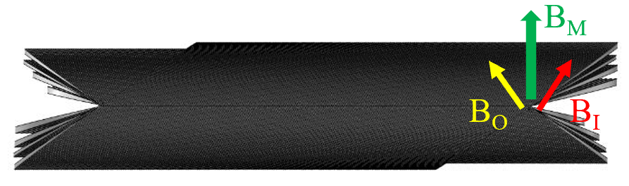
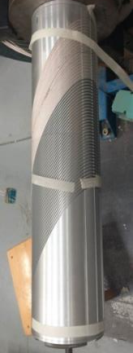
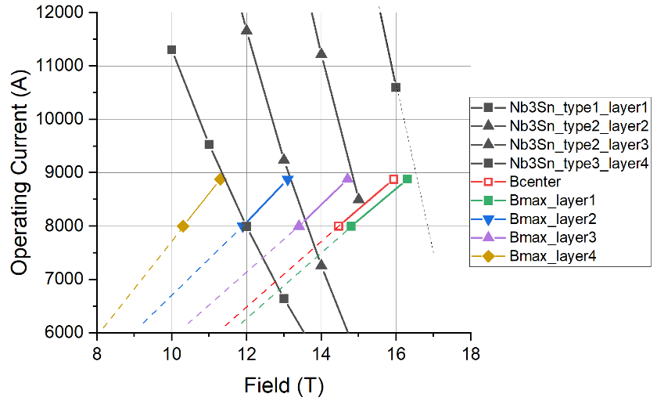
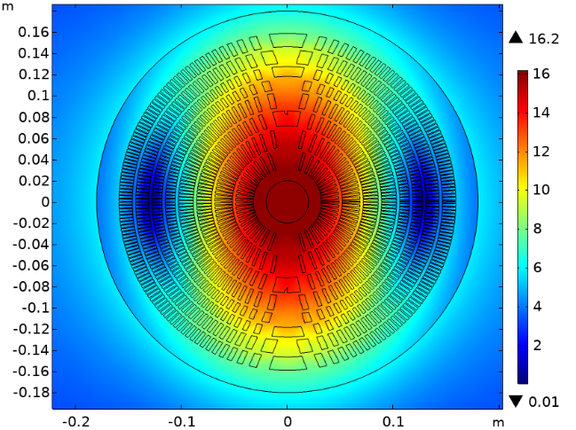
R&D of the High Field Model Dipoles
16-T Dipole with CCT configuration
Canted-Cosine-Theta (CCT) technology;
  Superior field quality;
  Stress management
  Developed industrial assembly line;
Graded Nb₃Sn Rutherford cables;
Multiple replaceable coil modules;
The geometry of the 4 module CCT magnet
CCT subscale
At 4.2 K, the magnet produces 16 T at 100% load-line with 8.8 kA operating current
6

Slide 7
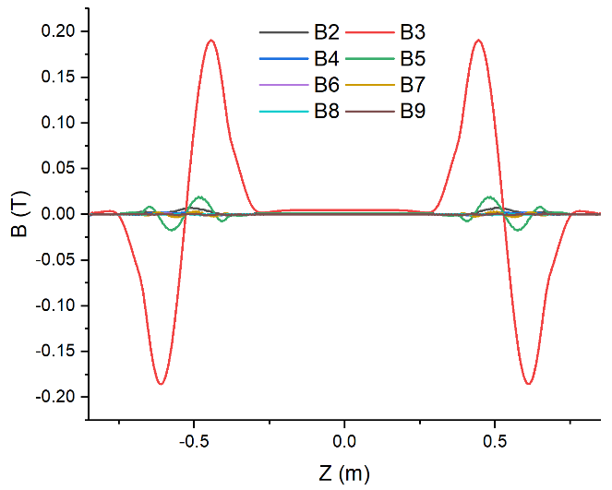
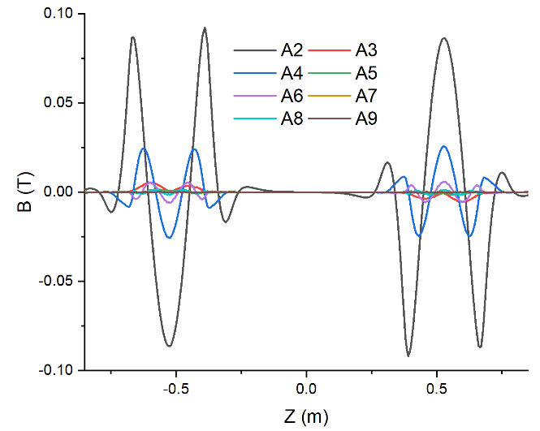
R&D of the High Field Model Dipoles
High-order harmonics along axis - Bn
High-order harmonics along axis - An
Harmonics：10⁻⁴ | b2 | a2 | b3 | a3 | b4 | a4 | b5 | a5 | b6 | a6 | b7 | a7 | b8 | a8
Cross section-2D | 0.6259 | 0.0119 | 2.9824 | -0.0006 | 0.0537 | 0.0002 | 0.5189 | 0.0002 | 0.0183 | -0.0020 | -0.0845 | 0.0016 | -0.0036 | 0.0009
Integrated-3D | 1.5989 | 0.0101 | 3.8649 | -0.0320 | 0.3047 | 0.0802 | 1.4069 | -0.0175 | 0.0750 | -0.3695 | 0.1163 | 0.0734 | -0.0223 | -0.2090
7

Slide 8
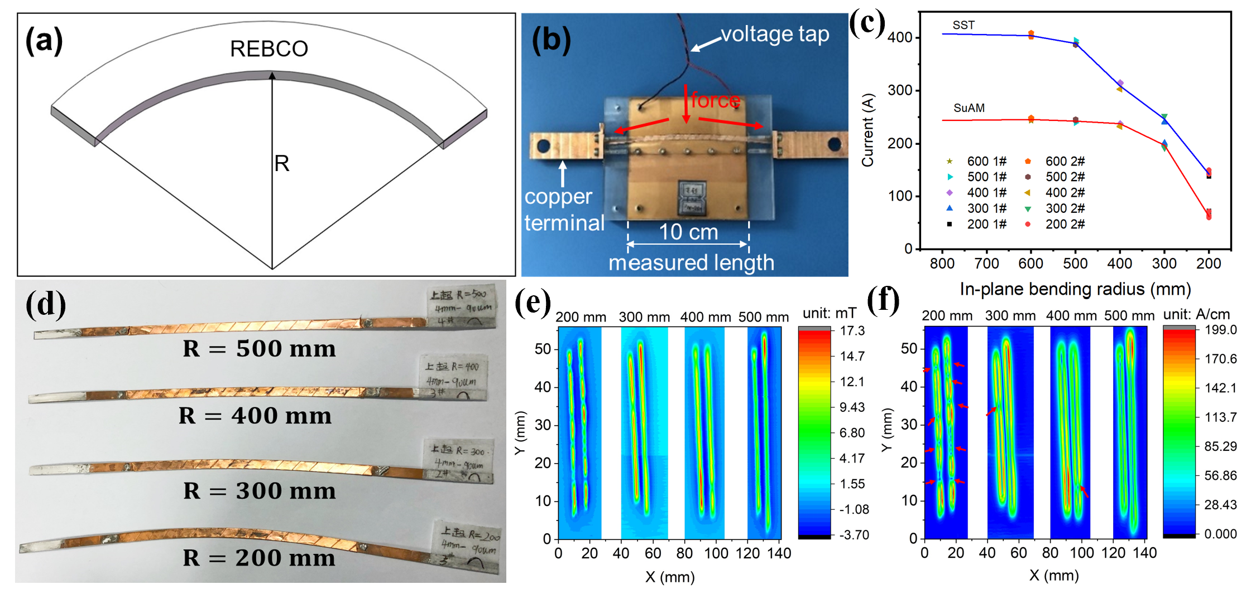
R&D of the High Field Model Dipoles
Development of a Roebel-like Transposed Cable with the in-plane bending of HTS tapes
8
J. Wang et al, Superconductivity 3 (2022) 100019

Slide 9
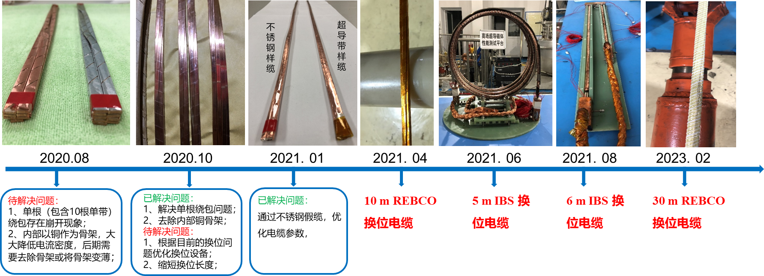
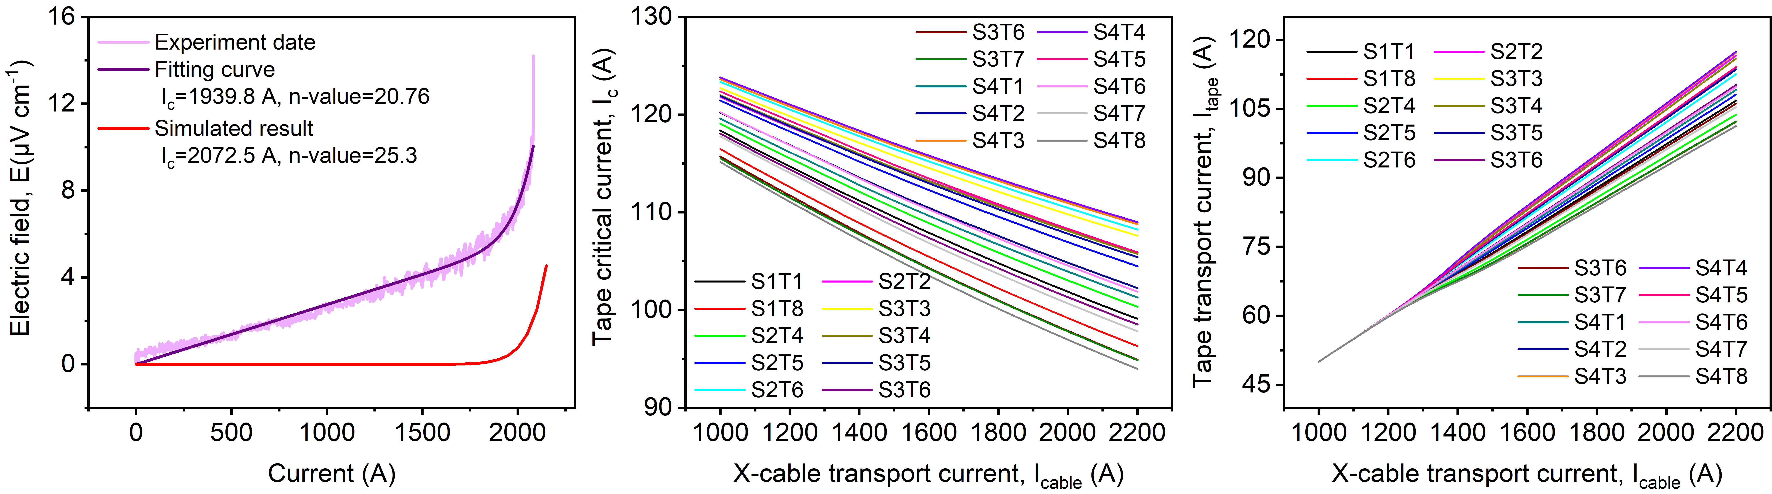
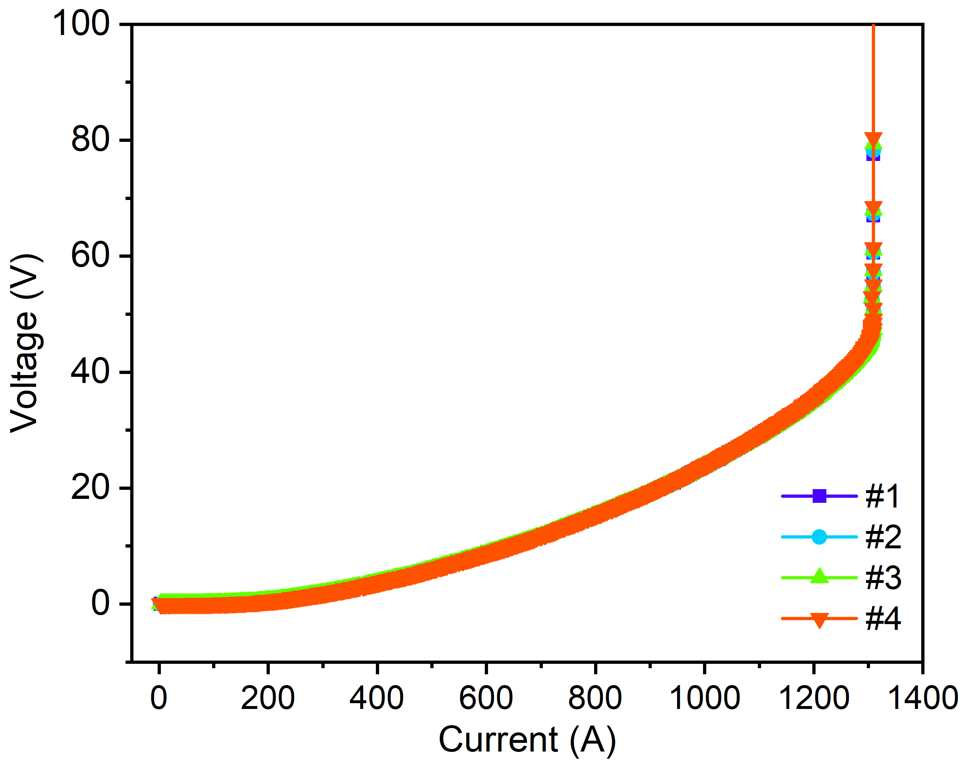
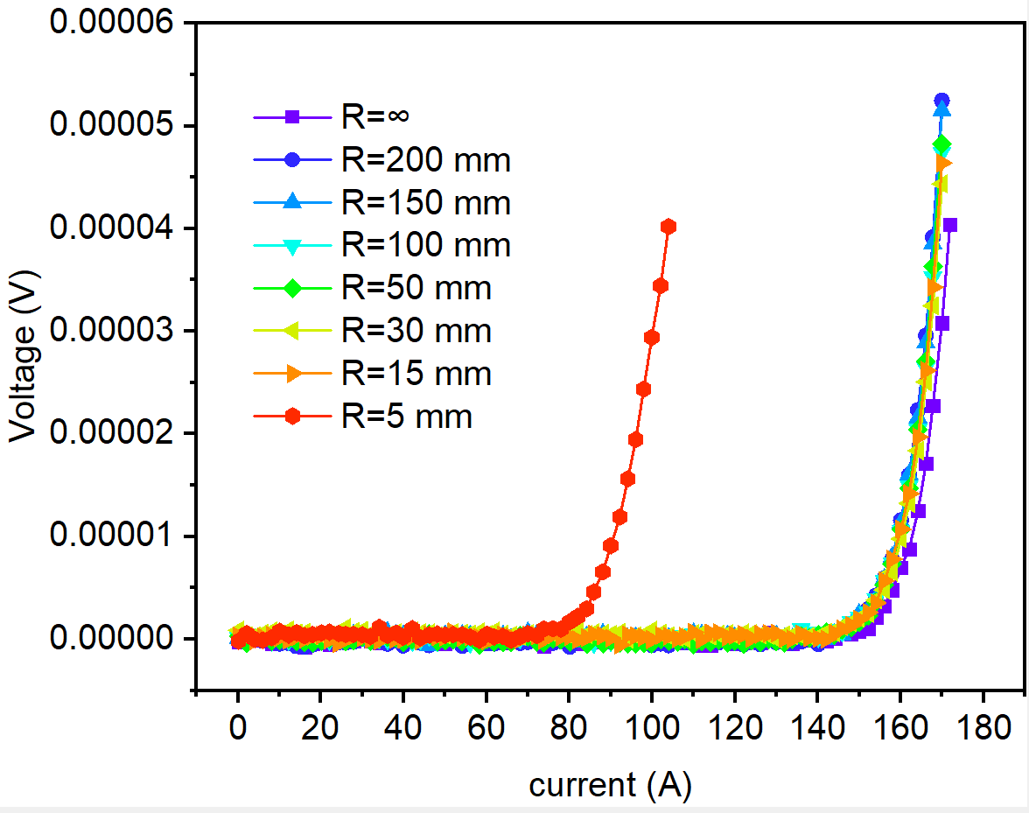
R&D of the High Field Model Dipoles
Development of a Roebel-like Transposed Cable with the in-plane bending of HTS tapes
9

Slide 10
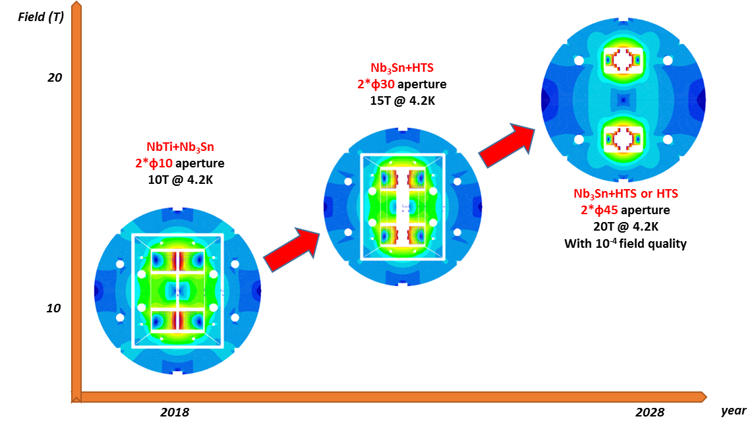
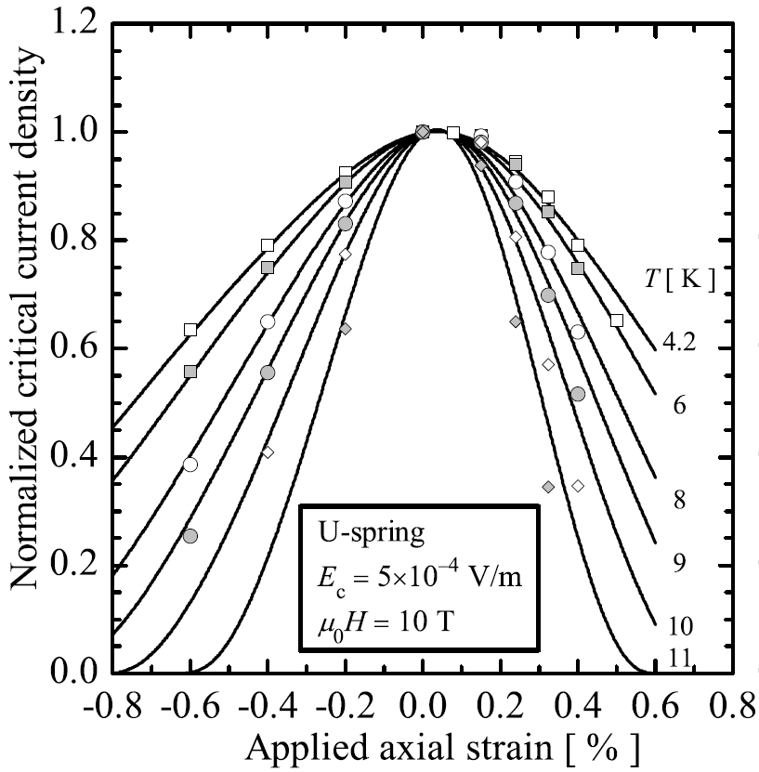
R&D of the High Field Model Dipoles
Roadmap for Future
Challenges: Stress control, quench protection, field quality control,……
10

Slide 11
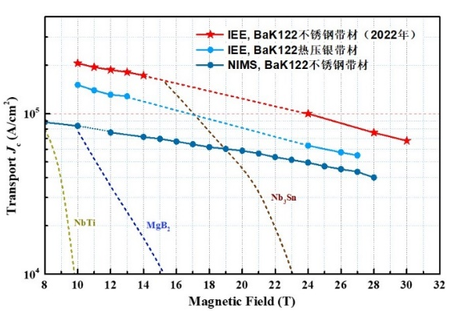

IBS Technology: Status and Outlook
Stainless-steel stabilized IBS tape achieved the highest J_{e} in 2022!
Significantly reduced the cost and raised the
mechanical properties.
IBS 2025
IBS 2022
IBS 2019
IBS 2016
11

Slide 12
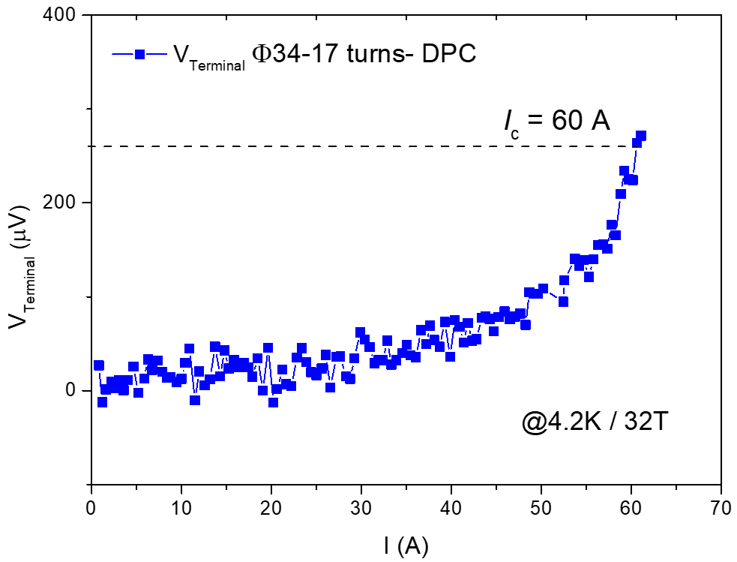
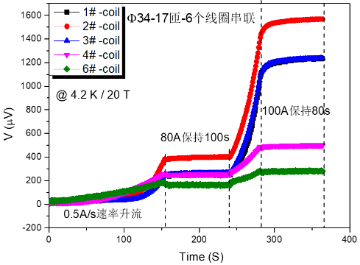

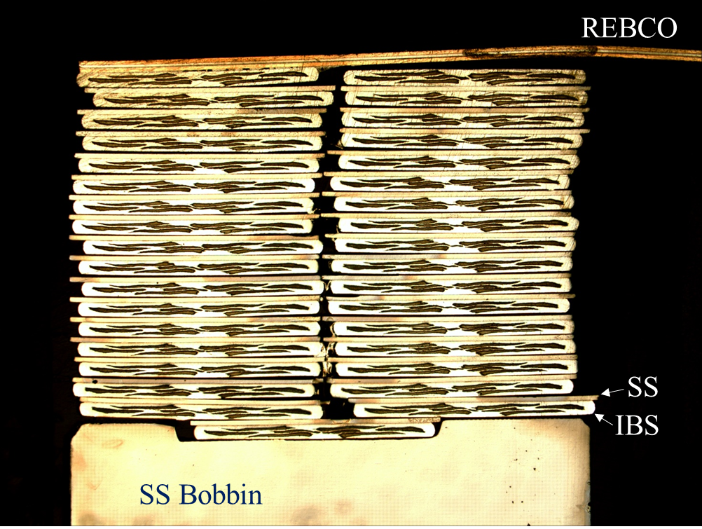

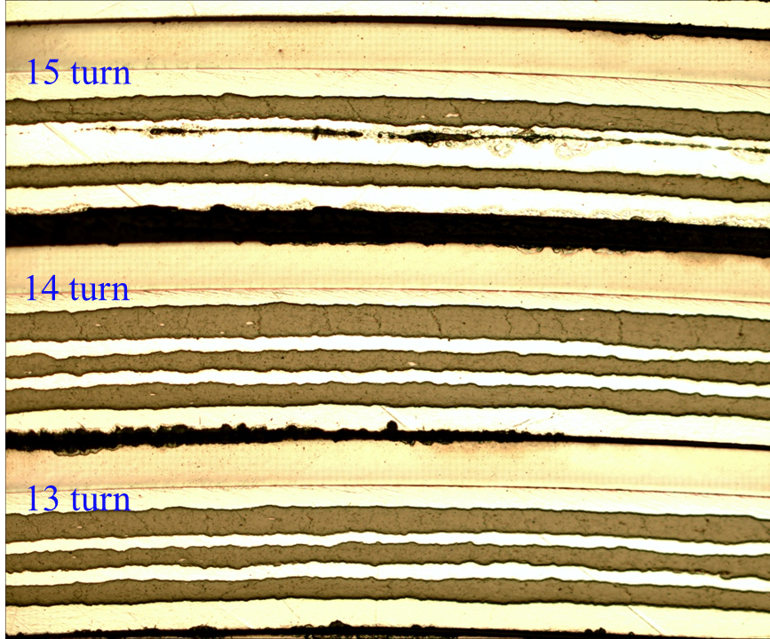
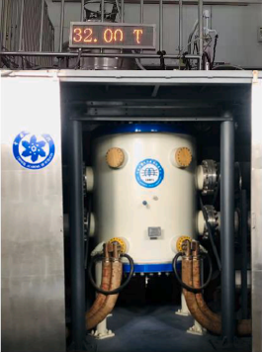
IBS Technology: Status and Outlook
The First IBS Solenoid Coil at 32 T background field
I_{c} of Φ34mm-17 turns-DPC reached 60 A at 4.2 K and 32 T, world’s highest record up to now.
12

Slide 13
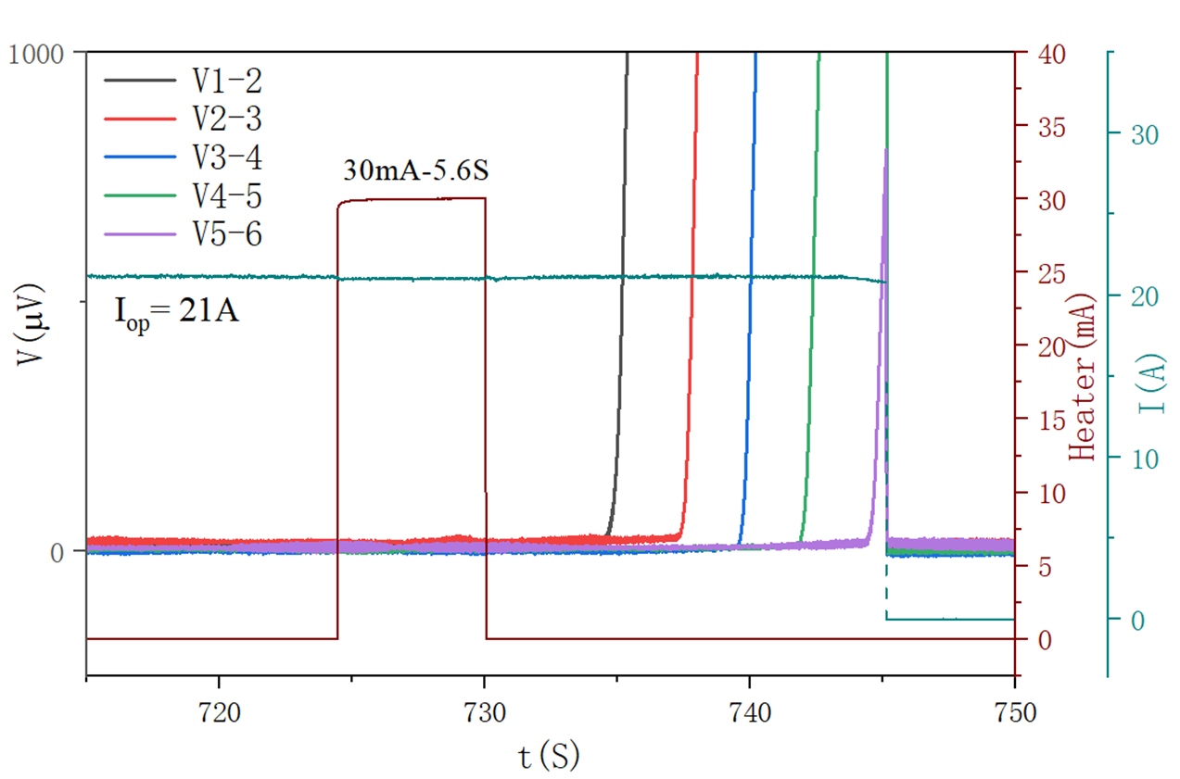
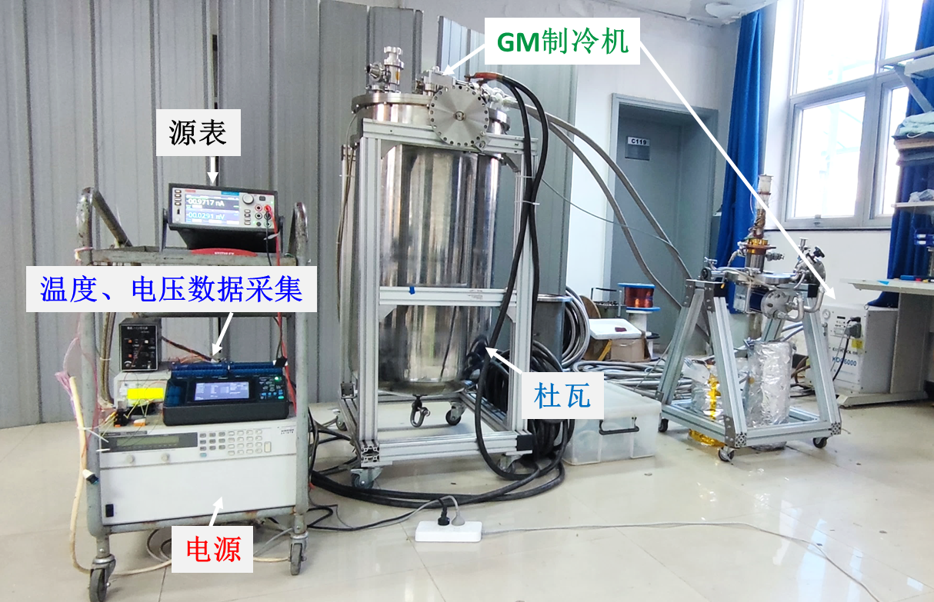
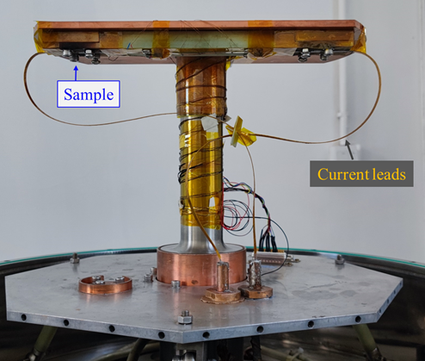
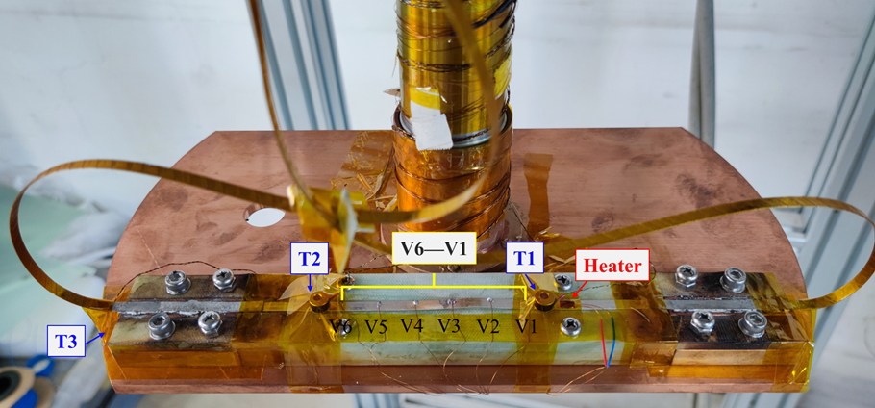
IBS Technology: Status and Outlook
Quench propagation study of the IBS coils
Experimental data shows significant quench propagation in the IBS coils! More testing will be carried out.
13

Slide 14
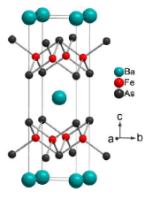
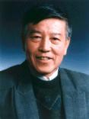
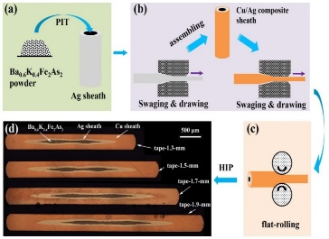
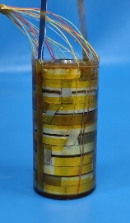
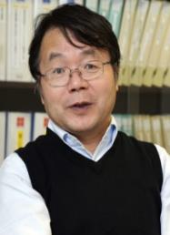
IBS Technology: Status and Outlook
IBS solenoid at 32 T
Racetrack at 10 T
1.3 kA transposed cable
J_{e} > 450 A/mm²
@ 10 T, 4.2 K
100-m 7-core IBS tape fabricated
J_{e}= 100 A/mm²
@ 10 T, 4.2 K
Z. Zhao
IBS (T_{c} 55K)
2008.02
2008.04
2008.09
2016
2018
2020
2022
Discovery of IBS
Discovery of
122 phase IBS
IBS solenoid at 24 T
Racetrack at 8 T
J_{e}= 300 A/mm²
@ 10 T, 4.2 K
H. Hosono
IBS (T_{c} 26K)
J_{e} of IBS expected to be similar as ReBCO in 5 years with better mechanical properties and lower cost
14

Slide 15








Development of CCT Magnets for HL-LHC
China provides 13 units CCT twin-aperture dipole magnets for HL-LHC
To be installed in the ATLAS & CMS interaction regions, help to raise the luminosity by 5 times
The 1st time CCT type magnets applied to an operating accelerator.
All the magnets delivered to CERN passed the performance double-check at 1.9 K.
Test results of the 1st full-length prototype from China:
“Each aperture, individually and combined, arrived to ultimate current without quench”
“Operation range test checked without quench”……
15

Slide 16




Development of CCT Magnets for HL-LHC
Items | Values
CCT skew angle | 30°
No. of turns per layer | 365
Slot size in former (mm) | 2×5
Spacing per turn | 5.222
Inside/Outside diameter of the former (mm) | Inner former:105.35/119.35 Inner former:120.80/134.85
Inside diameter of the groove/slot(mm) | 1st layer: 109.15/119.15 2nd layer: 124.65/134.65
Reference radius (mm) | 35
Diameter of aperture (mm) | 105
Current (A) | 395
Cooling hole
Hole for tie rod
Aperture
Yoke alignment
CCT Coils
Ø 614 mm
Items | Values
Diameter of yoke (mm) | 614
Thickness of yoke lamination (mm) | 5.8
Diameter of aperture (mm) | 167
Position of aperture (mm) | 94.19
Yoke key slot(mm) | 8(3.01) ×6
Diameter of cooling hole (mm) | 110
Position of cooling hole (mm) | 205
16

Slide 17


Training of MCBRD01
Development of CCT Magnets for HL-LHC
Aperture1 of the 1st series magnet
Aperture2 of the 1st series magnet
The 1st practice coil from Bama with new fabrication process wet wind plus 5-bar VPI.
The 2nd coil from Bama with direct wind process plus 5-bar VPI, similar to the process of the 1st prototype.
17

Slide 18






Development of CCT Magnets for HL-LHC
Successful design upgrade to solve the “long training problem”, significantly reduced the times of quench during training, ensured the project progress “on track”.
HL-LHC Schedule for the Collaboration Board 2022
18

Slide 19







Training of MCBRD02 & MCBRD03
Development of CCT Magnets for HL-LHC
AP1(CB12，25 quenches 526A) reached ±422A after 11 quenches.
AP2(CB09, 33 quenches 530A; after thermal cycle ＞500A) reached ±422A without any quenches.
19

Slide 20

Development of CCT Magnets for HL-LHC
HL-LHC加速器升级中国贡献
20

Slide 21
Summary
Long-term advanced superconducting magnet R&D for future high-energy accelerators is ongoing at IHEP-CAS.
Strong domestic collaboration for the advanced superconductor R&D (HTS & Nb₃Sn): Stainless-steel stabilized IBS tape achieved the highest J_{e} in 2022! Significantly reduced the cost and raised the mechanical properties.
10+ T model dipoles being developed at IHEP, reached 12.47 T at 4.2 K in mid 2021. 16 T (Nb₃Sn+HTS) model dipole under development, and to be tested in 2023. 20+ T accelerator magnets expected to be realized in 2020s.
China & CERN Collaboration on accelerator technology: development of HL-LHC CCT magnets going well.
Thanks for your attention!
21

