Slide 1


The Networking and Computing Status at IHEP
QI Fazhi
CC, IHEP, CAS
2023-04-13

Slide 2
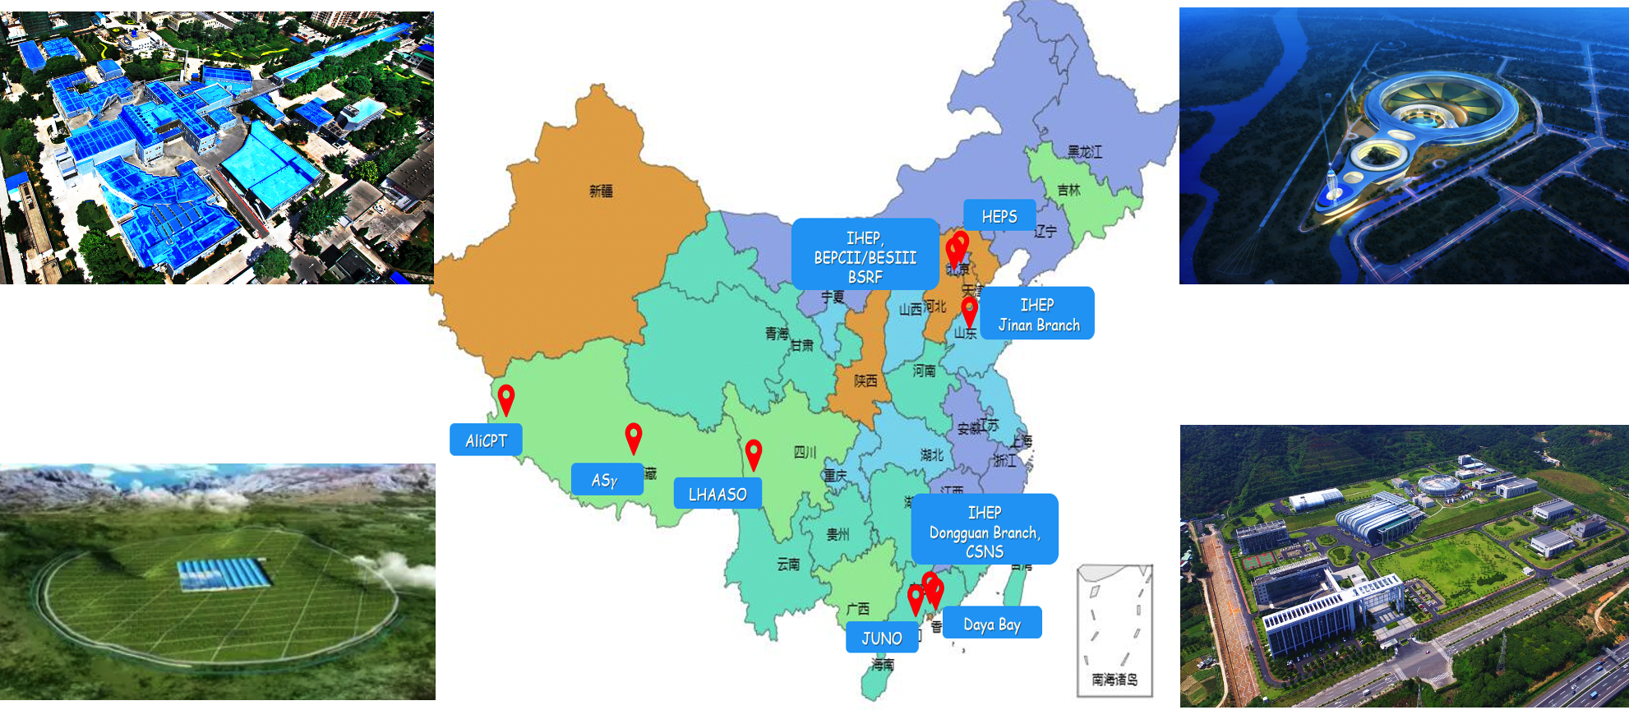
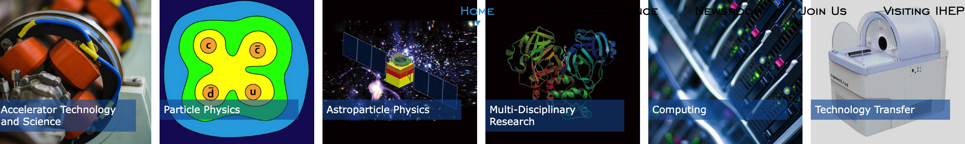
IHEP Overview
Institute of High Energy Physics, Chinese Academy of Sciences
Focus on fundamental researches in
  particle physics
  particle astrophysics and cosmology
  accelerator physics and technology
  detection technology and electronics
  radiation applications
  Computing technologies and applications

Slide 3
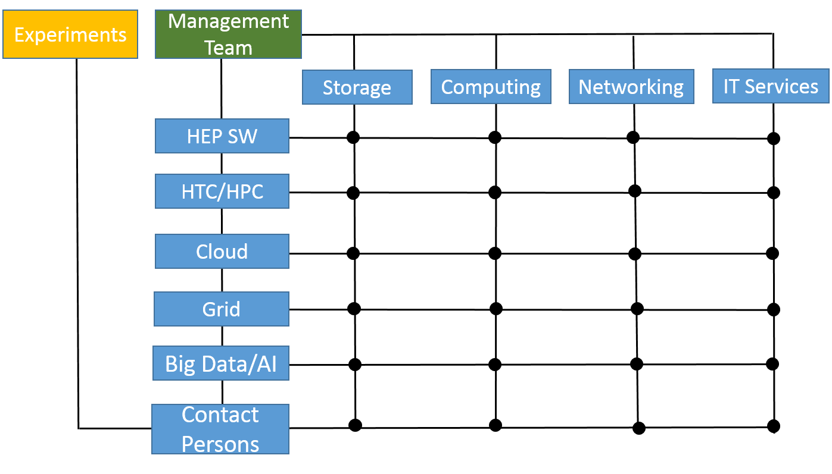
About IHEP CC
55 staffs(Beijing & Dongguan) + 50 Post Dr. & students
Mission
1. Provides high performance computing environments for HEP experiments
  Facilities
  Computing
  Storage
  Network
  Software
2. Research & Development on IT
  to promote scientific research and discovery
    Network , Storage, Computing, Software
  to facilitate management and improve operation efficiencies of the institute
    Information services development and deployment

Slide 4
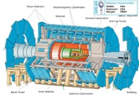
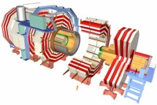

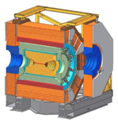
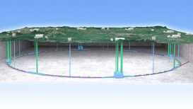
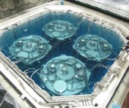
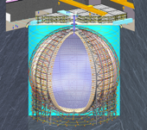
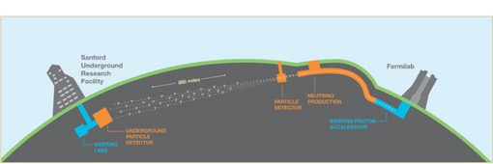
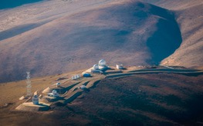
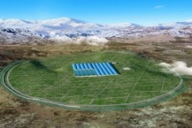
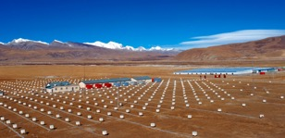
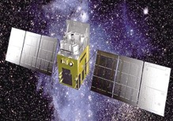
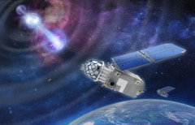
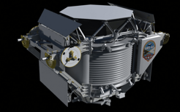
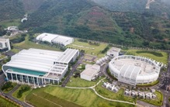
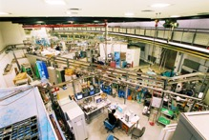
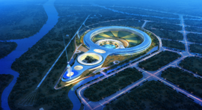
IHEP Related Projects
Accelerator based particle physics
ATLAS
BESIII
CEPC
CMS
BELLE II
Neutrino experiments and CMB telescope
DYB
AliCPT
JUNO
DUNE
Cosmic ray and astrophysics experiments
AS𝛾
HXMT
GECAM
AMS02
LHAASO
BSRF
Neutron Source and Synchrotron Radiation Facilities
CSNS
HEPS

Slide 5
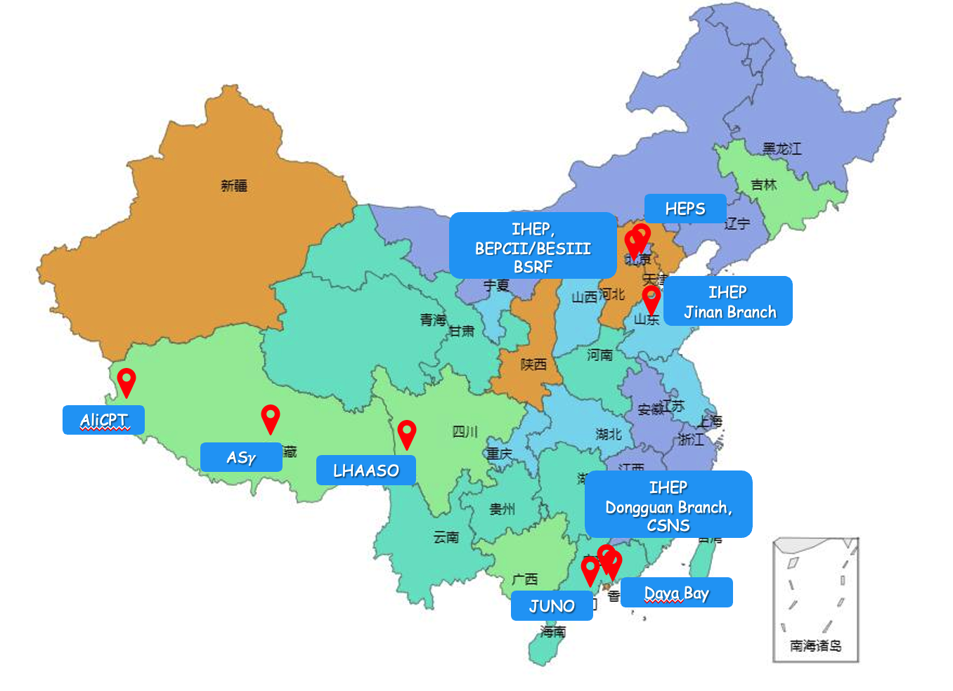
Science Facilities & Sites of IHEP

Slide 6
Data and Computing Challenges @IHEP
Type | Experiment Name | Features | Data volume | Computing resoure | Location | Status
Practical Physics | BESIII | HTC (CPU) | 2PB/year | 10,000 CPU Cores | Beijing | Running
 | DYB |  | 500TB/year | 3,000 CPU Cores | Shenzhen | Closed
 | JUNO |  | 3PB/year | 10,000 CPU Cores | Jiangmen | In construction
 | CEPC |  | 10PB/year | 100,000 CPU Cores | TBD | TBD
 | LHC |  | 1PB/year | 2000 CPU Cores | WLCG | Running
Cosmic ray & astrophysics | LHAASO |  | 6PB/year | 10,000 CPU Cores | Daocheng | Running
空间项目 | HXMT/GECAM/AliCPT |  | 500TB/year | 5,000 CPU Cores | Beijing | Running
 | HERD eXTP |  | 3PB/year 400TB/year | 2,000 CPU Cores 2,000 CPU Cores | Beijing | In 3 Years In 3 Years
Neutron and Synchrotron Radiation | CSNS SPS |  | 1PB/年 >300PB/year | 2,000 CPU Cores >10,000 CPU Cores | Dongguan Dongguan | Running TBD
 | HEPS |  | >300PB/year | >10,000 CPU Cores | Huairou,Beijing | In 3 Years
Theory Physics | LQCD | HPC(CPU+GPU) | 1PB | >1P Flops (double) | Beijing | Running
Accelerator Design | Accelerator Simulation |  | 1PB | >1P Flops (double) | Beijing | Running
Hundreds of thousands cores with heterogeneous computing resource, EB-level data storage and 100Gbps network connections

Slide 7
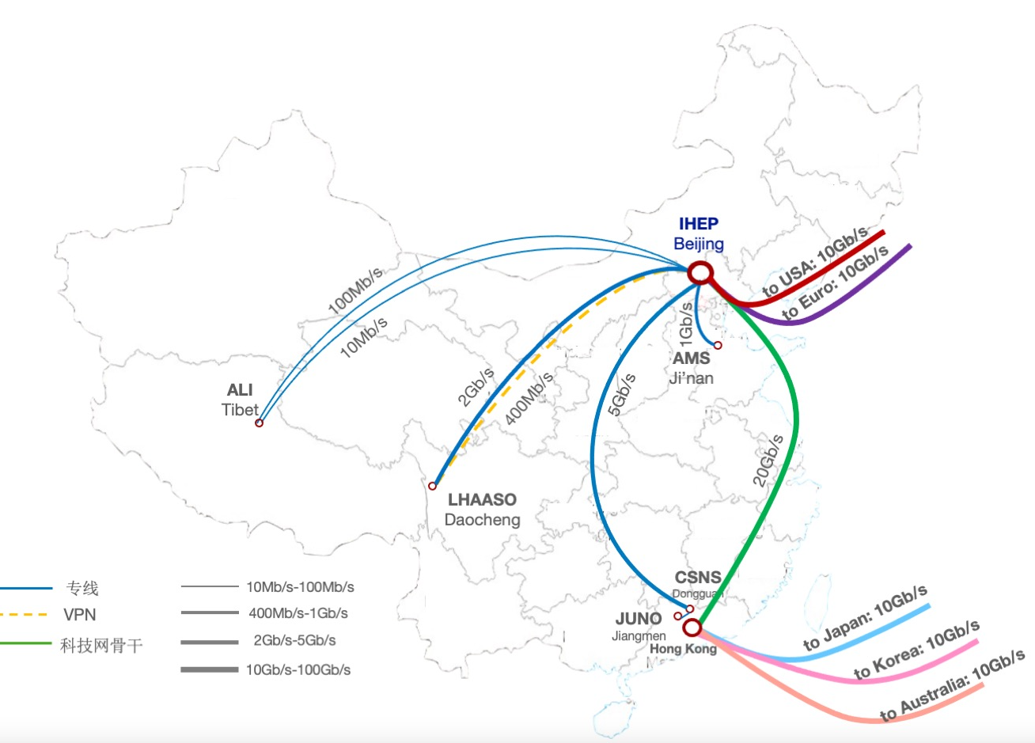
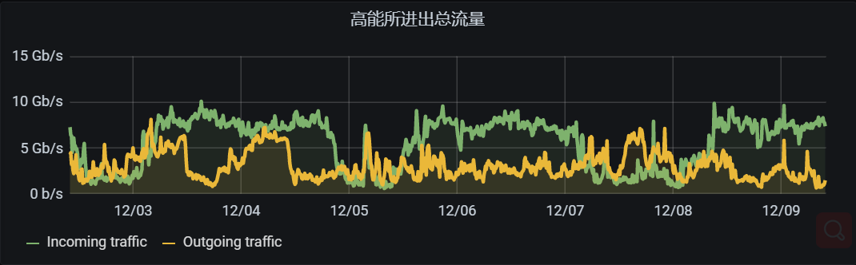
Domestic and International Connections
Dedicated links for remote sites
  10Mbps to 20Gbps
  Some will be upgraded to 100Gbps soon
International networks
  IHEP-Europe: 10 Gbps + 10 Gbps
  IHEP-USA: 10 Gbps + 10 Gbps
  ~50 PB data exchange in 2022
  LHCONE
  Peering to ESNet, Internet2, GEANT were established
  All the LHCONE peers are finished

Slide 8
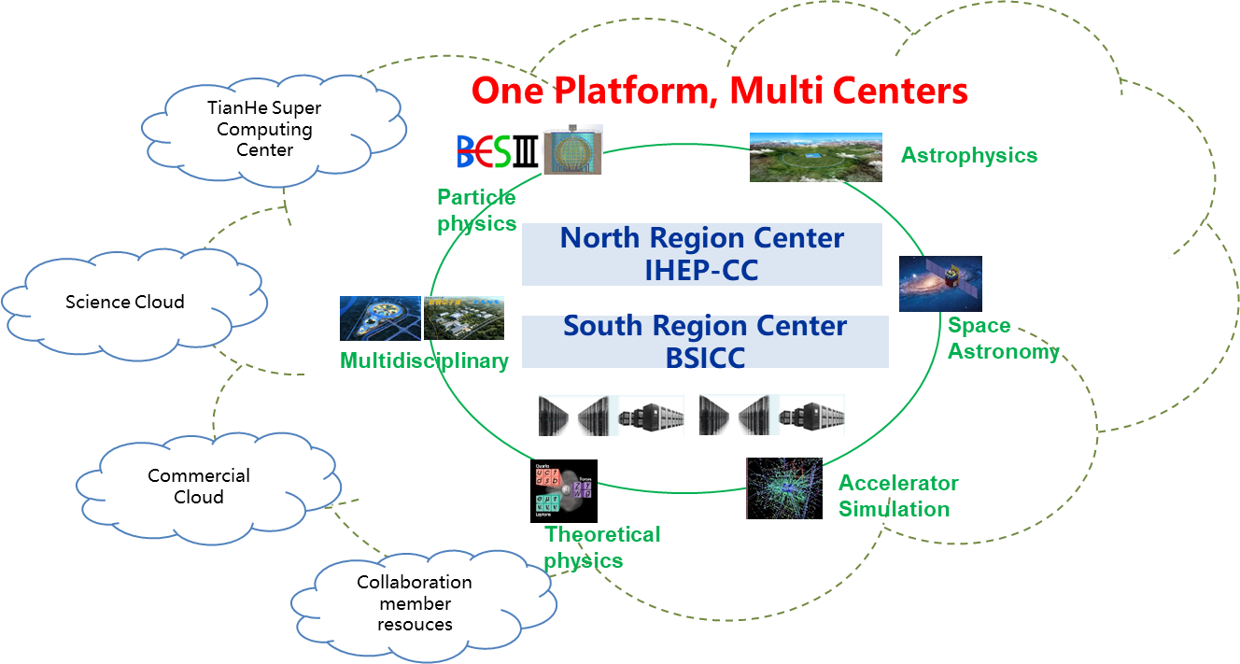
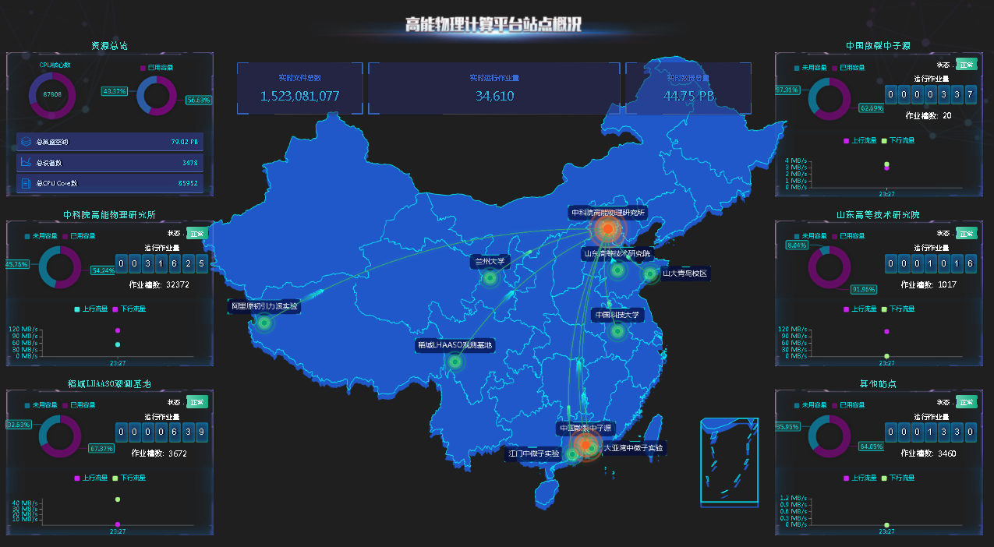
Computing Model: One Platform, Multi Centers (1/2)
The main strategy of IHEP-CC
  A platform serves the data processing demands of HEP scientific research fields.
    particle physics, theoretical physics, space astronomy, ray science, and accelerator design
  Appropriately use opportunistic resources with as little change of user habit as possible.
Two main region centers
  Two main region centers IHEP Computing Center (Beijing) & Big Scientific and Intelligent Computing Center (Dongguan).
Several edge sites in China
  Experiments onsite resources.
    For fast data processing.
  CC from Collaboration members.
    Shandong Univ., Univ. of Science and Technology of China, Lanzhou Univ. etc.).
  On-demand resources.
    commercial clouds and super computing centers.

Slide 9
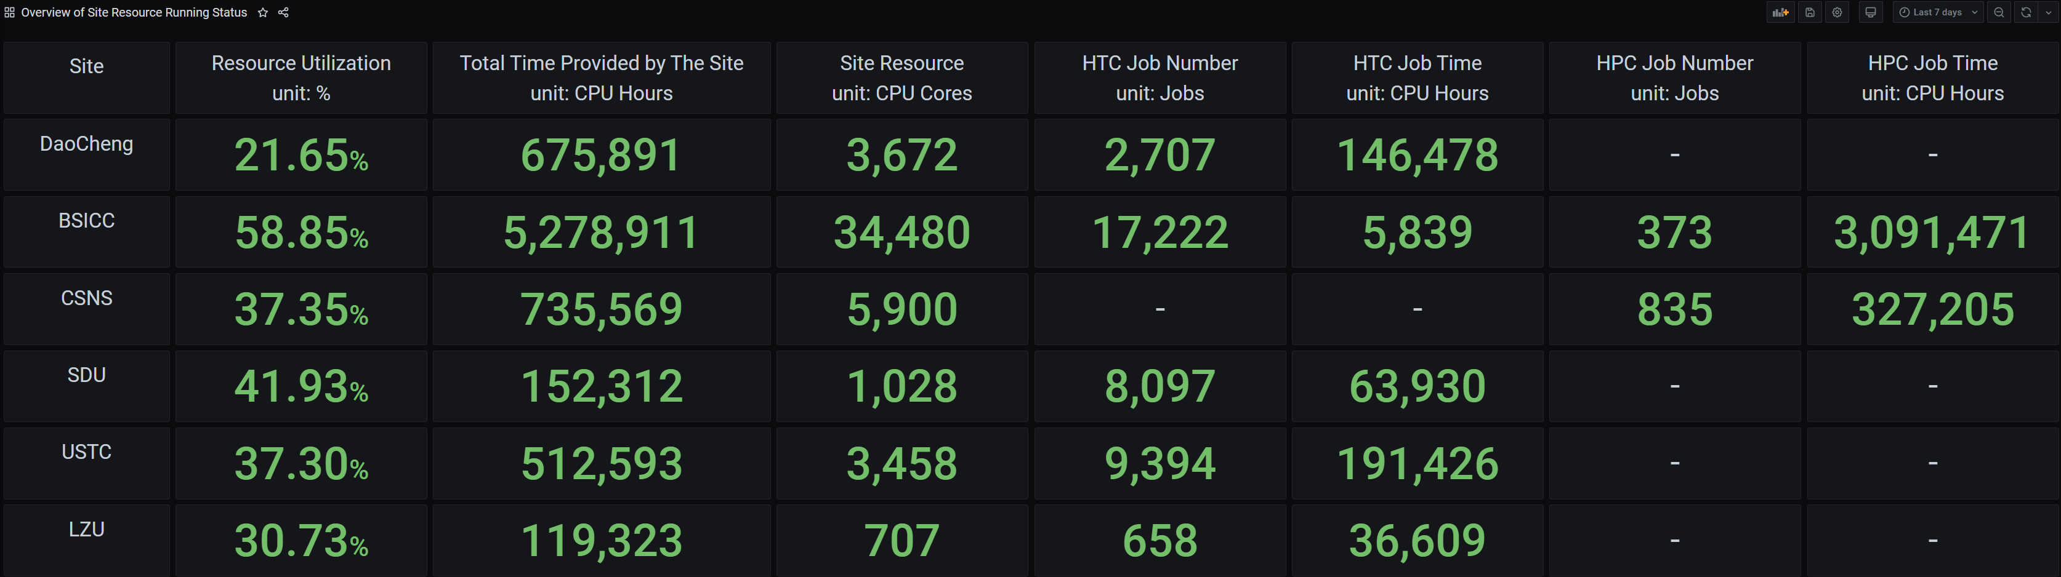
Computing Model: One Platform, Multi Centers (2/2)
Current Status
  Resource of two region centers
  OMAT, a Monitor tool, is developed and deployed to collect sites running status.
  The solutions for computing and storage integration is undergoing
    LHAASO simulation jobs from IHEP-CC (Beijing) HTC Cluster have been dispatched to BSICC (Dongguan) HPC cluster.
      In hand roll way.
      Data result is transferred back by HTCondor.
      Users among sites are mapped directly.
    Xcache & EOS remote replica are being studied.
    Token-based authentication and authorization are being studied.
 | CPU | GPU card | Disk | Tape | Network
IHEP-CC (Beijing) | 43,000 intel-x86 | 250 Nvidia V100 | 80 PB | 80 PB | 40Gpbs internet connection 400Gpbs internal connection
Big Scientific and Intelligent Computing Center (Dongguan) | ~20,000 intel-x86; ~10,000 arm | ~100 Nvidia v100 | 6PB | --- | 20Gpbs internet connection 400Gpbs internal connection

Slide 10
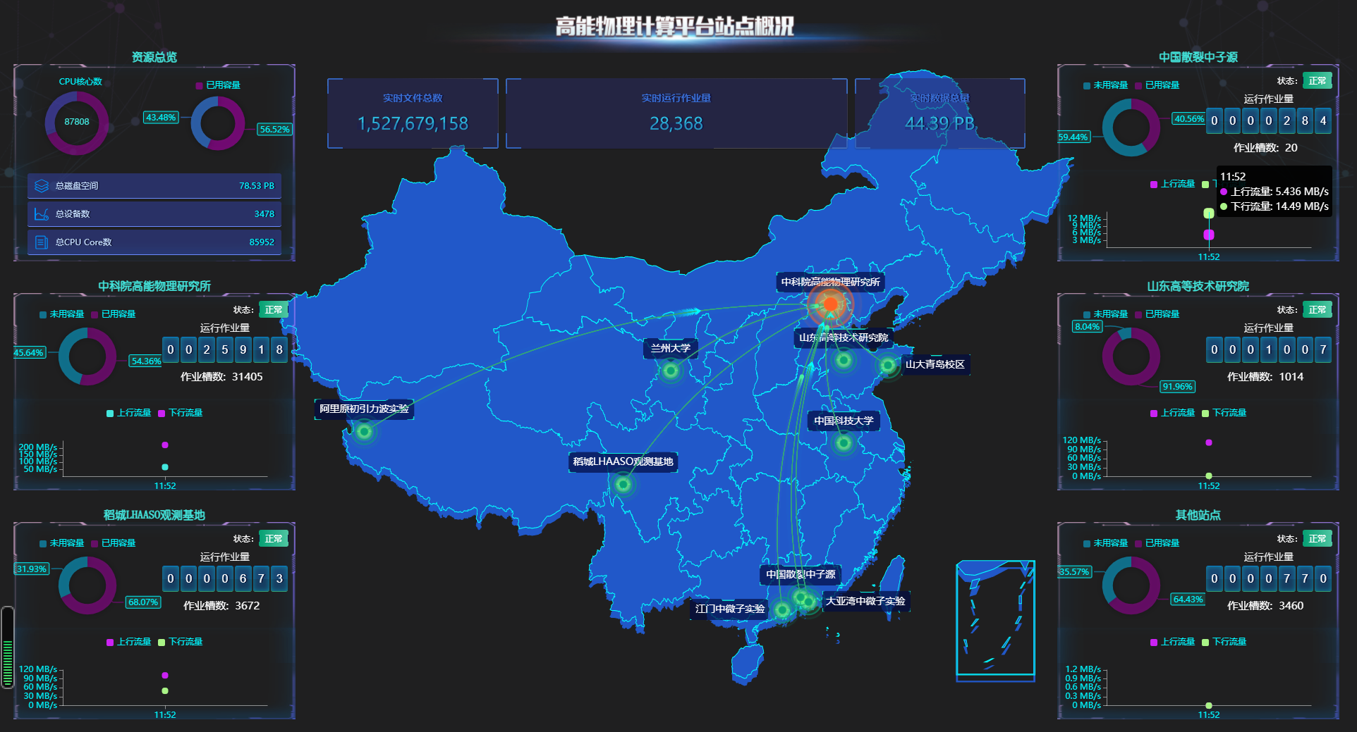
Current Status of“One Platform, Multi Center”
100Gbps
10
Notes:
1+5+n
解释
2025-2035

Slide 11
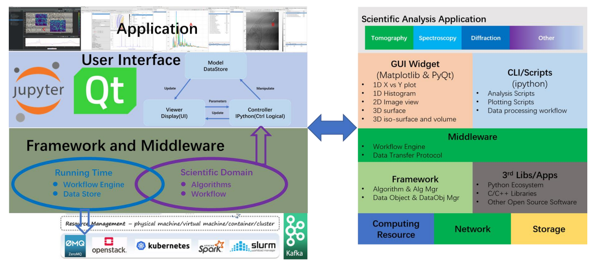
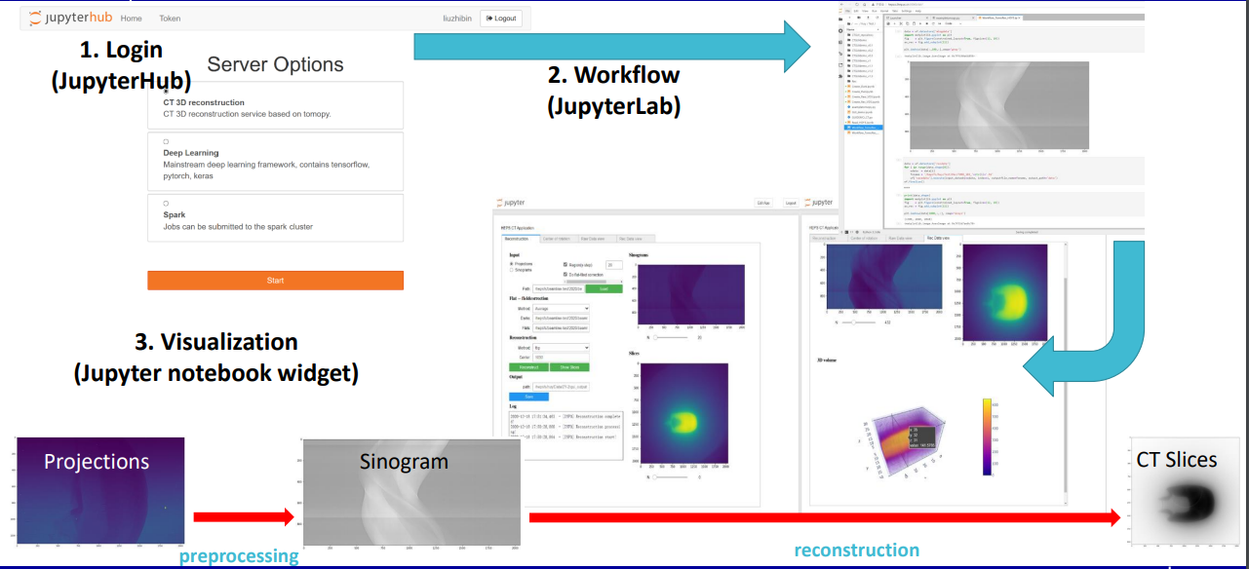
R&D: Computing for HEPS
High Energy Photon Source (HEPS), will be in production in 2025;
Computing & Communication system (HEPSCC)
  Network, Computing, Storage, Data analysis framework,
  Data management, Database & Public Service , Monitoring,
  Security.
Progress of R&D for HEPSCC system
  Computing
    Docker+K8S+JupyterHub, supporting multi-core CPU and GPU.
    Integrate with data analysis framework, deploy docker image.
  Data analysis framework
    Develop IDE and user GUI base on PyQt.
    Integrate methods and algorithms: Tomopy, UFO, pyFAI.
    Provide data visualization and analysis based on Jupyter
    notebook Widget.
  Data management system
    Metadata catalogue: API server + MongoDB.
    Data transfer: full path data transfer with ACLs of files
    and folders.
Notes:
In the experiment of high energy photon source, HEPS, we developed the whole computing and communication system for it, from the top layers to the middle layers, then to the bottom resources and network. We have achieved much R&D progresses on computing, data analysis framework and data management system.

Slide 12
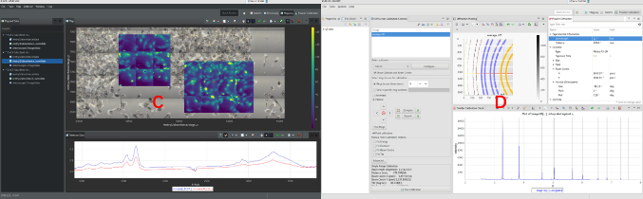
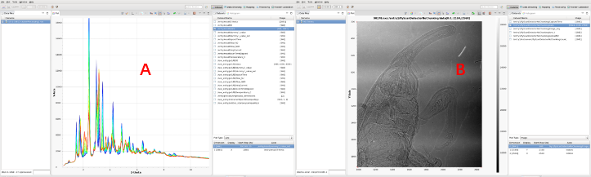
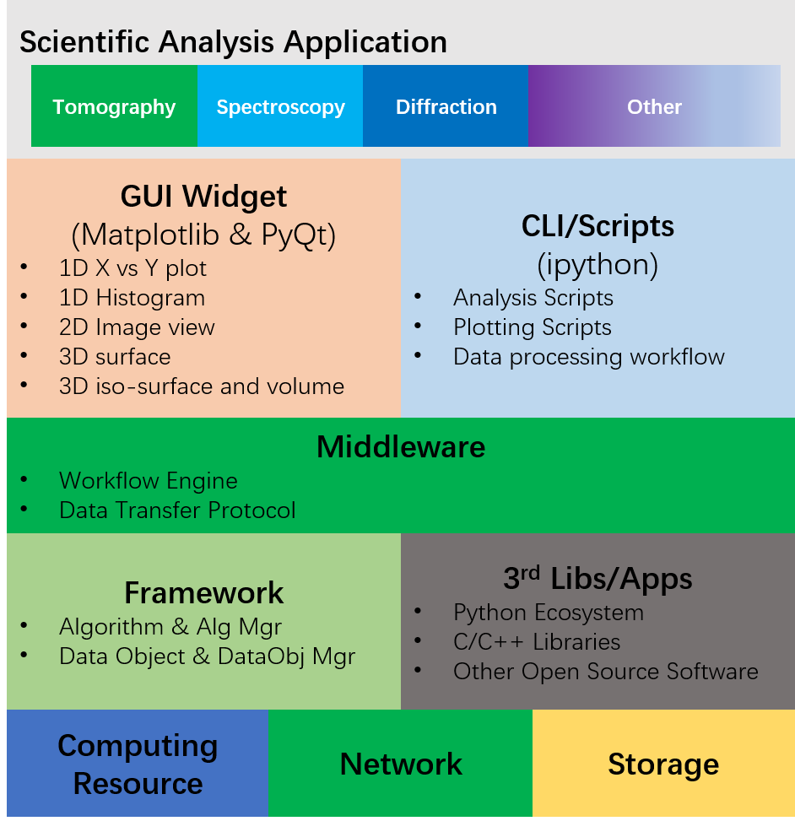

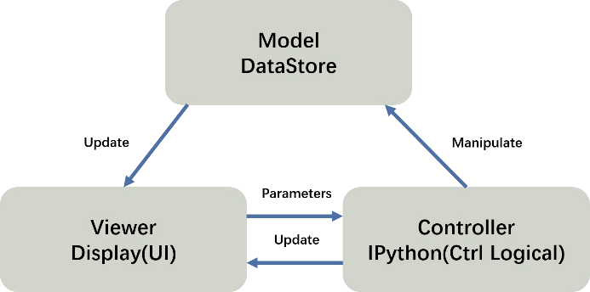



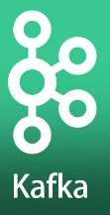

Data Analysis Integration Software Framework for Xray Experiments（DAISY）
Data Organization Management and Access Software（DOMAS）
Application
User Interface
Framework and Middleware
Running Time
Scientific Domain
Workflow Engine
Data Store
Algorithms
Workflow
Yu Hu, Hao Hu, The Design and Development of the scientific data and software for High Energy Photon Source in China

Slide 13
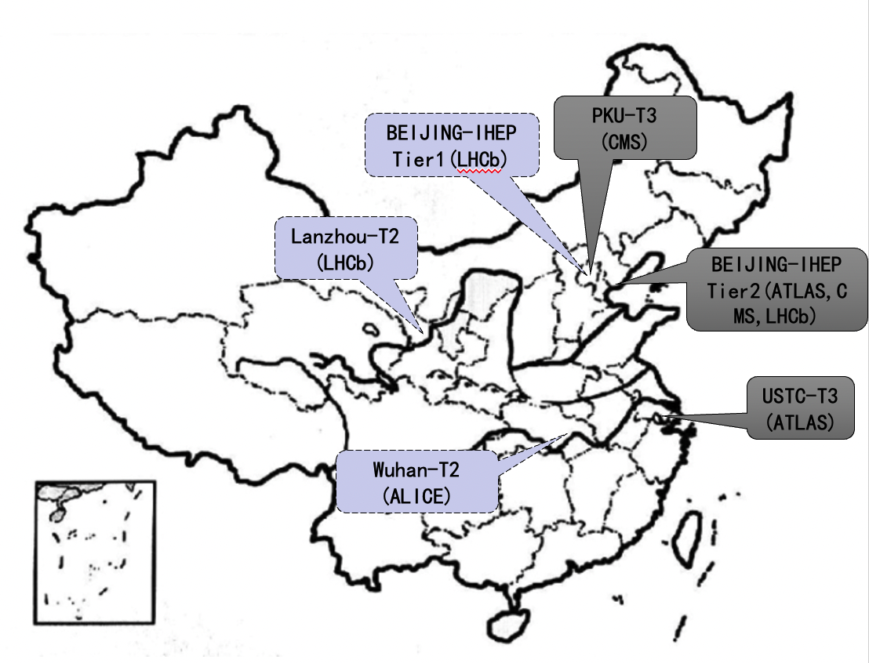
Current Status of WLCG in China-Mainland
Tier-2 sites
  BEIJING-IHEP (ATLAS, CMS, LHCb)
Tier-3 sites
  PKU-T3 (CMS)
  USTC-T3 (ATLAS)
Certification Authority at IHEP
  cagrid.ihep.ac.cn
Sites under development
  Tier-1: BEIJING-IHEP (LHCb)
  Tier-2: Lanzhou-T2 (LHCb)
  Tier-2: Wuhan-T2 (ALICE)

Slide 14
WLCG sites at IHEP
WLCG Tier2 Sites
  ATLAS, CMS, from 2006
  LHCb, from 2018
Computing Resources
  ~4.2K CPU cores
Disk Storage
  ~ 1.7 PB
Network
  10Gbps network link to Europe
  IPv4/IPv6
Proposal of LHCb Tier-1 at IHEP was approved by WLCG Overview Board in Dec. 2022(proto-WLCG T1 Center for LHCb)
It should be ready before Jul. 2023

Slide 15
LHCb Tier-1 @IHEP
IHEP LHCb Tier 1 site is under construction
  Storage and computing resources are completed procurement and gradually arrived
    3000 CPU cores, Intel Xeon Platinum 8352Y,
    ~3.2PB disk storage, DELL PowerVault ME484,
    Lenovo TS4500 Tape Library, LTO9 Drives and Tapes.
  Network devices and connections will be ready soon
    Devices: 100G Router linecards and Optical modules are arrived
    CSTNET to GEANT 10G -> 100G
    IHEP to CSTNET 20G -> 100G
Notes:
LHC实验需要
希望中国合作组的计算贡献与物理共享匹配；借助运行t1站点满足目前中国合作组对计算平台(特别是数据传输)的需求
通过与WLCG交流与合作，提升IHEP CC的技术能力

Slide 16
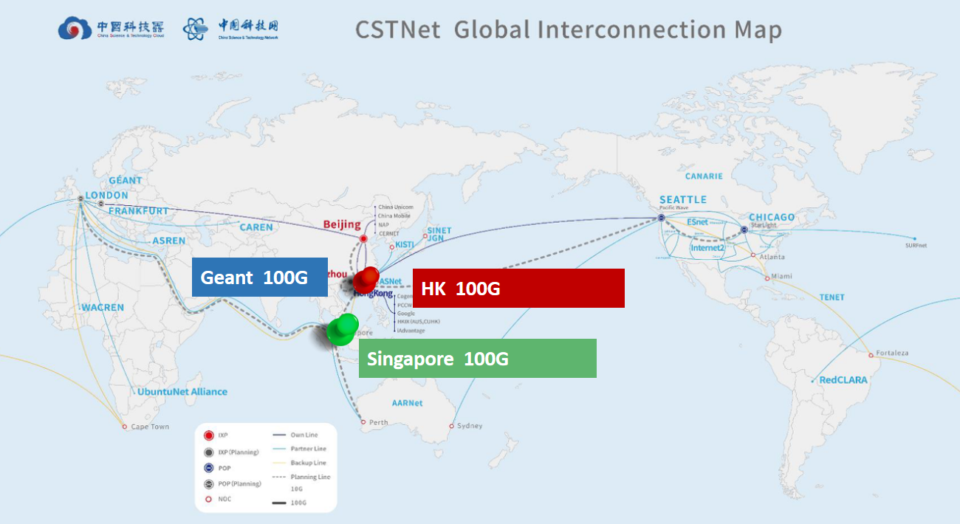
Plan:100G global interconnection is coming (CSTNet)

Slide 17
Summary
The computing and networking capability, and “One platform, multi centers” strategy has been expanded in the last two years to accommodate more applications of particle physics, photon source and neutron source.
The LHCb Tier-1 center @IHEP will be ready before Jul.
More work （especially software R&D）should be carried out to meet the increasing requirements.

Slide 18
Thanks

