Slide 1
Advanced dosimetry for accelerator based radiation therapy: Overview of development in Australia
Anatoly Rozenfeld
AFAD , 12-14 April, Melbourne, Australia

Slide 2
Acknowledgement of Contribution
Centre for Medical Radiation Physics, UOW, Australia
Peter MacCallum Cancer Centre , Melbourne, Australia
University of Adelaide, Australia
QUT, Australia
University of Newcastle
St George CCC, Kogarah, Australia
Illawarra Cancer Care Centre, Wollongong, Australia
ANSTO, Australia
University of Bologna
University of Surrey
QST NIRS, Japan
SINTEF , Norway
Groningen University Medical Centre, The Netherland
SPA BIT, Ukraine

Slide 3
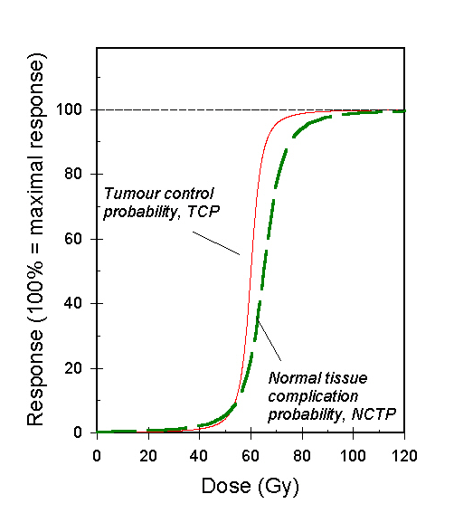
Required dose uncertainty in radiobiology
Depends on steepness of the dose response curve
5% difference in dose make a 15% difference in tumour control probability in head and neck patients - this is clinically detectable

Slide 4
Dose should be accurate
To target:
  5% too low - may result in clinically detectable reduction in tumour control (eg. Head and neck cancer: 15%)
To normal tissues:
  5% too high - significant increase in normal tissue complication probability = morbidity = unacceptable side effects

Slide 5
High spatial and temporal resolution dosimetry:
Magic Plate

Slide 6
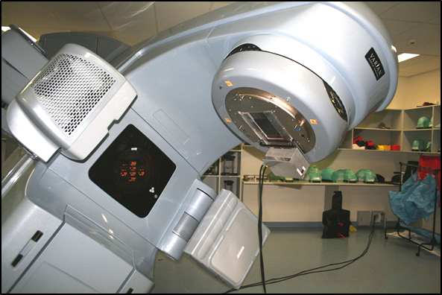
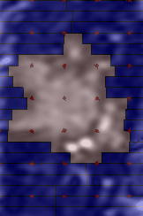
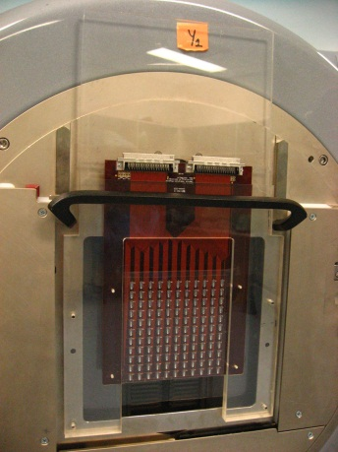
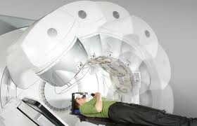
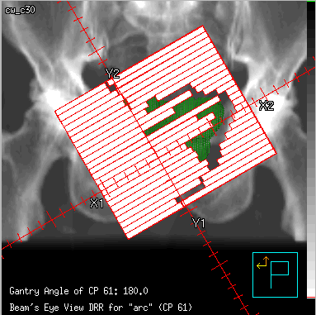
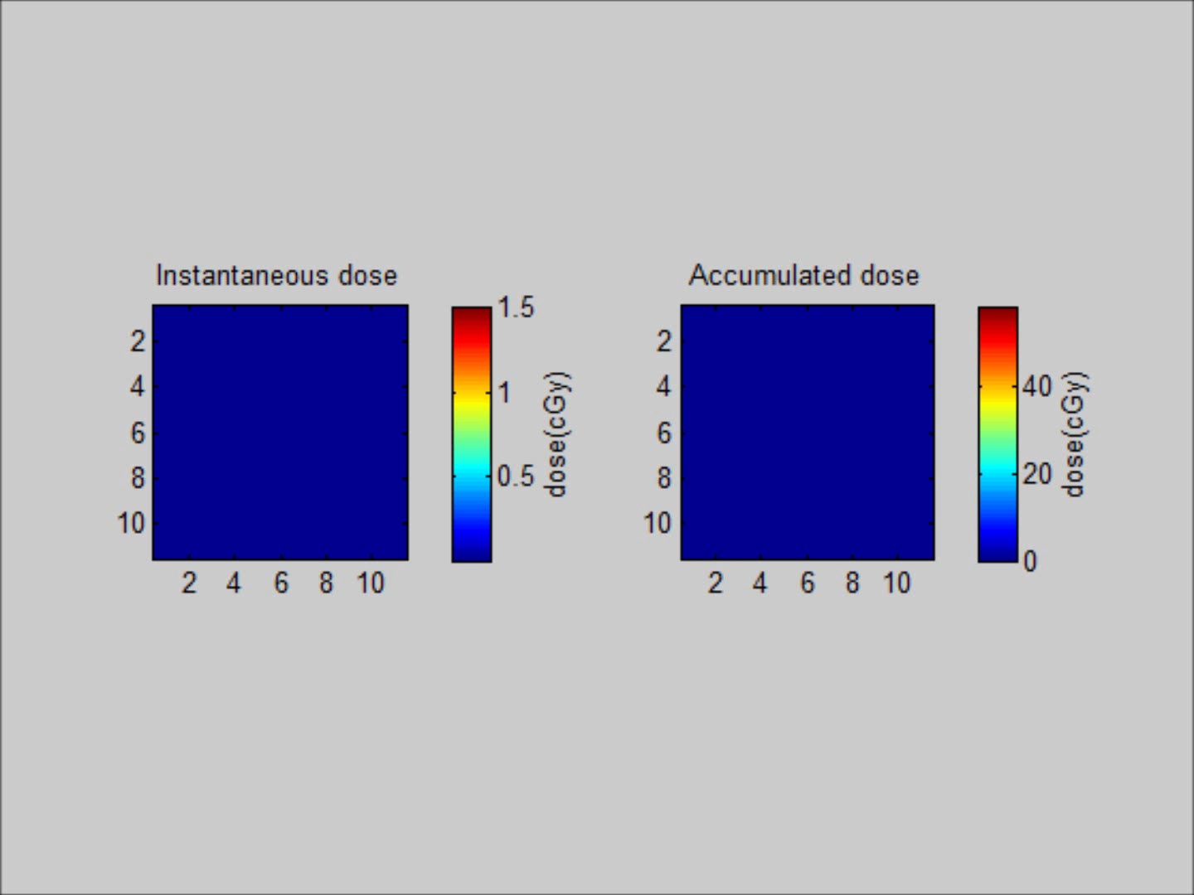
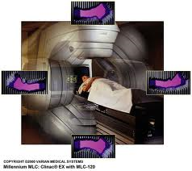
Photon Therapy: Magic Plate QA Concept
Innovative 2D radiation detection QA systems MP –
Invented at CMRP; spatial resolution down to 0.1mm

Slide 7
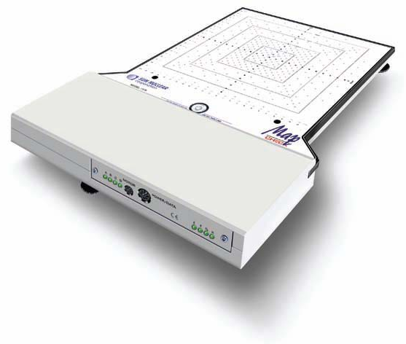
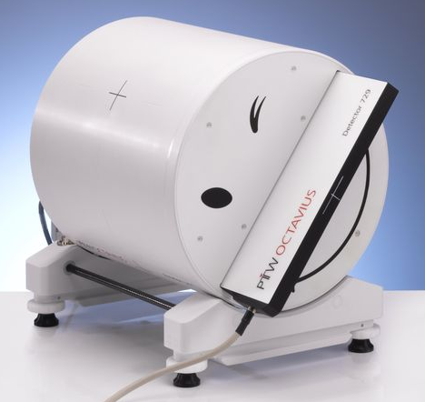
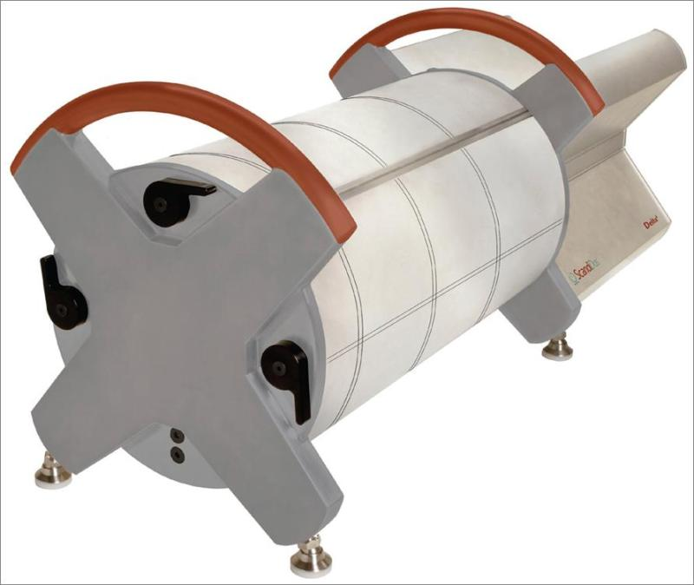
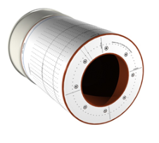
Modern QA devices
Limitations
  Spatial resolution
  Sampling frequency
  Beam perturbation
  Not real time
Ball cube phantom (V. Feygelman et. al. 2008)

Slide 8
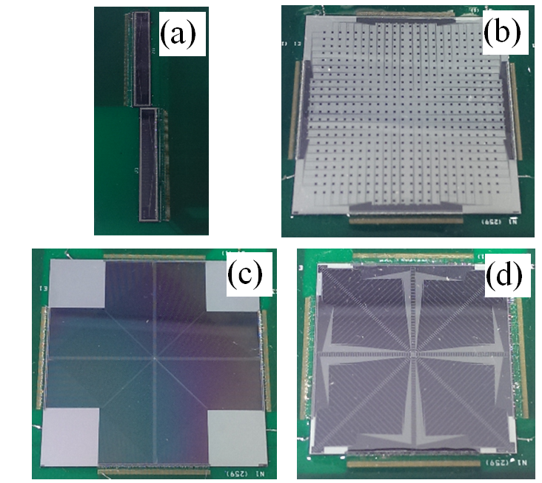
1D and 2D High Resolution Dosimeters
The Centre for Medical Radiation Physics (CMRP) has designed and developed a family of high resolution silicon detectors
a) sDMG: 256 channels with
0.02x2mm² detectors and 0.2mm spatial resolution (SR)
b) M512 matrix: 512 channels with 0.5x0.5mm² detectors in a monolithic sensor, SR: 2mm
c) DUO: 512 channels with 0.02x0.5mm² detectors in 4 linear radial arrays, SR 0.2 mm
d) OCTA: 512 channels with 0.02x0.5mm² detectors in 8 linear radial arrays, SR 0.32 mm

Slide 9
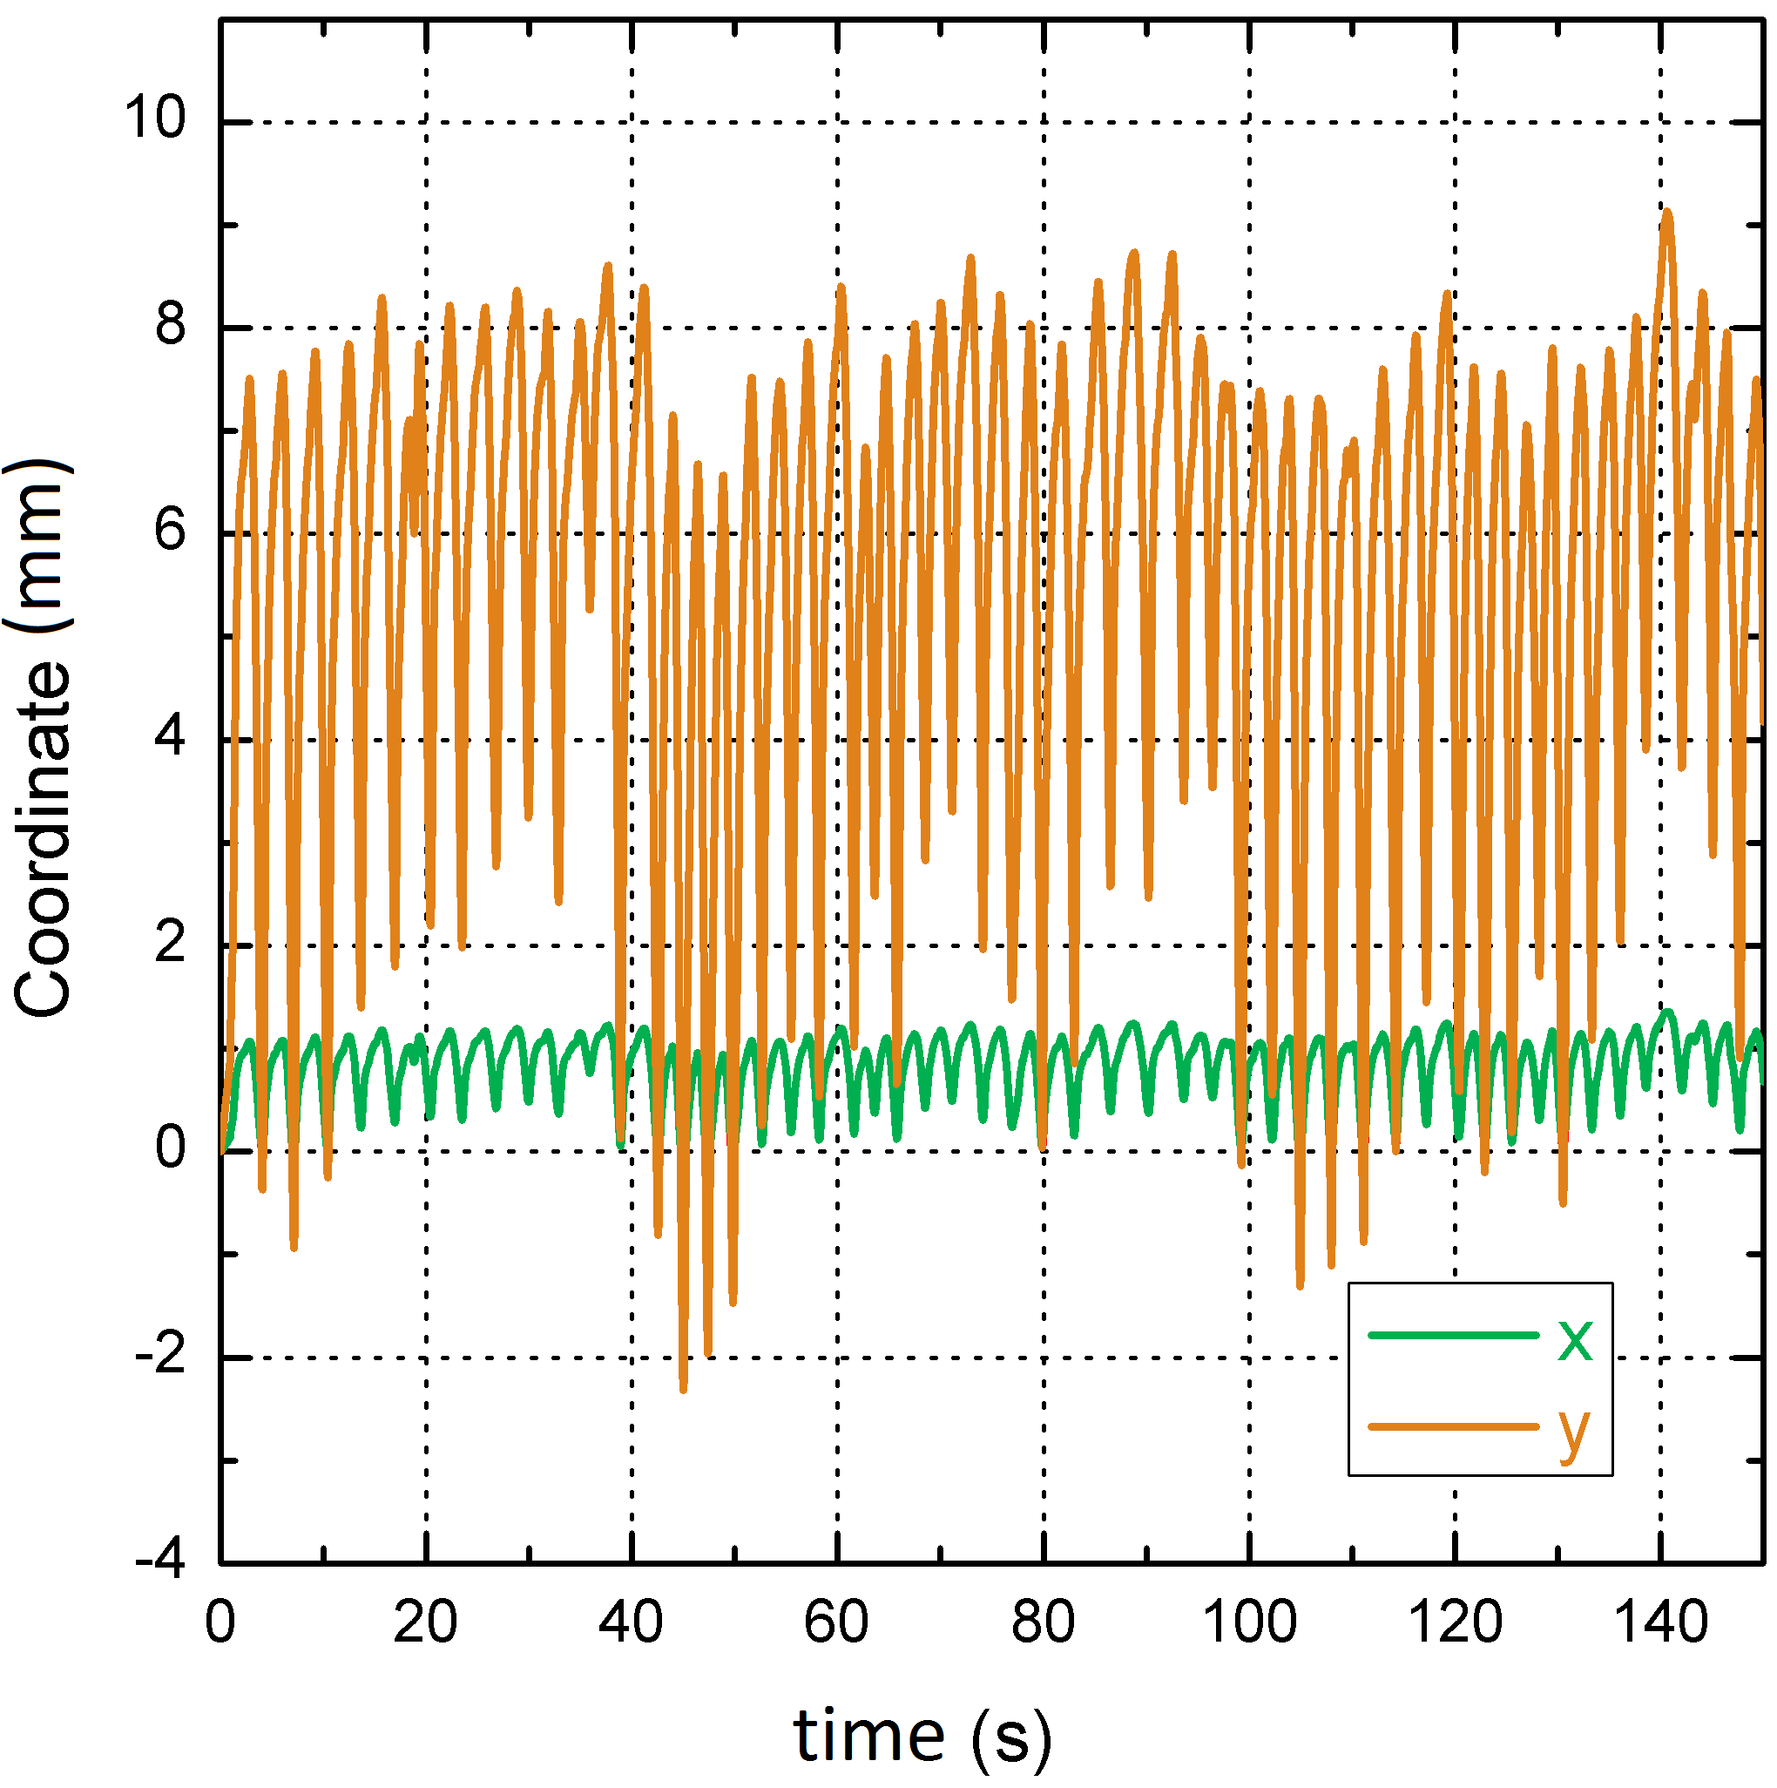
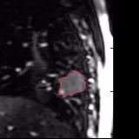
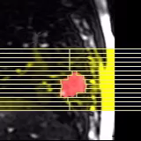
Experimental Methodology
Investigate use of CMRP detectors for real time adaptive radiotherapy with small fields
Irradiated by Multi-leaf Collimator (MLC) defined square fields:
  1x1cm², 2x2cm² and 3x3cm²
A patient-specific lung motion trace was supplied to the platform with motion isolated to X and Y directions only.
Clinical patient lung trace in x y directions.
For the cases:
  Without motion
  With motion (provided by HexaMotion platform)
  With motion and MLC tracking enabled.
Defined coordinate system on experimental setup.

Slide 10
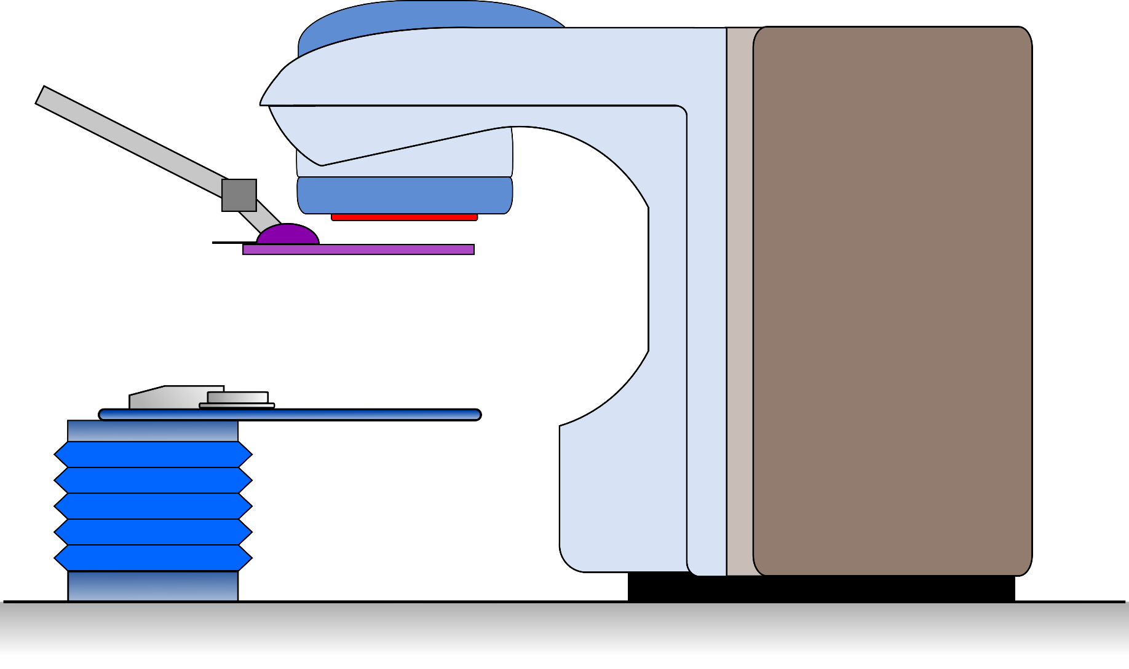
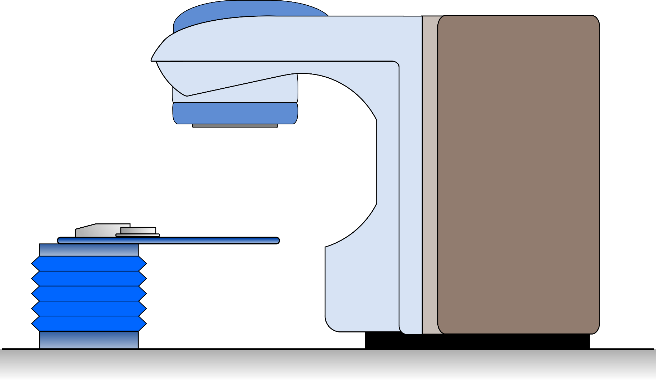

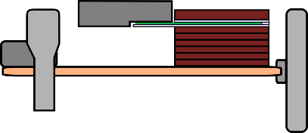
Methodology – Motion Cases
No Motion | Motion | Motion+Tracking | Motion+Tracking+Prediction
No Motion
Motion
Motion+Tracking
Motion+Tracking+Prediction
+Y
+X
Motion platform loaded with clinical patient lung trace, detector moving throughout beam delivery $→$ Motion
Introduction of motion tracking system and MLC tracking throughout beam delivery to moving system $→$ Motion+Tracking
MLC defined square field delivered to stationary detector $→$ No Motion
Inclusion of predictive algorithm in MLC tracking system $→$ Motion+Tracking+Prediction
Notes:
Four motion cases were investigated:
First we irradiate the detector in the static delivery case i.e. the phantom and detector are stationary, this forms the ‘No Motion’ case.
Next, the motion trace is loaded to the platform and initiated at the time of beam delivery, ‘Motion’.
Then, the Calypso motion tracking system is introduced and the MLC tracking system is engaged to track the motion of the detector during treatment delivery, denoted ‘Motion+Tracking’.
Lastly, the predictive algorithm is introduced to the MLC tracking system, ‘Motion+Tracking+Prediction’.

Slide 11
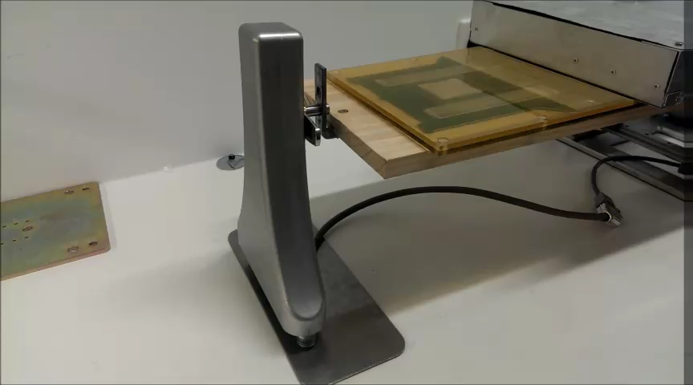
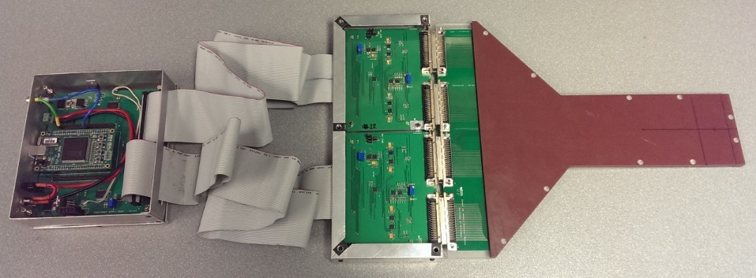
Experimental Methodology
MagicPlate 512 (MP512) or sDMG placed upon Scandidos Hexamotion movable phantom.
Lung motion pattern from 4D CT lung library

Slide 12
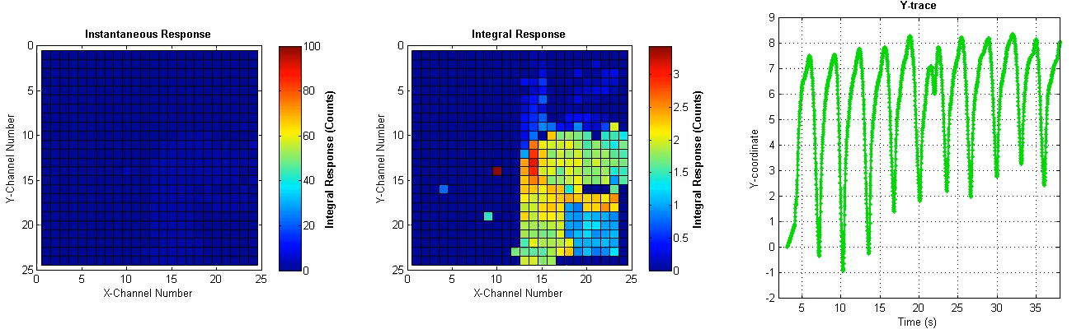
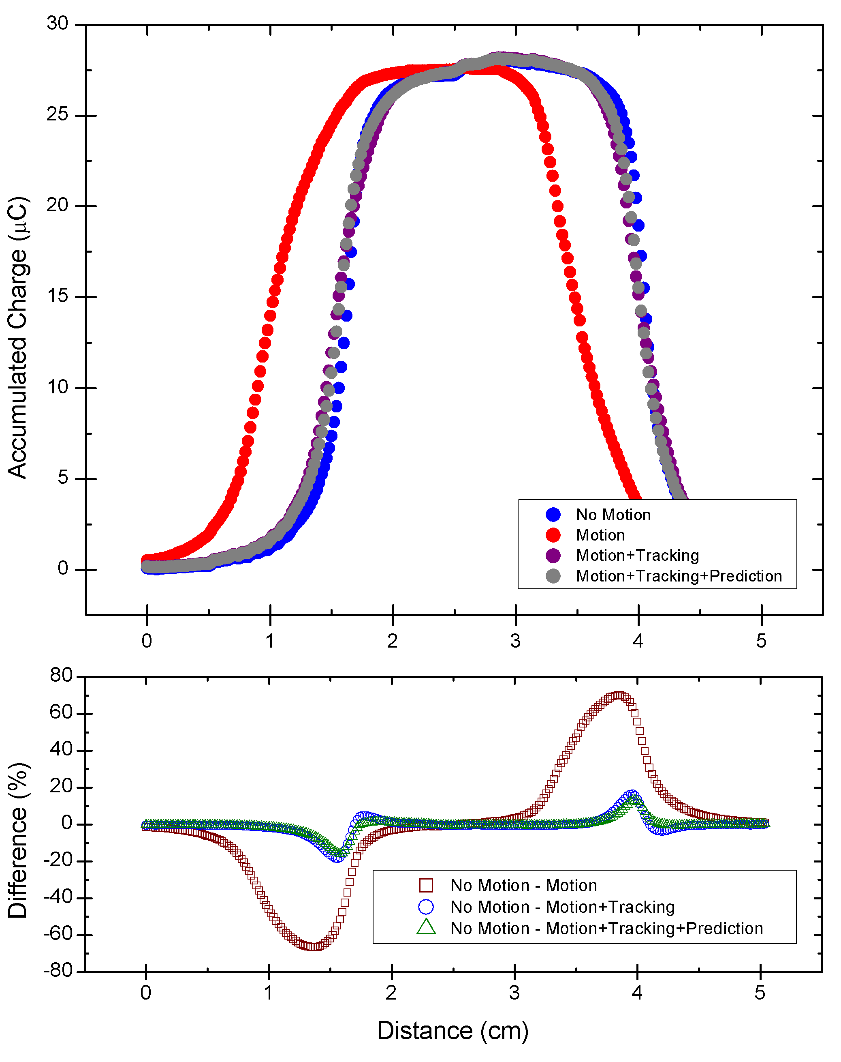
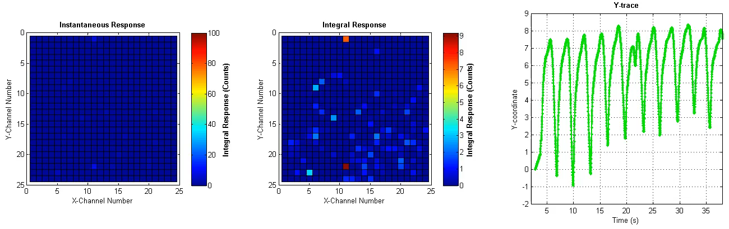
Results – MP512
With Motion – 1x1cm² field size
Superior-Inferior Motion (Y-direction)
With Motion and MLC Tracking - 1x1cm² field size
Med Phys., 42, 2992 (2015)
M.Petasecca et al “MagicPlate-512: a two dimensional silicon detector array for Quality Assurance of stereotactic motion adaptive radiotherapy” Med.Phys., 42(6) , 2992-3004, 2015

Slide 13
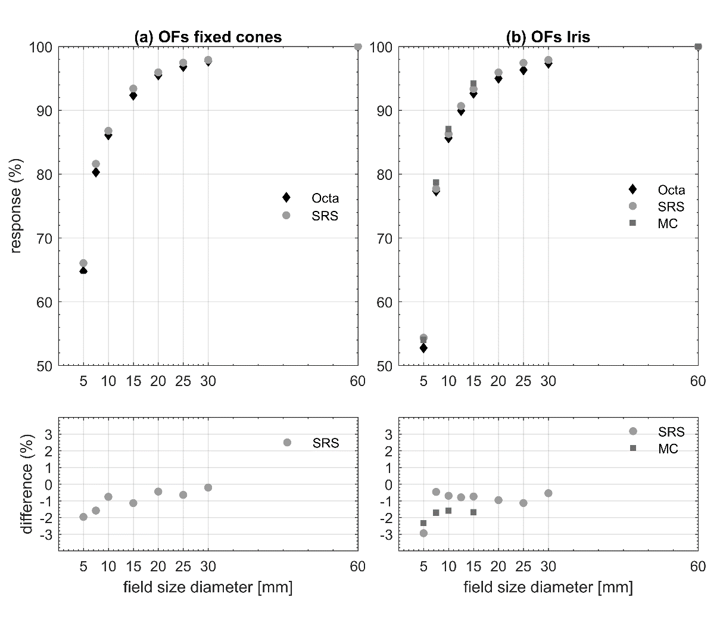
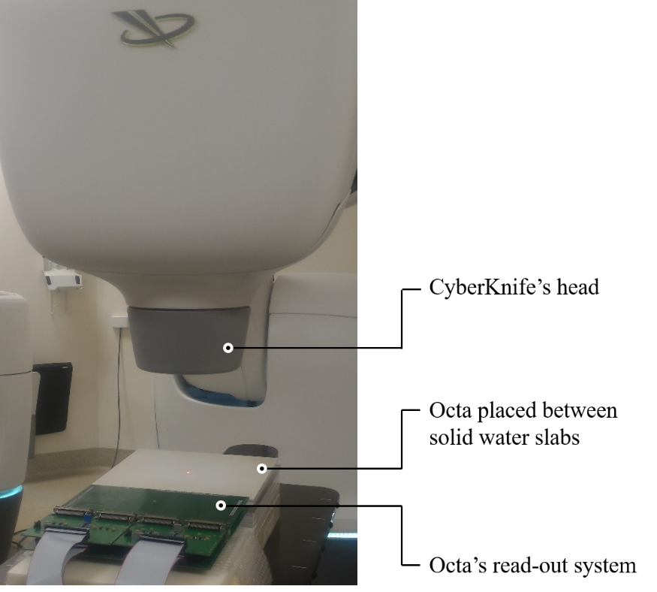
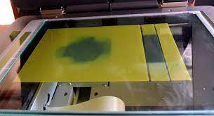
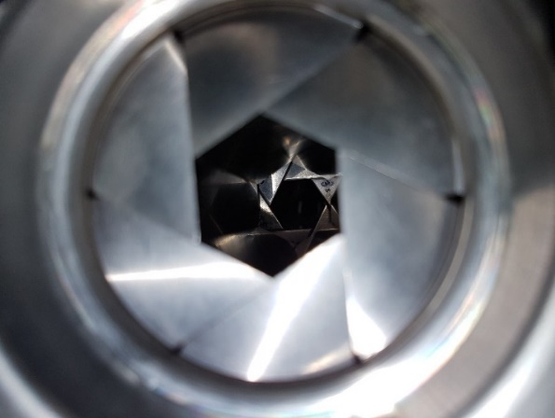
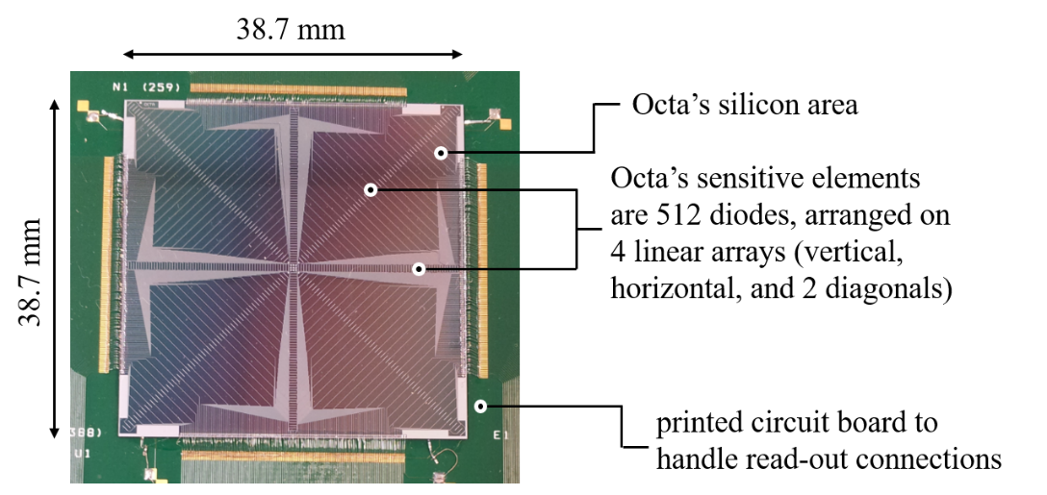
Small field dosimetry on CyberKnife: Octa advantage
From film to….
Iris or fixed cone
collimator
Octa
Output Factor measured with OCTA is within 2.9% agreement with Monte Carlo for 5 mm field
Correction-free dosimeter
Rosenfeld et al.,Phys.Med.Biol. ,65(16), 2020 Topical Review

Slide 14
Dosimetry in
Microbeam Radiation Therapy
Organic Semiconductor and Amorphous Silicon Sensors

Slide 15
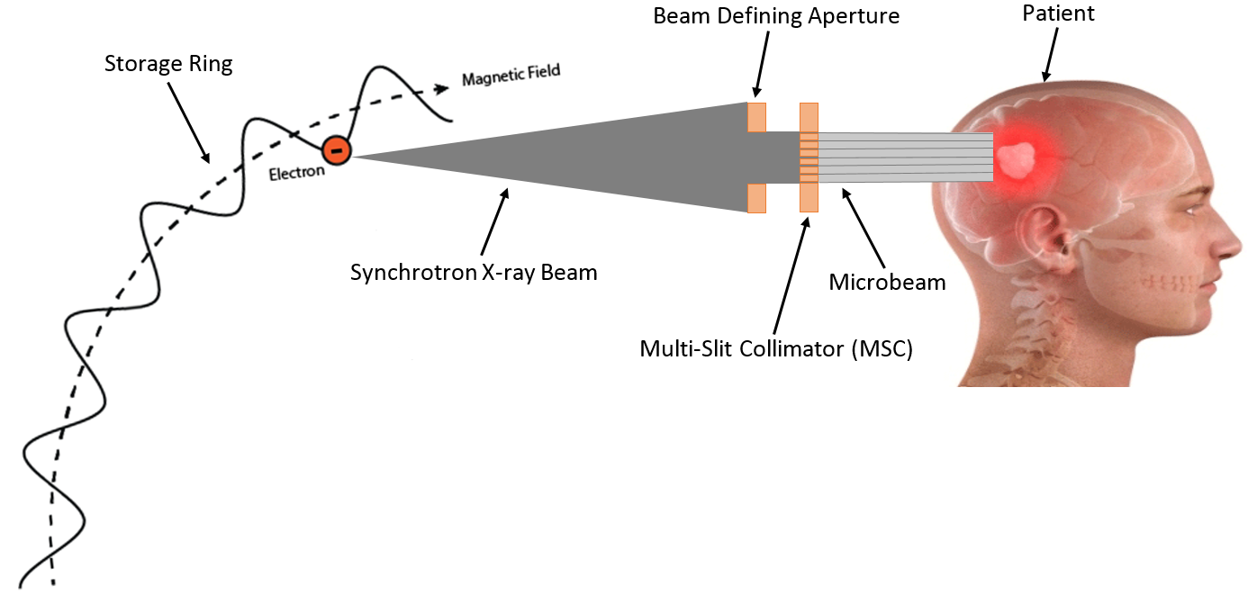

What is MRT?

Slide 16
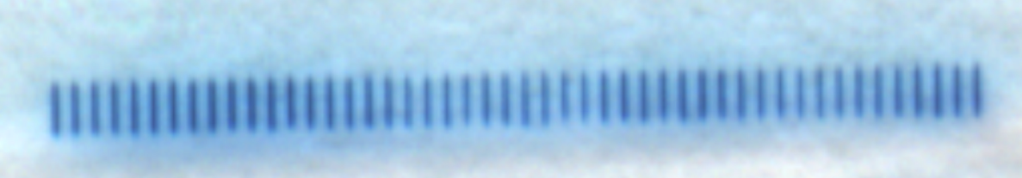
What is MRT?
Energy (keV)
0.5 mm
0.5 mm
50 mm (max)
Australian Synchrotron
Medical Beam Line (IMBL)
50 microbeams: 50μm/400 μm

Slide 17
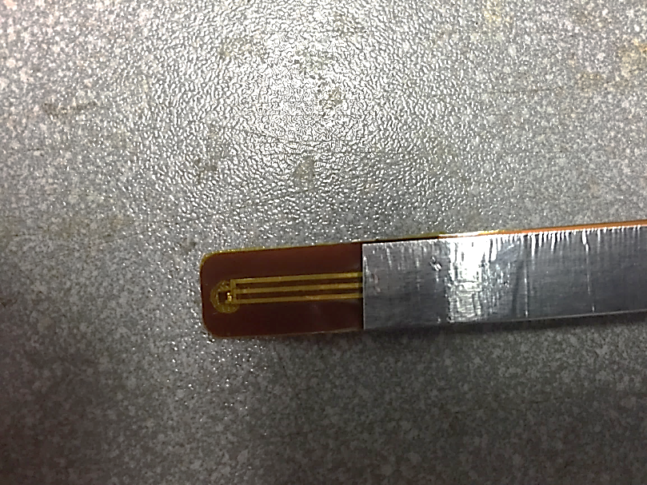
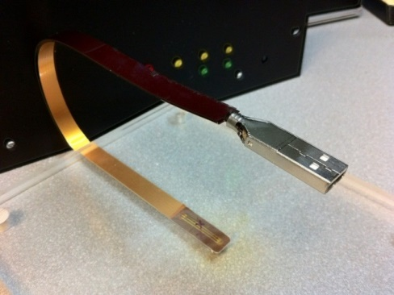
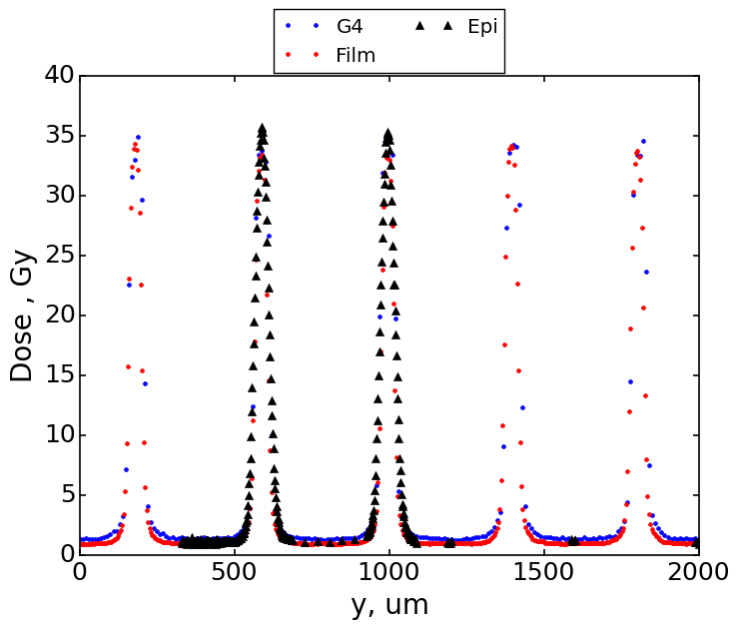
Epitaxial SSD and X-TREAM
Epitaxial Single Strip Detector and readout:
37 μm thick epitaxial layer p-Si
370 μm Si substrate, p-Si
Single n+ strip surrounded by a n+ guard-ring
N+ Strip dimensions: 7 µm × 500 μm
SSD embedded in a Waterproof Kapton pigtail
Dynamic range: 0.5-1.5x10⁵ nA
Sampling rate:1MHz
0.5 mm

Slide 18
Organic Photodiode (OPD) as a Dosimeter
OPDs are constructed of acceptor and donor materials,
they are structured as a blended heterojunction
Donor: conjugated polymer poly(3-hexylthiophene) (P3HT) blended with
Acceptor: phenyl-C61-butyric acid methyl ester (PCBM)
Fabricated by ISORG, France
Radiation Hardness
Cross section of OPD
25 nm PET
500 nm
Spectral Response
Direct mode response: to <E>=70keV,
synchrotron;
Radiation: 1.2kGy/h,
Co-60
Acceptor polymer PCBM (370nm) more radiation hard than the donor polymer P3HT (450-600nm),
Two modes of operation:
with/without plastic scintillator RP400
0.5-2 mm thick optically coupled to OPD
Jessie Posar et al , Med. Phys, 47, 2020

Slide 19
Organic Photodiode (OPD) as a Dosimeter
Response of OPD to 6MV X-ray from medical Linac
190 pC/cGy
170 pC/cGy
Energy response , V=-2V:
(2 mm BC400 scintillator):
40kGy pre-irradiated OPD,
Response driven by energy
response of scintillator BC400
Linac Pulse duration:3.6μs
Response of 40kGy pre-irradiated
OPD, V=-2V: direct and indirect (0.5mm BC400 scintillator)
Signal delay in direct mode due to e- traps filling
Indirect mode dose response ,
V=-2V:(0.5mm BC400 scintillator):
0kGy and 40kGy pre-irradiated OPD,
Excellent linearity
Dose per Linac pulse response ,
V=-2V:direct and indirect (0.5mm BC400 scintillator);
0kGy and 40kGy pre-irradiated,
Direct mode OPD dose rate dependent for <60 Gy/s

Slide 20
Organic Photodiode (OPD) as a Dosimeter
Response of OPD to 6MV X-ray from medical Linac
Direct mode depth dose response ,
V=-2V; Comparison with Ionisation Chamber (IC)
Non-irradiated OPD (0 kGy),
Response enhancement is due to
electron capture on traps and hole current enhancement (see slide ..)
Indirect mode depth dose response,
V=-2V,
:(0.5, 1, 2 mm BC400 scintillator):
Non -irradiated OPD,
Thicker scintillator –better agreement due to increasing ratio of optical/direct signal
Indirect mode depth dose response
V=-2V:(1 mm BC400 scintillator):
0kGy and 40kGy pre-irradiated OPD,
High RadHard :indirect mode
Jessie Posar et al , Med. Phys, 47, 2020

Slide 21
OPD: Synchrotron MicroBeam Dosimetry
Wide synchrotron beam
Response of 500nm OPD for X-ray dose rate:
3668 , 500 and 209 Gy/s,
Spectra X-ray peaked at : 48, 76, 88 keV
Microbeam array: 50μm width, 2 cm high, 400μm pitch
Filtering: combination Cu-Al
Calibration: against pin point (PTW 31014) IC , V=3V
PDD: OPDvs μ-diamond
Detector
Cu-Cu filter
OPD
Solid Water Phantom
Schematic of Experiment :
Edge on OPD is scanning across of micorbeams
The spectra at the IMBL for a 3T wiggler field strength
produced by the different filtration configurations
Jessie Posar et al J. Synchrotron Rad. (2021). 28, 1444-1454

Slide 22
Printable Semiconductor Organic Dosimeter
P3HT:o-IDTBR photodetectors coupled to 2mm thick RX400 scintillator, no bias
a)Indirect detection <E> = 50 keV X-rays
b) Pulses from 6MV linac with insert shows
Individual 3.6μs pulses
c) Dose Response : 6MV (1.2MeV average)
and 50KeV X-ray; coupled with 2mm LYSO
inorganic scintillator (high linearity)
d) A comparison of the temporal response
for detection of 3.6 μs pulses at <E> = 1.2 MeV:
Si diode vs OPD+RX400 plastic scintillator
(no difference)
e) X-ray image of the metal washer with
pixelated OPD+RX400
f) An image of an inkjet-printed array of
scintillator dots deposited onto organic
photodetectors with pixel pitch of 120 μm
Jessie Posar et al., Published 27th May 2021. Advanced Materials Technologies, 2001298.

Slide 23
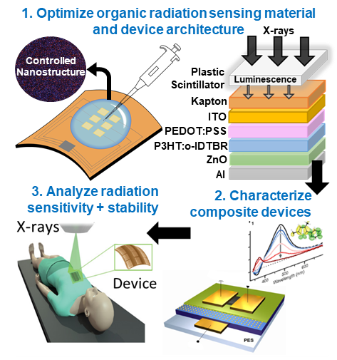
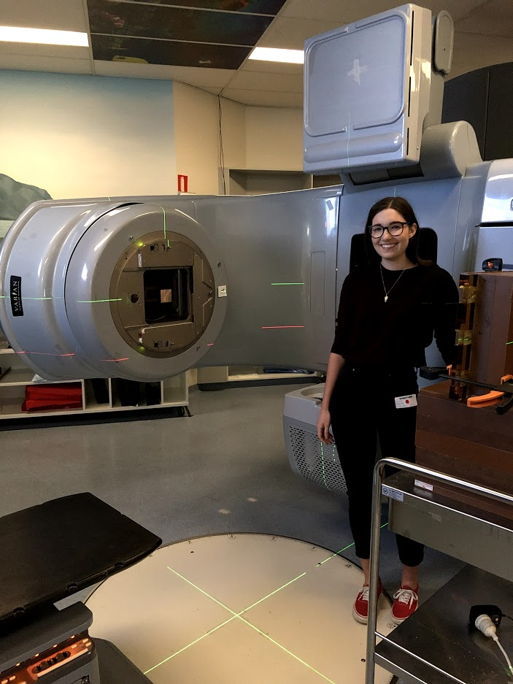
Conclusion
Organic Semiconductor materials are
useful for X-ray tissue equivalent dosimetry
Robust to environment and to operation, linear and reproducible response in a wide range of X-ray energies
Lightweight , bendable, conformable, X-ray transparent
Operating under low voltage down to zero volts
Inkjet printable, that make them suitable for the
next generation of real time wearable 2D
in vivo dosimetry in radiation therapy
Dr Jessie Posar
Marco Petasecca, E: marcop@uow.edu.au

Slide 24








HASPIDE Collaboration
M.J. Large¹, M.Bizzarri^{2,3}, M.Boscardin^{4,5}, L.Calcagnile⁶, M. Cameron¹, M. Caprai², A.P. Caricato⁶, G.A.P. Cirrone⁷, M. Crivellari⁵, I. Cupparo⁸, G. Cuttone⁷, V. De Rover¹, S.Dunand⁹, E. Engels¹, L. Fanò^{2,3}, B.Gianfelici^{2,3}, O. Hammad⁵, M. Ionica², K. Kanxheri², M. Lerch¹, G. Maruccio⁶, M. Menichelli², A. Monteduro⁶, F. Moscatelli^{2,10}, A. Morozzi², A. Papi², D. Passeri^{2,11}, M.Pedio^{2,10}, F.Peverini^{2,3}, G.Quarta⁶, S. Rizzato⁶, A.Rosenfeld, A. Rossi^{2,3}, G. Rossi², A. Scorzoni^{2,11}, L. Servoli², C. Talamonti⁸, G. Verzellesi^{4,12}, N. Wyrsch⁹ & M. Petasecca¹
This work was partially supported by the “Fondazione Cassa di Risparmio di Perugia” RISAI project n. 2019.0245.
1. Centre for Medical Radiation Physics, University of Wollongong, Northfields Ave Wollongong NSW 2522, (AUSTRALIA).
2. INFN, Sez. di Perugia, via Pascoli s.n.c. 06123 Perugia (ITALY).
3. Dip. di Fisica e Geologia dell’Università degli Studi di Perugia, via Pascoli s.n.c. 06123 Perugia (ITALY).
4. INFN, TIPFA Via Sommarive 14, 38123 Povo (TN) (ITALY).
5. Fondazione Bruno Kessler, Via Sommarive 18, 38123 Povo (TN) (ITALY).
6. INFN and Dipartimento di Fisica e Matematica dell’Università di Lecce, Via per Arnesano, 73100 Lecce (ITALY).
7. INFN Laboratori Nazionali del Sud, Via S.Sofia 62, 95123 Catania (ITALY).
8.INFN and Dipartimento di Fisica e Astronomia dell’Università di Firenze, Via Sansone 1, 50019 Sesto Fiorentino (FI) (ITALY).
9. Ecole Polytechnique Fédérale de Lausanne (EPFL), Institute of Electrical and Microengineering (IME), Rue de la Maladière 71b, 2000 Neuchâtel, (SWITZERLAND).
10. CNR-IOM, via Pascoli s.n.c. 06123 Perugia (ITALY).
11. Dip. di Ingegneria dell’Università degli studi di Perugia, via G.Duranti 06125 Perugia (ITALY).
12. Dip. di Scienze e Metodi dell’Ingegneria, Università di Modena e Reggio Emilia, Via Amendola 2, 42122 Reggio Emilia (ITALY).

Slide 25
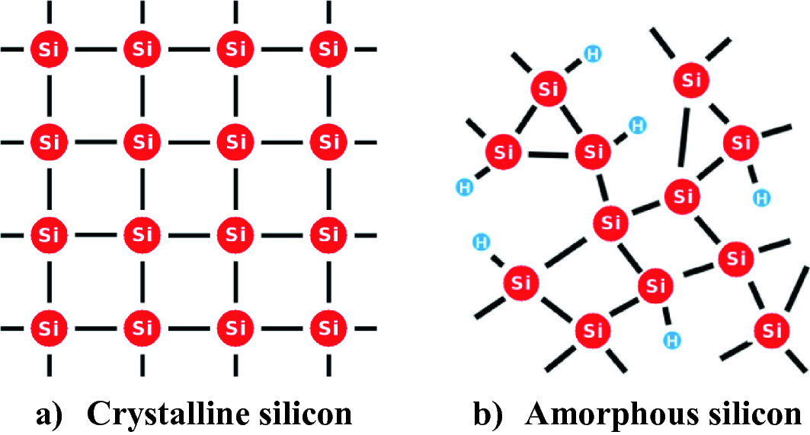
Overview of a-Si:H
Fabrication of a-Si:H
a-Si:H fabricated by PECVD of a mixture of Silane (SiH₄) and molecular hydrogen.
Fabrication methods developed and optimised at EPFL, Neuchatel Switzerland
Why a-Si:H for dosimetry?
  Reliable and cheap fabrication
  Deposition over large areas and variety of substrates (including mechanically flexible options)
  Intrinsic radiation hardness
  Thin active layer + thin substrate/contacts
Shah A. (2020). Springer Series in Materials Science, vol 301. Springer, Cham. Doi: 10.1007/978-3-030-46487-5_6
École polytechnique fédérale de Lausanne

Slide 26
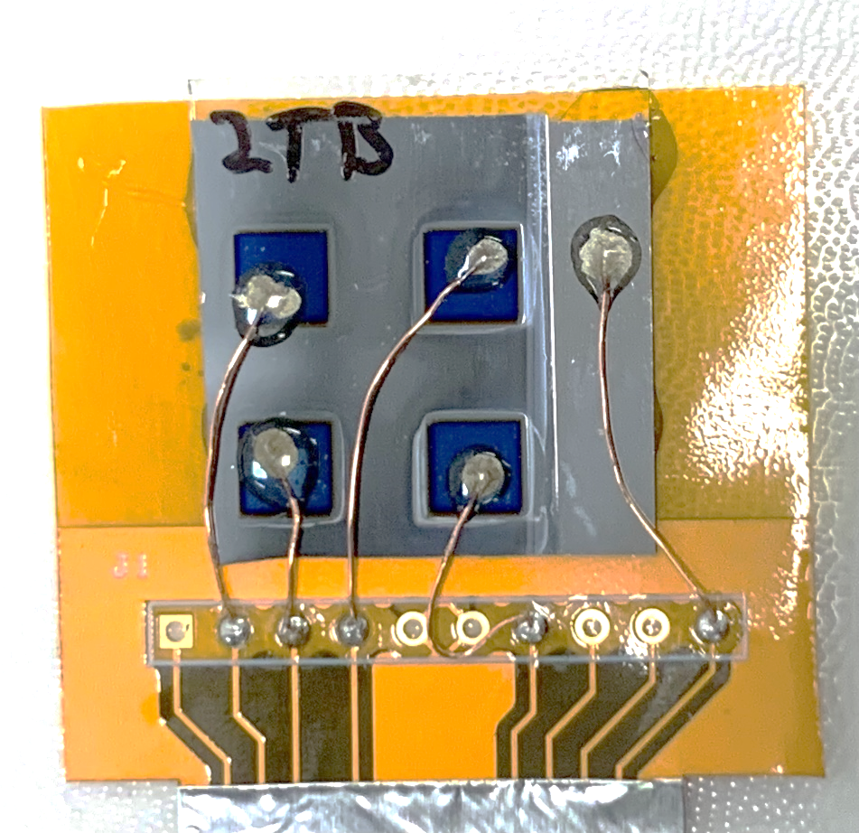
Device Architecture
Glass Substrate
a-Si:H Layer
10 nm Cr + Electron Selective Contact
Hole Selective Contact (MoO_{x}) + ITO
- 20nm + 60 nm, respectively
Silver Conductive Paint
2-Part Epoxy
50 µm Coated Copper Wire
VARIATIONS:
a-Si:H layer: 0.8 µm or 6.2 µm (for sample identification:1-xx or 2-xx, respectively)
Electron Selective Contacts: 60 nm of Al:ZnO or 10 nm of TiO₂
(for sample identification: _AB or _TB, respectively)

Slide 27
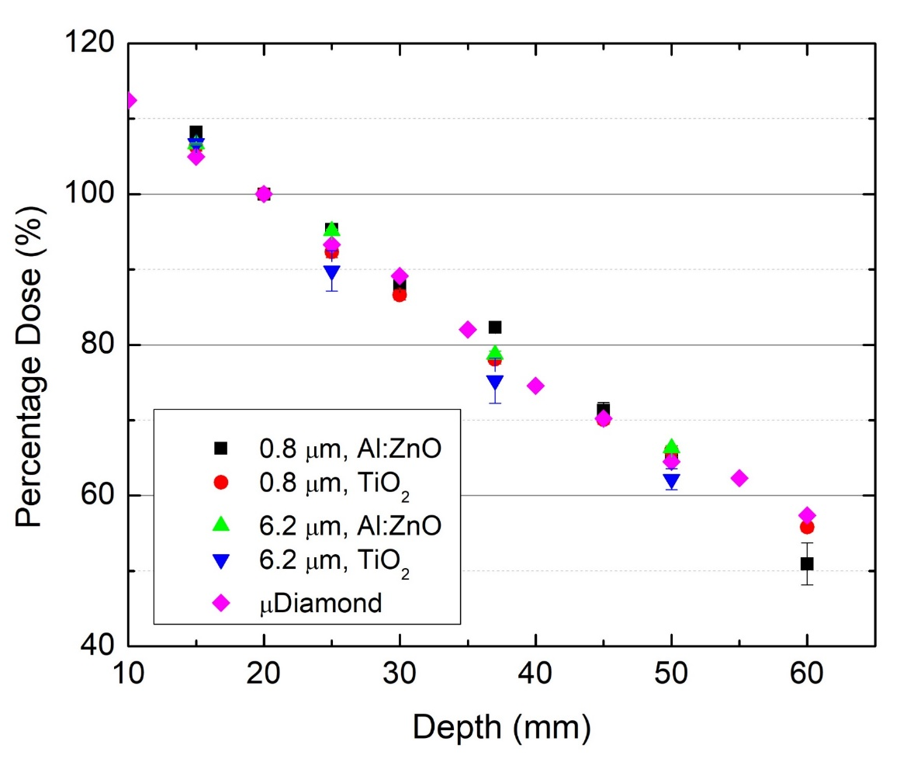
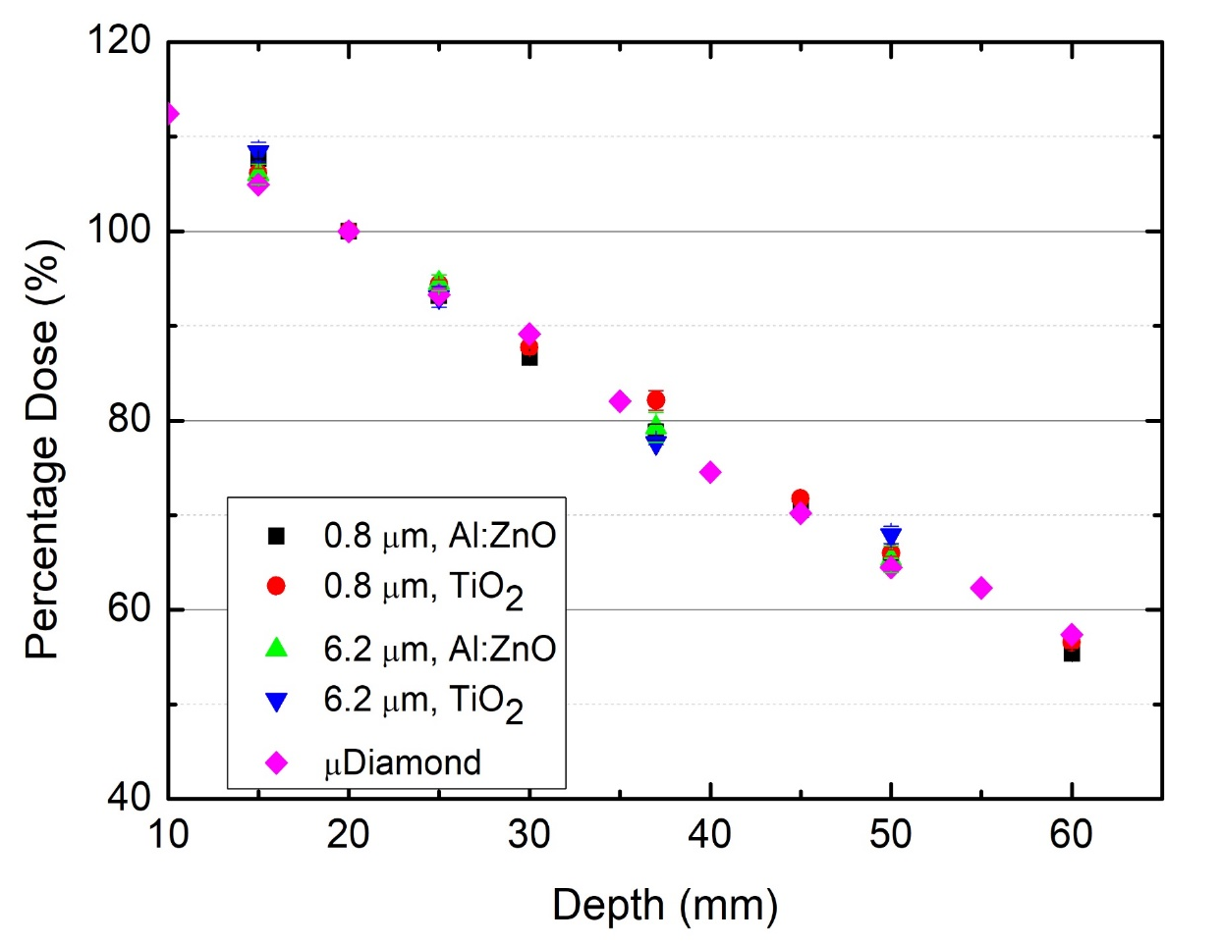
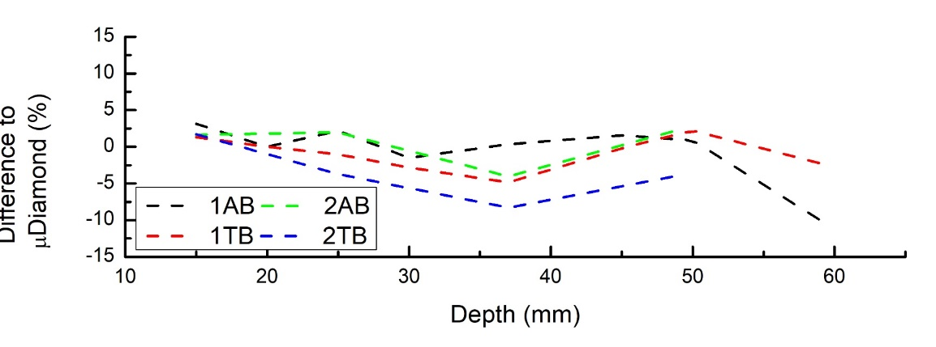
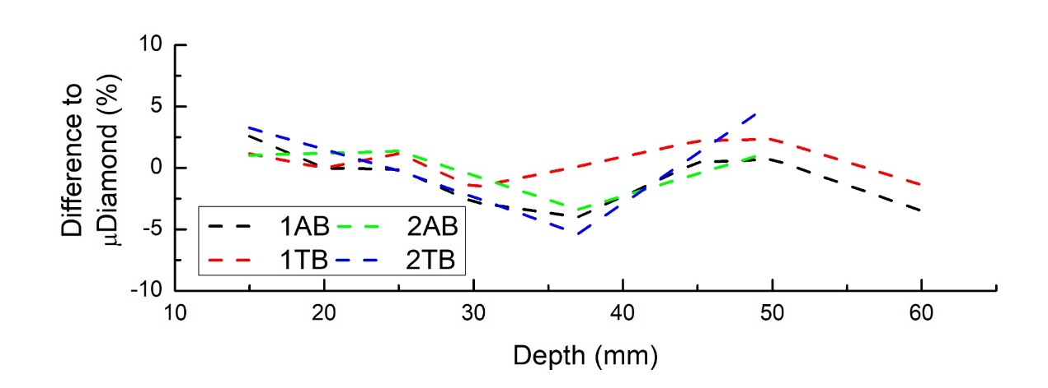
Percentage Depth Dose
µDiamond Reference Data:
(Livingstone, 2016) 10.1118/1.4953833
PASSIVE (0V)
BIAS
Notes:
Main talking point - Al:ZnO samples have a more stable and “tissue equivalent” response than the TiO₂ samples. Even so, under bias all samples are within 5% variation from uDiamond, which is acceptable for machine QA.

Slide 28
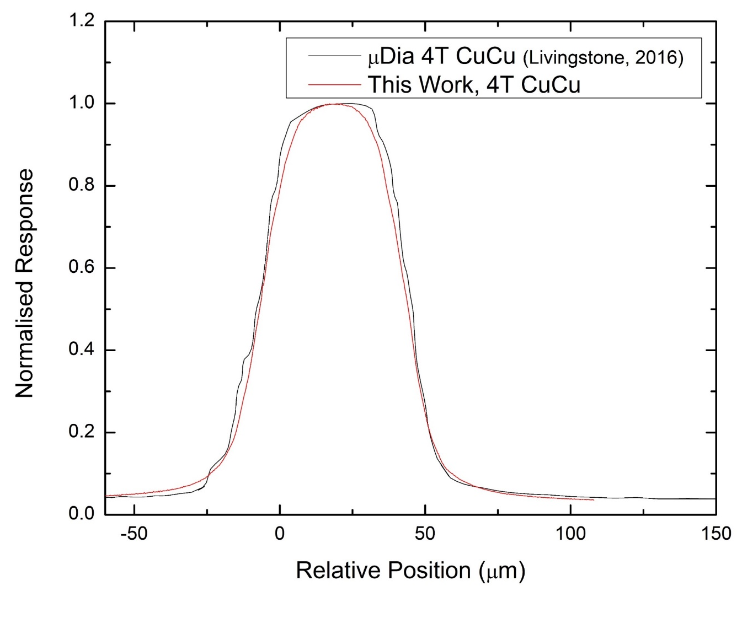
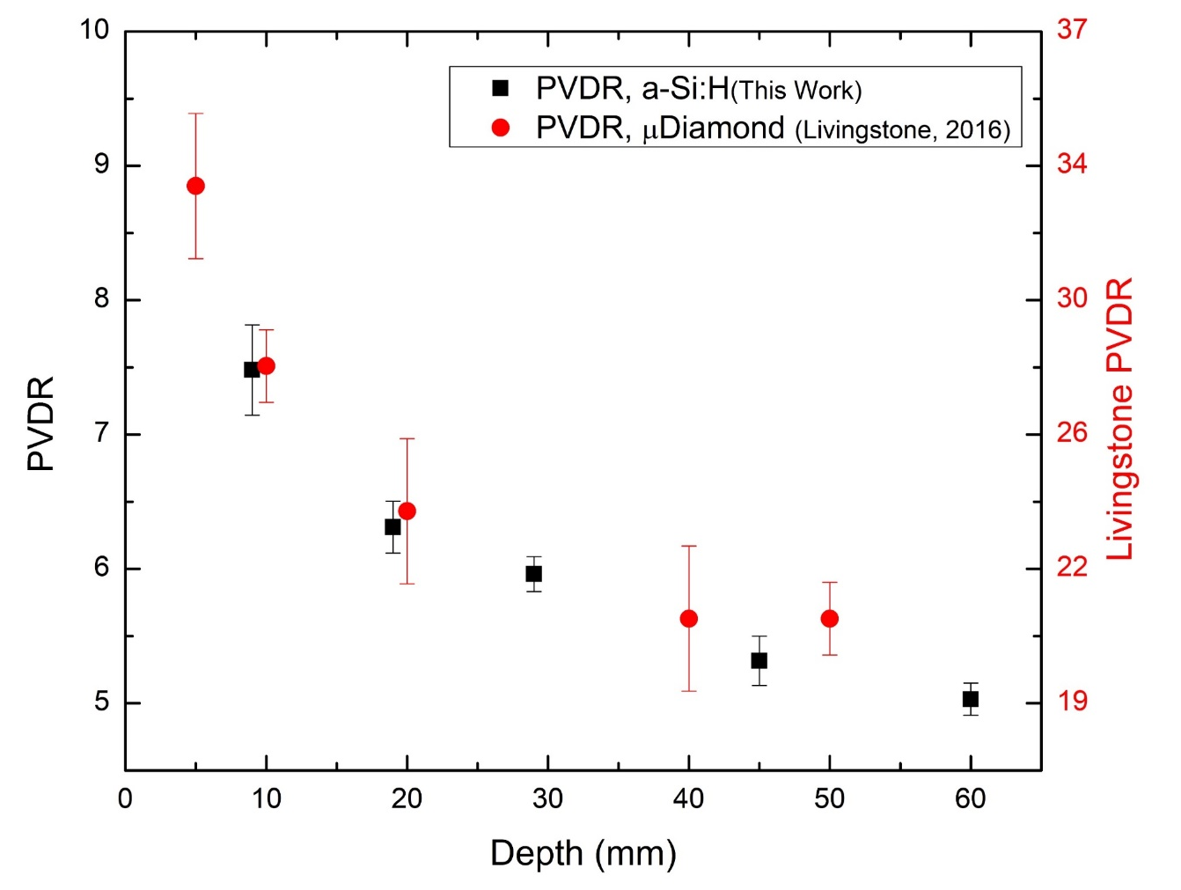
4T Cu-Cu Microbeam Profiling and PVDR
(Step-and-shoot irradiate mode)
Expected Microbeam Parameters
Peak-to-peak: 400 µm
FWHM: 50 µm
Measured Microbeam Parameters
Peak-to-peak: 405 ± 1 µm
FWHM: 55 ± 1 µm
µDiamond Reference Data: (Livingstone, 2016) 10.1118/1.4953833

Slide 29
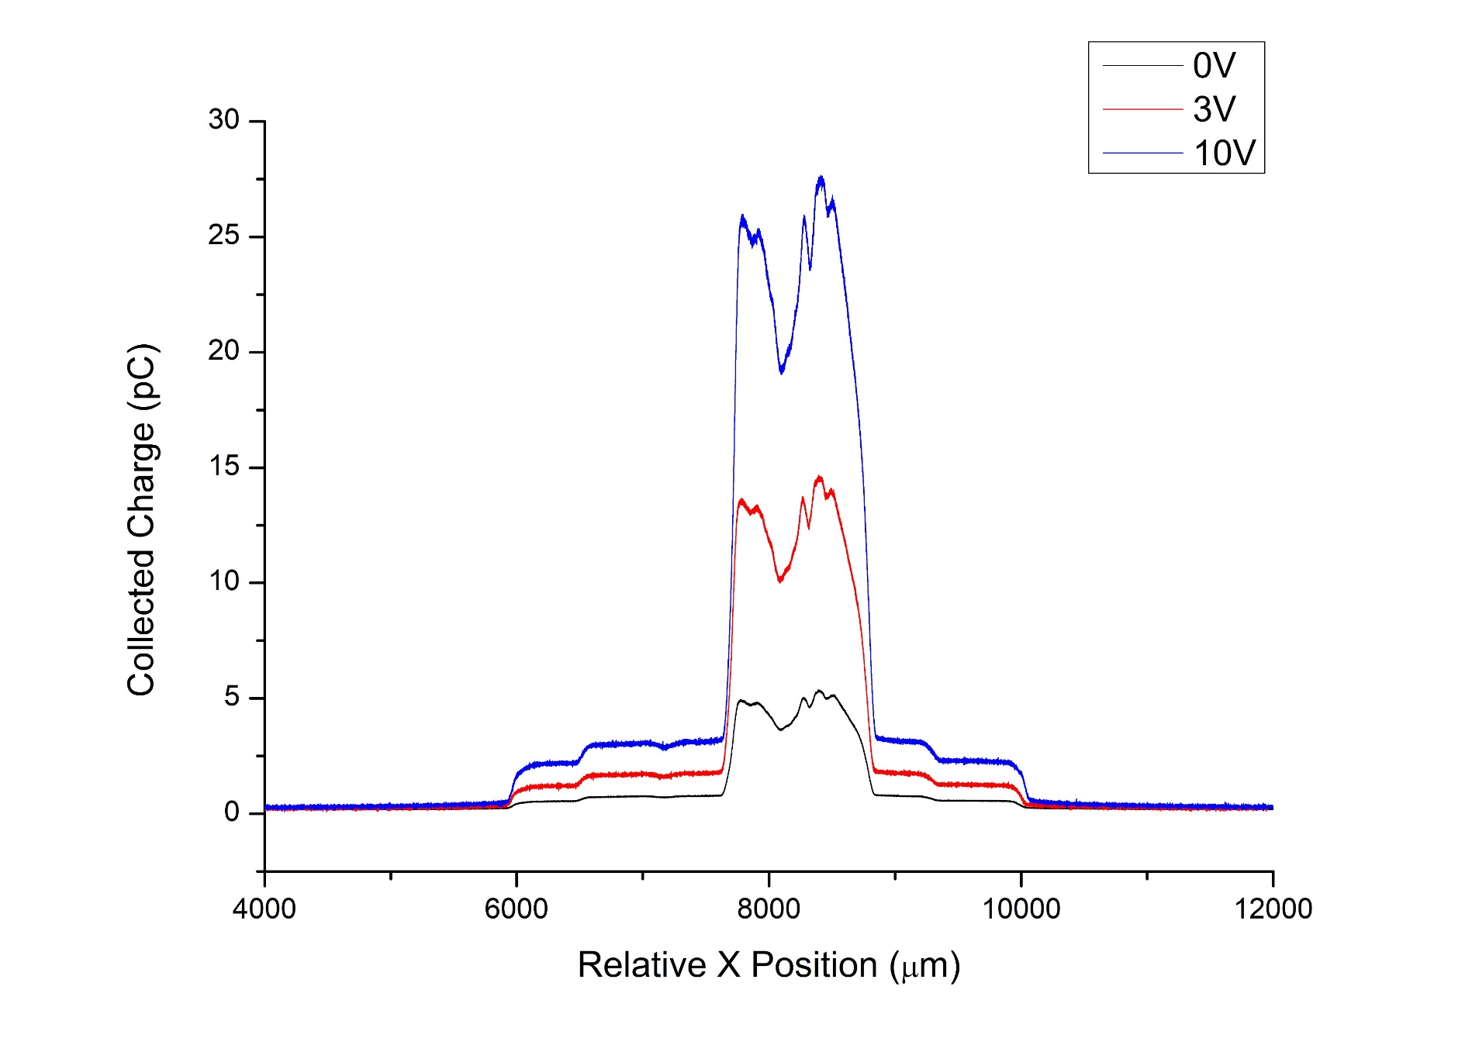
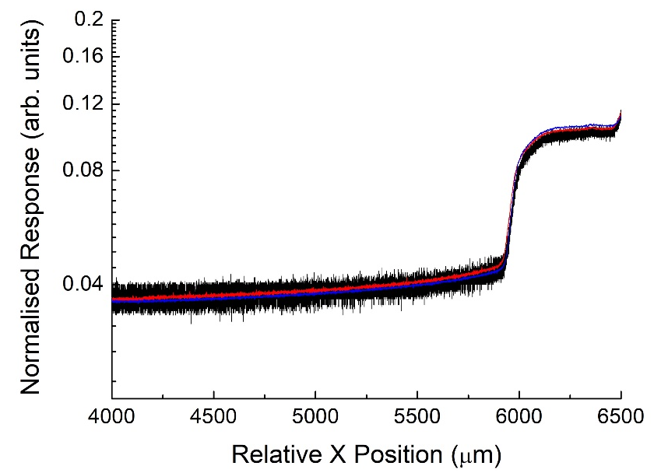
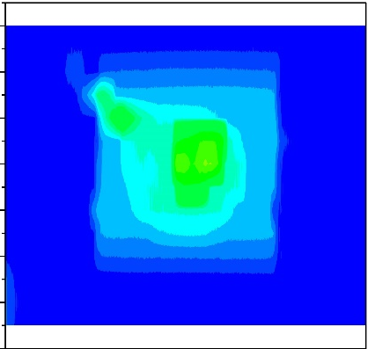
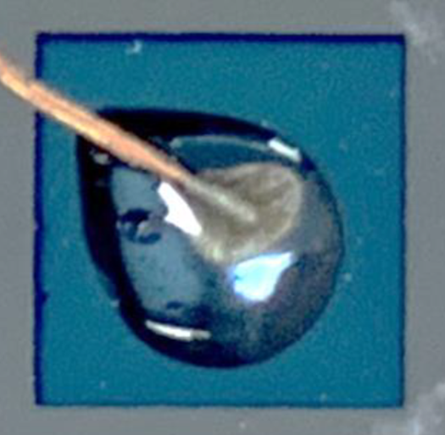
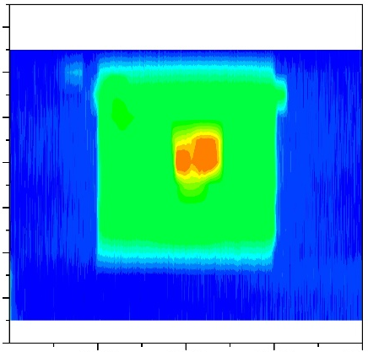
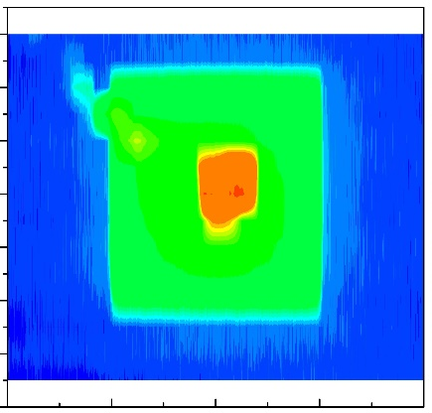
XBIC
0V
Silver glue contact
Epoxy protected
3V
10V

Slide 30


Dose-Rate Dependence
Varian TrueBeam Clinical LINAC
6MV Photons
600 MU/min
Reference Dosimetry w PTW Farmer type chamber (0.6 cm³)
Measurement Conditions
1.5 cm depth + 8 cm backscatter water-equivalent plastic
Source-to-surface (SSD) distance varied from 80-250 cm

Slide 31


SUMMARY
Excellent performance of a-Si:H devices in broad beam dosimetry for high dose-rate fields
Pixel sensitivities varying by less than 20%
PDD results matching reference within 5%
Quantified radiation resistance of a-Si:H to total ionizing doses far higher than previously investigated
Heating/thermal runaway present in radiation damage
Exceptional spatial resolution
Device architecture and bonding sub-optimal for MRT dosimetry
Dose enhancement from silver (via XBIC maps)
Poor PVDR (3x lower than reference from micro-diamond)
Dose rate dependence can be mitigated with bias AND pre-irradiation
Reduction of 75% is observed up to approx. 0.8 Grad x-ray irradiation.
When devices operated in edge-on modality
data.

Slide 32
Sensors for ion and proton beam energy measurements

Slide 33




sDMG: Proton Beam Therapy Range Verification QA
sDMG: Miniature multi-strip silicon detector designed by the Centre for Medical Radiation Physics (CMRP), University of Wollongong
  Two linear silicon diode arrays – 128 sensitive silicon strips each.
sDMG housed in solid water phantom (GAMMEX, WI, USA)
  Small air volume surrounds the silicon to prevent damage of Si detector
Si strip detector-DMG.
(Left): Photograph of sDMG linear array of detectors. An arrow indicates the direction of the axis of detection.
(Right): Schematic of sDMG mounted on a pigtail PCB carrier and housed in the solid water phantom
Air Volume
Close up schematic of sDMG.

Slide 34


Ion Range Meter: new, accurate and fast approach – C-12, HIMAC
The detection axis is aligned parallel to the direction of the C-12 beam.
C-12 ion beam, energy 290 MeV/u and 10x10cm² square field.
  PBP (pristine Bragg peak)
Depth Dose Profiles: PBP measurements conducted with increasing depth in PMMA (+/- 1mm).
Data Acquisition System
sDMG detector in PMMA
C-12 beam
Figure – Schematic of experiment, beam energy E₀ is modified along trajectory through materials & detector to deposit PBP in sensitive volumes for measurement.
E.Debrot et al , Med Phys , 45(2), 953-962, 2018

Slide 35





Results: Energy Reconstruction for Heavy-Ions
Technology Implemented
Table III – Energy Reconstruction for C-12.
Mayo Clinic, MN
MGH, Boston
E₀ determined by Monte-Carlo simulation to be 275 MeV/u +/- 0.01%,
E₀ determined by detector reconstruction to be (278 +/- 1) MeV/u

Slide 36






DMG-256 for range verification in PBS proton therapy: Mayo Clinic collaboration
30°
DMG : Range PBS beam, field 5x5 cm²
Debrot et al., Phys.Med.Biol.,66(9), 2021 doi: 10.1088/1361-6560/abf1b9

Slide 37






Proton Beam Experiment – PBS Spot Profile (MGH)
PBS “Golden” data obtaining
(a)
(b)
DUO
Profiles compared between DUO and MatrixX at each depth investigated.
A sample of the measurements taken is shown.
(d)
(c)
(d)
(c)
(a)
(b)

Slide 38









MOSkinTM Dosimetry
Applications
Brachytherapy
In vivo rectal wall dosimetry
MRI Linac
Skin dosimetry
The MOSkin™ advantages:
Skin dosimetry at depth 0.07mm
In VIVO real time dosimetry
Disposable or multi-use
Invisible in X-ray beam
MOSkin™ Detector

Slide 39




Dosimetry challenge on MRI Linac and solutions
Australian MRI Linac
PDD response normalized
to 50mm depth
PSD readout:
2 PMT RCA 45-26
Farmer IC
EBT 3 film
Plastic Scintillator Detector (PSD)
Distortion
OF:Eska CK-40
PSD is reliable and accurate for MRI Linac relative dosimetry
Water equivalent materials
2mm diameter , 1mm length
Symmetric
No electronics in B field
L.Madden et al., BPEX, 7(2), 2021 and Phys.Med.,73, 111-116 ,2020

Slide 40
Skin Dosimetry with MOSkinTM on MRI-Linac
PDD f as measured with MOSkinTM, microDiamond, EBT 3 film and Monte Carlo :
a) In a CAX ,field 11.8x11.5 cm²; b)off –axis and CAX field 5.8x5.8 cm²
MOSkinTM is B-field immune and measure
Skin Dose at depth 0.07mm
N.Roberts et al., Med.Phys.,46(12), 2019; E.Patterson et al., JACMP, 2022, e13951 and Phys.Eng.Sci. in Med., 2023 Elizabeth Patterson

Slide 41
Optical fibre exposed to proton beams. Australian Bragg Centre for PT
In collaboration with Massachusetts General Hospital, Boston, USA.
PMMA and silica optical fibres exposed to varying dose-rates.
A passive-scattering proton beam of range 14 cm (energy of 140 MeV).
PMMA:
Total light collection:
  linear with constant dose-rate
  linear with dose-rate
A M C Santos and N Depauw 2020 J. Phys.: Conf. Ser. 1662 012029

Slide 42
Optical fibre exposed to proton beams Australian Bragg Centre for PT
In collaboration with Massachusetts General Hospital, Boston, USA.
PMMA and silica optical fibres exposed to varying dose-rates.
A passive-scattering proton beam of range 14 cm (energy of 140 MeV).
Silica:
Total light collection:
  Sensitive to accumulated dose
  Accumulated dose effect observed at all dose-rates.
A M C Santos and N Depauw 2020 J. Phys.: Conf. Ser. 1662 012029

Slide 43

BeO ceramic fibre-coupled luminescence dosimetry
Two dose measurements
Scintillation or radioluminescence (RL) measured in real-time during radiation exposure.
Optically stimulated luminescence (OSL) measured post radiation exposure.
BeO ceramics:
A water equivalent material
Has both RL and OSL
Been shown to be a promising material for proton dosimetry
Signal (counts/sec)
RL
OSL
BeO
time (sec)
PMT
Laser
Optical fibre
Santos et al. Medical Physics 42, 6349 (2015)

Slide 44
BeO ceramic fibre-coupled luminescence dosimetry
Real-time OSL
During exposure, to pulse the stimulation laser:
  Between the pulses will be RL+Stem
  During the pulses will be OSL+RL+Stem
Subtraction of the two will provide a measurement of the OSL which is stem effect free.
Currently investigated in x-ray fields, next application is proton therapy.
Santos et al. Physica Medica 65 (2019) 167–171

Slide 45


Proton Imaging at Australian Bragg Centre for PT
Treatment margins to account for X-ray imaging uncertainties
Replace/supplement X-ray imaging with proton imaging
Outcome
Reduced uncertainty margins
Reduction in irradiated healthy tissue
Potential reduction in treatment-related side effects
S.Penfold et al.
Single particle spatial detectors
Single particle energy detector

Slide 46




QUT Gel Dosimetry
Gel dosimeter in CIRS head phantom
Gel dosimetry is a water
equivalent 3D dosimetry system.
Radiation sensitive materials
infused in a gel
Materials change proportional to dose
Held in place by gel to give a 3D dose distribution
…and Presto, it worked!!!
3D dose mapping
using optical scanner
J.Trapp

Slide 47
Microdosimetry sensors for Particle Therapy

Slide 48



CMRP Microdosimeters
Using advanced 3D MEMS detector technology

Slide 49








Advantages of Proton and Heavy Ion Therapy
Bragg Peak discovered in 1903
Proposed to use clinically in 1946
Radiobiological Efficiency (RBE)
William Henry Bragg
University of Adelaide
Robert Wilson
Harvard University
Bragg Peak
Spread-out Bragg Peak
Georg, P. Particle therapy in head and neck cancer—expanding therapeutic options. memo 13, 389–394 (2020). https://doi.org/10.1007/s12254-020-00623-y
Indirect DNA damage
RBE = 1
Direct DNA damage
RBE_{Carbon} = 2-4

Slide 50








Mechanistic understanding
$$y=\frac{ε_{1}}{\overline{l}}$$
Chromosomal aberration will be fatal, especially if clustered.
Energy deposition to the chromosomal size (~μm) is the keystone.
Spatial energy deposition in μm scale is highly dependent on the incident radiation … Microdosimetry
10µm
Can measure an array of cells
Provides true microscopic SV
Compact size
Low voltage
High spatial resolution
Courtesy Scholz (GSI) and Matsufuji (NIRS)

Slide 51






Radiobiological Effectiveness (RBE)
Microdosimetric Kinetic Model (MKM)
~1 μm
$$S(D)=\exp\left[−αD −βD^{2}\right]$$
Physics/Biology
$$α=α_{0}+\frac{β}{ρπr_{d}^{2}}y^{∗}$$
$$RBE_{10}=\frac{2βD_{10,R}}{\sqrt{α^{2}−4β\ln\left(0.1\right)}−α}$$
where $α$ and $β$ are cell- and radiation-specific characteristics
For MIAPaca cells:
α_{o}= 0.001 Gy⁻¹; β= 0.085 Gy⁻² ; r_{d} = 0.57 µm is radius of sub cellular domain in MK model, y_{o} = 260 keV/µm
Single lesion in any domain leads to cell death
$$Poission\left(0,\overline{L}\right)$$
Hawkins, Rad. Res. (2003)
Kase et al., Rad. Res. (2006)
~10 μm
Courtesy of N.Matsufuji,
QST, Japan
Notes:
The TDRA assumes that the number of lethal lesions in a microscopic cellular nucleus or a subcellular structure designated as a ‘‘site’’ is proportional to the square of the
specific energy of that site
The site concept of the TDRA was further developed by Hawkins (14) in a microdosimetric kinetic (MK) model to account for cell survival after exposure to a heavy-ion
beam. In the MK model, it is postulated that the average number of lethal lesions in a subcellular structure referred to as a ‘‘domain’’ is given by a linear-quadratic correlation with the specific energy, z, of the domain for any type of radiation. The surviving fraction of cells irradiated using low-LET radiation can be derived by assuming the Poisson distribution of lethal lesions among the cells, which is thought to be valid even in the case of heavy charged particles exhibiting a locally concentrated energy deposition near the track. However, for high-LET charged particles, it is necessary to add the non-Poisson distribution correction to the surviving fraction (15), as will be described below
Validation of the MKM and its parameters was demonstrated in many types of cell survival studies. For instance, the human salivary gland (HSG) tumor cells with MKM parameters, ao= 0.13 Gy1,b = 0.05 Gy2, and rd= 0.42 lm.11 The mentioned parameters of the HSG cell line were used as an example of RBE derivation in this study. The RBE is proton dose-dependent and related to particular survival fractions S(Dp) and can be obtained from (3) using the following formula:

Slide 52



“Mushroom” microdosimeter: Patent to reality
SINTEF MINALAB
(Micro-and Nanotechnology Laboratory, Oslo)

Slide 53







“Mushroom” microdosimeter: Fabrication process
DRIE
Doping, filling electrodes
Ion implantation, metal deposition
Silicon etching
1: 30 aspect ratio
DRIE
Silicon etching
Polyimide deposition

Slide 54









CMRP Silicon Microdosimeters:18 years of development
Bridge MD Version 2
SEM image of Mushrooms
From patent U.S. Patent No. 8421022
EP 2 102 685 B1
To reality
Median energy map showing good sensitive volume yield in the Mushroom microdosimeter, biased at -10 V
MicroPlus probe with SOI Mushroom Microdosimeter, and SEM image showing 3D sensitive volumes
A.Rosenfeld “Novel detectors for silicon based microdosimetry, their concepts and applications”, NIM A, 809, 156-170, 2016

Slide 55


The 6MV SIRIUS Tandem Accelerator, ANSTO for Ion beam induced charge collection (IBIC) study
New nuclear microprobe–Confocal Heavy Ion Micro-Probe (CHIMP)
Microbeam spatial resolution:
0.6 µm x 1.5 µm for 3 MeV H⁺
1.5 µm x 1.5 µm for 6 MeV He²⁺

Slide 56






Mushroom microdosimeter (5- 10 µm thick)
Poly-trenched
IBIC 3 MeV He²⁺ ions
Cross-section image of the 5um thin mushroom microdosimeter.
0V
10V

Slide 57
SF: MicroPlus predicted vs TPS in SOBP
MicroPlus
SOBP
TPS: RBE₁₀xD
10x10x6 cm³
$$α= α_{o}+\frac{β}{ρπr_{d}^{2}} y^{∗}$$
MicroPlus
SOBP
Linear Quadratic Model
S(D) = exp [ - αD - βD²]
Dose in SOBP
measured by Markus IC
Good prediction
of SF
S.H.Lee et al “Estimating the biological effects of helium, carbon, oxygen, and neon ion beams using 3D silicon microdosimeters”, PMB , 66(4) 2021

Slide 58







LET_{d} verification at proton therapy University Medical Center Groningen (UMCG)
Variable RBE must be implemented in PT
D(GyEq) = RBE × D = (1+ κ LET_{D}) × D
A
B
C
Critical organ
↑25 cGy
2.5mm
MicroPlus dosimeter probe installed in a water (A) and a head and neck phantom (B) in Groningen Proton Therapy Center and (C) a coronal projection of CT scan of the CIRS 731-HN phantom. The red circles indicate the target areas used in treatment planning to create three treatment plans (i.e. brain, nasopharynx, neck). The left half of phantom was replaced with solid water.
TPS predicted physical dose x RBE 1.1 and variable RBE biological dose based on calculated LET_{d} and measured $\overline{y_{D}}$ for nasopharynx plan in a head phantom.

Slide 59

Dosimetry at Peter Mac
Imaging
Theranostics
Radiation Safety
Radiotherapy

Slide 60


Stereotactic radiotherapy of vertebral metastases
Very steep dose gradients from the vertebral target to the spinal cord
Measurements for every patient
Design of customised phantom for film
Hope on high spatial and temporal resolution semiconductor arrays
In house designed phantom for radiochromic film and diamond detectors
high
Typical target volumes in SBRT of vertebral metastases – consensus guidelines
Cox et al IJROBP, 83 (e597-605) 2012

Slide 61






MOSkinTM commercialisation
Start Up Electrogenics Laboratories Ltd: licensee of UOW MOSkinTM technology

Slide 62





CMRP-SINTEF business partnership
Microdosimeter sensor “Mushroom”
CMRP: Invention, prototyping and licencing to SINTEF
SINTEF: 3D detector technology and sensors fabrication
CMRP: Implementation to space and clinical practice
Jointly: ESA the best radiation sensors for space mission (see below)
http://space-env.esa.int/index.php/news-reader/items/tissue
-equivalent-crew-dosimeter-based-on-novel-3d-si-processing.html
IEEE NSS MIC 2018, November, Sydney

Slide 63









Acknowledgements
Thank you
for your attention!
HIT: HIMAC, Japan
SINTEF
MGH
Contacts: Prof Anatoly Rozenfeld
Email: anatoly@uow.edu.au

Slide 64





Development of radiation sensors at the Centre for Medical Radiation Physics, University of Wollongong

Slide 65
Organic Semiconductor
Energy levels of occupied and
unoccupied levels for σ and π−bonds
Orbitals of 2 connected C-atoms
The common property of these organic compounds is that they consist of chains of connected carbon atoms:
either as closed benzene rings (oligomers) or
expanded chains (usually referred to as “backbone”) in polymers.
  In both cases the key to the charge conduction are π-bonds between adjacent carbon atoms.
  Production: Spin Casting of polymer from solvent or through
  Physical Vapor Deposition
Energy levels of s-bonds (18 e) and
energy levels of delocalized π-bonds (6 e).
Benzene ring with delocalized
system of π-bonds
>2.5 eV
HOMO (the Highest Occupied Molecular Orbit)
LUMO (the Lowest Unoccupied Molecular Orbit)
Bands structure is related to molecular properties while e and h can travel through these bands resulting in current conduction through “thermal hopping” mechanism from one molecule to another.

