Slide 1

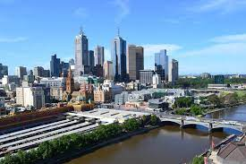
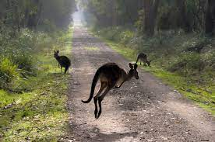
Welcome to Melbourne!
Local Organising Committee
Rohan Dowd (Australia, ANSTO)
Eugene Tan (Australia, ANSTO)
Anatoly Rozenfeld (Australia, University of Wollongong)
Roger Rasool (Australia, University of Melbourne)
Nikolai Lobanov (Australia, ANU)
Peter Jackson (Australia, The University of Adelaide)
Anthony Williams (Australia, The University of Adelaide)
.
Notes:
Our forum is being held on the lands of the Wurundjeri people and I wish to acknowledge them as Traditional Owners.
I would also like to pay my respects to their Elders, past and present and emerging.
Good to return after 3 years and isolation. Return to partial face to face.

Slide 2
Venue Information
Wifi available through guest login. Details in you registration pack.
Water fountains and toilets are located in and around the building.
The university is a NO SMOKING venue. To smoke you need to leave the university campus (50m walk to Swanston St.)
Lunch and coffee breaks will be available near the registration desk.
Central to city and restaurants

Slide 3
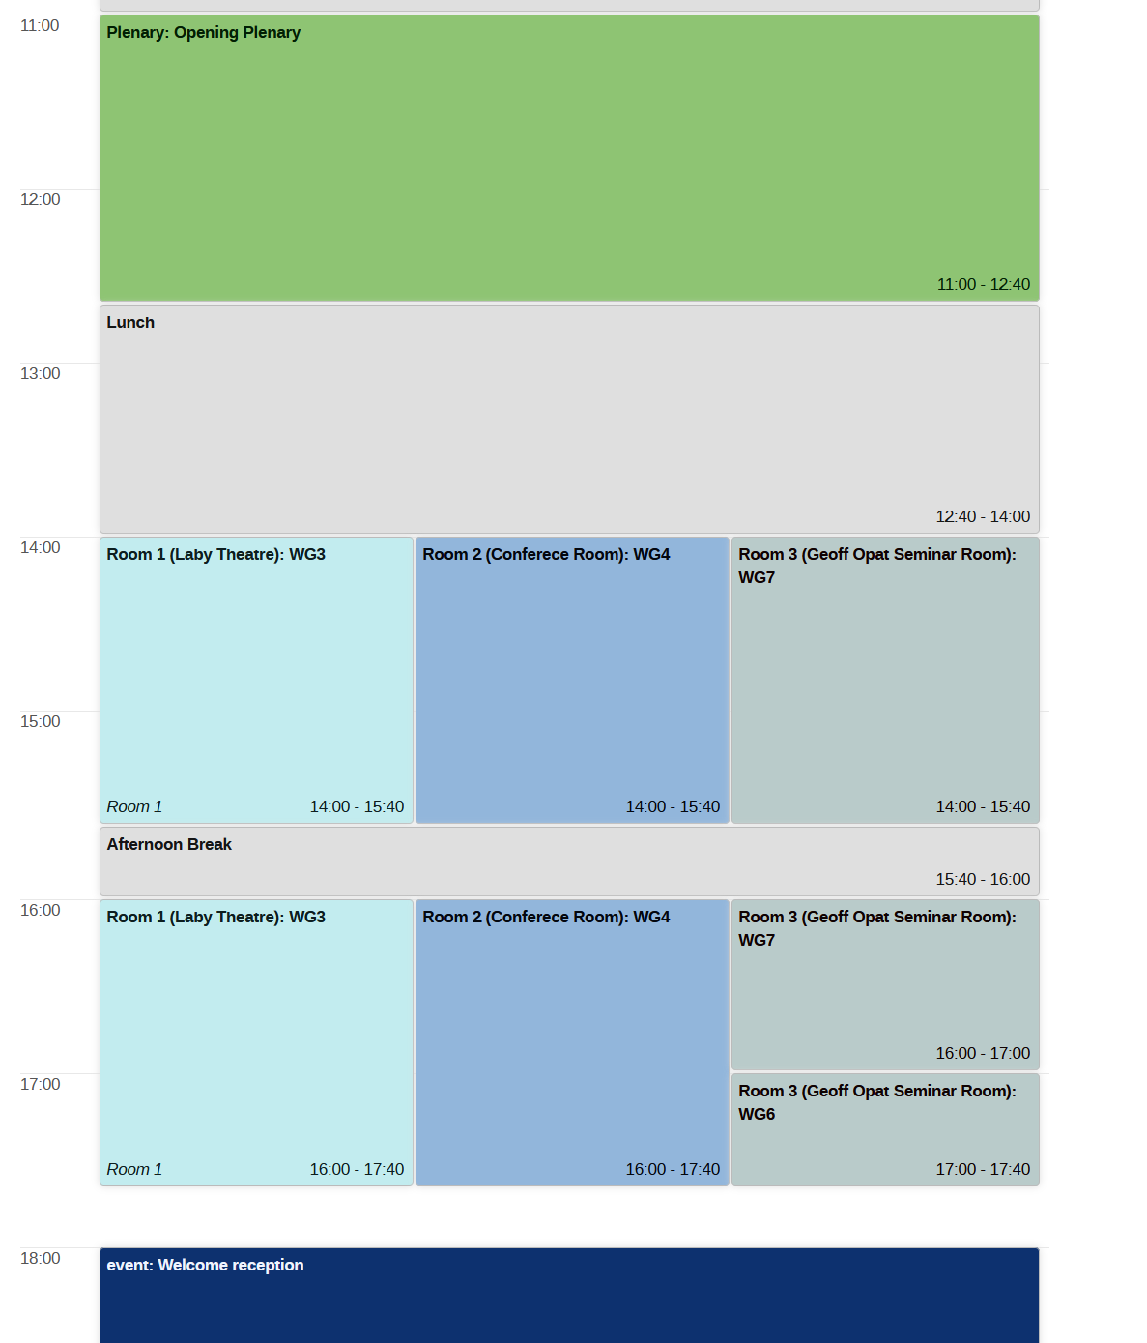
Program
AFAD23 program contains 4 Plenary and 76 presentations acrosee 7 working groups
Parrallel sessions are split between three rooms
Delegates will have the opportunity to attend multiple working group sessions.
Later starts/finish times were chosen to accommodate remote participants

Slide 4
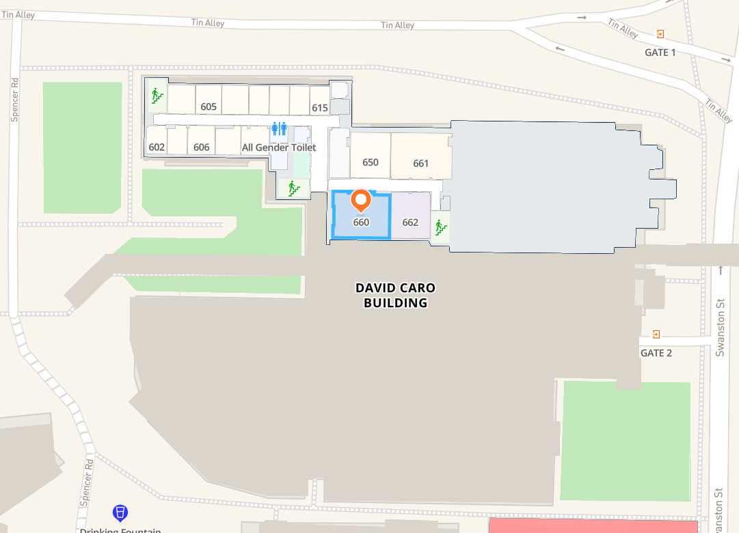
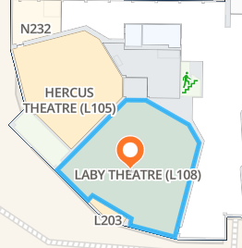
Geoff Opat Seminar Room
Go up to level 6 via elevator
Water

Slide 5
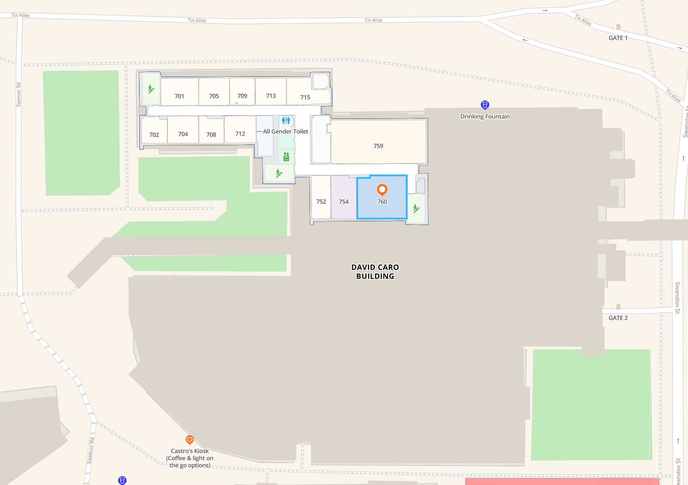
Conference Room
Go up to level 7 via elevator
Water

Slide 6
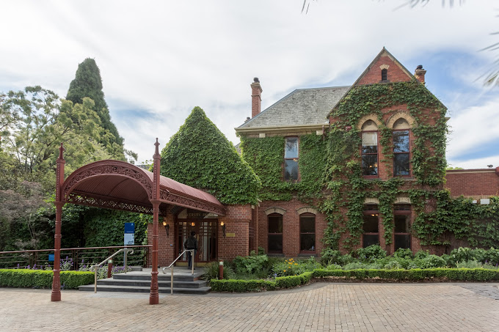
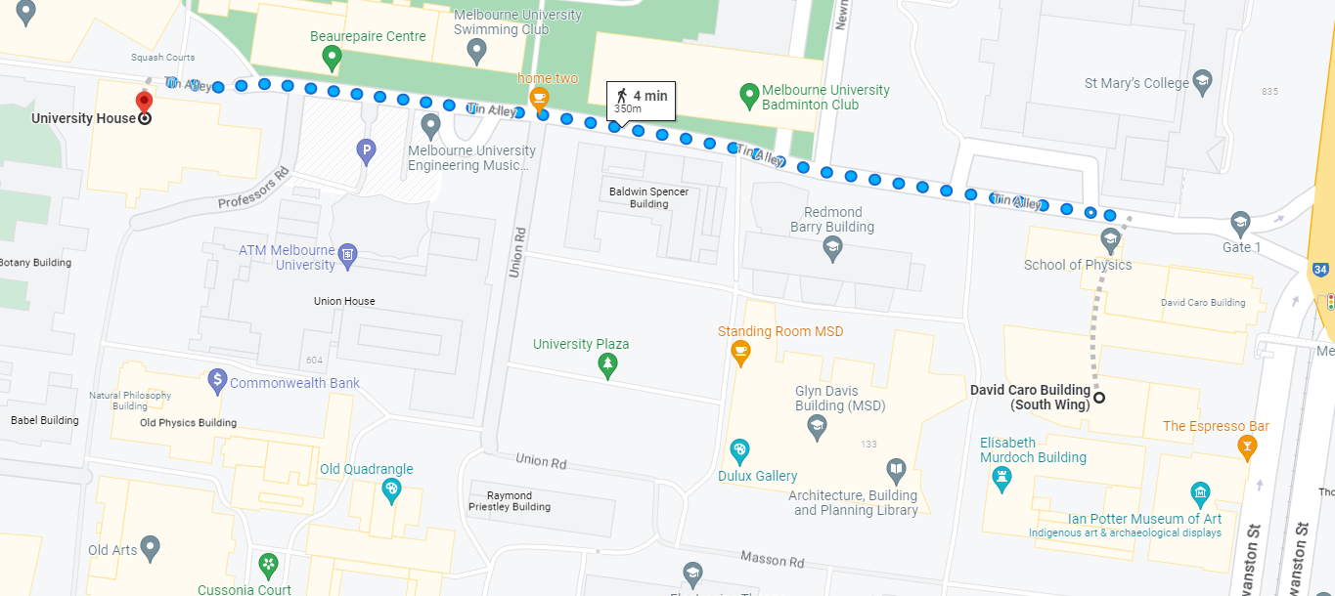
Welcome reception
400m Walk
Canapes and drinks
6:00-7:30pm

Slide 7
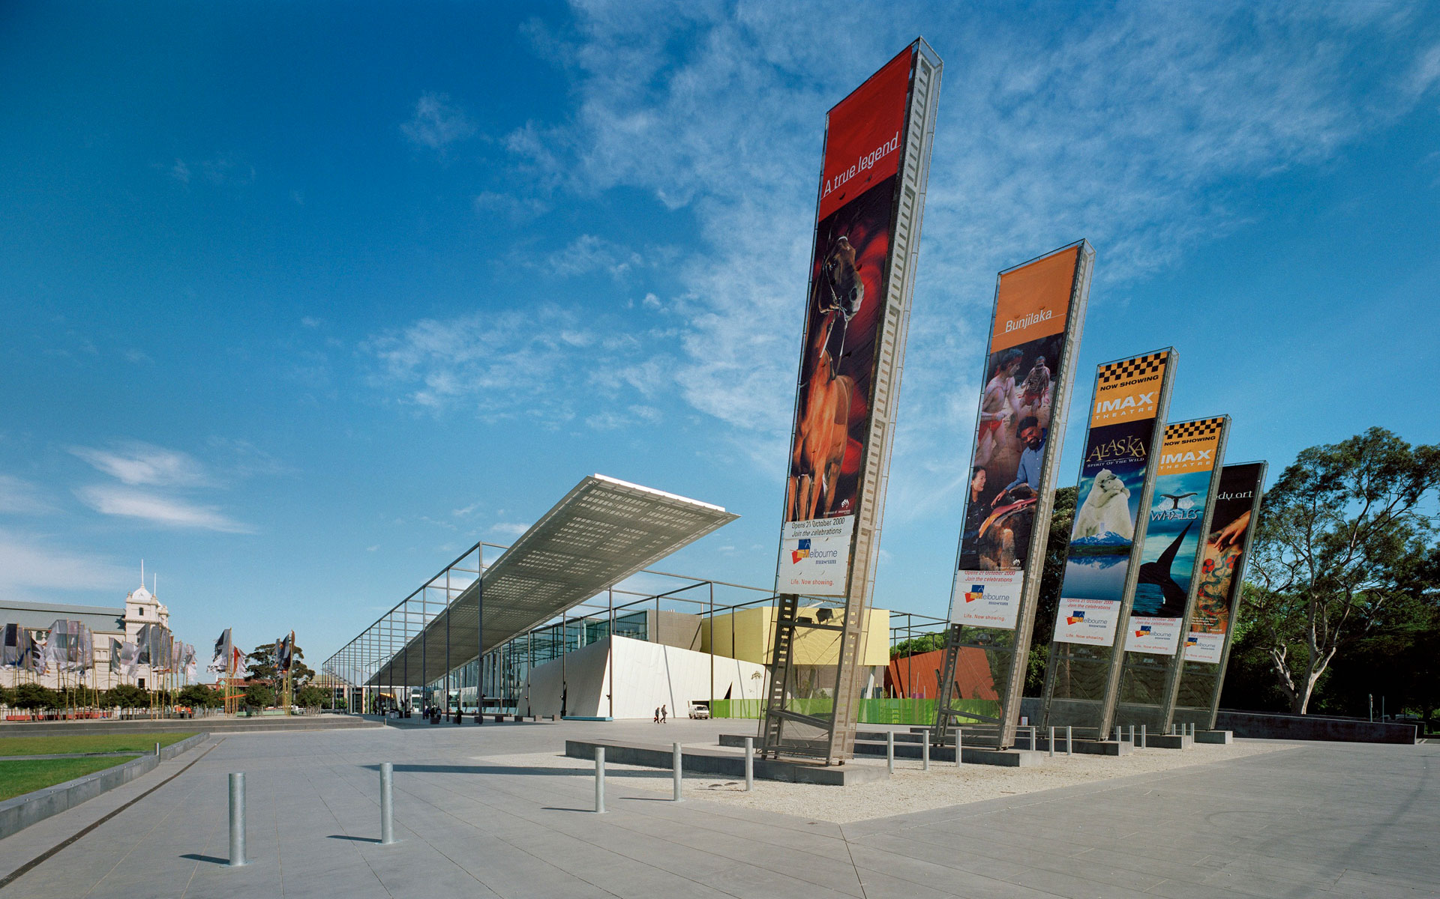
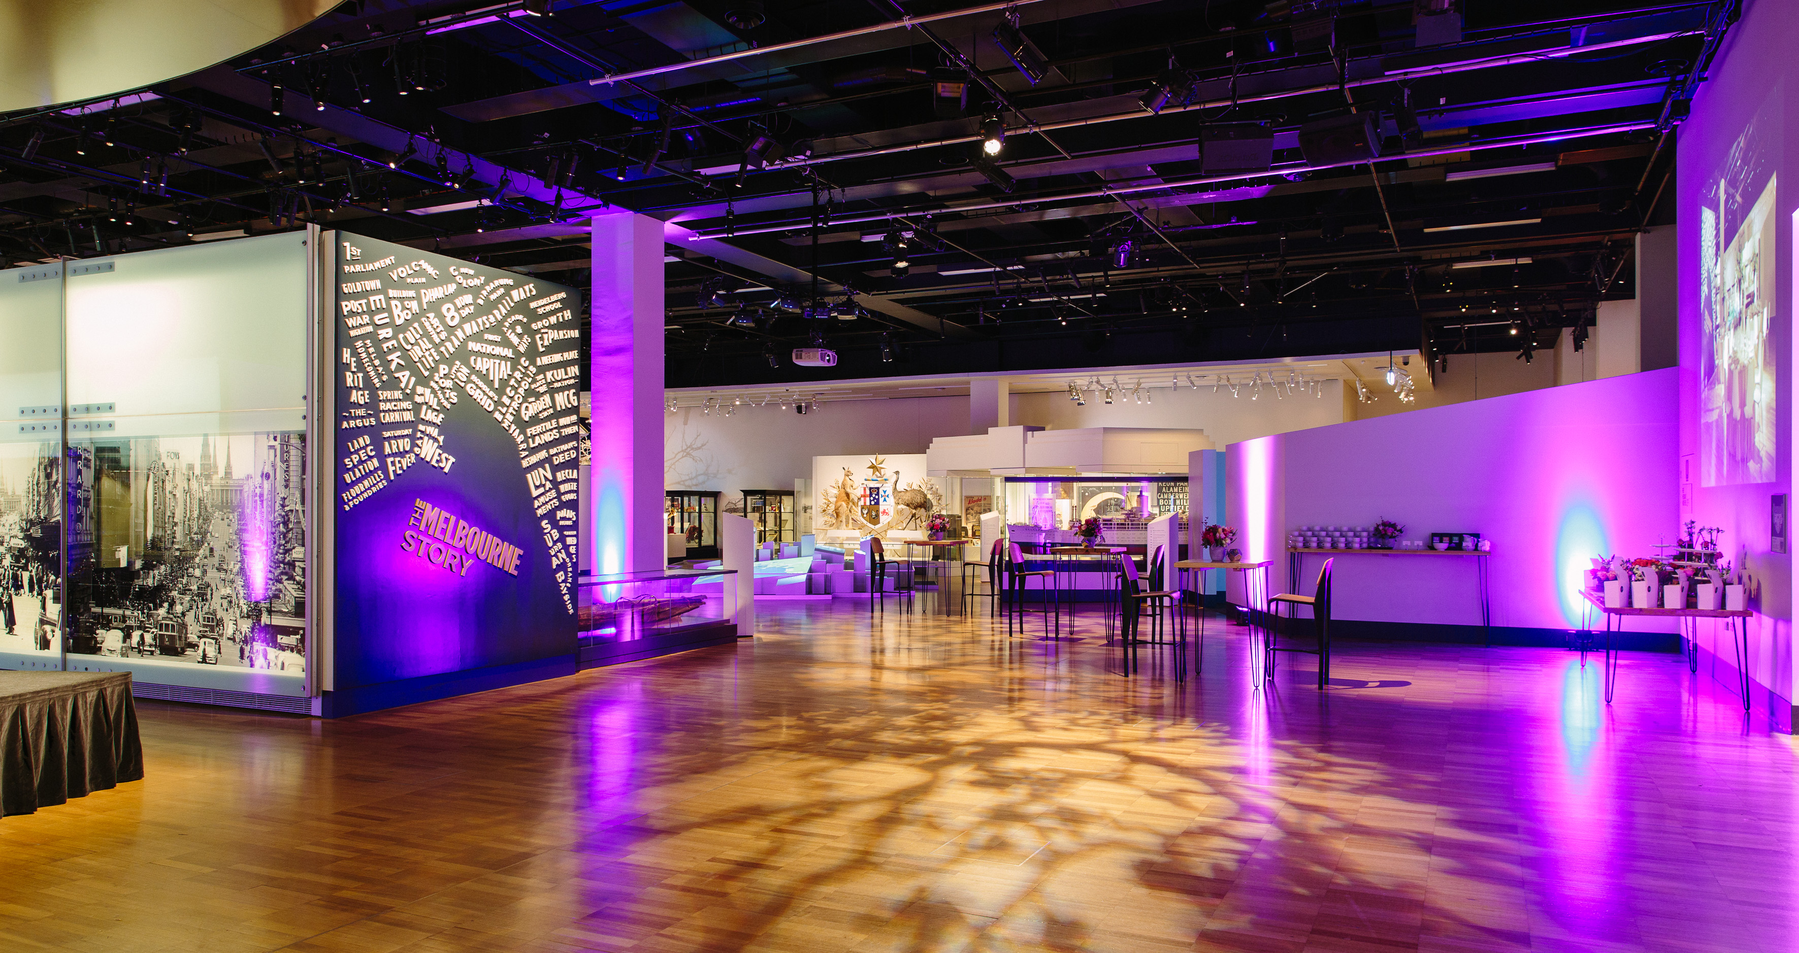
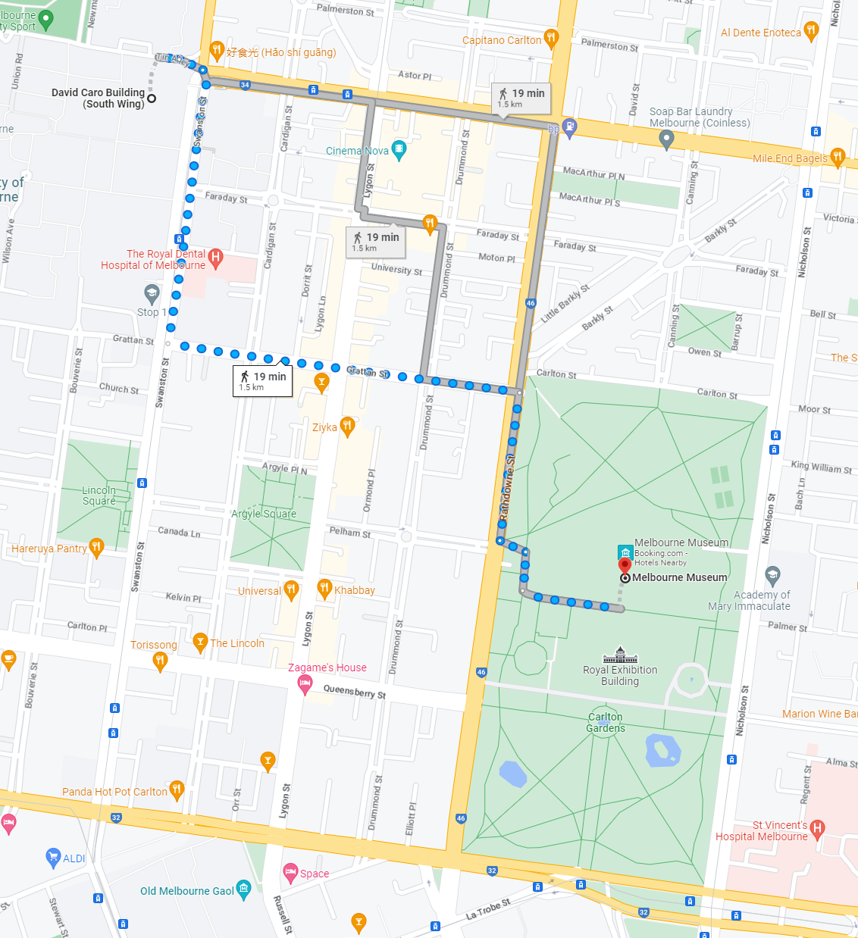
Workshop Dinner – Melbourne Museum
1.5 km walk
Start at 6pm from registration desk, LOC members will guide delegates.
Dinner duration 6:30-9:30 pm

Slide 8
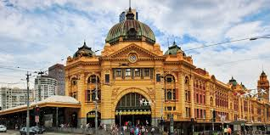
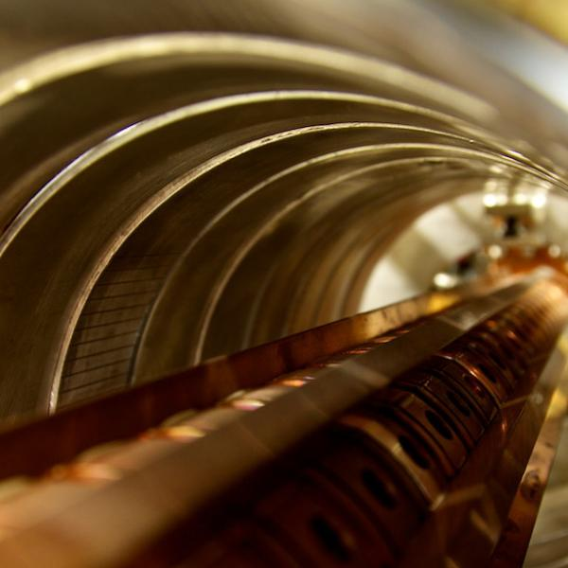
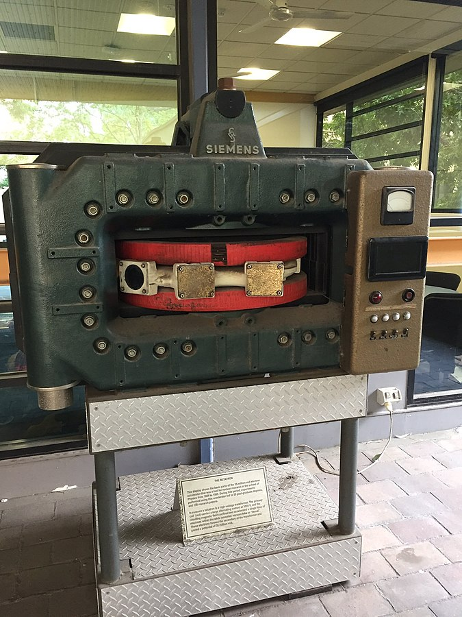


We hope you enjoy a varied and interesting scientific program!

