Slide 1
WG1 Summary

Slide 2
8 talks scheduled, 1 cancellation

Slide 3
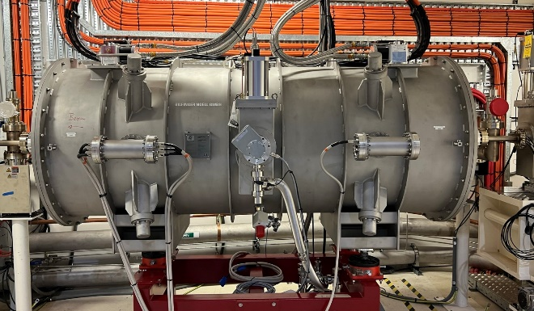
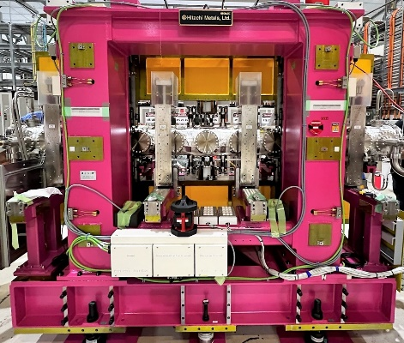
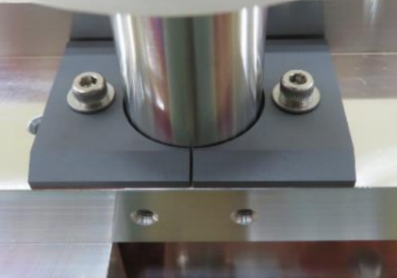
SCU16 - BioSAX
Experiences with new Insertion devices at the Australian Synchrotron – Eugene Tan
U17 – MX3
ADS (3.5m, 150 keV)
SCW - 4.5T; 45 mm; 2m;
BioSAX (2.5m, 12.4 keV)
SCU - 16 mm, 1.6 m (98),
1.084 T (K = 1.62)
MX3 (3.5m, 13.0 keV)
IVU – 17.2 mm, 3.0 m (172),
0.888 T (K = 1.427)
NANO (3.5m, 5 – 25 keV)
CPMU – 18.0 mm, 3.0 m (164),
1.23 T (K = 2.07)
Parameter | Value
Cryostat length | 2.5 m
Magnet Period | 16.01 mm
Magnet Length | 1.6 m
Num. Full Periods | 98
Maximum Field / K | 1.084 T / 1.62
Magnet Gap | 8.0 mm
Vert. Vacuum Gap | 5.4 mm
Horiz. Vacuum Gap | 60.0 mm
Field Stability (144 hr) | < 200 ppm
Horiz. roll-off (±10 mm) | < 0.35%
Phase Error | 10° - 16°
Parameter | Value
Materials | NMX-S41EH / 49Co-2V-Fe
Br | 1.24 T
Hcj (25°C) | >1990 kA/m
Magnet Period | 17.2 mm
Magnet Length | 3.0 m
Num. Full Periods | 175
Maximum Field / K | 0.9225 T / 1.48
Min. Magnet Gap | 5.5 mm
Vert. Vacuum Gap | 5.3 mm
Phase Error | < 2.53°
Spring compensated, improved phase error
Ferrites to damp expected trapped modes.
Vacuum conditioning down to 1e-9 mbar at open gap with beam.
Conduction cooled superconducting undulator, “Cryogen-free”.
Designed and built by BILFINGER NOELL GmbH (BNG) Based on SCU20 (KIT).
Operating for 6 months perfectly.
Flux improvement of to 25% with some optimisation of the SCU16.
~1e14 ph/s @ 12 keV (5th harmonic)
U17
SCU16
Ferrites

Slide 4
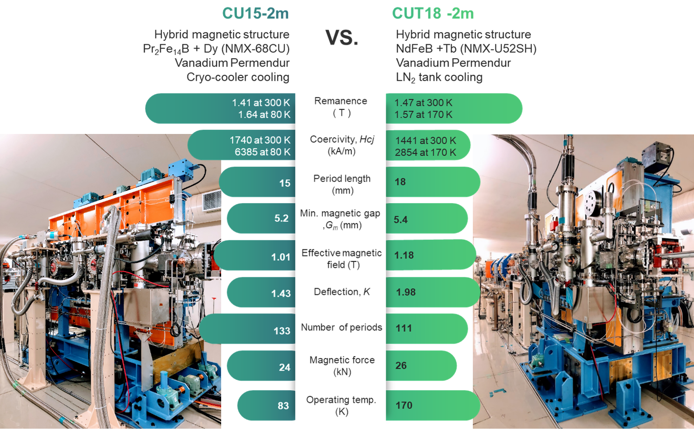
Operational experiences of two CPMUs at NSRRC
  Two CPMUs with magnetic and cryogenic performance above the required specifications have been successfully developed at the TPS, NSRRC.
  Unique features of cryogenic system at TPS-CPMUs are
  (1) Conduction cooling of magnet arrays to avoid damage to the accelerator ultra-high vacuum, (2) Compatibility with both cryocoolers and liquid nitrogen tanks as a cooling source.
  With a temperature control system, the temperature of magnets can be stabilized, and the CPMUs can provide stable, reproducible photon energy spectra.
  The main heating source at CU15 / CUT18 is derived from broadband impedance including resistive wall heating and geometric impedance from taper/step structure.
  The photon flux at 20 keV using the CU15-2m is 3 times higher than that using the IU22-3m. The experimental time can efficiently decrease to one third on replacing IU22 with CU15.
Jui-Che Huang, and et. al. NSRRC

Slide 5
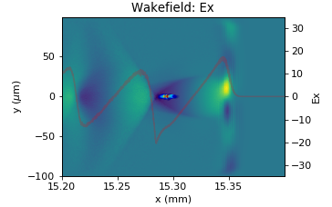
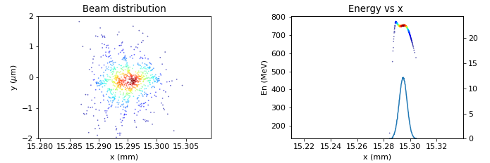
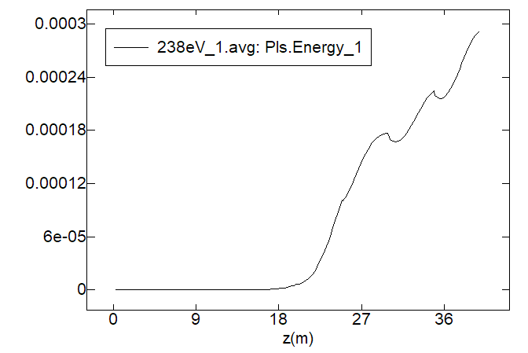
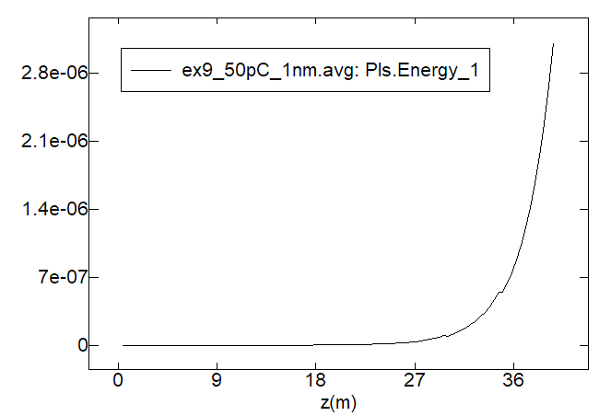
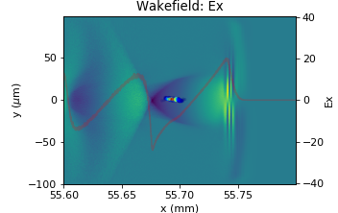
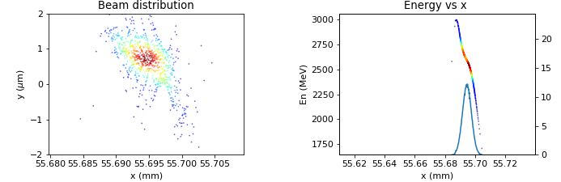
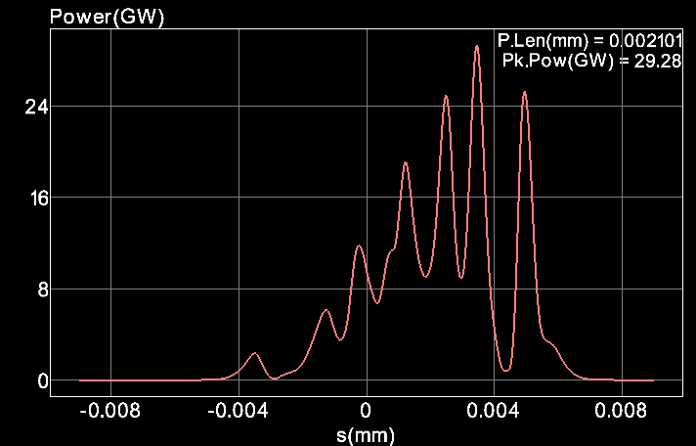
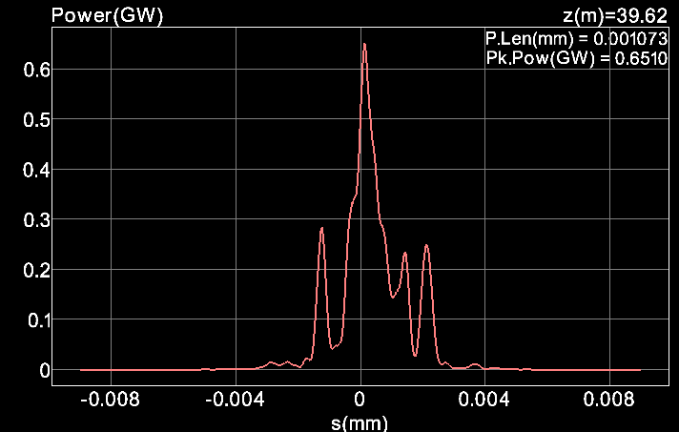
WG1- Laser plasma wakefield accelerators with external injection for soft X-ray free electron laser at PAL-eLABs
Inhyuk Nam
Laser system
200 TW, 40 fs
GW scale soft X-ray
Photon energy:
200 – 1000 eV
Laser
UV, 100 fs
Photocathode gun
Plasma lens
2.5 GeV
Soft X-ray undulator
70 MeV
Triplet
Linac
Bunch compressor
E-beam
Discharged Capillary
PIC simulation results
FEL simulation results
LWFA with external injection
Soft X-ray free electron laser
E_{c} = 230 eV (K = 3.5)
E_{c} = 1057 eV (K = 1.1)
Gain curve
e-
Laser
FEL energy (J)
Power
Target:
- Beam energy = 2.5 GeV
- Emittance = 1 mm mrad
- Energy spread = < 1%
Results:
- Beam energy = 2.5 GeV
- Emittance = 5 mm mrad
- Energy spread = 5 %
Optimization is still ongoing

Slide 6
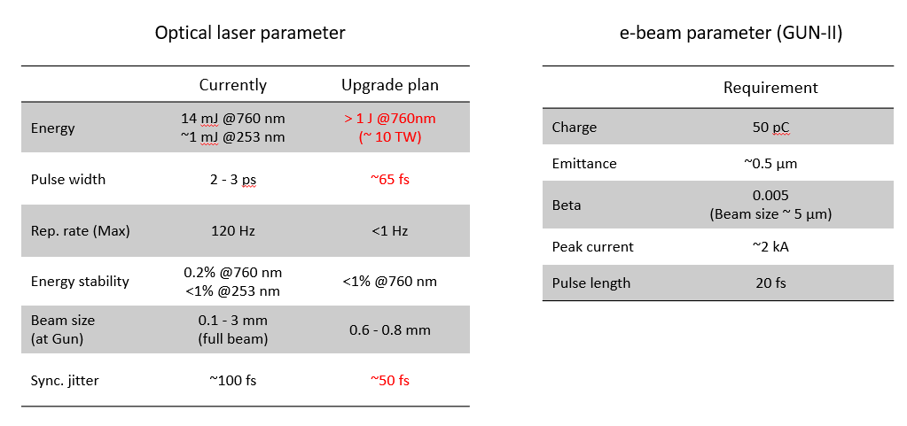
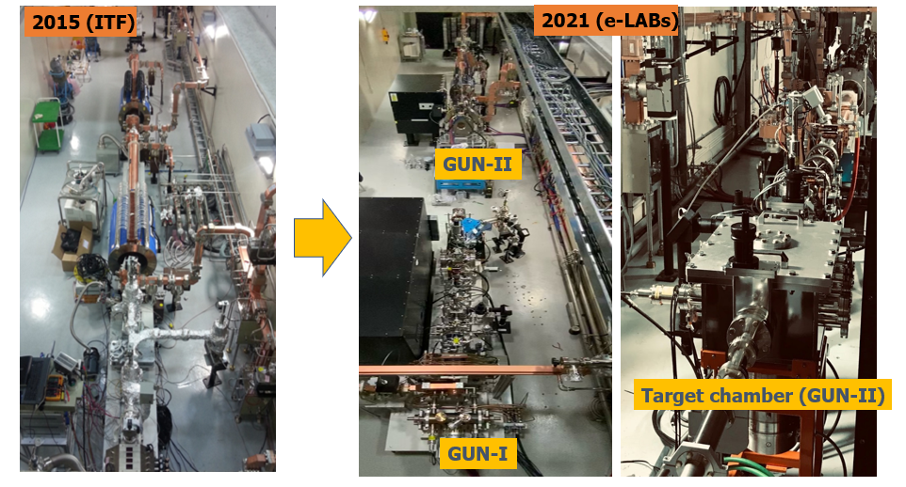
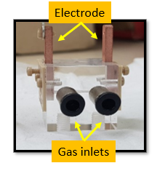
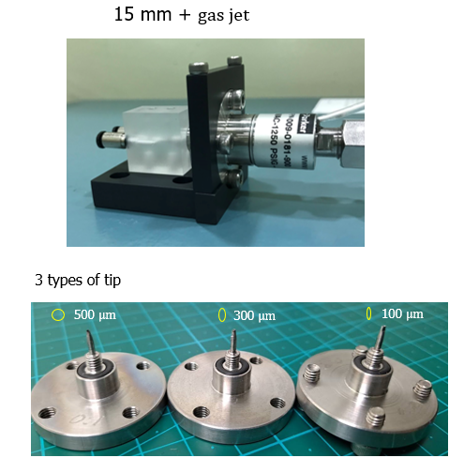
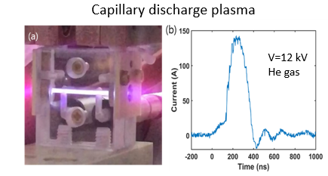
PAL-eLABs
Researches at e-LABs
Capillary development
GUN-I
Ultrafast electron diffraction (UED)
User beamline in the future
GUN-II
E-beam based R&D beamline
Advanced compact accelerators
New conceptual accelerator technology
Other e-beam based researches

Slide 7
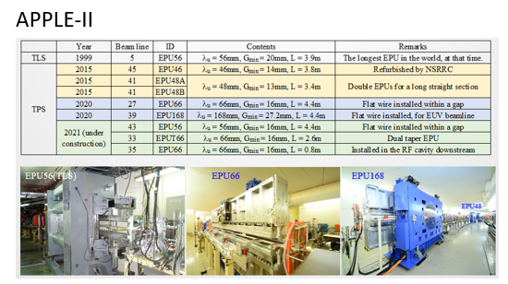
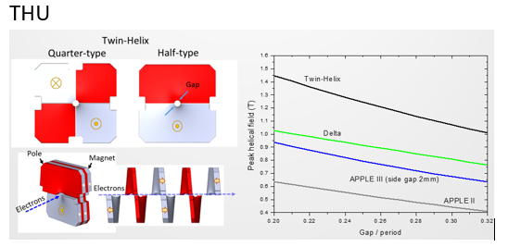
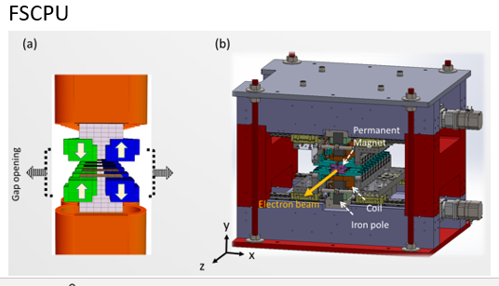
Feasibility study of the Polarization control of synchrotron radiation in NSRRC
TingYi Chung
The development of insertion devices dramatically improves the brightness of the synchrotron radiation source. Various polarized light requirements can be fulfilled by the development of Elliptically polarized undulator (EPU). After years of research and development, NSRRC has many experiences in building “good” EPU. NSRRC is not only working on the development of APPLE-II but also researching new types of EPUs to meet upcoming MBA lattice. A short period EPU, called THU and Delta operated with an APU mode, and an EPU, called FSCPU, that allows for fast polarity switching are the directions that NSRRC is pursuing.

Slide 8
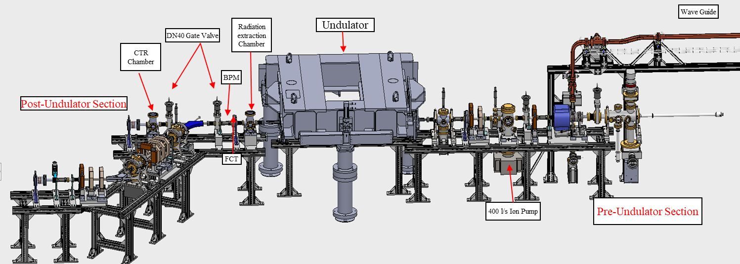
Commissioning status of Compact FEL-THz facility at IUAC and the first energy measurement of the electron beam
Subhendu Ghosh, Inter University Accelerator Centre, New Delhi. (The project is jointly supported by IUAC and DAE-BRNS)
Deliverables from FEL facility (Delhi Light Source) of IUAC
Results (10 March ’23)
THz Radiation
Input Power of RF gun (MW) | Acc. Field of RF gun (MV/m) | Mag. Field (BM#1) (Gauss) | Measured Energy of e-beam (MeV)
4 | 65 | 550 | 4.5
Frequency | Time width of the THz pulse train | Power of THz in one pulse train
(THz) | (ps) | (kW)
0.18 | 189.3 | 0.232
1 | 40 | 72
2 | 20 | 87.5
3 | 16 | 72
Electron beam
Time width | No. of electrons | Total electron current
~ 300 fs | 9.3 × 10⁷ | 75 A
1 sec. | 1.4 × 10¹² | 22.5 nA
12 | ~109 |  | 8
8 MeV is expected within a few months
Conclusion
DLS – Final stage of commissioning
Photocurrent e - beam: 4.5 MeV is measured
E-energy to be increased from 4.5 to 8.0 MeV
Beamline components, undulator are functional
Pilot experiment with e-beam will be performed
Demo of THz by undulator : by end of 2023

Slide 9
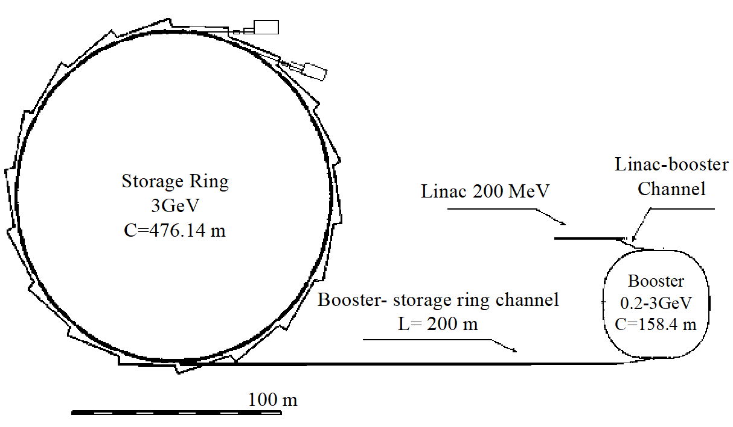
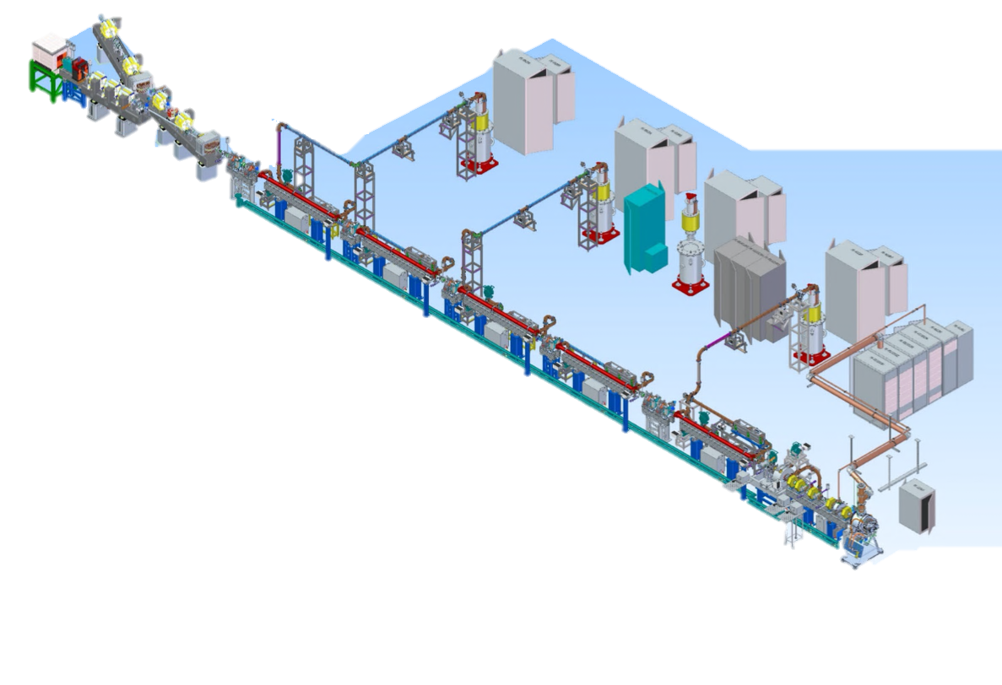
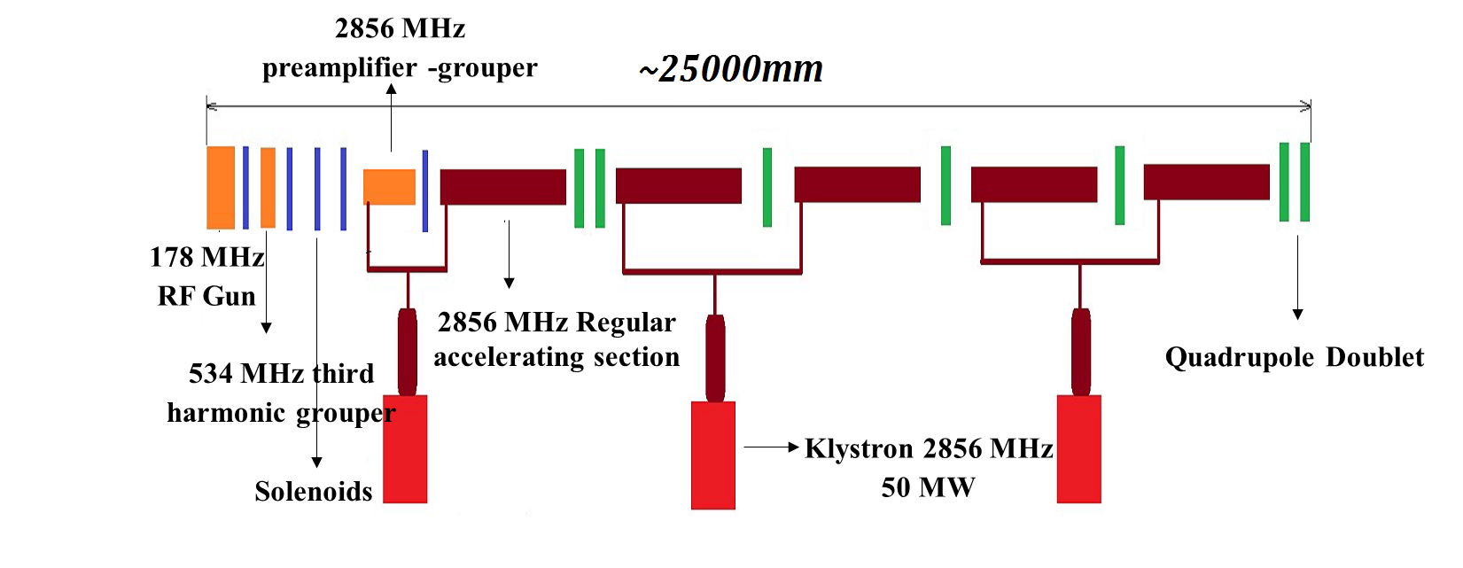
The recent results on linear accelerator of Siberian Ring Synchrotron Light Source (SKIF)
Xiaochao Ma
LINAC layout
Parameter | Value
Operating energy | 200 MeV
Energy spread (RMS) | 1%
Injection rate | 1 Hz
Bunch period | 5.6 ns
Number of bunches | 55
Single bunch charge | 0.3 nC
Horizontal emittance at 200 MeV | 150 nm
RF gun
Bunching system
Pre-accelerator
Five accelerating structures

Slide 10

Conclusion
Linear accelerator of the SKIF injector was developed. The main devices of the accelerator were produced and measured. Test stand with the RF gun, bunching system, the first accelerating structure and diagnostic system are operating in Budker Institute of Nuclear Physics. The first beam is accelerated in the accelerating structure. The achieved beam parameters are: an energy up to 30 MeV with RF power of about 15 MW, the bunch charge up to 1 nC, the bunch duration about 12 ps. It corresponds to our simulations. Measurements of beam parameters are in progress.
At present, all beam parameters are usable for the linear accelerator of the SKIF injector.

Slide 11
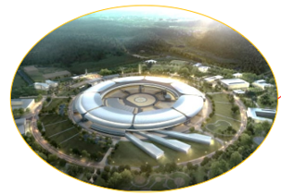
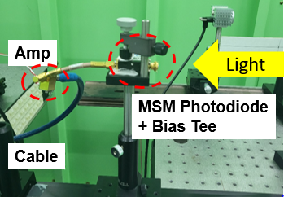
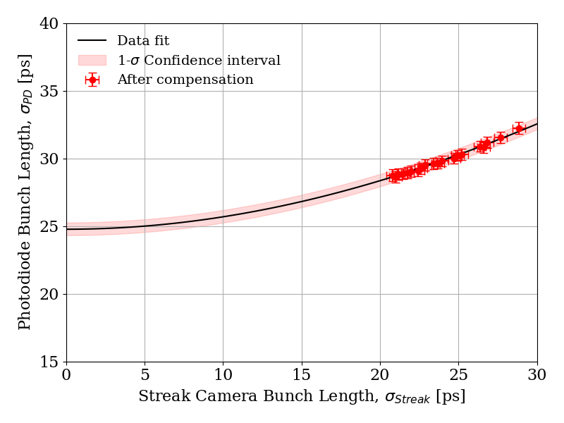
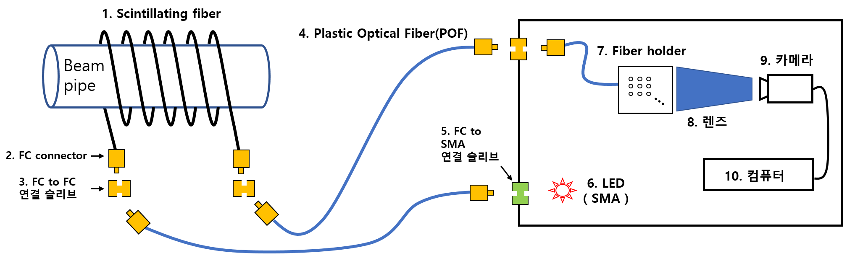
WG1:Development status of beam diagnostic devices for Korea-4GSR project and PLS-II – Garam Hahn (PAL)
Asian Forum for Accelerators and Detectors 2023 - April 13th, 2023
Since 2021, Korea-4GSR Project has been conducted by two institutions with 750M USD
  KBSI (Korea Basic Science Institute) for facility construction
  PAL for the accelerator and beamline construction
  Diffraction-limited storage ring; energy of 4 GeV, circumference of 800 m,
  and natural emittance of 61 pm
Two types of beam diagnostic devices were recently developed and tested for Korea-4GSR Project
  We have experimentally demonstrated an online bunch-by-bunch diagnostics that enables filling pattern (~ 3 µA resolution) and bunch length (~ 1 ps resolution) monitoring with visible light at the PLS-II storage ring
  A cheap and easy-to-make beam loss monitor (100 sample/sec/ch x 32 ch) was quickly developed, installed, and worked well.

