Slide 1

Progress in Development of Accelerators for Medical and Industrial Application
Summary WG-3
Convener: Anatoly Rozenfeld
12-14 April, 2023, Melbourne, Australia

Slide 2
Medical Applications

Slide 3
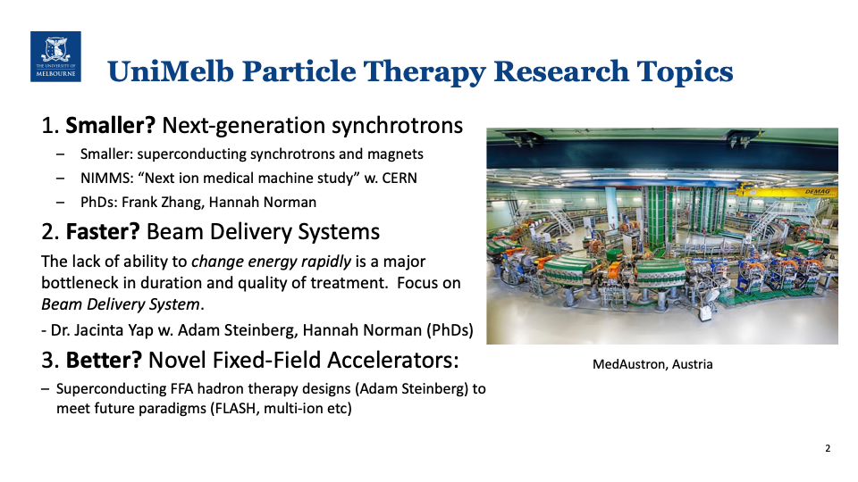

Slide 4
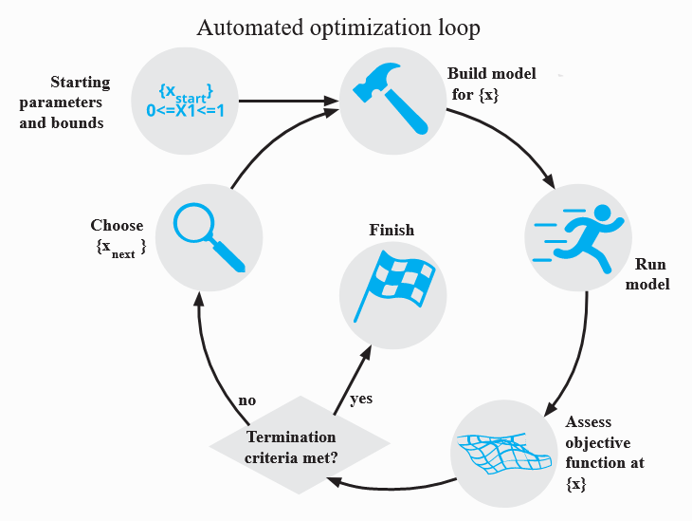
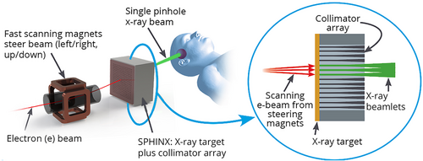
Do we need MLS for medical linac? NO.
SPHINX designs for user-input beamlet widths were generated using Bayesian Optimisation of topas monte
carlo simulations
Outcome of simulations: The optimal Dose per Charge achieved for 7mm beamlet width
Brendan Whelan

Slide 5
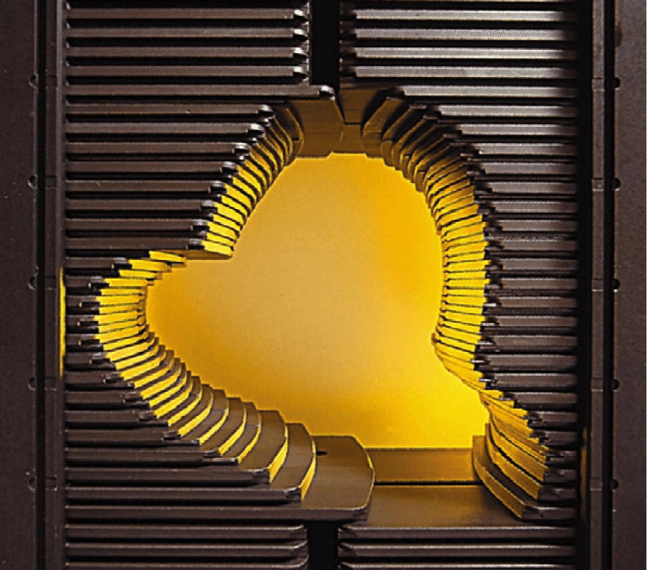
Robust Radiotherapy for Low- and Middle- Income Countries
G. S. Peiris, B. Whelan, S. L. Sheehy
Treatment Plan Quality
Treatment plans were generated for an LMIC caseload to compare MLCs of differing leaf widths. The metrics compared were target conformity and
Background
There is a dramatic shortfall of radiotherapy linear accelerators (RT LINACs) in Low and Middle Income Countries. By 2030, 75% of cancer related deaths will be in these nations and the technology they currently possess cannot handle the demand.
compared were target conformity and dose homogeneity. In all anatomical sites, narrower leaf widths would provide a marginal improvement in dose homogeneity and target coverage. However, all leaf widths provide clinically acceptable results.
Multi-Leaf Collimator (MLC)
The MLC is an x-ray collimator that shapes the beam to the size and shape of the tumour using tungsten leaves. Though the leaves have become thinner over time, perhaps using wider leaves can make the machines more reliable without compromising treatment quality.
Homogeneity Index
Conformity Index
Failure Rates and Downtime
RI – Reference Isodose
TV – Target Volume
D_{XX}- Dose to XX of Volume
RT LINACs are broken down for 7 times longer in LMICs than in High Income Countries and the MLC is responsible for a significant portion of the breakdowns.
Conclusions
The failure rate in LMICs is far worse than in HIC
There is potential to improve machine reliability with wider MLC leaves and not lose treatment plan quality
References
¹ Zubizareta E, Fidarova E, Healy B, Rosenblatt E, Need for radiotherapy in low and middle income countries – the silent crisis continues. Clin Oncol, 2015;27:P107-P114. doi: 10.1016/j.clon.2014.10.006
² Pistenmaa D, Coleman N, Developing Medical Linacs for Challenging Regions. CERN Courier;2017.
³ L. Wroe, T. Ige, O. Asogwa, S. Aruah, S. Grover, R. Makufa, M. Fitz-Gibbon, and S. Sheehy, “Comparative analysis of radiotherapy linear accelerator downtime and failure modes in the UK, Nigeria and Botswana,” Clinical Oncology, vol. 32, no. 4, pp. e111–e118, 2020.
⁴ Peiris, GS, Pawiro, SA, Kasim, MF, Sheehy, SL. Failure modes and downtime of radiotherapy LINACs and multileaf collimators in Indonesia. J Appl Clin Med Phys. 2022;e13756. https://doi.org/10.1002/acm2.13756
Notes:
But even after all of this, we concluded that 1.55:1 is nowhere near the level of manipulation we wanted. Something of the order 10:1 would have been better. The other concern was that adding a quadrupole might increase the complexity of the machine, introducing additional pathways to failure. It ends up being another component engineers and radiologists need to know how to fix on top of an already cumbersome machine.

Slide 6
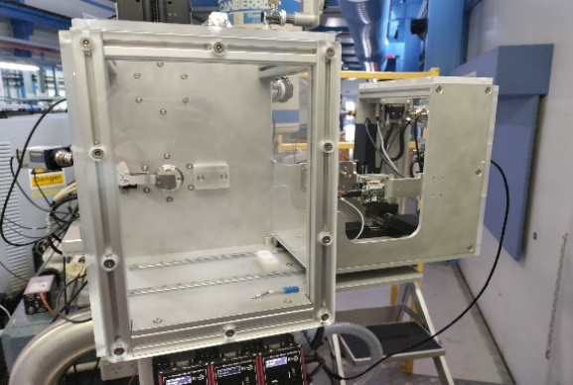
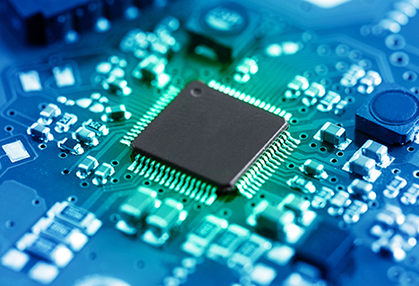
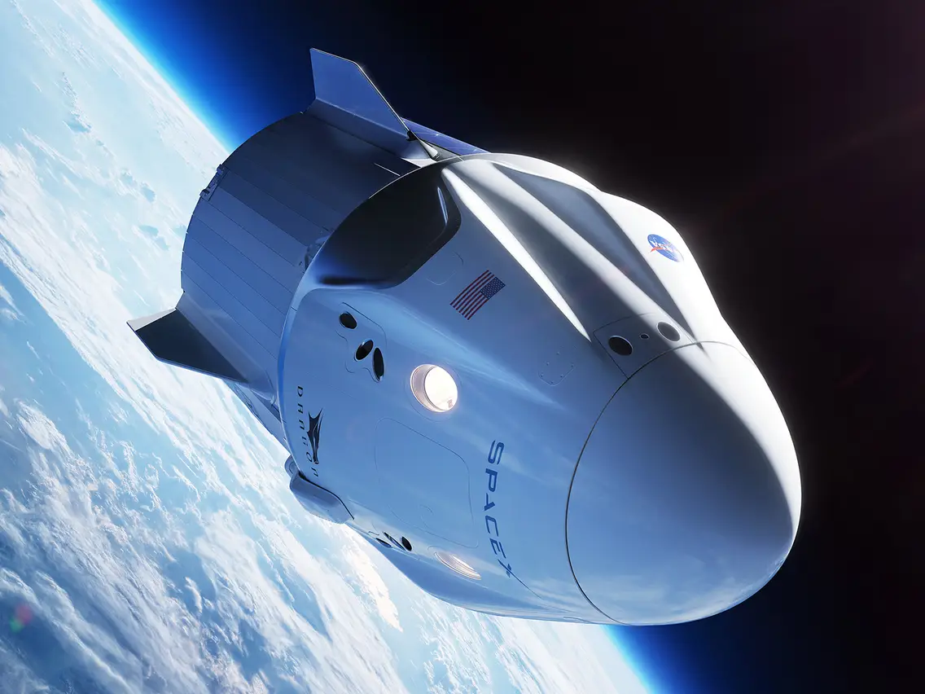
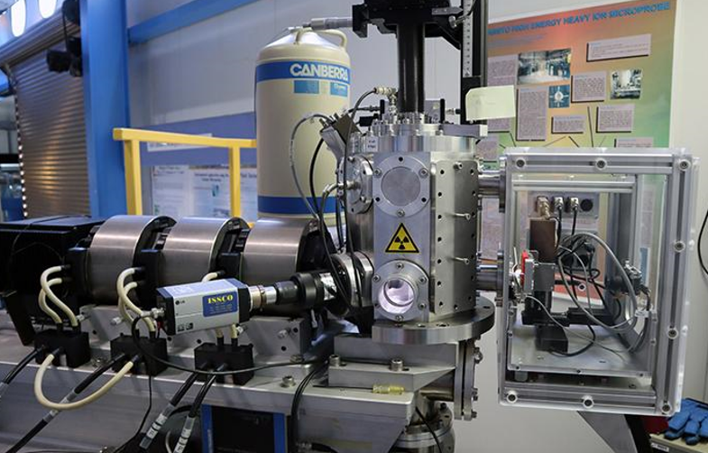
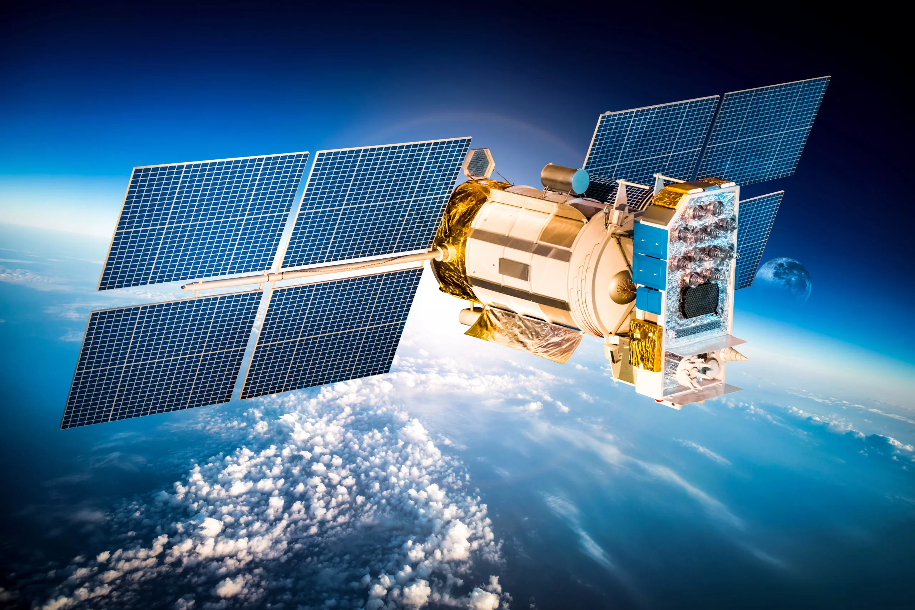
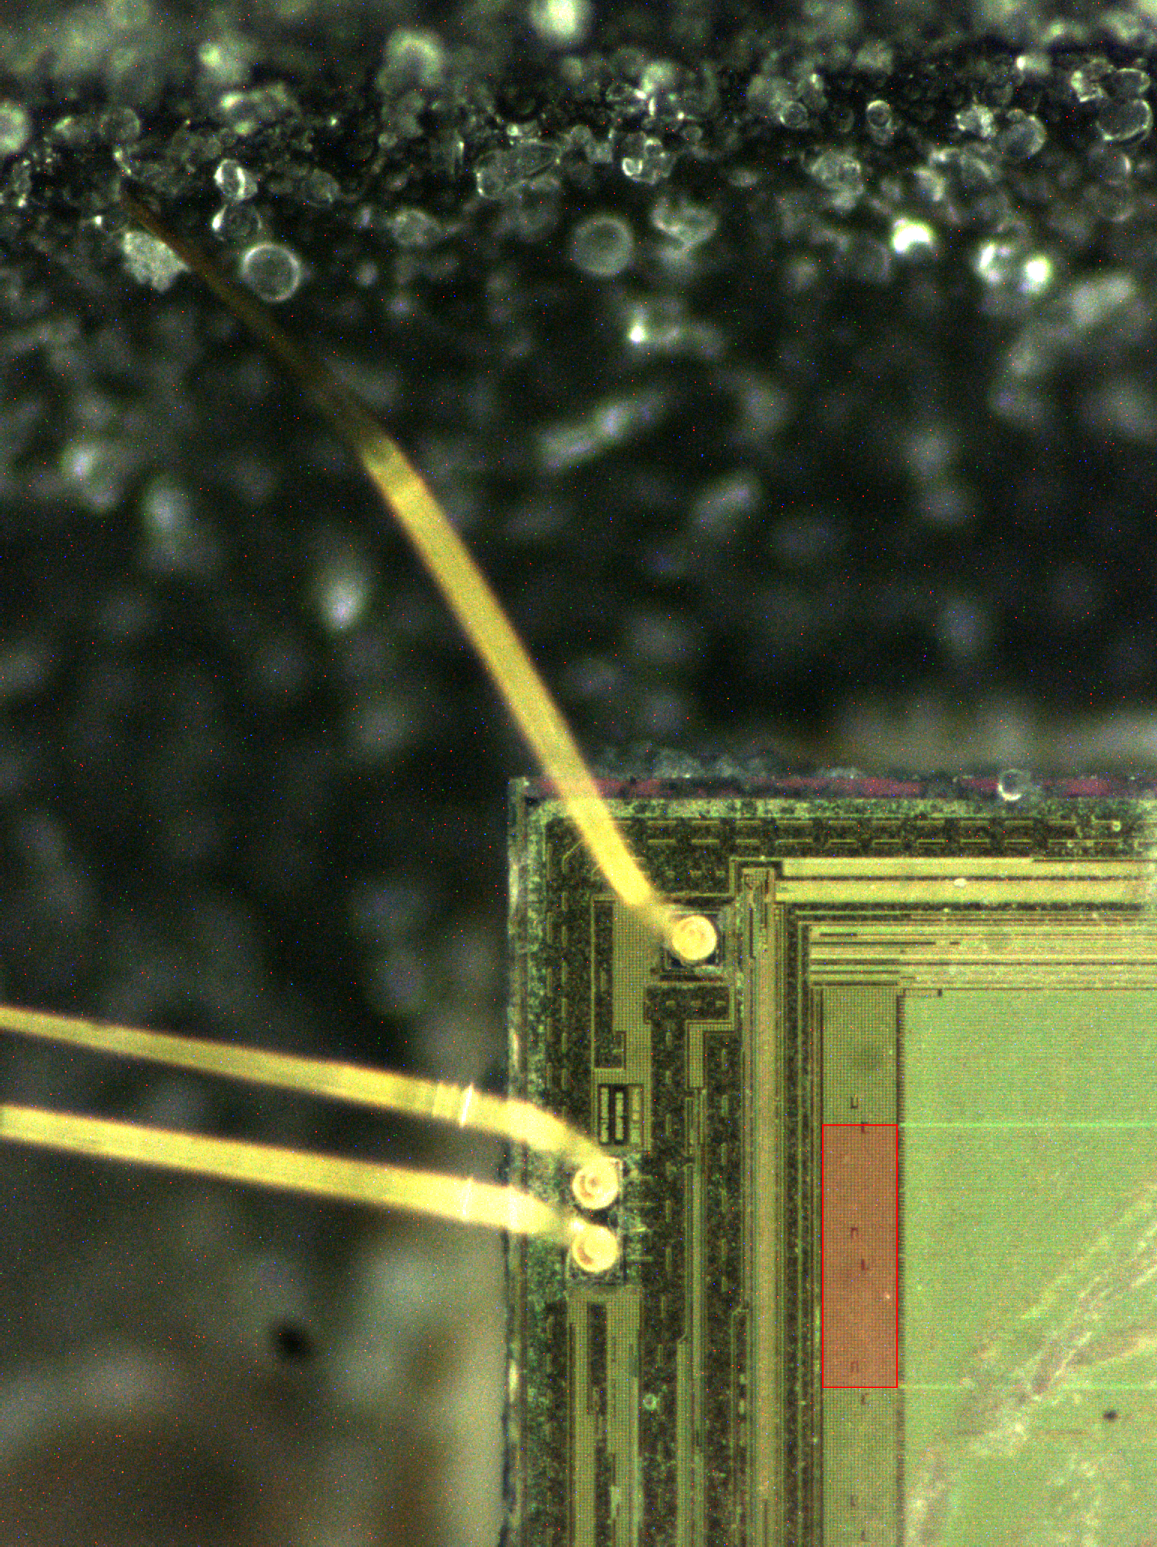


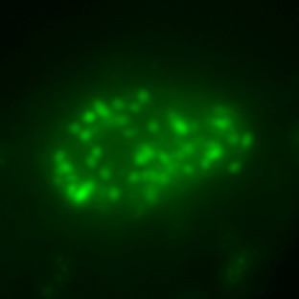
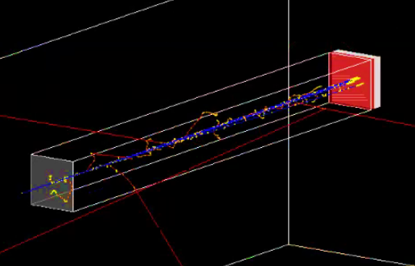
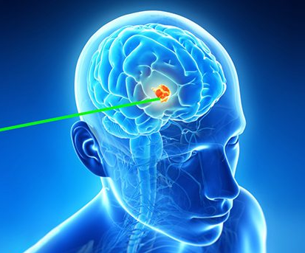
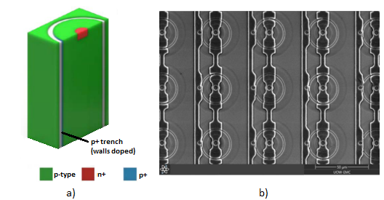


AUSTRALIA’S ION MICROBEAM FACILITY AND CAPABILITY FOR SPACE AND MEDICAL APPLICATIONS
Dr Stefania Peracchi – Accelerator Scientist - speracch@ansto.gov.au
FACILITIES
CENTRE FOR ACCELERATOR SCIENCE, Australian Nuclear Science &Technology Organisation Lucas Heights, NSW Australia 4 Accelerators (up to 10 MV) 2 Heavy Ion Nuclear Microprobes The only ones in Australia ! More than 20 ion species (from H to Au) Energy above 100 MeV Single ion & High current regimes
CAPABILITIES
 | External Ion Microbeam In addition to the standard vacuum chamber, we have An enclosed chamber for irradiation in ambient air.
 | Selective Irradiation Customisable pattern of scanning beam on selected areas to irradiate micron-sub-regions.
 | GEANT4 Modelling Accurate modelling of beam transport, LET and dose rate profile along the target, and precise selection of preferred flux (or fluence) during the irradiation.
APPLICATIONS
 | Space (NSQN) Radiation effects on electronics Shielding materials Photovoltaic technologies for satellites Detectors for dosimetry Space radiation environments’ modelling
 | Health & Radiobiology Radiation effects on astronauts’ DNA Microdosimeters for Quality Assurance in hadron therapy Fundamental radiobiology for particle therapy Inhibitor drugs

Slide 7

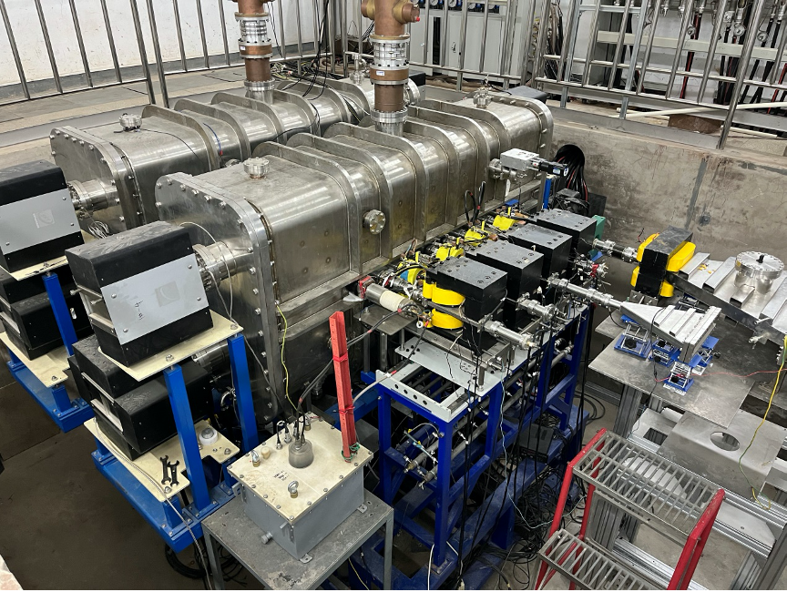
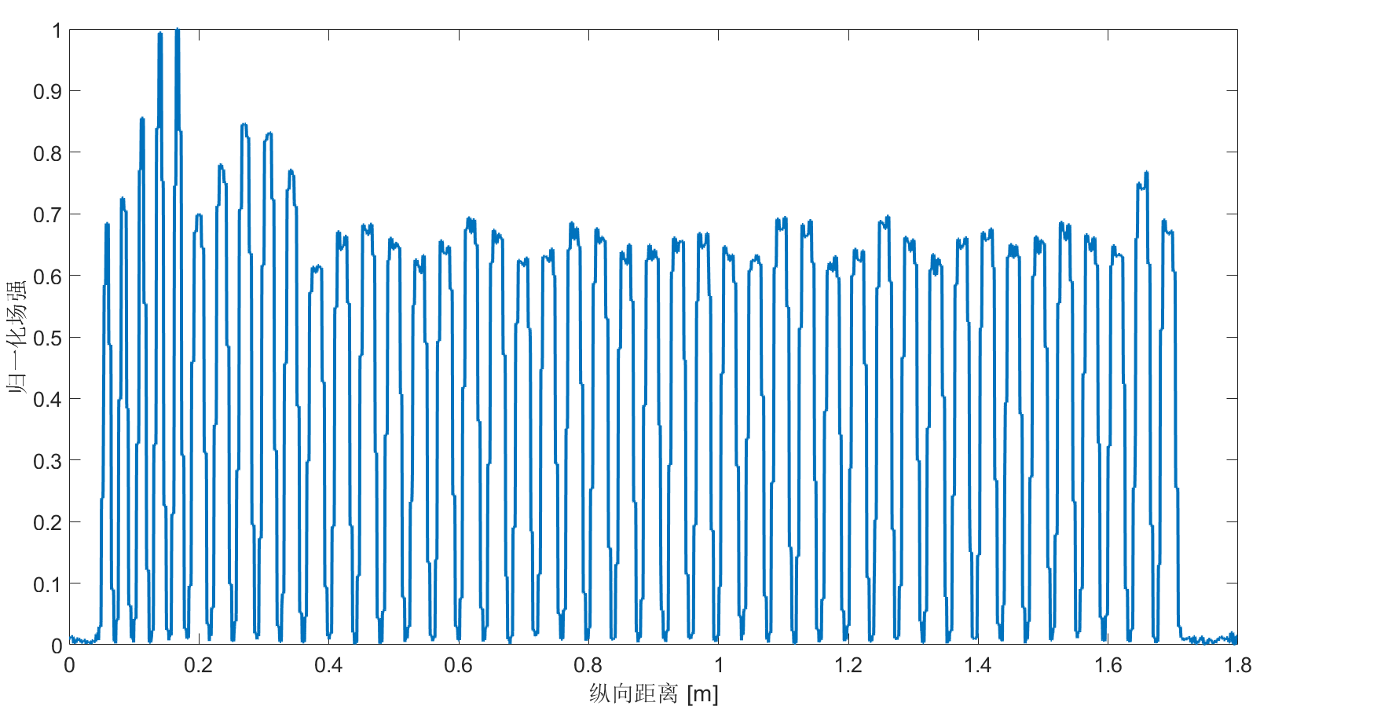
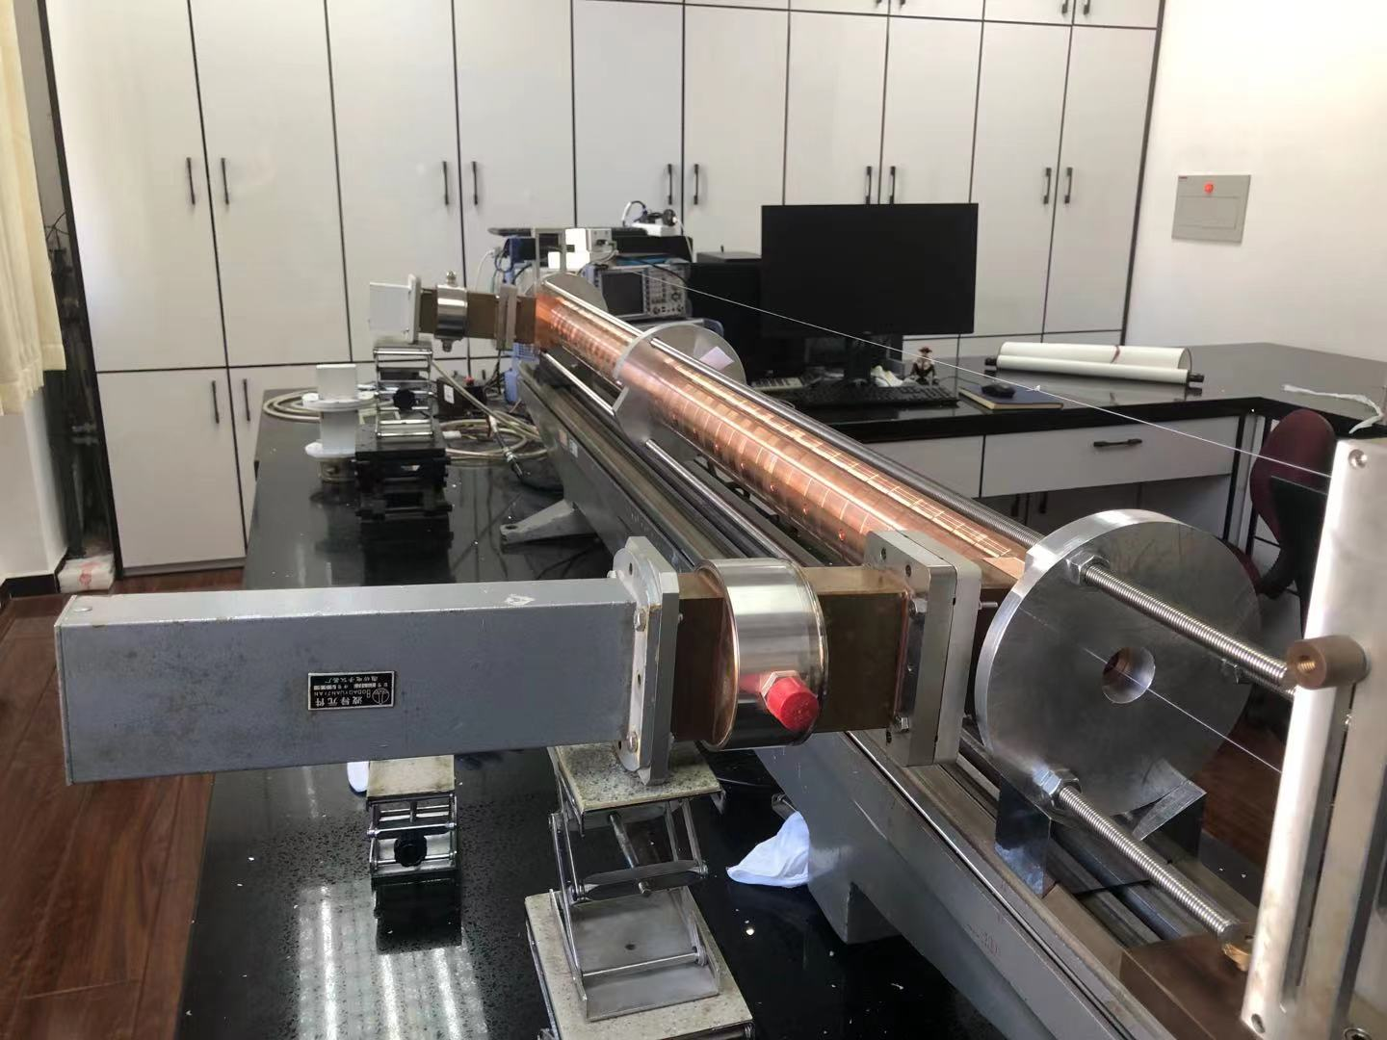
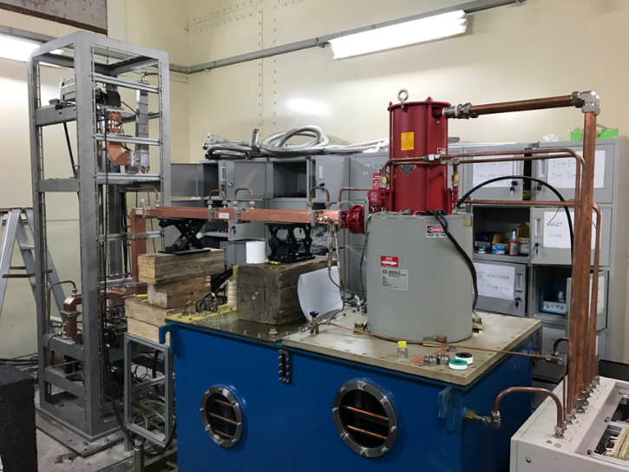
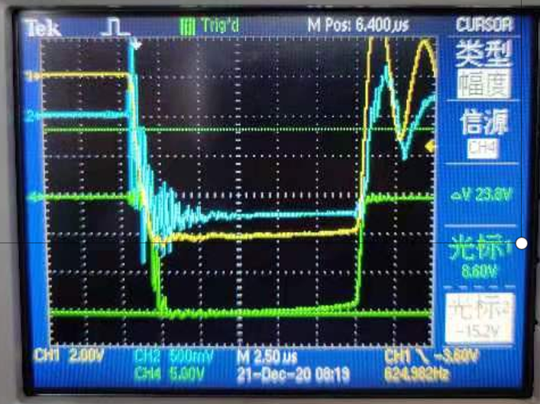
Development of 10MeV Irradiation Accelerators in China (Jiaru Shi)
. 2023 Mar;50(3):1680-1698.
. 2023 Mar;50(3):1680-1698
Several types of NEW high-energy irradiation accelerators has been successfully developed recently, Aiming at higher average beam power and higher efficiency.
Linac
New Backward Traveling Wave (BTW) accl. Tube @ Tsinghua
Solved BBU problem!!
Mass production
~10 sets / year
FLASH therapy UHDR X-ray application
Med.Phys. (2023) ,50(3), 1680-1698
Pulsed 300mA
Average 2.4mA
Energy 10.5MeV
Power 25kW
Ridgetron prototype @ CIAE
Energy 9.8MeV
Power 56kW
https://mp.weixin.qq.com/s/6UnU6Y2rANfxFH3jW9Lo6w

Slide 8
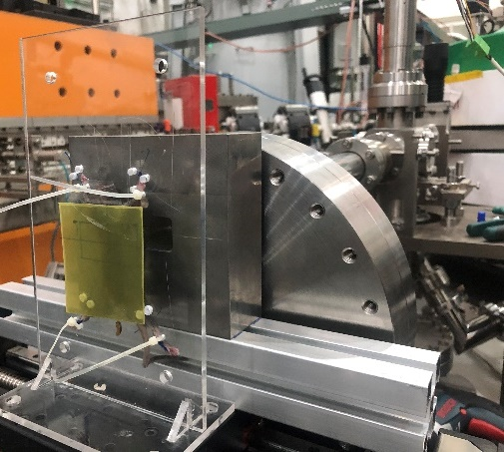
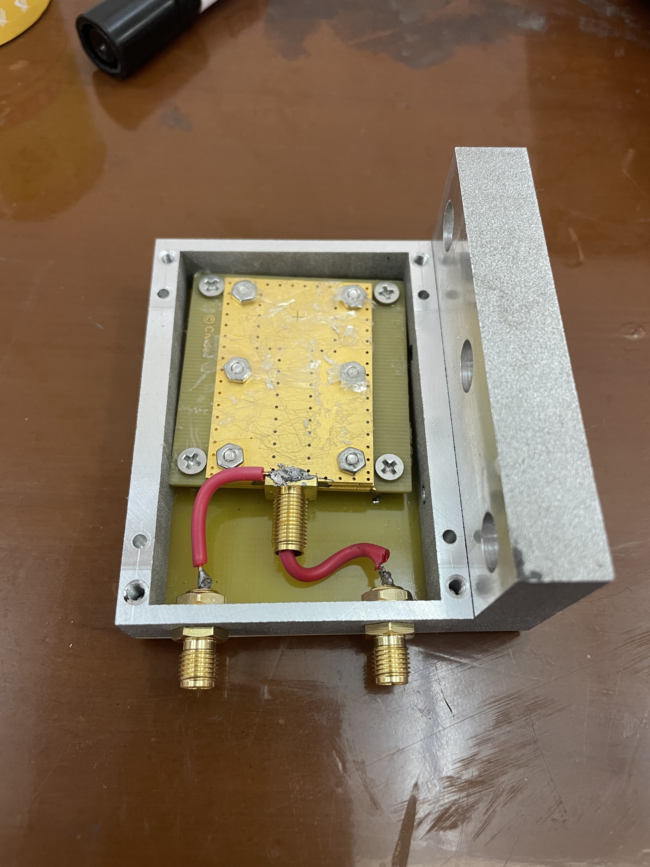

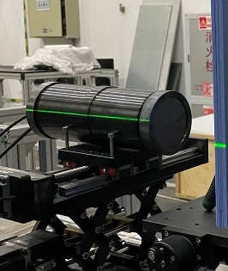
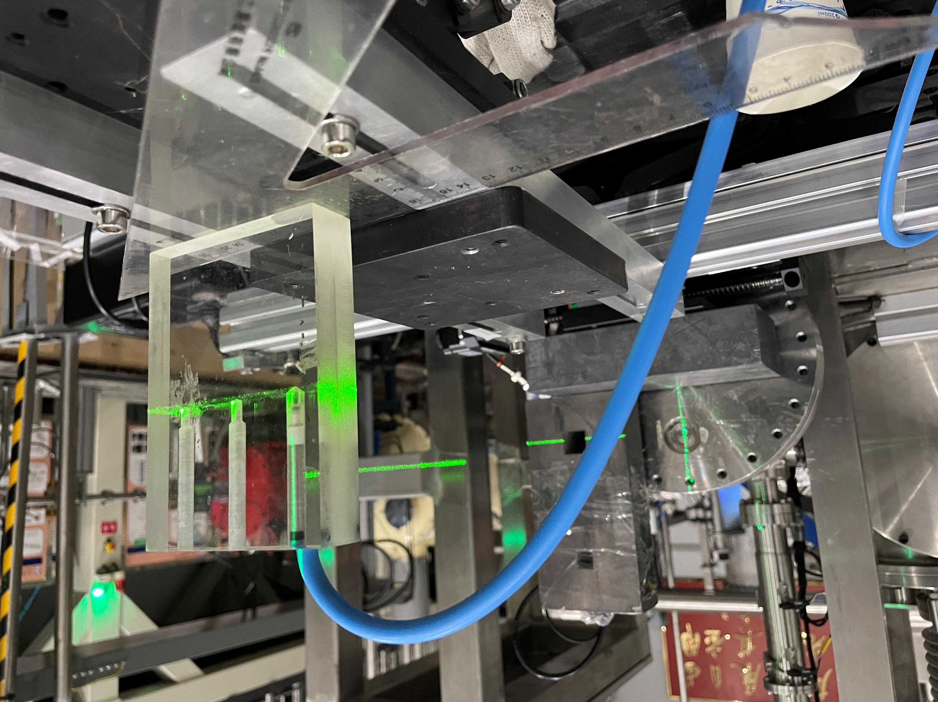
Metrological solution for ultrahigh dose-rate (FLASH) radiotherapy
Detector saturation: main metrological challenge for FLASH radiotherapy
A dose measurement system was established for MVs X-ray FLASH, including dose monitor and dosimeter.
Good linearity between monitors but scintillator shows serious radiation damage
Monitor:
1) Diamond
2) Scintillator
3) FCT
Dosimeter:
1) EBT3 film
2) Ionization chamber
SSD: 20 cm
6
unpublished data
A
2
1
3
4
8
7
10
5
e⁻
Good linearity between monitor and dosimeter
Good agreement between EBT3 and PTW IC
9
unpublished data
1:Scintillator detector；2：EBT3 film；3：PMMA tissue compensator；4：Secondary collimator；5：Flattening filter; 6：Primary collimator; 7:Diamond detector；8：Tungsten target；9：Support bench ；10：FCT beam monitor
Yiwei Yang, et al. FLASH radiotherapy using high energy X-rays: Metrological challenge and solution in dose measurement, 14:00 on 13th April

Slide 9
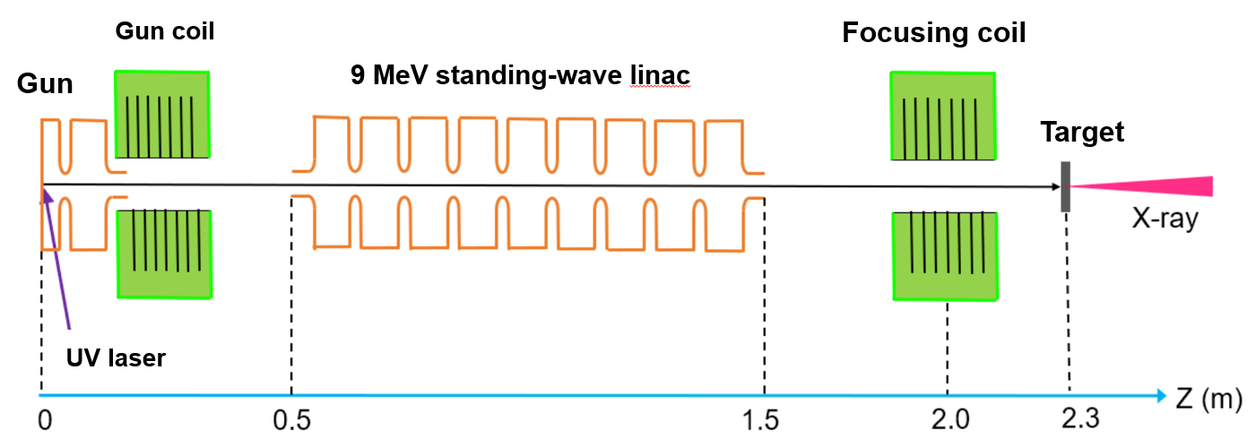
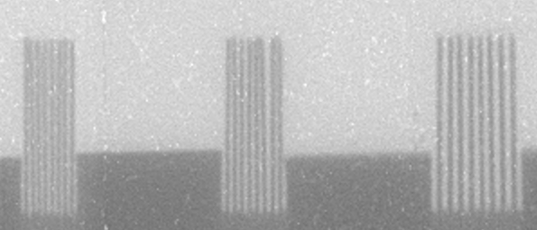
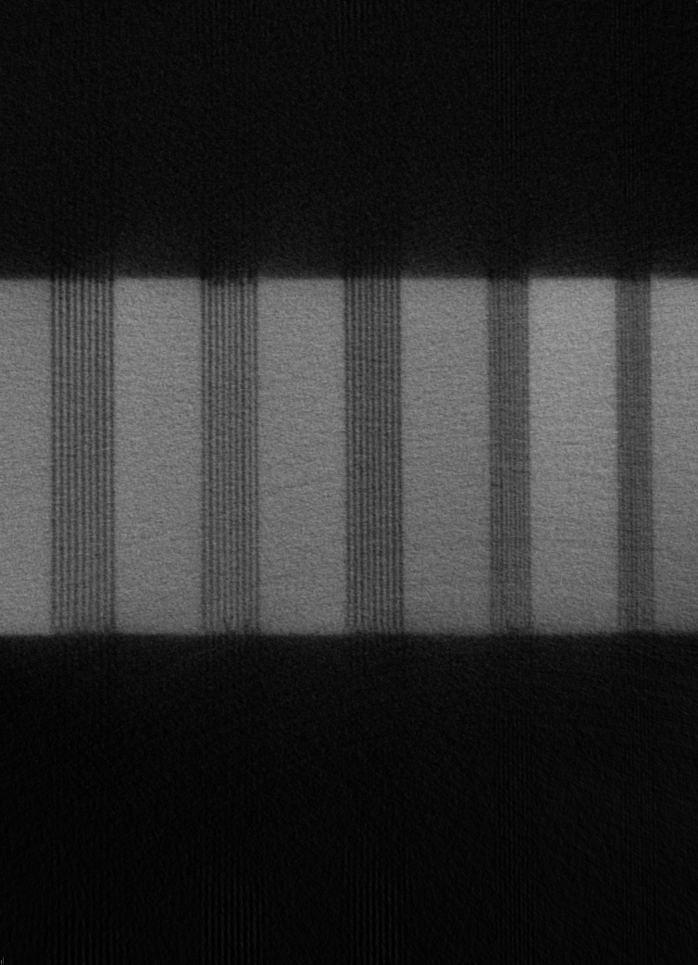
High brightness photoinjector driven high-resolution high-energy X-ray CT
High energy X-ray CT is one of the most power tools in NDT (Zheng Zhou)
We have built a high-resolution high-energy X-ray CT using high-brightness photo-injector, state-of-the-art high quality electron beam source.
DR image
50 μm
60 μm
75 μm
10 Lp/mm
CT image
5 Lp/mm
Unprecedented resolution of 50μm is achieved, thus significantly improving practical performance of high-energy industrial X-ray CT.
50 μm
60 μm
75 μm
85 μm
100 μm

Slide 10
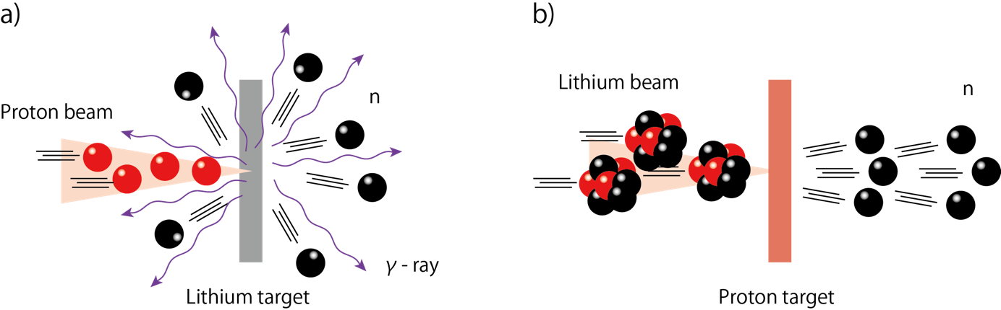
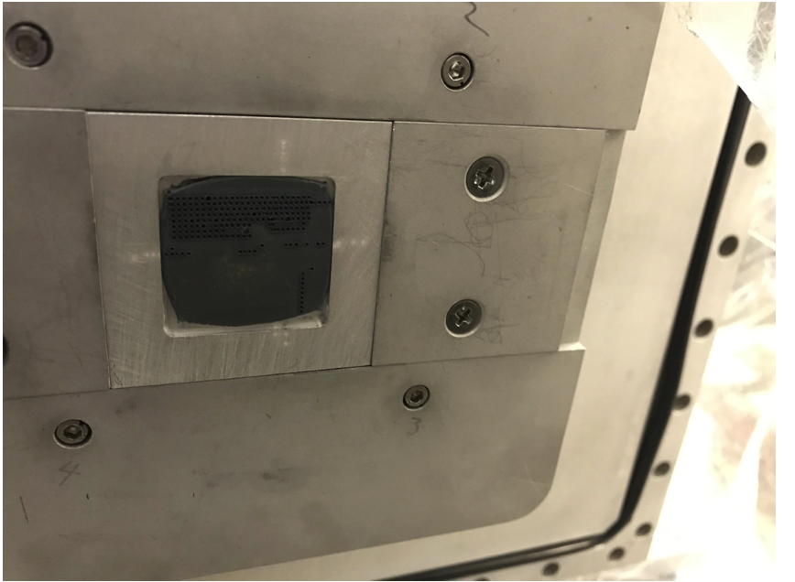
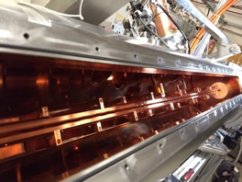
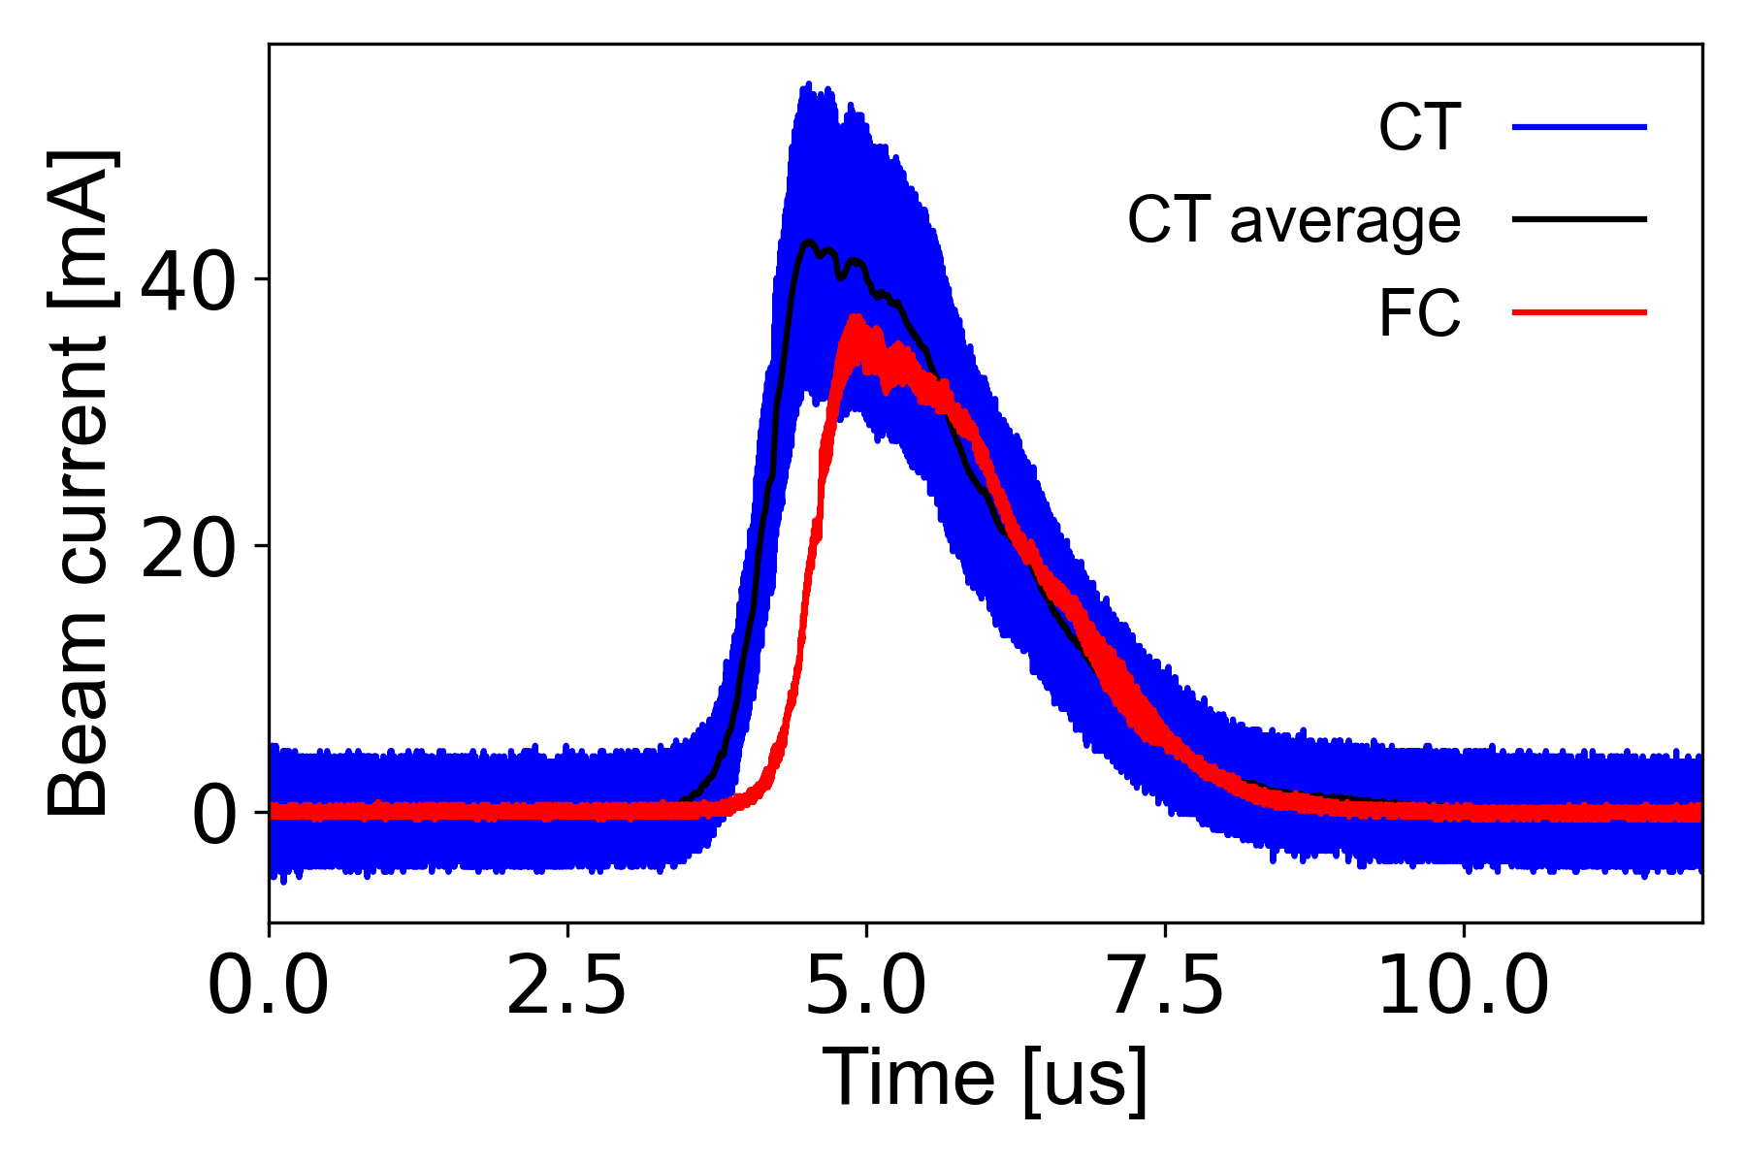
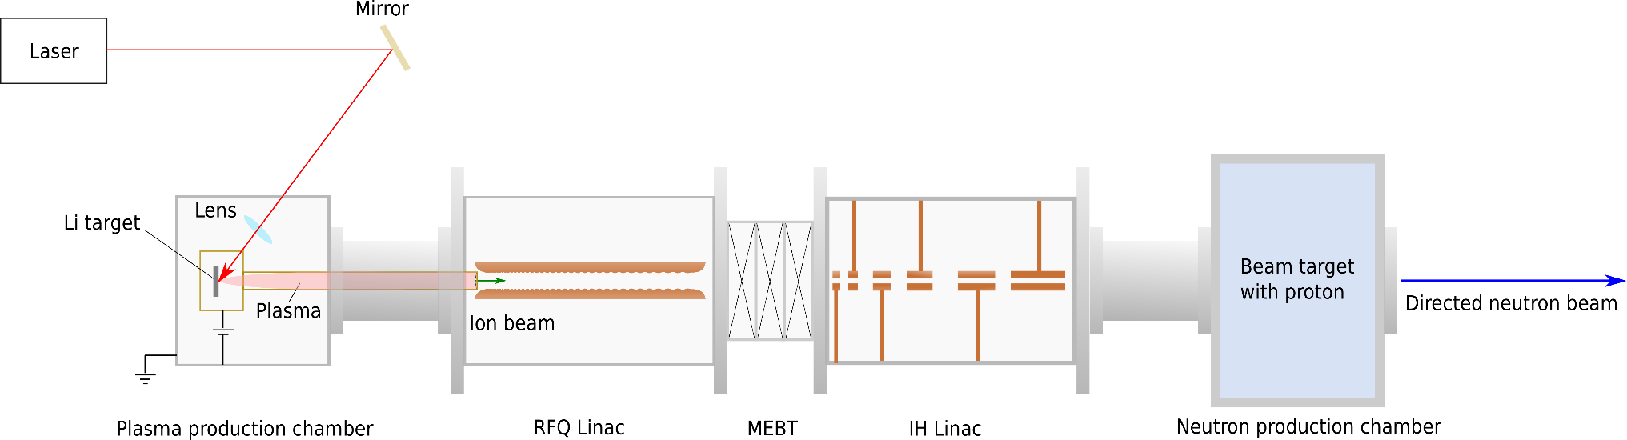
Present Status on Li-beam driving neutron generator R&Ds at BNL
A compact accelerator-driven neutron generator that uses a lithium beam driver could be a promising candidate since it produces almost no undesired radiation. However, providing an intense lithium-ion beam has been difficult, and it has been thought that the practical application of such a device would be impossible. The most critical problem of insufficient ion fluxes has been solved by applying a direct plasma injection scheme. In this scheme, a pulsed high-density plasma from a metallic lithium foil generated by laser ablation is efficiently injected and accelerated by a radio-frequency quadrupole linear accelerator (RFQ linac). We have obtained a peak beam current of 35 mA accelerated to 1.43 MeV, which is two orders of magnitude higher than a conventional injector and accelerator system can deliver.
Key concept
When heavy ions are delivered, neutrons are directed to forward because of the high gravity center velocity.
Neutron flux can be increased while beam energy is kept near the threshold.
Lithium foil target for LIS
LIS provides ⁷Li³⁺ intense beam
DPIS plus RFQ capture the beam
The world brightest ⁷Li³⁺ beam
This part was verified
Li beam energy | 14-15 MeV
Beam pulse width | 2 us
Repetition rate | 1000 Hz
Peak ion beam current | 35 mA
Average ion beam current | 70 uA
Neutron energy | 1 MeV -5 MeV
Average neutron flux | 7×10⁹ n/s/sr
To achieve intense ⁷Li³⁺ beam, we employed laser ion source (LIS) and direct plasma injection scheme (DPIS)
Masahiro Okamura
Li beam driving neutron generator (Anticipated Completed Projections)
Masahiro Okamura, Shunsuke Ikeda, Takeshi Kanesue, Brookhaven National Laboratory, New York 11973, USA
Antonino Cannavò, Giovanni Ceccio, Department of Neutron Physics, Nuclear Physics Institute of CAS, Prague, Czech Republic
Kazumasa Takahashi, Department of Electrical Engineering, Nagaoka University of Technology, Niigata 940-2188, JAPAN

Slide 11
Summary
Vacuum Insulated Tandem Accelerator(VITA) applications
Industrial
Medical
Cross-sections of nuclear reactions
Material investigations
BNCT investigations
BNCT trials
Proton beam:
Deuteron beam [3]:
Blistering investigations [4]
In vitro & in vivo studies [6]
Pets [9]
⁷Li(p,p՛γ)⁷Li [1]
⁷Li(p,α)⁴He [2]
⁷Li(d,nα)α
⁷Li(d,α)⁵He
α+n
⁶Li(d,α)α
⁶Li(d,p)⁷Li
⁶Li(d,p)⁷Li*
γ (478 keV)
Qualification and testing materials for ITER and CERN [5]
VITA in Xiamen
Dosimetry studies [7]
VITA in Moscow
…
Drug delivery systems [8]
VITA in Pavia
…
…
…
S. Taskaev et al. NIMB 502 (2021)
S. Taskaev et al. NIMB 525 (2022)
To be published
S. Taskaev et al. NIMB 481 (2020)
A. Shoshin et al. Fusion Eng. Des. 178 (2022)
A. Zaboronok et al. Biology 10 (2021) 1124
S. Taskaev et al. Front. Nucl. Eng. publishing
A. Zaboronok et al. Pharmaceutics 13(9) (2021)
A. Zaboronok et al. Biology 11 (2022) 138
Current :1nA-10mA
…
Yaroslav Kolesnikov

Slide 12
Industrial Applications

Slide 13
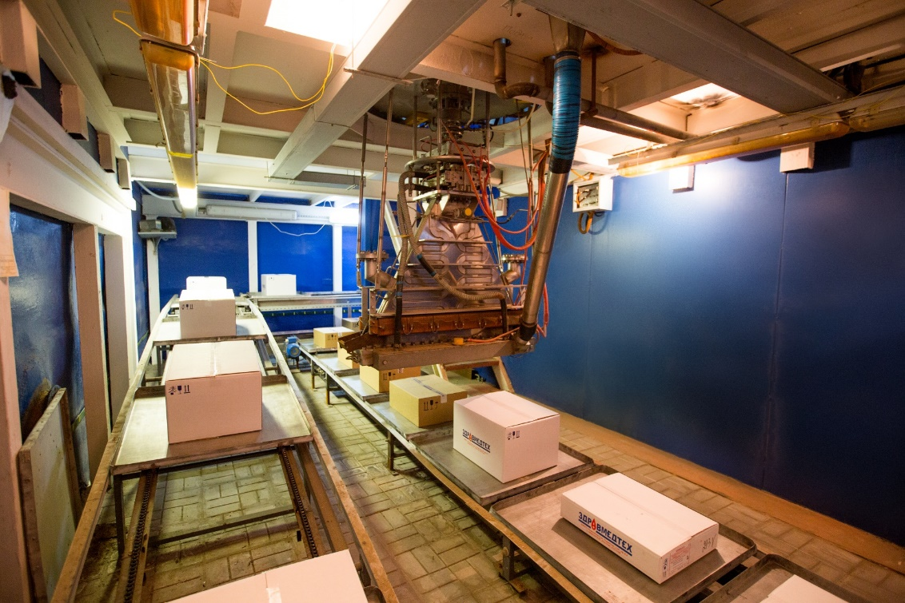
ILU RF electron accelerators for e-beam and X-ray applications.
Aleksandr Bryazgin
Budker Institute of Nuclear Physics
Novosibirsk, Russia
Presented the line of RF industrial accelerators with energy 1-10 MeV and power up to 100 kW.
Showed examples of application these accelerators in industry sites.

Slide 14
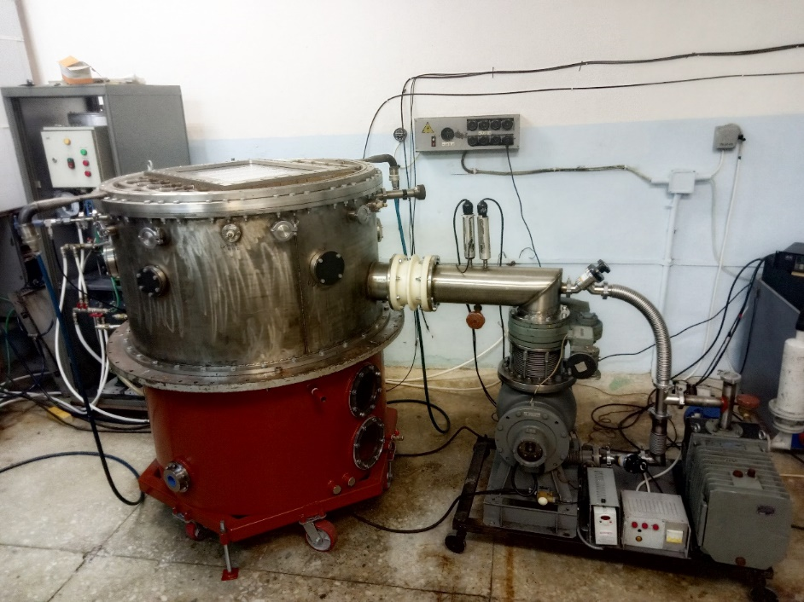
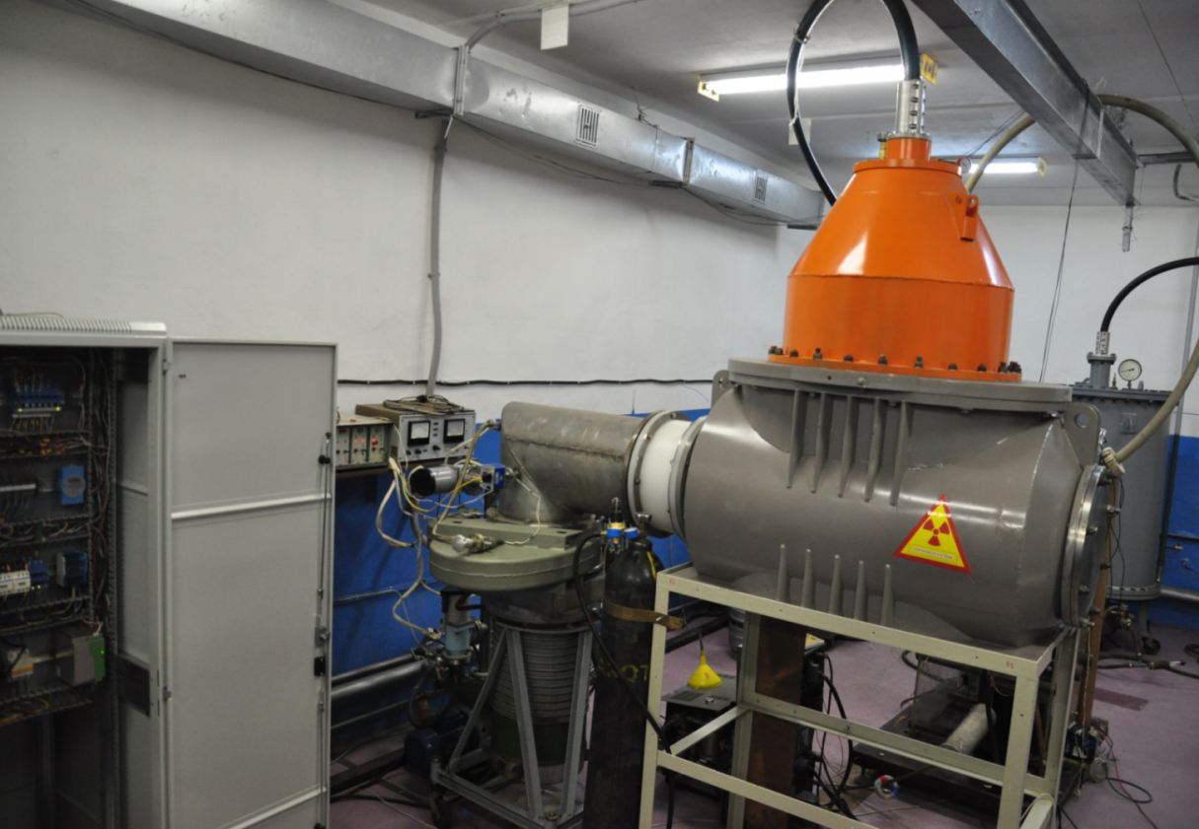
Development of High Current Electron Accelerators at Institute for High Current Electronics
Low Energy Electron High Current Accelerators with Plasma Emitters
Helion (plasma anode)
Duet (plasma cathode)
SOLO-M plasma cathode
The main characteristics of the facility:
Beam current 20-250 A;
Electron energy 5-25 keV;
Pulse duration 50-200 µs;
Pulse repetition 0.3-20 s⁻¹;
Operating pressure 0.01–0.05 Pa;
Working gas argon;
Beam diameter up to 5 cm;
The dimensions of the manipulaton
scanning region 200×200 mm;
  arc deposition system
PC control of all units and devices with programmable preset and
control of the e-beam parameter and of the treatment process.
Main parameters:
Electron energy, keV up to 200
Beam current, A up to 30
Pulse duration, μs up to 100
Pulse-repetition frequency, s⁻¹ up to 50
Beam cross section, mm² (750×150)
Current density inhomogeneity, % ±10
    Efficiency, % >60
    Average beam power, kW up to 5
    Electron energy up to 150 keV
    Beam Current 1 − 40 mА
    Current density 1 − 15 µA /cm²
    Beam dimension 45×65 cm
Maxim Vorobyov

Slide 15
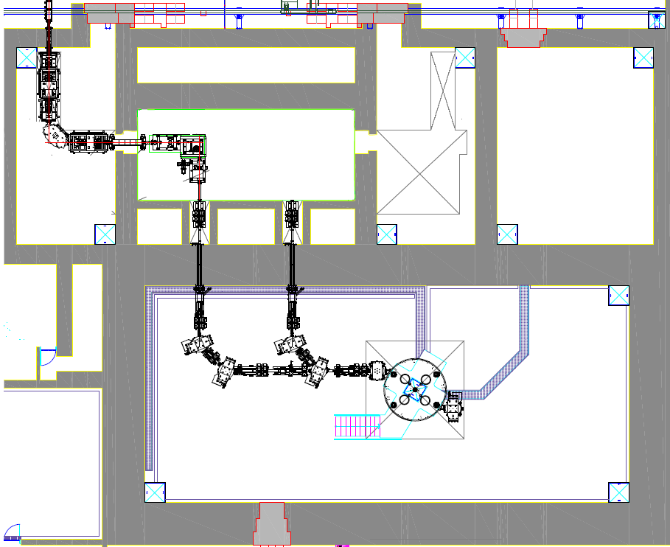
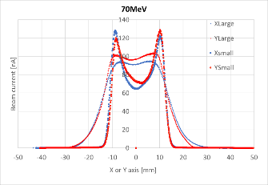
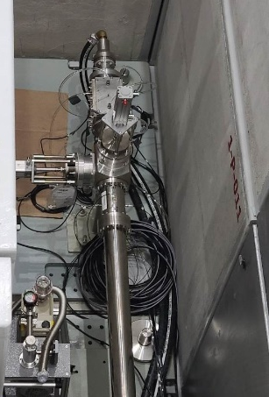
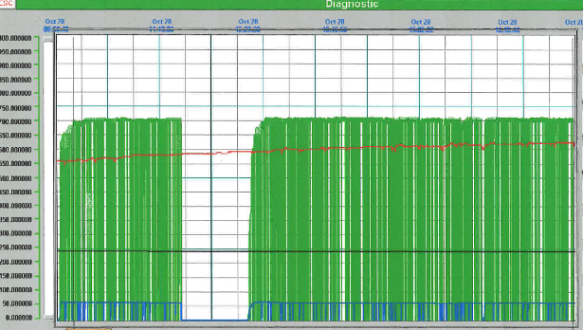
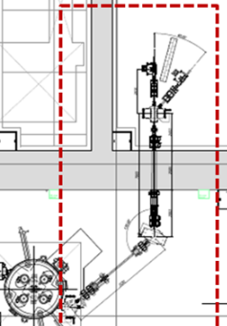
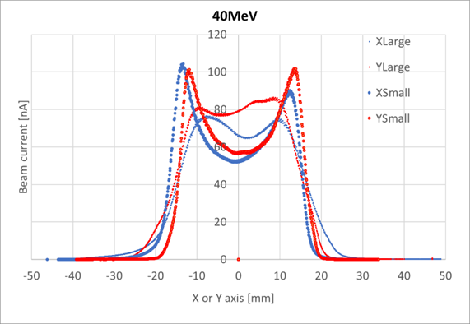
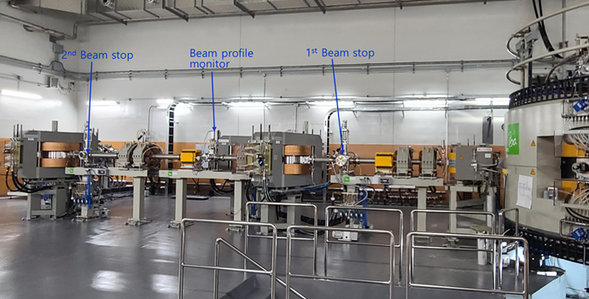
A 70-MeV Proton Cyclotron System of IBS for Multidisplinary Utilization
Jongwon Kim (IBS, Korea)
Commissioning completed in Dec. 2022.
Utilizations (Isotope Separation On Line (ISOL), neutron, medical isotopes)
1. Beam profile formation tests using wobbler (Cave A)
2. High-power test (Cave B): 70 MeV, 50 kW for 6 hrs
Spare vault
(Medical isotope)
Cave A (ISOL)
Cave B
(Neutron)
2nd extraction port
Cyclotron vault

Slide 16
AUSTRALIA’S ION MICROBEAM FACILITY AND CAPABILITY FOR SPACE AND MEDICAL APPLICATIONS
Dr Stefania Peracchi – Accelerator Scientist - speracch@ansto.gov.au
FACILITIES
CENTRE FOR ACCELERATOR SCIENCE, Australian Nuclear Science &Technology Organisation Lucas Heights, NSW Australia 4 Accelerators (up to 10 MV) 2 Heavy Ion Nuclear Microprobes The only ones in Australia ! More than 20 ion species (from H to Au) Energy above 100 MeV Single ion & High current regimes
CAPABILITIES
 | External Ion Microbeam In addition to the standard vacuum chamber, we have An enclosed chamber for irradiation in ambient air.
 | Selective Irradiation Customisable pattern of scanning beam on selected areas to irradiate micron-sub-regions.
 | GEANT4 Modelling Accurate modelling of beam transport, LET and dose rate profile along the target, and precise selection of preferred flux (or fluence) during the irradiation.
APPLICATIONS
 | Space (NSQN) Radiation effects on electronics Shielding materials Photovoltaic technologies for satellites Detectors for dosimetry Space radiation environments’ modelling
 | Health & Radiobiology Radiation effects on astronauts’ DNA Microdosimeters for Quality Assurance in hadron therapy Fundamental radiobiology for particle therapy Inhibitor drugs

Slide 17
Materials science research at Indus beamlines
Tapas Ganguli
Head, Accelerator Physics and Synchrotrons Utilization Division (APSUD), Raja Ramanna Centre for Advanced Technology (RRCAT), Indore, INDIA.
Indus–1 and Indus-2 synchrotron radiation sources are National Facilities, which are in operation in round the clock mode, since Feb 2010
Indus-2 details
3rd generation light source, 2.5 GeV, 200 mA machine
Double bend achromat lattice with 8 periods
Provision for 5 insertion devices, with 3 operational devices
Topics to be covered in the talk:
Introduction to Indus Synchrotrons
Brief details of the beamlines at Indus
Some examples of interesting research carried out by users
Brief review of materials research at APSUD, RRCAT (Intermetallic alloys, large bandgap oxides)
Operational beamlines in Indus-1: 7; in Indus-2: 18
Around 1000 user experiments carried out annually
In recent years, Indian pharmaceutical industries using Indus facilities regularly
Facilities have also contributed to several projects of national importance: Indian Lunar missions Chandrayaan-I, Chandrayaan-II

