Slide 1

WG4: Innovative accelerator techniques
WG5: Accelerator and its related technologies for hadron (neutron) science

Slide 2
Commissioning of X-LAB: a very high-capacity X-band RF test stand facility at the University of Melbourne
Development of laser wakefield acceleration driven by few-TW pulses in a sub-mm, dense nitrogen gas target
Energy-conserving theory of strongly nonlinear plasma wakefields
High-Field Physics Related to LWFA on Dual-Beam Ultrafast High-Power Lasers
Beamline simulations for the University of Melbourne X-LAB
Chip-size accelerator enabled single-electron FEL
Focusing and reduction of correlated energy spread of chirped electron beams in passive plasma lens
High resolution imaging and CT using a table-top ultrafast light source based on the laser wakefield accelerator
Studies of beam quality control in plasma accelerators at IHEP
Simulation studies on the development of an advanced electron/ion accelerator using a laser-plasma interaction in Korea University Sejong Campus
Recent progress on CEPC Plasma Injector
Generation and Application of High Energy Electron Beams and Hard-X-rays from Laser Wakefield Accelerator.
Laser-plasma schemes of narrowband THz emission for THz electron acceleration
Temporal diagnostics on electron bunches from laser wakefield acceleration via single-shot electro-optic spatial decoding
High efficiency uniform positron acceleration in plasma wakefield accelerator
Advanced Quasistatic Approximation
New painting injection scheme for the CSNS-II
Genetic Mutation using Small Neutron Source
Design and Beam Commissioning of Dual Harmonic RF System in CSNS RCS
Low Beta 650MHz 5-cell SCRF (LB650) Cavity activities at VECC ,Kolkata and Status Update

Slide 3

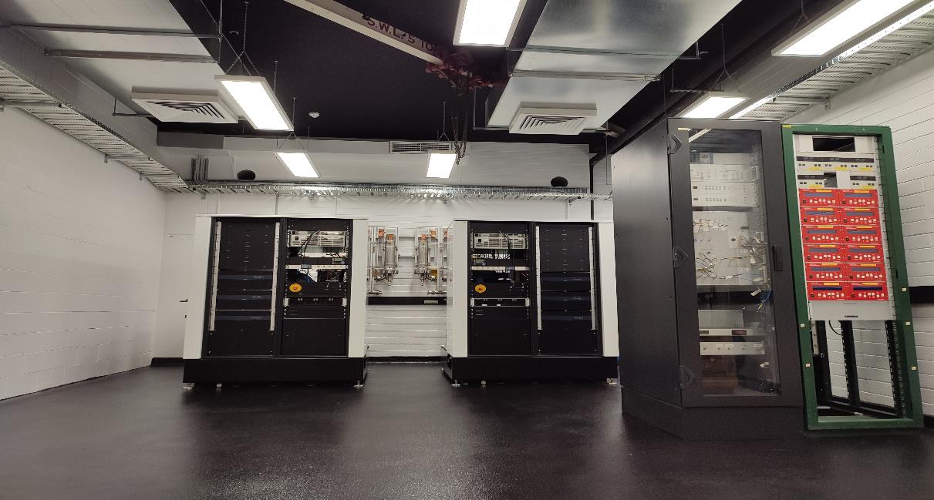
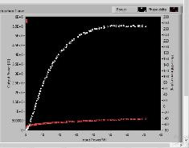
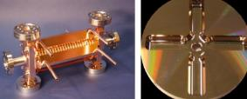
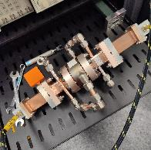
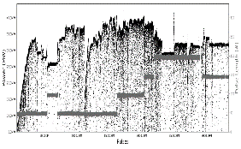
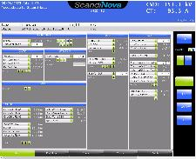
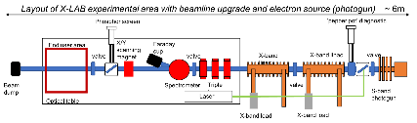
Previously used for 35 MeV betatron
~70m²: Space for x-band linac and medical applications
  Refurbishing scheduled for the next months
Commissioning of The first southern hemisphere’s first X-band radio-frequency test facility at the University of Melbourne.
TD24 structure so far reached 40.45 MW (97.9 MV/m)
(ns)
At the heart of the project is the X-band high power equipment including modulator and klystron feeding rf power to two copper accelerating structures. An electron source will also enable acceleration of electron beams

Slide 4
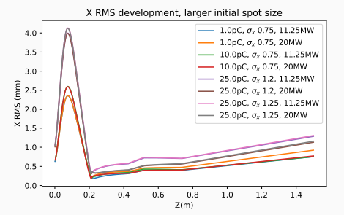
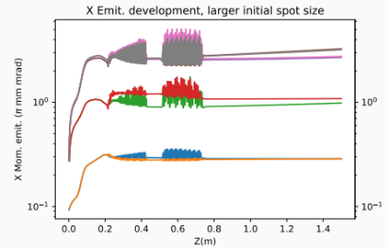
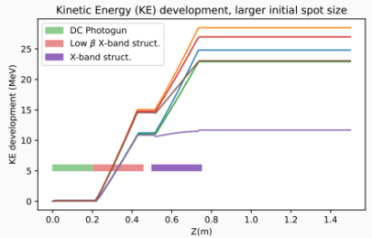
Beamline simulations for the University of Melbourne X-LAB
Proposed beamline for the University of Melbourne X-LAB is being simulated, simulations beyond the preinjector stage are maturing as we speak.
Various electron preinjector configurations have been simulated, each with different tradeoffs.
These simulations will inform the final design plan of the University of Melbourne X-LAB compact X-band beamline.

Slide 5
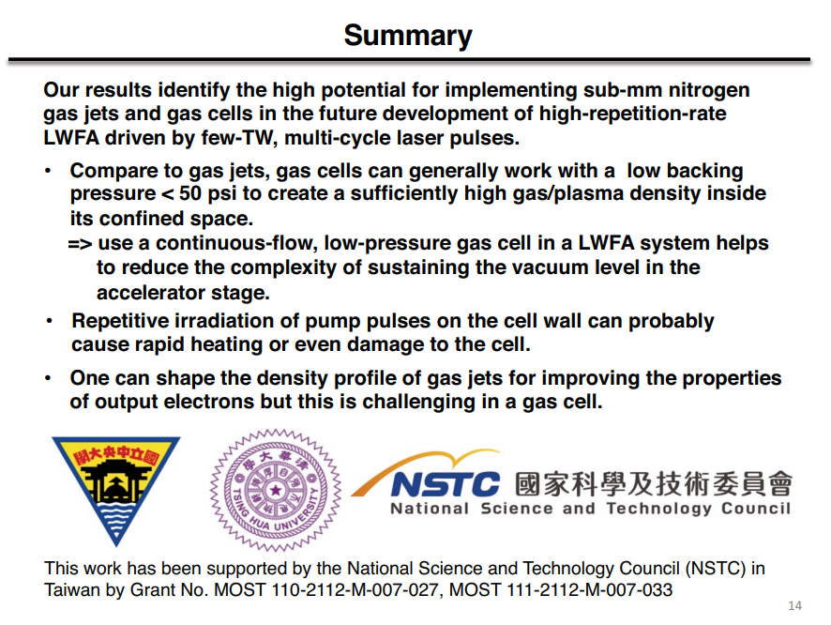
Development of laser wakefield acceleration driven by few-TW pulses in a sub-mm, dense nitrogen gas target

Slide 6
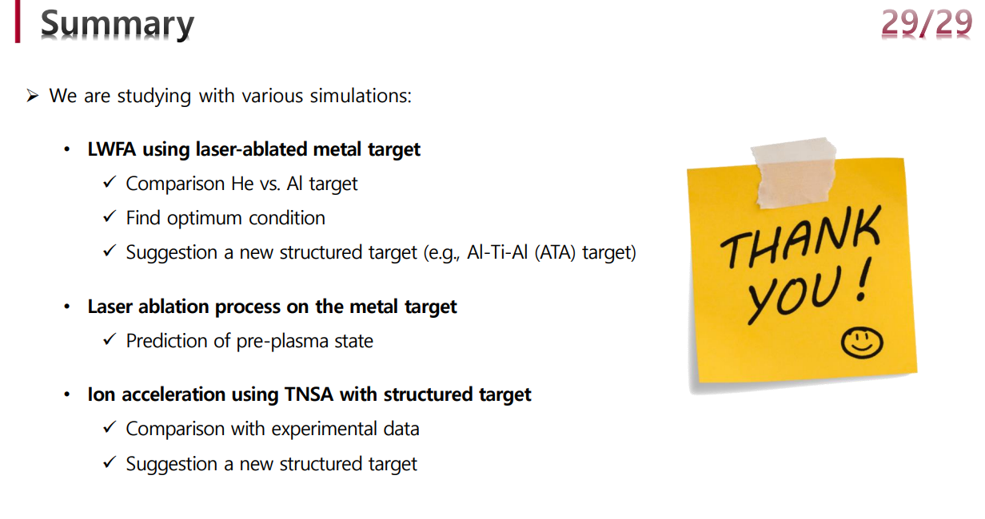
Simulation studies on the development of an advanced electron/ion accelerator using a laser-plasma interaction in Korea University Sejong Campus

Slide 7
High-Field Physics Related to LWFA on Dual-Beam Ultrafast High-Power Lasers
One ultrahigh intense CPA laser pulses will act as two means: first used to accelerate electrons by laser driven wake field (LWFA) to hundreds MeV, and second, from split beam or LWFA-leftover energy reflected by plasma mirror, to collide on the electron for the generation of X/γ-rays.
Such characteristics, especially from a compact source, are highly advantageous for numerous advanced X-ray applications. Moreover, the scattering interaction can act a test bed for high-field QED study.
Also, preliminary plan of laser wake-field accelerator and radiation source in two high-power laser facilities, 0.5PW in SJTU and 2.5PW in TDLI will be presented, both of the lasers include two independently compressed two beamlines.

Slide 8
Focusing and reduction of correlated energy spread of chirped electron beams in passive plasma lens
We will present numerical results of passive plasma lens of an electron beam via self-consistent and relativistic particle-in-cell (PIC) simulations.
The focusing of an electron beam by a passive plasma lens is a non-linear and dynamic process, which strongly depends on the space charge induced evacuation of the plasma electrons in the vicinity of the propagating electron beam.
An initially negative energy chirp is essential in suppressing the unwanted growth in the relative energy spread of the electron beam during the passive lensing.
A passive plasma element is useful for both a single as well as multi-stage laser wakefield acceleration configuration.

Slide 9
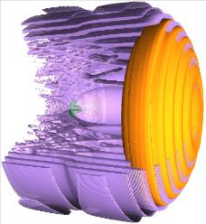
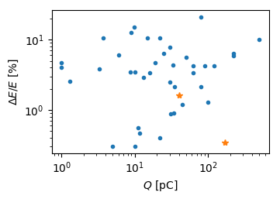
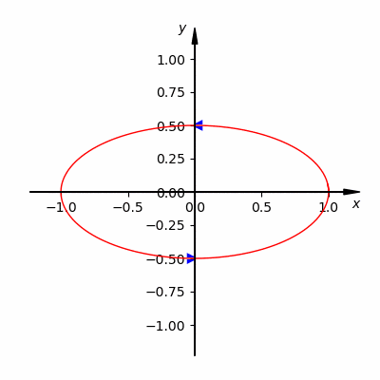
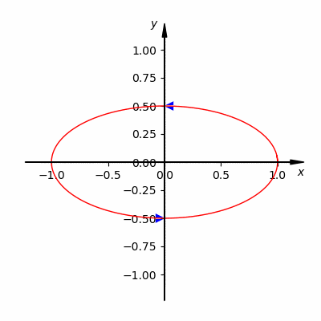
Studies of beam quality control in plasma accelerators at IHEP
Simultaneous optimization of energy spread and charge for plasma accelerators
  Ponderomotive injection
  Scissor-cross ionization injection
  Interference injection by coaxial lasers
Betatron oscillation and radiation reaction
  Build 3D betatron oscillation model
  Obtain averaged equations
  Find 3 new phenomena for long-distance plasma accelerators
  Can be applied to optimization of future large-scale plasma accelerators
M. Zeng et al., New J. Phys. 22, 123003 (2020)
Jia Wang et al., Plasma Phys. Control. Fusion 64, 045012 (2022)
Jia Wang et al., Matter Radiat. Extremes 7, 054001 (2022)
Yulong Liu and Ming Zeng, Phys. Rev. Accel. Beams 26, 031301 (2023)
zengming@ihep.ac.cn

Slide 10
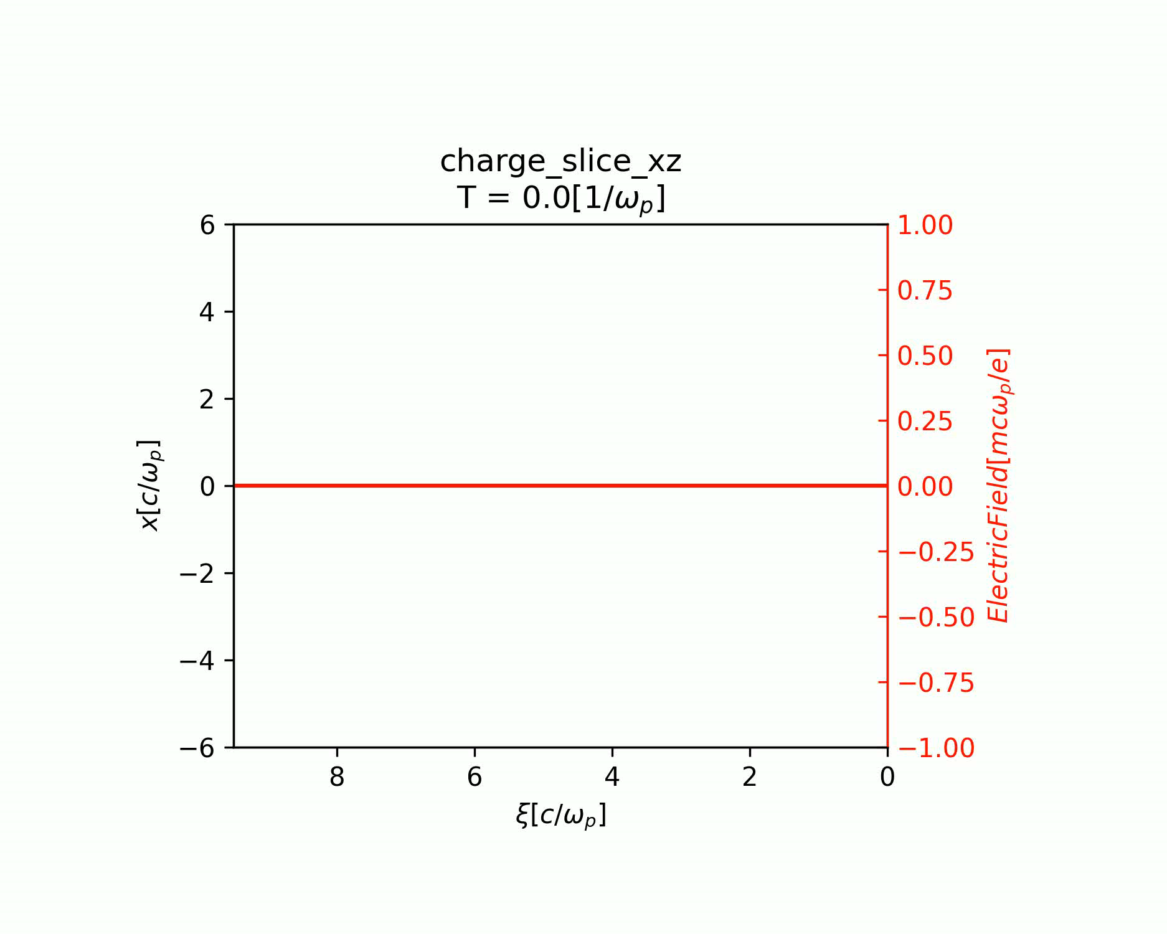
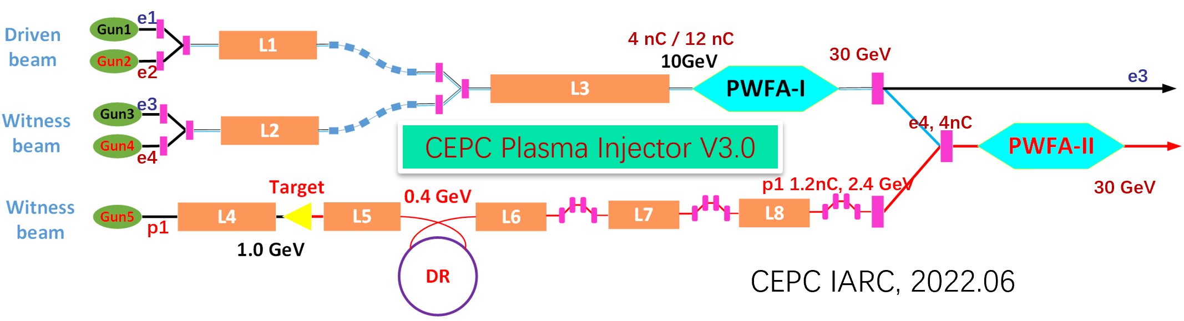
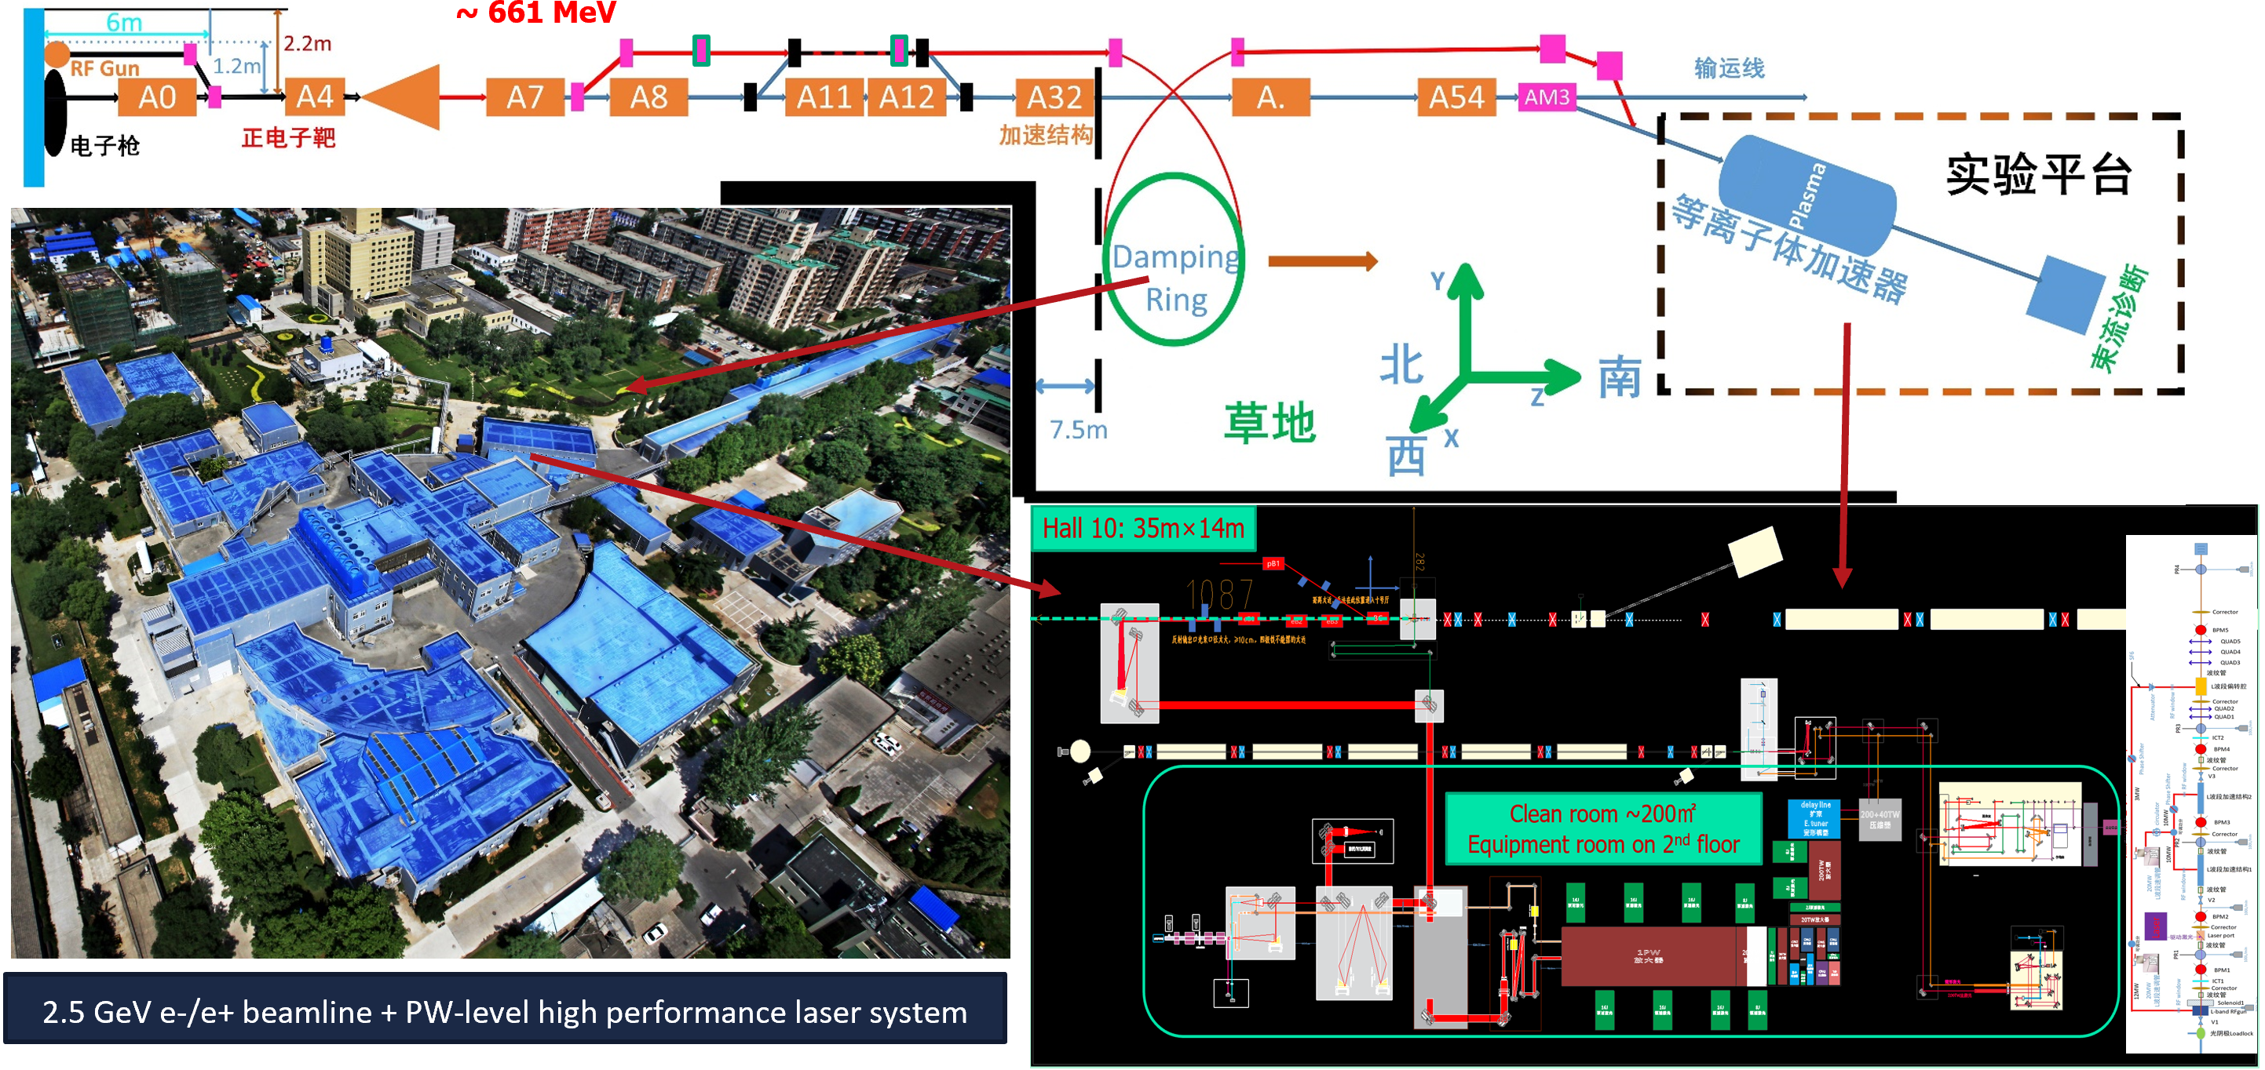
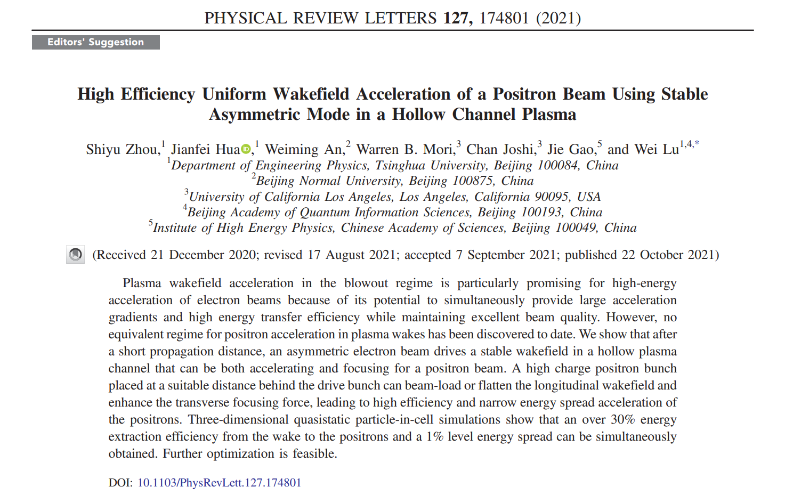
Summary—Recent progress on CEPC plasma injector
e- acc. TR=2 with ion motion
e+ acc. Asymmetry e- driver in hollow plasma channel
Proposed PWFA TF based on BEPC-II Linac

Slide 11
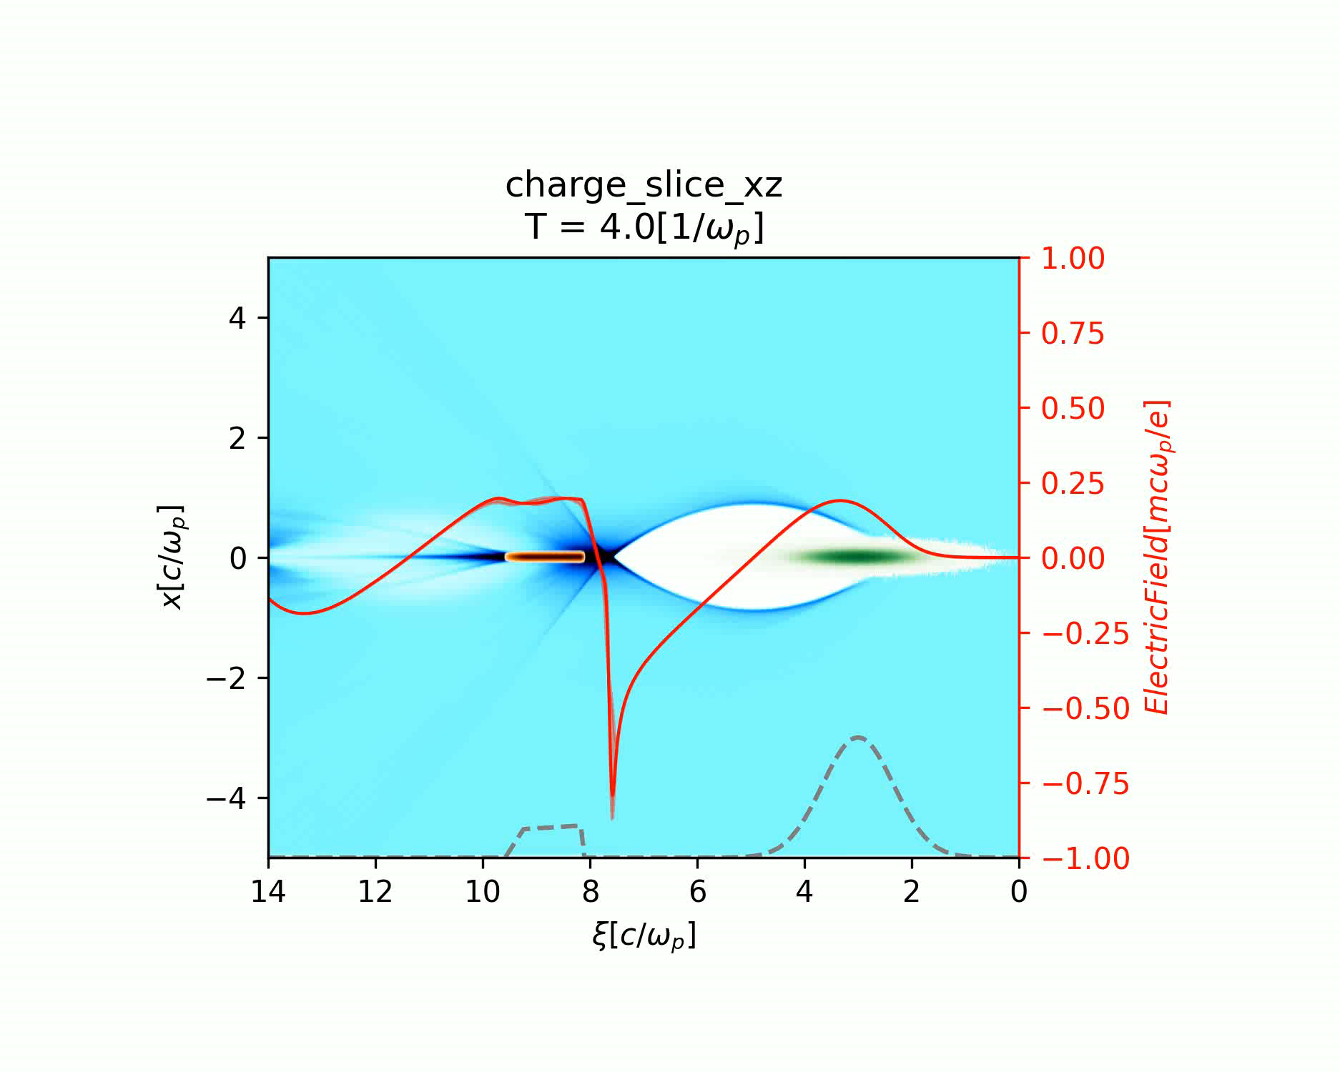
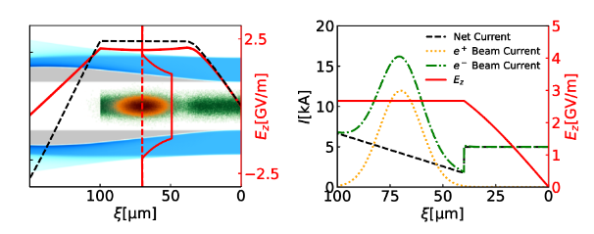
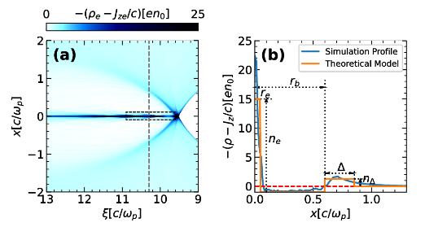
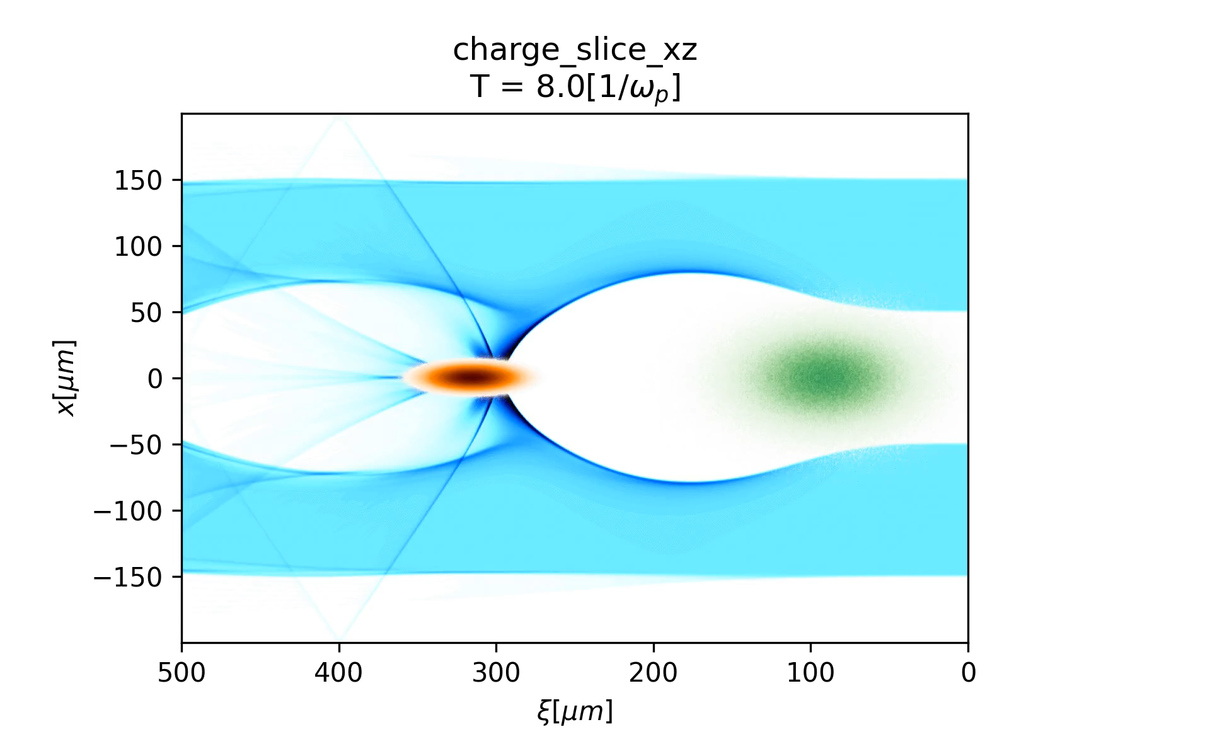
Plasma wakefield positron acceleration regimes
Positron acceleration in the blowout regime
Positron overlapped with an electron driver in the hollow plasma channel
Positron acceleration with an asymmetric mode in the hollow plasma channel

Slide 12
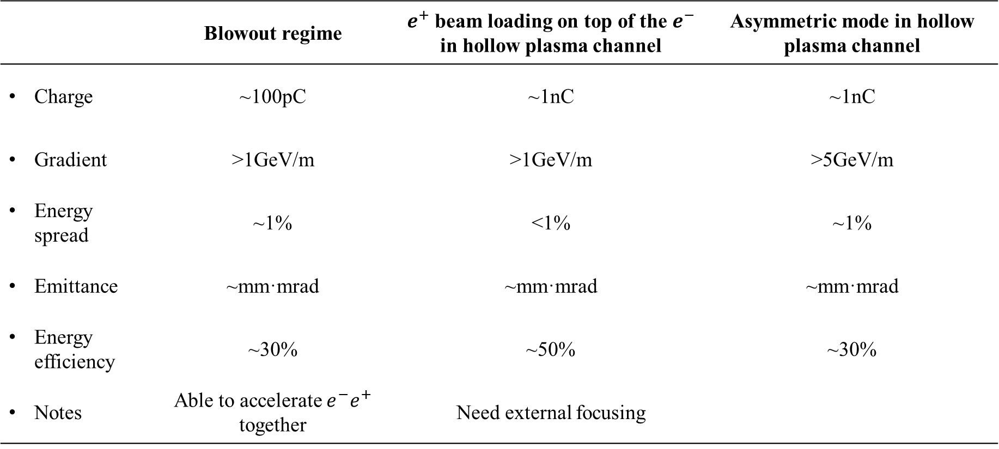
Summary of positron acceleration regimes
 | Blowout regime | $e^{+}$ beam loading on top of the $e^{−}$ in hollow plasma channel | Asymmetric mode in hollow plasma channel
Charge | ~100pC | ~1nC | ~1nC
Gradient | >1GeV/m | >1GeV/m | >5GeV/m
Energy spread | ~1% | <1% | ~1%
Emittance | ~mm·mrad | ~mm·mrad | ~mm·mrad
Energy efficiency | ~30% | ~50% | ~30%
Notes | Able to accelerate $e^{−}e^{+}$ together | Need external focusing
Shiyu Zhou et al., arXiv:2211.07962.
Shiyu Zhou et al., PRAB 25, 091303 (2022)
Shiyu Zhou et al., PRL 127, 174801 (2021) (Editors’ Suggestion)

Slide 13
High resolution imaging and CT using a table-top ultrafast light source based on the laser wakefield accelerator
Laser wakefield accelerators (LWFA), first proposed by Tajima and Dawson in 1979, utilize the plasma wakefield excited by the interaction between ultra-intense ultra-short laser pulses and underdense plasmas to accelerate electrons with an acceleration gradient of >100GV/m. Benefitting from μm-scale dimensions of the plasma wakefield, the electron beams and x-ray sources driven by LWFA are naturally featured few-femtosecond (fs) duration, μm-level transverse size and high brightness. With the intensive development of LWFA in the past two decades, key principles and advanced concepts to generate electron beams with GeVs energy, low emittance and kiloampere peak current have been verified, and phase-contrast imaging, computed tomography and ultrafast x-ray absorption spectroscopy performed with betatron sources and all-optical inverse Compton scattering sources have been demonstrated. These results show that LWFA is capable of becoming a competitive candidate for the next generation compact light sources and electron-positron colliders.
LWFA is sensitive to temperature, humidity and cleanliness. Temperature fluctuation causes mechanical deformation of optomechanical components, resulting in the pointing jitter and quality deterioration of laser beams. Humidity fluctuation and poor cleanliness cause optical surface contamination, even damage the optical mirrors, lenses and crystals. To date, general LWFA systems are almost installed in fixed laboratories or facilities with relatively large scales to meet the operation requirements of a clean environment with constant temperature and humidity. It is still a major challenge for LWFA to operate reliably, steadily and flexibly in a complicated environment for different application scenarios.
Here, we have developed a real table-top LWFA based ultrafast synchrotron radiation source having a size of 1.5m×3m. The apparatus, consisting of an industry level compact 40TW Ti:Sapphire laser (also developed by ourselves) and a compact vacuum system capable of 10Hz repetition frequency, has been proved to have a capacity of continuous and stable operation for a few days. Utilizing the table-top synchrotron radiation source, high resolution images and computed tomography of biological and industrial specimens with a 10μm-level resolution are obtained. Our work paves a way for the application and industrialization of high resolution imaging based on the table-top ultrafast synchrotron radiation source.

Slide 14
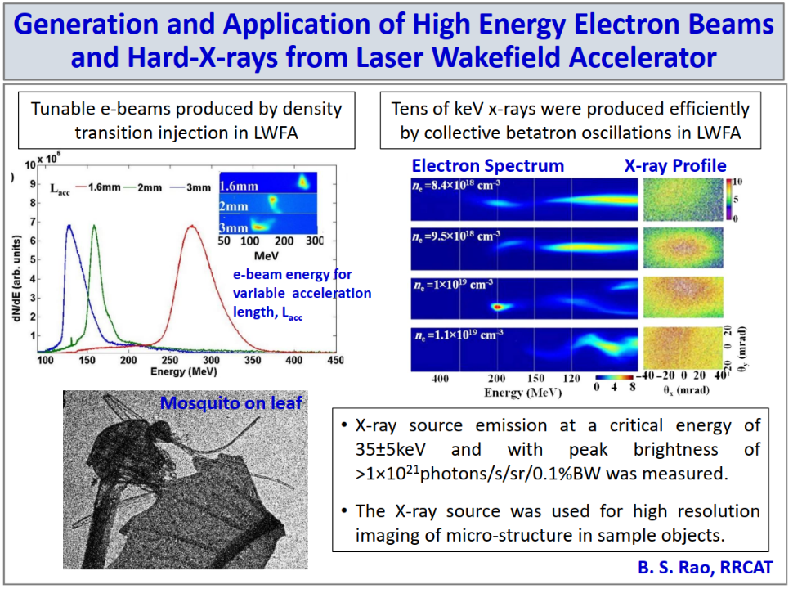

Slide 15
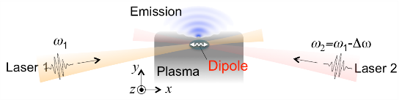
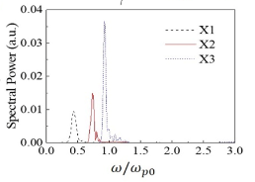
Summary page of MinSup Hur’s talk
Laser-Plasma Schemes of Narrowband THz Emission for THz Electron Acceleration
Laser-plasma-based, Narrowband, GV/m THz field can be used for compact accelerators. In this talk, I introduced a novel concept of plasma dipole oscillator as a powerful, quasi-narrowband THz source.

Slide 16
Temporal diagnostics on electron bunches from laser wakefield acceleration via single-shot electro-optic spatial decoding
We established electro-optic (EO) sampling techniques adequate for the diagnostics of electron temporal information in laser wakefield acceleration (LWFA).
For the investigation of electron timing jitter and injection process, EO spatial decoding on the electron Coulomb field was performed. The spherical wavefront of the Coulomb field and plasma-density-dependent electron emission timing were discovered.
For the determination of electron bunch durations, EO spatial decoding on the coherent transition radiation (CTR) produced when electrons passing through a metal foil was conducted. Electron beam timing fluctuation of 7 fs and bunch durations of few tens of femtoseconds had been demonstrated.
This research not only showed the capability of EO sampling serving as a real-time electron temporal diagnostic for laser-driven sources but also demonstrated the ultra-fast nature of laser-driven electron sources for various applications.

Slide 17
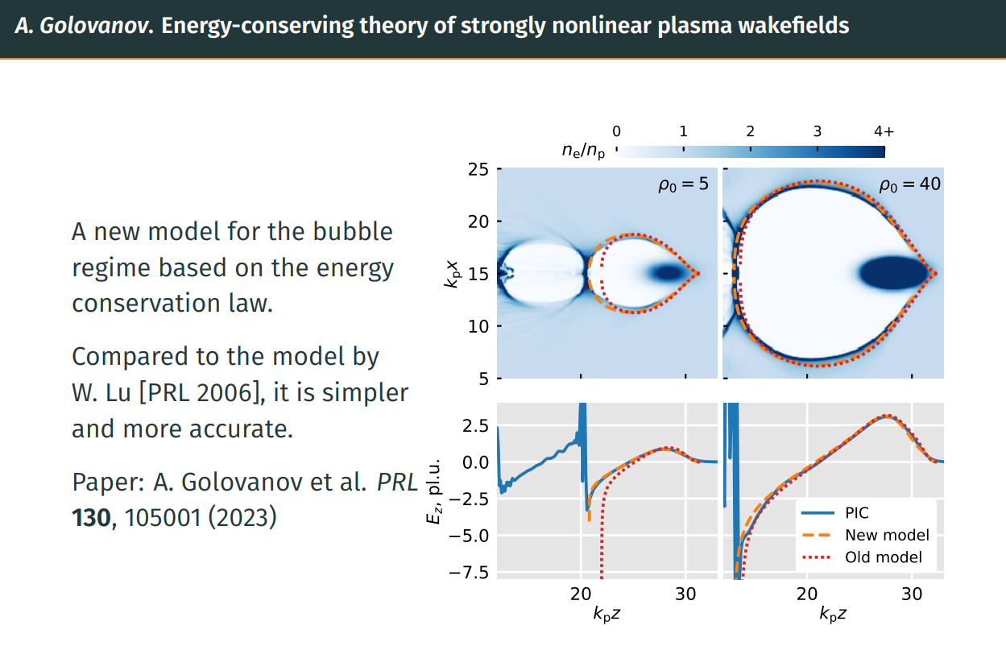

Slide 18


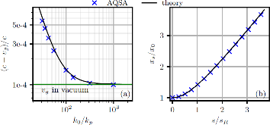
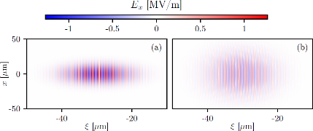
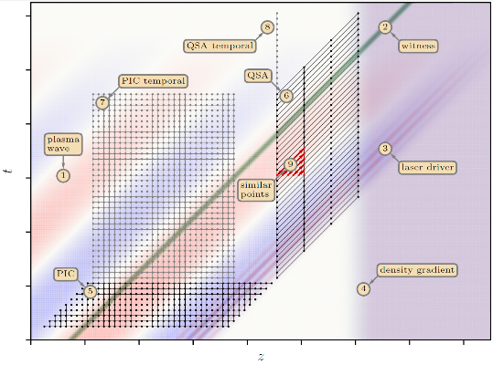
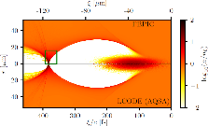

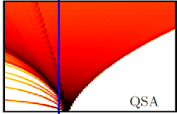
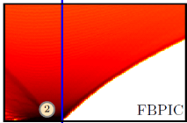
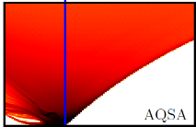
Advanced Quasistatic Approximation (Konstantin Lotov, Budker INP, Novosibirsk, Russia):
Quasistatic approximation offers advantages of speed and reduced dimensionality in simulations of plasma (laser) wakefield acceleration, but until now it was limited to very slowly changing beams in uniform plasmas.
More accurate change of variables
(retaining small terms in equations of plasma response) allows to extend the applicability area of quasistatic codes, and this was demonstrated with two examples.
Laser pulse propagation in uniform plasma: correct group velocity and transverse dispersion are provided by the plasma solver.
Short electron beam propagation through non-uniform plasma in bubble regime:

Slide 19

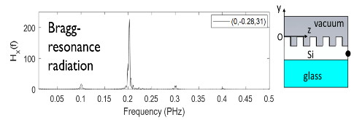
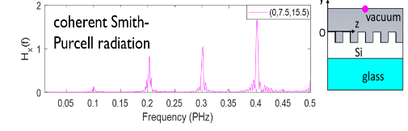
Chip-size-accelerator-enabled single-electron FEL
Yen-Chieh Huang, Luo-Hao Peng, Hossein Shirvani, Wen-Chi Chen
HOPE Laboratory, Institute of Photonics Technologies
National Tsinghua University (NTHU), Hsinchu, Taiwan
ychuang@ee.nthu.edu.tw
Dielectric laser accelerator and photonic FEL can be integrated into a chip-size substrate via microfabrication techniques.
FEL chip
Coherent Smith-Purcell Radiation
laser at 3 μm
in-plane polarization
vacuum
25 periodic electrons @ 0.1 PHz
φ
Thin-film waveguide, n_{f}
Dielectric laser accelerator driven by a 3 µm (0.1 PHz) laser
Bragg-resonance radiation
Thick material substrate, refractive index = n_{s}
coherent harmonic radiation from a train of single electrons

Slide 20
New painting injection scheme for the CSNS-II
A new method has been proposed to perform the correlated painting based on the mechanical structure of the anticorrelated painting scheme.
By using the correlated painting, the beam power on the target has successfully risen from 50 kW to the design value of 100 kW.
A new painting scheme for the CSNS-II has been proposed. It not only realizes the compatibility of correlated and anticorrelated painting, but also greatly reduces the peak temperature of the stripping foil and the edge focusing effect of the chicane bump.
In the simulation, the new painting scheme has been verified to be feasible and has obvious advantages compared with the traditional bump painting scheme

Slide 21
Genetic Mutation using Small Neutron Source
Fast neutron irradiation gives a higher LET than gamma radiation, making it a very effective approach for mutagenesis and is widely used to create mutants in many plant species.
Neutron irradiation is mainly performed using nuclear reactors and, more recently, accelerators, but both are limited to large facilities, and general access to their use is a bottleneck.
In this talk, we report the possibility of fast neutron irradiation using a small neutron source, evaluated using particle and heavy ion transport code (PHITS).

Slide 22
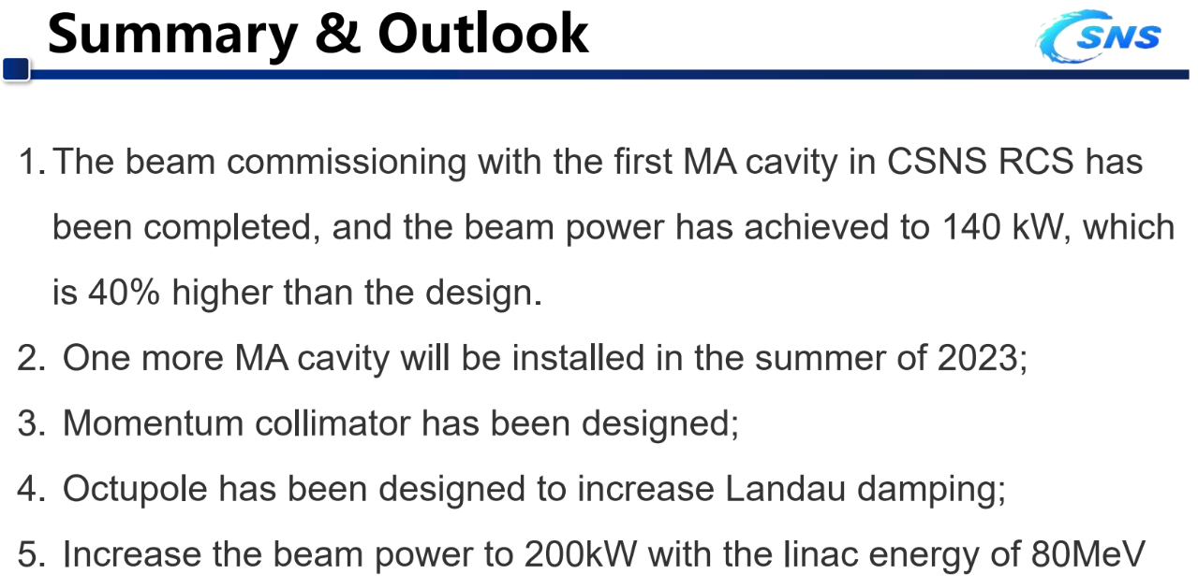

Slide 23


Summary Slide of the TALK
VECC, Kolkata, has been involved in the design and development of 650 MHz, β=0.61, 5-cell elliptical shape Superconducting RF linac cavity(LB650 cavity), under Indian Institutions- Fermilab collaboration (IIFC).
650 MHz, β=0.61, elliptical LB650 cavity has been designed to satisfy FRS/TRS criteria set by Fermilab.
650 MHz, β=0.61, elliptical LB650 cavity niobium cavities are being developed by VECC, with the help of Electron Beam Welding (EBW) facility at IUAC, New Delhi.
Before fabrication of 5-cell cavity, VECC developed two single cell prototype niobium cavities with the help of electron beam welding facility at IUAC, New Delhi
The single cell cavities have been processed and successfully tested in Vertical Test Cryostat at Fermilab and achieved high accelerating gradient. The first cavity reached upto 34.5 MV/m at maximum power(~200W) with no quench and the unloaded quality factor Q₀ was 1.5E+10 at 30 MV/m gradient. The second cavity reached gradient of 25 MV/m @2K and unloaded cavity quality factor was Q0 =1.5E+10 at 25 MV/m .
To validate the process of fabrication of 5- cell LB650 niobium cavity , a prototype 5- cell copper LB650 cavity has been developed before the development of 5- cell LB650 niobium cavity and Based on the learnings from the fabrication of copper prototype cavity, some steps have been taken for fabrication of niobium cavities.
For fabrication of two LB650 niobium cavities, 12 niobium mid halfcells , 4 niobium pen halfcells and 4 niobium end halfcells, 12 set of of stiffener rings are developed. EB welding of beam pipes , coupler pipes and Iris to Iris EB Welding of four dumbbells for one LB650 cavity have been carried out.
Frequency Measurement of niobium dumbbells and CMM measurement and Frequency Measurement of niobium halfcells have been carried out.
Asian Forum for Accelerators and Detectors AFAD-2023,April 12-14,2023

