Slide 1
AFAD
Summary of Working Group 6
Martin Sevior, University of Melbourn

Slide 2
Overall
3 Country-level presentations on Computing to support accelerator-based science (China, Taiwan and Korea)
3 Facility specific presentation (KEK, Aus. Synchrotron, HEPS)
Grid site (ATLAS-Tokyo)
Belle II distributed Computing
Development of Cloudbased Grid SE (Melbourne)

Slide 3
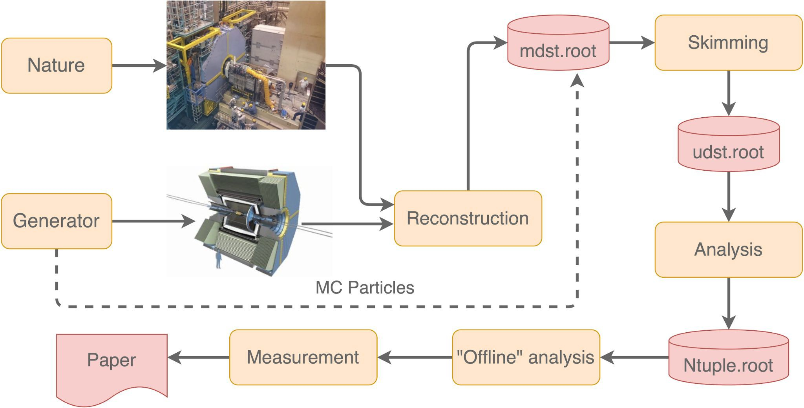
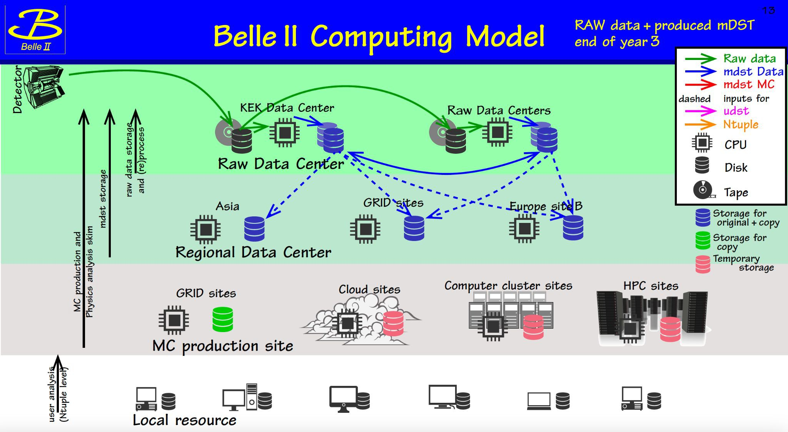
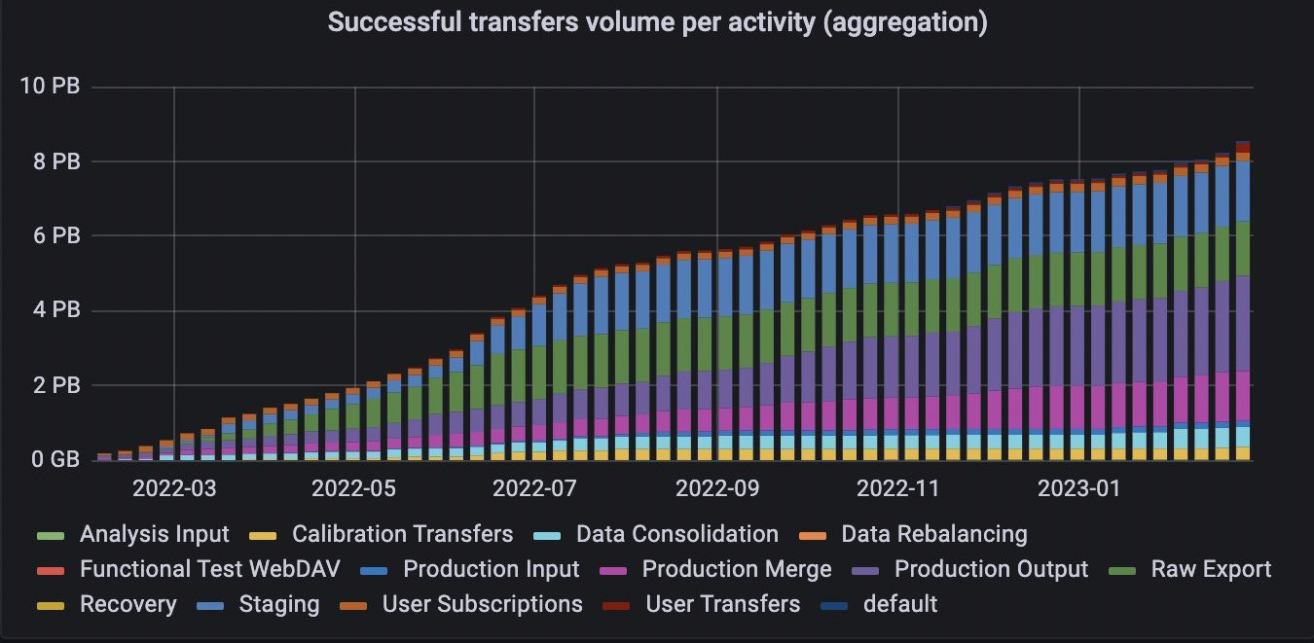
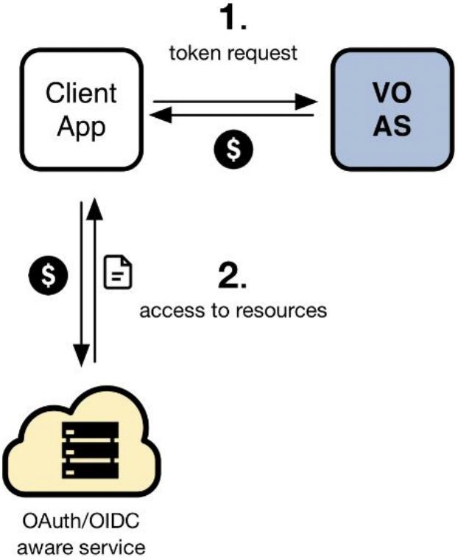
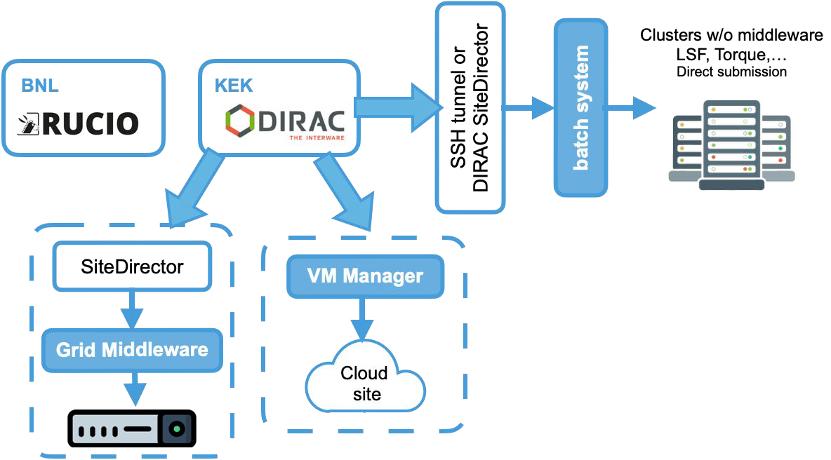
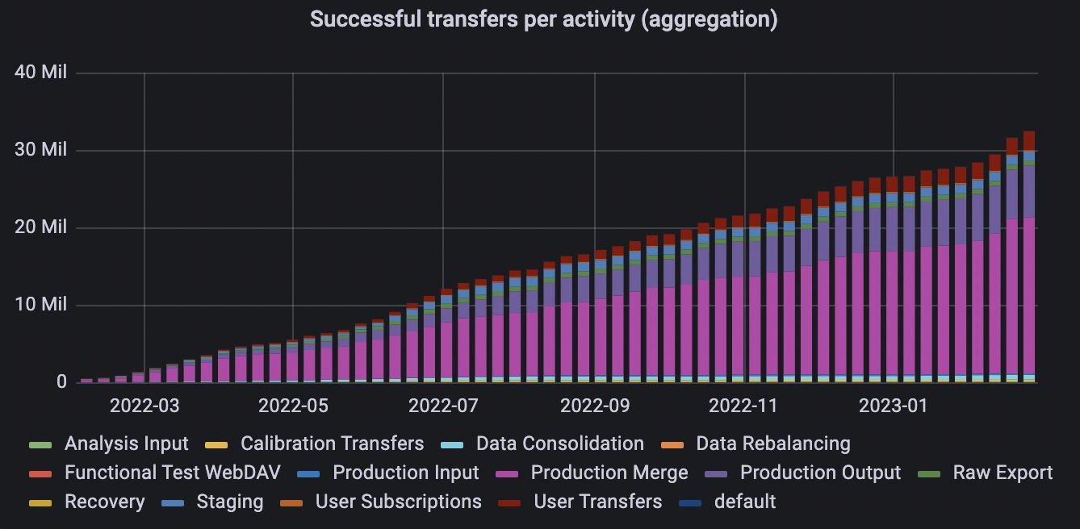
Belle II computing. Update on infrastructure and activities.
Martin Sevior on behalf of the Belle II Computing group
Up to 35K jobs/day
Up to 110 TB data/day data transfer managed by Rucio
Moving to:
Token-based auth.
Webdav transfer with
3rd party copy

Slide 4
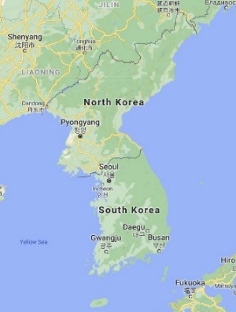
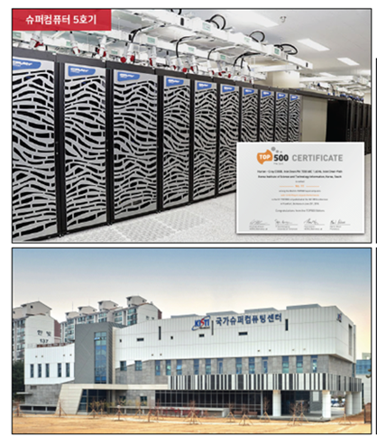
HEP Computing in Korea
Kihyeon Cho (KISTI)
1. Due to COVID-19 pandemic,
e-Science is coming back
(eg. KISTI’s Belle II remote control room).
2. New physics beyond Standard Model
needs machine learning and
evolving computing architecture.
3. HEP computing merges
from Grid farm (eg. KISTI-GSDC)
to evolving computing architecture
(eg. KISTI-5,6 supercomputer)
⇒ Therefore, KISTI-6 supercomputer
will play an important role to study
HEP in Korea besides Grid farms.
Yonsei
U.Seoul
Soongsil
KISTI
KNU

Slide 5
Summary from Science Cloud Development in Taiwan (Eric Yen)
Based on WLCG core technologies, ASGC is supporting big data analysis and AI in innovations for broader disciplines
  Reliability and efficiency are the foundation of a production system
  Flexible Collaboration models - turning research needs into services
  Upkeep of scientific computing and big data analysis systems
  Workflow integration, customization and efficiency improvement
  Resource federation for extension of the research infrastructure
  Research data management framework is available for FAIR-enabled open data
  Capacity building: consulting, training, workshop, hackathon, etc.
Demands of ML-Cloud services are booming, which will be a core of the Science Cloud in Academia Sinica
Research infrastructure and science cloud capacity will continuously evolve according to the research needs
Notes:
ASGC model holds the potential to ease the burdens and costs of providing support for research computing in any area of science that is reliant on computational tools and techniques, thus freeing up more time and resources for actual research.

Slide 6
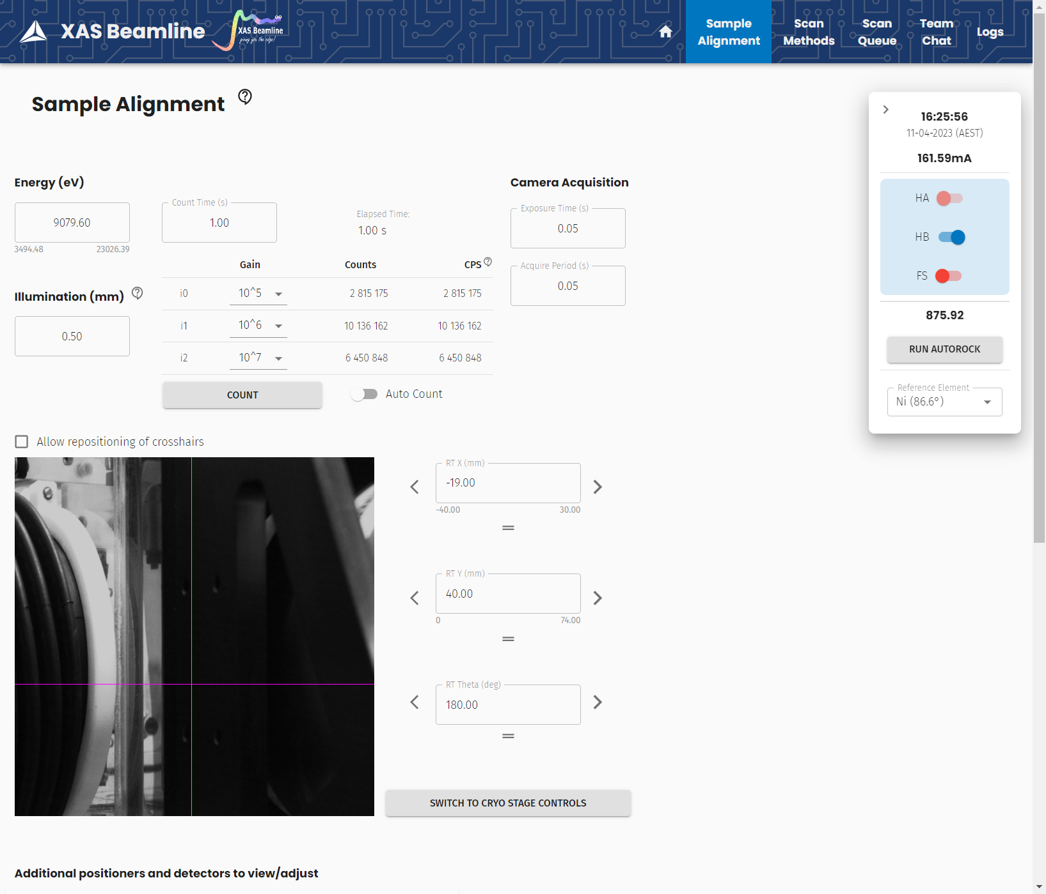
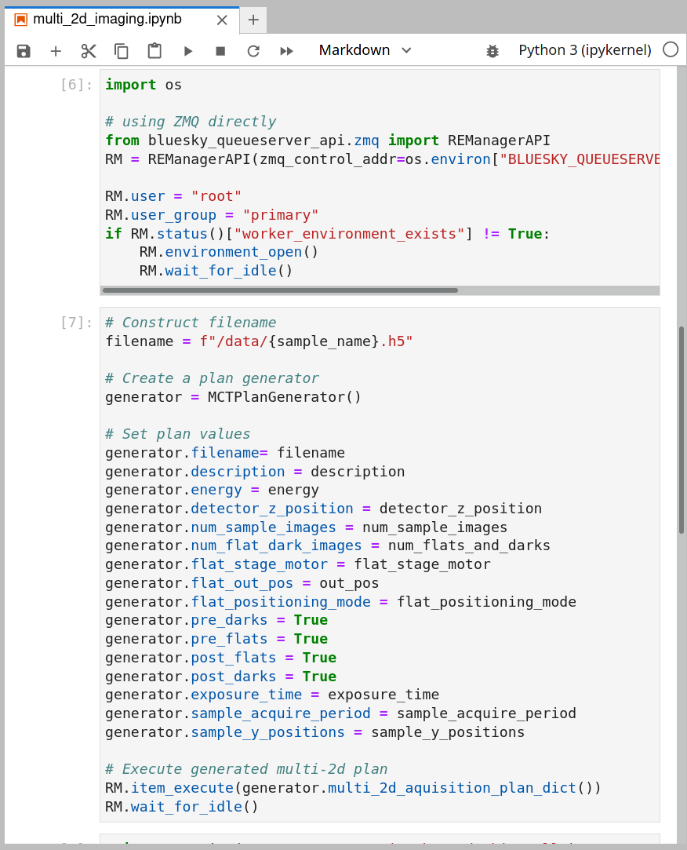
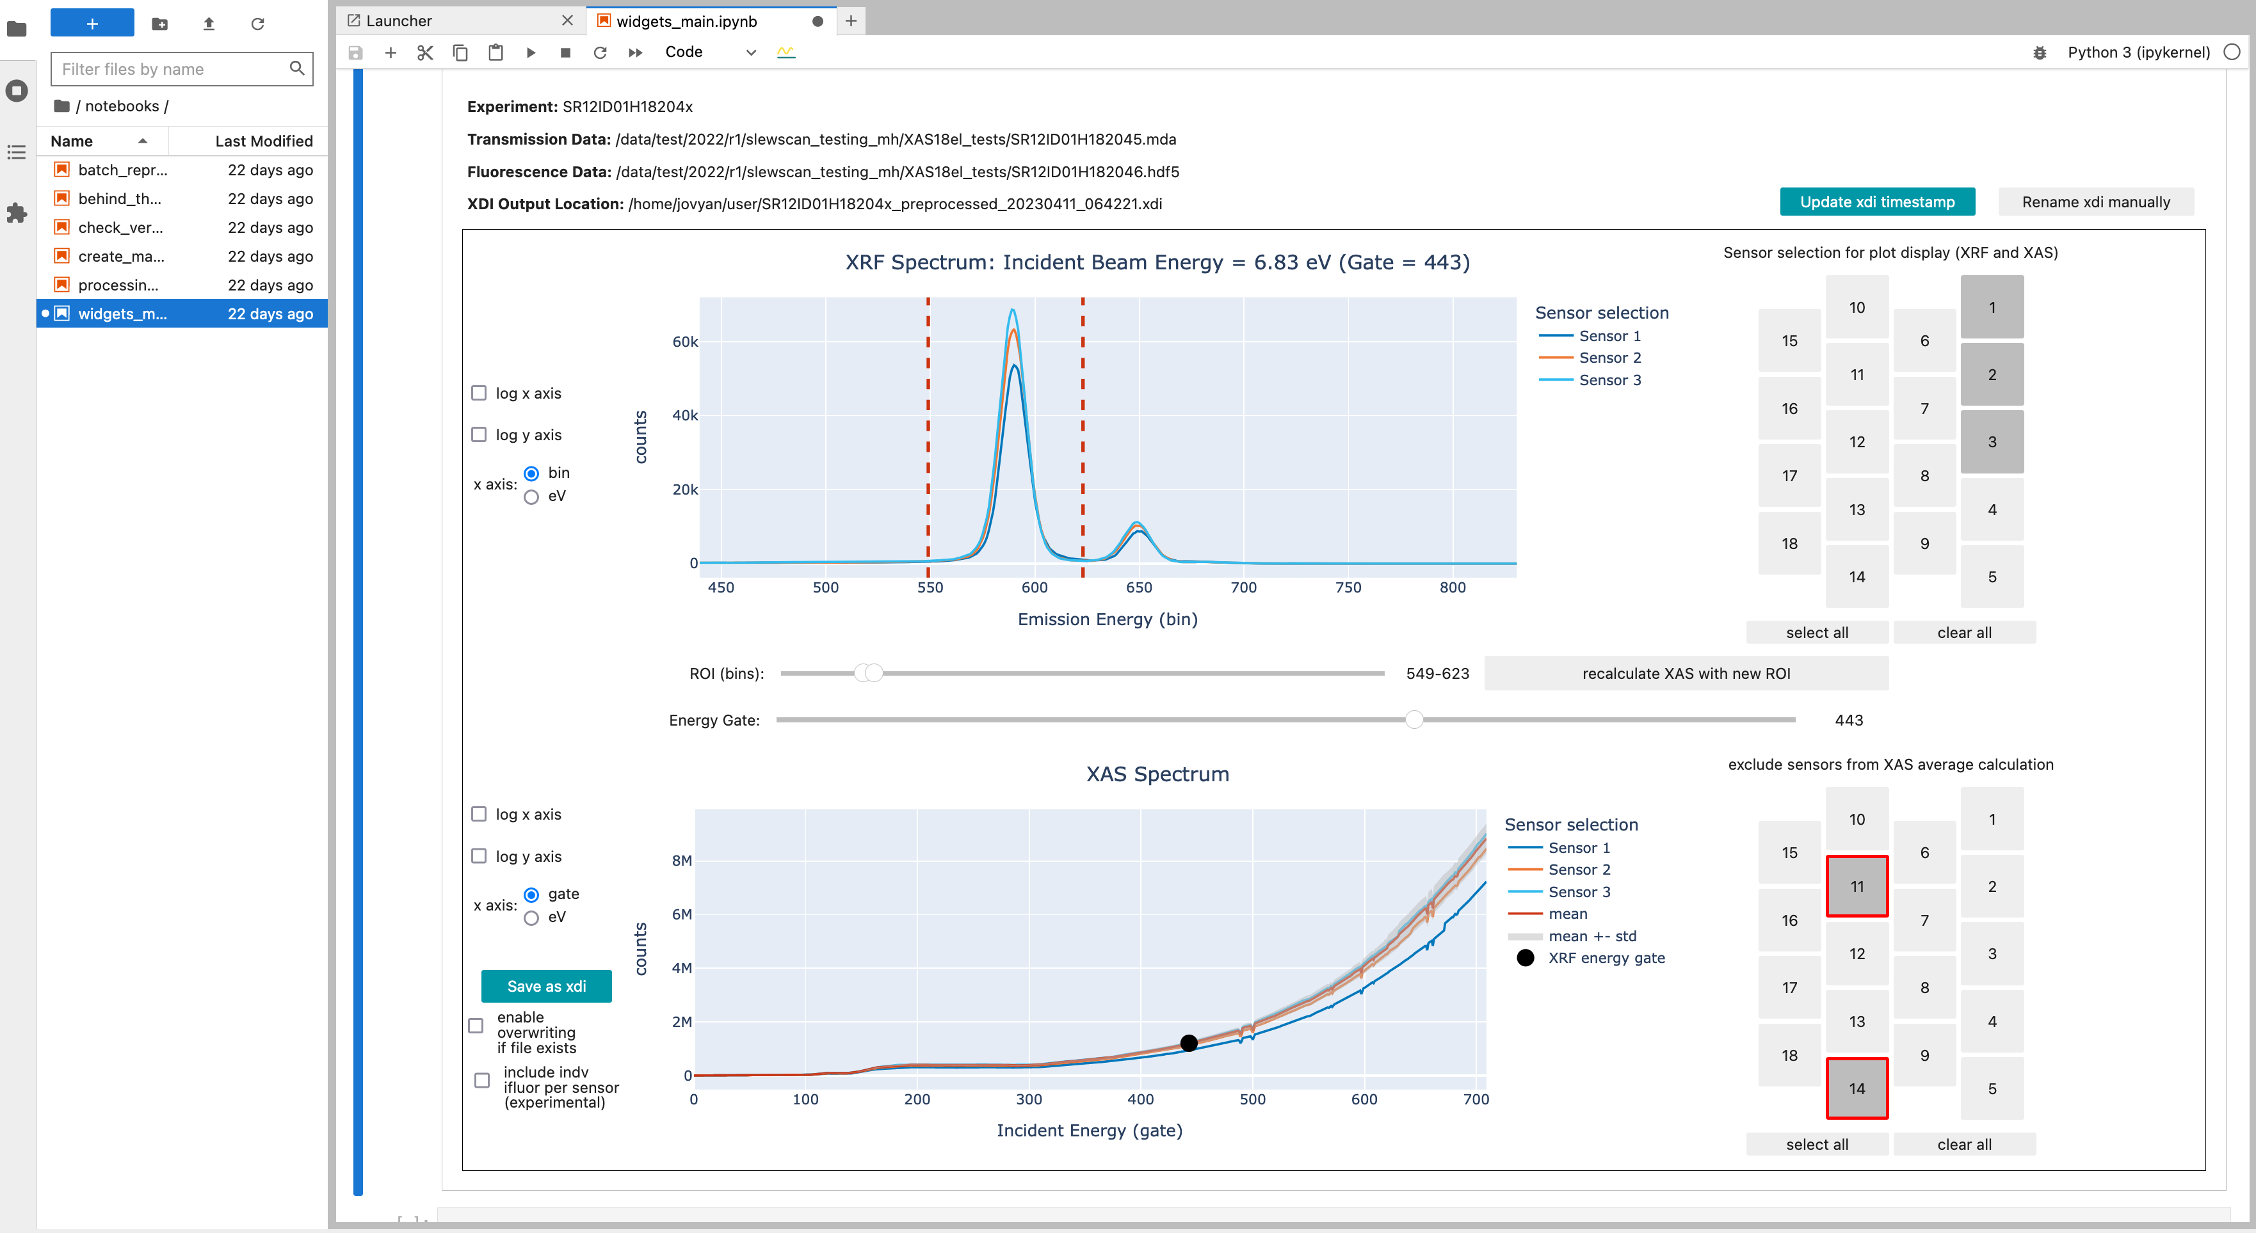
Scientific Computing at Australian Synchrotron
Andreas Moll
A new chapter of science
8 new beamlines
New, modern software stack
High throughput & automation
Focus on user experience
Reliable and fast
Industry standard tools where possible
Containerisation for reproducibility
IaC and Kubernetes for reliability
Established frameworks for data processing

Slide 7
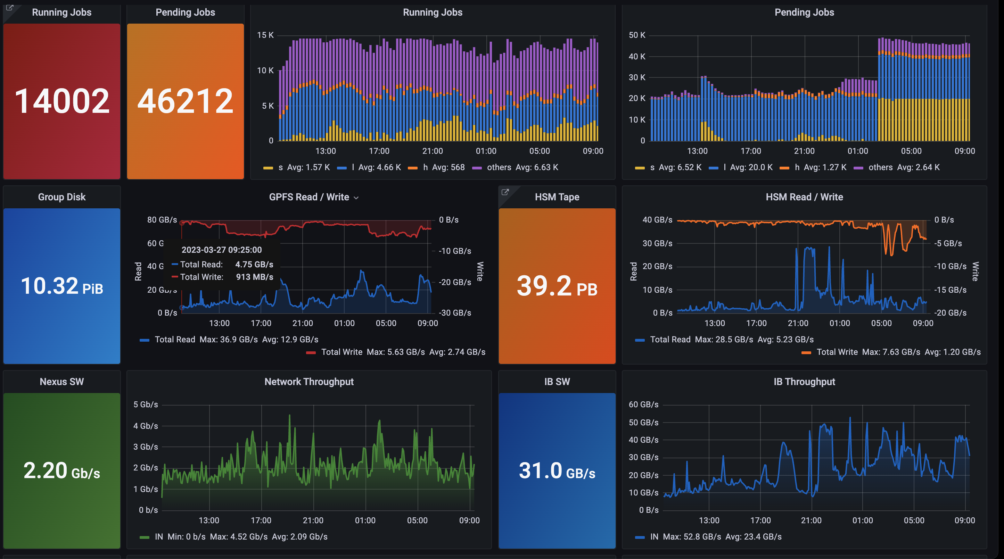
KEK computing research center
Tomoe Kishimoto (KEK)
The KEKCC provides computing resources and IT services to support many research activities in KEK
  Experimental data stored in the tape system reached 40PB
  Grid system plays an important role in international collaborations, such as raw data transfers for Belle2 experiment
Data transfers between other sites

Slide 8
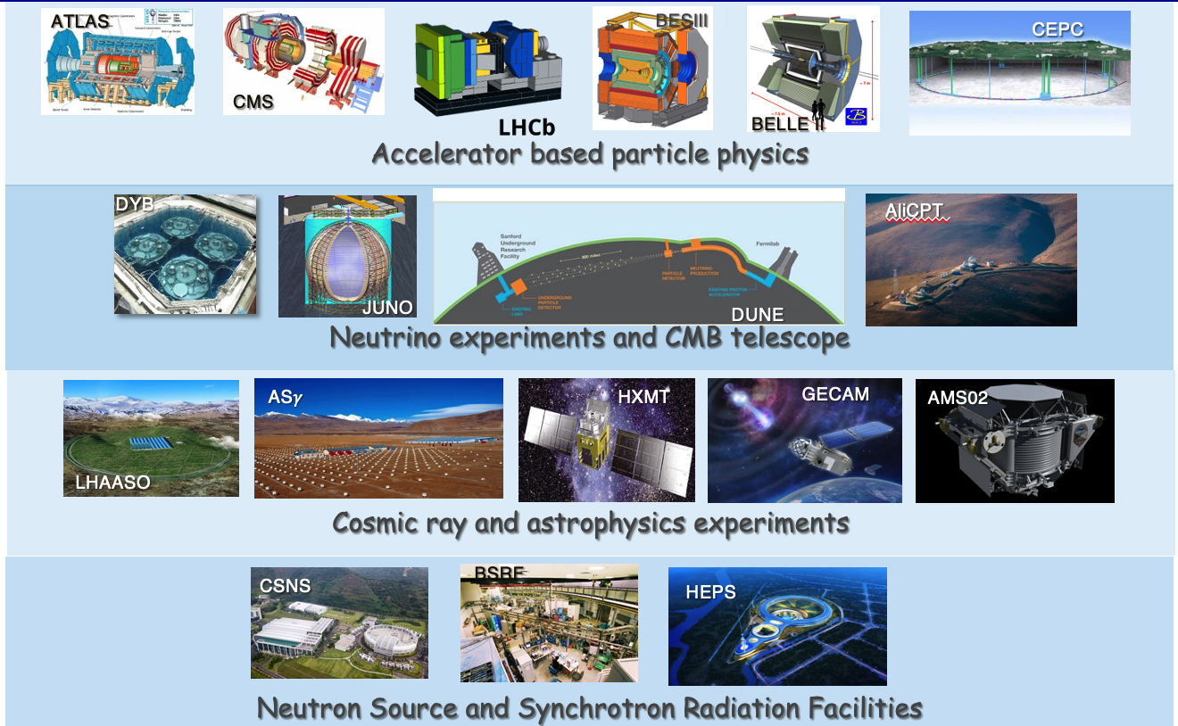
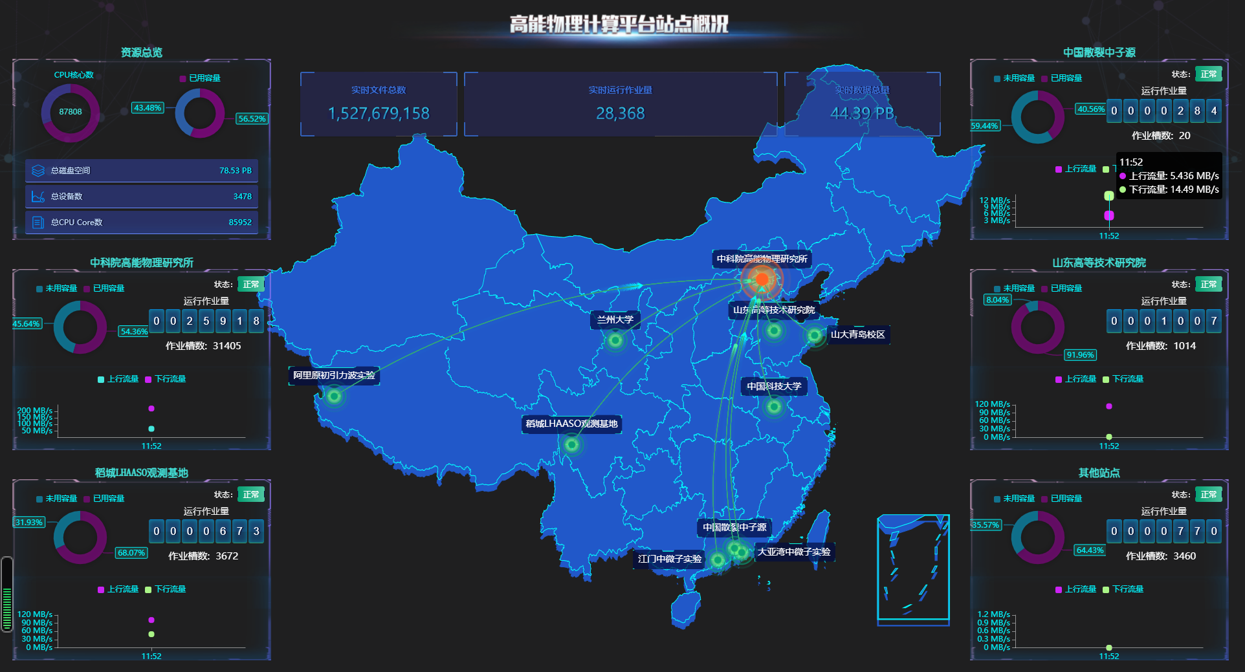
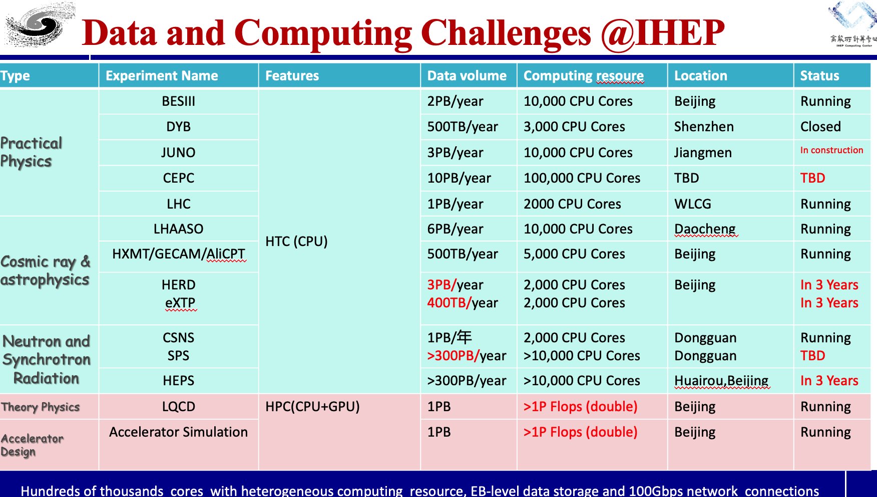
Summary: The Networking and Computing @IHEP
Fazhi Qi (IHEP)
IHEP CC is facing big challenge on data and computing from HEP experiments.
The computing and networking resources, “One-platform, multi-centers”has been expanded and are severing more and more applications of particle physics, photon source and neutron source in China.
LHCb Tier-1 center @IHEP will be ready before Jul.
More work(especially on software) should be carried out to meet the demands from future experiments and challenges.

Slide 9



Melbourne Tier 2 Cloud
David Dossett, (Melbourne)
We are replacing our Tier 2 for ATLAS and Belle II with cloud resources
Attempting to re-use institutional resources + expertise from Melbourne and U. Vic. (Canada) to get the most from our funding. Initially we have:
●
1024 allocated VCPUs + 1200 preemptiable VCPUs
800 TB Ceph object storage
~ 2/3 hardware funding still available to use after commissioning is finished
●
●
Grid job submission to OpenStack cloud is relatively simple to create and commonly used
S3 access is the only grid supported way to access our Ceph storage at the moment
We are commissioning Dynafed with S3 storage for Belle II now, and in discussion with ATLAS about testing Dynafed in their ecosystem, or any other options they can come up with

Slide 10
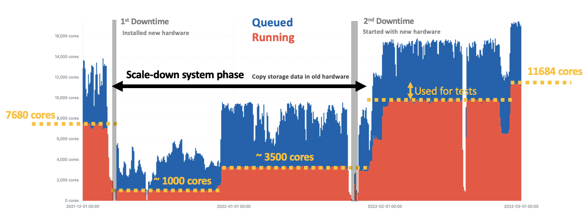
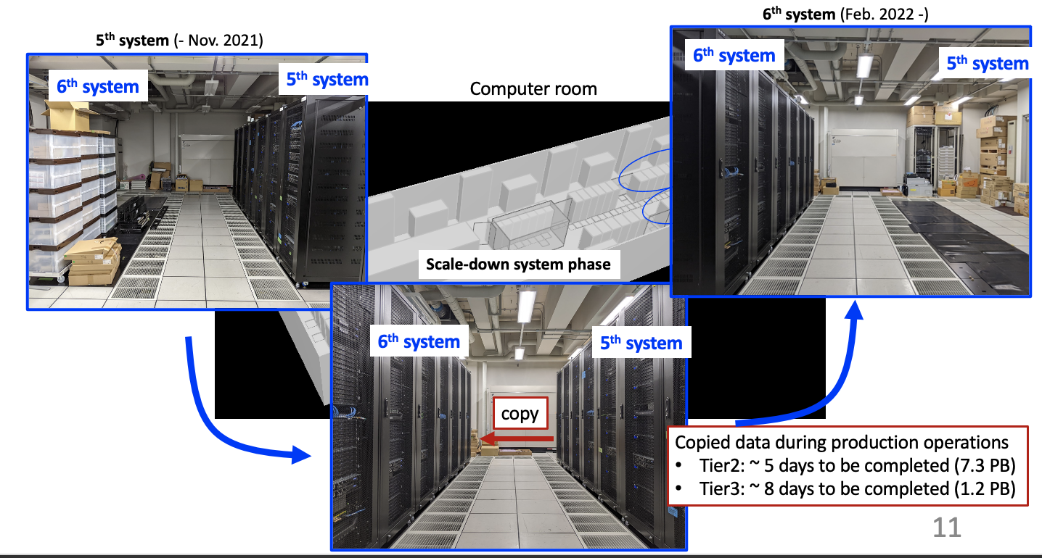
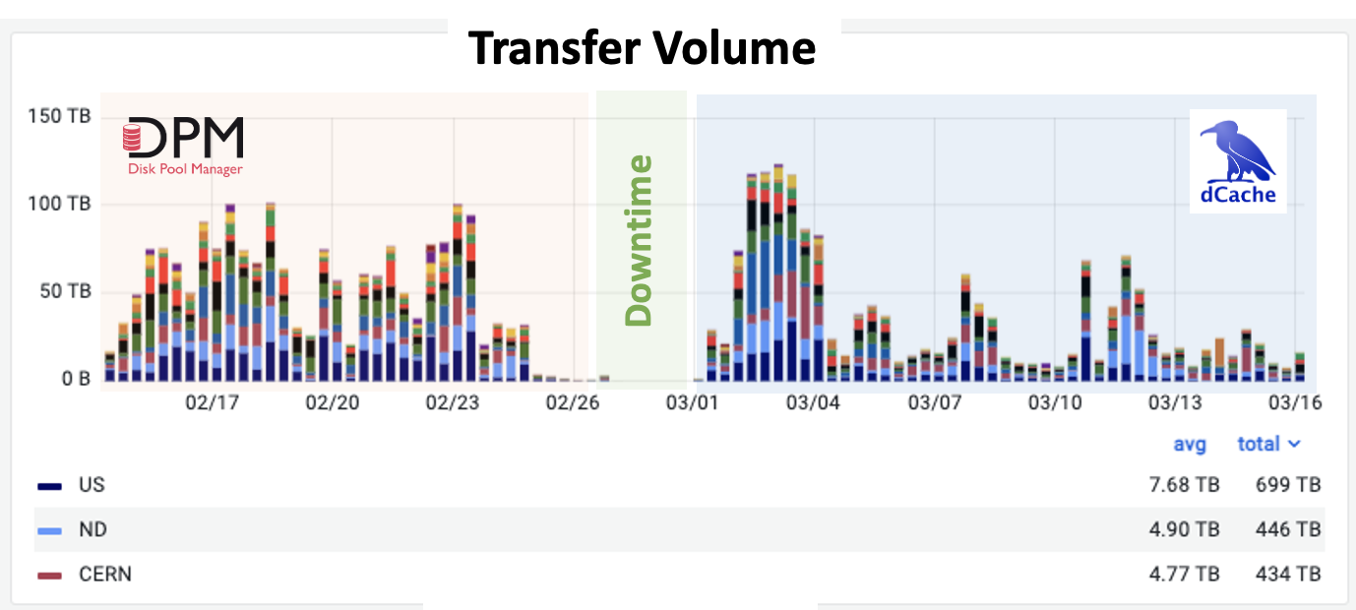
Status report from Tokyo Tier-2
Masahiki Saito, (Tokyo)
ICEPP regional analysis center is operating stably.
Provide ~11k CPU cores & ~10 PB disk storage as WLCG Tier2
  Contributes to ~5% CPU and ~3% Disk of ATLAS sites
Connected to SINET6 with 40 Gbps, but sometimes saturated. Plans to upgrade to 100 Gbps.
Hardware replacement was successfully completed in Q1 2022.
  Operated scale-down system for two months
Storage middleware was successfully migrated (DPM → dCache)
  DPM had 10 PB and 70M objects. Migration downtime was 55 hours.
  In-place and transparent to users

Slide 11
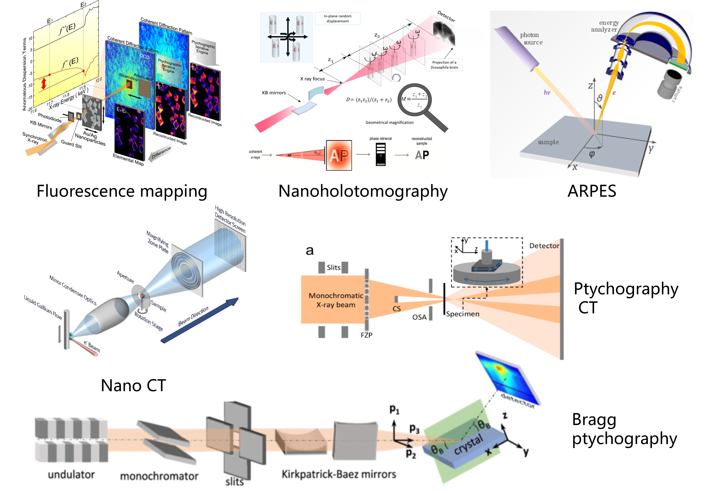
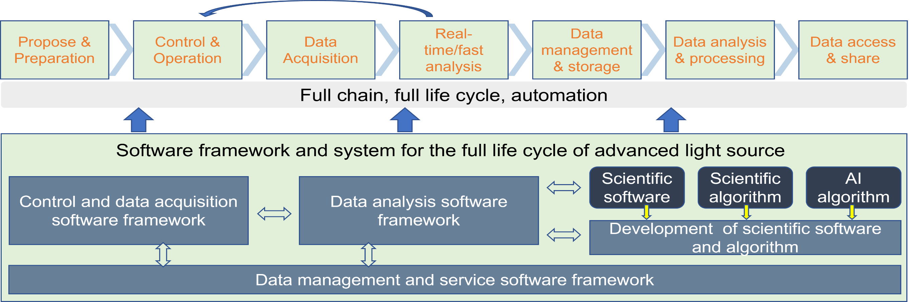
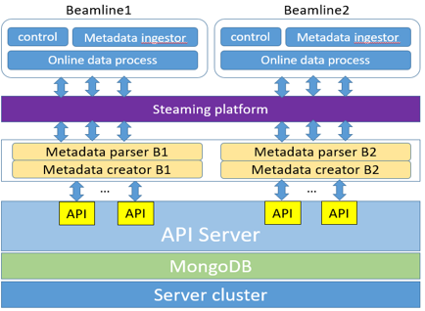
The Design and Development of the scientific data and software for High Energy Photon Source in China
Yu Hu, (HEPS)
Finished the core function modules
  Metadata catalogue
  Metadata ingestion
  Interfaces with other systems: control system, transfer module, storage system, analysis system
  Automatic data management when using Hierarchical storage policy (beamline storage → central storage → tape)
Finished the design of data management scheme when network interrupts
  when network interrupts，metadata and data are saved to local disk
  After the network recovers, metadata will be sent to be catalogued
HEPS data format design
Designed and released data format for 5 beamlines
The system design has been finished
Cooperation with other facilities and community is ongoing
The basic framework has been stable and tested on the test bed
Based on the framework, scientific software integration and application development are ongoing
The development of scientific software ecosystem also needs the support and participation of user community

