Slide 1
AFAD Closeout

Slide 2
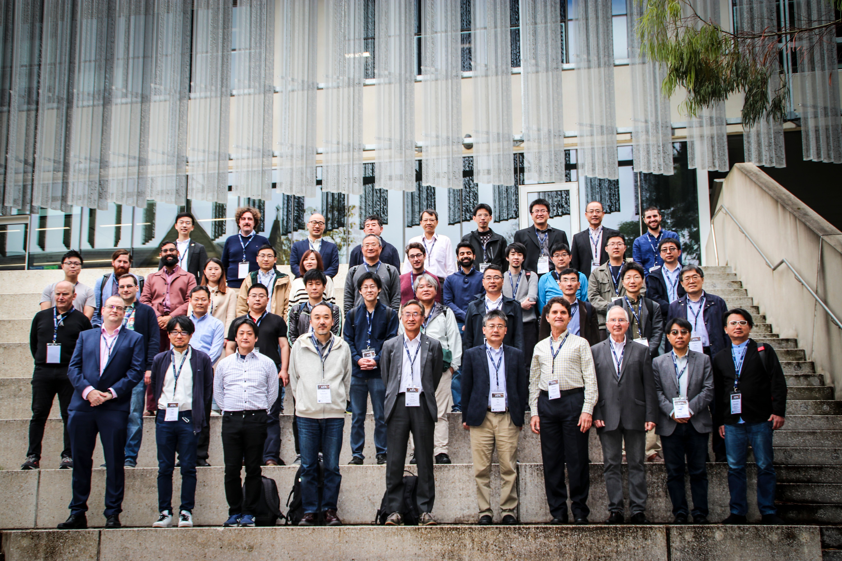
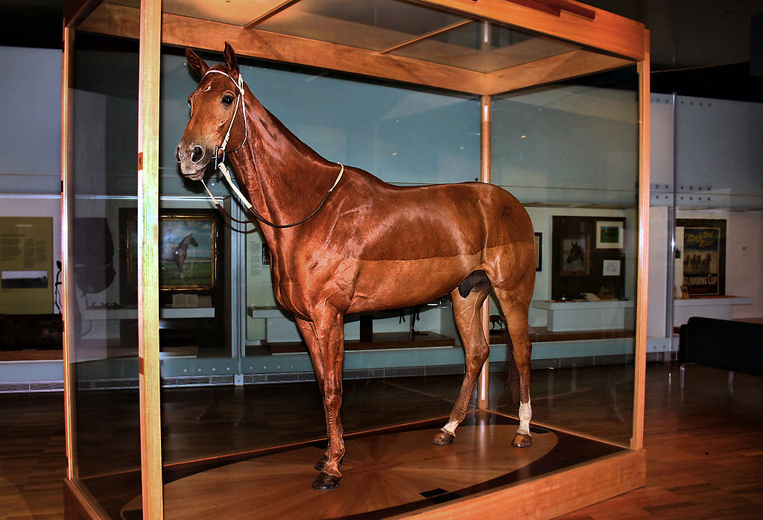
Asian Forum for Accelerators and Detectors 2023
Total Registrations – 108, 50 in person
87 Contributions
7 Working groups
1 famous horse

Slide 3
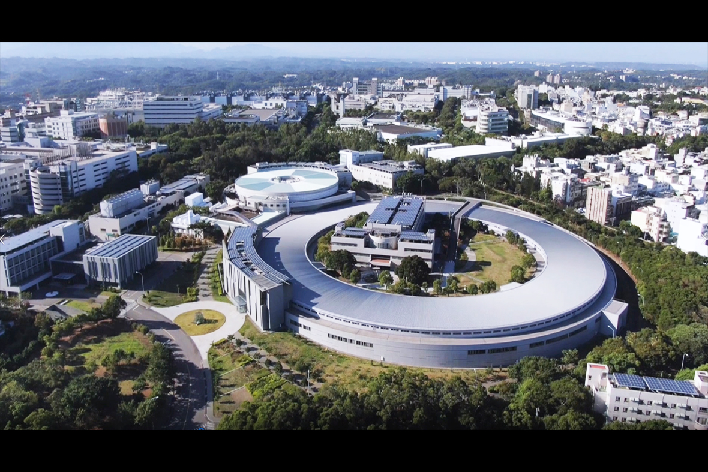
AFAD 2024 will be hosted by NSRRC in Taiwan.
We’re looking forward to your coming !!
Taiwan Photon Source at National Synchrotron Radiation Research Center (NSRRC)

