Slide 1
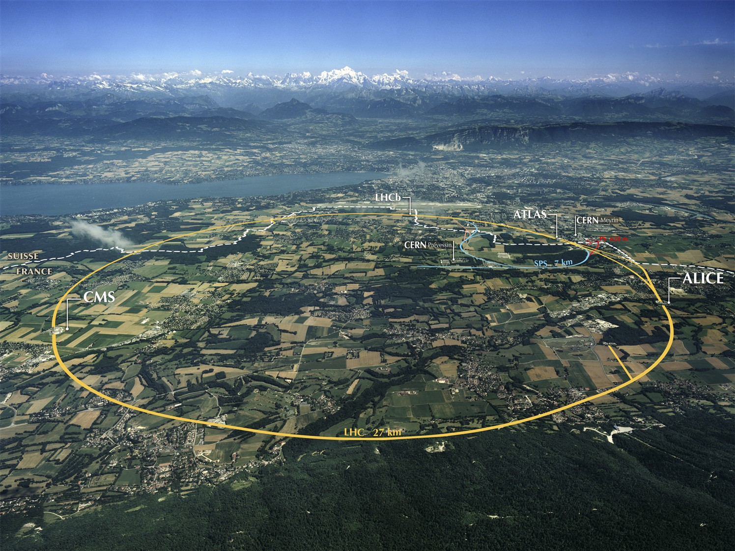

LHC Run II Commissioning and HL-LHC Status
Paul Collier, CERN
Notes:
1

Slide 2
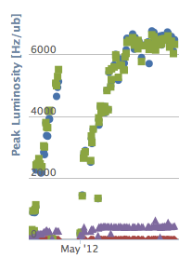
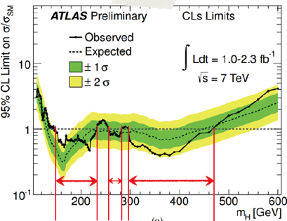
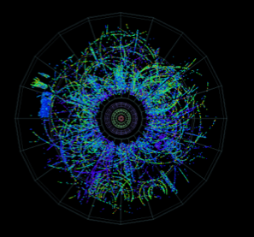
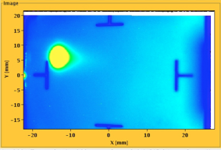
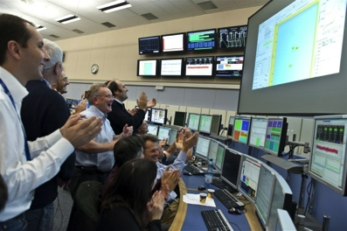

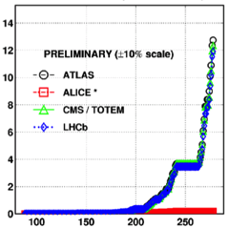
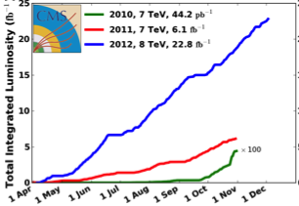

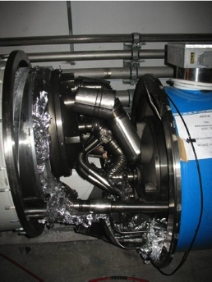
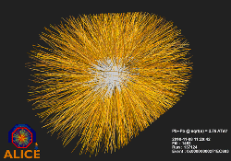
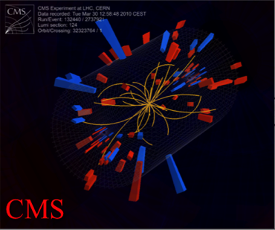
August 2008
First injection test
LHC Run 1
May 2012
Ramping Performance
Feb. 2013
p-Pb⁸²⁺
New Operation Mode
October, 2011
3.5x10⁺³³, 5.7 fb⁻¹
First Hints!!
November 29, 2009
Beam back
Sept. 10, 2008
First beams around
June 28 2011
1380 bunches
1380
March 14th
2012
Restart
with Beam
October 14, 2010
L= 1x10⁺³²
248 bunches
Nov. 2012
End of p⁺ Run1
Σ 30 fb⁻¹
Repair and Consolidation
2008
2009
2010
2011
2012
2013
November 2010
Pb⁸²⁺ Ions
March 30, 2010
First collisions at 3.5 TeV
Higgs Day
Sept. 19, 2008
Disaster
Long Shutdown
November 2011
Second Ion Run
January 20th 2014
October 4th 2013
Paul Collier – Royal Society
Paul Collier – Riga Technical University
2
2

Slide 3
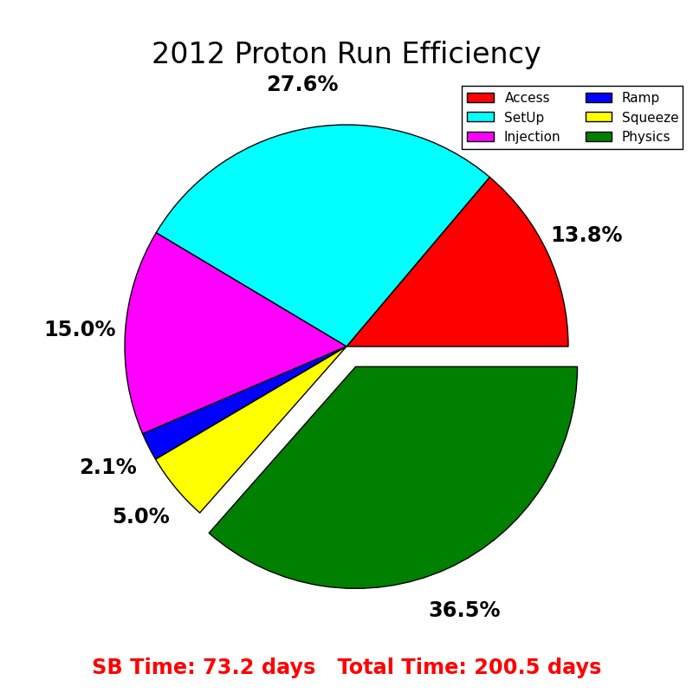
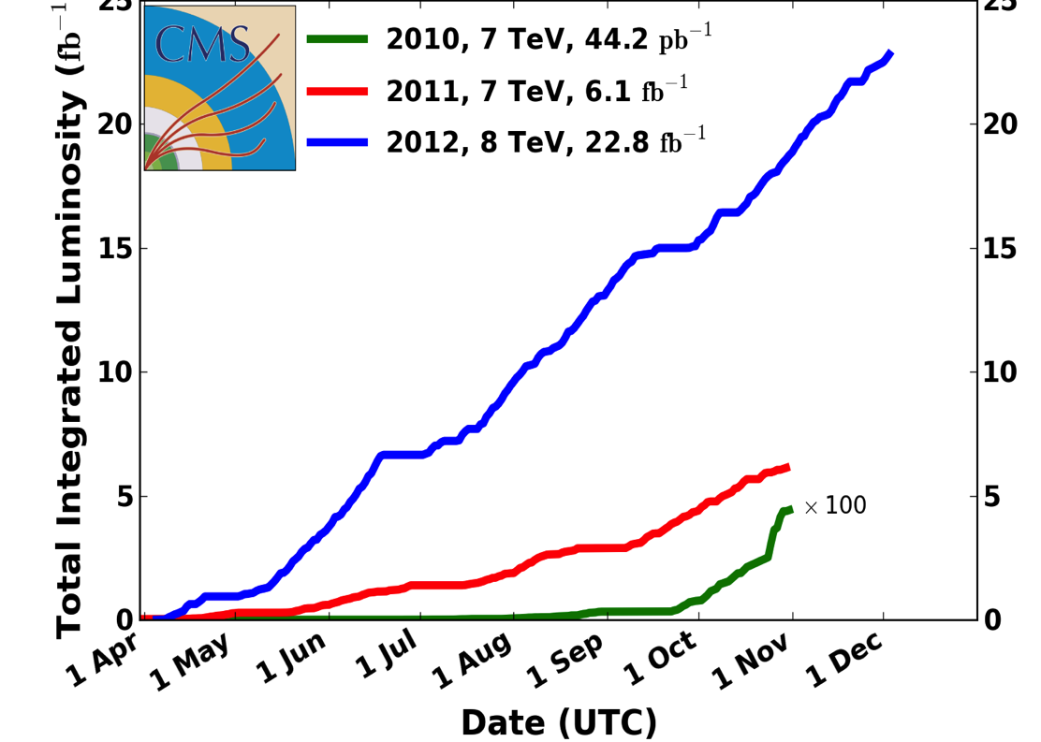
Run 1 Output at a Glance
Operation at 3.5-4 TeV/beam (nominal 7 TeV/beam)
1 fb⁻¹ represents approximately 100 Trillion (10¹⁴) proton-proton collisions
Remarkably high availability for a machine of this size and complexity

Slide 4
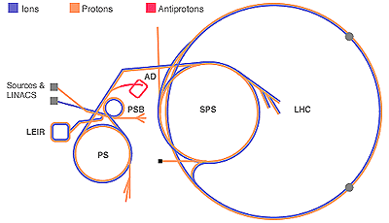
Long Shutdown 1: Feb 2013-April 2015
16th Feb.
2013
2014
2015
F
M
A
M
J
J
A
S
O
N
D
J
F
M
A
M
J
J
A
S
O
N
D
J
F
M
A
LHC
SPS
PS
PS Booster
beam to beam
available for works
Physics
Beam commissioning
Shutdown
Powering tests
Prepare the LHC for Operation at Nominal Energy
Consolidate and Upgrade the LHC and Injector performance
Major Maintenance Programme
Over 1.5 million hours worked in the LHC tunnel

Slide 5
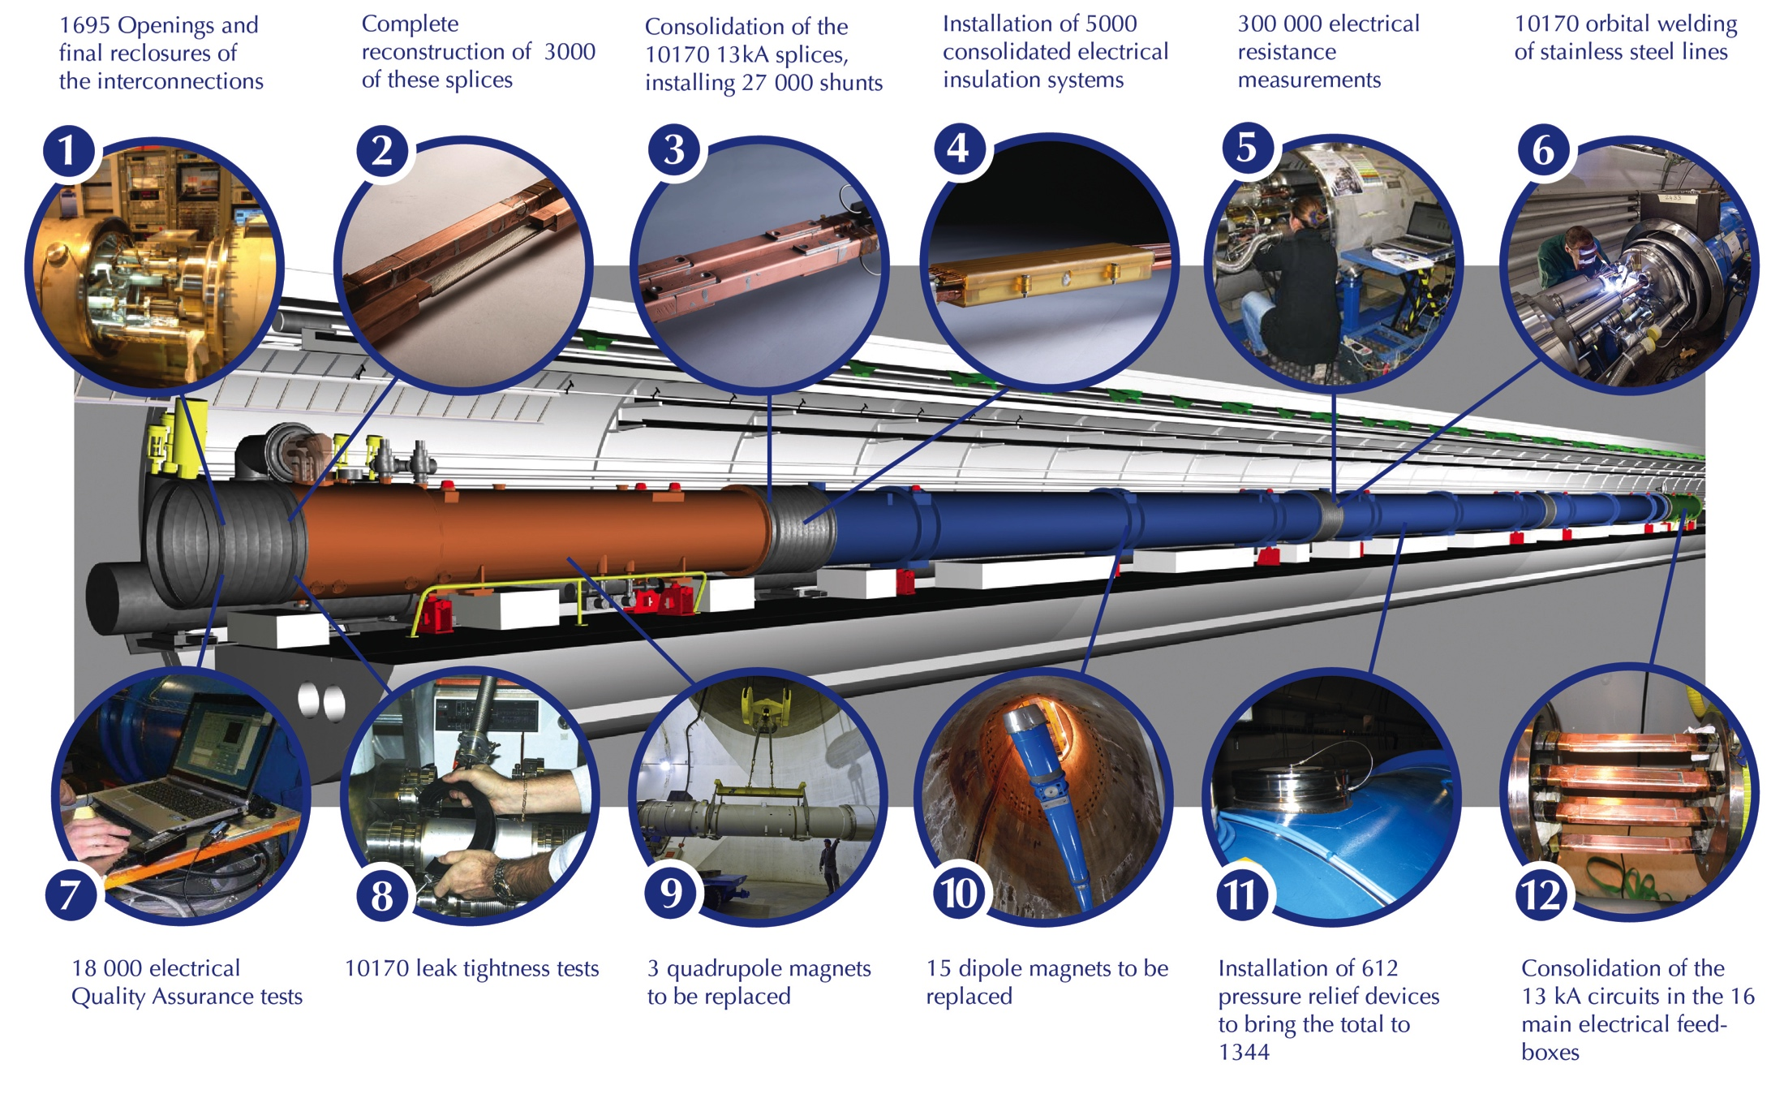
LS1 : The Main LHC Consolidation

Slide 6
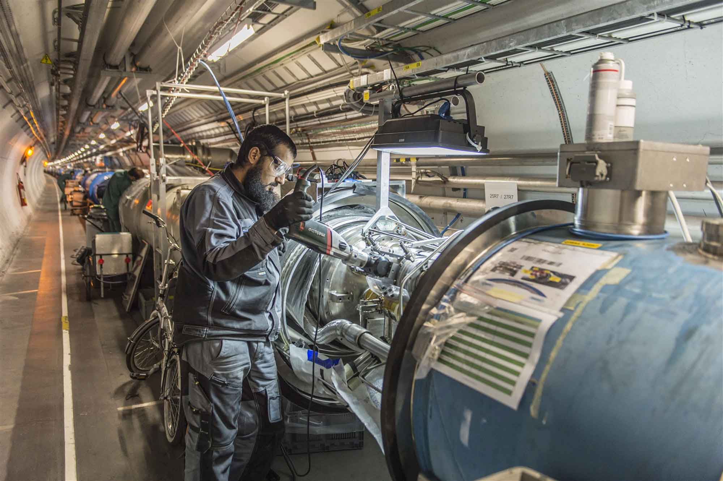

Slide 7
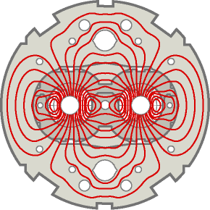
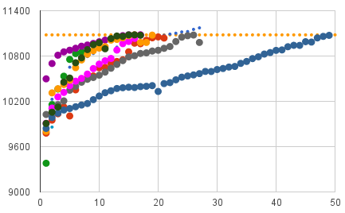
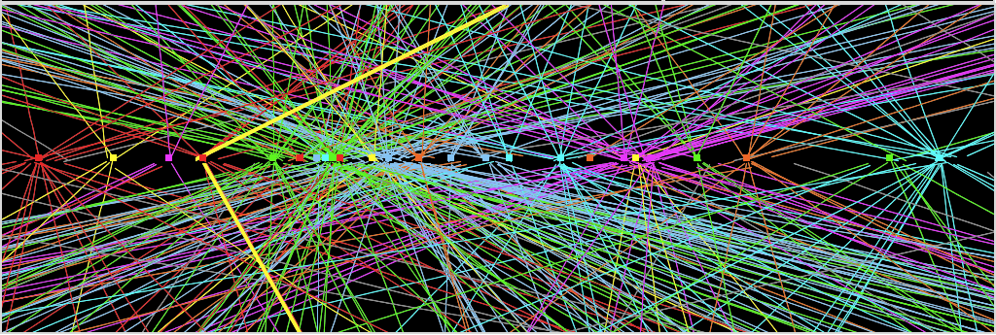
LHC 2015 – A Learning Year
Target energy: 6.5 TeV
  Limit the magnet training required (still needed >150 quenches!)
  Small operational margin 100A in 11kA
β* in ATLAS and CMS: 80 cm
  Ease commissioning …
  …but investigate lower β* for later
Bunch spacing: 25 ns
  strongly favored by the experiments, limit pile-up
Energy
25 ns
  Lower quench margins
  Lower tolerance to beam loss
  Higher stored energy in the magnets and the beam
  Hardware closer to maximum (beam dumps, power converters, quenches…)
  Electron-cloud
  UFOs
  More long range collisions
  Larger crossing angle
  Higher total beam current
  Higher intensity per injection

Slide 8
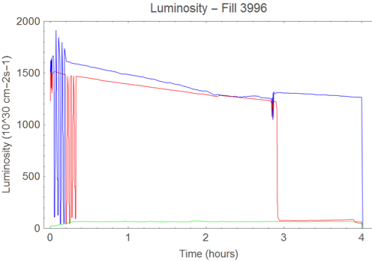
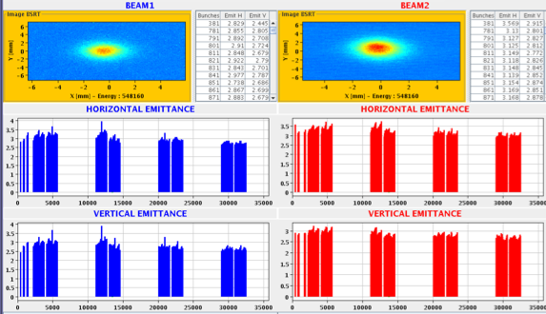

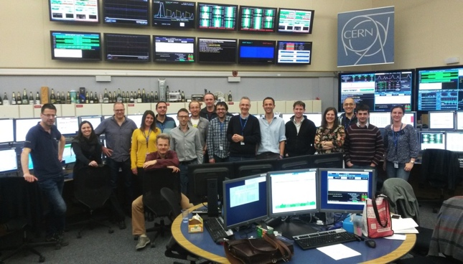
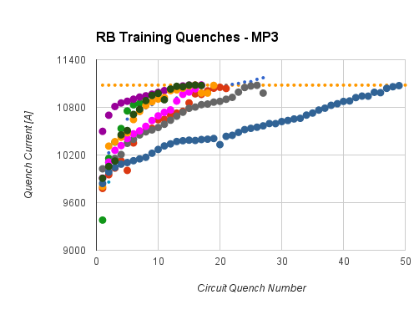
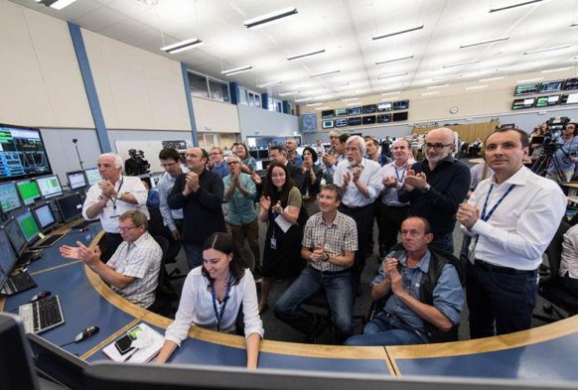
2015 At a Glance
1.6x10³³ cm⁻²s⁻¹
5th April
first beam
September –25 ns intensity ramp-up: 2300 bunches
L > 5x10⁺³³ cm⁻²s⁻¹
July 14th: 476b (50 ns)
10th April: 6.5 TeV for the first time
TS1
50 ns Scrubbing
Intense beam commissioning phase
50ns Physics
25ns Physics
25ns Physics
March
April
May
June
July
August
September
Oct
3rd June: First Stable Beams
MD1
25 ns Scrubbing
TS2
Card Change
Finish magnet training
25 ns Ramp-up
219 bunches

Slide 9

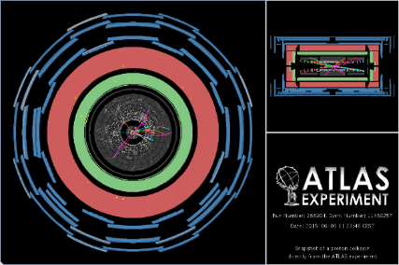
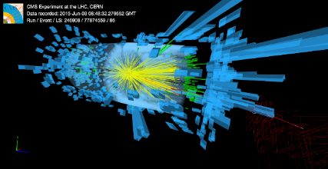
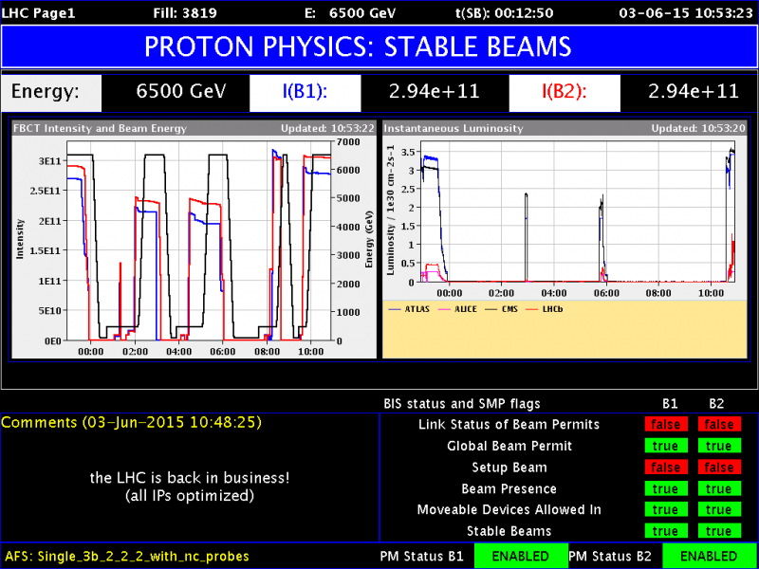
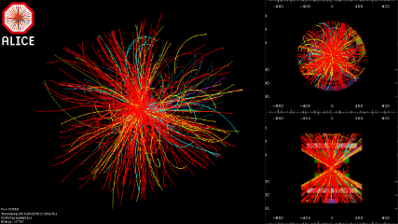
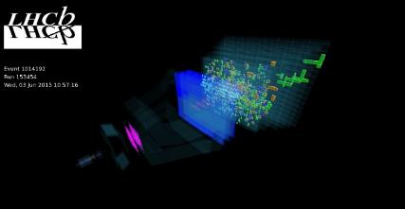
LHC Is Back! But now at 13 TeV

Slide 10
Challenges/Issues in 2015
2015 was a commissioning year – meant to flush out any issues with increasing the intensity of the beam … in this respect, it has been very successful!
Magnet Quench Protection System (QPS)
  Non radiation hard components – now solved 1,300 cards changed!
Electron Cloud
  Causes beam instabilities and stresses the Cryogenics system
Unidentified Falling Objects (UFOs)
  Widely distributed all around the ring
Unidentified Lying Object (ULO)
  Aperture limitation inside the beam vacuum tube
Injection Protection device Issues
  Potential performance limitation until the year end technical stop
Electrical Earth faults (not intensity related)

Slide 11
Electron Cloud
200 eV
10 eV
2 keV
Beam screen
5 eV
25 ns
Typical e– densities10¹⁰–10¹² m^{–3}
Possible consequences:
  instabilities, emittance growth, desorption – bad vacuum
  excessive energy deposition in the cold sectors
Electron bombardment of a surface has been proven to reduce drastically the secondary electron yield (SEY) of a material. This technique, known as scrubbing, provides a mean to suppress electron cloud build-up.
Electron cloud significantly worse with the bunch spacing we now operate with (25ns = 7.5m)

Slide 12
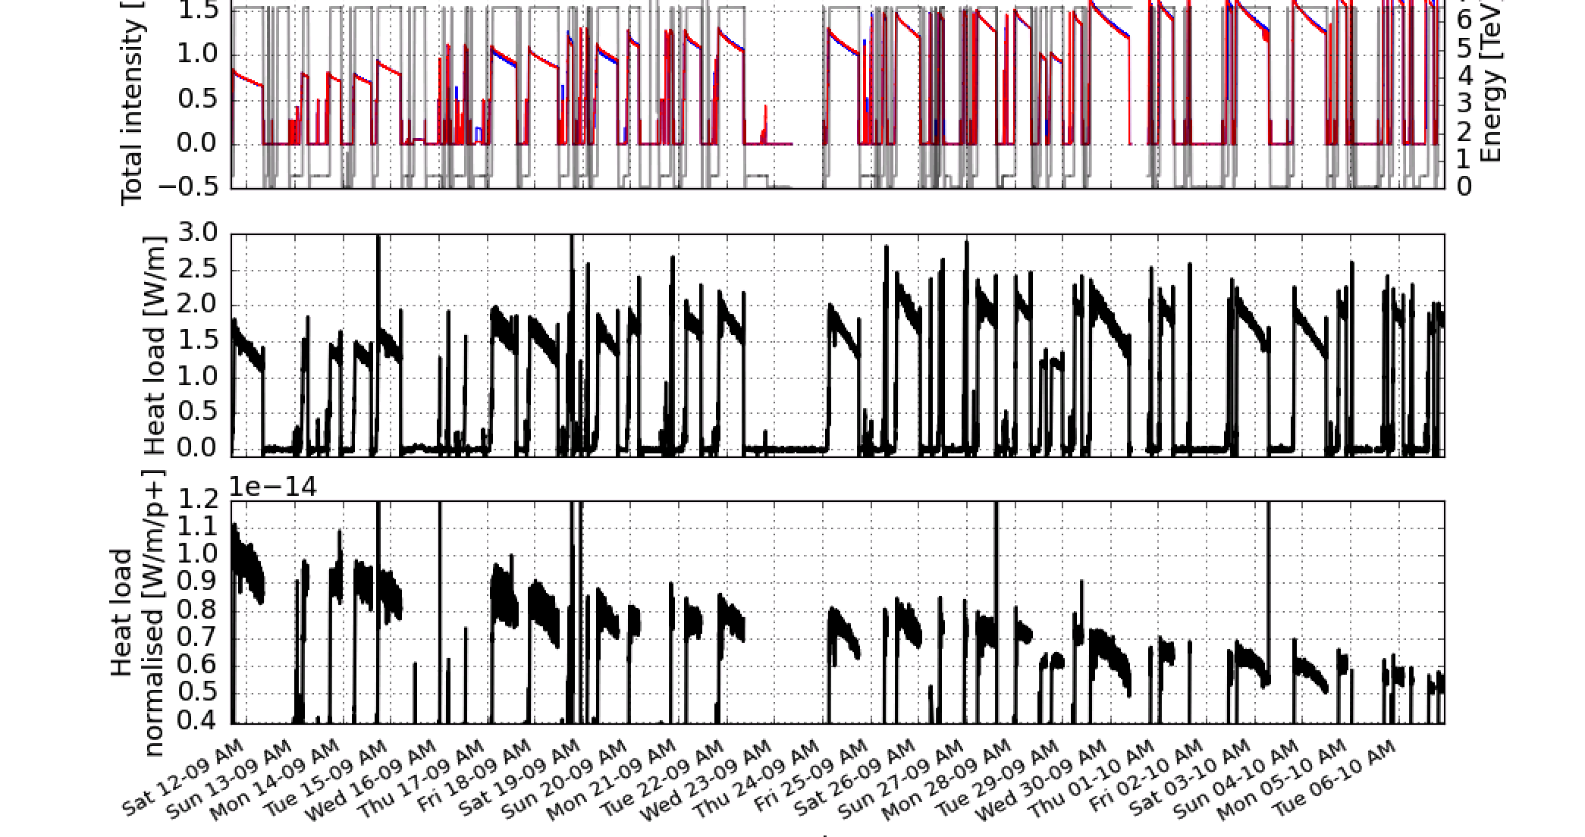
Solution is “Scrubbing”
Condition the Surface of the vacuum chamber by bombarding it with the electrons from the electron cloud itself – Gradually increase the number of bunches in the beam. It works … but slowly!

Slide 13
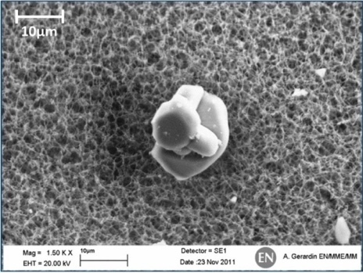
UFO’s – What are they?
Dust particles falling from the top of the beam screen.
Is ionized by the primary protons in the beam.
Inelastic collisions result in particle showers\that cause small amounts of beam loss
The positively ionized dust particle is eventually repelled from the beam.
4.
2.
R~10 µm
Most events are very fast … A few hundred μ-seconds
3.
The origin of these particles is unclear
They are more-or-less evenly distributed around the machine
The good news is that they seem to ‘condition’ away

Slide 14
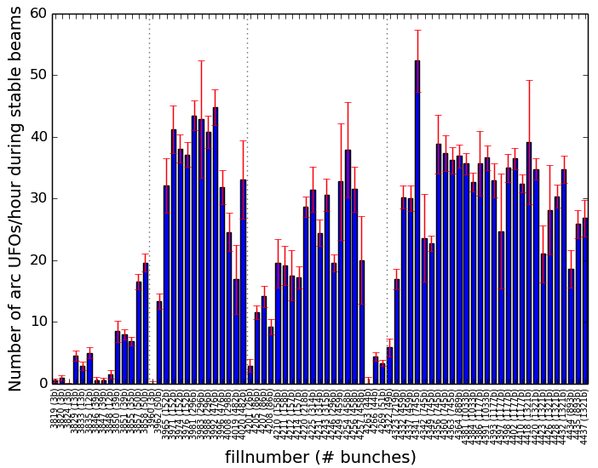
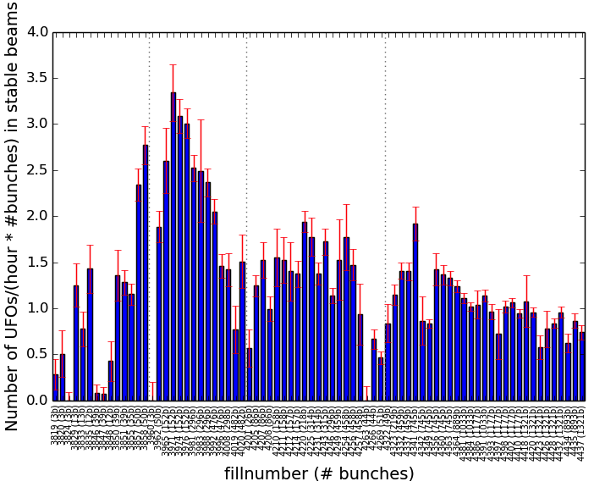
UFO’s Continued
Arc UFO’s/h in Physics
UFO/bunch/h in Physics
The number is remaining rather constant but normalizing to the number of bunches indicate some conditioning
Most are very small, ~5% exceed 10% of the dump threshold
Occasionally cause a beam abort (losses too high)
The Beam loss monitoring system protects the machine and prevents quenches

Slide 15
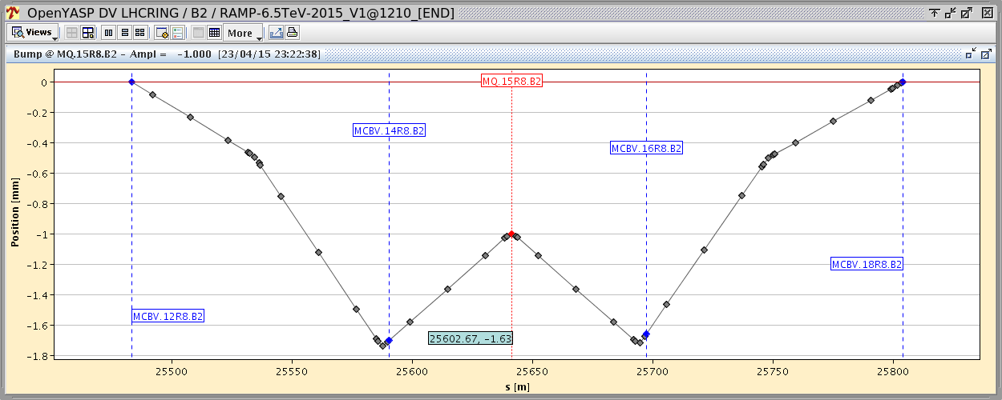
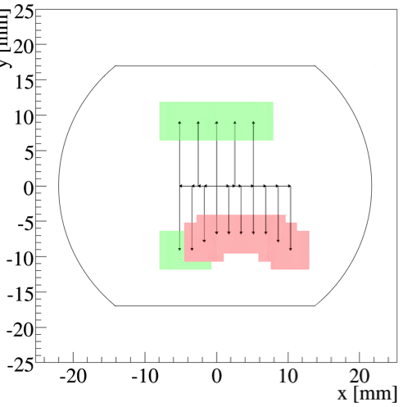
The ULO: Aperture Restriction in a Magnet
…Clear Aperture restriction seen
Position is right in the middle of a dipole magnet
Measured at injection and 6.5 TeV
Probably not a limiting aperture for operation
Presently running with orbit bumps to optimize available aperture
Behaviour with higher intensities so far looks OK
BUT – we do not know what is is!
…since then
We occasionally have a look … but generally let sleeping dogs lie!
Seems not to cause us a problem … we will leave it there

Slide 16
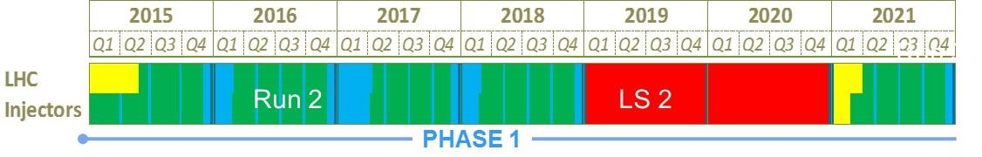
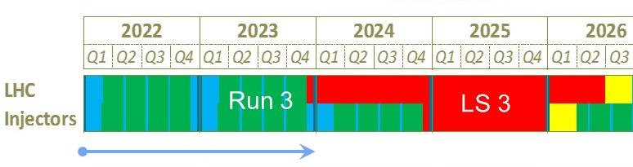
Run 2 Goals : 2015-2018
Integrated luminosity goals:
  2015 : ~4 fb⁻¹
  Run2: ∼100-120 fb⁻¹
  300 fb⁻¹ before LS3
30 fb⁻¹
300 fb⁻¹
2015 Priority : Establish Production running

Slide 17
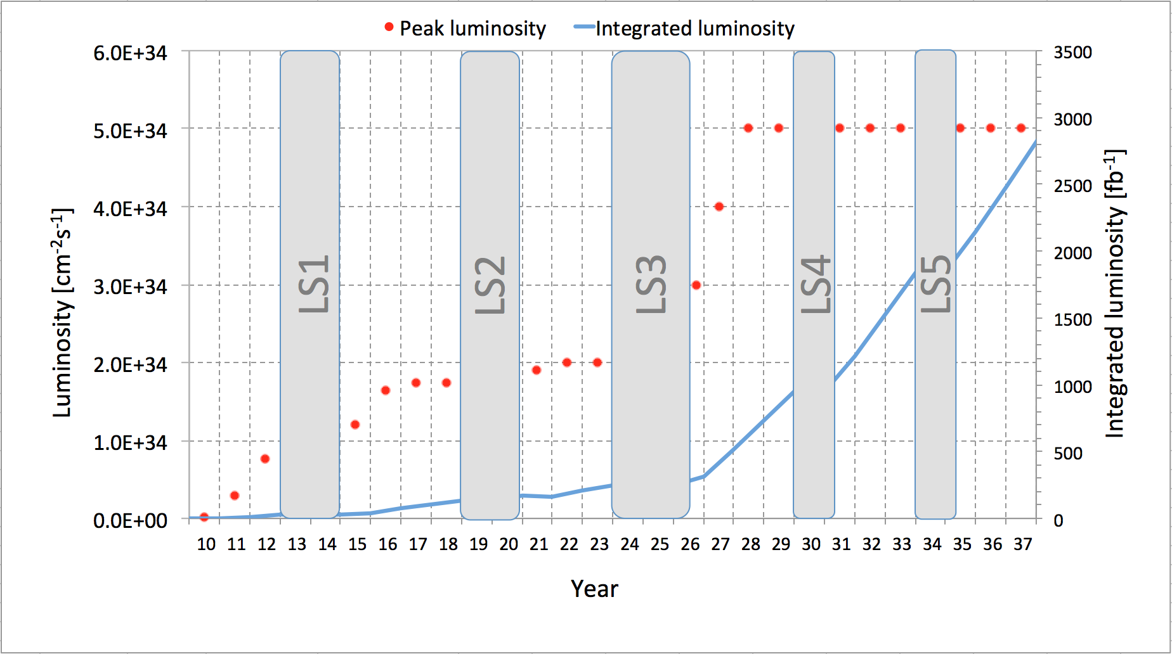
…and Beyond
Run I
Run II
Run III
3000 fb⁻¹
Splices fixed
Injectors
upgrade
New
Low-β*
quads
Crab
Cavity
Phase2
300 fb⁻¹
30 fb⁻¹
The HL-LHC Project (& LHC Injector Upgrades)
to Increase the amount of Data Delivered by a factor 10

Slide 18

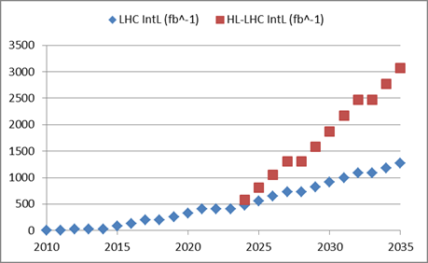
Why High-Luminosity LHC?
By implementing HL-LHC
Almost a factor 3
By continuous performance improvement and consolidation
Around 300 fb⁻¹ the present Inner Triplet magnets & experiments’ trackers reach the end of their useful life (due to radiation damage)
and must be replaced.
Goal of HL-LHC project:
  250 – 300 fb⁻¹ per year
  3000 fb⁻¹ in about 10 years
Corresponding Upgrades of the Experimental Detectors Mandatory to cope with the Increased machine performance

Slide 19
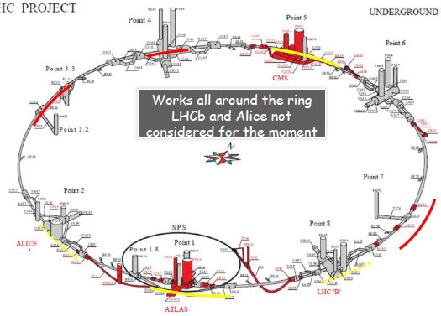
HL-LHC Project Scope
New IR-quads Nb₃Sn (inner triplets)
  New 11 T Nb₃Sn (short) dipoles
  Collimation upgrade
  Cryogenics upgrade
  Crab Cavities
  Cold powering
  Machine protection
  …
Major interventions on more than 1.2 km of the LHC
Total cost ~900MCHF

Slide 20
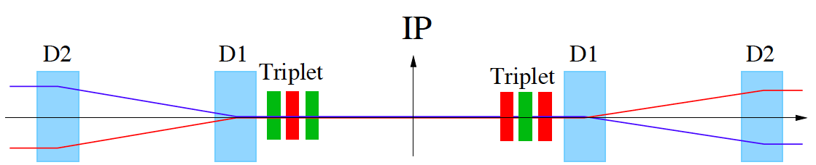
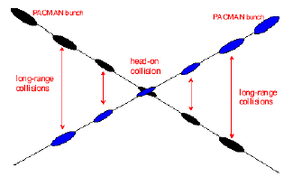
HL-LHC Challenges
Insertion Layout:
ca.130m
ca.50m
Parasitic bunch encounters:
Operation with ca. 2800 bunches @ 25ns spacing ➔ approximately 30 unwanted collision per Interaction Region (IR).
Operation requires crossing angle
Combined with very large β in the IT
non-linear fields from long-range beam-beam interaction:
efficient operation requires large beam separation at unwanted collision points
  Separation of 10 -12 σ ➔ large triplet apertures for HL-LHC upgrade!!

Slide 21
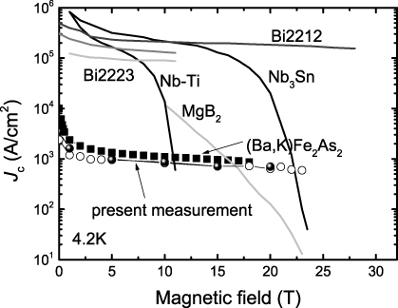
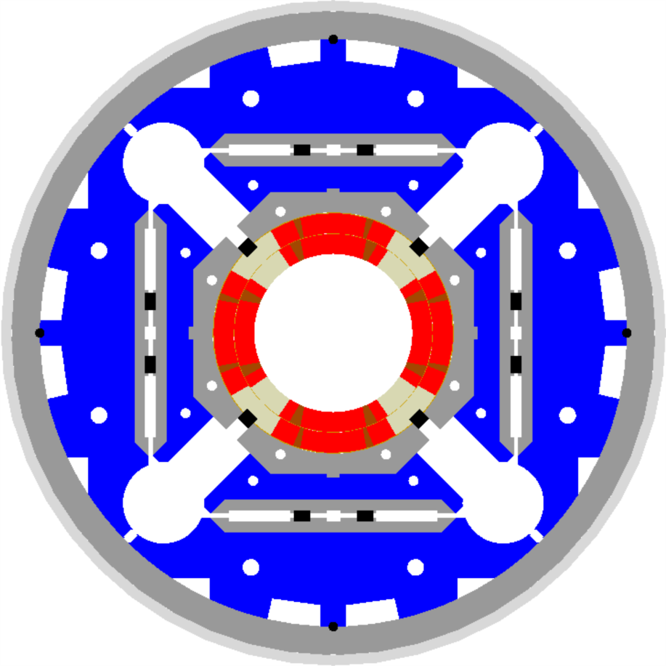
HL-LHC Upgrade: Triplet Magnets
Nominal LHC triplet: 210 T/m, 70 mm coil aperture
➔ ca. 8 T @ coil
➔ 1.8 K cooling with superfluid He (thermal conductivity)
➔ current density of 2.75 kA / mm²
➔ At the limit of NbTi technology (HERA & Tevatron ca. 5 T @ 2kA/mm²)
HL-LHC triplet: 140 T/m, 150 mm coil aperture
  ➔ Aperture for shielding, β* and crossing angle)
➔ ca. 12 T @ coil ➔ 30% longer
  Requires Nb₃Sn technology
  ➔ ceramic type material (fragile)
  ➔ ca. 25 year development:
  new magnet technology!
  US-LARP – CERN collaboration

Slide 22
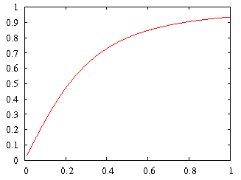
LHC Upgrade: Crab Cavities
Geometric Luminosity
Reduction Factor:
Reduces the effect of geometrical reduction factor
Independent for each IP
Noise from cavities to beam?!?
Challenging space constraints:
➔ requires novel compact
cavity design
➔ Installation will be phased.
effective cross section
HL-LHC

Slide 23
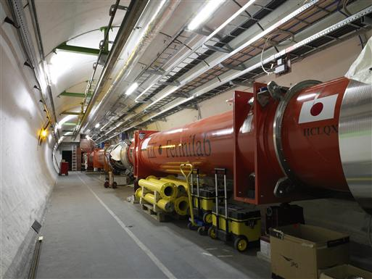

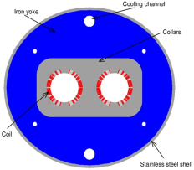

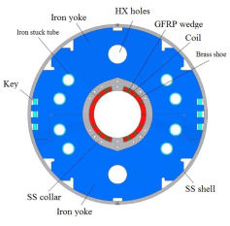
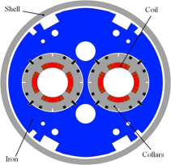
The Critical Zones around IP 1 and IP5
ATLAS
CMS
3. For collimation we also need to change the DS in the continuous cryostat: 11T Nb₃Sn dipole
2. Also need to modify a large part of the matching section
e.g. Crab Cavities &
D1, D2, Q4 & corrector
New triplet Nb₃Sn
required due to:
-Radiation damage
-Need for more aperture
Changing the triplet region is not enough for reaching the HL-LHC goal!
More than 1.2 km of LHC !!
Plus technical infrastructure
(e.g. Cryogenics and Powering)!!
Major Civil Engineering

Slide 24
IR1 & IR5 Underground Civil Engineering

Slide 25
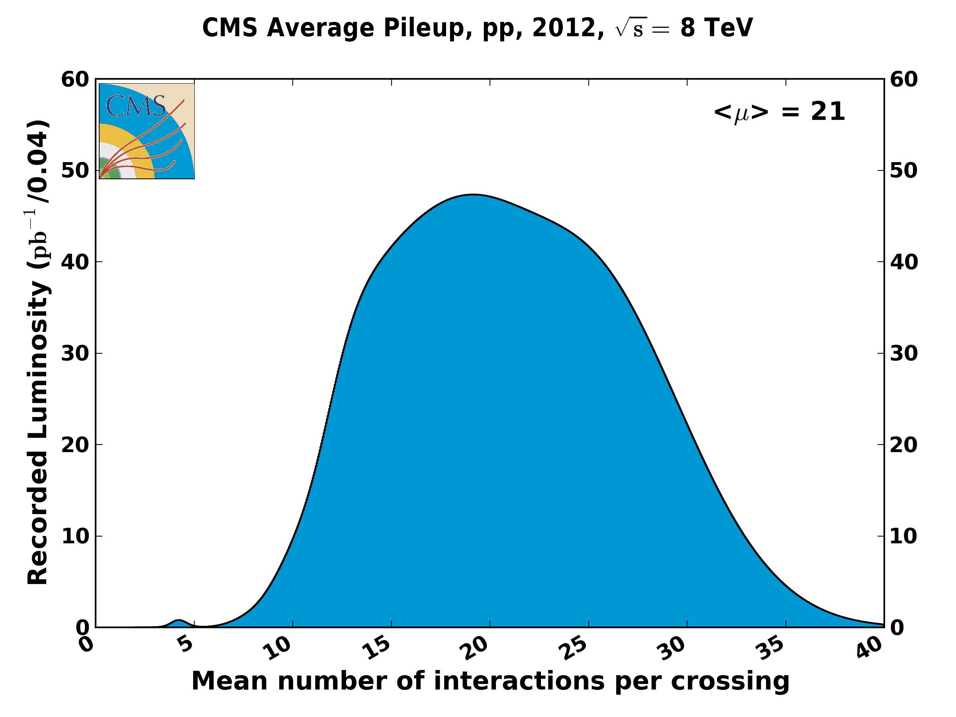
HL-LHC Operation: Luminosity Leveling
Vertex Reconstruction for 0.7 10³⁴ cm⁻² s⁻¹ @ 50ns
HL-LHC Performance Optimization:
Use leveling techniques for keeping average
Pileup around 140 events per bunch crossing
(β* leveling most likely)
➔ level luminosity at 5 10³⁴ cm⁻² s⁻¹
Z→ μμ event from 2012 data with 25 reconstructed vertices
Z→ μμ
Extrapolating to 5 10³⁴ cm⁻² s⁻¹ implies:
➔ <μ> = 280; μ_{peak} > 500 @ 50ns bunch spacing
➔ <μ> = 140; μ_{peak} = 280 @ 25ns bunch spacing

Slide 26

HL-LHC Operation: Efficiency for ∫Ldt
All our assumptions are based on forecast for the operation cycle:
Consolidation of infrastructure !
But also new paradigm: remove as much as possible from the tunnel
η ≥ 50%
High reliability and availability are key design goals

Slide 27

Radiation to Electronics (R2E)
SEU Failure analysis & Actions
2008-2011
  Analyze and mitigate all safety relevant cases and limit global impact
2011-2012
  Focus on equipment with long downtimes; provide shielding
LS1 (2013/2014)
  Relocation of power converters
LS1 – LS2:
  Equipment Upgrades
LS3 -> HL-LHC
  Remove all sensitive equipment from underground installations
~400 h
Downtime
~250 h
Downtime
Relocation
& Shielding
~12 dumps / fb⁻¹
~3 dumps / fb⁻¹
Equipment
Upgrades
LS1 – LS2 Aiming for
<0.5 dumps / fb⁻¹
HL-LHC: < 0.1 dumps / fb⁻¹

Slide 28









In-kind contributions and collaborations
for design, prototypes and production
Discussions ongoing with several other countries,
ATLAS
CMS
Q1-Q3 : R&D, Design, Prototypes and in-kind USA
D1 : R&D, Design, Prototypes and in-kind JP
MCBX : Design and Prototype ES
HO Correctors: Design and Prototypes IT
Q4 : Design and Prototype FR
CC : R&D, Design and in-kind USA
CC : R&D and Design UK

Slide 29
LHC Roadmap
LS2 starting in 2019 => 24 months + 3 months BC
LS3 LHC: starting in 2024 => 30 months + 3 months BC
Injectors: in 2025 => 13 months + 3 months BC
Physics
Shutdown
Beam commissioning
Technical stop
Run 3
Run 2
LS 2
LIU installation
PHASE 1
Run 4
Run 3
LS 3
Run 4
HL-LHC installation
PHASE 2
LS 4
LS 5
LS 4
Run 5
LS 5

Slide 30
Summary
The LHC Adventure will cover over half a century from first concept to completion of data taking!
During Run 1 the machine performed well beyond expectations and allowed the discovery of the Higgs particle (albeit at reduced energy)
A Long Shutdown has just been completed to prepare the machine for “nominal” operation (Energy and Luminosity)
An upgrade plan has been elaborated to provide a performance well beyond design and the goal of reaching 3000fb⁻¹ delivered to the high-luminosity experiments (10x the original design)

Slide 32
Performance Optimization
  Injector upgrade to maximize bunch brighness (N_{i}/ε_{n})
  Minimize the beam size at the IP via β*
  Maximize the number of bunches n_{b}
  Compensate for the reduction factor F coming from the crossing angle
  Use F & β* to level the luminosity avoiding too high a pile up in the experiments
  Improve machine efficiency
New Magnets
25ns spacing
Special RF System
minimize number of unscheduled beam aborts

Slide 33






13kA Bus-bar Splices
« Old Splice » « Machined Splice » « Consolidated Splice »
« Cables » « New Splice »
Total interconnects in the LHC:
  1,695 (10,170 high current splices)
Number of splices redone: ~3,000 (~30%)
Number of shunts applied: > 27,000
« Insulation box »

