Slide 1

Structural Insights into Bak Activation and Oligomerisation
Jason Brouwer
PhD Student
Colman/Czabotar Lab

Slide 2
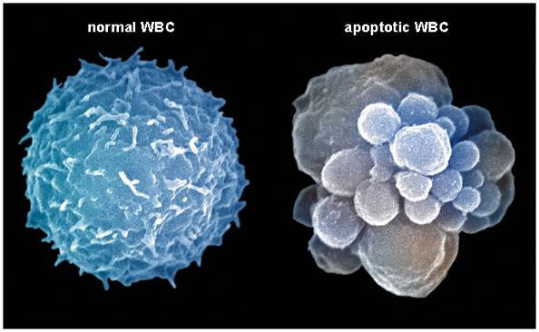
Programmed Cell Death: Apoptosis
Apoptosis
Process used to eliminate cells that are no longer needed, damaged or dangerous.
  Embryogenesis: organ development and shape
  Cell population maintenance, “cleaning process”, homeostasis
  Defense mechanism against pathogens
- Finely controlled process
20 - 60 billion cells per day
Nurse (2000) Science 289:1711-1716

Slide 3
Bcl-2 Protein Family
Regulates Intrinsic Apoptosis
Pro-apoptotic proteins:
Effectors
Bak and Bax
Sensors (BH3-only proteins)
Bim, Bid, Bad, Puma, Noxa, HRK, BMF and BIK
Pro-survival proteins:
Bcl-2, Bcl-xL, Bcl-w, Mcl-1 and A1
Mitochondria
BH3-only
Pro-survival
Bak/Bax
Cytochrome c
Apoptosis
Notes:
Bcl-2 family regulate apoptosis – number of sub groups.
A key event is permeablisation of OMM and release of cyt c = point of no return.
This event is controlled by Bax and Bak
During apop bh3 only prot activate bak and bax which results in a series of conformation changes and oligomerisation leading to membrane permabilisation.

Slide 4
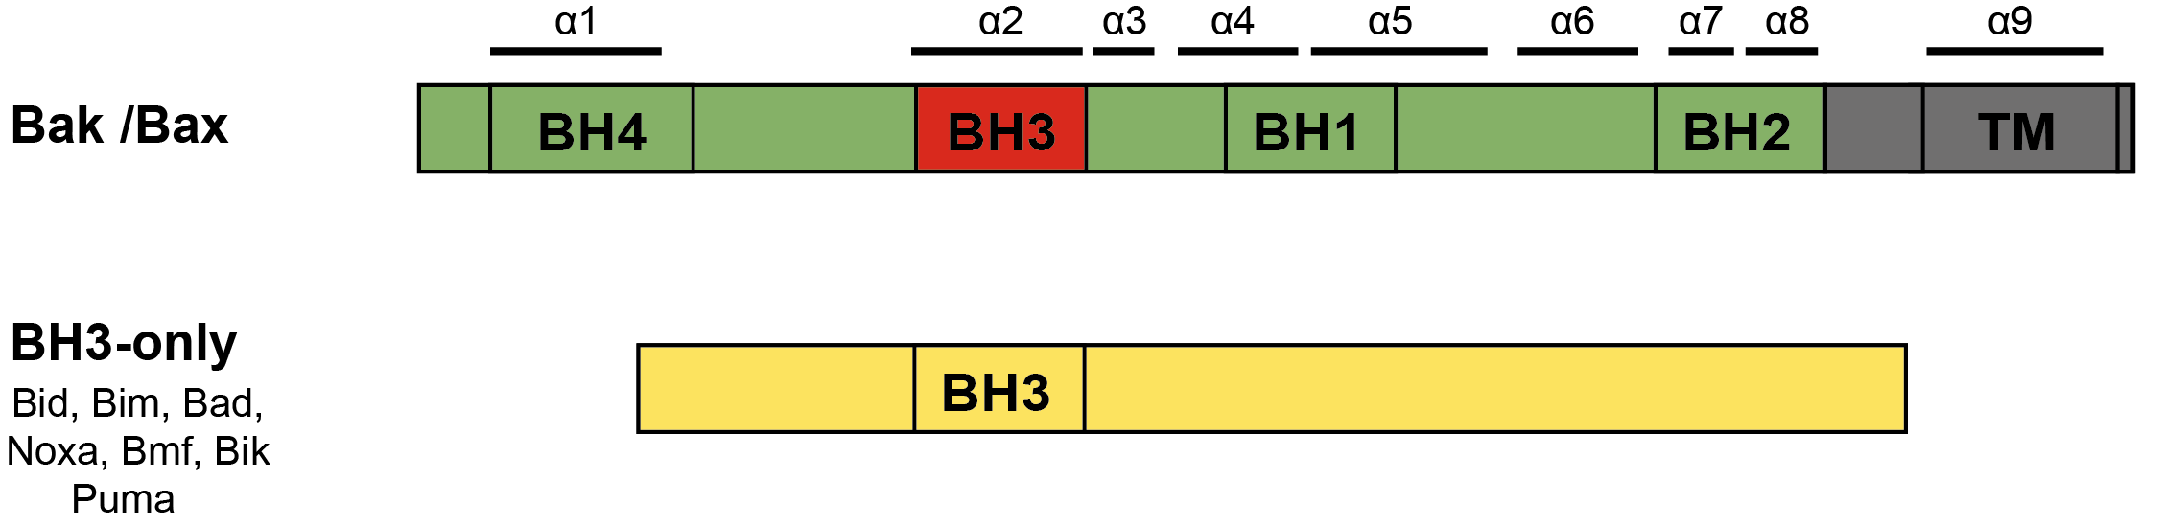
Bak Activation

Slide 5
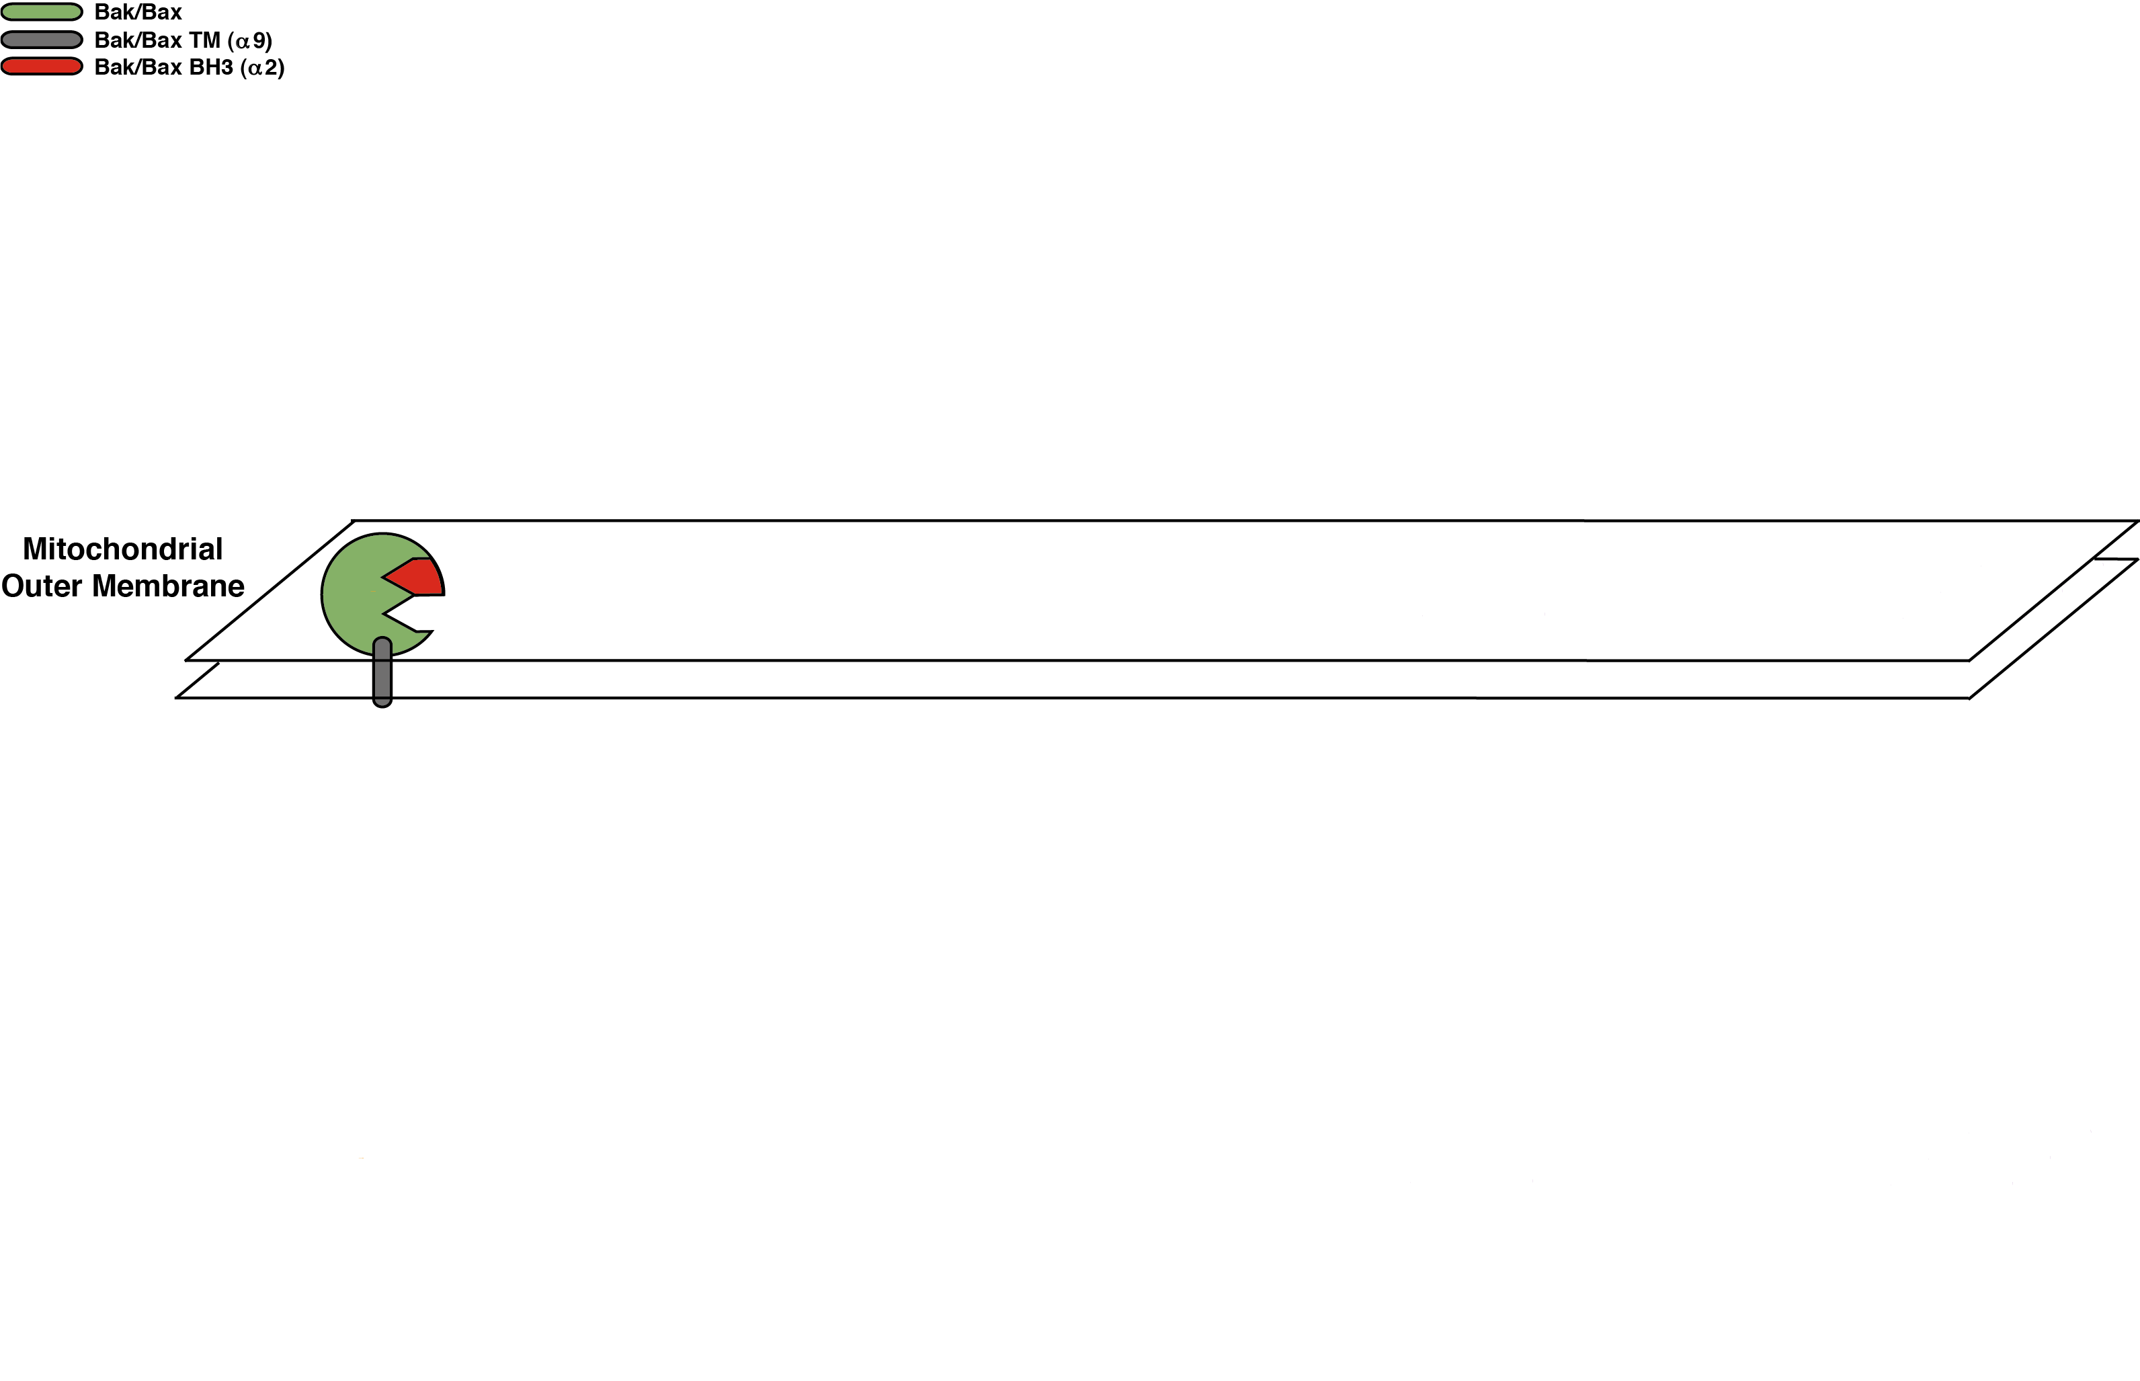
Bak Activation

Slide 6
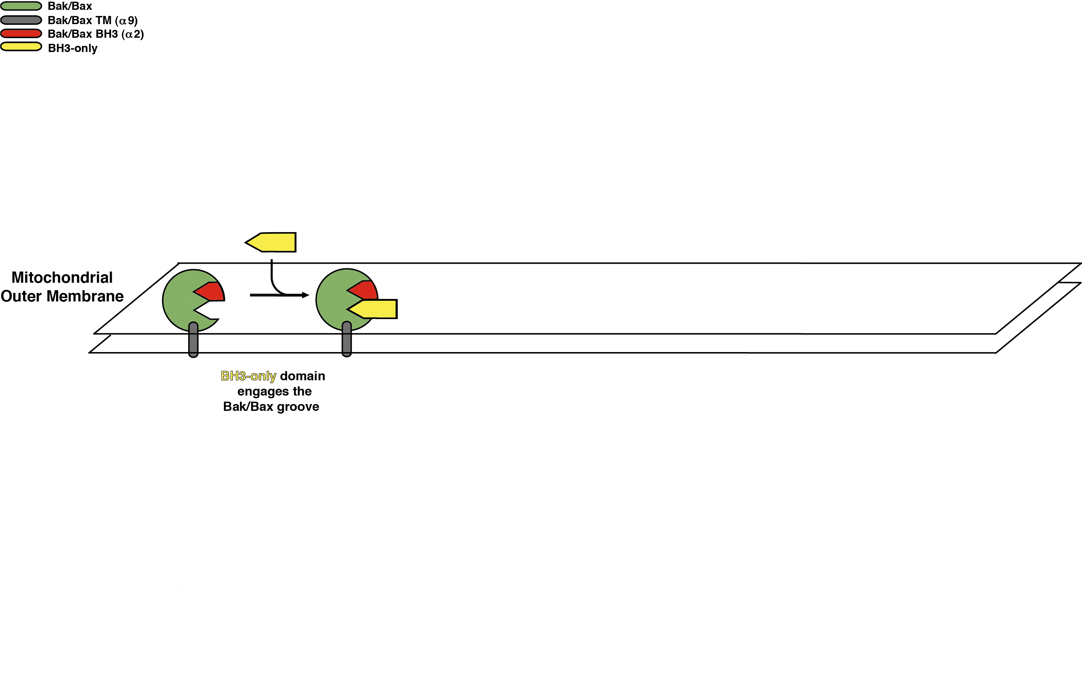
Bak Activation

Slide 7
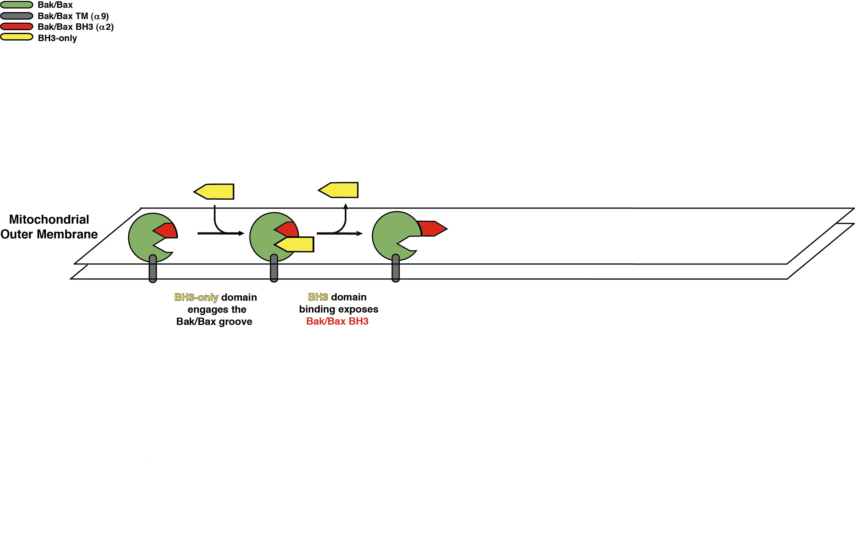
Bak Activation

Slide 8
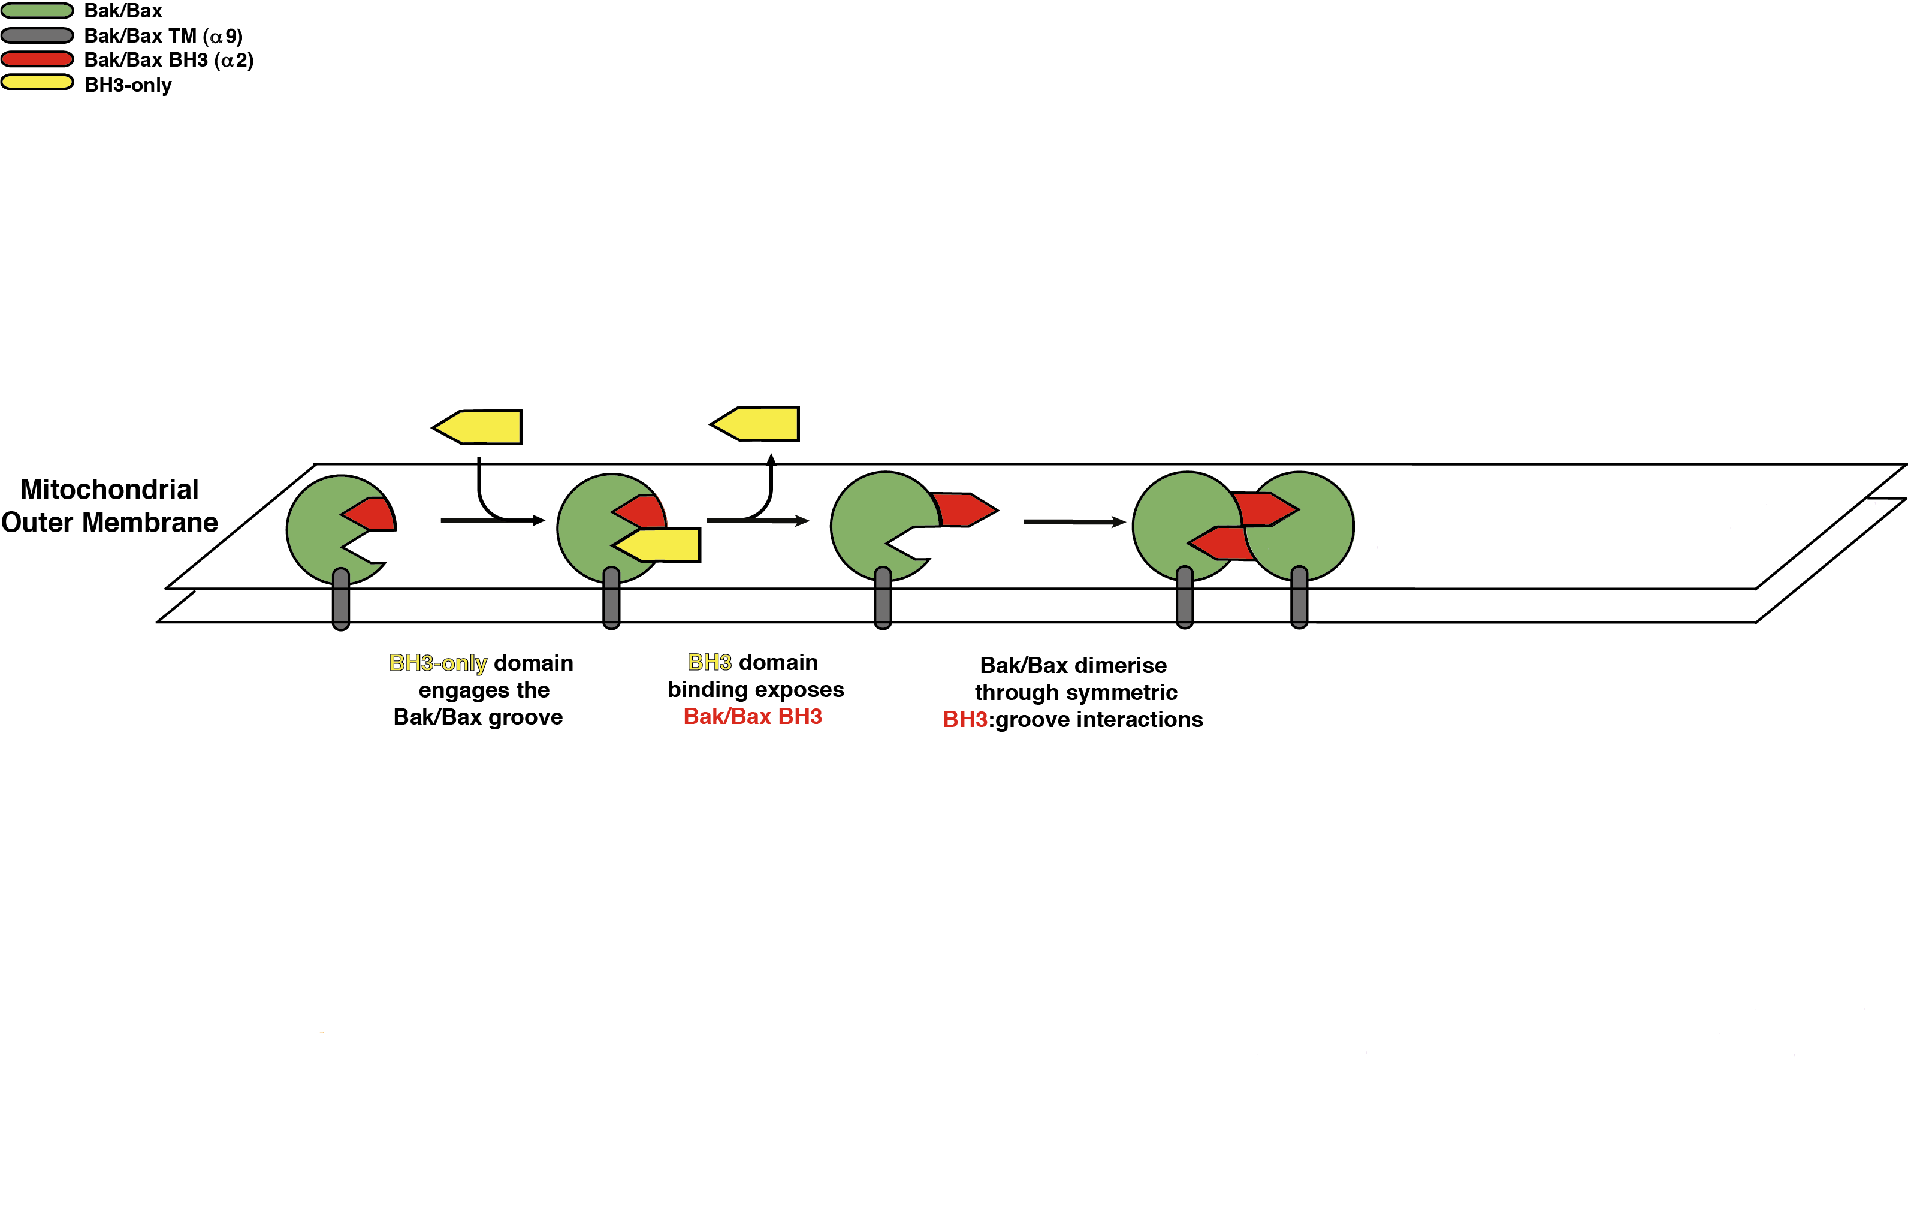
Bak Activation

Slide 9
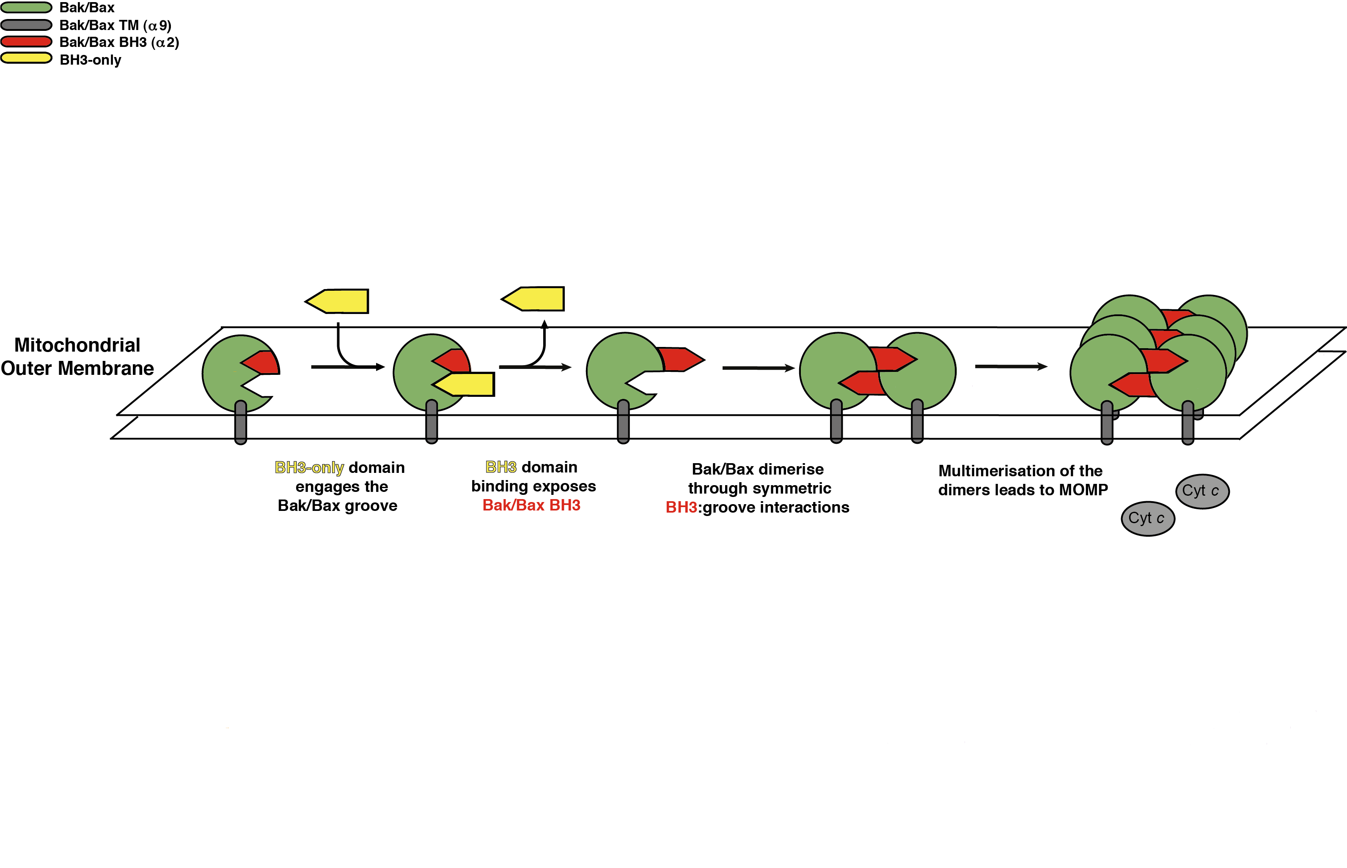
Bak Activation

Slide 10
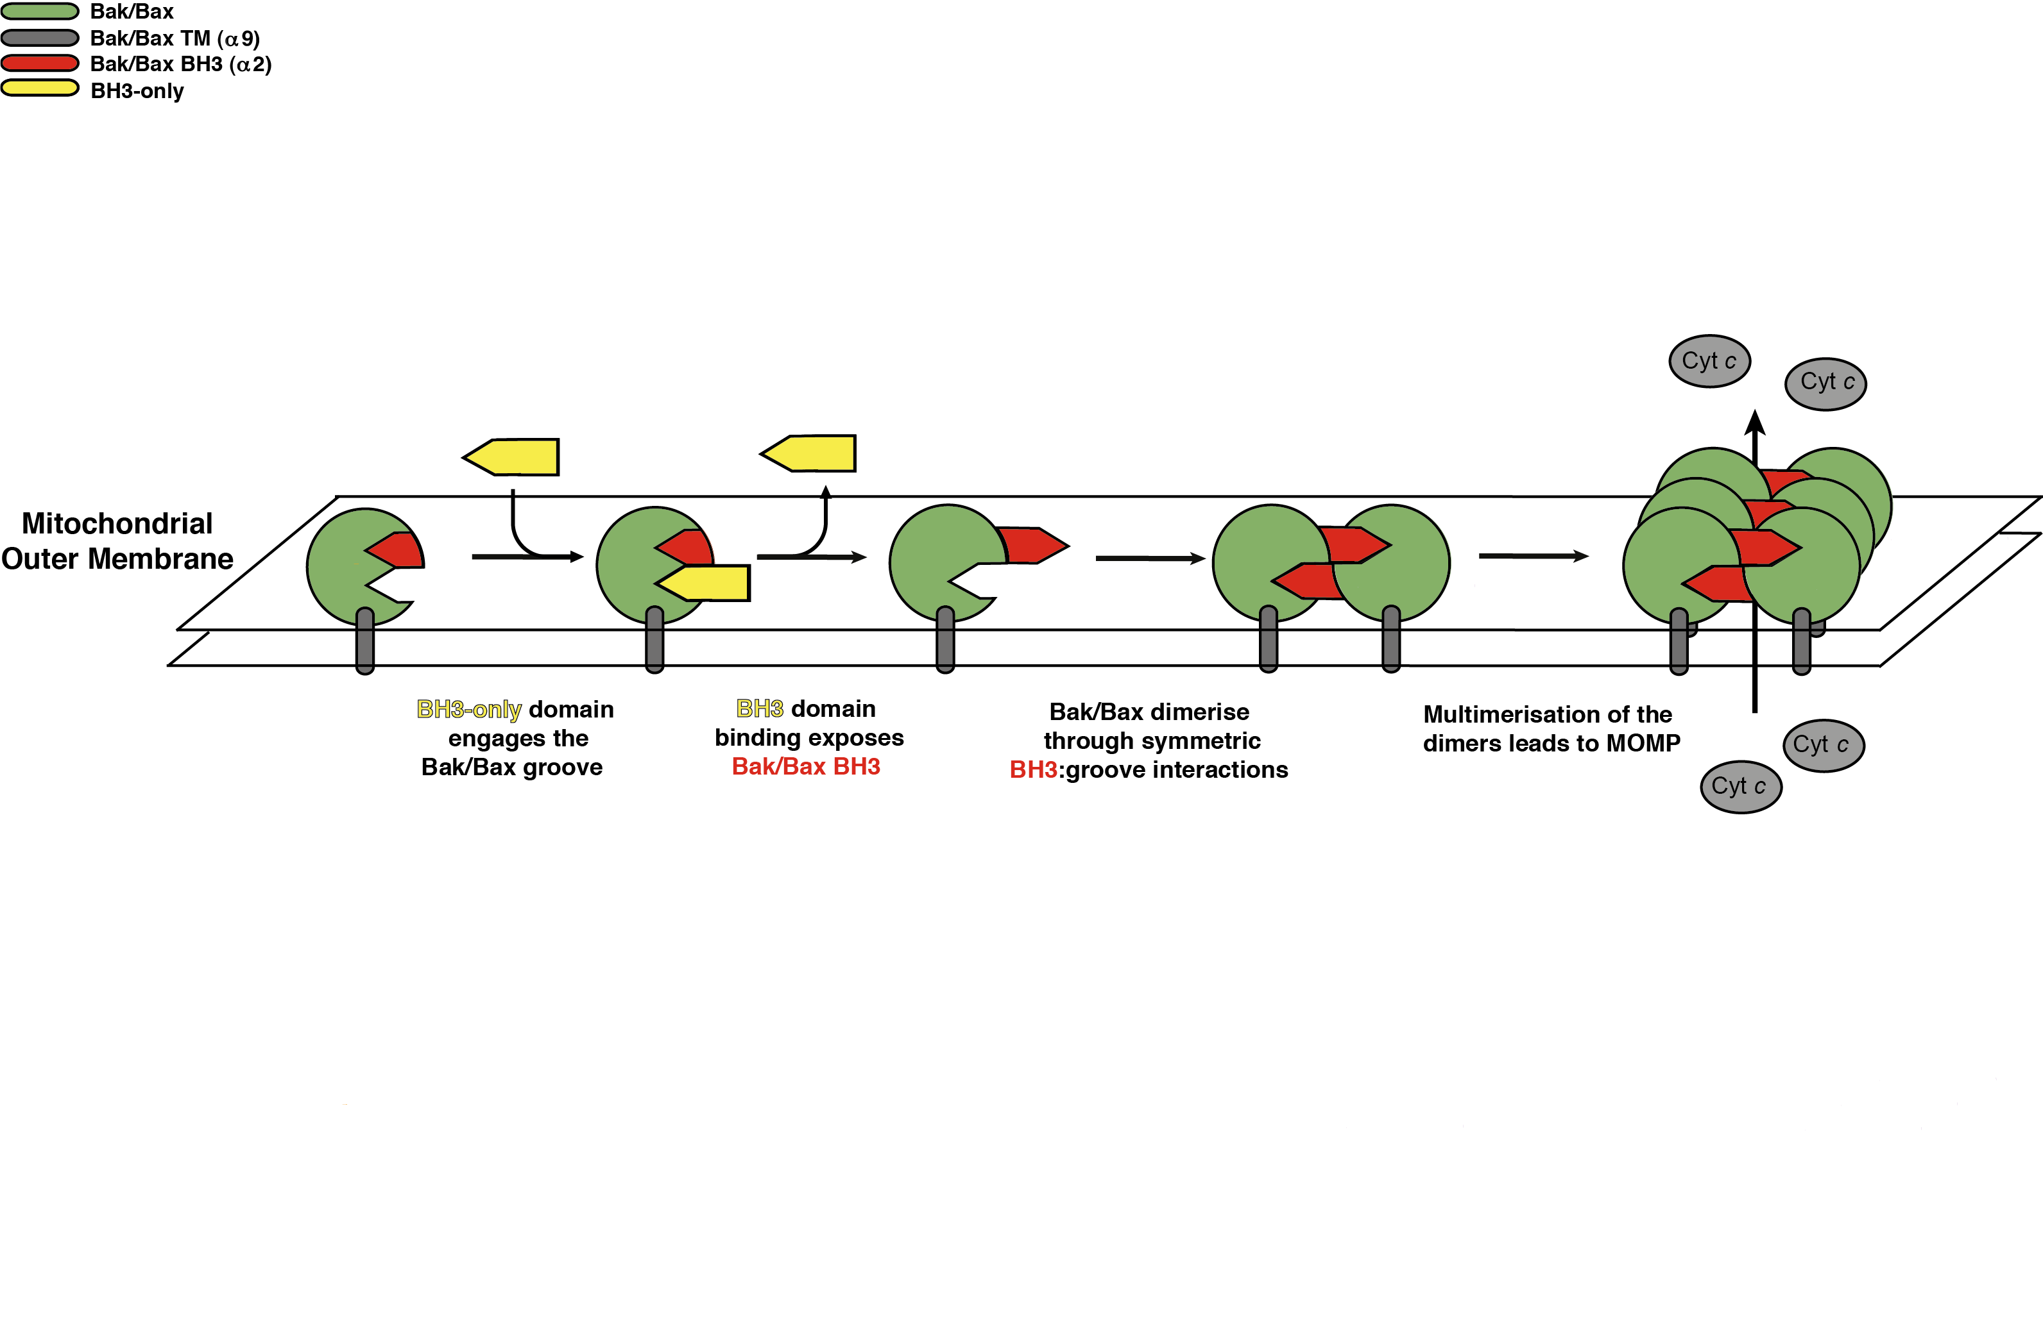
Bak Activation
Notes:
We are interested in understanding this at a molecular level.

Slide 11
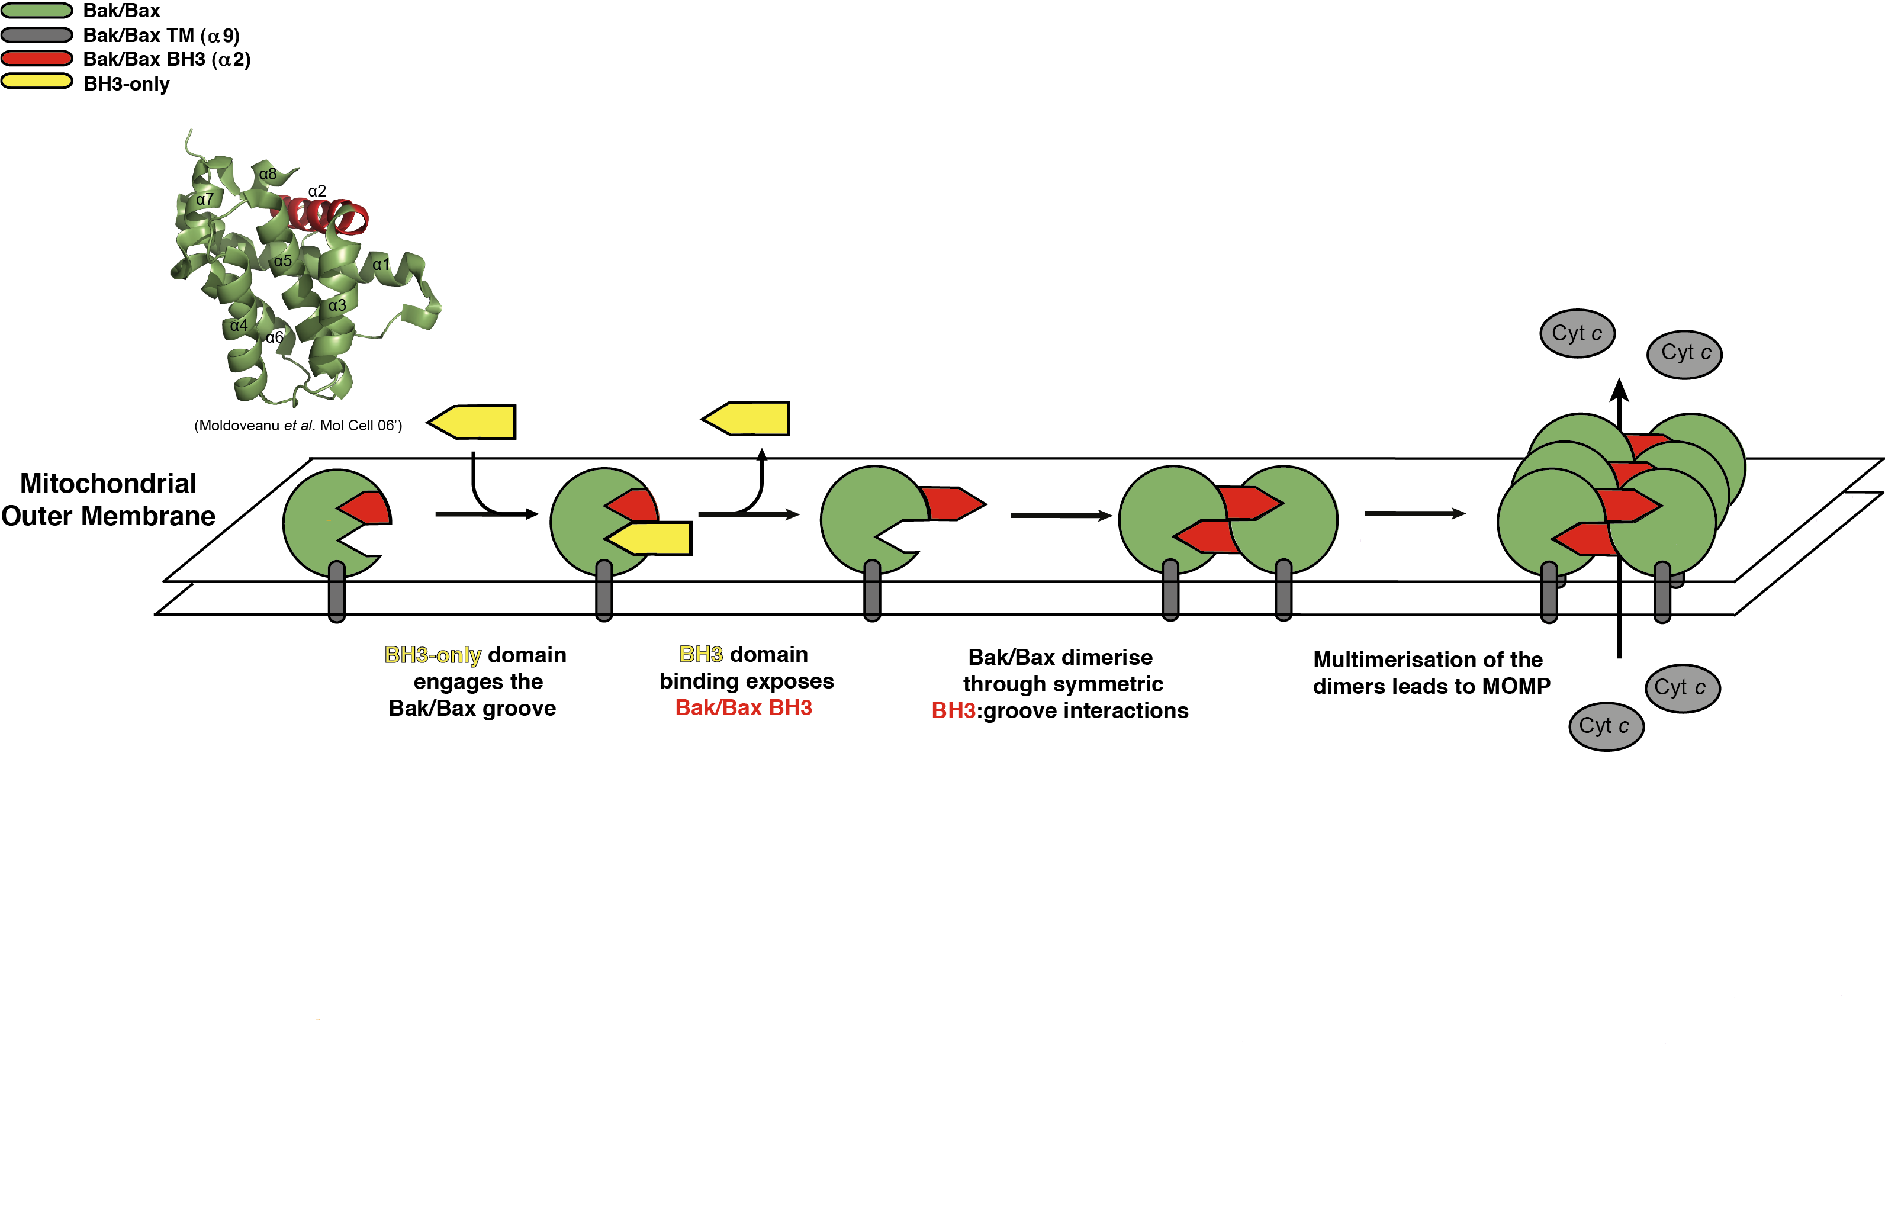
Bak Activation
Notes:
CRYSTAL STRUCTURE
8 helix globule, 9th helix removed, conserved fold of the bcl-2 family.

Slide 12
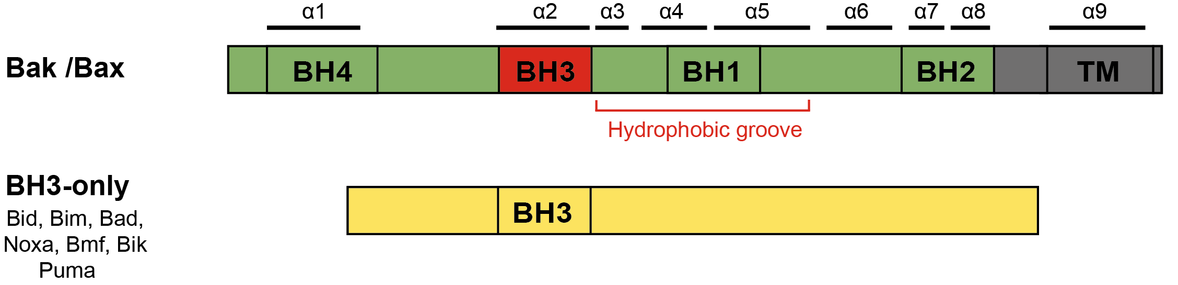
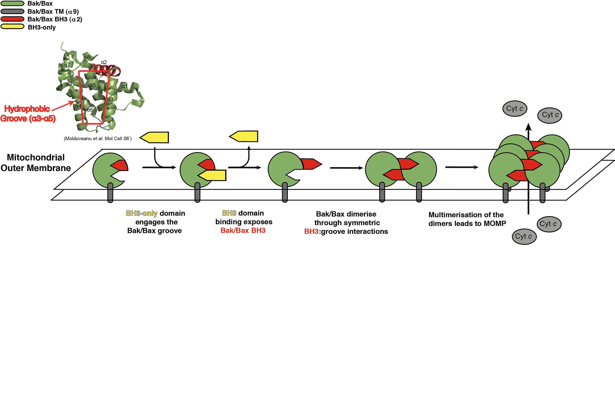
Bak Activation

Slide 13
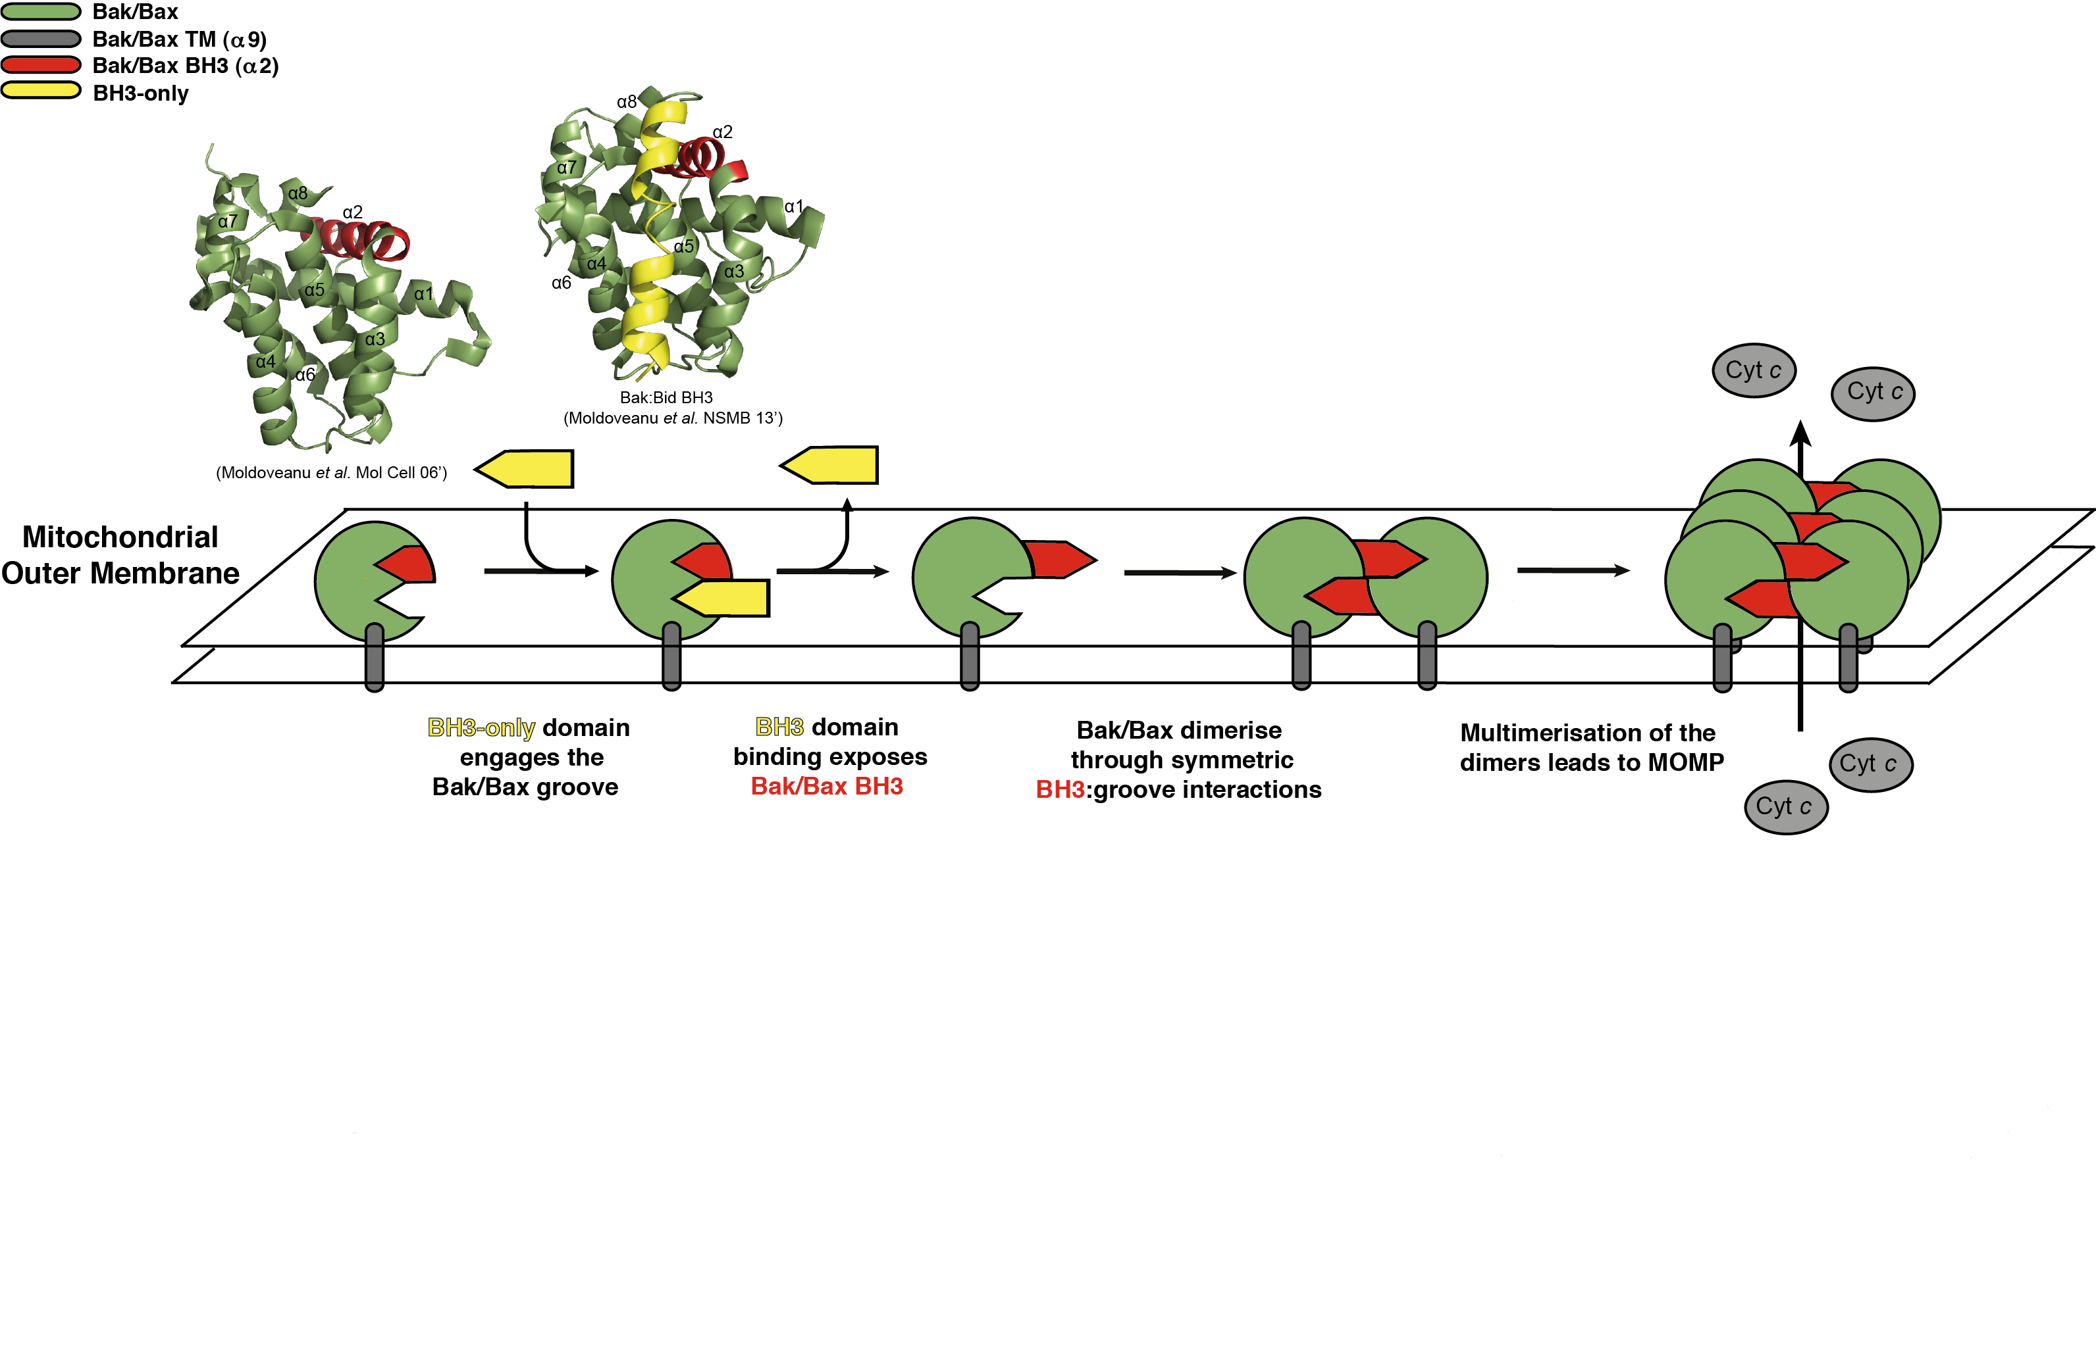
Bak Activation
Notes:
NMR STRUCTURE

Slide 14
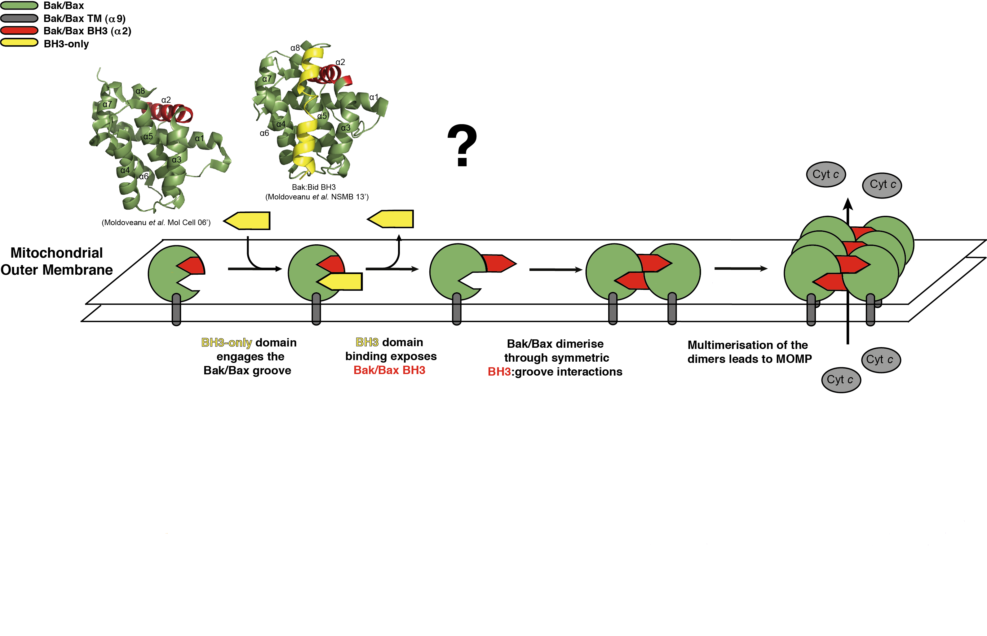
Bak Activation

Slide 15
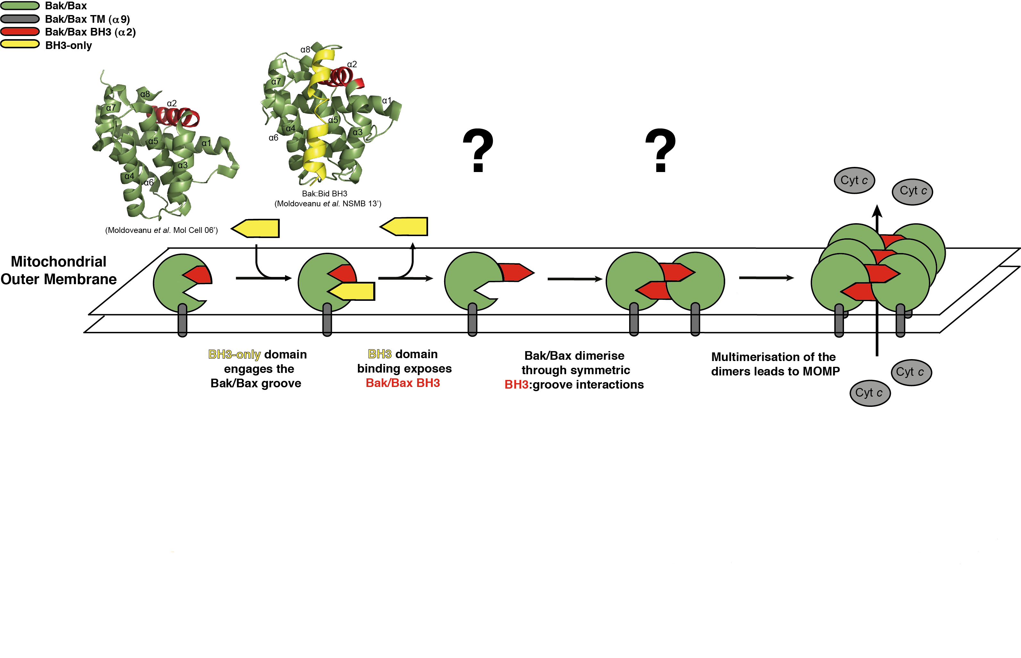
Bak Activation

Slide 16
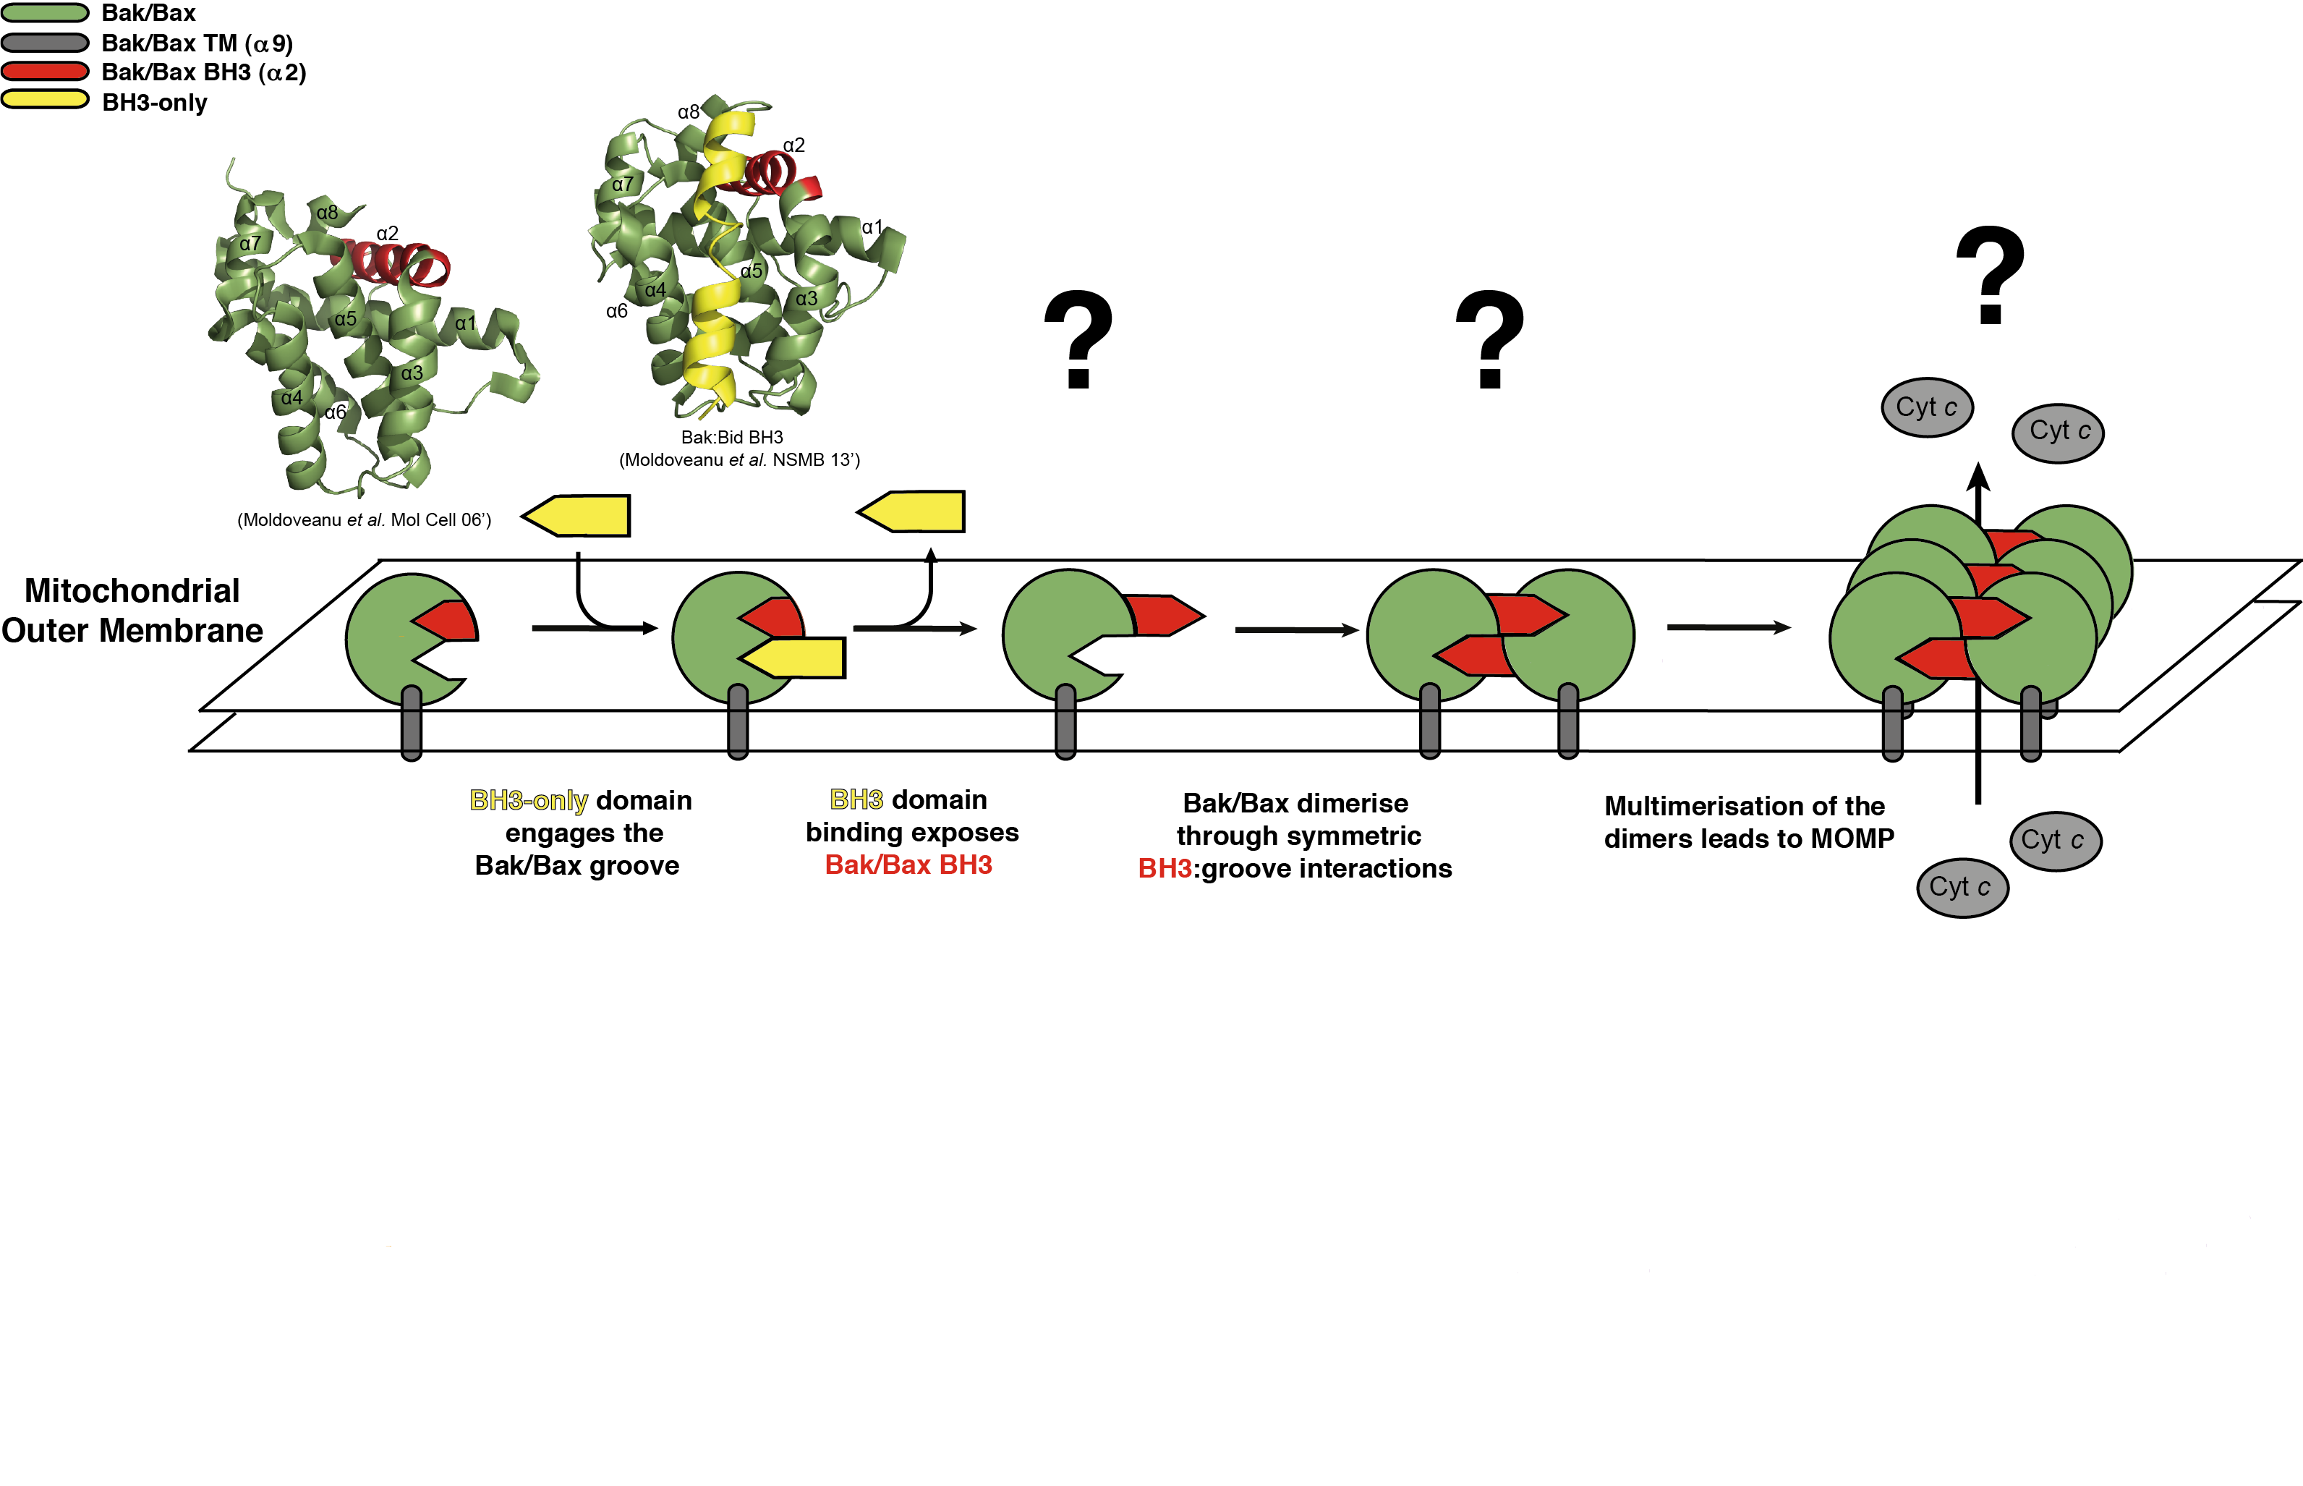
Bak Activation
Notes:
Investigate:
Bak activation by BH3 peptides.
Interactions of BH3 peptides with Bak.
Activated form of Bak.
Bak BH3:groove dimer.
Compare with the existing knowledge for Bax (Czabotar et al. 2013).

Slide 17
Bak Activation
Monomer
Ab 280nm (mAU)
mL
Monomer
Dimer
Ab 280nm (mAU)
mL
Size exclusion chromatography (S75 10/300)
Notes:
DSD, One monomer of bak in colour, one in grey.

Slide 18
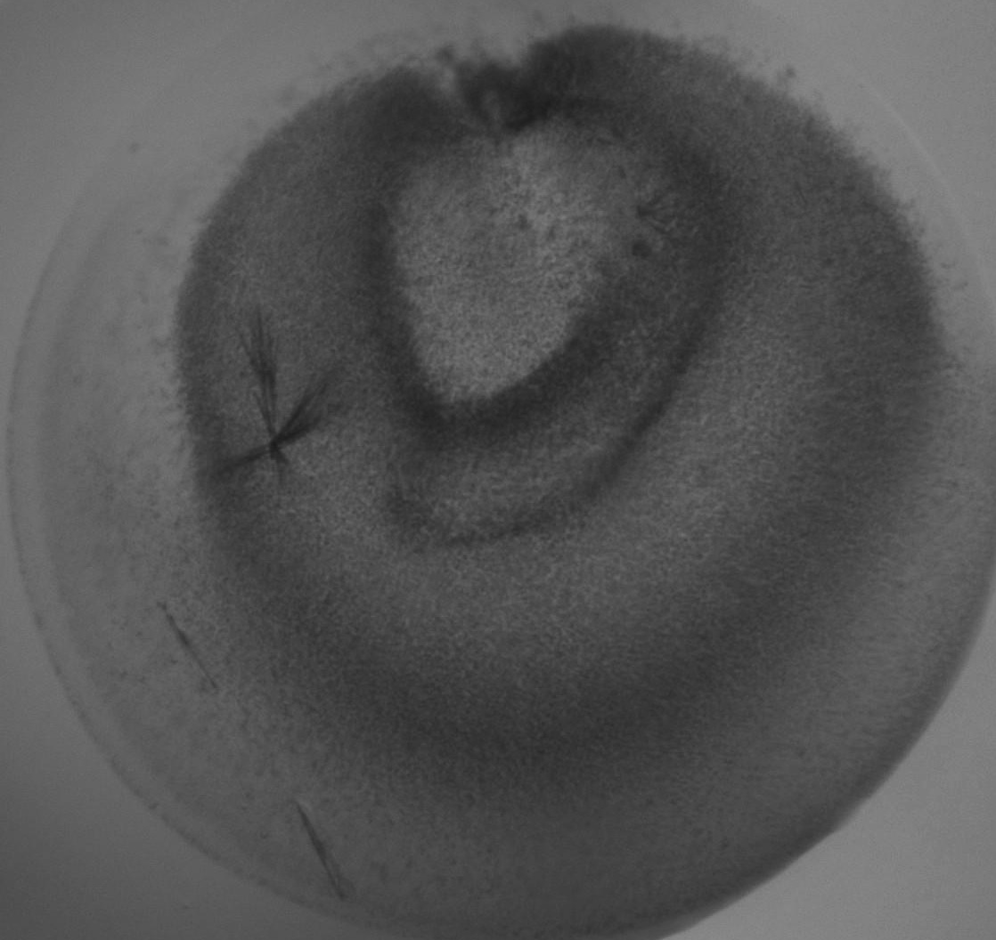
Bak Activation
Monomer
Ab 280nm (mAU)
mL
Monomer
Dimer
Ab 280nm (mAU)
mL
Size exclusion chromatography (S75 10/300)
Notes:
DSD, One monomer of bak in colour, one in grey.

Slide 19
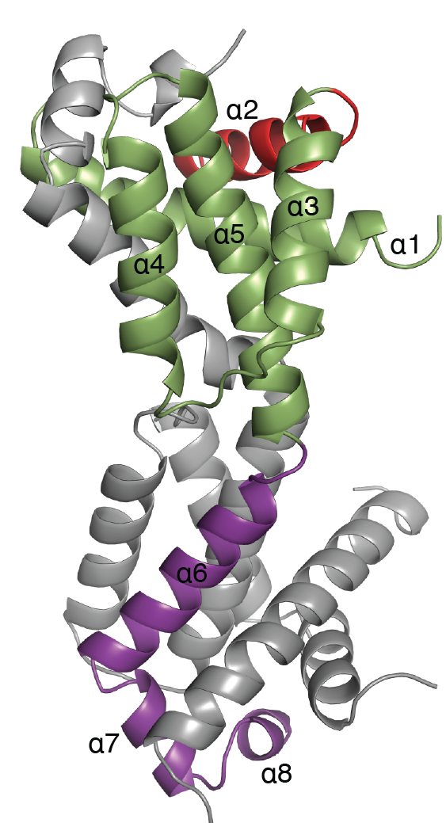
Bak Activation
Bid + CHAPS induced
Domain swapped dimer
Monomer
Ab 280nm (mAU)
mL
Data collection
Space group | C 2
Cell dimensions
a, b, c (Å) | 110.65, 39.48, 88.15
a, b, g (°) | 90, 117.71, 90
Resolution (Å) | 48.98 - 2.9 (3 - 2.9)
R-merge | 0.2262 (1.046)
I/sI | 6.31(1.33)
Completeness (%) | 99.1 (95.8)
Redundancy | 3.66 (3.65)
CC(1/2) outer shell | 46.2
Refinement
Resolution (Å) | 48.98 - 2.9 (3.24 – 2.9)
No. reflections | 7624 (761)
R-work/ R-free | 22.74 / 29.44 (31.26 / 37.35)
Monomer
Dimer
Ab 280nm (mAU)
mL
Size exclusion chromatography (S75 10/300)
Notes:
DSD, One monomer of bak in colour, one in grey.

Slide 20
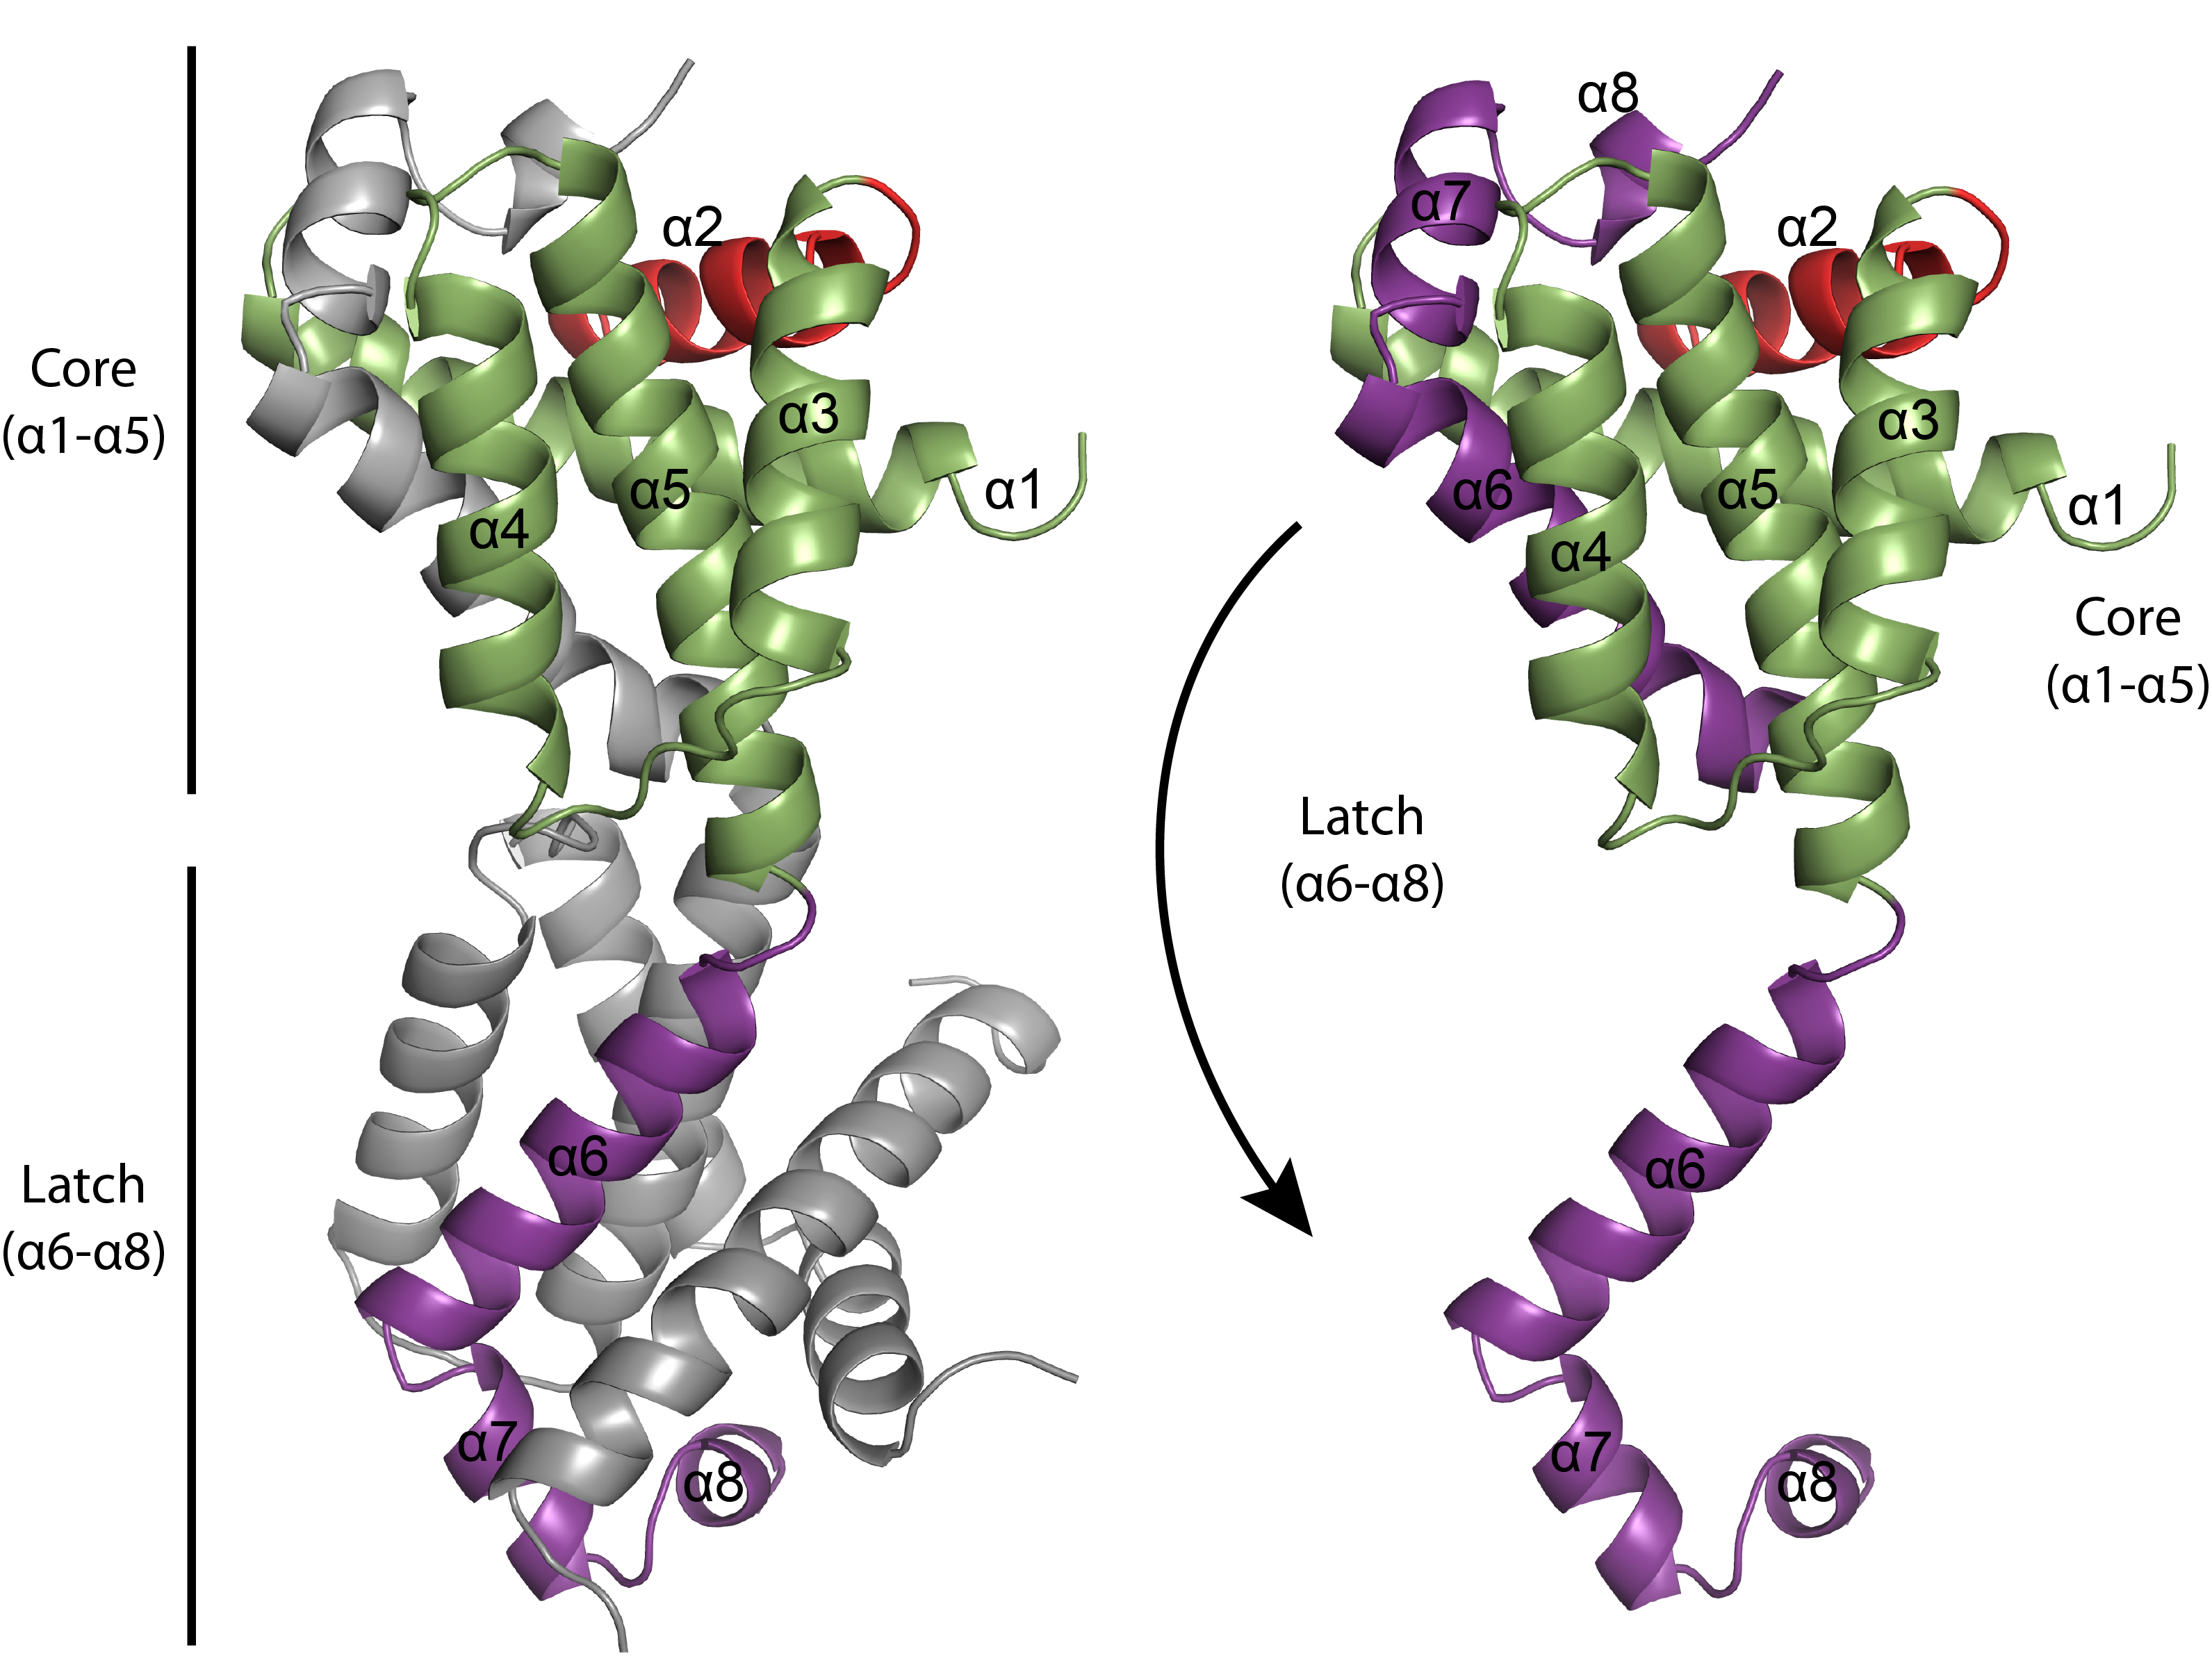
Bak Activation
Notes:
Liner b/w 5 and 6. Monomer opens up 6,7,8 comes out. no peptide in xtal struct NO PEPTIDE
Binds into the equivalent region of its neighbour.
Each globule is the structure of the inactive monomer.

Slide 21
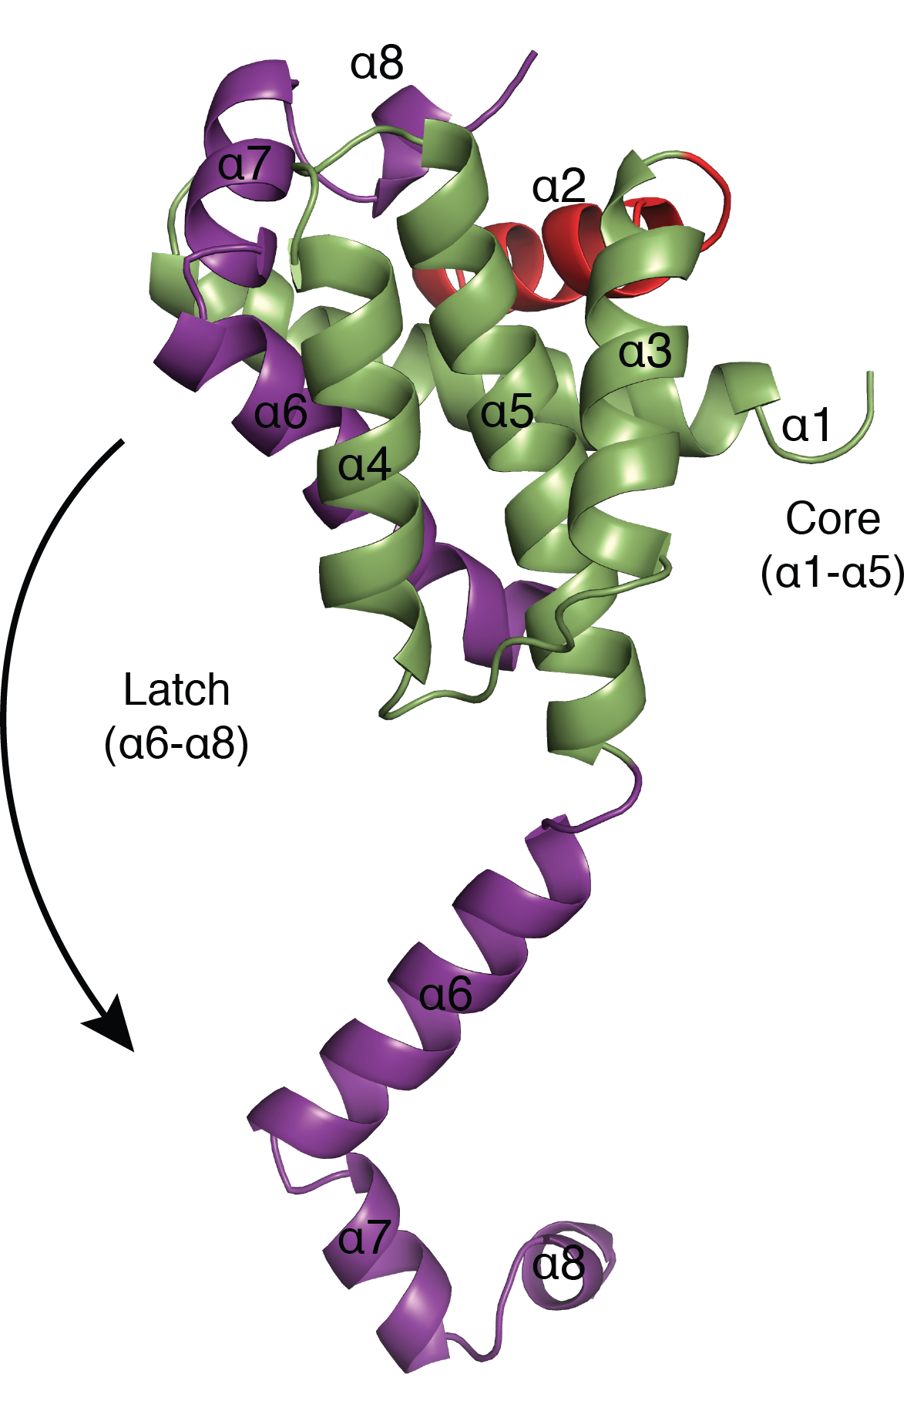
Bak Activation – Bak FL Test
Notes:
Functional assay on full-length Bak looking for Cytochrome c release
Isolated mitochondrial fractions from

Slide 22
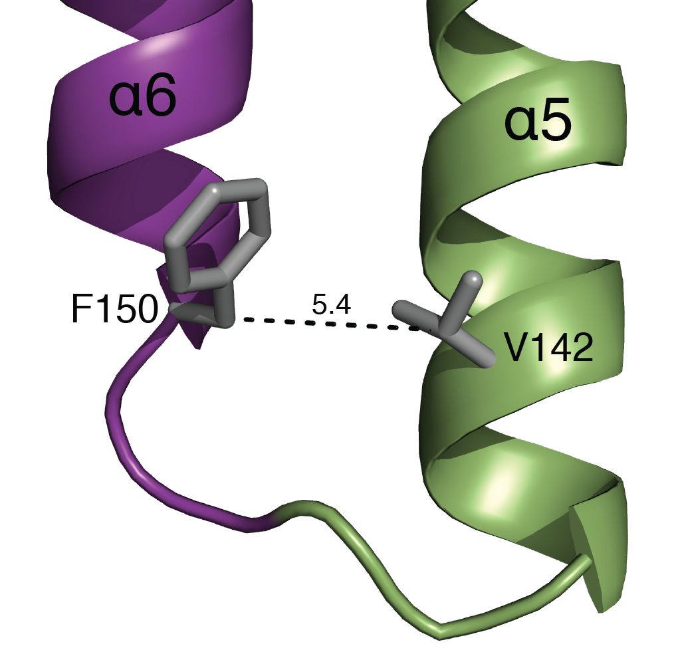
Bak Activation – Bak FL Test
Notes:
Functional assay on full-length Bak looking for Cytochrome c release
Isolated mitochondrial fractions from

Slide 23
Bak Activation – Bak FL Test
(Bak^{-/-}Bax^{-/-} DKO MEFs)
Isolated mitochondrial fractions
Notes:
Functional assay on full-length Bak looking for Cytochrome c release
Isolated mitochondrial fractions from

Slide 24
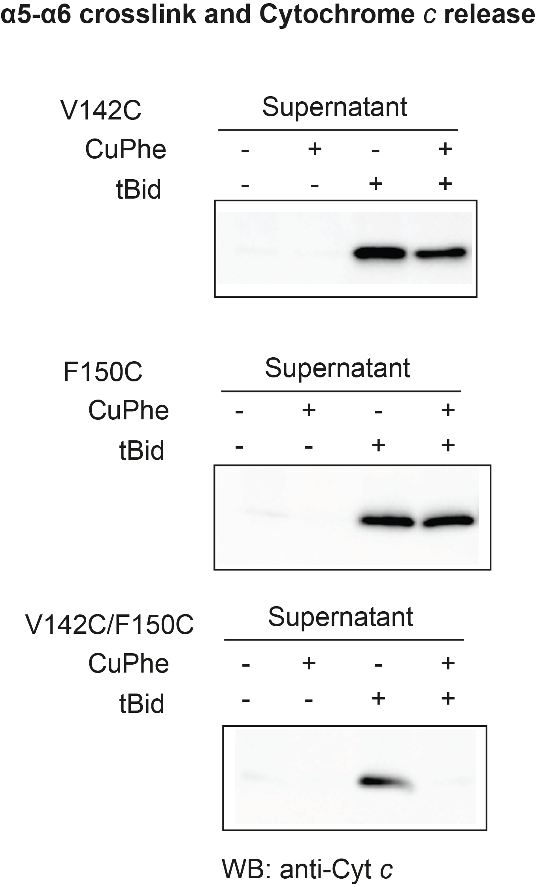
Bak Activation – Bak FL Test
(Bak^{-/-}Bax^{-/-} DKO MEFs)
Isolated mitochondrial fractions
SDS PAGE, WB – Anti Cyt c
Notes:
Functional assay on full-length Bak looking for Cytochrome c release
Isolated mitochondrial fractions from

Slide 25
Bak Activation – Bak FL Test
(Bak^{-/-}Bax^{-/-} DKO MEFs)
Isolated mitochondrial fractions
Tethering α5 to α6 prevents Cytochrome c release
SDS PAGE, WB – Anti Cyt c
Notes:
Functional assay on full-length Bak looking for Cytochrome c release
Isolated mitochondrial fractions from

Slide 26
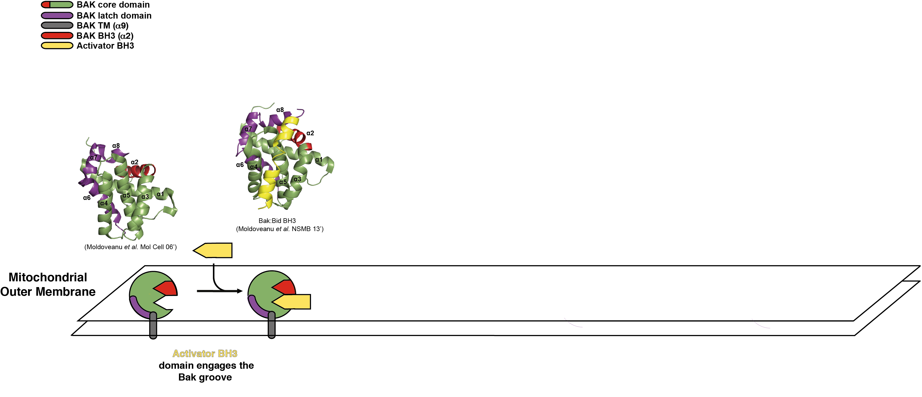
Bak Activation

Slide 27
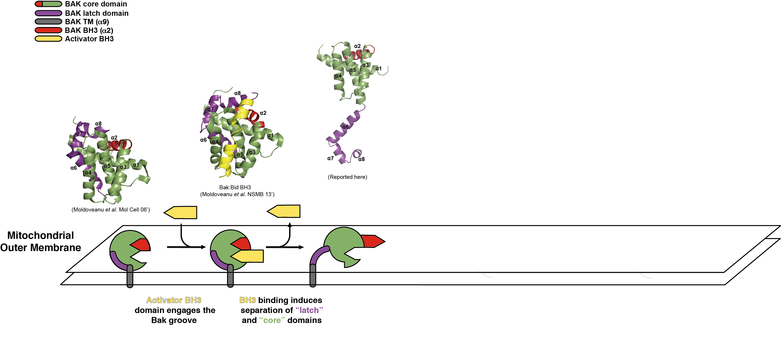
Bak Activation

Slide 28
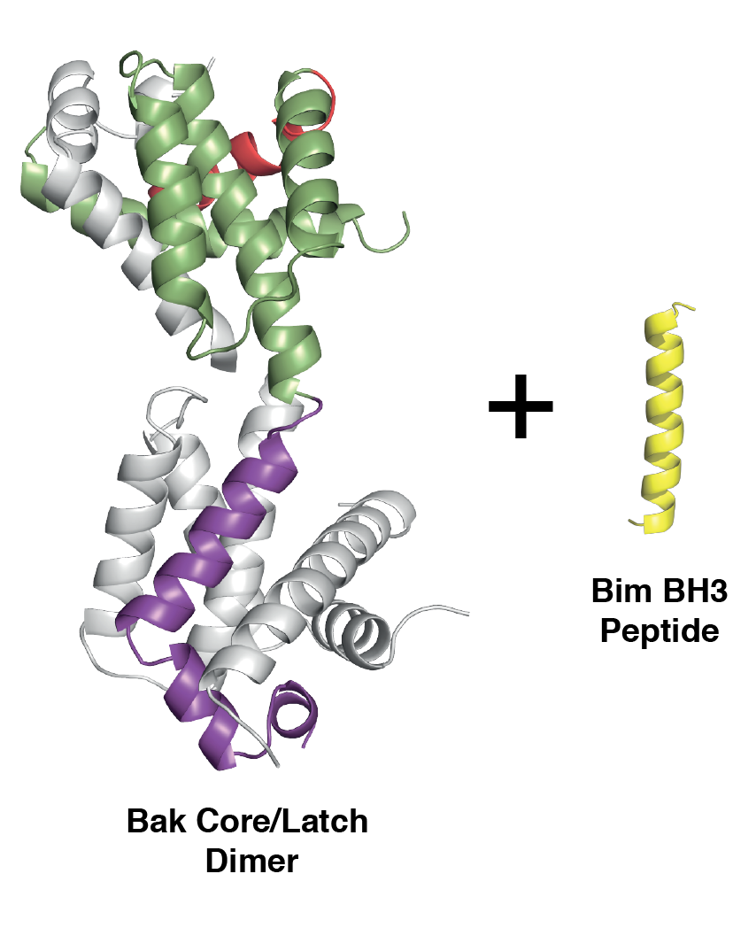
Bak:Bim BH3 Complex

Slide 29
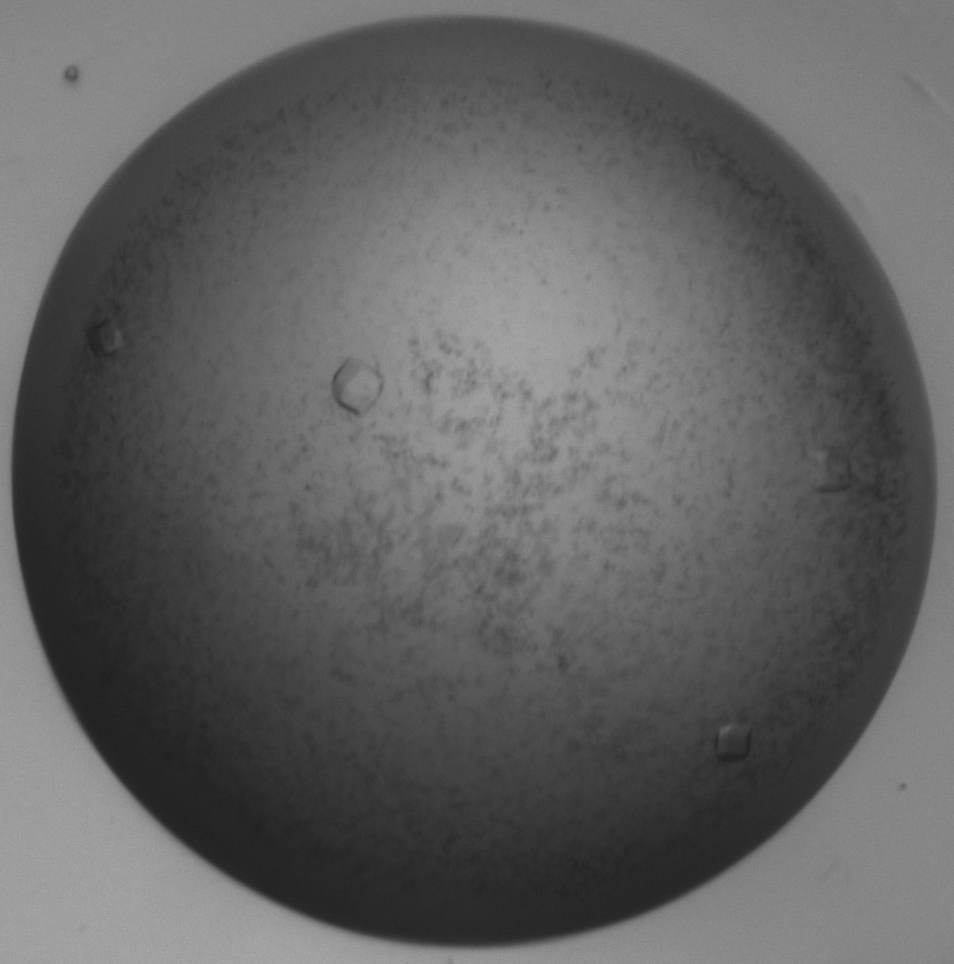
Bak:Bim BH3 Complex

Slide 30
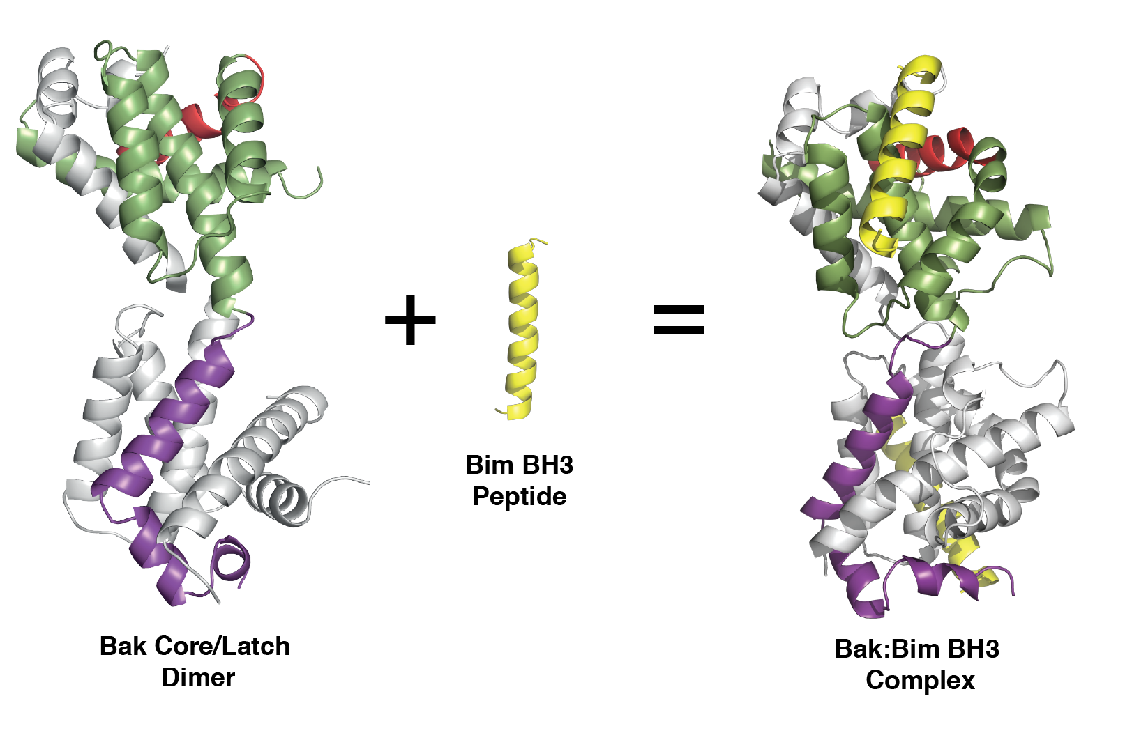
Bak:Bim BH3 Complex
Data collection
Space group | P 4₁ 3 2
Cell dimensions
a, b, c (Å) | 139.404 139.404 139.404
a, b, g (°) | 90, 90, 90
Resolution (Å) | 49.29 - 1.9 (1.94 - 1.9)
R-merge | 0.271 (6.334)
I/sI | 24.8 (1.5)
Completeness (%) | 100.00 (99.97)
Redundancy | 72.0 (71.2)
CC(1/2) outer shell | 63.7
Refinement
Resolution (Å) | 42.03 - 1.9 (1.965 – 1.9)
No. reflections | 2681508 (167932)
R-work/ R-free | 15.46/17.35 (27.86/28.41)

Slide 31
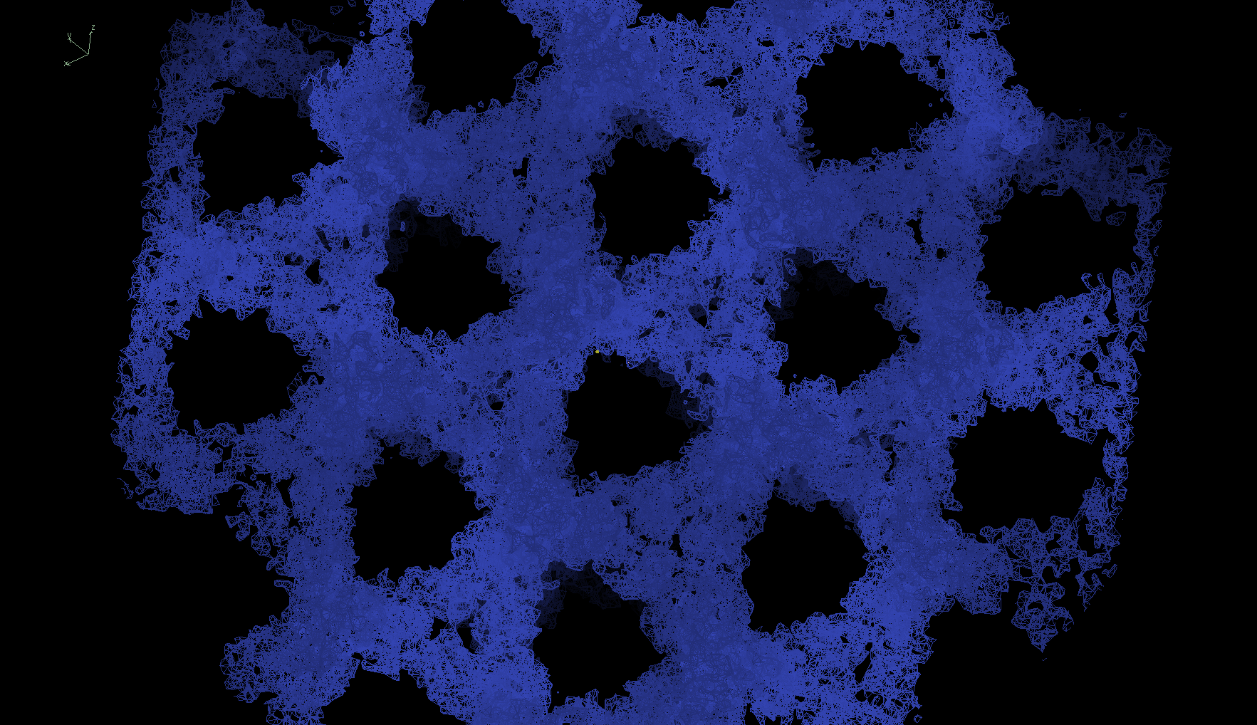
Bak:Bim BH3 Complex
~80% solvent, 1.9 Å resolution!

Slide 32
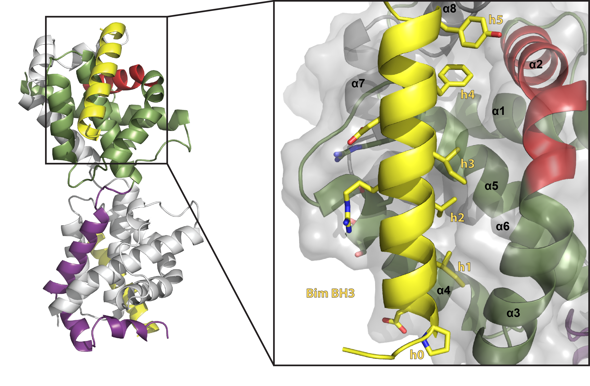
Bak:Bim BH3 Complex

Slide 33
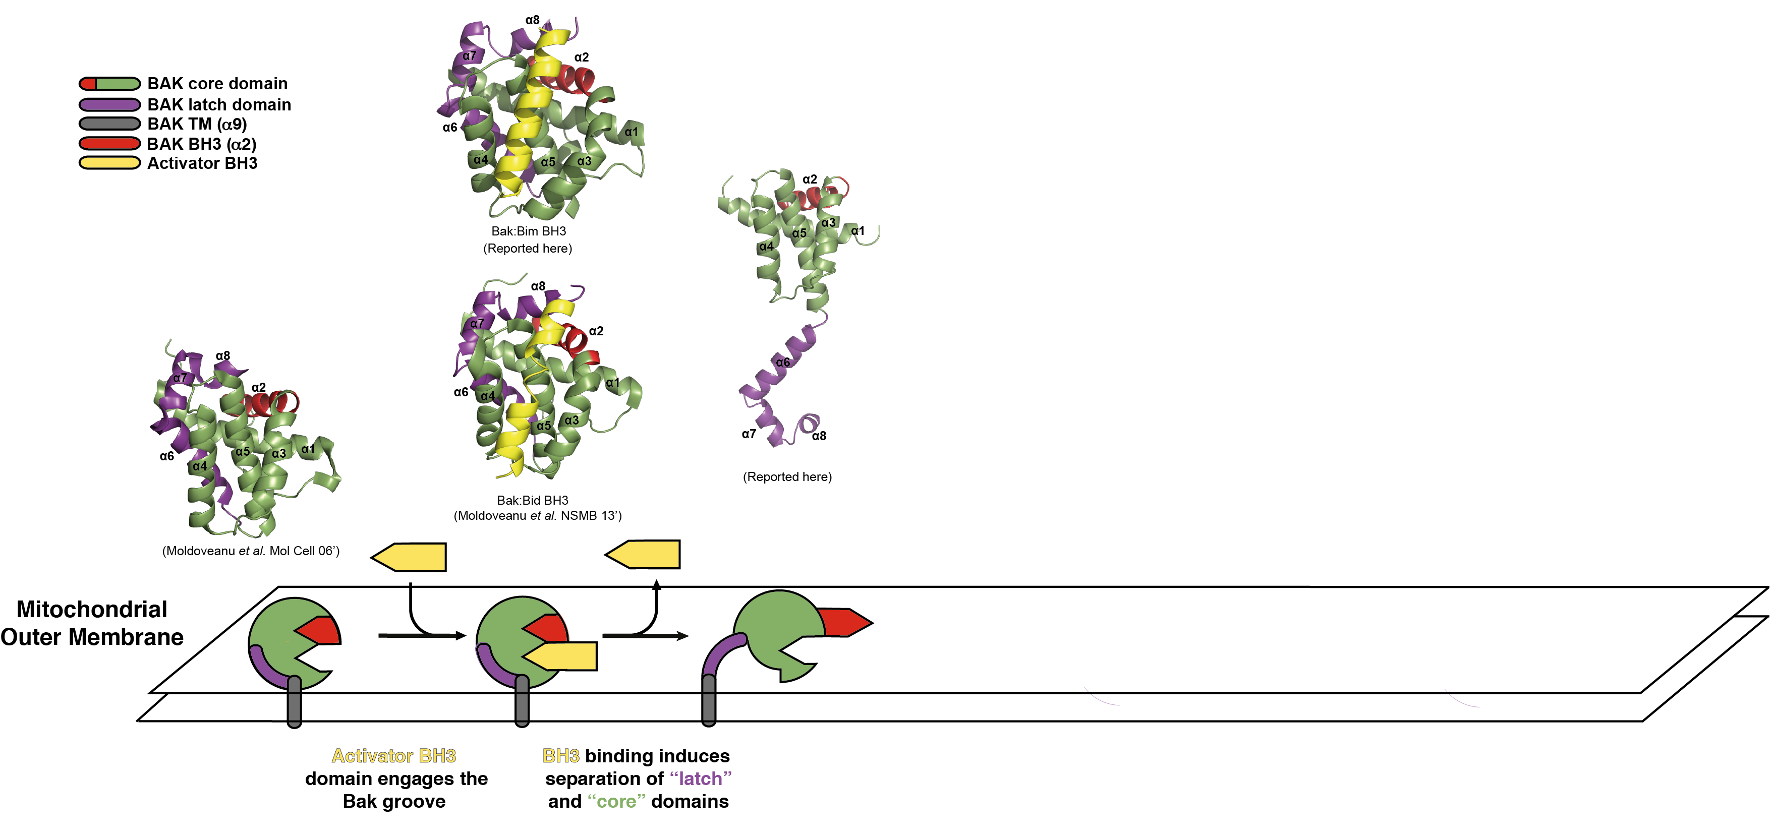
Bak Activation

Slide 34
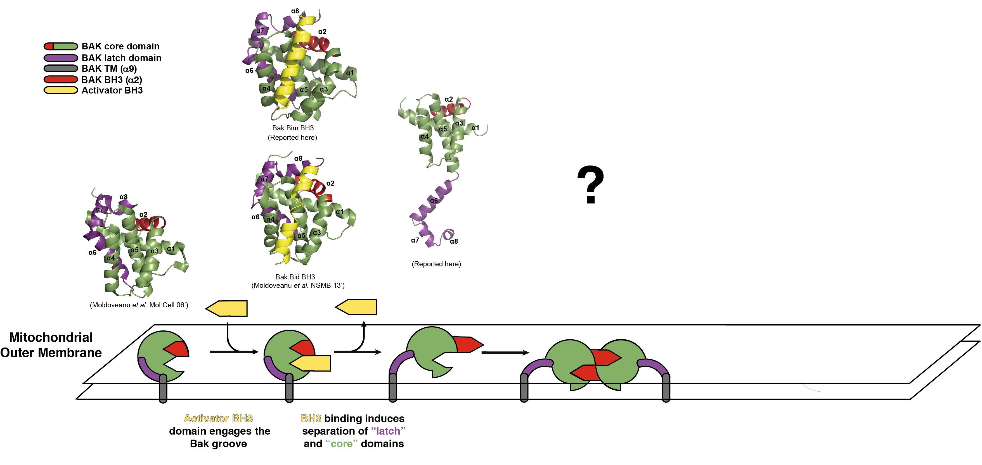
Bak Activation
Notes:
We had evidence that once released these core domains are invovled in dimerisation.
So to understand that we attempted to obtain a structure of the core domain.

Slide 35
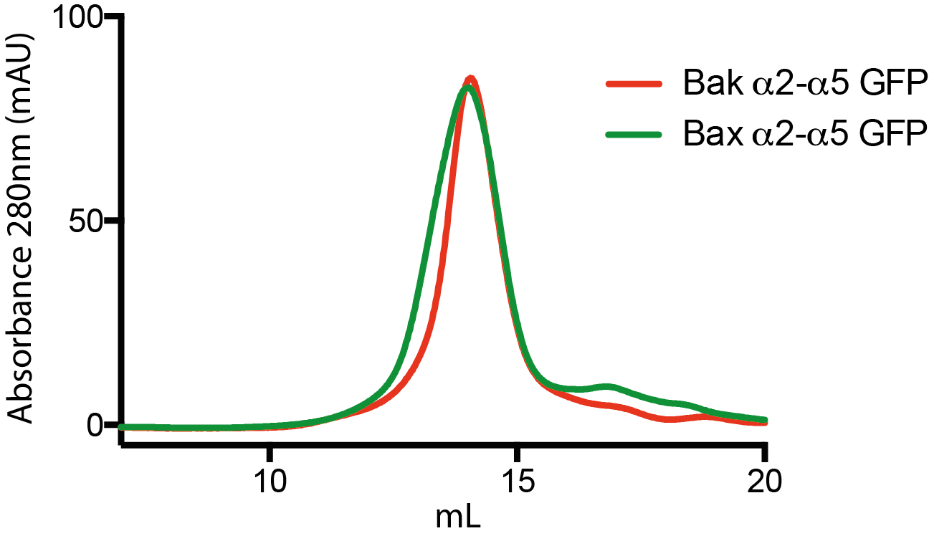
Bak BH3:groove Dimer
Bak α2-α5 GFP appeared to form a similar tetramer to Bax.
Bax was crystallised in presence of CHAPS.
Similar crystallisation conditions were tested for Bak α2-α5 GFP – No crystals.
Therefore needed to screen for stabilising detergents.
SEC S200 10/300

Slide 36
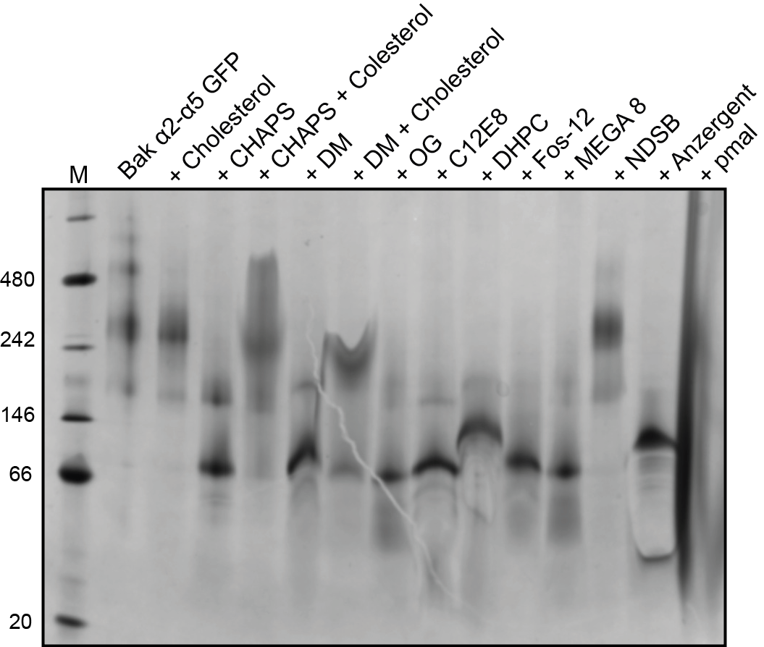
Bak BH3:groove Dimer
Blue Native PAGE

Slide 37
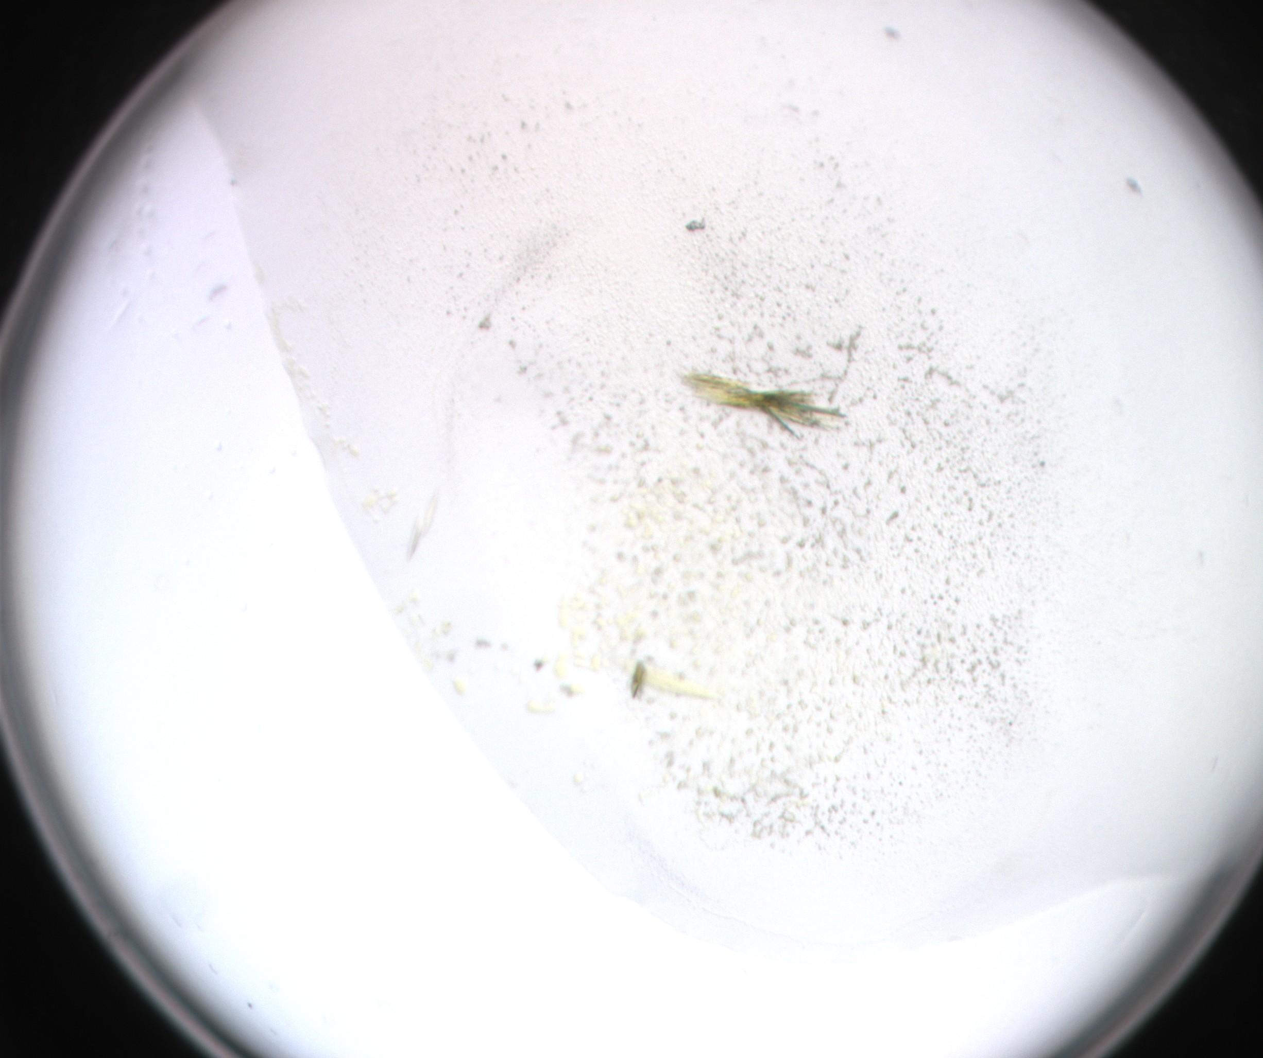
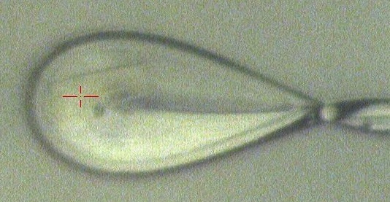
Bak BH3:groove Dimer

Slide 38
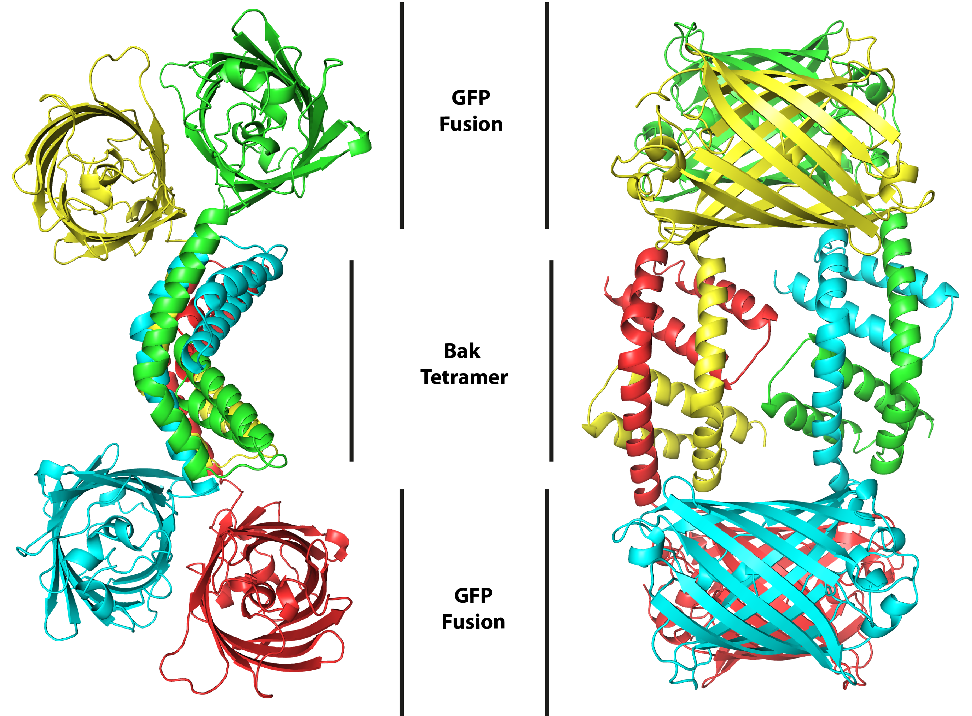
Bak BH3:groove Dimer
Data collection
Space group | P 2₁
Cell dimensions
a, b, c (Å) | 109.19, 63.84, 122.02
a, b, g (°) | 90, 98.35, 90
Resolution (Å) | 20 - 2.3 (2.382 - 2.3)
R-merge | 0.1619 (2.84)
I/sI | 7.92 (0.5)
Completeness (%) | 99.88 (99.63)
Redundancy | 3.7 (3.64)
CC(1/2) outer shell | 16.9
Refinement
Resolution (Å) | 20 - 2.3 (2.382 – 2.3)
No. reflections | 74145 (7328)
R-work/ R-free | 19.55 / 24.74 (36.92 / 40.94)

Slide 39
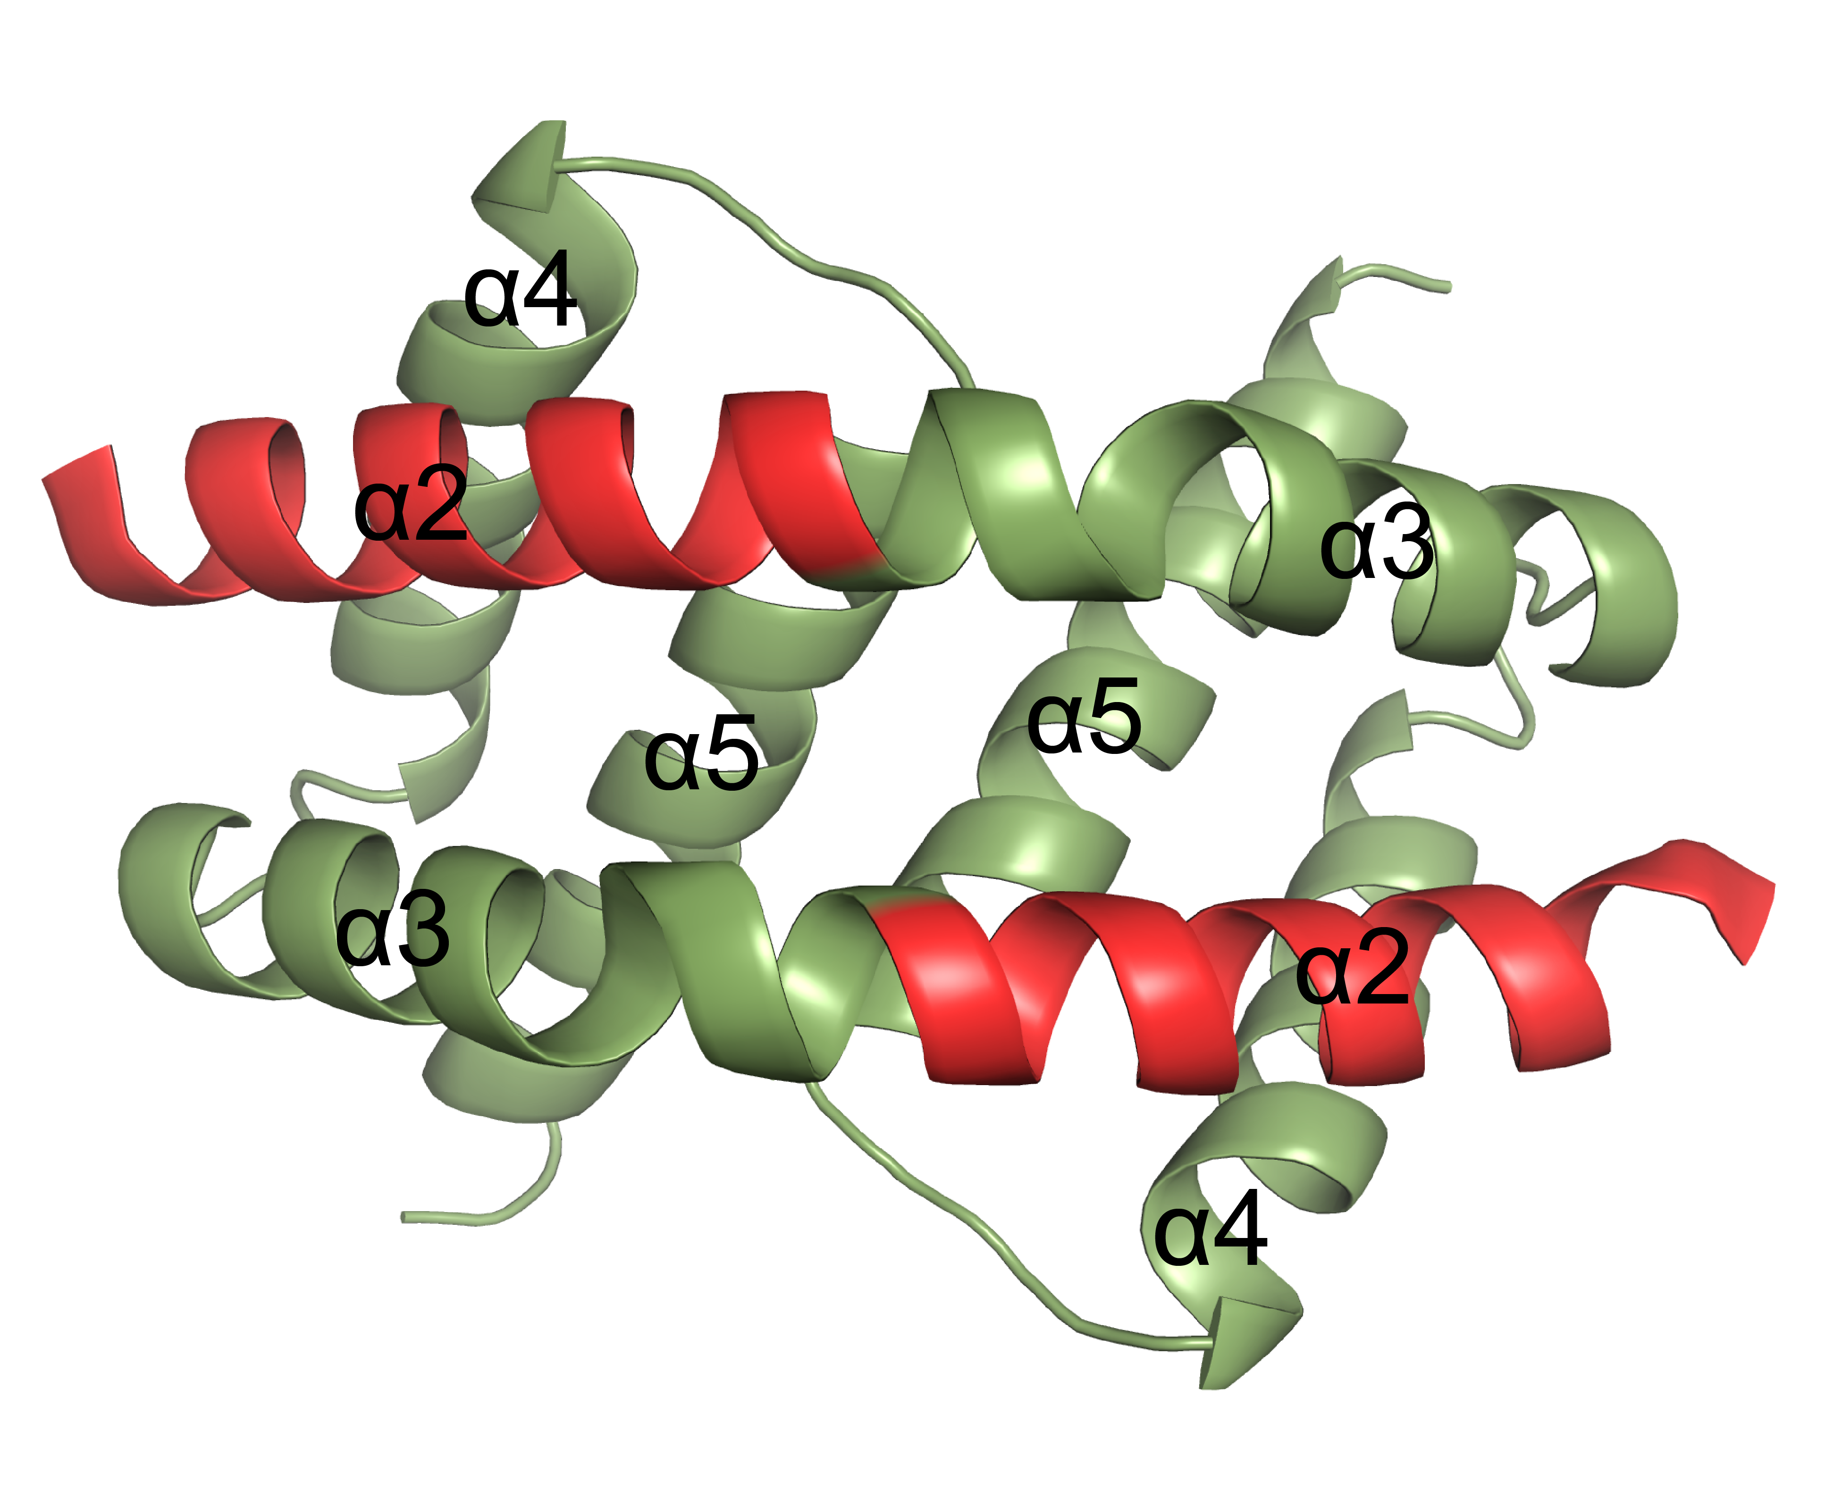
Bak BH3:groove Dimer
Top View

Slide 40
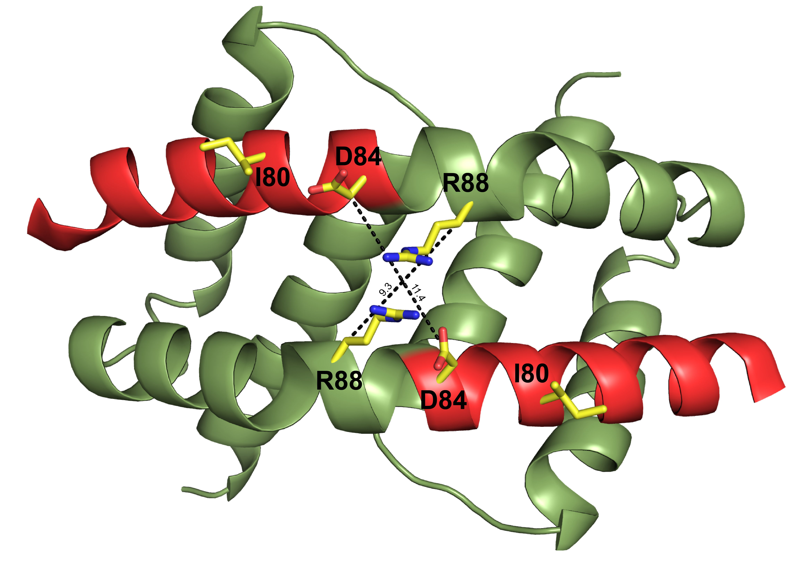
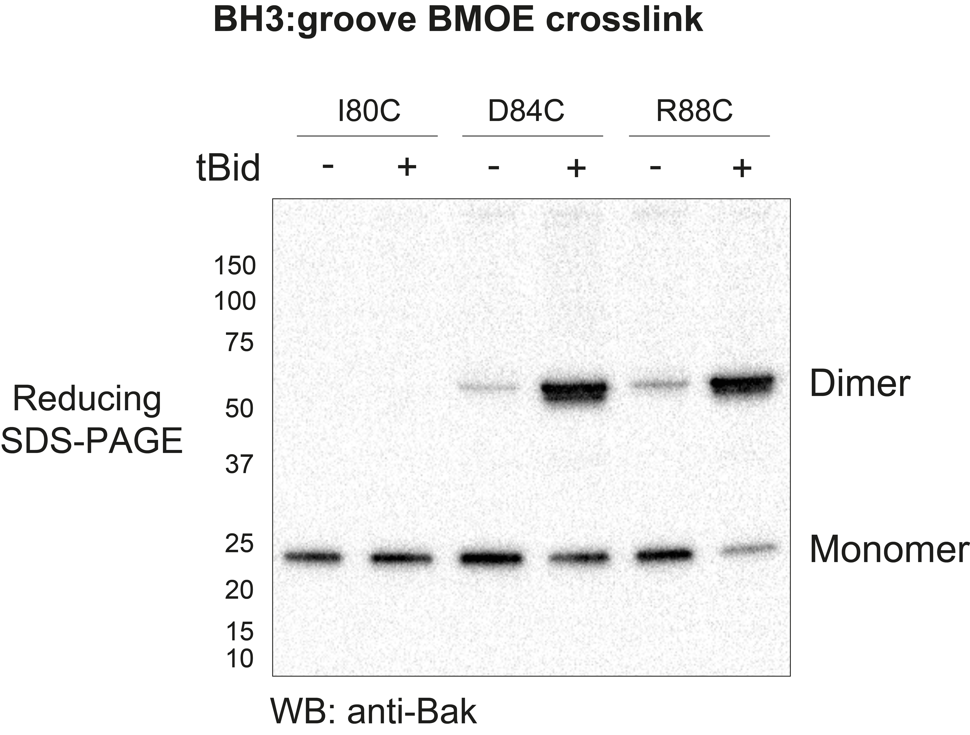
Bak BH3:groove Dimer
(Bak^{-/-}Bax^{-/-} DKO MEFs)
Isolated mitochondrial fractions
Notes:
If this structure is representative of the activated Bak dimers in cells we should be able to link residues close to the dyad axis.

Slide 41
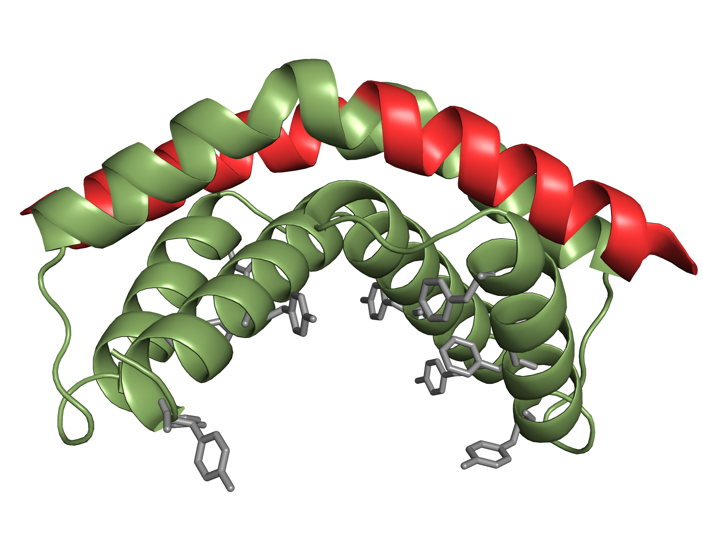
Bak BH3:groove Dimer
Top View
Side View

Slide 42
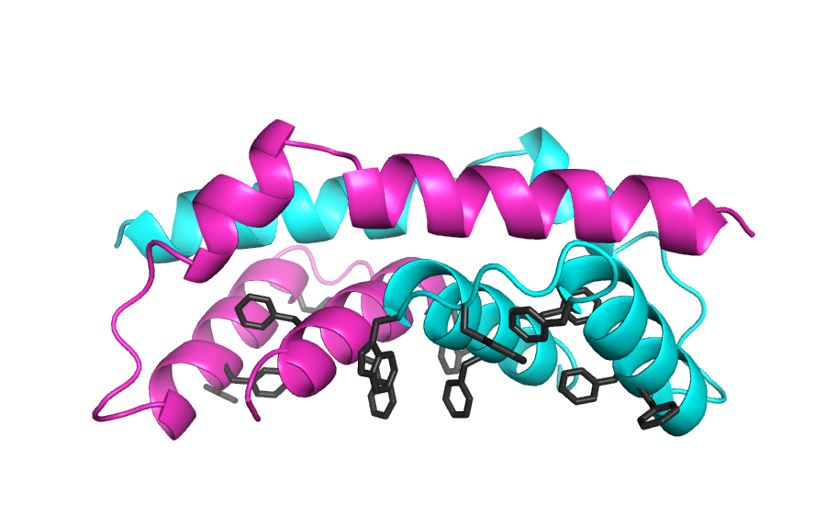
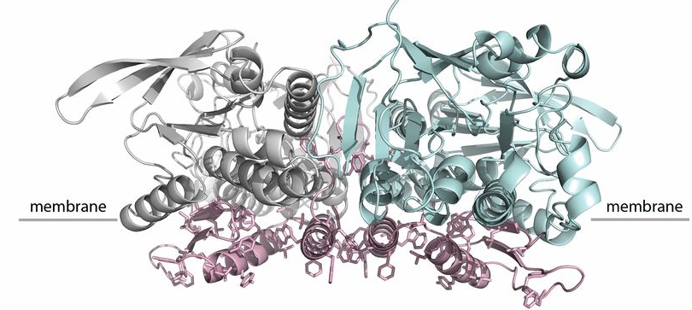
Bax vs Bak BH3:groove Dimer
The Bcl-2 family network
Bax BH3-in-groove dimer
Bak BH3-in-groove dimer
Structure of a monotopic membrane protein
Ndi1, Respiratory complex 1
Iwata M et al. PNAS 2012;109:15247-15252
Notes:
reminiscent

Slide 43
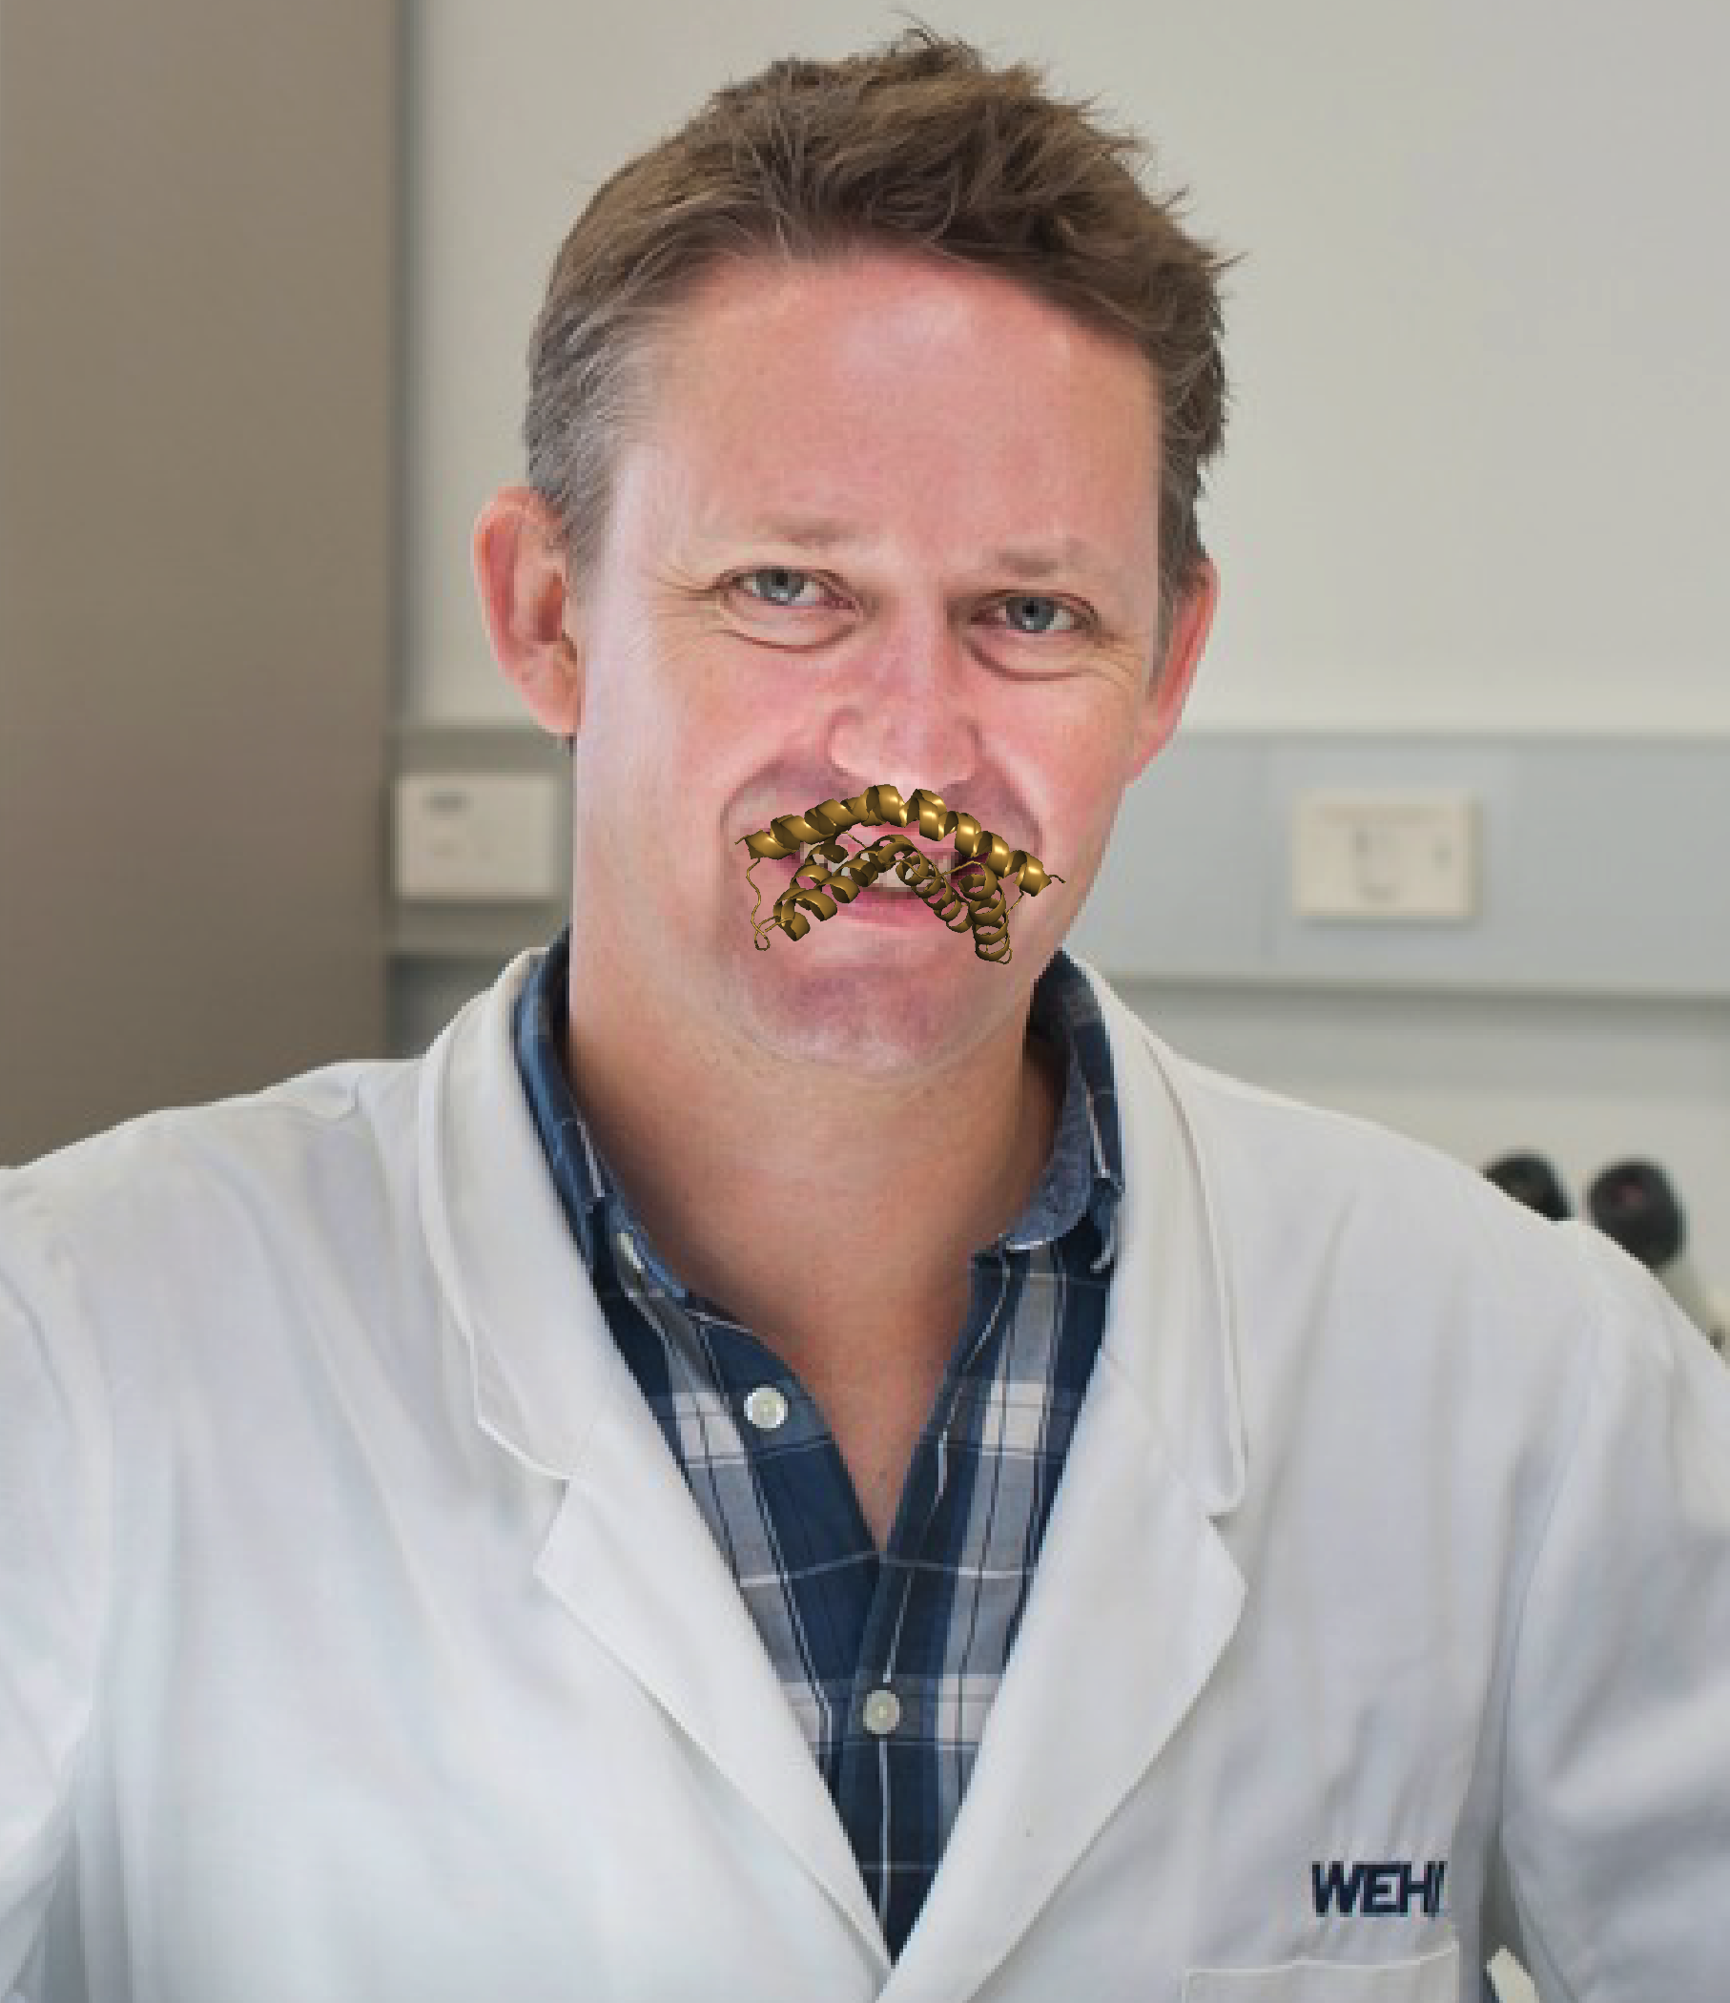
I moustache you a question!
http://www.comicsanscriminal.com/

Slide 44
au.movember.com/team/1680997
Or
Google: Movember WEHI
I moustache you a question!
http://www.comicsanscriminal.com/

Slide 45
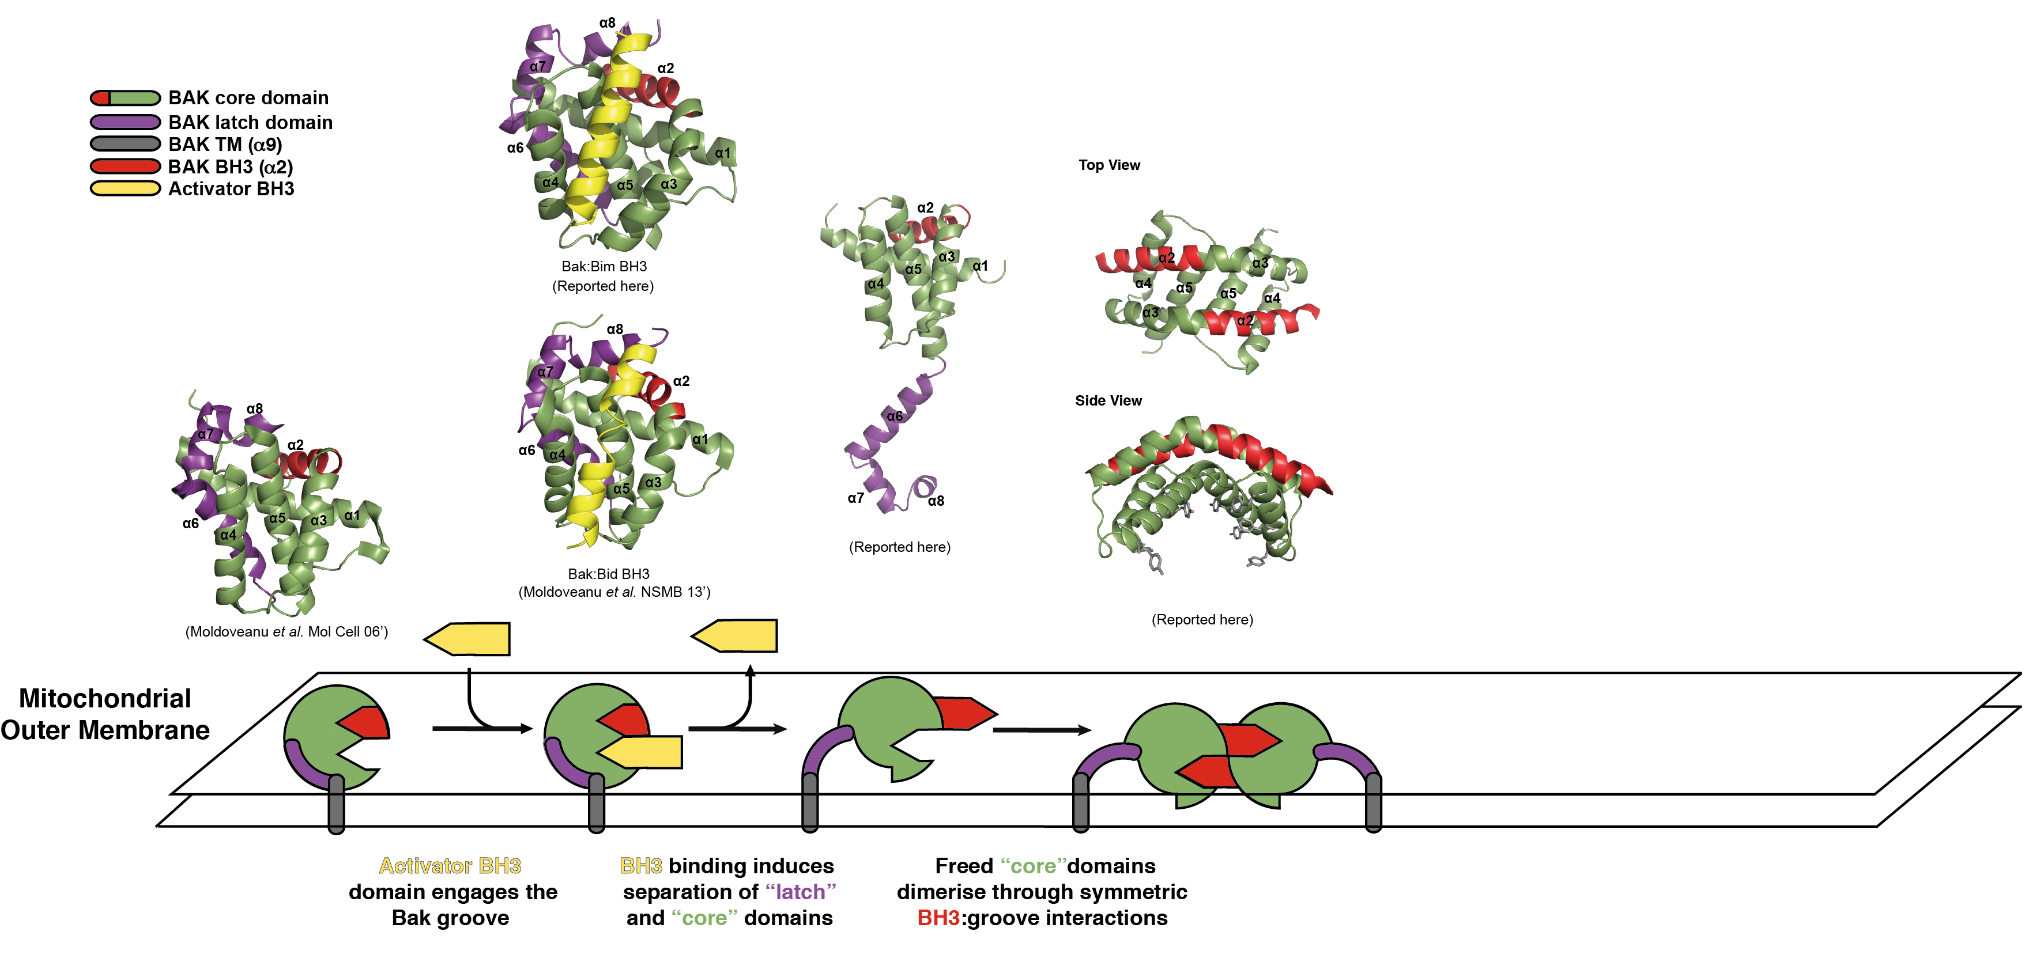
Bak Activation

Slide 46
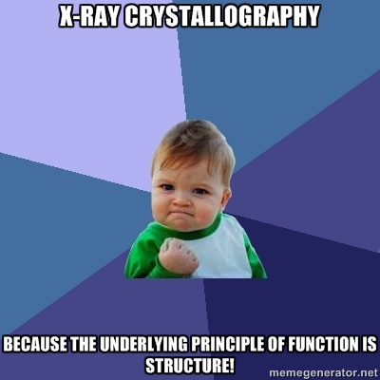

Slide 47
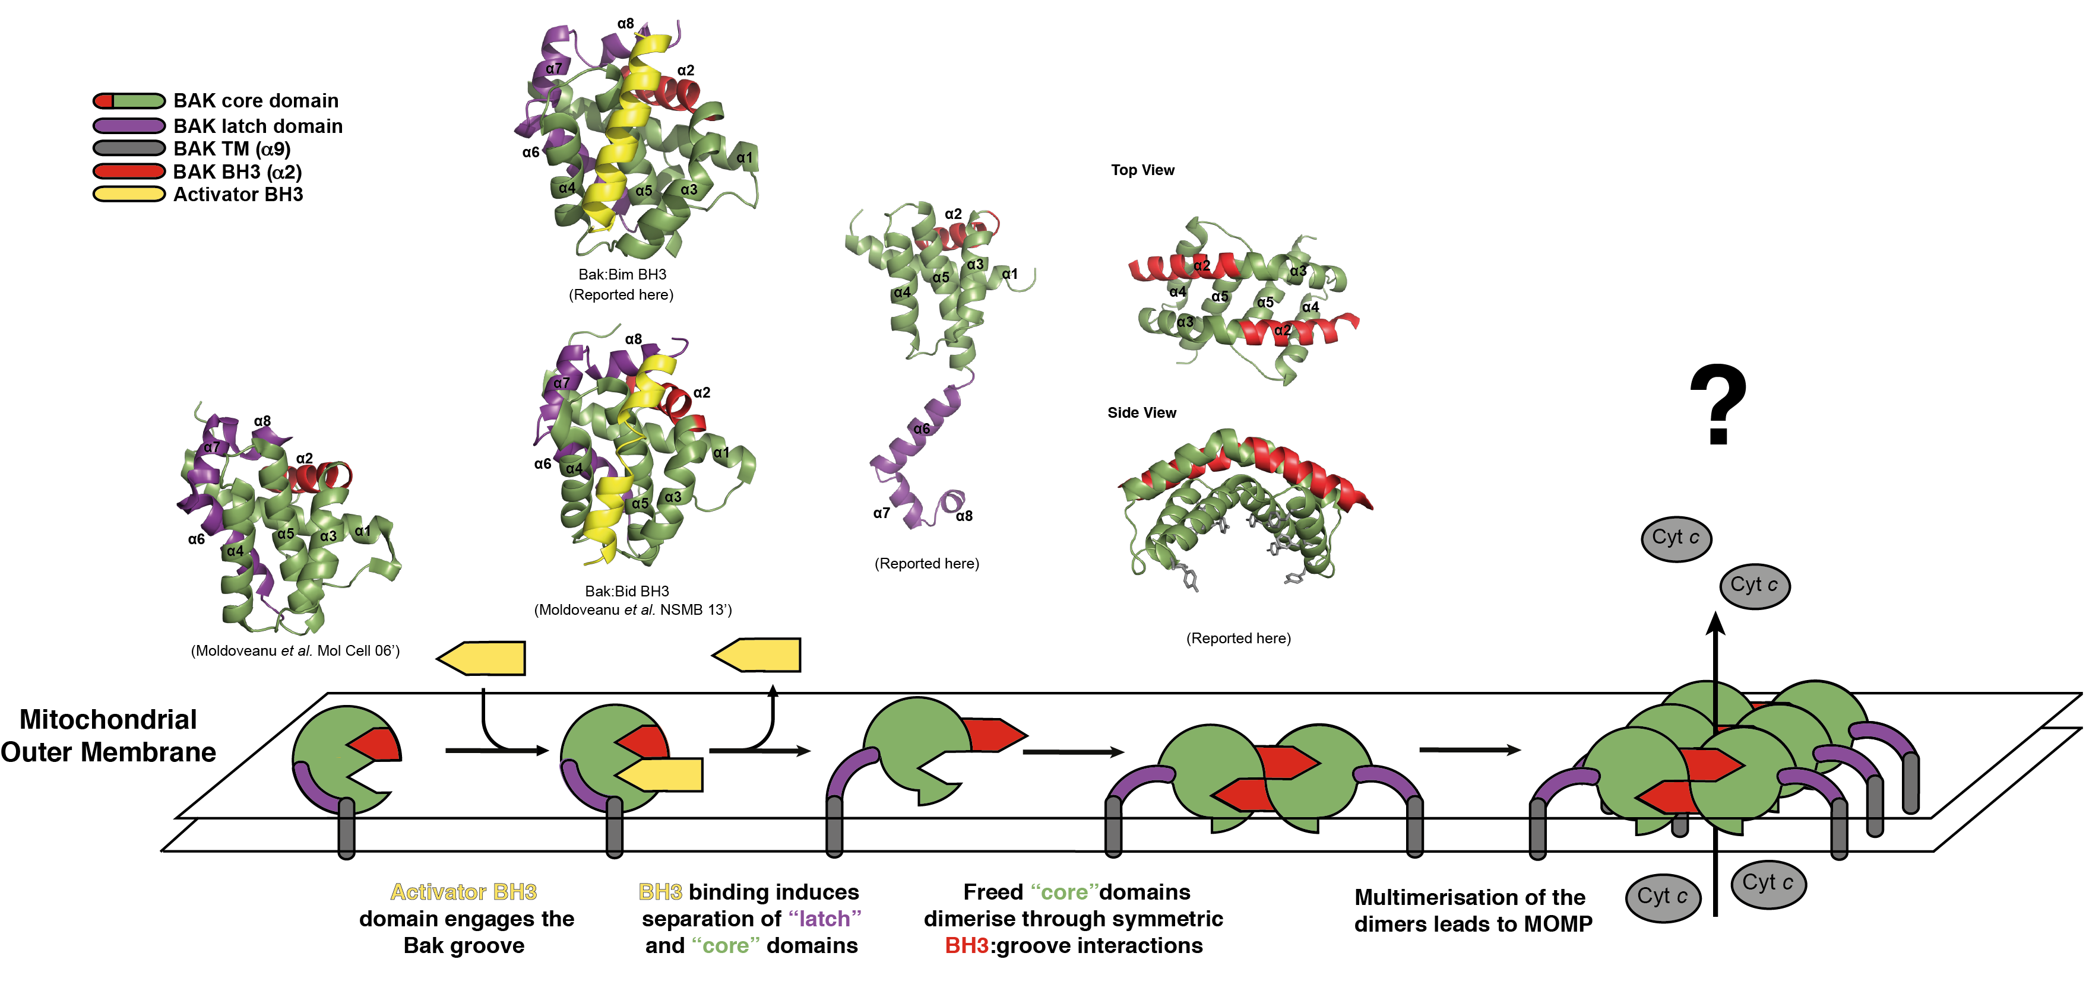
Bak Activation

Slide 48
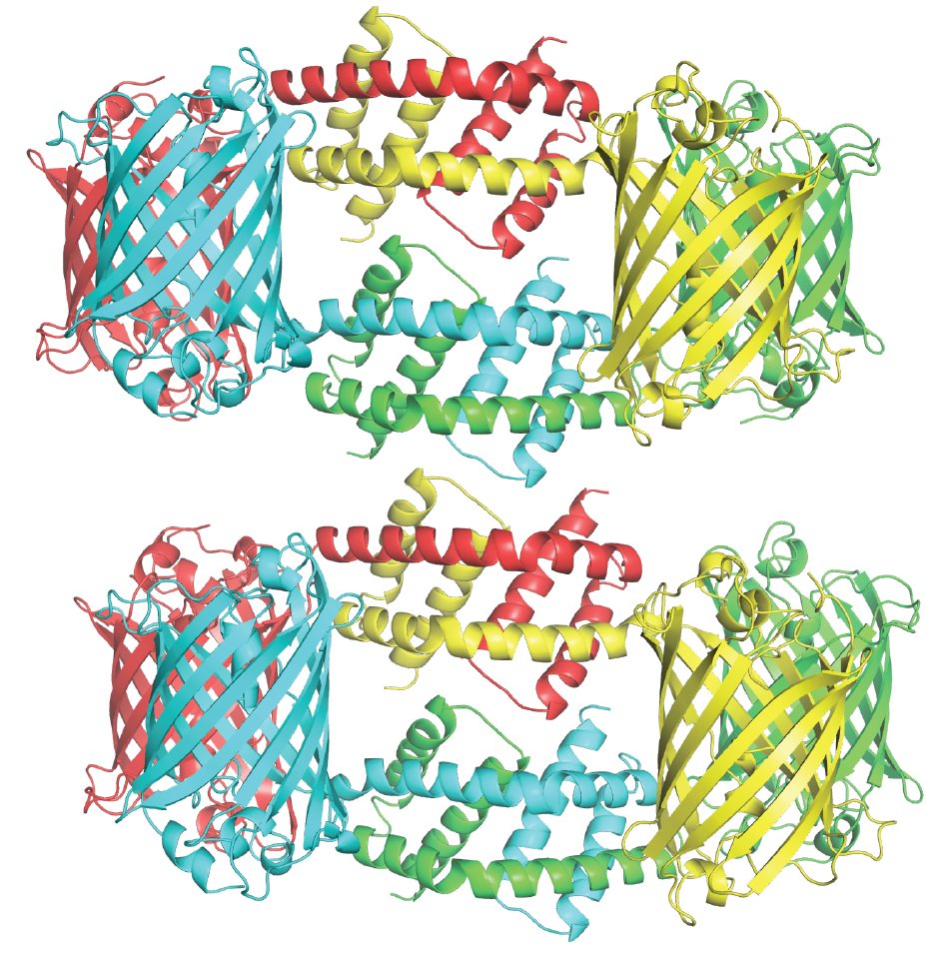
Bak Oligomer

Slide 49
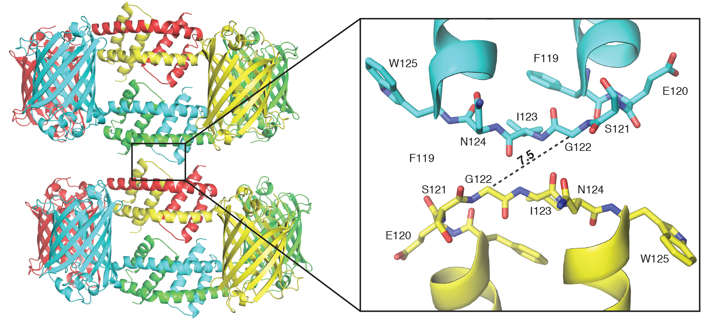
Bak Oligomer

Slide 50
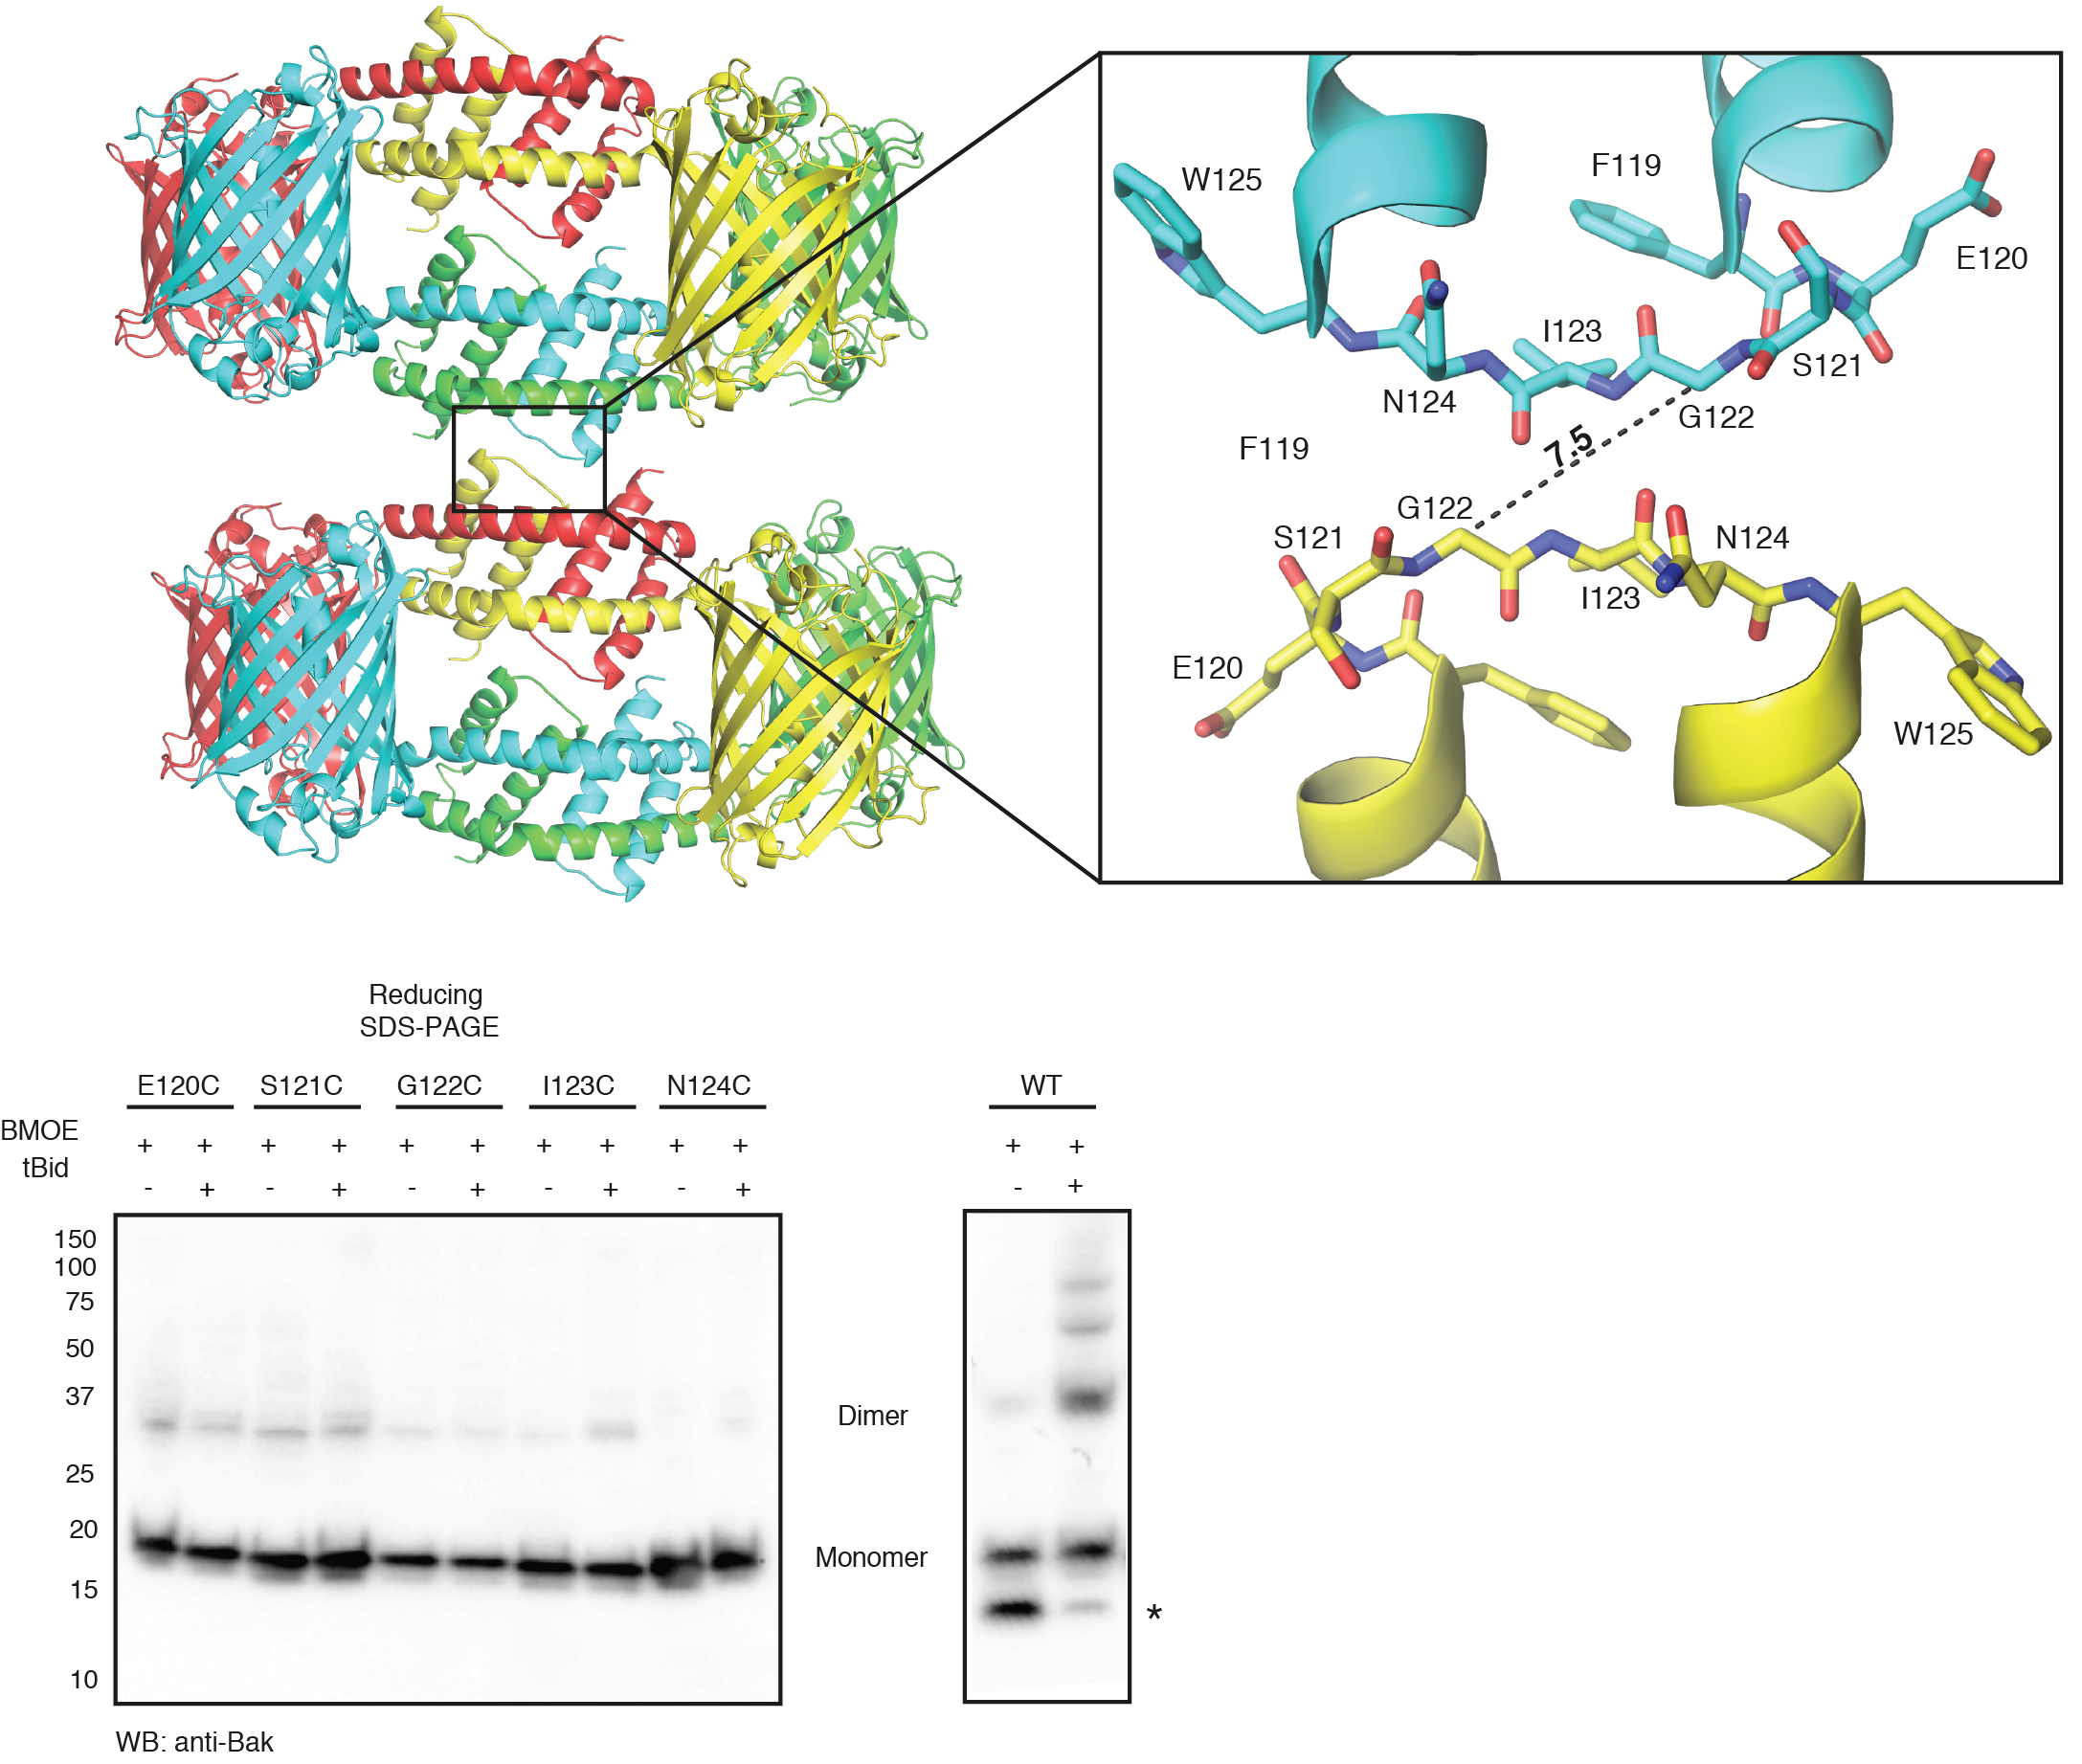
Bak Oligomer

Slide 51
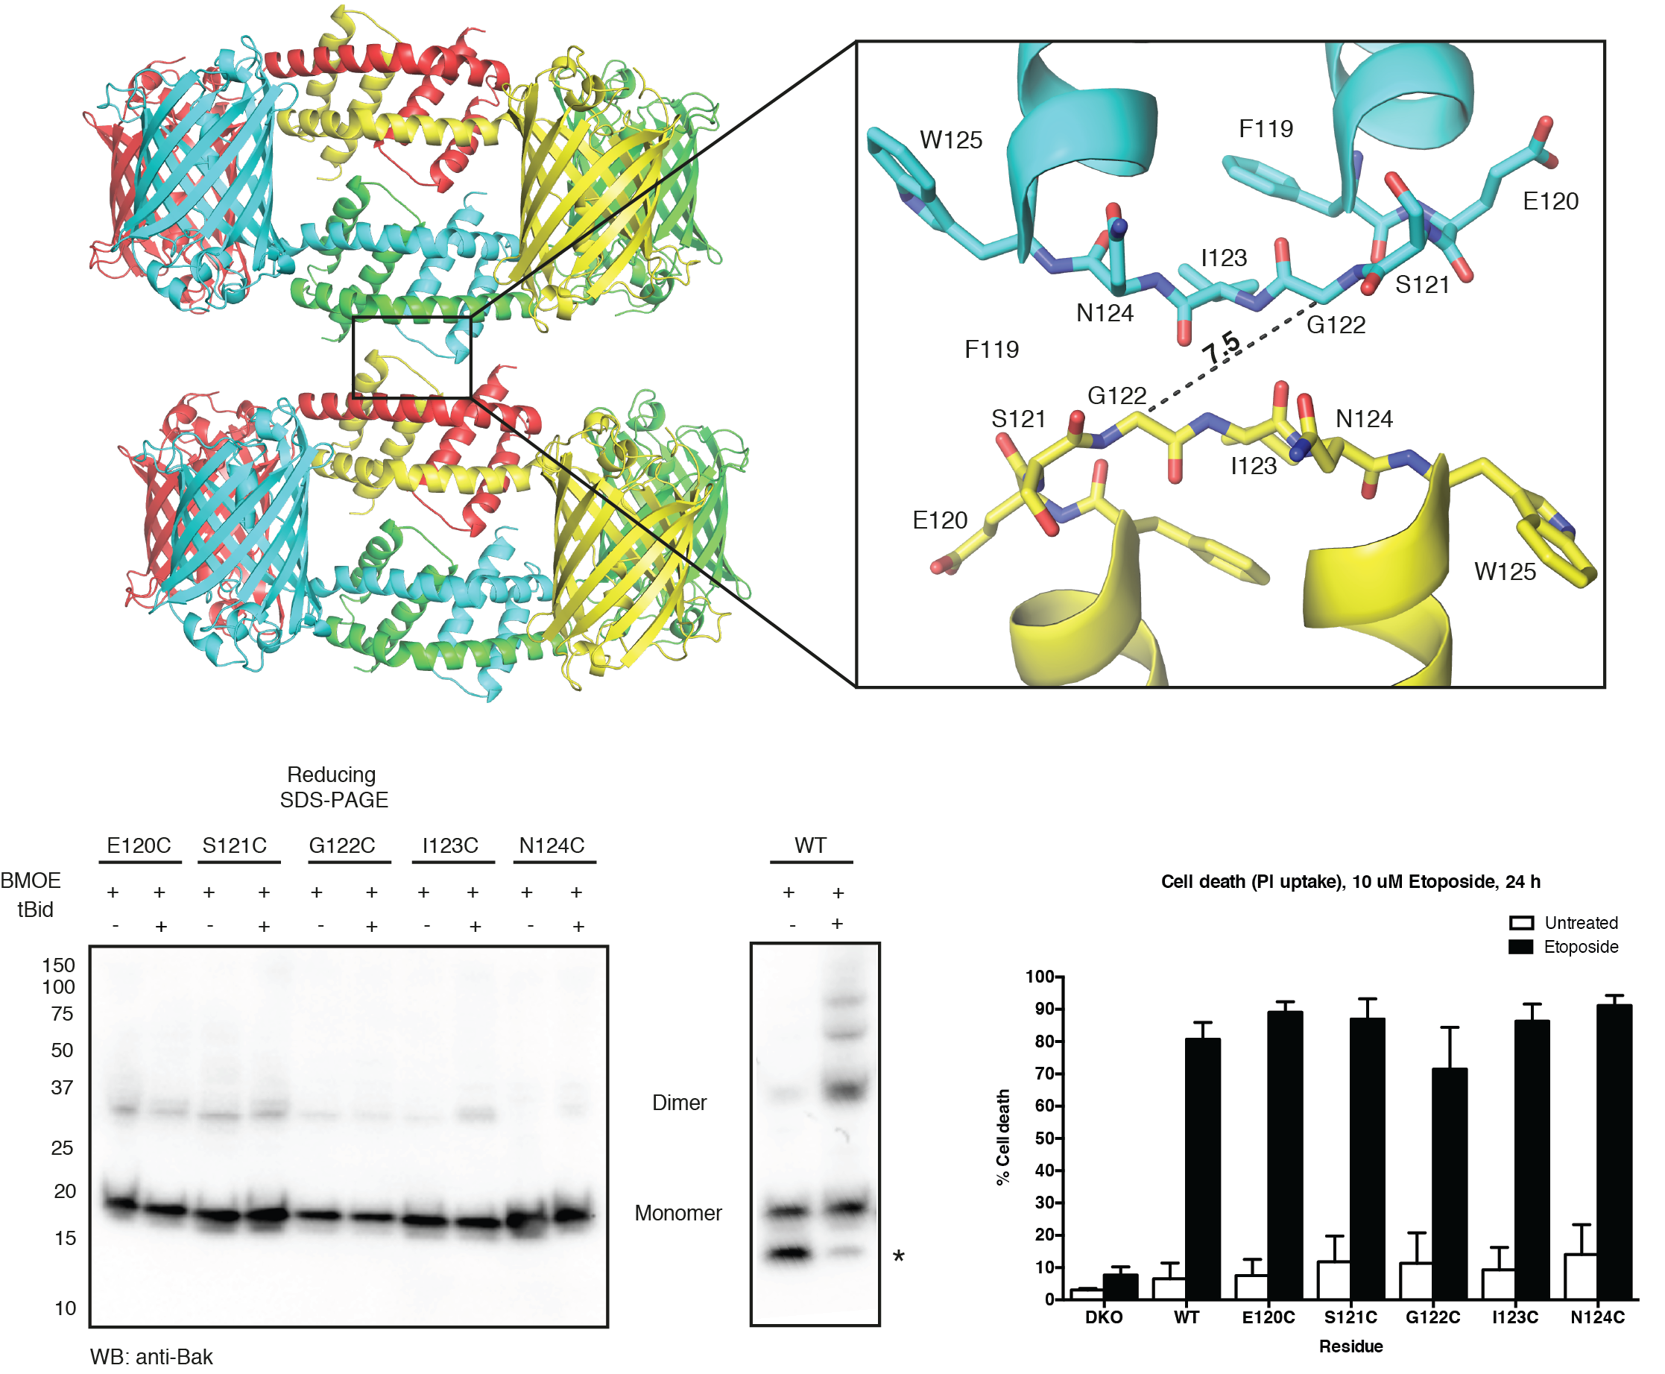
Bak Oligomer

Slide 52
Bak Activation

Slide 53
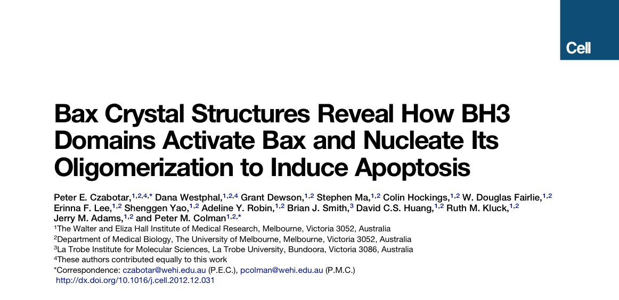

Slide 54

Bax vs Bak Activation

Slide 55

Bax vs Bak Activation

Slide 56

Bax vs Bak Activation

Slide 57

Bax vs Bak Activation

Slide 58

Bax vs Bak Activation

Slide 59

Thanks!
Structural Biology
Doug Fairlie
Erinna Lee
Jeff Babon
Callum Lawrence
Chemical Biology
David Segal
David Huang
CSIRO C3
Janet Newman
Shane Seabrook
La Trobe Uni
Brian Smith
PhD committee: Jacqui Gulbis
Ruth Kluck
Matt Call
Peter Colman
Peter Czabotar
Czabotar and Colman Labs
Adeline Robin
Geoff Thompson
Ahmad Wardak
Angus Cowan
Michael Roy
Sean Hewetson
MGC
Ruth Kluck
Ray Bartolo
Dana Westphal
Rachel Uren
Colin Hockings
Khatira Anwari
Sweta Iyer
Amber Alsop
Steph Fennell
Grant Dewson
Rob Ninnis

