Slide 1
Surface Science at the Soft X-ray Beamline
Anton Tadich
Soft X-ray Spectroscopy eamline

Slide 2
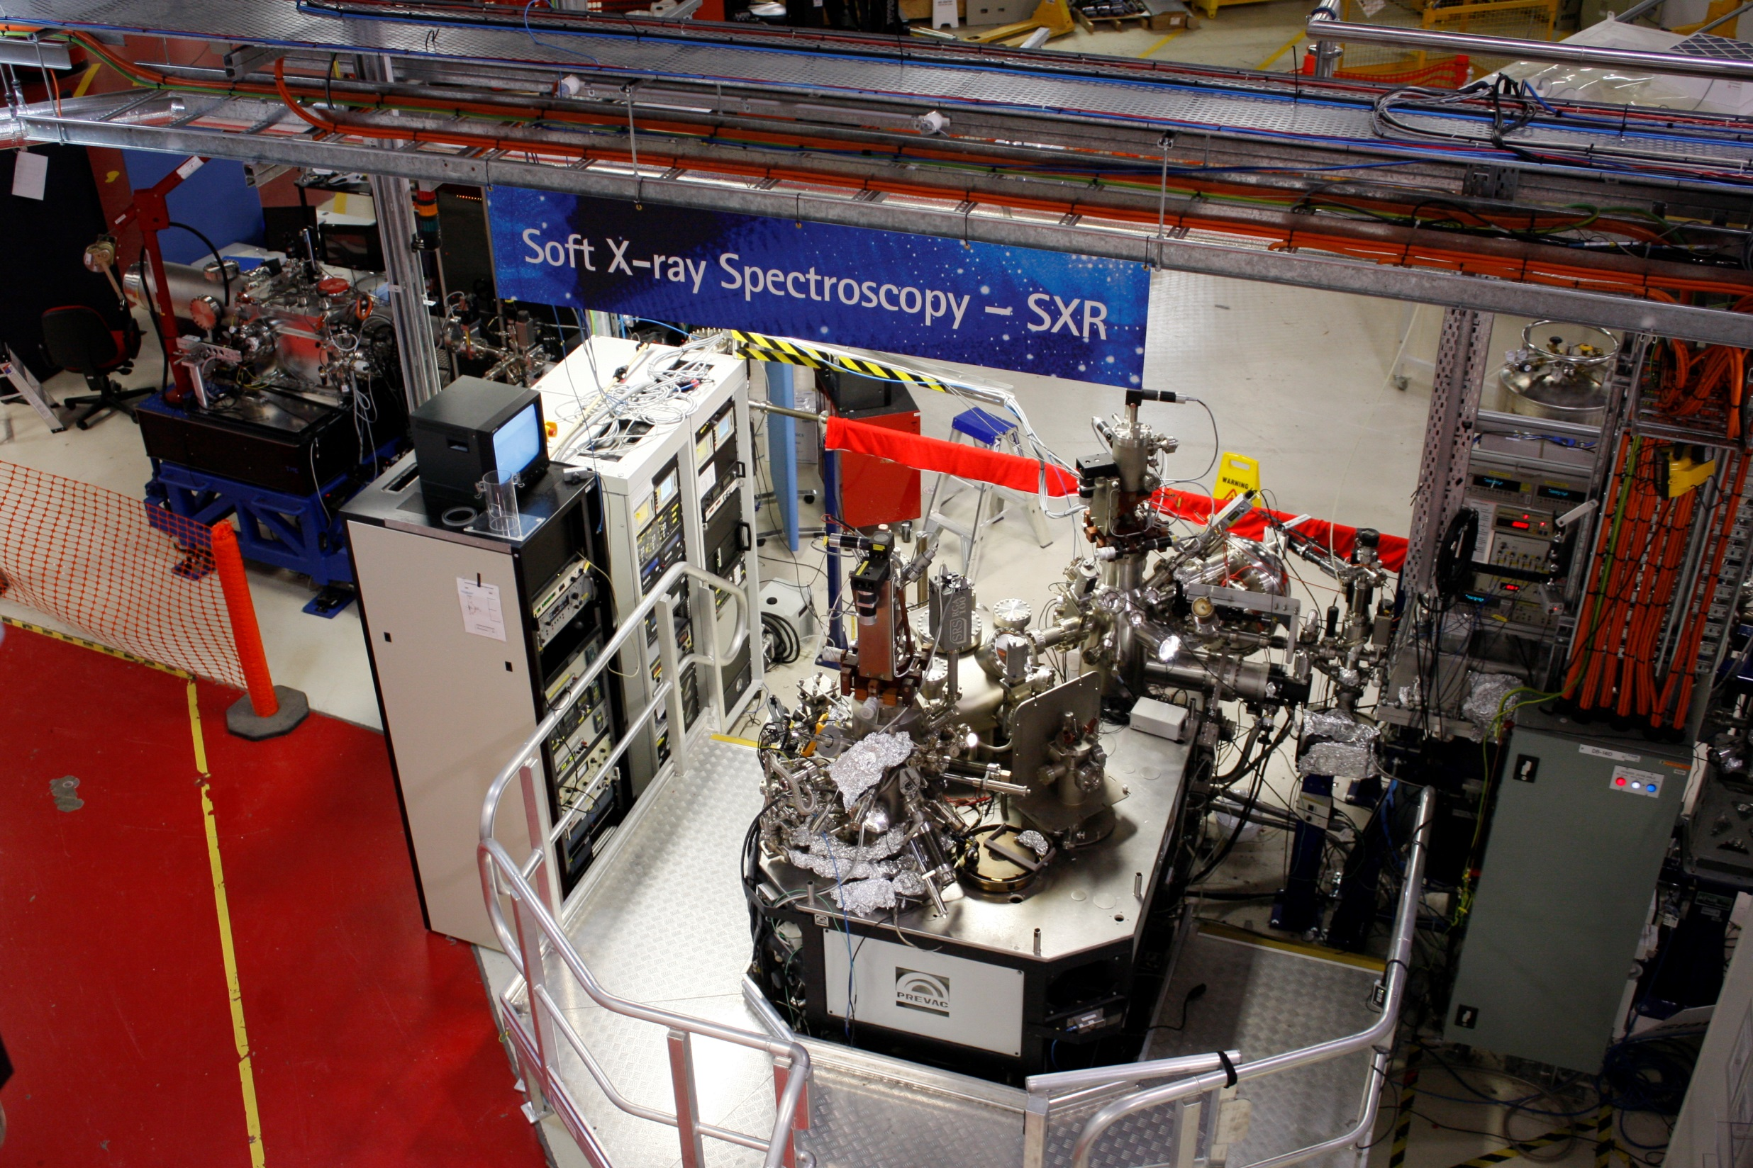

Slide 3
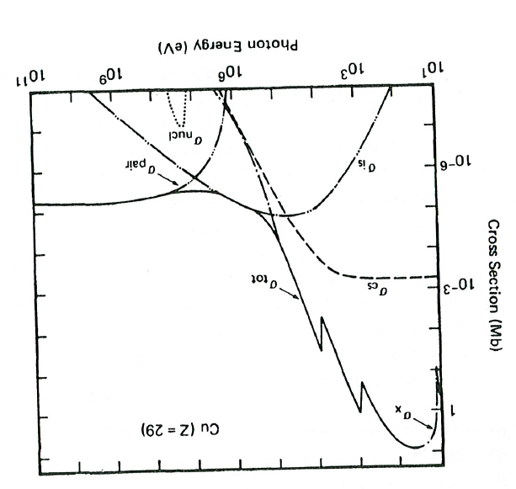
Soft X-ray Spectroscopy
Soft X-ray Region
X-ray Interaction with matter
For Soft X-ray Energies:
X-ray absorption (“electron absorbs photon”) probability dominates by orders of magnitude
We offer two main techniques:
Near Edge X-ray Absorption Fine Structure (NEXAFS)
Soft X-ray Photoelectron Spectroscopy (SXPS)
Courtesy: J.H Hubbell et al. J. Phys. Chem .Ref. Data 9, (1023), 1980
Notes:
Pair Production: production of electron and positron via annilation of incoming photon in vicinity of nucleus: min energy is 2 x 511MeV which is rest mass energy of electrons. Only therefore occurs at photon energies above 1MeV.
Incoherent scattering (also sometimes called Compton scattering) photon transfer part of its energy to an electron and continues with less energy. Energy and momentum of system is conserved. Electron released from atom. Process only starts to occur when photon energy comparable to rest mass energy of electron i.e 511keV
Coherent Scattering: scattering without change in energy e.g diffraction . Definite phase relationship between incident and scatterered waves
The main difference between coherent and incoherent scattering is that the phases of the scattered x-rays from scattering centres are correlated for coherent radiation and uncorrelated for incoherent radiation.
Nuclear Photoabsorption: abso

Slide 4
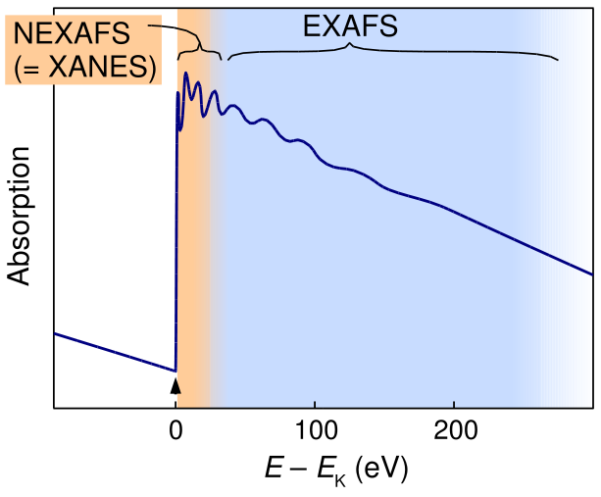
NEXAFS Spectroscopy
X-ray Absorption Spectroscopy
X-ray absorption
Measure the x-ray absorption of the sample as the x-ray energy is tuned across the “edge energy” of the core level
hν
K Edge
Near Edge X-ray Absorption Spectroscopy (NEXAFS)
Extended X-ray Absorption Fine Structure (EXAFS)
Local probe of structure around emitter using photoelectron wave
Interference between outgoing electron wave and backscattered wave off neighboring atoms
Probe transitions to unoccupied, bound states
Sensitive to local chemical environment, bond geometry
http://upload.wikimedia.org/wikipedia/commons/thumb/c/c2/NEXAFS_EXAFS_schematic.svg/613px-NEXAFS_EXAFS_schematic.svg.png
Notes:
NEXAFS sometimes known as XANES
NEXAFS was developed initialyl as means of testing the structure of molecuels bonded to surfaces
During the 70s, the near edge strucutre was largely ignored due to its complexity, and only the EXAFS structure was of interest

Slide 5
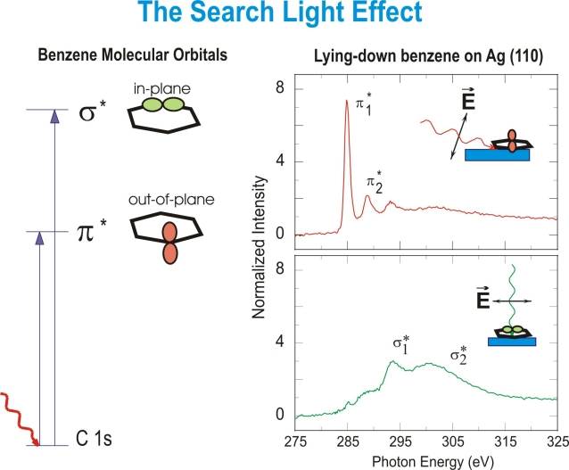
Molecular orientation using NEXAFS
Molecular Orientation with NEXAFS
NEXAFS with polarised light is a powerful tool for determining the orientation of molecular orbitals
Polarised soft x-rays act as a “search” light for unoccupied orbitals aligned with the E vector
J. Stohr SSRL

Slide 6
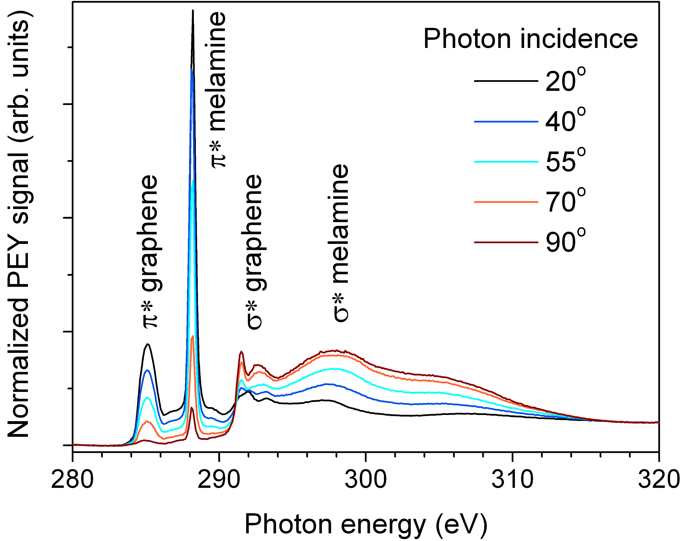
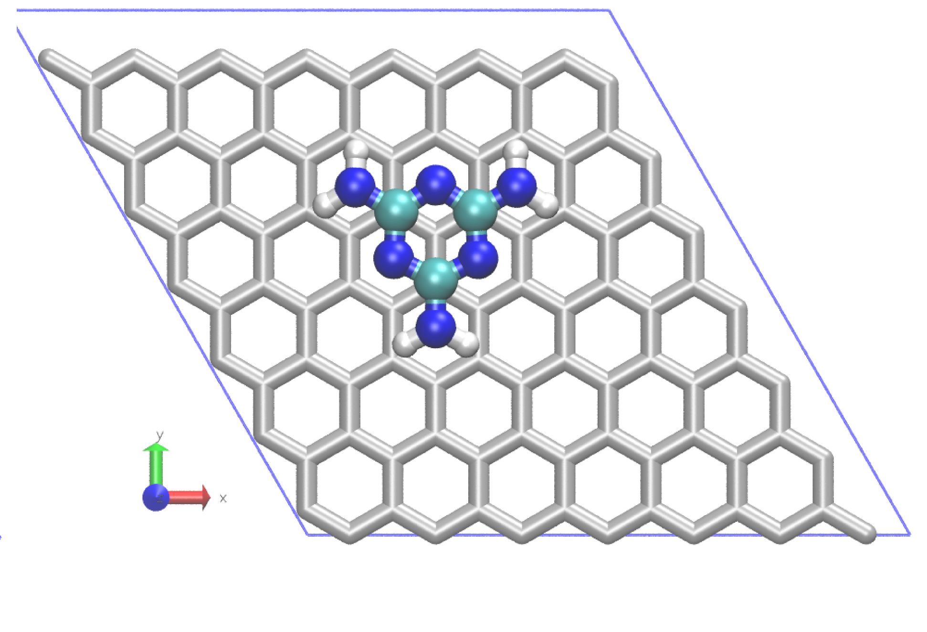
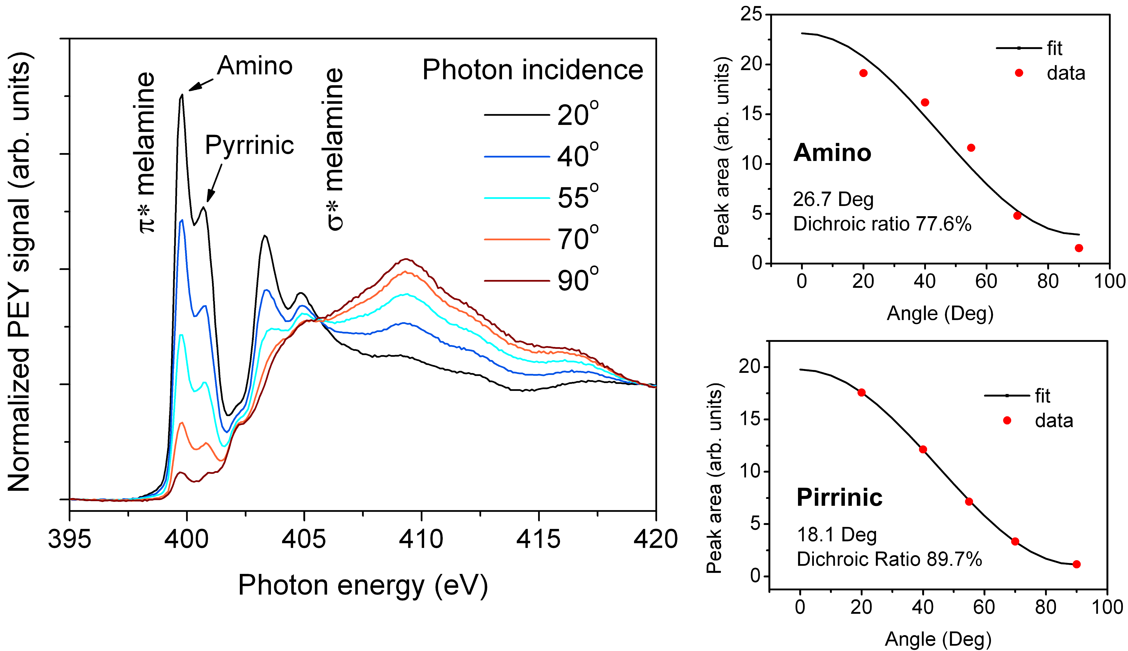
Example: Melamine on graphene
Optimised DFT adsorption geometry
Context: Using graphene as small molecule sensor
C K- edge and N K- edge NEXAFS data suggest a flat adsorption geometry up to 3.6ML
Amino π* angle dependence indicates 8° tilt angle from plane
Courtesy J Cervenka, University of Melbourne

Slide 7
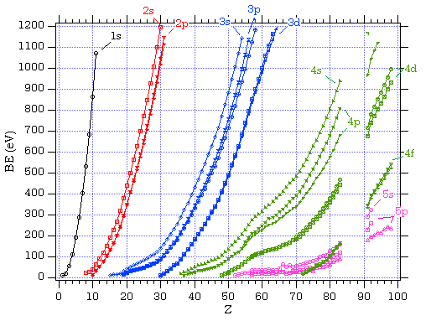
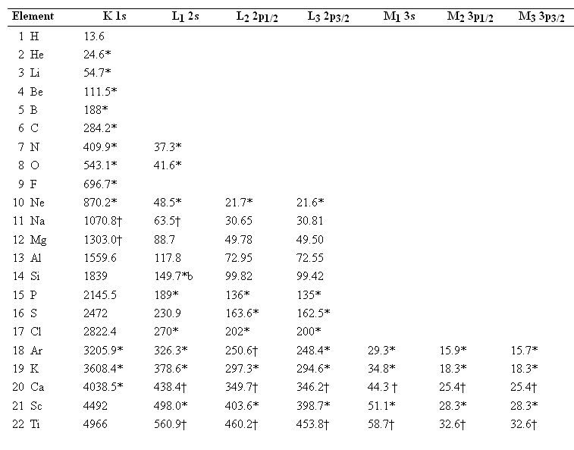
Soft X-ray Photoelectron Spectroscopy
Electron Binding Energy
  Electrons in atomic core shells (1s, 2s, 2p,etc) are bound to the nucleus with element specific binding energies
http://xdb.lbl.gov/Section1/Table_1-1a.htm
http://www.ifw-dresden.de/institutes/ikm/organisation/dep-31/methods/x-ray-photoelectron-spectroscopy-xps/xps2.jpg

Slide 8
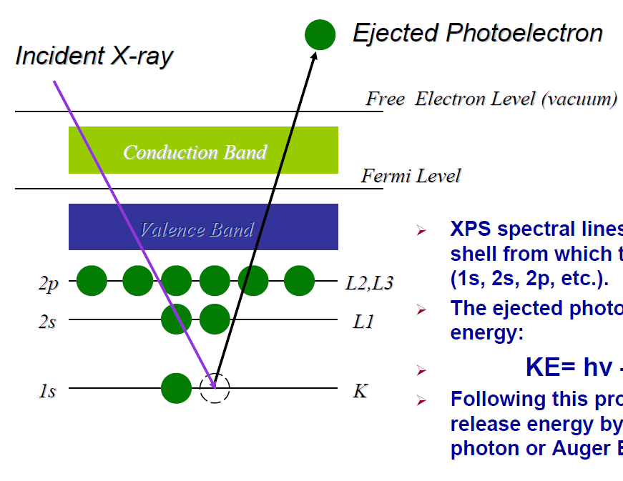
Soft X-ray Photoelectron Spectroscopy
  The Photoemission Process
  With sufficient photon energy, electrons from occupied core levels can be liberated and detected with an electron spectrometer
  The kinetic energy of the electron yields its corresponding binding energy E_{B} via the equation:
  E_{kin} = hν – E_{B} – φ
  (where φ represents the work function of spectrometer)
hν
E_{kin}
φ
E_{B}

Slide 9
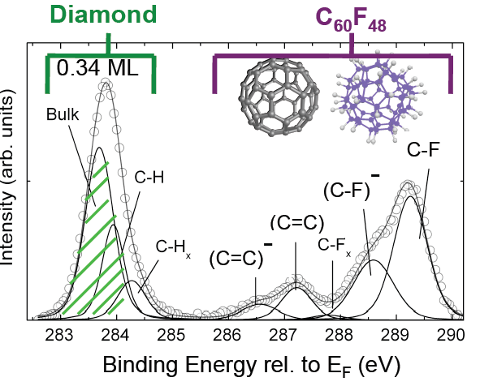
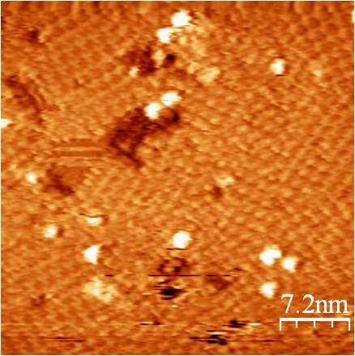
Creating a 2D hole gas on diamond with C₆₀F₄₈
Soft X-ray Photoemission: X-ray in – Electron out technique
Probes chemical and charge environment of molecules on the surface
C1s @ 330eV
SXR light
e⁻
e⁻
e⁻
e⁻
  E_{kin} = hν – E_{B} – φ
Ionised (doping) and neutral (non-doping) C₆₀F₄₈ components are resolved!

Slide 10
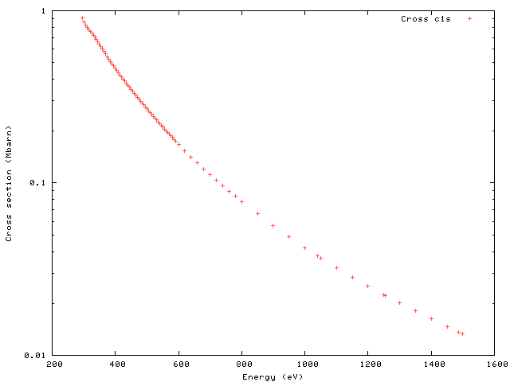
XPS WITH SR: ADVANTAGES
1. Cross Section Optimization
C1s Excitation Cross Section
The photoionisation cross section for a given shell (e.g 1s or K) exhibits a rapid increase, followed by a smooth decrease, at the threshold energy
SR @ 600eV
For lab based X-ray source energies (e.g Al-Kα 1486.6eV), the cross-section is quite low for light, low Z elements
Cross Section (Mbarn)
Lab XPS
@1486.6eV
One can lower the x-ray energy to obtain an order or more magnitude in excitation probability
Photon Energy (eV)
http://ulisse.elettra.trieste.it/services/elements/WebElements.html
10

Slide 11
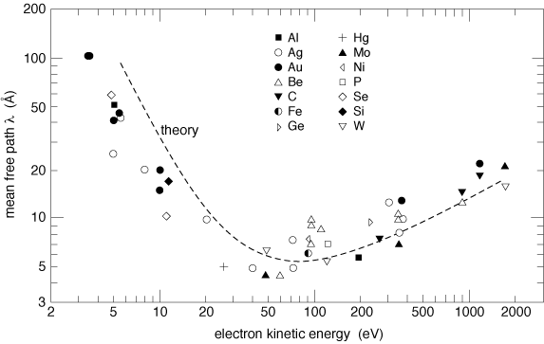
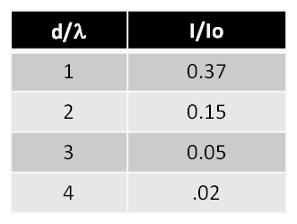
SXPS: surface sensitivity
Electron Mean Free Path
  XPS derives its surface sensitivity from the fact that photoelectrons and Auger electrons possess extremely short mean free paths (λ)
hν
I = I₀e^{-d/λ}
d
I_{O}
http://www.philiphofmann.net/surflec/fig3_2.gif
I₀
  95% of photoelectrons have scattered within 3λ from the surface

Slide 12
XPS WITH SR: ADVANTAGES
2. Tuning The Core Level Kinetic Energy
Inelastic scattering => most of the signal comes from a few MFP of the surface.
XPS is extremely surface sensitive,
http://www.philiphofmann.net/surflec/fig3_2.gif
With SR: one can “tune” the KE of a photoelectron to obtain depth information
Qualitative (Easy)
Quantitative (Harder)
Notes:
Altough one can adjust the angle of detection in conventional XPS to be more surface sensitive, it is done at the expense of count-rate.

Slide 13
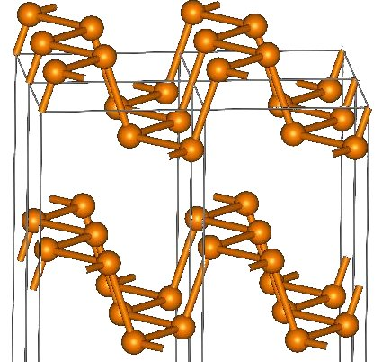
Black Phosphorus Oxidation
Cleave in Vacuum
-> measure
Expose to air
-> measure

Slide 14
Oxide Peaks
O1s=531.62 eV
O1s=533.24 eV
O1s=531.7 eV
O1s=533.49 eV
How we are beginning to interpret the data
Literature values for Phosphite
531.8 eV and 533.3 eV
J. Non-cryst. Solids 160, 73 (1993)
531.5 eV and 533.3 eV
Phys. Chem. Glass. 36, 247 (1996)
The lower BE O1s corresponds to bridging oxygen and higher BE O1s to non-bridging oxygen in NaPO₃.
.

Slide 15
Black Phosphorus
Oxide Peaks
P2p_{3/2}=130.06 eV
P2p_{1/2}=130.94 eV
P2p_{3/2}=130.17 eV
P2p_{1/2}=131.04 eV
Oxide Thickness
P2p_{3/2}=130.58 eV
P2p_{1/2}=131.52 eV
P_{Oxide1}=132.65
P_{Oxide2}=134.42 (PO₃)
P2p_{3/2}=130.1 eV
P2p_{1/2}=130.95 eV
0.24nm
P2p_{3/2}=130.16 eV
P2p_{1/2}=131.01 eV
P2p_{3/2}=130.64 eV
P2p_{1/2}=131.58 eV
P_{Oxide1}=132.8
P_{Oxide2}=134.65 (PO₃)
0.43nm

Slide 16
hν = 180 eV 350eV 800eV
This peak related to surface species

Slide 17
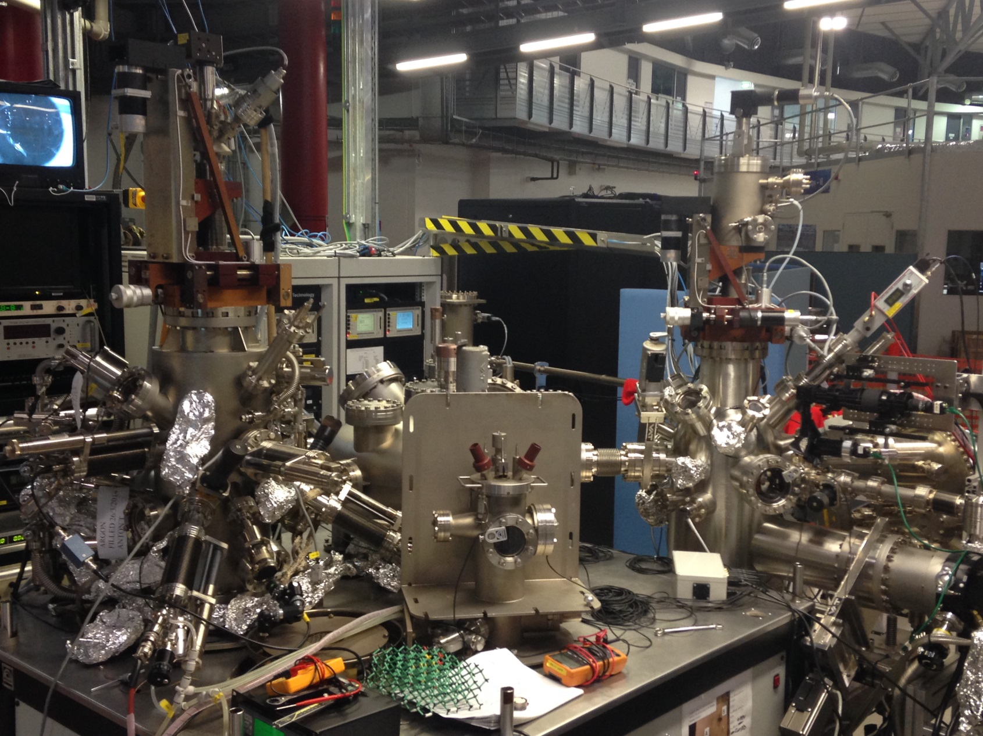
The Soft X-ray Endstation
Multi purpose Ultra High Vacuum (UHV) endstation dedicated for XPS and NEXAFS
Key Features
Multiple NEXAFS detectors (PEY, TFY)
High resolution electron spectrometer
Multifunction preparation chamber
User friendly sample transfer
Crystal cleaving chamber
Inert atmosphere “glovebox”
Electron flood gun for insulators
SAMPLE ENDSTATION IMAGE

Slide 18
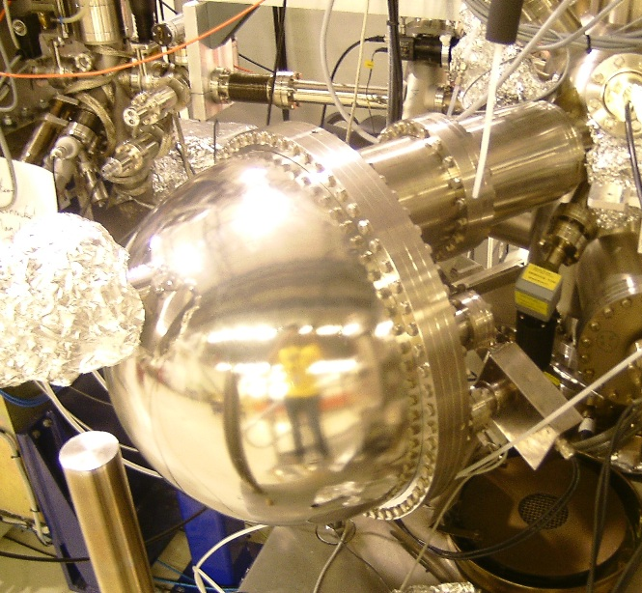
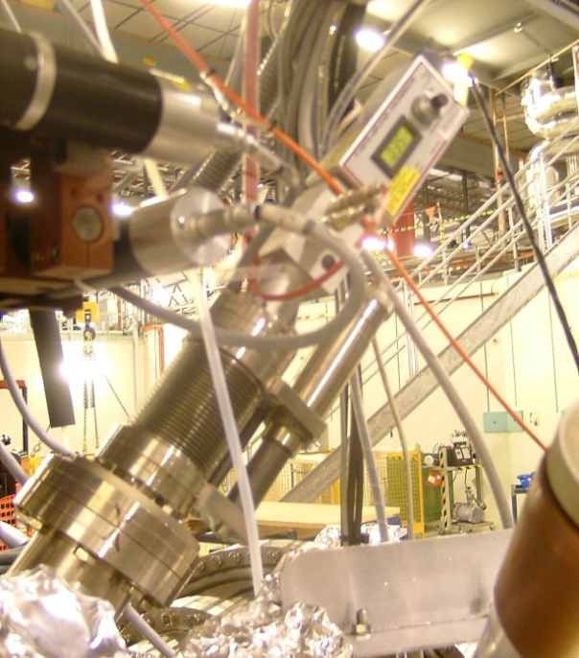
Main Detectors
Photoemission
NEXAFS
SPECS Phoibos 150 hemispherical analyser
  150mm mean radius
  9 channeltron detector
  K.E up to 3.5keV. ΔE = 141meV @ 10eV pass
  Various Lens modes
Total electron yield (sample current)
Retarding Grid Analyzer (Partial Electron Yield or Total Fluorescence Yield)
Channeltron (Partial Electron yield)
Simultaneous bulk (<100nm) and surface (<10nm) NEXAFS

Slide 19
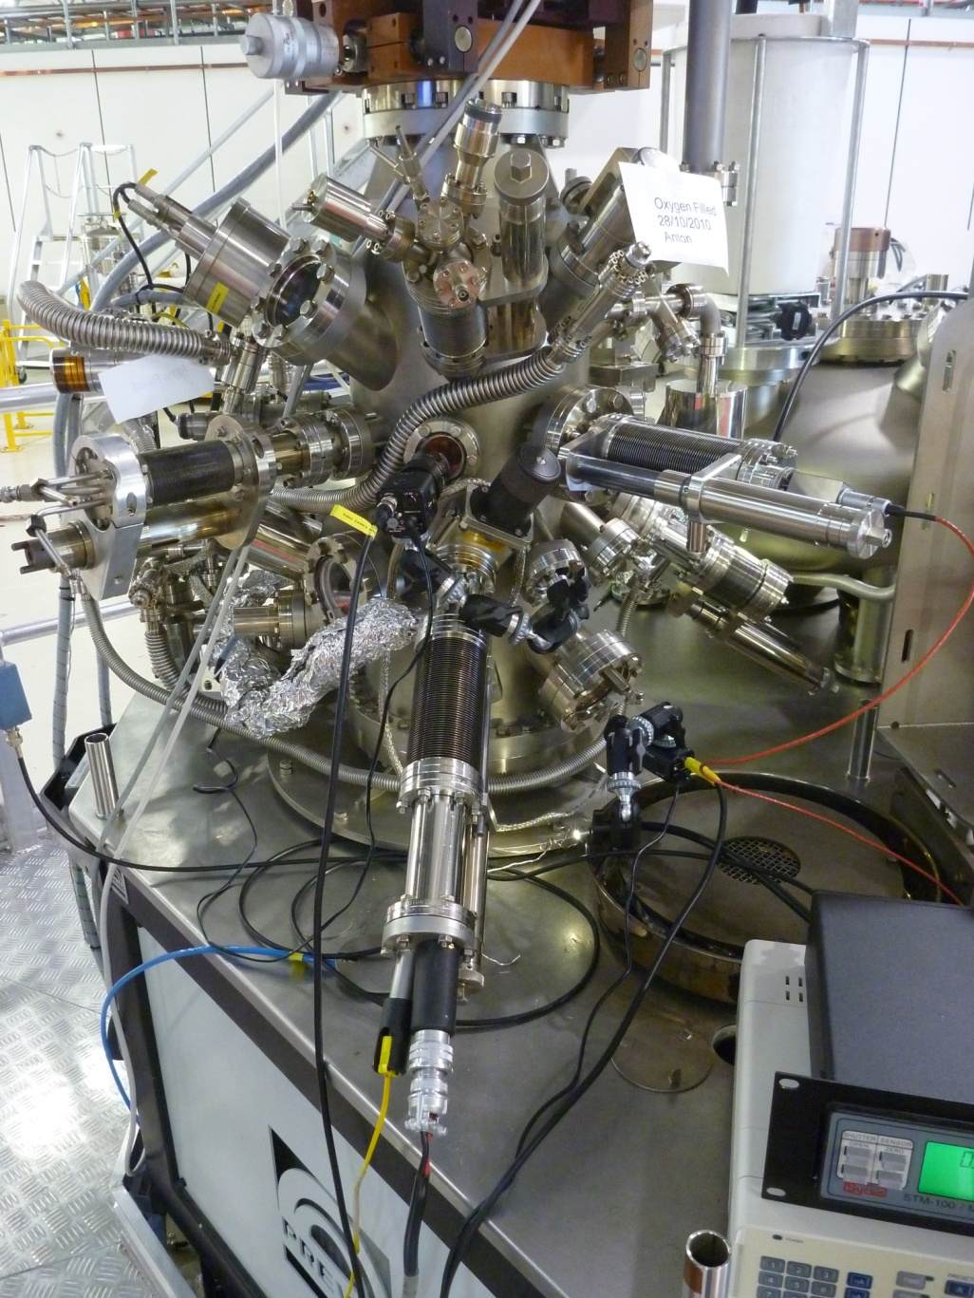
PREPARATION/CHARACTERISATION CHAMBER
A wide range of sample preparation and characterisation options:
Residual Gas Analyser (to 300amu)
Electron beam evaporator (to >3000C)
Wide range effusion evaporator (200C to 1400C)
Organic Material Evaporator (RT to 300C)
Medium Temp Evaporator (300C to 800C)
Low Energy Electron Diffraction (LEED)
Quartz crystal microbalance
Argon ion sputtering 0.1 – 5keV
Heating/cooling of sample: -160C to 1200C
Gas Dosing (up to 10⁻⁶ mbar)
Cleaving of layered materials
4-point conductivity probe (basic elec. meas.)
Kelvin Probe (Alt. work function measurement)

Slide 20
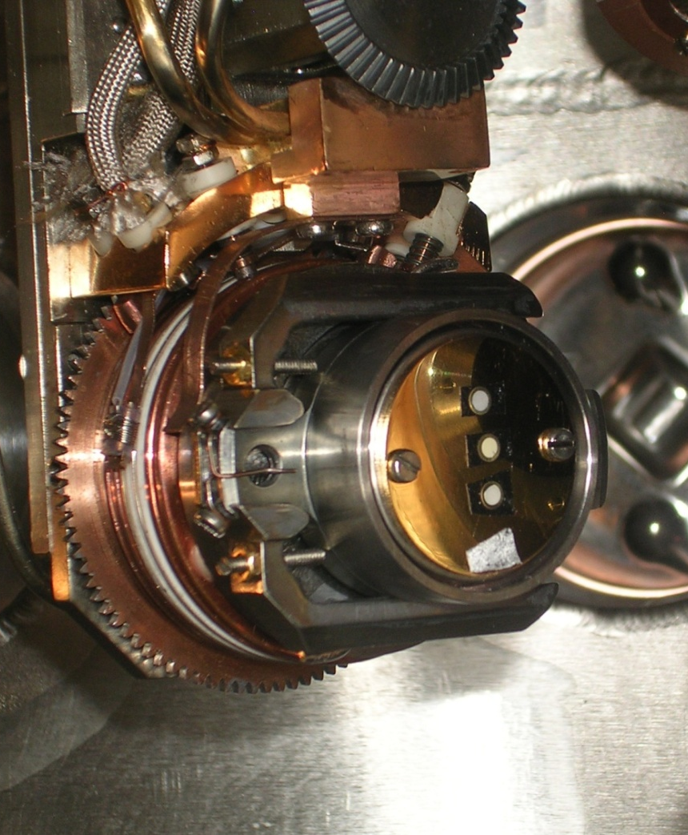
Sample Requirements
Samples
Size Requirements
Samples must fit on 25mm diameter disc
Sample height must be no more than 3 -4mm
Form of Samples
Wafers, powders, crystals, liquids (ionic), minerals, polymers.
Samples must be UHV Compatible!!! Need to maintain < 10⁻⁹ mbar during measurement
Also….
Multiple samples possible per holder
Introduction time of single holder to system ~ 2 hours

Slide 21
Information for new users
Applying as a New User
Merit based selection for beamtime
Contact beamline scientists for advice on experiment proposal!
Pre beamtime
A basic knowledge of photoelectron/Auger electron spectroscopy, and NEXAFS, goes a long way toward a successful experiment
Contact beamline staff regarding: samples, experimental plan, people,…
The Beamtime
Dedicated Beamline Scientist as “Local Contact”!
4 to 6 days beamtime, depending on experiment and user skill
1 day spent training without beam on the endstation
At least 1-2 days with beam before “real” data starts being taken

Slide 22
Information for new users
NEXAFS Proposals
NEXAFS is more difficult to interpret than XPS, less literature on systems
Reference materials (e.g coordination chemistry, functional groups) vital
Insulators: very doable, more so than XPS
Carbon NEXAFS: Add extra day of learning, especially for dilute systems.
XPS Proposals
Will need to demonstrate that you seek more than just “what’s there”
Will need to justify why a lab based XPS system is not suitable (surface sensitivity, cross section, resonance arguments)
Insulators: tend to be quite difficult, lineshape not good even with flood gun, fitting problematic
Email: softxray@synchrotron.org.au
Thank You!

