Slide 1
Post-HIPing of Transparent Polycrystalline
Alumina Ceramics Prepared by Pulsed Electric Current Sintering
HIP2017
Sydney, Australia
Dec. 6, 2017
Makoto Nanko¹, Hien Huu Nguyen¹
and Itaru Masuoka²
1. Department of Mechanical Engineering,
Nagaoka University of Technology
2. Engineering Section, Heavy Machinery Department, Machinery Business, Kobe Steel, Ltd.

Slide 2
INTRODUCTION
Transparent Polycrystalline Alumina (TPA)
Properties
Optical transparency
Mechanical properties
Chemical inertness
Thermal conductivity
Applications
Optical lenses, windows, protectors
Host material for solid-state laser
Fabrication methods
Pulsed Electric Current Sintering (PECS)
Notes:
- windows for laser communications
- Insulators and heat radiation plates
- Metal matrix composites

Slide 3
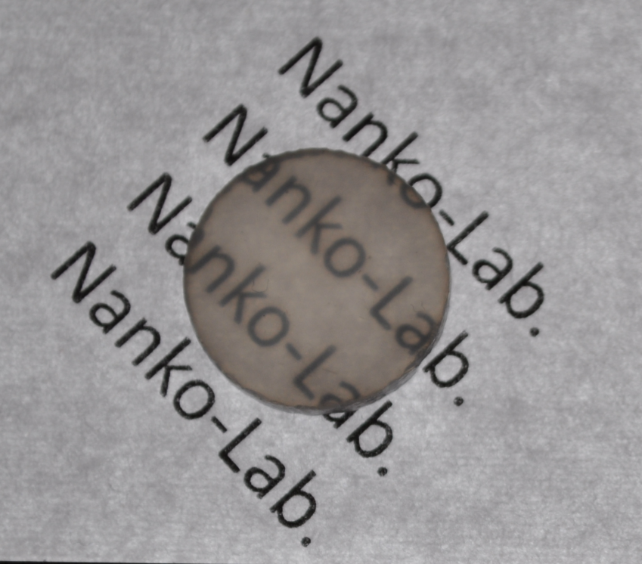
INTRODUCTION
TPA by Two-step PECS
(TS-PECS)
- 1st step: 1000°C in 60 min
- 2nd step: 1200°C in 20 min
- Heating rate: 100 ºC/min
Sample size: Φ15 mm
As-sintered thickness: 3 mm
Good transparency
Homogeneous
10 mm
Density: 100%
Grain size: 0.33 μm

Slide 4
INTRODUCTION
Transparent Al₂O₃ Prepared by PECS
  Transparent, but Darker:
  Carbon Contamination?
  Can Improve
  by HIPing?
    More Transparent
    More Clear

Slide 5
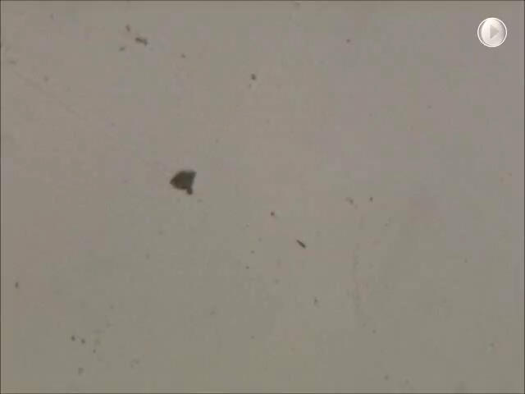
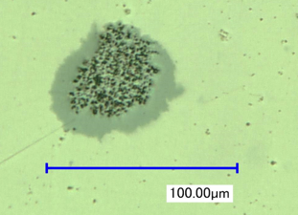
Introduction
Macro-Defects Caused by Agglomeration
Optical Microscope
50 μm
Can HIPing
Remove the Pores?
OM Image Moving the Focus
from the Surface

Slide 6
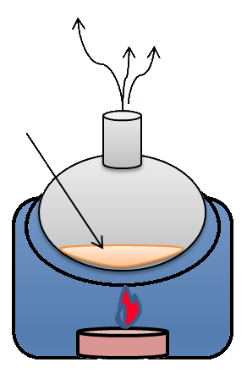
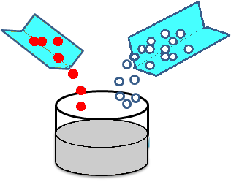
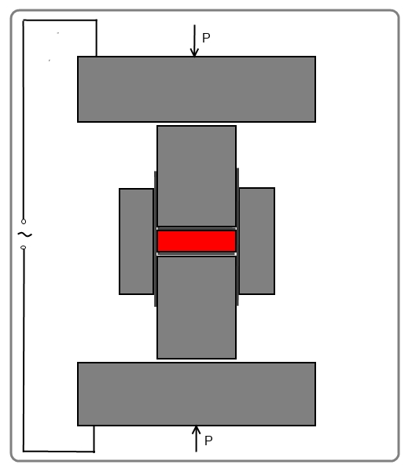
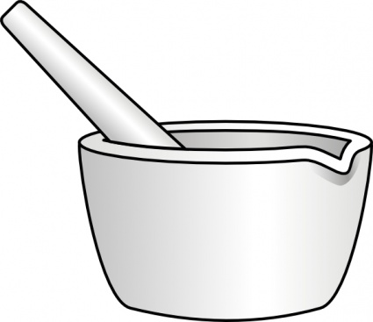
Experimental Procedure
Ball milling
Drying
Slurry preparation
Cr(NO₃)₃.9H₂O or Ti(OCH(CH₃)₂)₄
Slurry mixture
Al₂O₃
400ºC, 60 min
Ball/powder: 5:1
Time: 24 h
TS-PECS
Size: 10 mm
1st step: 1000ºC / 60 min
2nd step: 1200ºC / 20 min
Heating rate: 100 ºC/min
Applied press.: 100 MPa
High vacuum: <5×10⁻³ Pa
Manual
milling
30 min

Slide 7
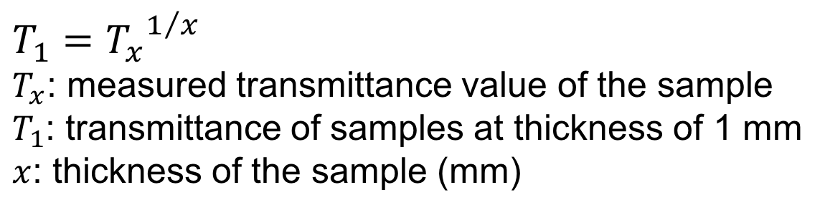
Experimental Procedure
As-sintered samples → Grinding, Polishing
HIPing process
Transmittance
Mask with Φ5 mm hole
Heater: Mo
Atmosphere: Ar/ 100 MPa
1000 - 1400°C/ 1 h,
400°C/h
Sensor
Sample
55 mm
SolidSpec-3700DUV
$$T_{1}={T_{x}}^{1/x}$$
$T_{x}$: measured transmittance value of the sample
$T_{1}$: transmittance of samples at thickness of 1 mm
$x$: thickness of the sample (mm)

Slide 8
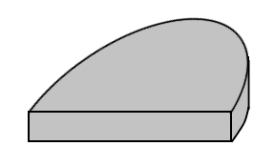
Experimental Procedure
Sample notations
SEM images
Dopants | HIPing temperature
Undoped Cr-doped Ti-doped | 0 1000 1200 1400
Edge
Center
Und.0 → undoped Al₂O₃ without HIP
Cr.1400 → Cr₂O₃ doped with HIP at 1400°C
Radial axis
Density measurement
Fracture surface

Slide 9
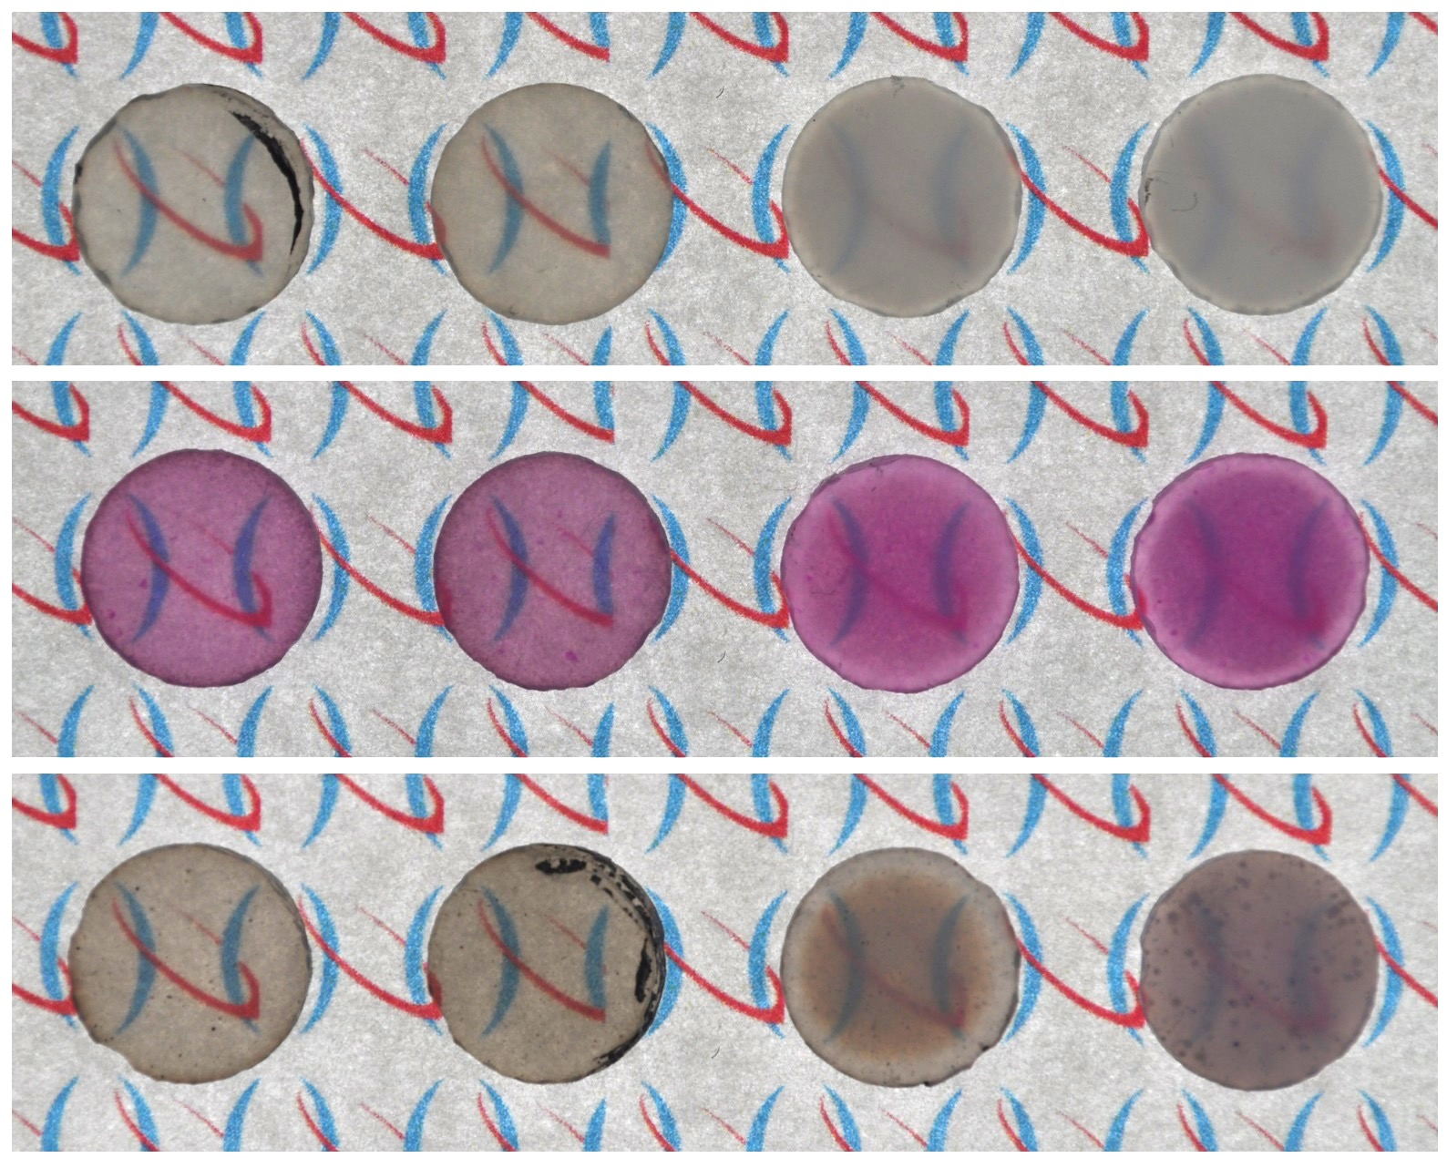
Results
Photos of all samples
NoHIP
HIP1000
HIP1200
HIP1400
Undoped
Cr-doped
Ti-doped

Slide 10
Results: Density & Grain Size
Sample | Relative density (%) | Average grain size (μm)
 |  | Center | Edge
Undoped.0 | 99.9 | 0.36 | -
Cr.0 | 100 | 0.33 | -
Ti.0 | 99.9 | 0.27 | -
Undoped.1000 | 100 | 0.39 | 0.37
Cr.1000 | 99.9 | 0.38 | 0.36
Ti.1000 | 99.9 | 0.28 | 0.28
Undoped.1200 | 99.6 | 2.51 | 1.54
Cr.1200 | 99.5 | 2.23 | 1.42
Ti.1200 | 99.8 | 2.08 | 0.83
Undoped.1400 | 99.6 | 5.74 | 2.61
Cr.1400 | 99.5 | 4.43 | 2.54
Ti.1400 | 99.7 | 4.22 | 2.70

Slide 11
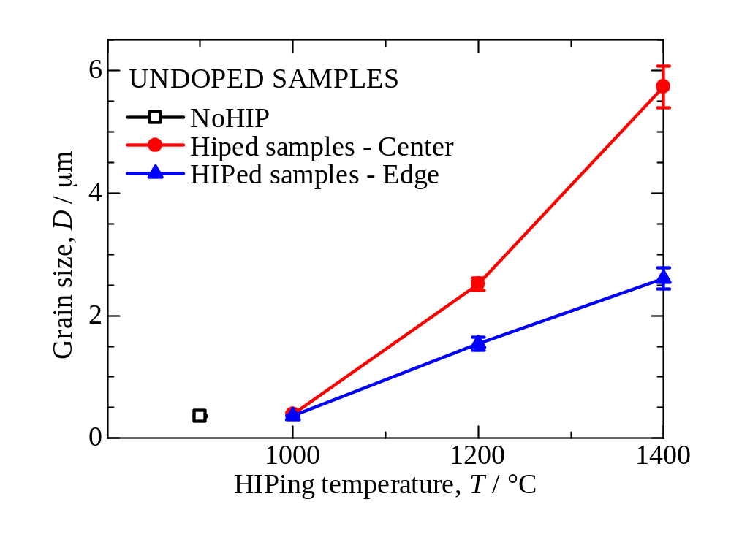
Results
Grain size of undoped samples

Slide 12
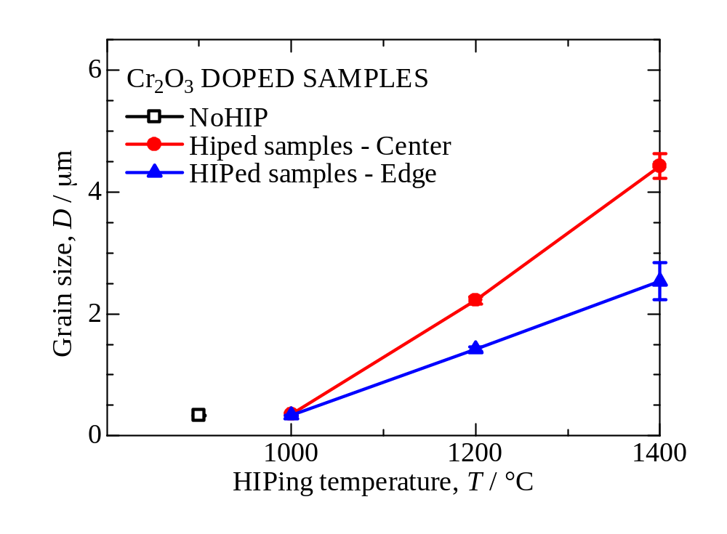
Results
Grain size of Cr₂O₃-doped samples

Slide 13
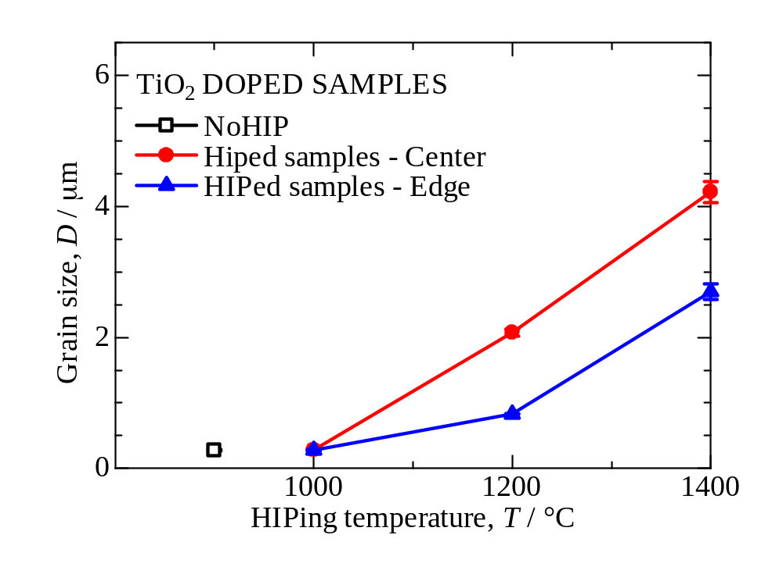
Results
Grain size of TiO₂-doped samples

Slide 14
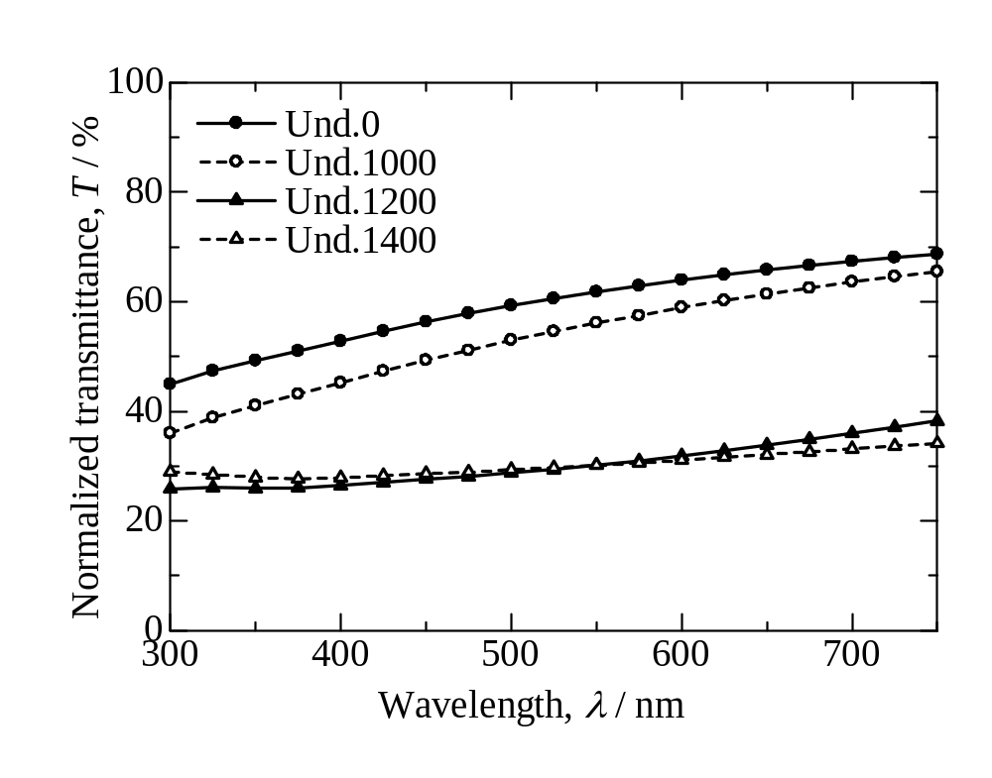
Results
Transmittance of undoped samples

Slide 15
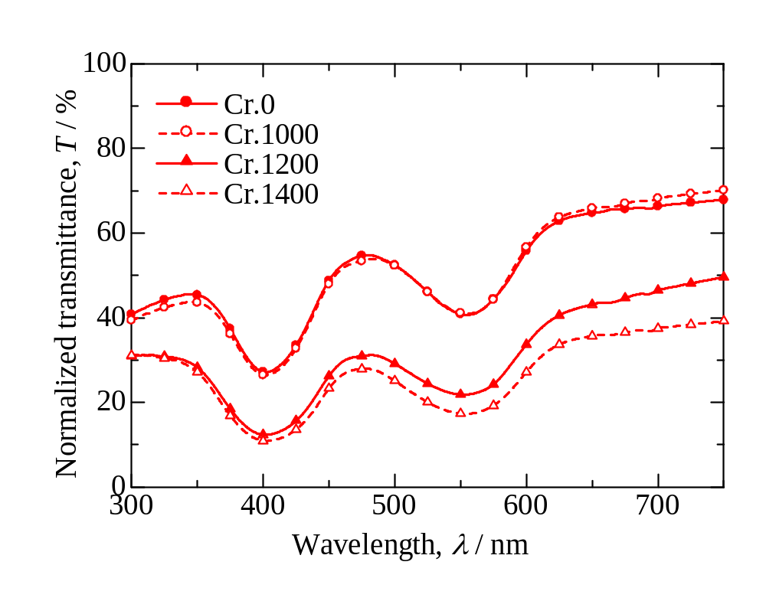
Results
Transmittance of Cr₂O₃-doped samples

Slide 16
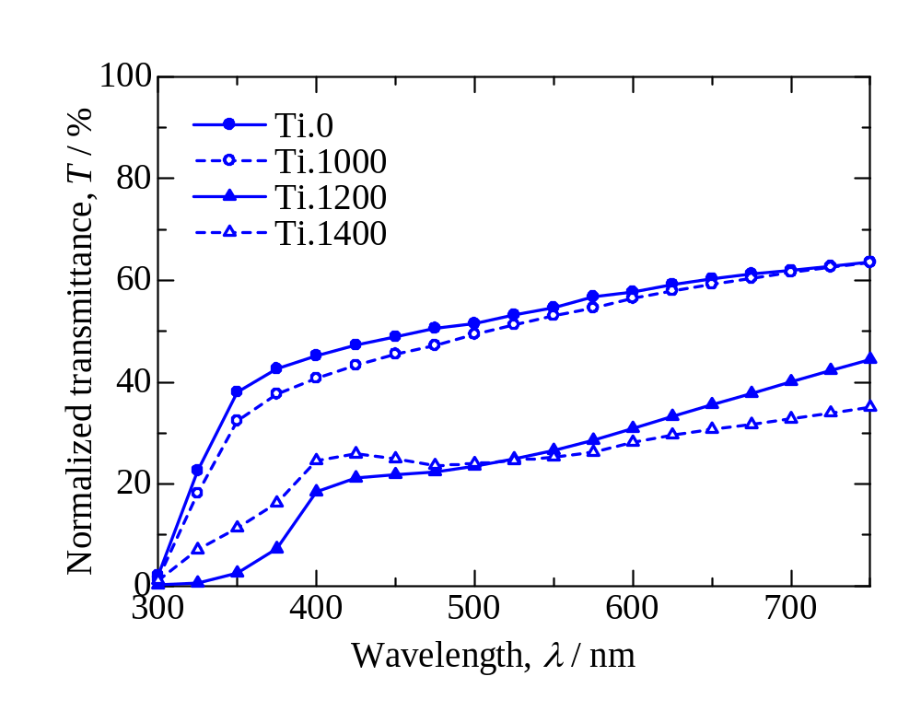
Results
Transmittance of TiO₂-doped samples

Slide 17
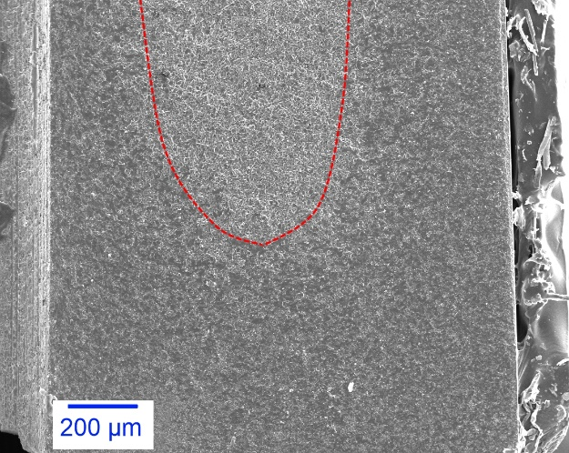
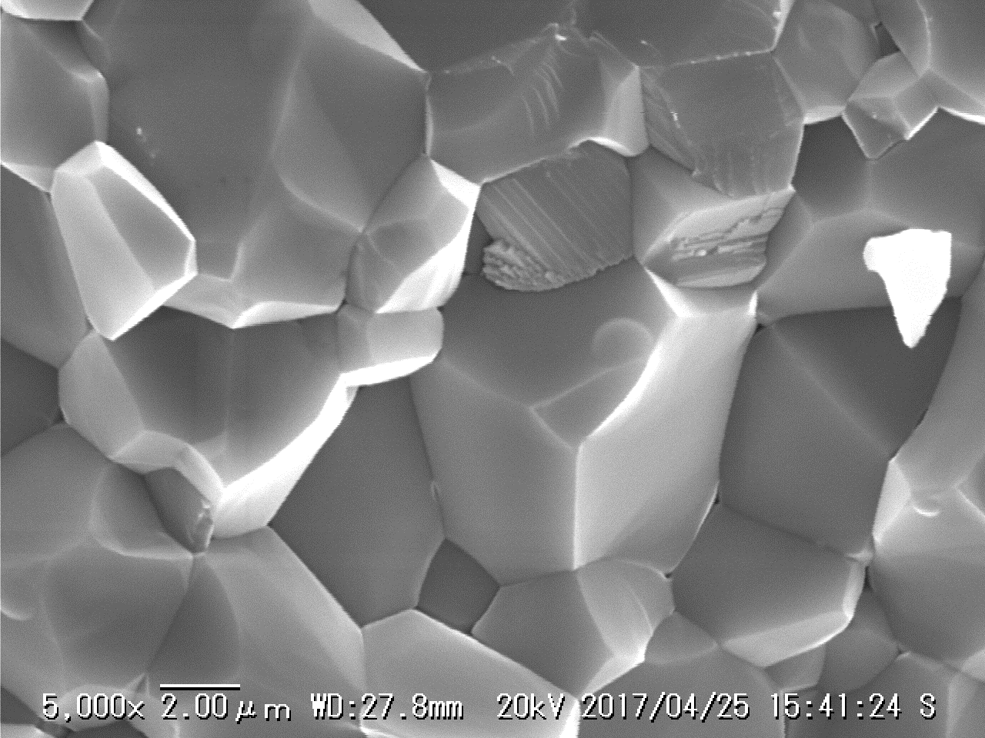
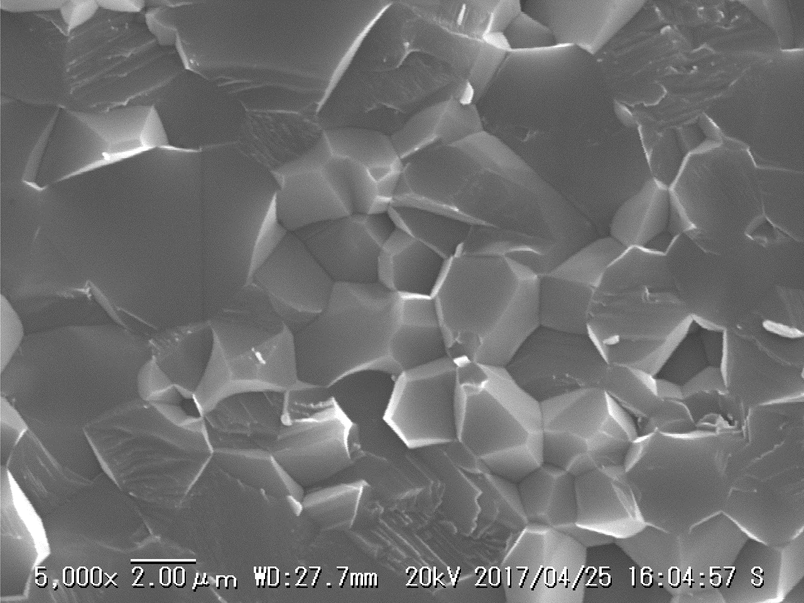
Discussion
Influences of HIPing processes
Higher HIPing temperature
→ Larger grain size + Slightly lower density
→ Lower transmittance
Cr.1400 sample
Pores
4 μm
Heterogeneous grain growth: faster at the center
Pore growth near the edge:
much slower than at the center
4 μm

Slide 18
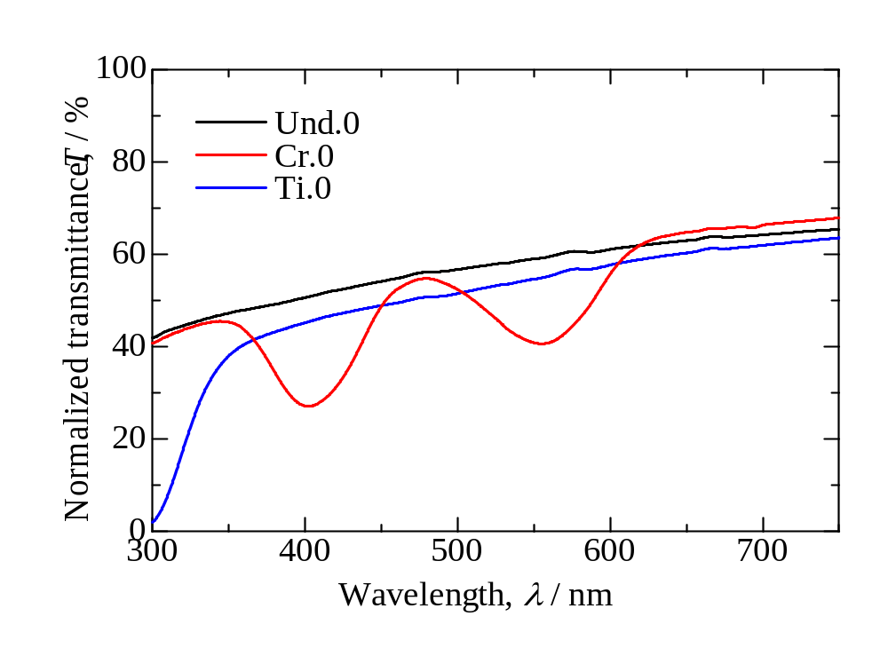
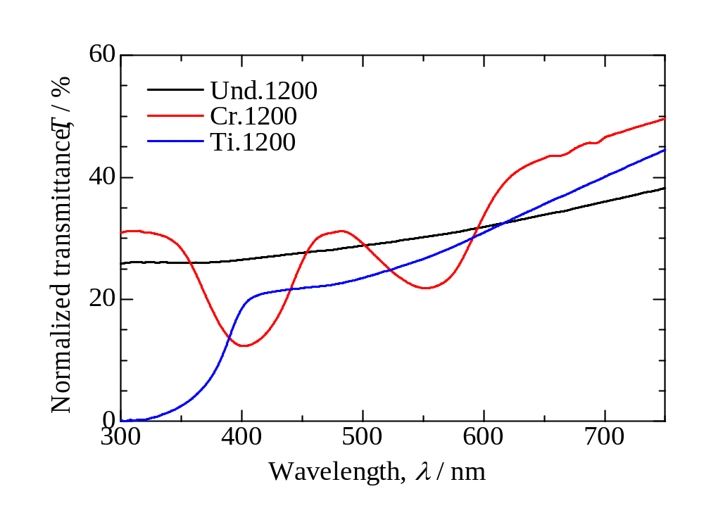
Discussion
Influences of dopants
Dopants
Cr: Slightly prohibit grain growth
basically higher transparency than undoped
Ti: Prohibit grain growth stronger than Cr-doped
A bit dark color
→ lower transparency than undoped

Slide 19
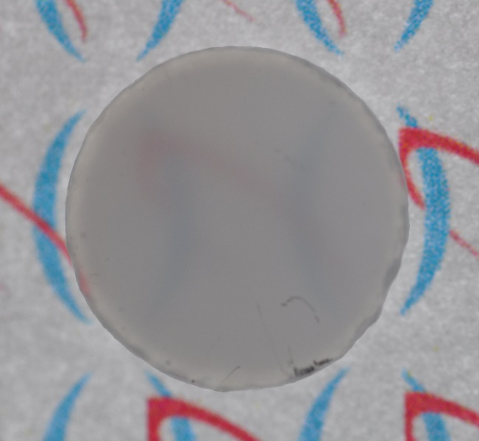
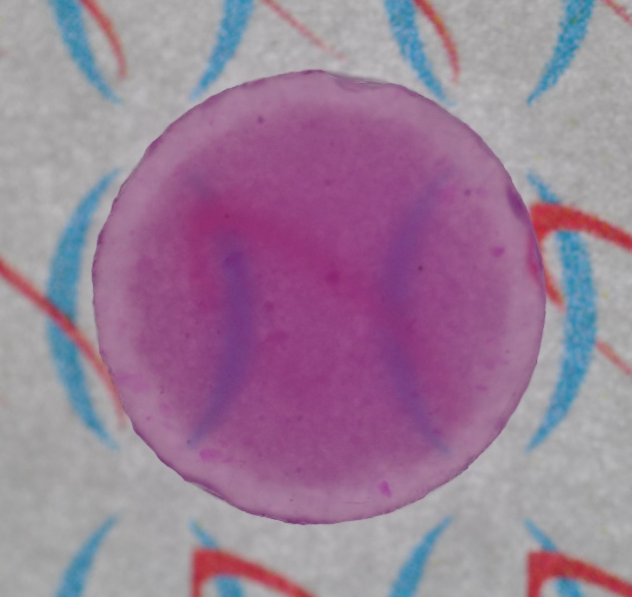
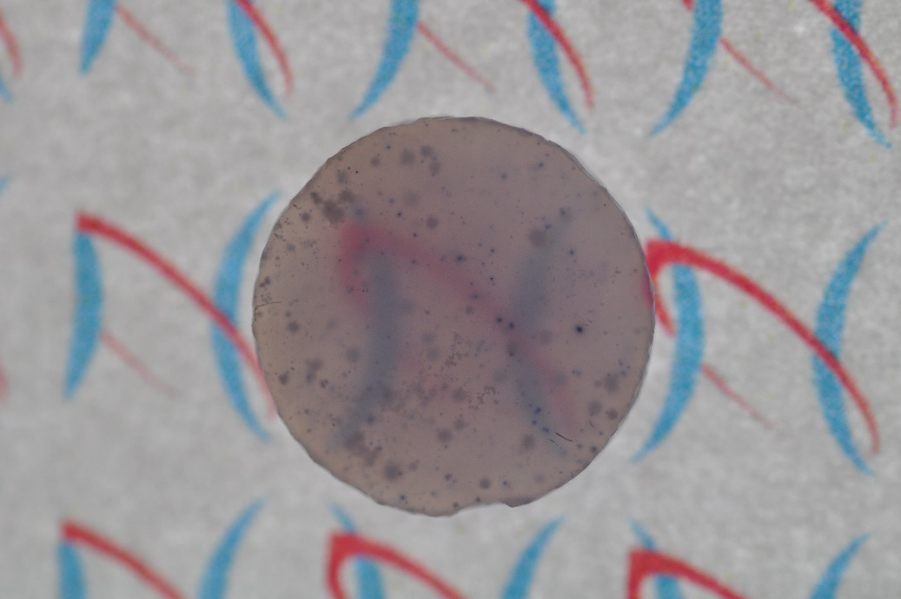
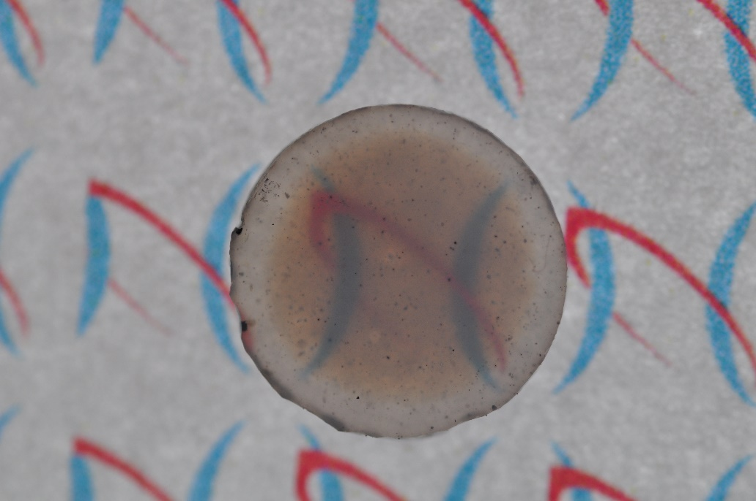
Discussion
Influences of dopants
Und.1400
Cr.1400
Ti.1400
At high HIPing temperature (1400°C)
Cr-doped: cloudy
→ heterogeneous grain size
Ti-doped: many black dots
→ formation of Al₂TiO₅???
Ti.1200

Slide 20
Summary
Post-HIPing of Transparent Al₂O₃ Prepared by PECS
  HIPing CANNOT Improve Transparency
    HIPinng@1000°C: No Change
    HIPing@1200&1400°C:
    Grain Growth in the Inside Samples

