Slide 1

12th International Conference on Hot Isostatic Pressing
Hot isostatic Pressing interest for Turbine parts in future Engines
B.picqué (A&D), JM.Franchet (Safran)

Slide 2
outline
Eramet group / Eramet Alloys branch
Powder producer / production sites
HIP’ed parts producer
Focus on an aerospace application : low pressure turbine
Aeronautic Context
HIP technology Interest compared to Traditionnal manufacturing road for an example of engine complex part : the LPT casing
HIP’ed PM properties Interest compared to Traditionnal C&W materials for highly stressed parts : the Safran N19 PM
Conclusion

Slide 3
agenda
Eramet group / Eramet Alloys branch
Powder producer / production sites
HIP’ed parts producer
Focus on an aerospace application : low pressure turbine casing
Aeronautic Context
HIP technology Interest compared to Traditionnal manufacturing road for an example of engine complex part : the LPT casing
HIP’ed PM properties Interest compared to Traditionnal C&W materials for highly solicited parts : the Safran N19 PM
Conclusion

Slide 4
Eramet at a glance
ERAMET
Group
12800 employees
2897 M€ turnover in 2016
ERAMET Engineering (100 %)
ERAMET Research (100 %)
ERAMET
Nickel
ERAMET
Alloys
ERAMET
Manganese
4800 employees
949 M€
5000 employees
1439 M€
2500 employees
595 M€
ERASTEEL
AUBERT & DUVAL
Two companies, Aubert & Duval and Erasteel, with a global strategy and a single governance - Grouped together to better serve their customers

Slide 5
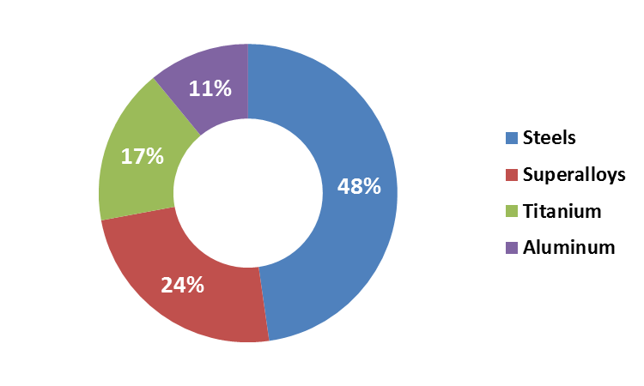
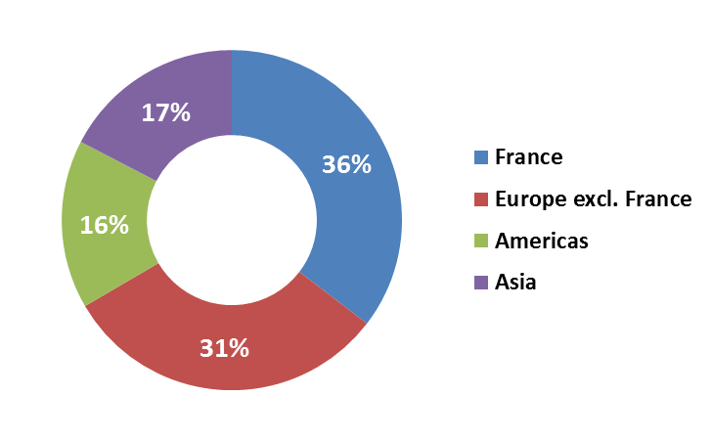




ERAMET ALLOYS:
A recognized player for high-tech markets
Worldwide presence
Multi materials expertise
Aerospace
Energy
Tooling
Specialties*
*Specialties: defense, marine, medical, transmissions,
automotive, mandrels, mechanical, powders …
59%
14%
20%
7%

Slide 6
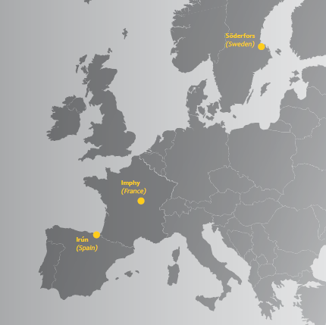
Powder production sites
ASP® &
Pearl stainless steel powders for HIP – Steel for AM in devlpmt
Ti base powders
(in devlpmt => 2020
Ni powders
& PM HIP parts (Imphy & Les Ancizes)
Ni & Co base
fine powders
for additive manufacturing

Slide 7
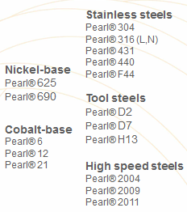


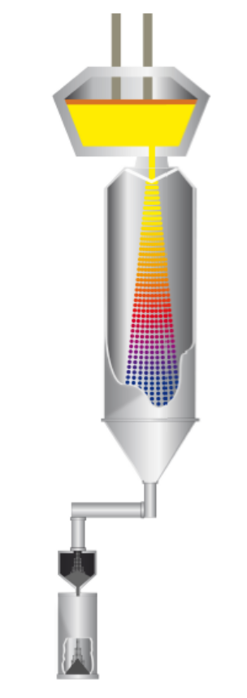
Sweden capacity
Pearl® metal powders - Sweden
Dvalin™ atomization tower (opened in 1971)
Durin™ atomization tower
(opened in 2011)
A powder atomization process pioneered in Söderfors, Sweden in 1969
World leader in PM HSS with ASP® for tooling & component applications
Opening of a new large capacity atomization tower in Söderfors, to double production capacity in 2011
The largest gas-atomized powder production capacity worldwide
Gas atomization
Steel powders

Slide 8

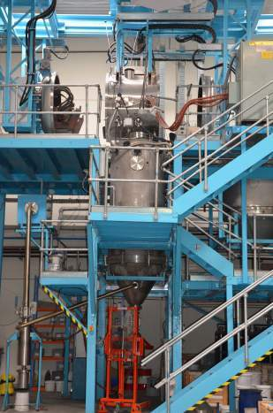
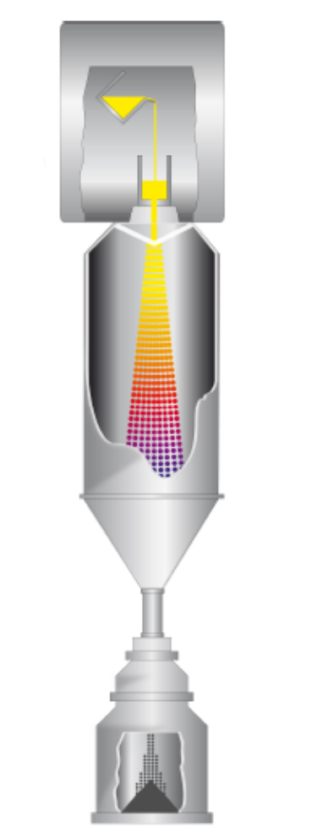

Spain (A&D Irun) capacity
Location: Spain (Ni, Co)
AD IRUN ex Metallied): Created in 2007 and is a spin-off of the CEIT based in San Sebastian, Spain
Specialized in fine powders (mainly Ni & Co base alloys)
Tailor made alloys and sizes
State-of-the art technology
Flexible and reactive service
Technical support
Possibility to accompany strategic customers in their developments
VIM gas atomization

Slide 9
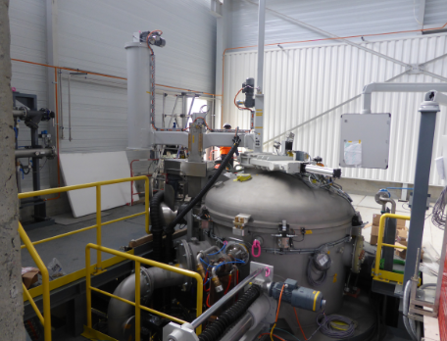
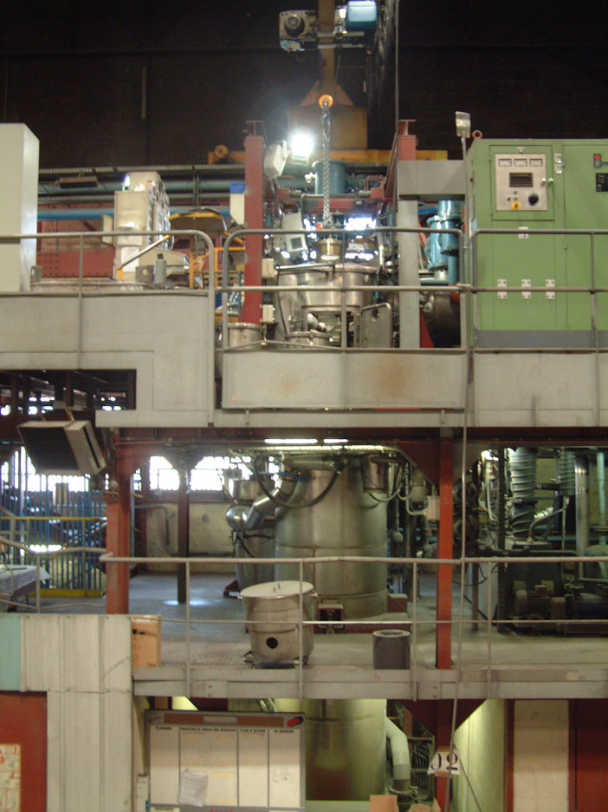
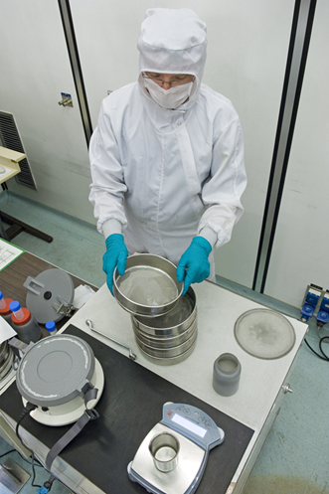
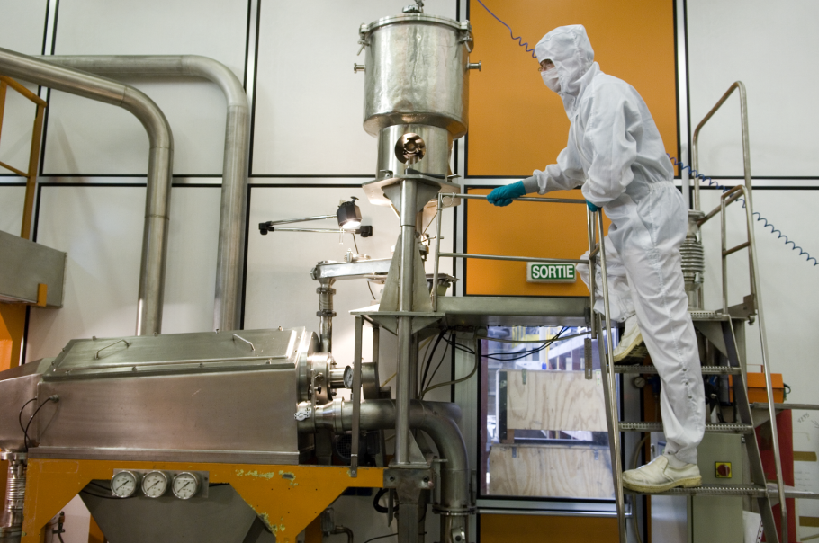
France capacity (Imphy/les ancizes)
2 locations : Imphy / Les Ancizes
350kg Tower: VIM / Argon atomization
Batch size: 100 to 2500kg
Materials: Ni-based superalloys
High cleanliness powders (Aero spec)

Slide 10
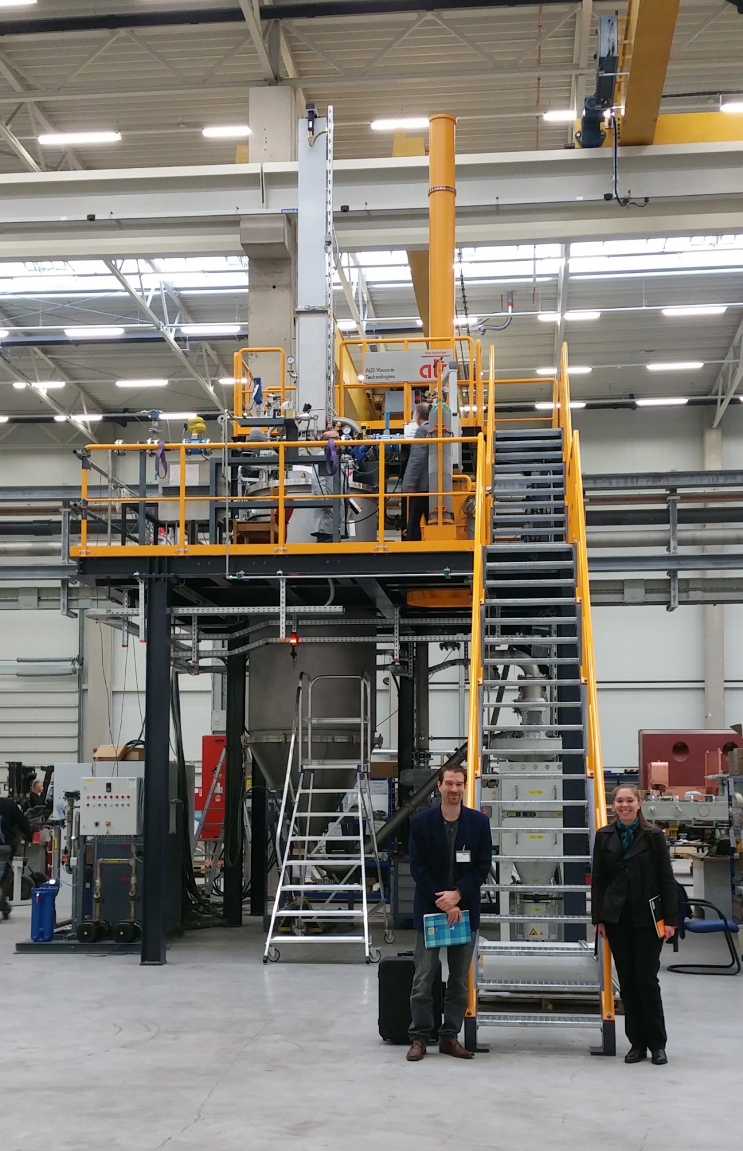
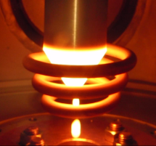
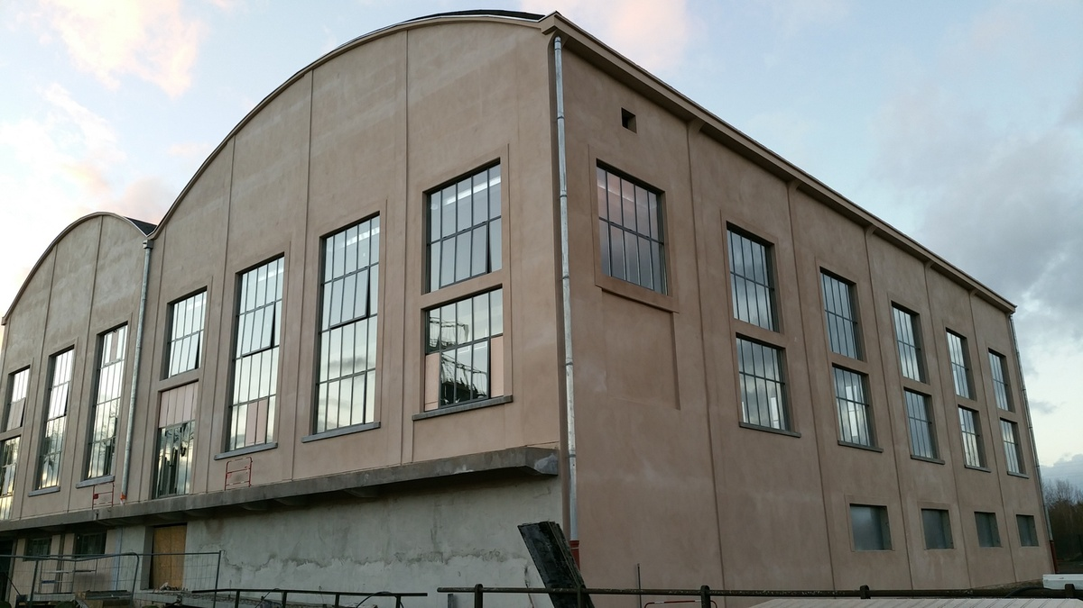
France capacity (Ti)
Metafensh / Safran / A&D
Pilot tower
Technology: EIGA
  Electrode melting by induction, without contact
  Electrode Ø 70-150 x 1000 mm for lots from 17 to 70 kg (TA6V)
  Atomisation by argon
  « free-fall » nozzle type

Slide 11
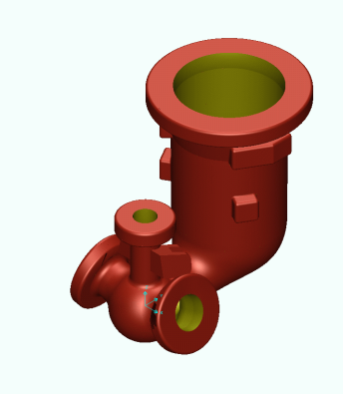
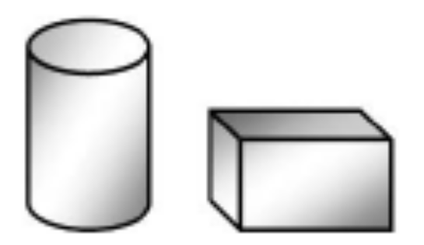
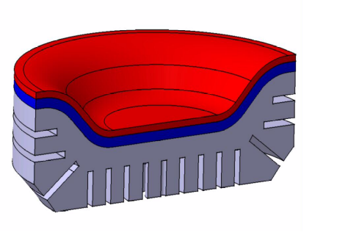
Types of hip parts produced in a&d
Simple shapes
(further machined
or forged/rolled)
Bimetal parts
(or multilayer parts)
Complex shapes
(Near Net Shape
or Net Shape)

Slide 12
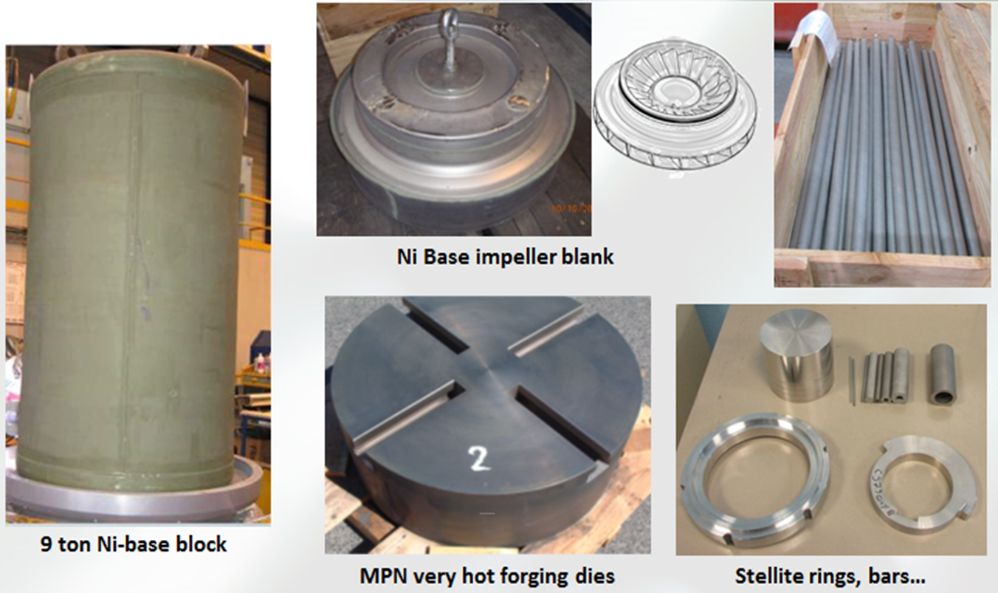
Examples of simple shape Parts
Ni base impeller blank

Slide 13
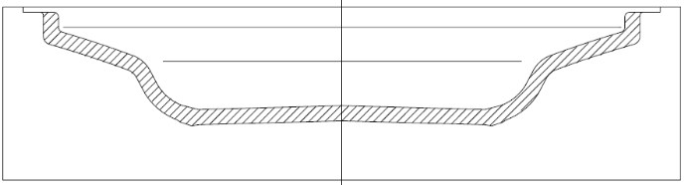
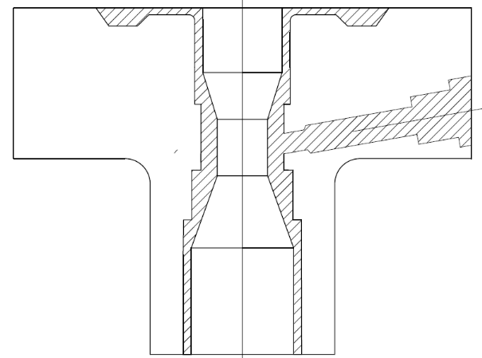
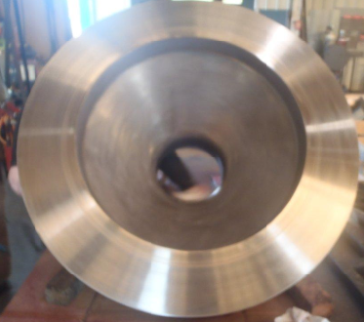
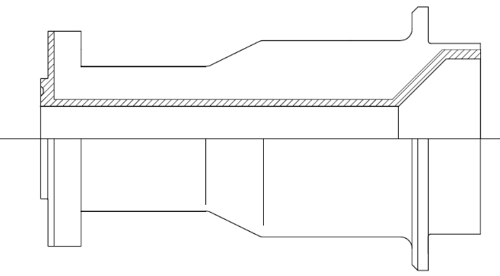
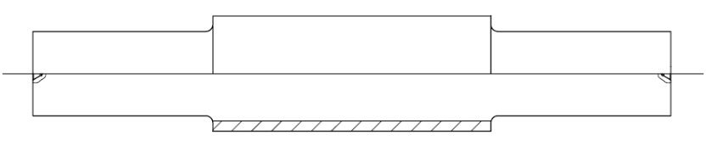
Bimetal parts
Oil flow
Glass mould
Ni625 Powder
on a steel substrate
Bonnet for oil and gas industry
Large extrusion die/ SA coating
Sea
water
Tool steel powder
on a steel substrate
Roll
for stainless steel sheet rolling
Marine part
Ni625 Powder

Slide 14
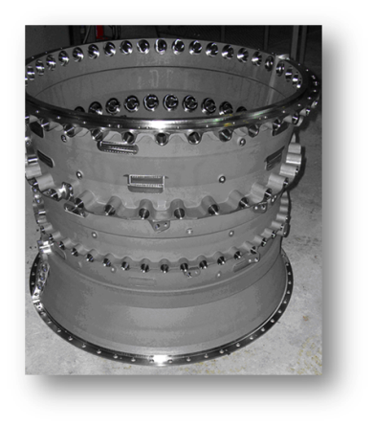
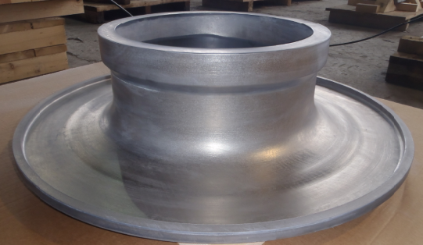

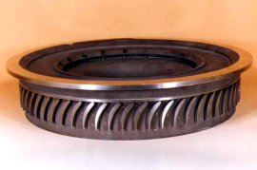
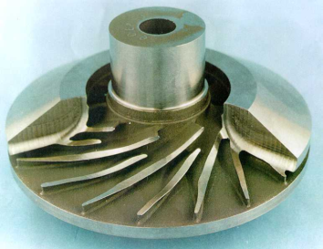
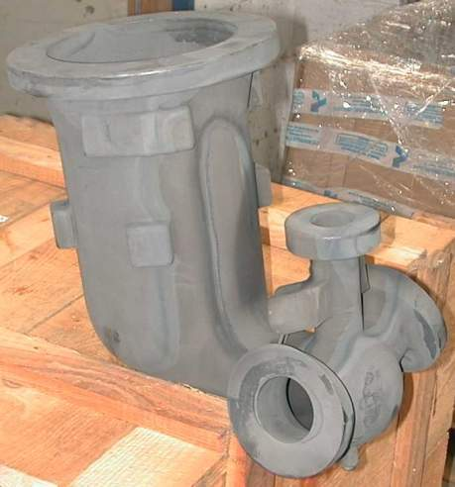
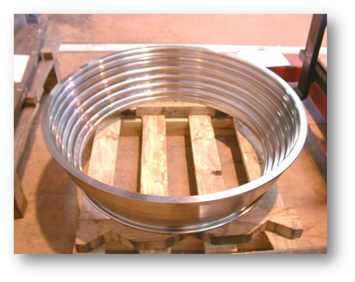
Examples of complex shape parts
NNS Astroloy Shroud
NS Ti6-4 compressor casing
316L part Nuclear application
SY625 diffusor
NS Ti6-4 shrouded impeller
Astroloy Gas generator
for space rocket
NNS Astroloy turbine casing

Slide 15
outline
Eramet group / Eramet Alloys branch
Powder producer / production sites
HIP’ed parts producer
Focus on an aerospace application : low pressure turbine
Aeronautic Context
HIP technology Interest compared to Traditionnal manufacturing road for an example of engine complex part : the LPT casing
HIP’ed PM properties Interest compared to Traditionnal C&W materials for highly solicited parts : the Safran N19 PM
Conclusion

Slide 16

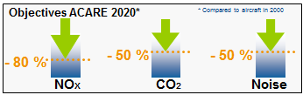
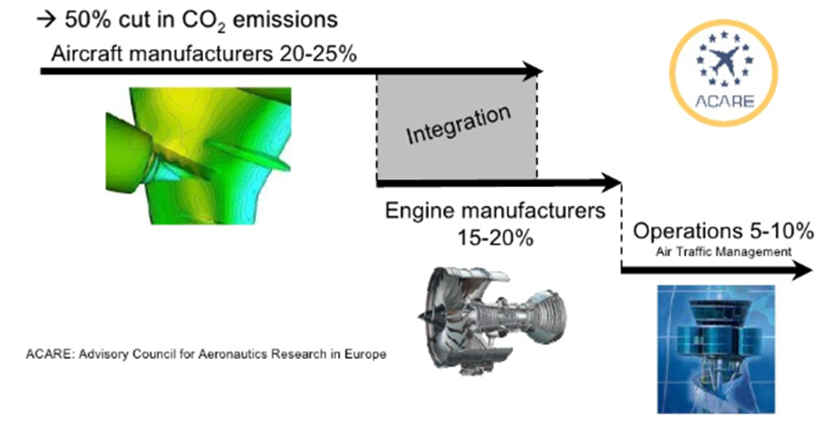

Context / interest
Perspective in Air traffic:
A Traffic increase around 4,7% per year
Need to manage/minimize impact
Main challenges for next generation jet engine (2025):
Better performance :
Improve jet engine yields
Limit environment impact
lower consumption
Lower noise
Lower pollutant gas emission
Pkt = nb passengers x nb km

Slide 17
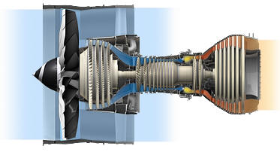
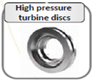
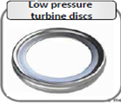
Context / interest
Main challenges: improve performance / Limit impact (noise, consumption…)
To reach these objectives, an increase of the engines internal temperature is needed. (>700-750°C)
HPT discs
LPT discs
New materials for discs (rotative parts) with an ability to be processed by C&W route
HPT / LPT
  C&W materials : AD730, R65, 718+ (Ring rolling / closed die forging)
  Powders by extrusion + isothermal forging (RR1000, N18, MERL, Rene88) (expensive solution)
        Consequence:
        work T° of all the turbine is increasing

Slide 18
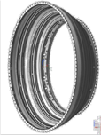
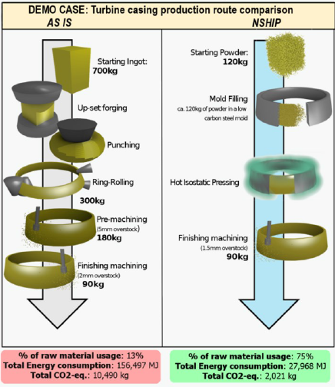
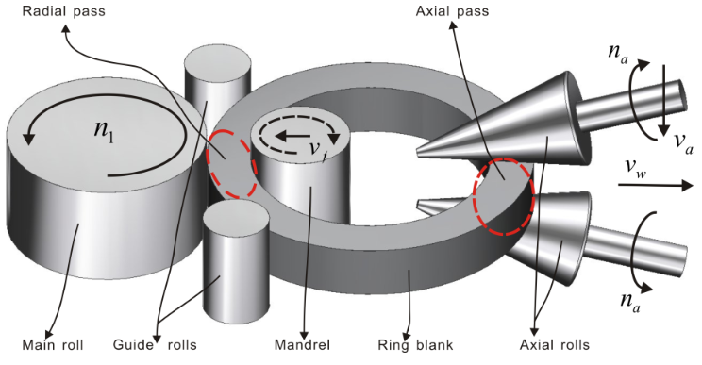
Casing application: the context
What about casing?
Actual solution: 718 or waspaloy
Not possible to produce casing with low workability materials to work until 750°C using ring rolling
Need to cool (pipes = weight)
For such part, a technological rupture is needed…
HIP is a good solution

Slide 19
Casing application: the context
  Possibility to use more alloyed materials (example of astroloy but no limitation in using even more alloyed superalloy with poor/no workability)
  Possibility to save a lot of material and reduce drastically the quantity of machining
  Fully isotropic and homogeneous microstructure, no fibering (UT inspection) / higher and homogeneous mechanical properties
  Lead time reduced

Slide 20
Casing application
The Main tasks for capsule design, process modeling and technology to increase geometrical precision in an industrial production are:
  Capsule design must be robust enough to withstand the distortions caused by the fabrication techniques and shrinkage during HIP
  Capsule design and filling techniques must provide stable reproducible filling density with a scatter less that 1%. Density non-uniformity within the volume of the capsule must be minimized to be accounted for numerical modeling.
  Improvement of modeling precision (very important for large diameter parts)
  Capsule design principles taking into account the shrinkage control, economical aspect and production as close to theoretical definition for the HIP containers.
  Mastering of the dimensional scatter due to all technological parameters (capsule and material accuracy, powder batches/producers, temperature gradients during the ramping part of HIP cycle…)

Slide 21
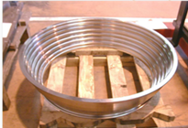
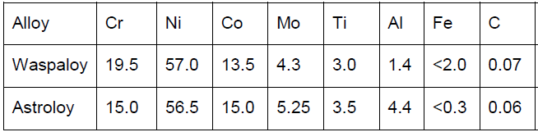
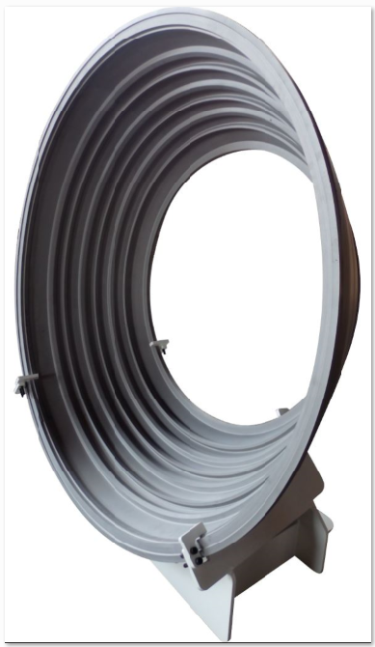
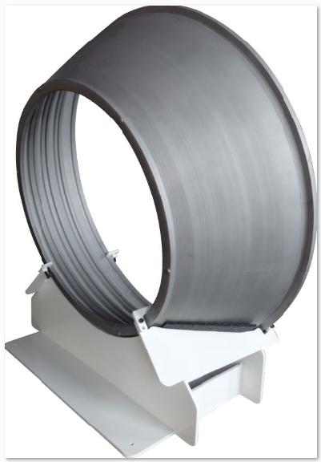
Casing application
Several prototypes have been produced in astroloy instead of waspaloy during the last years
Dimension of casings up to Φ1200mm
Overstock material around 2mm on delivered parts in a reproducible way
Very good numerical modeling precision (<1mm)
Material input weight divided by more than 4 (machining)
Mechanical properties (tensile, creep and fatigue) are improved with Astroloy material allowing to increase work temperature
Upgrade material is easy
HIP casing after machining
Higher γ’ content
As-HIP + HT casing after acid leaching

Slide 22

PM superalloy N19
The disk PM superalloy N19 was developed in the frame of a
consortium comprised of ONERA, Ecole des Mines de Paris and Safran Aircraft Engines (Snecma)
  Safran: international high-technology group, tier-1 equipment supplier in Aeropsace and Defense
  Onera: French aerospace lab
  Ecole des Mines de Paris: French Engineer School
It was designed to achieve the desired combination of properties up to 750°C, for compressor or turbine discs application (operating life of several thousands of hours):
High tensile properties
An improved crack propagation and fatigue resistant microstructure
Capability to handle high temperatures in disk rims prone to creep damage (need a coarse grain microstructures )
Metallurgical stability for long time exposure up to 750°C

Slide 23
PM superalloy N19
N19 = two-phase alloy:
  γ phase formed of Ni base solid solution: metallurgical grains matrix
  γ’ phase: structure based on intermetallic Ni₃Al and constituted of several inter or trans-granular precipitates
Intergranular γ’ precipitates have allow to control γ matrix grain size => Possibility of grain size monitoring using a sub or supersolvus heat treatment and γ’ hardening precipitate distributions and morphologies control
  Subsolvus HT = fine grains: for application <650°C – priority to tensile and fatigue (low creep issues)
  Supersolvus HT = coarse grains: for application >650°C up to 750°C – priority to creep in keeping high level of tensile and fatigue
  For supersolvus HT, Importance to have an enough large range of temperature between γ’ solvus and alloy melting point to be industrial

Slide 24
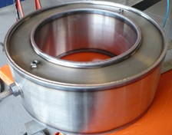
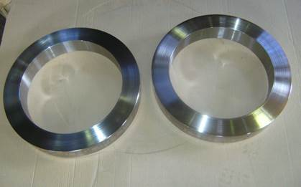
PM superalloy N19
Objective of the study:
Evaluation of N19 mechanical properties in a simple direct as-HIP (+HT) use (instead of classical road: HIP+Extrusion+Isothermal forging)
N19 HIP’ed ring samples have been produced using two particles sizes argon atomized powders:
<53µm
<125µm
Production:
HIP : subsolvus temperature – 3h – 100MPa
Heat treatment : supersolvus solutionning – fan air cooling + single step aging performed on SafranAE Gennevilliers equipment
Mechanical characterization:
  Tensile (16), creep (28), Fatigue (28), Crack propagation (4)
  Evaluation of mechanical properties on N19 HIP ring samples and comparison with Waspaloy / Inco718 / N19 HIP extruded & forged

Slide 25
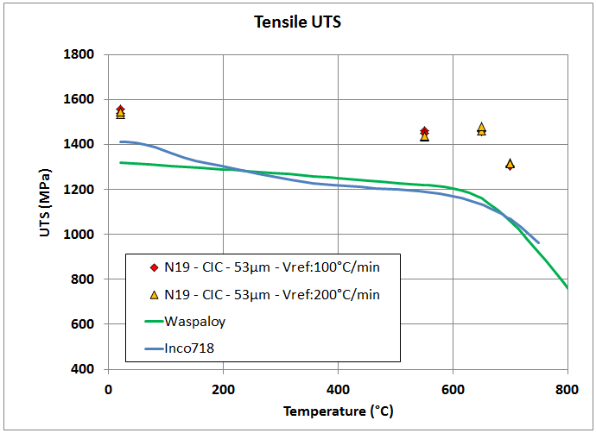
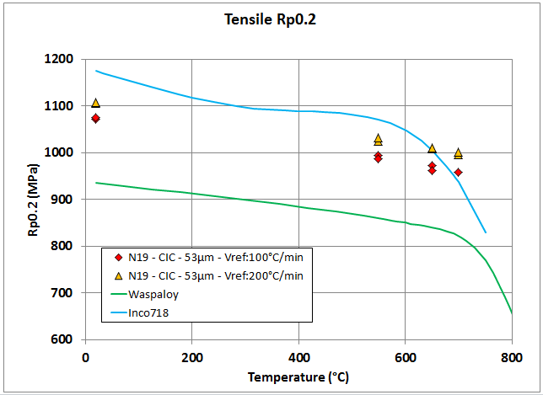
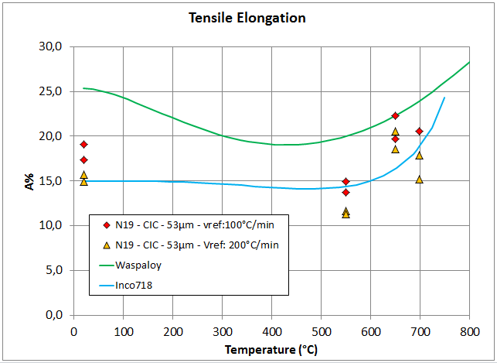
N19 Vs 718 and waspaloy
Tensile properties
No difference between <53 & <125µm
Slight increase of YS in doubling speed cooling
+10 to +20% on static properties compared to waspaloy and 718

Slide 26
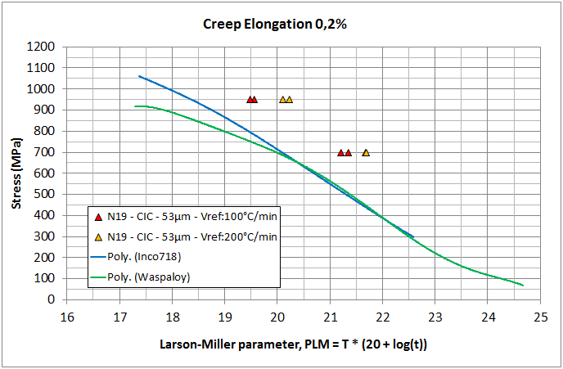
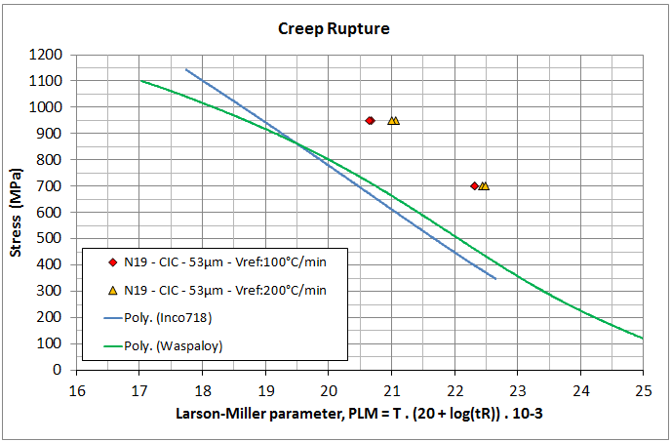
N19 Vs 718 and waspaloy
Creep properties
No difference between <53 & <125µm
+50 to +75°C compared to waspaloy & 718
+200 to +300MPa compared to waspaloy & 718
+10 to +20% on static properties compared to waspaloy and 718
Increase until 100MPa in doubling cooling speed

Slide 27
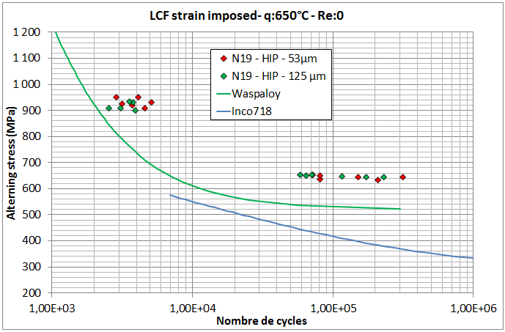
N19 Vs 718 and waspaloy
Fatigue properties

Slide 28
N19 Vs n19 EXTR/FORGED
N -19 HIP |  | N19 Extruded/forged | Waspaloy | Inco 718
Tensile | UTS | +2 à +4% | +15 to +20% | +10 to +20%
 | R0.2% | -1 à +4% | +13 to +15% | -10 to +2%
Creep | 53µm | = | +50 to +75°C | +50 to +75°C
 | 125µm | = | +50 to +75°C | +50 to +75°C
Fatigue | 53µm | = | +2σ | +5σ
 | 125µm | = | +2σ | +5σ
The N19 PM only “HIP’ed” version gives comparable results to the classical “HIP + Extrusion + Isothermal forging” road
No significant difference between <53µm and <125µm
Difference could appear on a statistical point of view on fatigue results with more data.

Slide 29
Conclusion

Slide 30
Conclusion
In future years, the high traffic increase will lead to raise temperatures and pressures in the heart of the engine in order to minimize impact on environment (noise, gas emission…)
Increase temperature of works leads to use more demanding materials (like powder metallurgy material) and require to develop alternative technologies
HIP is a well adapted technology to produce complicate parts like PM casing, impossible today to produce by another process. The only one limitation could be today the number and the size of vessels
In addition to be a very good candidate for disk applications thanks to its high level of mechanical properties, PM superalloy N19 confirms its promising potential in a simple as-HIP (+HT) process
N19 would have a great interest for several turbine parts in allowing to significantly increase the engine temperature of work.

