Slide 1
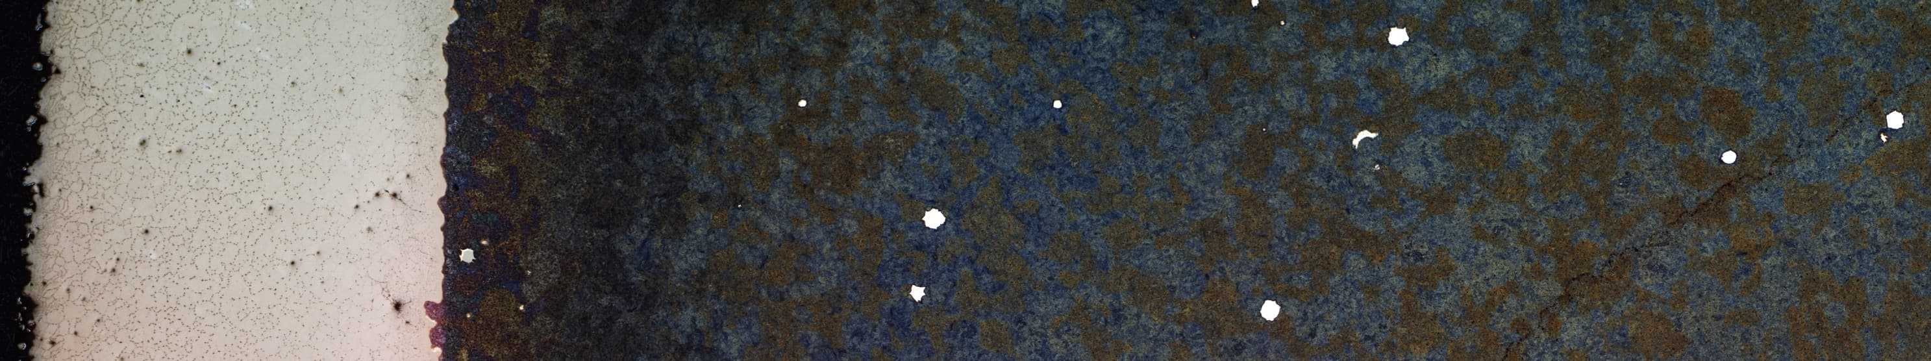
Taylor-Made Net-Shape
Composite Components by Combining
Additive Manufacturing and Hot Isostatic Pressing
Sebastian Riehm, Anke Kaletsch, Christoph Broeckmann (RWTH Aachen University, Aachen/Germany)
Vera Friederici, Sandra Wieland, Frank Petzold (Fraunhofer IFAM, Bremen/Germany)
HIP17 – 12th International Conference on Hot Isostatic Pressing, 2017-12-08, Sydney/Australia
Notes:
- Ongoing research project together with Fraunhofer IFAM Bremen of Prof Frank Petzold

Slide 2
Outline
Introduction
  Aim of Project
Experimental Work
  SLM of Capsules
  HIP of Capsules
  FEM Simulation
Results & Discussion
  Numerical Simulation of Shrinkage and Densification
  Metallographical Investigation
Conclusion

Slide 3
Introduction

Slide 4
Additive Manufacturing & Hot Isostatic Pressing
AM: Pros | & Cons
Building of complex geometries Overcome limits of conventional manufacturing Integrated into CAD/CAM process chain Material-saving New manufacturing method | Long building time needed Not very large parts possible Anisotropic properties Residual porosity Only one material at the same time
HIP: Pros | & Cons
Isotropic properties Very fine microstructure Full density achievable Applicable to a wide range of metallic materials | Simple geometries for powder HIP Complex process needed Closed porosity needed HIP parameters dependent on material selection

Slide 5
Combination of Additive Manufacturing & Hot Isostatic Pressing
AM-build capsule for Powder HIP
  Virtually limitless freedom of geometry
  Design of capsule based on FEM simulation
Fill and close capsule with powder conventionally
  Either same material as capsule material
  Or second complemental material
HIP filled capsule
Project aim:
Complex-shaped composite component with functional outer layer and tough core
exhibiting tailor-made properties and full density
AM Capsule
Powder
HIP
Composite Component

Slide 6
Experimental Work

Slide 7
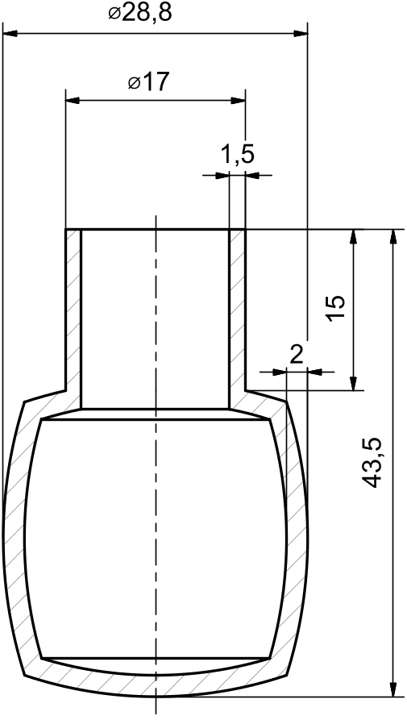
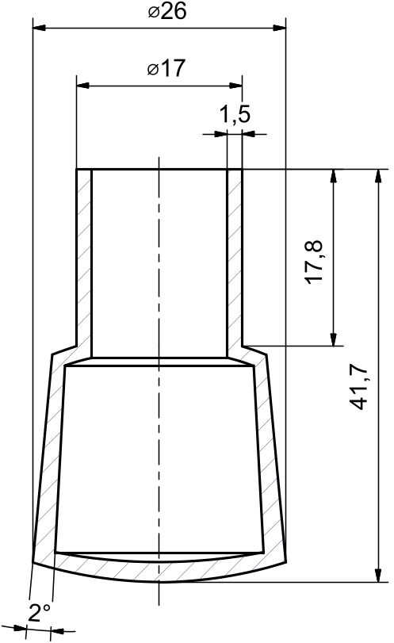
Preliminary Choices
Materials Selection
Capsule Design
Capsule | Bulk
Austenitic stainless steel AISI 316L (X2CrNiMo17-13-2; 1.4404) |  | Martensitic tool steel AISI L6 (56NiCrMoV7; 1.2714)
Carbide rich, wear resistant steel AISI A11 (X245VCrMo8-5-1; FeCrV10) |  | Martensitic tool steel AISI L6 (56NiCrMoV7; 1.2714)
constant
varied:
1.0 mm
1.5 mm
2.0 mm
Complex-shaped
fully dense composite components
with corrosion or wear resistant surface and
tough core built
in comparatively short time
Variable wall thickness
Notes:
2nd enhanced design
1st design plain cylinders
Short feed pipe at top with constant wall thickness to weld filling pipe
Session parallel, but look proceedings

Slide 8
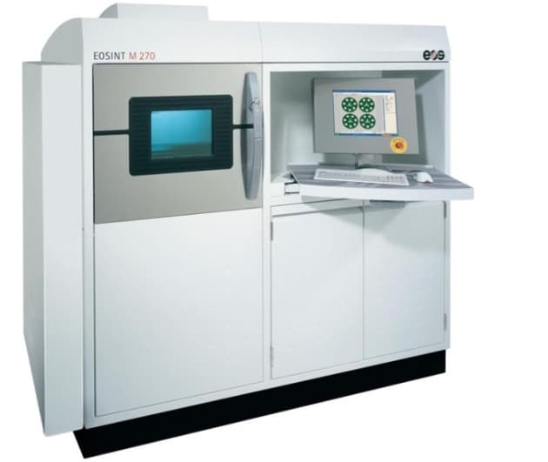
Determination of SLM Parameters
EOS M270 Dual Mode (at Fraunhofer IFAM, Bremen)
Parameter variation
Lines and squares,
cubes, blocks and thin walls
Fine tuning of parameters
Job volume | 250 mm x 250 mm x 215 mm
Layer thickness | 40 µm
Line spacing | 100 µm
Laser type | Yb-color laser, 200 W
Focal spot size | 70–100 µm
Inert gas | Nitrogen
Substrate heating | max. 80°C
Recoater | ceramic
overhangs and different angles
overhangs and different angles
Final parameter set
Capsules with different wall-thicknesses
(0.3 mm; 0.5 mm; 1.0 mm; 1.5 mm; 2.0 mm)

Slide 9
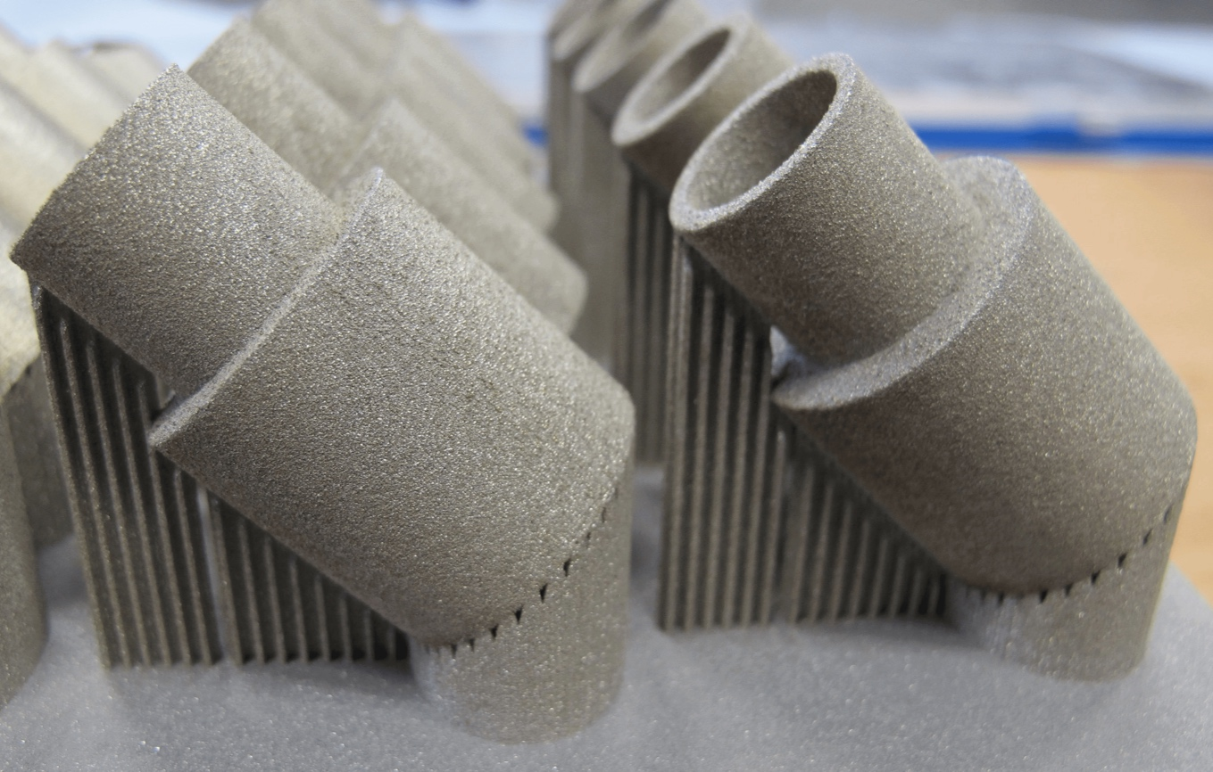
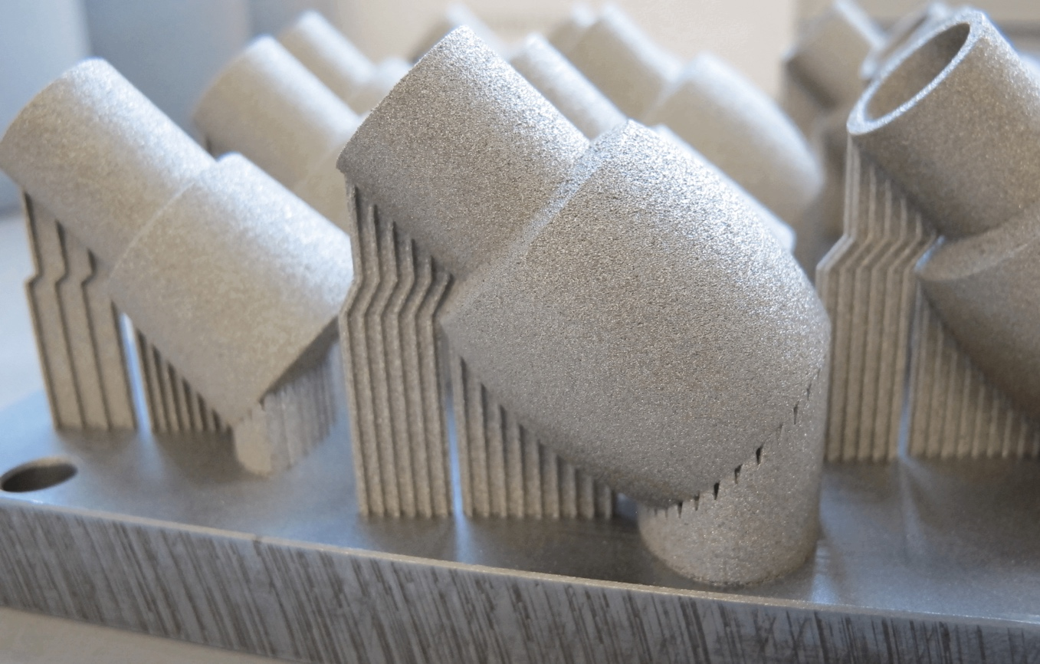
SLM-building of HIP Capsules (316L)
1st Design
2nd Enhanced Design
Notes:
Capsules with support structure on building plates
Support structures to be removed
After some initital benchmark tests:
Final SLM building parameters were set rather quickly
“good-natured“ material for SLM-building
1st design: short feed pipe not constant wall thickness -> under 1 mm not possible to TIG-weld

Slide 10
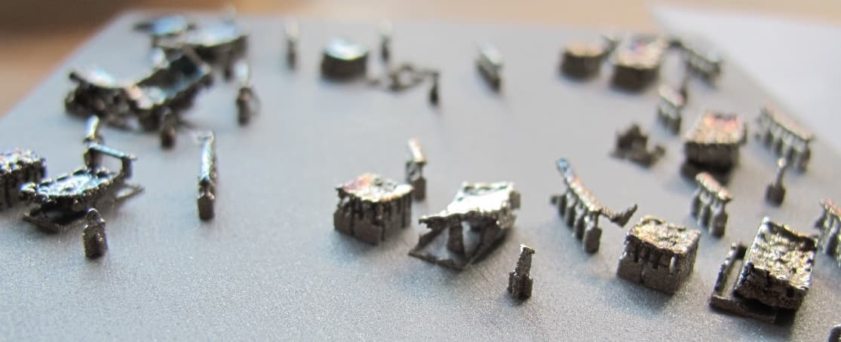
SLM-building of HIP Capsules (A11)
Pure A11
Possible Solutions:
Test lines: best results with energy density of
75–100 J/mm³
Cubes with height > 1 mm: 80 ºC substrate temperature not enough to avoid cracks and delamination
Higher substrate temperature
→ building above Martensite start temperature
Powder-mixing with low-carbon powder
→ decrease overall carbon content
Notes:
Capsules with support structure on building plates
Support structures to be removed
After some initital benchmark tests:
Final SLM building parameters were set rather quickly
“good-natured“ material for SLM-building
1st design: short feed pipe not constant wall thickness -> under 1 mm not possible to TIG-weld

Slide 11
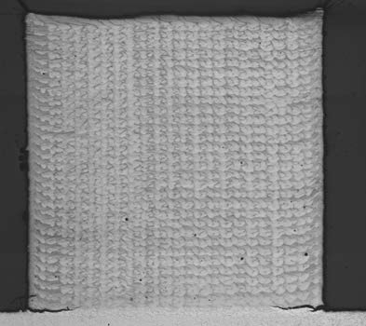
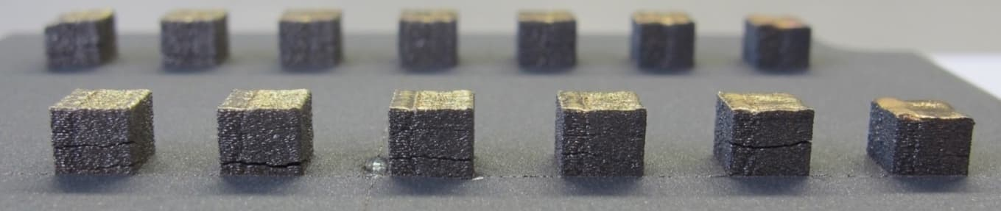
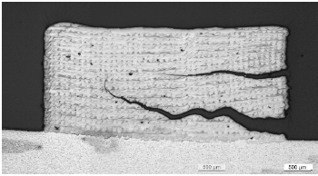
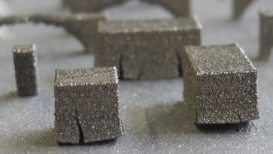
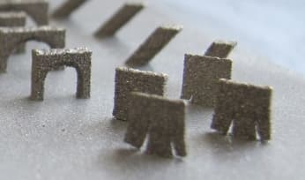
SLM-building of HIP Capsules (A11)
1. Increase substrate temperature
2. Powder-mixing
Substrate temperature of 300 ºC
Cubes of pure A11 can be built
Still cracks
A11 + 17.5 % 430L
A11 + 430L
300 ºC substrate heating
only few cracks above
17.5 % 430L
  80 ºC substrate temperature, 50% 430L:
500 µm
500 µm

Slide 12
Mixture of A11 with 430L
“Dilution” of wear-resistant properties?
Influence on Carbide Ratio
T = 1200 ºC
VC
Measurement of Hardness
Material | Hardness HV10
A11 | 836 ± 29
A11 + 17.5 % 430L | 784 ± 10
A11 + 50 % 430L | 475 ± 20
C in Austenite

Slide 13
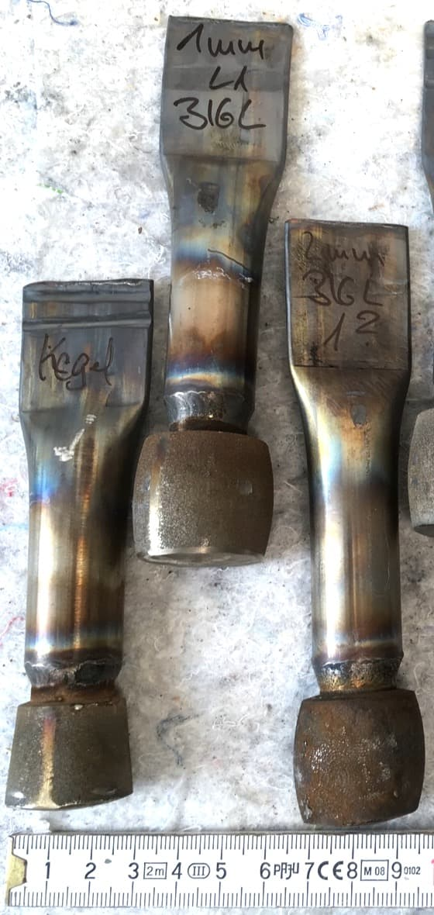
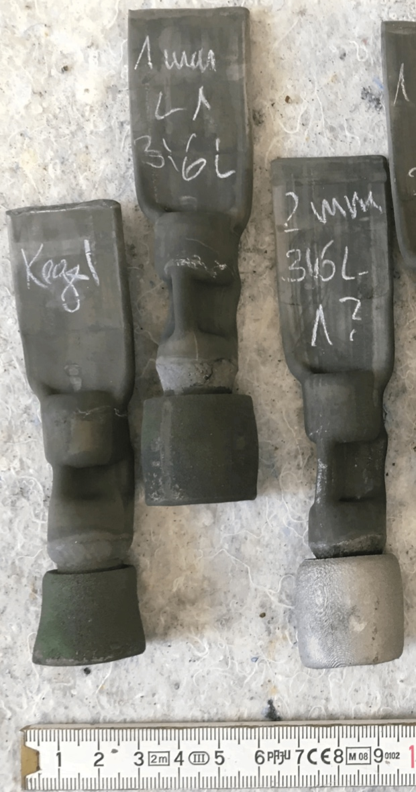
HIP of SLMed Capsules
Cleaning
TIG-Welding of filling pipes
Powder-filling
Evacuating
Sealing
Powder size used for filling:
  316L: 0–500 µm
  L6: 63–300 µm
Achieved relative powder density after filling:
  316L: 65%
  L6: 61%
T_{HIP} = 1125 ºC
p_{HIP} = 110 MPa
t_{Hold} = 3 h
Pressure above 750 ºC
Argon atmosphere
T [ºC]
p [MPa]
Before HIP
After HIP

Slide 14
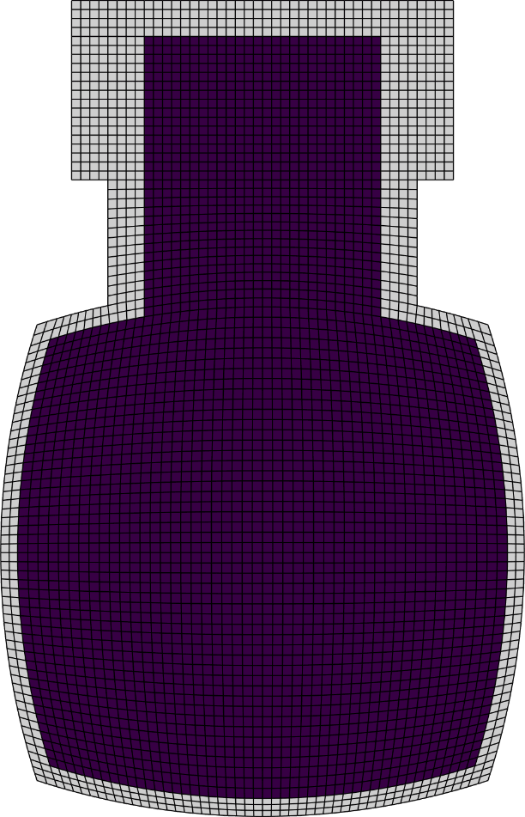
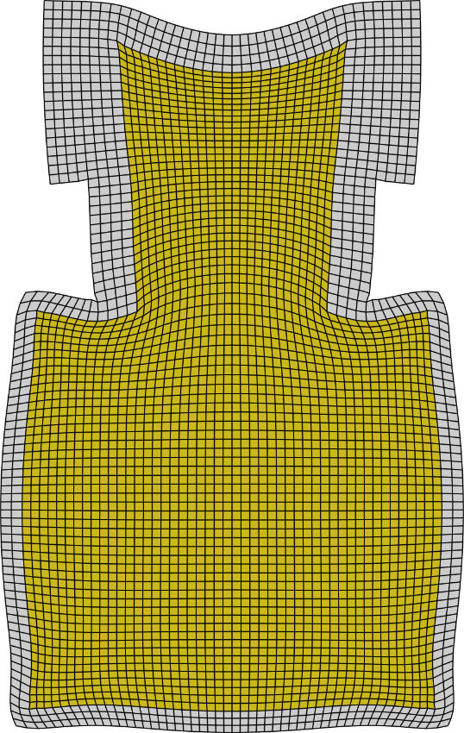
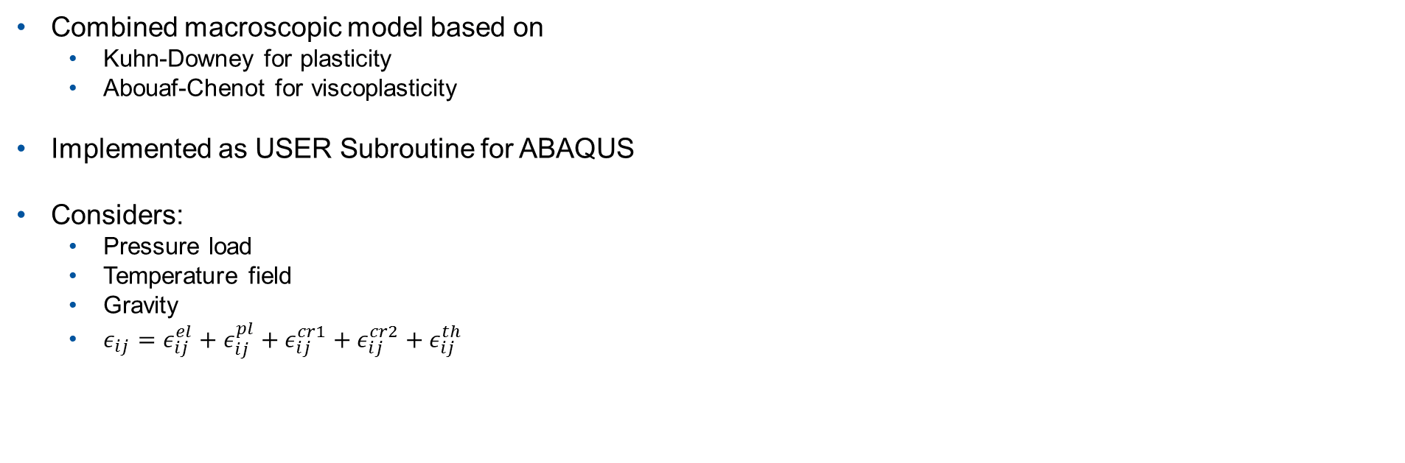
FEM-Simulation
Prediction of shrinkage and densification through HIP
Combined macroscopic model based on
  Kuhn-Downey for plasticity
  Abouaf-Chenot for viscoplasticity
Implemented as USER Subroutine for ABAQUS
Considers:
  Pressure load
  Temperature field
  Gravity
  $ε_{ij}=ε_{ij}^{el}+ε_{ij}^{pl}+ε_{ij}^{cr1}+ε_{ij}^{cr2}+ε_{ij}^{th}$
T_{HIP}
p_{HIP}
t_{Hold}
Material
properties
Initial
relative
density

Slide 15
Results & Discussion

Slide 16
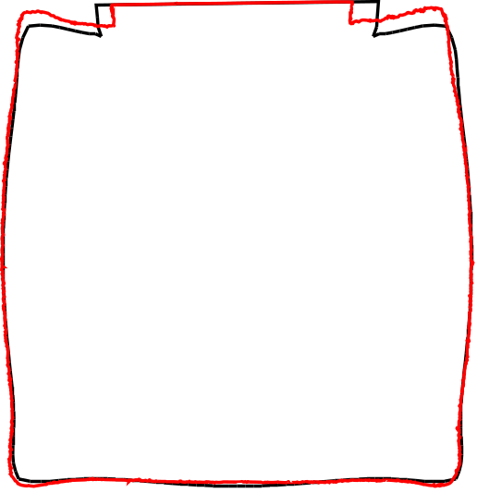
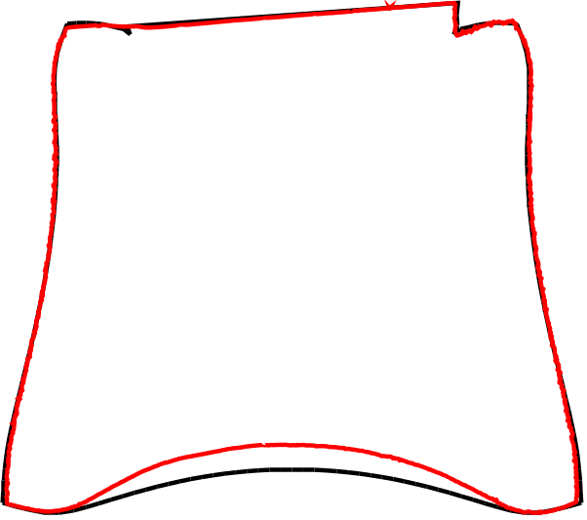
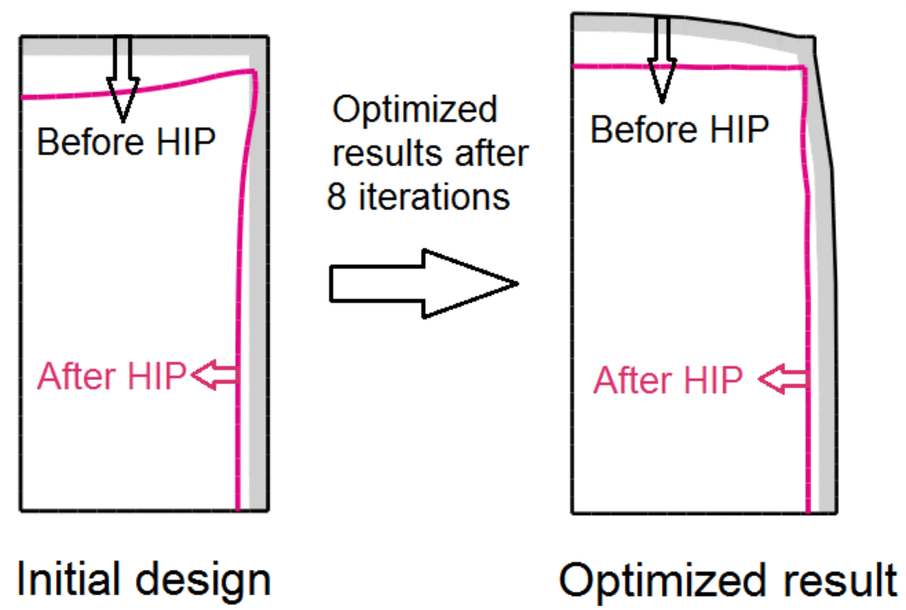
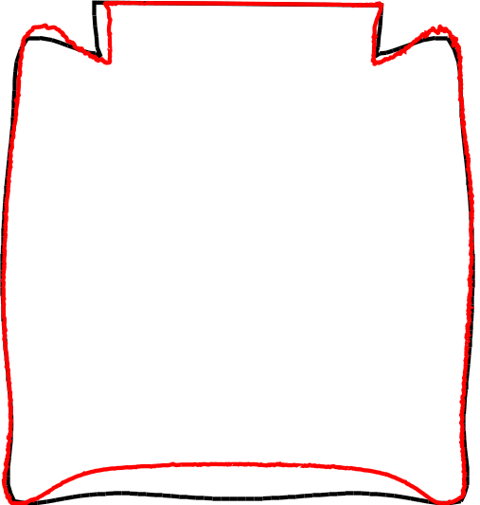
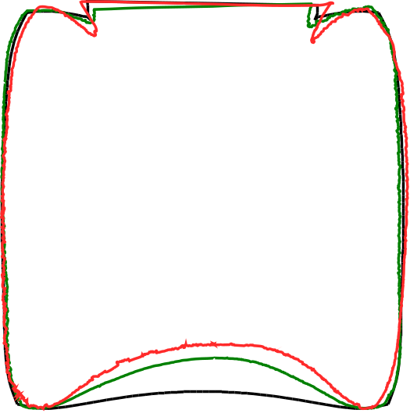
Comparison of Real HIPed and Simulated Shrinkage
1 mm WT
Capsule 316L
Bulk 316L
Cone
Capsule 316L
Bulk L6
Next step:
Geometry design of net-shape capsule prior to HIP
Complex- and irregular-shaped capsules totally appropriate for SLM-manufacturing
1 mm WT
Capsule 316L
Bulk L6
2 mm WT
Capsule 316L
Bulk L6
— after HIP
— Simulation
Input parameters:
Material properties: 316L
Relative powder density from filling
Homogenous density distribution
Notes:
Almost perfect for monolithic 316L
Slight deviations on L6 capsules:
Not correct material properties
Working on determining properties for L6

Slide 17
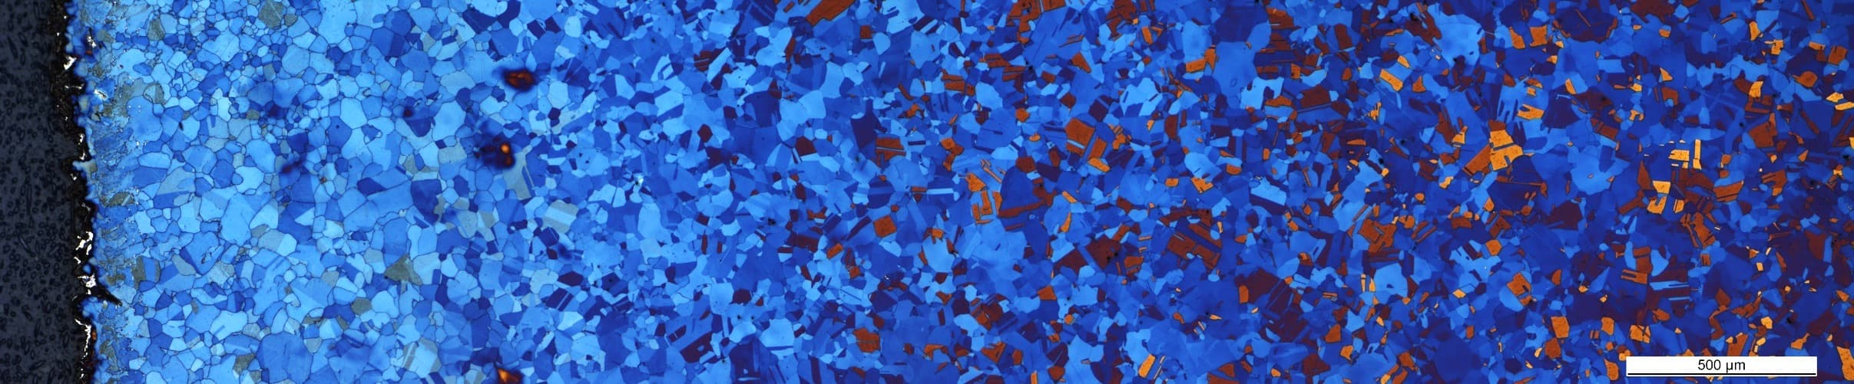
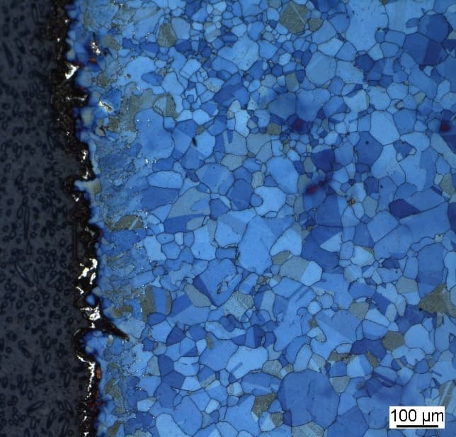
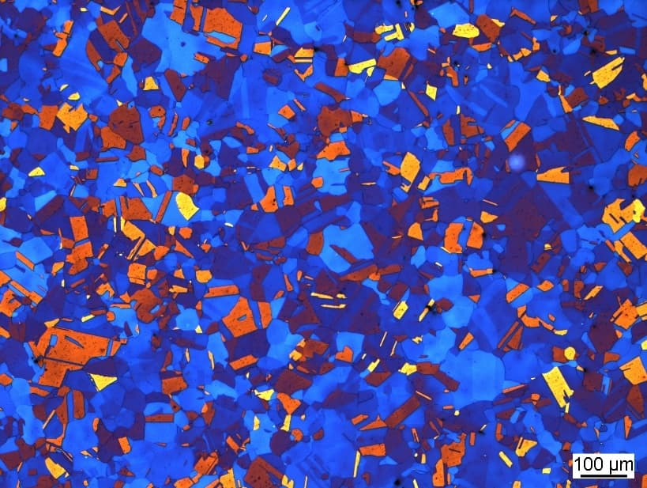
1 mm Wall Thickness, Capsule & Bulk 316L
500 µm
Capsule | Bulk
50 µm
100 µm

Slide 18
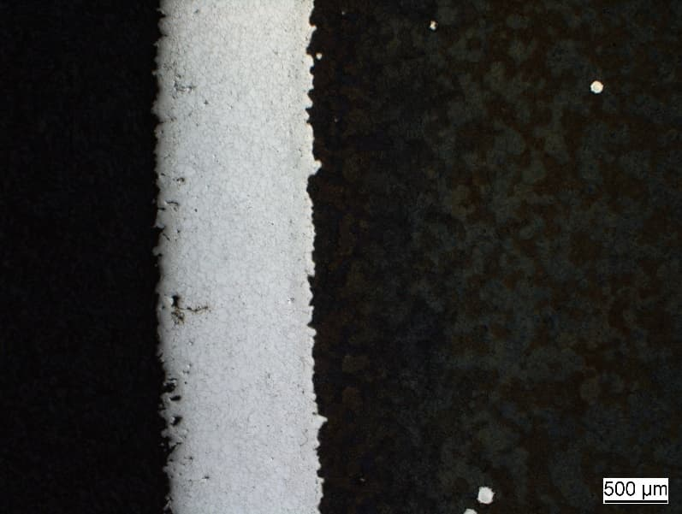
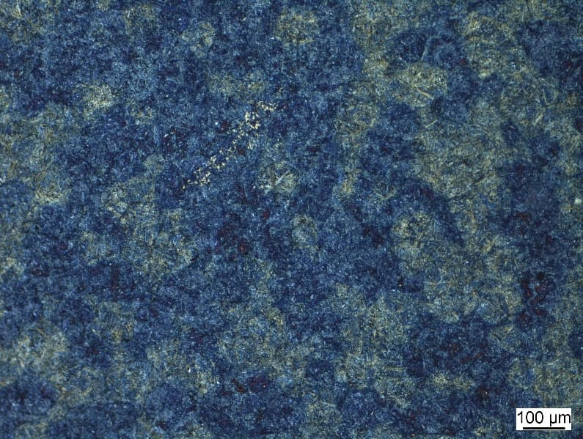
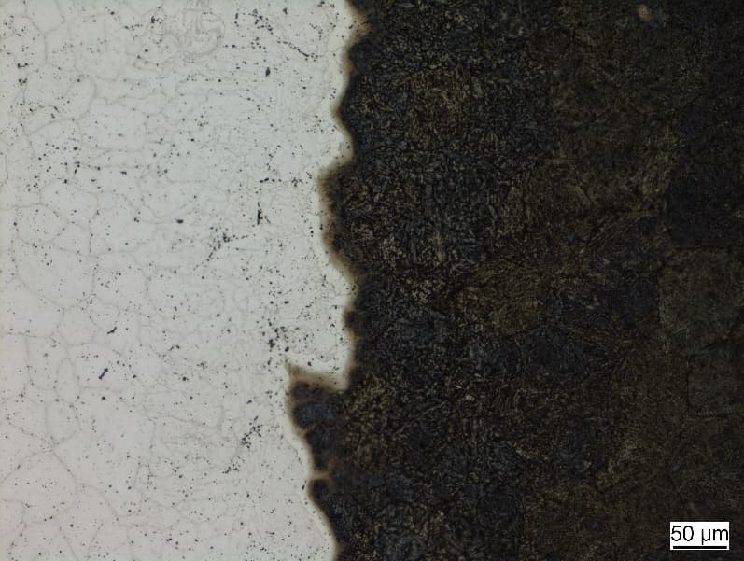
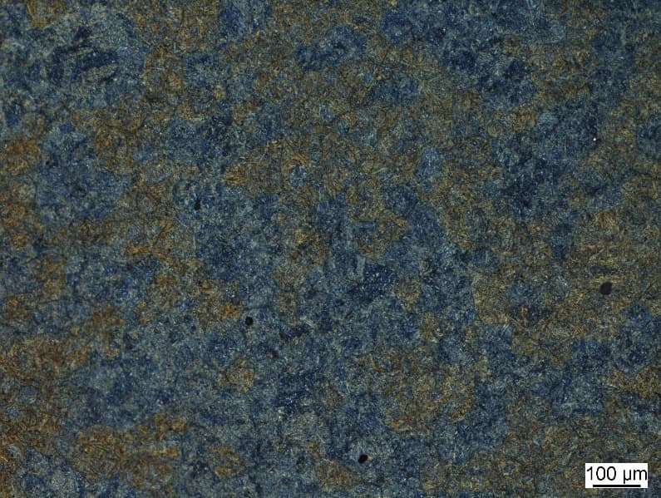
1 mm Wall Thickness, Capsule 316L, Bulk L6
Capsule | Bulk
500 µm
100 µm
50 µm
500 µm

Slide 19
EDX of Intersection Between Capsule and Bulk
Capsule: 316L, Bulk: L6
Capsule Bulk
1
2
3
4
5
6
7
Ni
Cr

Slide 20
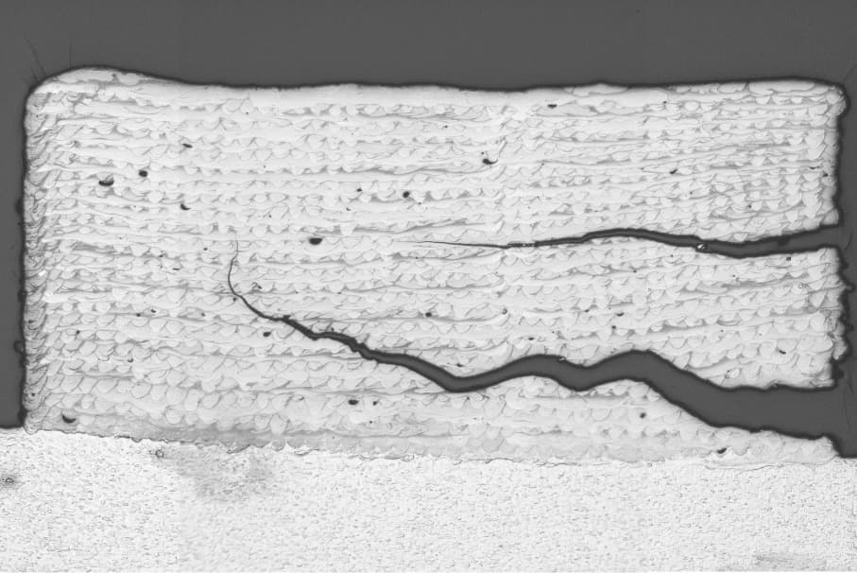
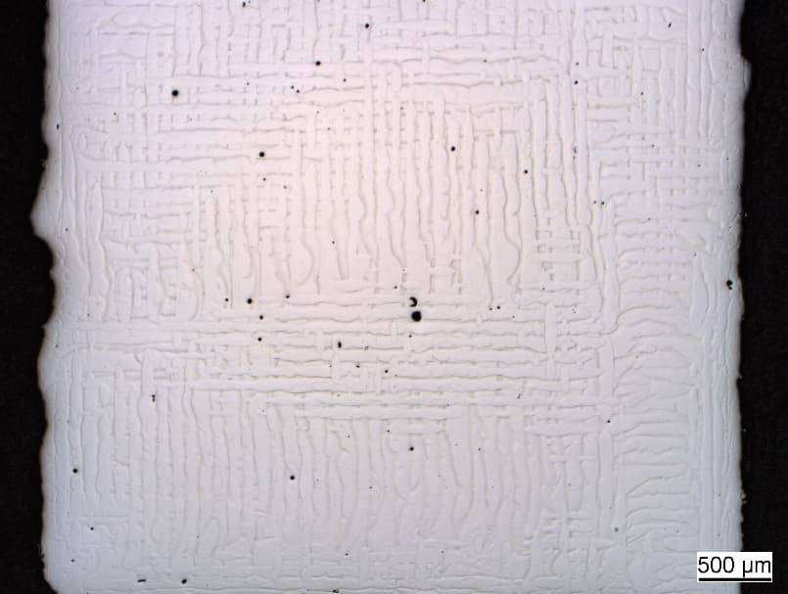
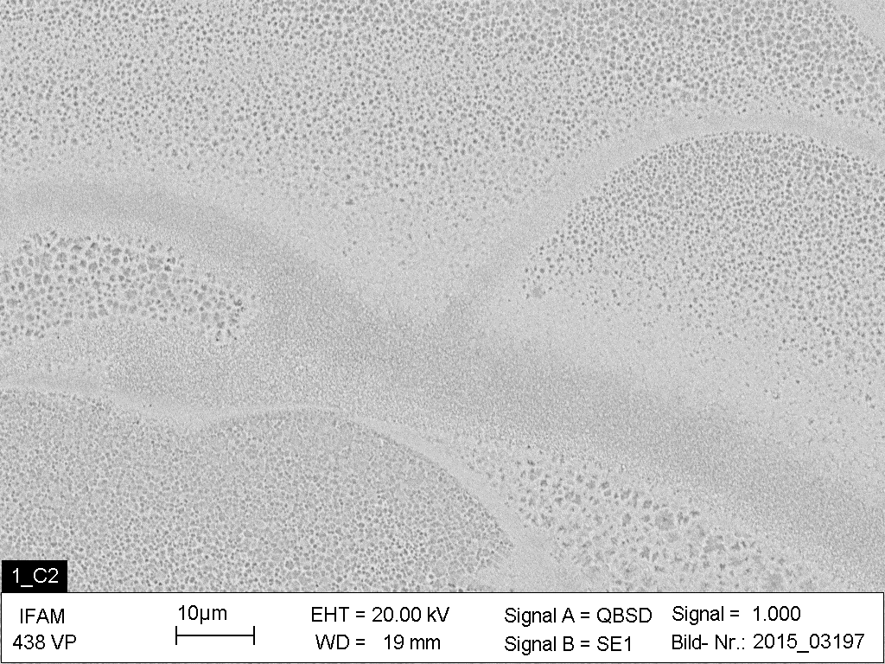
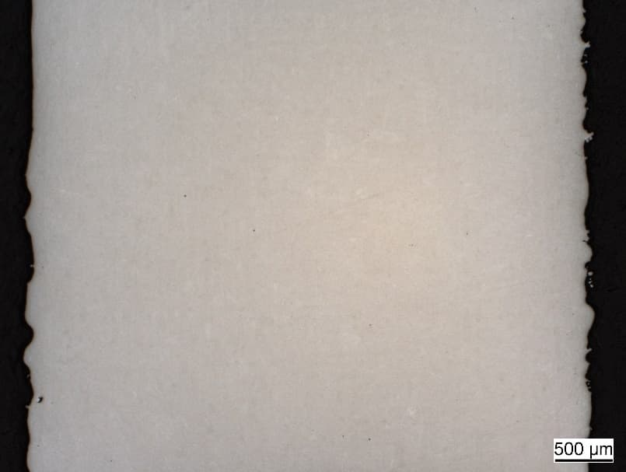
SLM & HIP of Carbide-rich Steel A11
SLMed cube of pure A11 | Pure A11 before HIP
SEM of pure A11 | Pure A11 after HIP
500 µm
500 µm
500 µm

Slide 21
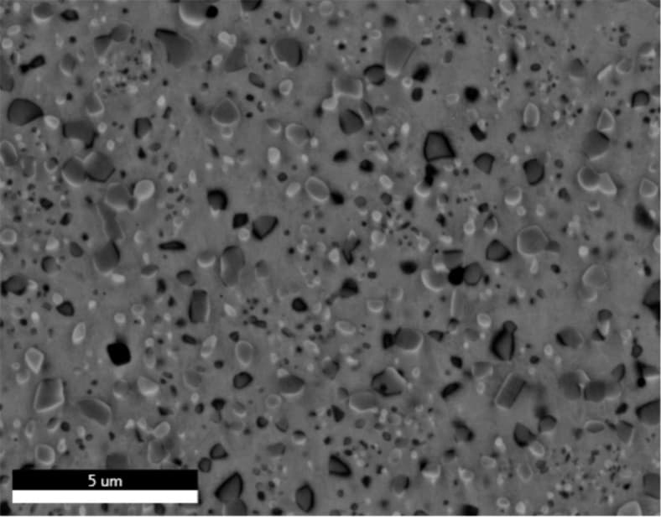
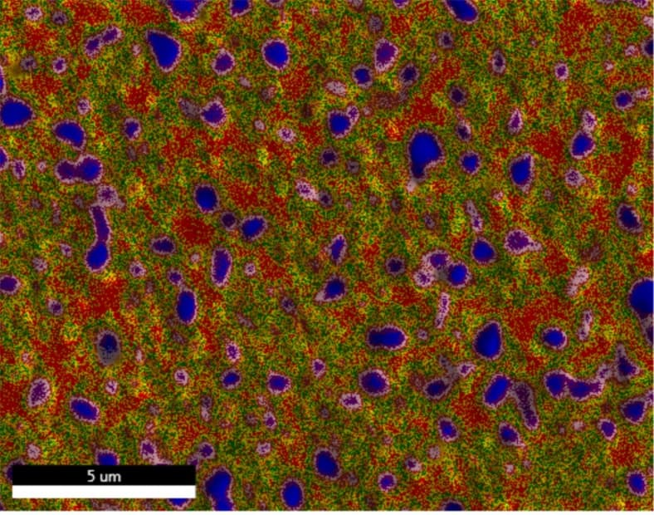
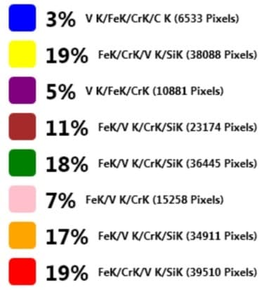
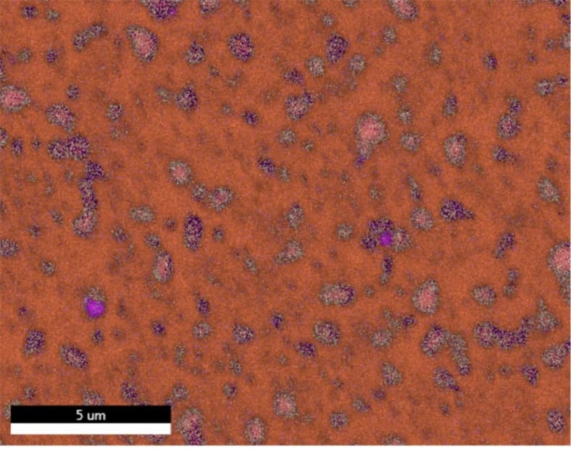
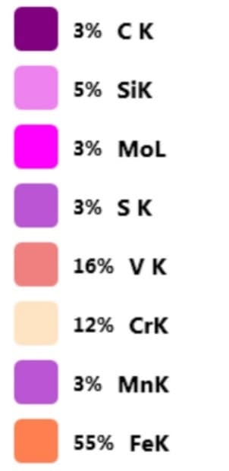
EDX of A11 + 10% 430L after HIP (1/2)
Back
Scatter
Phase
Mapping
Element
Mapping

Slide 22
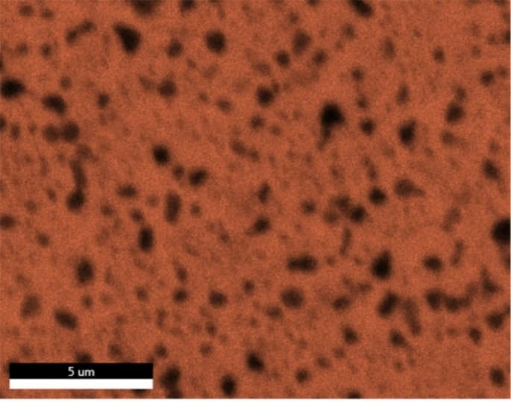
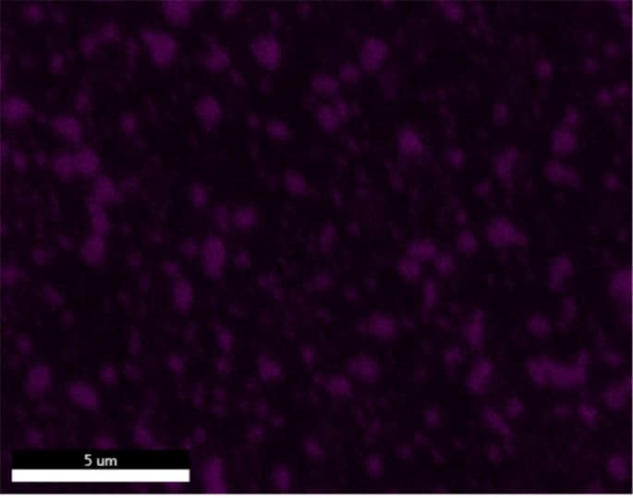
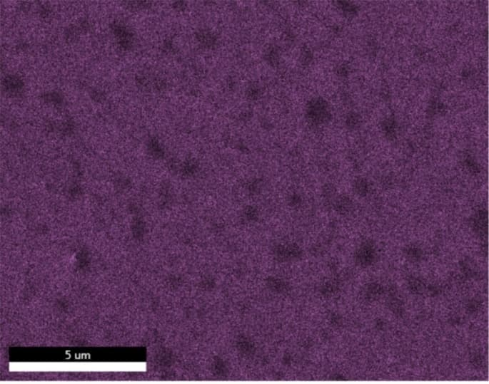
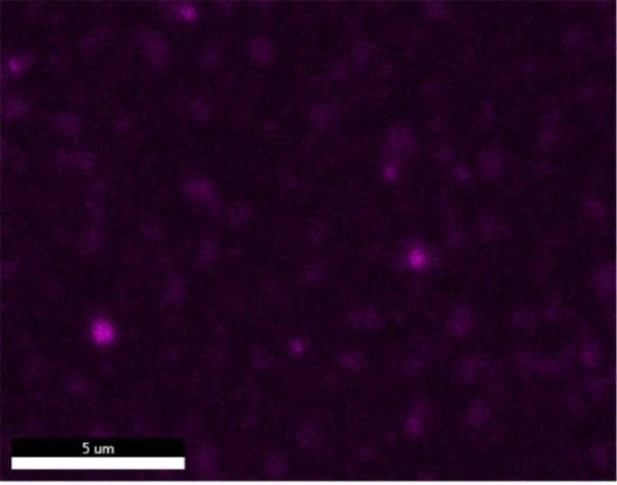
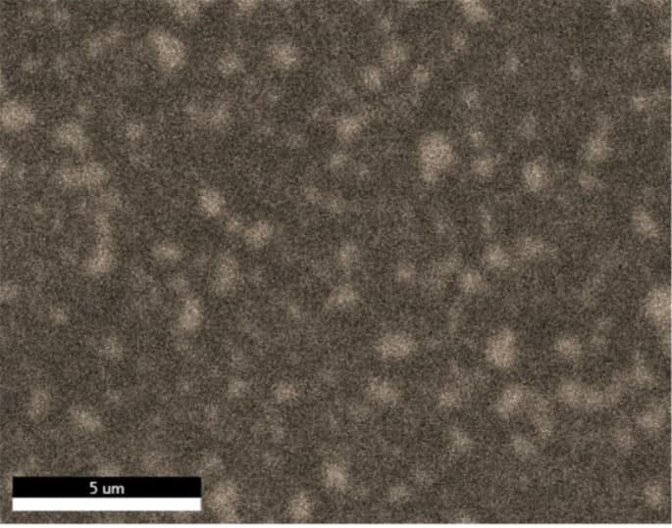
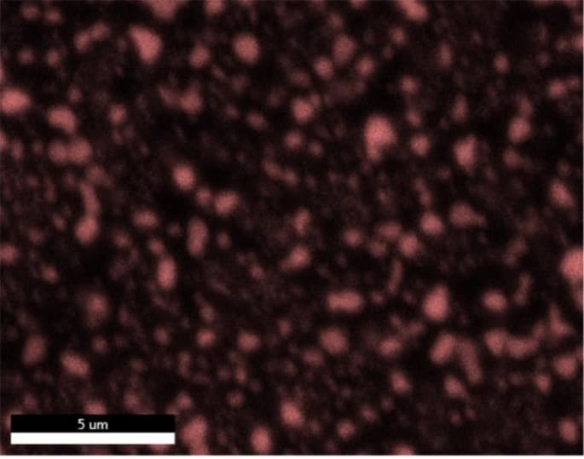
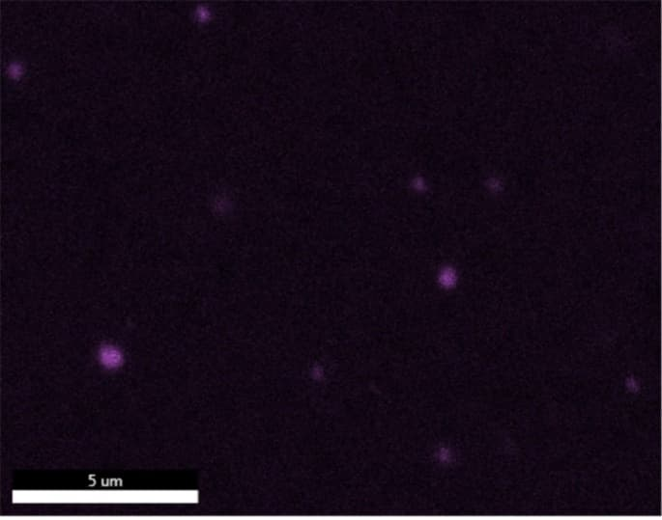
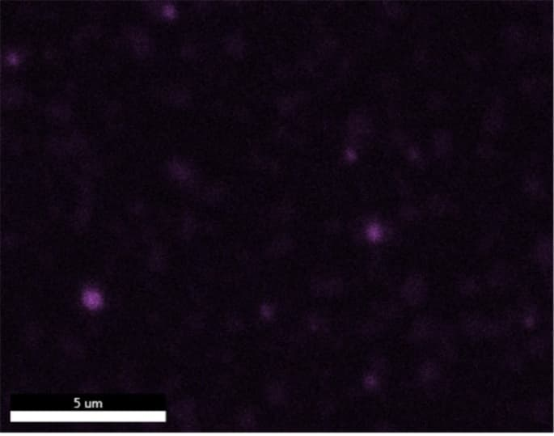
EDX of A11 + 10% 430L after HIP (2/2)
Fe | C | Si | Mo
Cr | V | Mn | S

Slide 23
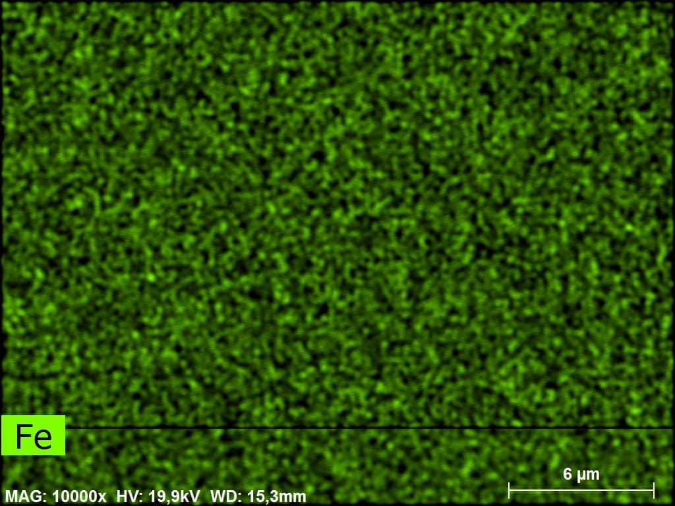
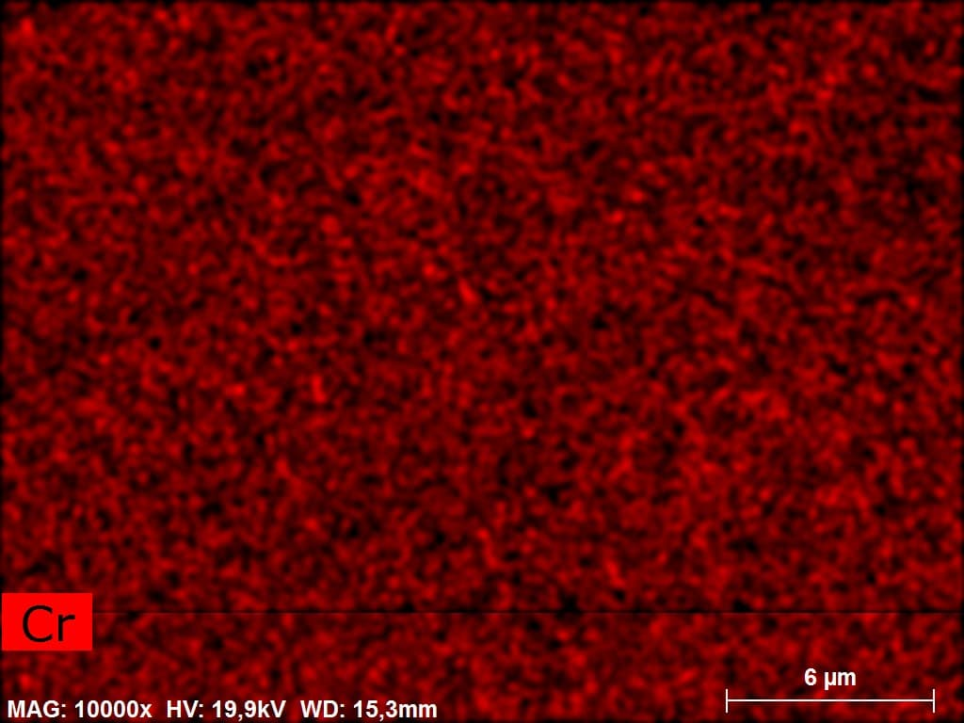
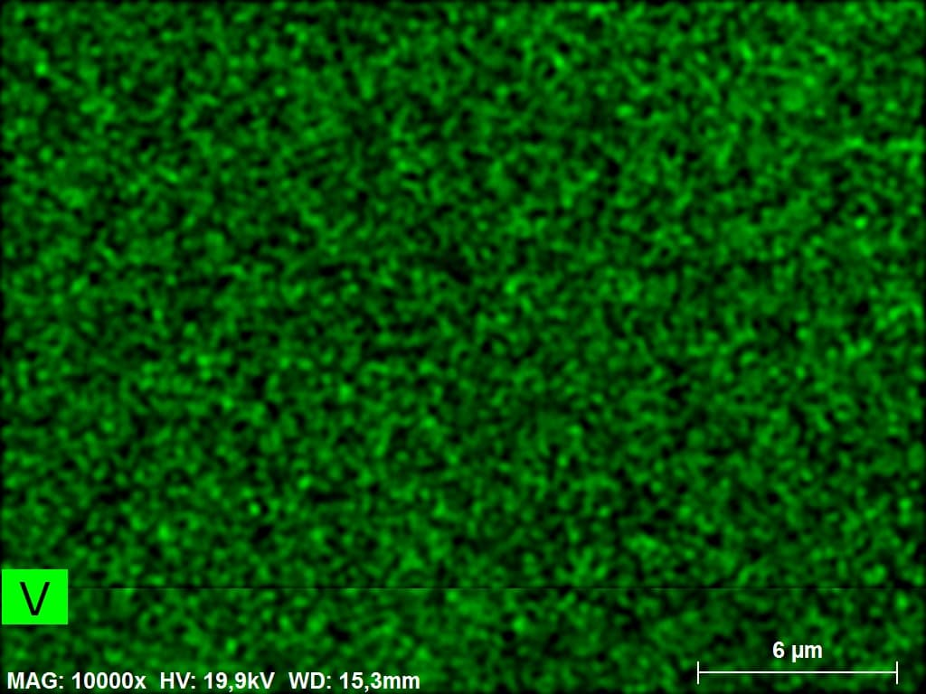
EDX of A11 + 50% 430L before HIP

Slide 24
Conclusion

Slide 25
Composite Components Produced By SLM and HIP
Build complex- and irregular-shaped HIP-capsules by SLM
  SLM of 316L and L6 is possible without much effort
  Ongoing research on best parameter set for SLM of A11
Design net-shape capsules with help of numerical simulation
Fill, close and powder-HIP capsules conventionally
Result: composite components with functional outer layer and tough core
Ongoing: determination of best mixture for A11
Next: Demonstrator component with industrial partner

Slide 26
We want to thank especially AiF e. V., FPM e. V. and all engaged companies for making this research possible.

