Slide 1

60 years after Battelle:
Why to HIP, What to HIP and How to HIP?
Science and Technology behind the Wall of an Autoclave
Victor Samarov
Synertech PM Inc.

Slide 2
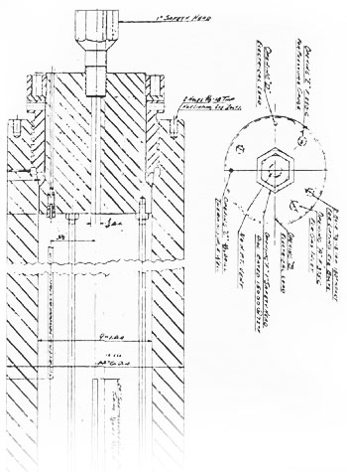
1956
Early examples of fabrication vessels using gas pressure and temperature to produce advanced alloy and ceramic products
Today HIP is used in industry worldwide to produce advanced alloy and ceramic products, particularly complex-shaped parts and products. HIP uses gas pressure and temperature to fabricate parts and products, bond and densify materials, consolidate powders, and heal defects. Developed in order to bond components of small Zircaloy-clad pin-type nuclear fuel elements, the process was soon applied to compact powders for use in tool steel, superalloys for jet engines, and materials for space applications. The strict dimensional control provided in a HIP vessel makes it useful as a manufacturing technique for near-net-shape processing and other complex fabrications.
Drawing (dated 12/31/54) of the reactor assembly used by Auto-clave Engineers, Inc. to manufacture the first cold-wall gas-pressure bonding vessel for Battelle.

Slide 3
Battelle Researchers Who Played a Role in the Development of HIP
Albert Adams Albert Ashhurst John L. Baker Ronald L. Bartoe Arthur A. Bauer Roger K. Beal Edward G. Bodine Charles B. Boyer Clifford M. Brockway Ronald J. Carlson Edward O. Carlton Donald C. Carmichael William C. Chard R. Michael Conaway Paul W. Cover George W. Cunningham *Russell W. Dayton Kieth Dentner Robert J. Diersing Norman S. Eddy Sherwood L. Fawcett James Fleck Ellis L. Foster, Jr. John B. Fox Gilbert Forrier Gerald Ira Friedman Michael Gedwill, Jr. Ralph W. Getz Stanley Gelles Danny L. Glenn Glenn R. Goetsch Galen C. Gregg Frank Grimm Paul J. Gripshover Nathan Guttman Hugh D. Hanes George Harth Jack Hatfield *Edwin S. Hodge Ronald E. Hord Charles Huff Donald E. Kizer Donald L. Keller Vonne D. Linse Donald E. Lozier Larry G. McCoy Hugh R. McCurdy James McFarlin Hoy O. McIntire Charles A. McMillan Kenneth Meiners Herman Midkiff Robert L. Minton Douglas Morrison John J. Mueller Keith R. Newton Dale E. Niesz F. Dean Orcutt Darrell Owenby Ronald Pacey Robert B. Palmer *Stan J. Paprocki William M. Pardue Andrew W. Pea James Perrin James H. Peterson William Pfeifer Gale Phillips Charles Pierce Stanley W. Porembka William Rector Steven H. Reichman Terry C. Rhodes Fred Roehrig Howard Russell Erwin Ruth Michael J. Ryan *Henry A. Saller William W. Scheidegger David A. Seifert Robert L. Shaw Charles Simonds William Six James Skagsberg Edward G. Smith, Jr. Richard H. Snider James Stone Amos Tapp Roger Vickroy Albert Webster Robert Whitman J. B. Williamson Richard Yates George Zinn David Zucker *Co-inventors

Slide 4
Consolidation of powder alloys during HIP has 7 fundamental differences from the conventional metallurgical processes

Slide 5
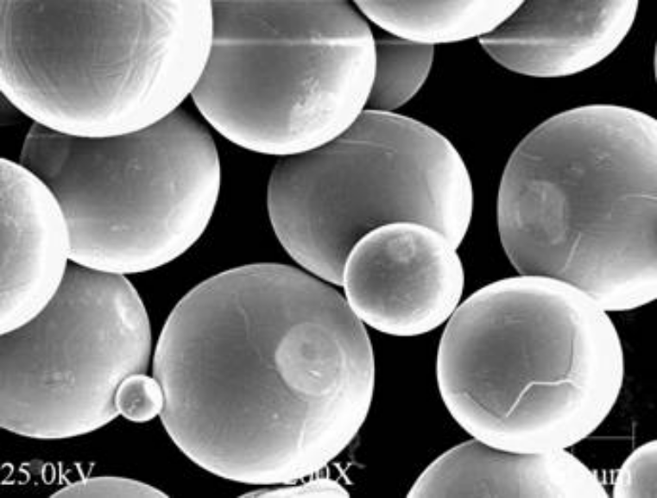
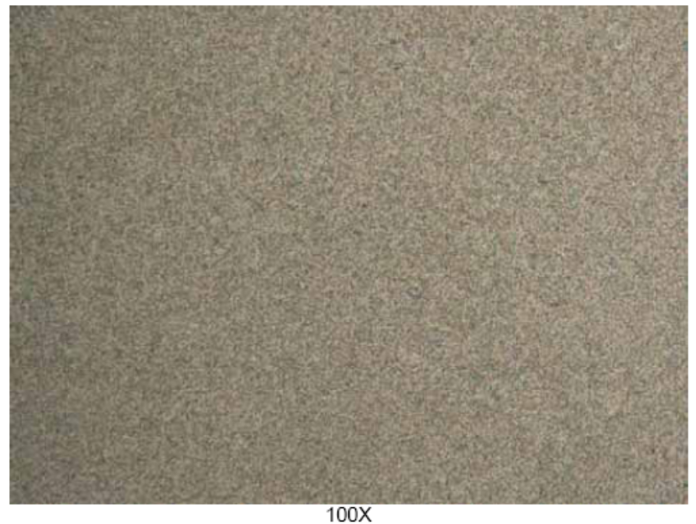
1. Consolidation of powder particles during HIP and formation of the 100% dense micro-structure is all done in a solid state phase without incipient melting due to the consecutive action of plastic deformation, creep and diffusion.

Slide 6
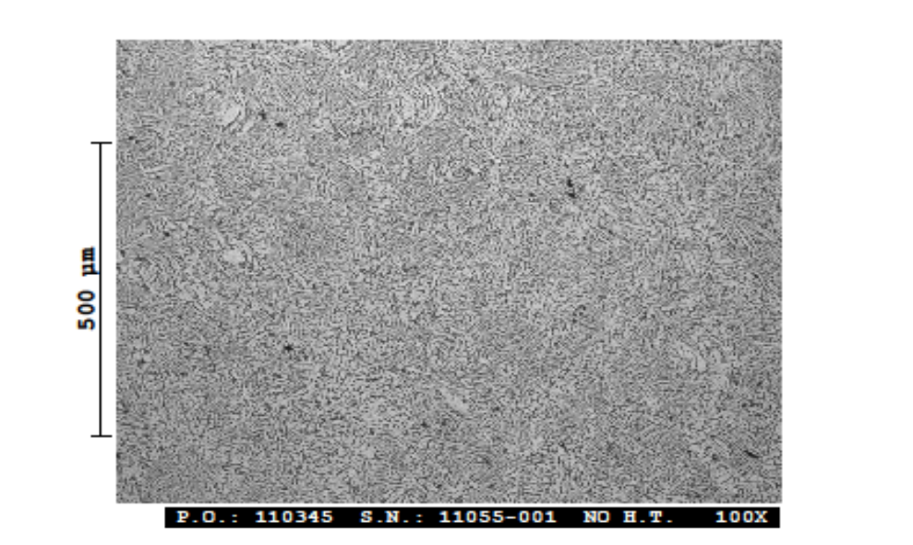
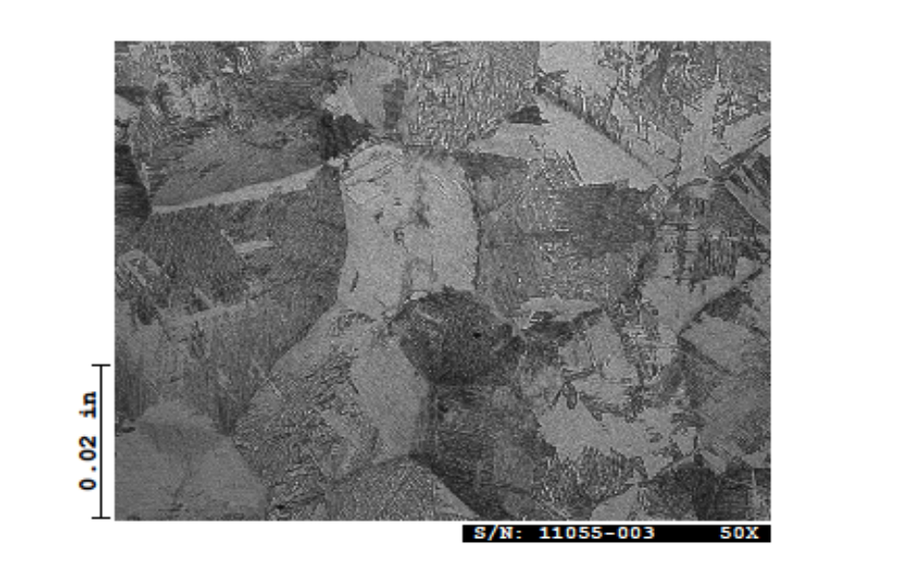
2. This enables to preserve after HIP in the materials and HIPed blanks of practically unlimited dimensions the fine grain size initial meta-stable structures obtained during rapid solidification, uniform and isotropic and well susceptible to the subsequent heat treatment.
Ti 6-4 after HIP and after Beta Heat Treatrent

Slide 7
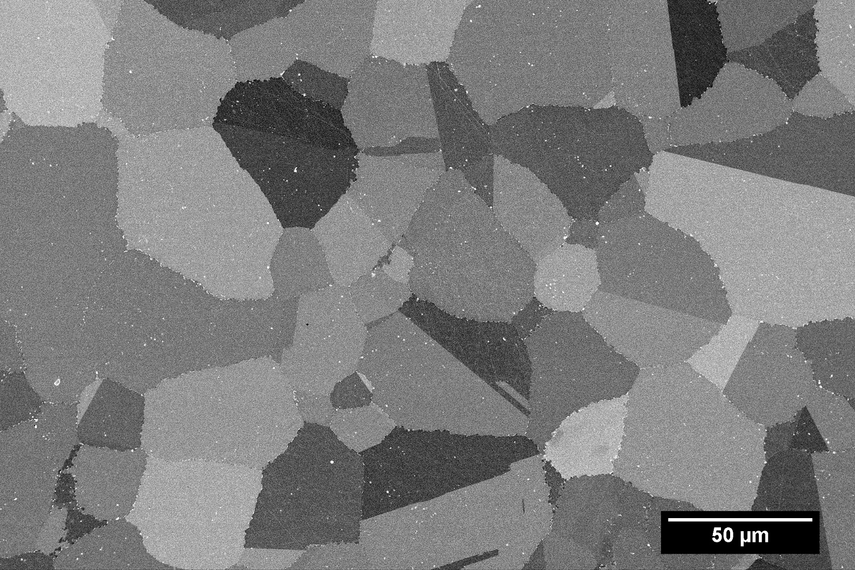
3. PM HIP enables to create Ni base and Ti materials alloyed far above the metallurgical limits of solubility
Chemical composition and micro-strucrure of Ni base alloy with >60% of the Gamma Prime phase

Slide 8
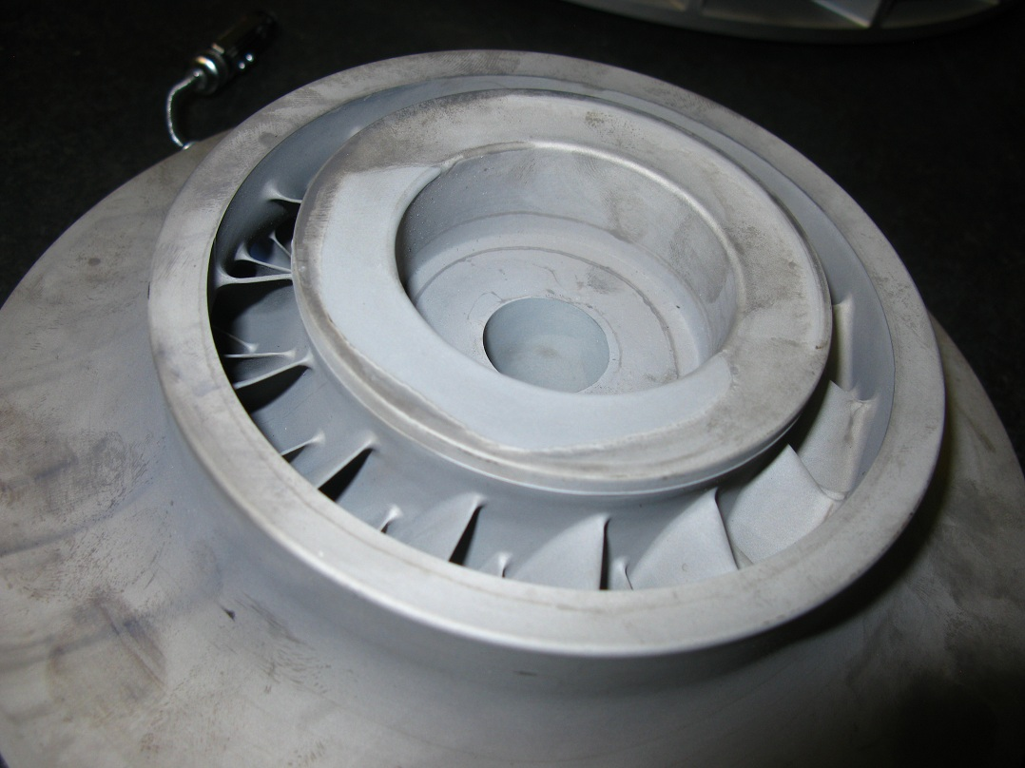
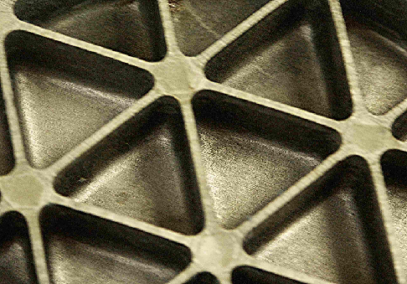
4. Atomized spherical powders are so flowable that with vibration can fill cavities of any shape and size. Therefore the formation of complex parts during HIP is determined only by the complexity of the HIP cans and their design based on the process modeling

Slide 9
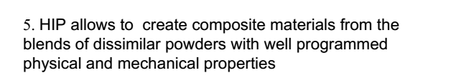
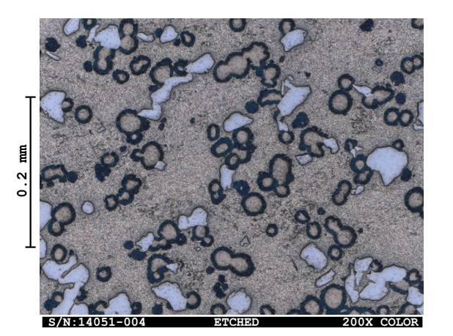
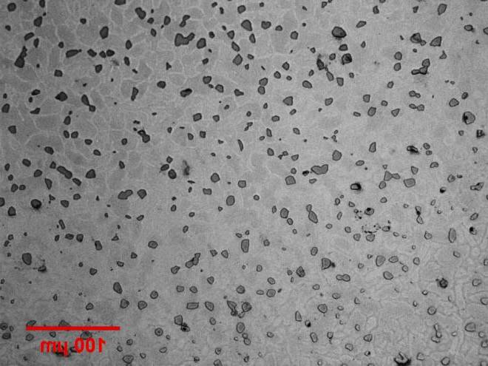
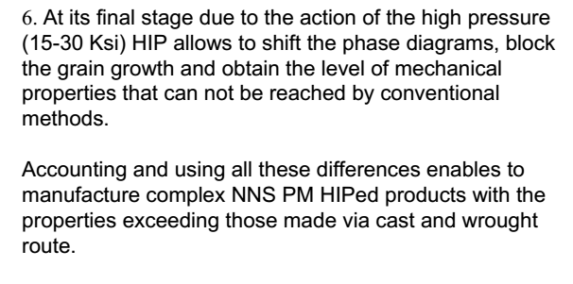

Slide 10
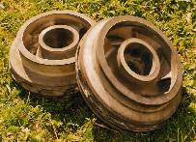
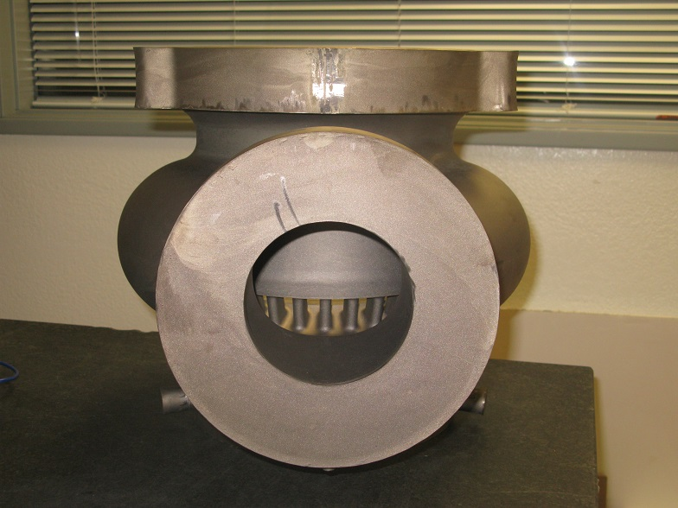
7. During HIP there is no rigid shaping tool, HIP capsule becomes as essential factor in providing dimensional accuracy
Is Net Shape HIP Possible?
Examples of Success through the Product Development

Slide 11
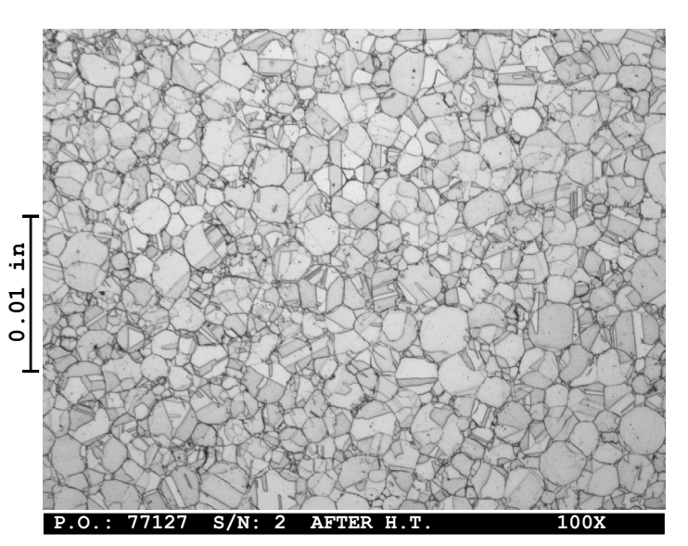
Prior Particle Boundaries (PPBs)- an Eternal Headache of HIP
Typical micro-structure of Ni base alloy with PPBs

Slide 12
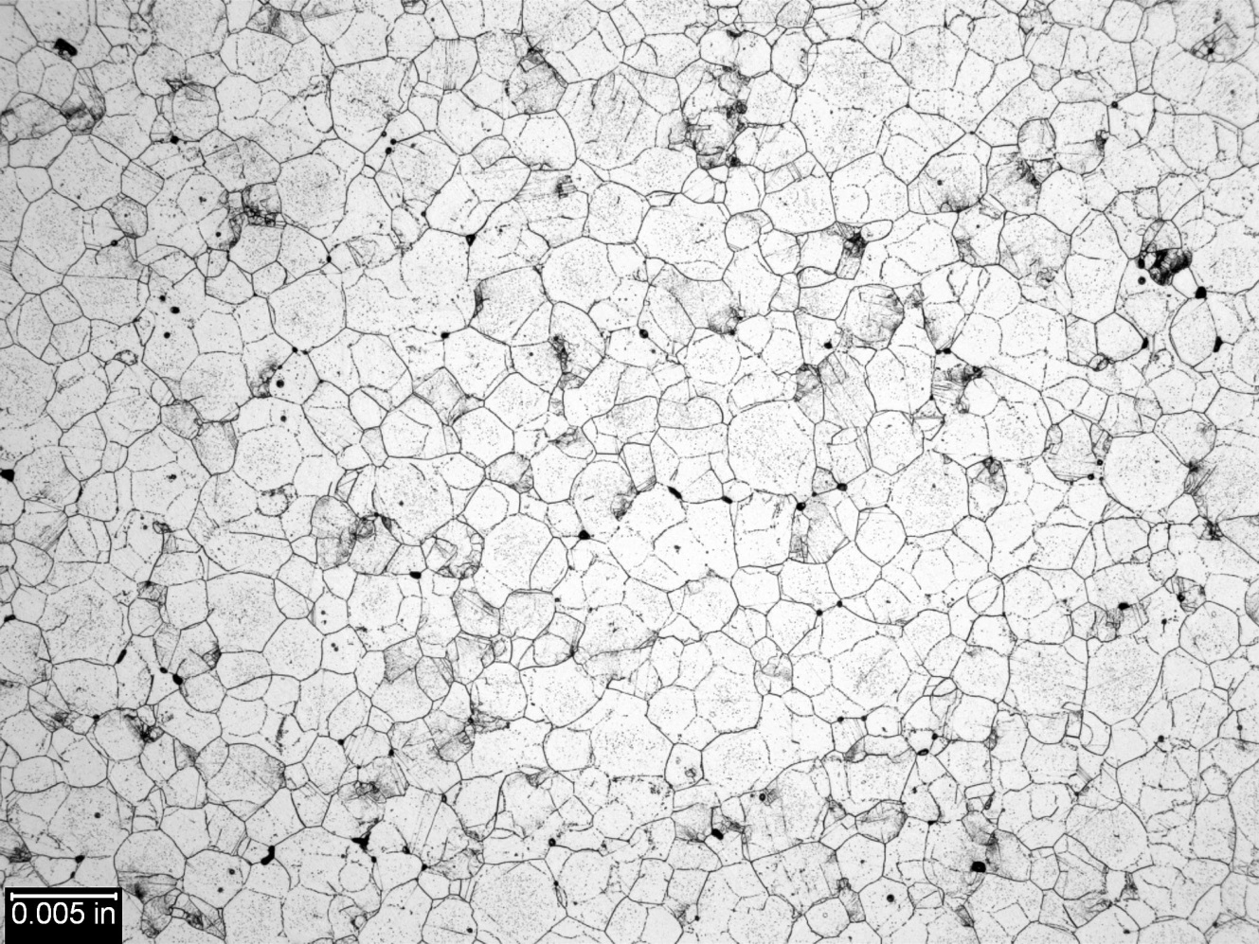
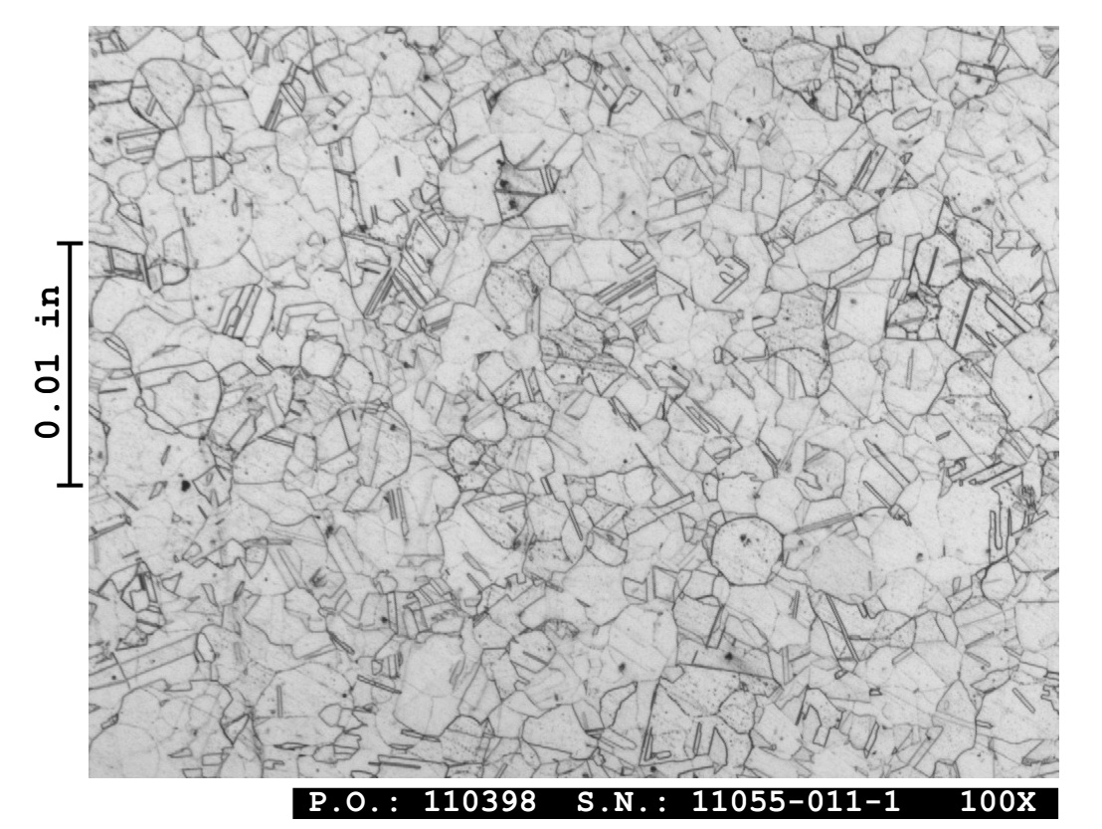
Suppression of PPBs through HIP Cycle and Heat treatment

Slide 13
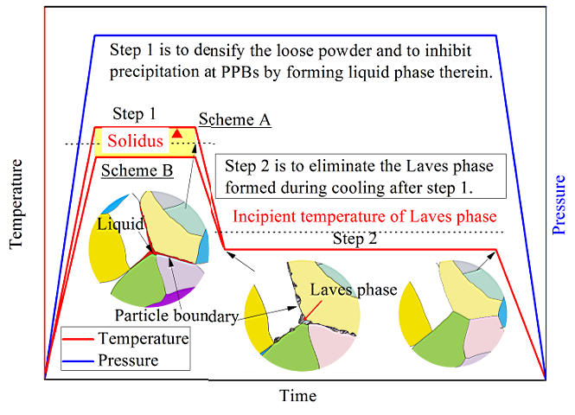
Suppression of the PPBs through the HIP cycle for IN718.
Scheme A works not scheme B

Slide 14
Ti, Nb, Cr, Al oxides are precipitating the PPBs, oxides thermo-dynamically stick to carbides and nitrides during HIP and heat treatment
3 Techniques of Powder Processing Prior to HIP Can Solve the Problem:
Chemical removal of the oxides from the initial powder particle boundaries may be a remedy;
High temperature vacuum outgassing of the dispersed powders
Solid state “Micro-alloying” of powders to optimize the chemistry

Slide 15
Current Disk Alloy Capabilities
1000
650° C/800 MPa/0.2% Creep time
100
Time - hrs
10
IM/PM
PM
PM
IM
IM
1
Rene88
IN100
U720
Wasp.
IN718
T3 > 700 °C requires higher T disk alloy
Courtesy of Jim Williams, GE

Slide 16
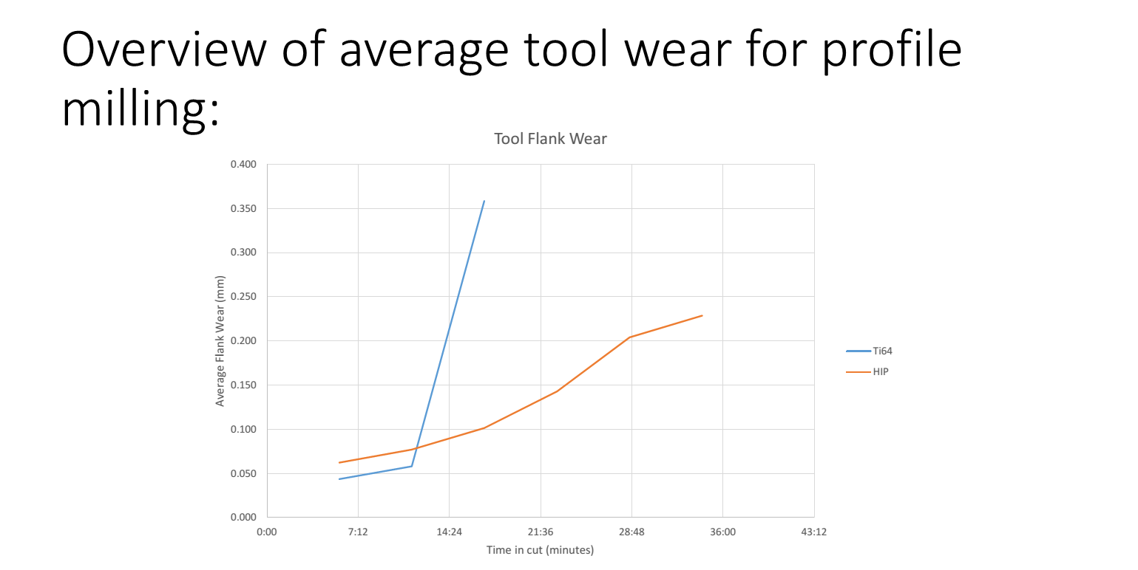

Slide 17
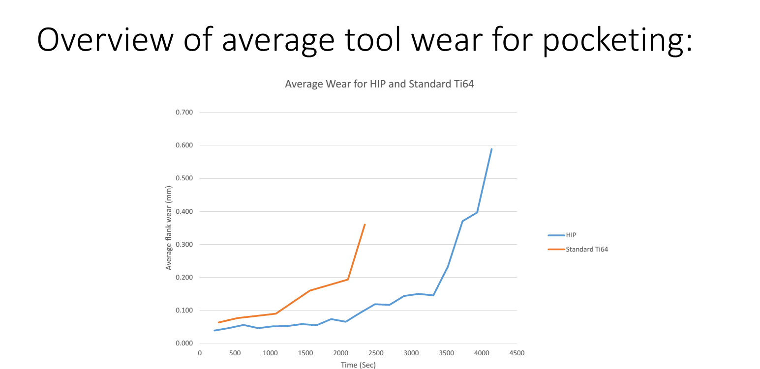

Slide 18
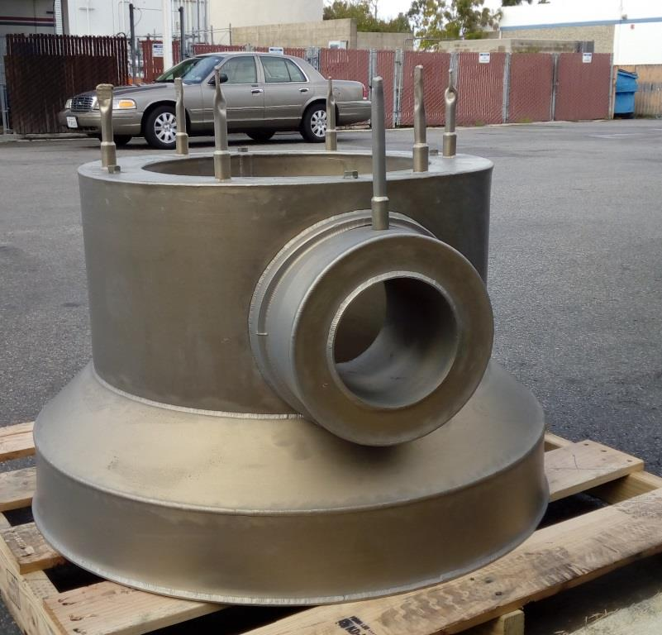
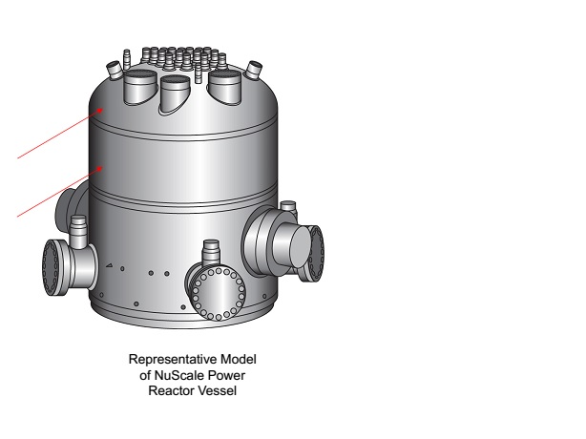
The major advances in performance of the PM HIPed parts and in PM HIP technology built on the physical principles of thermo-dynamics and heat and mass transfer, are realized through:
- development of large size complex shape components much beyond the limits of casting and forging processes,
.

Slide 19
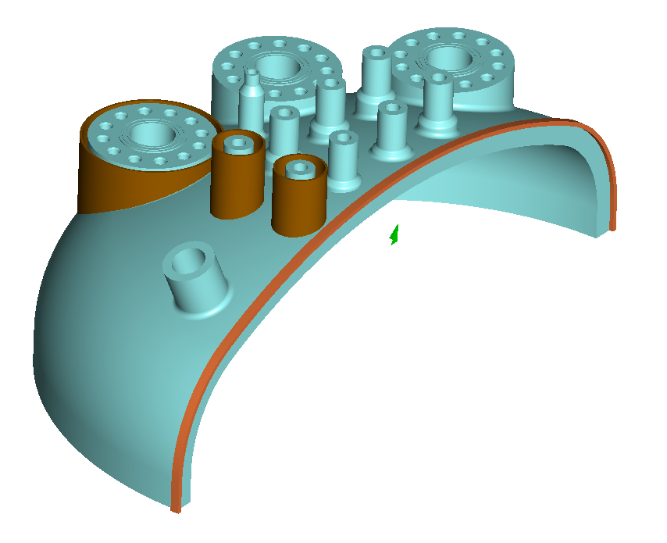
NNS Concept for the RPV Upper Head

Slide 20
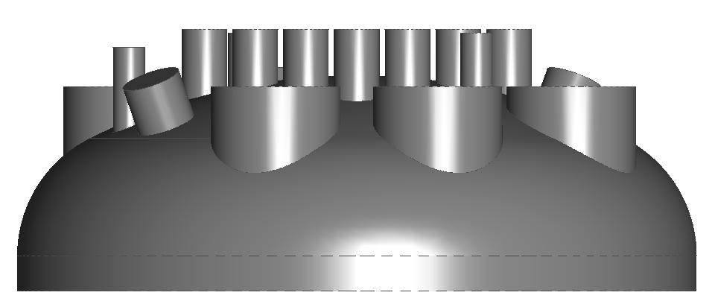
HIP capsule for RPV ½ scale RPV Upper Head 50 inch Diameter

Slide 21
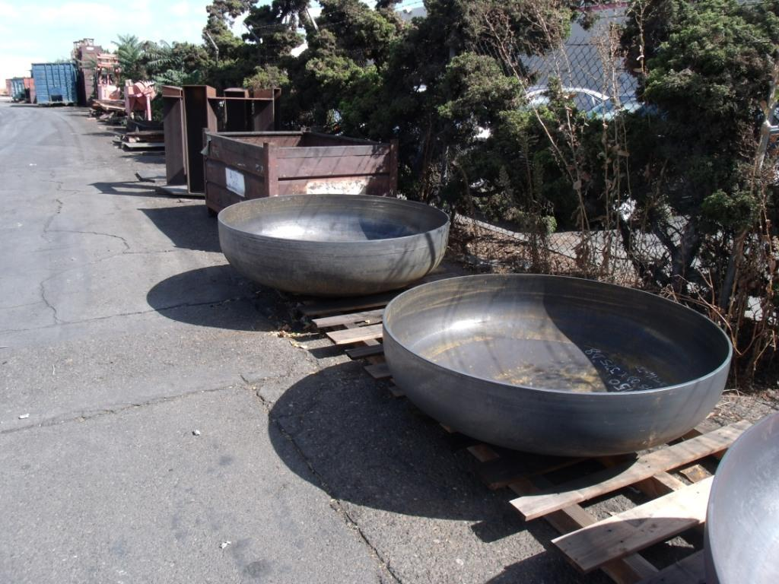
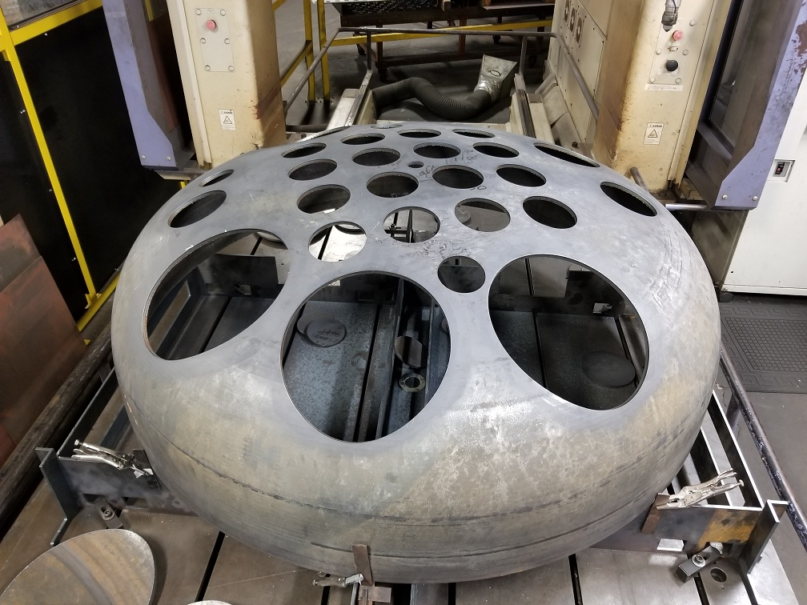
New capsules

Slide 22
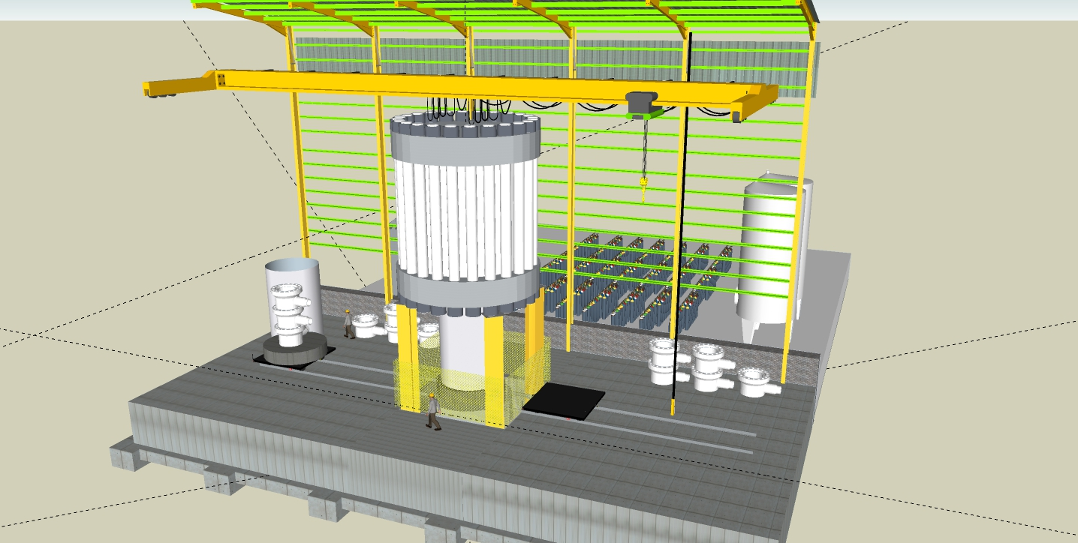
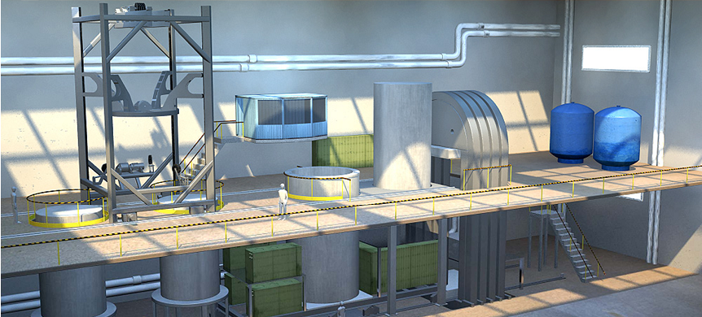
Immediately needed:
New modeling accounting filling and non-uniform heat transfer
New HIP capsule technologies
New HIP with up to 140” diameter Hot Zone

Slide 23
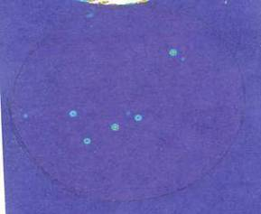
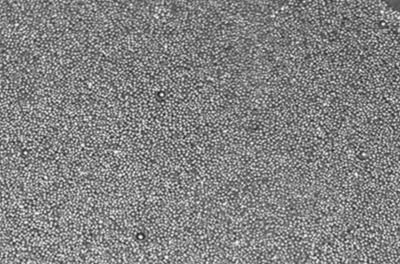
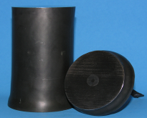
- radical enhancement of non-destructive inspection of HIPed materials and shapes;
C-scan
Looking Down
Can diameter
A
Seeds will move (up/down left/right) during
handling between fill and HIP.
F
E
C
G
B
D
UT
Titanium Powder (-60 Mesh)
0.006” seeded WC balls
Technique: Automated immersion c-scan, pulse-echo
Uniform, fine grain size greatly reduces background ultrasonic noise compared to cast/forge Titanium

Slide 24
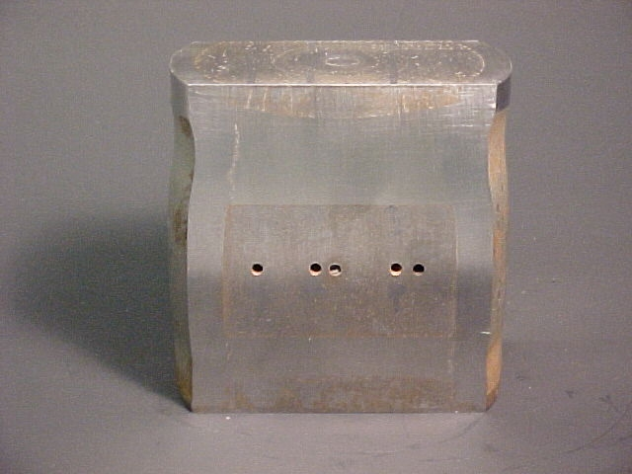
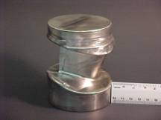
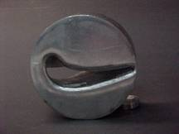
Ultrasonic Testing of Selectively
Net Shape Powder Metal Components
Through-the-Tooling Inspection
Udimet 720 Blade
After Tool Removal
Rotated 90°
Tooling to Form Blade

Slide 25
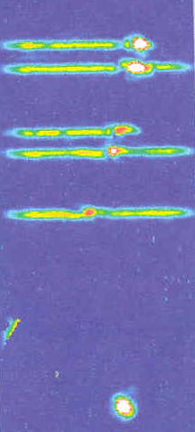
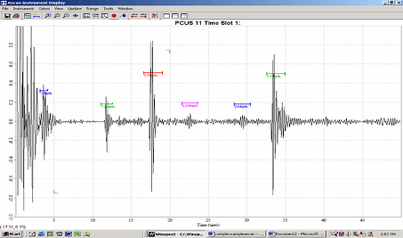
Ultrasonic Testing of Selectively
Net Shape Powder Metal Components
Through-the-Tooling Inspection
X
Transducer
Location 1
Gate 1
Sound Path
Gate 2
Gate 3
Side-drilled hole
Gate 6
PM/Can
Gate 3
Gate 1
Can/PM
Gate 2
PM/Tooling
Gate 4
Can/PM
Gate 5
Tooling/PM
Gate 4
Gate 5
Gate 6

Slide 26
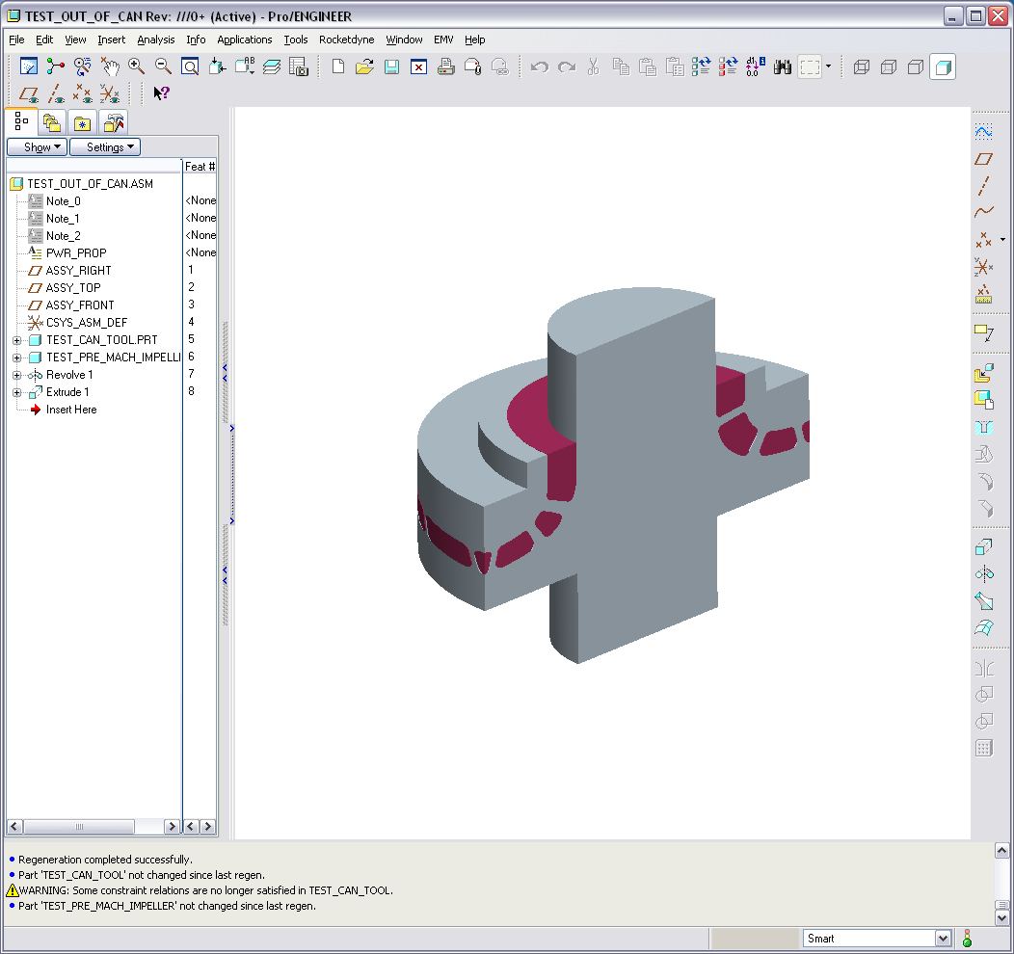
Ultrasonic Testing of Selectively
Net Shape Powder Metal Components
Through-the-Tooling “Conceptual Complex Shapes”
UT
Probe
Tooling
Before Removal
Area of
Inspection
Sonic Shape
SNS Part

Slide 27
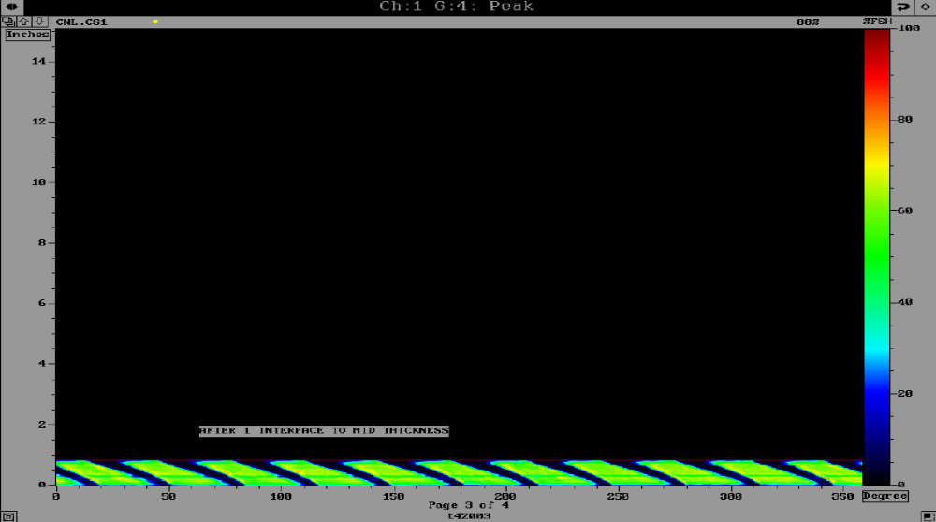

Slide 28
Near Net Shape PM Technology Imposes requirements to the HIP Equipment and HIP cycles
1 | Temperature Uniformity of the components in the HIP furnace at the ramp stage beginning with 100-200C be maintained within 50C(90F). | HIP Process | Essential for Large Complex Shape Parts taking the major volume of the furnace, as with the conventional HIP temperature profiles, densification will start at a different time in different areas of the HIP tooling, impossible for the shape control. Innovative HIP furnace design solutions are needed such as specially focused heating zones

Slide 29
Near Net Shape PM Technology Imposes requirements to the HIP Equipment and HIP cycles
2 | Temperature uniformity of +/- 25F(14C) measured on the external and internal surface of the parts at the dwell stage of HIP cycle | HIP process, furnace, controls | Stability of mechanical properties of the large parts

Slide 30
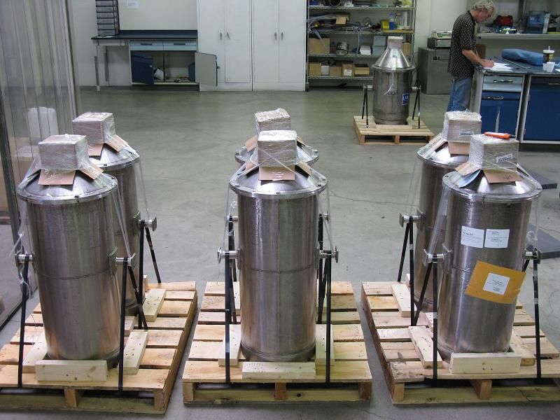
Material Affordability
- Cost efficient Powders are available in any heat size;
- Decrease of “buy- to fly” ratio 3-5 times for complex shapes;
- Properties as wrought or better, shape- as cast or better;
- Efficient Non-destructive inspection ;
- Capability for re-design of critical components to their best performance;

Slide 31
CONSLUSIONS
The major advances in performance of the PM HIPed parts and in PM HIP technology built on the physical principles of thermo-dynamics and heat and mass transfer, are REALIZED through:
- development of large size complex shape components much beyond the limits of casting and forging processes,
- near-net shaping (NNS) capabilities brought by modeling and HIP tooling design;
- enhancement of the properties and performance of large parts through the use of advanced PM alloys and powder compositions;
- radical enhancement of non-destructive inspection of HIPed materials and shapes;
- modeling of micro-structural evolution and formation of mechanical properties during HIP consolidation;

