Slide 1
Heat treatment inside the HIP-Unit
12th International Conference on Hot Isostatic Pressing 2017
05.12. - 08.12.17 Sydney
N. Wulbieter, A. Rottstegge, W. Theisen

Slide 2
Contents
Introduction
HIP cooling rates – measuring and benchmark
HIP-quenching of martensitic steels
Summary and outlook

Slide 3
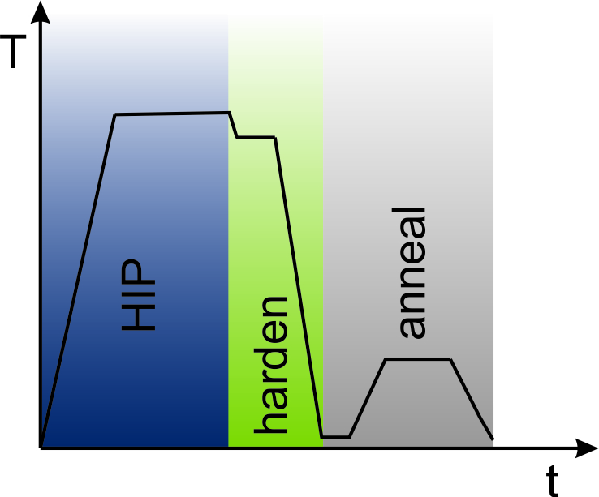
Introduction
Advantages of fast cooling in a HIP-Unit
Shortens processing time
Densification and heat treatment in one process step
Benefits of gas-quenching:
  Clean surfaces
  Less distortion
Heat treatment under high pressure

Slide 4
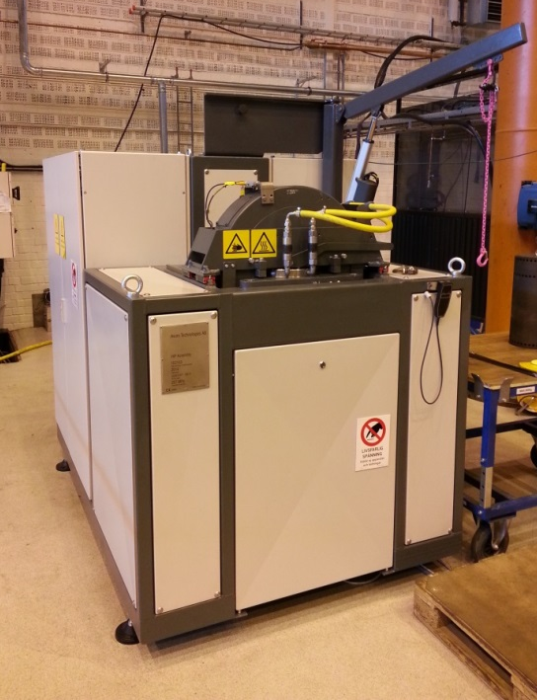
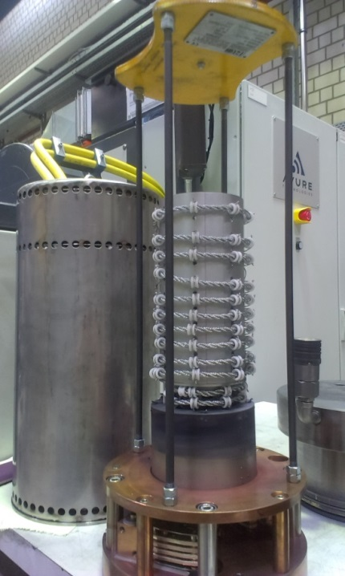
Introduction
HIP-Unit „Quintus QIH9“ with Uniform Rapid Quenching (URQTM)
Furnace: Ø 86 mm x 160 mm
Max. temperature: 1400 °C (molybdenum), 2000 °C (graphite)
Max. pressure: 207 MPa
Max. pressure for fast cooling:
  170 MPa
Process gas:
  Argon
  Nitrogen

Slide 5
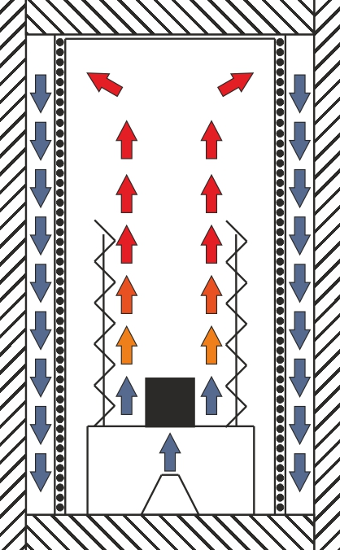
Introduction
Schematic of fast cooling in QIH9
Cold gas outside the heatshield is pressed into the hot zone
Hot gas is cooled when passing the heatshield which acts as a heatsink
Circulation of gas inside the pressure vessel
Fast cooling works since difference in temperature exists between gas in- and outside the heatshield

Slide 6
Contents
Introduction
HIP cooling rates – measuring and benchmark
HIP-quenching of martensitic steels
Summary and outlook

Slide 7
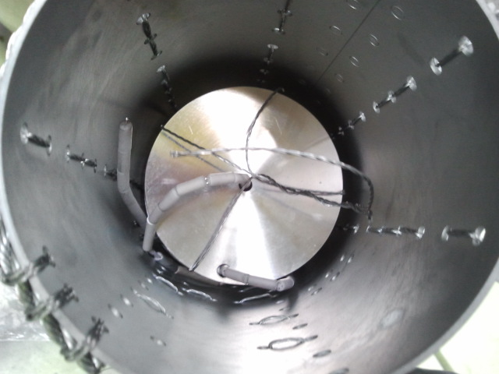
HIP cooling rates
Procedure
Test material: 1.4404 (AISI 316L)
Inserted thermocouples for determination of cooling rates
Start temperature: 1300 °C
Different sample diameters tested
Different gas inlet nozzles tested
Different pressures tested

Slide 8
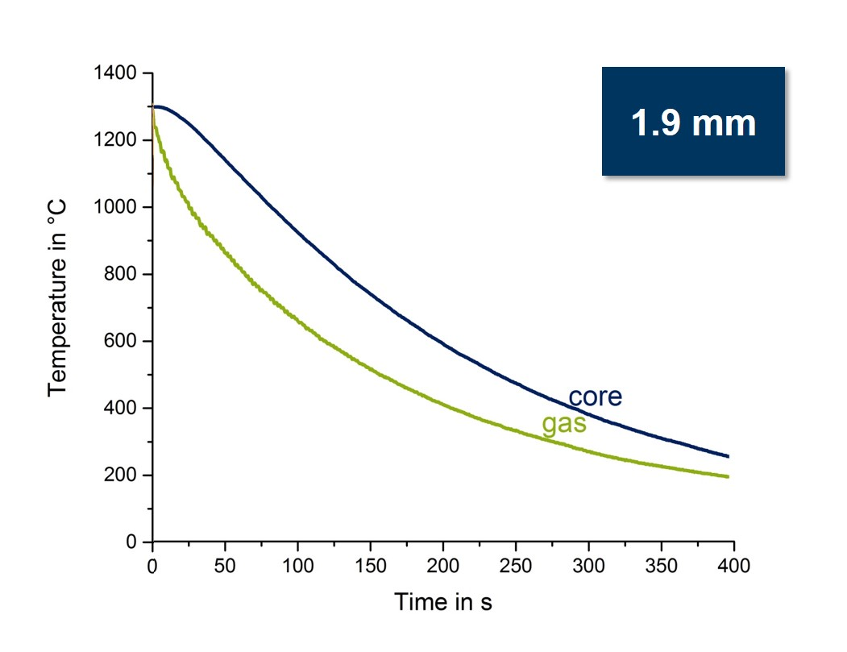
HIP cooling rates
Results for 1.4404 (Ø 30 x 90 mm) at 100 MPa
Ø 1.9 mm
Gas nozzle

Slide 9
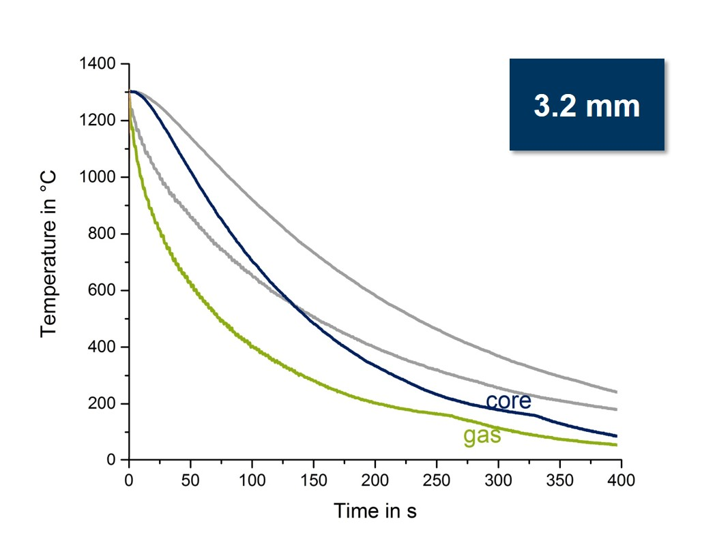
HIP cooling rates
Results for 1.4404 (Ø 30 x 90 mm) at 100 MPa
Ø 3.2 mm
Gas nozzle

Slide 10
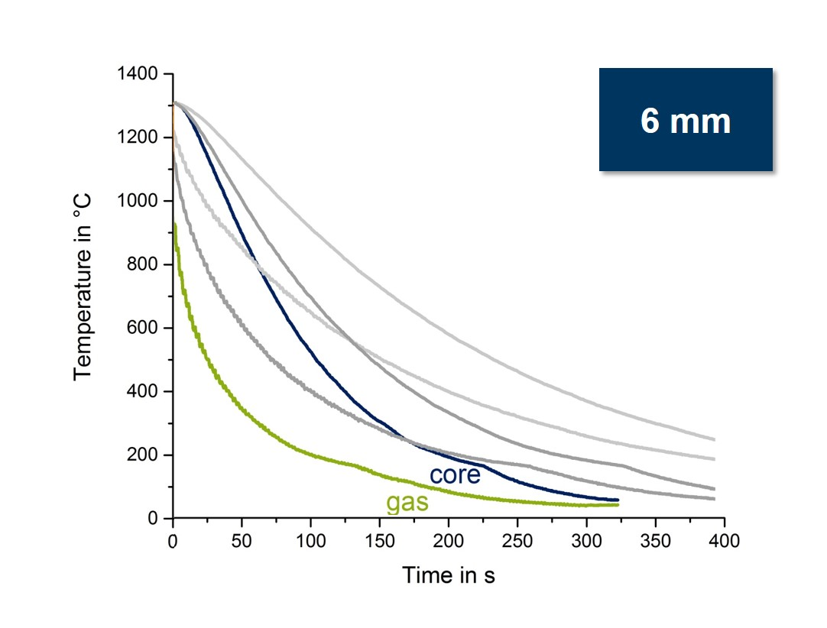
HIP cooling rates
Results for 1.4404 (Ø 30 x 90 mm) at 100 MPa
Ø 6 mm
Gas nozzle

Slide 11
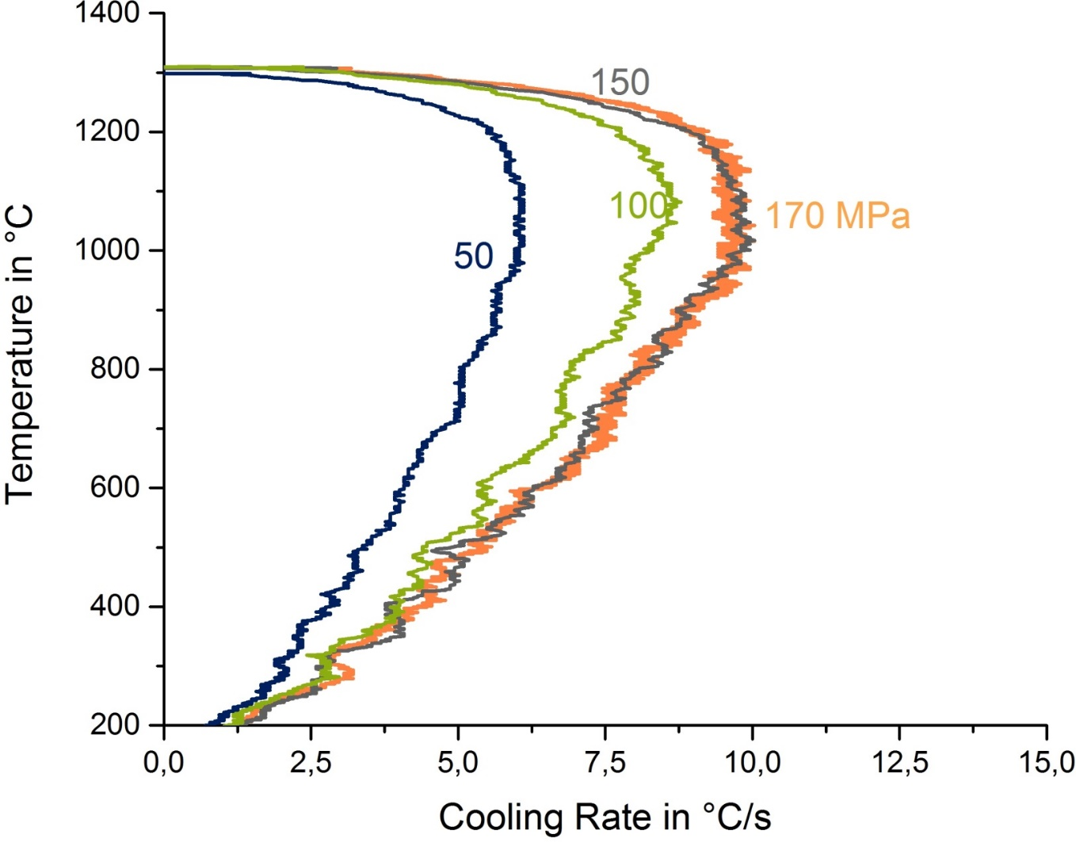
HIP cooling rates
Cooling rates as a function of gas pressure for the core of 1.4404 (Ø 30 x 90 mm)
0.0
2.5
5.0
7.5
10.0
12.5
15.0

Slide 12
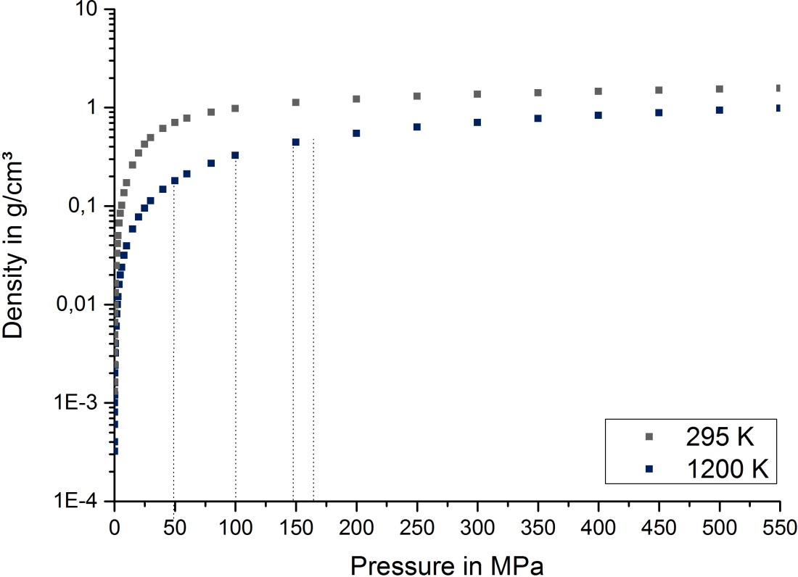
HIP cooling rates
22 °C
972 °C
Ref.: R.B. Stewart (1989)
Literature: Density as a function of pressure (Argon)

Slide 13
HIP cooling rates
Heat transfer coefficient for HIP (calculated) and conventional quenching media (literature)
Nitrogen, 6 bar
HIP - 170 MPa
Helium, 6 bar
Oil
Salt bath
Oil with convection
Air
Ref.: G.E. Totten (1997)

Slide 14
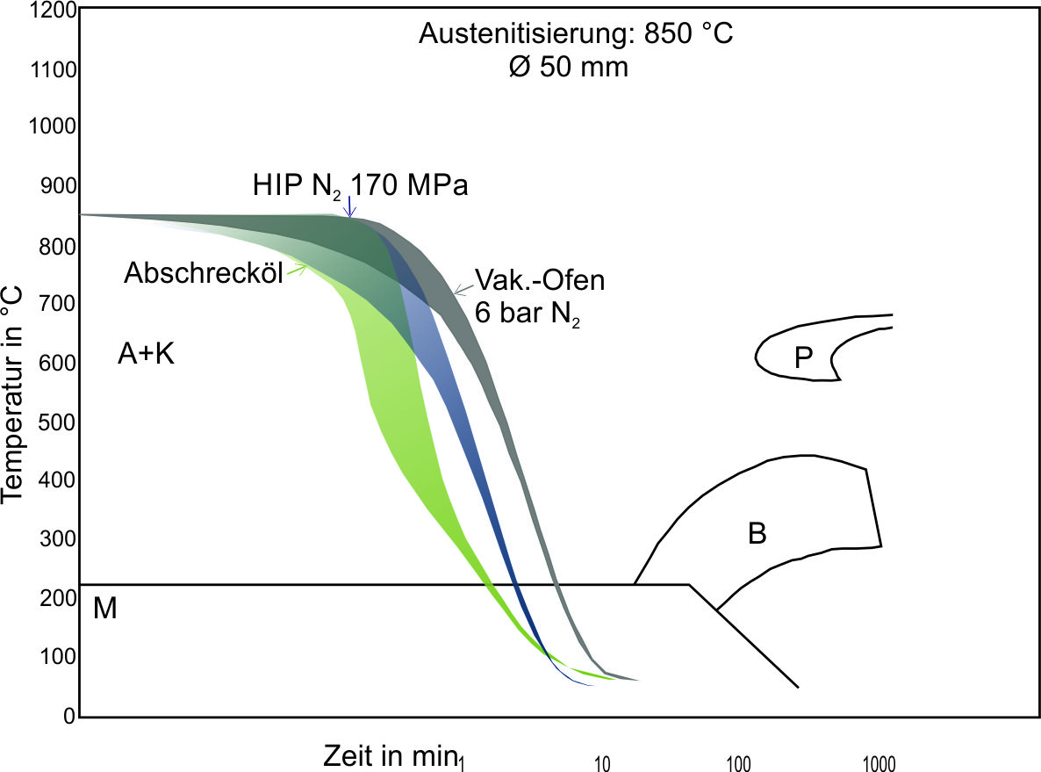
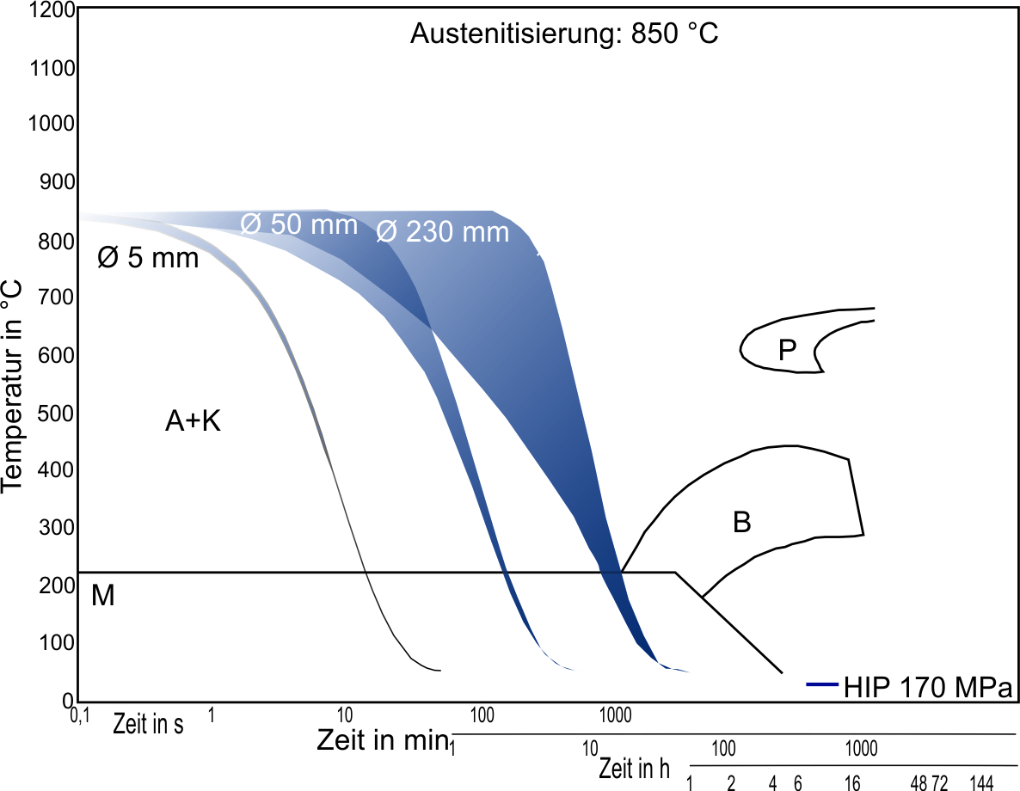
HIP cooling rates
Hardening temperature 850 °C
Ø 50 mm
HIP 170 MPa
Oil-quenching
N₂ 6 bar
Temperature in °C
Surface
Core
Zeit in s
Time in s
Time in min
Zeit in h
Time in h
56NiCrMoV7
Ref.: Dr. Sommer, Stahlwissen Navimat

Slide 15
HIP cooling rates
Hardening temperature 850 °C
Temperature in °C
Zeit in s
Time in s
Zeit in min
Time in min
Zeit in h
Time in h
56NiCrMoV7
Ref.: Dr. Sommer, Stahlwissen Navimat

Slide 16
Contents
Introduction
HIP cooling rates – measuring and benchmark
HIP-quenching of martensitic steels
Summary and outlook

Slide 17
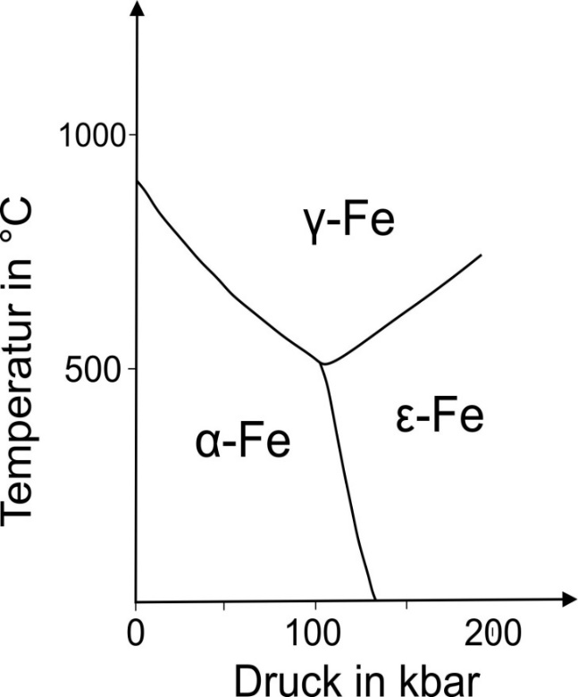
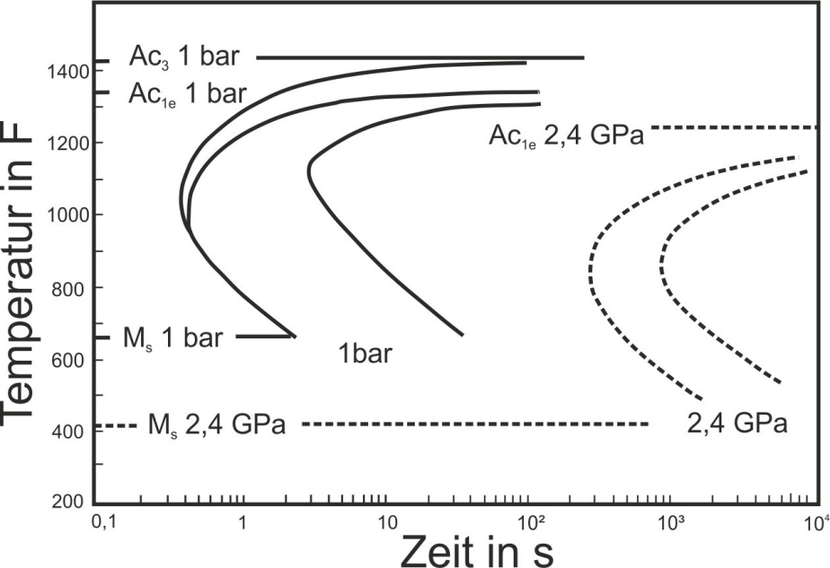
Hardening in HIP
Literature: Influence of pressure on thermodynamics and kinetics
Temperature in °C
0 10 20
Pressure in GPa
Time in s
Ref.: F.P. Bundy (1961)
Ref.: T.G. Nilan, 1967

Slide 18
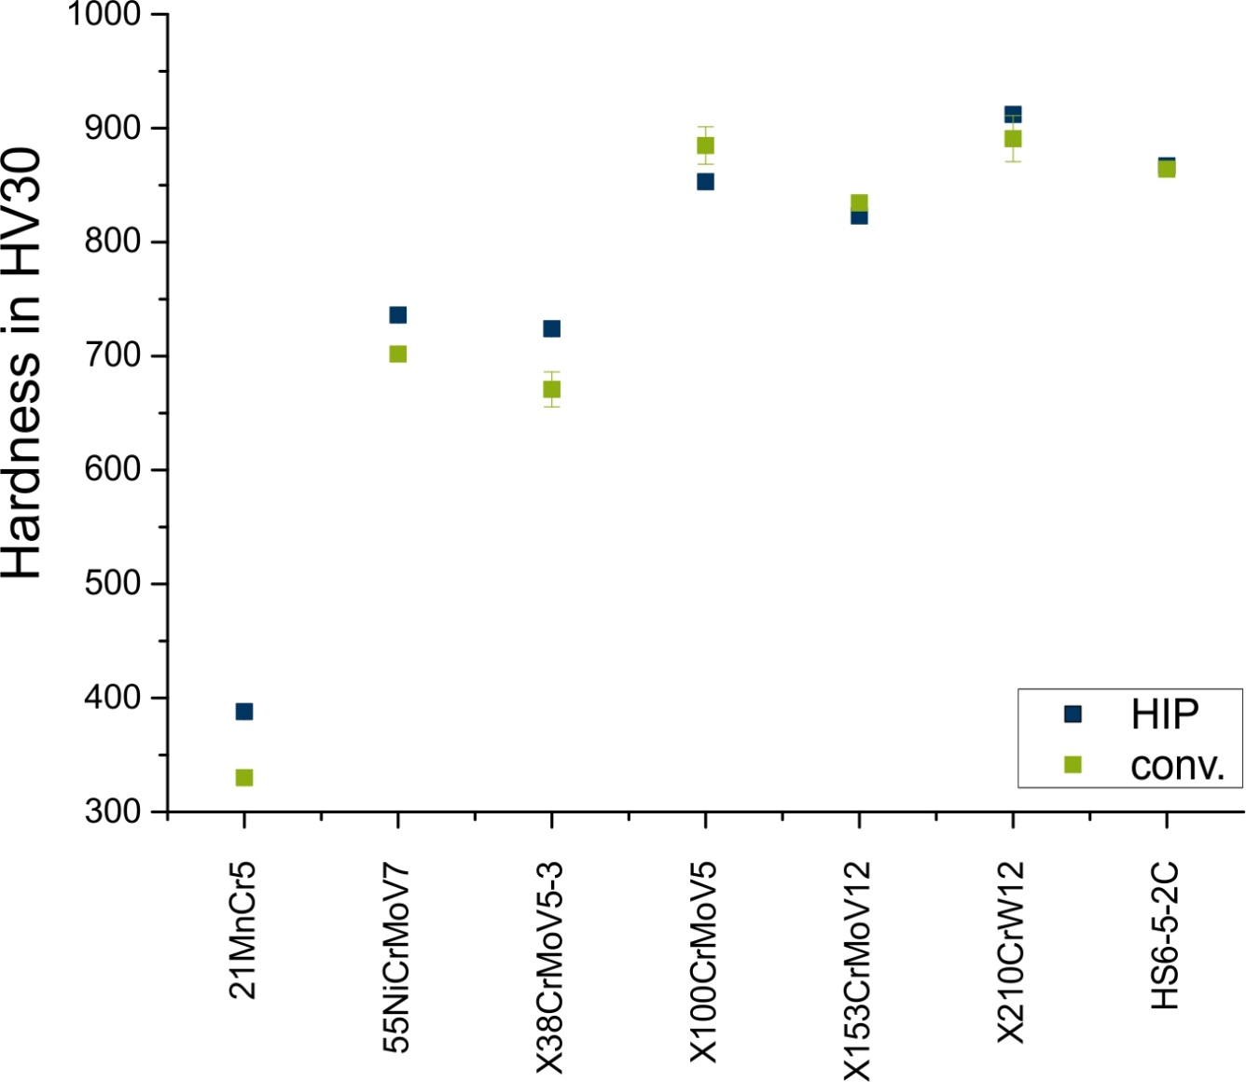
Hardening in HIP
Oil vs. HIP

Slide 19
Hardening in HIP
Oil vs. HIP

Slide 20
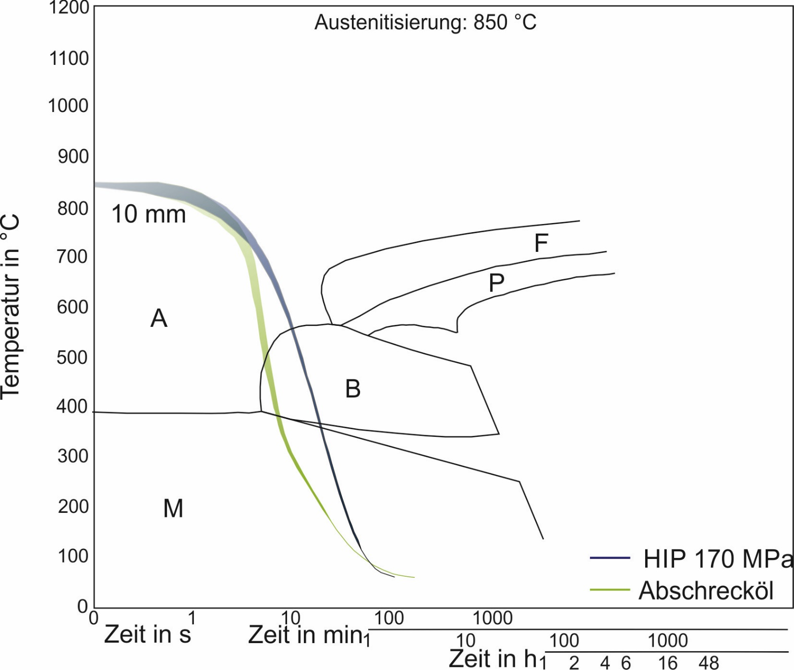
Hardening in HIP
Oil vs. HIP
Hardening temperature 850 °C
Temperature in °C
HIP 170 MPa
Oil
21MnCr5
Time in s
Time in min
Zeit in h
Time in h
Ref.: Dr. Sommer, Stahlwissen Navimat

Slide 21
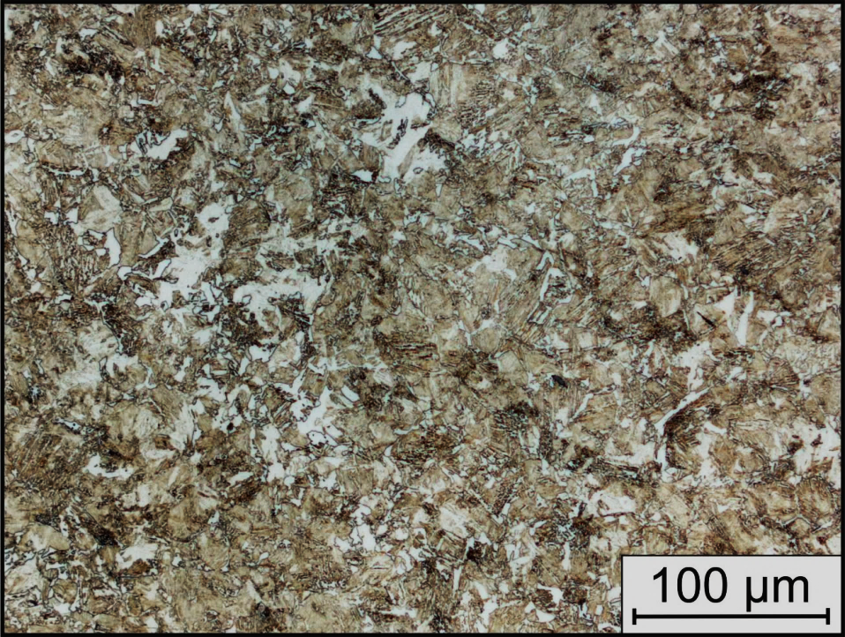
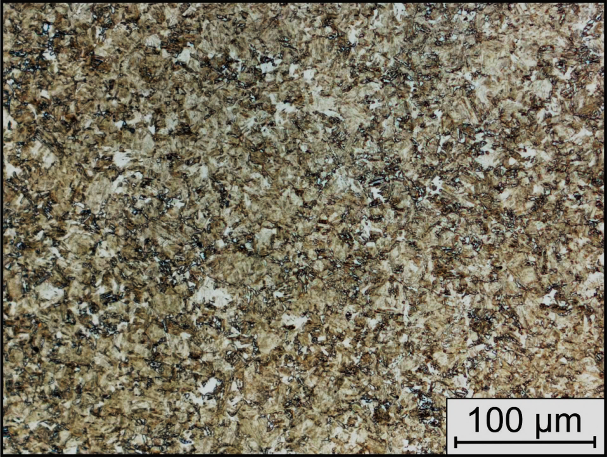
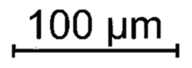
Hardening in HIP
Oil vs. HIP
21MnCr5 Oil
21MnCr5 HIP (170 MPa)
330 ± 3 HV30
388 ± 5 HV30

Slide 22
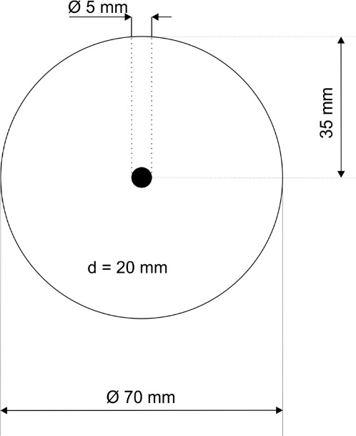
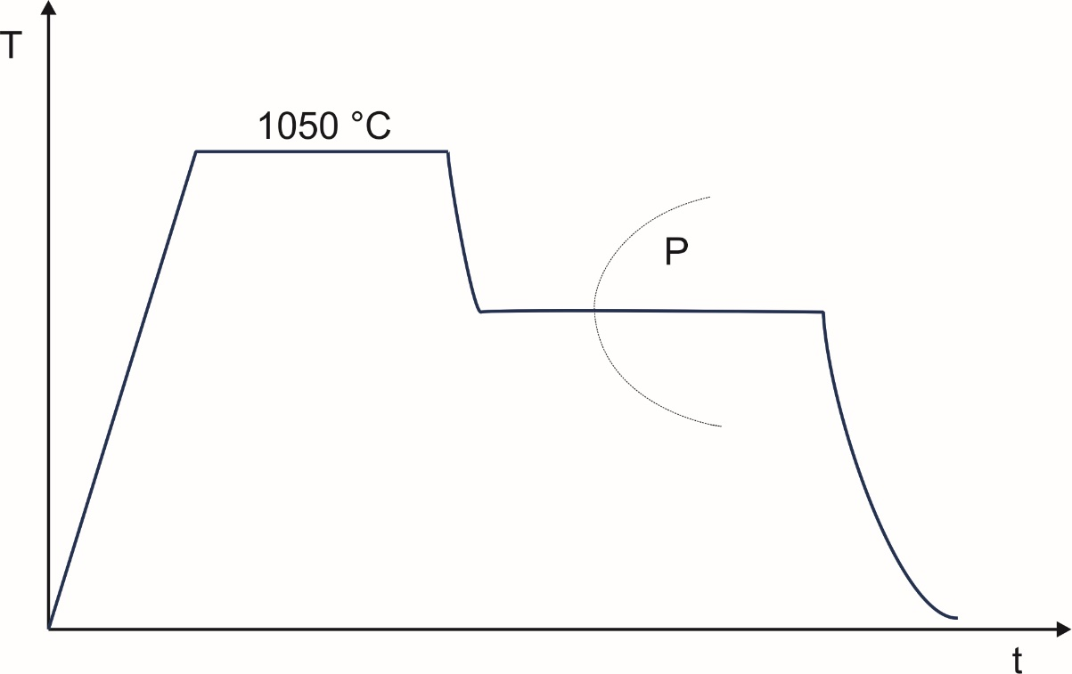
Hardening in HIP
Measurement of latent heat during isothermal holding as indicator for phase transformation
X40CrMoV5-1 (AISI H13)

Slide 23
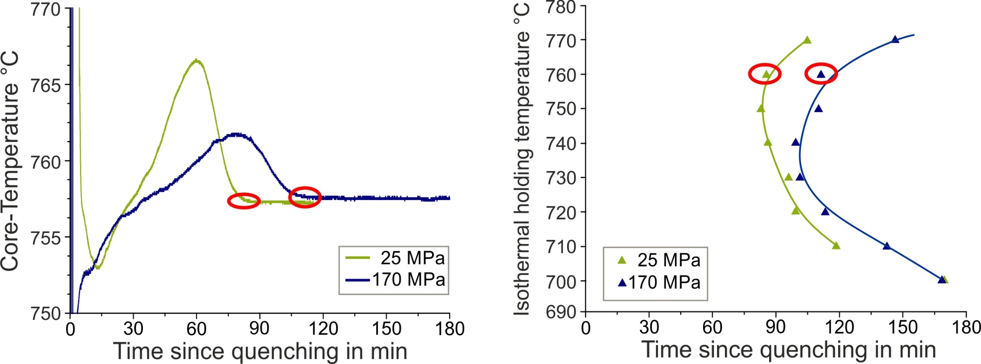
Hardening in HIP
Delay of isothermal transformation under HIP-pressure of 170 MPa

Slide 24
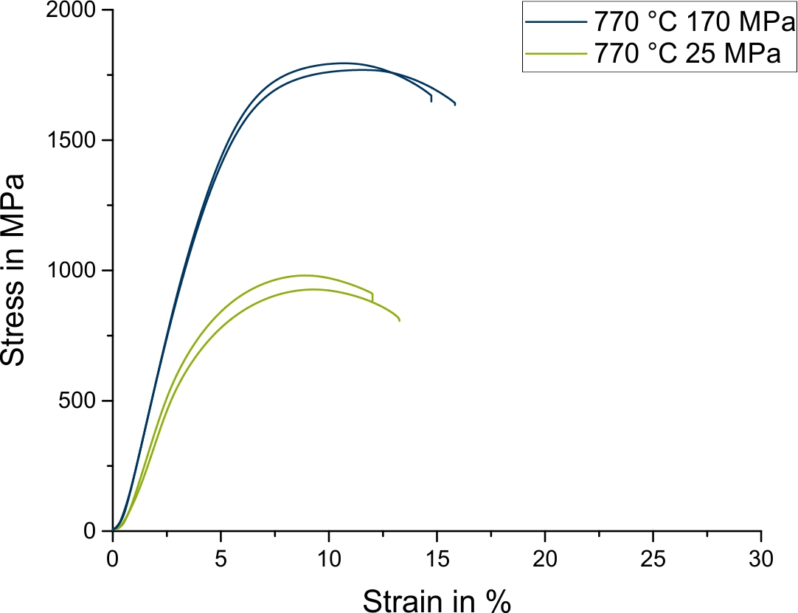
Hardening in HIP
Influence of 170 MPa HIP-pressure on microstructure and mechanical properties

Slide 25
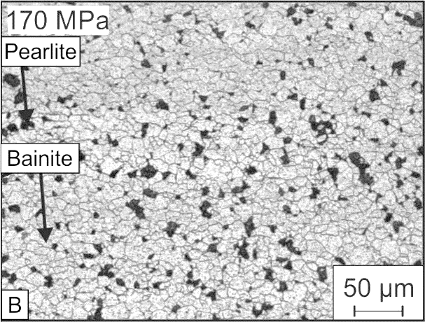
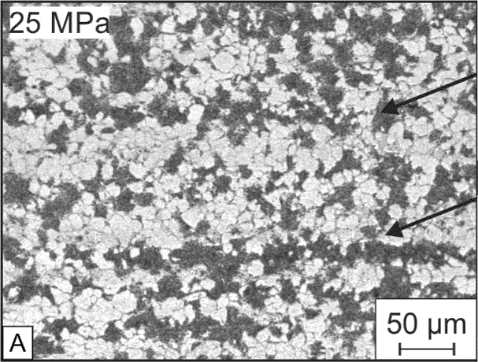
Hardening in HIP
Influence of 170 MPa HIP-pressure on microstructure and mechanical properties
Pearlite
Bainite

Slide 26
Contents
Introduction
HIP cooling rates – measuring and benchmark
HIP-quenching of martensitic steels
Summary and Outlook

Slide 27
Summary
Cooling speed in HIP-Unit with URQ is a function of gas pressure and gas inlet nozzle
Calculated thermal heat coefficient of HIP with 170 MPa ranks between oil and conventional gas quenching
Quenching under high pressure can effect the material properties
The delay of isothermal austenite to perlite transformation can be determined by measuring of latent heat

Slide 28
Outlook
Verification of calculated hardenability for different steels with increased geometry (Ø 80 mm)
Using electrical conductivity measurements to determine influence of pressure in more detail → TTT-diagrams under HIP-pressure
Research project with RWTH University Aachen:
  Densification and heat treatment in a single process step for near-net-shaped tool steels
  FEM Simulation of shrinkage and internal stresses during the process

Slide 29
Thank you for your attention!
Do you have questions?
Contact:
Nils Wulbieter
Ruhr-Universität Bochum
Bochum, Germany
wulbieter@wtech.rub.de

