Slide 2
Outline
Introduction
Aim and objectives
Powder characterisation
Powder filling: simple-shaped tooling
  DEM model and experimental work for validation
Hot Isostatic Pressing (HIP): simple-shaped tooling
  FEM model and experimental work for validation
Powder filling and shaking: complex-shaped tooling
  DEM model
  Relative density distribution from DEM
Hot Isostatic Pressing: complex-shaped tooling
  Relative density uniformly distributed
  Relative density non-uniformly distributed (DEM)
  Comparison against in-house experimental results
Conclusions

Slide 3
Introduction
HIP is a manufacturing process widely used in powder metallurgy to produce
near-net-shape components
HIP presents high cost associated with tooling design
  Iterative approach to obtain the desired dimension of the final component
Numerical analysis represents a powerful alternative approach to:
  Reduce the costs by reducing the experimental trials (calibration)
  Provide alternative information difficult to obtain experimentally
    Distribution and evolution of the relative density (RD) during HIP
    Force at the die-powder interface

Slide 4
Introduction
Previous works show:
  An inhomogeneous distribution of the powder in the tool based on experimental observations [1]
  That the relative density (RD) gradient prior HIP strongly depends on the filling and pre-consolidation process [2]
This usually contributes to a non-uniform tool shrinkage or high distortion of the final component
Numerical models up to date:
  Usually consider a homogeneous powder distribution inside the tool before HIP
[1] C. Van Nguyen, A. Bezold, C. Broeckmann, HIP’14 (2014)
[2] C. Van Nguyen, A. Bezold, C. Broeckmann, (2015)

Slide 5
Aim and Objectives
The aim of the work is to develop a numerical model able to predict and take into account the relative density distribution when simulating the HIP process
The aim of the work is achieved by means of the following objectives:
  Predict the RD distribution in the tool after filling and pre-consolidation processes using the Discrete Element Method (DEM)
  Develop a FEM model able to simulate the HIP process
  Import the RD distribution obtained from the DEM model to the FEM model to simulate the HIP process with a non-homogeneous RD distribution

Slide 6
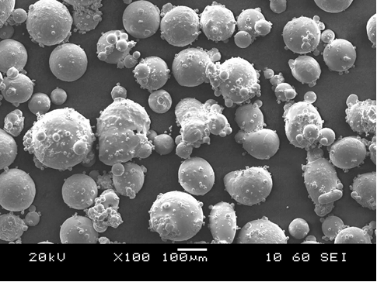
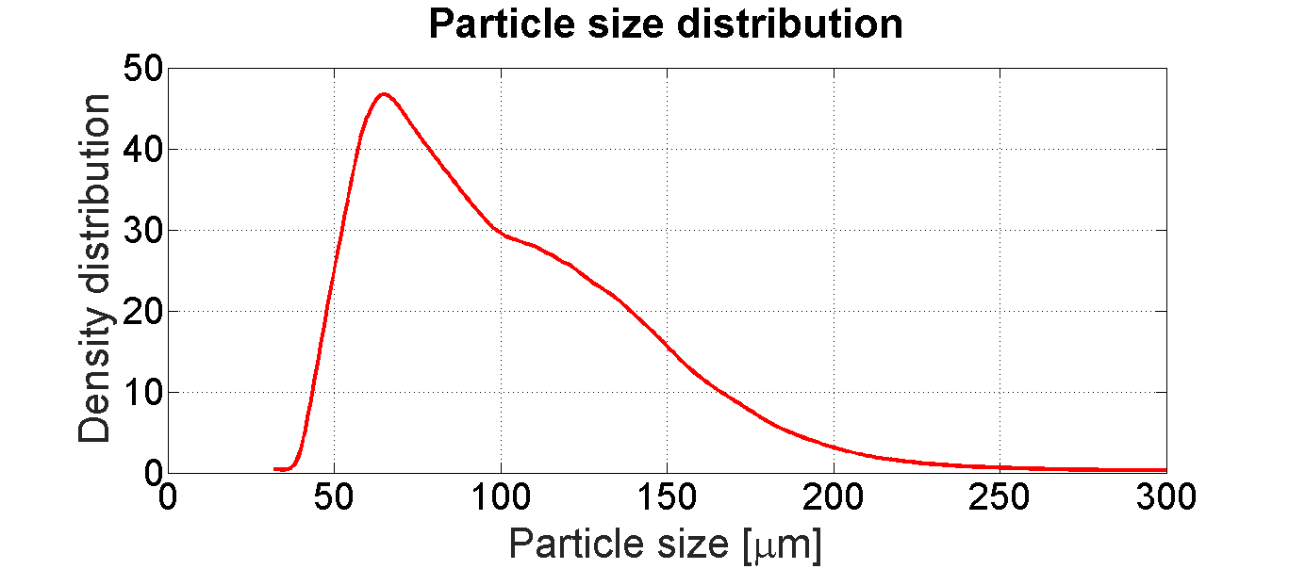
Powder characterisation
Ti-6Al-4V gas atomised TLS Technik powder
  Typical gas atomised powder
    Spherical with some irregular particles
  Large amount of satellites
  Particle size range: 45-180 μm
  Tap density: 59.1%
Scanning Electron Microscope

Slide 7
Experiments
Powder filling
Simple-shaped tooling

Slide 8
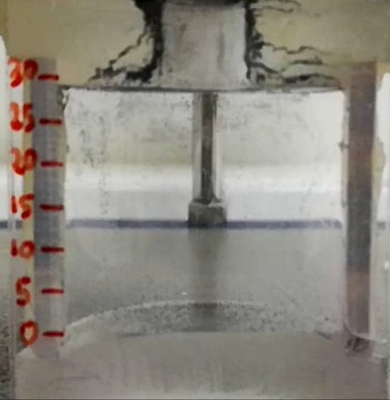
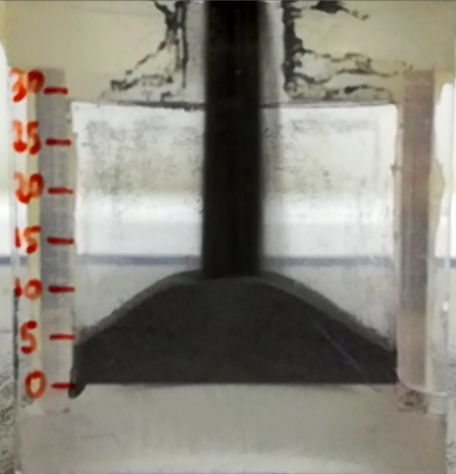
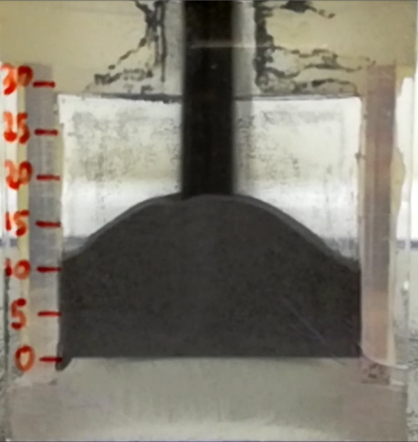
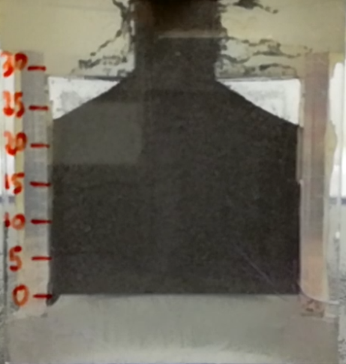
Powder filling - Simple shape
Geometry: half cylinder
  Made of plexiglass (transparent)
Powder flow: h and α_{L/R}
Filling time: 4.54 seconds
30%
54%
100%
α_{L}
α_{R}
h

Slide 9
Numerical Model
Powder filling
Simple-shaped tooling

Slide 10
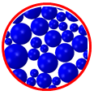
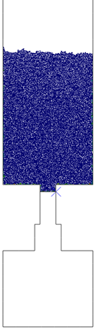
Discrete Element Method
Abaqus/Explicit: 14,076 particles
Assumptions:
  Two-dimensional model (CPU time reduction)
  Particles’ diameter scaled up four times
  Perfectly spherical and rigid particles
Boundary condition on the particles
  Rotational degree of freedom suppressed
Steps: Positioning / Filling
Particles radii according to experimental distribution
Positioning

Slide 11
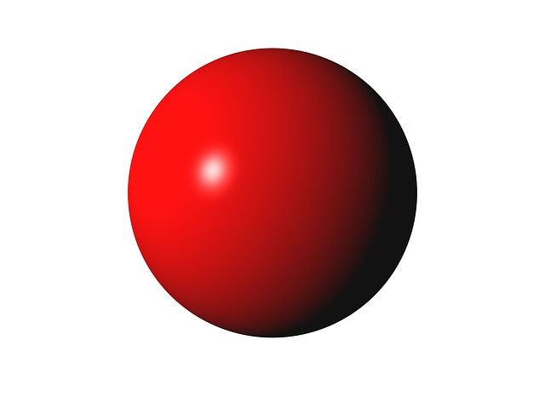
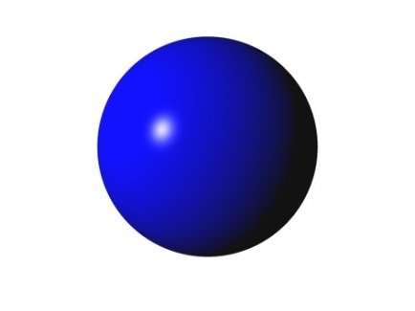
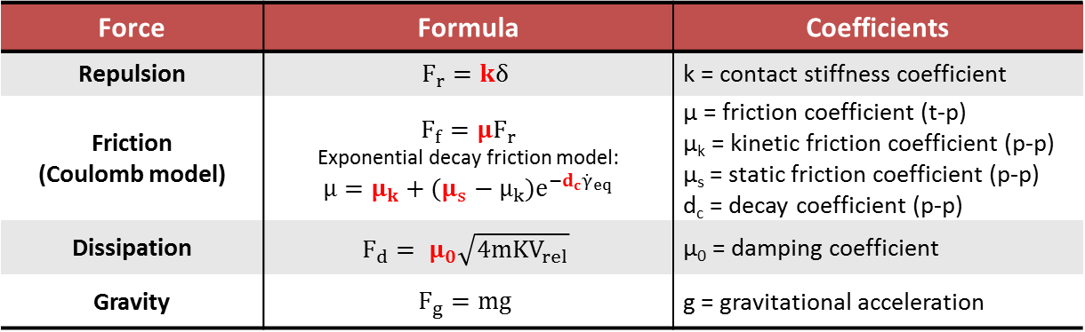
Discrete Element Method
Interaction:
  Particle - Particle (p-p)
  Tool - Particle (t-p)
μ
K_{t}
μ_{0_t}
Particle 2
K_{n}
V₂
R₁
V₁
Particle 1
R₂
μ_{0_n}
Force | Formula | Coefficients
Repulsion | $$F_{r}=kδ$$ | k = contact stiffness coefficient
Friction (Coulomb model) | $$F_{f}=μF_{r}$$ Exponential decay friction model: $$μ=μ_{k}+(μ_{s}−μ_{k})e^{−d_{c}{\dot{γ}}_{eq}}$$ | μ = friction coefficient (t-p) μ_{k} = kinetic friction coefficient (p-p) μ_{s} = static friction coefficient (p-p) d_{c} = decay coefficient (p-p)
Dissipation | $$F_{d}= μ_{0}\sqrt{4mKV_{rel}}$$ | μ₀ = damping coefficient
Gravity | $$F_{g}=mg$$ | g = gravitational acceleration
Notes:
Exponential decay friction model
Damping coefficient as a fraction of critical damping
is a schematic representation of the contact stiffness and damping between two particles. The spring stiffness acts in the contact normal direction and may represent a simple linear or a nonlinear contact stiffness. The dashpot represents contact damping in the normal direction. The tangential spring stiffness along with the friction coefficient represent friction between the particles. The dashpot represents contact damping in the tangential direction.

Slide 12
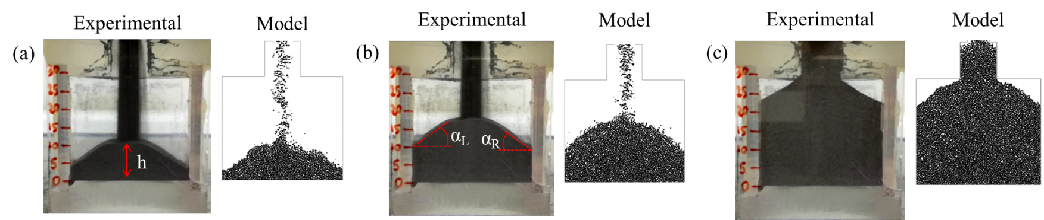
Results
30%
54%
100%
 | Experiment |  |  | Model |  |  | Error (%)
Filling time | h [mm] | α_{L} [deg] | α_{R} [deg] | h [mm] | α_{L} [deg] | α_{R} [deg] | h | α_{L} | α_{R}
30% | 10.33 | 33.29 | 29.06 | 9.8 | 32.55 | 28.5 | 5.13 | 2.22 | 1.92
54% | 17.55 | 34.65 | 31.26 | 17 | 37.1 | 36.35 | 3.13 | 7.07 | 16.28
100% | Filled | 31.46 | 29.5 | Filled | 33.14 | 33.5 | 0 | 5.34 | 13.56
Notes:
Filling in the model is faster because it is a 2D model

Slide 13
Numerical Model
Hot Isostatic Pressing
Simple-shaped tooling

Slide 14

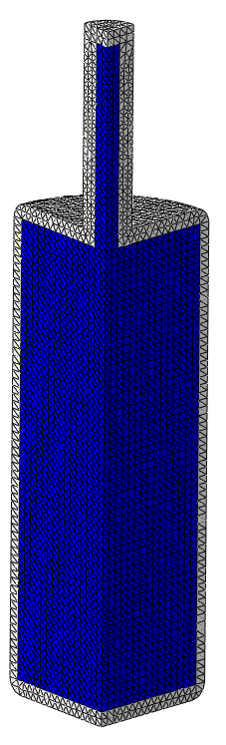
FEM Model
Abaqus/Standard: 90,322 elements
Coupled thermal-displacement analysis
Tool Geometry: cylindrical
A quarter of the component simulated
  Reduce the CPU time
Element type: tetrahedron
Element size: 1.5 mm
Sym.
Sym.
Experiment
Model

Slide 15
FEM Model
HIP cycle:
  T_{max}: 930 °C
    Heating/cooling rate: 10 °C/min
  P_{max}: 100 MPa
  Holding time: 4 hours
Temperature
Pressure

Slide 16
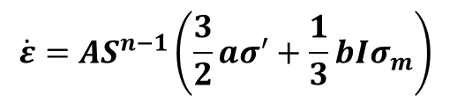

Titanium Powder
Abouaf densification model
  User-defined CREEP subroutine
Creep strain rate:
  S: is the equivalent Mises stress for a porous material
  σ_{e}, σ_{m} : effective stress and hydrostatic stress
  A, n: creep constants
  a, b: coefficients function of the relative density (RD)
$$\dot{ε}=AS^{n−1}\left(\frac{3}{2}aσ^{′}+\frac{1}{3}bIσ_{m}\right)$$
$$S^{2}=aσ_{e}^{2}+bσ_{m}^{2}$$

Slide 17



Titanium Powder
Elastic constants (USDFLD subroutine)
  Young’s modulus
  Poisson’s ratio
Thermal properties
  Thermal conductivity
  Thermal expansion
  Specific heat
Initial Relative Density (RD)
  Equal to the experimental tap density (59.1%)
  Uniformly distributed over the powder domain
$$E=f(T,RD)$$
$$ν=f(T)$$
$$f(T)$$

Slide 18



Canister
Material: 304 stainless steel
Elasto-plastic material model
  Elastic constants
  Plastic region
    Von Mises yield criterion
    Isotropic hardening
Thermal properties
  Thermal conductivity
  Thermal expansion
  Specific heat
$$E, v=f(T)$$
$$f(T)$$
$$f(T)$$
Notes:
the plastic region was defined by means of the Von Mises yield criterion and isotropic hardening

Slide 19
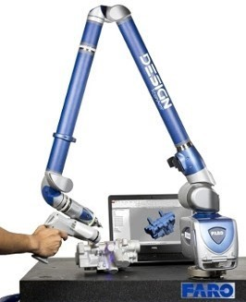
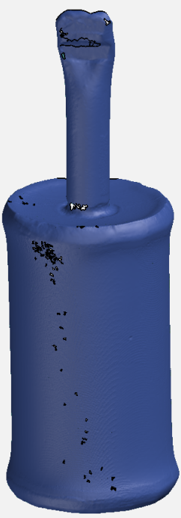

Model validation
Experimental results post-processing
Faro Edge scanner
  to obtain a 3D CAD model of the tool after HIP
GOM Inspect 2017
  to compare experimental and numerical results in terms of tool shrinkage

Slide 20
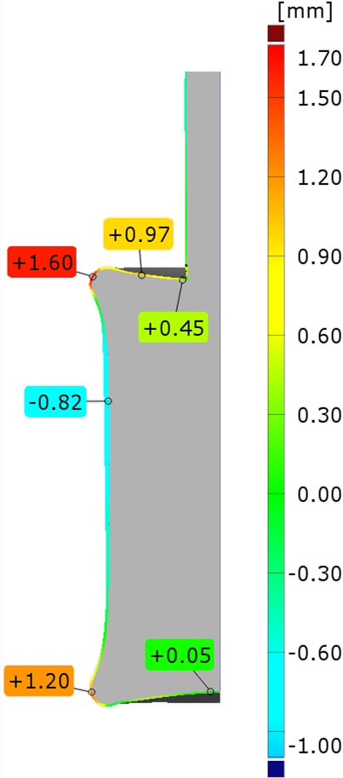
Results
Deviation of the tool shrinkage from experimental results
  Negative values: higher shrinkage compared with experiment
  High deviation in correspondence of welding points
    Upper welding zone 1.60 mm
    Lower welding zone 1.20 mm
  Deviation generally below 1 mm
Good agreement between numerical
and experimental results
Notes:
Negative values in Fig. 7 represent a higher level of shrinkage compared with the experiment

Slide 21
Experiments
Powder filling and shaking
Complex-shaped tooling

Slide 22
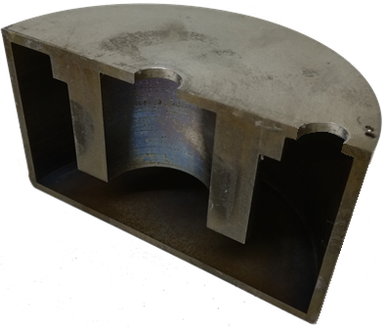
Powder filling - Complex shape
HIP components usually have a complex shape
Two filling tubes to obtain a fully filled tool

Slide 23
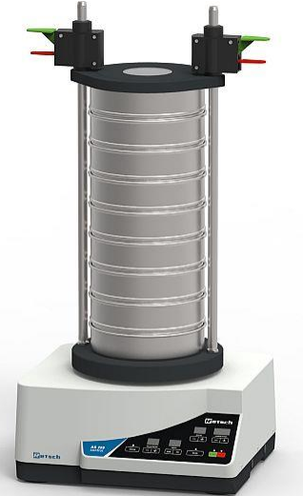
Powder filling - Complex shape
Shaking: vibratory shaker AS 200-Control Retsch
  Amplitude 1 mm
  9 cycles - 10 minutes shaking each
    Assuring a fully filled canister
Vertical throwing (1) motion with angular momentum (2)
1
2

Slide 24
Numerical Model
Powder filling
complex-shaped tooling

Slide 25
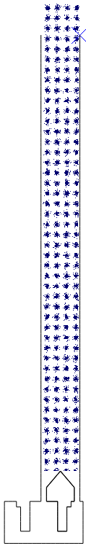
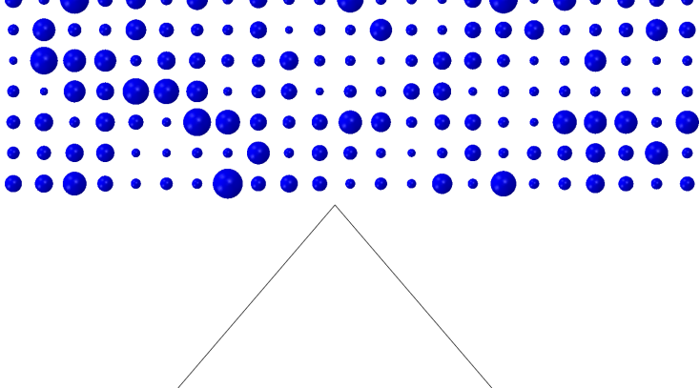
Powder filling - Complex shape
Abaqus/Explicit: 38,416 particles
Assumptions:
  Two-dimensional model (CPU time reduction)
  Particles’ diameter scaled up four times
  Perfectly spherical and rigid particles
Boundary condition on the particles
  Rotational degree of freedom suppressed
Simultaneous filling and shaking

Slide 26

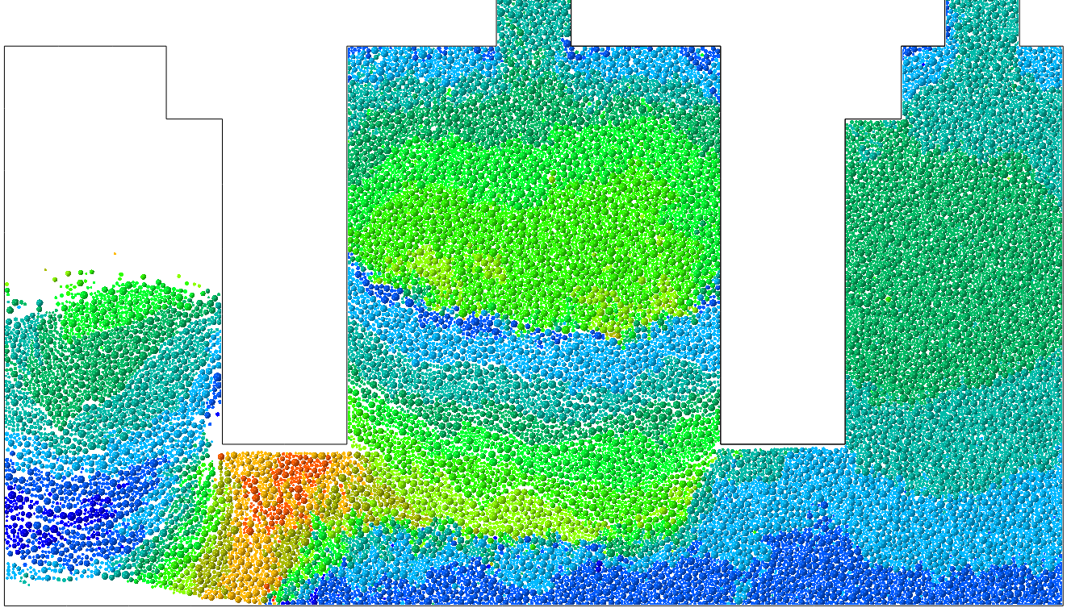
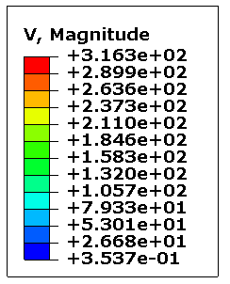
Powder filling - Complex shape
Two-dimensional model
  Vertical throwing motion (1)
  angular momentum (2)
X
1
2
X

Slide 27
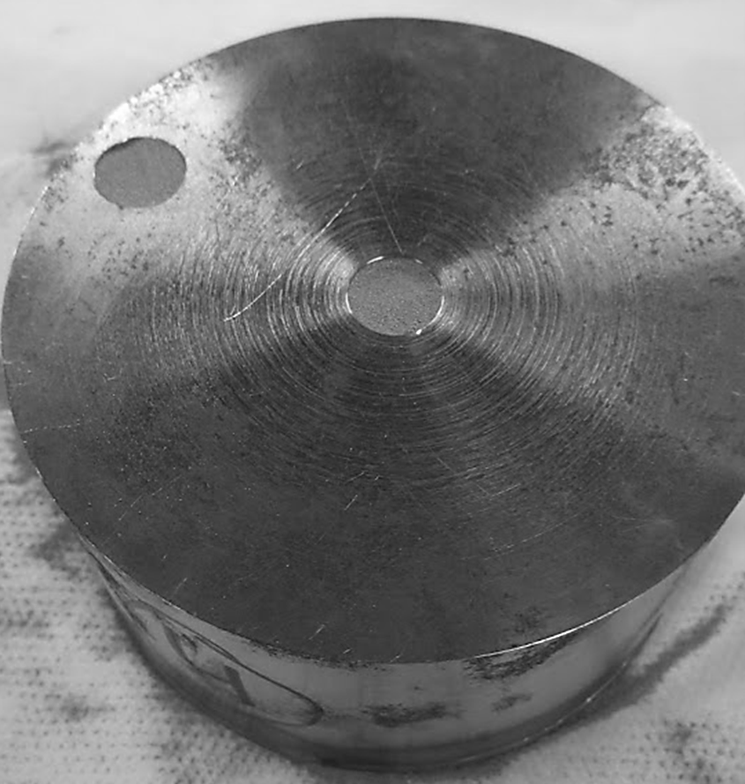
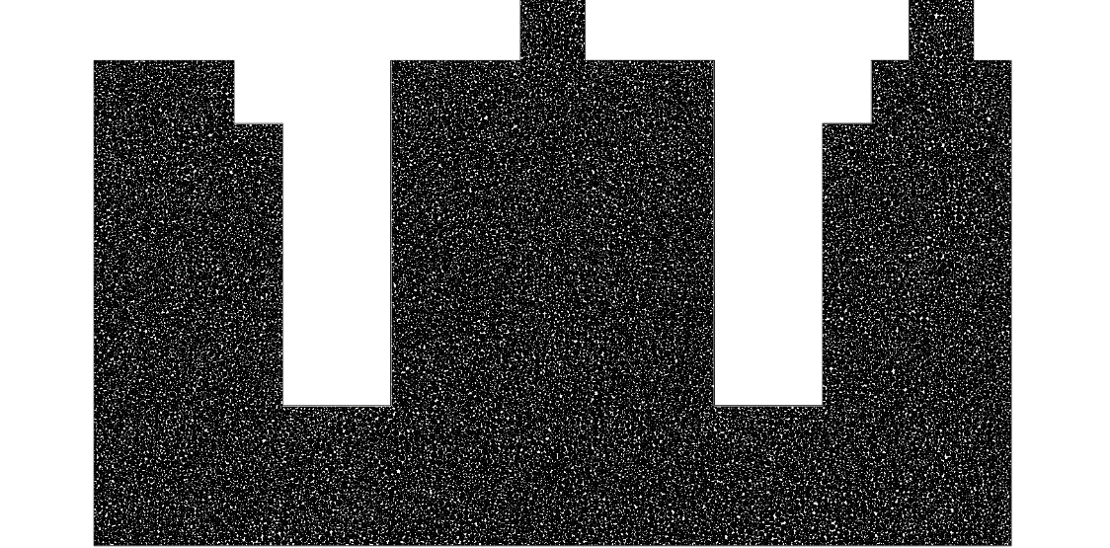
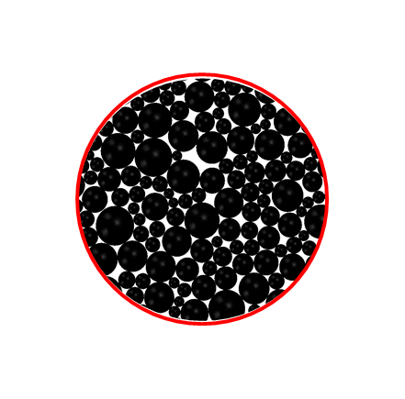
Results
Model predicts a fully filled canister in agreement with experiments
Filling
tube
Filling
tube
Experiment
DEM
Model

Slide 28


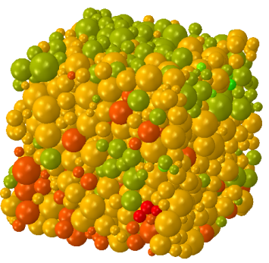
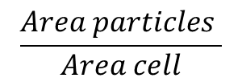
Relative density distribution
Image analysis
  2D Powder domain divided in 136 cells: C_{i}
  RD calculated for each cell
  RD from 2D to 3D
$$\frac{Area particles }{Area cell}$$
Filling
tube
Filling
tube
RD-2D
RD-3D
C_{i}

Slide 29
Numerical Model
Hot Isostatic Pressing
Complex-shaped tooling

Slide 30
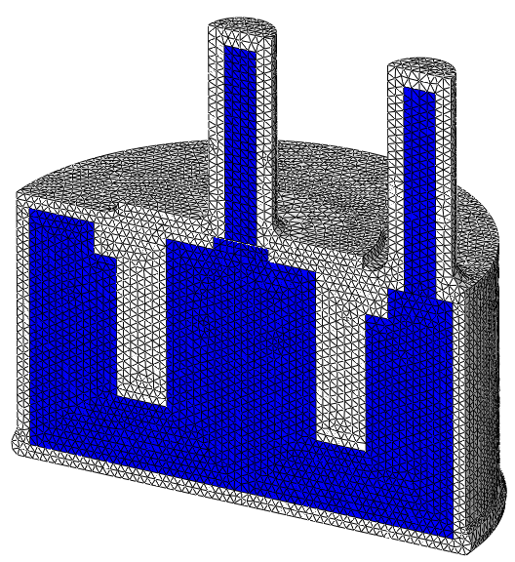
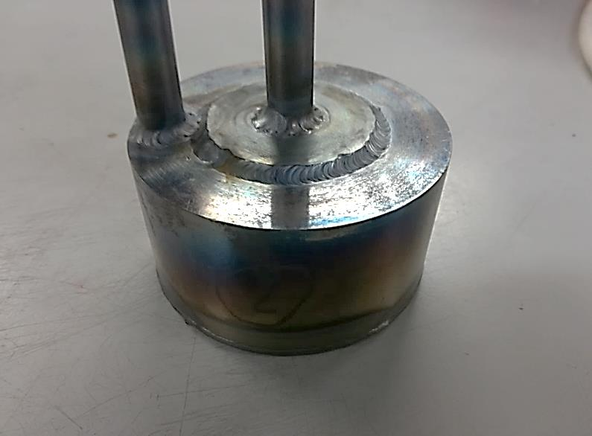
FEM Model
Abaqus/Standard: 323,081 elements
Coupled thermal-displacement analysis
Half component to reduce the CPU time
Element type: tetrahedron
Element size: 1.5 mm
Model
Experiment
Symmetry

Slide 31
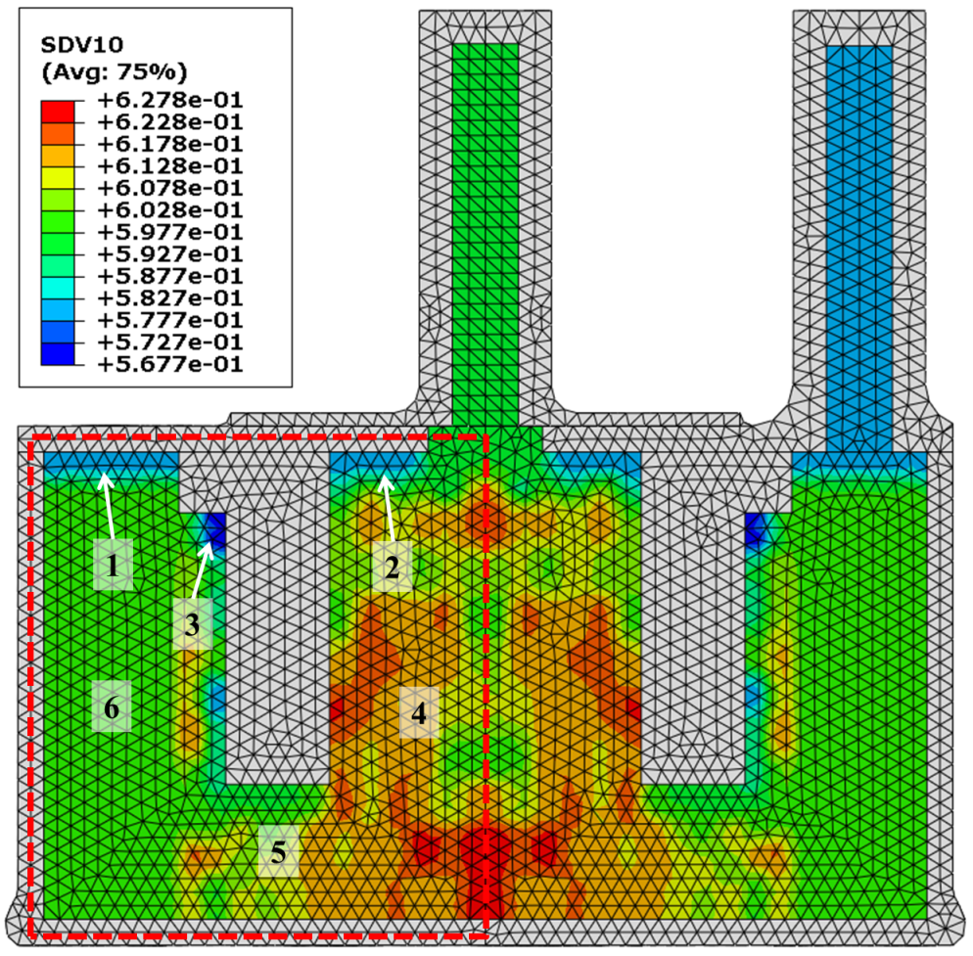
Initial relative density
RD calculated from DEM applied to FEM
  USDFLD subroutine
Low RD
  Top (1-2) and corners (3)
RD zone 4 > RD zone 6
  Filling tube location
  Powder path to fill zone 6
Higher vibration time could
increase RD in zone 6
3D Model
Welding
Welding

Slide 32
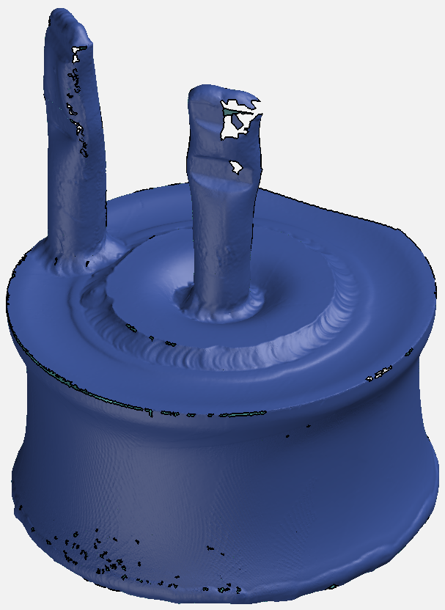
Model validation
Experimental results post-processing
Faro Edge scanner
  3D CAD model of the tool after HIP
GOM Inspect 2017
  to compare experimental and numerical results in terms of tool shrinkage

Slide 33
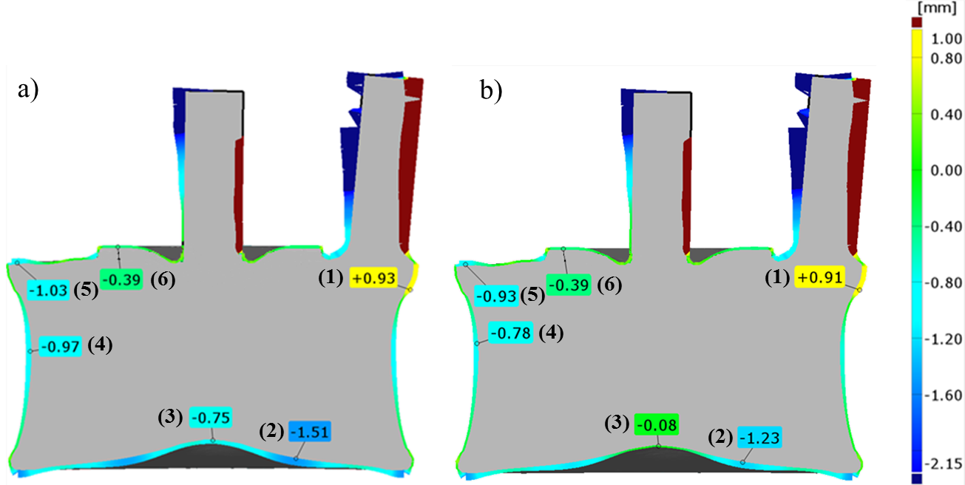
Results
Deviation from experiment
  Negative values: higher shrinkage
  compared with experiment
1) Uniform initial RD
 | Deviation from experiment
Point | RD uniform Model 1 (mm) | RD from DEM Model 2 (mm) | Improvement Model 2 (%)
1 | 0.93 | 0.91 | 2.15
2 | -1.51 | -1.23 | 18.54
3 | -0.75 | -0.08 | 89.33
4 | -0.97 | -0.78 | 19.58
5 | -1.03 | -0.93 | 9.71
6 | -0.39 | -0.39 | 0
2) Non-uniform initial RD
(from DEM)
FARO scanner?

Slide 34
Conclusions
A DEM model was developed to determine the RD distribution after powder filling and pre-consolidation in a complex-shaped tooling
The RD distribution obtained from the DEM model was implemented in a FEM model for simulating the HIP process
Results were compared with those obtained considering a uniform RD distribution and against in-house experiments
Results suggest the need to take into account the inhomogeneous powder distribution inside the canister to improve the model capability in predicting the tool shrinkage
Results show the ability of the DEM to:
  Simulate the powder filling and shaking in a complex-shaped tooling
  Provide reliable values for the RD distribution which are very difficult to obtain experimentally

Slide 35
Acknowledgment
This work has been partly funded by EMUSIC which is part of an EU-China collaboration and has received funding from the European Union’s Horizon 2020 research and innovation programme under grant agreement No. 690725 and from MIIT under the programme number MJ-2015-H-G104.

Slide 36
Thank you

Slide 37
Conclusions
A DEM model for simulating the titanium powder filling in a cylindrical tool was developed
  Validated against in-house experiment
  Good agreement in terms of the powder flow and level during filling
A FEM model for simulating the HIP for a cylindrical tool was developed
  Validated against in-house experiment
  Good agreement in terms of the tool shrinkage (deviation < 1 mm)

Slide 38
Conclusions
A DEM model for simulated filling and shaking of the titanium power in a complex-shaped tool was developed
  Calculus of the RD distribution by means of the image analysis technique
Two FEM models were developed:
  A FEM model implementing the RD distribution from DEM
  A FEM model implementing a uniformly distributed RD
Comparison against in-house experiment showed:
  A significant improvement of the tool shrinkage prediction when using a non- homogeneous RD distribution (up to 90%)

Slide 39
Conclusions
Results suggest the need to take into account the inhomogeneous powder distribution inside the canister to improve the model capability in predicting the tool shrinkage
Results show the ability of the DEM to:
  Simulate the powder filling and shaking in a complex-shaped tooling
  Provide reliable values for the RD distribution which are very difficult to obtain experimentally

Slide 40
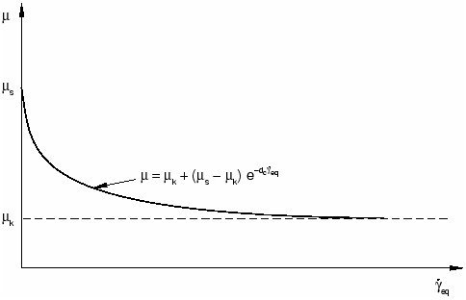


Particle – Particle
Exponential decay friction model
μ
μ_{s}
$$μ=μ_{k}+(μ_{s}−μ_{k})e^{−d_{c}{\dot{γ}}_{eq}}$$
μ_{s}
$${\dot{γ}}_{eq}$$

Slide 41
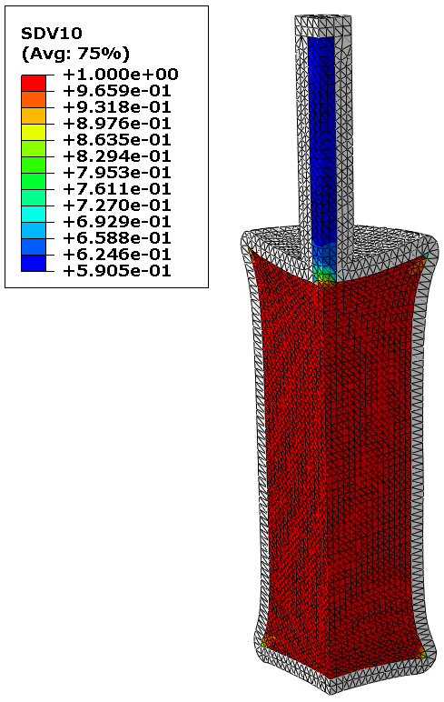

Slide 42
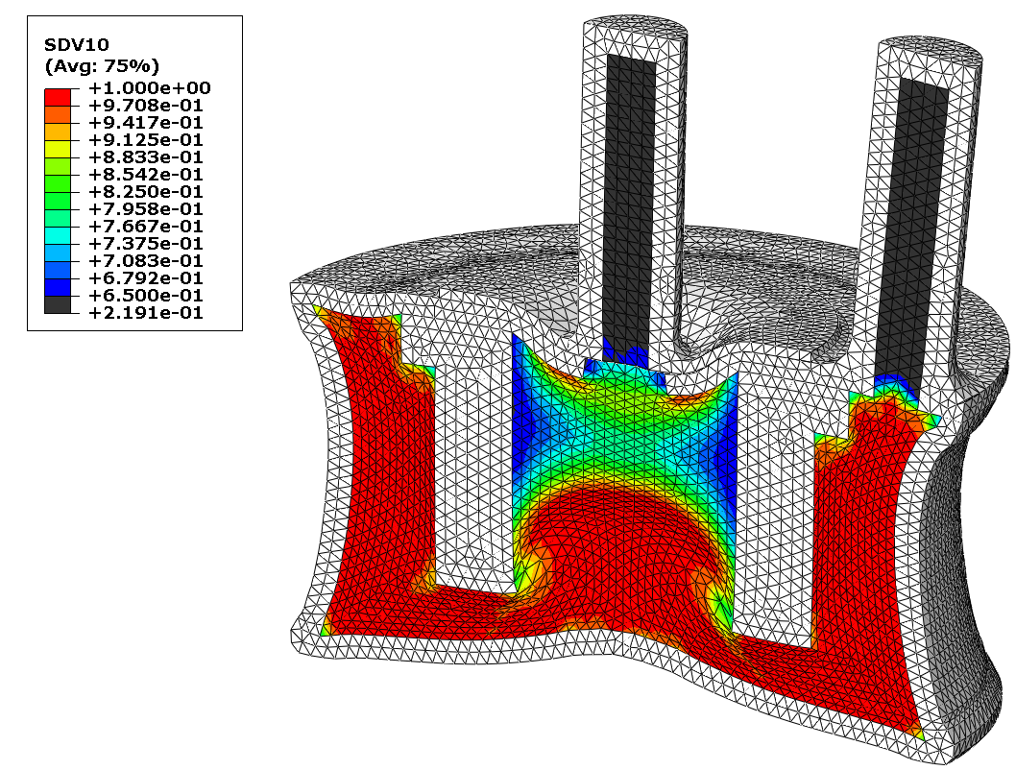
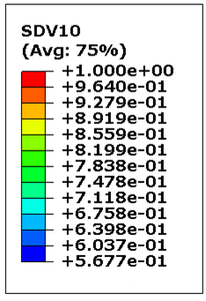
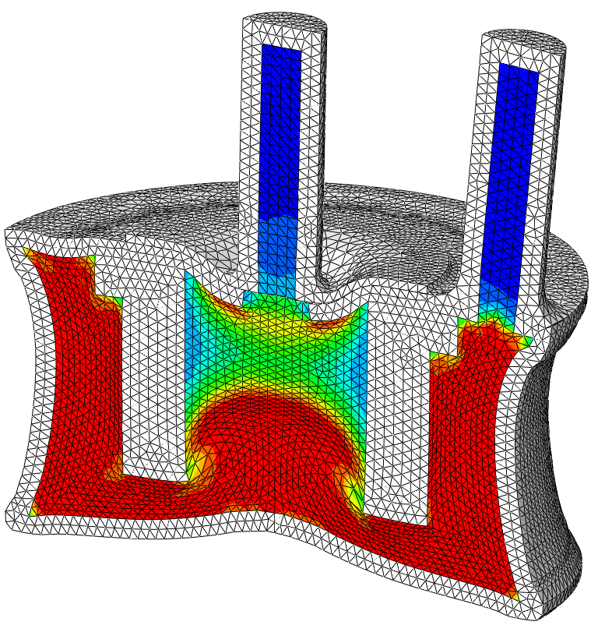
Results
RD

