Slide 1
Recent Developments of HIP Equipment In Japan
Megumi Kono, Katsumi Watanabe
Heavy Machinery Department,
Industrial Machinery Division,
Kobe Steel, Ltd.
Presented at HIP’17
Sydney, Australia 5–8 December 2017
Notes:
Thank you Mr. Chairman and Good Morning, Ladies and Gentlemen.
The title of my presentation today is "Recent Developments of HIP Equipment In Japan."
My name is Katsumi Watanabe from Kobe Steel.

Slide 2
OUTLINE
Market forecast
History of developing in Japan
New Rapid cooling method
  Background for the development
  Developed New Rapid cooling method
  Introduction of the first commercial unit
Other Topics
Conclusion
Notes:
I’d like to show you the contents of my presentation.
My presentation is mainly about the new rapid cooling system for the HIP (Hot Isostatic Pressing) equipment developed by Kobe Steel.
First, I will talk about market forecast.
Next, I will look back on a history of developing in Japan.
And then I will explain the development of our new cooling method.
The background for the development of our new cooling system
Developed New rapid cooling method,
Introduction of our first commercial equipment that employs the new cooling system
Additionally, I will introduce our other development.
Finally, I will give a conclusion.
To start with, let me look back on a history of developing in Japan.
the background for the development of our new rapid cooling system.

Slide 3
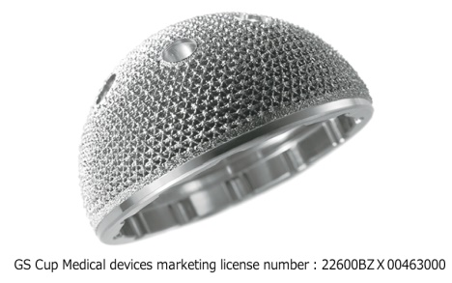

Market forecast
Typical HIP demanding market
Additive Manufacture machine
38,313
new
17,499
Delivery total
33,160
20,814
replace
15,661
existing
5,153
Notes:
HIP system is used to produce high value added material.
And there are more and more demand of high value added material.
Aerospace and Additive manufacturing are the representative of HIP demanding market.
These markets are growing significantly in this few years.

Slide 4
Market forecast
Market growth in global scale
Europe
North America
Japan
China
（MUS$）
Notes:
Other than Aerospace and Additive manufacturing, market such as:
Automotive, Medical and Dental, Semiconductor, Ceramics are also very important market for HIP.
These are the expected market figures from the survey KOBELCO has done.

Slide 5
History of developing in Japan
*Small R&D high pressure gas equipment | 1964
*Production HIP for cemented carbide parts | 1971
*Production HIP for high speed tool steel billets | 1977
*Production HIP for soft ferrite | 1978
*Modular HIP system for soft ferrite production | 1982
*Nitrogen HIP unit | 1980s
*Oxygen HIP unit for R&D of ceramics | 1986
*Oxygen HIP unit for commercial production | 2002
*Oxygen partial pressure control HIP | 2002
*Mechanical properties testing equipment in hydrogen | 2003
*New Rapid cooling method | 2015
Notes:
These are the typical development which was accomplished by KOBELCO.

Slide 6
Development challenges(1)
Diversification of process atmosphere
  Nitrogen HIP system
    Silicon nitride used for ceramic ball bearing
  Oxygen HIP system
    Superconductivity material of electrical wire
    Transparent ceramics
  Shroud HIP system
    To prevent damage from out gas of the product
Notes:
Kobelco started the sales of HIP equipment in 1970’s.
Basic gas atmosphere for HIP is always been argon.
Though, in Japan there was many requirement of various gas.
What is in production today is , for example:
Nitrogen gas for silicon nitride used for ceramic ball bearing.
Oxygen + Argon for superconductivity material of electrical wire or for transparent ceramics.
Shroud HIP to prevent damage from out gas of the product.
Kobelco always tried to find better way to handle various gas.
And these HIPs are still in use today and produces important parts for the industry.

Slide 7
Development challenges(2)
High productivity
  Bottom loading system
  Modular HIP system
  Rapid cooling HIP system
Notes:
HIP equipment must have a thick-walled pressure vessel for high pressure.
That makes HIP equipment more costly than commonly used heat treatment equipment.
Moreover, raising and lowering the temperature takes time, and in very large HIP equipment, one HIP cycle may take a whole day or more to complete.
In order to address such issues, productivity improvement was required to reduce the processing cost per workpiece.
From the very beginning, KOBECLO has been designed the bottom loading system to considerate of high productivity.
In 1980’s Modular HIP system was incorporated in HIP equipment.
In 2015 newly developed rapid cooling system was installed.

Slide 8
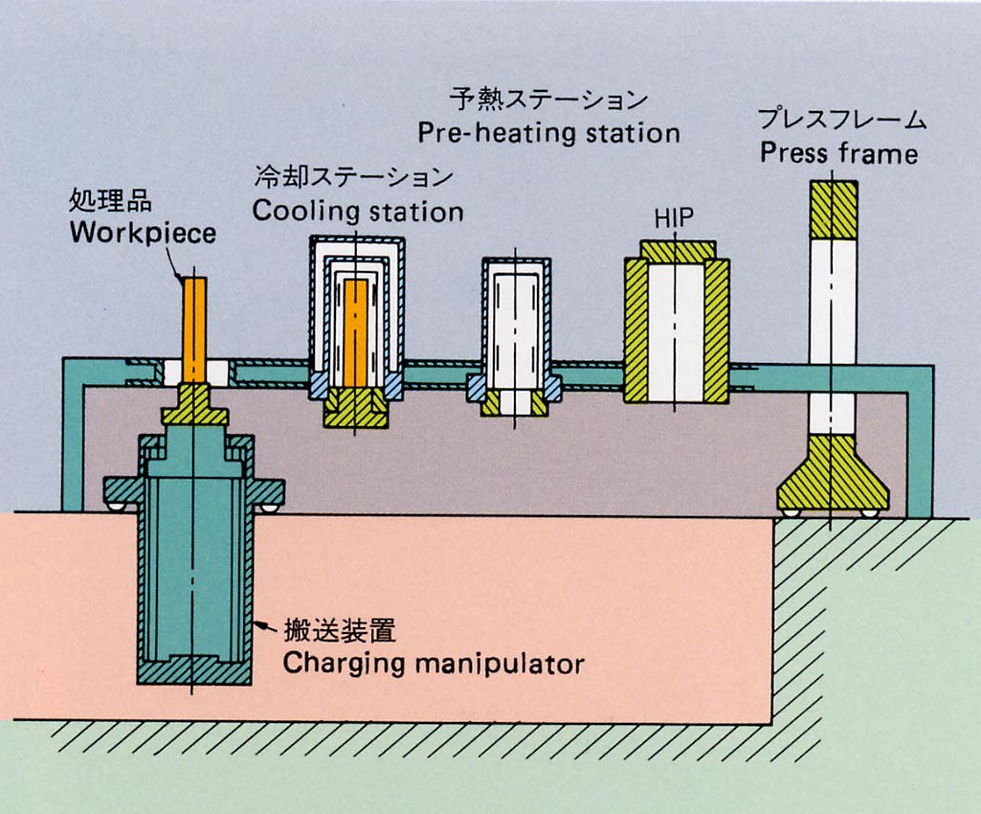
Modular HIP system
Notes:
In 1980’s, a modular HIP system was incorporated in HIP equipment for high quality soft ferrite production to give full density.
A modular HIP system has two or three cooling stations and preheating stations as shown in the figure.
The workpiece can be transferred while kept in an inert atmosphere furnace.
It allows the preheated workpiece to be inserted into the pressure vessel for HIP treatment, or taken out in a hot state after HIP treatment and transferred to the cooling station to cool down.
As a result, only the pressure raising, holding lowering processes are performed in the HIP pressure vessel, leading to 2 to 2.5 times higher productivity.
The modular system ensures such high productivity, but it has a critical problem that a cycle time including temperature raising and lowering processes is longer than the conventional HIP treatment, and the entire processing time for a workpiece is longer. (わざわざデメリット言わなくても）

Slide 9
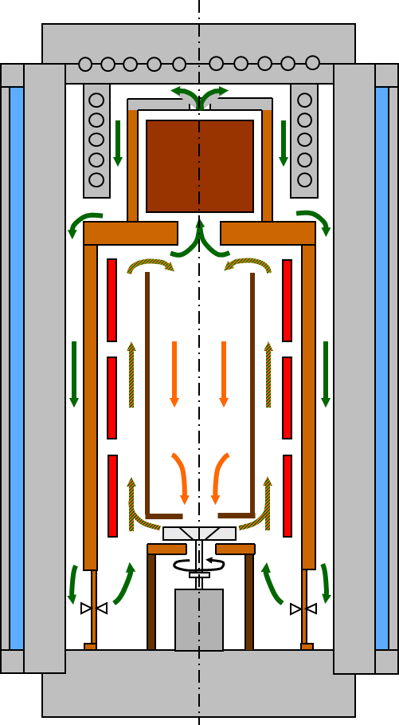
KOBELCO Old Rapid cooling system
Top Closure
KOBELCO developed rapid cooling system in 1990’s
  Mono-block pressure vessel
  Need of heat sink
  Need of stirring fan
Insufficient cooling capacity
Low capacity efficiency
Heat sink
Pressure vessel
Cooling water
Hot zone
Flow Straightening Pipe
Stirring fan
Control valve
Bottom Closure
Notes:
In the global market, rapid cooling furnaces that directly cool the high temperature and high pressure treatment chamber were made commercially available, significantly contributing to the reduction of processing time.
Kobelco also worked on the development of a rapid cooling furnace. In 1990’s, we produced a prototype and conducted a performance verification test.
Unfortunately, however, we could not put it into a commercial production.
At that time, ASEA had a patent on wire-wound, interior cooling vessels that provide most efficient cooling performance, and competitors including Kobelco had to use liner type cooling vessels for small and middle size units and mono block vessels incorporating a rapid cooling furnace for large size units.
Mono block vessels with low interior cooling performance allows excessive temperature rise at the pressure vessel inner surface due to direct rapid cooling gas.
To prevent such excessive temperature rise, a heat sink was required inside the pressure vessel to dissipate heat from the treatment chamber.
A mechanism for keeping the treatment chamber at a uniform temperature in rapid cooling was also needed.
The very low volumetric efficiency of the pressure vessel impeded cost effective treatment and full utilization of rapid cooling properties.
Consequently, ASEA had an oligopoly in the direct, rapid cooling HIP market.

Slide 10
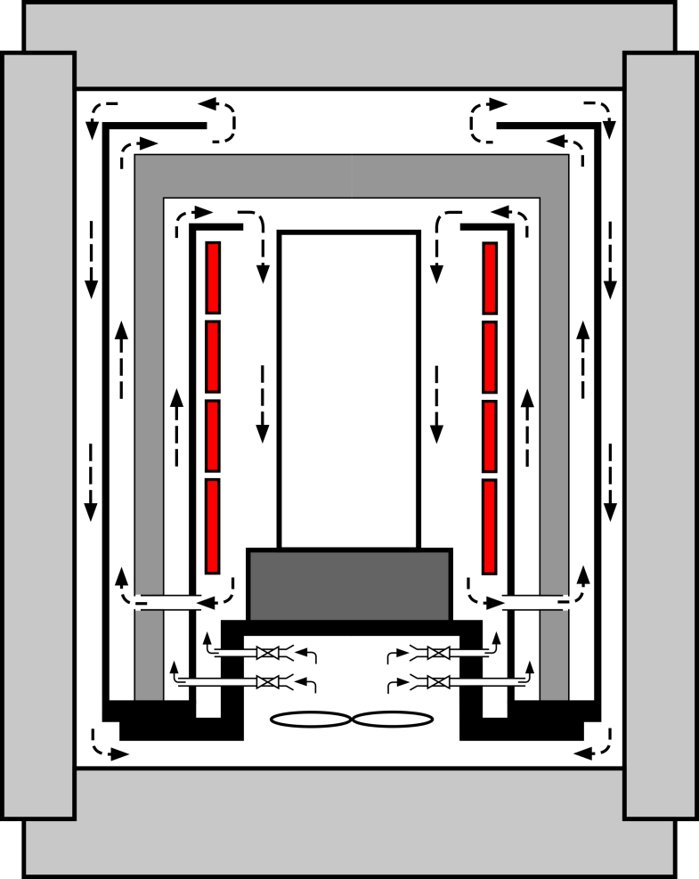
New Rapid cooling furnace
Flow “B”
Top Closure
Flow “A”
Cooling
water
Pressure vessel
Heat Insulator
Hot zone
Cooling fan
Bottom Closure
Heater
Notes:
To solve the problem, KOBELCO have developed a new rapid cooling system.
It has following features.
The treatment chamber is surrounded by the heat insulating barrier that blocks heat transfer to provide thermal control when the temperature in the treatment chamber gets high.
The new rapid cooling system has vertical cylinders inside and outside of the heat insulating barrier to direct the medium gas upward.
These cylinders feature circulation flows generated inside and outside of the heat insulating barrier.
The gas blown by the fan circulates, flowing between the outer cylinder and the heat insulating barrier up to the top of the heat insulating barrier, then between the heat insulating barrier and the pressure vessel down to the fan while being cooled along the pressure vessel inner wall. This is called “first circulation flow.”
Then the gas blown by the fan flows between the inner cylinder and the heat insulating barrier up to the top of the treatment chamber;
It flows therefrom into the treatment chamber to cool the hot gas in the treatment chamber, and then merges with the first circulation flow to form a circulation flow back to the fan.
This is called “second circulation flow.” Rapid cooling by using these two circulation flows is the one of the biggest features of the new system.

Slide 11
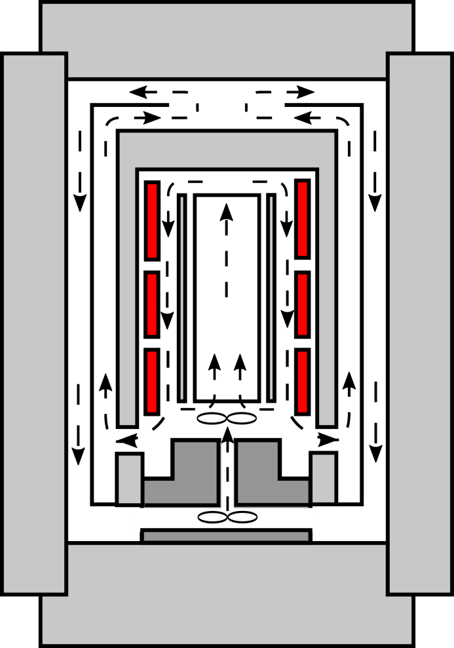
New Rapid cooling furnace
Typical Conventional
furnace
New furnace
Flow rate = small
↓
Heat transfer
= small
Flow rate = large
↓
Heat transfer
= large
Stirring fan
Cooling fan
Cooling fan
Notes:
As you may know if you are familiar with fluid mechanics, the higher the gas flow rate, the higher the heat exchange rate between the gas and metal on the metal surface.
The commonly used rapid cooling method roughly uses the second circulation flow only to perform rapid cooling, as shown in the figure.
In this case, the cooling rate in the treatment chamber depends on the amount of the cooling gas in the treatment chamber.
The hot gas passing through the treatment chamber is directed to the pressure vessel inner surface, thus it is necessary to reduce the gas flow rate to a certain level or lower in order to prevent excessive temperature rise at the pressure vessel inner surface. That means the maximum gas flow rate is limited.
On the other hand, in the new rapid cooling method, the first circulation flow does not pass through the treatment chamber, enabling an increase of the gas flow rate regardless of the cooling rate.
The second circulation flow is cooled while merging with the first circulation flow that prevents excessive temperature rise at the pressure vessel inner surface and allows an increase of the first circulation flow rate.
As a result, heat exchange is performed between the relatively cool mass flow of gas and the pressure vessel inner surface.
The sufficiently increased heat exchange rate between the gas and the pressure vessel inner surface allows effective use of the entire pressure vessel inner surface for heat exchange to prevent excessive temperature rise at the pressure vessel inner surface and make best use of the heat extraction capability of the pressure vessel.
Another feature of this new rapid cooling system is that the treatment chamber does not require any special means such as a circulation fan since the temperature in the treatment chamber can be kept constant.
This is made possible by introducing the second circulation flow from the top of the treatment chamber.

Slide 12
New Rapid cooling furnace
- Typical case by calc. with no load -
Conventional furnace
New furnace
Wall Temp.
150℃
Wall Temp.
150℃
Amount of heat transfer
Amount of heat transfer
Notes:
This figure is a schematic diagram showing the heat exchange rates in the rapid cooling only with the second circulation flow and that with the first and second circulation flows.
As you can see, the rapid cooling with the first and second circulation flows on the right side can absorb more heat than the rapid cooling only with the second circulation flow on the left side.
It is necessary to discharge more heat from the treatment chamber through the pressure vessel to rapidly lower the temperature in the treatment chamber.
This new rapid cooling system can discharge more heat from the pressure chamber to achieve faster cooling of the treatment chamber, compared to the conventional cooling system.

Slide 13
New Rapid cooling furnace
- Typical case by calc. with no load -
Conventional furnace
New furnace
40℃/min
60℃/min
X1.5
Notes:
This figure is a schematic diagram showing the heat exchange rates in the rapid cooling only with the second circulation flow and that with the first and second circulation flows.
As you can see, the rapid cooling with the first and second circulation flows on the right side can absorb more heat than the rapid cooling only with the second circulation flow on the left side.
It is necessary to discharge more heat from the treatment chamber through the pressure vessel to rapidly lower the temperature in the treatment chamber.
This new rapid cooling system can discharge more heat from the pressure chamber to achieve faster cooling of the treatment chamber, compared to the conventional cooling system.

Slide 14
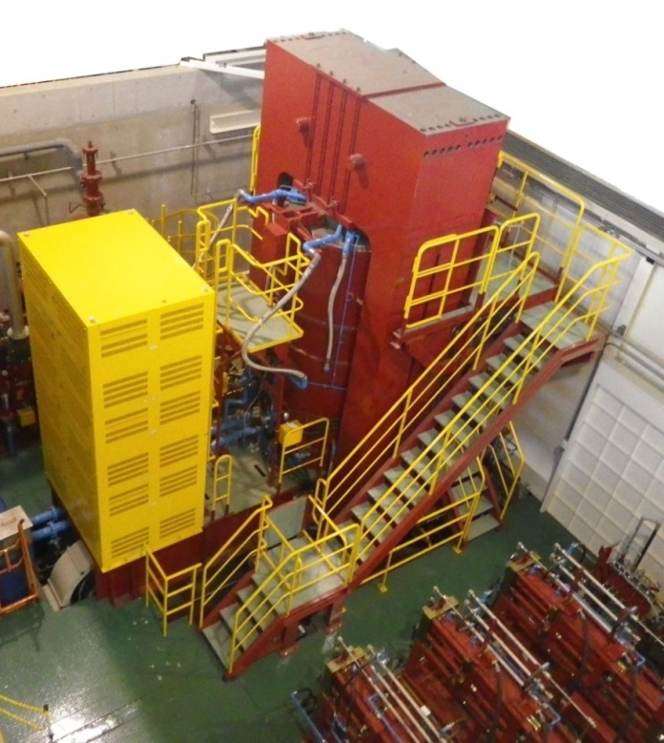
First commercial unit
- main specification -
First commercial unit with new rapid cooling
  Wire wound pressure vessel
  WZ : diameter 850mm, height 2,500mm
  Temperature： Max 1400℃
  Pressure： Max 147MPa
  Loading capacity： 4,500kg
  Cooling rate no load:
  40 degC/min
  Cooling rate 2ton load:
  15degC/min
Notes:
In 2016, the first commercial HIP equipment employing this new rapid cooling system was delivered to the customer.
I’d like to introduce the cooling performance of the new rapid cooling system based on the data taken in the test operation.
This table shows the main specifications of this HIP equipment — largest scale in our product line. We have developed wire-wound, interior cooling vessels in parallel to the development of the rapid cooling system.
This large HIP equipment has our largest interior cooling vessel with piano wire wound around the cylindrical core using a spacer.
・Hot zone diameter: 850 mm
・Hot zone height: 2500 mm
・Maximum temperature: 1400°C
・Maximum pressure: 147 MPa
・Maximum weight of work load: 4,500 kg
A heater has been designed and developed by incorporating the new rapid cooling system to meet the following requirements and installed in this HIP equipment.
・Rapid cooling rate with no load: 40°C/min
・Rapid cooling rate with a 2-ton load: 15°C/min

Slide 15
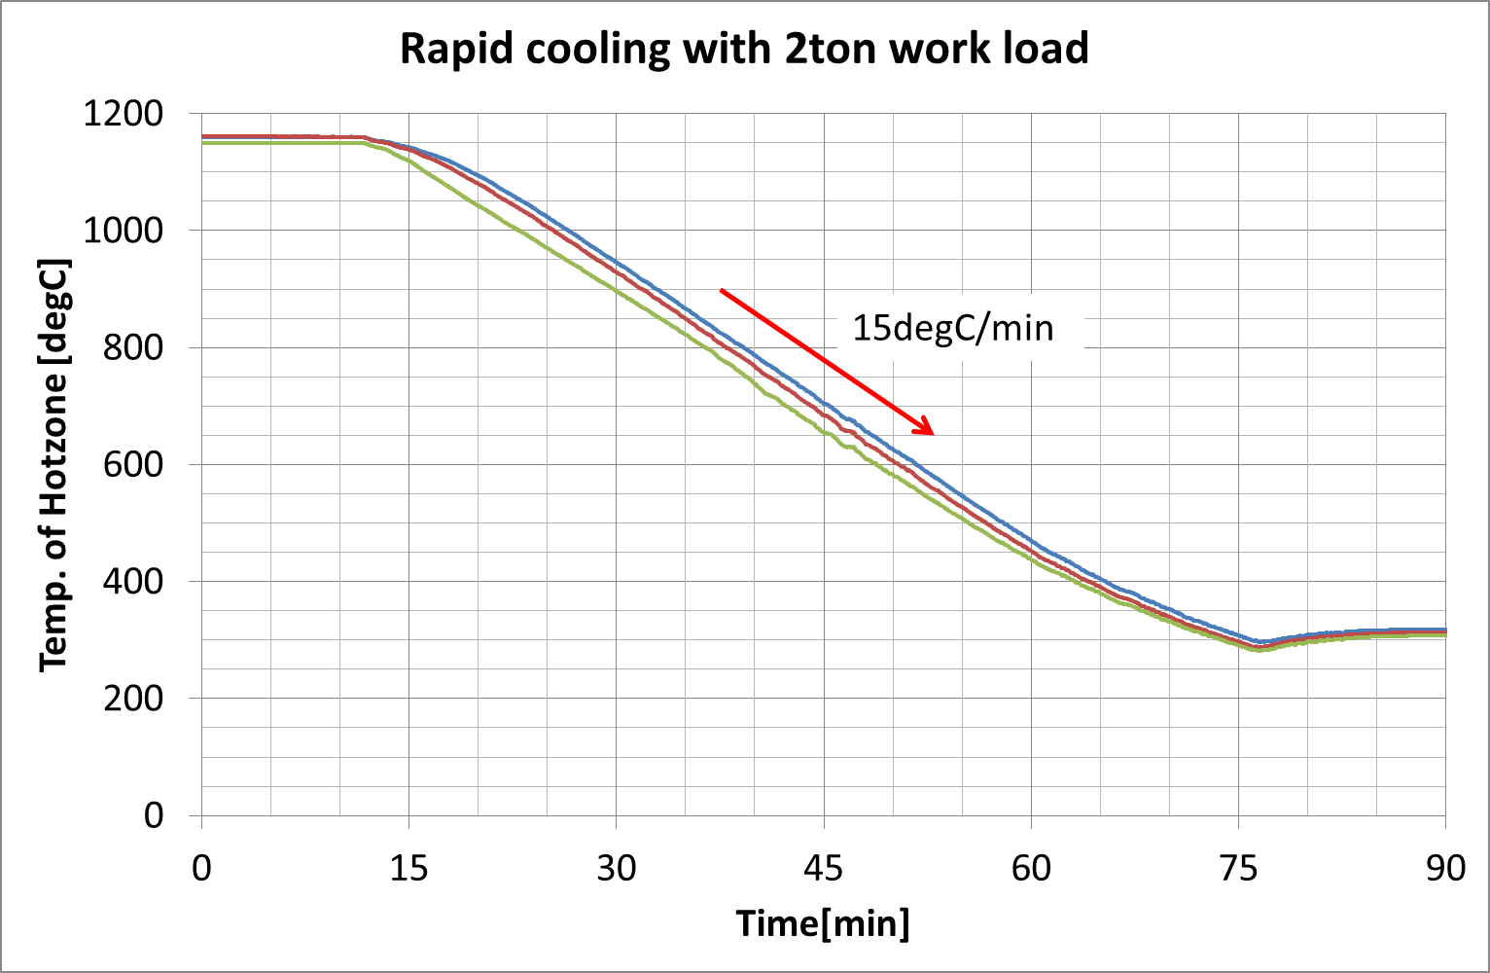
First commercial unit
- actual performance with 2ton load -
Notes:
Let me describe the results of the rapid cooling performed at the cooling rate of 15°C/min with approximately 2-ton load using this HIP equipment.
As shown in this graph, the rapid cooling was performed in the range of 1150°C down to about 400°C at the cooling rate of approximately 15°C/min.

Slide 16
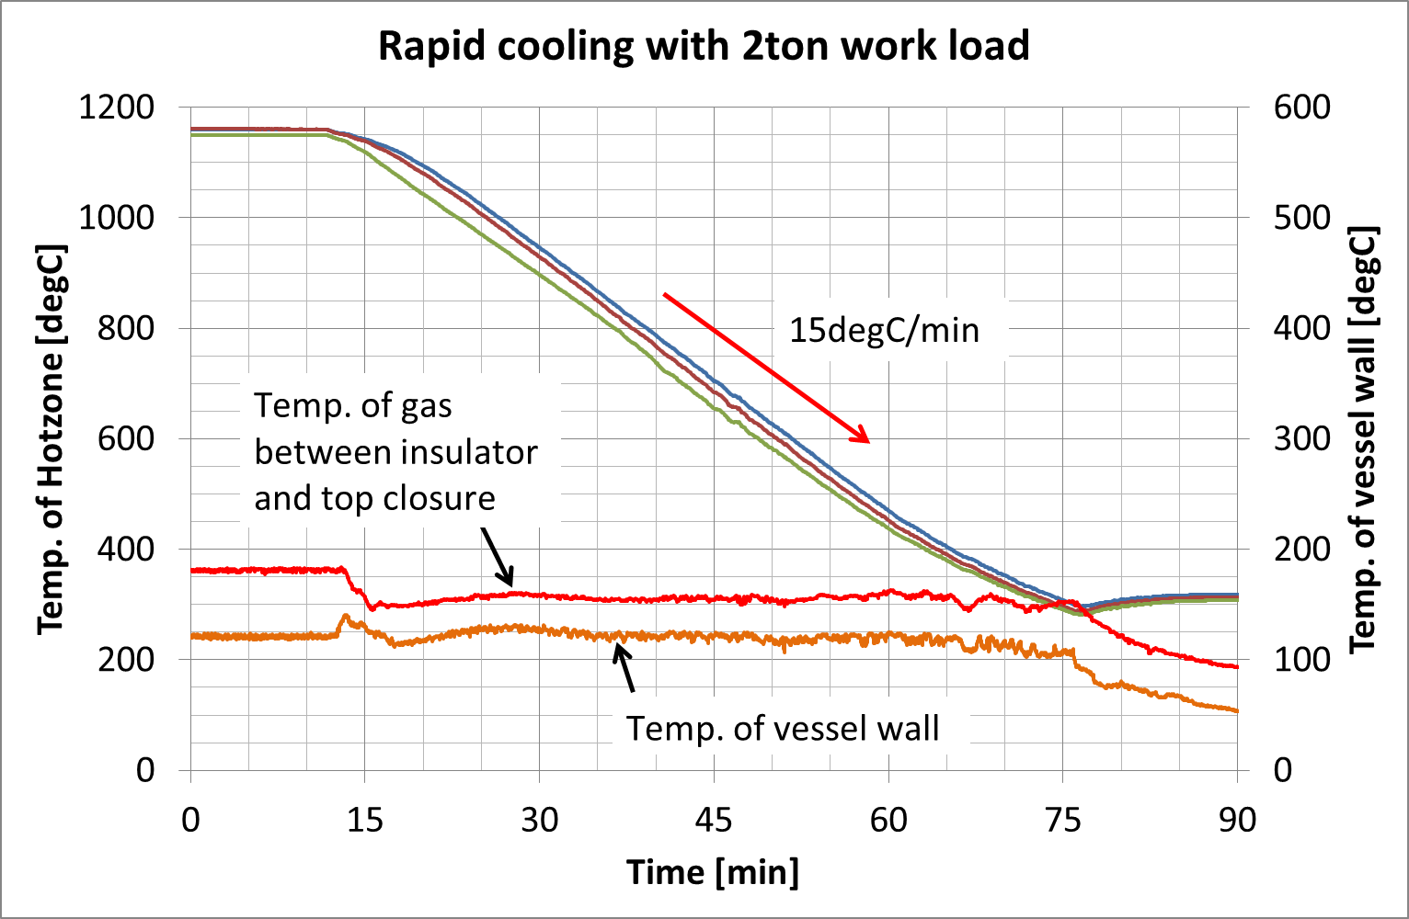
First commercial unit
- actual performance with 2ton load -
Notes:
The temperature of the pressure vessel inner surface was raised to 120°C, and then stabilized at about 110°C.
This can well demonstrate the benefits of the new rapid cooling method — “prevention of excessive temperature rise at the pressure vessel inner surface, and best use of heat extraction capability of the pressure vessel.”
The design temperature of the pressure vessel inner surface is 150°C that allows for the heat extraction capability of the pressure vessel.
Therefore, faster cooling can be achieved by increasing the rapid cooling gas flow rate.

Slide 17
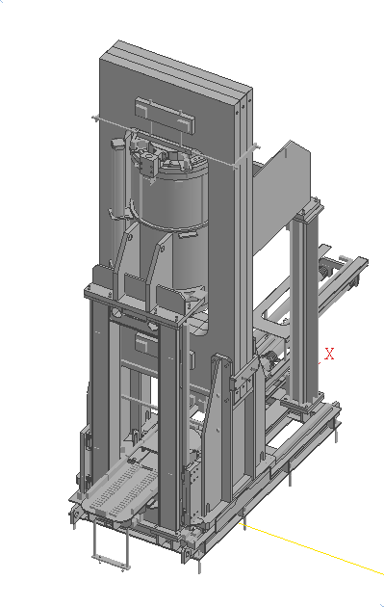
Other Topics
New “HP400”
  Small Standard model
  Bottom Loading system
  Automatic work conveyance system
New furnace for “SYS50X-SB”
  Up to 2,200deg C, 200MPa
Notes:
Let me introduce our new model of HIP.
New HP400
200MPa 2000degC working zone diameter mm working zone height mm
Small standard model for R&D and production.
New SYS50X-SB
196MPa 2200degC working zone diameter mm working zone height mm
We have designed a new furnace to achieve 2200degC

Slide 18
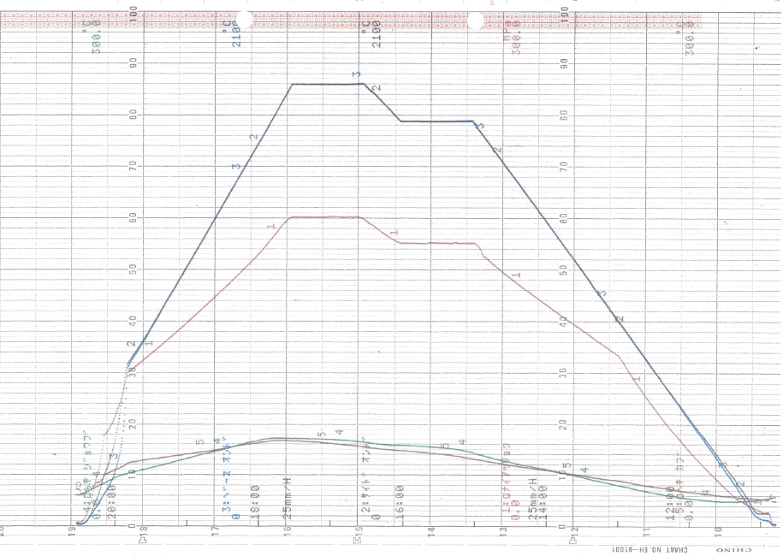
Other Topics
Tungsten Furnace for small R&D units
  Clean atmosphere
1800degC
1650degC
180MPa
Notes:
Tungsten heater is now in under development.
With Tungsten heater it is possible to have more clean HIP atmosphere in higher temperature.
And it will improve the quality of XXXXXXX

Slide 19
Conclusion
KOBELCO developed new rapid cooling system
Plural other developments are on-going
Expand HIP field for better material
Notes:
Kobelco has developed a new rapid cooling system as previously shown.
And plural other developments are on-going.
With these results we expect it will expand the field of HIP.
We sincerely hope that HIP technologies will contribute to the development of the world industry..

Slide 20



April 2017,
KOBELCO affiliated Quintus Technologies AB
  The two became a strong partner
Provide solution best for the customers
together
Notes:
Since April 2017, KSL affiliated Quintus Technologies AB and the two became a strong partner.
We have been working together to integrate our knowledges for providing better technologies.
We will provide HIP technology which will provide solutions what is best for the customers.

Slide 21
Thank you !

