Slide 1
The influence of post-HIP heat-treatments on the tensile and HCF properties of Ti6Al4V
Miren Aristizabal, M.H. Loretto, H.L. Fraser, Z.T. Zachary
Interdisciplinary Research Centre, School of Metallurgy and Materials

Slide 2
Introduction
Why?
Net-shape HIPping can be used with titanium-based materials to obtain cost reduction by reducing the amount of difficult titanium machining and the large amount of material lost.
Objective:
The aim of the work is to assess whether or not it is possible to improve the fatigue properties of powder HIPped Ti6Al4V by changing the HIP conditions or by post-HIP heat treatments.

Slide 3
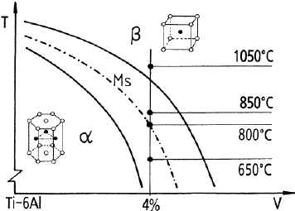
Introduction
Material
Ti6Al4V is a two-phase (α + β) alloy. The mechanical properties are sensitive to the microstructure which can be varied by different heat treatments. O and Al strengthen alloy.

Slide 4
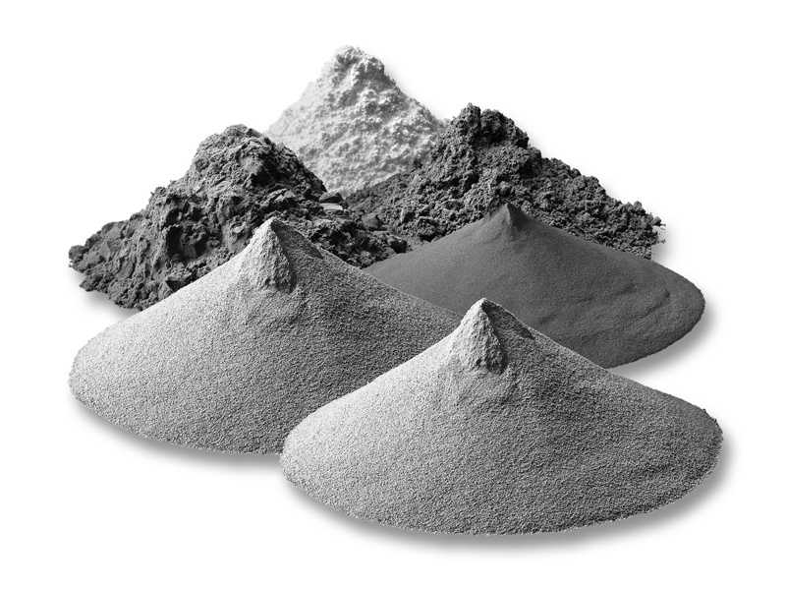
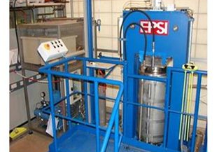

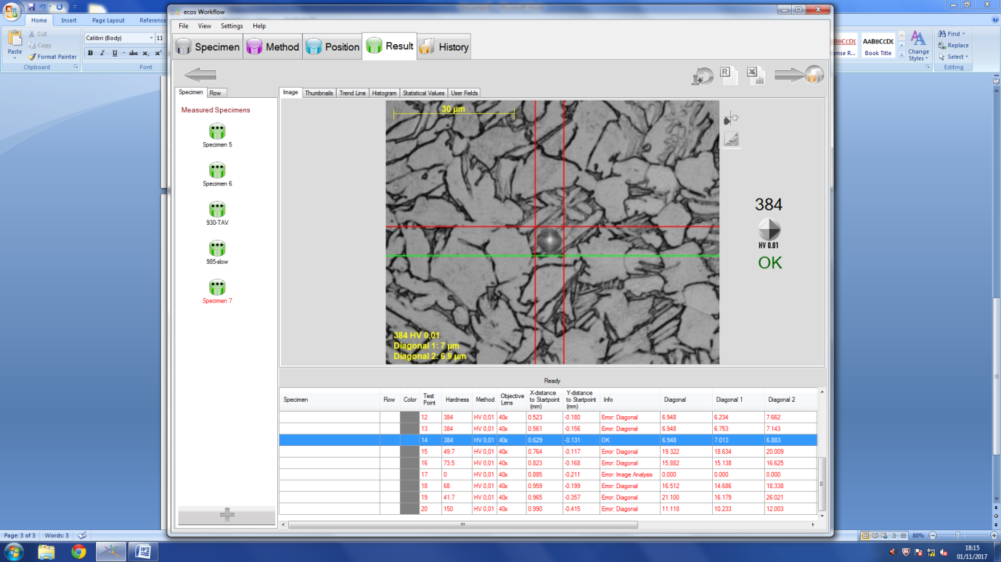
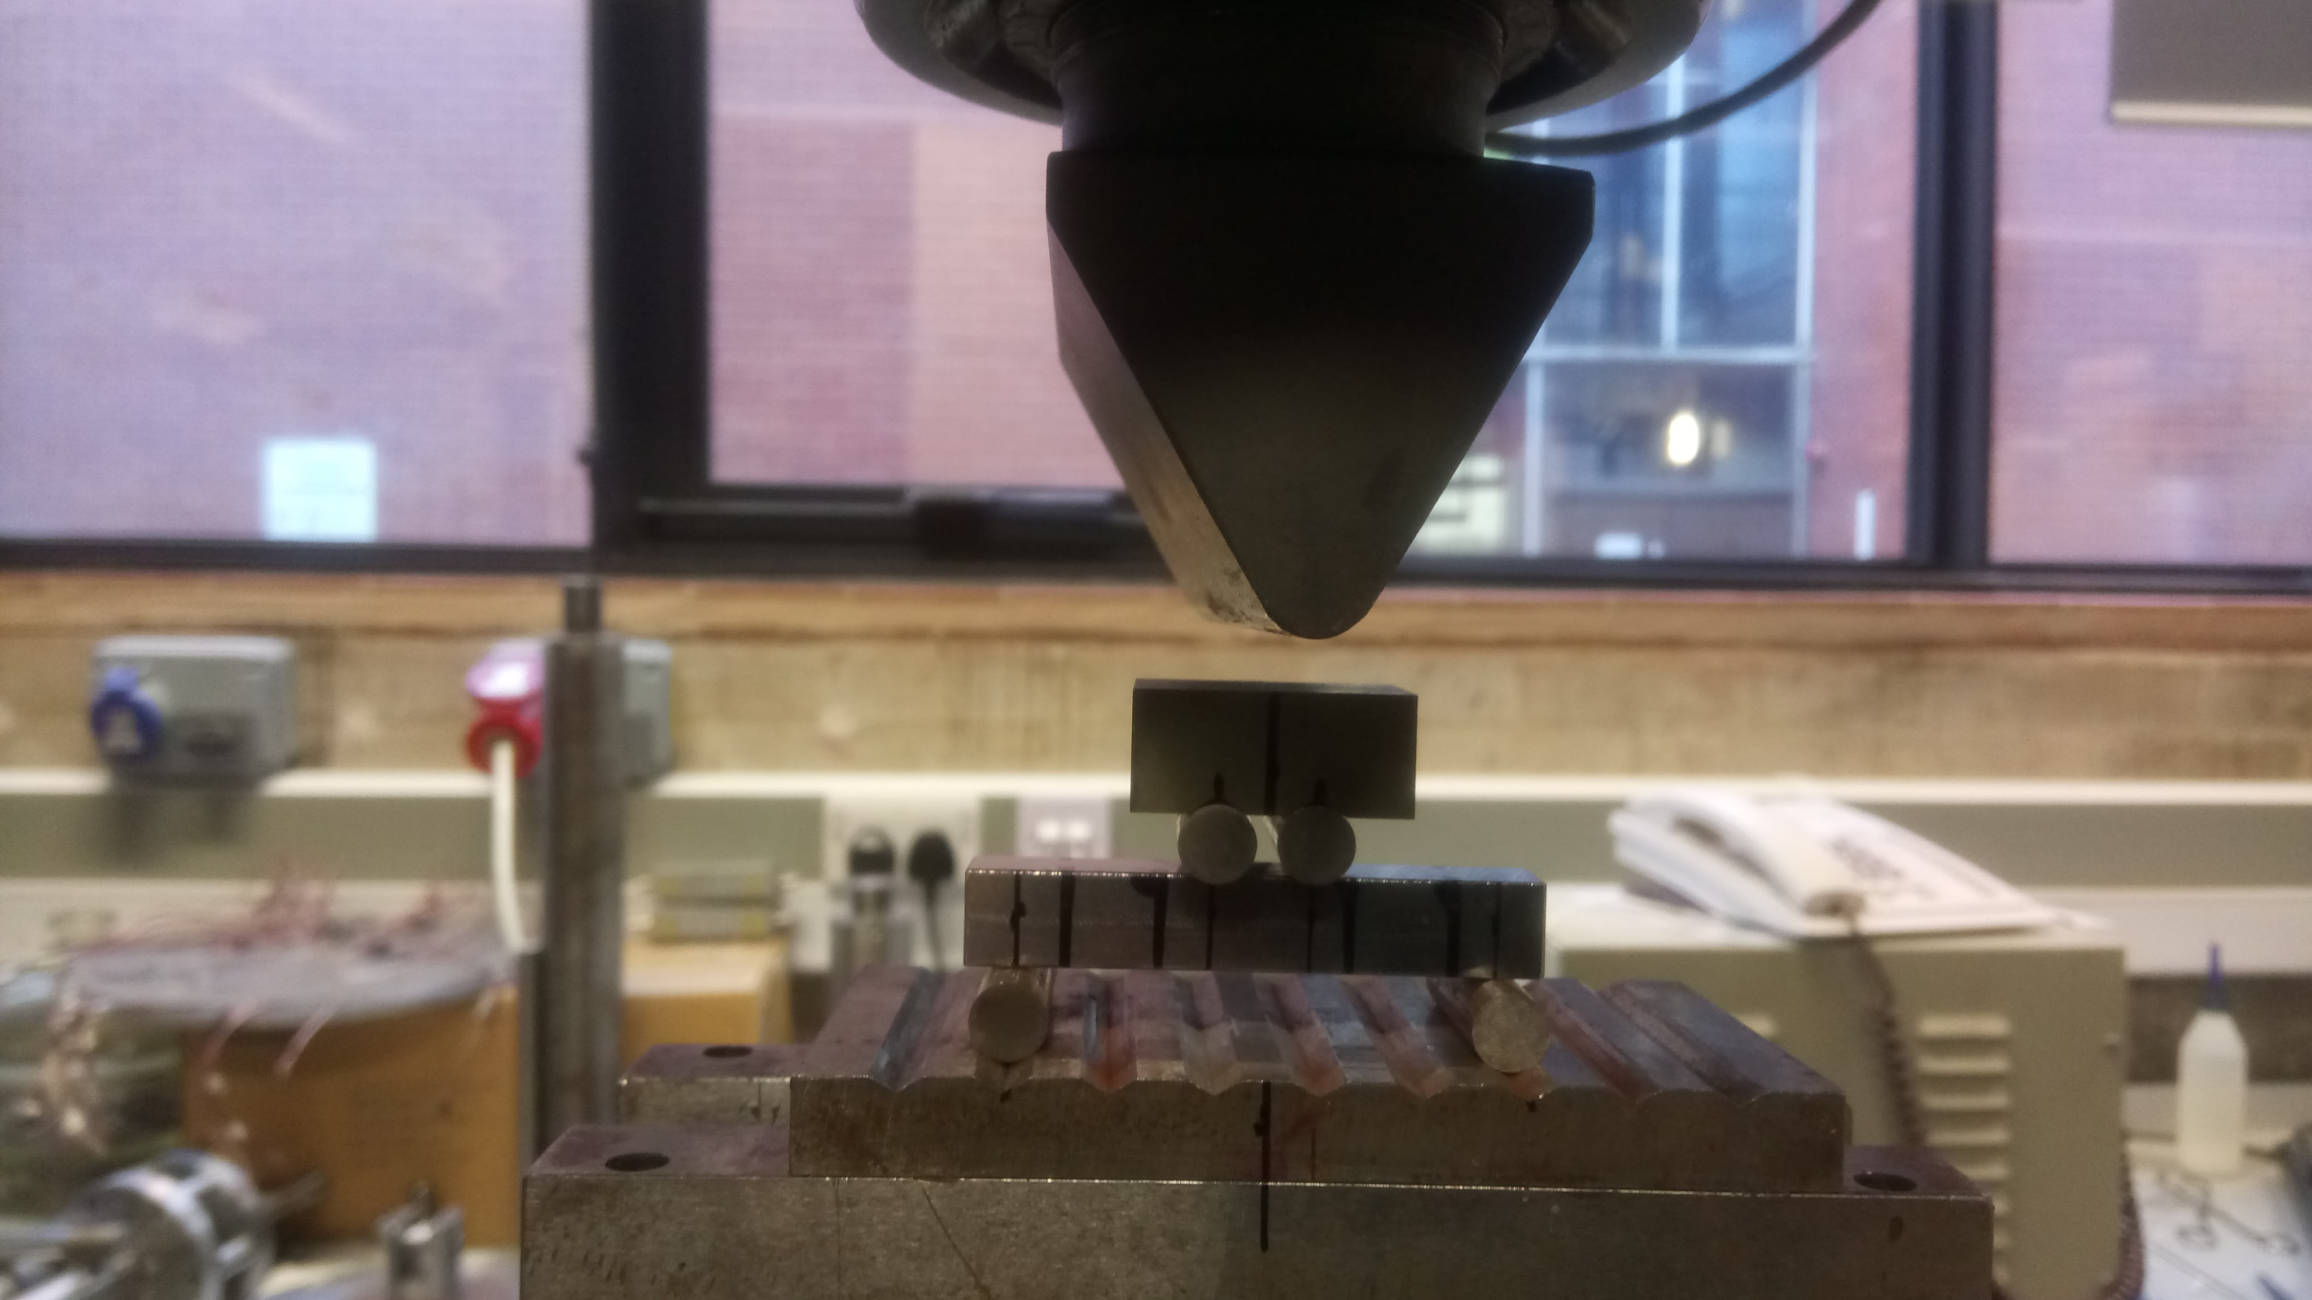
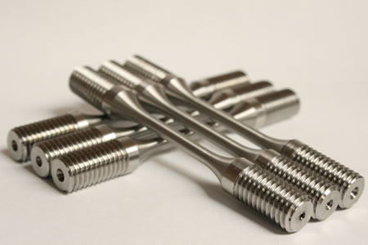
Experimental
Heat treatments
Maximum pressure: 200MPa
Maximum temperature: 1450ºC
Vessel size: Ø120mm x 300mm
Microstructure observations
SEM JEOL 7000
0.1Kg Vickers Hardness
Struers DuranScan equipment
Tensile test (ASTEM E8)
Westmoreland mechanical testing & research Ltd.
4 point bending fatigue
Amsler Vibrophore
R=0.1; ~72Hz
1x10⁷ cycles = runout

Slide 5
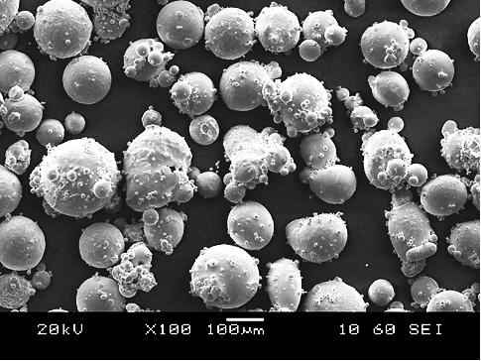
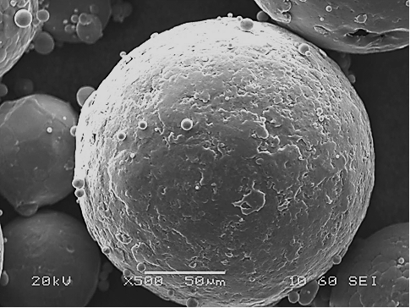
Powder
Powder | Al | V | O | Size range (µm)
TLS (GA) | 6.31 | 3.92 | 0.10 | 45-180

Slide 6
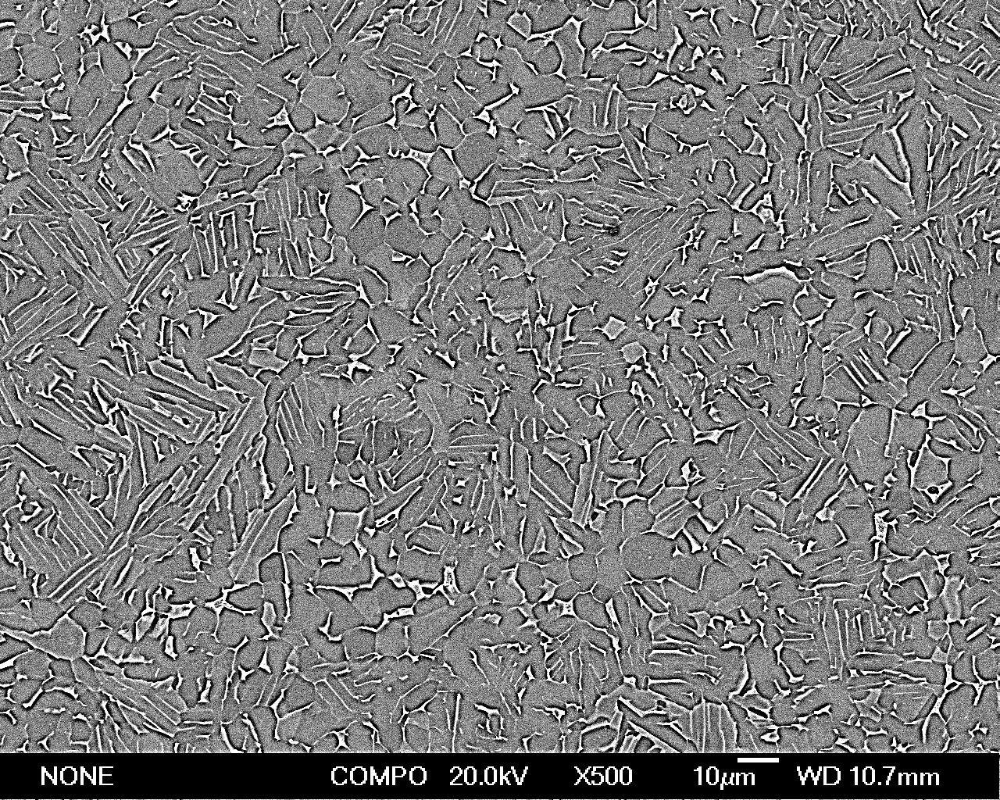
Standard HIP cycle for Ti64
930ºC/100MPa/4h
5ºC/min cooling rate
The standard microstructure consists of equiaxed α (dark phase) with about 10 vol.% β (white phase).
Notes:
Martensite plates pseudo lamellae. Coming from quench powder

Slide 7
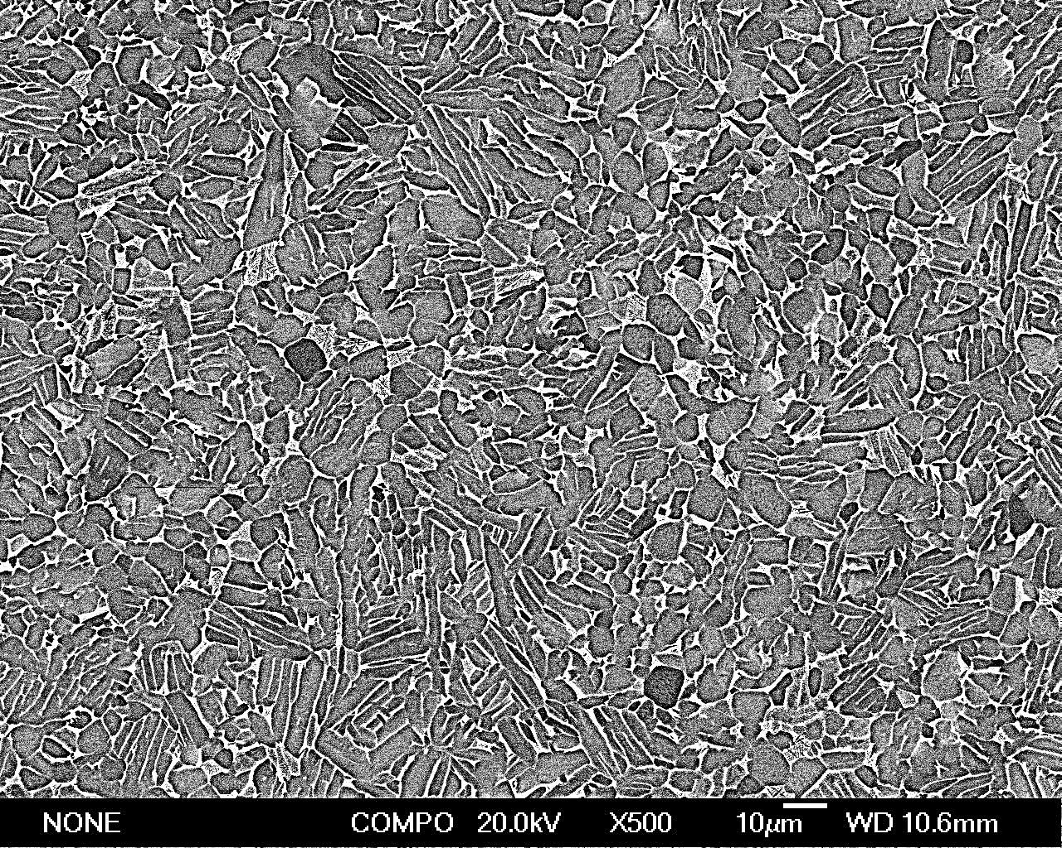
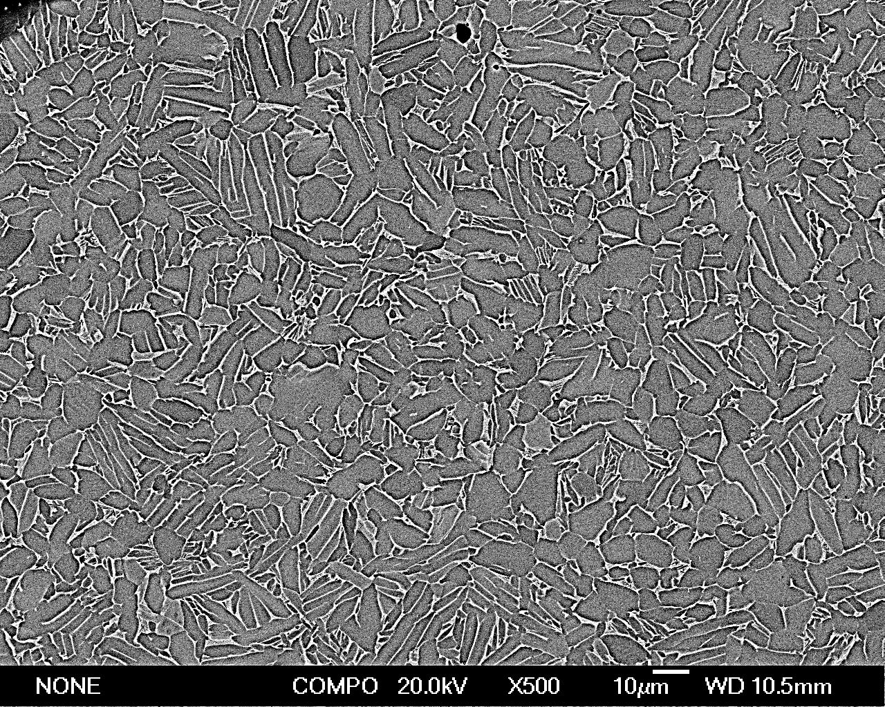
Influence of cooling rate on microstructure
HIP @930ºC/100MPa/4h
5ºC/min
50ºC/min
100ºC/min
Microstructure changes from equiaxed alpha plus beta to primary alpha + transformed beta.

Slide 8
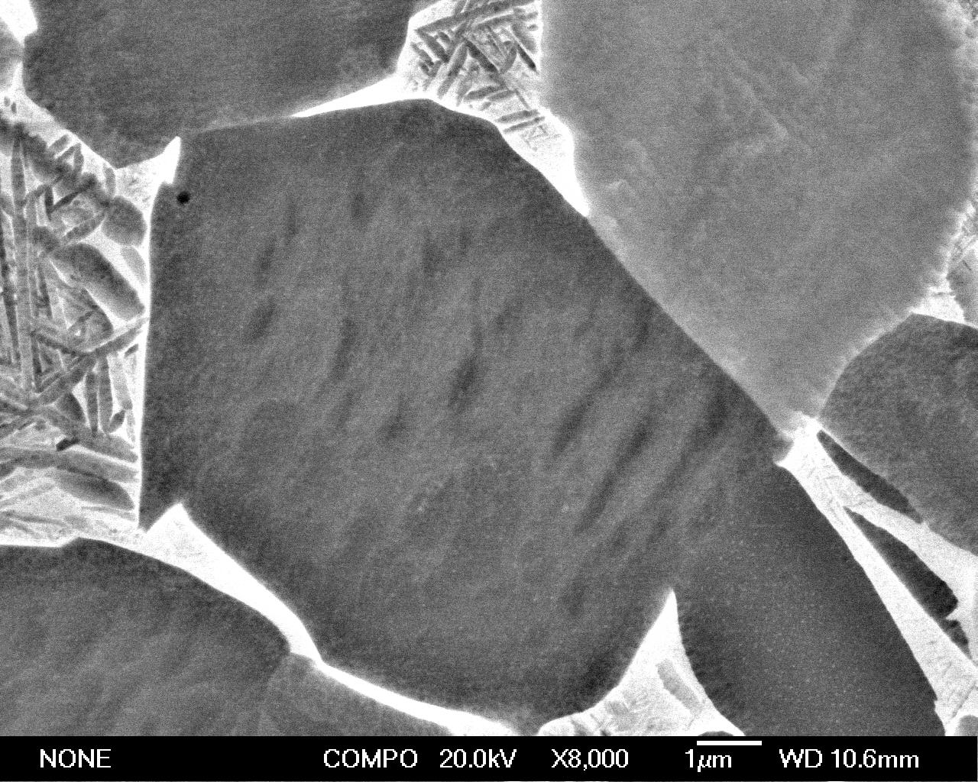
Influence of cooling rate on microstructure
HIP @930ºC/100MPa/4h
50ºC/min
Transformed
beta
100ºC/min
On rapid cooling the microstructure changes from equiaxed alpha and beta to primary alpha+ transformed beta.

Slide 9
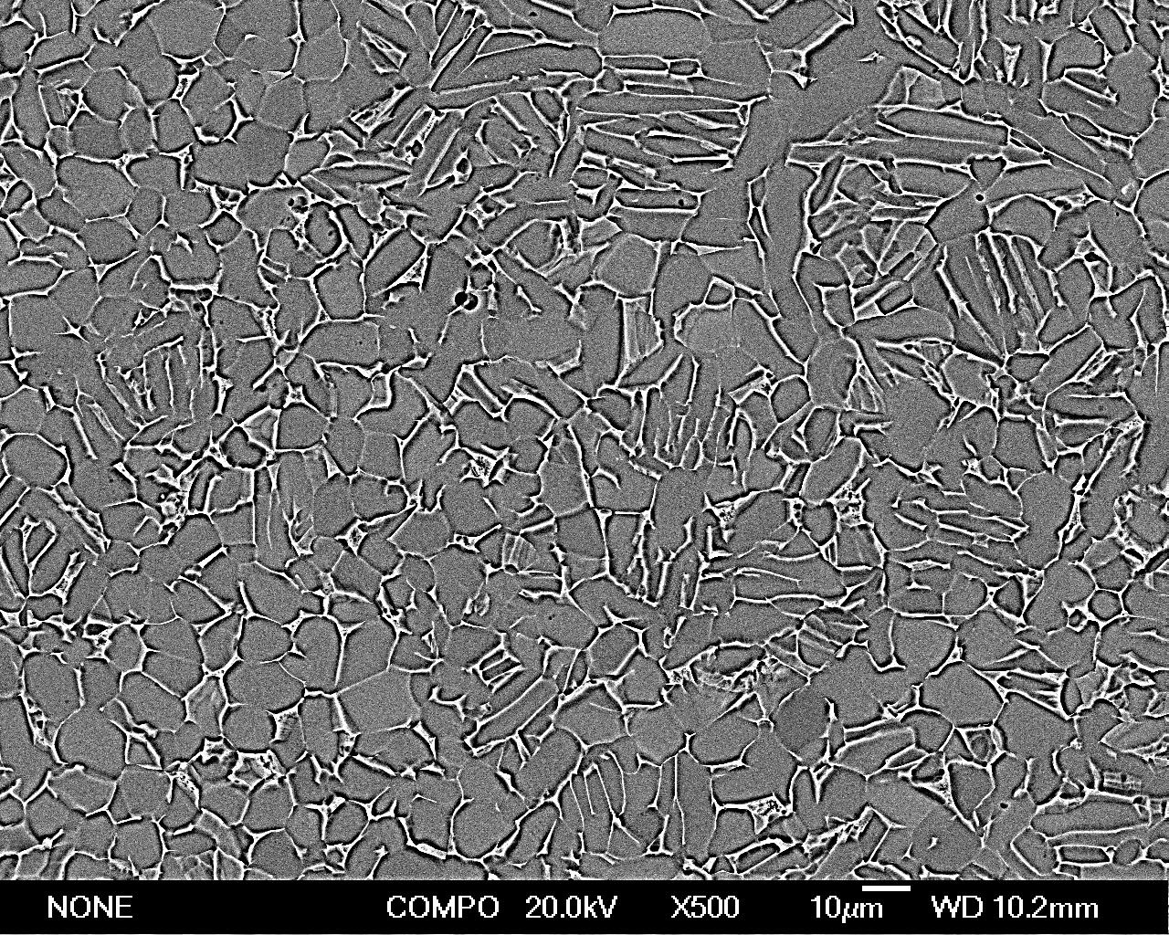
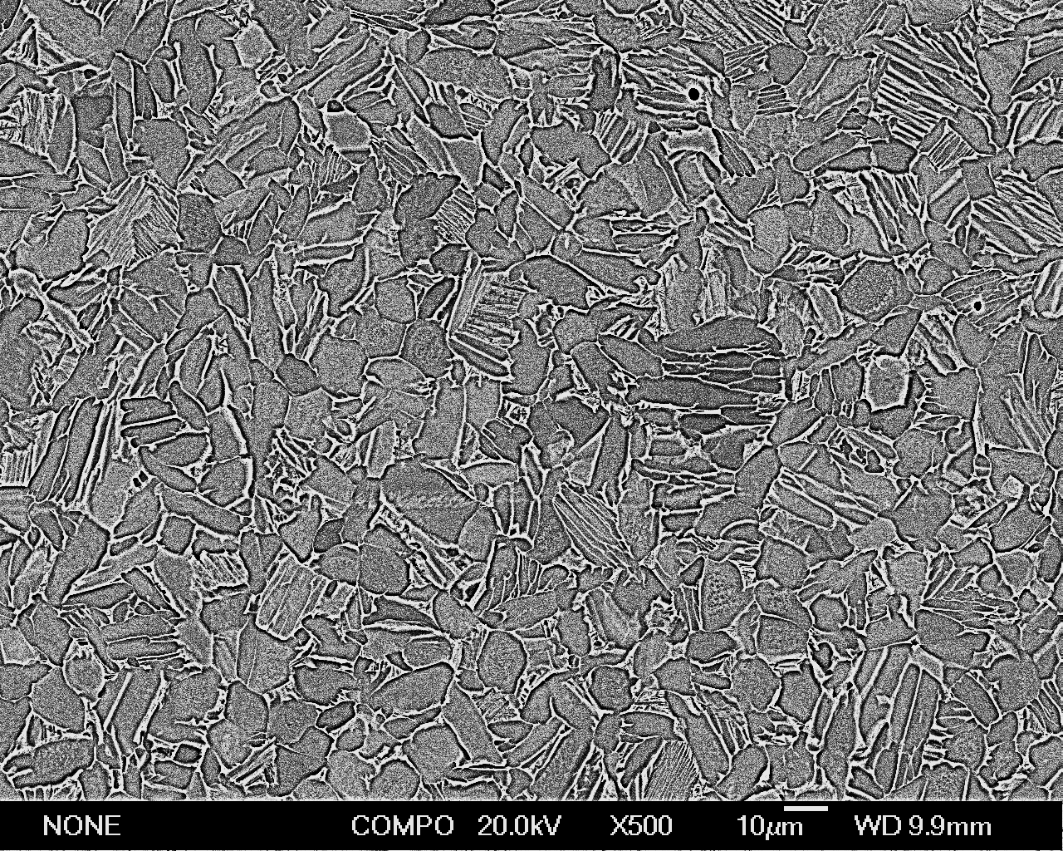
Influence of cooling rate on microstructure HIP cycles at 985˚C
5ºC/min
50ºC/min
5ºC/min from 985ºC 0.1kg-HV | 50ºC/min from 985ºC 0.1kg-HV
312 (equiaxed α) | 360 (primary α + transformed β)

Slide 10
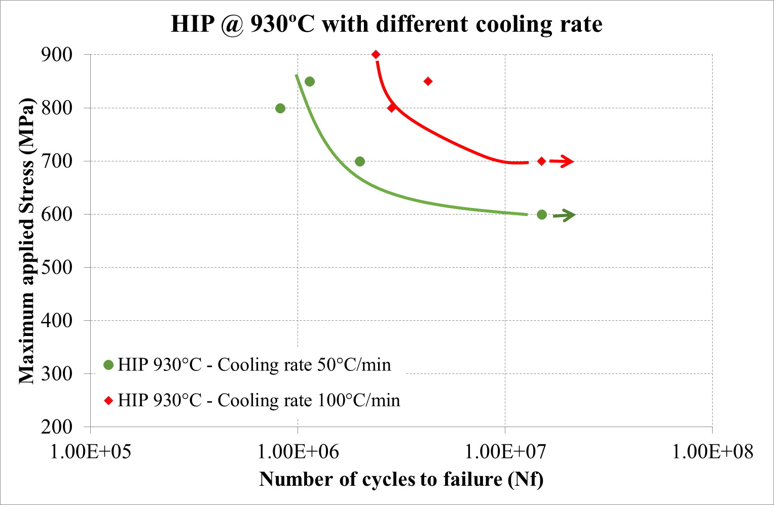
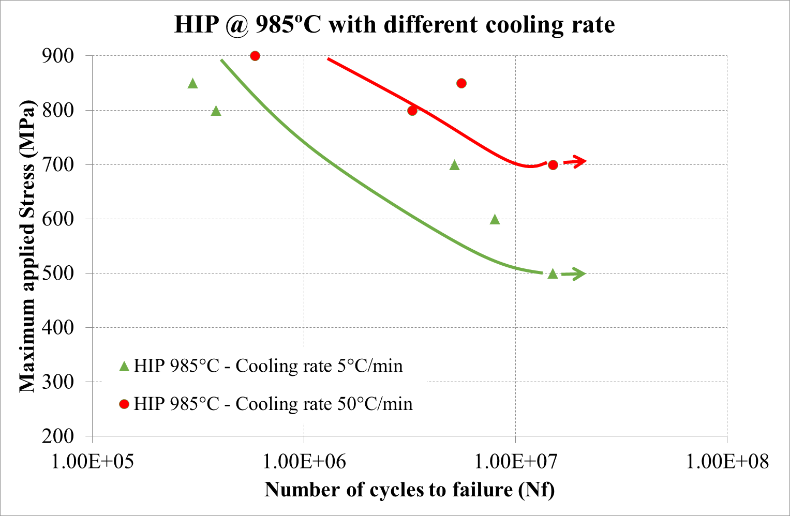
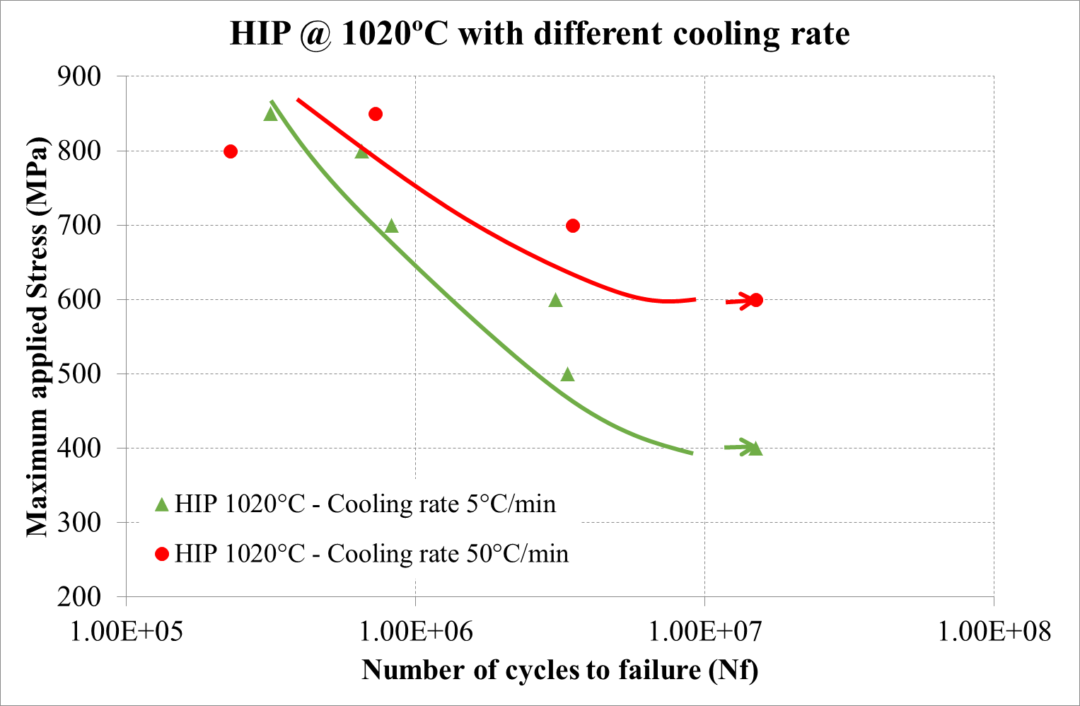
Cooling rate on fatigue
Faster cooling rate improves the fatigue life of HIPped Ti64.
But higher temperature reduces it (coarsens microstructure).

Slide 11
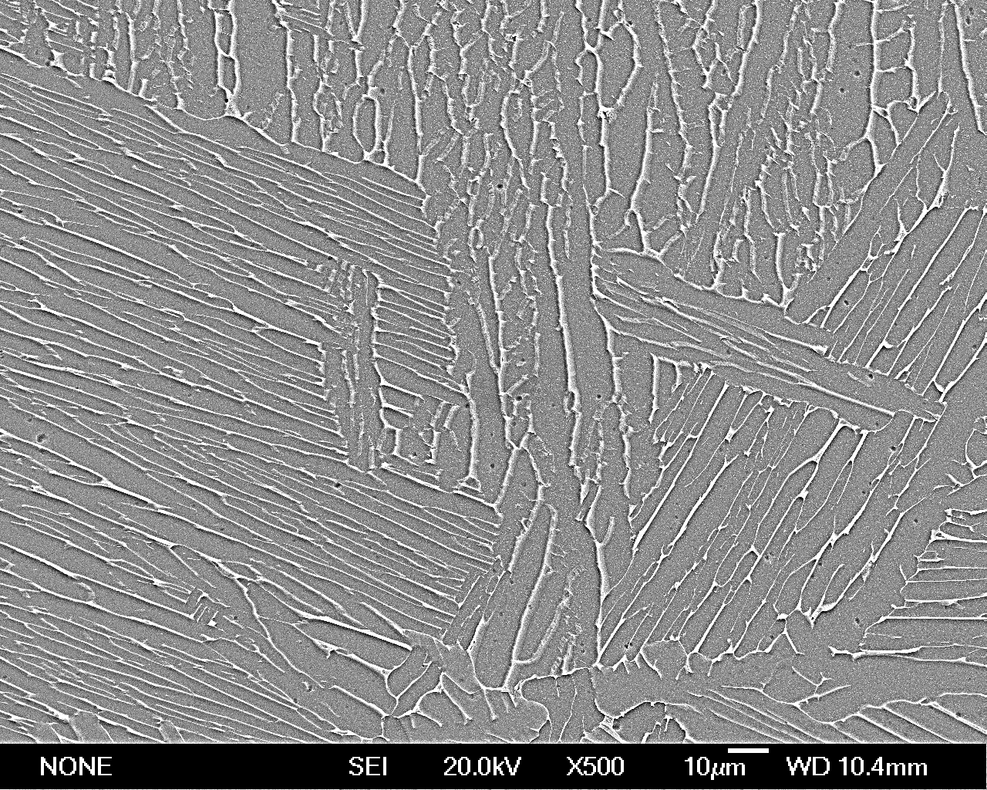
HIP cycles at different temperatures
930ºC
985ºC
1020ºC
The microstructure is coarser as the HIP temperature is increased.

Slide 12
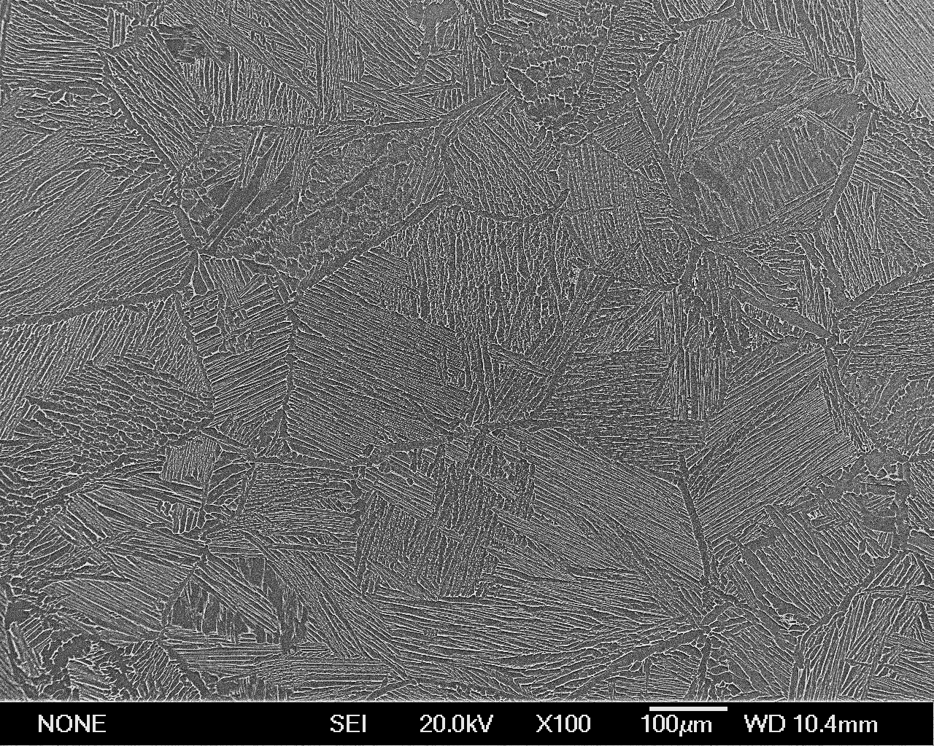
HIP cycles at different temperatures
1020ºC
1020˚C is clearly above the transus with coarser beta grains giving grain boundary α and lamellar microstructure.

Slide 13
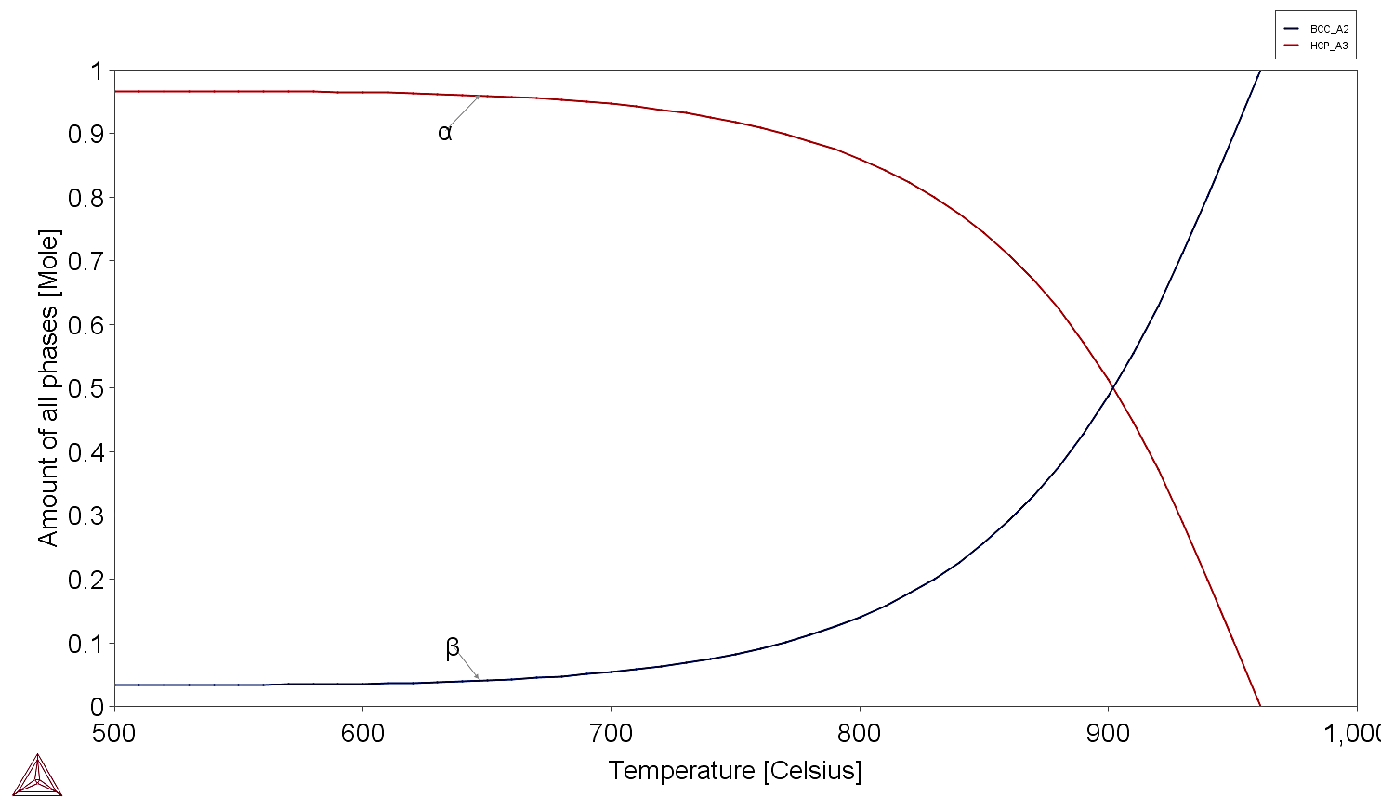
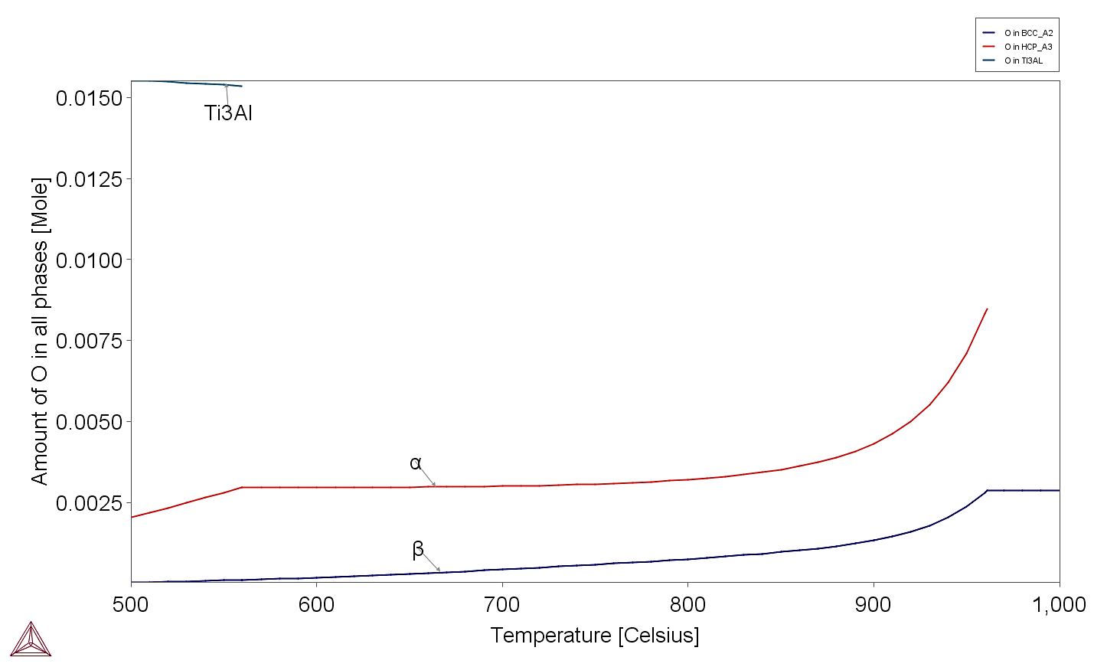
Oxygen partitioning
α
The amount of α decreases as approach the transus which despite the increased partitioning limits the total amount of O in α.
Phase amount
β
More O is thus present in the β and if cool rapidly can retain the higher O in the α in the transformed β, strengthening the alloy.
Oxygen in phases
α
β
β transus temperature
(~995˚C)
Thermocalc®: TTTI3 database

Slide 14
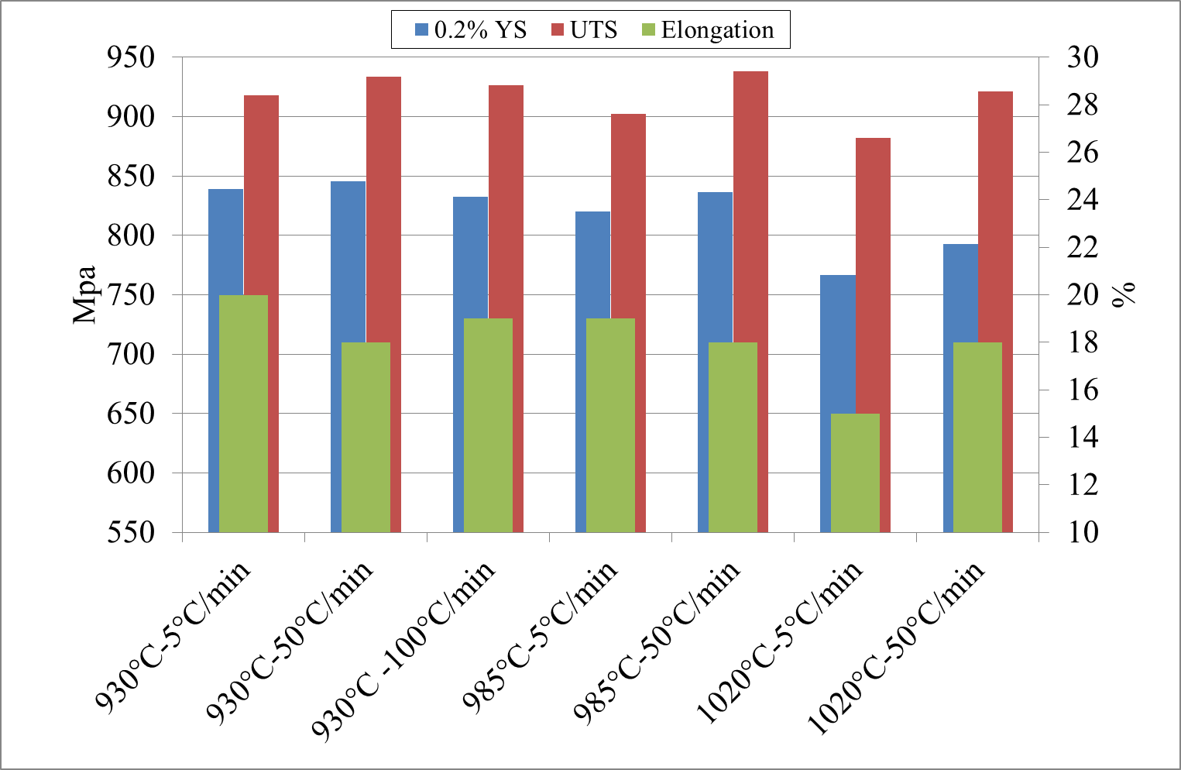
Tensile properties as f(Cooling rate)
Limited benefit using rapid cooling from 985˚C since coarsening and partitioning both affect strength.

Slide 15
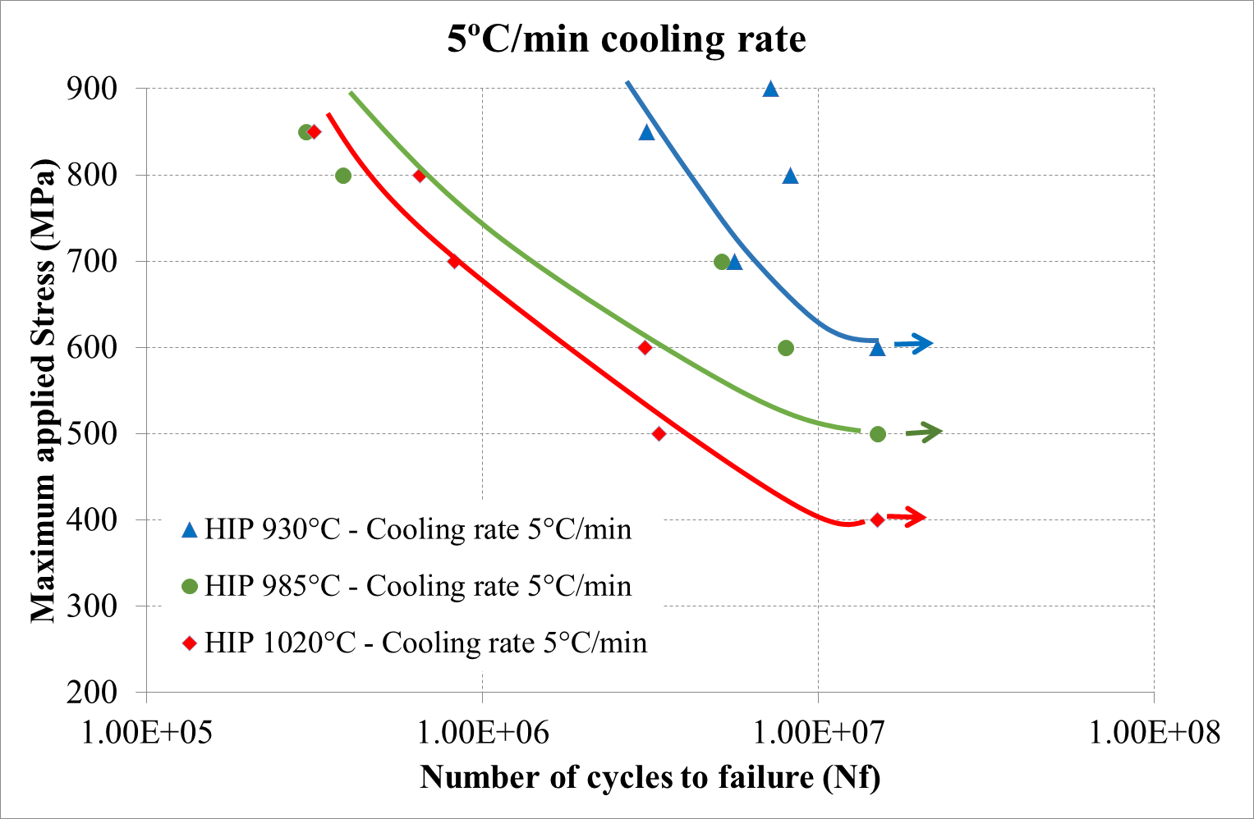
Coarsening vs partitioning on fatigue slow cooling
In the samples that were slowly cooled the fatigue properties decrease when the grains coarsen. Samples HIPped at 930˚C show the best fatigue.

Slide 16
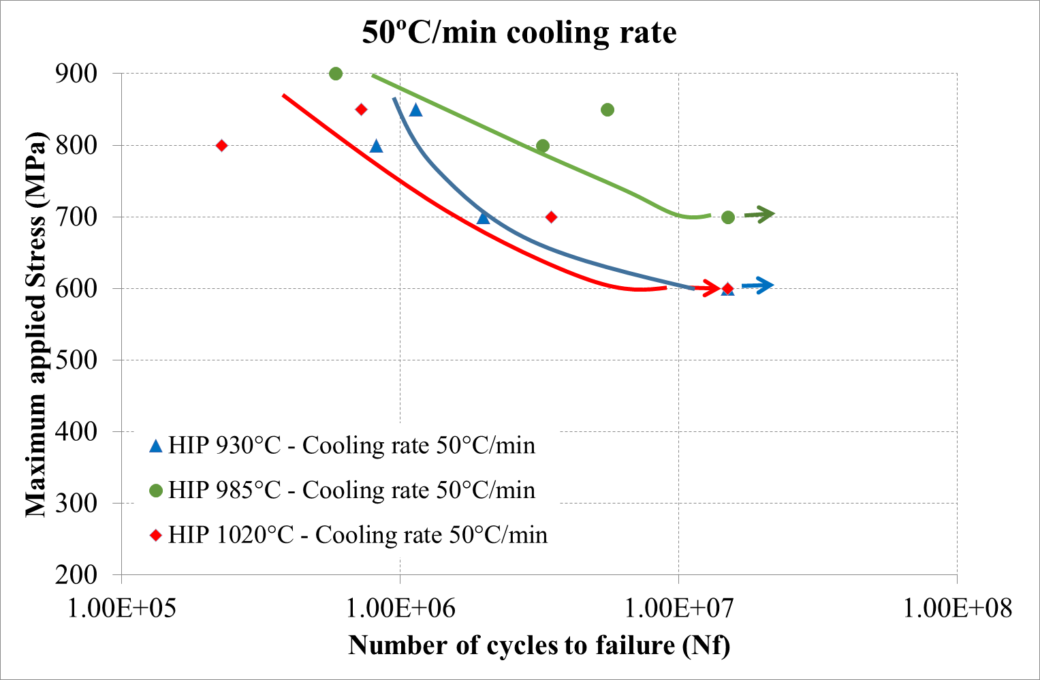
Coarsening vs partitioning faster cooling
When introducing the fast cooling the effect of partitioning starts to be visible in fatigue properties. Thus the samples HIPped at 985˚C, close to the transus, showed the best fatigue properties.

Slide 17
Conclusions
Fast cooling refines the microstructure and forms lamellar regions of transformed beta.
Fast cooling from all HIPping temperatures used improves the fatigue properties of HIPped Ti64.
HIPping or heat treating close to the beta transus, followed by fast cooling enhances the fatigue strength because the alpha in the high fraction of transformed beta, which is formed when cooling from high temperatures, is richer in oxygen than in slowly cooled samples.
However HIPping at higher temperatures induced grain coarsening which decreases the mechanical properties.

Slide 18
Future work
Therefore it is clear that the mechanical properties of Ti64, in particular fatigue properties, can be improved by post-HIP heat treatments aiming to get microstructures with oxygen-strenghtened transformed-beta. However to increase this effect shorter holding times during HIP will be needed to avoid the grain coarsening. It is clear that since 4h at 930˚C is sufficient to consolidate Ti64 that HIPping for 1h is probably adequate at 985˚C.

Slide 19
Acknowledgment
This work has been partly funded by TIMET and by EMUSIC which is part of an EU-China collaboration and has received funding from the European union’s Horizon 2020 research and innovation programme under grant agreement No. 690725 and from MIIT under the programme number MJ-2015-H-G-104.

Slide 20

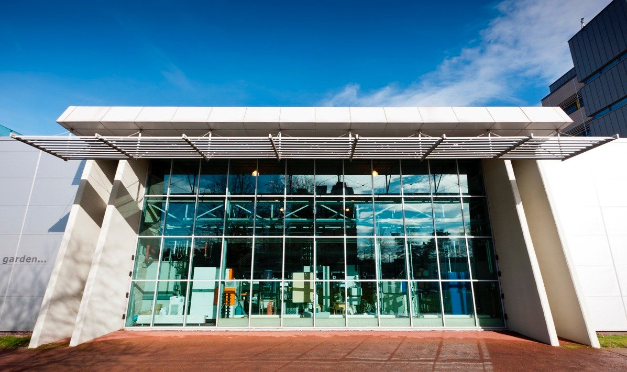
Thank You

