Slide 1
HIP Processing of Improved Tooling Materials for High-Productivity Hot Metal Forming Processes
HIP’17 - 12th International Conference on Hot Isostatic Pressing, Sydney, Australia, 5 – 8 December, 2017
Maxime Gauthier, Guillaume D’Amours, Fabrice Bernier
December 7th, 2017

Slide 2
Outline
Introduction
Objectives
Development of HTC Tool steel composite by HIP
  Properties of HIPed Hot Work Tool Steel and HTC Tool Steel
  Conformal-Cooled, Hemispherical Toolings
Hot Stamping of Aluminum Sheets with HIPed Toolings
Conclusions

Slide 3
Introduction
Hot stamping installations are expensive and process cycle time has to be minimized to increase productivity, especially for automotive applications;
Die cooling cycle can be long according to the conformal cooling design and the tool steel used;
Developing a High Thermal Conductivity (HTC) tool steel composite could help in decreasing die cooling time and improve hot stamping productivity;
HIP is a very efficient and versatile process to manufacture high-quality, hot-work tooling materials;

Slide 4
Objectives
Develop and Characterize a HIPed, HTC tool steel composite
Process hemispherical, conformal-cooled toolings by HIP
Evaluate impact of tooling material on hot stamping of Al alloy sheets

Slide 5
Development of HTC Tool steel composite by HIP
D2 steel powder was chosen as baseline;
The first candidate HTC tool steel composite was based on the addition of 30 vol.% of copper particles to D2 powder;
Two billets based on these compositions were HIPed:
  D2
  D2+30vol%Cu
The HIPed materials were then characterized and their thermal and mechanical properties were compared;

Slide 6
Development of HTC Tool steel composite by HIP (cont.)
Initial Powders:
  D2 tool steel powder, spherical, -150+45 mm (Sandvik);
  Copper powder, grade 153A, spherical, 2%max+100μm/Bal+45μm/10%max-45μm (ACuPowder)

Slide 7
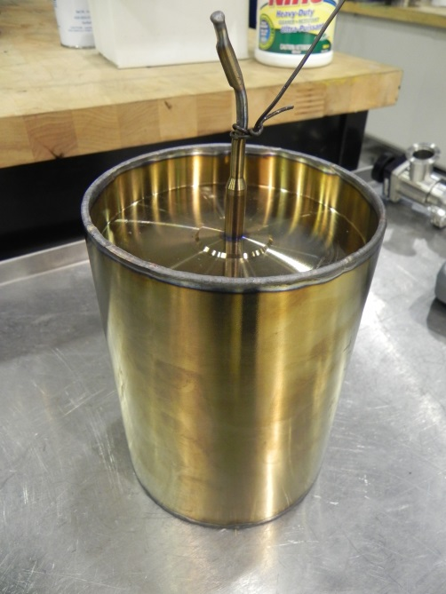
Development of HTC Tool steel composite by HIP (cont.)
304L canisters were filled & tapped;
Vacuum Degassing
  14 h @ 150°C, 4h @ 550°C under mechanical vacuum (∼7x10⁻² Torr)
Crimping and Sealing
  Crimping of vacuum tube using a 100-ton Hydraulic press;
  Sealing by TIG welding
Degassed and Sealed Canister, OD = 5,438’’ (138,1 mm)

Slide 8
Development of HTC Tool steel composite by HIP (cont.)
Hot Isostatic Press:
  AIP10-30H from American Isostatic Presses, Inc.
HIP Cycles
  For D2:
    4h @ 1100°C and 15000 PSI (103 MPa)
  For D2+30vol.%Cu:
    4h @ 1000°C and 15000 PSI (103 MPa)
No additional heat treatment was applied to these materials;

Slide 9
Properties of HIPed Hot Work Tool Steel and HTC Tool Steel
The HIPed D2 and D2+30vol.% Cu bulk materials were characterized:
  Metallography
  The following properties were evaluated:
    Heat Capacity (Cp);
    Thermal Diffusivity (α);
    Thermal Conductivity (k);
    Coefficient of Thermal Expansion (CTE);
    Hardness / Microhardness;
    Wear Resistance / Coefficient of Friction (CoF);

Slide 10


Metallography → HIPed D2
98,9 % Dense
50x
500x

Slide 11
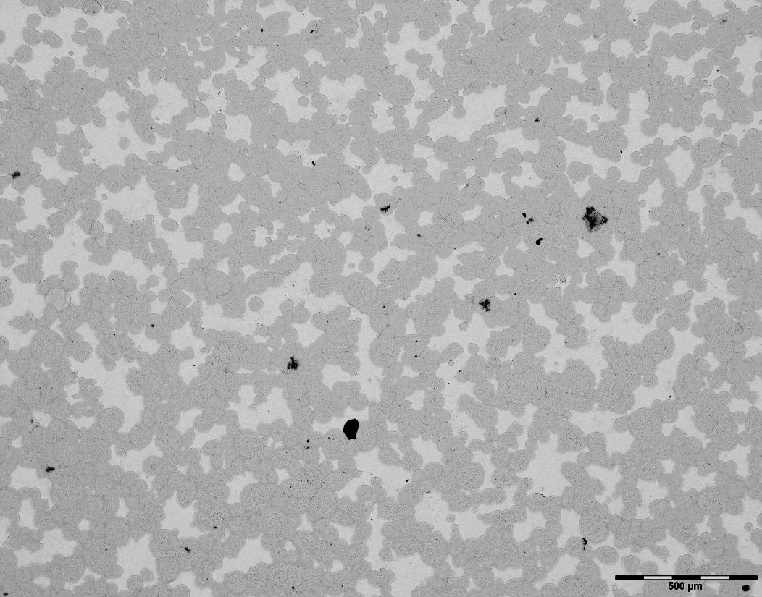
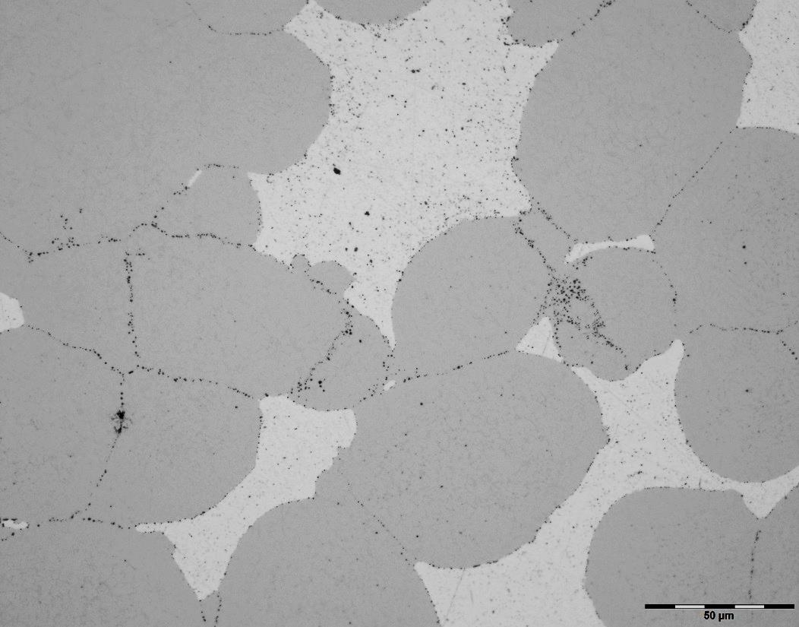
Metallography
→ HIPed D2+30vol.%Cu
98,2 % Dense
D2
50x
500x
Cu

Slide 12
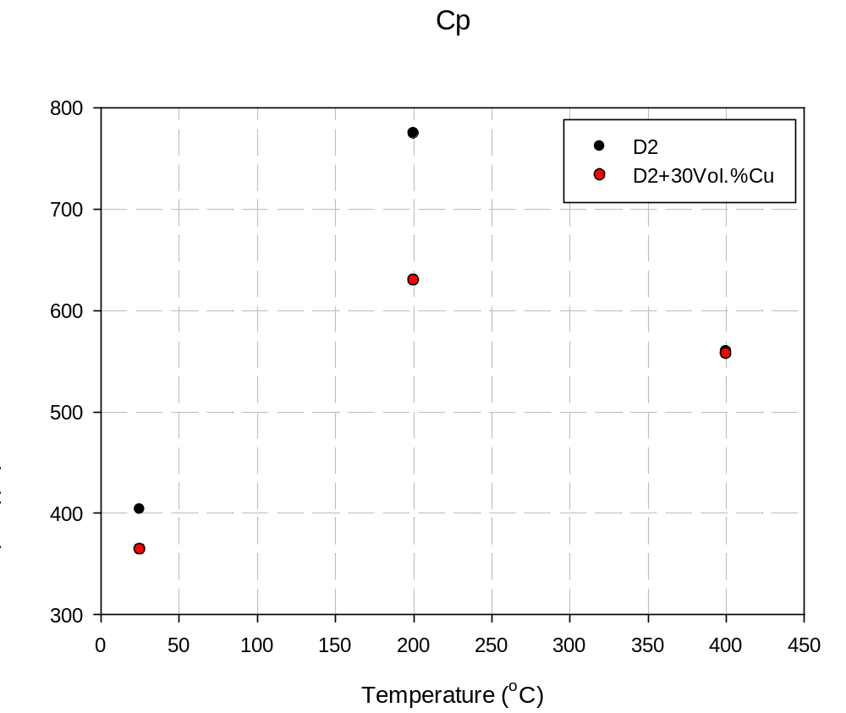
Heat Capacity (Cp)
Bizarre behaviour of Cp vs Temperature for both materials
Will be investigated further to confirm or invalidate these results

Slide 13
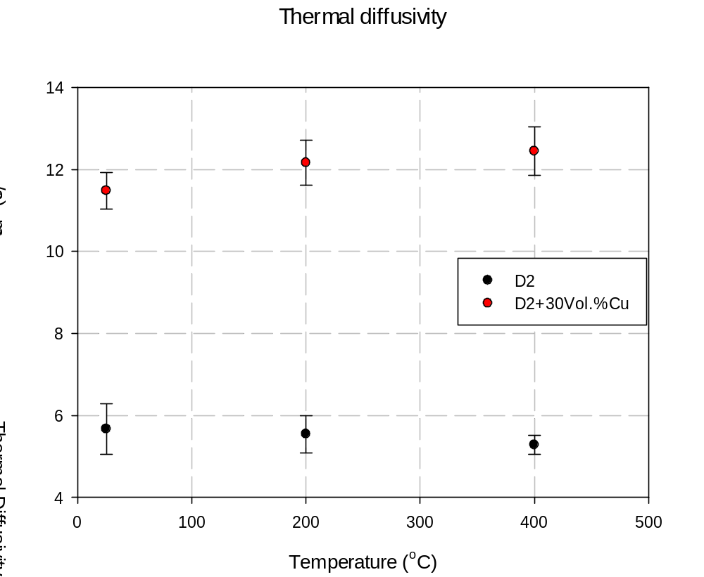
Thermal Diffusivity (α)
Thermal Diffusivity is significantly increased by adding 30Vol.% Cu to D2

Slide 14
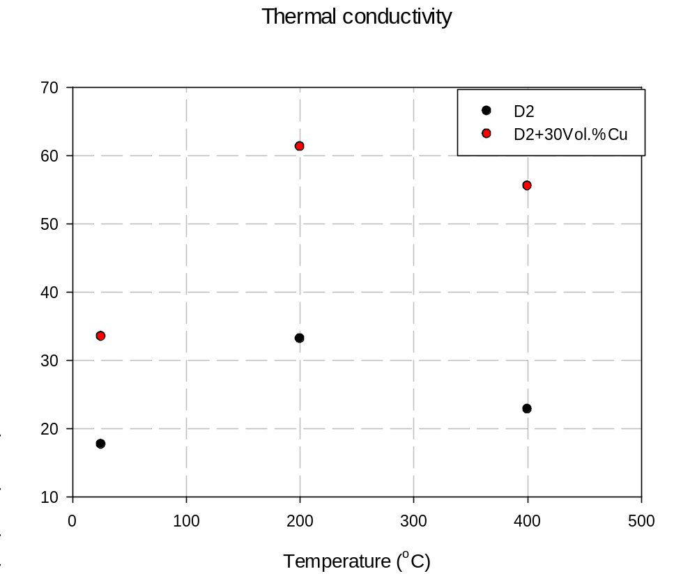
Thermal Conductivity (k)
Adding 30Vol.% Cu to D2 dramatically increases k at all temperatures:
17.6 to 33.5 @ 25°C (x 1.9)
33.1 to 61.3 @ 200°C (x 1.85)
22.8 to 55.5 @ 400°C (x 2.44)

Slide 15
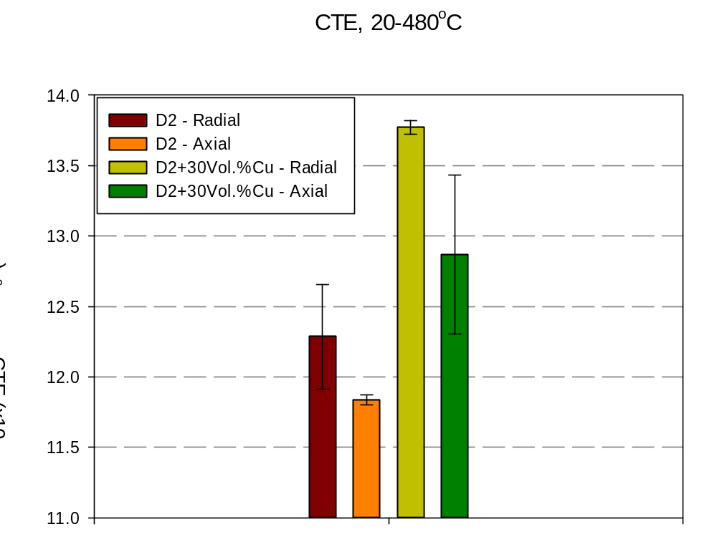
Coefficient of Thermal Expansion (CTE)
It is clear from the graph that:
  CTE_{D2+Cu} >CTE_{D2}
  CTE_{radial} >CTE_{axial}
The difference between materials is relatively small;
The radial-axial difference is encountered in both materials;
No major impact of difference in CTE is expected during sheet metal forming

Slide 16
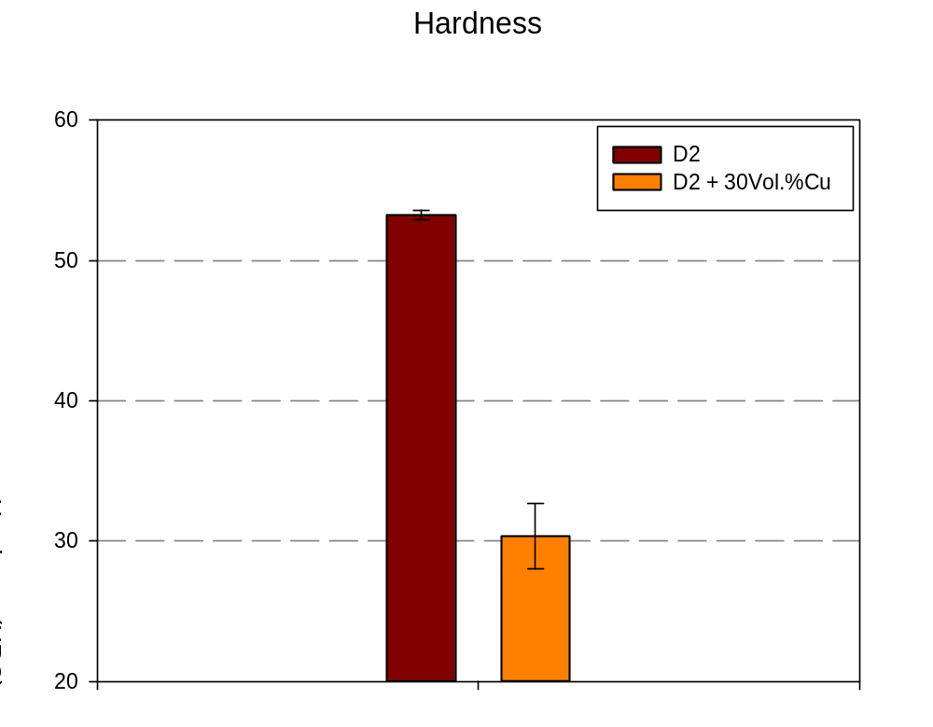
Hardness
53,3 ± 0,34
As expected, the hardness of the Cu-containing material is much lower than the pure D2 counterpart
30,3 ± 2,32

Slide 17
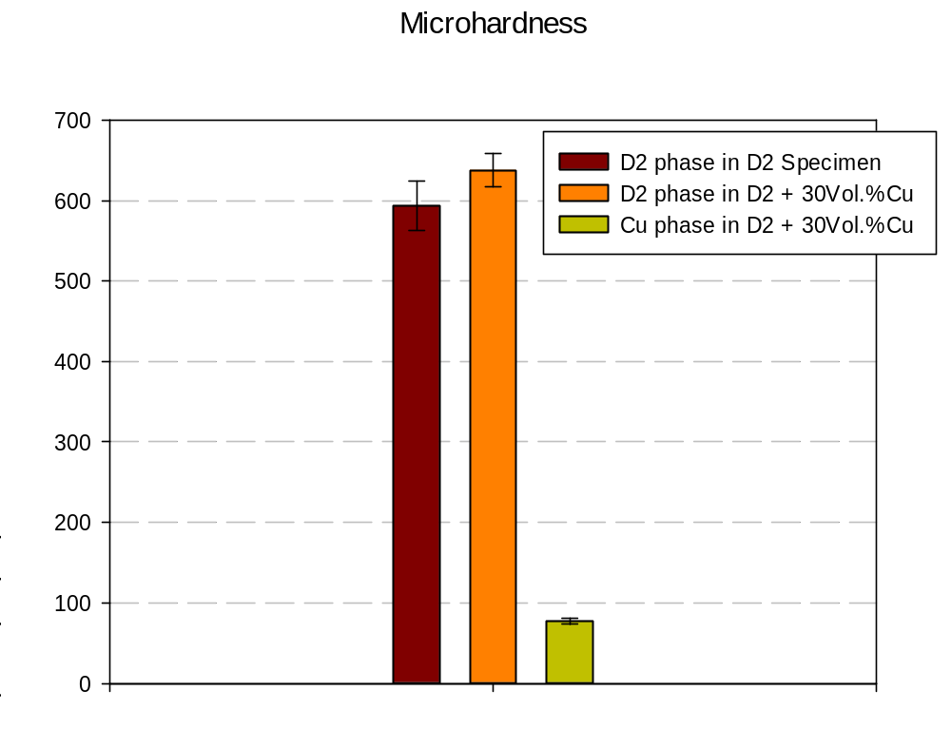
Microhardness
638 ± 21
594 ± 30
The microhardness of the D2 phase in D2+30Vol.%Cu is slightly higher than that in the D2 specimen → maybe some solid-solution strengthening;
The Cu phase is much softer, of course;
77 ± 4

Slide 18
Wear Resistance / Coefficient of Friction (CoF)
Wear Testing Parameters:
  Type: Ball on disk
  Charge: -50 N
  Slider from zero: 14 mm.
  Duration: 24000 sec.
  Linear Velocity: 15000mm/min (0.25m/sec.)
  Ball Size/Material: 10mm Sintered Alumina

Slide 19
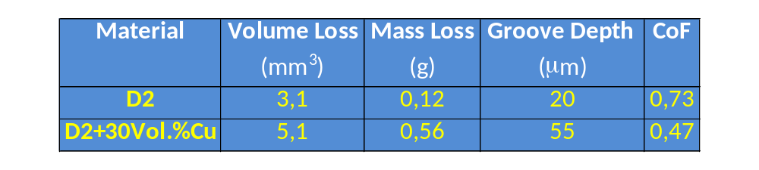
Wear Resistance / Coefficient of Friction (CoF) (cont.)
The wear resistance of the HTC composite is much lower than the HIPed D2 (higher volume and mass losses, deeper groove);
The D2+30Vol.%Cu material has a lower CoF, which is probably due to the presence of copper (soft metals like Cu are sometimes used as solid lubricants)

Slide 20
  Conformal-Cooled, Hemispherical Toolings
The processing of conformal-cooled, hemispherical toolings followed similar processing steps and HIP cycles as were used for HTC tool steel processing:
  Tooling made of D2 only was HIPed at 1100°C;
  Toolings including copper were HIPed at 1000°C.
The use of a copper core in two of the three designs enabled to HIP-clad a 2-mm-thick layer of either D2 or D2+30Vol.%Cu on the said core to improve cooling;

Slide 21

  Conformal-Cooled, Hemispherical Toolings (cont.)
Schematic cross-sections of canister with core and powder used to prepare HIP-clad toolings:
2 mm
Powder
HIP & Machine
Solid Cu Core
Solid Cu Core
304L Canister

Slide 22
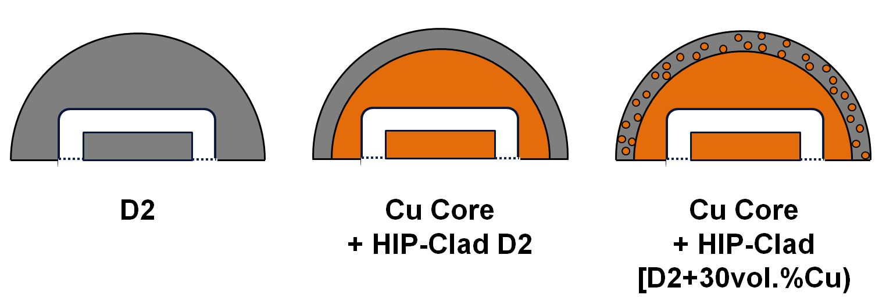
  Conformal-Cooled, Hemispherical Toolings (cont.)
Schematic cross-sections of the dome part of toolings processed by HIP:
Water-Cooling Channels
D2+Cu
D2
D2
Cu
Cu

Slide 23
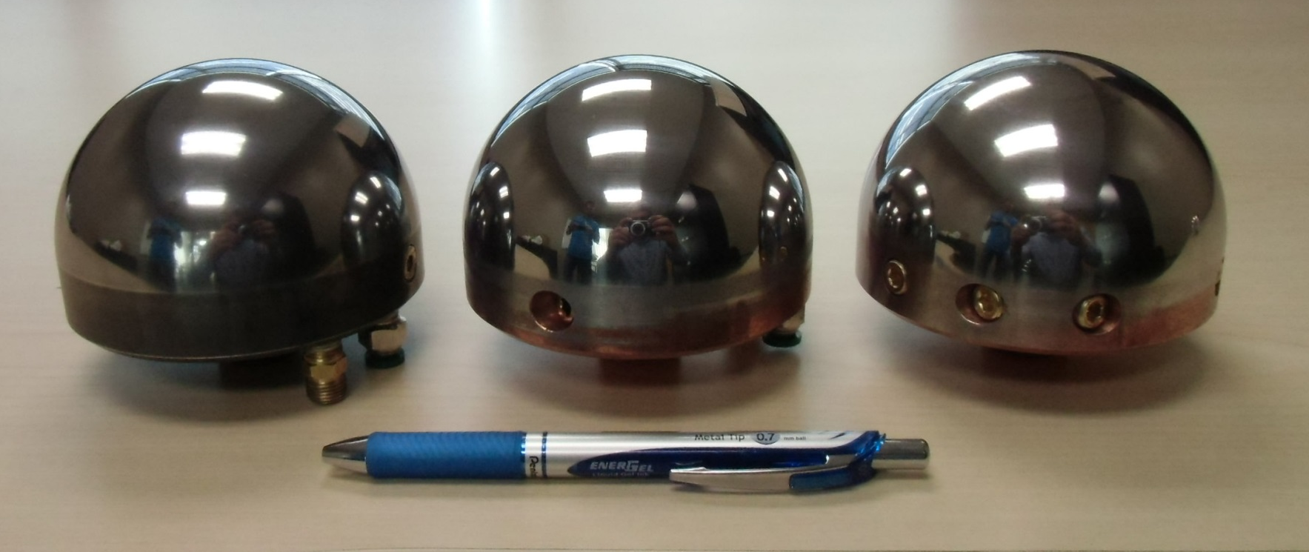
  Conformal-Cooled, Hemispherical Toolings (cont.)
Hemispherical toolings processed by HIP:
D2
Cu Core
+ HIP-Clad D2
Cu Core
+ HIP-Clad [D2+30vol.%Cu)

Slide 24
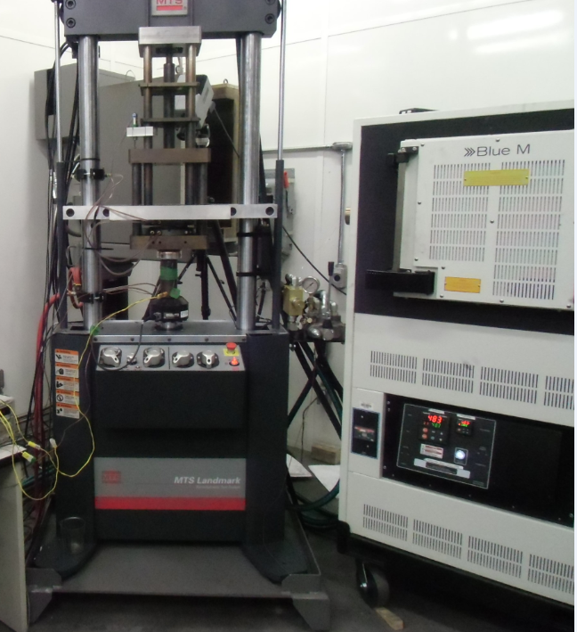
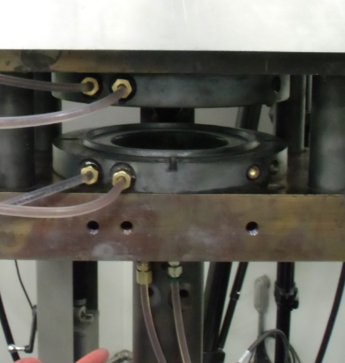

Hot Stamping of Aluminum Sheets with HIPed Toolings
Hot Nakazima lab-scale test setup (490°C)
Hot stamping of high strength AA7xxx aluminium alloy sheets was carried out in the following way :
  Aluminium blanks are solutionized
  A blank is transferred to the press
  Tooling moves up and blanks are stamped
  Die closes and blanks are quenched
  Blanks are removed and the tooling cools

Slide 25
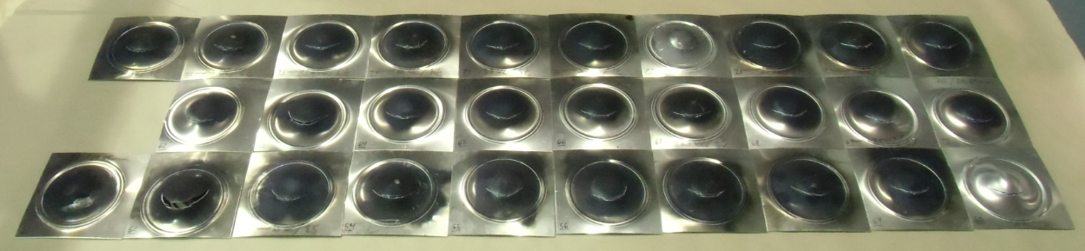
Hot Stamping of Aluminum Sheets with HIPed Toolings (cont.)
The three different hemispherical toolings were tested;
Ten (10) hot stamping tests per tooling;
Punch cooling time of 7 min. between each test;
Three thermocouples were installed in each punch to measure temperature close to the contact surface.
All tested specimens are identical which shows a good repeatability from one stamping to another

Slide 26
Hot Stamping of Aluminum Sheets with HIPed Toolings (cont.)
Hot Stamping Tests Results
  Three curves corresponding to three thermocouples per tooling;
  Heating-cooling curves are presented for the last stamping test of each batch;
  D2 temperature results are used as reference for the two other punches;
  Temperature derivatives which represent heat transfer and cooling rate are used for the analysis;

Slide 27
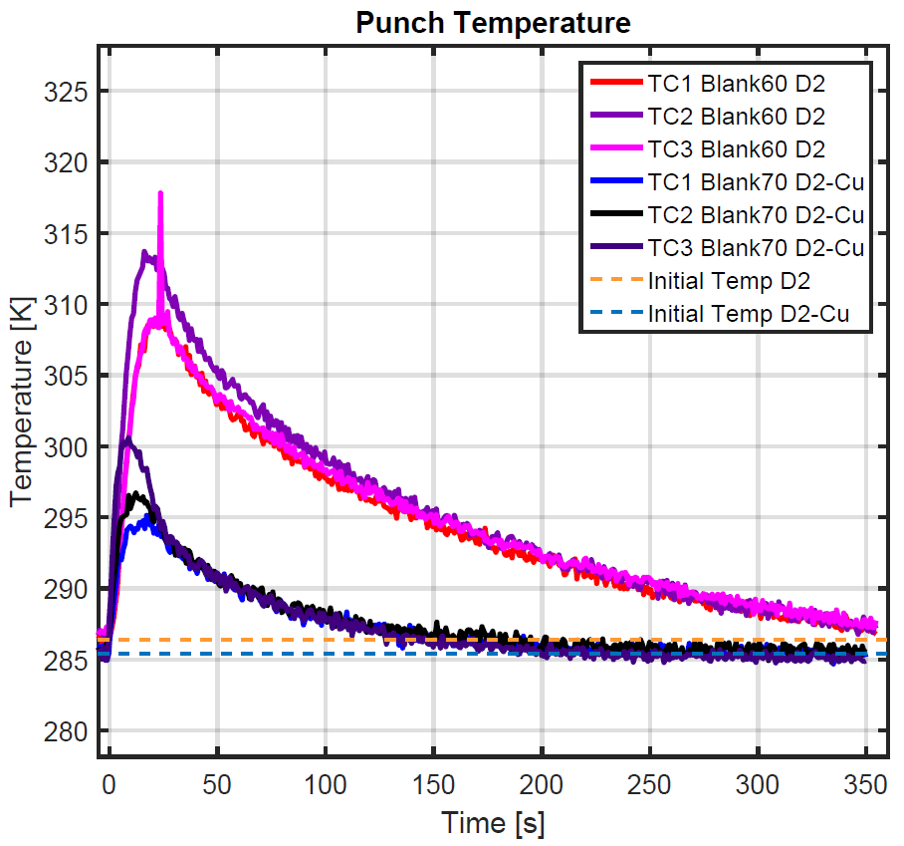
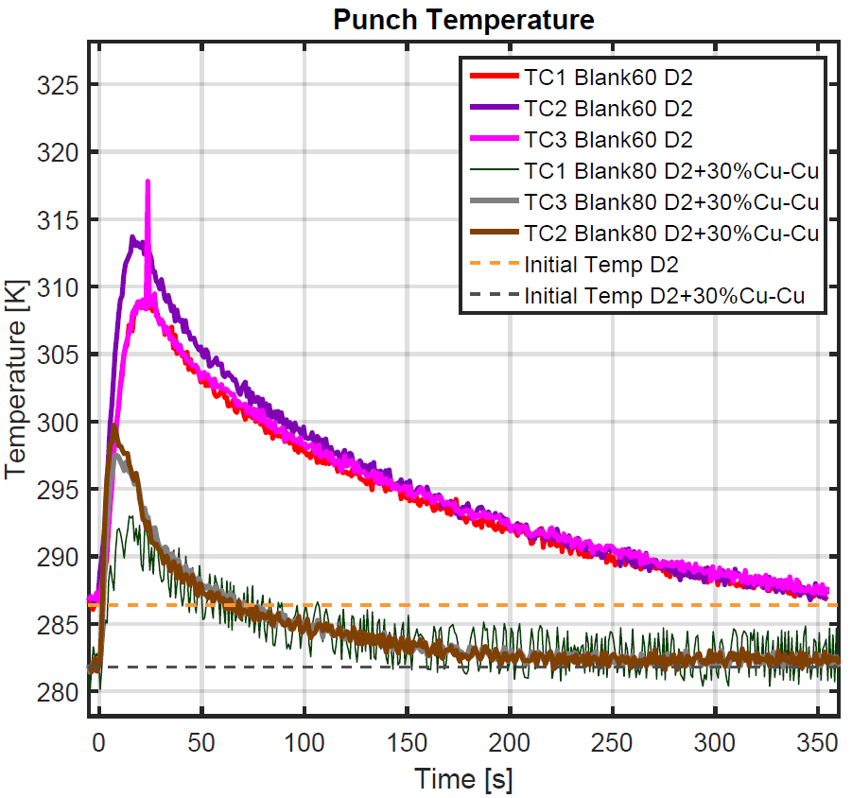
Hot Stamping of Aluminum Sheets with HIPed Toolings (cont.)
D2
D2
D2 on Cu
HTC on Cu

Slide 28
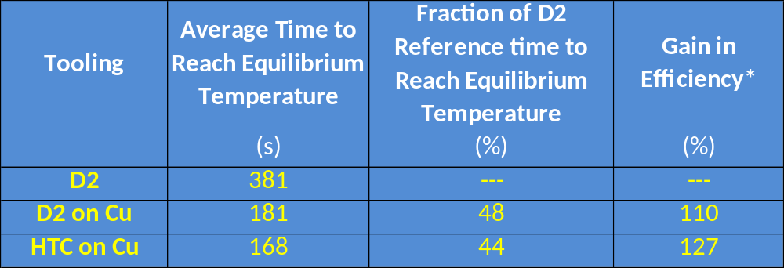
Hot Stamping of Aluminum Sheets with HIPed Toolings (cont.)
For the three toolings, the time required to reach punch temperature equilibrium after hot stamping was determined:
  *Gain in efficiency = [(cycle time D2/cycle time new material) -1] x 100

Slide 29
Conclusions
A HTC composite hot work tooling material was successfully processed by HIP:
  Its thermal properties were improved over the D2 reference, while its mechanical properties were lower, except for an improvement in CoF;
  Work on an optimal HTC composite should continue;

Slide 30
Conclusions (cont.)
Conformal-Cooled, Hemispherical Toolings were manufactured by HIP and used for hot stamping trials:
  Performance was as follows:
  HTC on Cu > D2 on Cu > D2
  Gains in efficiency were of 127% for HTC on Cu and 110% for D2 on Cu;
A thin, HIP-clad layer of HTC tool steel on a conformal-cooled copper core significantly contributes to productivity increase and should be considered for automotive sheet forming.

Slide 31
Thank you
CONTACT
Maxime Gauthier
Senior Research Officer
Automotive and Surface Transportation Research Centre
National Research Council Canada
75 de Mortagne Blvd, Boucherville (Québec)
Canada, J4B 6Y4
Maxime.Gauthier@cnrc-nrc.gc.ca

