Slide 1
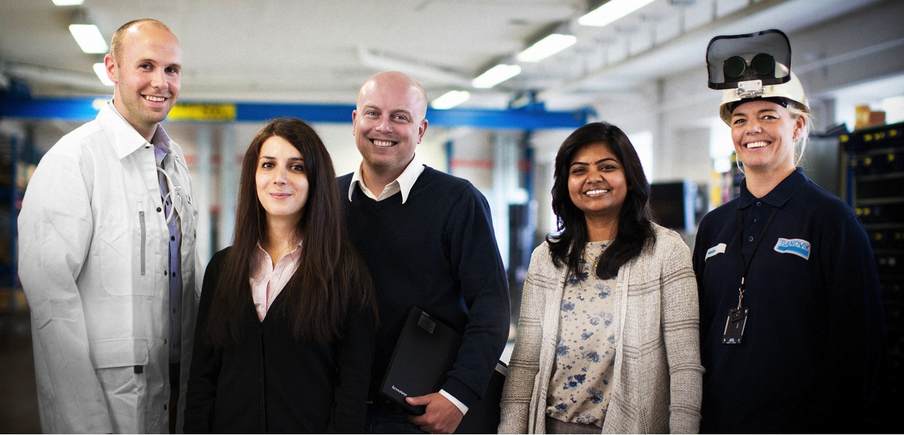

Oxygen content in PM HIP 625 - its effect on toughness
Notes:
Sandvik är en högteknologisk verkstadskoncern med avancerade produkter och en världsledande position inom utvalda områden.

Slide 2
Oxygen content in PM HIP 625 - its effect on toughness
Fredrik Meurling Tomas Berglund
Senior Research Engineer Technical Marketing
Powder R&D Sandvik Powder Solutions Sandvik Materials Technology

Slide 3

Presentation Outline
Introduction
  Introduction
Experimental
  Material and manufacturing
  Material testing and characterization
Results
  Chemistry
  Microstructure
  Mechanical properties
  Oxygen content
Conclusions

Slide 4
Introduction
Powder metallurgical materials are sensitive to oxygen, especially in HIP
Many studies have investigated the influence of oxygen on mechanical properties
  General consensus is that it has a strong influence, especially on impact toughness
There is a trend of setting lower and lower limits on oxygen content in specifications
  More costly and might not have the desired effect on properties

Slide 5
Presentation Outline
Introduction
  Introduction
Experimental
  Material and manufacturing
  Material testing and characterization
Results
  Chemistry
  Microstructure
  Mechanical properties
  Oxygen content
Conclusions

Slide 6
Experimental
Materials
Process and powder handling parameters was varied to give different distribution of oxygen in the powder
Vacuum induction melted
Argon and Nitrogen gas atomized powders was studied
All powder sieved at -250µm
Consolidated at 1150ºC, 1000bar for 3 hours
  Capsule size 180x70x50mm
Tested in the as HIPed condition

Slide 7
Experimental
Material testing
Microstructure characterized using LOM and SEM/EDS
Mechanical testing was performed at room temperature using
  ISO 6892-1:2009 for tensile testing
  ISO 148-1:2009 for impact testing
Fracture surfaces on charpy specimens was characterized using SEM/EDS
Oxygen content was measured on as HIPed material and 4 size fractions of powder

Slide 8
Presentation Outline
Introduction
  Introduction
Experimental
  Material and manufacturing
  Material testing and characterization
Results
  Chemistry
  Microstructure
  Mechanical properties
  Oxygen content
Conclusions

Slide 9
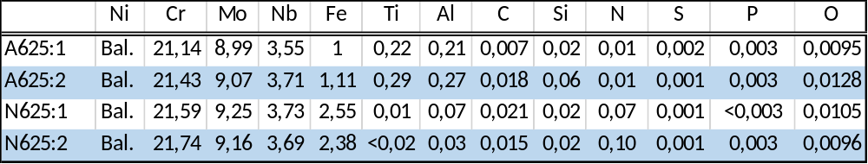
Results
Chemical composition
Two main differences
  N atomized powders contain lower amounts of strong nitride formers like Ti and Al
  N atomized powders have higher nitrogen content
A625:2 has a higher C-content compared to A625:1

Slide 10
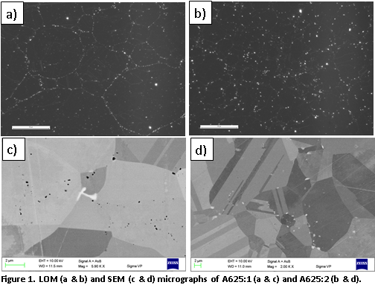
Results
Microstructure of Ar-atomized powders
A625:1
  Pronounced PPB oxide network
  Almost pure Al-oxides in the network
  Some single C, Mo, Cr and Nb rich particles are found in the bulk
A625:2
  Less pronounced PPB oxide network
  Almost pure Al-oxides along PPBs but some contain Ti
  C, N, Mo, Cr and Nb rich particles along grain boundaries but also in the bulk (more than A625:1)

Slide 11
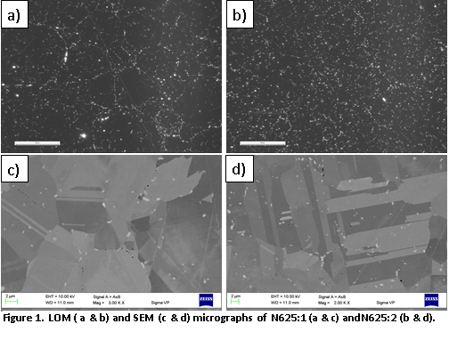
Results
Microstructure of N-atomized powders
Both materials contain more nitrides than Ar-atomized material
N625:1
  Pronounced PPB oxide network
  Almost pure Al-oxides in the network
  Some single N, Mo, Cr and Nb rich particles are found in the bulk
N625:2
  Much less pronounced PPB oxide network but more oxides inside the particles
  Almost pure Al-oxides along PPBs
  N, Mo, Cr and Nb rich particles along grain boundaries but also in the bulk

Slide 12
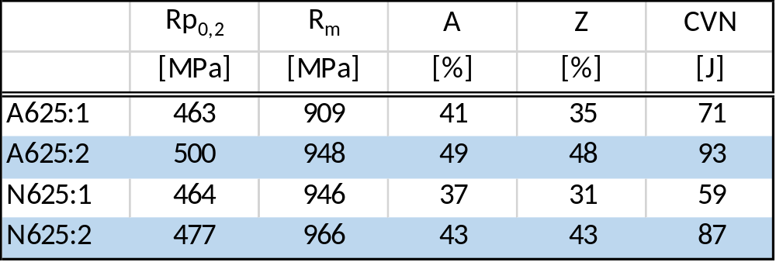
Results
Mechanical properties
All materials have similar strength, ductility and toughness
There is a correlation between ductility and toughness
  Not always the case
A625:2 has higher strength than A625:1
  Higher C-content

Slide 13
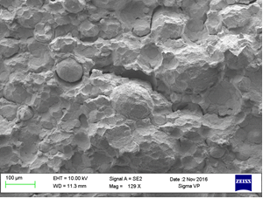
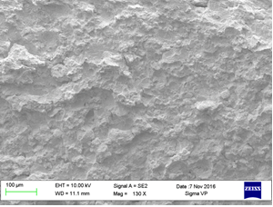
Results
Impact toughness testing
Fracture in A625:1 has progressed along PPBs
  Especially on larger particles
  Exposed particles surfaces contain dimples with aluminum rich oxide particles containing some Ti
Fracture in A625:2 seem at first to primarily transgranular
  Higher magnification reveals a combination of PPB guided fracture and trans granular
  In the PPB fracture the dimples contain aluminum rich oxide particles containing some Ti
  NbC precipitates are also found in the dimples but to much lower extent than oxide particles

Slide 14
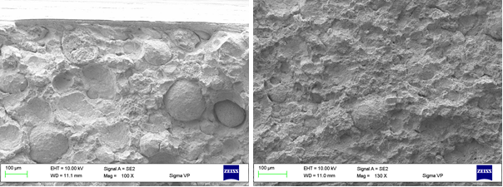
Results
Impact toughness testing
Fracture in N625:1 has progressed along PPBs
  Uncovered particles surfaces contain a high amount dimples with aluminum rich oxide particles
Fracture in N625:2 combination intragranular and transgranular fracture
  Trans granular fracture guided by Nb, Cr and Mo rich particles
  Intragranular fracture is uncommon but when it occurs it’s guided by nitrides and PPB alumina particles and along larger powder particles

Slide 15
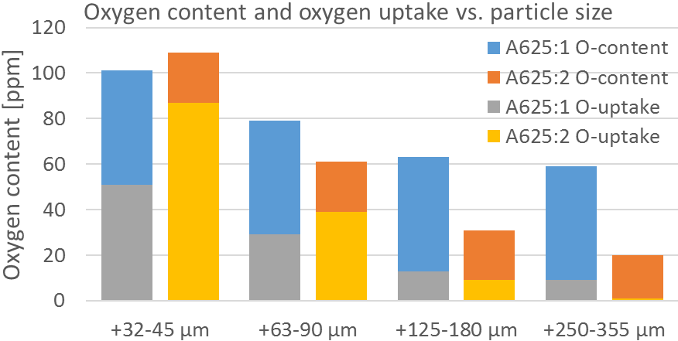
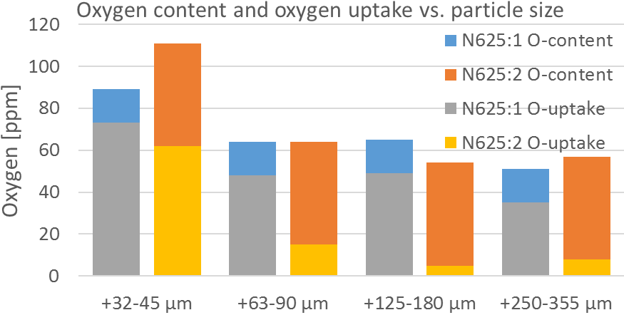
Results
Oxygen content
As expected oxygen content is higher in the finer particle size fractions
A625:2 has higher oxygen uptake in smaller size fractions
The materials with higher impact toughness has lower oxygen uptake in the coarser size
  O-uptake is oxidation of particles
  PPB guided fracture mainly on larger particles
  A625:2 has a larger d50 i.e. more of low oxygen containing particles

Slide 16
Presentation Outline
Introduction
  Introduction
Experimental
  Material and manufacturing
  Material testing and characterization
Results
  Chemistry
  Microstructure
  Mechanical properties
  Oxygen content
Conclusions

Slide 17
Summary and Conclusions
Higher oxygen content material can have higher impact toughness
Higher surface oxygen content on powder particles has much more adverse effect on impact toughness than bulk oxygen
Fracture in material with a pronounced PPB network occurs along the PPBs with a lower impact toughness consequently
Fracture in material with lower surface and higher bulk oxygen content occurs trans granular with a higher impact toughness consequently
Results indicate that oxidation of coarse powder particles has a larger effect than oxidation of finer particles

Slide 18
Summary and Conclusions
Higher oxygen content material can have higher impact toughness
Higher surface oxygen content on powder particles has much more adverse effect on impact toughness than bulk oxygen
Fracture in material with a pronounced PPB network occurs along the PPBs with a lower impact toughness consequently
Fracture in material with lower surface and higher bulk oxygen content occurs trans granular with a higher impact toughness consequently
Results indicate that oxidation of coarse powder particles has a larger effect than oxidation of finer particles

Slide 19
Summary and Conclusions
Higher oxygen content material can have higher impact toughness
Higher surface oxygen content on powder particles has much more adverse effect on impact toughness than bulk oxygen
Fracture in material with a pronounced PPB network occurs along the PPBs with a lower impact toughness consequently
Fracture in material with lower surface and higher bulk oxygen content occurs trans granular with a higher impact toughness consequently
Results indicate that oxidation of coarse powder particles has a larger effect than oxidation of finer particles

Slide 20
Summary and Conclusions
Higher oxygen content material can have higher impact toughness
Higher surface oxygen content on powder particles has much more adverse effect on impact toughness than bulk oxygen
Fracture in material with a pronounced PPB network occurs along the PPBs with a lower impact toughness consequently
Fracture in material with lower surface and higher bulk oxygen content occurs trans granular with a higher impact toughness consequently
Results indicate that oxidation of coarse powder particles has a larger effect than oxidation of finer particles

Slide 21
Summary and Conclusions
Higher oxygen content material can have higher impact toughness
Higher surface oxygen content on powder particles has much more adverse effect on impact toughness than bulk oxygen
Fracture in material with a pronounced PPB network occurs along the PPBs with a lower impact toughness consequently
Fracture in material with lower surface and higher bulk oxygen content occurs trans granular with a higher impact toughness consequently
Results indicate that oxidation of coarse powder particles has a larger effect than oxidation of finer particles

Slide 22
Thank You for Your attention!
Tomas Berglund
Sandvik Powder Solutions
AB Sandvik Materials Technology
Phone: +46 26 65408
Mailto:tomas.berglund@sandvik.com
Fredrik Meurling
R&D, Powder Technology
AB Sandvik Materials Technology
Phone: +46 26 263839
Mailto: fredrik.meurling@sandvik.com

