Slide 1

PRECIPITATION OF Y-Ti-O NANOPARTICLES DURING THE HIP CONSOLIDATION OF GAS ATOMIZED FERRITIC POWDERS
Sydney, 6th December 2017
I. Iturriza
Additive Manufacturing and Laser Group. Materials and Manufacturing Division. Ceit-IK4
Notes:
ooo

Slide 2

PRECIPITATION OF Y-TI-O NANOPARTICLES DURING THE HIP CONSOLIDATION OF GAS ATOMIZED FERRITIC POWDERS
D. Pazos¹, N. Ordás¹, E. Gil¹, V. de Castro², T. Leguey², A. Anspoks³, J. Purans³ , P. Fernández⁴, I. Iturriza¹*
¹Ceit-IK4 and Tecnun (Universidad de Navarra), Manuel de Lardizábal 15, 20018, San Sebastián
²University Carlos III Madrid, Avda. de la Universidad 30, 28911 Leganés, Madrid
³Institute of Solid State Physics, University of Latvia, Kengaraga street 8, 1063 Riga, Latvia
⁴Ciemat. National Fusion Laboratory. Avda. Complutense 40, 28040 Madrid, Spain

Slide 3
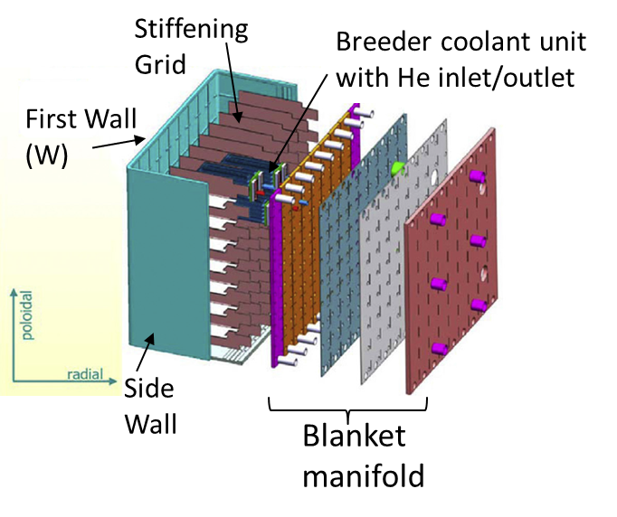
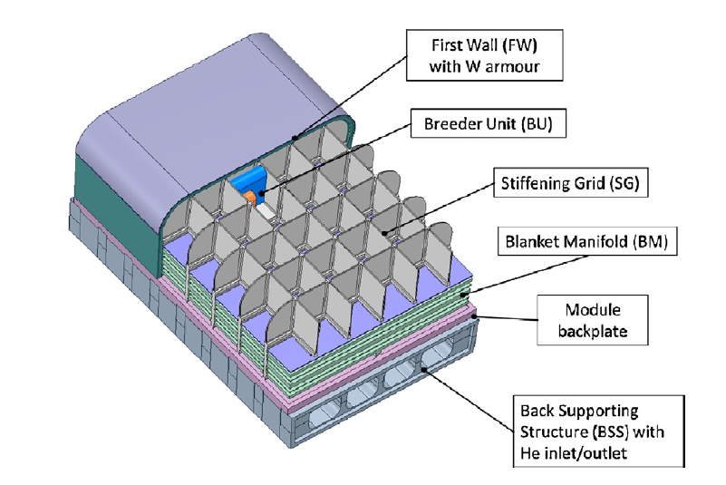
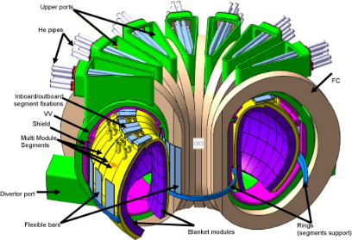
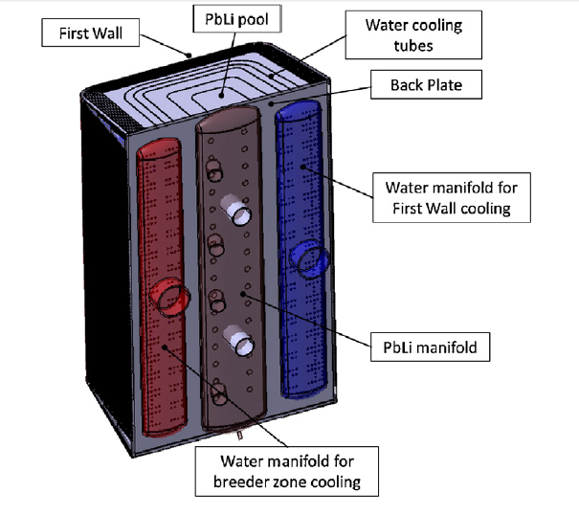
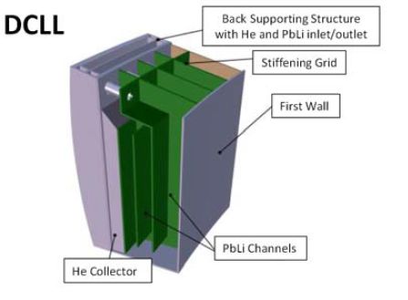
INTRODUCTION
ODS FS as structural materials in future fusion applications
DEMO
EU Blanket designs
HCLL (He Cooled Lithium-Lead) blanket
HCPB (He Cooled Pebble beads) blanket
ODS FS
  Plates supporting the plasma facing material (W tiles)
  Intermediate material between W tiles and structural EUROFER (RAFM, reduced-activation ferritic-martensitic steel)
WCLL (Water Cooled Lithium-Lead) blanket
DCLL (Dual Coolant Lithium-Lead) blanket
Fusion Engineering and Design 109–111 (2016) 1637–1643

Slide 4
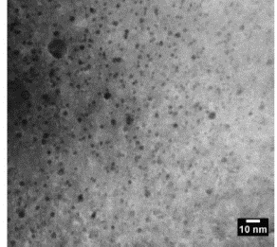
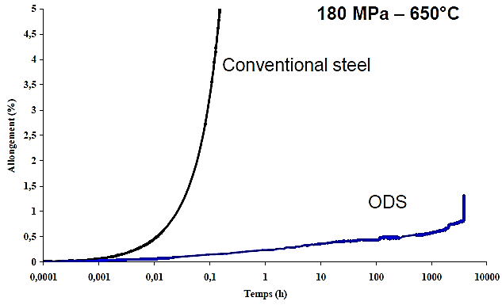
INTRODUCTION
ODS FS as structural materials in future fusion applications
Basic requirements:
  High density dispersion of stable nanometric precipitates and dislocation structure to provide high creep strength, up to 750 °C. Low DBTT temperature
  Benefits:
  Trapping of He into fine scale bubbles to prevent void swelling and GB embrittlement
  Operation temperature above displacement damage regime (> 0.3-0.4 Tm), no radiation hardening or embrittlement
Divertor

Slide 5
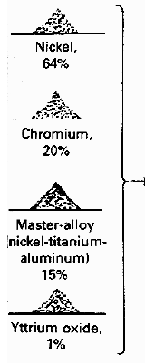

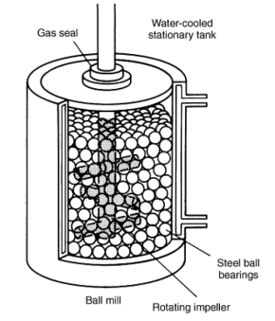


INTRODUCTION
Conventional route to produce ODS steels
Fe
Mechanical alloying
Steel
can
HIP
Thermal treatment
Hot rolling
Ball mill
Recrystallization
Prealloyed Fe-Cr-W-Ti powder
Cr
OBJECTIVE: To develop an alternative route able to face those challenges
+
Or
W
Machining
+
Y₂O₃
Ti
Final product
Y₂O₃
↑ cost of mechanically alloyed powders uniform alloying requires long process time
Local heterogeneities
Batch-to-batch ≠ composition
Contamination from milling media & air (C, N, O)
  Current challenges:
  High variability in properties
  Small, lab-scale batches available
  Low fracture toughness at RT
Issues associated with MA

Slide 6
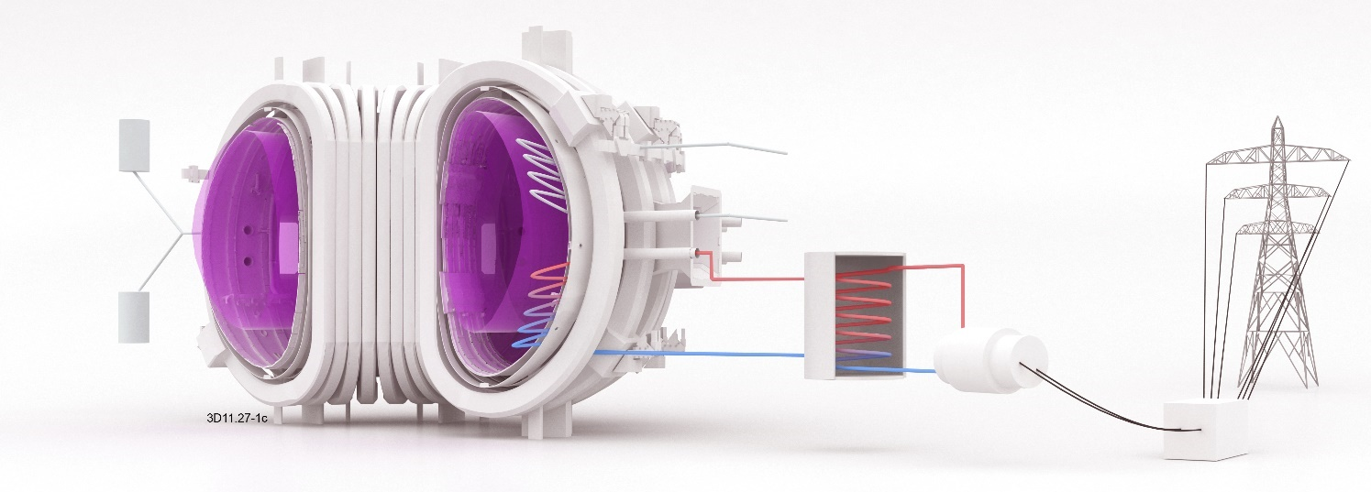
STARS route
PROPOSAL

Slide 7
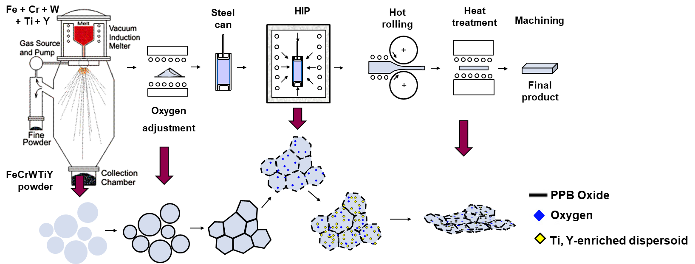
STARS route: Surface Treatment of gas Atomized powder followed by Reactive Synthesis
Atomized powder: Ti & Y in solid solution
Powder oxidation: ultra-thin Cr- & Fe-rich oxide layer
HIP at high temperature:
    Dissociation of metastable Cr- & Fe-rich oxides
    O diffusion from Prior Particle Boundaries
    Formation of Y, Ti-rich oxide dispersions

Slide 8
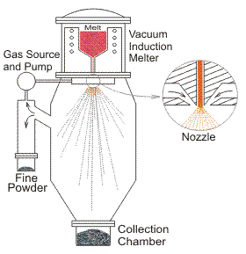

STARS route: Surface Treatment of gas Atomized powder followed by Reactive Synthesis
STARS route vs Mechanical Alloying
Fe + Cr + W + Ti + Y
Prealloyed Fe-Cr-W-Ti powder
Oxygen adjustment
Y₂O₃
FeCrWTiY
powder
ADVANTAGES
CHALLENGES
Higher processing rate of powder
Lower contamination levels
No local heterogeneities in composition
Control of Y in atomized powder → Industrializable process?
Control of oxygen uptake to allow complete dissociation of metastable oxides and Y and Ti reaction
Density and distribution of ODS phase

Slide 9
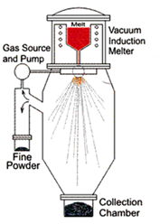

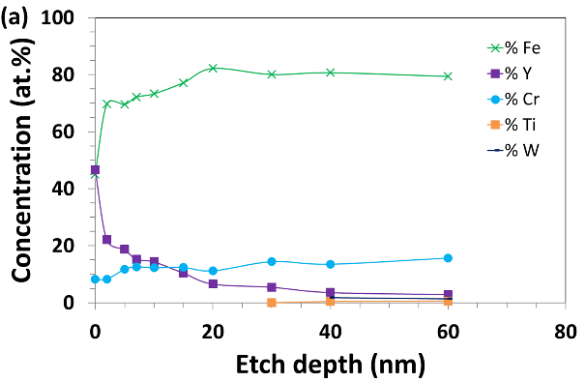
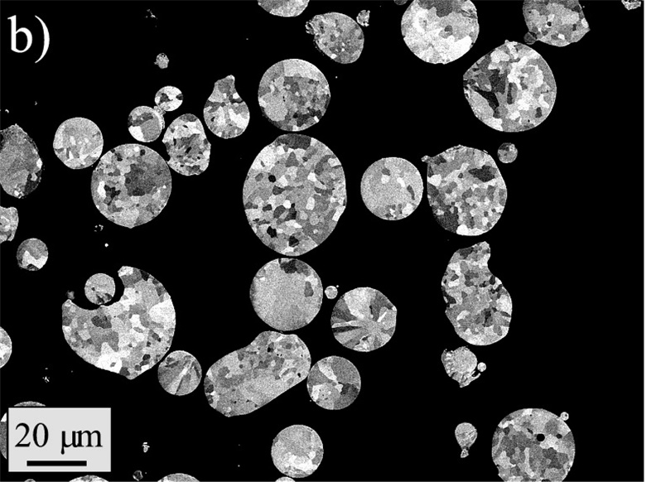
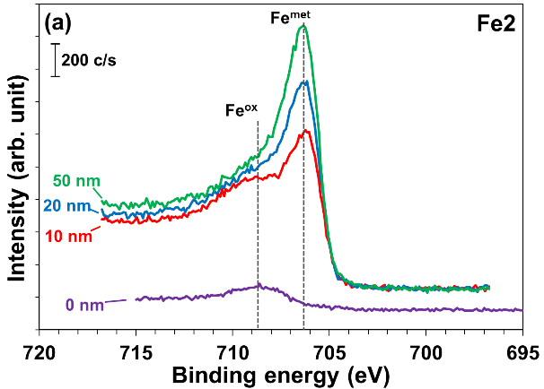
STARS: gas atomization of Fe-14Cr-2W-0,3Ti-0,23Y
Composition (wt. %)
Fe | Cr | W | Ti | Y
Bal. | 13,9-14,1 | 1,9-2,0 | 0,27-0,3 | 0,20-0,23
Lab. Scale (<3 kg)
Industrial Scale
  Spherical powder particles
  Fine control of composition, at laboratory and industry
  No metallic iron in the surface, Y segregation

Slide 10
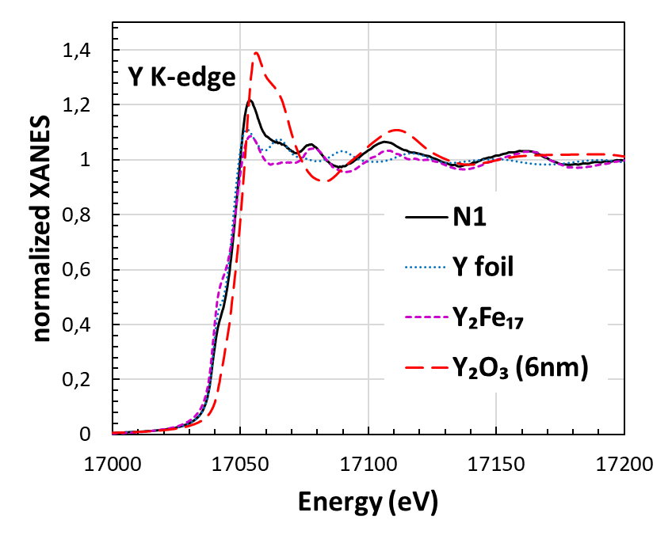
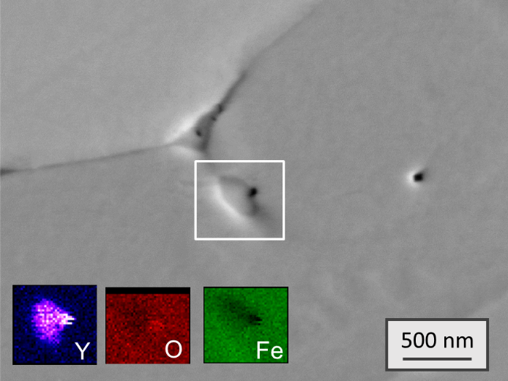
STARS: gas atomization of Fe-14Cr-2W-0,3Ti-0,23Y
Composition (wt. %)
Fe | Cr | W | Ti | Y
Bal. | 13,9-14,1 | 1,9-2,0 | 0,27-0,3 | 0,20-0,23
How is the Y?
as-atomized
  SEM & XAS: Y remains metallic inside particles (probably Fe-Y), available to form Y-Ti-O nanoparticles
XAS: X-ray Absorption Spectroscopy. Performed with synchrotron radiation (Soleil and Alba)
XANES: X-ray Absorption Near Edge Structure → metallic, oxide, carbide…
X-ray absorption near edge structure (XANES), also known as near edge X-ray absorption fine structure (NEXAFS), is a type of absorption spectroscopy that indicates the features in the X-ray absorption spectra (XAS) of condensed matter due to the photoabsorption cross section for electronic transitions from an atomic core level to final states in the energy region of 50–100 eV above the selected atomic core level ionization energy, where the wavelength of the photoelectron is larger than the interatomic distance between the absorbing atom and its first neighbour atoms

Slide 11
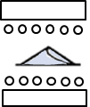
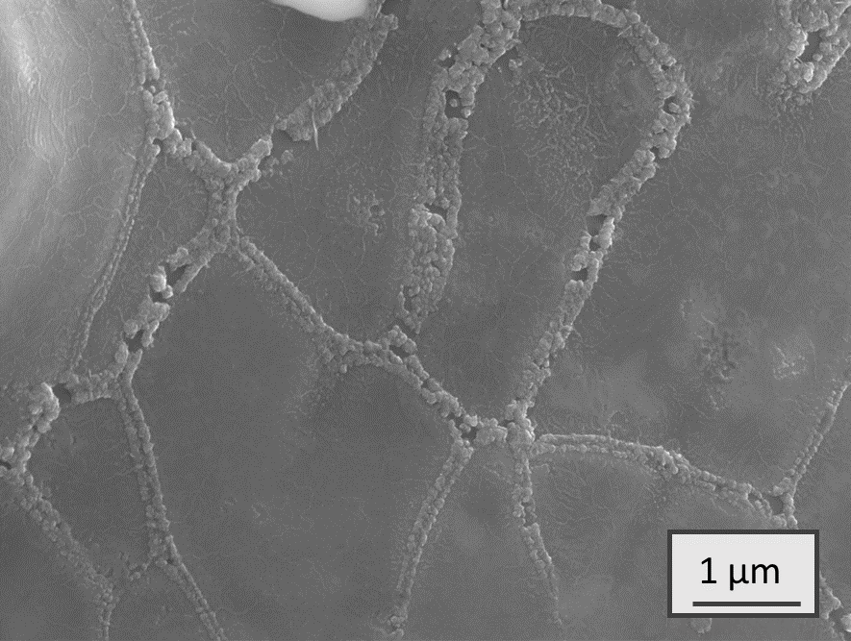
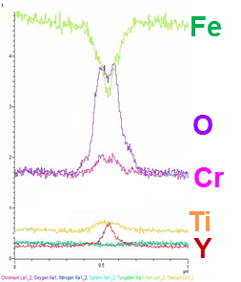
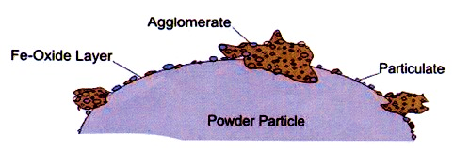
STARS: surface oxidation of powder
  Oxidation at low temperature → Control of oxygen gain
  Oxygen uptake tailored to specific composition
  Fe Oxide layer thickness 7,5 → 18,5 nm
  Y remains metallic inside particles, oxidized at the surface.
  Nanometric metastable Cr₂O₃ + Fe₂O₃ oxide layer provides oxygen to form Y-Ti-O nanoparticles during HIPping
Fe₂O₃
Cr₂O₃ +Y₂O₃
Detailed XPS spectra of Cr & Fe of oxidized powder
L. Nyborg and E. Hryha, “Surface Oxides on Gas and Water Atomized Steel Powders,” Advances in Powder Metallurgy & Particulate Materials, vol. 2, pp. 153–161, 2014.

Slide 12
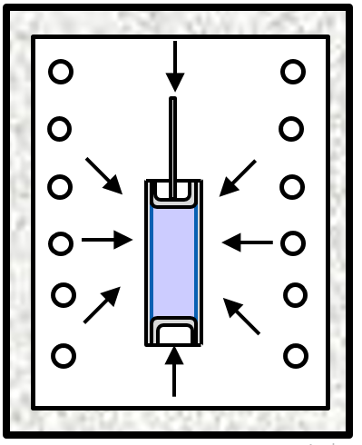
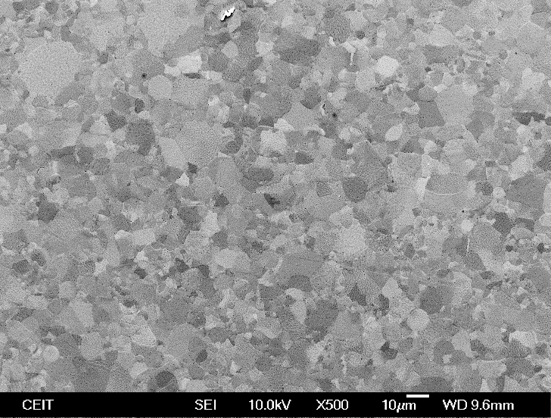
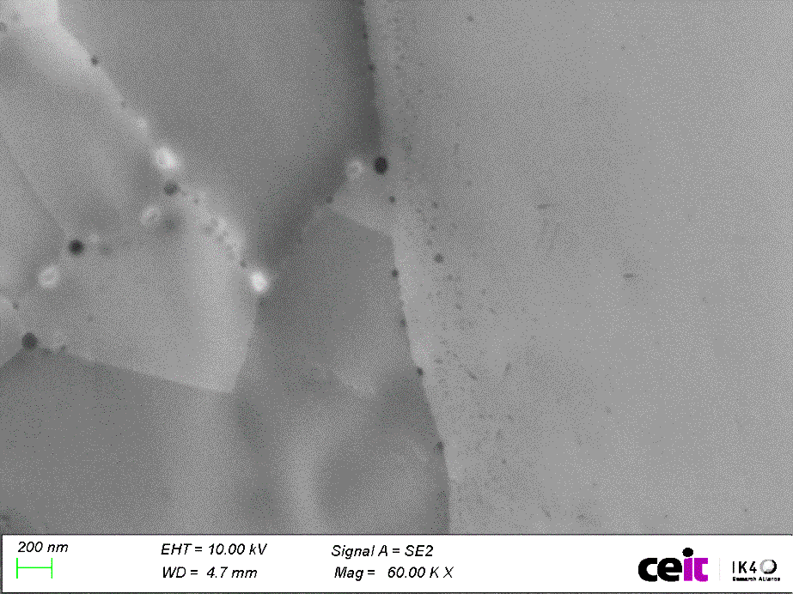
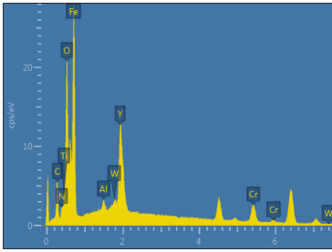
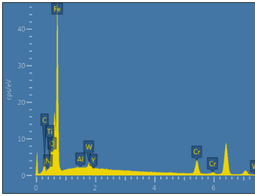
STARS: HIP and reactive synthesis of nanoparticles
HIP at high temperature
Effect of powder particle size
<20 µm, 1000 ppm Oxygen. HIP 1220 °C 2h
matrix
Y-Ti-O
NPs
Elem. | Wt%
Fe | 52,2
Y | 14,8
Cr | 10,3
O | 8,3
Ti | 7,1
C | 4,9
W | 2,0
Al | 0,5
Elem. | Wt%
Fe | 81,4
Cr | 13,4
C | 2,8
W | 1,9
O | 0,3
Ti | 0,2
Al | 0,0
Y | 0,0
Clean PPBs, free from metastable Cr-, Fe-rich oxides
Nanometric Y- and Ti-rich precipitation at GBs and inside grains
Y completely oxidized, but Ti remains in solid solution in matrix
Finer powder leads to finer and more homogeneous grain distribution and finer nanoparticles (NPs)
20-45 µm, 1000 ppm Oxygen. HIP 1220 ° C 2h

Slide 13
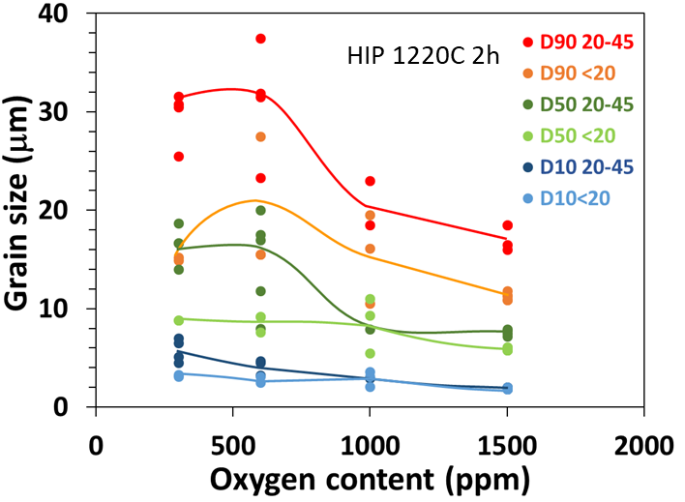
STARS: HIP and reactive synthesis of nanoparticles
HIP at high temperature
Effect of oxygen concentration
<20 µm, 600 ppm Oxygen. HIP 1220 °C 2h
Grain growth takes place when oxygen content is lower, incomplete Y oxidation
Minimum Oxygen concentration function of powder particle size and HIP parameters: >1000 ppm
Higher oxidation degree of powders avoids also abnormal grain growth

Slide 14
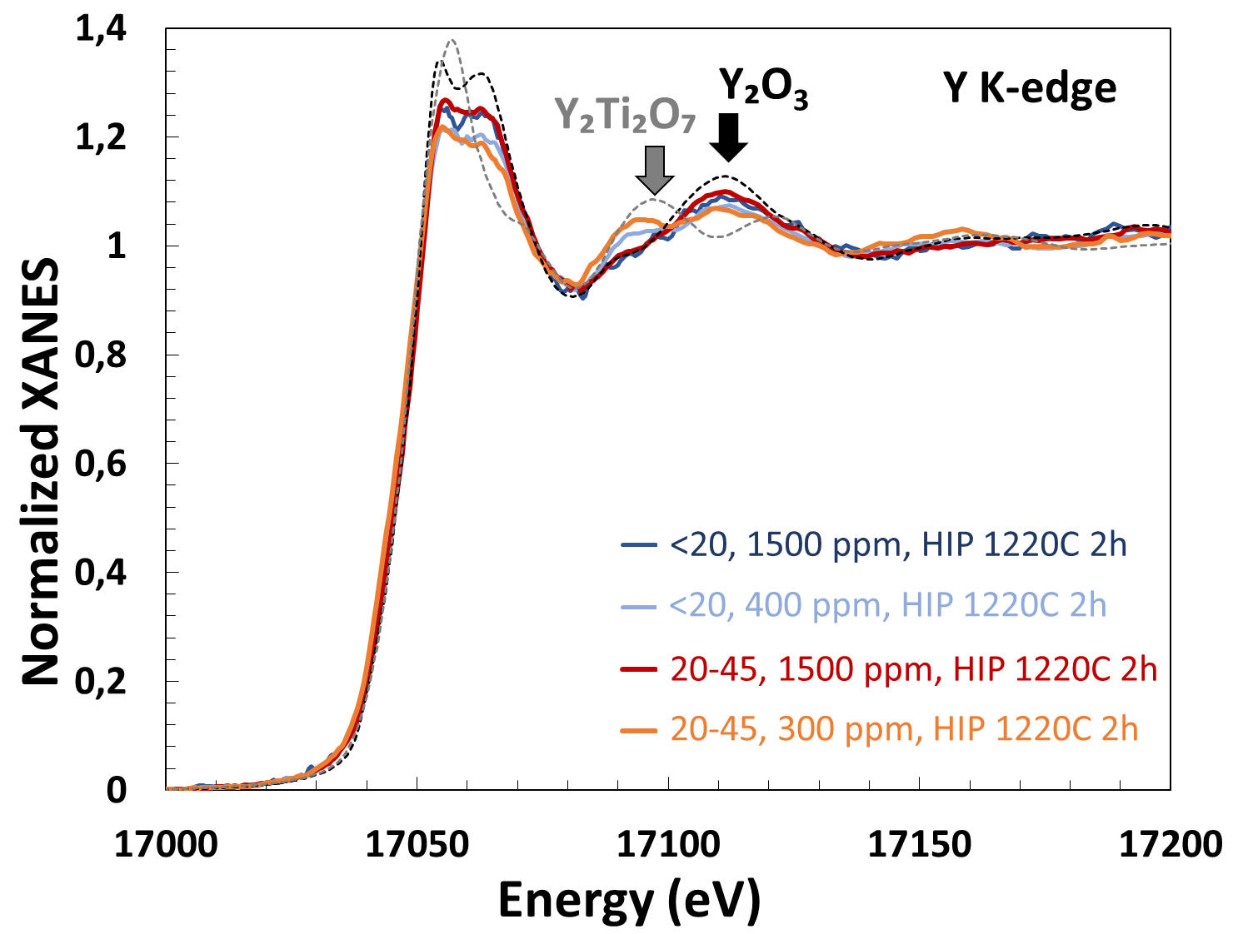
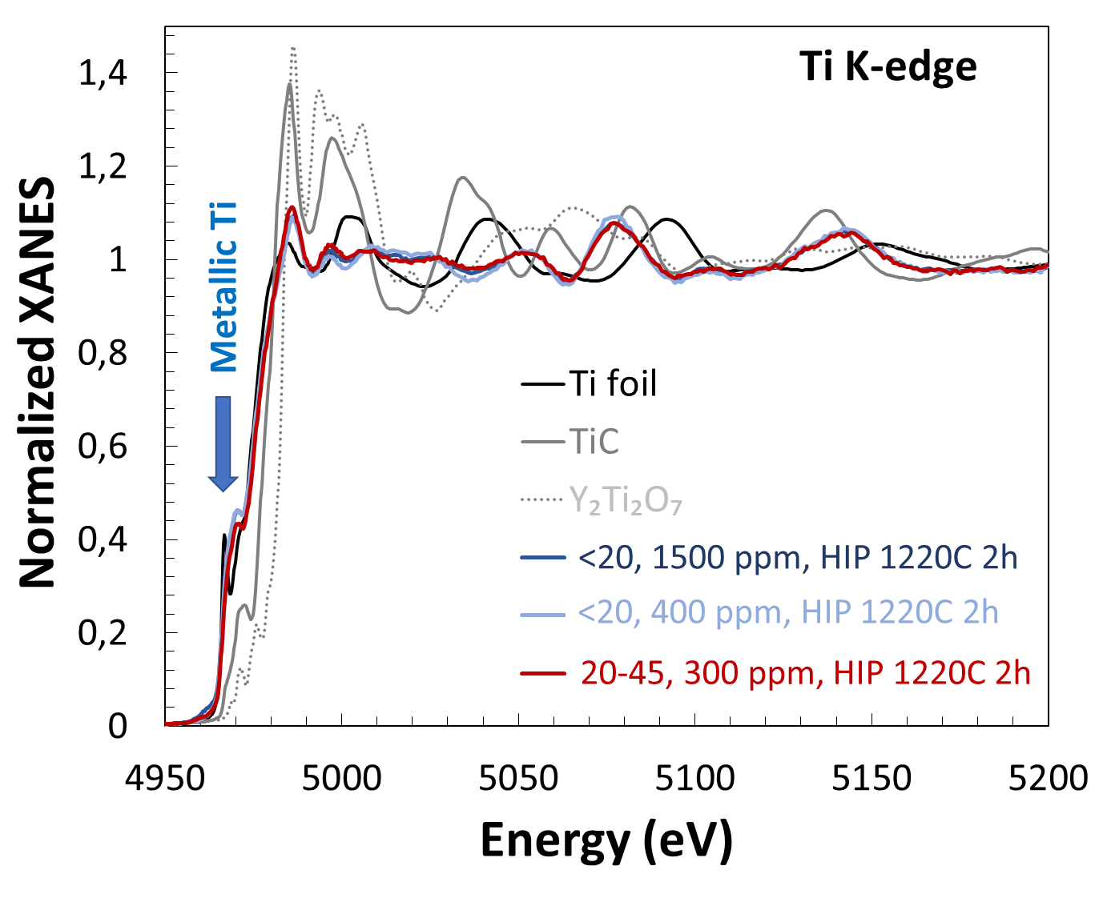
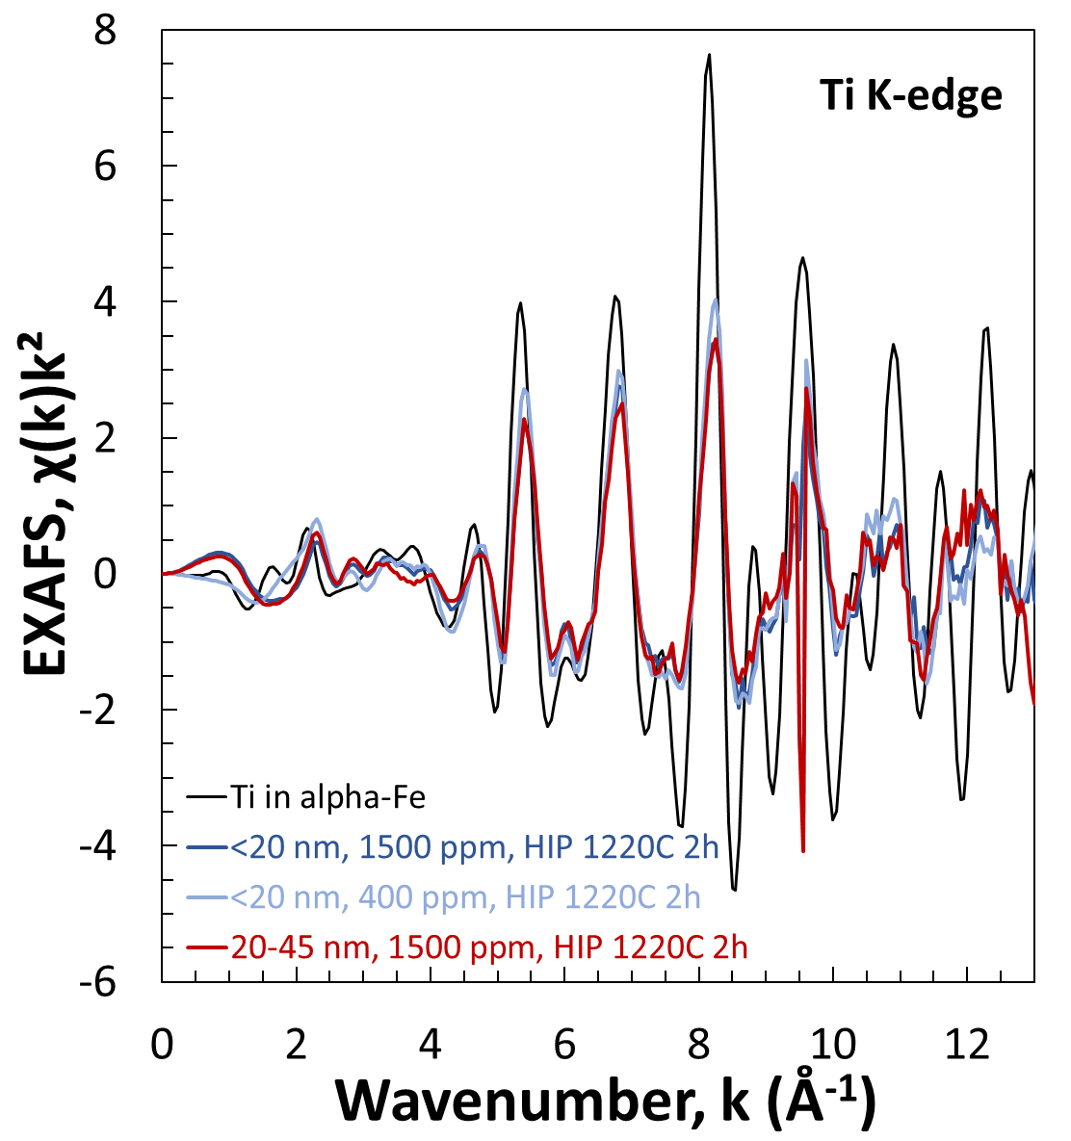
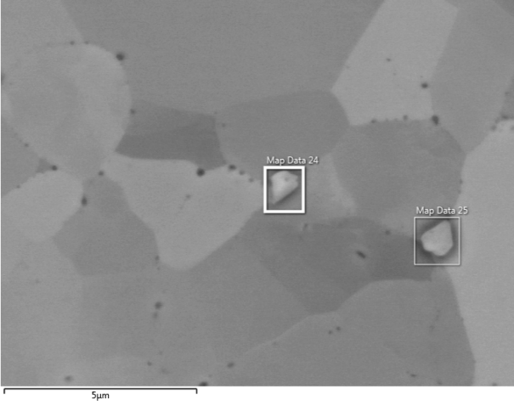
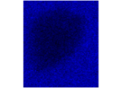
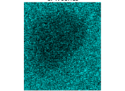
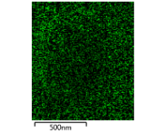
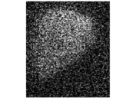
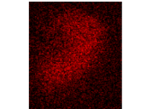
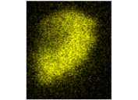
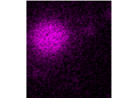
STARS: HIP and reactive synthesis of nanoparticles
HIP at high temperature
Oxide nanoparticles
W-,Ti-rich
Fe
Cr
O
C
YO_{x}, x<3/2
W
Ti
Y
High oxygen:
  Y-rich NPs are Y₂O₃
  Minor presence of Y-Ti-O (<10%)
Low oxygen:
  Y₂O₃ + partially oxidized Y
An important fraction of Ti remains metallic, probably in solid solution in the ferritic matrix
Minor presence of Ti-rich carbides or oxides
Notes:
X-ray absorption spectroscopy measurements were performed at room temperature using the multipole wiggler beam line BL22 – CLÆSS at the ALBA synchrotron radiation facility . X-ray radiation was produced by the storage ring operated in the top-up mode at the energy E=3.0 GeV and the maximum stored current I=110 mA. The synchrotron radiation was monochromatized using a pair of Si(111) or Si(311) crystals, and focused onto the sample by toroidal mirror. Collimating and focusing mirrors were responsible for harmonic rejection. X-ray absorption near-edge structure (XANES) and extended x-ray absorption fine structure (EXAFS) at the Ti, Fe and Y K-edges were analysed using conventional methodology and two software packages – EDA and Athena . Theoretical calculations of X-ray absorption spectra were performed using the FEFF8.5L codes

Slide 15
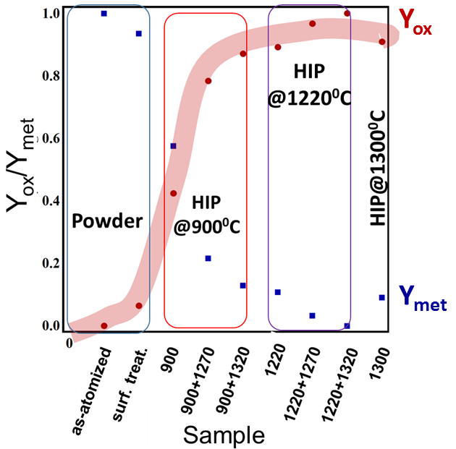
STARS: HIP and reactive synthesis of nanoparticles
Monitoring of Y oxidation through XAS
Linear combination analysis of the XANES spectra , using as-atomized powder and sample HIPped at 1220 °C + HT at 1320 ° C as standards
Notes:
Meter el IN718

Slide 16
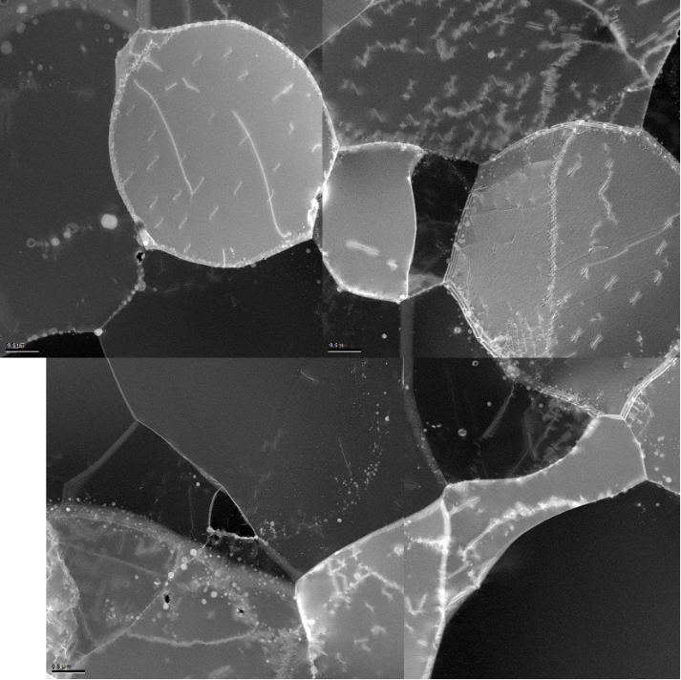
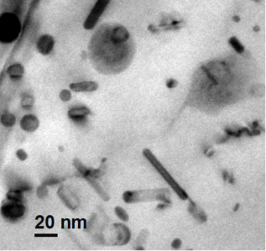
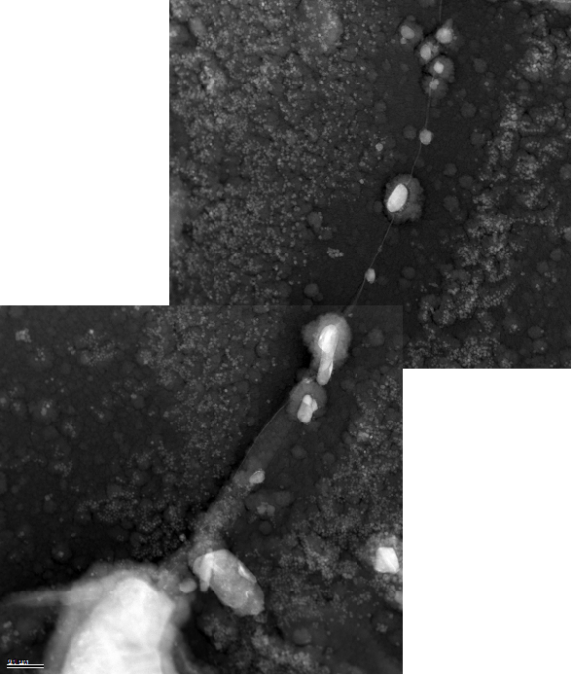
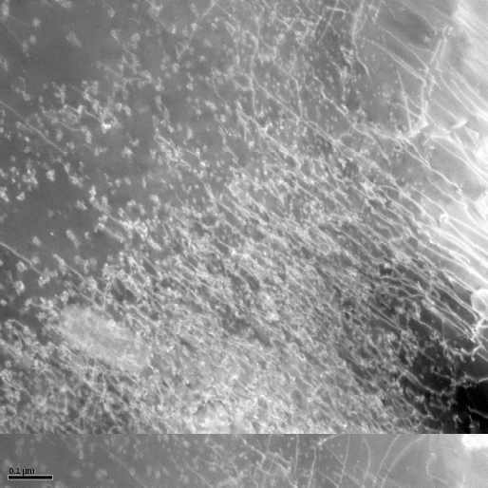
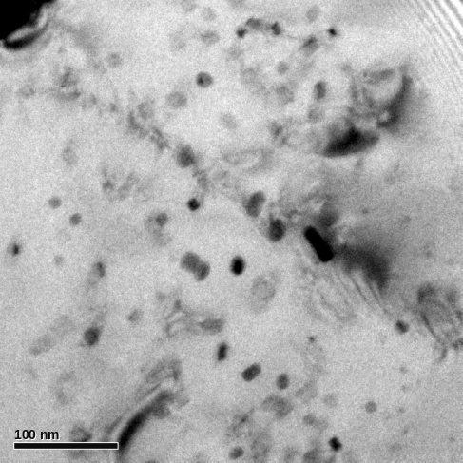
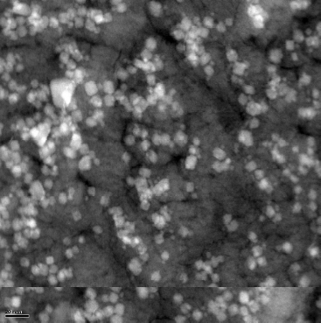
STARS: HIP and reactive synthesis of nanoparticles
HIP at high temperature
Oxide nanoparticles
100 nm
500 nm
100 nm
20 nm
Heterogeneous distribution: 10²⁰-10²² m⁻³
Preferentially at or close to GBs
Round morphology and elongated
Large and small NPs (10-20 nm ~100 nm)
Most NPs <20 nm (80%).
∼ 62% of NPs <10 nm.
Higher density in dislocation-rich areas
Ti remains partially in solid solution in ferrite
TMTs to increase the density of dislocations, preferential sites for the nucleation of ODS phase

Slide 17
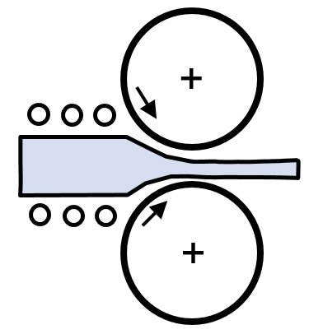
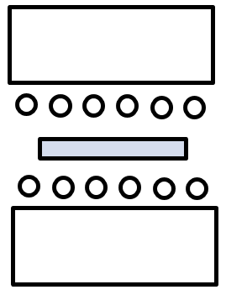
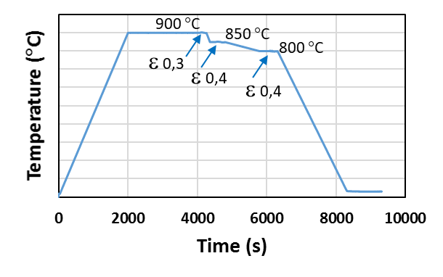
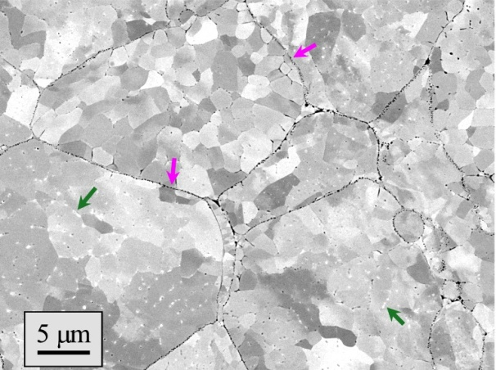




STARS: Thermo-Mechanical Treatment
Experimental simulation of TMTs
Consolidation at low temperature to maintain metastable oxides at PPBs
Deformation at low temperature to maintain metastable oxides and introduce high density of dislocations (preferential nucleation sites of NPs)
Heat treatment at high temperature to dissociate metastable oxides and precipitate NPS
HIP at low temperature
Example of deformation dilatometry schedule

Slide 18


STARS: Thermo-Mechanical Treatment
Experimental simulation of TMTs with dilatometry
True stress & strain calculated from experimental values and calculated instantaneous cross-sectional area.
1500 ppm
Strain hardening during 3rd pass, especially with finer powder and deformation at lower temperature.
700 °C
Samples were sectioned along their longitudinal axis, selecting the region corresponding to a maximum area fraction of nominal strain and reduced strain gradient.
750 °C
800 °C
800 °C
850 °C
900 °C

Slide 19


STARS: Thermo-Mechanical Treatment
Experimental simulation of TMTs with dilatometry
<20 µm, 1500 ppm oxygen. HIP 900 °C 2h. + Dil. 800 ε 1,1 + HT 1220 °C 2h
Abundant precipitation of extremely fine NPs.
Improved distribution of NPs
High density of dislocations
improved behaviour at high temperature

Slide 20
Conclusions
STARS route is potentially suitable to produce ODS FE
FeCrWTiY
alloyed powder.
  Nanometric metastable Cr₂O₃ + Fe₂O₃ oxide layer provides oxygen to form Y-Ti-O nanoparticles when dissociates
Oxygen concentration and HIP parameters have a strong effect on the nature and distribution of NPs precipitated
HIP low T +
Hot deformation +
HT high T
provide a remarkable increase of NP and their distribution
HIP oxidized powders leads to a low concentration of NPs located close to grain boundaries
Precursor powder containing Ti and Y at industrial scale, OBTAINED

Slide 21

THANK YOU
Iñigo Iturriza; iiturriza@ceit.es

