Slide 1






Thermal Treatment of
High Dose Spent Absorbents
Neil C Hyatt*, Paul G. Heath, Laura J. Gardner, Claire L. Corkhill and Martin C. Stennett
Department of Materials Science and Engineering
The University of Sheffield
*n.c.hyatt@sheffield.ac.uk
Scientific Basis for Nuclear Waste Management Symposium
29th October – 3rd November 2017
@ISL_Sheffield
The views expressed in this talk are the personal opinion of the speaker and do not necessarily reflect those of sponsors or funding agencies

Slide 2
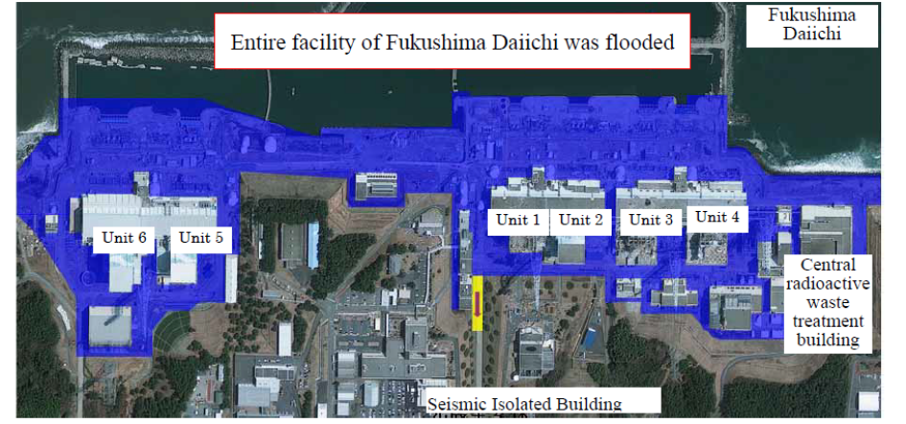
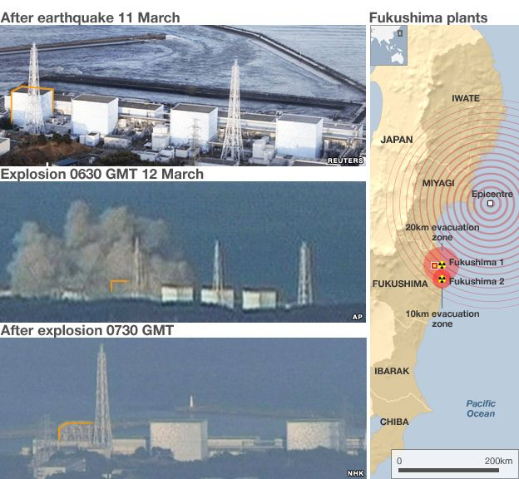
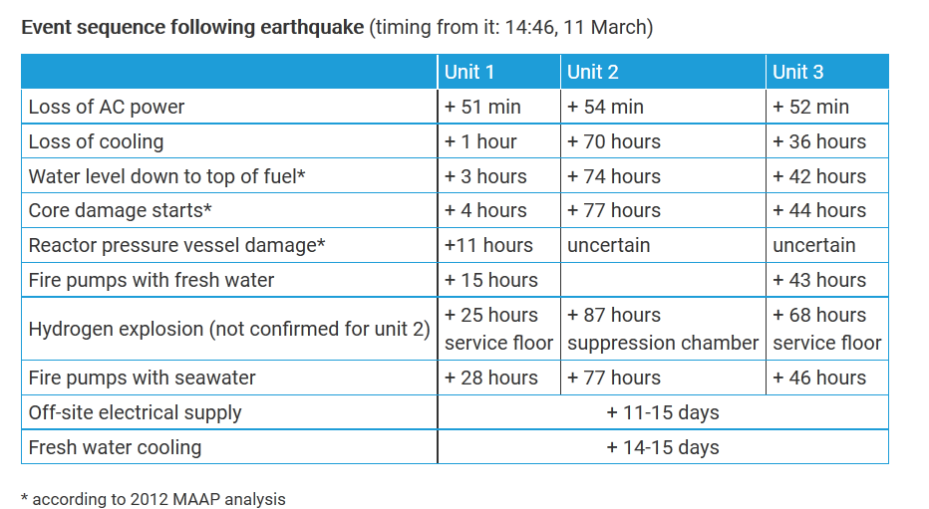

March 11th 2011 Triple Disaster:
Earthquake, Tsunami and Nuclear Accident
A 9.0 magnitude earthquake resulted in 15m tsunami that inundated the Fukushima Daiichi NPP site (10m above sea level). Power outage and damaged back-up generators resulted in the loss of cooling to units 1-3, which lead to a level 7 major nuclear accident.
Information credit: TEPCO (http://www.tepco.co.jp/en/decommision
Information credit:
http://www.bbc.co.uk/news/science-environment-12726628
Generation of highly contaminated water
Notes:
Reactors 1-3 lost active cooling of the core, water circulation functions (spent fuel)
Reactor cores 1-3 melted during the first three days
Plants 10 metres above sea level, sea pumps 4 m above sea level
Turbine halls were under 5 m of water at daiichi
After the earthquake units 1-3 were automatically shutdown, power via 6 external sources were lost due to earthquake damage so the emergency generators in turbine building basements took on the load of active cooling and heat exchange. The tsunami submerged the seawater pumps and dieseal generators. Residual heat from the fuels rods, led to the generation of steam, which was directed into the suppression chamber but the pressure still continued to rise.
As the water level decreased exposing the fuel, the temp rose to 2800oC. The pressure should normally vent through the stack however with the loss of power this backflowed into the top of the reactor building.
Until water treatment plants were built that could treat and recycle the water coolent, units 1-3 had to be stabilised with water additions, which began with clean water however that was replaced with sea water. In addition to cooling the reactors, the spent fuel ponds above the reactor cores needed active cooling.
14:46: A 9.0 magnitude earthquake: reactors 1-3 automatically shut down, reactors 4-6 in maintenance mode
Loss of power due to the earthquake
15:27: First tsunami hits the site
A 14-15 metre tsunami overcomes the se wall inundating the facility and disables the 12/13 backup diesel generators (all but one in the basements, fuel tanks washed away). And heat exchangers + sea pumps. Surviving generator for reactors 5+6
The emergency core cooling along with all electrical power supply faied
Reactors 1-3 lost active cooling of the core, water circulation functions (spent fuel)
Reactor cores 1-3 melted during the first three days
Plants 10 metres above sea level, sea pumps 4 m above sea level
Turbine halls were under 5 m of water at daiichi

Slide 3
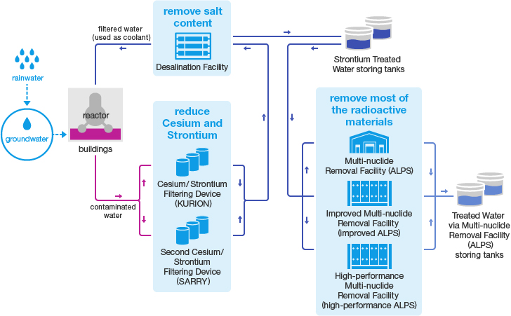
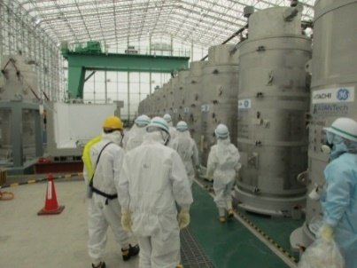
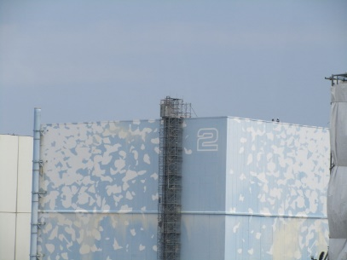
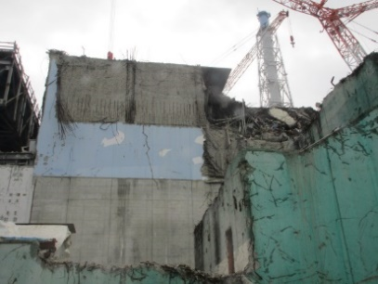
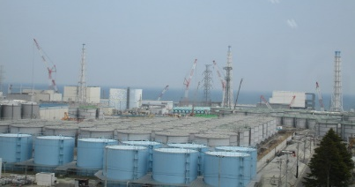
Generation of High Dose Spent Absorbents
Water Treatment Plan
Image credit: TEPCO
Unit 2
Unit 3
SARRY: IONSIV and crystalline silicotitanate
Kurion: “ion specific media” a.k.a. engineered chabazite
ALPS: CsTreat®, SrTreat® CoTreat® and SbTreat (Fortum Co.)
Photographs courtesy of TEPCO (1st April 2016)
Notes:
Simplified active water and retrieval and recovery system (SARRY)
ALPS Multi-nuclide removal equipment
Designed to remove 62 radionuclides (excluding tritium and Cs)
- Waste materials (slurry, spend absorbent) are transferred into high integrity containers (HIC), stored at the temporary storage facility

Slide 4
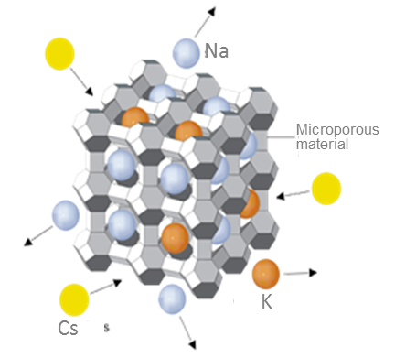
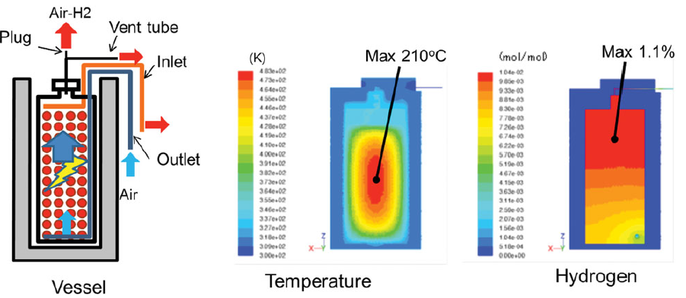
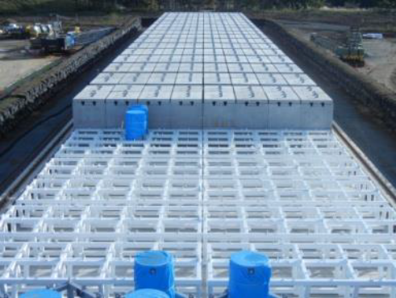
High Dose Spent Absorbents
Challenges associated with High Dose Spent Adsorbents
Several ion-specific microporous materials
Key nuclides include: ⁹⁰Sr, ¹³⁷Cs, ⁶⁰Co
Granular dispersible materials
Self heating (steam production)
Radiolysis (hydrogen production)
Stress corrosion cracking (sea salt aggravated)
HDSAs require waste conditioning process
3,232 HICs as of 21/06/2016
Ref: TEPCO (http://www.tepco.co.jp/en/decommision/planaction/alps/index-e.html
Image: Yamagishi JNST 51 (2014) 1044.

Slide 5
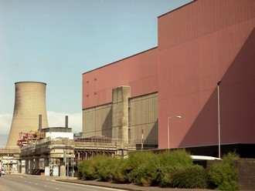
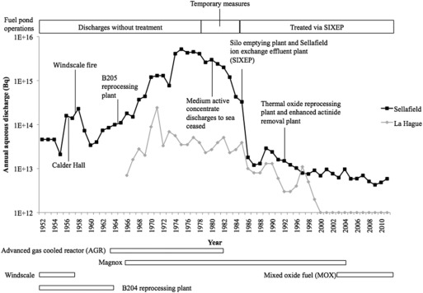
High Dose Spent Absorbents
Sellafield
SIXEP: Site Ion-exchange Effluent Plant
(a.k.a. “the kidneys of Sellafield”)
Built to decontaminate pond water priotr to discharge to Irish Sea, operating since 1985
Process uses clinoptilolite ion exchange media and sand filtration bed
Waste arisings: 2,146.8 m³; activity α 2 x 10⁻² TBq/m³ β,γ 7 x 10¹ TBq/m³
Cement encapsulation potentially problematic:
* Pozzolanic reaction with cement matrix
* Volume increase by a factor of 5-10
Interest in alternative conditioning process for granular HDSA

Slide 6
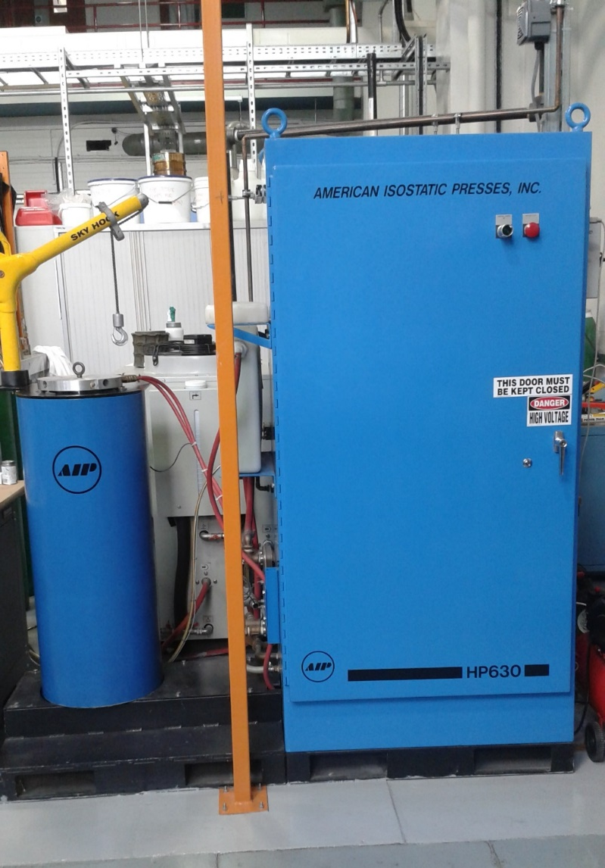
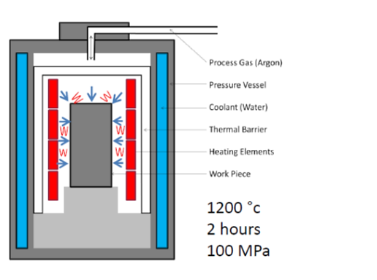
Hot Isostatic Pressing
Advantages of HIPing
No volatile off gas during process; min. secondary waste
One process for multiple waste streams
100 % waste loading possible
Conditioned waste volume minimised
Batch process: flexibility and accountability
Inherently scalable
UoS HIP: Typical can diameter 30 – 300 mm
Image credit:
Stephanie Thornber

Slide 7
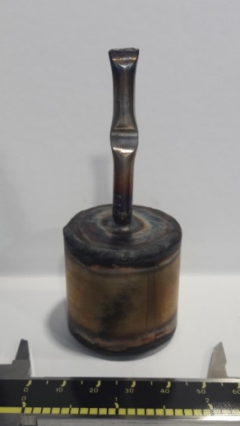
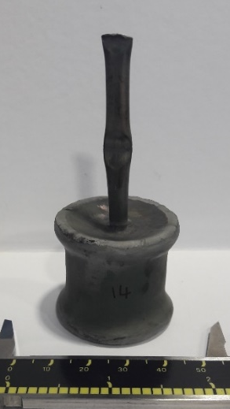
Hot Isostatic Pressing
Advantages of HIPing
No volatile off gas during process; min. secondary waste
One process for multiple waste streams
100 % waste loading possible
Conditioned waste volume minimised
Batch process: flexibility and accountability
Inherently scalable
A
B
UoS HIP: Typical can diameter 30 – 300 mm
Photographs of HIP canisters:
(A) Pre-HIP, (B) Post-HIP

Slide 8
Case Study 1: Clinoptilolite
Notes:
Optimization – reduce the risk of treatment of nuclear waste, if lower T and P is used the plant can have a higher throughput which improves productivity and the economics of HIPing a waste treatment method. To assess if successful, the performance will be measured. Evaluate and feed back in to fine tune the optimised HIP cycle conditions. Make the conditions as low as possible whilst maintaining a durable product.

Slide 9
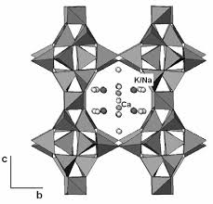
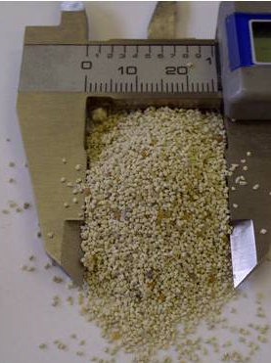
Clinoptilolite Structure
Composition: (Na,K,Ca)_{2‑3}Al₃(Al,Si)₂Si₁₃O₃₆·12H₂O
Oxide | wt. %
SiO₂ | 76.5
Al₂O₃ | 13.6
TiO₂ | 0.1
MgO | 0.8
Na₂O | 3.8
CaO | 1.9
Fe₂O₃ | 1.1
K₂O | 1.8
BaO | 0.1
SO₃ | 0.1
SUM | 100.0
As-received Clinoptilolite
Cs/Sr exchanged – 10wt% Cs₂O & 0.5wt% SrO
Mixed with sand and 5wt% Na₂B₄O₇ or NaAlO₂
HIP: 600ºC bake out, 1200 ºC / 2h, 100 MPa
Clinoptilolite was supplied by the National Nuclear Laboratory

Slide 10
Clinoptilolite HIP wasteform

Slide 11
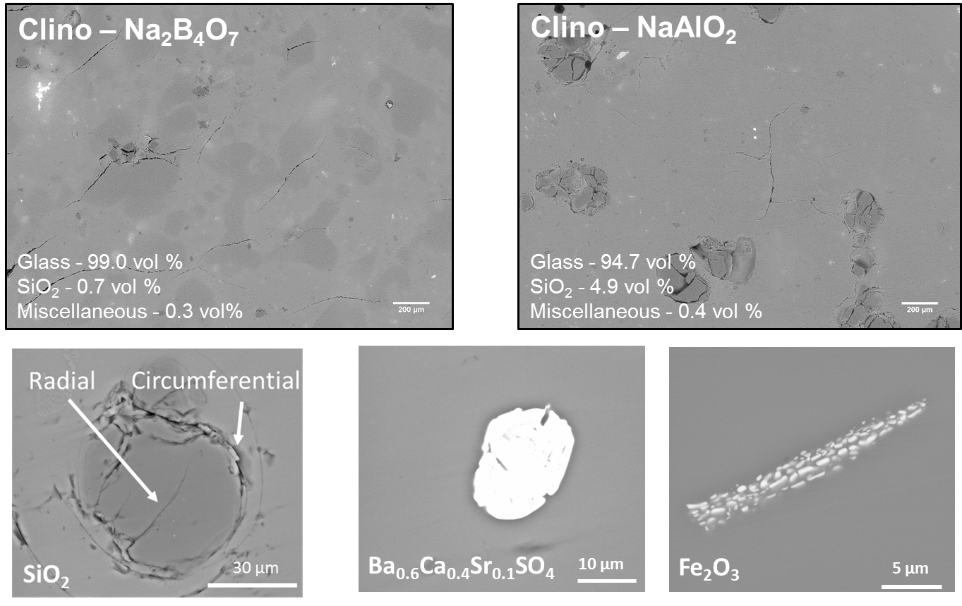
Clinoptilolite HIP wasteform

Slide 12
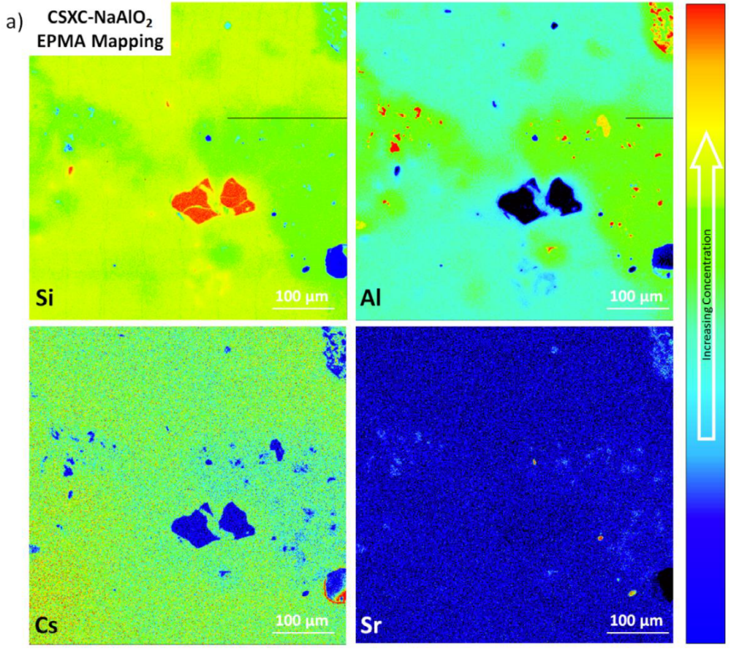
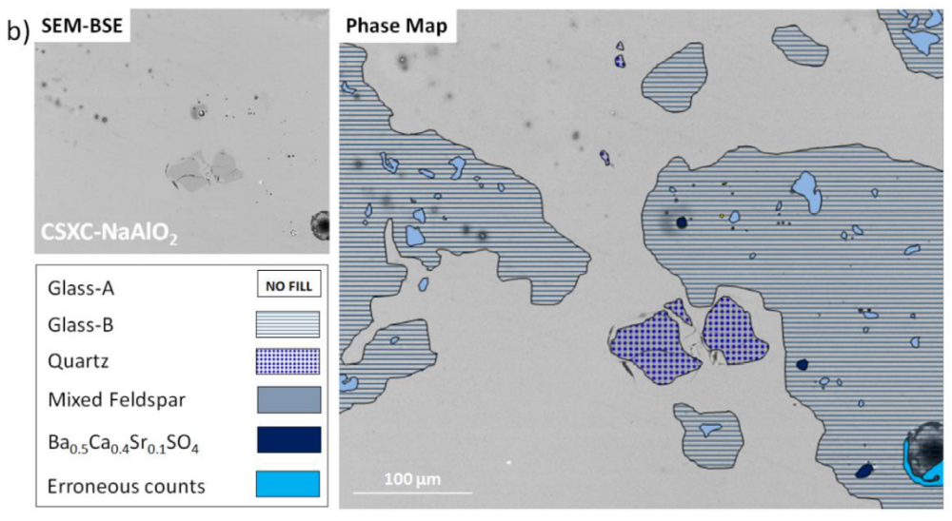
Clinoptilolite HIP wasteform

Slide 13
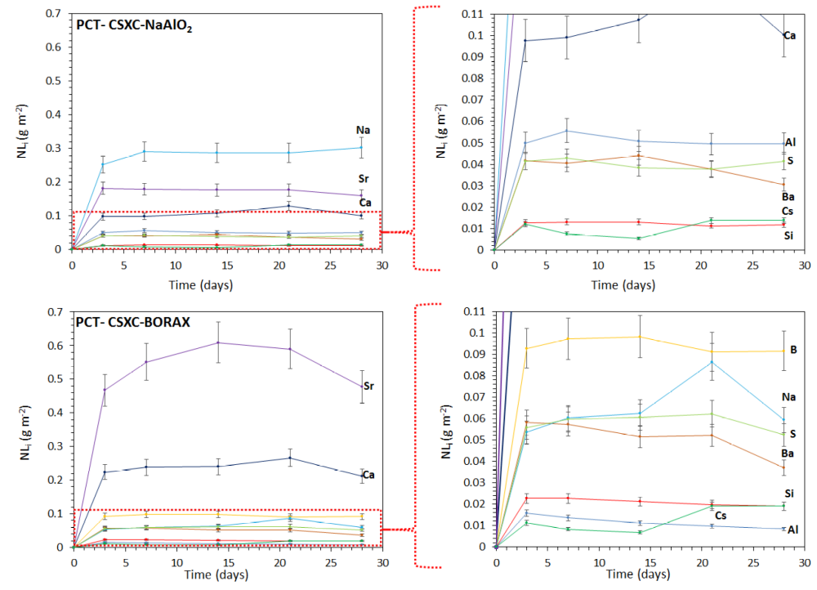
Clinoptilolite HIP wasteform

Slide 14
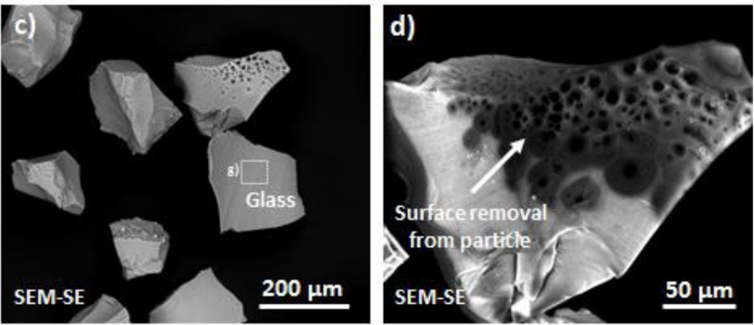
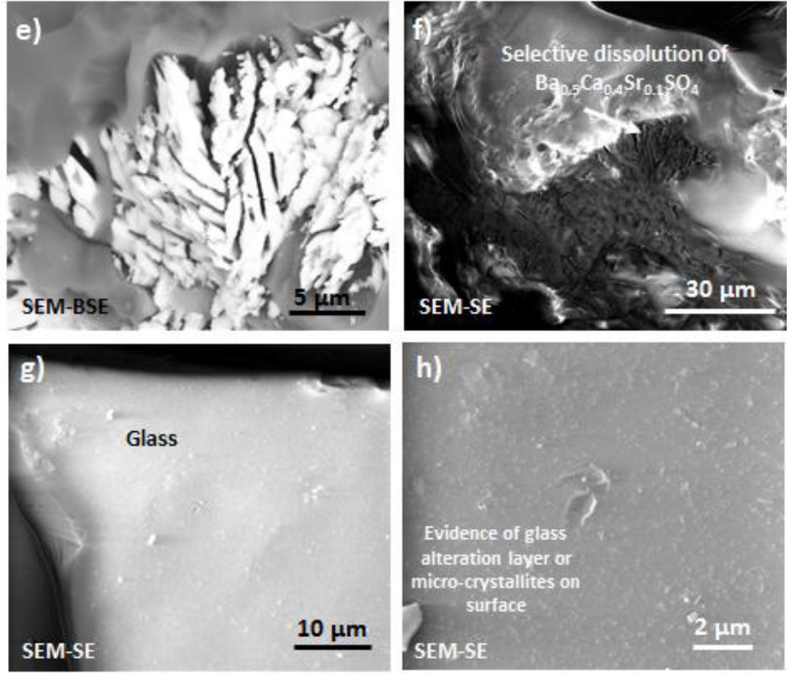
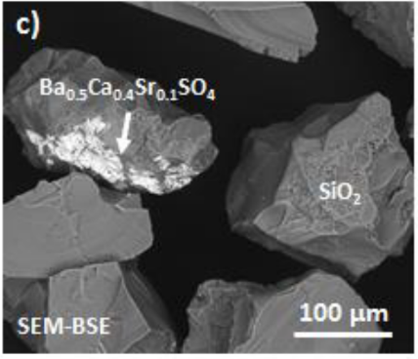
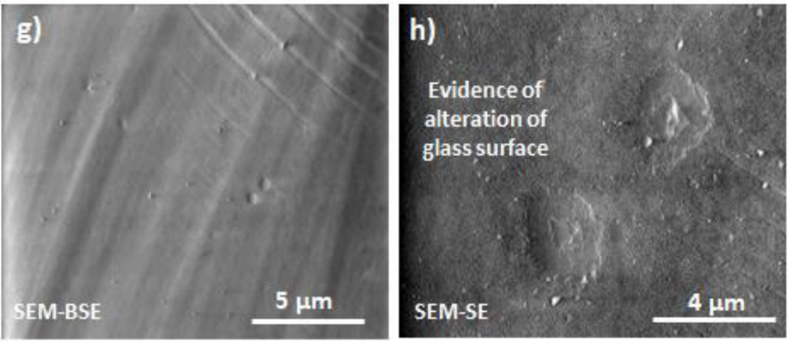
Clinoptilolite HIP wasteform
Clino-Na₂B₄O₇
Clino-NaAlO₂

Slide 15
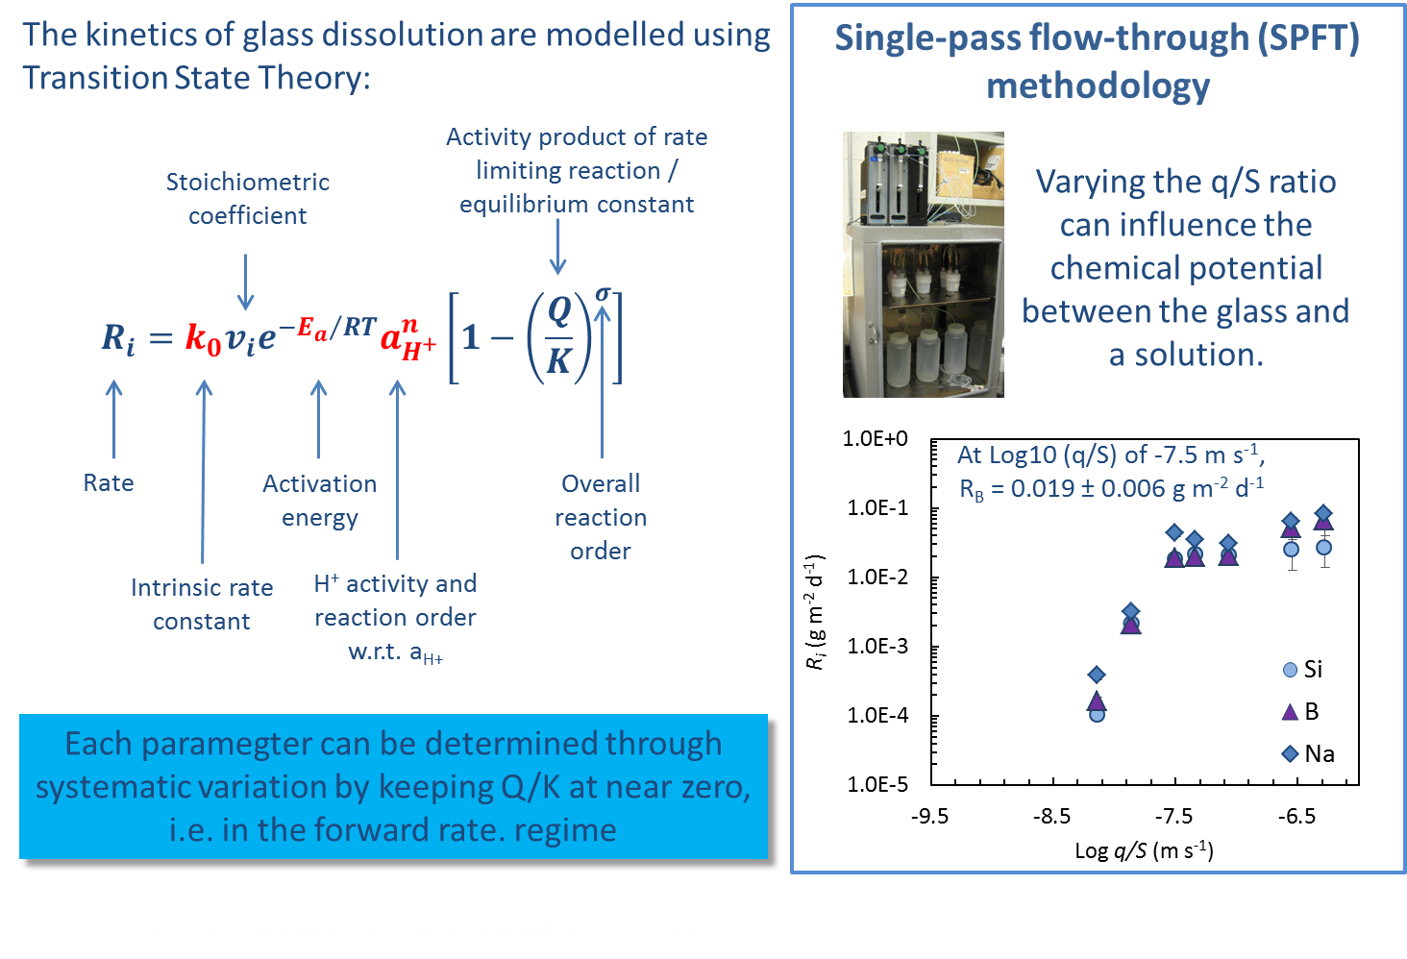
Clinoptilolite HIP wasteform
Cassingham et al., Min. Mag., 79, 1529-1542 (2015)

Slide 16
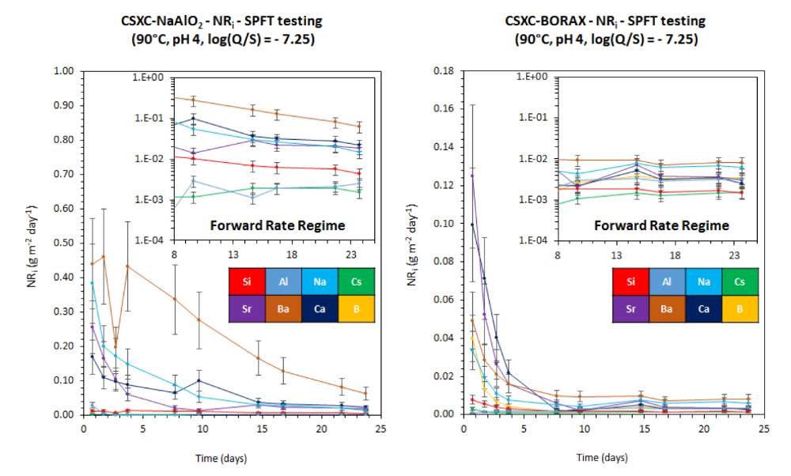
Clinoptilolite HIP wasteform

Slide 17
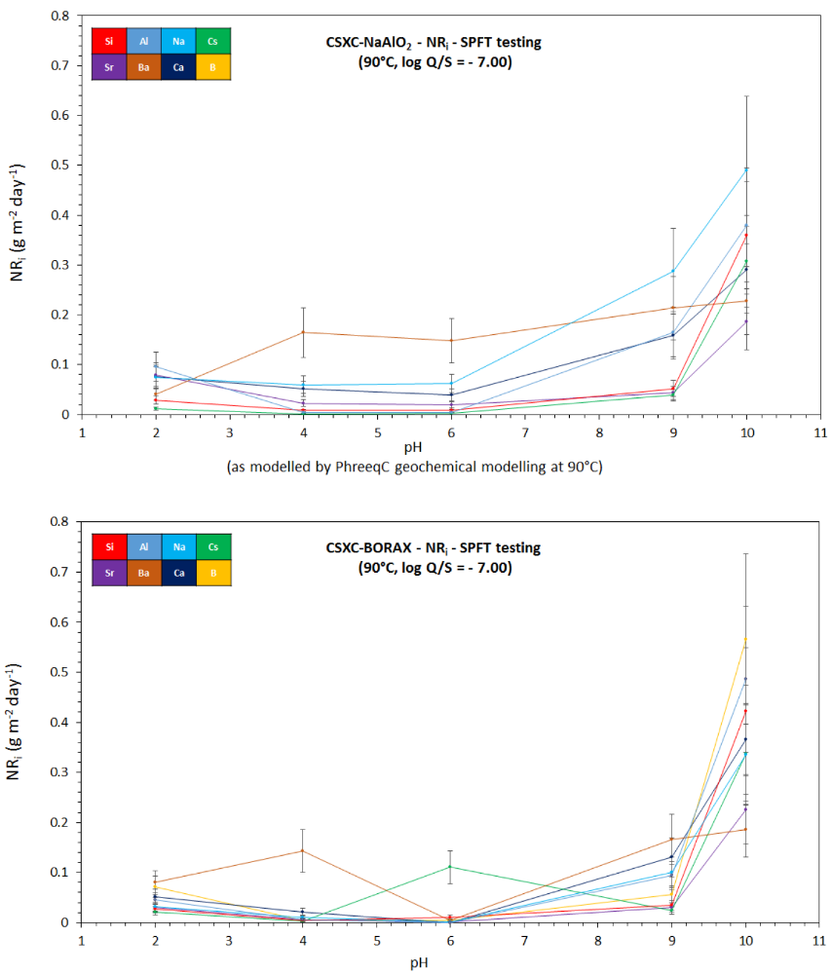
Clinoptilolite HIP wasteform

Slide 18
Clinoptilolite HIP wasteform

Slide 19
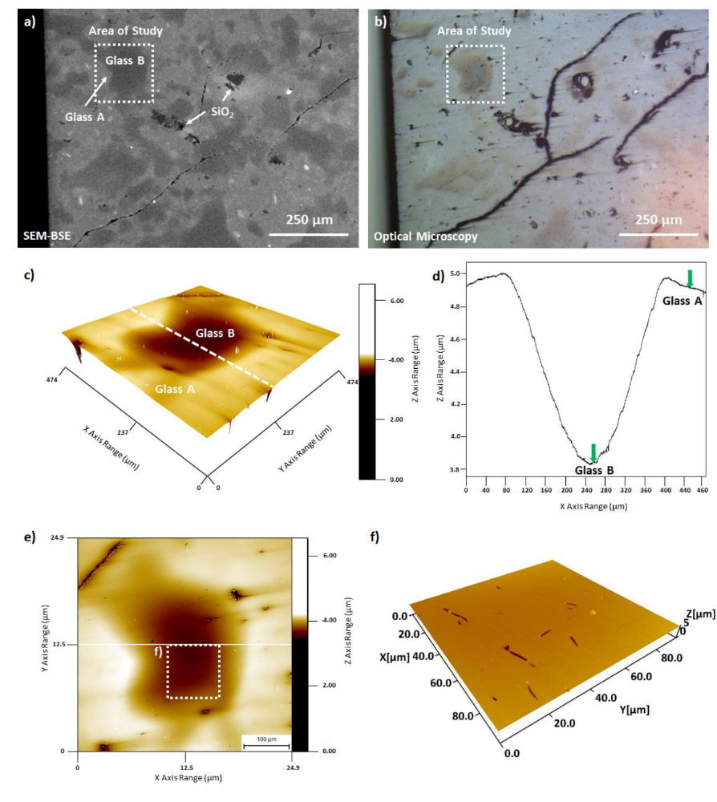
Clinoptilolite HIP wasteform

Slide 20
Case Study 2: SrTreat®
Notes:
Optimization – reduce the risk of treatment of nuclear waste, if lower T and P is used the plant can have a higher throughput which improves productivity and the economics of HIPing a waste treatment method. To assess if successful, the performance will be measured. Evaluate and feed back in to fine tune the optimised HIP cycle conditions. Make the conditions as low as possible whilst maintaining a durable product.

Slide 21
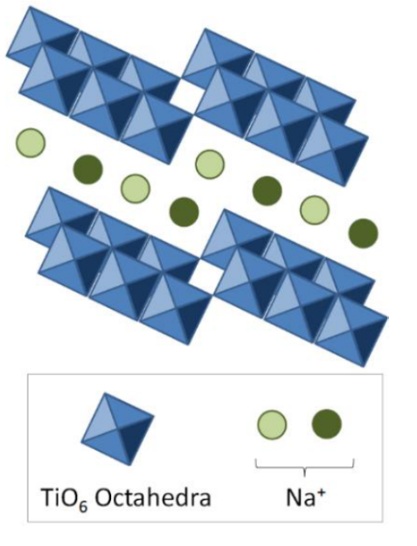
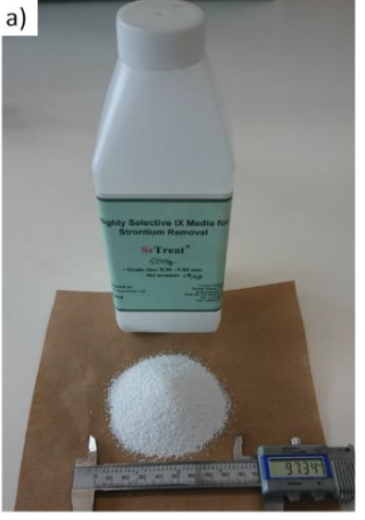
SrTreat® Structure
Composition: “Na₂Ti₃O₇·xH₂O”
OxideMnO2 | wt. %
TiO₂ | 92.1
Na₂O | 7.9
K₂O | 0.0
SrO | 0.0
Cr₂O₃ | 0.0
MnO2 | 0.0
Fe₂O₃ | 0.0
NiO | 0.0
SUM | 100.0
As-received Sr-Treat®
Sr exchanged – 14wt% SrO
HIP: 600ºC bake out, 1200 ºC / 2h, 100 MPa
SrTreat® was supplied by the Fortum Nuclear Services

Slide 22
SrTreat® HIP Wasteform
Cs/Sr exchanged SrTreat® – HIPped without additives, i.e. 100 % waste loading
HIP: 600ºC bake out, 1200 ºC / 2h, 100 MPa
Sr Exchanged SrTreat®
Hiped SrTreat®
1 mm
Waste form comprised of well defined sintered grains retaining evidence of the original Sr gradient as shown in the pre-treated powders

Slide 23
SrTreat® HIP Wasteform
Cs/Sr exchanged SrTreat® – HIPped without additives, i.e. 100 % waste loading
HIP: 600ºC bake out, 1200 ºC / 2h, 100 MPa

Slide 24
SrTreat® HIP Wasteform
A = Na_{1.8}Sr_{0.2}Ti₆O₁₃ B = Na_{1.3}Sr_{0.7}Ti₃O₇ C = SrTiO₃

Slide 25
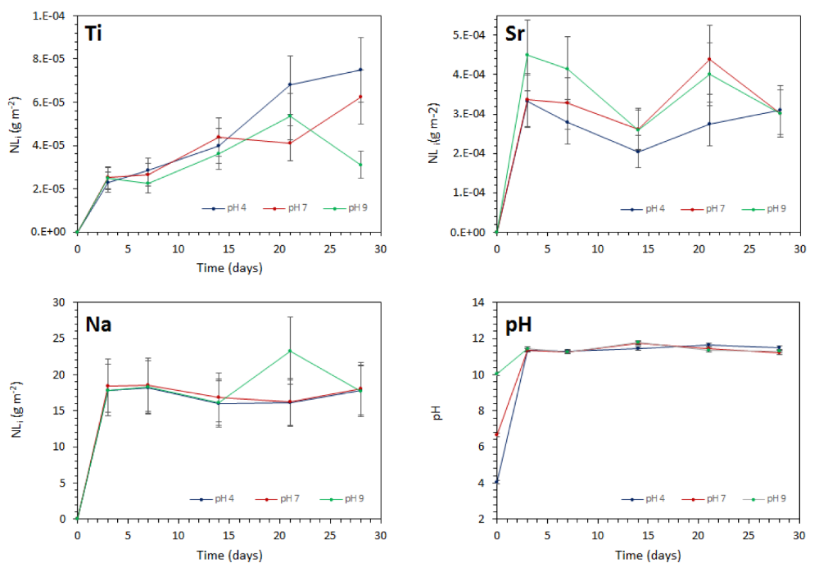
SrTreat® HIP Wasteform

Slide 26
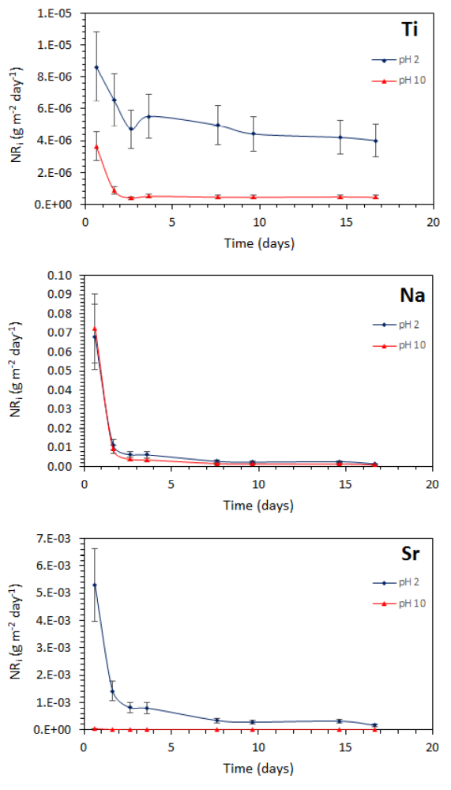
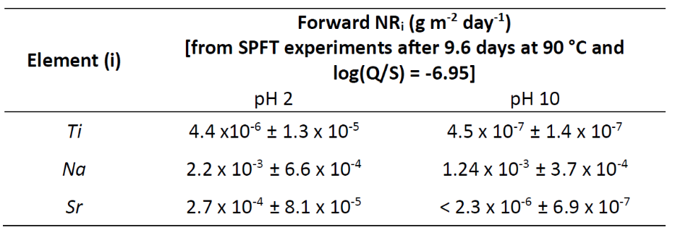
SrTreat® HIP Wasteform

Slide 27
Thermal Treatment of
High Dose Spent Absorbents
Conclusions
Hot isostatic pressing of HDSAs yields robust glass and ceramic wasteforms
Material dissolution rates are similar to or several orders of mag. below HLW glass
VSI is a powerful and necessary technique for resolving phase contributions
Net volume reduction of ca. 20% vs. untreated waste (vs. 5-10x dilution cement)
Capable of delivering >£100M savings in storage, transport and disposal
@ISL_Sheffield
The views expressed in this talk are the personal opinion of the speaker and do not necessarily reflect those of sponsors or funding agencies

Slide 28
Case Study 3: Chabazite
Notes:
Optimization – reduce the risk of treatment of nuclear waste, if lower T and P is used the plant can have a higher throughput which improves productivity and the economics of HIPing a waste treatment method. To assess if successful, the performance will be measured. Evaluate and feed back in to fine tune the optimised HIP cycle conditions. Make the conditions as low as possible whilst maintaining a durable product.

Slide 29
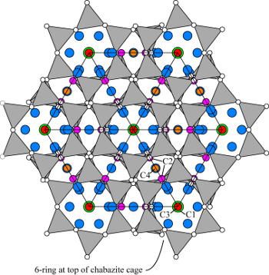
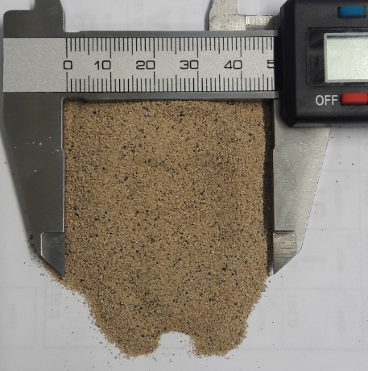
Chabazite Structure
Composition: (Na_{0.14}K_{1.03}Ca_{1.00}Mg_{0.17})[Al_{3.46}Si_{8.53}O₂₄]·9.7H₂O
Oxide | wt. %
SiO₂ | 52.0
Al₂O₃ | 17.0
TiO₂ | 0.5
P₂O₅ | 0.3
MnO | 0.2
MgO | 2.0
Na₂O | 0.6
CaO | 5.7
Fe₂O₃ | 3.6
K₂O | 6.1
H₂O* | 12.0
Image credit: www.iza-online.org
As-received Chabazite
70 % Chabazite – used in Kurion process
18 % Volcanic glass (i.e. obsidian glass)
5 % K-feldspar (K-aluminosilicates)
3 % Pyroxene (e.g. diopside)
2 % Biotite
2 % Phillipsite
*Structural water lost at 120 °C
Chabazite was purchased from Verdi as product “Zeover”

Slide 30
Chabazite Ion Exchange
Method: Chabazite (250g) was exchanged in a 0.1 M CsNO₃ solution (using 1 L UHQ @ 18.2 MΩ) for 24 hours. The solution was then replaced and mixed for an additional 24 hours. After 48 hours, the ion exchanged (IX) chabazite was vacuum filtered and dried for 48 hours at 95 °C. IX chabazite: Cs₂O 1.8 wt. %
Ideal bake-out temperature for Chabazite is >300 °C.
Therefore all HIP canisters were baked-out at 300 °C under vacuum
K-feldspar = orthoclase (KAlSi₃O₈)

Slide 31
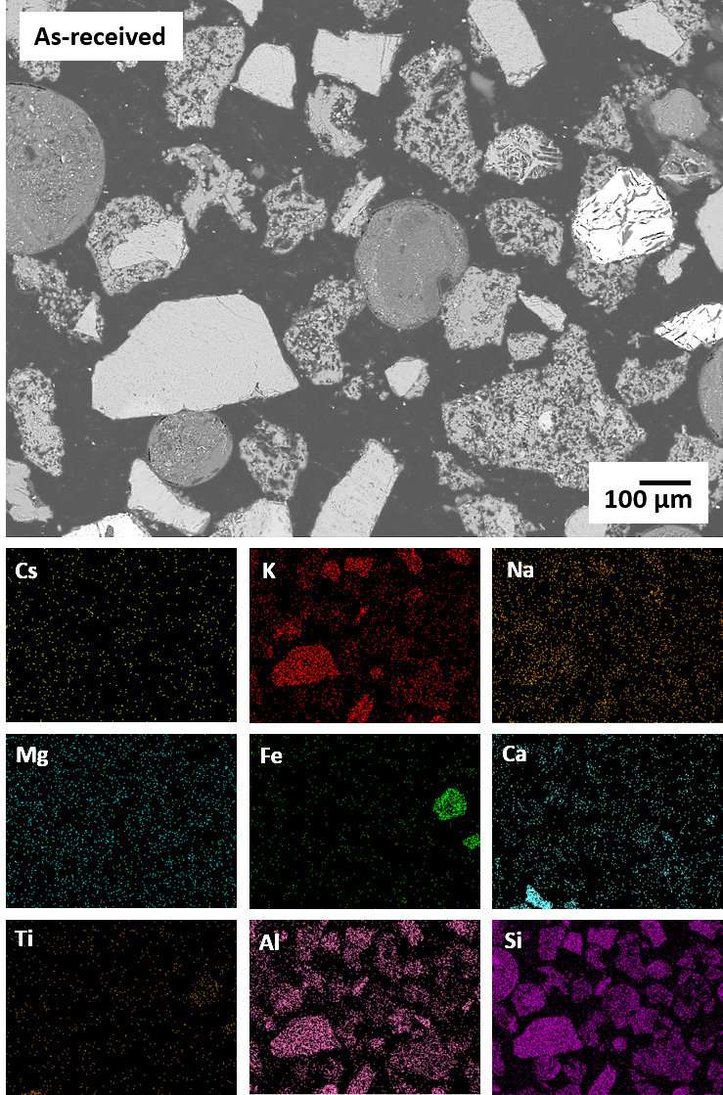
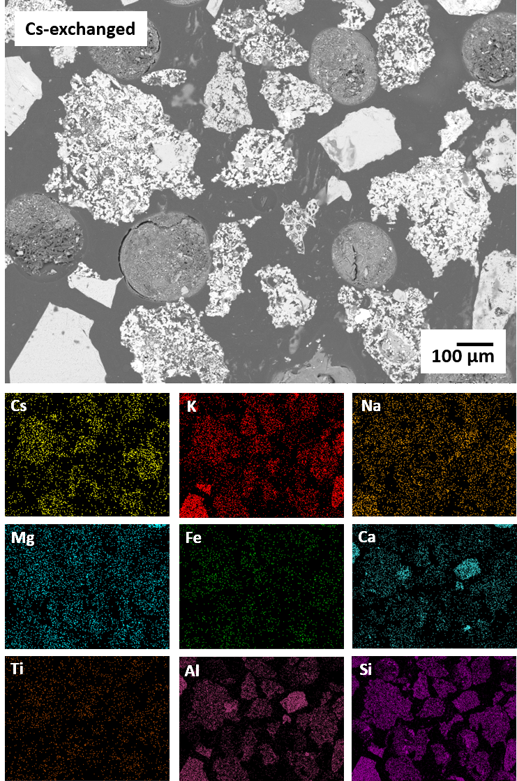
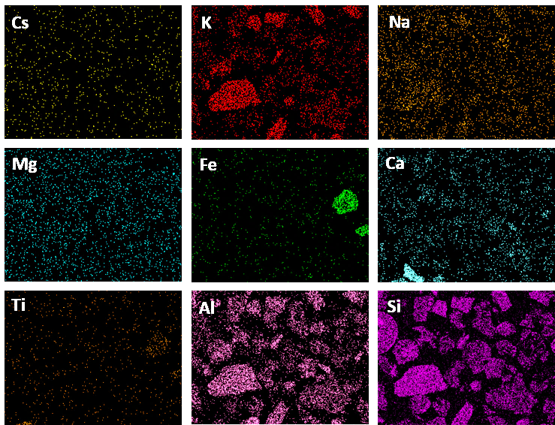
Chabazite Ion Exchange
Obsidian glass
Obsidian glass
Anorthite
Chabazite
Chabazite
K-feldspar
K-feldspar
Anorthite
Heterogeneous mix of chabazite, anorthite, K-feldspar and obsidian glass
Cs sorption only associated with the porous chabazite particles
Resin mounted and polished to a 1 µm finish

Slide 32
HIPed Chabazite: XRD
100 MPa
50 MPa
K-feldspar
Anorthite+ Albite
The chabazite structure has collapsed at all T and P studied, leading to the formation of multiphase glass-ceramics.
Phases formed include: albite, anorthite, diopside and K-feldspars, plus amorphous glass phase (diffuse scattering)
Increasing process temperature leads to formation of K-feldspar at expense of anorthite and diopside
A: CaAl₂Si₂O₈ B: NaAlSi₃O₈ D: MgCaSi₃O₈ K: KAlSi₂O₆

Slide 33
SEM/EDX: HIPed at 100 MPa
A: 1250 °C
B: 1150 °C
C: 1050 °C
G(A)
Spinel vein
G
G
Cs-K
Fe Oxide
Cs-K
A
A
Cs-K
K
A
Cs-K
K
Anorthite (A): CaAl₂Si₂O₈ Albite (B): NaAlSi₃O₈ Diopside (D): MgCaSi₃O₈ K-feldspar (K): KAlSi₂O₆
Formation of glass-ceramic microstructure with negligible porosity at all temperatures
Cs partitions primarily to K-feldspar crystallised from glass melt (bright phase)
1050°C: evidence of anorthite and K-feldspar relics, micro-cracks from differential thermal expansion vs. matrix
1150°C: relatively homogeneous microstructure with trace anorthite and feldspar relics
1250°C: Na-Ca-Al-Si glass with primary and secondary recrystallized Cs / K-feldspar, no relic material.
Notes:
Increasing the temperature leads to a complete incorporation of silicate minerals within the bulk matrix, no major microstructural difference can be assigned due to reduced pressure.

Slide 34
SEM/EDX: HIPed at 50 MPa
A: 1250 °C
B: 1150 °C
C: 1050 °C
Fe Oxide
A
B
Cs rich K
A
A
Cs-K
Cs-K
A
D
Spinel vein
A
K
Anorthite (A): CaAl₂Si₂O₈ Albite (B): NaAlSi₃O₈ Diopside (D): MgCaSi₃O₈ K-feldspar (K): KAlSi₂O₆
Similar sequence of microstructure formation as at 100 Mpa
Cs primarily partitions to recrystallized K-feldspar phase
1250°C: Na-Ca-Al-Si glass with only primary Cs / K-feldspar, no relic material
1250ºC / 50 MPa – simple two phase microstructure, lowest process pressure – dissolution experiments
Notes:
Increasing the temperature leads to a complete incorporation of silicate minerals within the bulk matrix, no major microstructural difference can be assigned due to reduced pressure.

Slide 35
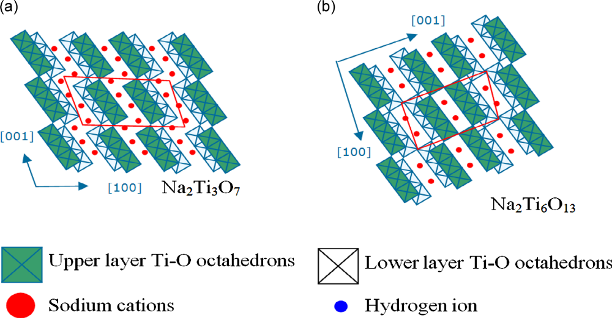
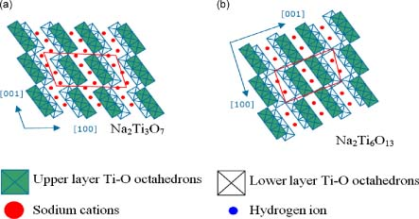
Case Study 2: CoTreat®
Part of the Fortum Nuclear Services Nuclide Removal System (NURES™)
Removes radioactive Co, corrosion products (Mn, Fe, Ni, Zn)
Inorganic sodium titanium oxide (grain size 0.30-0.85 mm)
Decontamination factor: 500 to 2000
Max operating tem: 300 °C
Optimal pH range: 5 to 7
Ref: http://www.fortum.com
Image adapted from Liu et al., (2010) J. Raman Spectroscopy

Slide 36
CoTreat® Ion Exchange
Simulant ocean water
The CoTreat® HDSA was ion exchanged with 200 ppm each of Ni, Fe, Mn, Zn, Ni, as:
Co(NO₃)₂·6H₂O
Fe(NO₃)₃·9H₂O
Mn(NO₃)₂·4H₂O
Ni(NO₃)₂·6H₂O
Zn(NO₃)₂·6H₂O
Method: Two 24 hour exchanges at pH 7 in distilled and simulant ocean water. After 48 hours, the IX CoTreat was vacuum filtered and dried for 48 hours at 95 °C.
Prepared according to ASTM D1141-98 (2003)

Slide 37
XRD
CoTreat® - 6 hr scan
High Temperature CoTreat®
The initial characterisation of CoTreat® indicated that the structure is based on a disordered sodium titanosilicate.
After ion exchange, subtle changes were observed in the diffraction patterns, this indicates that the exchange occurred within the titantate layers of the material.
After exposure of CoTreat to 1000 °C (1 hour) crystalline Na₂Ti₆O₁₃ was observed, change in relative intensities at 1200 °C – volatilisation of Na₂O
Notes:
HT – to see what is likely to form during HIP process

Slide 38
CoTreat® - SEM/EDX
The as-received CoTreat® consists of Ti and Na spherical particles of various sizes.
Uniform sorption of Co, Mn, Ni and Zn whilst the Fe appears localised within the between the larger CoTreat® particles.

Slide 39
CoTreat® - Dehydration
CoTreat® (H₂O exchanged)
Cs Exchanged CoTreat®
The ideal bake-out temperature for CoTreat® is >200 °C.
Therefore all HIP canisters were baked-out at 300 °C under vacuum

Slide 40
CoTreat® - XRD
Distilled H₂O
Ocean H₂O
At 600 °C: crystallisation of anatase TiO₂, plus residual non-crystalline component (diffuse scattering)
At 800-1200 °C: formation of rutile TiO₂ and Na₂Ti₉O₁₉ / Na₂Ti₆O₁₃
At 1400 °C: only rutile observed – volatilisation of Na₂O inventory
No distinctive separate phase incorporating Fe, Co, Ni, Zn
No difference in phase assemblage between ocean / distilled water exchange
Furnace programme: Ramp/Cool at 3 °C/min, dwell at T for 2 hours.

Slide 41
CoTreat® - Distilled H₂O
Effective sintering at 1200-1400ºC, but substantial loss of Na₂O inventory at 1200ºC
600-1000ºC: Ni, Co, Mn, Zn partition to Na₂Ti₉O₁₉ / Na₂Ti₆O₁₃ phase; Fe in separate Na-rich phase
1200-1400ºC loss of Na₂O inventory and formation of Na-rich phases; some phase separation of Mn and Ni phases
Residual porosity after sintering at all temperatures
Notes:
So prior to HIPing the IE materials, preliminary work looked at pressed pellets of the materials to get a rough understanding of what temperatures the materials start to react and where potential loss occurs. To see if HT processing works on these samples and if so, what phases are formed and when. Used to inform the HIP studies.

Slide 42
CoTreat® - Ocean H₂O
Similar to materials sintered from distilled water exchange
Chloride retained up to 1000ºC

Slide 43
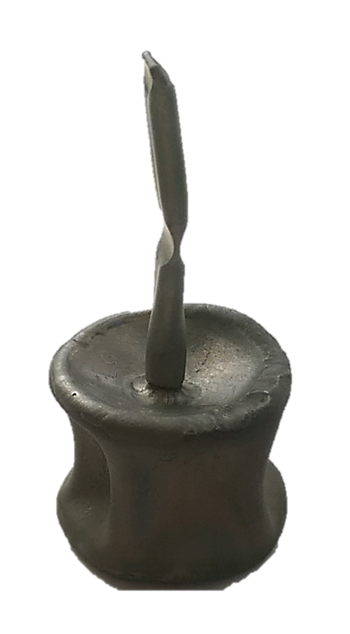
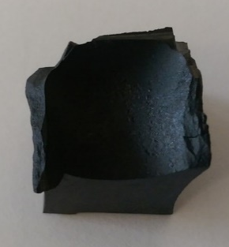
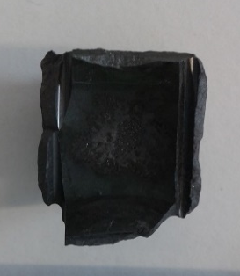
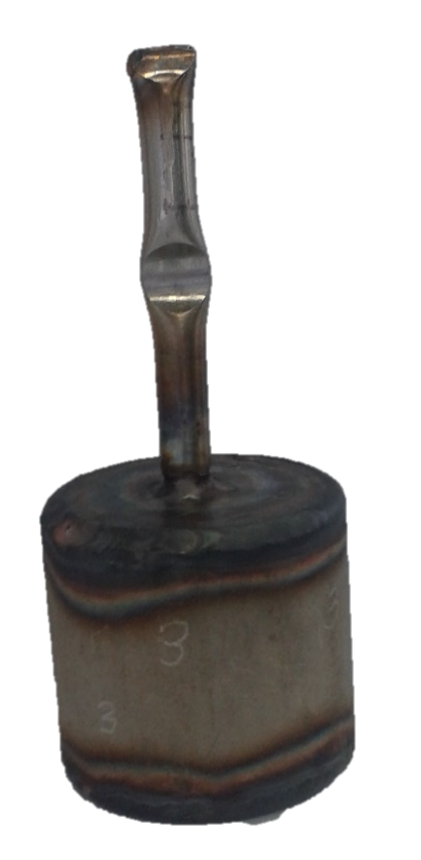
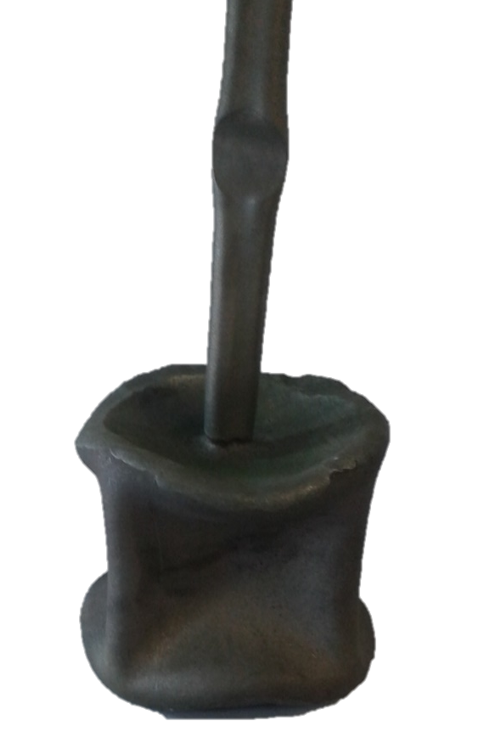
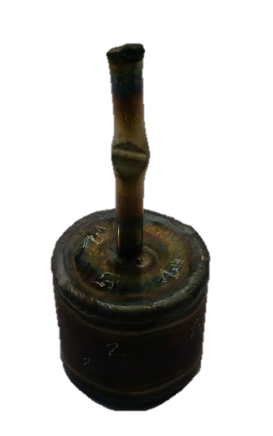
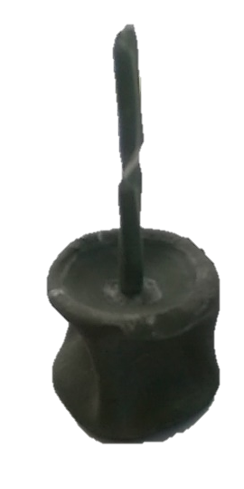



CoTreat® - HIPed at 1250 °C
Distilled H₂O
Ocean H₂O
100 MPa
37.68
38.98
10 mm
30.28
10 mm
38.15
29.24
1
26.38
3
25 MPa
39.74
31.49
10 mm
31.87
10 mm
38.10
28.94
2
26.00
4
CoTreat® formed dense monoliths after the HIPed process
Pre-dried at 300 °C for 12 hrs (general muffle furnace)

Slide 44
HIPed CoTreat® - XRD
100 MPa
25 MPa
Similar phase assemblage irrespective of distilled / ocean water and pressure at 1250ºC
The principal phases observed were rutile TiO₂, Na₂Ti₉O₁₉ and Na₂Ti₆O₁₃
HIP containment enables retention of Na inventory
Lower pressure preferred for process scale application – reduced stored energy

Slide 45
HIPed CoTreat® - SEM/EDX
Distilled H₂O
Ocean H₂O
Co, Fe, Ni, Mn, Zn partition mainly into Na₂Ti₉O₁₉ / Na₂Ti₆O₁₃ phases
Limited if any substitution into rutile TiO₂ phase
Formation of traceNiCl₂ and KCl in ocean water exchanged sample – encapsulated in Na-titanate matrix
Could consider isotopic dilution of Ni-63 by spiking with nat. NiO

Slide 46



Magnesium Potassium Phosphate Cements
Magnesium potassium phosphate cement (MKPC) is a near neutral cementitious system with a high early compressive strength. Acid-base reaction:
Applications
MgO _{(s)} + KH₂PO₄ _{(s)} + 5H₂O _{(l)} → MgKPO₄·6H₂O _{(s)}
Key characteristics
Rapid early strength
Set within 24 hours
Low water demand
Low permeability
Water is chemically bound within the crystal structure
Struvite-K
Magnox fuel¹
Magnox Swarf²
0.24 w/s: 1.7 MgO: 1 KH₂PO₄: 4.72 H₂O with 50 wt. % FA (or GBFS) + 2 wt. % H₃BO₃
[1] www.sellafieldsites.com/solution/spent-fuel-management/magnox-reprocessing/ [Date accessed: Nov/2016]
[2] NDA (2010) ‘Geological Disposal: Package evolution status report.’ NDA Report No: NDA/RWMD/031
Notes:
Emergency repair work (runways, roads, bridges)
Argonne National Laboratory (Ceramicrete) – stabilisation of various waste streams
Under investigation in the UK for reactive metal ILW encapsulation
To reduce the heat output from the exothermic acid-base reaction, MKPCs are blended with supplementary cementitious materials; in this case FA and GBFS.

Slide 47



Characterisation of MKPC binders
High field NMR (19.96 T) – University of Warwick
FA/MKPC GBFS/MKPC
²⁷Al
Secondary reaction products
²⁹Si
FA/MKPC
NMR: GBFS/MKPC shown only
Fly ash and slag have been demonstrated conclusively for the first time that FA and GBFS participate in the mechanical and microstructural development of blended MKPC binders through the formation of amorphous secondary reaction products. (Gardner et al., (2015) Cement and Concrete Research, vol. 74, pp. 78-87.)
Notes:
From the formulation experiments it was clear that the two SCMs result in differing mechanical and physical properties. To investigate this further detailed analysis on the chemical environments in both systems was carried out.
Start: To understand the MKPC binders, we had to analyse the chemical and microstructure environments of these blended MKPC binders after they have reacted, which involved the use of solid state NMR, SEM/EDX, XRD amongst other techniques especially as we expected there was an amorphous component to these systems
Different glasses fractions (FA/GBFS), resulting in a difference of compressive strength, which could likely be the result of partial dissolution of GBFS resulting in a postulated potassium aluminosilicate phase.
Even though my research has mainly focussed on cement, I feel that the techniques learnt and careful sample preparation will be applicable to glass research, especially alteration layers or precipitated phases.
To reduce the heat output from the exothermic acid-base reaction, MKPCs are blended with supplementary cementitious materials; in this case FA and GBFS. Through detailed SEM and solid state NMR, it was conclusively found that these SCMs take part in a secondary reaction, rather than being inert fillers, which was previously thought. The secondary reaction product is likely to be an amorphous potassium aluminosilicate phase. High field NMR conducted at the University of Warwick, revealed the presence of a second potassium environment that compared with the Al and Si NMR data from Durham University lead to the assumption of this type of phase. No evidence of alternative Mg or P phases was identified.
In the Al spectrum, the presence of the resonance at -9.5 ppm, clearly highlight that a reaction with the Al species occurred compared to the unreacted GBFS. In the Si spectrum,
There is a significant difference between the FA/MKPC and GBFS/MKPC binders at 0.24 w/s. FA/MKPC achieved a CS value of 24.7 MPa ± 3.0 MPa and GBFS/MKPC achieved a CS value of 34.7 MPa ± 0.5 MPa. The powder properties indicate that the density of GBFS was greater than FA, so it is expected to form a denser matrix in the reacted binders and thus, improve the mechanical properties. Also, the angular GBFS particles are expected to interlock much better with the matrix than the spherical FA particles, however this physical interlocking of the GBFS particles due to better particle packing cannot be solely attributed the significant 10 MPa difference observed in mechanical performance identified in the FA/MKPC and GBFS/MKPC systems as the 0.26 w/s GBFS/MKPC binder achieved comparable compressive strengths to the 0.26 w/s FA/MKPC binder.

Slide 48
MKPC Encapsulation - CoTreat® (25 wt. %)
FA/MKPC + CoTreat®
or Ti(HPO₄)₂·2H₂O
CoTreat®
FA
Formation of additional secondary reaction products
MKPC
MgO
GBFS/MKPC + CoTreat®
MgO
GBFS
MKPC
CoTreat®
Phases: Struvite-K, MgO
Data shown is for as-received CoTreat®

Slide 49
Conclusions
Key findings
Chabazite can be completely converted into multiphase glass-ceramic product with stable minerals: K-feldspars, anorthite, albite and diopside formed.
The microstructural features vary as a result of T/P: at lower conditions, more angular features were observed (associated with K-feldspars and anorthite, CaAl₂Si₂O₈).
Cs appears to be associated with K, Al and Si across all samples, although it is not incorporated into the anorthite regions.
Exposing CoTreat® to high temperature can predict the likely phases formed under HIP T/P conditions (up to 1200 °C).
HIPing ion exchanged CoTreat® can be successfully achieved at 100 and 25 MPa.
HDSAs can be encapsulated within MKPC (but with increased water additions!)
Ongoing Work
Evaluate the durability of the HIPed products using MCC-1 and PCT-B dissolution methods
Encapsulate the HDSA materials within cementitious systems (MKPC and PC) for comparison
Determine the radiation stability of the HIPed products

Slide 50


Acknowledgements
Thank you to Dr Paul Heath and Stephanie Thornber
Thank you!
This research was performed in part at the MIDAS Facility, at the University of Sheffield, which was established with support from the Department of Energy and Climate Change
We gratefully acknowledge funding support from:

