Slide 1

Towards understanding the dissolution of vitrified nuclear waste in a cementitious geological disposal facility
Claire Corkhill, Colleen Mann, Daniel Backhouse, Adam Fisher, Russell Hand, Neil Hyatt
University of Sheffield
Scientific Basis for Nuclear Waste Management 2017, Sydney, November 2017
@clairecorkhill
@ISL_Sheffield

Slide 2
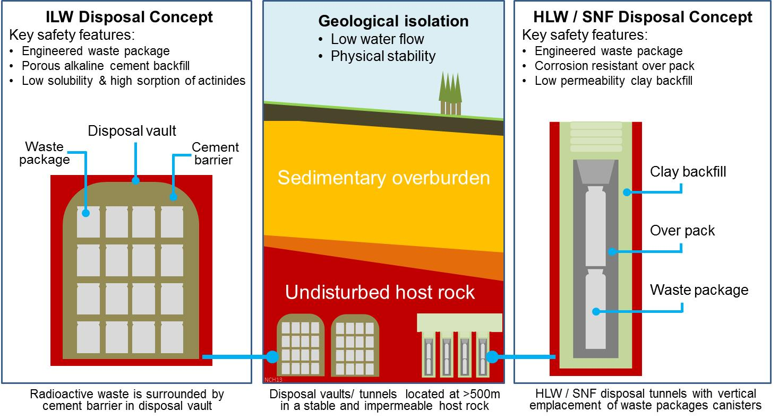
High pH environments in geological disposal
Notes:
We are interested in high pH glass dissolution for several reasons:
1. under slow groundwater flow conditions, the repository is likely to buffer to slightly alkaline pH – bentonite will buffer to values between 7 and 10.5, depending on the groundwater composition
2. there is potential for interaction of alkaline solutions from concrete vault structures on the long time scales of geological disposal
3. the potential co-location of vitrified UK HLW with cementitious UK ILW may lead to the interaction of vitrified products with a high pH, Ca-rich groundwater from the cement backfill

Slide 3
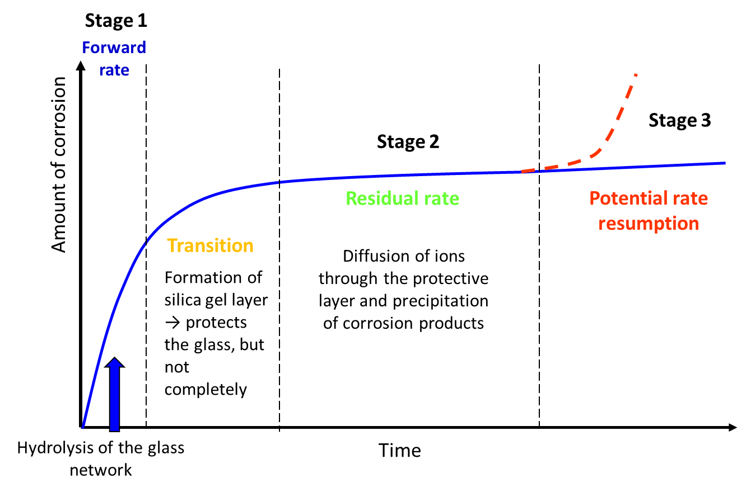
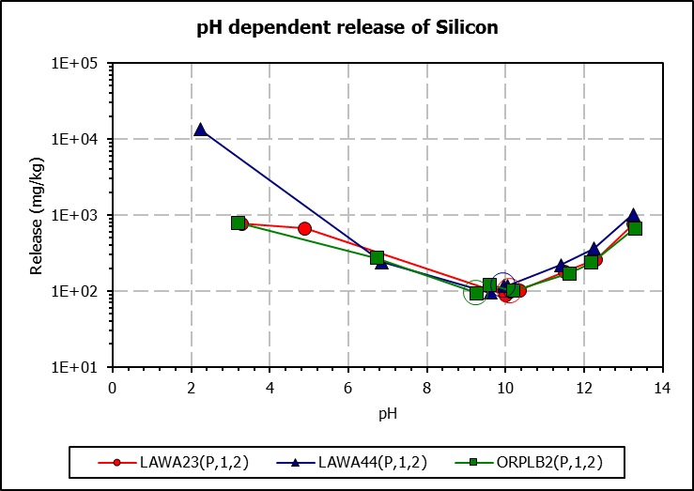
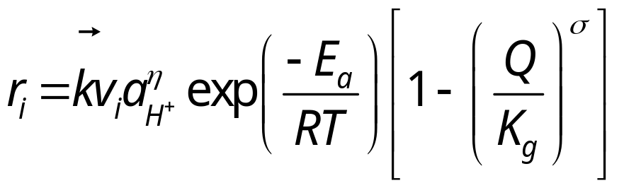
Glass dissolution and high pH
Under hyperalkaline conditions, the solubility of sparingly soluble species increases
Transition State Theory for glass: (Grambow, 1985)
When combined with Ca leached from cement, the formation of Si-gel is disrupted and a range of minerals are precipitated.
Notes:
Glass dissolution is a complex process, which is highly dependent on both the composition of the glass and the environment in which dissolution takes place. It can be described by a range of processes, which are here also split into several stages:
In the first, when glass comes into contact with water, interdiffusion between hydrogenated species and alkalis occurs, followed by hydrolysis of Si-O-M bonds. This part is known as the forward rate of reaction.
As the solution becomes saturated with dissolved species from the glass, particularly silica, thermodynamic quasi-equilibrium is approached, and a layer of si-containing gel recondenses on the glass surface. This forms a protective layer, and corresponds to a drop in the dissolution rate (the rate drop)
The residual rate refers to the period of glass dissolution where lots of different processes compete to keep the dissolution rate relatively low, for example further diffusion of water into the glass leads to the gradual build-up of gel and alteration layers containing various elements dissolved from the glass. It is also postulates that the slow transformation of amorphous alteration layer products into stable crystalline ones occurs. The mechanisms vary greatly depending on the glass and solution composition.
It has also been reported that glass dissolution can resume after long periods of time, again dependent on glass and solution compositions.

Slide 4
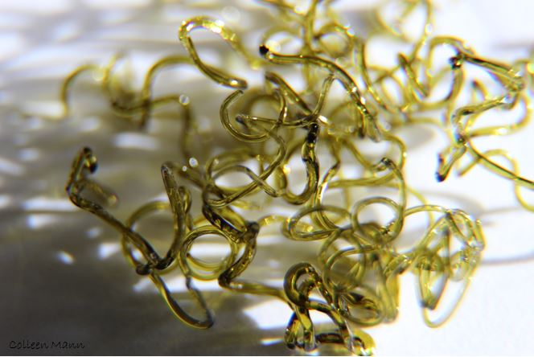
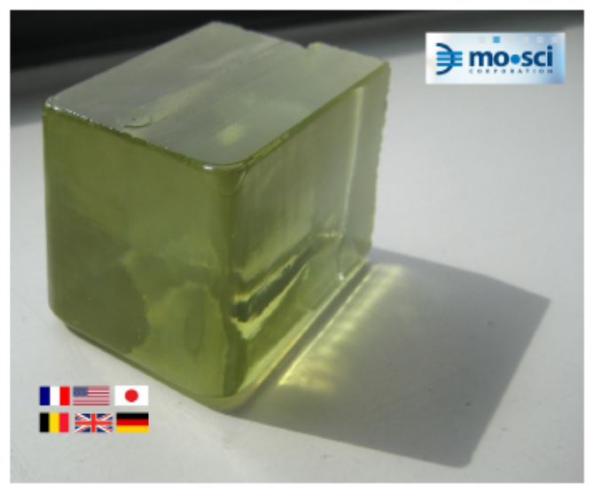
Glass compositions
MW25 (mol%)
SiO₂ | Al₂O₃ | B₂O₃ | MgO | BaO | SrO | Na₂O | Li₂O | Cs₂O | ZrO₂
47.67 | 2.55 | 18.65 | 6.82 | 0.15 | 0.17 | 9.57 | 9.24 | 0.24 | 0.77
Fe₂O₃ | CeO₂ | Cr₂O₃ | La₂O₃ | Nd₂O₃ | Pr₂O₃ | Sm₂O₃ | Y₂O₃ | TiO₂
1.31 | 0.45 | 0.29 | 0.13 | 0.39 | 0.12 | 0.08 | 0.06 | 0.03
P₂O₅ | NiO | MoO₃ | Gd₂O₃ | Total
0.09 | 0.48 | 0.67 | 0.01 | 99.94
International Simple Glass (mol%)
SiO₂ | Al₂O₃ | B₂O₃ | Na₂O | CaO | SrO | ZrO₂ | Total
56.2 | 6.1 | 17.3 | 12.2 | 5.0 | 0.17 | 3.3 | 100.1
Notes:
Glass dissolution is a complex process, which is highly dependent on both the composition of the glass and the environment in which dissolution takes place. It can be described by a range of processes, which are here also split into several stages:
In the first, when glass comes into contact with water, interdiffusion between hydrogenated species and alkalis occurs, followed by hydrolysis of Si-O-M bonds. This part is known as the forward rate of reaction.
As the solution becomes saturated with dissolved species from the glass, particularly silica, thermodynamic quasi-equilibrium is approached, and a layer of si-containing gel recondenses on the glass surface. This forms a protective layer, and corresponds to a drop in the dissolution rate (the rate drop)
The residual rate refers to the period of glass dissolution where lots of different processes compete to keep the dissolution rate relatively low, for example further diffusion of water into the glass leads to the gradual build-up of gel and alteration layers containing various elements dissolved from the glass. It is also postulates that the slow transformation of amorphous alteration layer products into stable crystalline ones occurs. The mechanisms vary greatly depending on the glass and solution composition.
It has also been reported that glass dissolution can resume after long periods of time, again dependent on glass and solution compositions.

Slide 5
What we’ve learnt (or now know what we don’t know)
Effect of high pH
Effect of Ca(OH)₂ rich solutions
Effect of cementitious solutions

Slide 6
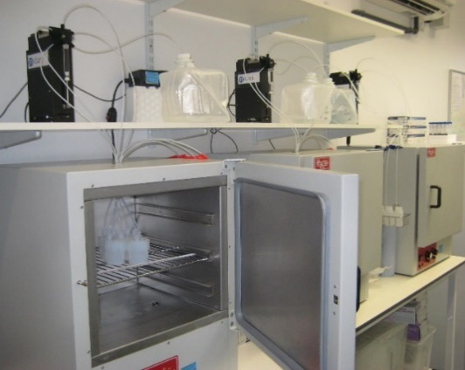
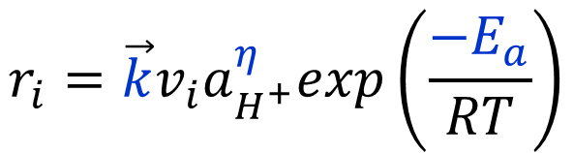
Dissolution kinetics in the forward rate
Under conditions of the single pass flow through experiment, the saturation state of the system is zero:
$$r_{i}=\vec{k}v_{i}a_{H^{+}}^{η}exp\left(\frac{{−E}_{a}}{RT}\right)$$
Solution composition | pH
 | 23°C | 40°C | 70°C
THAM / HNO₃ pH adjustment | 8.0 | 7.9 | 7.6
THAM / HNO₃ pH adjustment | 10.0 | 9.8 | 9.3
LiOH / LiCl pH adjustment | 12.0 | 11.5 | 10.7

Slide 7
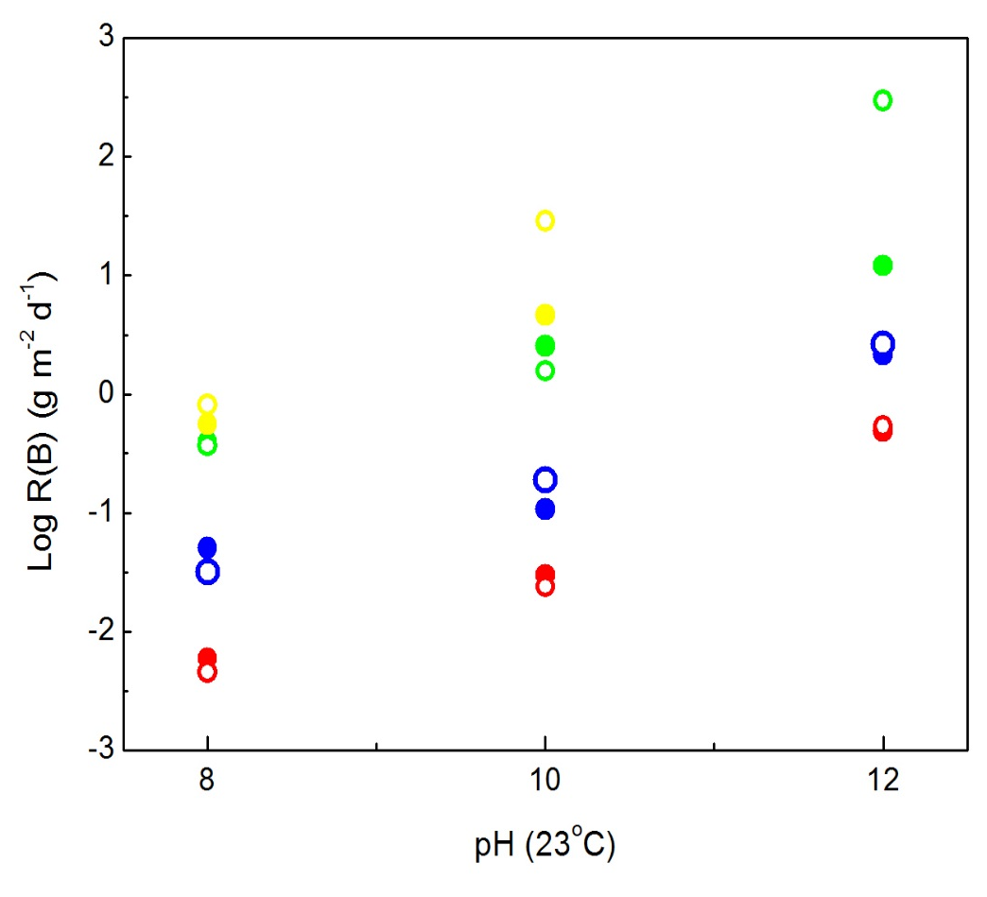
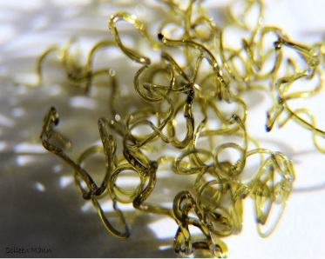
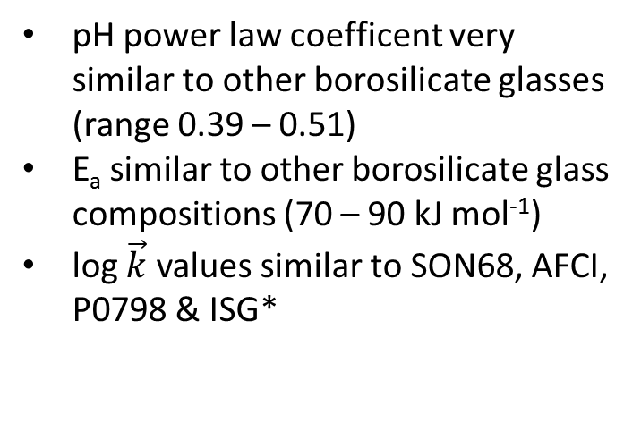
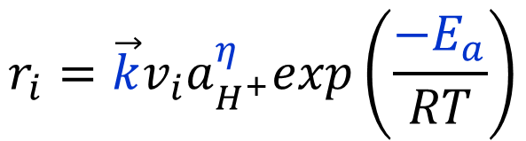
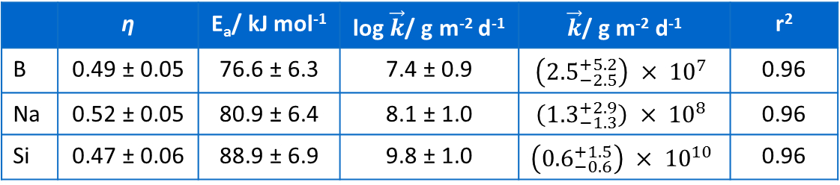
Dissolution kinetics at high pH
$$r_{i}=\vec{k}v_{i}a_{H^{+}}^{η}exp\left(\frac{{−E}_{a}}{RT}\right)$$
23°C
40°C
70°C
90°C
pH power law coefficent very similar to other borosilicate glasses (range 0.39 – 0.51)
E_{a} similar to other borosilicate glass compositions (70 – 90 kJ mol⁻¹)
log $\vec{k}$ values similar to SON68, AFCI, P0798 & ISG*
MW25
 | η | E_{a}/ kJ mol⁻¹ | log $\vec{k}$/ g m⁻² d⁻¹ | $\vec{k}$/ g m⁻² d⁻¹ | r²
B | 0.49 ± 0.05 | 76.6 ± 6.3 | 7.4 ± 0.9 | $$\left({2.5}_{−2.5}^{+5.2}\right) × {10}^{7}$$ | 0.96
Na | 0.52 ± 0.05 | 80.9 ± 6.4 | 8.1 ± 1.0 | $$\left({1.3}_{−1.3}^{+2.9}\right) × {10}^{8}$$ | 0.96
Si | 0.47 ± 0.06 | 88.9 ± 6.9 | 9.8 ± 1.0 | $$\left({0.6}_{−0.6}^{+1.5}\right) × {10}^{10}$$ | 0.96
Cassingham et al. Mineralogical Magazine, 79, 1529 (2015) & (2017); *Fisher et al. in prep
Notes:
The estimated error of log k is typically of the order of 10%. When standard propagation of error manipulation is undertaken, the error value is between two and three times the value of k, implying that k may become negative, which is physically impossible. The maximum negative error has been taken as being equal to k.

Slide 8
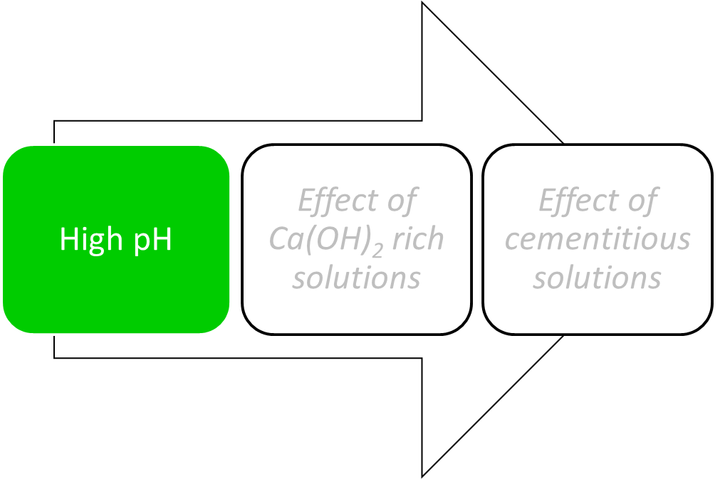
What we’ve learnt (or now know what we don’t know)
What we’ve learnt
What we don’t know
MW25 behaves similarly to other borosilicate waste glasses with respect to pH, in the forward rate
How far do you need to push the compositional envelope to get different behaviour?
e.g. Ca, Zn variation of MW25?

Slide 9
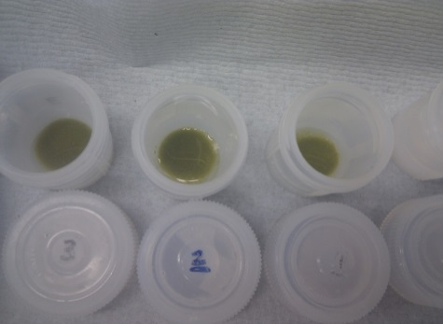
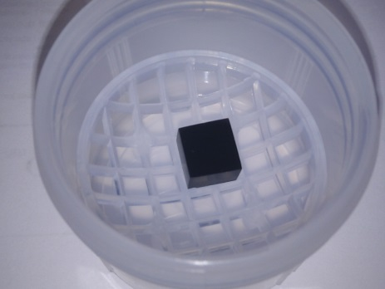

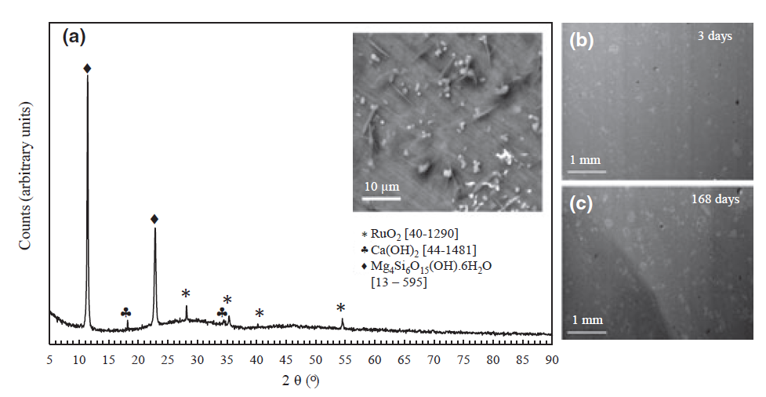
MW25 glass dissolution in Ca(OH)_{2,} 50⁰C, CO₂-exclusion
Dissolution in the presence of Ca(OH)₂ was an order of magnitude lower than in initially pure water.
Water
Ca(OH)₂
SA/V = 10,000 m⁻¹
SA/V = 10 m⁻¹
NR_{(B)} water = 1.29 x 10⁻⁴ g m⁻² d⁻¹
NR_{(B)} Ca(OH)₂ = 5.92 x 10⁻⁵ g m⁻² d⁻¹
Mg-Si phases were characterised on the surface of monoliths, and non-defined Ca-Si phases were observed.
Corkhill et al. International Journal of Applied Glass Science, 4, 341 – 356 (2013)
Notes:
Comparing boron release in deionised water and saturated calcium hydroxide solution we can see that the dissolution profiles are very different, thus the mechanisms of dissolution are expected to differ.
The dissolution rate was an order of magnitude lower in Ca(OH)2 than in initially pure water
When we look to the surface of monolith samples under the same conditions, we find that M-S-H phases (sepiolite) and uncharacterised C-S-H phases begin to form on the surface of the glass, which may be responsible for the observed “rate drop” in Ca(OH)2.
These were absent on the surfaces of glass leached in water.
In water, we observed an initial fast rate of Si release and solution saturation was achieved after ~28 days
In Ca(OH)₂, the mechanism is clearly different - Ca was consumed during the first 28 days of dissolution and Si was not released until the Ca concentration reached a threshold. This implies that Ca was reacting with the evolving glass surface.
(We observe this behaviour irrespective of glass compositions studied).
Note that Ca depletion cannot be attributed to carbonation and precipitation of calcium carbonate, because the Ca concentration in the blank solution remains constant.
Consistent with the solution data (and XRD data on the previous page), a thick alteration layer comprising Ca, Si, Al and Mg was observed in a cross section of the glass reacted in Ca(OH)₂, and in the region adjacent to the glass surface, we have found a thick calcium silicate layer.

Slide 10
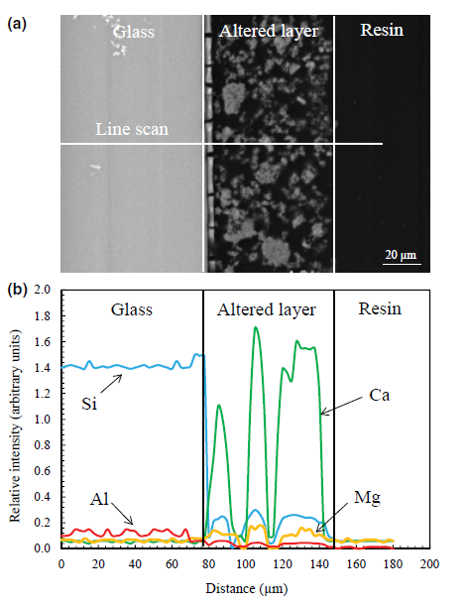
MW25 glass dissolution in Ca(OH)₂
Water: Si solution saturation was rapid
Ca(OH)₂: once Ca conc. dropped below 200 ppm and pH fell from ~12 to 10.5, Si was released to solution
A thick alteration layer comprising Ca, Si, Al and Mg was developed (C-S-H and M-S-H)
Ca(OH)₂
Blank
Corkhill et al. International Journal of Applied Glass Science, 4, 341 – 356 (2013)
Notes:
In water, we observed an initial fast rate of Si release and solution saturation was achieved after ~28 days
In Ca(OH)₂, the mechanism is clearly different - Ca was consumed during the first 28 days of dissolution and Si was not released until the Ca concentration reached a threshold. This implies that Ca was reacting with the evolving glass surface.
(We observe this behaviour irrespective of glass compositions studied).
Note that Ca depletion cannot be attributed to carbonation and precipitation of calcium carbonate, because the Ca concentration in the blank solution remains constant.
Consistent with the solution data (and XRD data on the previous page), a thick alteration layer comprising Ca, Si, Al and Mg was observed in a cross section of the glass reacted in Ca(OH)₂, and in the region adjacent to the glass surface, we have found a thick calcium silicate layer.

Slide 11
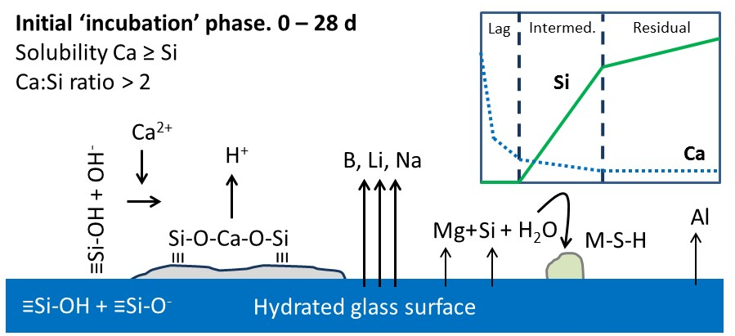
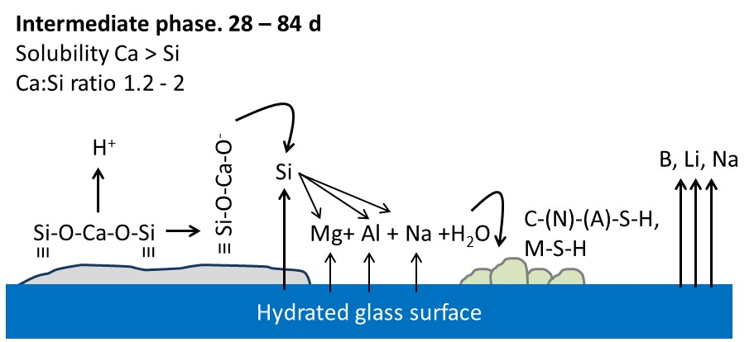
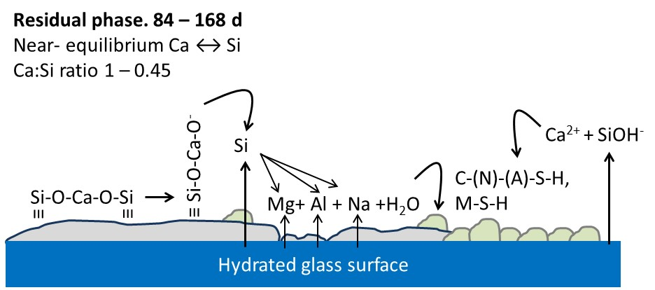
MW25 glass dissolution in Ca(OH)₂
Dissolution occurs in 3 regimes:
1. Incubation regime (0 – 28 days):
Incorporation of Ca into the hydrated glass surface and precipitation of M-S-H phases
2. Intermediate regime (28 – 84 days):
Precipitation of C-S-H phases, including a range of compositions in the C-(N)-(A)-S-H and M-S-H systems; rapid Si dissolution
3. Residual regime (84 – 168 days):
Precipitation of lower Ca/Si ratio C-S-H phases; steady concentration of Ca; slower dissolution of Si
Notes:
Together these data and thermodynamic modelling of the CaO-SiO-H₂O system allow us to develop a mechanistic description of glass dissolution in saturated calcium hydroxide media.
A schematic of Ca and Si in solution is shown at the top as a reference to 3 identified regimes of dissolution:
In the incubation regime, Ca is incorporated into the hydrated glass surface. We also observe the precipitation of M-S-H phases (sepiolite) during this time.
The intermediate regime occurs when Si is rapidly released into solution. Si is able to react with Ca to form a range of C-S-H phases with a high Ca / Si ratio, and also with other dissolved elements (Al, Mg, Na) to form a range of phases in the C-(N)-(A)-S-H and M-(A)-S-H systems.
In the residual regime, the Ca concentration in solution becomes constant and Si release into solution is significantly slowed. During this time there is further precipitation of C-S-H, but with a lower Ca:Si ratio, and also continued precipitation of other phases in the C-(N)-(A)-S-H and M-(A)-S-H systems.
It is important to note that the continuous release of boron to solution implies that this alteration layer is not protective in nature.

Slide 12
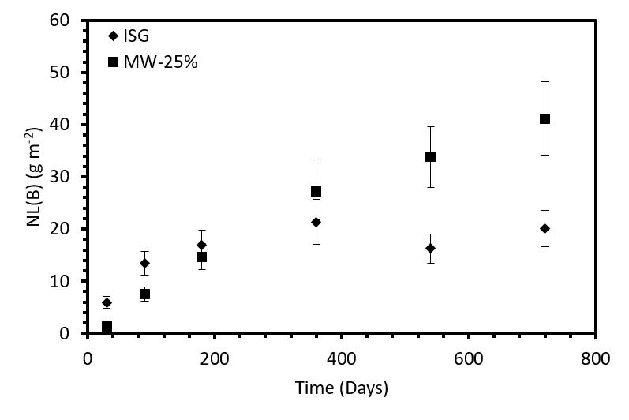
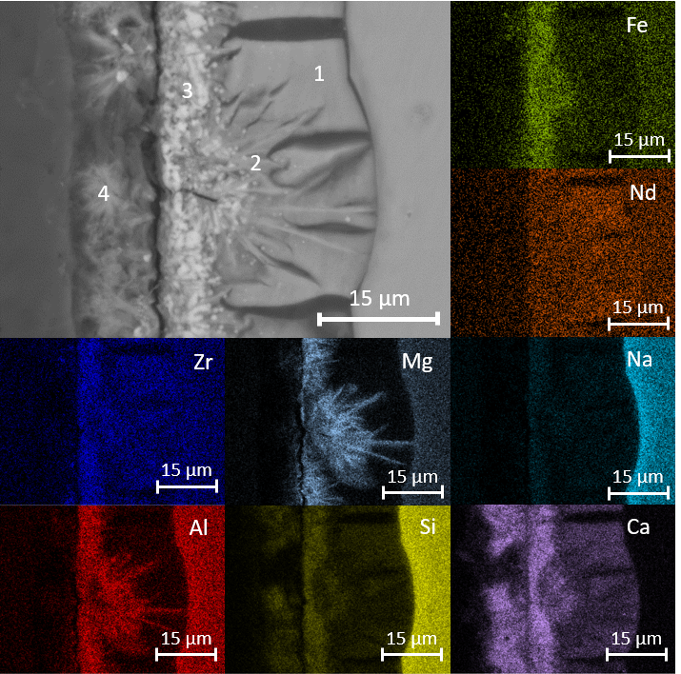
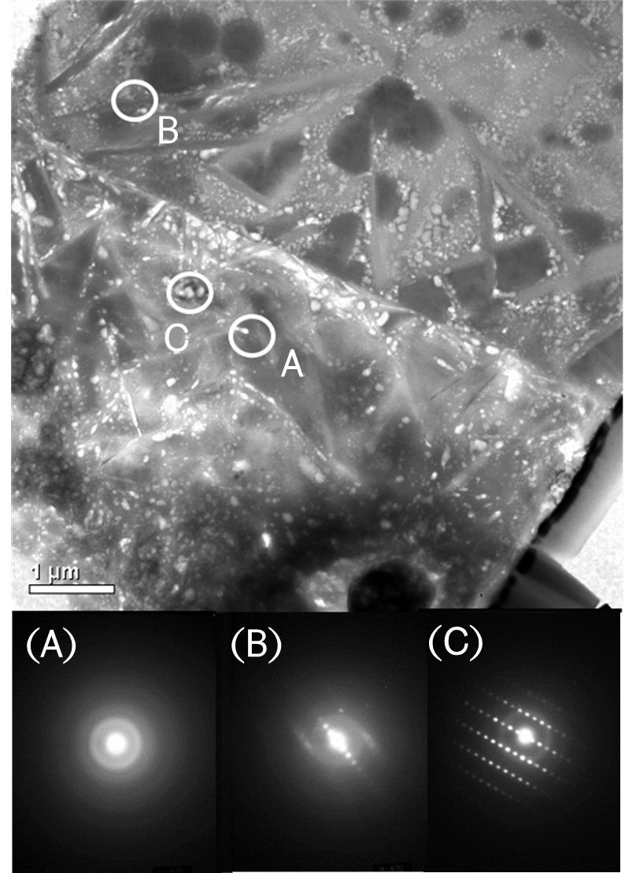
Alteration layer analysis
(ISG) NL_{(B)720d} = 20.13 ± 3.50 g m⁻²
(MW25) NL_{(B)720d} = 41.2 ± 7.0 g m⁻²
MW25 720d, Ca(OH)₂ 50˚C
MW25: SEM / EDX
MW25: TEM / SAED
Notes:
Micro-focus XRD summed over a 10 µm² area, combined with SAED confirmed the presence of the following phases corresponding to each of the regions: (A) amorphous Ca/Si gel; (B) acicular needles of mexinerite [Mg₆Al₂(OH)₁₈)·4.5H₂O]; (C) bright contrast Fe-rich phases (as yet unidentified). Also identified by µ-XRD were Portlandite [Ca(OH)₂] and brucite [Mg(OH)₂].

Slide 13

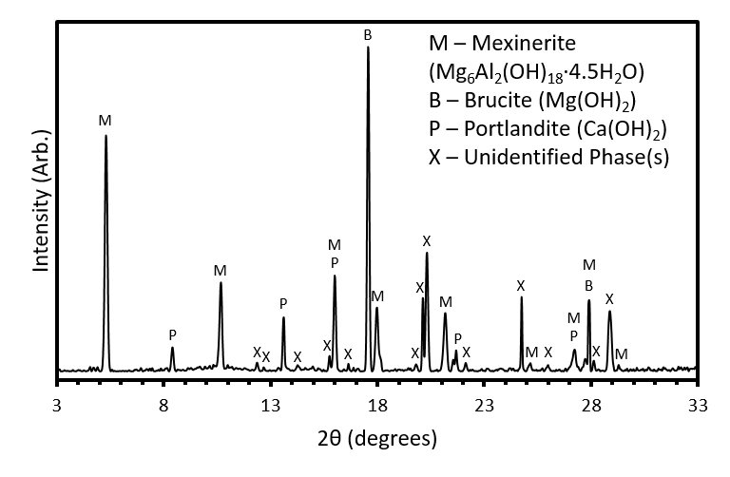
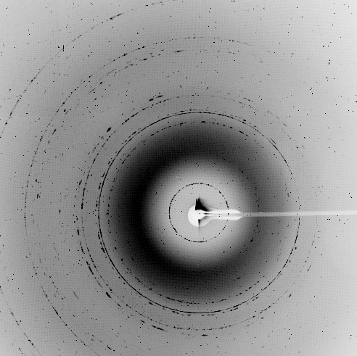
Alteration layer analysis
(ISG) NL_{(B)720d} = 20.13 ± 3.50 g m⁻²
(MW25) NL_{(B)720d} = 41.2 ± 7.0 g m⁻²
MW25 720d, Ca(OH)₂ 50˚C
MW25: SEM / EDX
MW25: μ-XRD
Notes:
Micro-focus XRD summed over a 10 µm² area, combined with SAED confirmed the presence of the following phases corresponding to each of the regions: (A) amorphous Ca/Si gel; (B) acicular needles of mexinerite [Mg₆Al₂(OH)₁₈)·4.5H₂O]; (C) bright contrast Fe-rich phases (as yet unidentified). Also identified by µ-XRD were Portlandite [Ca(OH)₂] and brucite [Mg(OH)₂].

Slide 14
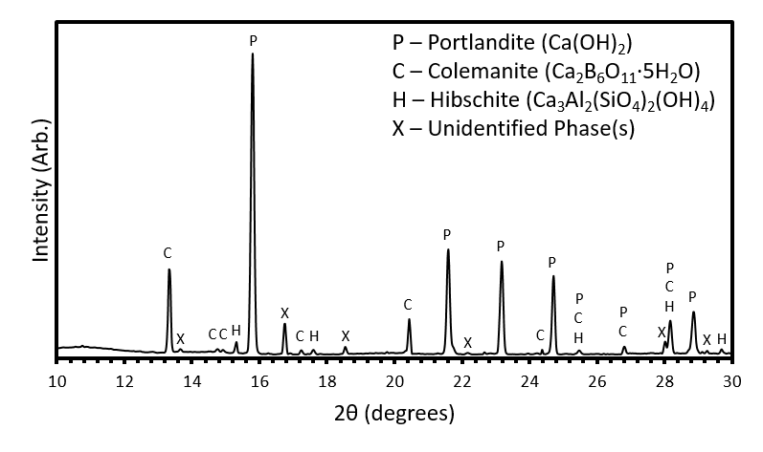
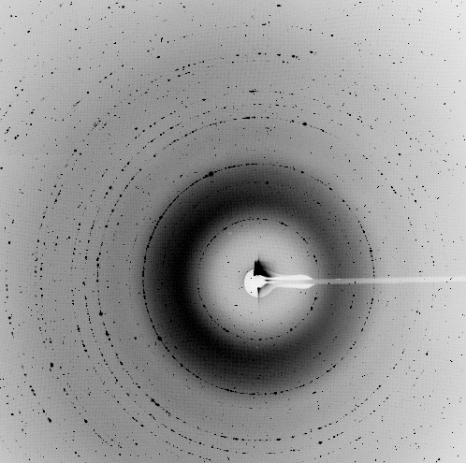
Alteration layer analysis
(ISG) NL_{(B)720d} = 20.13 ± 3.50 g m⁻²
(MW25) NL_{(B)720d} = 41.2 ± 7.0 g m⁻²
ISG 720d, Ca(OH)₂ 50˚C
ISG: SEM / EDX
ISG: μ-XRD
Notes:
Micro-focus XRD summed over a 10 µm² area, combined with SAED confirmed the presence of the following phases corresponding to each of the regions: (A) amorphous Ca/Si gel; (B) acicular needles of mexinerite [Mg₆Al₂(OH)₁₈)·4.5H₂O]; (C) bright contrast Fe-rich phases (as yet unidentified). Also identified by µ-XRD were Portlandite [Ca(OH)₂] and brucite [Mg(OH)₂].

Slide 15
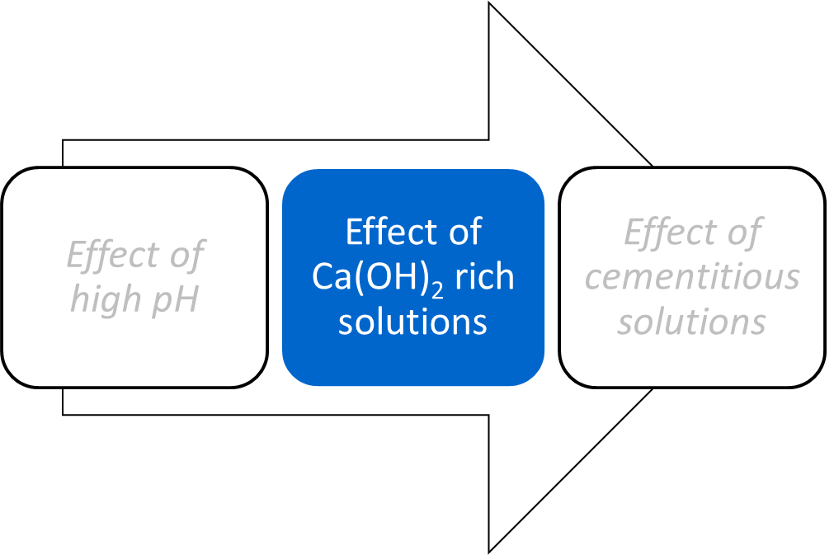
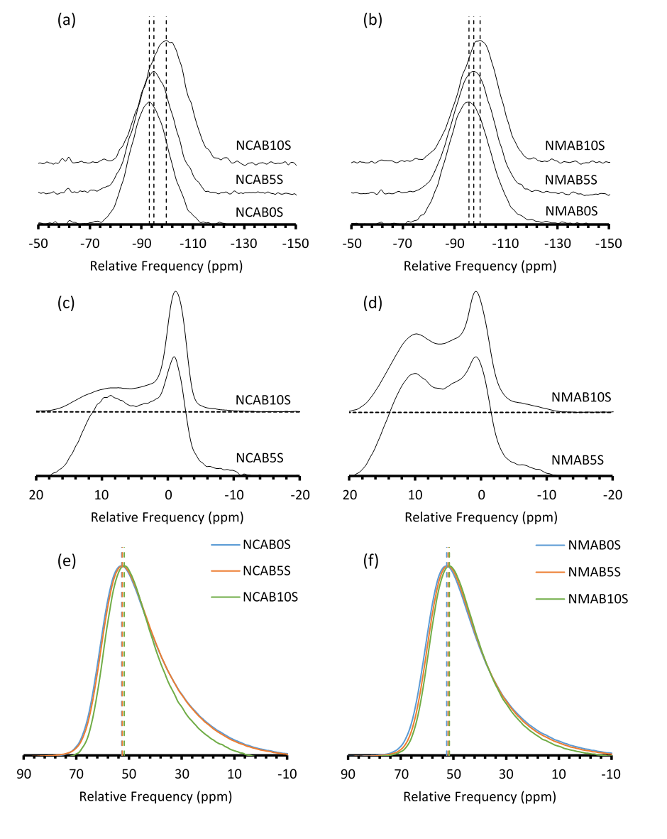
What we’ve learnt (or now know what we don’t know)
What we’ve learnt
Na₂O∙CaO∙(1–x)Al₂O₃∙xB₂O₃∙SiO₂ (NCABxS) Na₂O∙MgO∙(1–x)Al₂O₃∙xB₂O₃∙SiO₂ (NMABxS)
Quasi-equilibrium of Ca-Si phases controls dissolution of glass
Some alteration layer phases enhance dissolution, some reduce it.
Boron is not a good tracer for dissolution in Ca-rich solutions
²⁹Si
¹¹B
²⁷Al
What we don’t know
How exactly is Mg influencing dissolution behaviour?

Slide 16
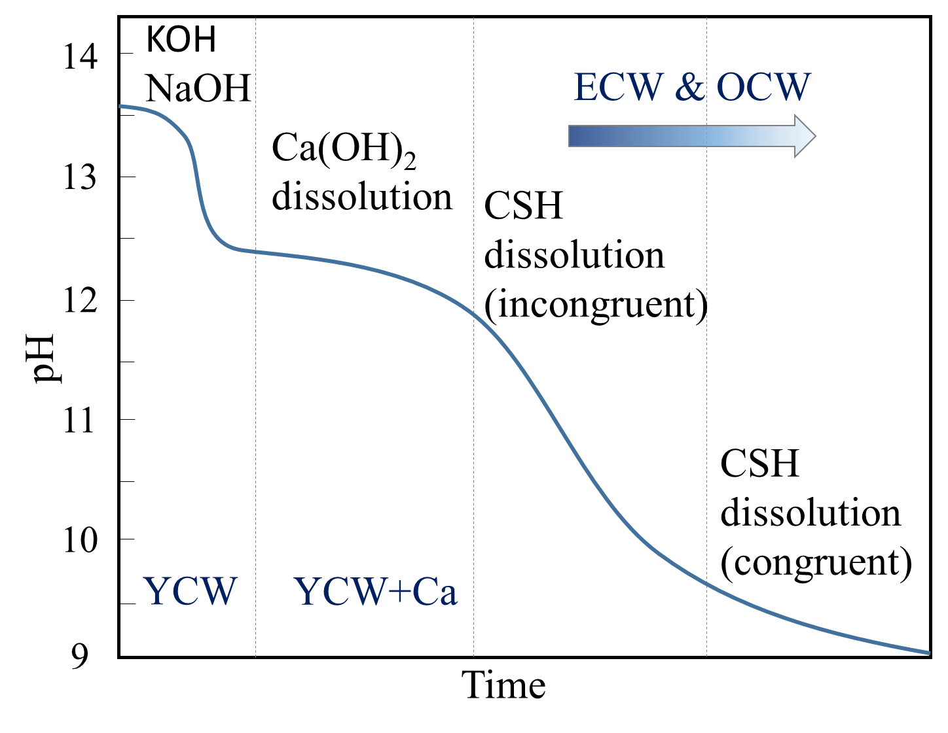
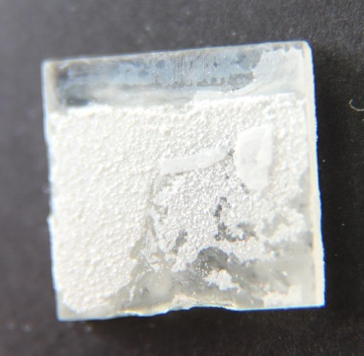
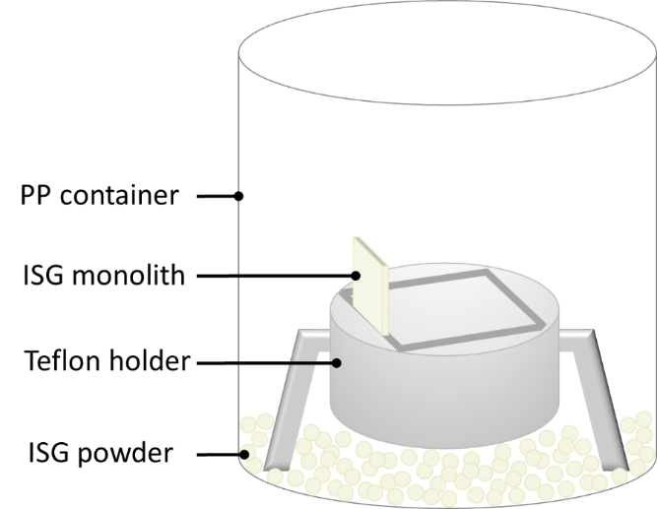


Dissolution in cement leachate
Synthetic Cement Water
 | YCWCa | ECW | OCW
Initial pH | 13.17 ± 0.02 | 12.58 ± 0.01 | 11.71 ± 0.04
Final pH | 13.12 ± 0.02 | 12.31 ± 0.11 | 11.61 ± 0.06
NaOH (1M) | P | P | P
KOH (1M) | P | - | -
KOH (0.1M) | - | P | -
Ca(OH)₂ | P | P | P
Na₂SO₄ | P | - | P
CaCO₃ | P | - | P
ISG
MW25
Up to 700 d at 70ºC

Slide 17
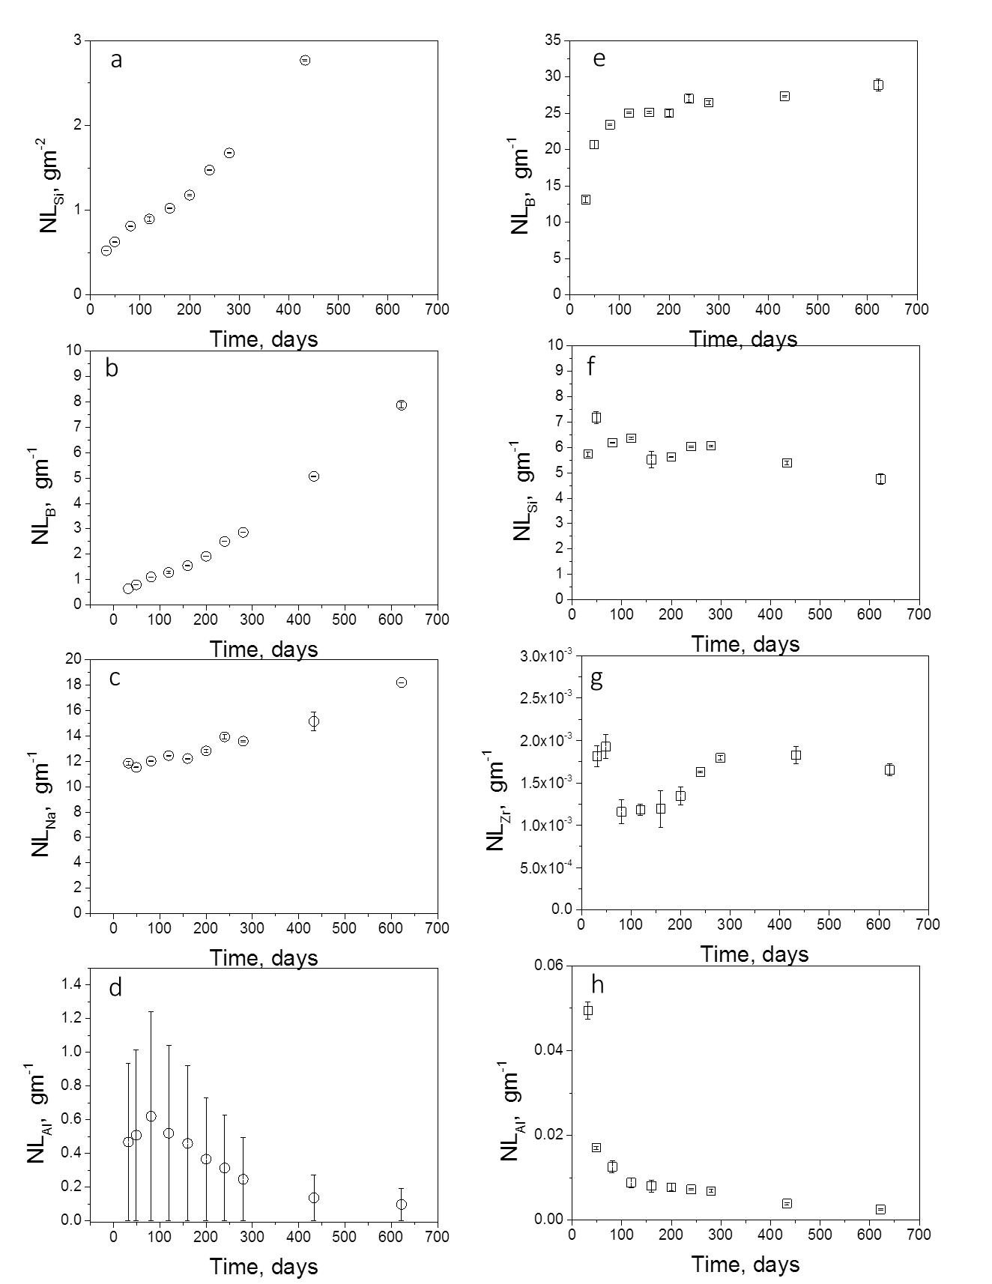
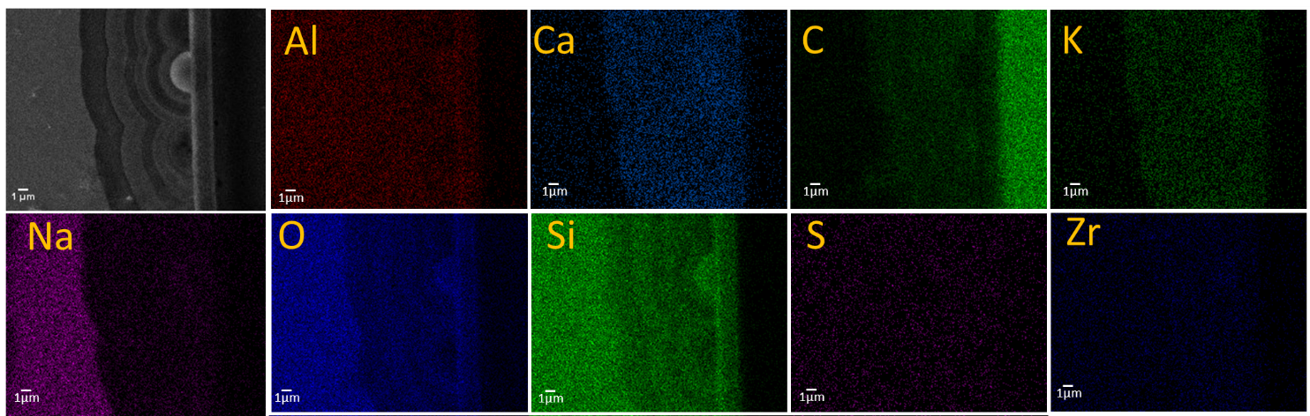
Dissolution of ISG in YCWCa
Element | Concentration (mg L⁻¹)
Al | <0.2
Ca | 15.7
K | 12900
Mg | <0.01
Na | 3300
Si | 5.4
Cl⁻ | <1
SO₄²⁻ | 188
Zr
Si
Al
B
720 d

Slide 18
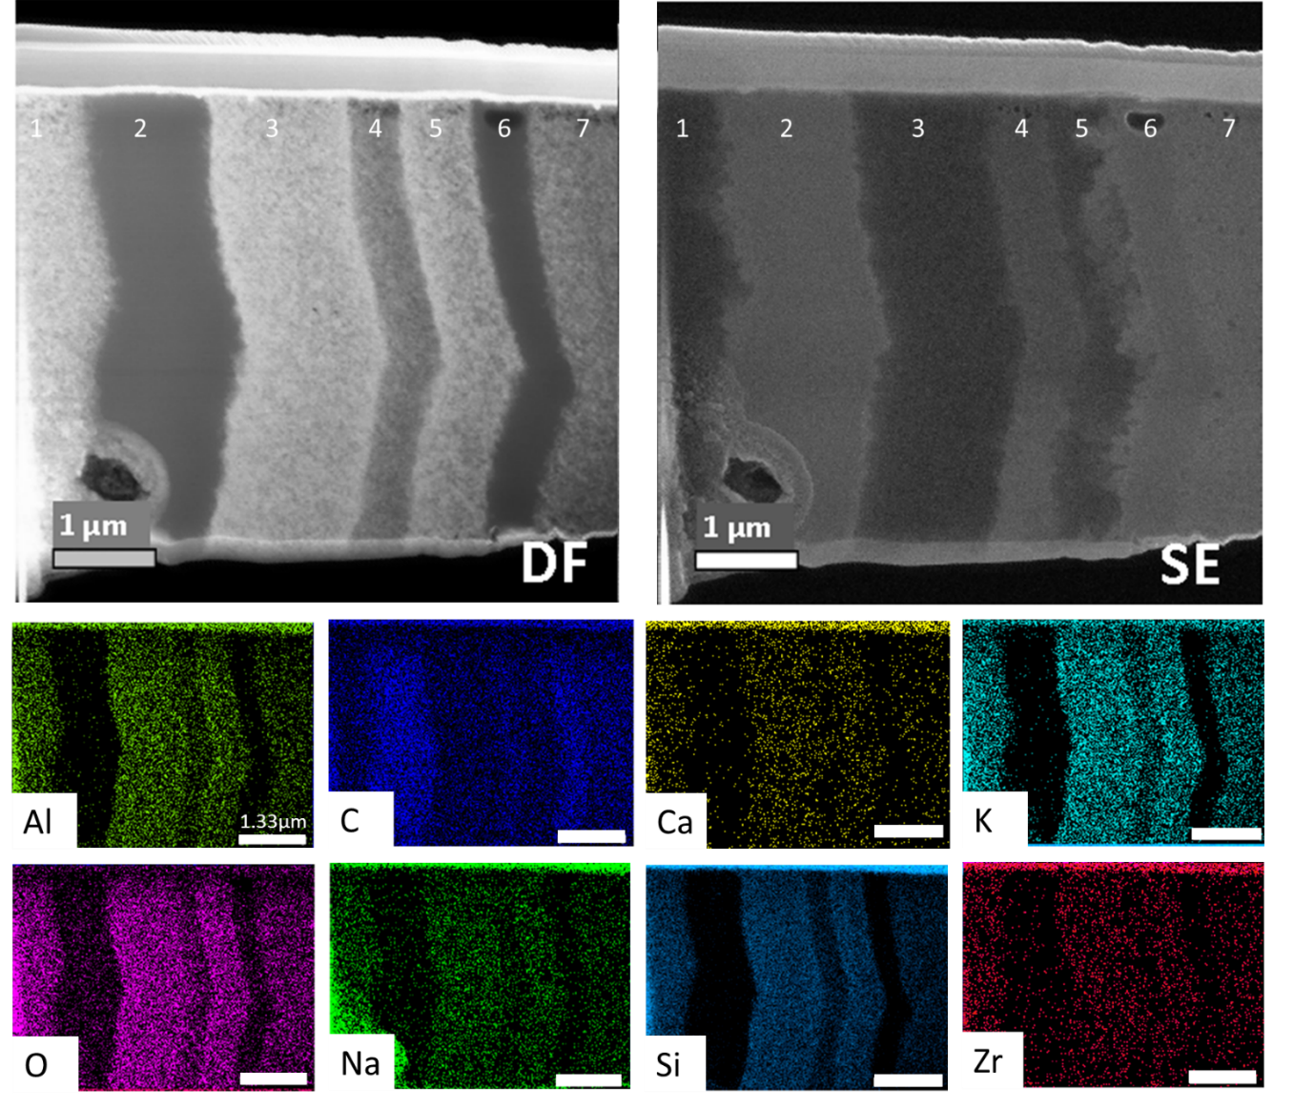
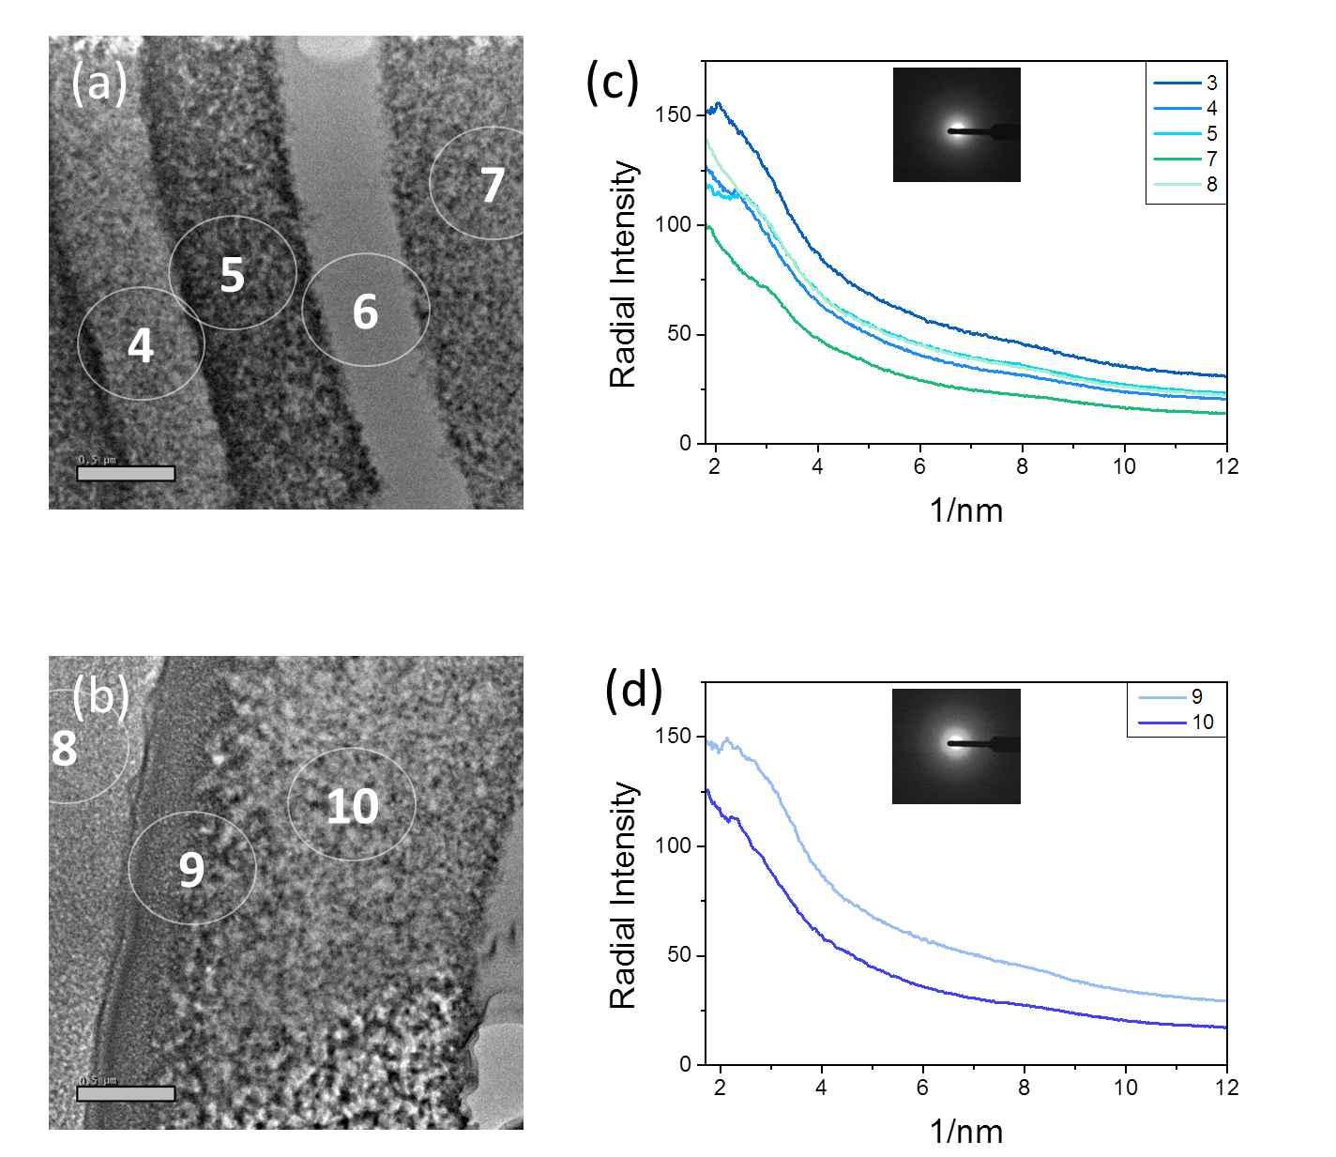
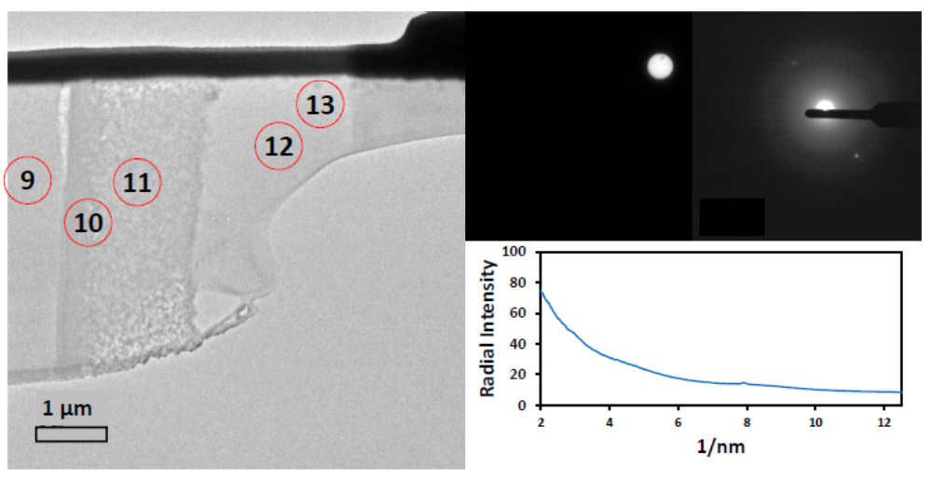
Dissolution of ISG in YCWCa
Pore size: 7 – 15 nm

Slide 19
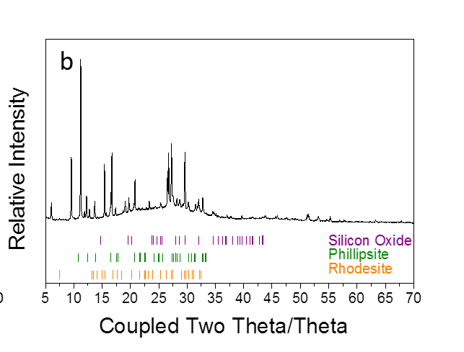
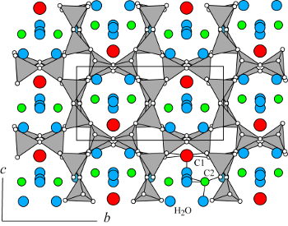
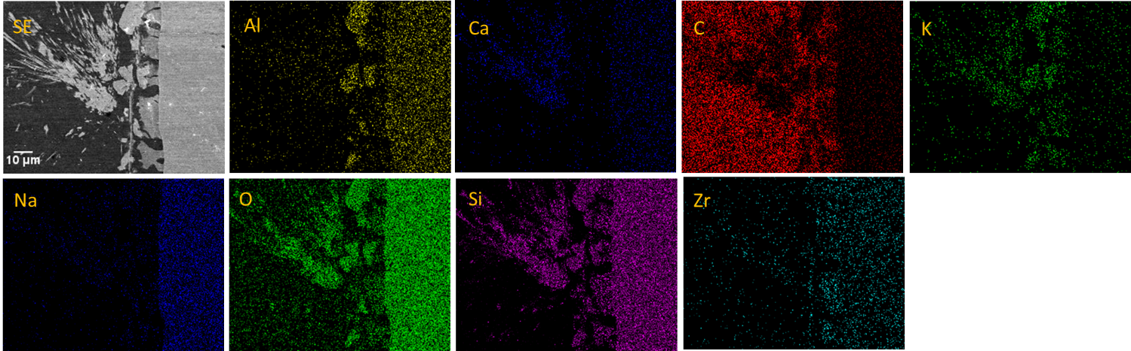
Dissolution of ISG in YCWCa
Quartz (SiO₂)
Phillipsite-K (Na₄KAl₅Si₁₁O₃₂.10H₂O)
Rhodesite (Ca, Na₂ K₂)₈Si₁₆O₄₀.11H₂O)
Phillipsite-K
Notes:
Rhodesite is not a zeolite, but the double layer silicates have a similar pore-filling structure
The ratio SiOz: Alz03 should be at least as high as for zeolite formation.

Slide 20
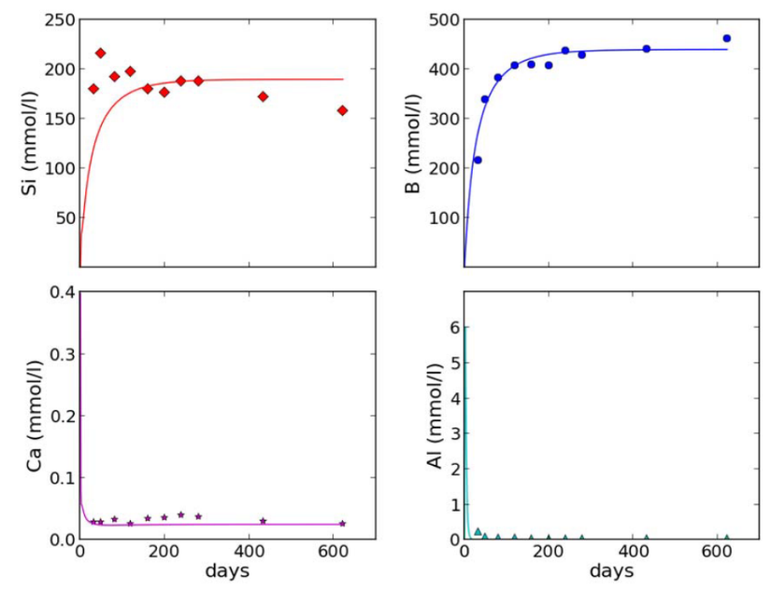
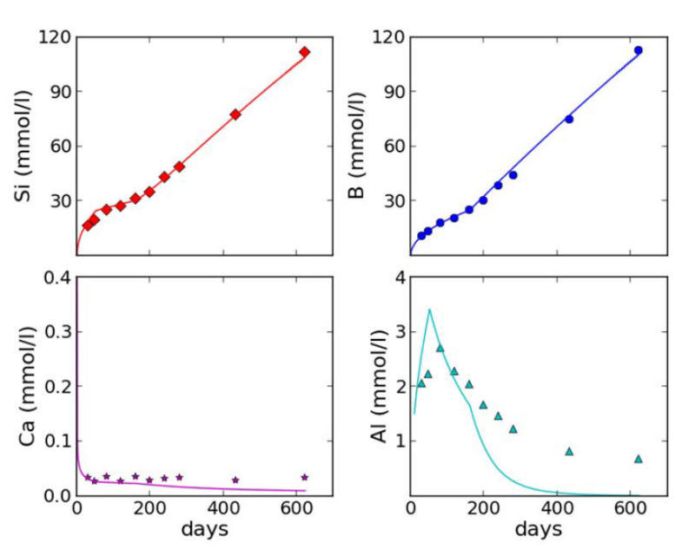
Dissolution of ISG in YCWCa
70°C
70°C modelled successfully using an affinity based term
30°C
Same experiments at 30°C modelled:
< 160d = diffusion model
> 160d = affinity based model but with the saturation term removed

Slide 21
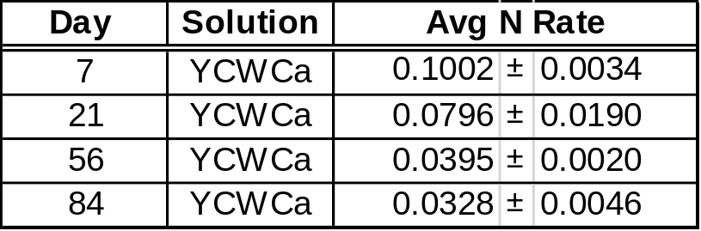
MW25 dissolution YCWCa
Rate (g m⁻² d⁻¹) based on Na, Li:

Slide 22
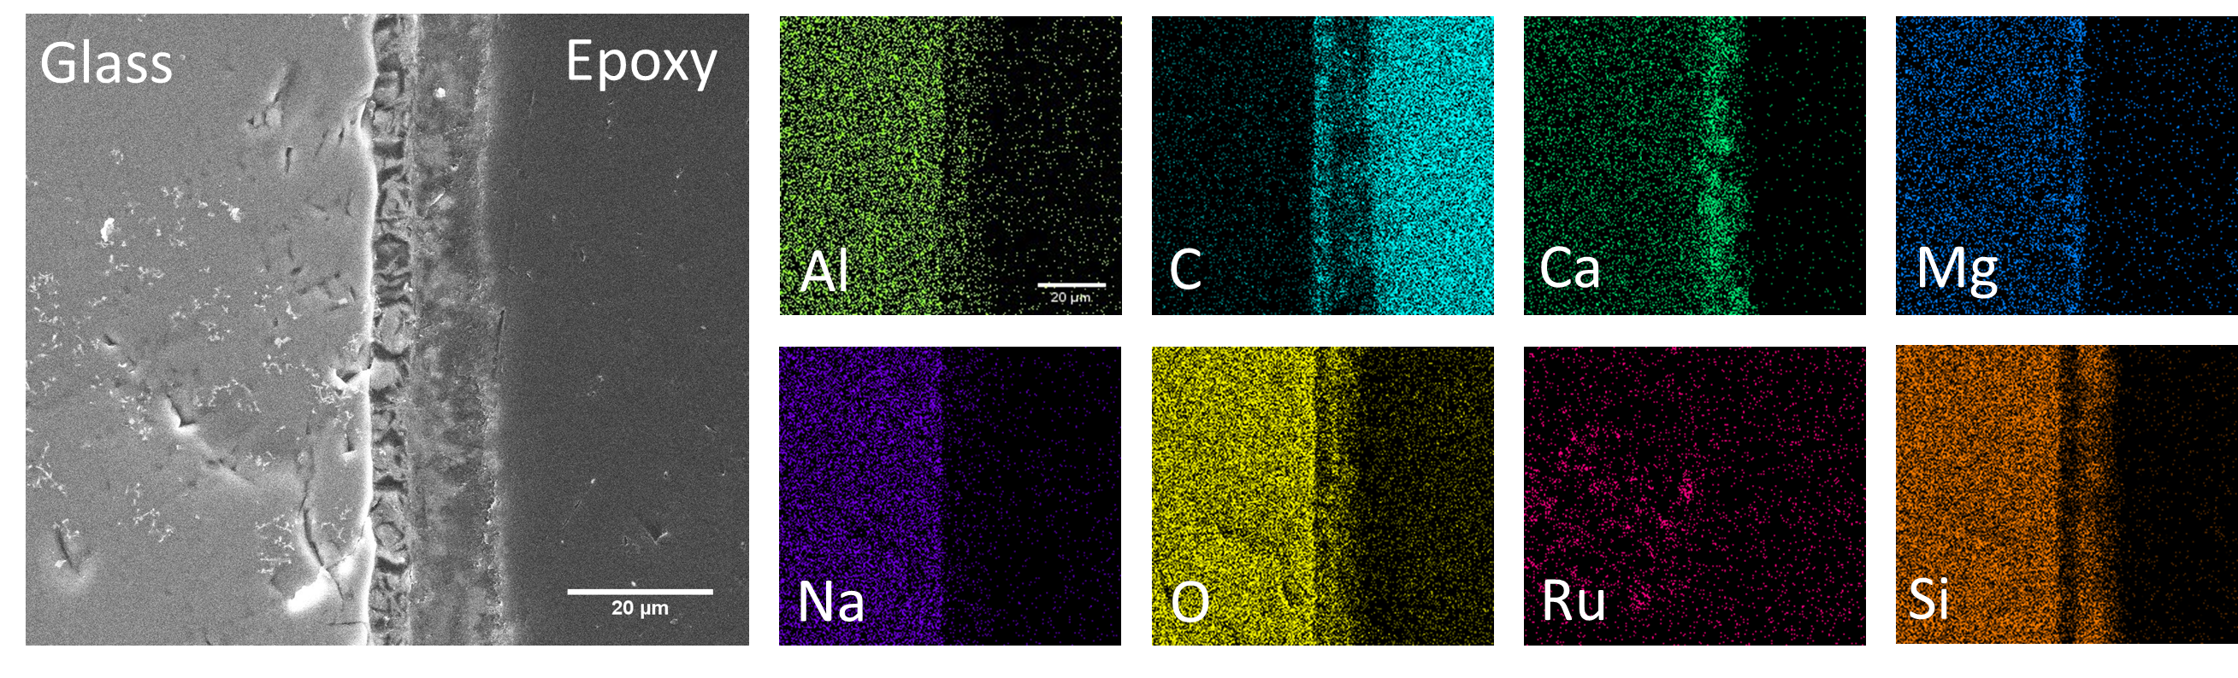
MW25 dissolution YCWCa
Rate (g m⁻² d⁻¹) based on Na, Li:

Slide 23
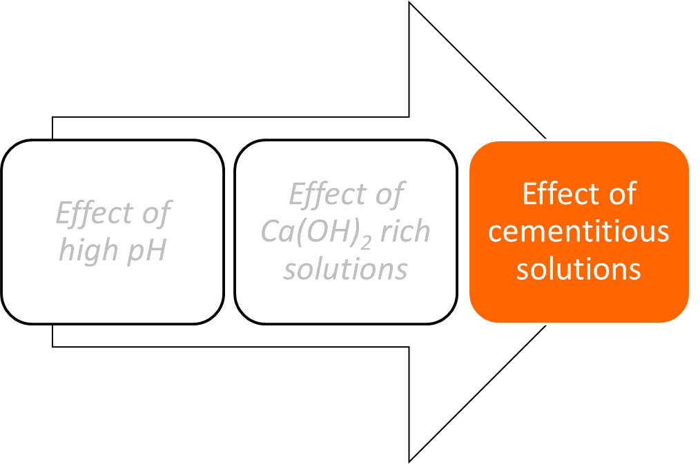
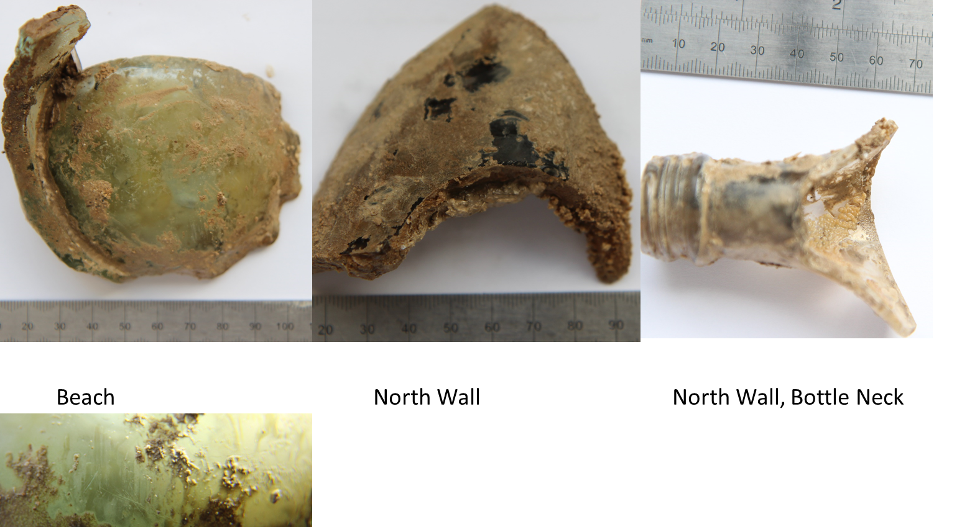
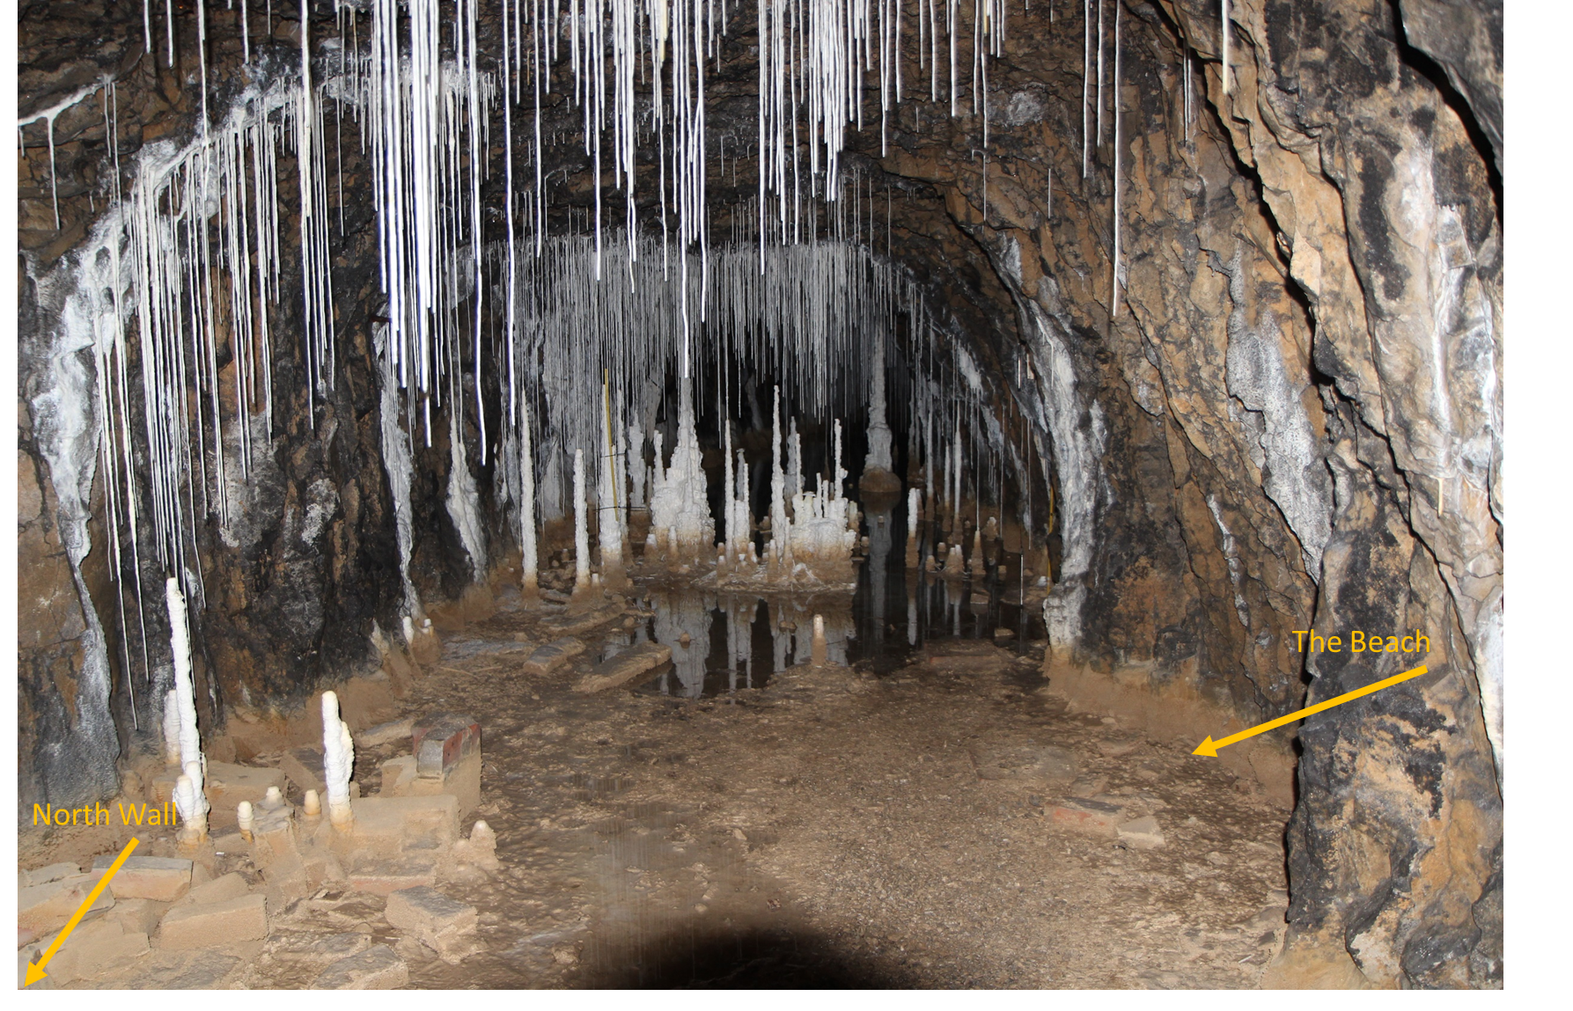
What we’ve learnt (or now know what we don’t know)
What we don’t know
Will dissolution in cement water lead to rate resumption?
How will glass dissolution evolve as a function of cement leaching?
What will happen if we use real cement leachates?
Why does Mg behave differently in cement leachate to Ca(OH)₂?
What we’ve learnt
Dissolution in cement water is complicated!

Slide 24


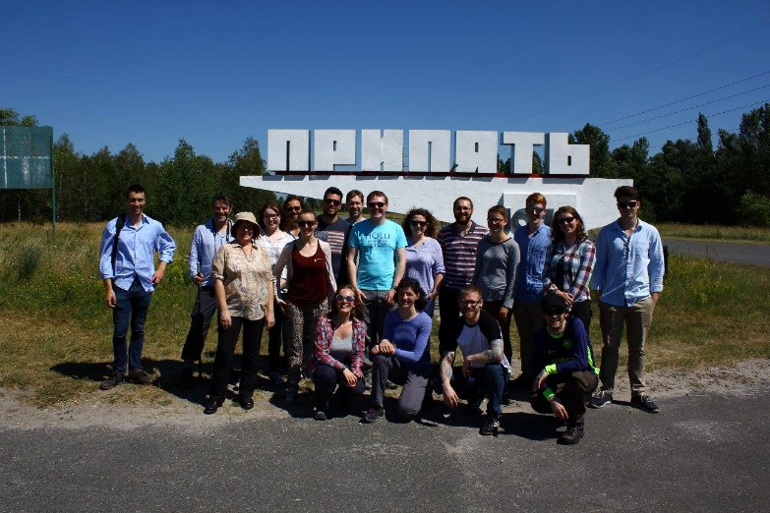



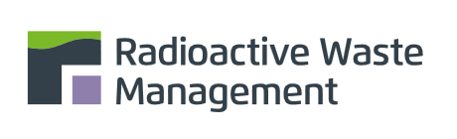
Acknowledgements
NucleUS Immobilisation Science Group
PhD students:
Daniel Backhouse
Colleen Mann
Adam Fisher
Nate Cassingham
Dr. Eric Pierce (ORNL) Dr. Dan Crean (AWE)
Dr. Joe Ryan (PNNL) Prof. Neil Hyatt (UoS)
Dr. Jim Neeway (PNNL) Prof. Russell Hand (UoS)
Dr. Karine Ferrand (SCK.CEN)
Dr. Karel Lemmens (SCK.CEN)
Dr. Daniel Grolimund (PSI)

Slide 25
Mg in MW25
Na₂O∙CaO∙(1–x)Al₂O₃∙xB₂O₃∙SiO₂ (NCABxS) Na₂O∙MgO∙(1–x)Al₂O₃∙xB₂O₃∙SiO₂ (NMABxS)
Replacement of Al₂O₃ by B₂O₃ leads to a decrease in the total number of Q₄(X) units and an increase in symmetric Q₄
Al was present in tetrahedral coordination, suggesting preferential charge compensation (over ^{IV}B)
~10 mol% of Na₂O is charge compensated by ~10 mol% Al₂O3, leaving CaO or MgO for ^{IV}B charge compensation
Fraction of ^{IV}B units is lower in Mg-glasses – Mg is ^{IV}-fold also, therefore it is not available for charge compensation of ^{IV}B units
Lower ^{IV}B units in Mg-glass results in lower number of Si-O-B bonds as seen in the ²⁹Si
²⁹Si
¹¹B
²⁷Al
Notes:
Increasing the B/Al ratio of the alkali-alkaline-earth aluminoborosilicate glasses led to an overall decrease in the proportion of non-silicate tetrahedral species (^{IV}Al + ^{IV}B) and a decrease in Si – O – X bonds (X = B, Al). This was found to correspond to an increase in dissolution rate for the Mg-bearing glass compositions compared to the Ca-bearing glass counterpart compositions
The relative frequency of the ²⁹Si spectra peaks shifted to more negative values with increasing B/Al ratio for both the NCABxS and NMABxS
The replacement of Al₂O₃ by B₂O₃ leads to a decrease in the total number of Q₄(X) units and an increase in symmetric Q₄
The ²⁷Al 3QMAS-NMR (Figure 2) spectra indicate that most of the Al present in the NCABxS and NMABxS glasses was in tetrahedral coordination . This implies that the Al tetrahedra are charge-compensated preferentially over the ^{IV}B tetrahedra, as suggested by Yamashita et al. [22], [23]. Thus, for the NCAB5S and NMAB5S glasses, ~10 mol.% of Na₂O is likely charge-compensated by ~10 mol.% of Al₂O₃, leaving CaO or MgO for ^{IV}B charge-compensation. Albeit in three different configurations? That’s what the data shows (and what you have written in the results).
Systematic differences are observable between the ²⁹Si and ¹¹B spectra of the NCABxS and NMABxS series. The relative frequency of the peaks of the ²⁹Si spectra is lower for each of the NMABxS glasses compared to their NCABxS counterparts (Figs. X and Y). In addition, the fraction of ^{IV}B units is lower for the NMABxS glasses than for the NCABxS glasses. This is attributed to the presence of Mg in the glass as tetrahedral ^{IV}Mg units. Mg is known to exist in four-fold coordination in glasses, whereas this is not the case for Ca, which prefers XX coordination [26]. If Mg was in four-fold coordination, it would not be available for charge-compensation of ^{IV}B units, and would thus lead to a lower ^{IV}B fraction than for the equivalent CaO-containing glass. Units of ^{IV}Mg would also require charge-compensation by Na⁺ cations [27], further reducing the number of cations available to charge-compensate the ^{IV}B units. The lower ^{IV}B fractions in the Mg-containing glasses would lead to lower numbers of Si – O – B bonds and hence fewer asymmetric Q₄ silicate tetrahedra, resulting in more negative ²⁹Si spectral shifts.
Ok, I get it, but there must be a better way to write this. Like, doesn’t this agree with the analysis of the B data? Point the reader to the figures for the claims you’re making, because it’s not easy to work out how you’re making these assertions (to my not-great-at-glass-structure brain, anyway).

Slide 26

MW25 glass dissolution in Ca(OH)₂
Secondary phase composition predictions
0 – 28 days
28 – 84 days
84 – 168 days
Saturated
Unsaturated
The following phases were predicted to form:
0 – 28 days: Sepiolite
28 – 84 days: tobermorite, sepiolite
84 – 168 days: analcime, phillipsite-Ca, tobermorite, sepiolite
Corkhill et al. International Journal of Applied Glass Science, 4, 341 – 356 (2013)
Notes:
Plotting the solution chemistry data on the CaO-SiO₂-H₂O phase diagram we can see that the solution chemistry evolves across the C-S-H stability fields, where C-S-H I is representative of high Ca:Si ratio calcium silicate hydrates and C-S-H II represents low Ca:Si precipitates.
This suggests that glass dissolution in Ca(OH)₂ is governed by C-S-H solubility and hence, Ca and Si “quasi-equilibrium” in solution.
Geochemical modelling supports this behaviour, and predicts that at early stages of dissolution minerals with a high Ca:Si ratio are saturated in solution and are therefore likely to form, and with time the Ca:Si ratio of the saturated phases falls.
The predicted alteration layer phases from geochemical modelling are:

