Slide 1




THE CORROSION OF COPPER NUCLEAR WASTE CONTAINERS UNDER DEEP GEOLOGIC CONDITIONS
T.Standish, S.Ramamurthy, J.Turnbull, D.Zagidulin, J.J.Noel# and D.W.Shoesmith#
Department of Chemistry and #Surface Science Western,
Western University, London, Ontario, Canada
www.sun.chem.uwo.ca
www.surfacesciencewestern.com
dwshoesm@uwo.ca
This research is funded under a research agreement between the Canadian Natural Sciences and Engineering Research Council NSERC) and the Canadian Nuclear Waste Management Organisation (NWMO)

Slide 2
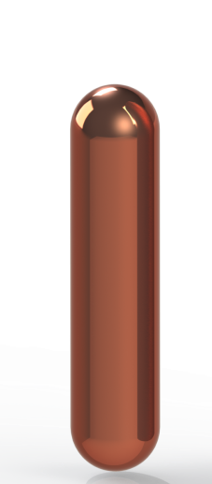


The Proposed Canadian Container is a Steel Vessel Coated with a thin (~3mm thick) Corrosion Resistant Copper Layer
~0.57 m
~2.5 m
Notes:
I can say that this is potentially the most dangerous failure mode (and that’s why NWMO is investing in researching this)
The motivation behind my research is ensuring the safe long-term management used nuclear fuel. Canada’s proposed long term management method involves placing used fuel bundles in a copper-coated carbon steel container (the Cu coating being either electrodeposited or cold spray), (sealing the containers), and placing them ~500 m below ground in a deep geological repository. In the repository, the containers will eventually come into contact with groundwater and can begin to corrode. This is where my research comes in.
These containers are the primary engineered barrier within the multi-barrier system proposed for the permanent disposal of spent nuclear fuel.

Slide 3
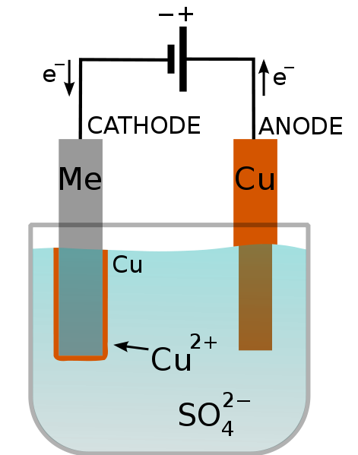
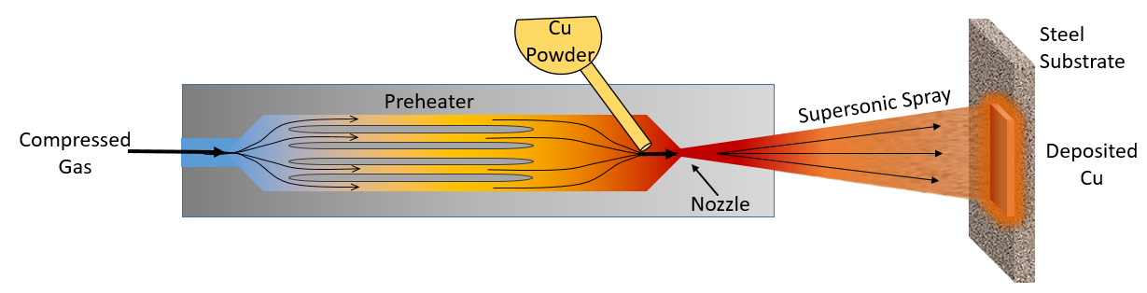
COATING PROCESSES
Cold Spray Deposition
Electrodeposition
Cu powder (1 – 50 µm (diameter))
400ºC
Pressurized carrier gas (He and/or N₂)
Pulsed electrodeposition
Details proprietary

Slide 4
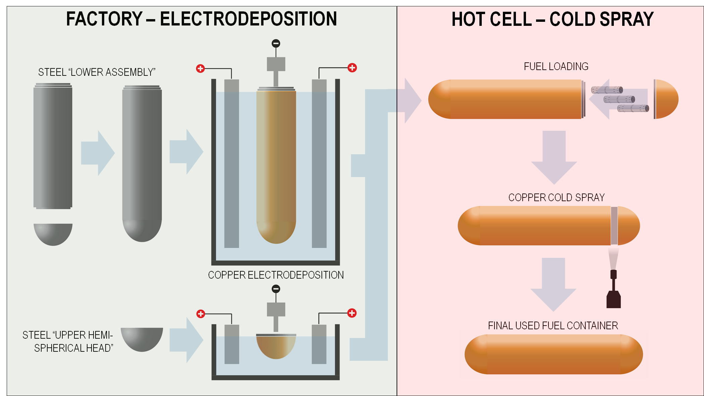
Container Fabrication
Fuel Loading and Container Sealing
Notes:
As we saw yesterday, two types of Cu coatings are used on the UFC – ED on body and CS on the region that’s welded shut.

Slide 5
Possible Container Corrosion Processes in Anticipated Repository Groundwaters (Expected to be Saline)
(Standish et al. Electrochim.Acta 211, 331 (2016)
ϒ radiation
H₂O₂
Radiolytic corrosion
e⁻
OH⁻
Cu
CuCl_{x}^{(1-x)+}
O₂
Corrosion of the steel by galvanic coupling to the coating possibly at a defective weld (possible delamination)
e⁻
OH⁻
Fe
Fe²⁺
O₂
STEEL CONTAINER
Corrosion by residual groundwater oxidants
e⁻
OH⁻
Crevice corrosion due to residual water in the container at the weld region
Cu
CuCl_{x}^{(1-x)+}
SH⁻
Corrosion due to sulphide transport arising from remote microbial activity
Cu₂S

Slide 6
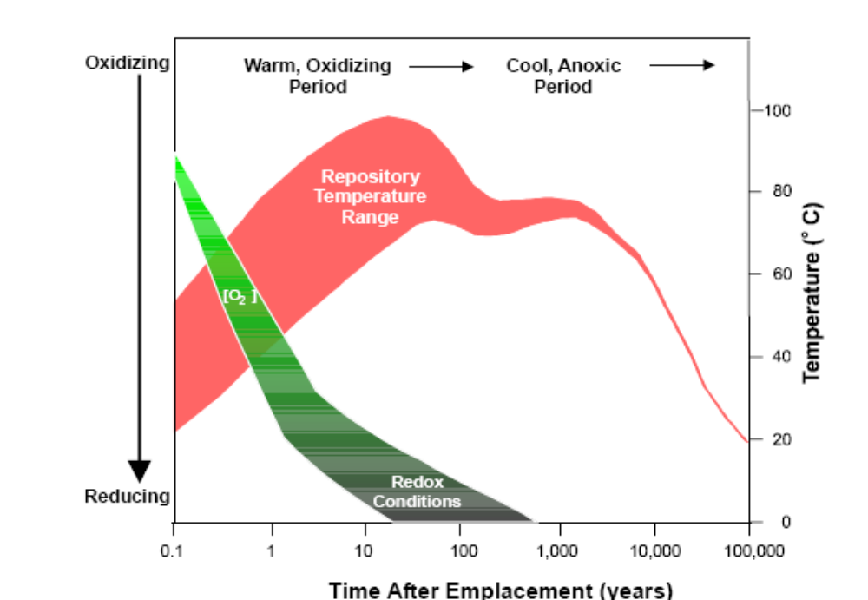
The importance of specific corrosion processes will change as the exposure environment evolves
Oxygen may not survive the partially re-saturated (moist) period
Radiation dose rate at surface
Dry
Moist
Wet
Corrosion in humid, aerated vapour
Corrosion in aerated aqueous environment
Galvanic corrosion of defected containers
Corrosion at a defective weld under anoxic conditions
Corrosion by remotely produced sulphide

Slide 7
Radiolytic corrosion in humid aerated vapour

Slide 8
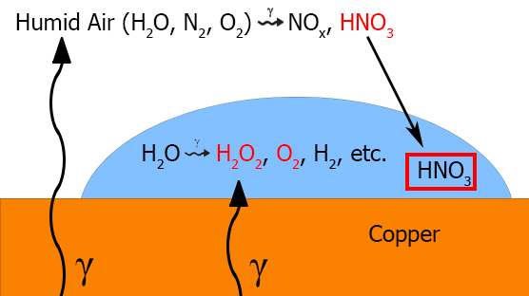
ϒ radiation
H₂O₂
For short term processes, determine a corrosion allowance
Radiolytic corrosion
e⁻
OH⁻
Cu
CuCl_{x}^{(1-x)+}
STEEL CONTAINER
Corrosion due to radiolytically-produced HNO₃ in H₂O condensed on the container surface.
Mechanism and rate determined in microcells.

Slide 9
Change in pH monitored in a small volume of aerated solution with various [HNO₃]
Corrosion eventually inhibited
Attributed to the accumulation of corrosion products
1.5 mL
HNO₂ ↔ NO₂⁻ + H⁺
Observation of NO₂⁻ confirms NO₃⁻ is acting as an oxidant
O₂ + 4H⁺ + 4e⁻ → 2H₂O
NO₃⁻ + 2H⁺ + 2e⁻ → NO₂⁻ + H₂O
2Cu → 2Cu⁺
Cu → Cu²⁺
Rate of H⁺ consumption independent of [HNO₃] suggesting NO₃⁻ is not the main oxidant

Slide 10
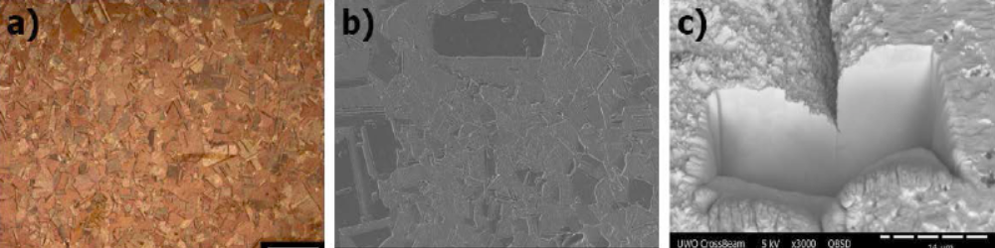
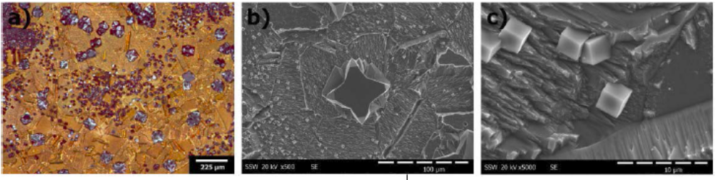
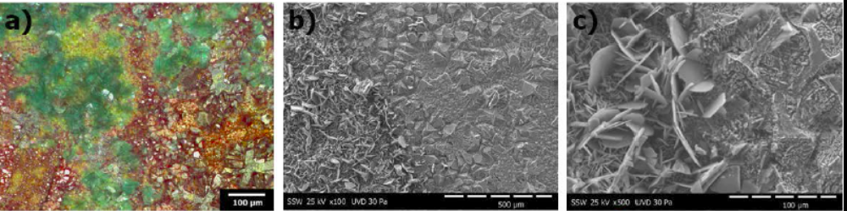
Evolution of the surface condition as corrosion progresses
1
2
1
2
3
3
Grain boundary etching in the early stages
Cu₂O and CuO accumulate and eventually block corrosion
Precipitation of Raouite (Cu₂NO₃(OH)₃) confirms all the NO₃⁻ is not consumed

Slide 11
HNO₃ unreactive in the absence of O₂
31d
119d
230d
Adsorbed NO₃⁻ and NO₂⁻ species appear to block the corrosion process
Small amount of O₂ could catalyze reaction with HNO₃ ??
4Cu + O₂ + 2H₂O → 4Cu⁺ + 4OH⁻
2Cu⁺ + NO₃⁻ + 2H⁺ → 2Cu²⁺ + NO₂⁻ + H₂O
363d

Slide 12
Corrosion at a defective weld

Slide 13
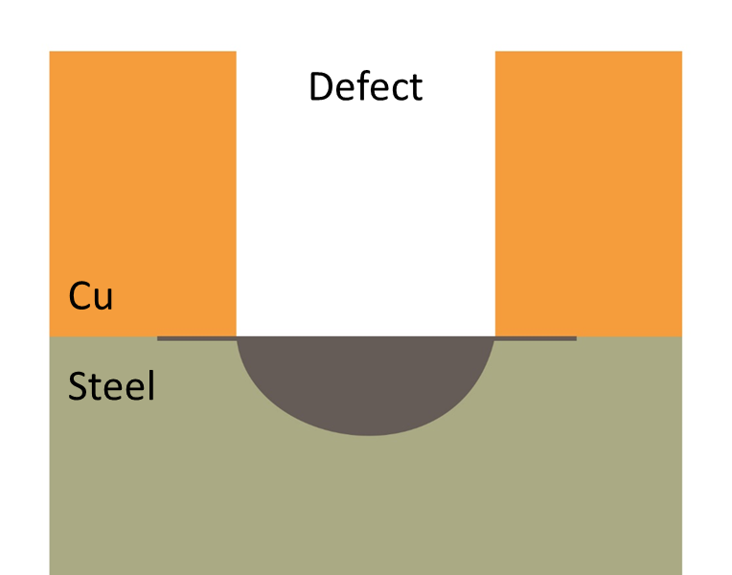
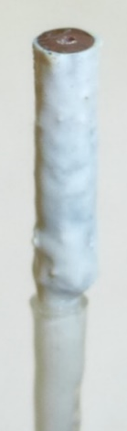
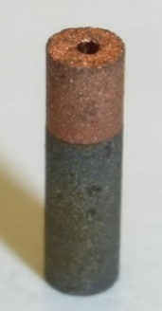
Emplacement of the container in a repository with a defective weld would represent immediate coating failure
0.5 mm
3 mm
Epoxy resin
Cu
O₂
e⁻
OH⁻
Wire
Fe
2 mm
Fe²⁺
Corrosion damage to steel at the base of a drilled defect in a Cu coating measured by X-ray microtomography (µ-XRT)
Calculate the material loss as a function of oxidant consumption
Develop a finite element model to predict the extent of corrosion and validate with µ-XRT data
STEEL CONTAINER
Cu

Slide 14
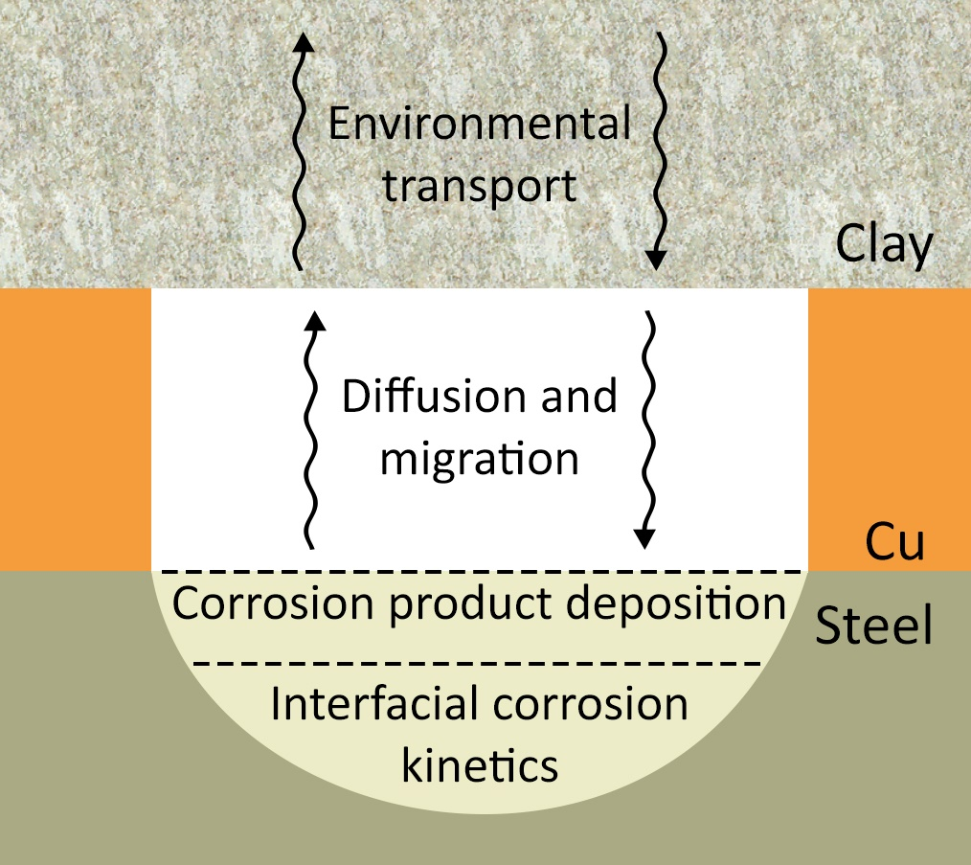
Electrochemical/analytical studies allows us to specify the key processes that must be Incorporated in to a corrosion model
Electrochemical results
Numerical database
Finite element model (using COMSOL Multiphysics modelling software)
Describe the evolution of damage to the steel under repository conditions
Notes:
Long term aim: build the numerical database required to develop a finite element model (using COMSOL Multiphysics Modelling Software) to describe the evolution of damage to the steel under repository conditions
This introduces why we’re doing the tomography (direct model development and model validation);
Electrochem defines the chemistry and helps develop the model

Slide 15
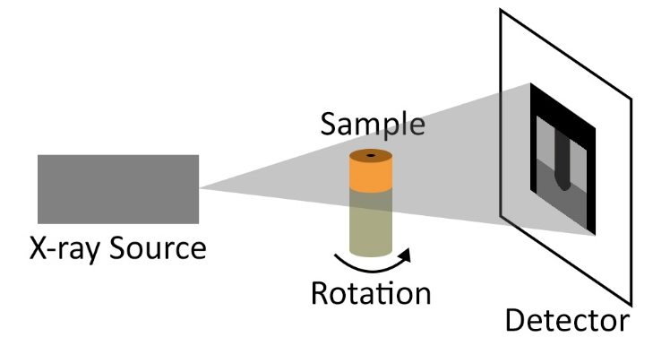

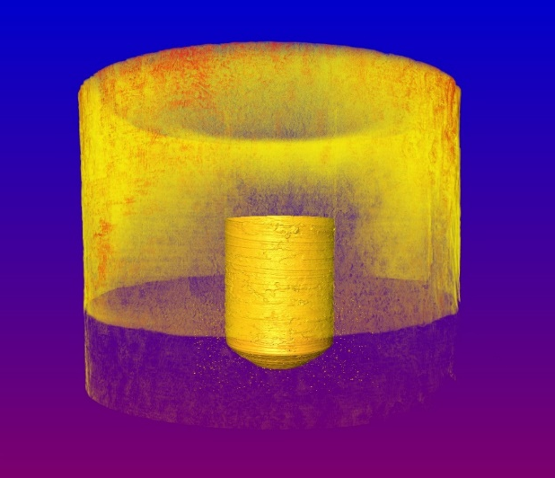
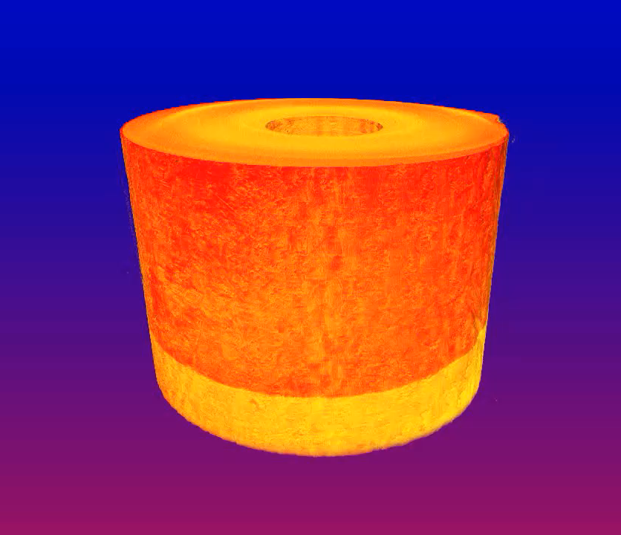
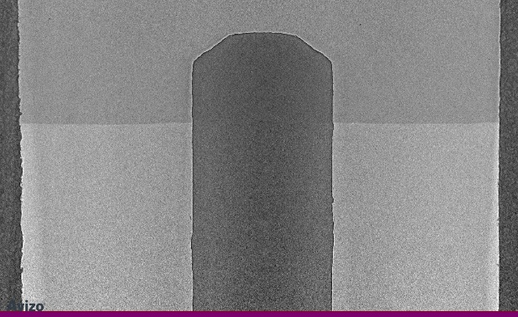

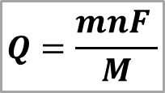
X-Ray Microtomography
Non-destructive 3D imaging technique – visualizes internal features
  Directly investigate damage volume and geometry
Defect
Defect
Cu
Cu
Steel
Steel
0.5 mm
0.5 mm
$$Q=\frac{mnF }{M}$$
$$m= ρV$$
Compare mass loss to O₂ consumed: Volume  

Slide 16
Where are the corrosion issues ?

Slide 17
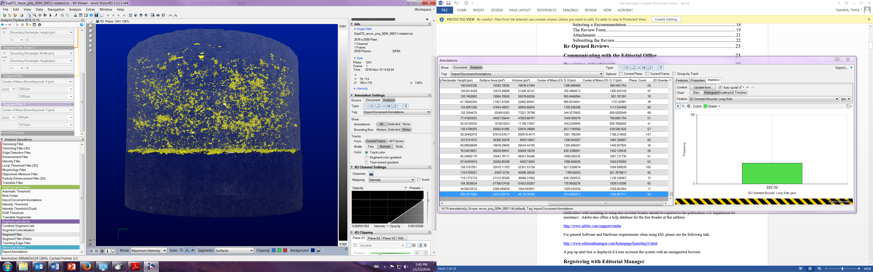
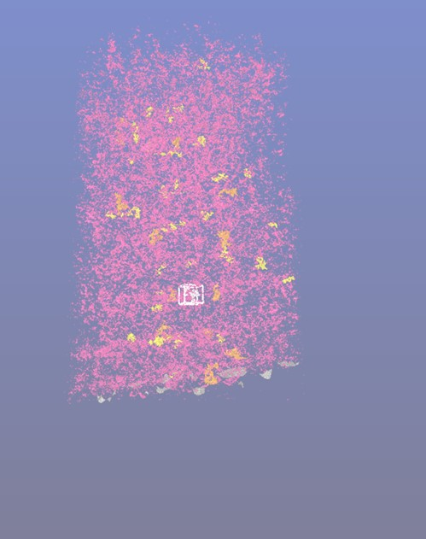
Uncorroded cold spray coated steel
Cold-spray/electrodeposited coating interface
A
Cold-sprayed
electrodeposited
Cu
B
steel
A – porosity in a cold-sprayed coating is an effective loss of coating thickness
B – Interfacial voids due to Cu particle impact on the steel
Al/Si particles deposited at the coating interface by surface treatment prior to cold spray coating could act as crevice initiation sites

Slide 18

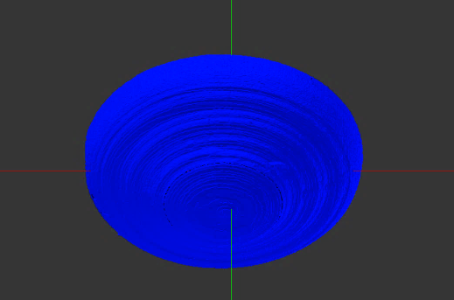
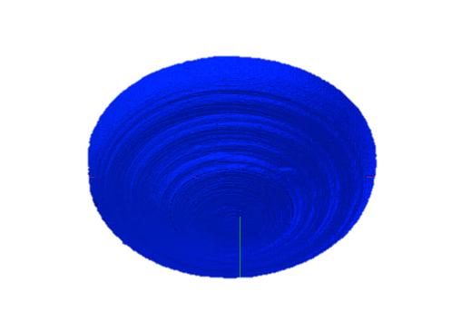
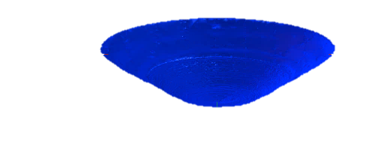
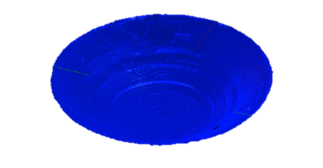
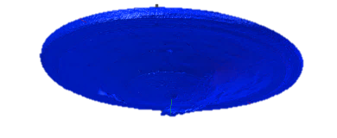
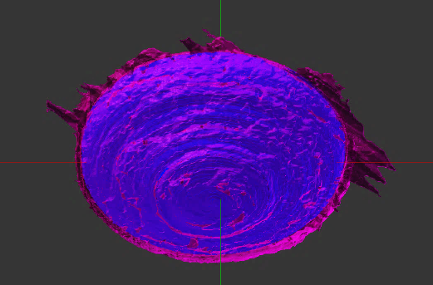
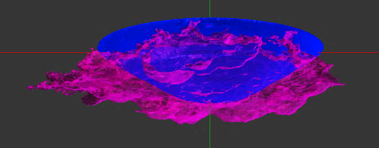
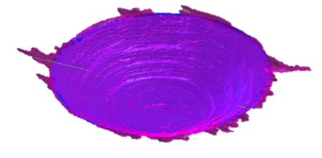
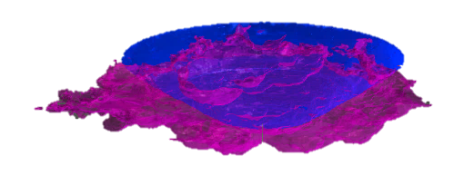
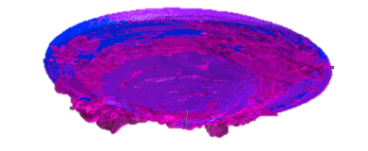
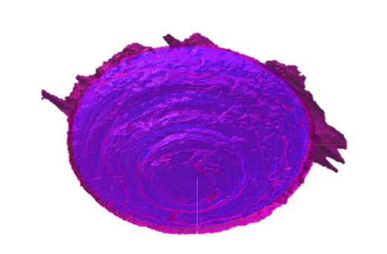
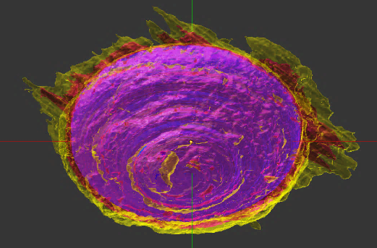
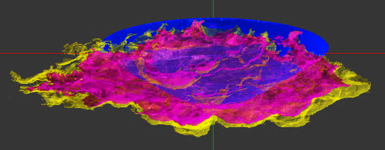
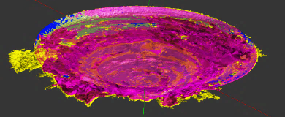
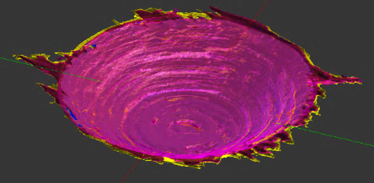
Evolution of Corrosion Damage Volume
Annealed Cold Spray
Electrodeposited
O₂-sparged
Air-sparged
O₂-sparged
Air-sparged
0 h
0 h
0 h
0 h
Cu
Cu
Cu
Cu
Steel
Steel
Steel
0.25 mm
0.25 mm
Steel
0.25 mm
0.25 mm
21 h
21 h
21 h
17 h
Cu
Steel
Corrosion
38 h
38 h
38 h
38 h
Cu
Steel
Corrosion
Corrosion along Cu-steel interface
Less extensive
Notes:
By monitoring the change in corroded volume over ~40 hours using synchrotron micro-CT, we can visually see how corrosion has propagated into steel and along the Cu-steel interface/that the extent of corrosion is greater with higher [O2] and that there has been some spread of corrosion along the interface, along with corrosion into the steel
Findings: interfacial corrosion; less extensive on ED.

Slide 19
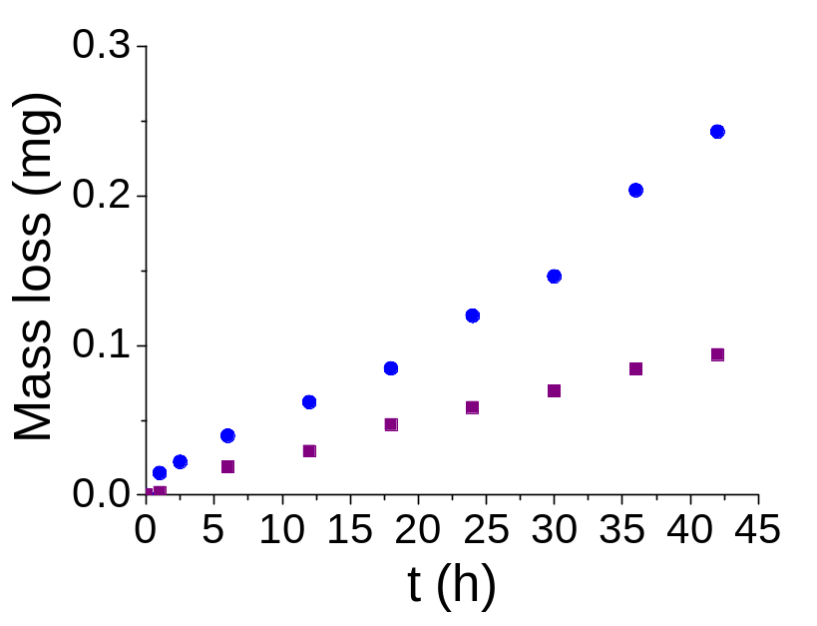
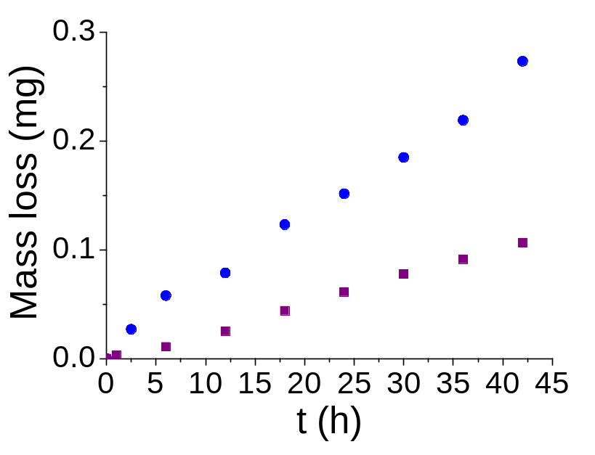
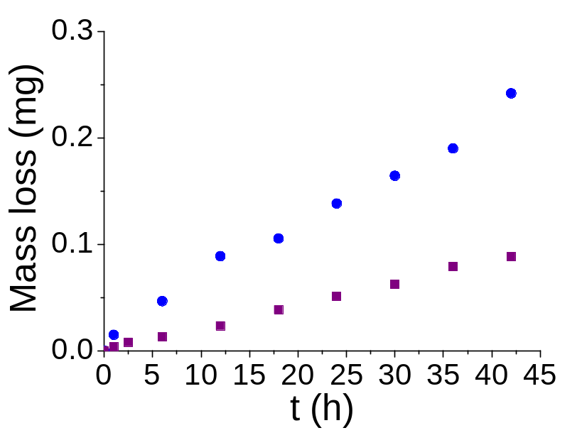

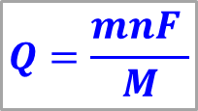
Irrespective of the fabrication process the amount of corrosion damage is determined by the [O₂]
Cold Spray
Annealed Cold Spray
● | Oxygenated
○ | Aerated
Electrodeposited
$m= ρV$
$$Q=\frac{mnF }{M}$$
Volume  
Can calculate the amount of O₂ consumed to cause this amount of corrosion and compare it to that available in the repository
Notes:
Effect of coating and [O₂] on damage evolution; Despite the different geometry, the overall extent of damage is very similar.

Slide 20

Jamie
Noel
Dmitrij
Zagidulin
Joseph
Turnbull
Thalia
Standish

Slide 21

SUMMARY
Enough Already!
Thanks for your Attention
Questions?

Slide 22
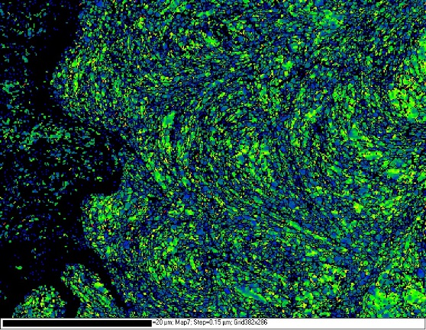
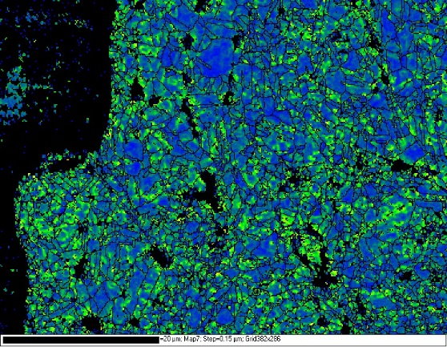
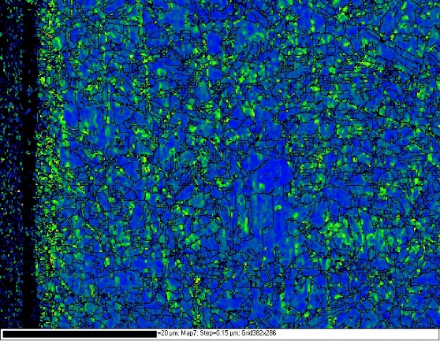
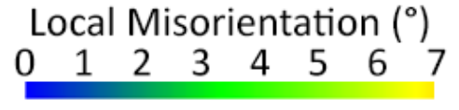
The Interfacial Corrosion Process Depends on the Coating Procedure
EBSD used to produce local misorientation maps (a measure of strain):
Cold Spray
Annealed Cold Spray
Electrodeposited
steel substrate
steel substrate
steel substrate
20 µm
20 µm
20 µm
Adhesion strength:
Cold Spray
Annealed Cold Spray
Electrodeposited
68-98 MPa
62-72 MPa
286-373 MPa
Notes:
Damage at the Cu-steel interface due to the coating process decreases in the order cold spray > annealed cold spray >> electrodeposited
Interfacial strain decreases in the order cold spray > annealed cold spray >> electrodeposited. Ultimate tensile strength decreases in the order electrodeposited >> annealed cold spray ≈ cold spray.
A greater degree of misorientation between grains indicates greater strain.

Slide 23
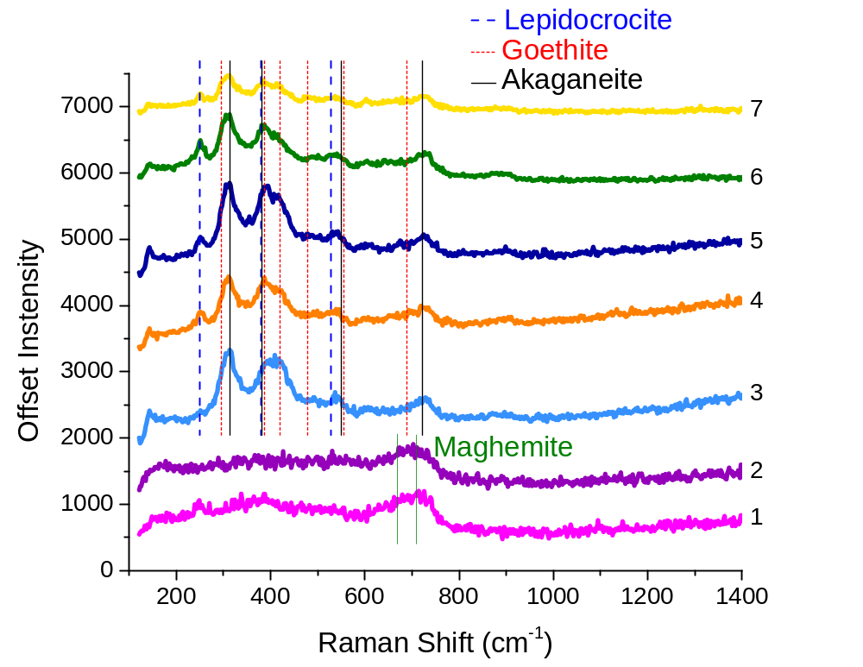
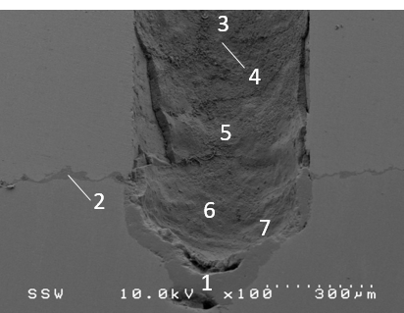
Distribution of Corrosion Products Formed Within the Defect in Oxygenated 3 mol/L NaCl
Base of the defect
Formation of FeOOH in O₂-containing solutions:
 | [Fe²⁺] | [Cl⁻]
Akaganeite (β-FeOOH) | High (≥ 0.5 M) | High (≥ 2 M)
Goethite (α-FeOOH) | High | Low
Goethite (α-FeOOH) | Low | High
Lepidocrocite (γ-FeOOH) | Low | Any (high [O₂])
Notes:
To determine the composition of the corrosion products formed inside the coating defect, a specimen corroded for 24 hours in oxygenated 3 M NaCl was mounted in resin and cross-sectioned. Figure 16 shows an SEM micrograph of the base of the defect (which penetrated slightly into the steel when first drilled) and a series of Raman spectra recorded at the numbered locations on the image. The image shows a substantial oxide film on the exposed steel surface (location 1). The two broad Raman peaks at 350 and 500 cm⁻¹ and the higher intensity peaks at 670 and 720 cm⁻¹ suggest the presence of maghemite, γ-Fe₂O₃ [19,20], as indicated by the vertical lines. However, the dominant A_{1g} mode of magnetite, Fe₃O₄ (670 cm⁻¹) [21] and a peak attributable to akaganeite (β-FeOOH) (723 cm⁻¹) [22] also occur in this region, making an unambiguous identification of the film impossible.
Raman analyses (location 2 in Figure 16) indicate the oxide formed (possibly maghemite) is identical to that formed on the steel surface at the base of the defect (location 1 in Figure 16). It seems likely, but is presently unproven, that the propagation of corrosion along the interface is due to the damaged nature of this location (as shown in Figures 6(c), 8(a), and 9(a) inflicted during the cold spray coating process. It also should be noted that the cold spray process used to form the coating cannot be considered to be optimized from a manufacturing standpoint.
Spectra recorded at locations 3 to 6 all exhibit the same peaks but with some variation in the intensities of individual bands. The vertical coloured lines indicate the characteristic Raman shifts for lepidocrocite (γ-FeOOH) [19,23], goethite (α-FeOOH) [19,23], and akaganeite [20,22]. These phases are expected to form in the presence of O₂ and Cl⁻ and which phase is dominant depends on their solution concentrations and that of Fe²⁺ [22]. Environments with high [Cl⁻] (≥ 2 M) and high [Fe²⁺] (≥ 0.5 M) favour the formation of akaganeite, while lower [Fe²⁺] favours lepidocrocite, and goethite forms when either [Cl⁻] of [Fe²⁺] is high while the other is low [22]. In solutions containing a high [O₂], lepidocrocite forms preferentially to goethite [22,24] but can transform to goethite with time [25]. Inside the defect, the corrosion product is a mix of the above 3 phases with the peaks for akaganeite being relatively the most intense. This would be expected for the high [Fe²⁺] and [Cl⁻] conditions likely to prevail within the defect.

